Slide 1
David Milstead

Slide 2
Where we stand politically.
2013 Strategy update
There is a strong scientific case for an electron-positron collider… The Technical Design Report of the International Linear Collider (ILC) has been completed, with large European participation... Europe looks forward to a proposal from Japan to discuss a possible participation.
CERN should undertake design studies for accelerator projects in a global context, with emphasis on proton-proton and electron- positron high-energy frontier machines. These design studies should be coupled to a vigorous accelerator R&D programme (CLIC, FCC hh,ee,ep … AWAKE)

Slide 3
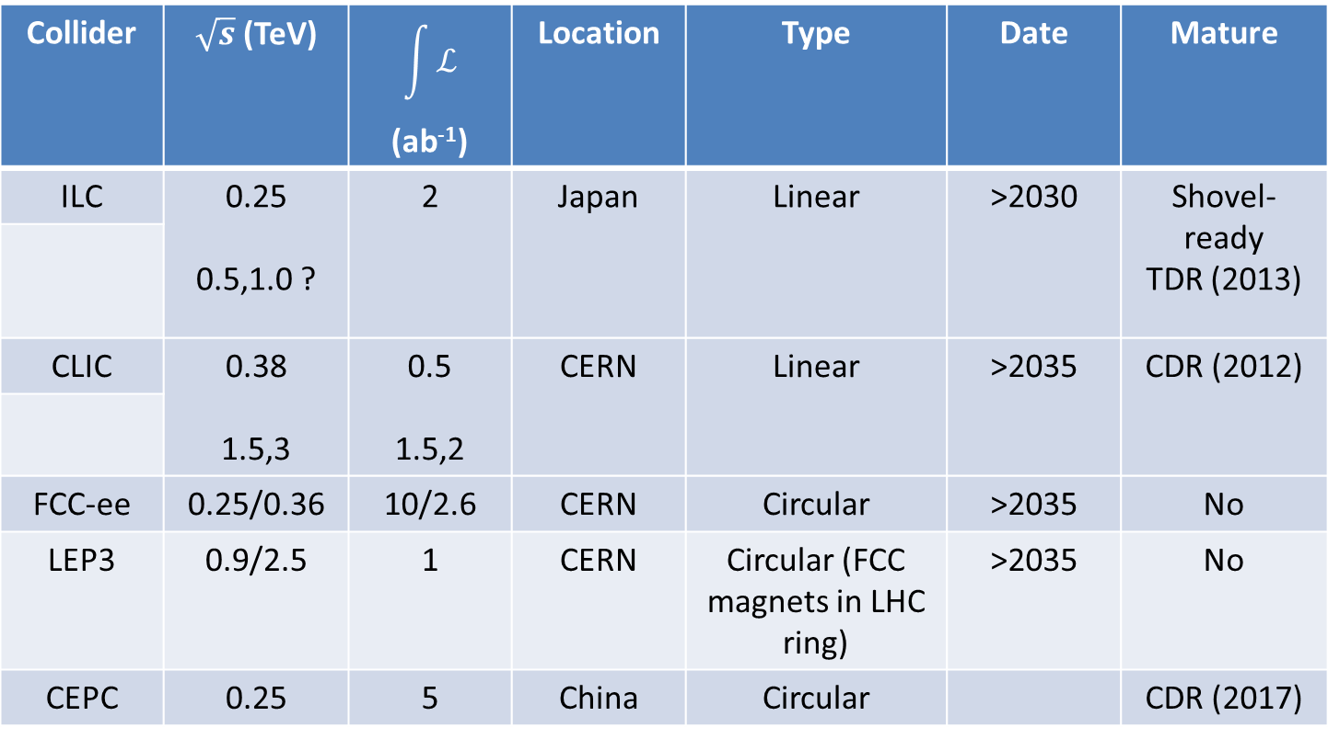
The e⁺e⁻ market place
Collider | $\sqrt{s}$ (TeV) | $$\int{ℒ}$$ (ab⁻¹) | Location | Type | Date | Mature
ILC | 0.25 0.5,1.0 ? | 2 | Japan | Linear | >2030 | Shovel-ready TDR (2013)
CLIC | 0.38 1.5,3 | 0.5 1.5,2 | CERN | Linear | >2035 | CDR (2012)
FCC-ee | 0.25/0.36 | 10/2.6 | CERN | Circular | >2035 | No
LEP3 | 0.9/2.5 | 1 | CERN | Circular (FCC magnets in LHC ring) | >2035 | No
CEPC | 0.25 | 5 | China | Circular |  | CDR (2017)

Slide 4
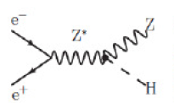
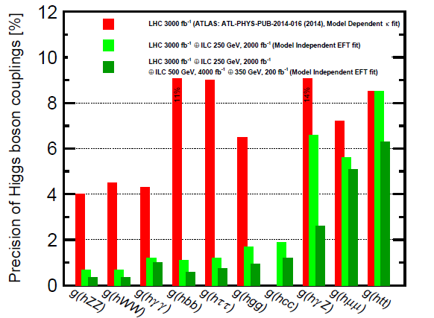
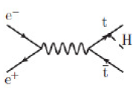
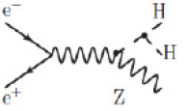
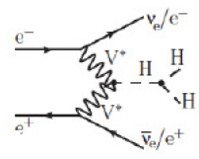
ILC~CLIC~LEP3 sensitivity
Further improvements with FCCee (factors ~2-5)

Slide 5
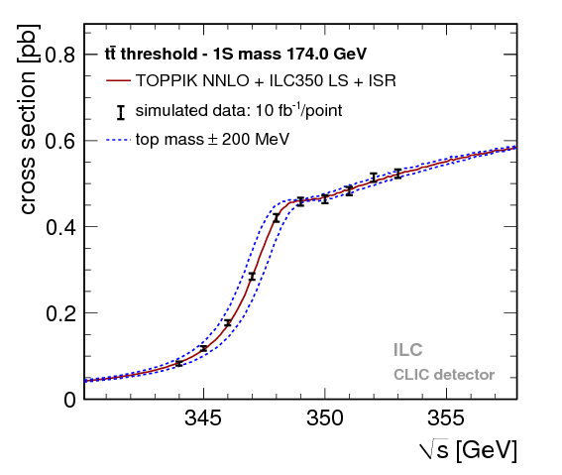
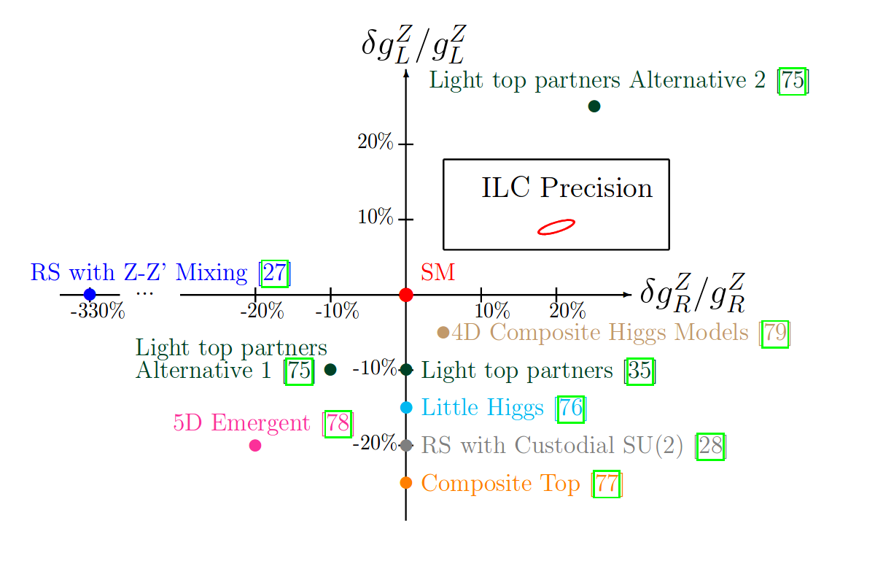
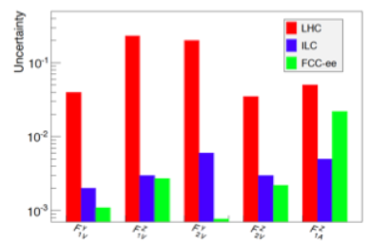

Slide 6
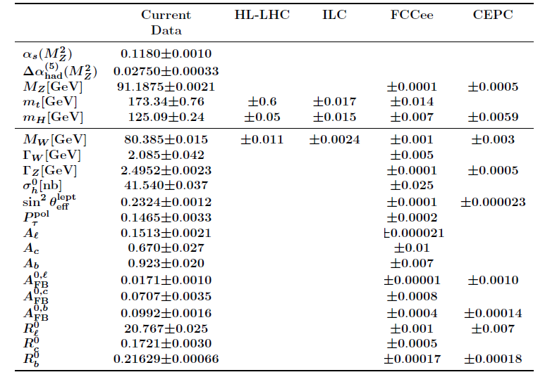
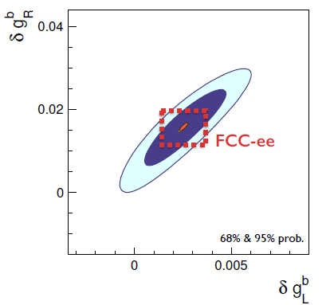
Related areas

Slide 7

The ILC
1990s -TESLA (Europe), NLC (US), JLC (Japan)
2005 - Global Design Effort formed.
2011 - Japanese Expression of Interest to host.
2013 - Technical Design Report
- Site: Kitakami - northern Japan
2018
  Japanese MEXT study groups Physics, TDR and cost, manpower, impact and spin-offs
  Waiting for picture from the LHC to become clear.
  International discussions between funding agencies
  Decision in 2018 in time for PP strategy ?
I did my PhD on the ILC design

Slide 8


Where we do we want to stand in 2020 ?
2013
There is a strong scientific case for an electron-positron collider… The Technical Design Report of the International Linear Collider (ILC) has been completed, with large European participation... Europe looks forward to a proposal from Japan to discuss a possible participation.
CERN should undertake design studies for accelerator projects in a global context, with emphasis on proton-proton and electron- positron high-energy frontier machines. These design studies should be coupled to a vigorous accelerator R&D programme (CLIC, FCC hh,ee,ep … AWAKE)
A 250 GeV ILC is not worth the money !
C !
Is the reduced ILC still what is needed ?
What works best for European PP ?
What works best for us ?
No FCC
No new physics, no new ring !
FCCee (or CEPC) in the strategy? How well motivated in light of Run 2 results ? HE-LHC/LEP3 ?

