Slide 1
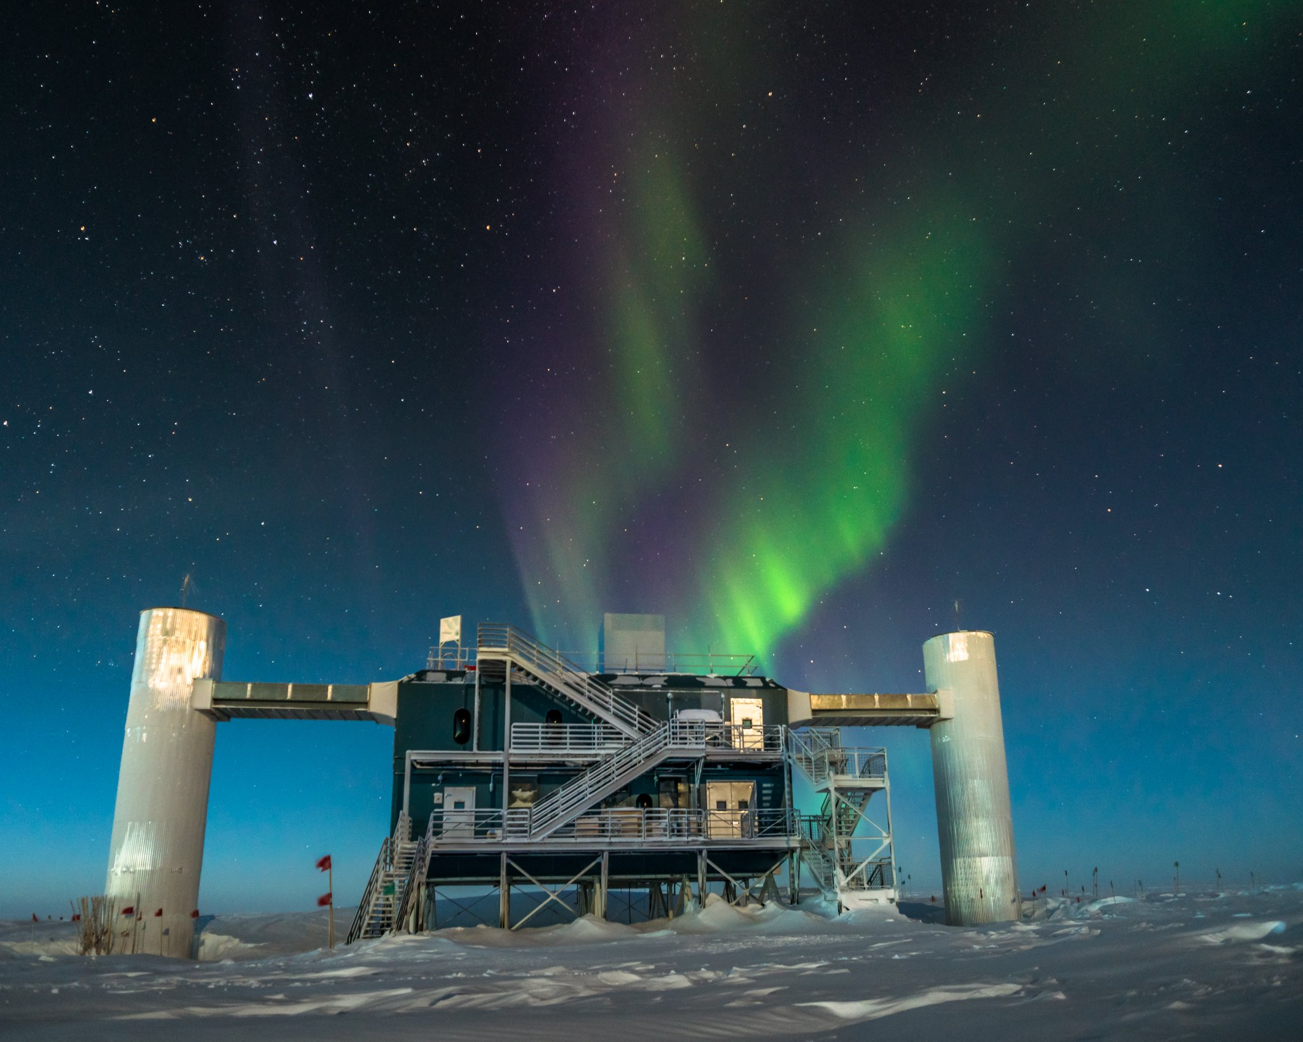
Neutrino Astroparticle Physics
Uppsala
2018 March 13
Photo: Martin Wolf

Slide 2
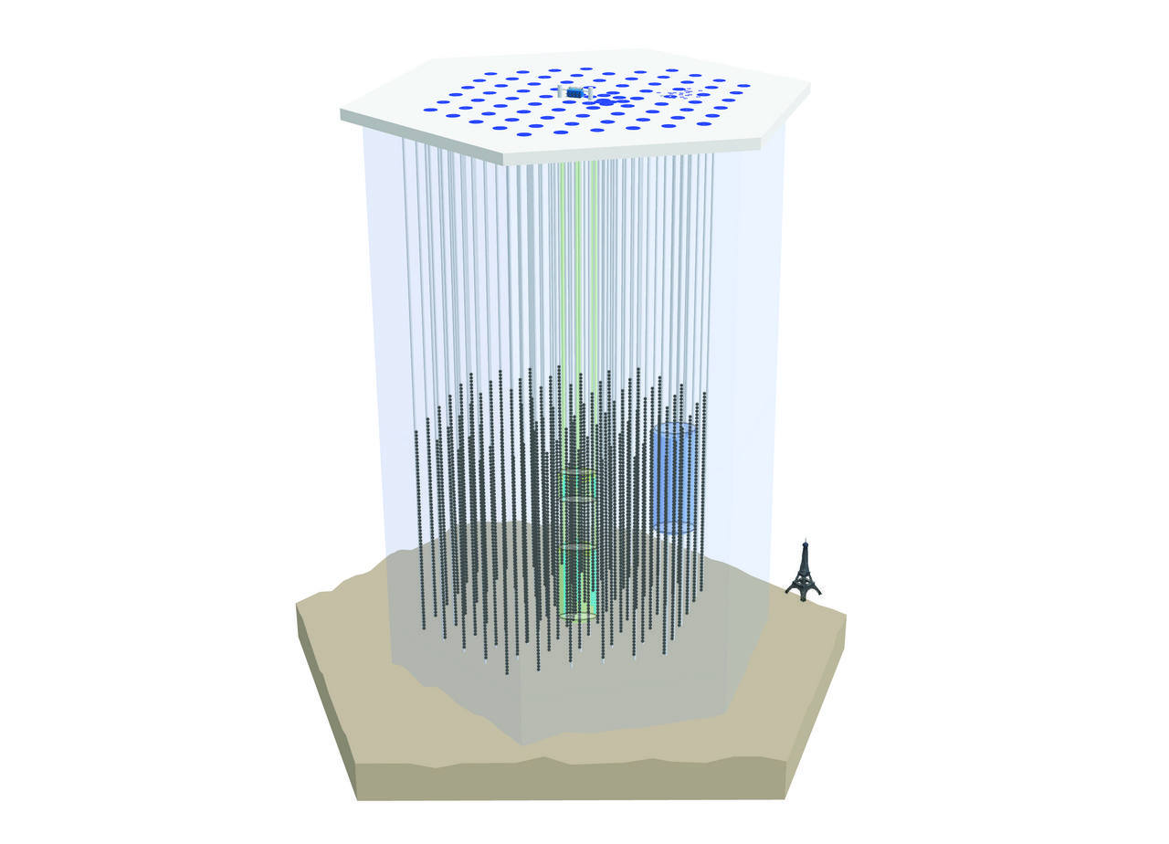
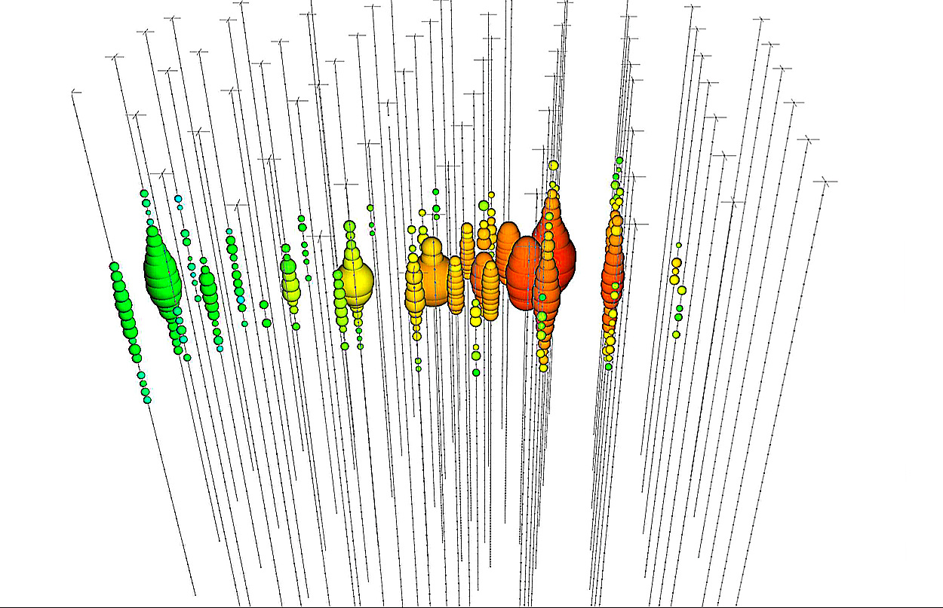
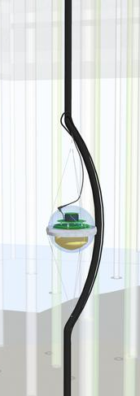
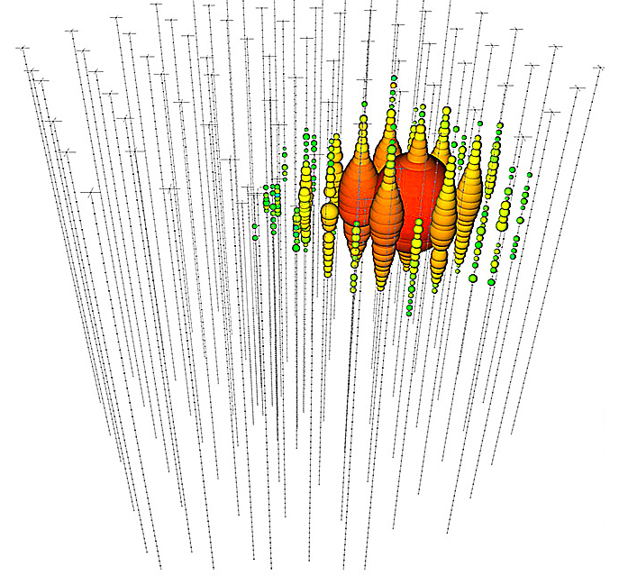
IceCube Neutrino Observatory
track topology =
good pointing
Digital Optical Module
High Energy Neutrino Events
AMANDA
DeepCore
cascade topology =
good energy resolution

Slide 3
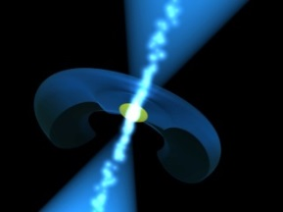
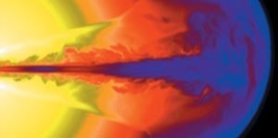
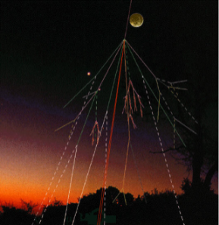
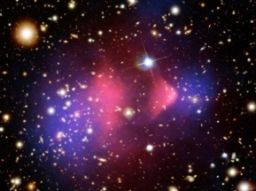
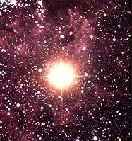
Neutrino Astroparticle Physics: Science goals (Sweden core activity)
Astrophysics of the extreme Universe; Multi-Messenger Astronomy
Sources of cosmic rays <=> sources of neutrinos
Analyses: Point-sources, Extended emissions, Transients, bursts, Diffuse flux (integrated emission over sky)
Targets: Supernovae remnants, Active Galactic Nuclei,
Gamma Ray Bursts, Starburst Galaxies, Microquasars, …
Dark matter annihilation produces neutrinos
Analyses search for signal from: Sun’s core, Galactic Center, Galactic Halo, Galaxy clusters and dwarf galaxies
Particle physics
Neutrino oscillations, neutrino mass ordering (core activity of new NBI group)
Charm production in cosmic ray interactions
Violation of Lorentz invariance, quantum decoherence
Exotic searches: magnetic monopoles, …
Ultrahigh Energy Neutrinos from cosmic ray interactions with CMB
Cosmic ray physics
energy spectrum around ”knee”, composition, anisotropy
Supernova in our galaxy (if one occurs)

Slide 4
Infrastructure Plans for Neutrino Astroparticle Physics
UU and SU prioritized infrastructure proposal to RFI
The IceCube Upgrade
New Ice Drill
7 New Strings, new module designs
Upgrade detector calibration
-> astrophysical neutrinos
Lower energy threshold
-> neutrino oscillation measurements
Chad Finley’s talk
at Partikeldagarna
The Radio Array
ARIANNA / ARA -type surface array
Detect ultrahigh energy neutrinos
-> astrophysical flux at higher energy than IceCube
-> cosmogenic neutrinos from GZK
Allan Hallgren’s talk
at Partikeldagarna

Slide 5
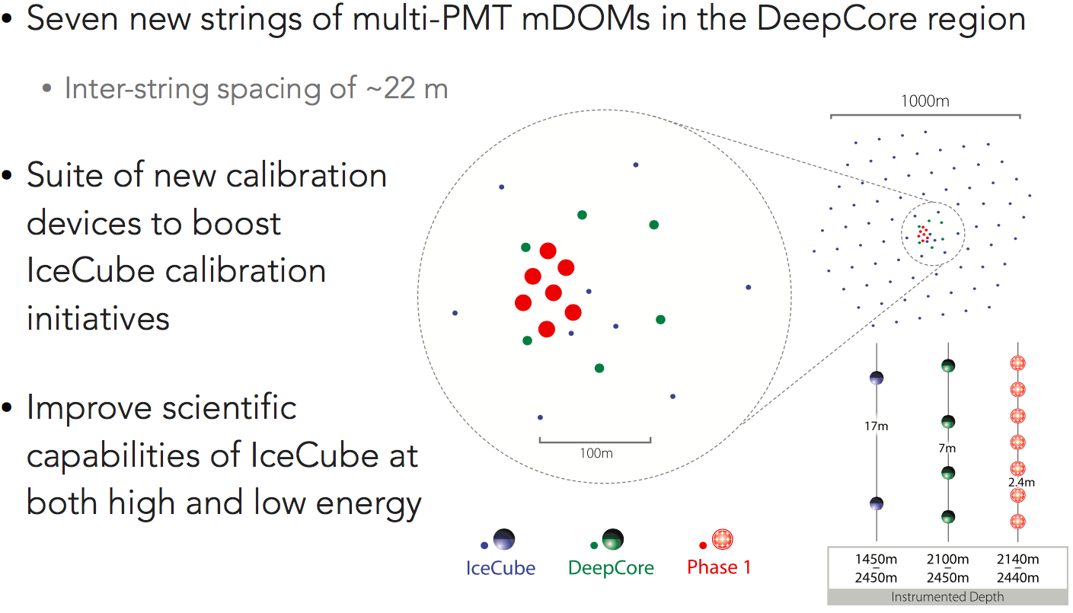
The IceCube Upgrade
Upgrade

Slide 6
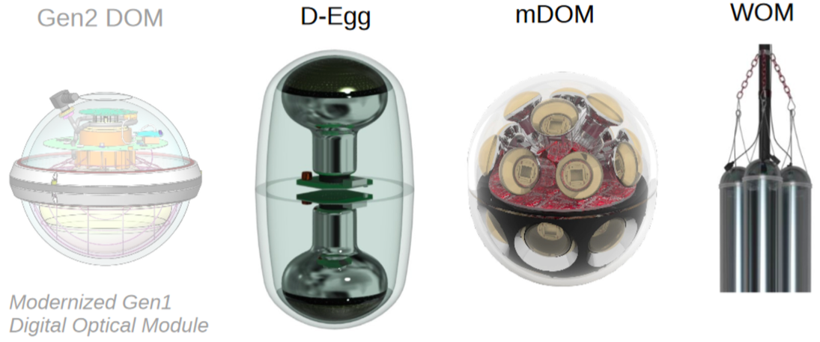
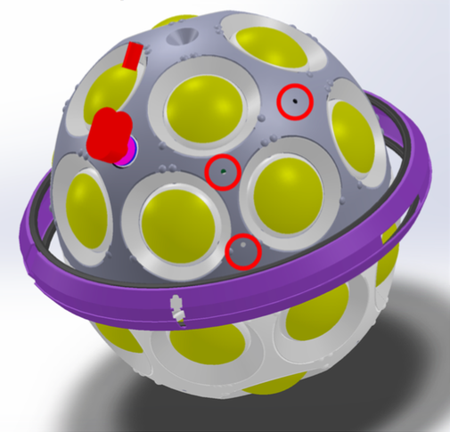
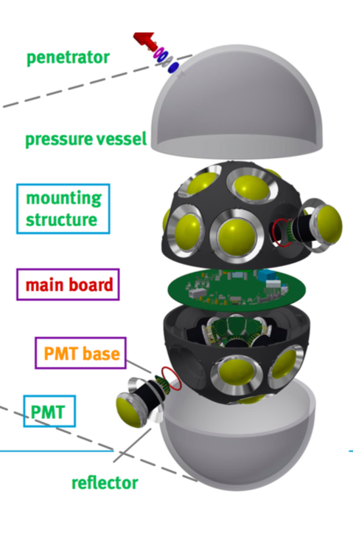
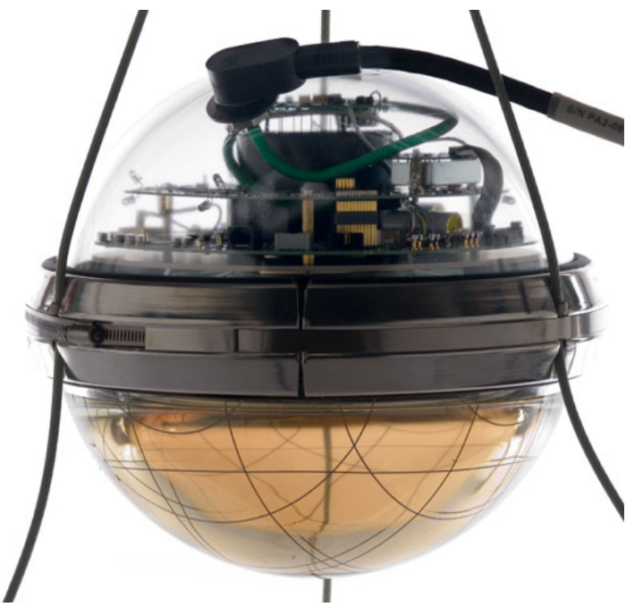
DOM (Digital Optical Module) – Upgrade Edition
The IceCube Upgrade
IceCube DOM D-Egg mDOM WOM
5 160 currently
operating in IC
(20% built in Sweden)
4π sensitivity
Compact diam.
reduces drilling
costs
4π sensitivity
Directionality
Low noise via coincidence req.
LED flashers in all directions for precision calibration

Slide 7
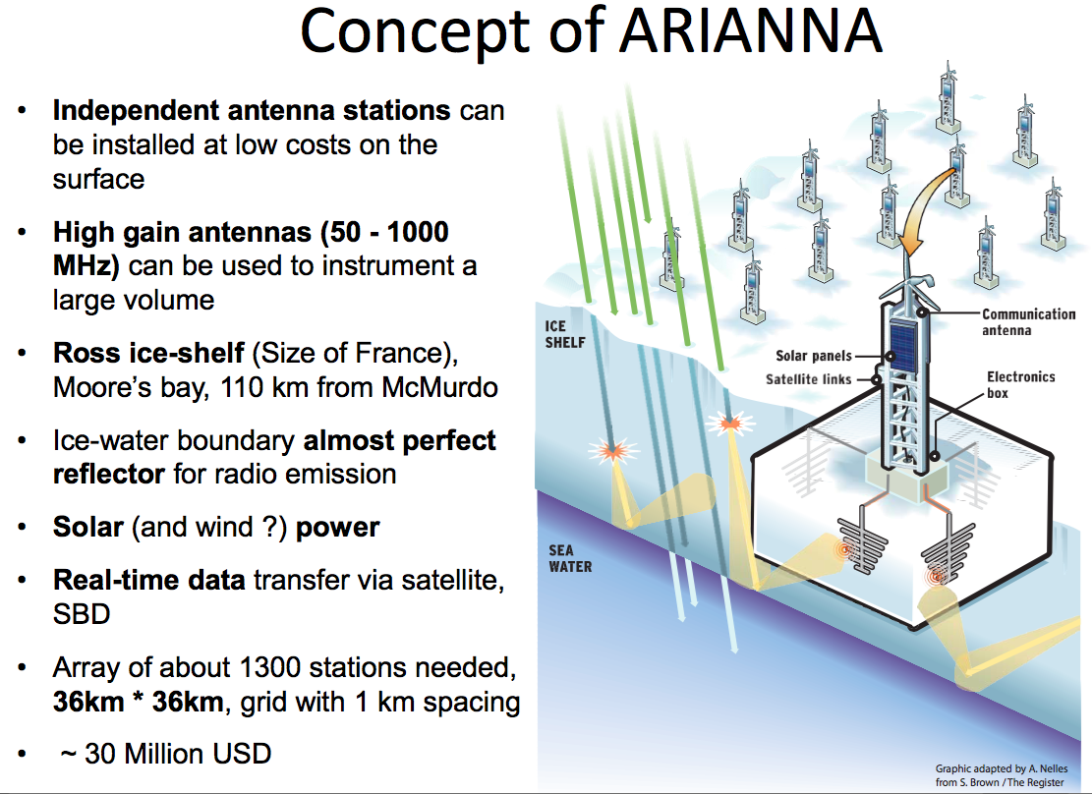

Slide 8
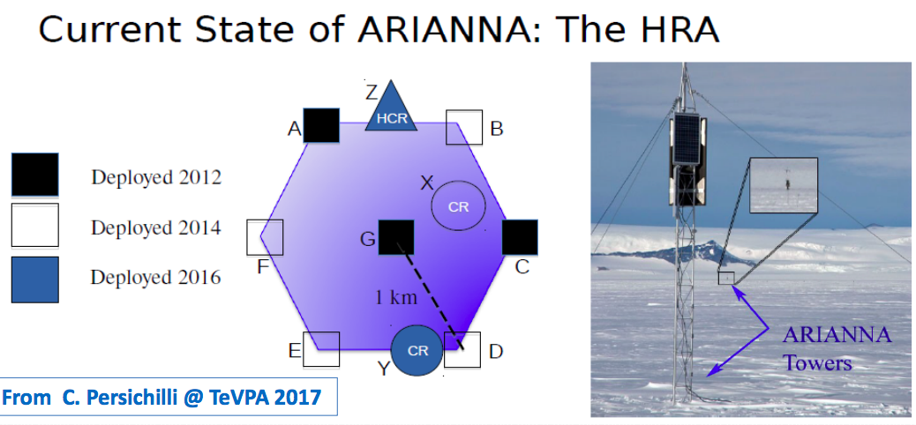

Slide 9
European Strategy for Particle Physics (2006)
Addressed under “non-accelerator based particle physics”
“A range of very important non-accelerator experiments take place at the overlap between particle and astroparticle physics exploring otherwise inaccessible phenomena;
Council will seek to work with ApPEC to develop a coordinated strategy in these areas of mutual interest.”
From the update (2013):
“A range of important non-accelerator experiments take place at the overlap of particle and astroparticle physics, such as searches for proton decay, neutrinoless double beta decay and dark matter, and the study of high-energy cosmic-rays. These experiments address fundamental questions beyond the Standard Model of particle physics. The exchange of information between CERN and ApPEC has progressed since 2006.
In the coming years, CERN should seek a closer collaboration with ApPEC on detector R&D with a view to maintaining the community’s capability for unique projects in this field.”

Slide 10
APPEC Roadmap
From “European Astroparticle Physics Strategy 2017-2026”
As a relatively new field, European astroparticle physics does not benefit from a natural and strong inter-governmental organisation that has a remit to drive it, in the same way as CERN, ESO and ESA help to drive their areas of specialism. This is why, in 2001, European scientific agencies founded APPEC (the Astroparticle Physics
European Consortium). Since 2012, APPEC became a consortium operated on the basis of a Memorandum of Understanding with the overarching aim of strengthening European astroparticle physics and the community engaged in this field.
Astroparticle physics risks “falling between the chairs”
10

Slide 11
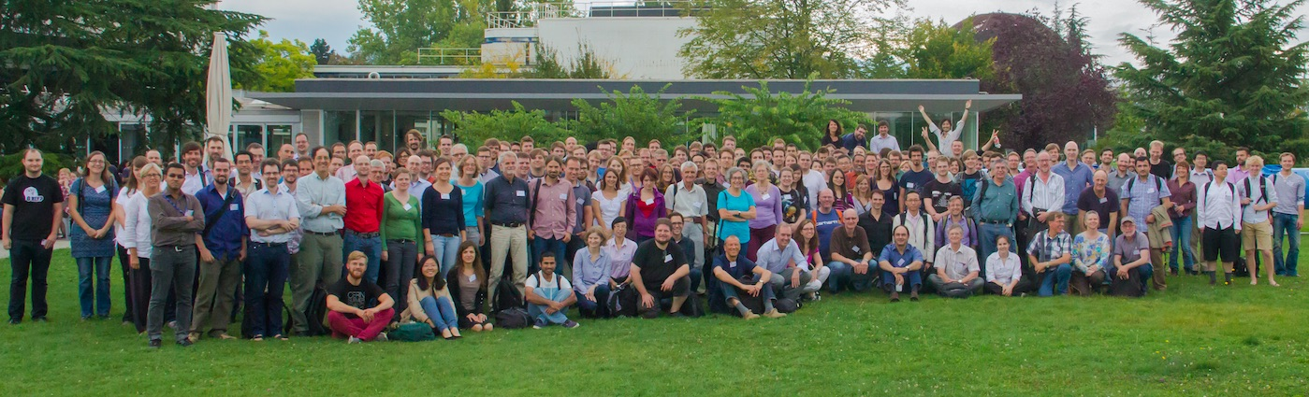
APPEC Roadmap
From “European Astroparticle Physics Strategy 2017-2026”
As a relatively new field, European astroparticle physics does not benefit from a natural and strong inter-governmental organisation that has a remit to drive it, in the same way as CERN, ESO and ESA help to drive their areas of specialism. This is why, in 2001, European scientific agencies founded APPEC (the Astroparticle Physics
European Consortium). Since 2012, APPEC became a consortium operated on the basis of a Memorandum of Understanding with the overarching aim of strengthening European astroparticle physics and the community engaged in this field.
Astroparticle physics risks “falling between the chairs”
IceCube Collaboration Meeting, CERN, 2014
Chad Finley - Oskar Klein Centre, Stockholm University
11

