Slide 1
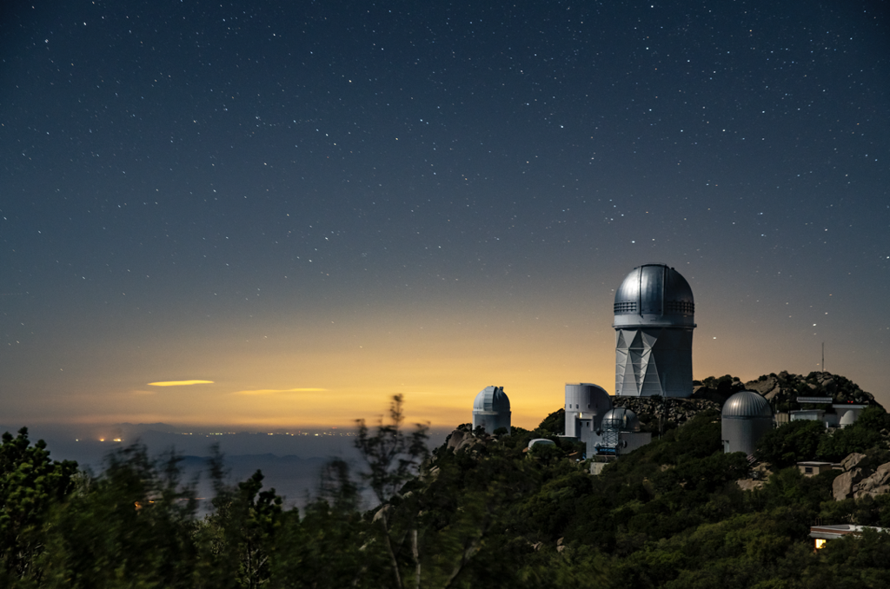
DESI Peculiar Velocity Survey
DR1 Fundamental Plane
Caitlin Ross, University of Queensland
On behalf of the DESI Collaboration
Cosmology 2025 @ Elba Island
8 September 2025

Slide 2
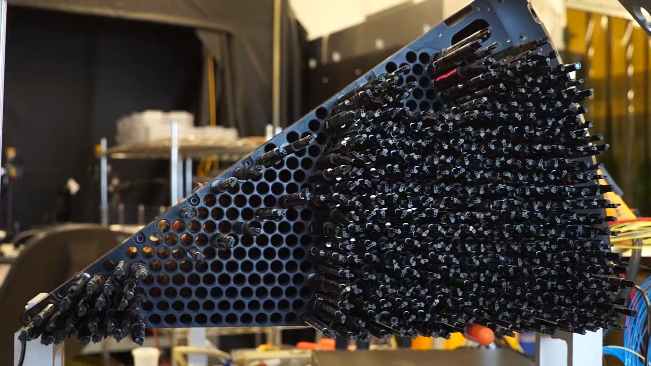
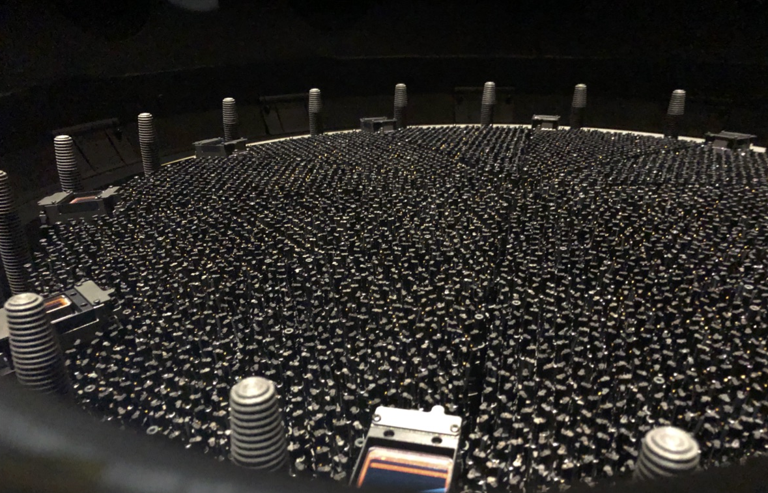
5000 robotically controlled fibres
Obtaining spectra approximately every 20 minutes

Slide 3
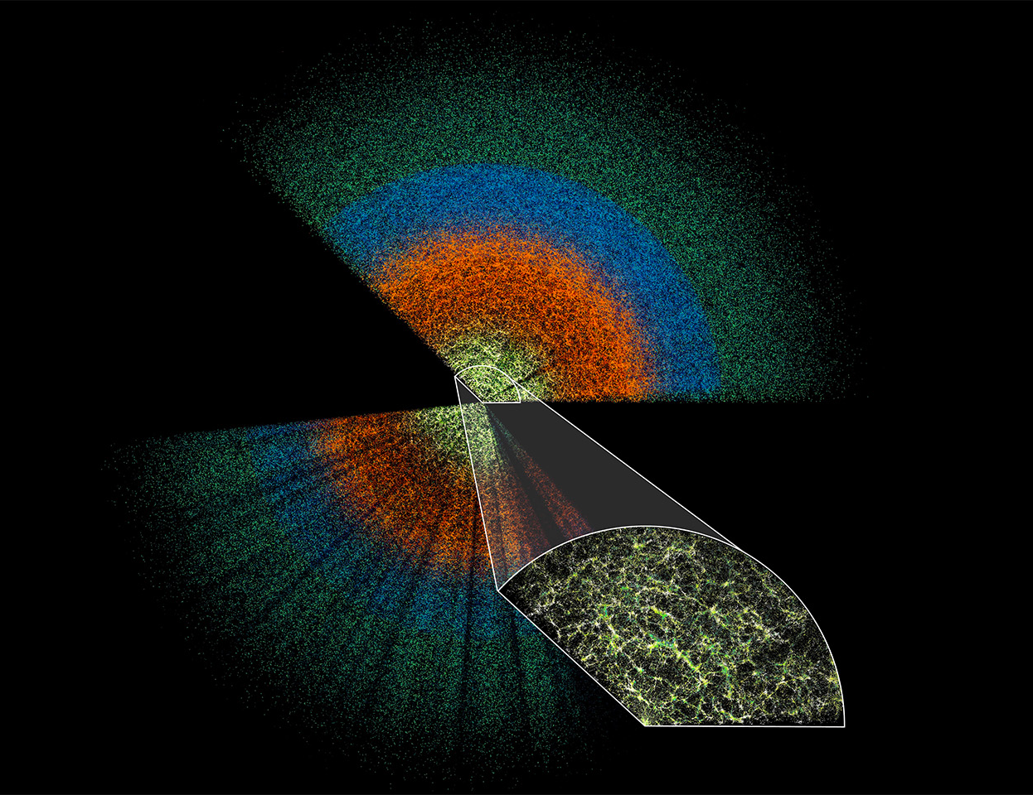
Dark Energy Spectroscopic Instrument
DESI Data Release 1
18.7 million objects:
  4 million stars
  13.1 million galaxies
  1.6 million quasars

Slide 4
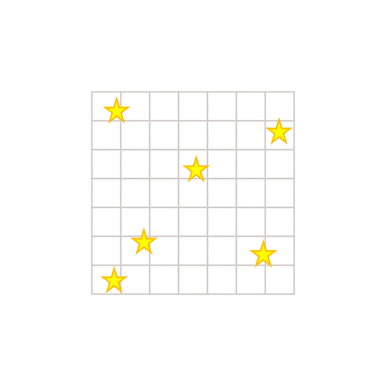
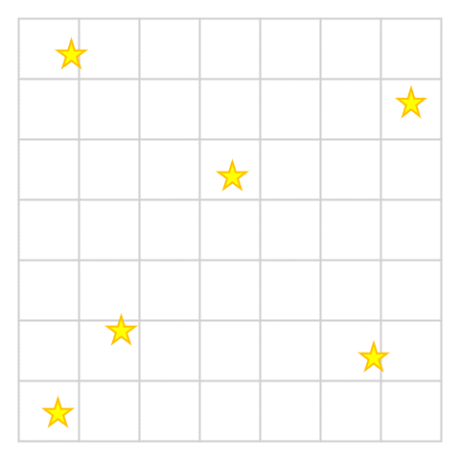
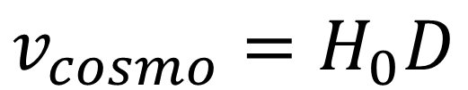
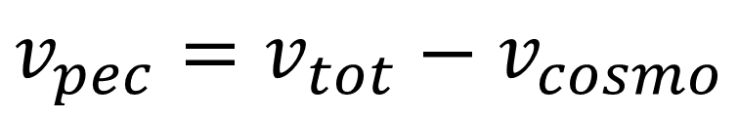
What are peculiar velocities?
$$v_{cosmo}=H_{0}D$$
$$v_{pec}=v_{tot}−v_{cosmo}$$

Slide 5
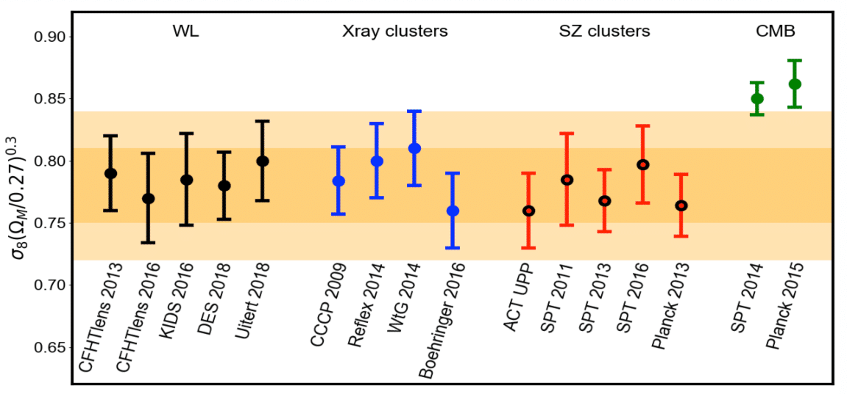
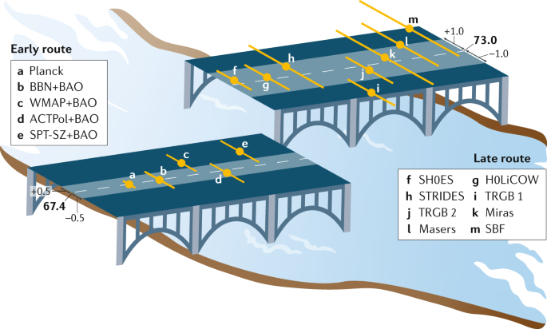
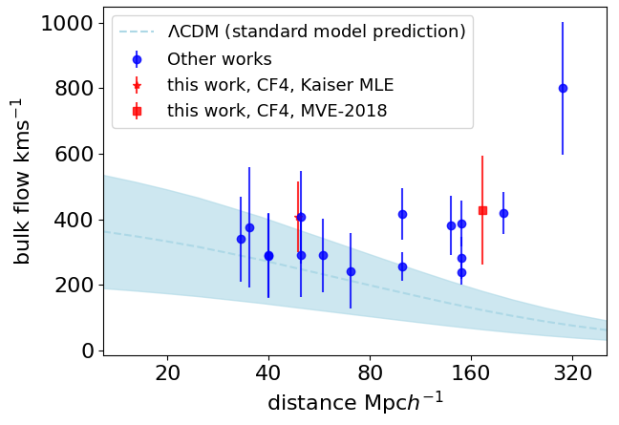
Why measure PVs?
(Douspis et al., 2018)
Tests of GR
(Riess et al., 2019)
(Whitford et al., 2023)

Slide 6
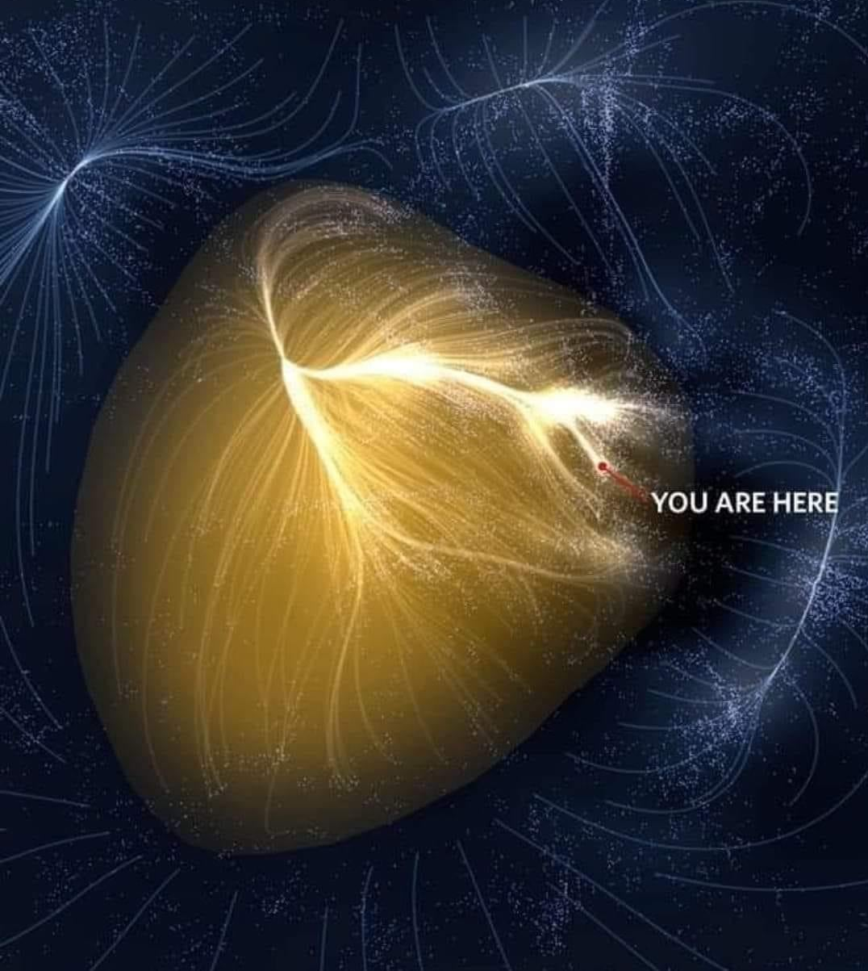
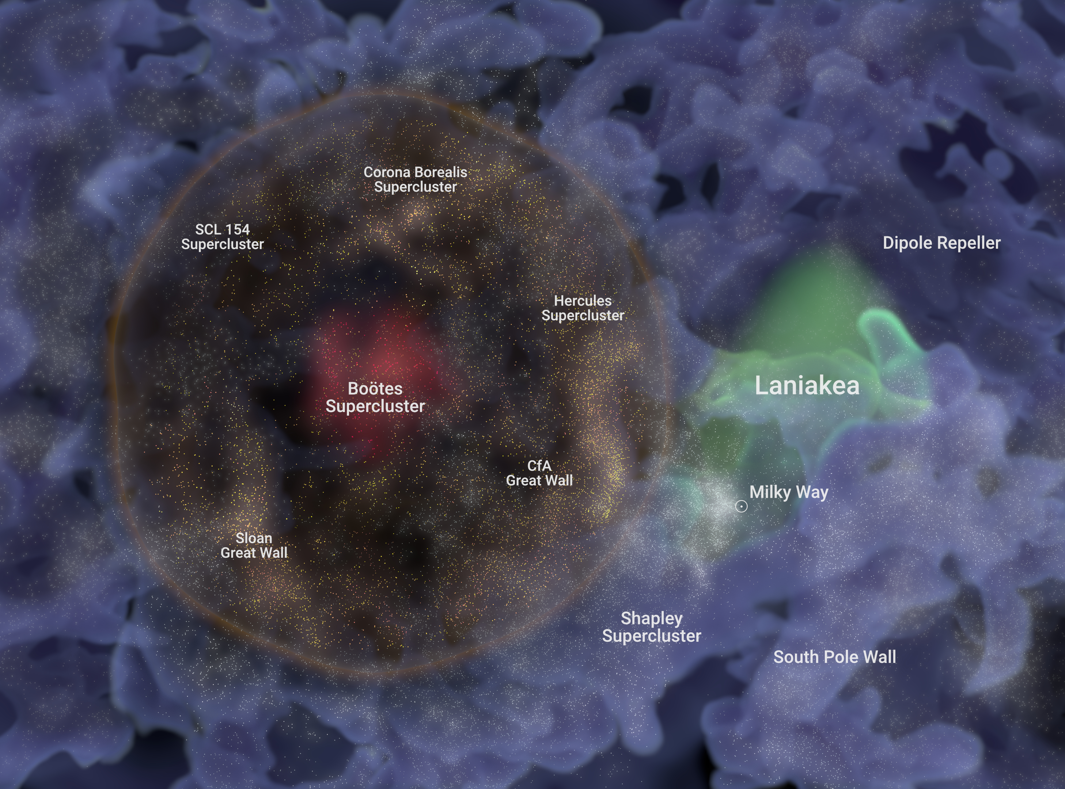
Why measure PVs?
Local Structure

Slide 7
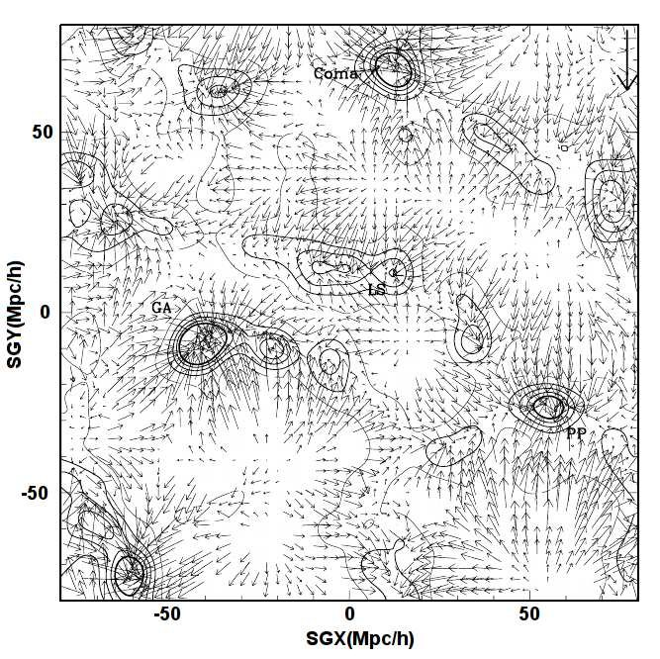
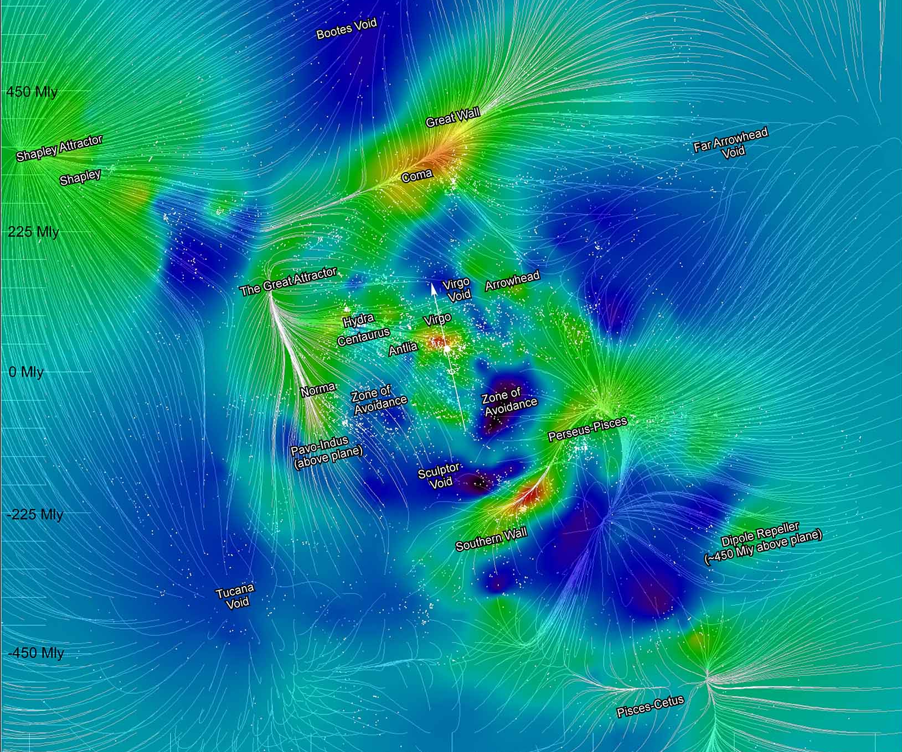
Why measure PVs?
Reconstructions

Slide 8
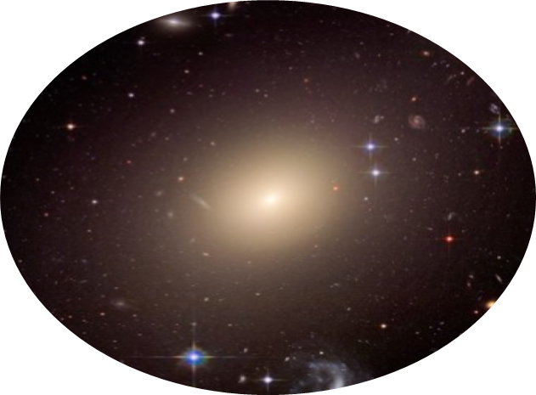
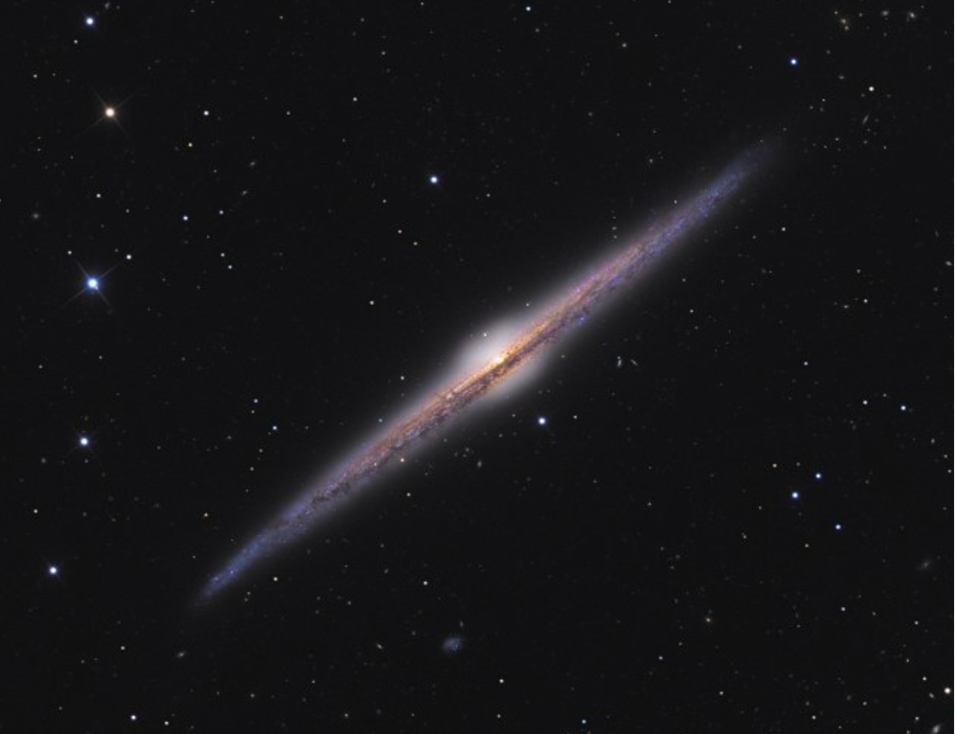
DESI PV Survey
Fundamental Plane
Tully Fisher
Velocity Dispersion
Surface Brightness
Angular Diameter
Rotational velocity
Apparent magnitude

Slide 9
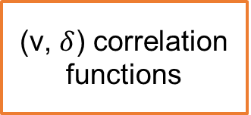
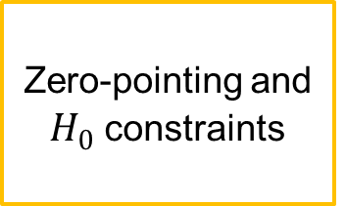

Outcomes and DR1 papers
(Ross et al., in prep)
(Douglass et al., in prep)
Fundamental Plane
Tully Fisher
(Carr et.al., in prep)
(Bautista et al., in prep)
Zero-pointing and
$H_{0}$ constraints
Mock Catalogues
Combined Sample
(Qin et al., in prep)
(Lai et al., in prep)
(Turner et al., in prep)
(Nguyen et al., in prep)
(v, $δ$) correlation functions
(v, $δ$) Power Spectrum
Maximum Likelihood field
Cross-correlations with Supernovae
Structure formation rate ($fσ_{8}$) constraints

Slide 10
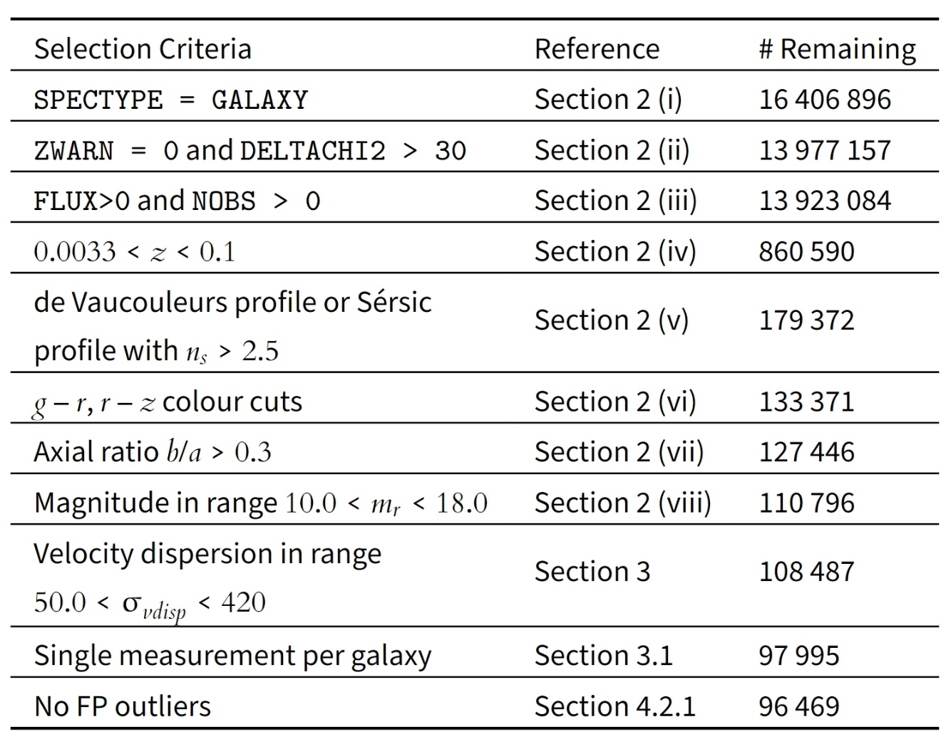
DR1 Fundamental Plane Sample
Quality Control
Isolation of Early Type Galaxies
Best measurement for galaxy
Sigma Clipping (Calibration only)

Slide 11
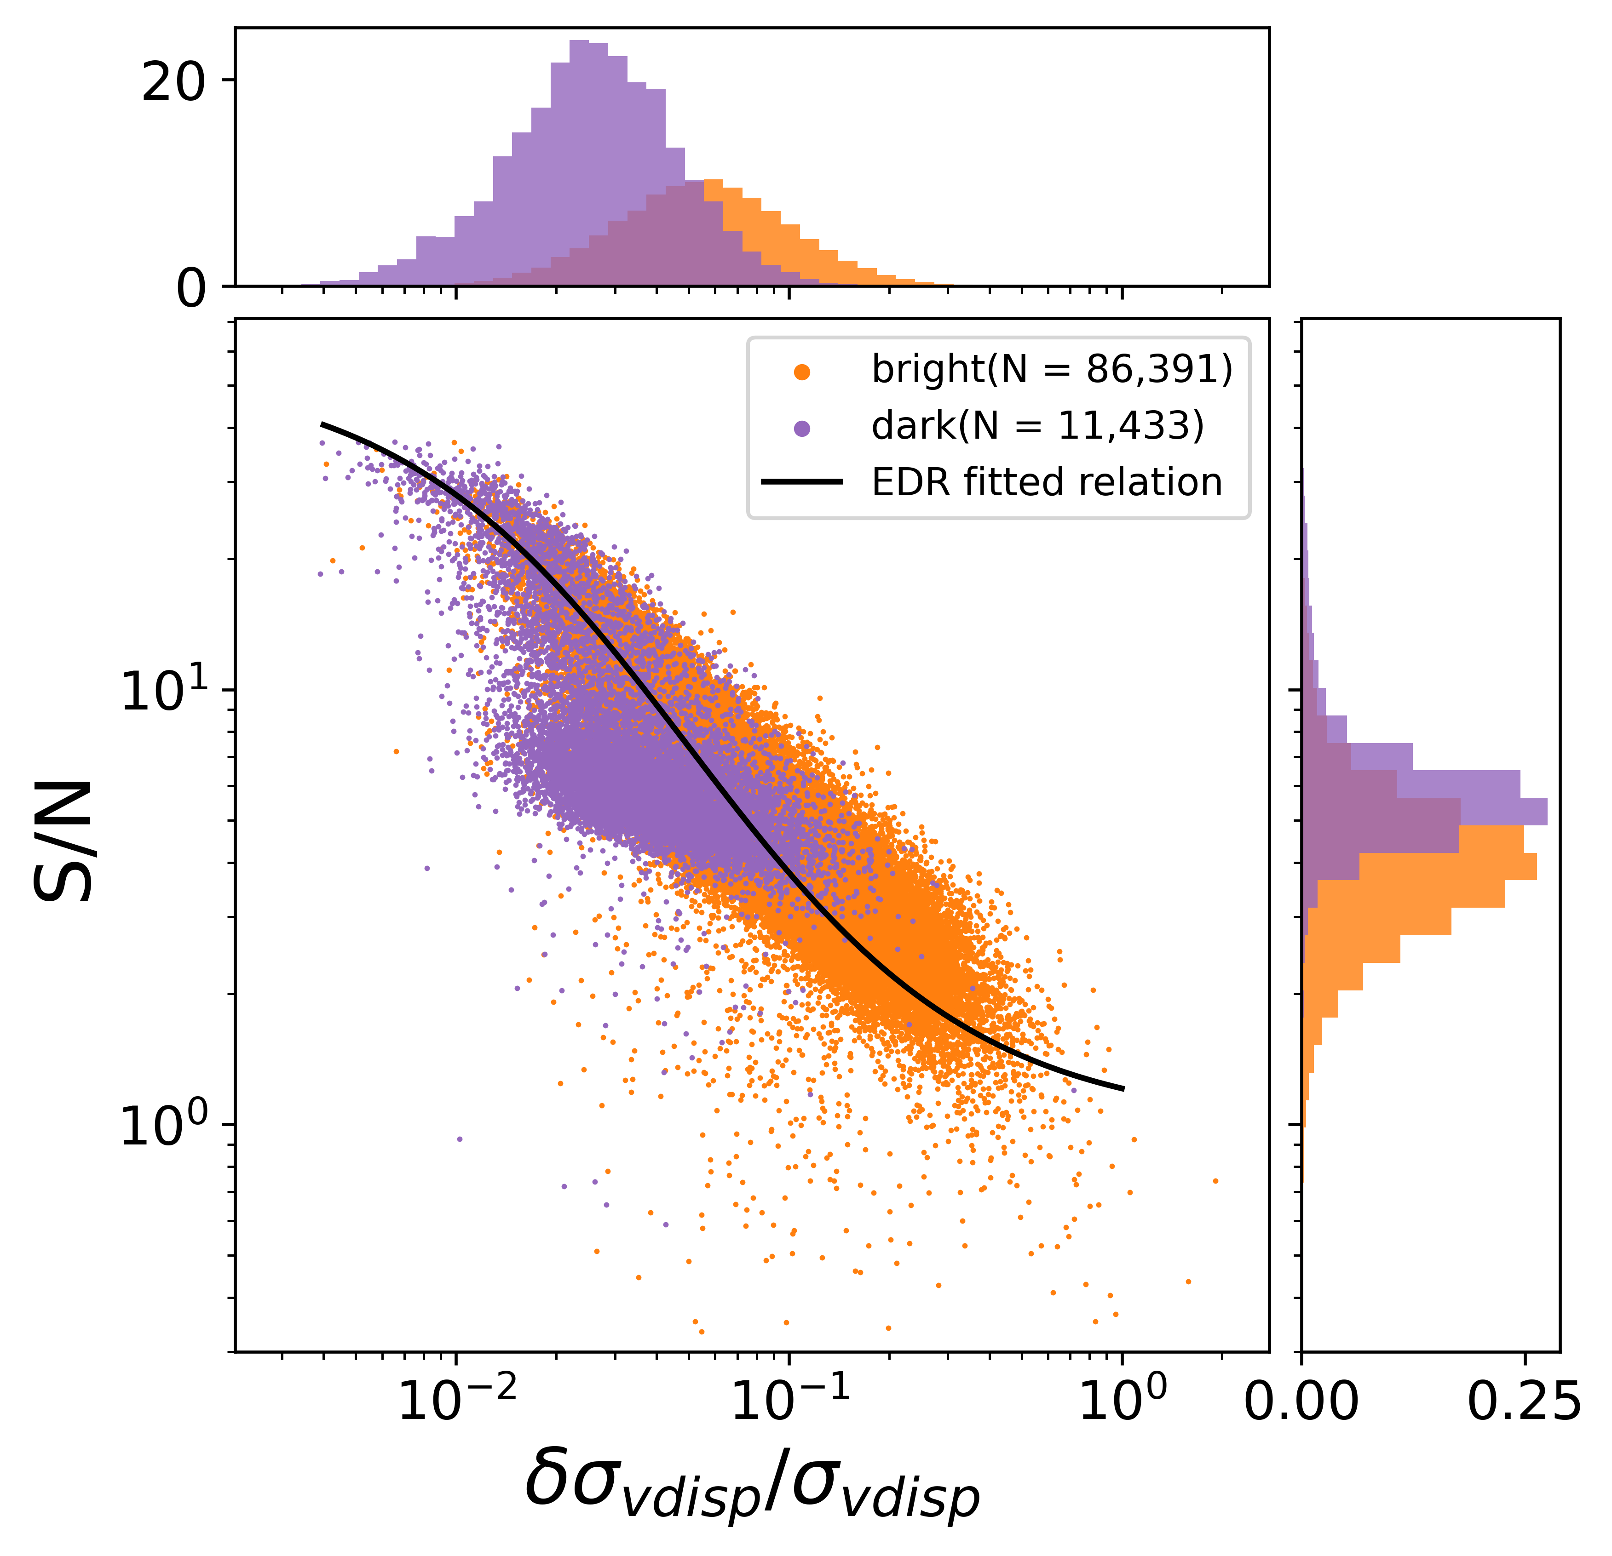
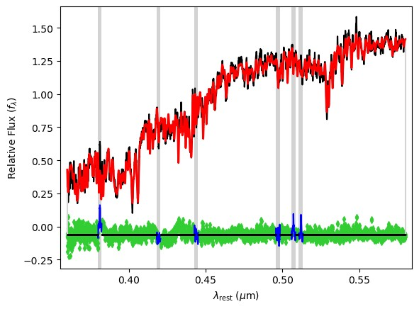
Velocity Dispersions
Fit Velocity Dispersions
Penalised Pixel Fitting
  Indo-U.S. Coudé Feed Spectral Library

Slide 12
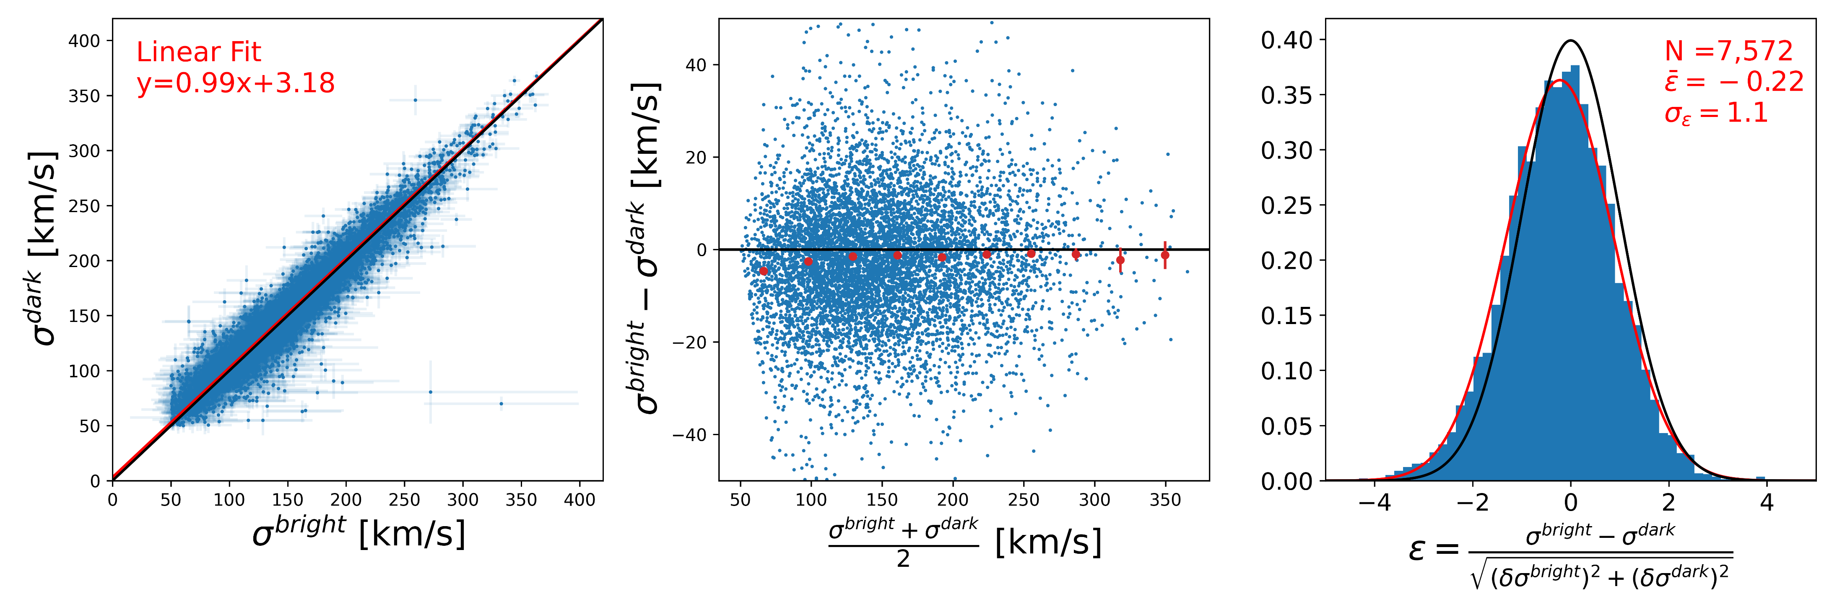
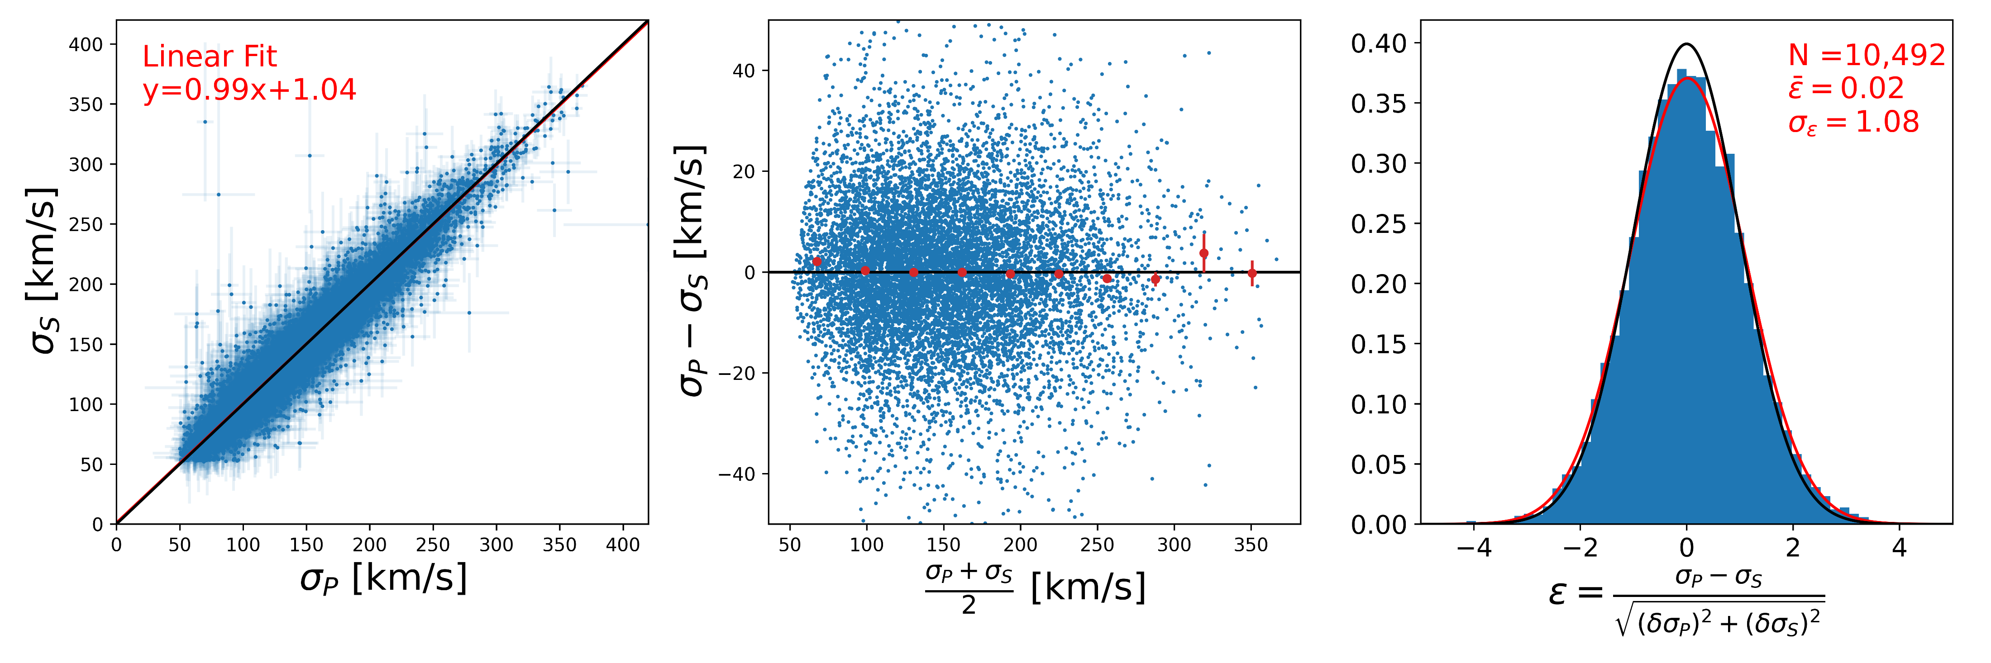
Different observing conditions
(for offsets between survey calibrations)
Repeat observations
(for error accuracy)

Slide 13
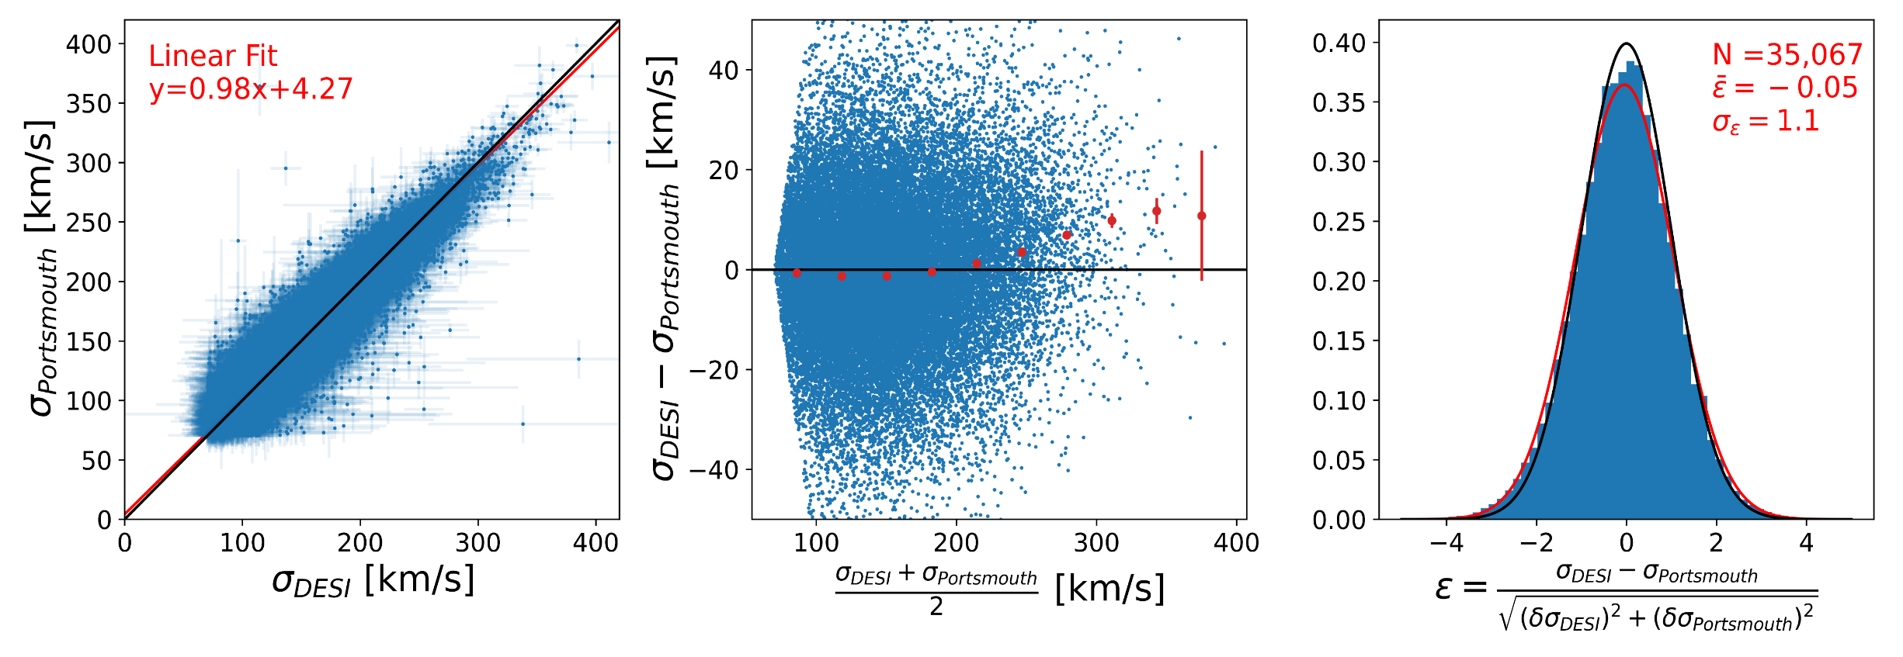
Velocity dispersion validation
Compare to SDSS
Good agreement
(0.05σ offset)

Slide 14
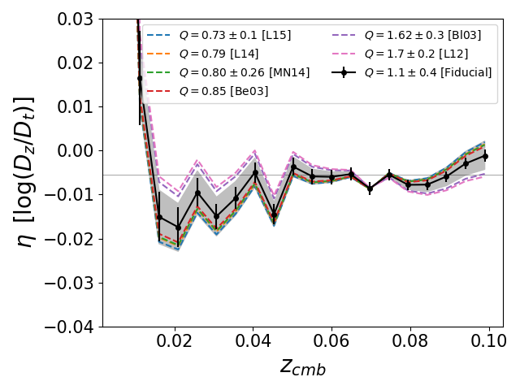
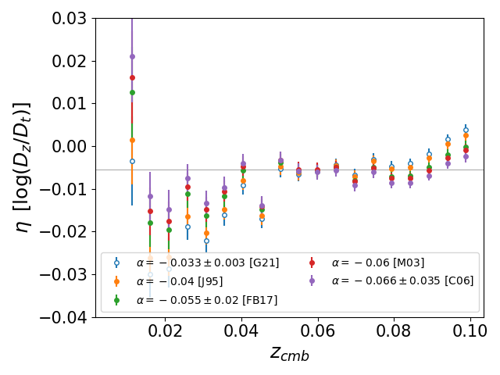
Systematics
Corrects for evolution of intrinsic galaxy brightness
Corrects for fixed spectral fibre size
Evolution correction parameter
Aperture correction parameter
Q corr
Alpha Corr

Slide 15
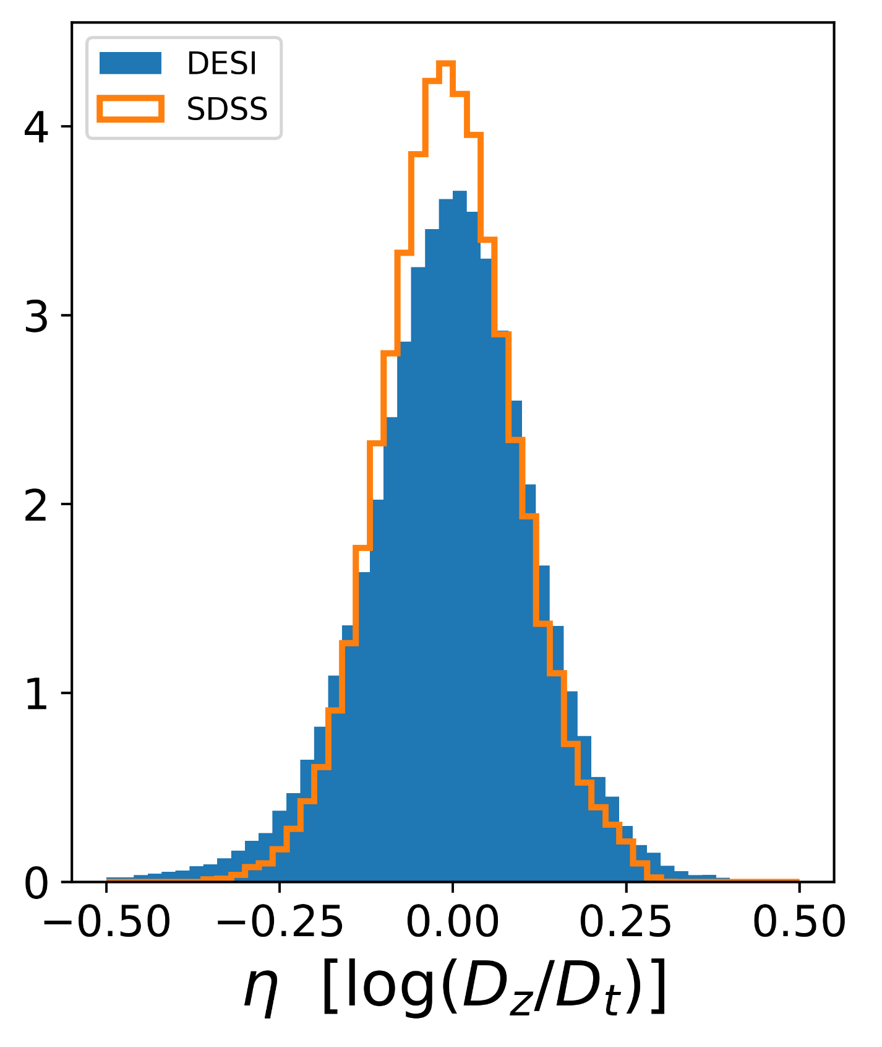
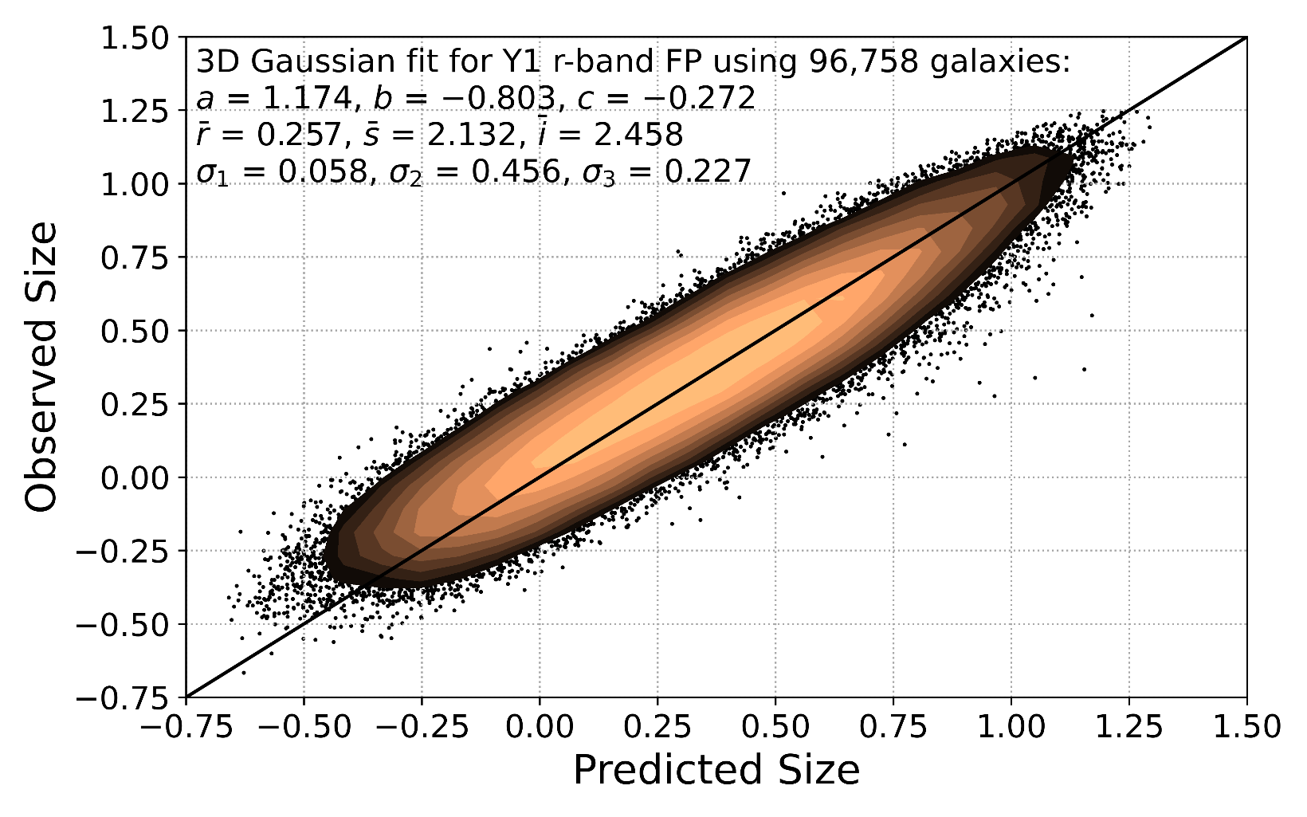

DR1 Fundamental Plane Sample
~26% distance uncertainty

Slide 16
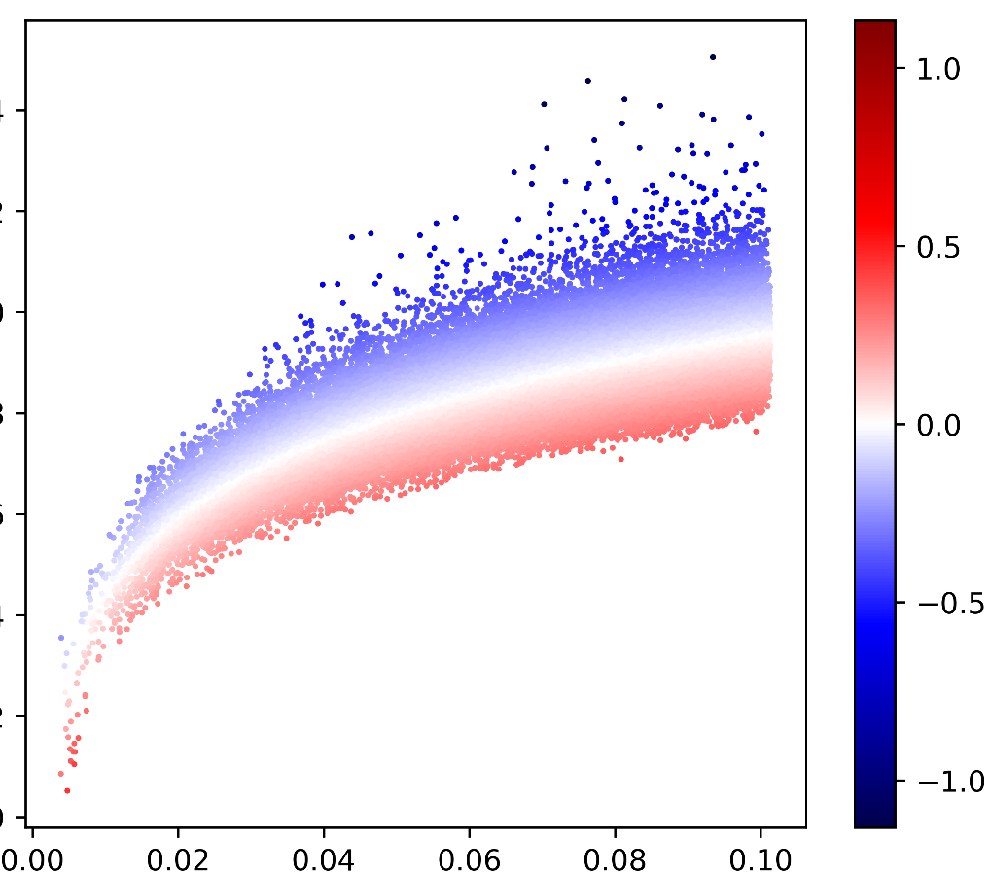
DR1 Fundamental Plane Sample
Distance modulus
η [log(Dz/Dt)]
Redshift

Slide 17
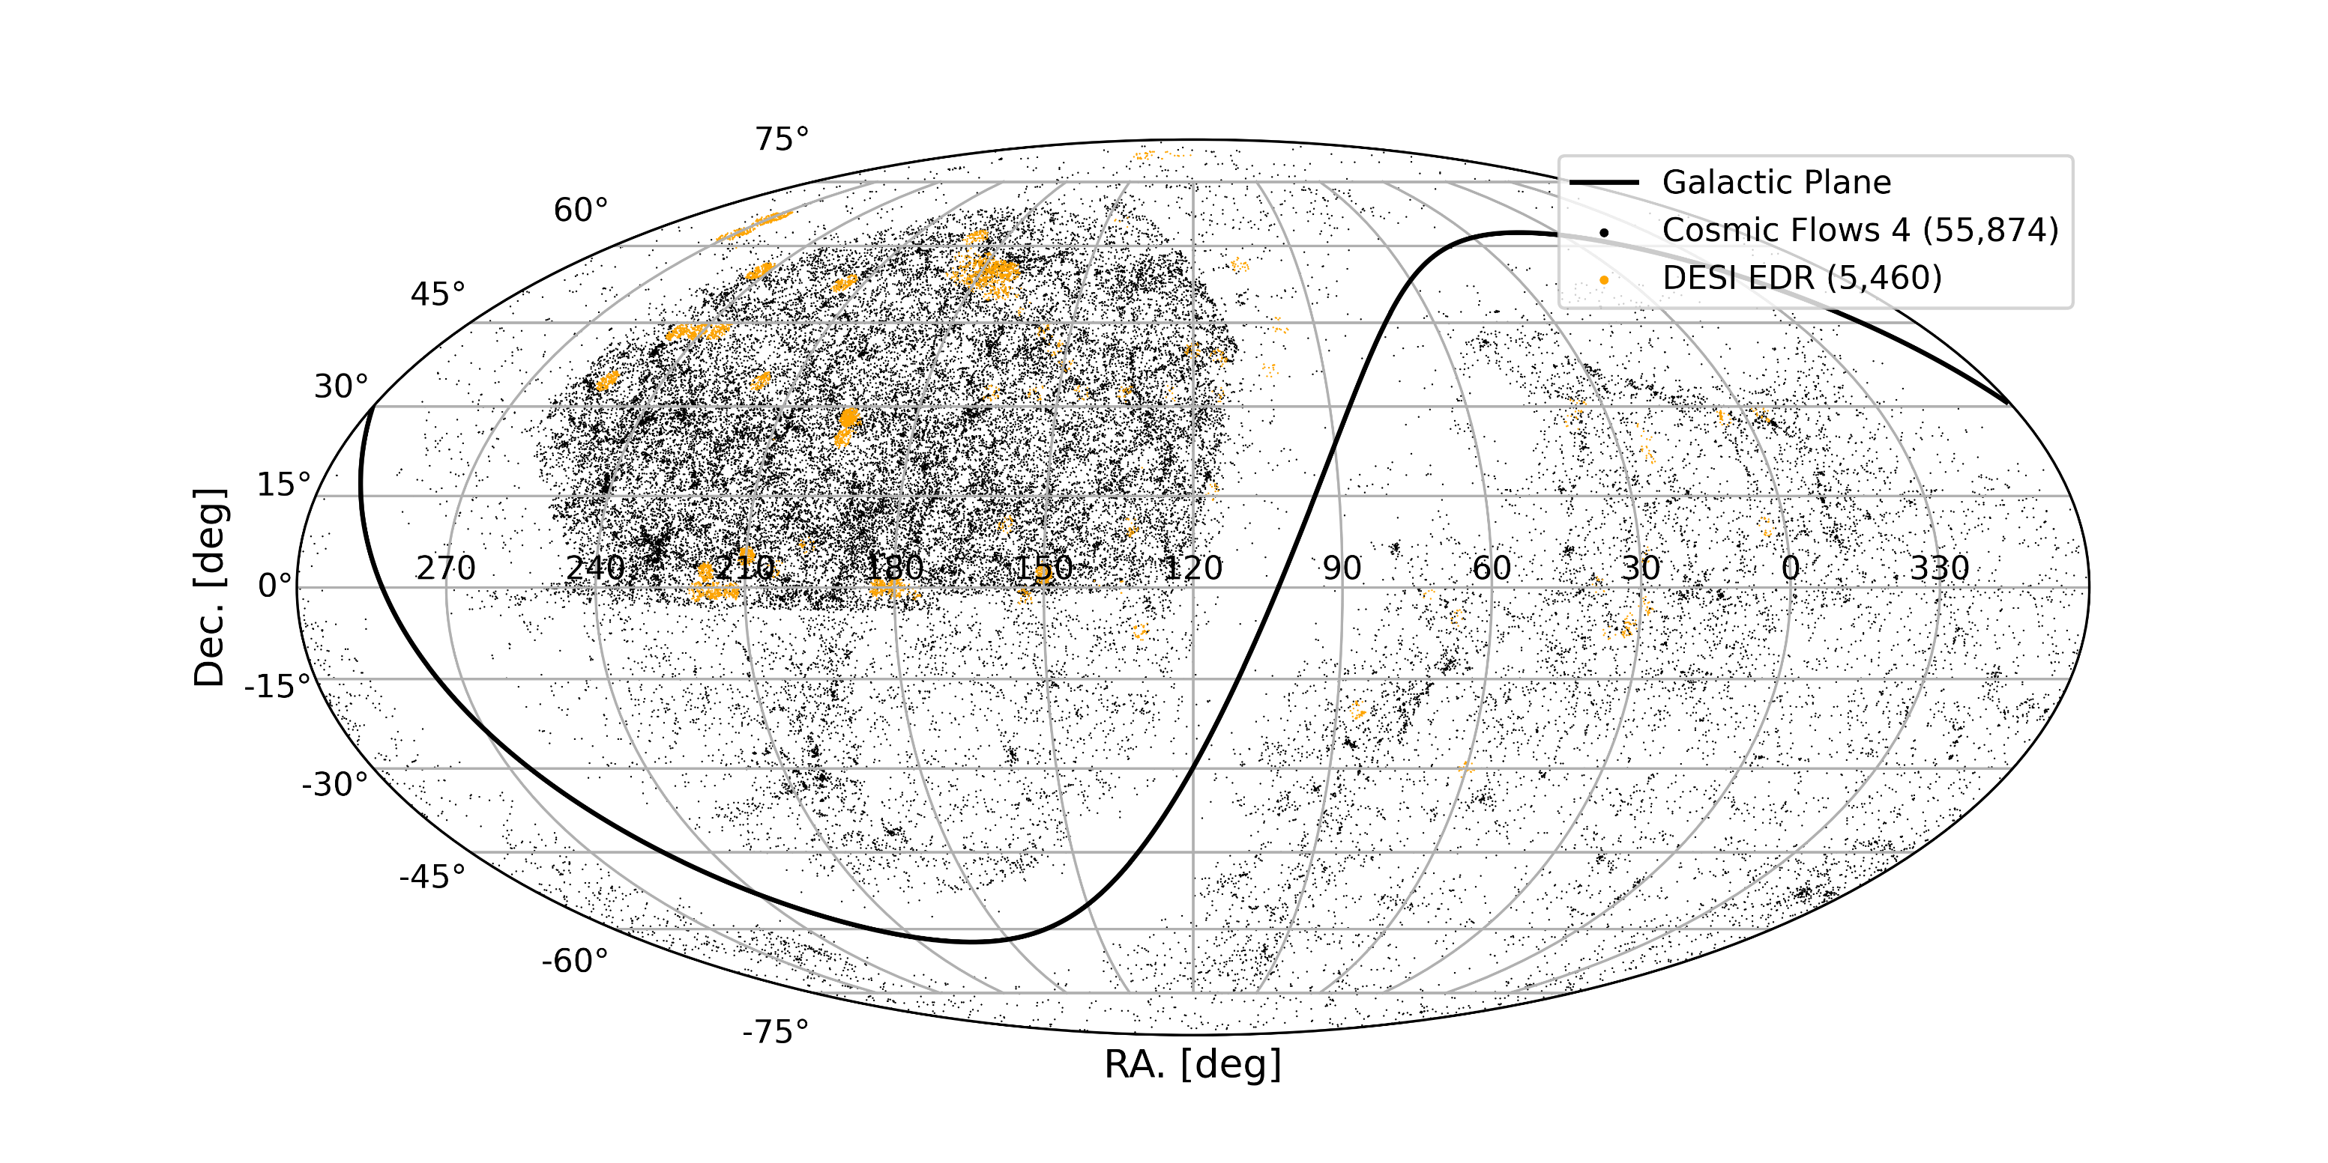
Existing Measurements

Slide 18
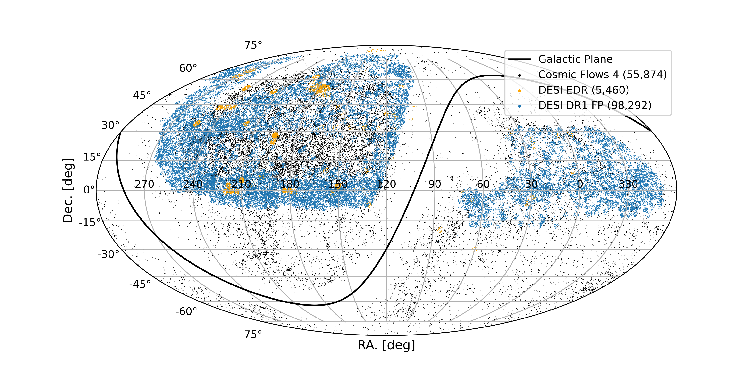
DESI Measurements

Slide 19
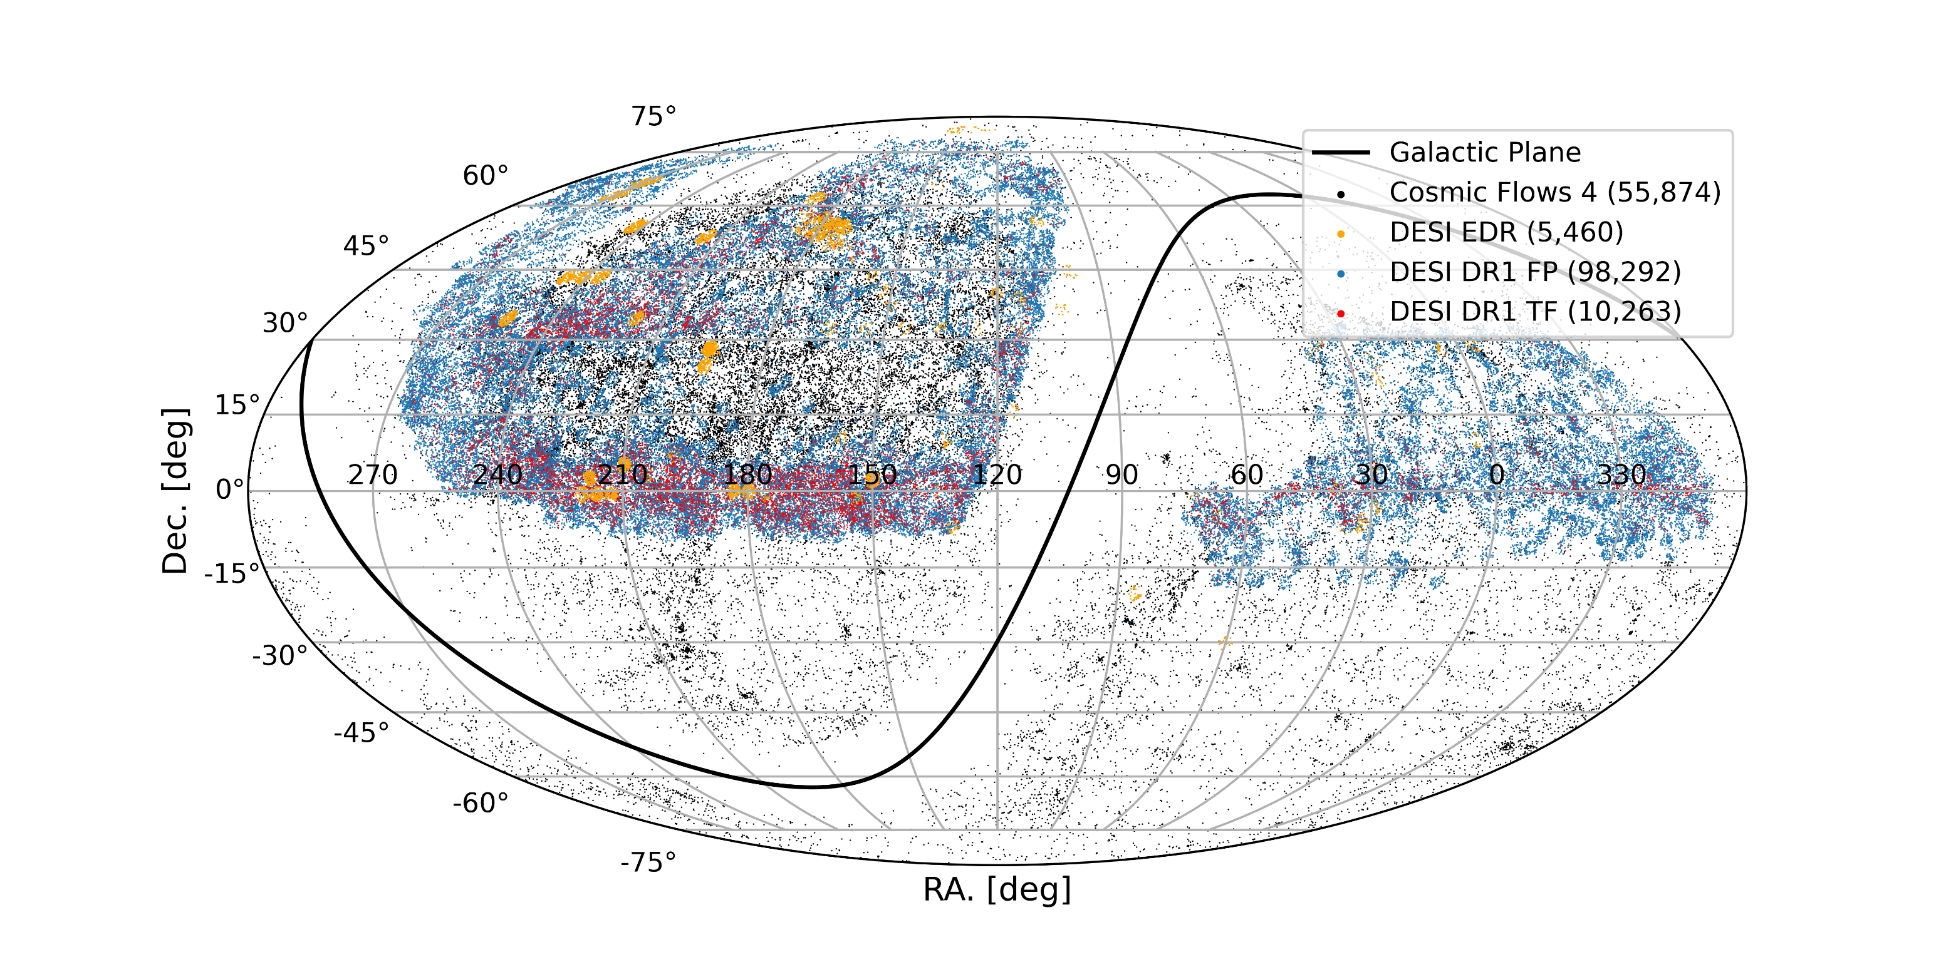
DESI Measurements

Slide 20
DESI DR1 PV Survey
(Ross et al., in prep)
(Douglass et al., in prep)
Currently drafting for December
arXiv release
Fundamental Plane
Tully Fisher
(Carr et.al., in prep)
(Bautista et al., in prep)
Zero-pointing and
$H_{0}$ constraints
Mock Catalogues
Combined Sample
(Qin et al., in prep)
(Lai et al., in prep)
(Turner et al., in prep)
(Nguyen et al., in prep)
(v, $δ$) correlation functions
(v, $δ$) Power Spectrum
Maximum Likelihood field
Cross-correlations with Supernovae
Structure formation rate ($fσ_{8}$) constraints

Slide 21
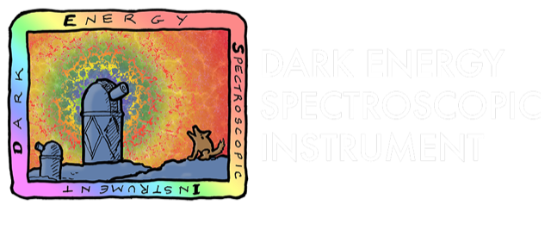
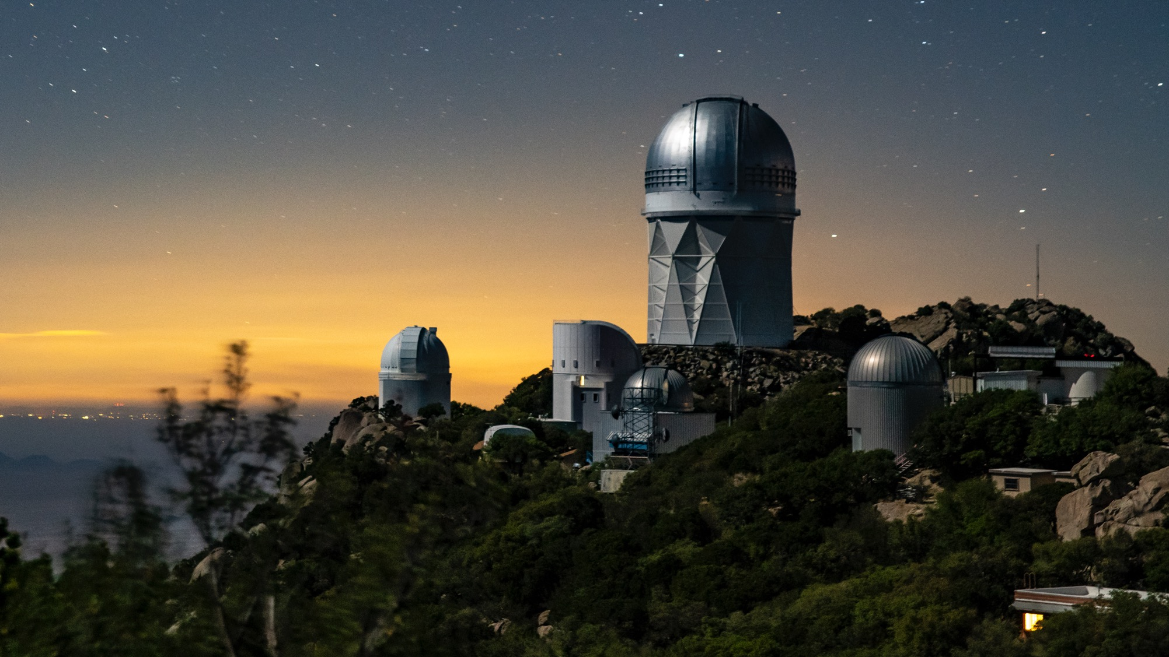









Thanks to our sponsors and
72 Participating Institutions!

