Slide 1
Evolution of Mass and Structure in Dark Matter Halos:
Scaling Laws from Dwarfs to Galaxy Clusters
Masao Mori
University of Tsukuba

Slide 2
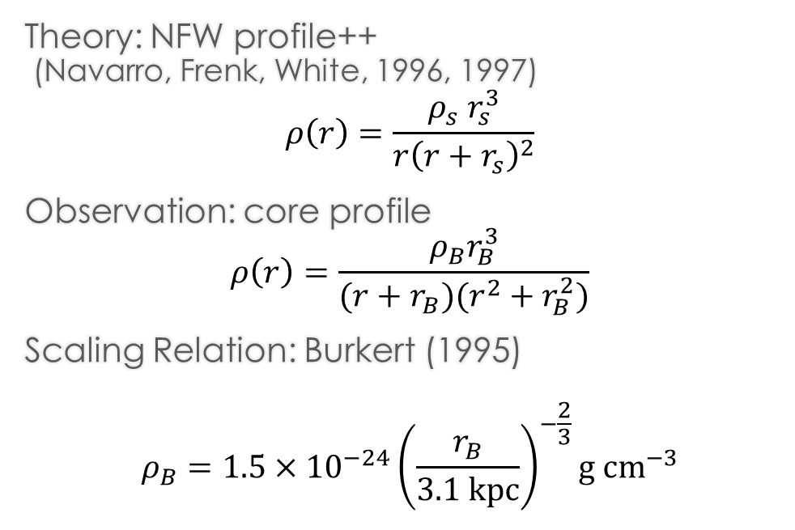


Observed Dark Matter Density Profile and Scaling Relation
Theory: NFW profile++
(Navarro, Frenk, White, 1996, 1997)
$$ρ\left(r\right)=\frac{ρ_{s} r_{s}^{3}}{r{\left(r+r_{s}\right)}^{2}}$$
Observation: core profile
$$ρ\left(r\right)=\frac{ρ_{B}r_{B}^{3}}{(r+r_{B})(r^{2}+r_{B}^{2})}$$
Scaling Relation: Burkert (1995)
$$ρ_{B}=1.5×{10}^{−24}{\left(\frac{r_{B}}{3.1 kpc}\right)}^{−\frac{2}{3}}g {cm}^{−3}$$
$$v_{φ}^{1.5}r_{B} [{\left(km∙s^{−1}\right)}^{1.5}]$$
$$r_{B} [kpc]$$
Burkert (1995)
Mori & Burkert (2000)

Slide 3
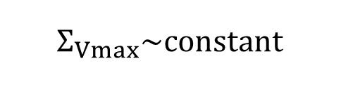
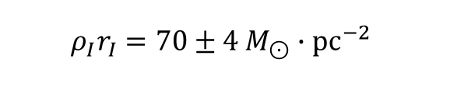


Observed Scaling Relation
$$log{ ρ}_{I}r_{I} [M_{⊙}∙{pc}^{−2}]$$
dSph, dIm
Sc-Im
disk galaxy
dSph
$$M_{B}$$
$$Σ_{Vmax}\sim constant$$
$$ρ_{I}r_{I}=70±4 M_{⊙}∙pc^{−2}$$
Kormendy & Freeman (2016)
Hayashi & Chiba, ApJ, 810, 22 (2015)
Cf. Donato et al. (2009); Salucci et al. (2012)

Slide 4

Universal scaling of dark matter halos with a cusp to core transition
Yuka Kaneda
Kaneda, MM, Otaki, PASJ. 76, 1206 (2024)
Observations reveal a clear scaling between surface mass density and mass in dark matter halos, yet its origin remains unknown.
Using the concentration mass relation from cosmological N-body CDM simulations, we derive links among surface mass density, maximum circular velocity, and scale radius.
The theoretical scaling relation holds from dwarf galaxies to galaxy clusters.
We add a relation for the cusp to core transition and outline observational tests.

Slide 5
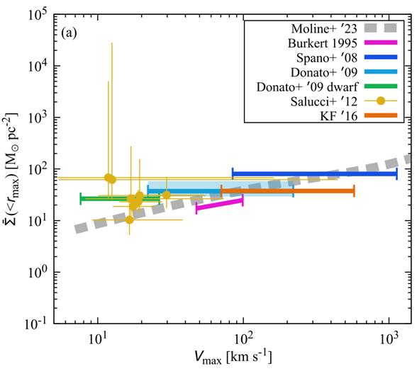
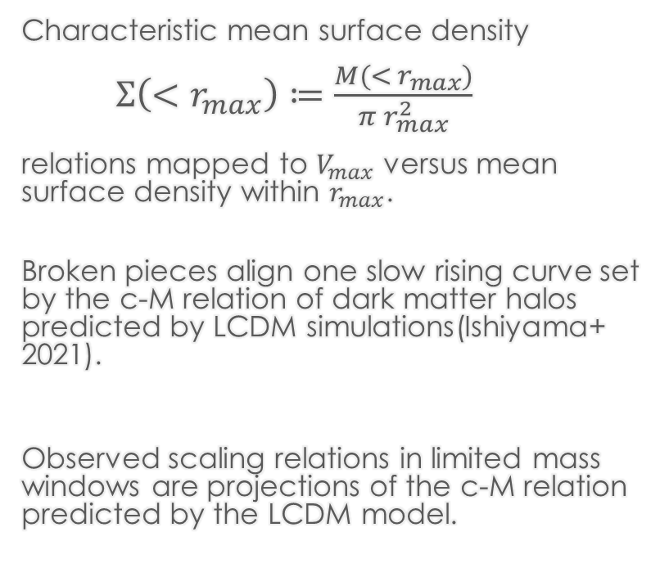
Observed surface density relations and theory
Kaneda, MM, Otaki, PASJ. 76, 1206 (2024)
Characteristic mean surface density
$Σ\left({<r}_{max}\right)≔\frac{M({< r}_{max})}{π r_{max}^{2}}$
relations mapped to $V_{max}$ versus mean surface density within $r_{max}$.
Broken pieces align one slow rising curve set by the c-M relation of dark matter halos predicted by LCDM simulations(Ishiyama+ 2021).
Observed scaling relations in limited mass windows are projections of the c-M relation predicted by the LCDM model.
Concentration-mass Rel.
Notes:
The left panel gathers classic relations.
We convert them to Vmax and mean surface density within rmax.
The grey curve comes from the c-M relation.
Dashed line shows c M from Lambda CDM on the Sigma Vmax plane.

Slide 6
Theory versus data across four planes
Dwarfs, spirals, groups, clusters.
Although there is some scatter, the theory shows no contradiction with observations across seven orders of magnitude in mass.
clusters
Spirals
groups
dwarfs
Notes:
The four planes test the model in complementary ways.
Theory and data agree from dwarfs to clusters.
At low and high ends there are small offsets.
Stellar mass modeling and core structure may explain part of the spread.

Slide 7
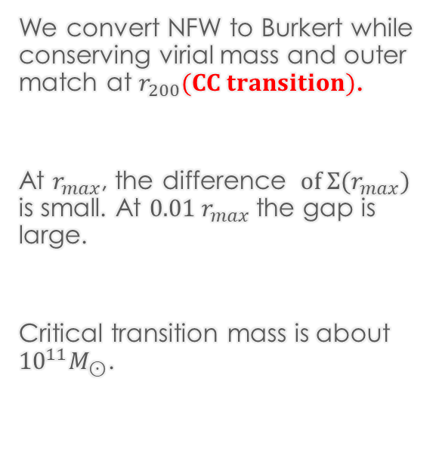
After CC transition
We convert NFW to Burkert while conserving virial mass and outer match at $r_{200}(CC transition)$.
At $r_{max}$, the difference $of {Σ(r}_{max})$ is small. At ${0.01 r}_{max}$the gap is large.
Critical transition mass is about ${10}^{11}M_{⊙}$.
cusp
core
Notes:
We solve for the core radius factor eta from the match conditions.
We transform c M into core parameters and back to c V and Vmax.
Near the centre the core and cusp differ strongly.
This enables an observational test with sufficient resolution.
The transition mass is around ten to the eleven solar masses.

Slide 8
Fitting Formulas and Coefficients
Kaneda, MM, Otaki, PASJ. 76, 1206 (2024)
The fitting formulas and coefficients for Σ and c are listed.
Both cuspy and cored families are provided.
These fits enable quick mapping to observational planes.

Slide 9
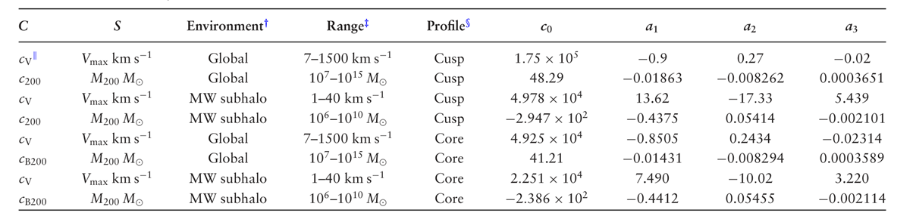
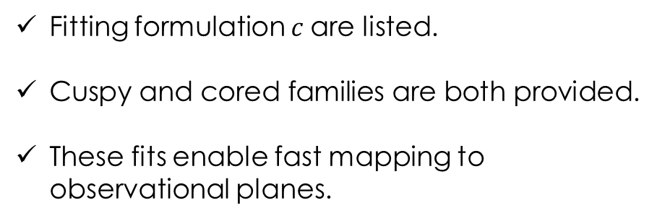
Fitting formula for c-M and c-V fits
Kaneda, MM, Otaki, PASJ. 76, 1206 (2024)
Fitting formulation $c$are listed.
Cuspy and cored families are both provided.
These fits enable fast mapping to observational planes.
Notes:
This table is the practical core of the paper.
It lists c V and c200 as functions of Vmax or M200.
Global and Milky Way subhalo cases are separate.
Cuspy and cored coefficients are both given.
Users can reproduce all model curves from these values.

Slide 10

Cusp-to-Core Transition of Dark Matter Halos across Galaxy Mass Scales
Kohei Hayashi
HAYASHI, KANEDA, MM, SHINOZAKI, submitted (arXiv:2507.22155)
Rotation curves for 175 SPARC galaxies
Cylindrical coordinate

Slide 11
Cusp-to-Core Transition of Dark Matter Halos across Galaxy Mass Scales
HAYASHI, KANEDA, MM, SHINOZAKI, submitted (arXiv:2507.22155)

Slide 12

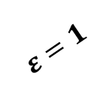
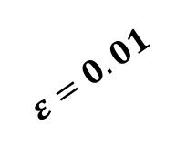
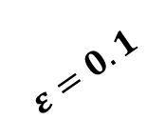
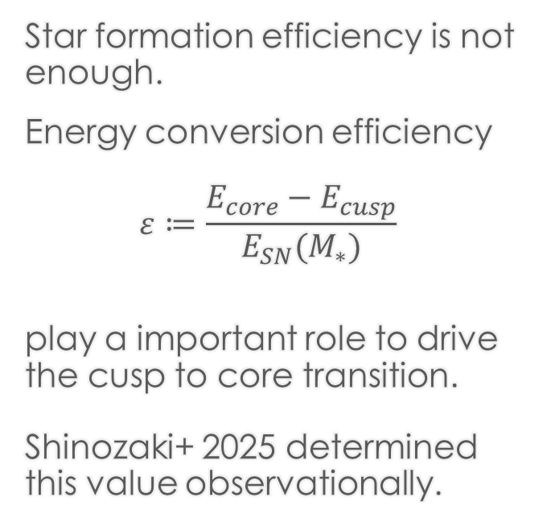
The Characteristic Mass and Energy Coupling Efficiency in the Cusp–Core Transition of Dark Matter Halos
Michi Shinozaki
Shinozaki, MM, Kaneda, Hayashi, to be submitted
Star formation efficiency is not enough.
Energy conversion efficiency
$ε≔\frac{E_{core}−E_{cusp}}{E_{SN}(M_{∗})}$
play a important role to drive the cusp to core transition.
Shinozaki+ 2025 determined this value observationally.
Behroozi+ (2019)
$$ε=0.01$$
$$ε=0.1$$
$$ε=1$$

Slide 13
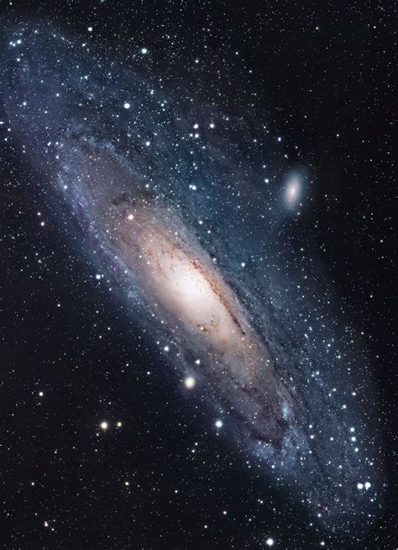
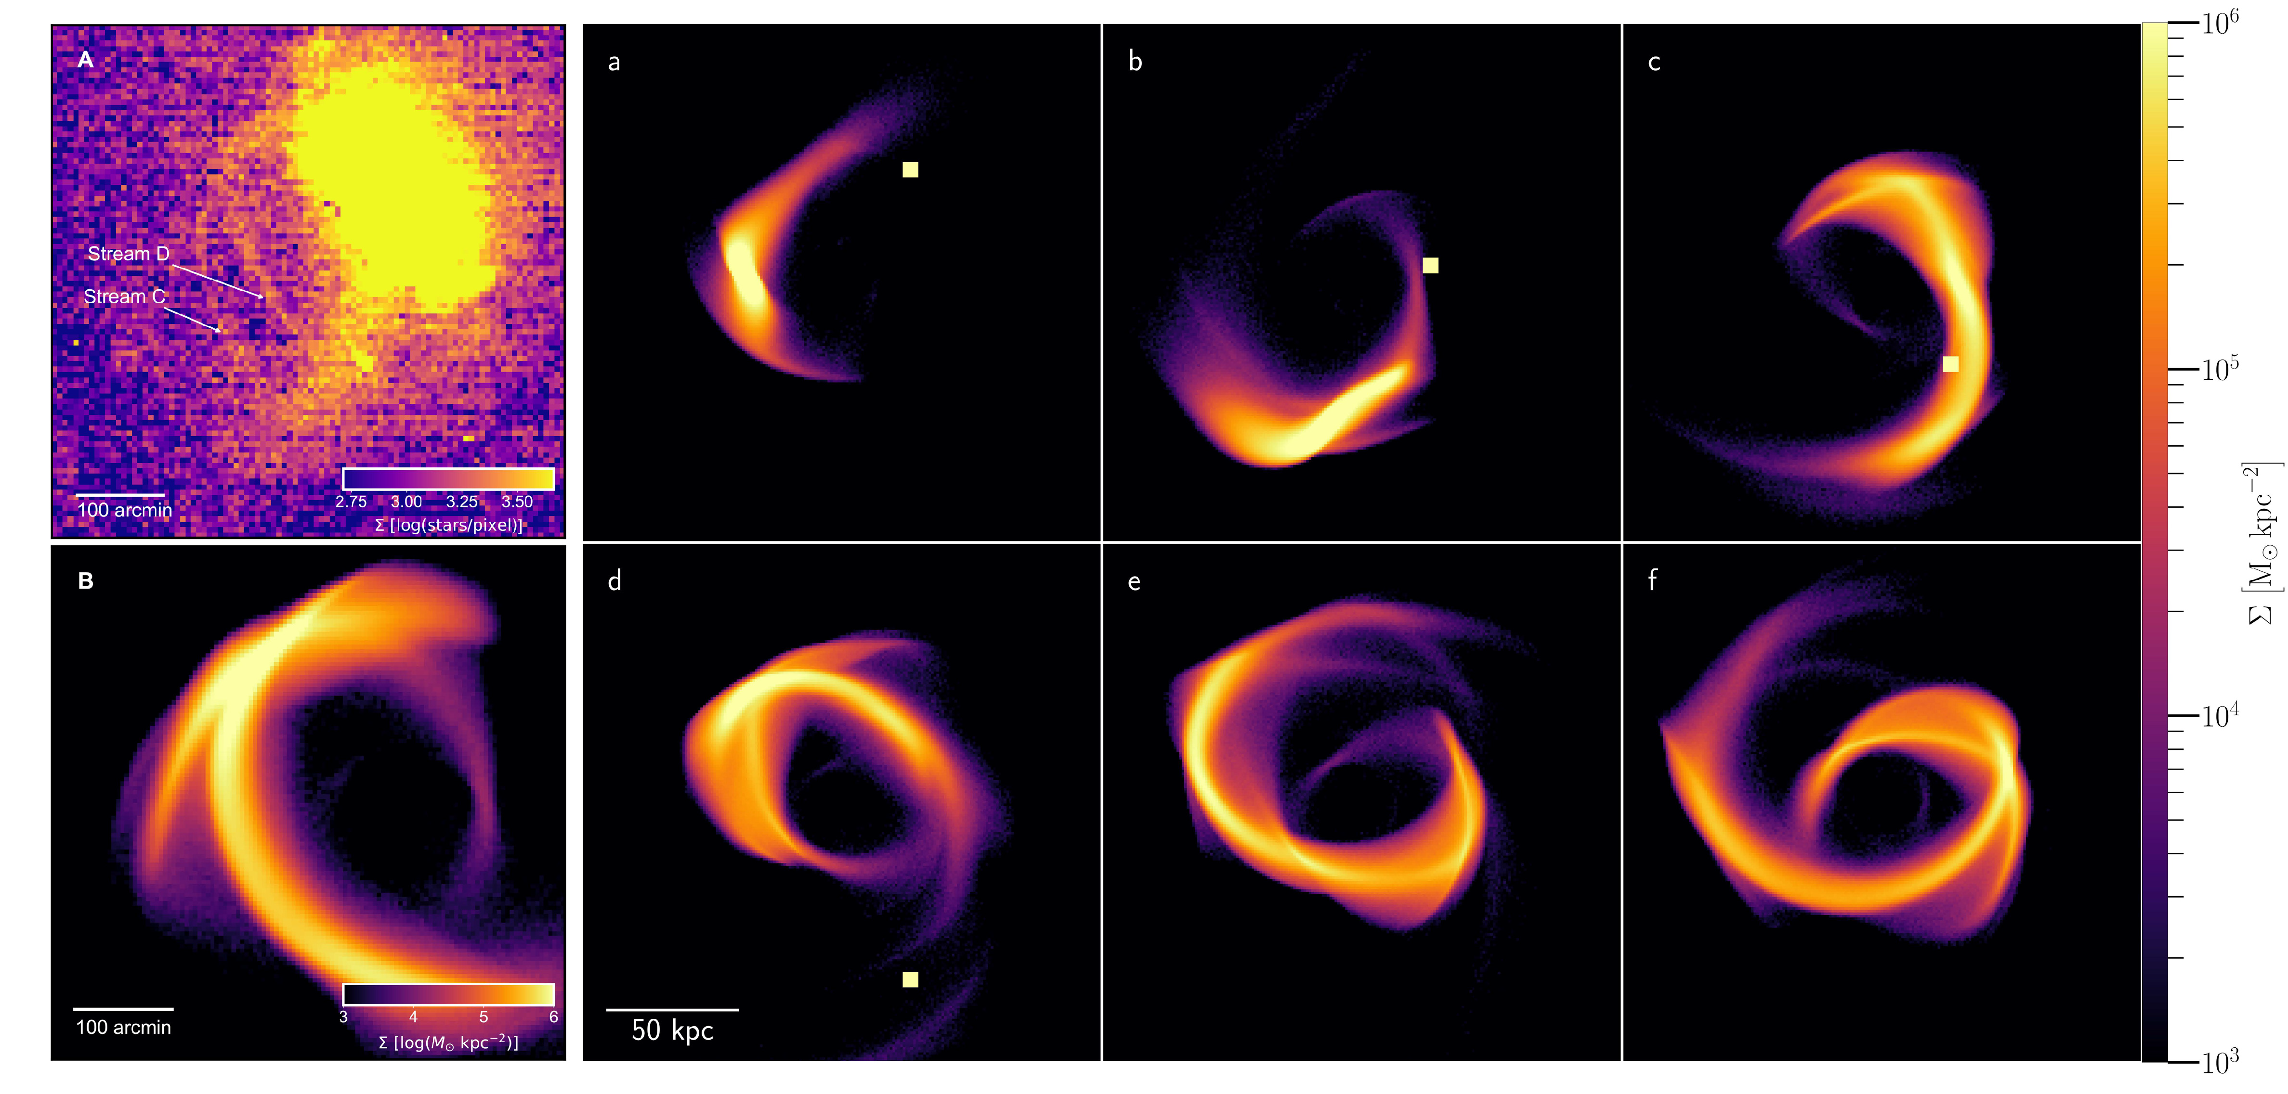
Stellar Streams as Detectors of Starless Dark Matter Subhalos and Intermediate Mass Black Holes
Yuka Kaneda
Kaneda, MM, Miki, Kirihara, Burkert, to be submitted
Recent studies test the existence of starless dark halos using perpendicular collisions with stellar streams.
Kaneda+ 2025 generalize to oblique encounters and show that this approach yields richer physics and sharper observational tests.
Intermediate mass black holes likewise leave clear stream signatures.
M31

Slide 14

Cosmological evolution of dark matter subhalos under tidal stripping by growing Milky Way–like galaxies
Yudai Kazuno
Kazuno, MM, Kaneda, Otaki, PASJ, 76, L39 (2024)
How do subhalos grow and then lose mass inside a growing host?
We analyze Phi-4096 (Ishiyama et al. 2021),
  a high resolution N-body simulation,
  following 27 Milky Way like hosts
  and 1,652,109 subhalos
to fit their mass histories, derive orbits, and compare the results with the GAIA satellite.
Subhalo evolution is universally two phase, with accretion first and stripping later; mass peaks near redshift one, smaller subhalos peak earlier, and over eighty percent show net mass loss.
Notes:
We study subhalo evolution inside Milky Way like hosts.
Large scale success of CDM is known. Small scale issues remain.
Subhaloes provide a clean dynamical probe. We use Phi 4096.
It gives very fine mass resolution. We select twenty seven hosts.
We track more than one point six million subhaloes. We fit each mass history. We derive orbital elements.
We compare with Gaia data. We find two phases. Accretion dominates early. Stripping dominates late.
The transition is near redshift one. Smaller systems peak earlier.
Most subhaloes lose mass overall.
.

Slide 15





Mass Evolution of Subhalos
$${10}^{5}≤M_{0}<{10}^{6}$$
$${10}^{6}≤M_{0}<{10}^{7}$$
Two phases: accretion and stripping
Over 80% of subhalos lose mass
Peak redshift decreases with mass
The late start of the stripping phase as the host grows.
→ Universal two-phase pattern
$$M_{0}≥{10}^{7} M_{⊙}$$
$${10}^{7}≤M_{0}<{10}^{8}$$
$$M_{0}≥{10}^{8}$$
Notes:
This Figure shows mass evolution of the most massive progenitors.
We normalise by present mass.
The median rises at early times.
Then it declines after the peak.
This is the signature of tidal stripping.
The transition occurs near redshift one.
Low mass subhaloes reach the peak earlier.
High mass subhaloes peak later. Resolution limits are shown.
We trust results above ten to the seven in h inverse solar masses.
The message is simple. Two phases are present in almost all cases.
We study subhalo evolution inside Milky Way like hosts. Large scale success of CDM is known. Small scale issues remain. Subhaloes provide a clean dynamical probe. We use Phi 4096. It gives very fine mass resolution. We select twenty seven hosts. We track more than one point six million subhaloes.
We fit each mass history. We derive orbital elements. We compare with Gaia data. We find two phases. Accretion dominates early.
Stripping dominates late. The transition is near redshift one. Smaller systems peak earlier. Most subhaloes lose mass overall.

Slide 16
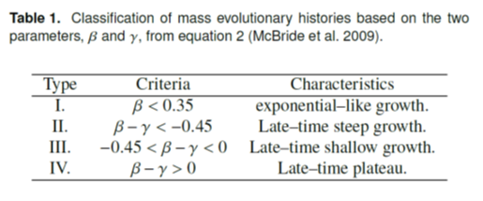
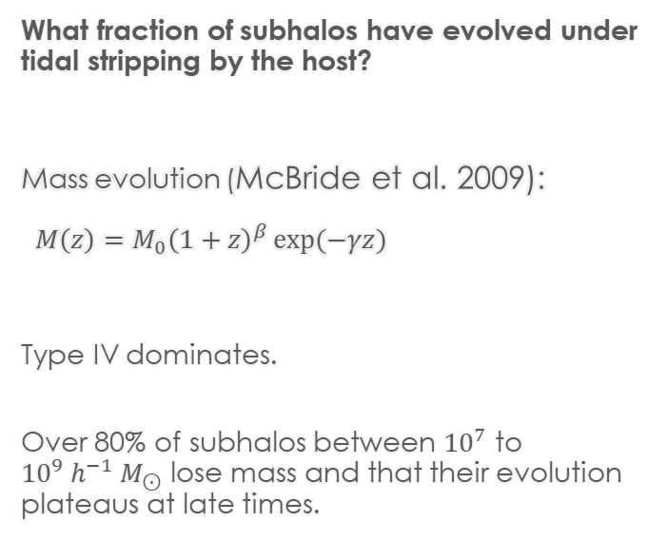
Classification of mass histories
What fraction of subhalos have evolved under tidal stripping by the host?
Mass evolution (McBride et al. 2009):
$M\left(z\right)=M_{0}{\left(1+z\right)}^{β}\exp{(−γz})$
Type IV dominates.
Over 80% of subhalos between ${10}^{7}$ to ${10}^{9} h^{−1} M_{⊙}$ lose mass and that their evolution plateaus at late times.
McBride+ (2009)
Notes:
We classify each mass history with the McBride two parameter model.
Types are set by beta minus gamma. Type four dominates.
This type shows a late time plateau.
This is a clear sign of stripping.
Type two is almost absent. The stripping phase starts late as the host potential deepens.
Thus growth does not keep rising exponentially. Subhaloes lose their outer parts first.
Tracks in Vmax and rmax retreat at late times. At present the cores look like early progenitors.

Slide 17
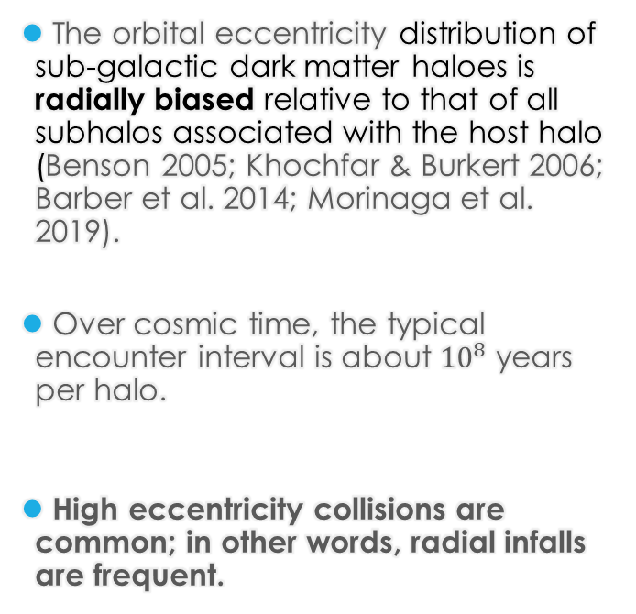
Possibility of central collision：cosmological simulations
Kazuno, MM, Otaki, PASJ, 76, L39 (2024)
The orbital eccentricity distribution of sub-galactic dark matter haloes is radially biased relative to that of all subhalos associated with the host halo (Benson 2005; Khochfar & Burkert 2006; Barber et al. 2014; Morinaga et al. 2019).
Over cosmic time, the typical encounter interval is about ${10}^{8}$ years per halo.
High eccentricity collisions are common; in other words, radial infalls are frequent.
Notes:
So far, studies show that the orbital eccentricity of sub-galactic dark matter halos is radially biased, compared to the overall subhalo population.
High-resolution cosmological N-body simulations indicate that thousands of subhalos have penetrated the central 10 kiloparsecs of Milky Way-sized halos.
From this, the average merger rate over cosmic time is estimated to be about one per hundred million years for each halo.
We selected Milky Way–sized dark matter halos from cosmological simulations,
and plotted the distribution of pericenters and eccentricities of the subhalos.
On top of that, we added the nearby dwarf galaxies observed by Gaia, shown as red symbols.
You can see that the CDM prediction agrees well with the observations.
It is clearly shown that the subhalos approaching the galactic center have orbits biased toward the radial direction.
Such radial orbits naturally lead to high-velocity interactions with the galactic center.

Slide 18
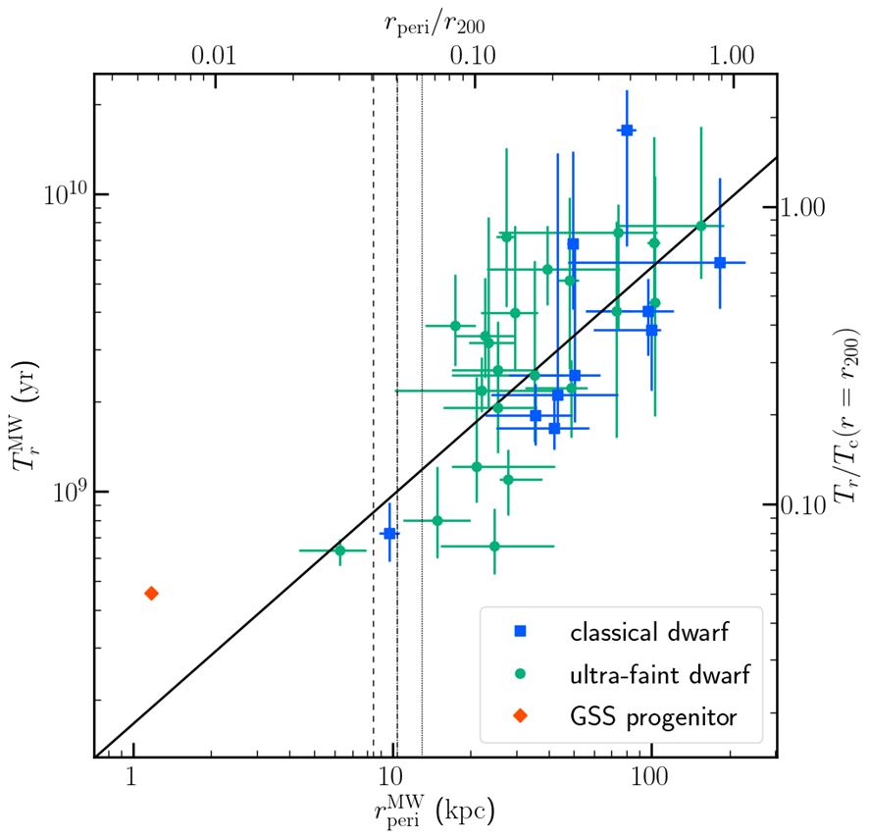
Possibility of central collision：
Orbit of MW satellites from GAIA
Integrated orbits of the satellite galaxies surrounding the Milky Way using the proper motion measurements provided by the Gaia DR2.
The distributions of orbital periods and periapsises show a linear trend from the upper right towards the lower left.
This figure indicate that sub haloes with smaller pericentric distance may be stretched and disrupted by the tidal force of the central galaxy, and that the debris has fallen into the galactic centre.
Their orbital periods are ～10⁸ yr. This is consistent with the inferred average merger rate derived by the cosmological simulation.
Notes:
We integrated the orbits of Milky Way satellites using proper motion data from Gaia DR2.
The distribution of orbital periods and pericenters shows a clear trend from the upper right to the lower left.
This suggests that subhalos with small pericentric distances are stretched and disrupted by the tidal force of the central galaxy.
The debris then falls into the galactic center.
Their orbital periods are about 10^8 years.
This is consistent with the average merger rate inferred from cosmological simulations.

Slide 19
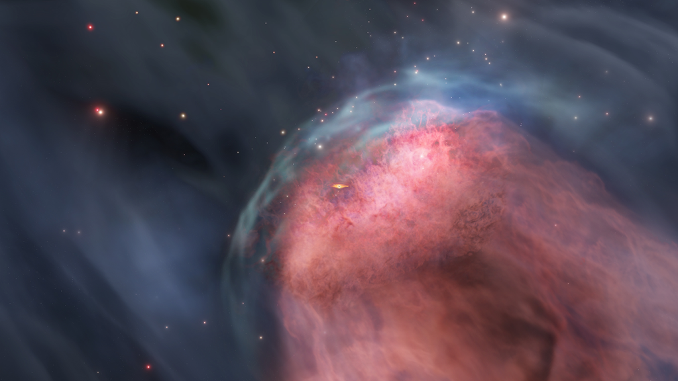

Destruction of the central black hole gas reservoir through head-on galaxy collisions
Yohei MIKI
Yohei MIKI, MM, Toshihiro KAWAGUCHI,
Nature Astronomy, 5, 478–484 (2021)
Notes:
Now, I would like to introduce a part of my research carried out in my group.
From the hydrodynamic interaction simulations we saw earlier,
I will highlight the cases where ram pressure and Kelvin–Helmholtz instability both play a role.
The first example comes from work with my first PhD student, Yohei Miki.
In this project, we looked at how gas from an infalling dwarf galaxy collides with the torus around the central black hole, and how the torus gas is stripped away in the process.

Slide 20
Can galaxy mergers shut down AGN activity?
Galaxy collisions have been supposed to enhance the central activity of galaxies, starburst and/or gas fuelling towards central black holes, via angular momentum transfer, resulting in the ignition of the AGNs (Sanders et al. 1988; Hopkins & Quataert 2010, etc.).
On the other hand, a fraction of luminous merging galaxies, such as ultra-luminous infrared galaxies, do not always harbour AGNs (e.g. Imanishi et al. 2010). Nor, searching for signatures of major mergers in host galaxies of AGNs using HST images shows no clear difference from inactive galaxies (Cisternas et al. 2011).
Namely, it is still controversial what controls the fates (e.g., ignition and duration) of the AGN activity.
Here, we show that galaxy collisions are also capable of suppressing black hole fuelling, by using an analytic model and three-dimensional hydrodynamic simulations and by applying the well-determined parameter sets for the galactic collision in the Andromeda Galaxy.
Notes:
Galaxy collisions are thought to enhance central activity, by driving starbursts and fuelling gas into the black hole.
This can ignite AGN activity.
But observations show a mixed picture.
any luminous mergers, such as ultra-luminous infrared galaxies, do not always host AGNs.
And HST studies find no clear difference between AGN hosts and inactive galaxies.
So, it is still controversial what really controls the ignition and duration of AGN activity.

Slide 21

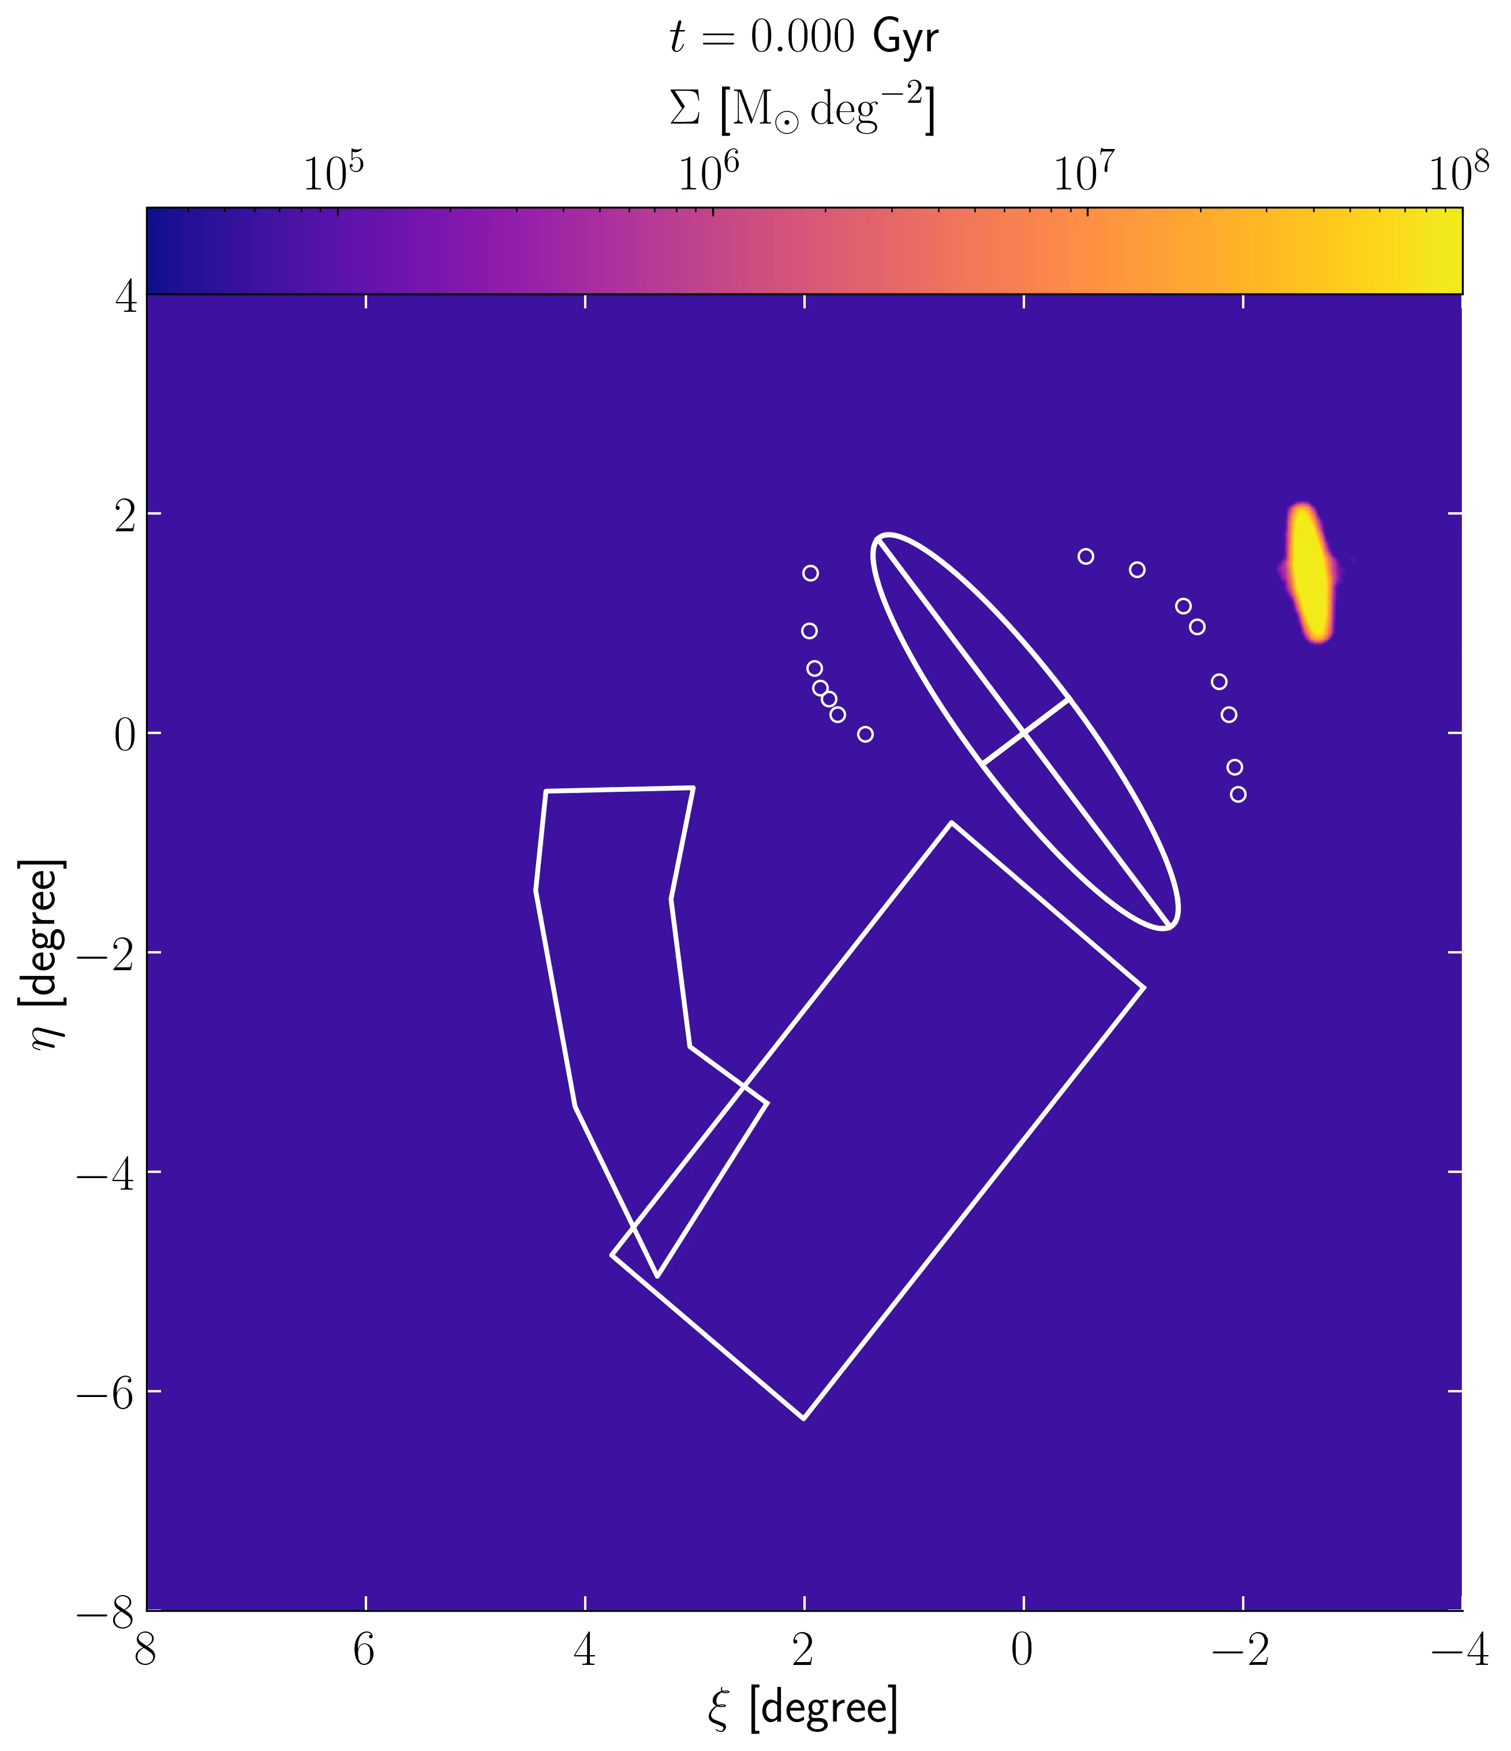
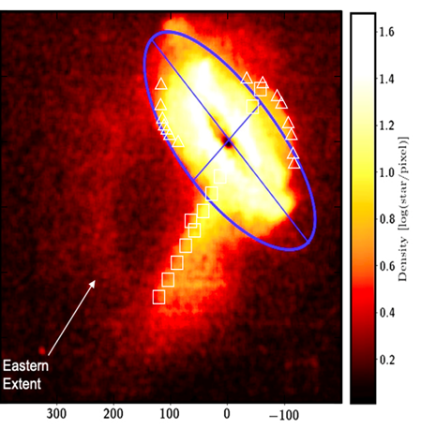
Galaxy collision between M31 and formation of the Andromeda Giant Stellar Stream
M. Yamaguchi
Yamaguchi, MM+, PASJ, 77, L36 (2025)
The Andromeda Giant Stellar Stream (AGSS), in particular, has been studied extensively due to its massive and distinctive structure and remains a focal point of research.
Progenitor galaxy is predicted as a disk galaxy (Fardal+ 2008; Hammer+ 2010; Kirihara, MM+ 2017), and the orbit is almost radial and central collision (Fardal+ 2007; Miki, MM+ 2014) for miner merger model.
160kpc
Notes:
The AGSS has been studied extensively because of its massive and distinctive structure. It remains a focal point of research.
The progenitor galaxy has been predicted as a disk galaxy, and the orbit is almost radial, leading to a central collision in the minor merger model.
Here, I would also like to mention a recent study, Yamaguchi et al. 2025.
This work provides new insights into the stream morphology and further refines the constraints on the progenitor and its orbit.
So far, most of the significant structures in the stream have already been reproduced by a single minor merger.

Slide 22
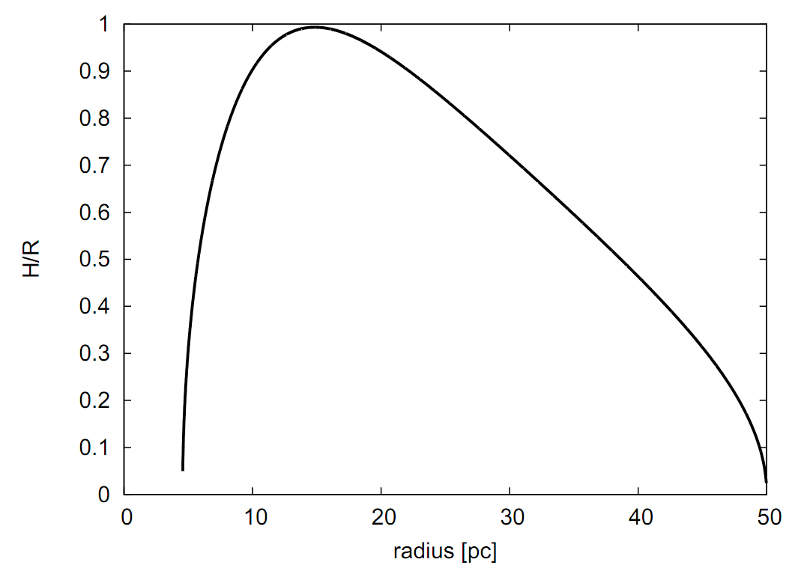
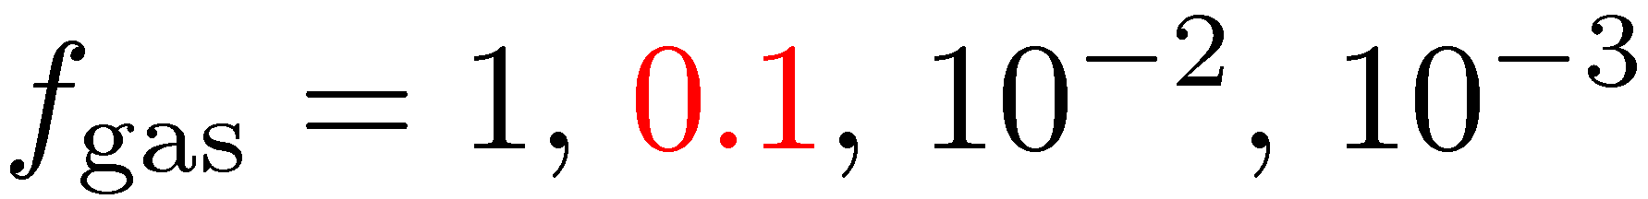
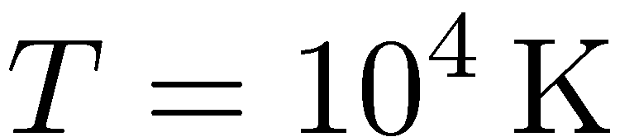
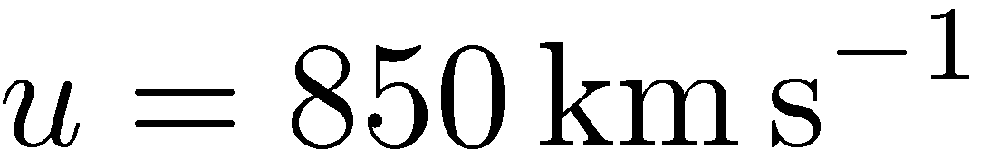
Hydrodynamic interaction between torus and infalling gas
Can central galaxy collisions have a negative effect on AGN activity?
⇒ hydrodynamical simulations.
Control parameter:
(Krolik & Begelman 1988; Greenhill & Gwinn 1997; Beckert & Duschl 2004; Schartmann et al. 2005; Honig et al. 2006; Nenkova et al. 2008; Mor et al. 2009)
Notes:
In this work, we ask a simple question.
Can central galaxy collisions have a negative effect on AGN activity?
AGN are fueled by the torus gas around the central black hole.
We test this idea using hydrodynamical simulations.

Slide 23
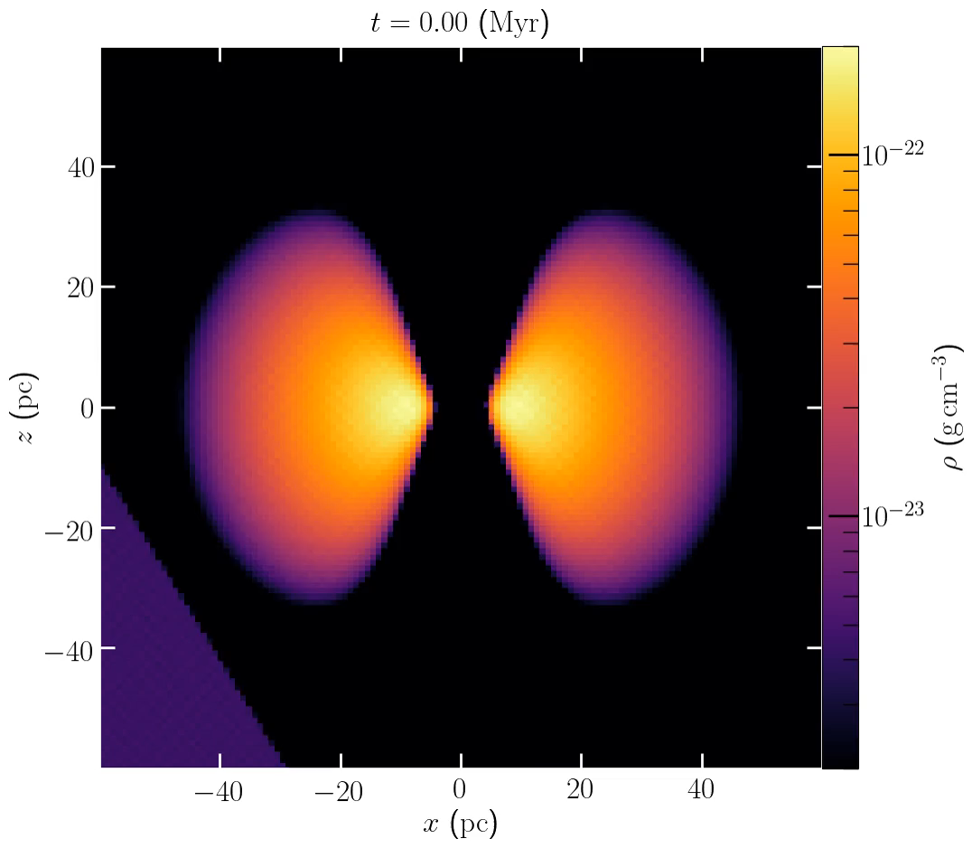
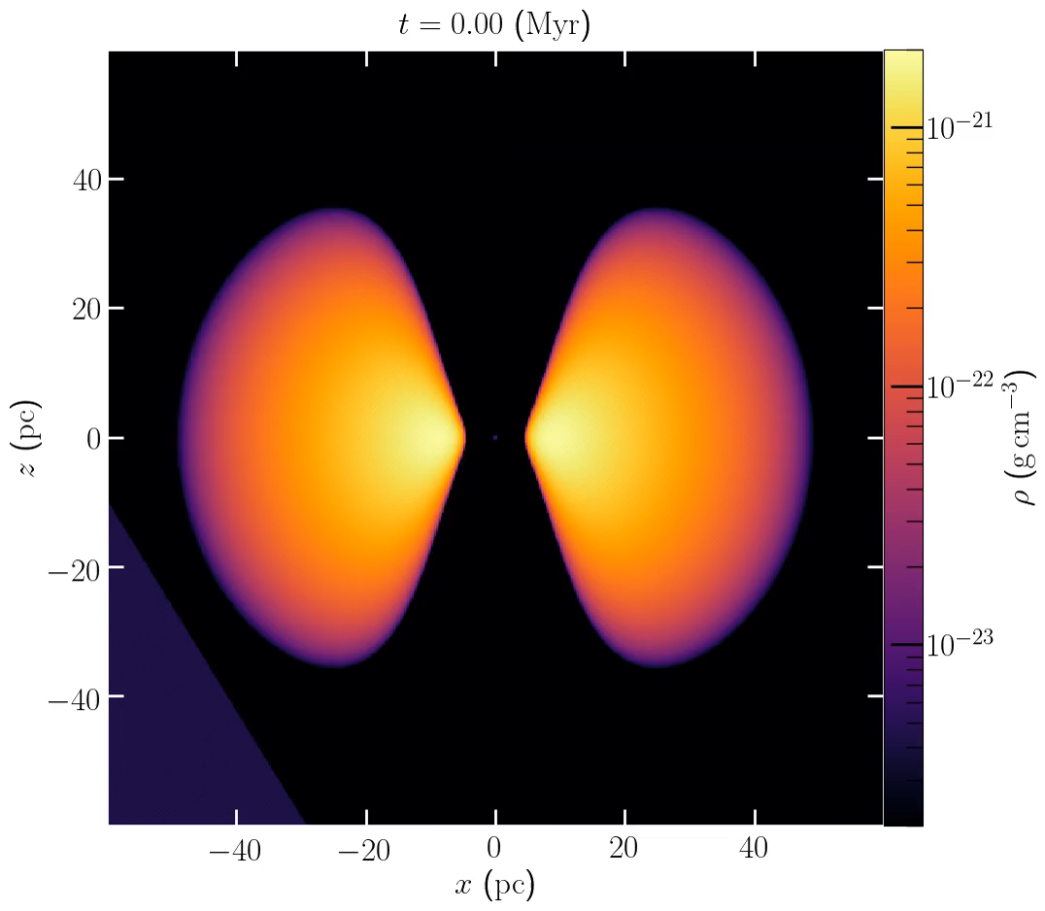

Result of simulation
Miki, MM, Kawaguchi, Nature Astronomy, 5, 478(2021)
Low density torus $Σ_{torus}<Σ_{sat}$ High density torus $Σ_{torus}>Σ_{sat}$
Notes:
These movies show simulations of the interaction between the torus gas and the satellite galaxy gas at a given collision angle.
The left panel shows a low-density torus. Its surface density is lower than that of the satellite galaxy.
The shock wave from the collision immediately strips the torus gas. This is the instantaneous stripping mode.
The right panel shows a high-density torus. Its surface density is higher than that of the satellite galaxy.
In this case, the torus survives under the gravity of the black hole. The outer gas is slowly stripped by the Kelvin–Helmholtz mode.

Slide 24
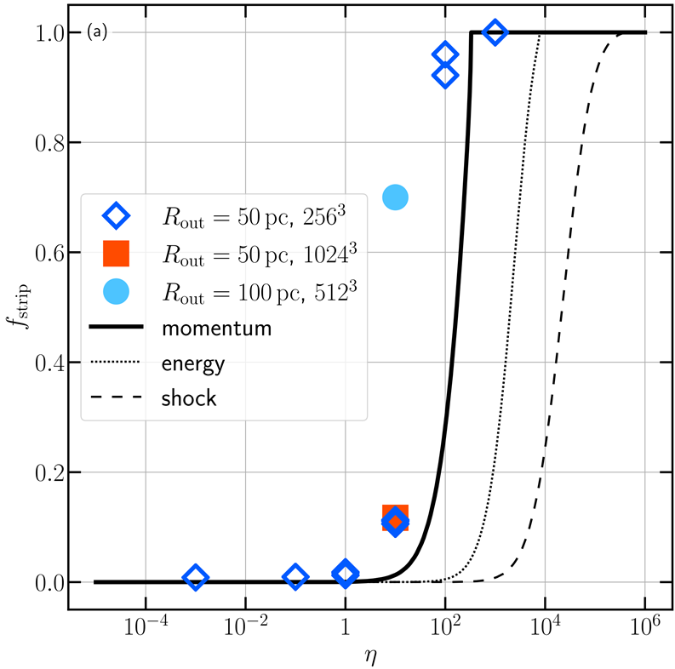
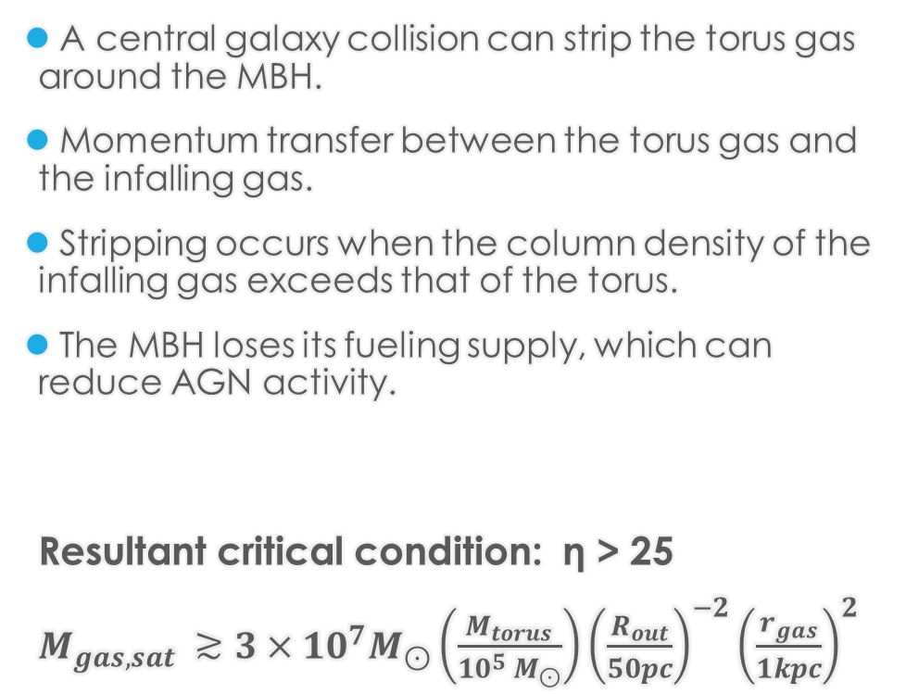
Critical condition for torus stripping
A central galaxy collision can strip the torus gas around the MBH.
Momentum transfer between the torus gas and the infalling gas.
Stripping occurs when the column density of the infalling gas exceeds that of the torus.
The MBH loses its fueling supply, which can reduce AGN activity.
Resultant critical condition: η > 25
$M_{gas, sat} ≳3×10^{7}M_{⊙}\left(\frac{M_{torus}}{10^{5} M_{⊙}}\right){\left(\frac{R_{out}}{50pc}\right)}^{−2}{\left(\frac{r_{gas}}{1kpc}\right)}^{2}$
Notes:
A central collision of galaxies can strip the torus gas around the black hole.
This torus gas is thought to be the fuelling source of the AGN.
The stripping happens through momentum transfer between the torus and the infalling gas.
It occurs when the column density of the infalling gas is higher than that of the torus.

Slide 25
Possibility of central collision：
Orbit of MW satellites from GAIA
Integrated orbits of the satellite galaxies surrounding the Milky Way using the proper motion measurements provided by the Gaia DR2.
The distributions of orbital periods and periapsises show a linear trend from the upper right towards the lower left.
This figure indicate that sub haloes with smaller pericentric distance may be stretched and disrupted by the tidal force of the central galaxy, and that the debris has fallen into the galactic centre.
Their orbital periods are ～10⁸ yr. This is consistent with the inferred average merger rate derived by the cosmological simulation.
Notes:
We integrated the orbits of Milky Way satellites using proper motion data from Gaia DR2.
The distribution of orbital periods and pericenters shows a clear trend from the upper right to the lower left.
This suggests that subhalos with small pericentric distances are stretched and disrupted by the tidal force of the central galaxy.
The debris then falls into the galactic center.
Their orbital periods are about 10^8 years.
This is consistent with the average merger rate inferred from cosmological simulations.

Slide 26
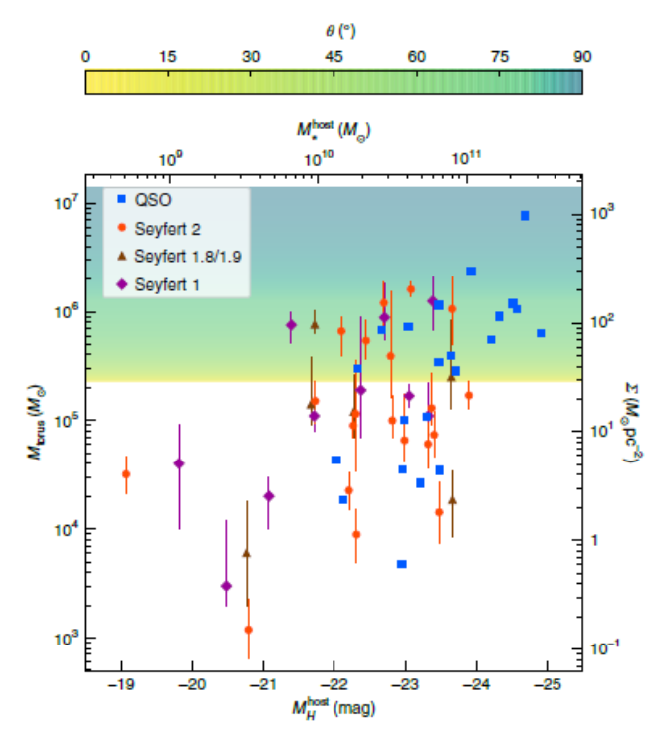
Application to the AGNs
We now translate the critical condition for AGN shut-off to a condition involving AGN parameters.
Below the critical zone (yellow to cyan coloured patch), where we find a notable fraction of AGN to be located, the AGN activity can cease by a central collision of a satellite galaxy.
The shaded zone indicates the stripping criterion for various orientation angles θ between torus and satellite rotation axis.
Edge-on infall increases the column density of the infalling gas and therefore enhances the torus stripping compared to the face-on infall.
Notes:
We now translate the critical condition for AGN shut-off into AGN parameters.
Below the critical zone, shown as the yellow-to-cyan patch, many AGNs are located.
In this region, AGN activity can stop if a satellite galaxy collides with the center.
The shaded zone marks the stripping condition for different orientation angles between the torus and the satellite.
Edge-on infall raises the column density of the infalling gas.
As a result, stripping becomes stronger compared to face-on infall.

Slide 27
Short summary
Central collisions of galaxies open up the new channel for suppressing central MBH fuelling.
Far-off-centre collisions or encounters are thought to trigger gas flows to the central MBH via angular momentum transfer and then enhance AGN activity occasionally.
Once gas fuelling is triggered, however, the nuclear activity could be suppressed by the central collisions, which happen every ~10⁸ yr, consistent with the current estimate of the AGN durations.
If orbital properties of satellite galaxies make a critical impact on the turning on/off of MBH fuelling, merging events of galaxies may play an essential role in the AGN duty cycle.
Notes:
Central collisions of galaxies can suppress fuelling of the central black hole.
In contrast, off-center collisions may trigger gas flows into the black hole by angular momentum transfer.
This can occasionally enhance AGN activity.
Once fuelling is triggered, the nuclear activity may again be shut off by central collisions.
These occur about every 10^8 years, consistent with the typical AGN lifetime.
So, if the orbits of satellite galaxies strongly affect the on–off state of fuelling,
merger events may play a key role in setting the AGN duty cycle.

Slide 28

Collision Parameter Study and Fate of Stripped Gas
A. Takayama
A. Takayama & MM, in prep.
In Miki et al. (2021), only a limited parameter range was explored.
Here, we conduct an extended collision parameter study:
    Collision angle
    Collision velocity
    Collision location
Key question: the fate of stripped torus gas
      Will the stripped gas escape, or re-accrete?
      If re-accreted, how much, and on what timescale?
Notes:
Background:
Miki et al. (2021) investigated only a limited parameter range.
Here, we extend to a broader survey of collision parameters—angle, velocity, and location—to understand gas stripping in detail.
Figure / Key:
Our goal is not only to ask whether the torus gas is stripped,
but also to study its fate. Does the stripped gas escape to infinity, or does it return and re-accrete onto the nucleus?
If it re-accretes, we need to quantify both the amount and the timescale.
Conclusion:
This parameter study allows us to determine the stripping conditions,
the subsequent accretion rate, and the long-term evolution of gas supply to the central black hole.
If the stripped gas escapes completely, the black hole will be starved.
If part of it falls back, then the amount and the timescale of re-accretion are critical,
because they directly control how the AGN is fueled and for how long.

Slide 29
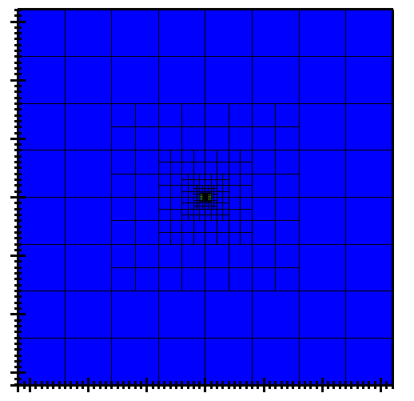


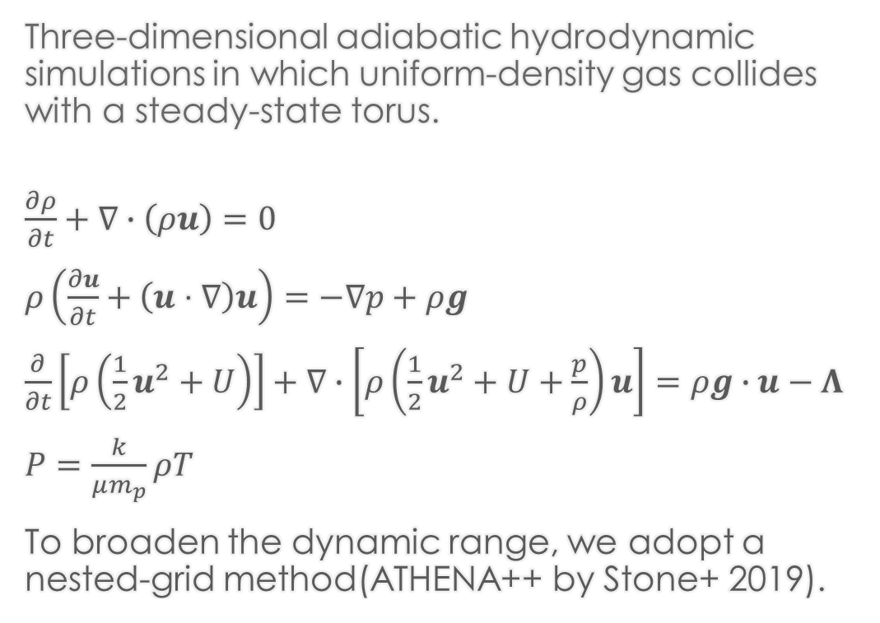






Simulation Setup I
Three-dimensional adiabatic hydrodynamic simulations in which uniform-density gas collides with a steady-state torus.
$\frac{∂ρ}{∂t}+∇∙\left(ρu\right)=0$
$ρ\left(\frac{∂u}{∂t}+\left(u⋅∇\right)u\right)=−∇p+ρg$
$\frac{∂}{∂t}\left[ρ\left(\frac{1}{2}u^{2}+U\right)\right]+∇∙\left[ρ\left(\frac{1}{2}u^{2}+U+\frac{p}{ρ}\right)u\right]=ρg∙u−Λ$
$P=\frac{k}{μm_{p}}ρT$
To broaden the dynamic range, we adopt a nested-grid method(ATHENA++ by Stone+ 2019).
$$3.2kpc$$
$$1.6kpc$$
$$800pc$$
$$1600$$
$$800$$
$$0$$
$$800$$
$$1600$$
[pc]
：Miki et al. 2021
Notes:
We perform three-dimensional hydrodynamic simulations,
where uniform-density gas collides with a steady-state torus.
The calculations obey mass, momentum, and energy conservation, together with the equation of state for an ideal gas.
To broaden the dynamic range, we use a nested-grid method.
All simulations are carried out with the ATHENA++ code, developed by Stone and collaborators, which provides efficient and accurate grid-based hydrodynamics.

Slide 30













Parameters
Parameter
Value
M31 potential:
Satellite properties:
Black hole mass
$$1.4×{10}^{8}M_{⨀}$$
(Bender et al. 2005)
Satellite mass
$$3.4×{10}^{7}M_{⨀}$$
Bulge mass
$$3.24×{10}^{10}M_{⨀}$$
Temperature
$${10}^{4}K$$
Bulge scale length
$$610pc$$
Hernquist potential
Velocity
$$850km/s$$
Torus properties:
Duration
$$1.1Myr$$
Torus mass
${10}^{6}M_{⨀}$ , ${10}^{5}M_{⨀}$
Inclination
$$0.0deg, 45.0deg, 90.0deg$$
Outermost radius
$$50pc$$
(Hönig et al. 2006)
Scale radius
$$9pc$$
Bulge properties:
Bulge gas mass
$$4×{10}^{6}M_{⨀}$$
Temperature
$${10}^{7}K$$
Notes:
Here, I summarize the simulation parameters in this table.
It lists the main physical conditions and numerical settings that we used in the runs.

Slide 31
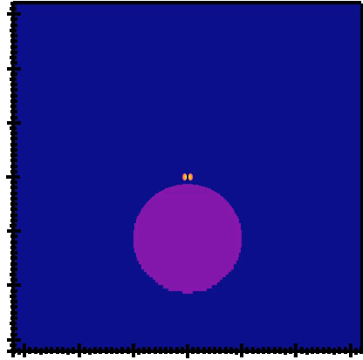
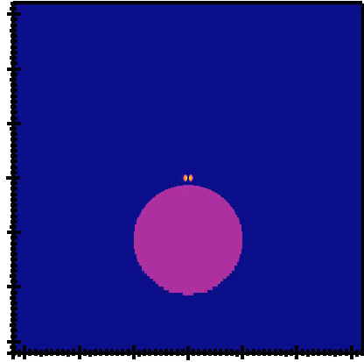
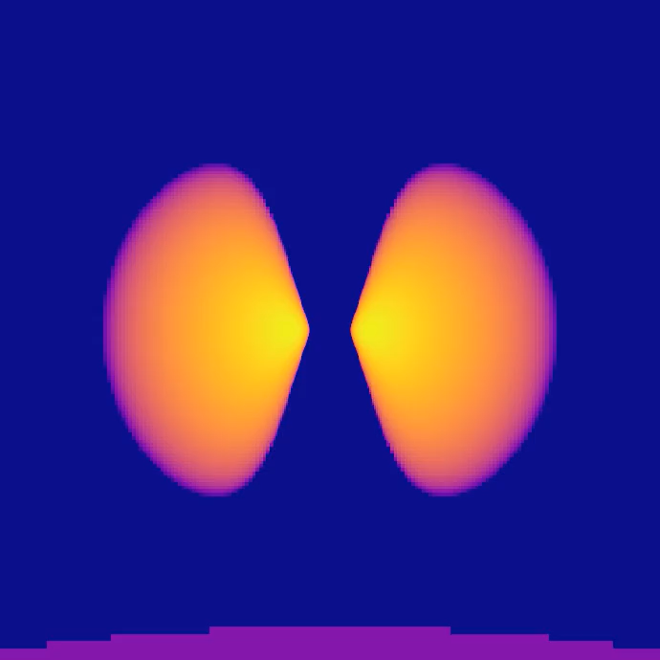
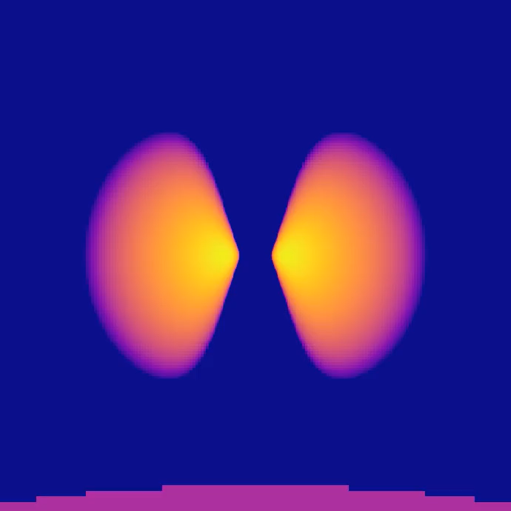
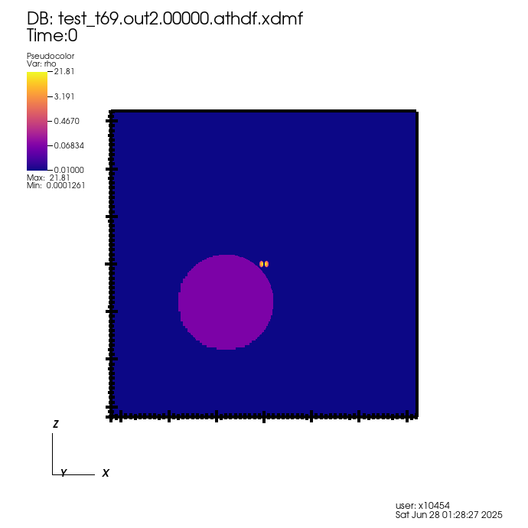

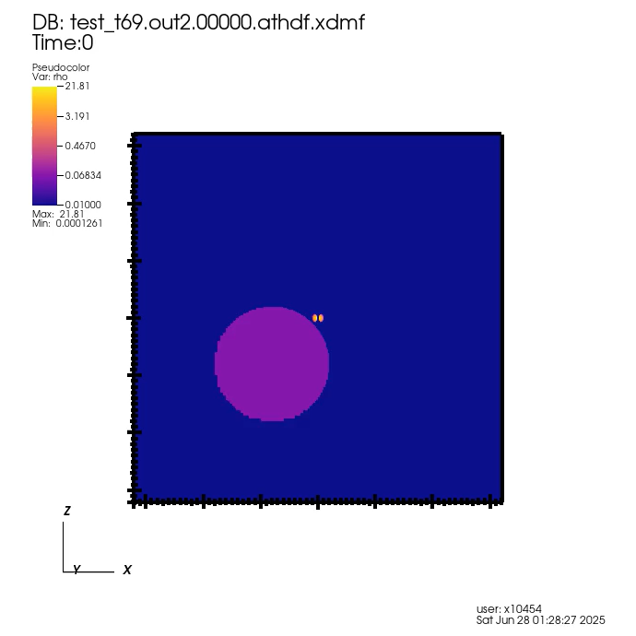




















Simulation results: Face-on collision
High density torus: Low density torus:
$$Σ_{torus}> Σ_{sat}$$
$$Σ_{torus}{< Σ}_{sat}$$
10 kpc
$$z$$
$$z$$
$$21.81$$
$$2.181$$
$$3.191$$
$$0.567$$
$$0.467$$
Time:[$Myr$]
$$0.147$$
$$0.068$$
$$0.01$$
$$0.038$$
[pc]
$$0.01$$
$$80$$
$$0$$
$$80$$
[pc]
$$80$$
$$0$$
$$80$$
Notes:
Theses movies show the simulation of the interaction between the torus gas and the satellite galaxy gas in a face-on collision.
The left panel corresponds to a high-density torus, where the surface density of the torus exceeds that of the satellite galaxy.
In this case, the torus survives under the gravitational potential of the black hole.
The right panel corresponds to a low-density torus, where the torus surface density is lower.
Here, the shock wave from the collision immediately strips the torus gas.
This is identified as the instantaneous stripping mode.

Slide 32
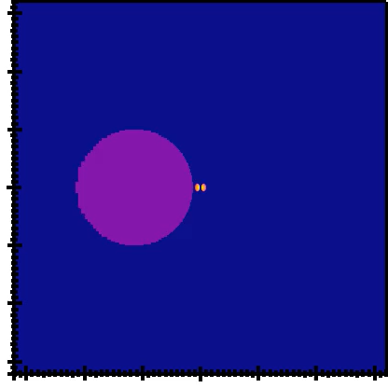
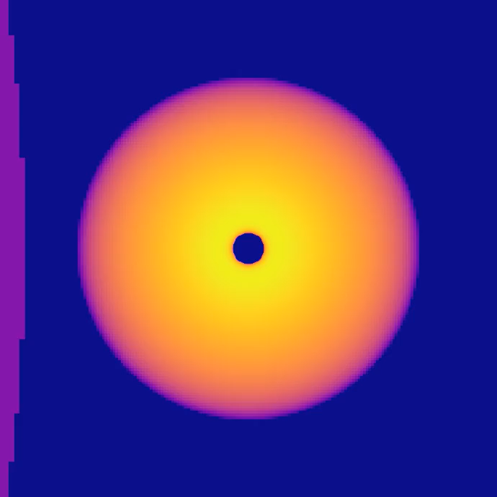
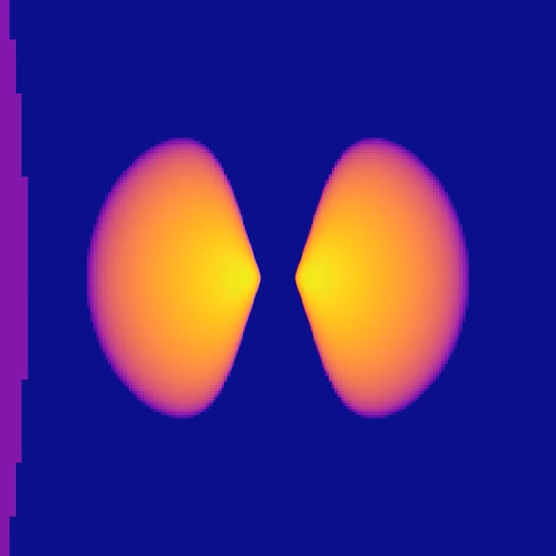









Simulation resuls: Edge-on collision
Edge-on view and Face-on view
Face-on view Edge-on view
$$y$$
$$21.81$$
$$z$$
$$3.191$$
$$0.467$$
Time:[$Myr$]
$$0.068$$
$$0.01$$
[pc]
$$80$$
$$0$$
$$80$$
[pc]
$$80$$
$$0$$
$$80$$

Slide 33
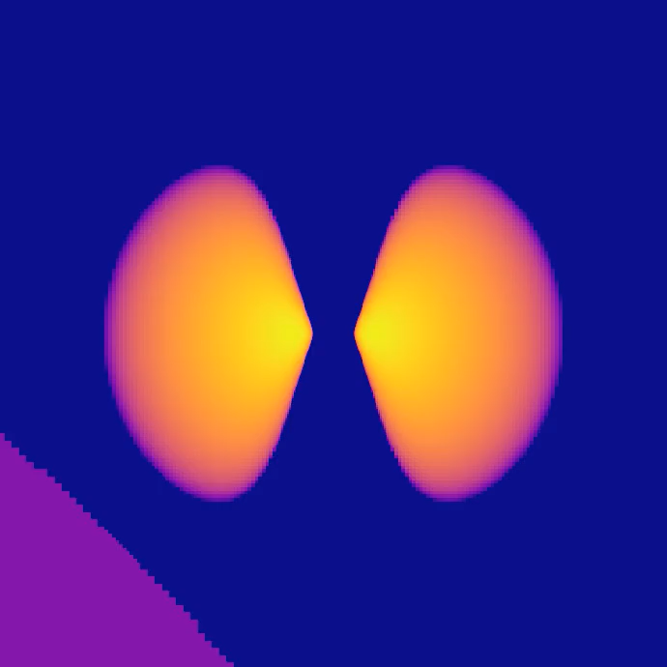













Simulation results: Dependence on Collision Angle
$$θ=90.0deg$$
$$θ=45.0deg$$
$$z$$
$$z$$
$$21.81$$
$$3.191$$
Time:[$Myr$]
$$0.467$$
$$0.068$$
[pc]
[pc]
$$80$$
$$0$$
$$80$$
$$0.01$$
$$80$$
$$0$$
$$80$$
Notes:
This slide shows simulations of collisions with a high-density torus at two different impact angles: 90 degrees on the left and 45 degrees on the right.
Despite the difference in collision angle, the final outcomes are quite similar.
As you can see, gas stripping shows only a weak dependence on collision angle in this regime.

Slide 34
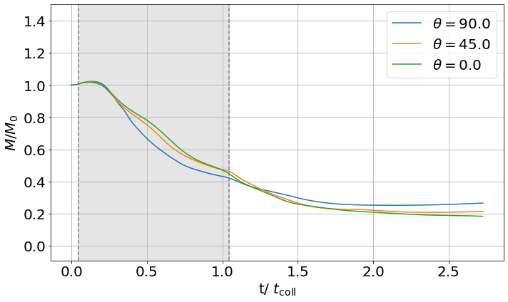
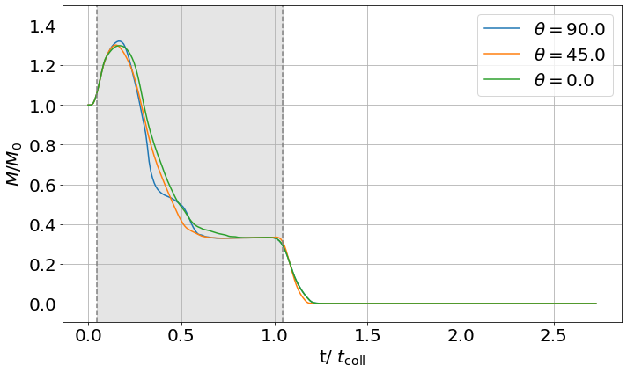


Time evolution of the total mass of torus gas
$$Σ_{torus}>Σ_{sat}$$
$$Σ_{torus}<Σ_{sat}$$
$t_{coll}$：crossing time of the satellite galaxy (1.1Myr)
Notes:
Next, I show the time evolution of the total torus mass.
The left panel corresponds to the high-density torus.
Here, the mass decreases slowly and settles at about 20 percent of the initial value.
The results show almost no dependence on the collision angle.
The right panel shows the low-density torus.
In this case, the mass is removed on a relatively short timescale, again with little dependence on the collision angle.

Slide 35
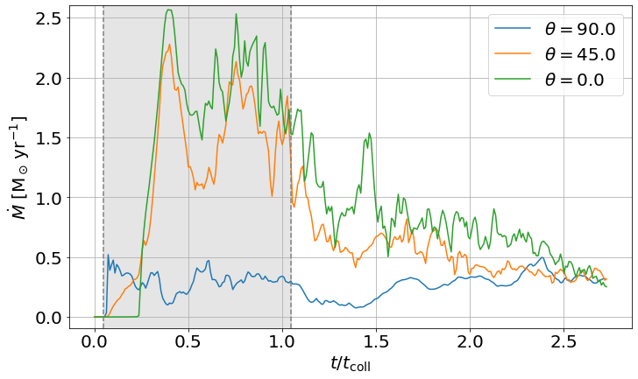
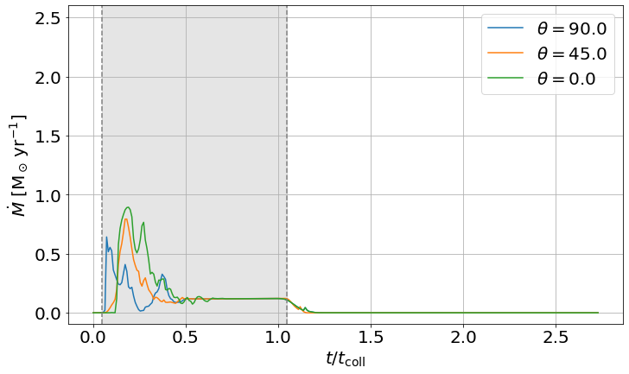
Time evolution of of the mass accretion rate
$$Σ_{torus}>Σ_{sat}$$
$$Σ_{torus}<Σ_{sat}$$
$t_{coll}$：crossing time of the satellite galaxy (1.1Myr)
Notes:
The next slide shows the mass accretion rate toward the center, measured at the Bondi radius.
As before, the left panel is the high-density torus and the right panel is the low-density case.
Here, in contrast to the total mass evolution, we see a strong dependence on collision angle.
In the high-density case, accretion proceeds steadily but varies with angle.
In particular, for face-on collisions, the accretion rate is much lower than in other cases.
In the low-density case, the accretion rate rises sharply, but the difference between face-on and edge-on collisions is small.

Slide 36
Summary (Preliminary)
Using three-dimensional hydrodynamic simulations with a nested-grid method, we explore central (and off-center) galaxy collisions.
Central collisions can suppress MBH fuelling by stripping the torus gas.
Off-center encounters may enhance fuelling through angular momentum transfer.
Gas stripping shows little dependence on collision angle, but BH accretion rate depends strongly on collision angle.
This suggests that shock-driven angular momentum transport is highly angle-dependent.
Stripping depends on the relative surface densities of the satellite and the torus (Collision velocity is fixed here; varying it may change the outcome — future work).
The orbital properties of satellites critically control the on/off states of MBH fueling.
Notes:
We performed three-dimensional hydrodynamic simulations using a nested-grid method.
Central collisions suppress MBH fuelling by stripping the torus, while off-center encounters may enhance it.
An interesting result is that gas stripping itself shows only weak dependence on collision angle.
In contrast, the accretion rate onto the black hole depends strongly on angle, which suggests that shock-driven angular momentum transport is highly angle-sensitive.
Stripping also depends on whether the satellite’s surface density exceeds that of the torus.
In this study, collision velocity was fixed, but varying it will likely change the outcome, and that is left for future work.
Overall, the orbital properties of satellites regulate the on/off states of MBH fuelling.

