Slide 1


A new channel for supermassive black hole formation
Carlos R. Argüelles
Collaborators: R. Ruffini, J. A. Rueda, A. Krut, E. A. Becerra-Vergara, M. Díaz, R. Yunis,
M. Mestre, V. Crespi, K. Boshkayev, J. Uribe-Suárez, P.-H. Chavanis
Cosmology 2023 in Miramare– August 28-September 2, SISSA, Italy
BASED ON: Argüelles, Boshkayev, Krut, et al. MNRAS (2023) arXiv:2305.02430
Argüelles et al. PDU (2018,2019) arXiv:1606.07040; arXiv:1810.00405 & MNRAS (2021) 2012.11709
Becerra-Vergara, Argüelles, et al. A&A (2020) arXiv:2007.11478 & MNRAS Lett (2021) 2105.06301

Slide 2
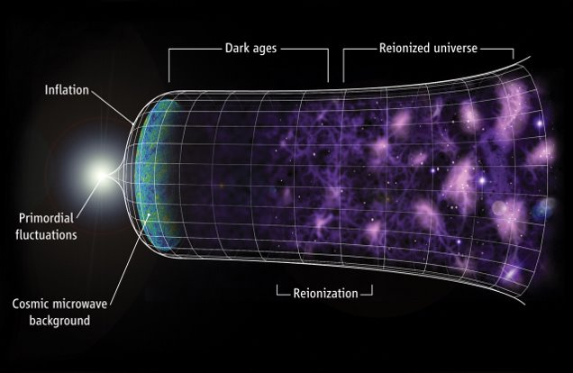

Slide 3
DM halo formation from a statistical mechanics approach

Slide 4
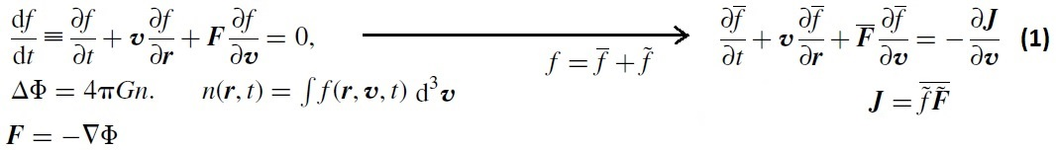
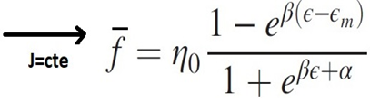

DM halo formation: collisionless relaxation & coarse-grained Entropy maximum
DM as a collisionless particle system described by a mean-field Vlasov-Poisson equation
Hablar Aca sobre:
CMB
CDM
Predicciones
1)
2) Take local average of V-P
Diffusion current
Maximum Entropy production
Pple. Chavanis, MNRAS (1998)
Chavanis, (2006)
stationary solution of Fermi-Dirac type including for evaporation: generalization of Lynden-Bell DF

Slide 5

DM halo formation: collisionless relaxation & coarse-grained Entropy maximum
DM as a collisionless particle system described by a mean-field Vlasov-Poisson equation
Hablar Aca sobre:
CMB
CDM
Predicciones
1)
2) Take local average of V-P
Diffusion current
For fermions, the maximum accesible value
of the DF is fixed by the Pauli principle

Slide 6
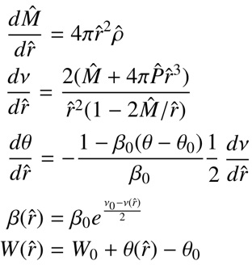
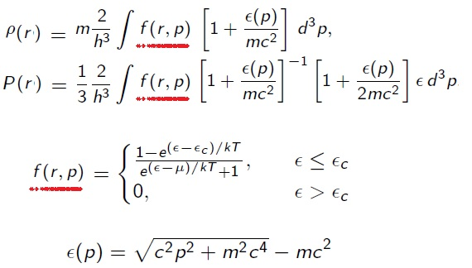
DM halos as equilibrium systems of self-gravitating fermions
Fermions under self-gravity DO ADMIT a perfect fluid approximation
Ruffini & Bonazzola, Phys. Rev. (1969) - by solving Einstein Dirac equations -
We solve Einstein equilibrium equations for Fermi Gas at finite T in hydrostatic equilibrium
(i.e. T.O.V), in spherical symmetry Argüelles, Krut, Rueda, Ruffini, PDU (2018)
T.O.V
KLEIN
TOLMAN
E conserv.
4 free parameters

Slide 7
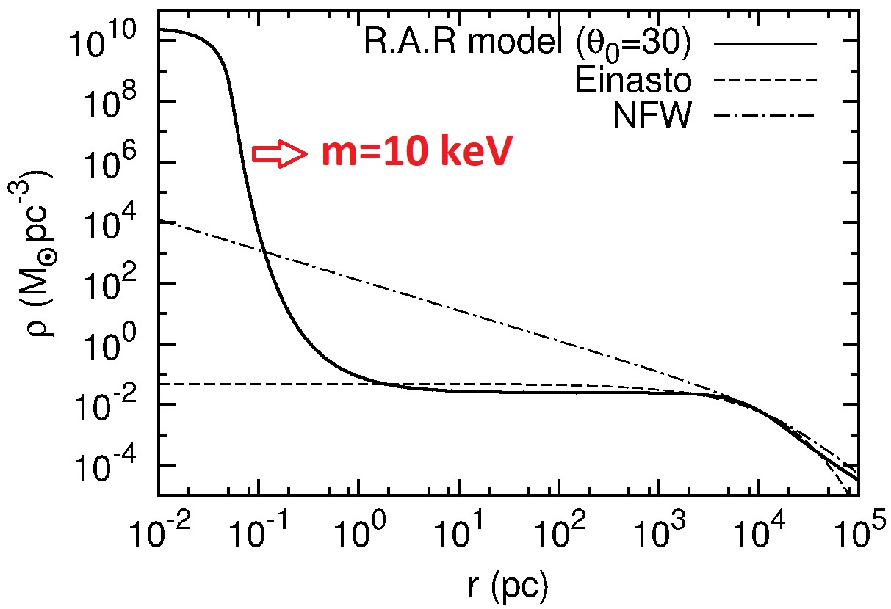

A novel "core – halo" Dark Matter profile for fermions
The highly non-linear systemd of coupled ODE is solved fulfilling a boundary condition problem in agreement with halo observables Ruffini, Argüelles, Rueda, MNRAS (2015)
Hablar Aca sobre:
Boltzmann Hierarchies (poner termino de interacciones)
Quien es f0 en el caso de neutrinos
Example: Typical spiral halo
Rh ~ 10⁴ pc
Mh ~ 10¹¹ Mo
:
The dense central core fulfills the 'quantum condition' :
DM profiles depend on the particle mass (see next slides)

Slide 8
Thermodynamics of self-gravitating fermions: Stability

Slide 9
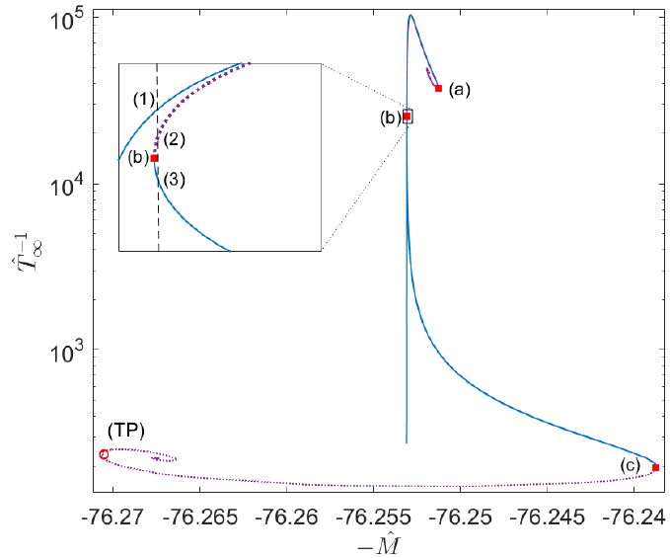


How a self-gravitating system of collisionless fermions reaches the steady state?
Dynamically stability - i.e having f(r,p) solution- DOES NOT necessarily imply thermodynamic stability (Some dynamically stable solutions are more likely in Nature than others)
To find dynamically and thermodynamicaly stable
configurations of fermions in GR, we need
solutions that maximize the global entropy
δ^2 S< 0
Gibbs-Duhem
Stability problem can be solved via the Katz criterion J. Katz, MNRAS (1978) : relies only in the derivatives of the caloric curve (E vs. 1/T∞)
Series of equilibrium along the caloric curve for fixed N and µ. The case of typical DM halos of M ~ 5 x 10¹⁰ Mo Argüelles et al. MNRAS (2021)

Slide 10


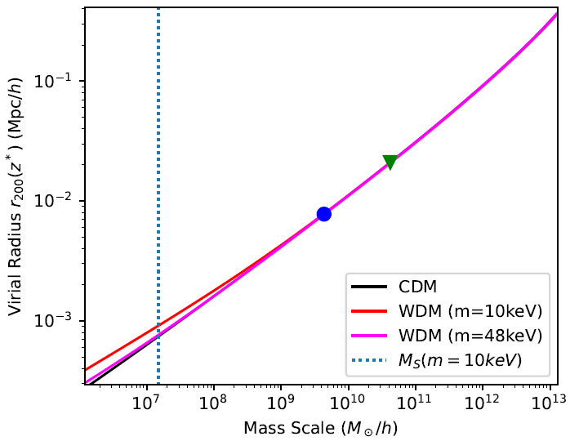
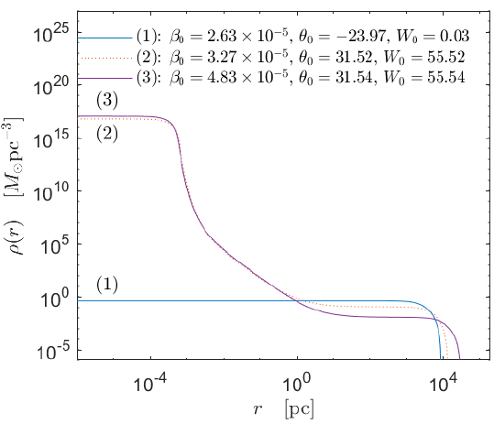
How do we obtain realistic DM halos in cosmology via this method ?
One should i) calculate the power spectrum P(k) in a given (~10¹ keV) cosmology (CLASS)
ii) apply the Press-Schechter formalism to obtain M_{vir} = M(R_{vir}) at given z_{vir};
Hablar Aca sobre:
Boltzmann Hierarchies (poner termino de interacciones)
Quien es f0 en el caso de neutrinos
Mass variance
Window top-hat function
Critical overdensity (spherical collapse)
M_{vir} = 5.4 x 10¹⁰ Mo
m=50 keV
iii) Use the stable family of solutions obtained at violent relaxation (i.e. valid at z_{vir}), in agreement with avobe virial constraints
Argüelles et al. MNRAS (2021)

Slide 11
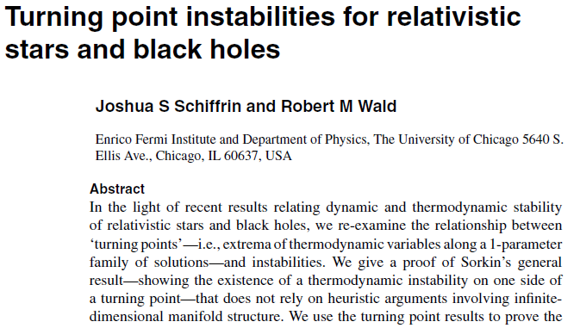
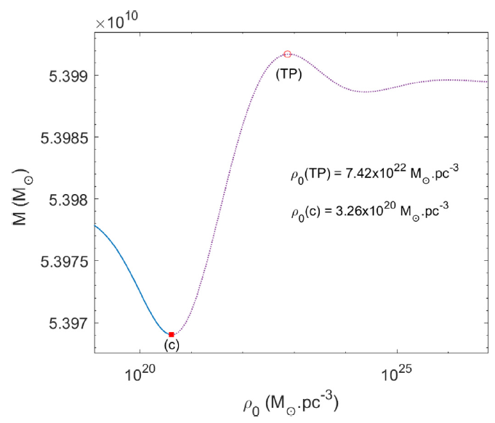
Turning point instability & last stable configuration
Hystorically, the gravitational collapse of a degenerate (and relativistic) `star’ was understood in terms of the onset of a thermodynamic instabiliy at a Turning-Point (TP), e.g. at dM/dρo =0
However TPs don’t provide a necessary condition for thermodynamic instability: the onset of instability can occur prior to the TP (or even without its existence) Schiffrin & Wald (2014)
For our case we have:
Argüelles et al. MNRAS (2021)

Slide 12
Phenomenology I: A new channel for SMBH formation

Slide 13
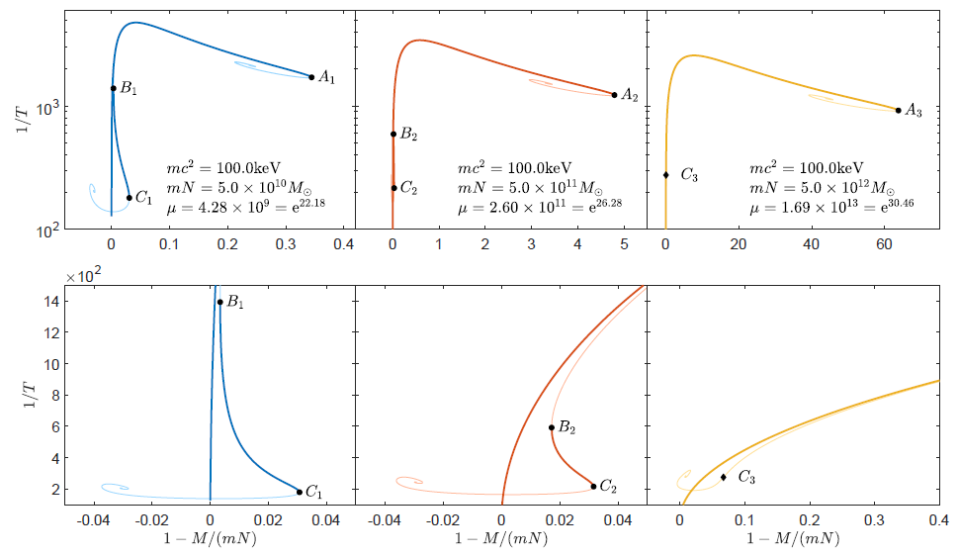
Stability analysis of fermionic halos in GR: M_vir = 5x10^(10) – 5x10^(12) Mʘ
Critical solutions (at C_i) fulfill with the boundary conditions from Cosmology at halo-formation (M_vir; r_s)
Stable Branch core-halo solutions correspond to B-C (The larger M the shorter the stable-branch up to M*)
Argüelles et al. MNRAS (2023)

Slide 14
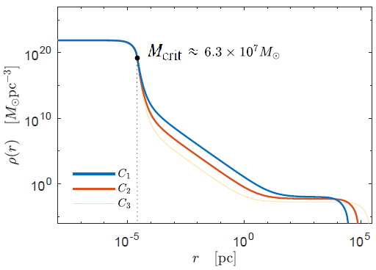
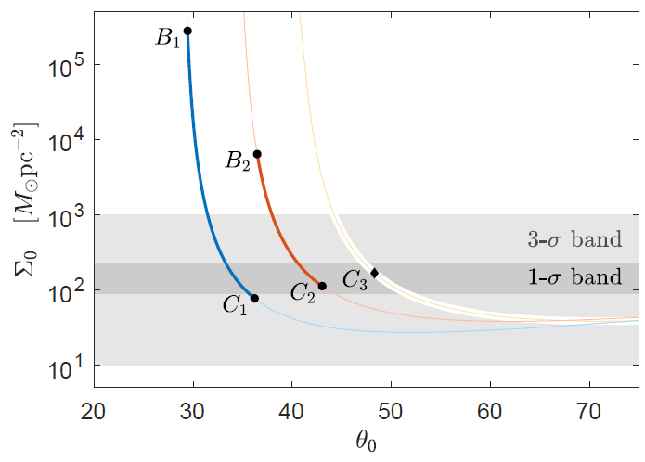
It does exist solutions of Einstein equations for self-gravitating systems of (neutral) fermions which gives hints to: (i) the mass of the DM particles; (ii) the formation of SMBH at the center
of active galaxies; (iii) the phenomenology and stability of DM halos
Critical solutions (at C_i) fulfill with the boundary conditions at halo-formation (M_vir; r_s)
Critical solutions fulfilling with the observational DM-Surface-density relation, Σo ρ_o r_o = 190 Mʘ/pc^2
Donato, Gentile, Salucci et al. MNRAS (2009)
Argüelles et al. MNRAS (2023)

Slide 15
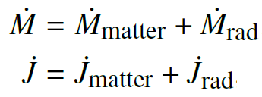
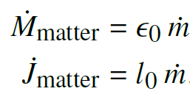
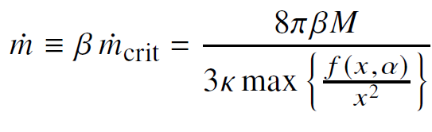
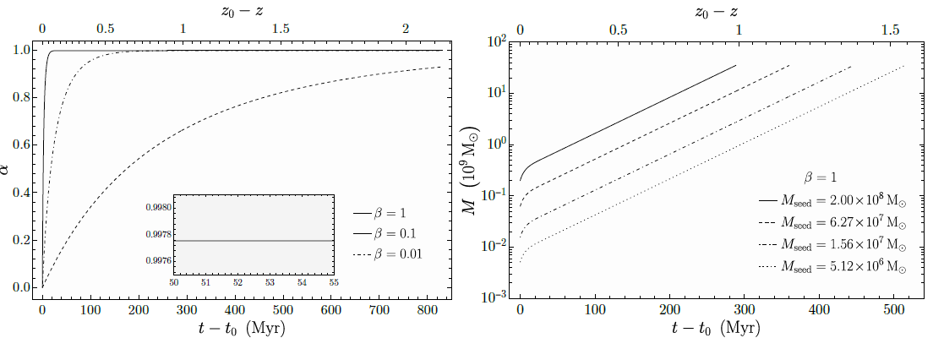
Growth of SMBH seeds formed from the gravitational collapse of DM cores
. We compute, in a Kerr metric, the evolution of mass and angular momentum of the BH using a geodesic general relativistic disc accretion model
Argüelles et al. MNRAS (2023)
. The rate at which the rest-mass dm flows inward through the local balance between gravitational acceleratoin and radiation pressure (along z-axis) is calculated
This BH-seeds are larger tan typical baryonic-sedes (e.g. Pop. III stars), and can grow up to 10^9 – 10^(10) Mʘ in a fraction of 1st Gyr of the life of the Universe without invoking unrealistic accretion rates !

Slide 16
Phenomenology II - Below critical core-halo solutions:
The Milky Way (Rotation Curve and S-stars)

Slide 17
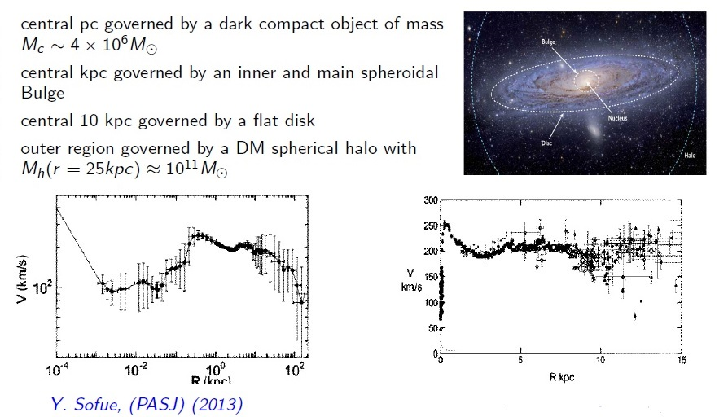
Milky Way observables: from central parsec to outer halo

Slide 18
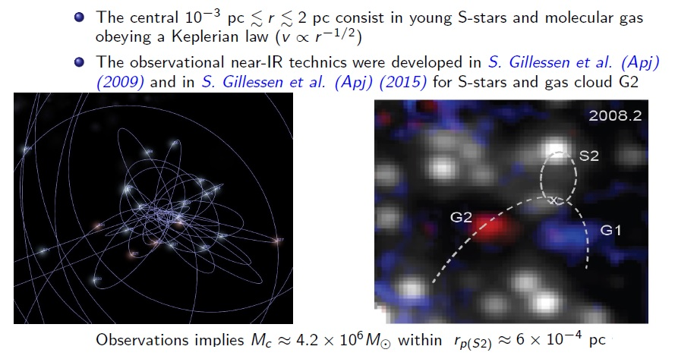
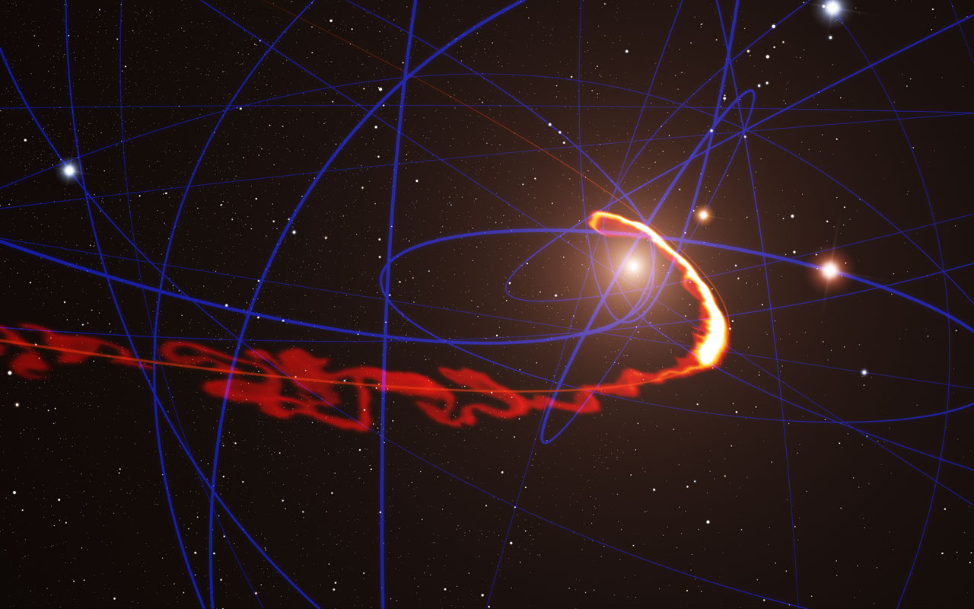
Milky Way observables. Inside the central pc: the S-star cluster

Slide 19
Fermionic 'core – halo' profiles: can their overall gravitational potential explain the Milky Way rotation curve as well as the S-star dynamics without the central BH hypothesis?
Hint: Need to solve the former boundary condition problem searching for a set of free R.A.R parameters able to fulfill:
Mc= 4.2 x 10⁶ Mo Gillessen et al., Apj (2017)
M(r = 20 kpc) = 9 x 10¹⁰ Mo Sofue, PASJ (2013)
M(r = 40 kpc) = 2 x 10¹¹ Mo Gibbons, Belokurov and Evans, MNRAS (2014)

Slide 20
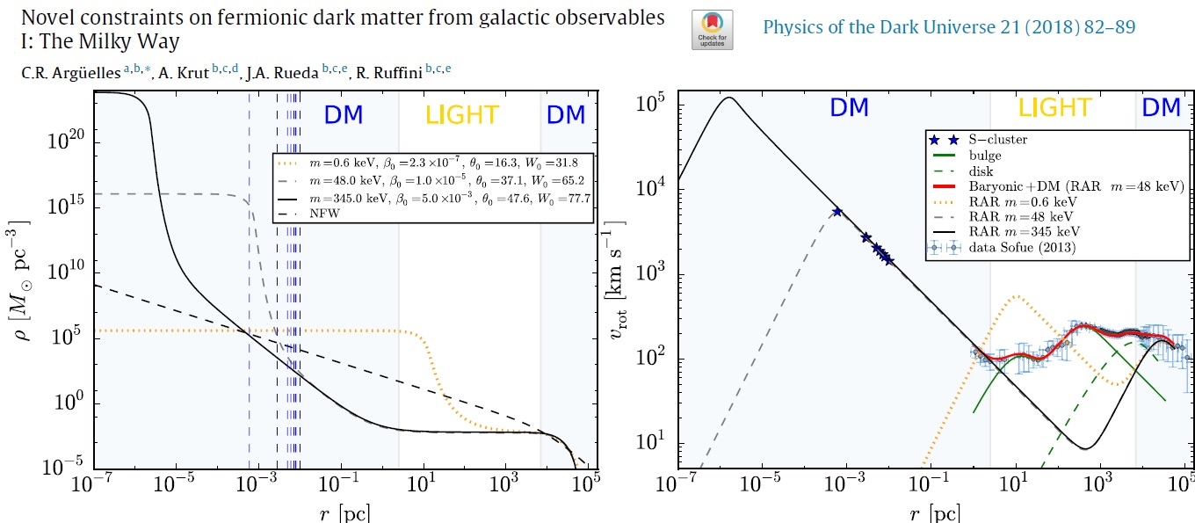
Hablar Aca sobre:
Expresion para los collision terms

Slide 21
Phenomenology II: The S2-star at the Milky Way Center

Slide 22
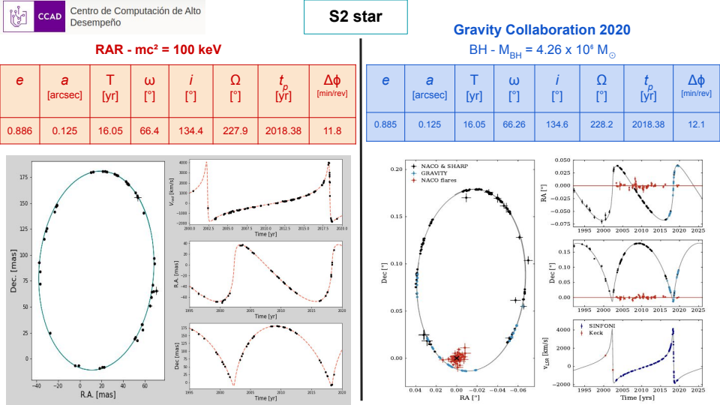

Slide 23
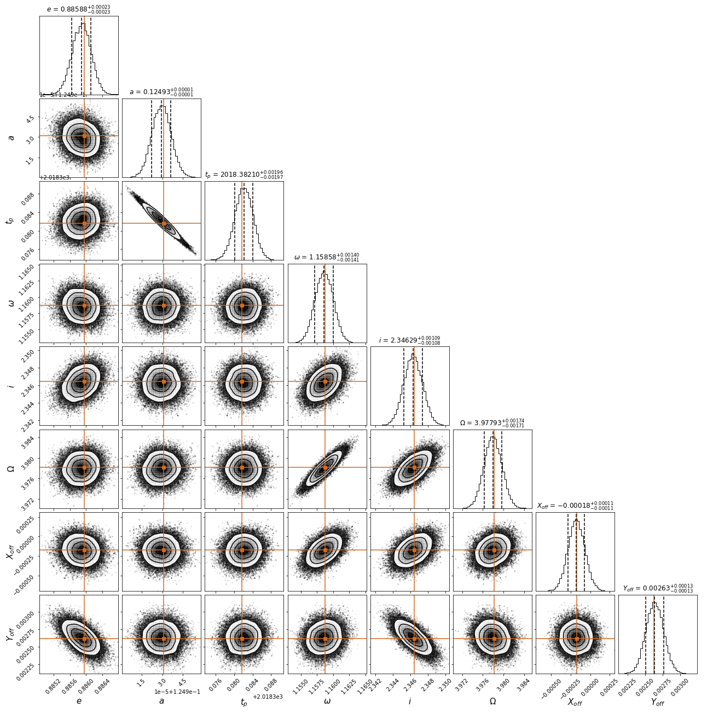
Posteriors of the S2-star orbital parameters
determined from ​a
Monte-Carlo Markov-Chain method within a core-halo non-criritcal
solution (m=100 keV)

Slide 24
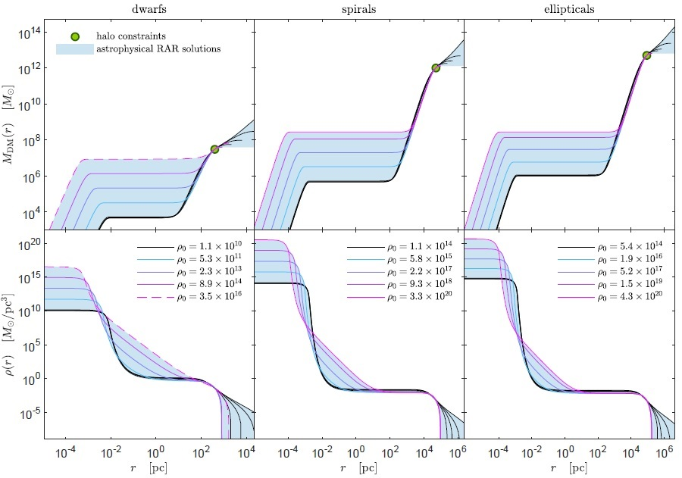



Fermionic core-halo profiles: From dwarf to elliptical galaxies
The same fermionic model can be applied to other galaxy types, from dwarf, to ellipticals, to galaxy clusters Argüelles, Krut, Rueda, Ruffini, PDU (2019)
Hablar Aca sobre:
Boltzmann Hierarchies (poner termino de interacciones)
Quien es f0 en el caso de neutrinos
For m ~ 50 keV we make a full coverage of free parameters of the theory, for realistic boundary conditions inferred from observables :
DWARFS: eight best resolved MW satellites
SPIRALS: sample of nearby disk galaxies from THINGS
ELLIPTICALS: sample analyzed via weak lensing

Slide 25
Discussion: standard SMBH formation channels

Slide 26
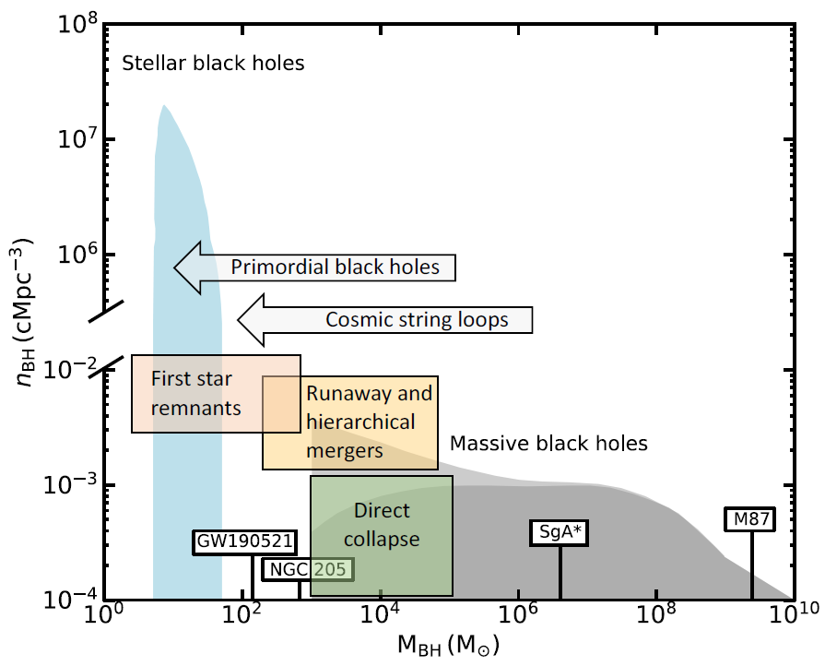
Different Massive BH formation channels: Baryonic & Early Universe channels
Volonteri et al. Nat. (2021)​
​
(I) Baryonic channels:
Pop. III stars (1st stars remnants)
Direct collapse of gas clouds
Runnaway collisions in star clusters
(II) Early Universe channels:
(poorly constrained epochs)
Topological defects (cosmic strings, domain walls)
(III) DM channels:
Fermionic DM core-collapse
SIDM (grav. catastrophe)

Slide 27
Back up slides

Slide 28

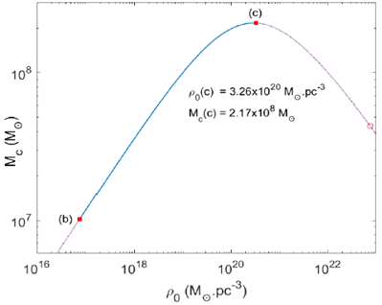
Novel SMBH formation scenario from DM core-collapse
This solution may provide initial seed for the formation of observed SMBHs in active galaxies such as M87 (without the need of unrealistic super – Eddington accretion rates)
The degeneracy pressure of the DM core cannot support its own weight and undergo a core-collapse towards a SMBH-seed from DM ! (i.e. without the need of barionic matter)
Argüelles et al. MNRAS (2021)

Slide 29
The shadow of SgrA*

Slide 30
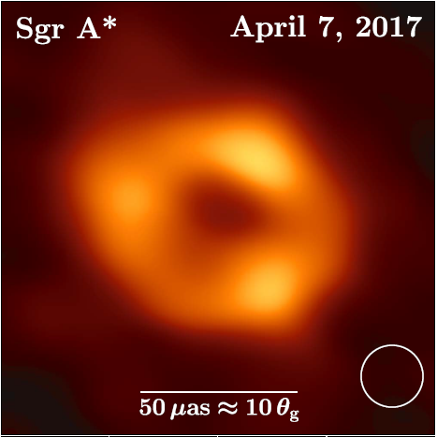
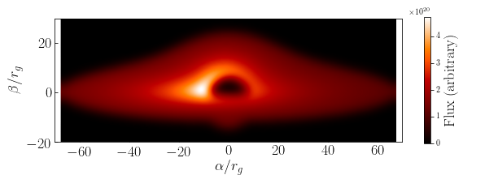
How does this DM model stands with the recent EHT results on SgrA*?
The EHT analysis support an image dominated by a bright thick ring with diameter of 52 µas ~ 10 Rg/D
(Rg=GM/c^2) The EHT collaboration, ApjL (2022)
Does exist any fermion-core compact enough to deflect light in a similar fashion tan the BH ? YES !
Solution prior to core-collapse has a maximal light deflection at 5 Rg !
Pelle, Argüelles, et al
(In prep.)
EHT collaboration, ApjL (2022)
Done with a GR ray-tracing code:
Skylight
Pelle, Reula, et al.,
MNRAS (2022)
DM fermion-cores (not yet collapsed) can develope light-images similar to the BH case, with a shadow feature !

Slide 31
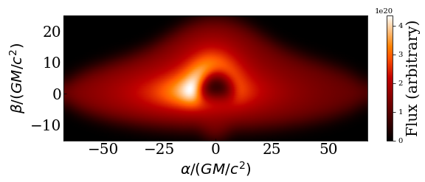
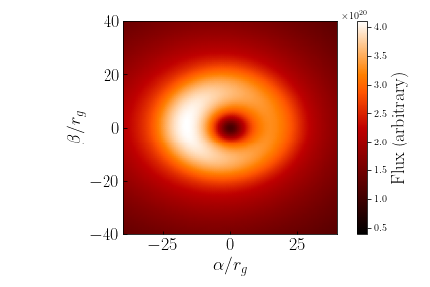
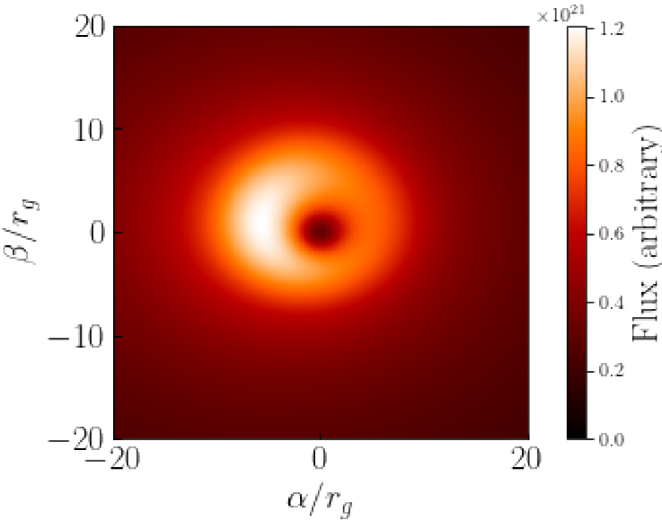

How does the RAR model stands with the recent EHT results on SgrA*?
Blurred (Gaussian filter) monochromatic Image (λ=1.3 mm) caused by light rays coming from an accretion disk (S&S) onto the stable DM core, seen by a far observer
Edge-on view
Face-on view
m=378 keV/c^2
m=300 keV/c^2
Pelle, Argüelles, et al (In preparation)

Slide 32
Phenomenology II: different galaxy types, and galaxy relations

Slide 33
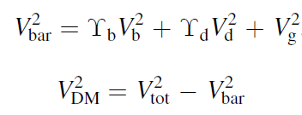
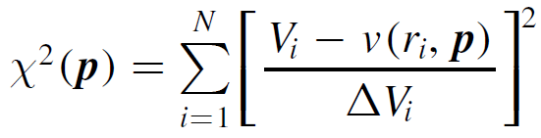
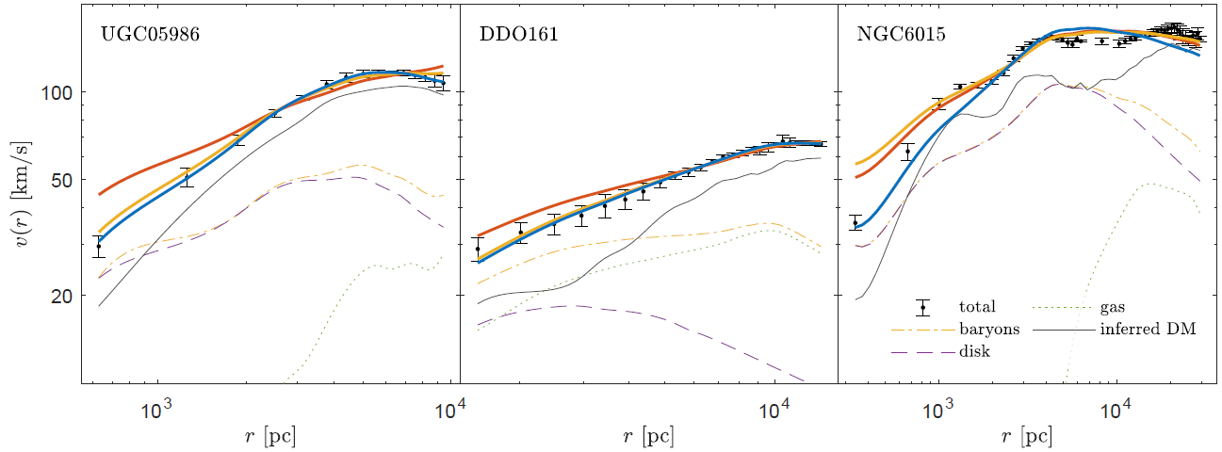
Testing the RAR model with the SPARC data-set of 120 disk galaxies
(Blue): Fermionic DM;
(Yellow): gNFW; (Red): NFW
Krut, Argüelles, Chavanis, Rueda, Ruffini, Apj (2023)​

Slide 34
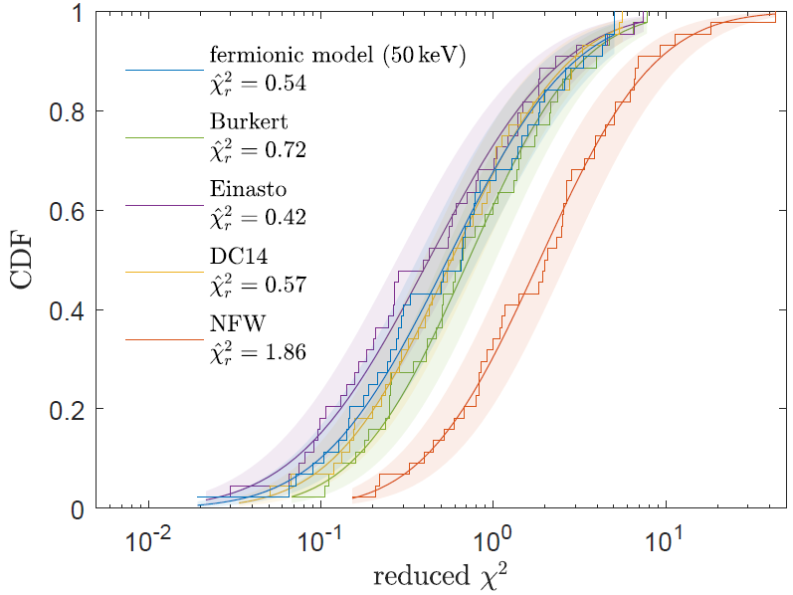
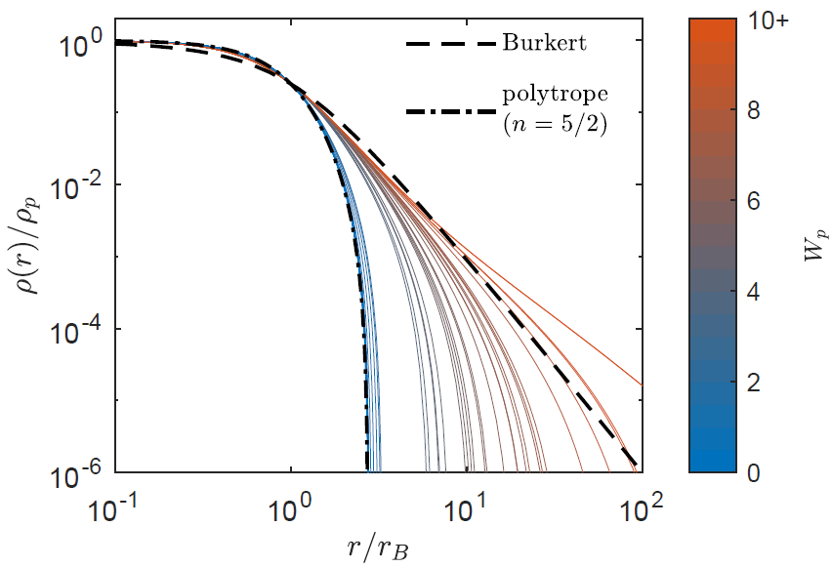
Testing the RAR model with the SPARC data-set of 120 disk galaxies
- RAR profiles which best-fit SPARC galaxies can develope halo shapes similar to Burkert
- Cuspy (NFW) DM profiles are clearly disfavoured w.r.t cored profiles by the SPARC RCs
Krut, Argüelles, Chavanis, Rueda, Ruffini, Apj (2023)​

Slide 35

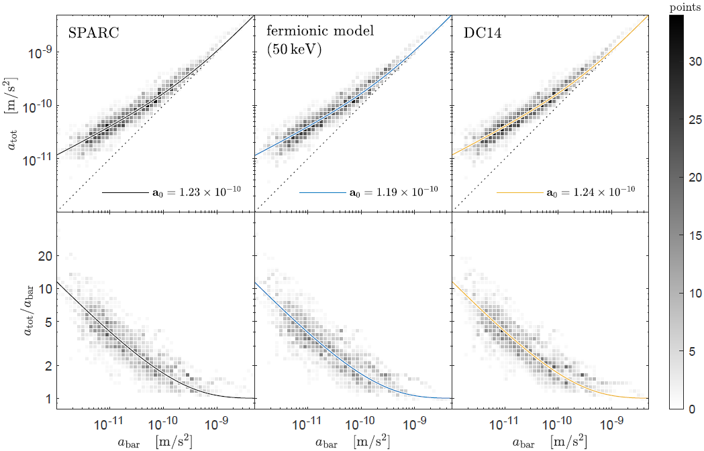
The RAR model explains the Radial Acceleration Relation and the BTFR
Radial Acceleration Relation: Non linear correlation between the radial acceleration caused by the total matter, and the one generated by the baryons only: Valid at any resolved galaxy radii !
These acceleration relations DO NOT imply of any new physics (i.e. MOND), and can be reproduced by the LCDM, and by the fermionic halos obtained from a MEP
Krut, Argüelles, Chavanis,
Rueda, Ruffini, Apj (submitted 2022)​

Slide 36
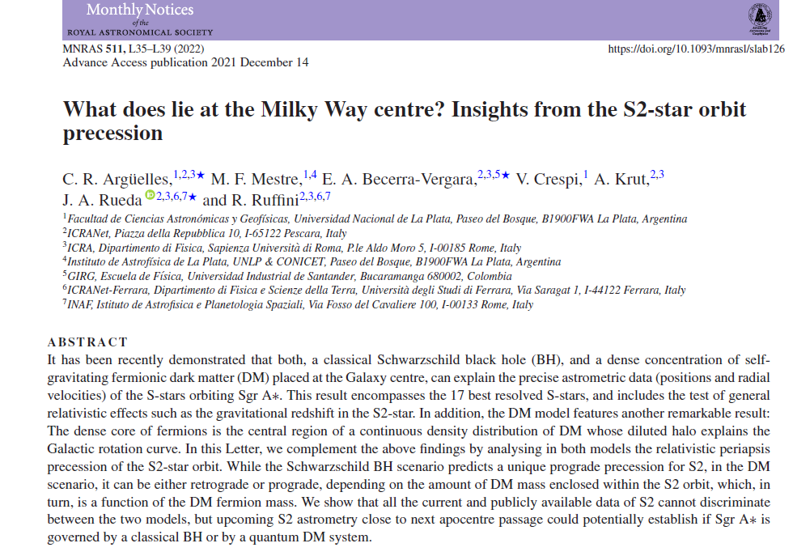

Slide 37
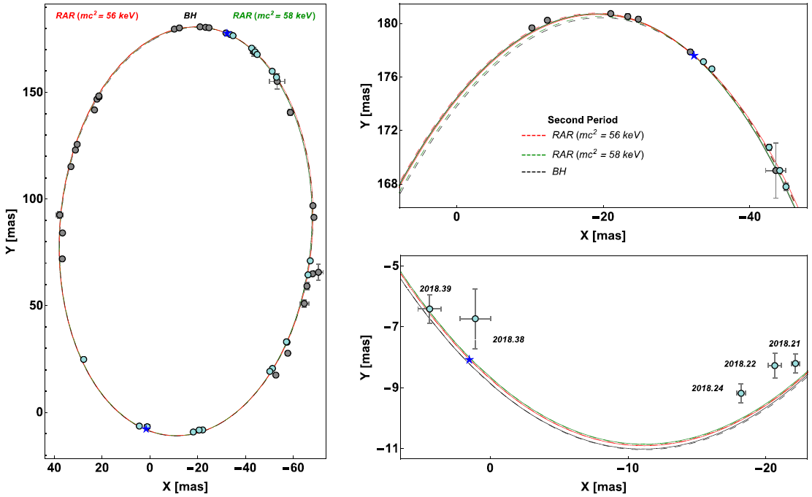
Testing the DM-core alternative to the BH with the S-2 star precession
Argüelles et al. MNRAS Lett. (2022)

Slide 38
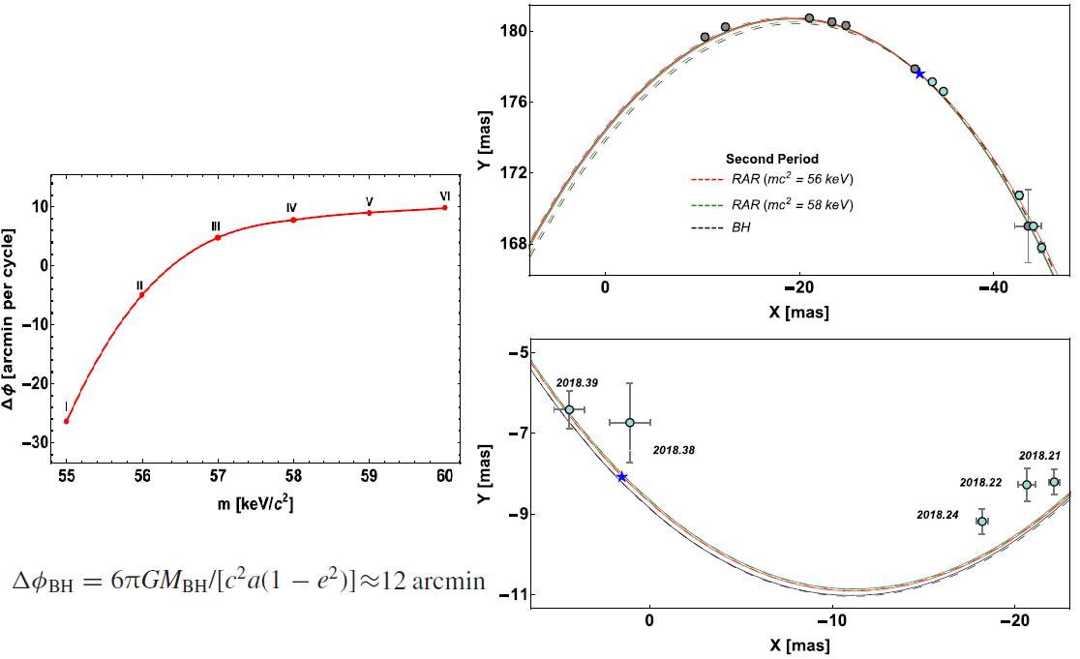
Testing the DM-core alternative with the S-2 star precession
Argüelles et al. MNRAS Lett. (2022)

Slide 39
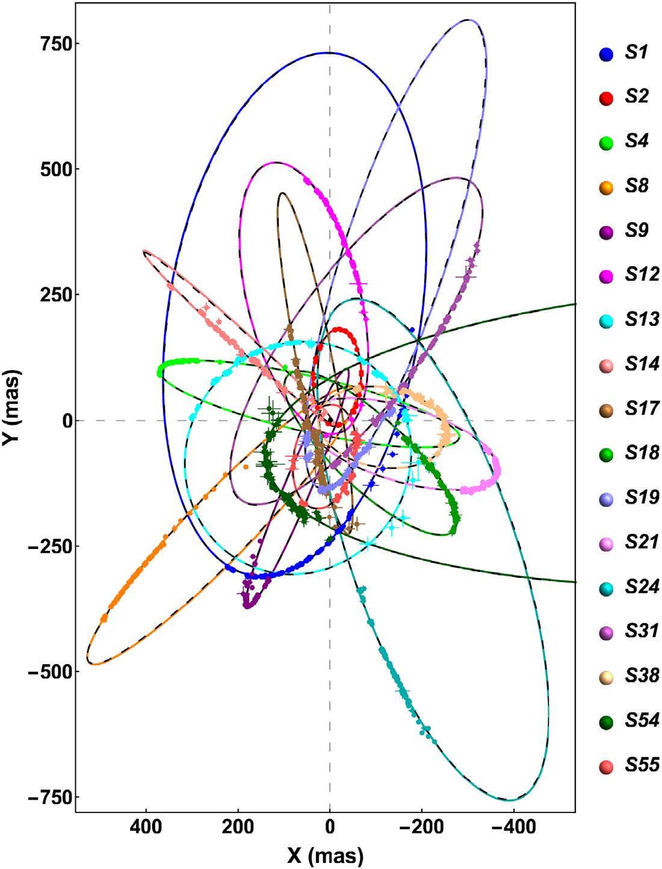


THEORETICAL and OBSERVED 17 best-resolved S-star orbits around SgrA*
THEORETICAL MODELS: calculated by solving the geodesic equation of a test particle in the gravitaitonal field of:
1) Schwarzschild BH of 4.07 x 10⁶ Mo
= 1.6
2) Fermionic DM distribution with
Mc = 3.5 x 10⁶ Mo (fermion mass m= 56 keV)
= 1.5
Becerra-Vergara, Argüelles, et al. MNRAS Lett (2021)
= 1.6
= 1.6
= 1.6

Slide 40
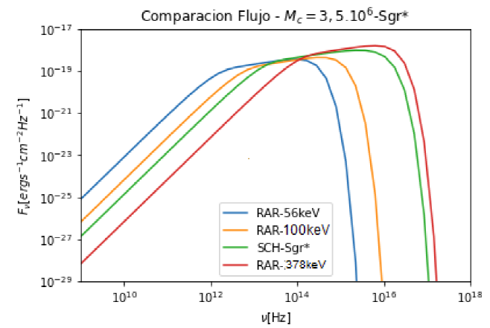
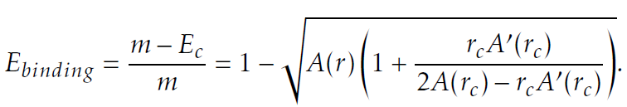
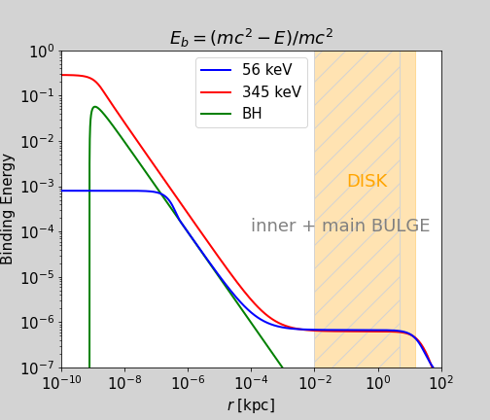
Disc accretion for horizonless dark compact objects: the fermion core
- Emmited flux for different fermion-core compacities (i.e. different DM particle masses) compared with the BH case →
The case of a Milky Way –like galaxy (shown as example)
Efficiency of energy extraction from the central object
- The fermion core is transparent and therefore the disc can eneter inside the core, where the efficiency saturates

Slide 41
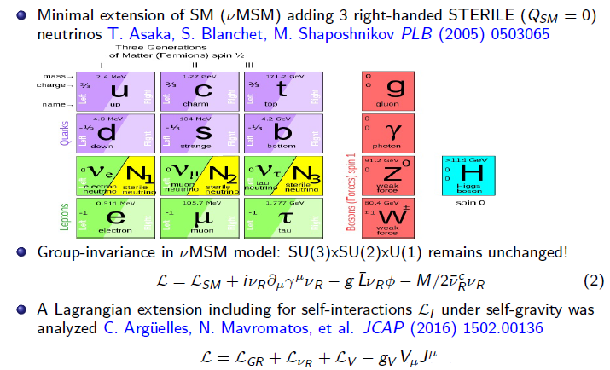

Slide 42
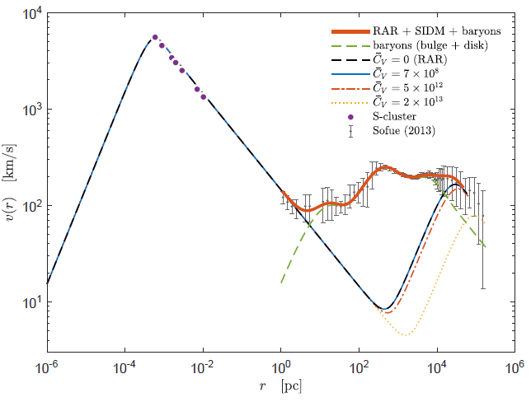
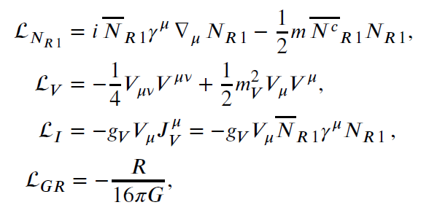
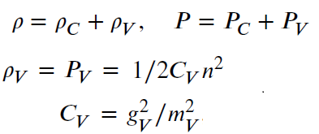
Effects of self-interacting right handed neutrinos in RAR - halos
The Higgs portal term in the Lagrangian is neglected given the bulk of sterile neutrinos live longer than the age of the Universe
We work in the Relativistic Mean Field theory approx. fields are replaced by their mean values in its ground state .
Yunis, Argüelles, Mavromatos, Moliné, et al. PDU (2020)​

Slide 43

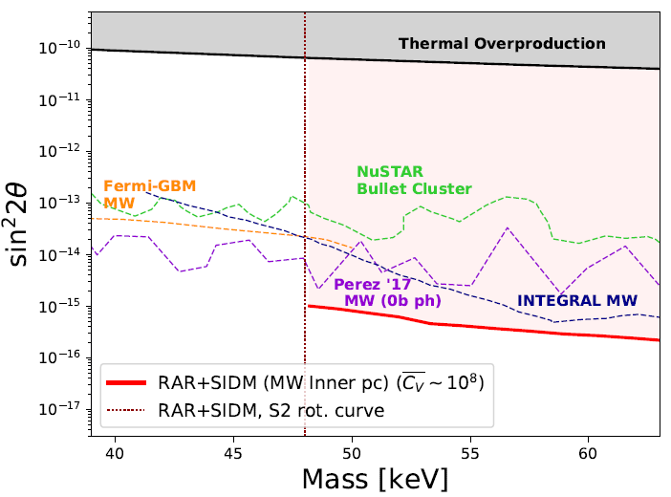


Effects of self-interactions in particle physics (nuMSM) constraints
The cross section constraints from colliding galaxy clusters D. Harvey et al. Science (2015)
Theoretical corss-section for the SI sterile neutrinos Argüelles, et al. JCAP (2016)
NuMSM parameter-space is relaxed by an additional production channel of s-neutrinos via the Vµ decay (lowering the bounds on interaction angle) Yunis, Argüelles, Mavromatos, et al. PDU (2020)

Slide 44

Rotation Curve fitting using state-of-the-art Machine Learning
We use machine learning tools (grdient descent, through PyTorch) to fit the observed Milky Way RC: Very useful to test semi-analitical models for DM (such as RAR, or Fuzzy DM) : can include > 10 free parameters (Baryonic + DM), minimizing the Loss-function in few hs time
Collazo, Argüelles & Mestre, http://fof.oac.uncor.edu/2022/posters/ (2022)

Slide 45


L.o.S dispersion velocity data and high resolution rotation curves in disk galaxies are well reproduced by the model​

Slide 46
Applications: Galactic Scales (Stellar-Stream tracers)

Slide 47

Stellar streams in the Galaxy: key tracers of the gravitational potential
Malhan, Ibata, et al. Apj (2022)

Slide 48

Constraining the fermionic DM model with the GD-1 stream
A cold stream (GD-1) travelling through the halo (shown in self-coordinates along the stream) Price-Whelan & Bonaca, Apj (2018)
Can the Gd-1observables be explained for a Milky Way composed of baryons + fermionic DM model ?

Slide 49



GD-1 observables
Ibata, et al. Apj (2020)
STREAMFINDER (Gaia DR2): 811 star candidate members;
Cross correlation with spectroscopy: 156 stars in RV sample

Slide 50

Best-fit RAR model parameters to GD-1
Full model: Galaxy potential + GD-1 stream
Galaxy potential: RAR(θ0, W0) + Baryons (fixed)
(m and β0 fixed to fulfill Mc=M_(SgrA*)
in agreement with S-stars)
GD-1 stream: Orbit (IC) (6 parameters)
We find a best fit parmeters
Θ0=36.2; W0=63.6
In Good agreement with overall rotation curve
(independent tracer!)
Mestre, Argüelles, et al. (In preparation)

Slide 51
Applications: Cosmological Scales (non linear regime)

Slide 52

N-body simulations in SI-WDM cosmologies (Gadget-4)
4 cosmologies (z=0), corresponding to different Power Spectrums within a SI-WDM model: (Box size: 20 Mpc/h; N=512^3 particles, softening length: 1 kpc)
WDM1: m=1 keV
WDM1 I : m=1 keV (C_v ≠ 0)
WDM10: m=10 keV
WDM10 I: m=10 keV (C_v ≠ 0)
Stahl, Yunis, Argüelles, et al. (In preparation)​

Slide 53


