Slide 1
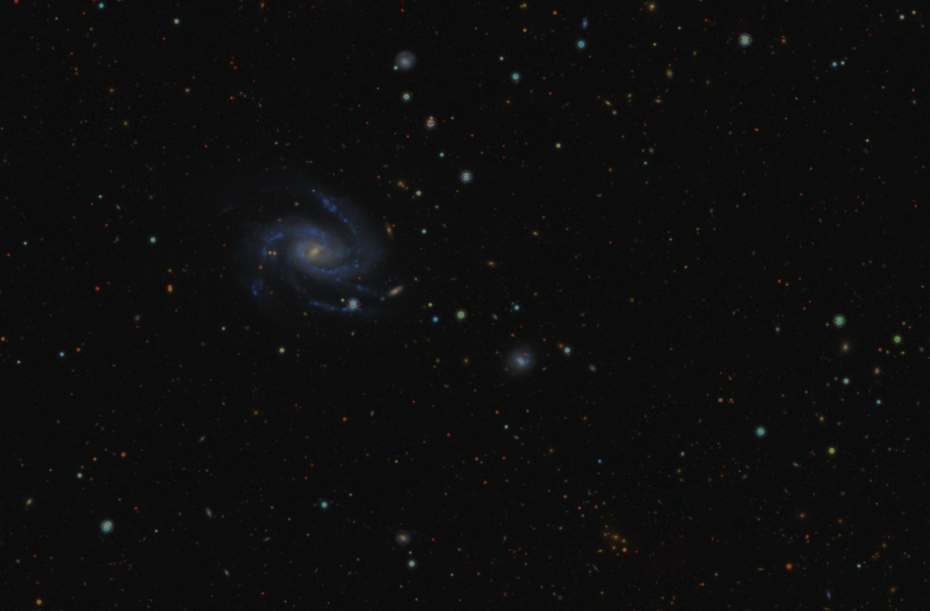
Investigating the dark side of the universe with the motion of galaxies
Yan Xiang Lai
Supervisors: Cullan Howlett, Tamara Davis
The University of Queensland
Notes:
Hi everyone, I am Yan from the University of Queensland in Australia. Today, I am going to talk about using the motion of galaxies to investigate dark energy and dark matter.

Slide 2
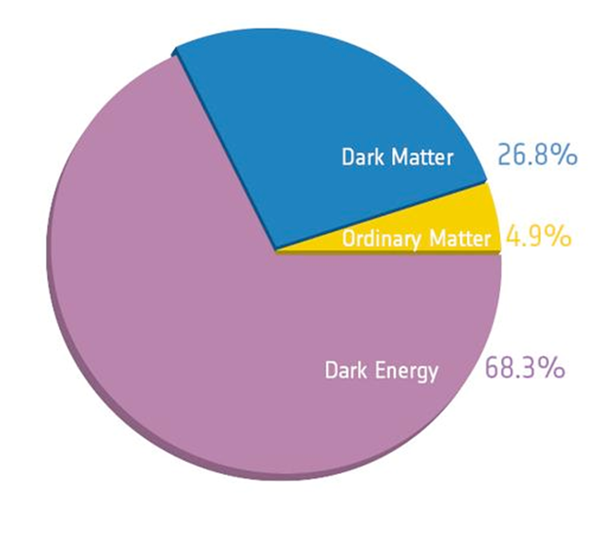
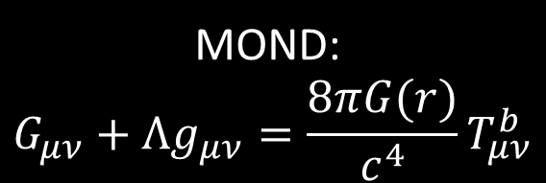
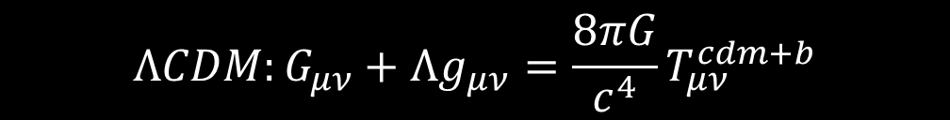
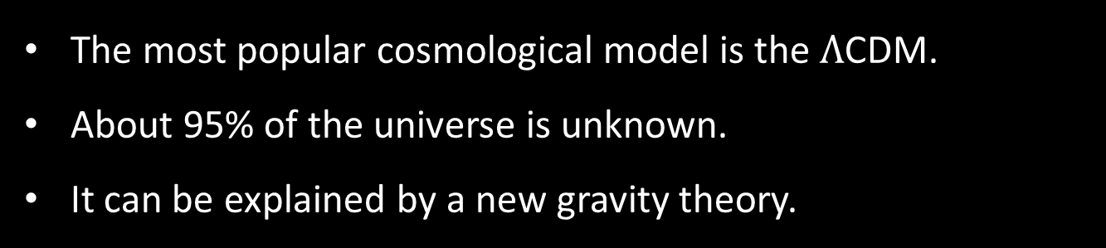
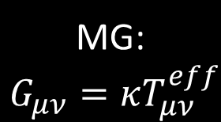
What are dark matter and dark energy?
The most popular cosmological model is the $Λ$CDM.
About 95% of the universe is unknown.
It can be explained by a new gravity theory.
$$ΛCDM:G_{μν}+Λg_{μν}=\frac{8πG}{c^{4}}T_{μν}^{cdm+b}$$
Dark Matter
Dark Energy
MOND:
$$G_{μν}+Λg_{μν}=\frac{8πG(r)}{c^{4}}T_{μν}^{b}$$
MG:
$G_{μν}=κT_{μν}^{eff}$
Credit: NASA
Notes:
The most successful cosmological model so far is the Lambda CDM model where Lambda stands for cosmological constant and CDM denotes the Cold Dark Matter. Despite its success, the figure on the right here shows the universe only is made up of 5% of ordinary matter. The unknown dark matter and dark energy make up the remaining 95%. Consequently, alternative theories such as modified gravity are developed to explain the dark sector of the universe. For example, Modified Newtonian Dynamics or MOND changes the strength of gravity to explain dark matter. While some other modified gravity theories changes the energy momentum tensor to explain the dark energy.

Slide 3
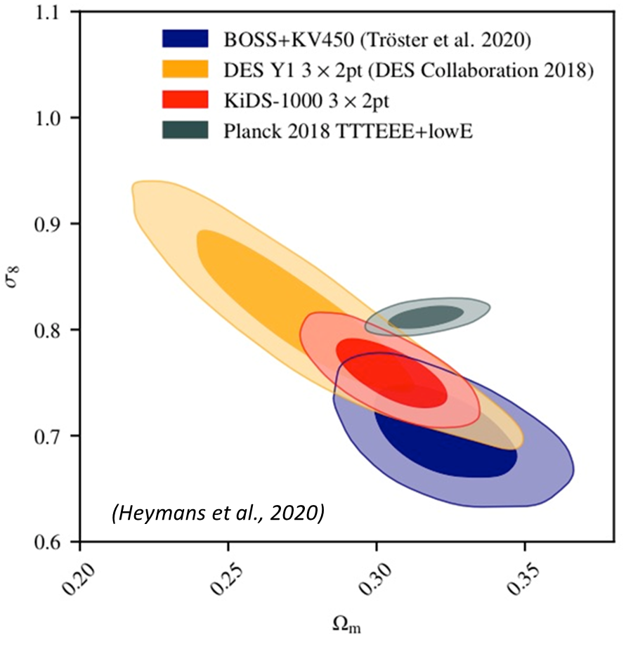
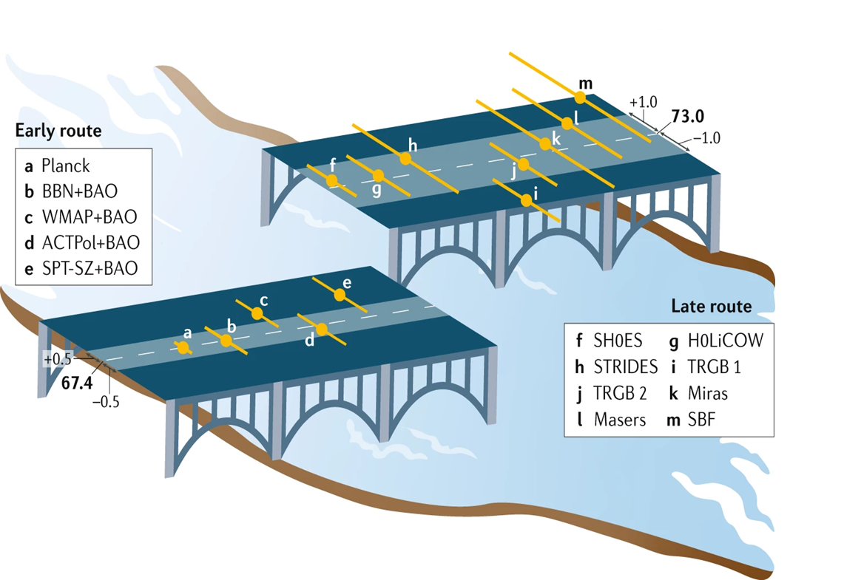
The cosmic tension
The constraints of cosmological parameters from early and late universe do not agree.
The differences could be statistical fluke, new model, or unknown systematic errors.
Aim: Test whether new models of gravity agree with observations.
Notes:
In addition to the unknown dark sector of the Lambda CDM model. Measurements of several cosmological parameters are in disagreement between early and late universes. The figure on the left shows measurement of the expansion rate of the universe or the Hubble parameters. This figure shows the late-universe measurements are consistently higher than the early universe measurements. On the right is the measurement of the sigma8 parameters which determine the amplitude of density fluctuation in the universe. It also shows the early universe measurement in the grey contour disagrees with various late redshift measurements. These differences could be statistical fluke, break down of our cosmological model or unknown systematics. Several modified gravity models are proposed to solve these tensions. To test these models, we want to know whether these models of gravity agree with observations.

Slide 4
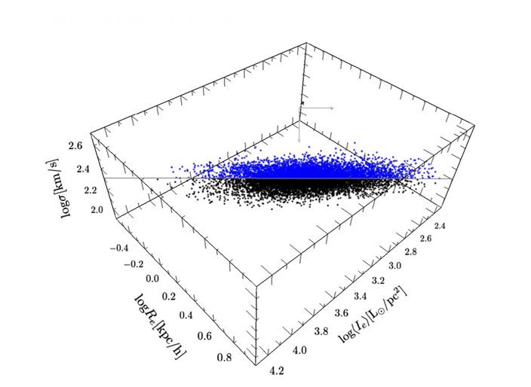
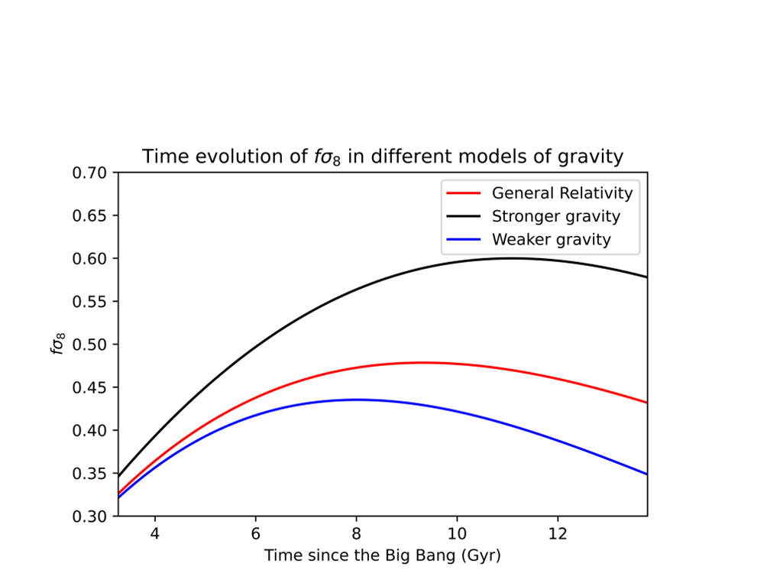
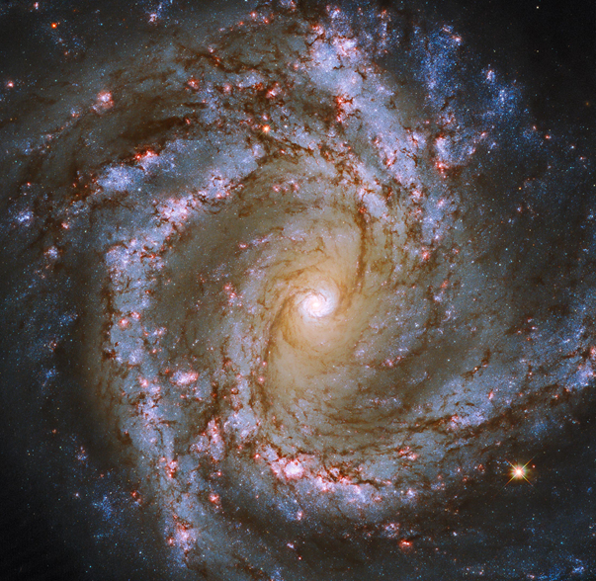
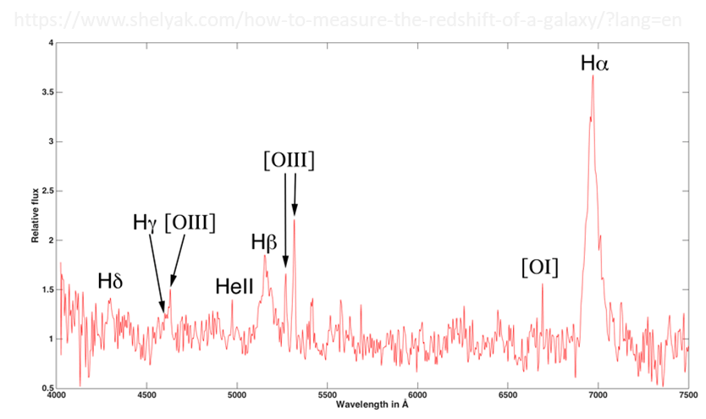
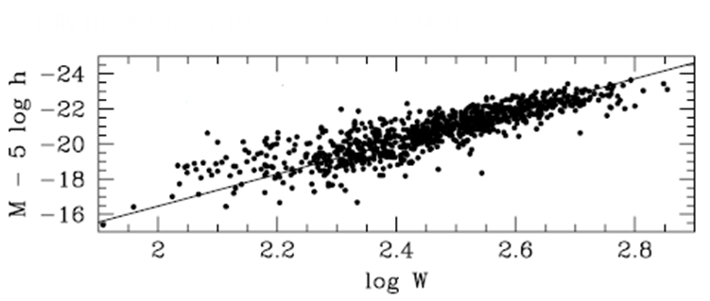





The peculiar velocity of galaxies
$$v_{tot}=$$
$$H_{0}r+$$
$$v_{p}$$
$$\left(1+z\right)=\left(1+\overline{z}\right)(1+z_{p})$$
Recession velocity
Total velocity
Expansion of the universe
Peculiar velocity
Gravitational interaction
Notes:
From Newton’s law of gravitation, we know the acceleration and hence the velocity of galaxies can help to determine the gravitational constant G. Therefore, we can use the motion of galaxies to determine the strength of gravity. We can use the spectrum of a galaxy to determine its velocity. The total velocity of a galaxy has two components, the first component is called the recession velocity due to the expansion of our universe. We can use Hubble’s law to estimate the recession velocity. To determine the distance “r”, we use either the Tully-Fisher relation which relates the absolute magnitude to rotation velocity of a spiral galaxy, or the fundamental plane which relative the surface brightness of an elliptical galaxy to its velocity dispersion and effective radius. The difference between the total velocity and recession velocity gives the peculiar velocity. In practice, we measure the redshift instead of distances because they are more accurate. Additionally, instead of measuring the gravitational constant G, we determine the growth rate of structure fsigma8. Similar to the gravitational constant, higher growth rate indicates a stronger gravity or vice versa.

Slide 5
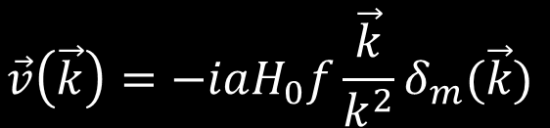
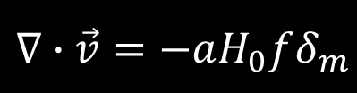
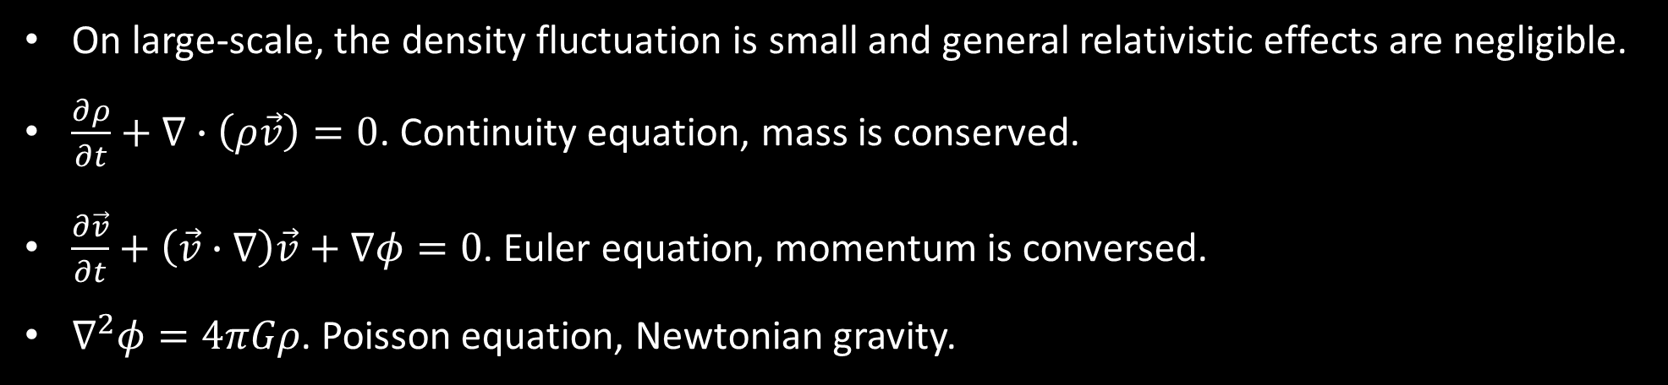
Measuring the growth rate with the velocity of galaxies
On large-scale, the density fluctuation is small and general relativistic effects are negligible.
$\frac{∂ρ}{∂t}+∇∙\left(ρ\vec{v}\right)=0$. Continuity equation, mass is conserved.
$\frac{∂\vec{v}}{∂t}+\left(\vec{v}∙∇\right)\vec{v}+∇φ=0$. Euler equation, momentum is conversed.
$∇^{2}φ=4πGρ$. Poisson equation, Newtonian gravity.
$$\vec{v}\left(\vec{k}\right)=−iaH_{0}f\frac{\vec{k}}{k^{2}}δ_{m}(\vec{k})$$
$$∇∙\vec{v}=−aH_{0}fδ_{m}$$
Configuration space
Fourier space
Notes:
So how do we convert the peculiar velocity into growth rate measurements. On large scale, the density fluctuations are small, so we can use perturbation theories. Additionally, the general relativistic effect are negligible, so we can use the Newtonian dynamics. Assuming dark matter is a perfect fluid, the motion of galaxies are governed by three hydrodynamic equations: the continuity equation, the Euler equation, and the Poisson equation, each representing the conservation of mass, conservation of momentum, and Newtonian gravity. With a little bit of algebraic manipulation, the peculiar velocity is related to the linear growth rate f with these two equations.

Slide 6
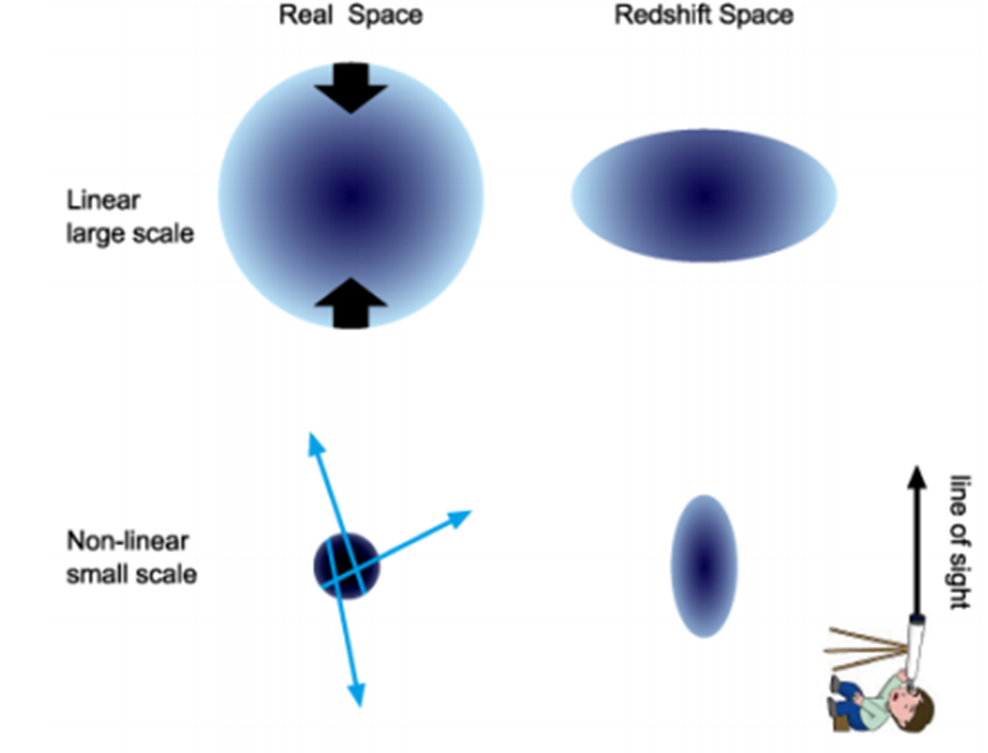

Improving the constraint with Redshift Space Distortion (RSD)
The peculiar velocity of galaxies introduces additional redshift through the Doppler effect.
Large-scale correction:
$δ_{g}=bδ_{m}+fμ^{2}$
$v\left(\vec{k}\right)=−iaH_{0}f\frac{μ}{\vec{k}}δ_{m}(\vec{k})$
$μ$: cosine of the line-of-sight angle.
Shun, S. (2016)
Notes:
Although the universe is homogeneous and isotropic in real configuration space, the motion of galaxies introduce additional redshift through the Doppler effect in the redshift space such that the distribution of galaxies depends on the line-of-sight. This effect is called the Redshift Space Distortion or RSD. The figure on the right shows on large-scale, the coherent motion of galaxies moving towards the densest region shrinks the distribution of galaxies along the line-of-sight. Mathematically, this is modelled by the Kaiser effect where mu is the cosine of the line-of-sight angle. After accounting for the Kaiser effect, the galaxy overdensity delta g also depends on the linear growth rate f. Therefore, we can combine both velocity and galaxy overdensity measurements to obtain a tighter constraint on the growth rate of structure.

Slide 7

Improving the constraint with Redshift Space Distortion (RSD)
The peculiar velocity of galaxies introduces additional redshift through the Doppler effect.
Small-scale correction (empirical):
$δ_{g}=\left(bδ_{m}+fμ^{2}\right)e^{−\frac{{\left(kμσ_{g}\right)}^{2}}{2}}$.
$v\left(\vec{k}\right)=−iaH_{0}f\frac{μ}{\vec{k}}δ_{m}(\vec{k})\frac{sin⁡(kσ_{u})}{kσ_{u}}$.
$σ_{v}$: Non-linear velocity dispersion.
Shun, S. (2016)
Notes:
On small-scale, the motion of galaxies are random, so it elongates the distribution of galaxies along the line-of-sight. Mathematically, it is modelled by a Gaussian kernel for the galaxy overdensity and a sinc function for the peculiar velocity. Both kernels are empirical but previous research found these are accurate up to scale of 0.23 h/Mpc. We also have an additional parameter sigmav determines the velocity dispersion of galaxies on small scale. On the right I show the Fisher forecast for the growth rate measurements. It illustrates combining both velocity and density significantly improves the constraints.

Slide 8
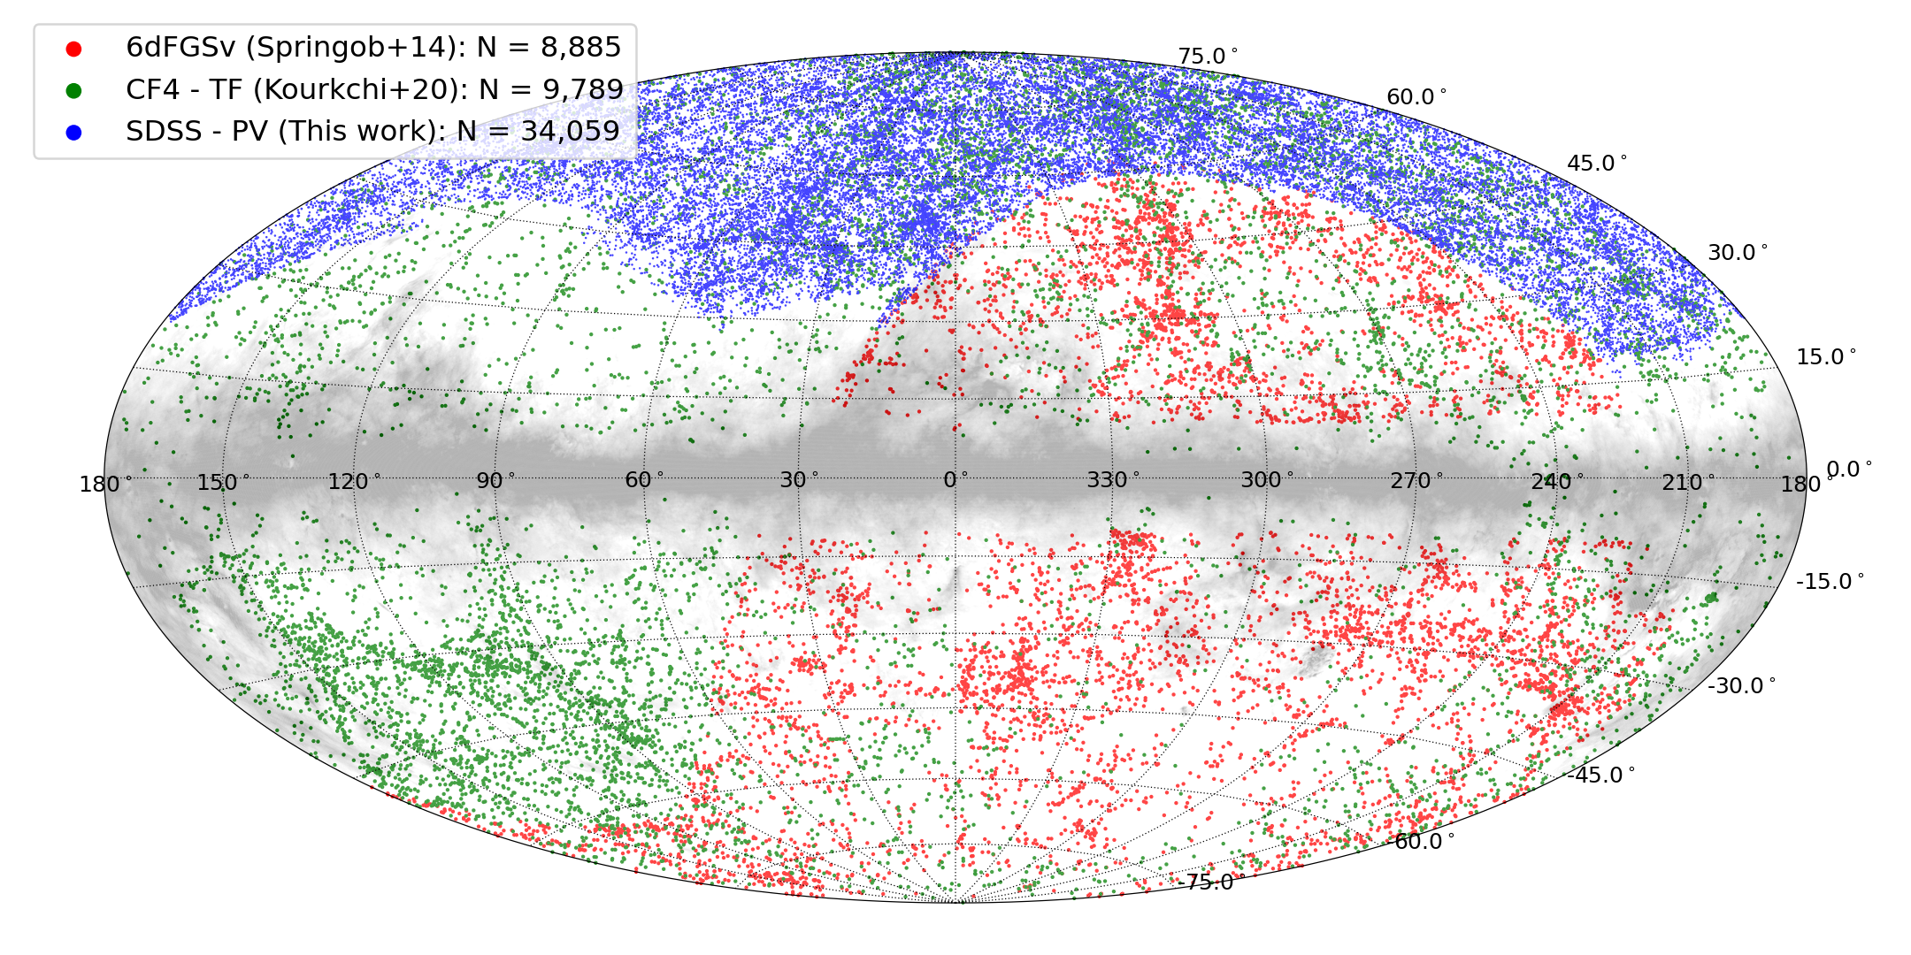
The SDSS peculiar velocity catalogue
The Sloan Digital Sky Survey (SDSS) peculiar velocity catalogue contains 34059 galaxies.
It is the largest and deepest single catalogue of a peculiar velocity survey.
(Howlett, etal, 2022)
Notes:
In my research, I use the largest and deepest sample of peculiar velocity from the Sloan Digital Sky Survey peculiar velocity catalogue. It contains more than 34 thousand galaxies which is more than 3 times larger than any previous peculiar velocity surveys. Additionally, it also contains velocity measurements up to redshift of 0.1 which is much deeper than previous survey which is limited to redshift of 0.055.

Slide 9
Bayes Theorem and MCMC
$$P\left(model | data\right)∝P\left(data | model\right)×P(model)$$
Posterior $∝$ Likelihood $×$ Prior
$$P\left(fσ_{8}\right|v, δ_{g})∝P\left(v, δ_{g} | fσ_{8}\right)×P(fσ_{8})$$
Notes:
To extract the growth rate of structure we use the Bayes theorem where the posterior probability of the growth rate depends on the likelihood multiplies by the prior. To obtain an objective constraint, we use a flat prior for the growth rate between 0 and 1.

Slide 10
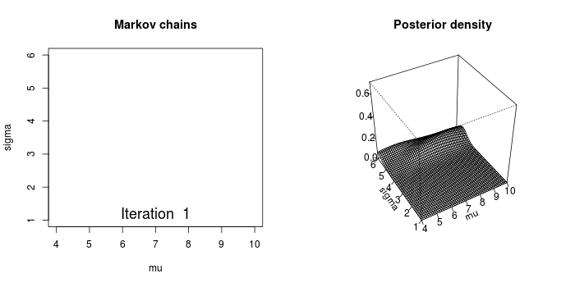
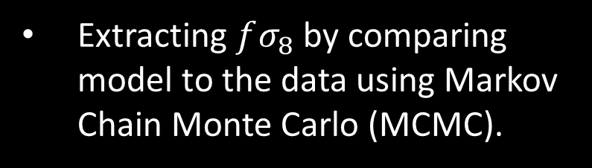
Bayes Theorem and MCMC
$$P\left(model | data\right)∝P\left(data | model\right)×P(model)$$
Posterior $∝$ Likelihood $×$ Prior
$$P\left(fσ_{8}\right|v, δ_{g})∝P\left(v, δ_{g} | fσ_{8}\right)×P(fσ_{8})$$
Extracting $fσ_{8}$ by comparing model to the data using Markov Chain Monte Carlo (MCMC).
https://blog.revolutionanalytics.com/2013/09/an-animated-peek-into-the-workings-of-Bayesian-statistics.html
Notes:
The Markov Chain Monte Carlo algorithm or MCMC is used to construct the posterior distribution of fsigma8. The walkers of the MCMC chains start at random position and then eventually sample the region with the highest posterior probability. The maxima of the posterior gives the best-fit parameters and the width of the posterior gives the uncertainty.

Slide 11
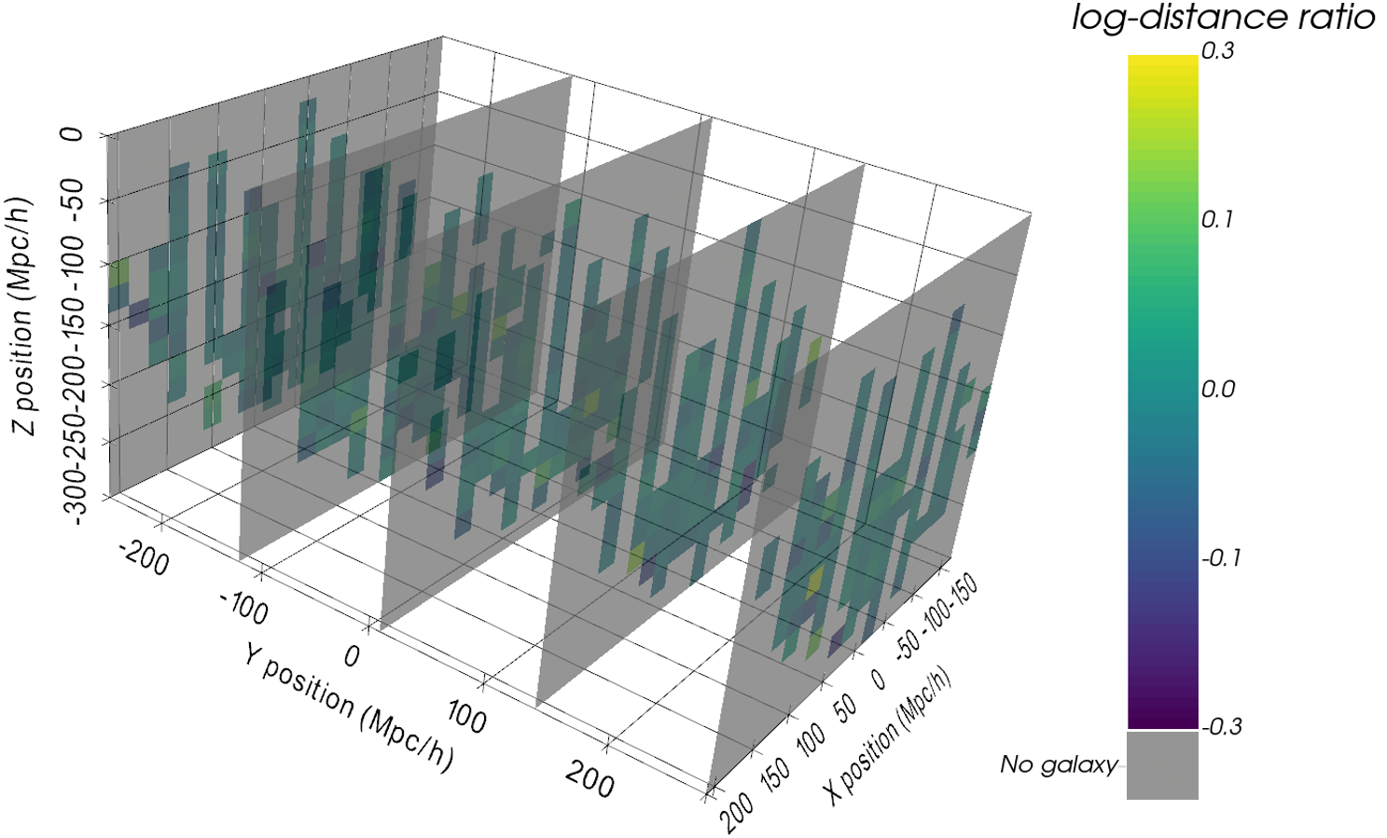
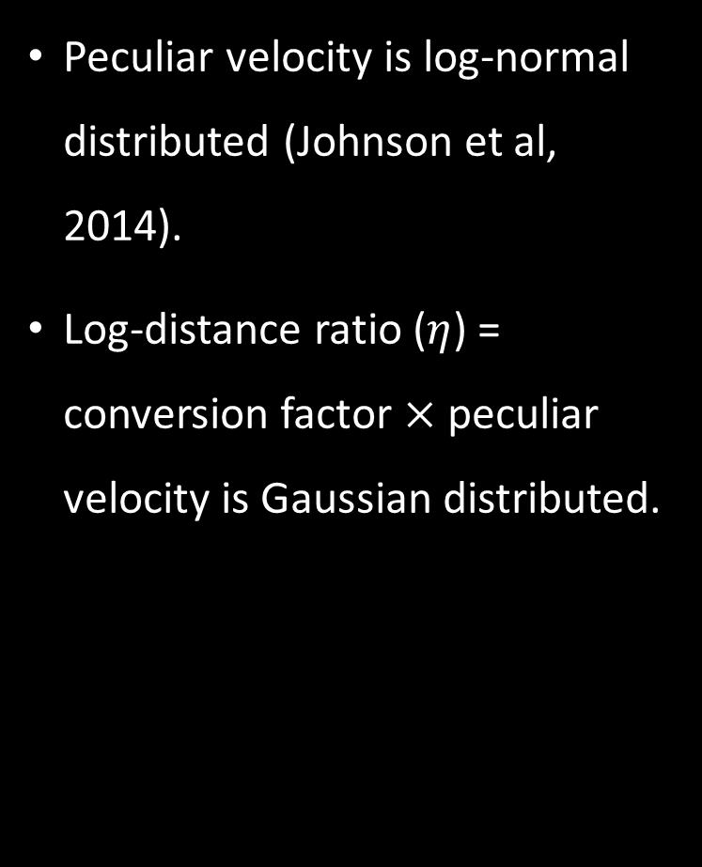
The likelihood function
Peculiar velocity is log-normal distributed (Johnson et al, 2014).
Log-distance ratio ($η$) = conversion factor $×$ peculiar velocity is Gaussian distributed.
Notes:
Since we have a flat prior on the growth rate, the posterior distribution will mainly depend on the likelihood. Previous research found the peculiar velocity doesn’t follow a Gaussian distribution. To use Gaussian likelihood, we convert the peculiar velocity to the log-distance ratios which are Gaussian distributed. The figure on the right shows the distribution of log-distance ratios in the SDSS peculiar velocity survey. We are located in the origin, and these are slices through the y-axis. The log-distance ratios here corresponds to peculiar velocity of few hundred km/s.

Slide 12
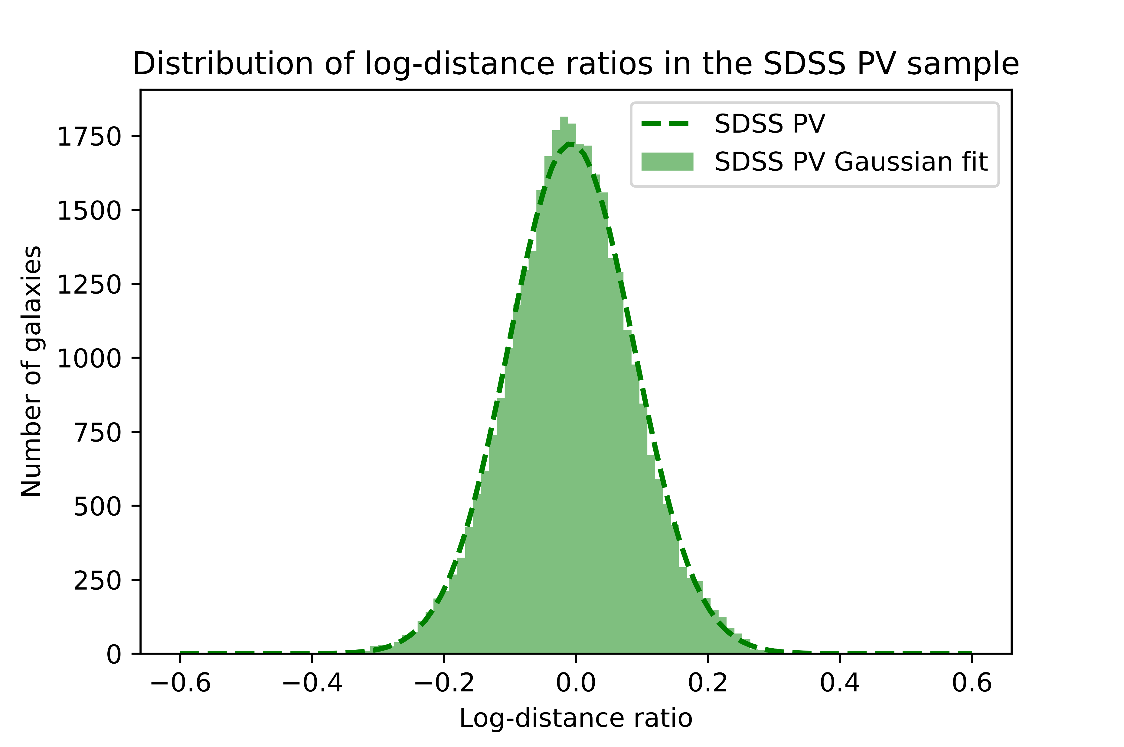
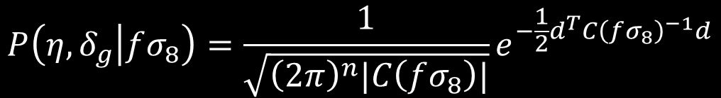
The likelihood function
$$P\left(η, δ_{g} | fσ_{8}\right)=\frac{1}{\sqrt{{\left(2π\right)}^{n}|C\left(fσ_{8}\right)|}}e^{−\frac{1}{2}d^{T}C{\left(fσ_{8}\right)}^{−1}d}$$
Notes:
The likelihood function is modelled by a multivariate Gaussian distribution where C is the covariance matrix. The covariance matrix is given by this equation here assuming the mean velocity and galaxy overdensity of the universe is zero. The bottom figure shows the log-distance ratios of the SDSS peculiar velocity survey follows the Gaussian distribution.

Slide 13
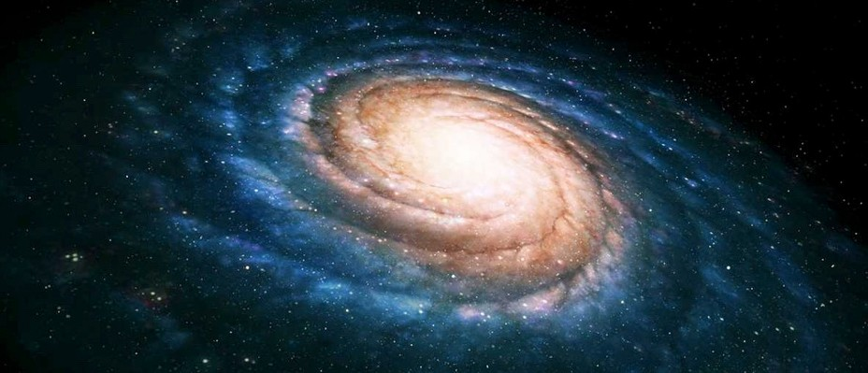
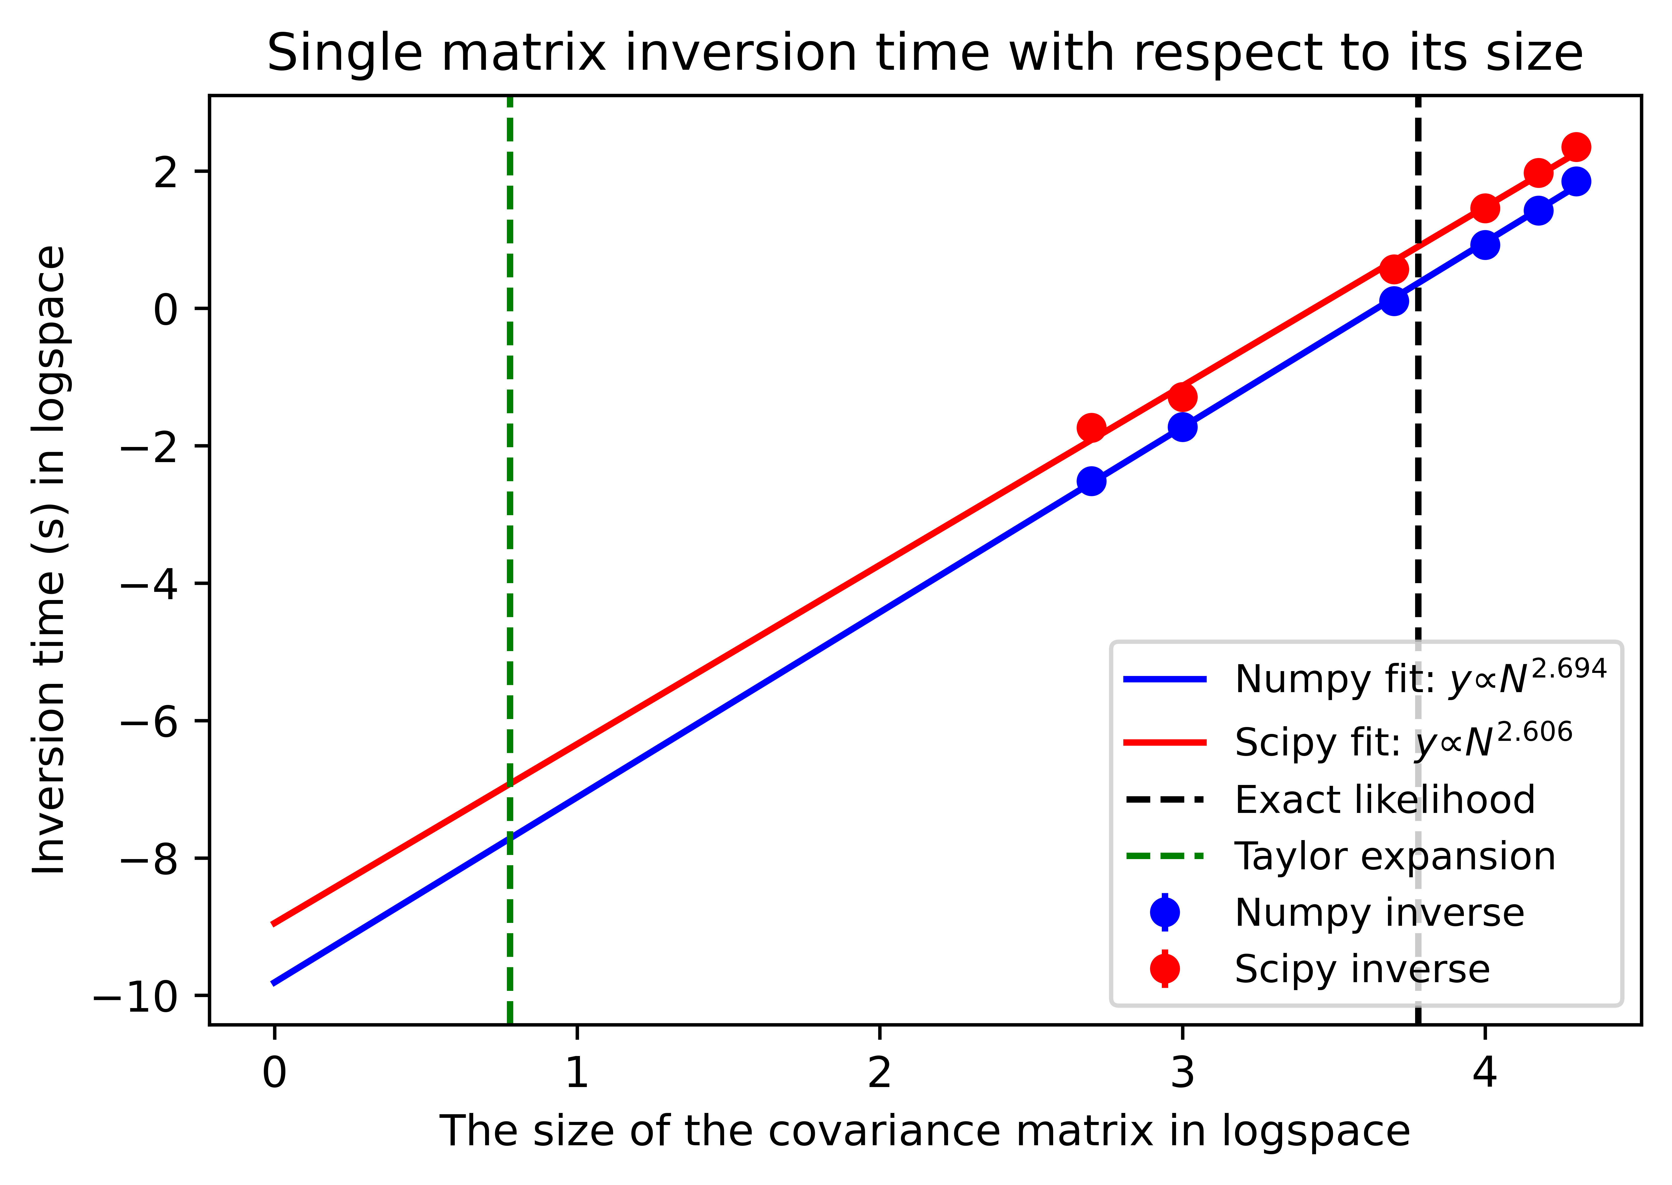
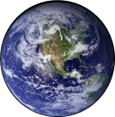

Accounting for all the systematics
The constraining power is determined by the covariance matrix.
Accounting for the wide-angle effect when calculating the covariance matrix.
Data systematics are added to the covariance matrix.
Using the Taylor expansion to interpolate the likelihood value during MCMC.
Notes:
The previous slide shows the constraining power of a survey depends on the covariance matrix. When previous studies computed the covariance matrix, they assume line-of-sight to both galaxies are parallel shown in green instead of the true line of sight shown in red. This approximation breaks down when the distance between two galaxies are big which introduces the wide-angle effect. My new approach accounts for this by using the true line of sight to calculate the covariance matrix. I accounted for other systematics in the data by adding them to the theoretical covariance matrix. The SDSS peculiar velocity survey contains more than 34000 galaxies, so the size of the covariance matrix is huge. During each step of MCMC, we need to calculate the inverse of the covariance matrix which significantly slows down the algorithm. To solve this problem, we use the second order Taylor expansion around the maximum likelihood to interpolate the likelihood during the MCMC. We only have to calculate the inverse of the covariance matrix when using the optimization algorithm to find the best-fit.

Slide 14
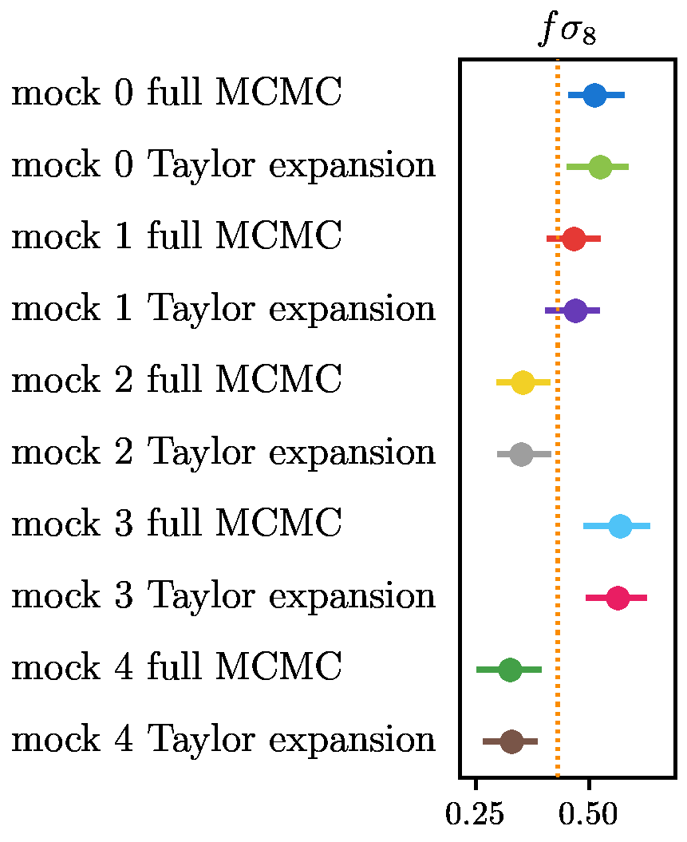
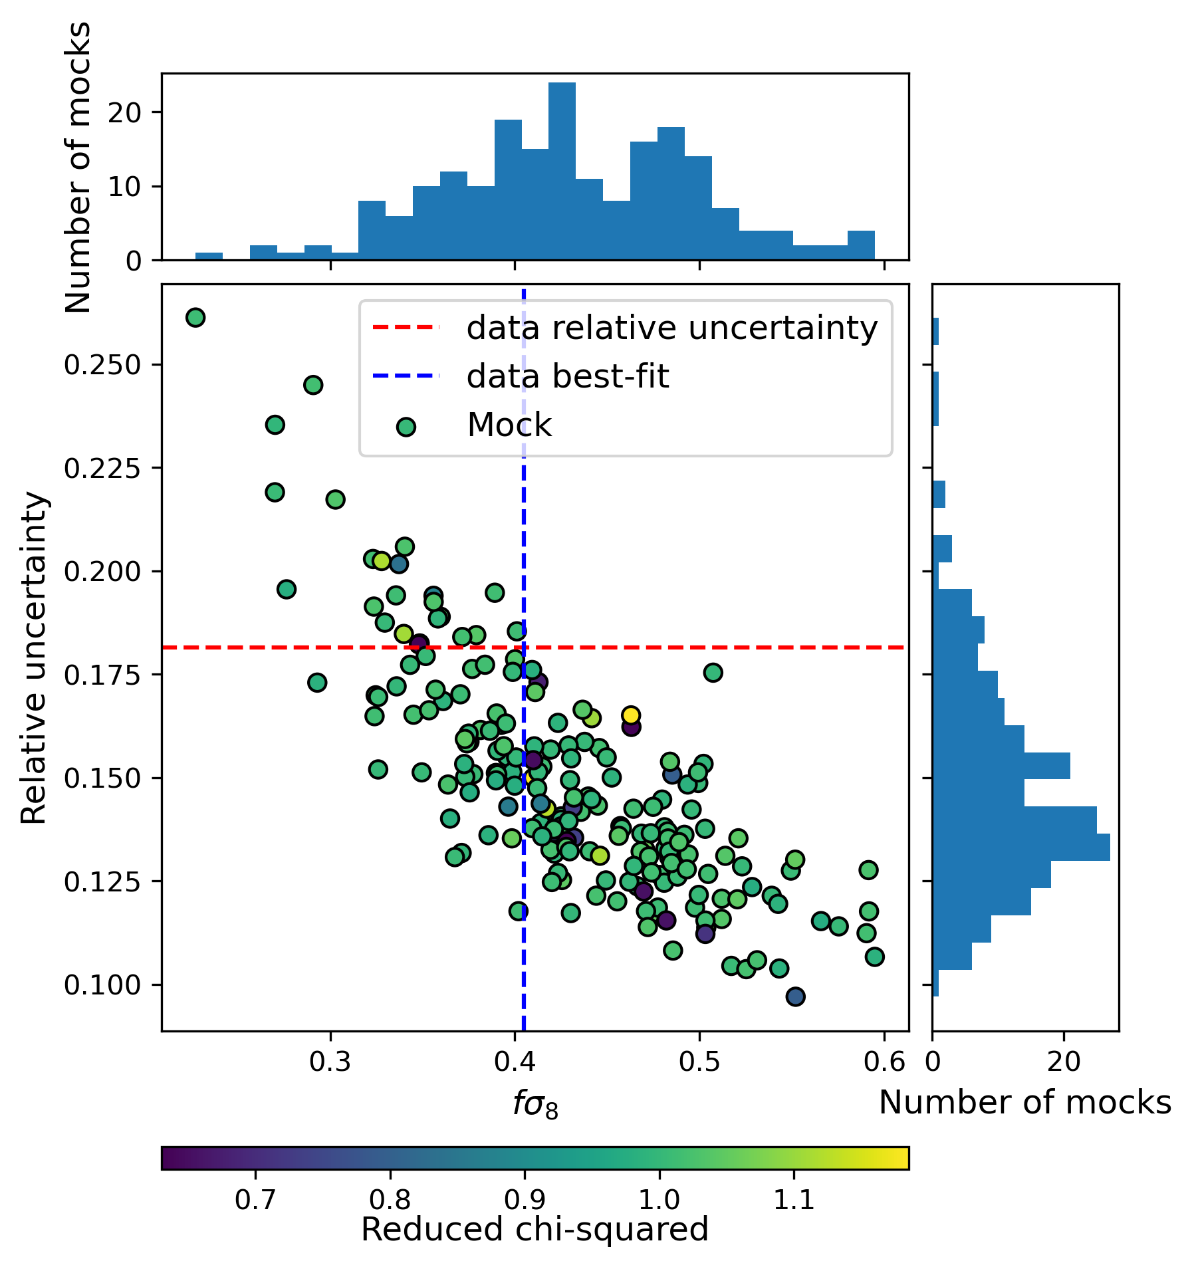
Testing the mocks
We generated 201 different mocks (simulated data sets) to test our new method.
Using the Taylor expansion is more than 30 times faster than using the exact likelihood.
Notes:
We use 201 different mocks to test our new method. We found the Taylor expansion is more than 30 times faster and did not introduce new systematics into our constraints. You can also see from the plot on the right that the data relative uncertainty and best fit are consistent with the mock data. Lastly, the reduced chi-squared for the fits are very close to one, indicates my model is a good fit for the data.

Slide 15
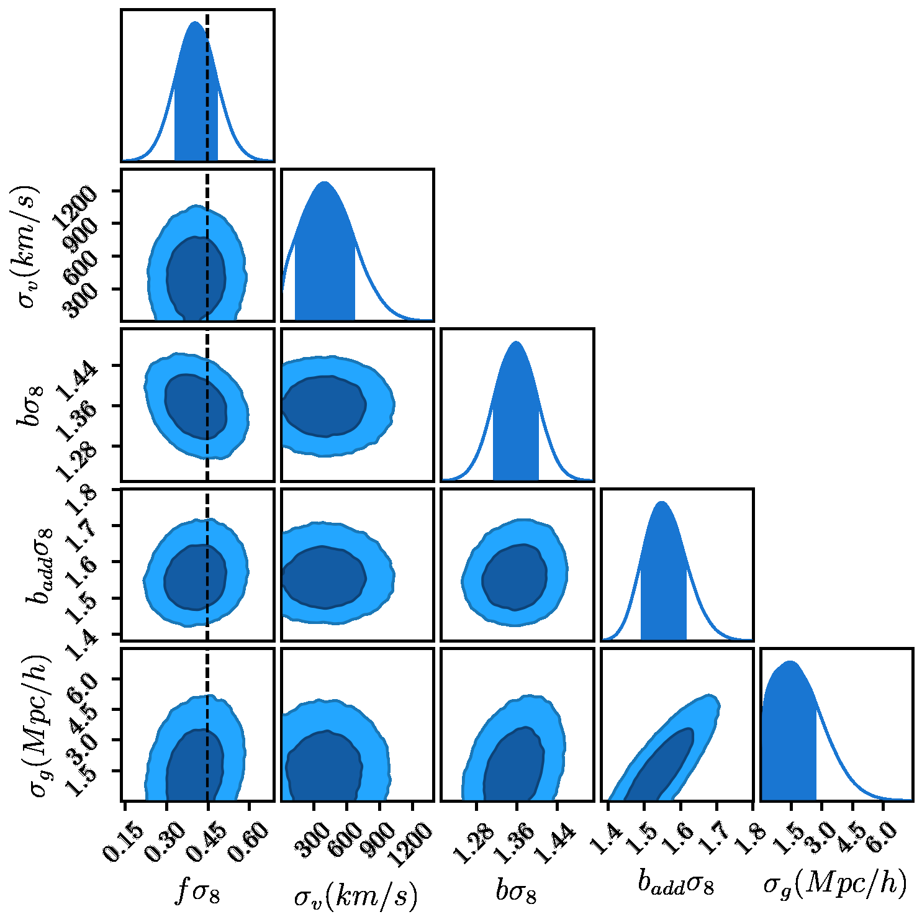
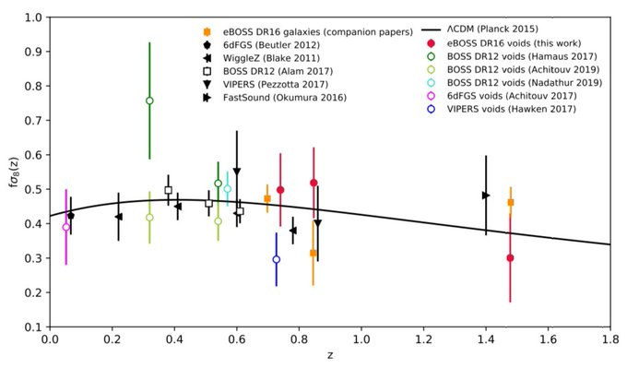

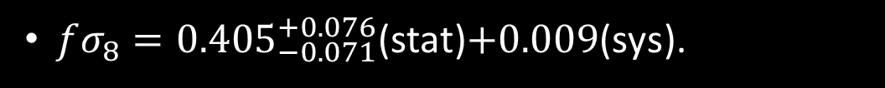
Result
$fσ_{8}={0.405}_{−0.071}^{+0.076}$(stat)$+0.009$(sys).
Consistent with the $Λ$CDM model (black dashed line).
Massive reduction in systematic uncertainty $15.89\% →1.81\%$ compares to Adams & Blake (2020).
(Aubert, et al., 2022)
Notes:
My constraints on the growth rate is consistent with the prediction from Lambda CDM which is indicated by the black dashed line. My new method also massively reduce the systematic uncertainty compares to previous approach. The plot on the right shows most measurements are consistent with Lambda CDM. My constraint is here on the plot. My result is consistent with other low-redshift measurements. The result is published on MNRAS.

Slide 16


The future of peculiar velocity surveys
40,000,000 Redshifts
200,000 Velocities
6,000,000 Redshifts
450,000 Velocities
More accurate distance measurements from Type 1a supernovae and GW.
Peculiar velocity could also be used to test the cosmological principle and measure neutrino mass.
Notes:
In the future, the Dark Energy Spectroscopic Instrument or DESI and 4HS can obtain an order of magnitude more galaxies than SDSS peculiar velocity survey, Additionally, other surveys can get more accurate distance measurements from supernovae or gravitational wave which reduces the error of the peculiar velocity. Together, these will help to obtain tighter constraints on the growth rate of structure. Furthermore, we can also use peculiar velocity to test the cosmological principle and determine the sum of the masses of neutrinos.

Slide 17


Summary
New theory of gravity can help to solve the mystery of dark matter and dark energy.
The growth rate of structure ($fσ_{8}$) can help to distinguish different models of gravity.
The density and velocity of galaxies can help to constrain $fσ_{8}$.
We use the largest peculiar velocity catalogue to date and find our constraint is consistent with the expected value from $Λ$CDM.
You can access the paper via this link https://arxiv.org/abs/2209.04166 or scan the QR code.
Notes:
In the interest of time, I will show the summary of my talk here. The result is published on MNRAS, you can access it via this link or scan the QR code. Thank you for listening.

Slide 18
Supplementary slides

Slide 19
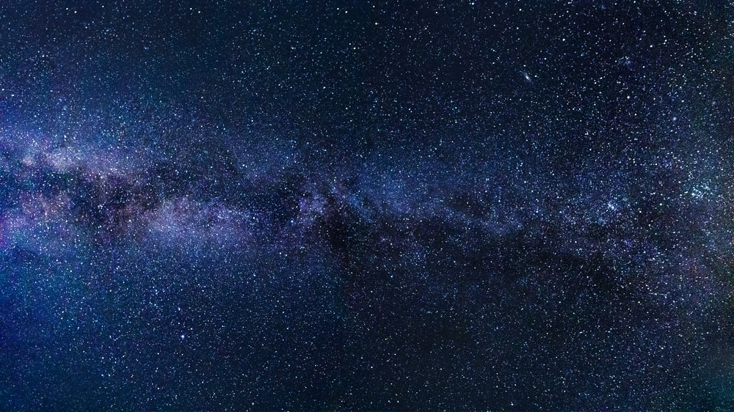
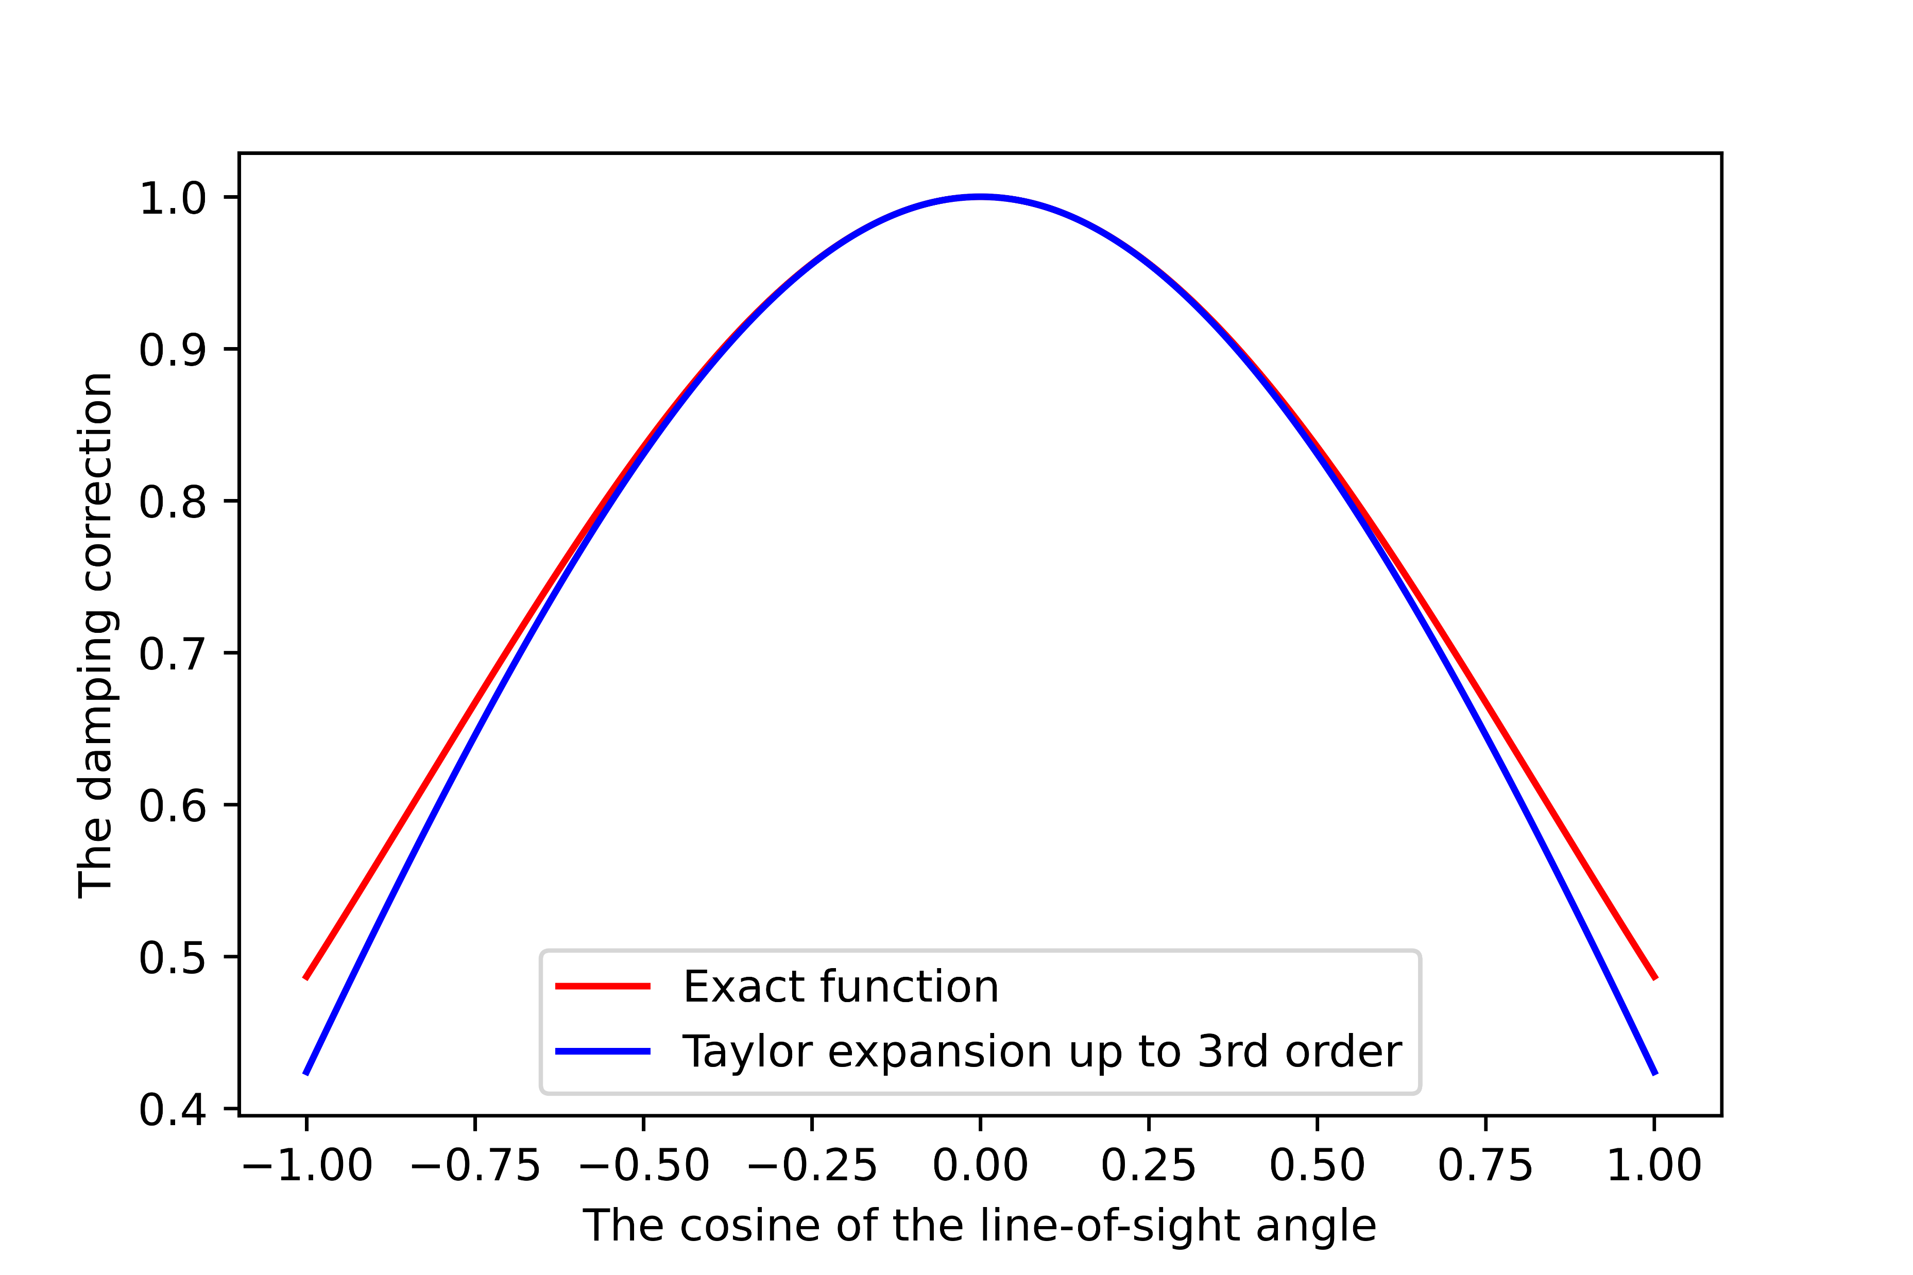
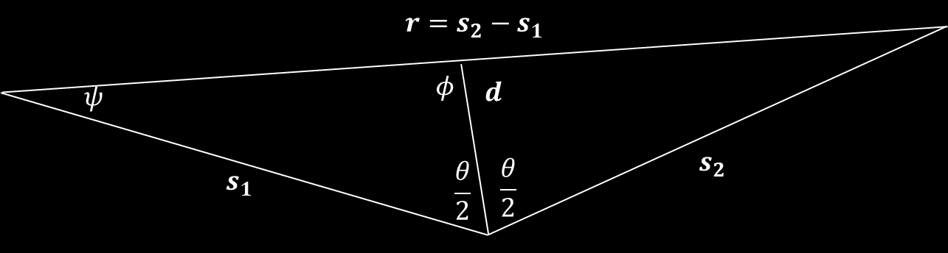


Improvement
Previous studies either ignore the effect of small-scale redshift space distortion ($D_{g}, D_{u}$) (Castorina & White, 2020) or use the plane-parallel approximation (Adams & Blake, 2020).
To account for both effects, we approximates $D_{g}=e^{−\frac{{\left(kμσ_{g}\right)}^{2}}{2}}=\sum_{i=0}^{∞}{\frac{{\left(−1\right)}^{i}{\left(kσ_{g}\right)}^{2i}}{2^{i}i!}μ^{2i}}$.
Multipole expansion $P\left(k,μ\right)= \sum_{l=0}{P_{l}\left(k\right)L_{l}(μ)}$.

Slide 20
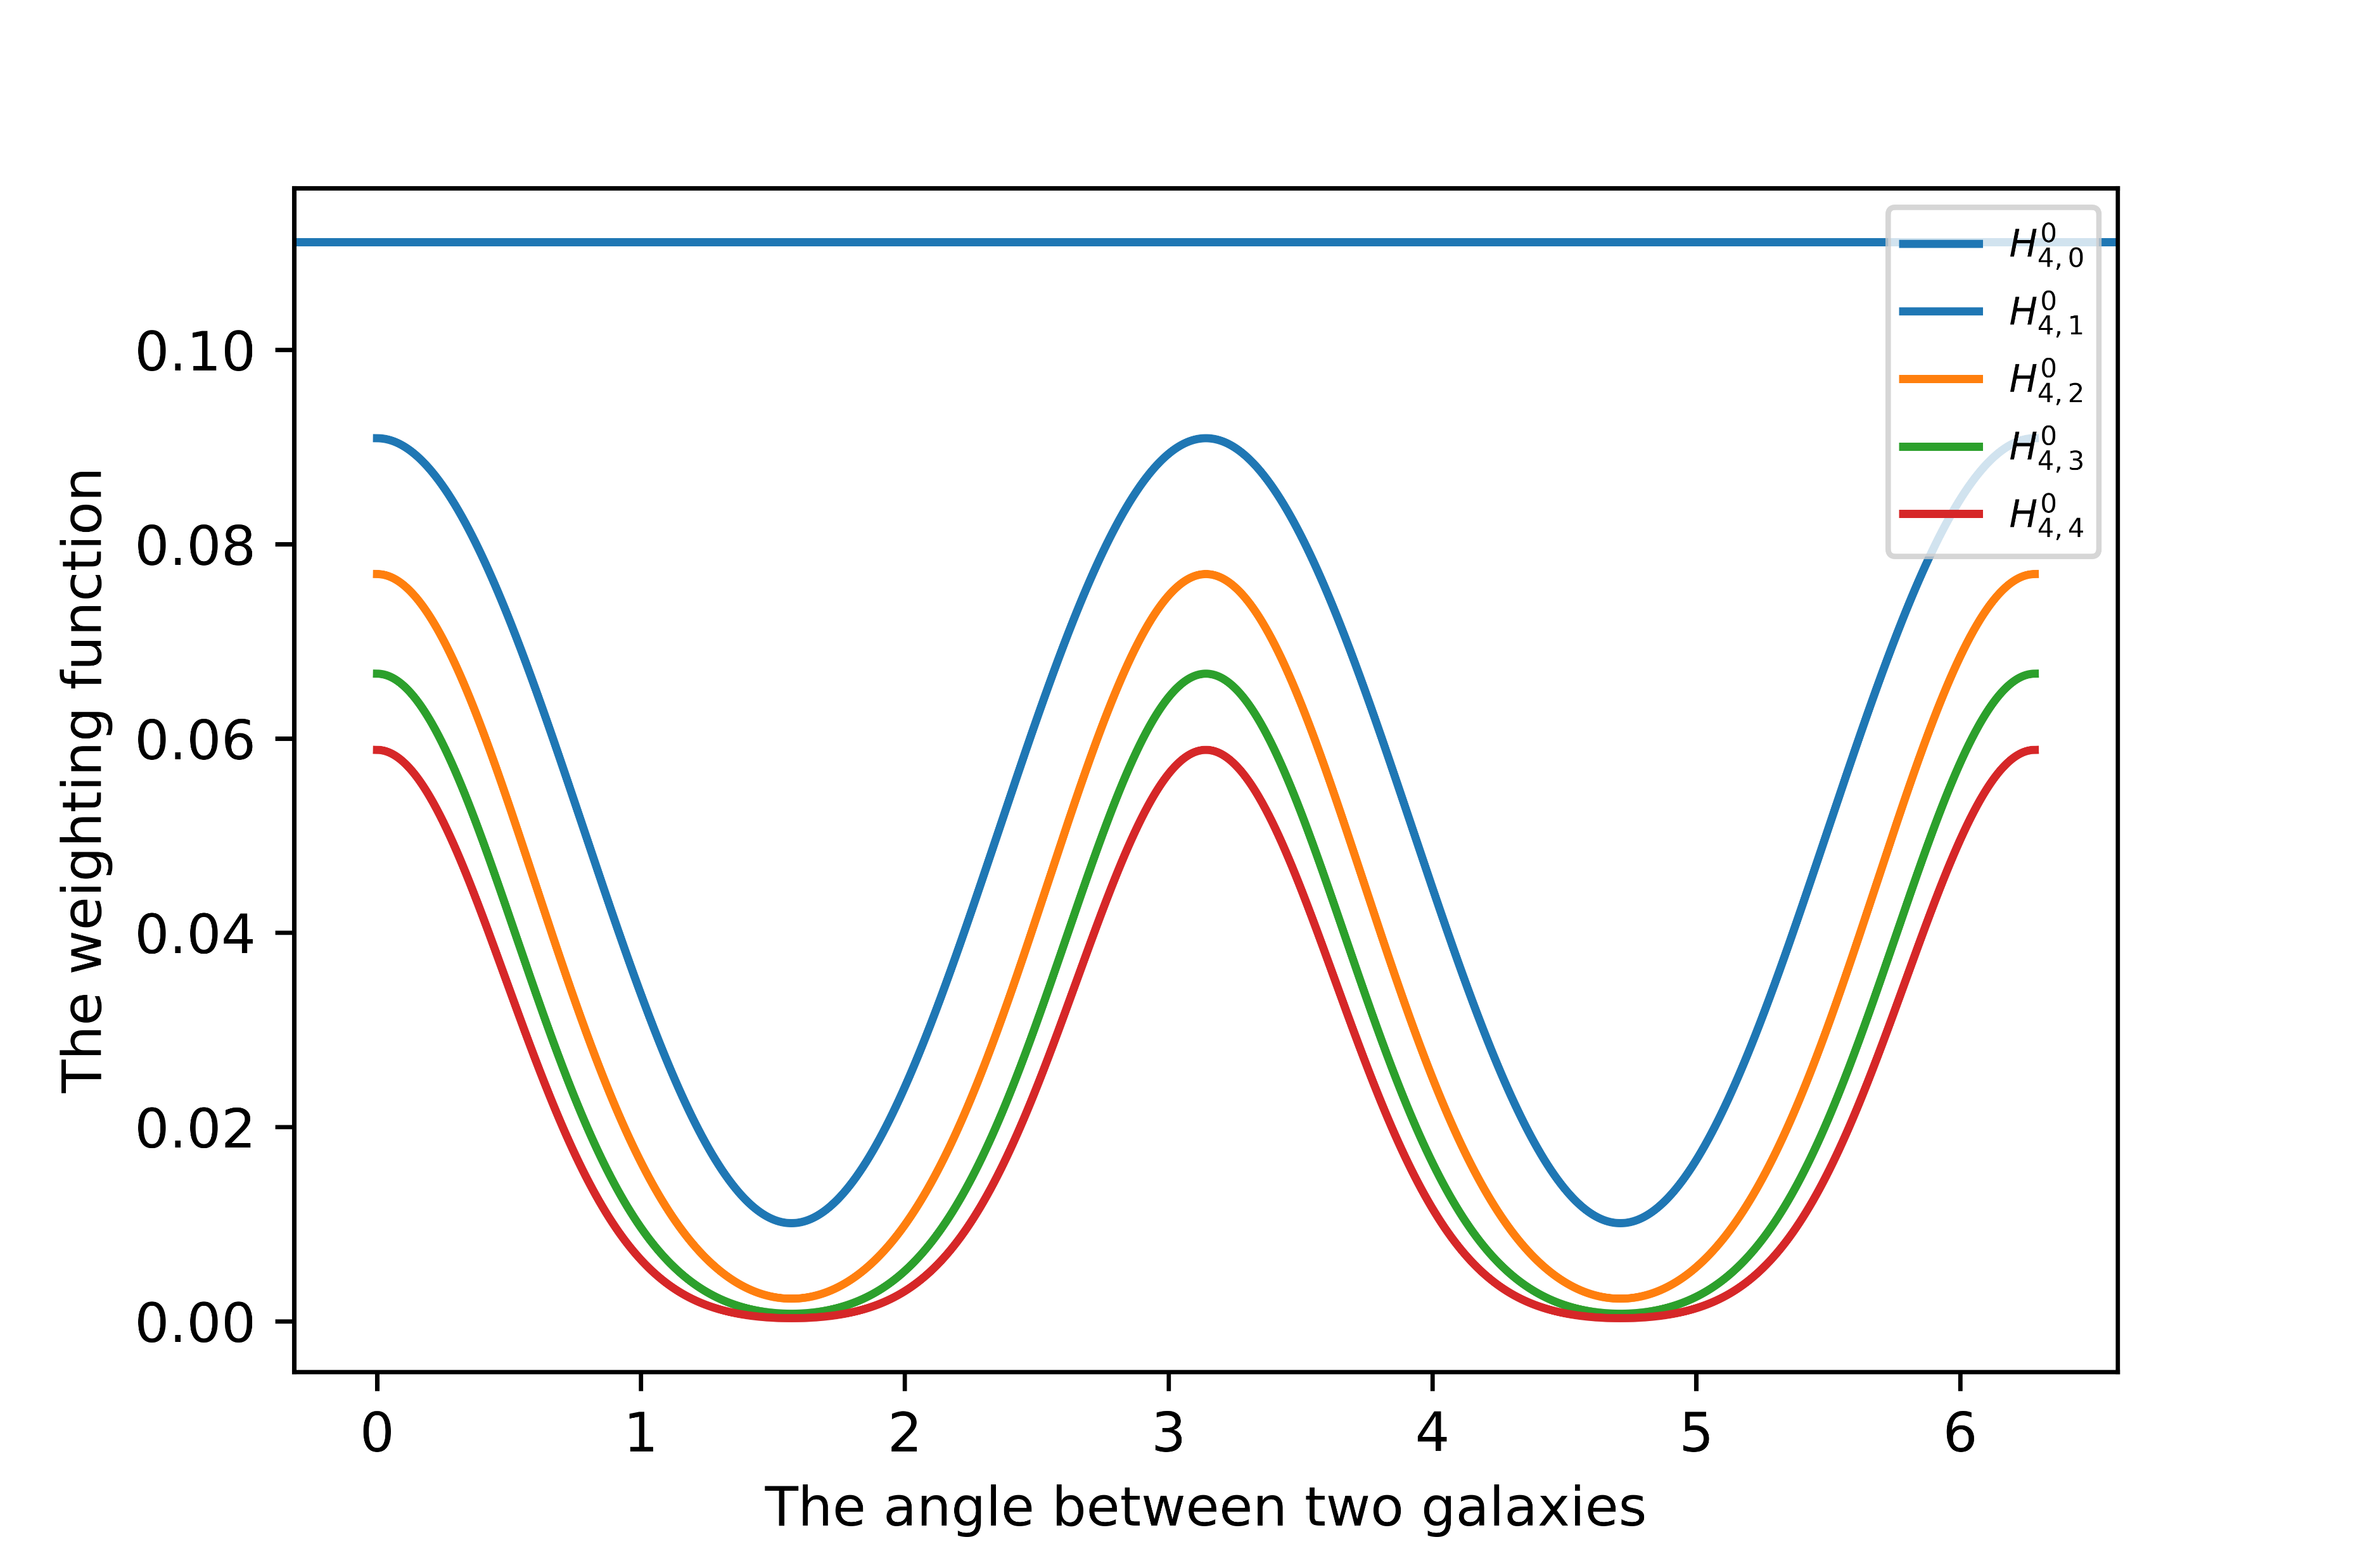

Final expressions
$C_{gg}\left(\vec{s_{1}}, \vec{s_{2}}, \vec{r}\right)= \sum_{p,q}{\frac{{\left(−1\right)}^{p+q}}{2^{p+q}p!q!}σ_{g}^{2\left(p+q\right)}\sum_{l, l_{1}, l_{2}}{i^{l}(bξ_{mm,l}^{p,q,0}\left(r,σ_{u}\right)H_{p,q}^{l,l_{1},l_{2}}(}}\vec{s_{1}}, \vec{s_{2}}, \vec{r})+bfξ_{mθ,l}^{p,q,0}\left(r,σ_{u}\right)\left(H_{p+1,q}^{l, l_{1},l_{2}}\left(\vec{s_{1}}, \vec{s_{2}}, \vec{r}\right)+H_{p,q+1}^{l,l_{1},l_{2}}\left(\vec{s_{1}}, \vec{s_{2}}, \vec{r}\right)\right)+f^{2}ξ_{θθ,l}^{p,q,0}\left(r, σ_{u}\right)H_{p+1,q+1}^{l,l_{1},l_{2}}(\vec{s_{1}}, \vec{s_{2}}, \vec{r})$.
$ξ_{ab,l}^{p,q,n}\left(r,σ_{u}\right)=\int_{k_{min}}^{k_{max}}{\frac{k^{2} dk}{2π^{2}}}P_{ab}\left(k\right)j_{l}\left(kr\right)k^{2\left(p+q\right)}D_{u}^{n}(k,σ_{u})$.
$H_{p,q}^{l,l_{1},l_{2}}\left(\vec{s_{1}}, \vec{s_{2}}, \vec{r}\right)=\frac{4π^{2}}{(2l_{1}+1)(2l_{2}+1)}\sum_{m_{1},m_{2},m_{3}}{G_{m_{1},m_{2},m_{3}}^{l, l_{1},l_{2}}Y_{lm}^{∗}\left(\vec{r}\right)Y_{l_{1}m_{1}}^{∗}\left(\vec{s_{1}}\right)Y_{l_{2}m_{2}}^{∗}\left(\vec{s_{2}}\right)a_{l_{1}}^{2p}a_{l_{2}}^{2q}}$.

Slide 21
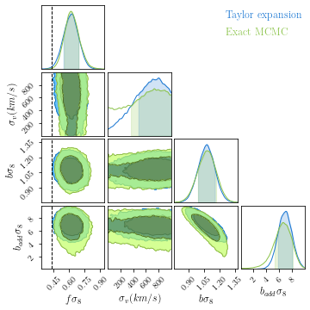
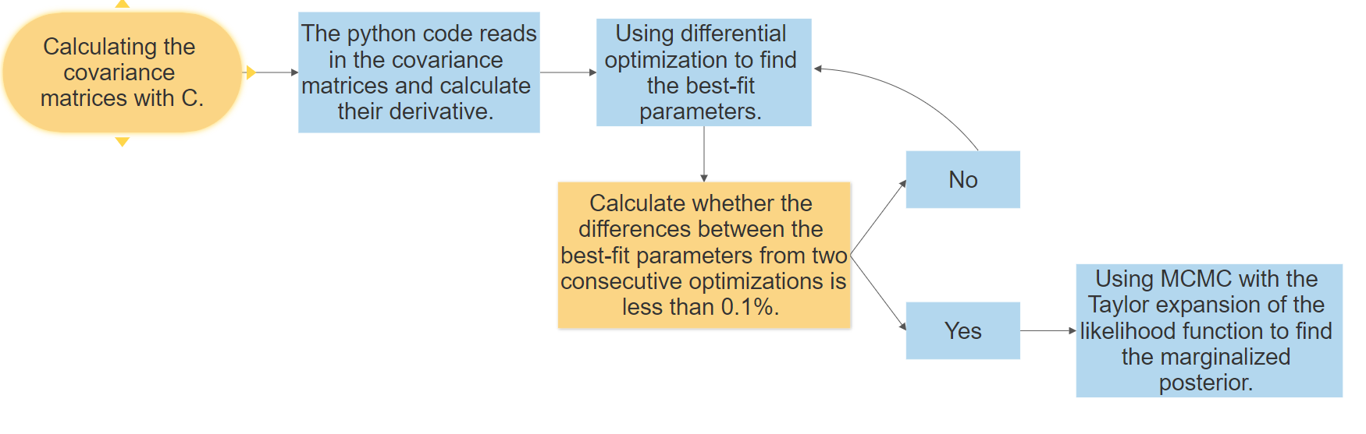

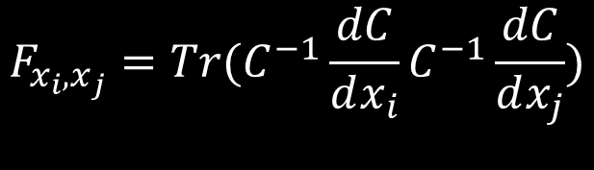
Numerical difficulties and solution
The size of the full covariance matrix is around $2000×2000$ which makes the likelihood calculation extremely slow.
It takes up to 1.5 days to finish the MCMC fitting and we cannot vary $σ_{u}$, $σ_{g}$ and $k_{max}$ as free parameters.
Using the Taylor expansion to approximate the likelihood function.
$$L\left(x\right)≈L\left(x_{max}\right)+\sum_{i}{Tr\left(\frac{dL}{dC}\frac{dC}{dx_{i}}\right)\left(x_{max,i}−x_{i}\right)−\frac{1}{2}\left(x_{max}−x\right)F{\left(x_{max}−x\right)}^{T}}$$
$$F_{x_{i},x_{j}}=Tr(C^{−1}\frac{dC}{dx_{i}}C^{−1}\frac{dC}{dx_{j}})$$

Slide 22

Testing systematic uncertainty
$σ_{u}$ and $k_{max}$ are fixed during the fitting which introduce additional systematic error.
This additional systematic error is $σ_{i}^{2}={\left(\frac{∂φ}{∂s}\right)}^{2}{\left(δs\right)}^{2}$.
Central finite difference method $\frac{∂φ}{∂s}=\frac{φ\left(s+δs\right)−φ(s−δs)}{2δs}$.
Total systematic uncertainty $σ_{sys}=\sqrt{\sum_{i}{σ_{i}^{2}}}$.

