Slide 1
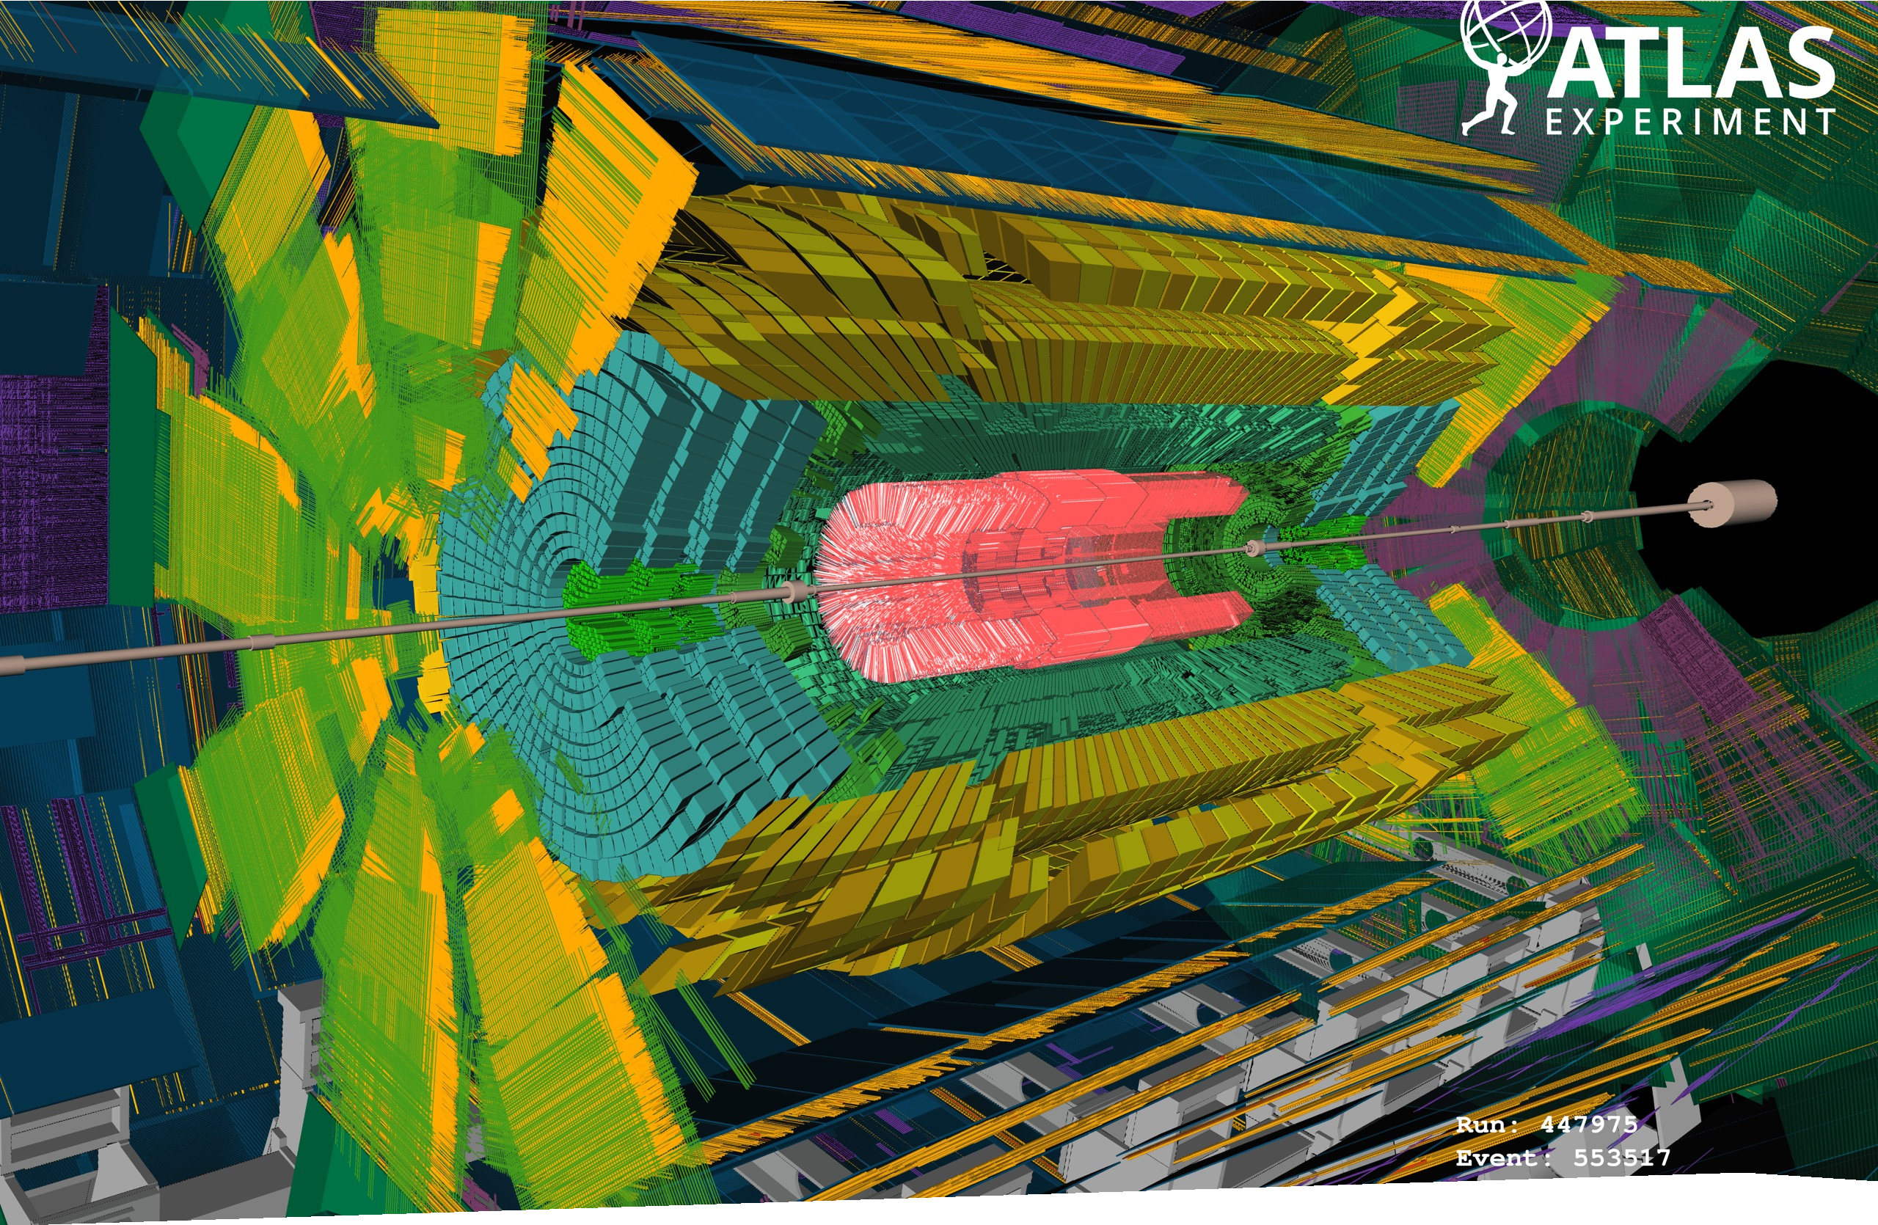
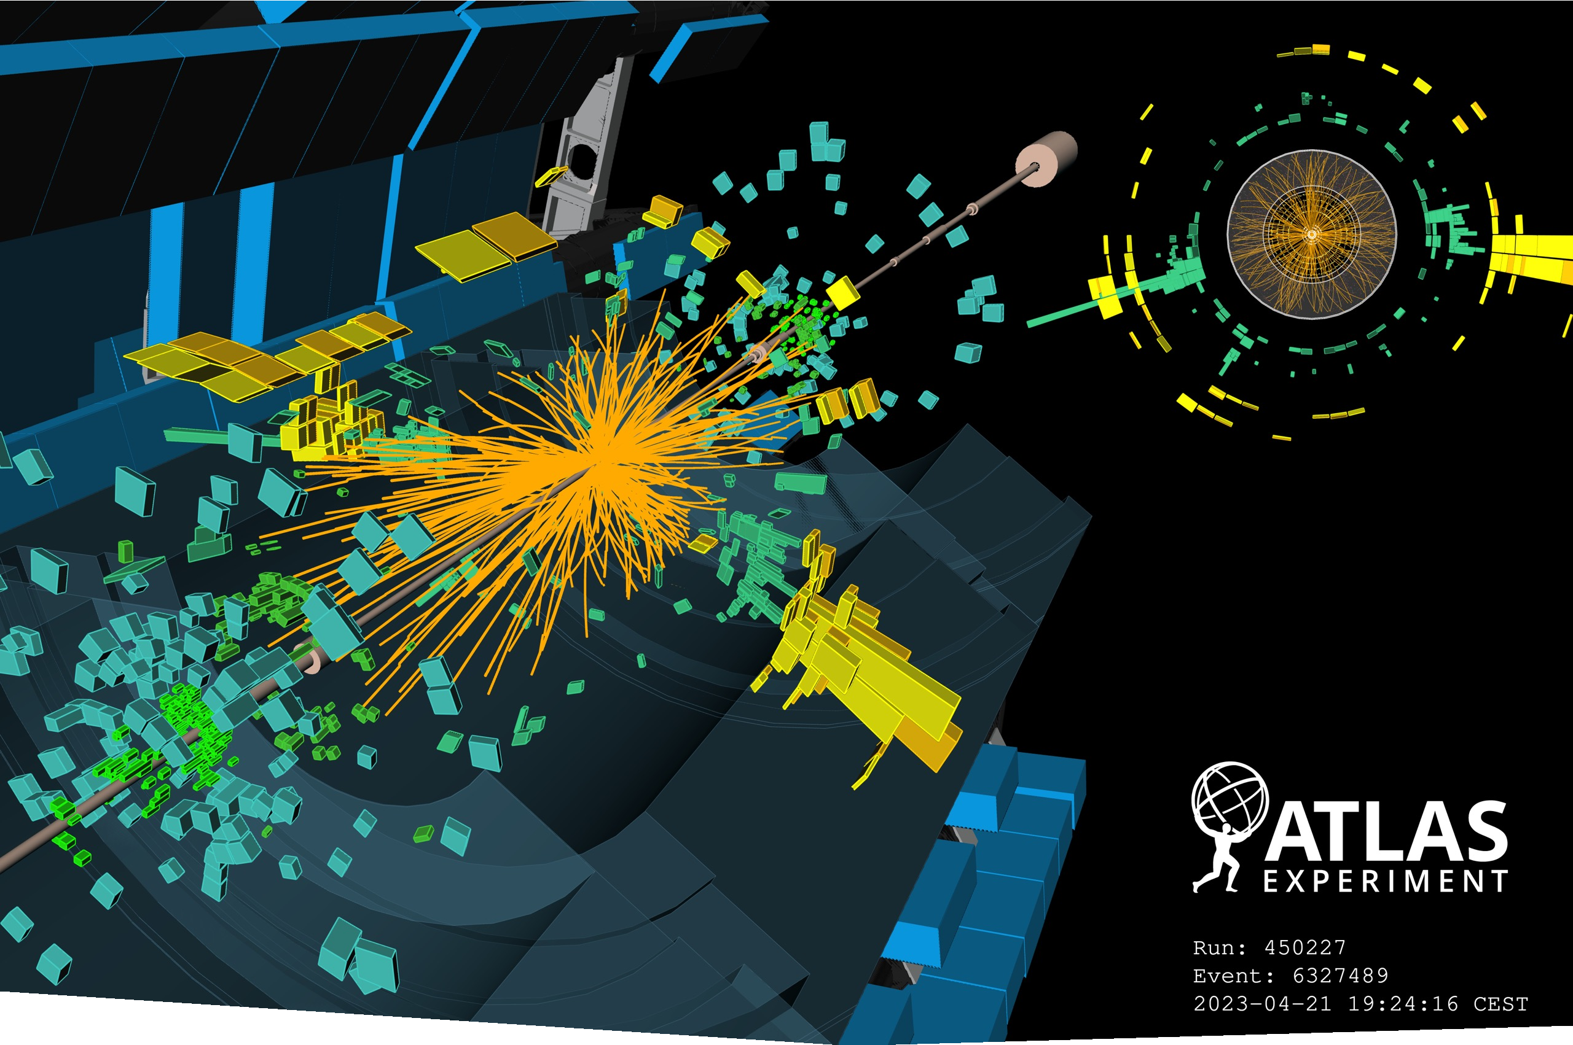



Beam Splashes 31 March 2023
First Stable Beam 21 April 2023
New ATLAS Results
Marina Cobal, on behalf of the ATLAS Collaboration University of Udine & INFN Trieste

Slide 2
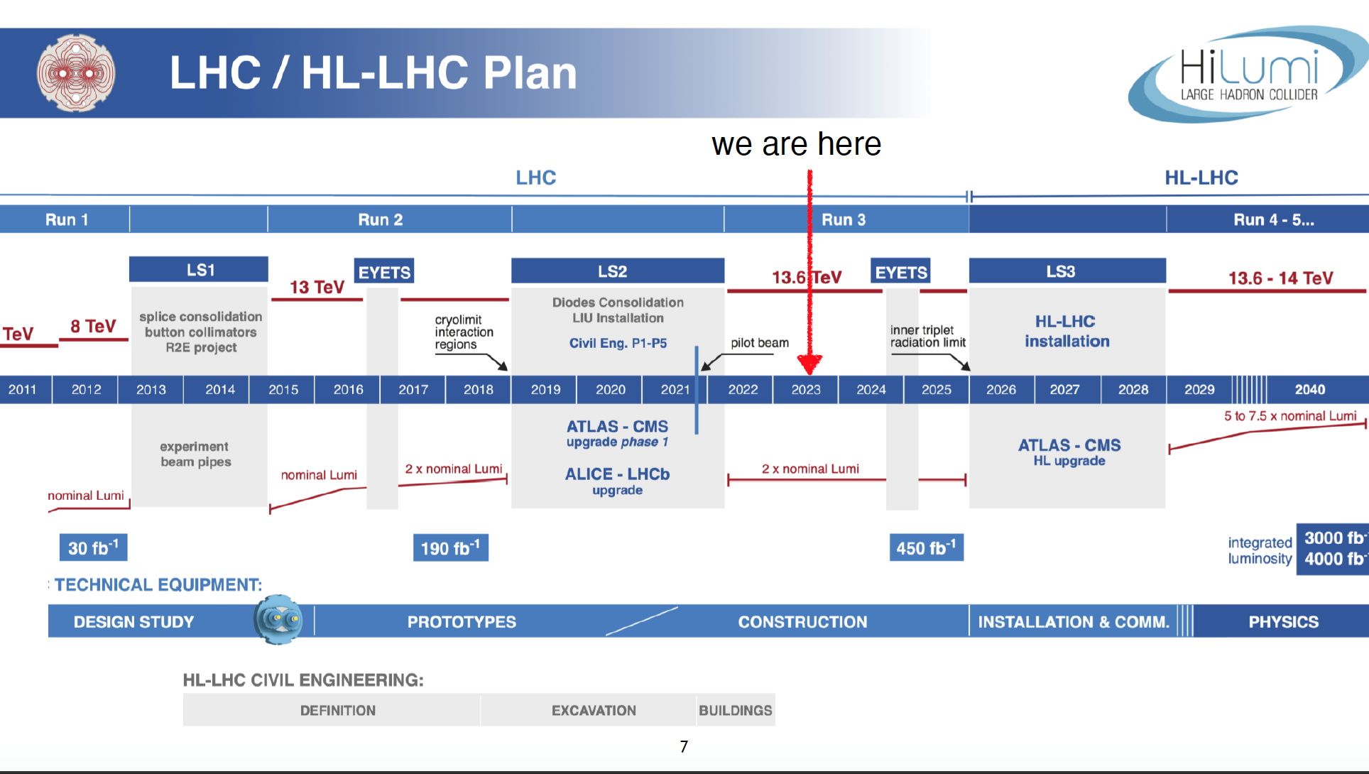
Notes:
HL-LHC promises to provide 15 times the present data sample instantaneous luminosity a factor of 5-7 larger than LHC nominal value.
• Up to 200 p-p interactions per bunch crossing !

Slide 3
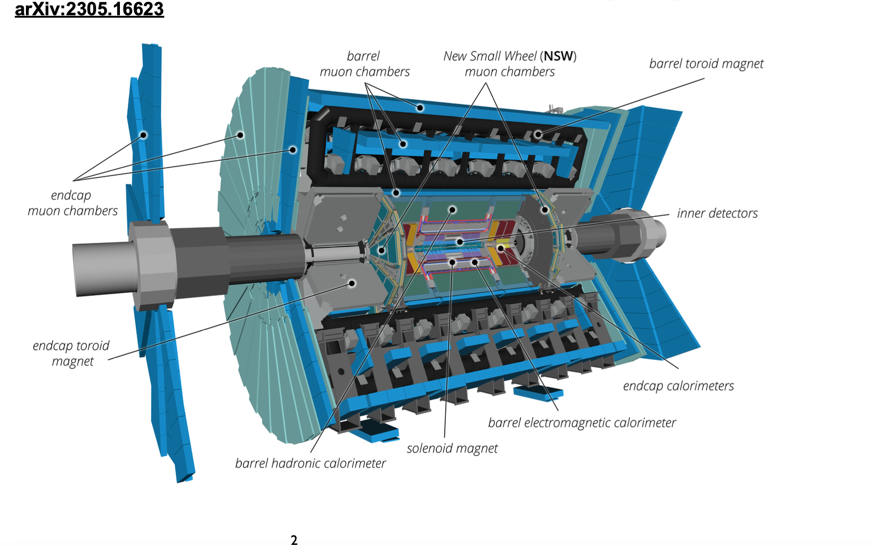
New ATLAS detector
Height: 25 m
Lenght: 46 m
Weight 7000 t
Scientists: 6027
Institutes: 264
Countries: 47 t
Extensive upgrades performed to prepare for Run 3
Enphasis on making detectors & trigger as robust as possible
First step to prepare ATLAS for HL-LHC

Slide 4
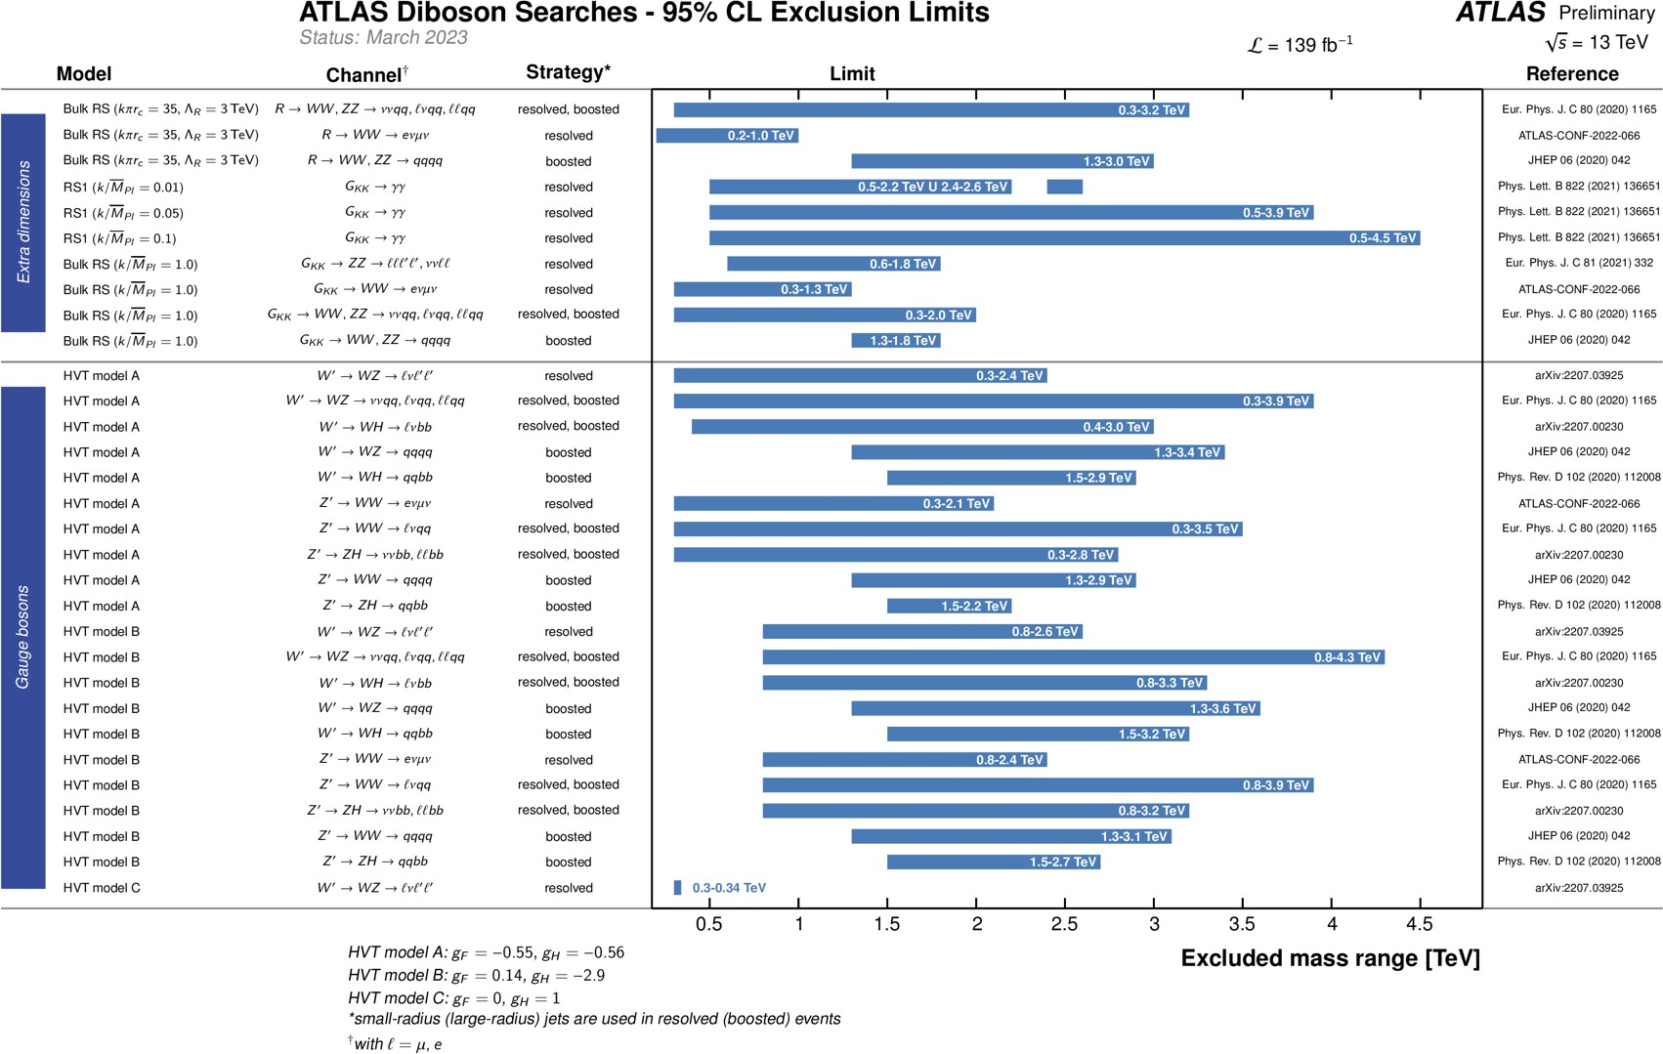
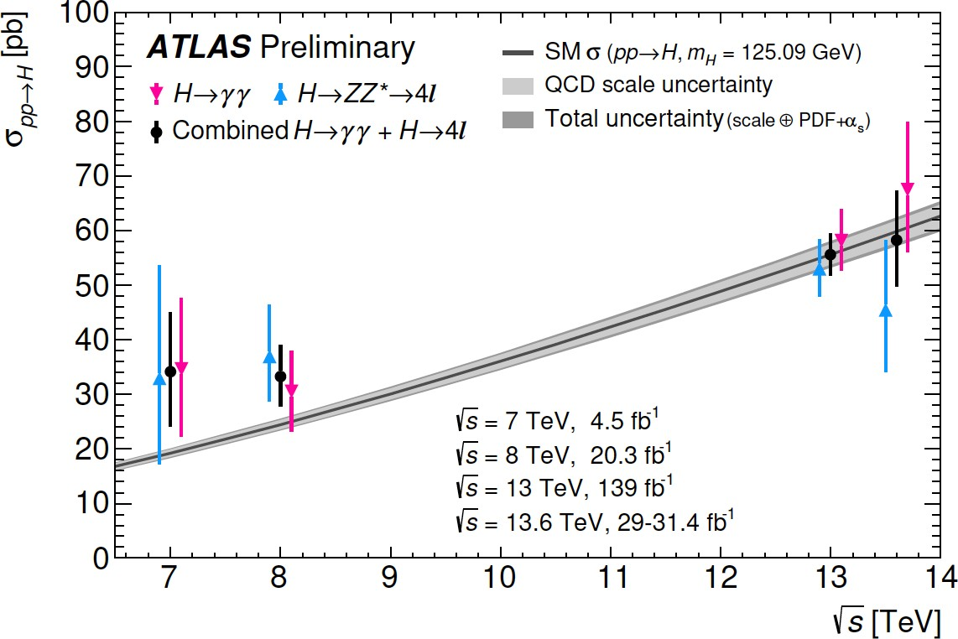
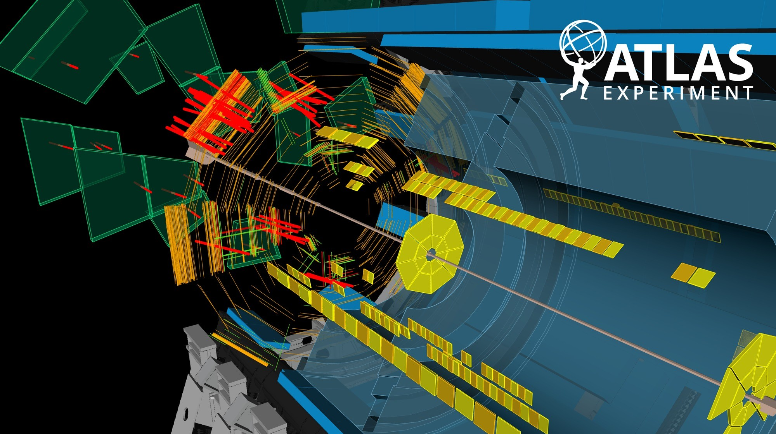
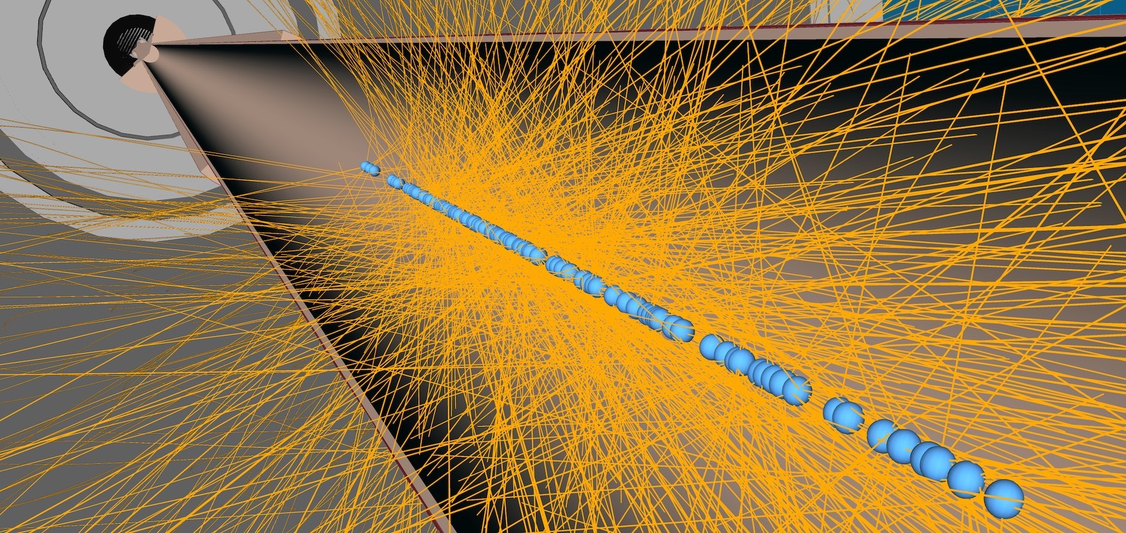
Run 2 Analyses
Run 3 Analyses
139 fb⁻¹ collected
261 papers
66 fb⁻¹ collected
Many ongoing activities
HL-LHC Upgrades
Phase-I Commissioning
2

Slide 5

We continue to improve our tools, developing techniques that let us extract more physics from our data, including getting a better handle on the amount of data we have taken.
The LHC, a high-energy discovery machine, is also becoming a precision EW machine.
3

Slide 6
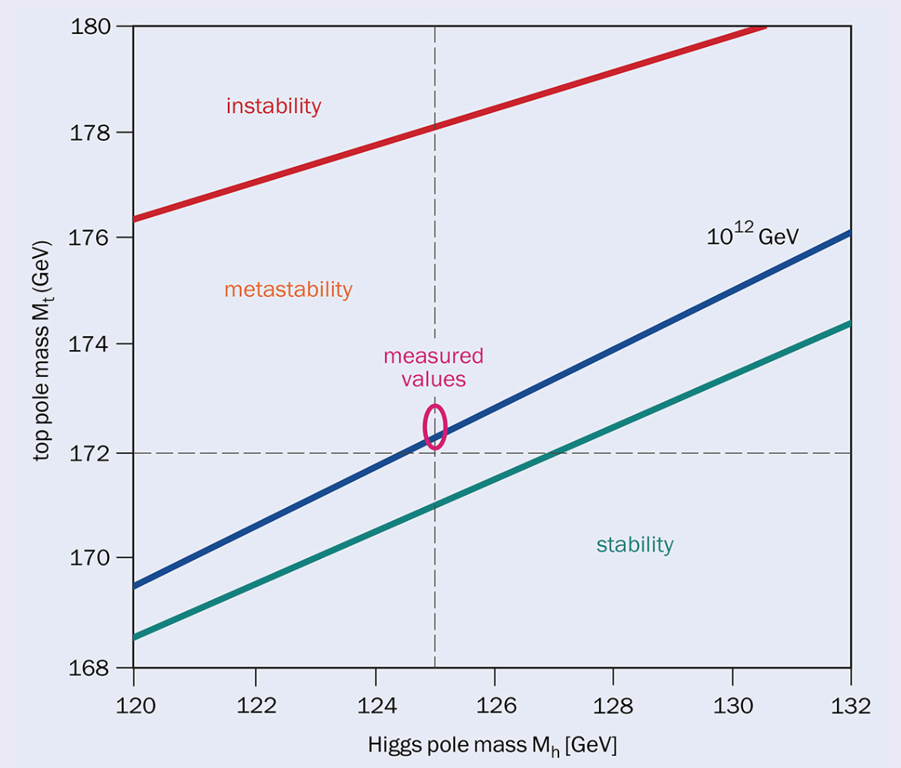
Re-observation of the Higgs boson
In the Standard Model: 15* unpredictable parameters out of 19* related to Higgs sector
Crucial to understand Higgs boson’s properties in various measurements
Connect to unresolved questions in the Universe
σ = 58.2 ± 8.7 pb
(*)not including neutrino mass
PDG JHEP 12, 089
EPS-HEP 2023 @ Hamburg
2
33
Notes:
On 4 July 2022, 10 years to the day after the discovery of the Higgs boson, the ATLAS Collaboration at CERN released its most precise and complete set of measurements of Higgs boson properties.
Values of the σ measure ments from this and previous ATLAS publications as a function of the centre-of-mass energy. The Standard-Model predicted values and their uncertainties are shown by the grey band.

Slide 7
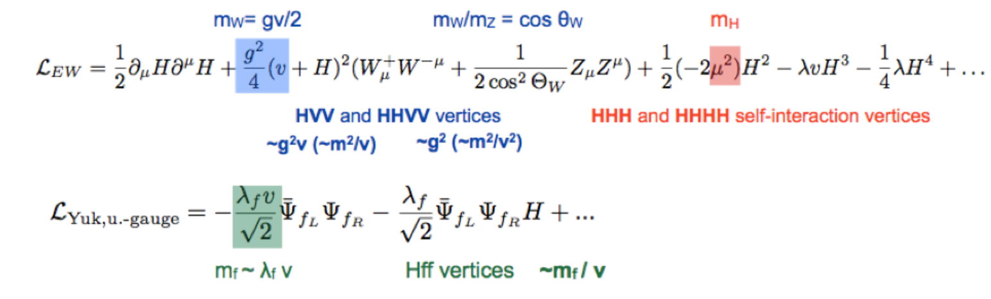
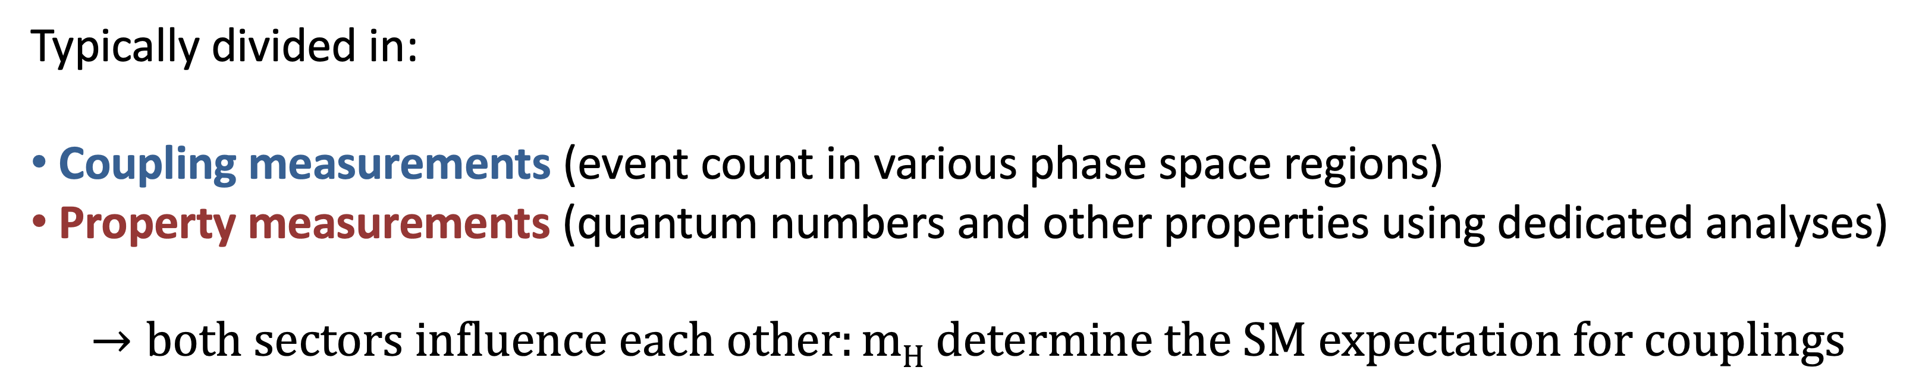
Higgs boson measurements
Typically divided in:
Coupling measurements (event count in various phase space regions)
Property measurements (quantum numbers and other properties using dedicated analyses)
$$→both sectors influence each other:mH determine the SM expectation for couplings$$

Slide 8

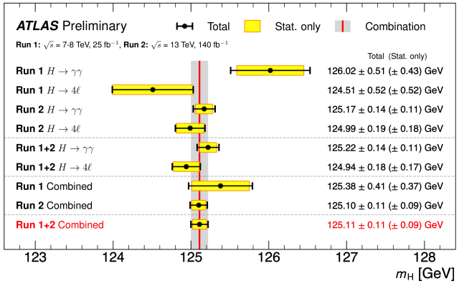

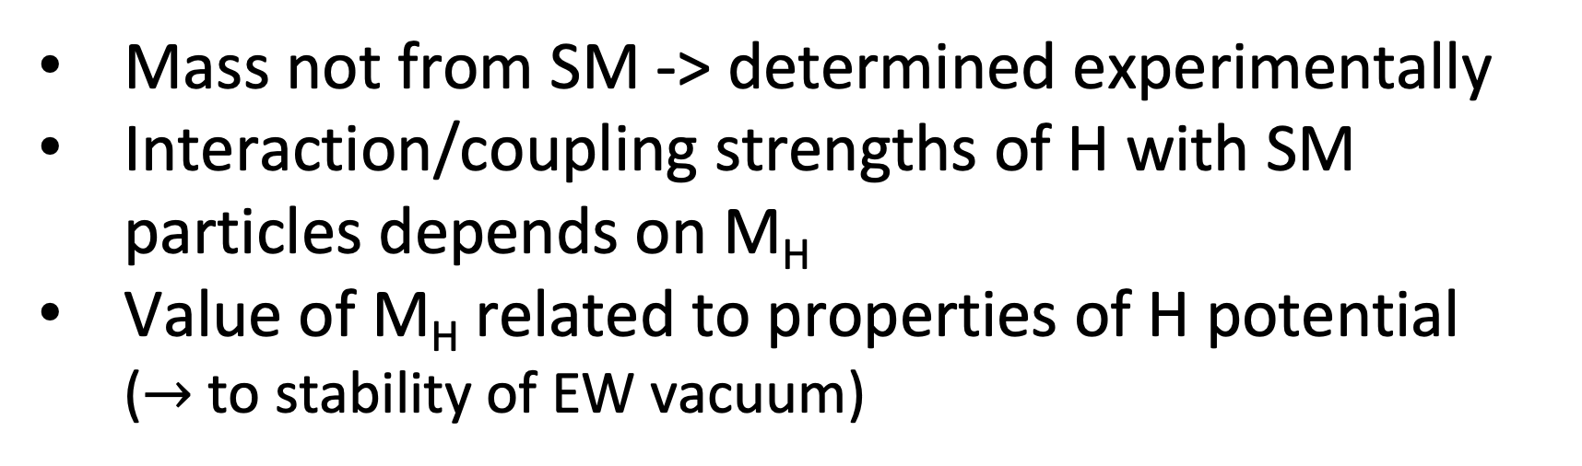

Higgs mass
Run 1+2 combined
Mass not from SM -> determined experimentally
Interaction/coupling strengths of H with SM particles depends on M_{H}
Value of M_{H} related to properties of H potential ($→$to stability of EW vacuum)
Huge efforts on γ calibration in Run2
  Reduced γ energy scale/resolution uncertainties
  320 MeV (previous Run 2 results) -> 80 MeV
Measured M_{H} with H→γγ (Run 1+2)
  125.22±0.11(stat)±0.09(syst) GeV
(0.11% precision!)
Combine H $→$ γγ and H → ZZ → 4l (Run1+Run2)
  125.11±0.09(stat)±0.06(syst) GeV
(0.09% precision!)
Notes:
In the eleven years since its discovery, studies of the Higgs boson have become a central avenue for shedding light on the fundamental structure of the universe. Precise measurements of Higgs-boson properties are among the most powerful tools physicists have to put pressure on the Standard Model – and now, it’s the turn of the Higgs-boson mass. The interaction (or coupling) strengths of the Higgs boson with Standard-Model particles depends on the Higgs-boson mass, and can only be calculated once the value of the mass is known. More importantly, the value of the Higgs-boson mass is intimately related to the properties of the Higgs potential – which determines the stability of the electroweak vacuum, and potentially the fate and evolution of our universe. measurement of the Higgs-boson mass in studies of Higgs decays to two photons using the full LHC Run 2 dataset (“H→γγ” or the diphoton channel), and a new combination of this measurement with the 2022 measurement of the Higgs-boson mass in studies of the Higgs decays to four leptons (the “H→4l" channel). The new H→γγ result significantly improves upon the previous ATLAS measurement in this channel, benefiting both from the full LHC Run-2 dataset – reducing the statistical uncertainty by a factor of two – and from dramatic improvements to the calibration of the photon energy response – reducing the systematic uncertainties by nearly a factor of four.

Slide 9

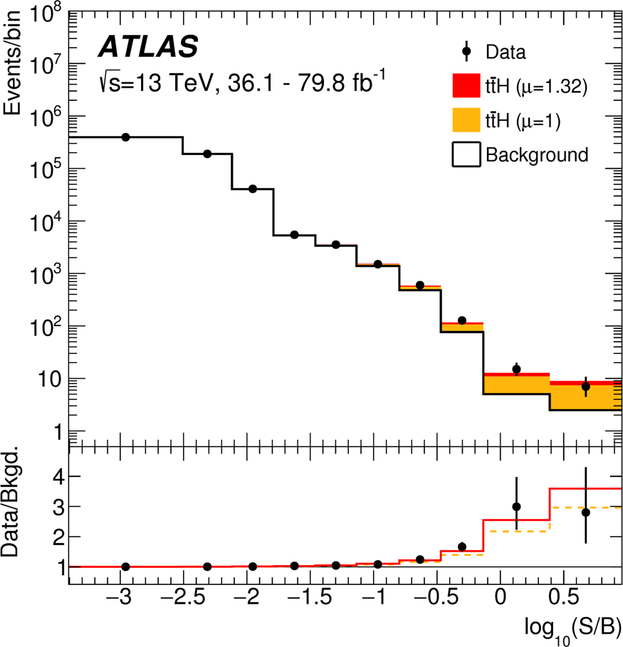
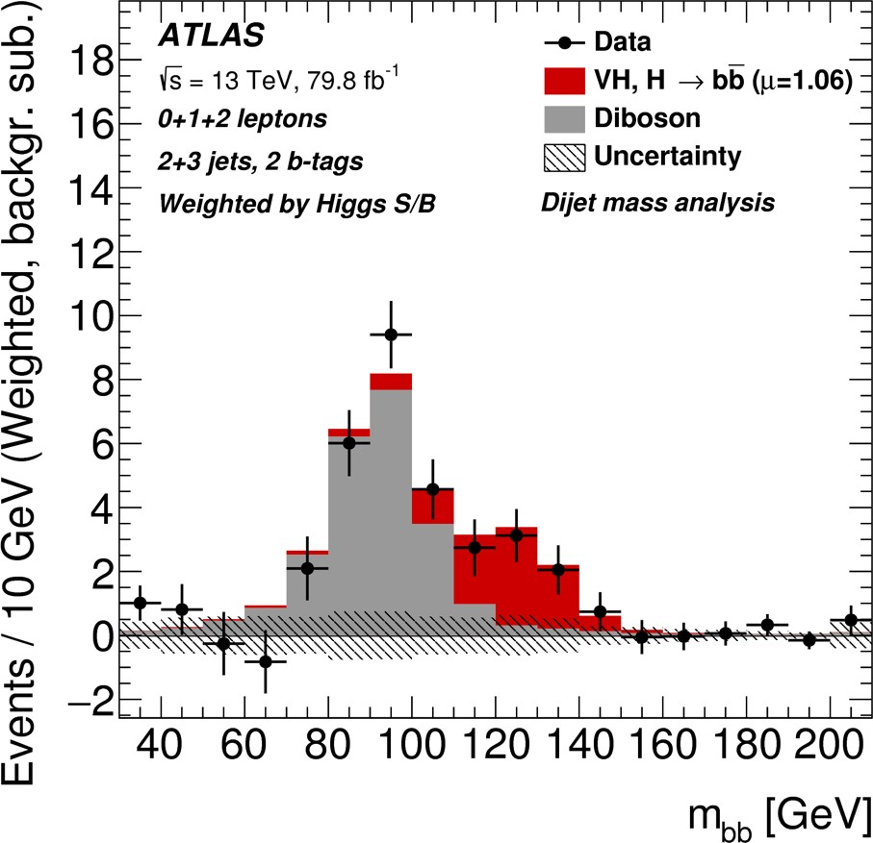
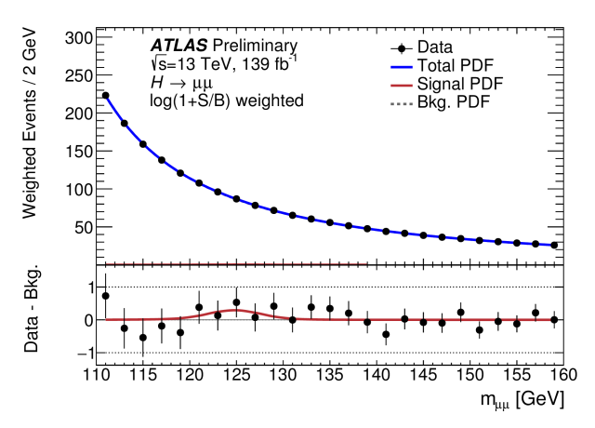
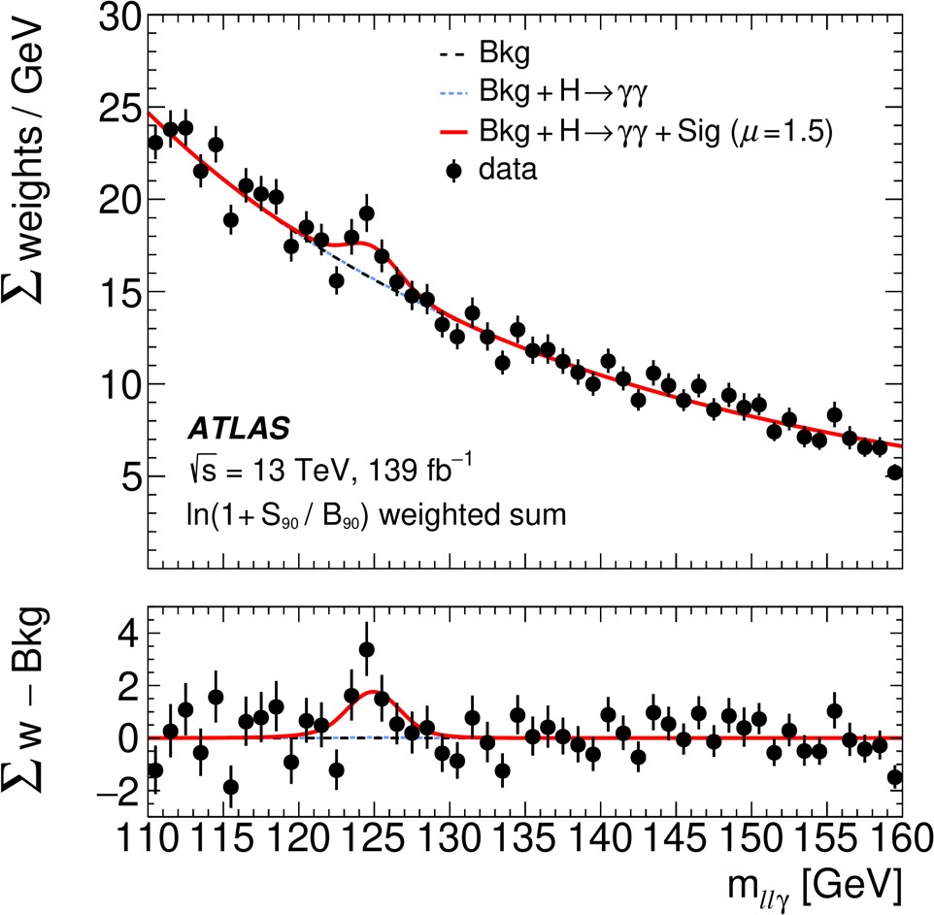

Run2 achievements and Run 3 status
2023/8/20
Run 2
13 TeV
ATLAS public page
ttH observation
Partial data
~80fb⁻¹
VH, H->bb observation
H->μμ evidence
Full data
~140fb⁻¹
H->llγ evidence
EPS-HEP 2023 @ Hamburg
Observed major production/decay processes in Run1 and Run2
Large LHC data opens the door to access rare Higgs processes and difficult corners of phase spaces
Run 3
13.6 TeV
~60fb⁻¹
3
Notes:
So far, physicists have collected conclusive evidence of the Higgs boson interacting with bosons and the heaviest elementary fermions belonging to the third fermion generation (tau-lepton as well as top and bottom quarks). Yet to date, there is no indication whether the Higgs boson interacts with the next lighter fermions, muon or charm quark, belonging to the second fermion generation. Despite a simple experimental signature, spotting this rare decay continues to be a challenge. This is due to the low probability of the Higgs boson decaying to muons (predicted to be just 0.02%) and the large number of events from similar Standard Model background processes that can dominate the search. Only 0.2% of selected muon-pair events with masses between 120 and 130 GeV from proton–proton collisions are expected to come from a Higgs-boson decay. To further increase the sensitivity of their analysis, ATLAS physicists divided their events into 20 mutually-exclusive “categories”. These categories focussed on the features of an event – such as the number and properties of its additional jets or leptons – to target specific production modes of the Higgs boson, including the scattering of two gluons or two weak bosons, and the associated production with a weak W or Z boson or a top-quark pair. Inside these categories, events were further split using dedicated multivariate discriminants (Boosted Decision Trees). As a result of this complex division, ATLAS physicists could separate out the few Higgs-boson-like events from the more common, but less Higgs-boson-like, events. The new ATLAS result gives a first hint of the Higgs boson decaying to a muon pair; the significance of the observed signal amounts to 2.0 standard deviations and the ratio of the observed signal yield to the one expected in the Standard Model is 1.2 ± 0.6.

Slide 10
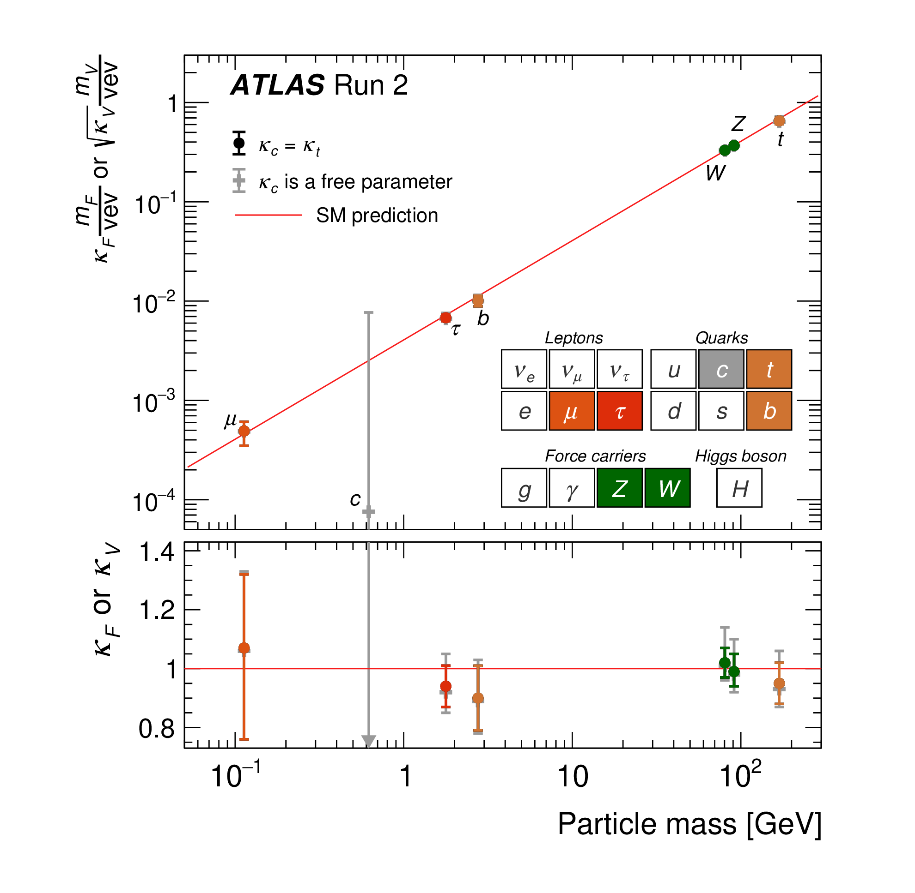
Higgs couplings
Higgs couplings agree with SM
over 3 order of magnitude in mass!!
(Visible) Branching Ratios:
H -> γγ: 0.23%
H -> µµ: 0.022%
H -> 4l: 0.012% (4e + 4µ + 2e2µ)
H -> Zγ: 0.010% (for Z -> ee, µµ)
Nature 607, 52-59 (2022)
Notes:
The coupling fit presented here is performed within the κ framework53 with a set of parameters κ that affect the Higgs boson coupling strengths without altering any kin- ematic distributions of a given process.
Within this framework, the cross-section times the branching fraction for an individual measurement is parameterized in terms of the multiplicative coupling strength modifiers κ.
educed Higgs boson coupling strength modifiers and their uncertainties. They are defined as κFmF/vev for fermions (F = t, b, τ, μ) and
κV mV /vev for vector bosons as a function of their masses mF and mV. Two fit scenarios with κc = κt (coloured circle markers), or κc left free-floating in the fit (grey cross markers) are shown. Loop-induced processes are assumed to have the standard model (SM) structure, and Higgs boson decays to non-SM particles are not allowed. The vertical bar on each point denotes the 68% confidence interval. The p values for compatibility of the combined measurement and the SM prediction are 56% and 65% for the respective scenarios. The lower panel shows the values of the coupling strength modifiers. The grey arrow points in the direction of the best-fit value and the corresponding grey uncertainty bar extends beyond the lower panel range. Data are from ATLAS Run 2.
The coupling fit presented here is performed within the κ framework53 with a set of parameters κ that affect the Higgs boson coupling strengths without altering any kin- ematic distributions of a given process.
Within this framework, the cross-section times the branching fraction for an individual measurement is parameterized in terms of the multiplicative coupling strength modifiers κ. A coupling strength modifier κp for a production or decay process via the coupling to a given particle p is defined as κ2 = σ /σSM or κ2 = Γ /ΓSM, respectively, ppp ppp where Γp is the partial decay width into a pair of particles p. The param- eterization takes into account that the total decay width depends on all decay modes included in the present measurements, as well as cur- rently undetected or invisible, direct or indirect decays predicted by the standard model (such as those to gluons, light quarks or neutrinos) and the hypothetical decays into non-standard model particles.
In the following, three classes of models with progressively fewer assumptions about coupling strength modifiers are considered. Stand- ard model values are assumed for the coupling strength modifiers of first-generation fermions, and the modifiers of the second-generation quarks are set to those of the third generation, except where κc is left free-floating in the fit. Owing to their small sizes, these couplings are not expected to noticeably affect any of the results.
All measured coupling strength modifiers are found to be compatible with their standard model predic- tion. When the coupling strength modifier κc is left unconstrained in the fit, an upper limit of κc < 5.7 (7.6) times the standard model predic- tion is observed (expected) at 95% C

Slide 11
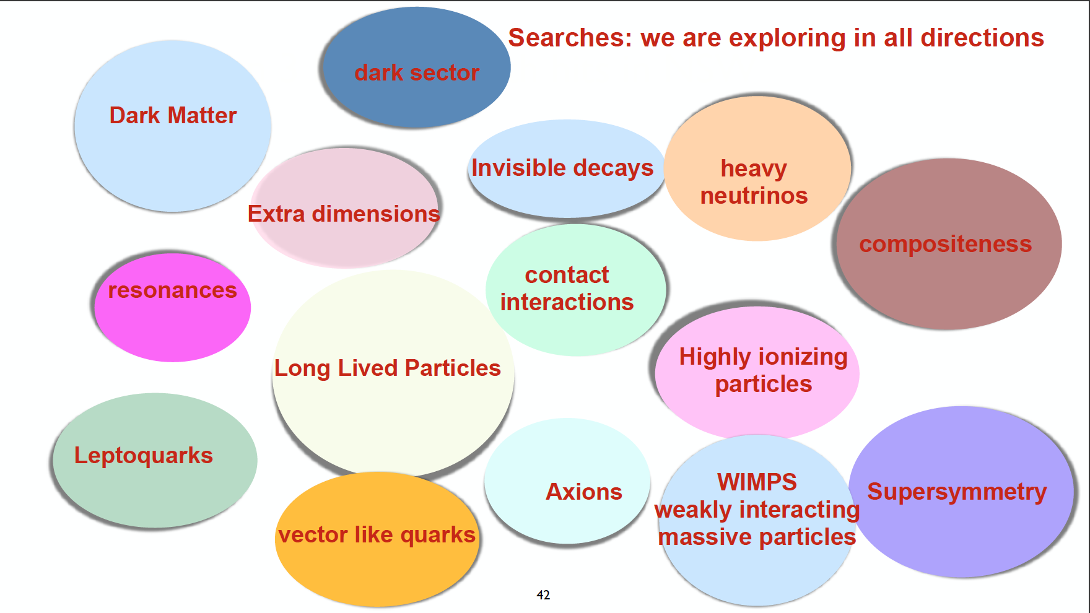

Slide 12
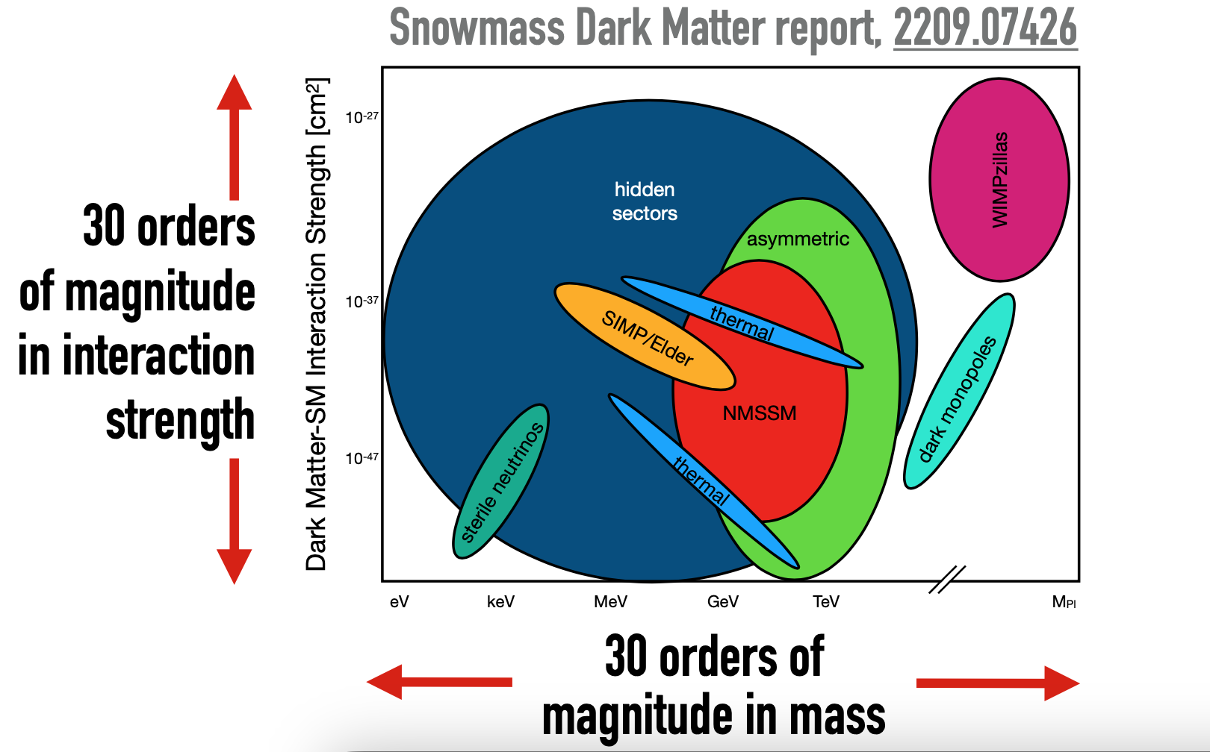


Delve deep, Search wild..
Notes:
One of the most important scientific goals of the next decade is to reveal the nature of dark matter (DM). To accomplish this goal, we must delve deep, to cover high priority targets including weakly-interacting massive particles (WIMPs), and search wide, to explore as much motivated DM parameter space as possible.
Complementary probes of DM are underway in several areas, from indirect searches for the products of dark matter annihilation or decay [9–17], searches for the direct detection of DM scattering elastically off nuclei and electrons [18–33], and recent searches using gravitational-wave interferometers [34, 35], to searches for the production of dark matter at collider experiments, such as the ATLAS experiment [36] at the Large Hadron Collider (LHC) [37]. General purpose particle physics experiments are sensitive to a wide variety of potential dark matter candidates, such as axions [38–42] or Weakly Interacting Massive Particles (WIMPs) [43].
Cartoon figure of the model space for direct detection. Included are candidates of thermal dark matter, supersymmetry, asymmetric dark matter [16], SIMP/Elder [220–223], dark monopoles [226], WIM- Pzillas [18], and hidden sector dark matter [25]. Note that the interaction cross-section can be for either scattering with nucleons or electrons, depending on the specific model. Particle DM is well-motivated and encompasses a wealth of scenarios that can explain the observed properties of DM, with characteristic mass scales from 1 eV to the Planck scale. A diverse, continuous portfolio of experiments at large, medium, and small scales that includes both direct and indirect detection techniques maximizes the probability of discovering particle DM. Dark matter dominates the matter content of the universe, but its identity is still a mystery. Indeed, some theorists speculate about the existence of an entire “dark sector” made up of dark photons and multiple species of dark matter. Numerous approaches are being pursued to detect dark matter directly, and these are complemented by searches at the LHC, surveys of large-scale structure and attempts to observe high-energy particles from dark-matter annihilation or decay in or around our Galaxy. Regarding direct detection, experiments are advancing steadily in sensitivity: the latest examples reported at ICHEP came from LUX in the US and PandaX-II in China, and already they exclude a substantial fraction of the parameter space of supersymmetric dark-matter candidates. Information on dark energy can be gleaned using both optical surveys of large-scale structure and data from surveying the cosmic microwave background. The are numerous probes of dark energy: the distribution of objects of known brightness in the sky, the angular diameter of objects of known size as a function of distance, structure growth in the universe as a function of redshift or time by counting clusters or through the measurment of weak lensing.

Slide 13
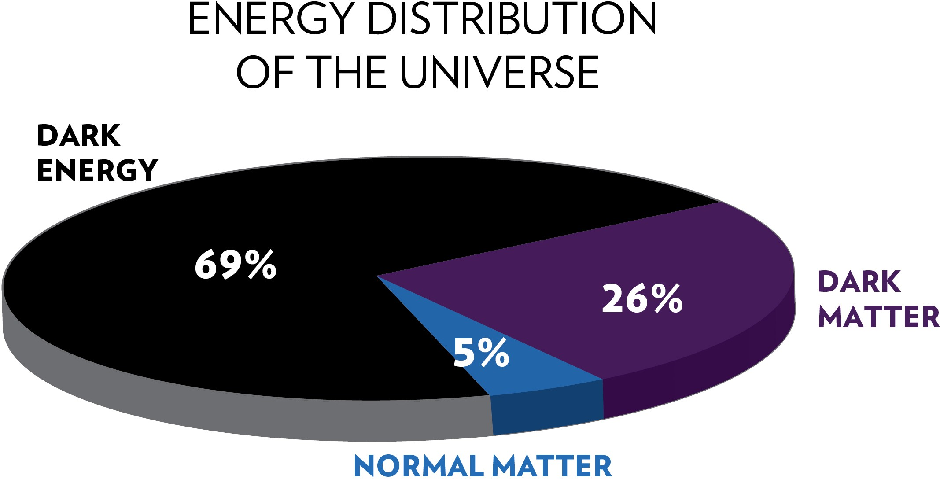
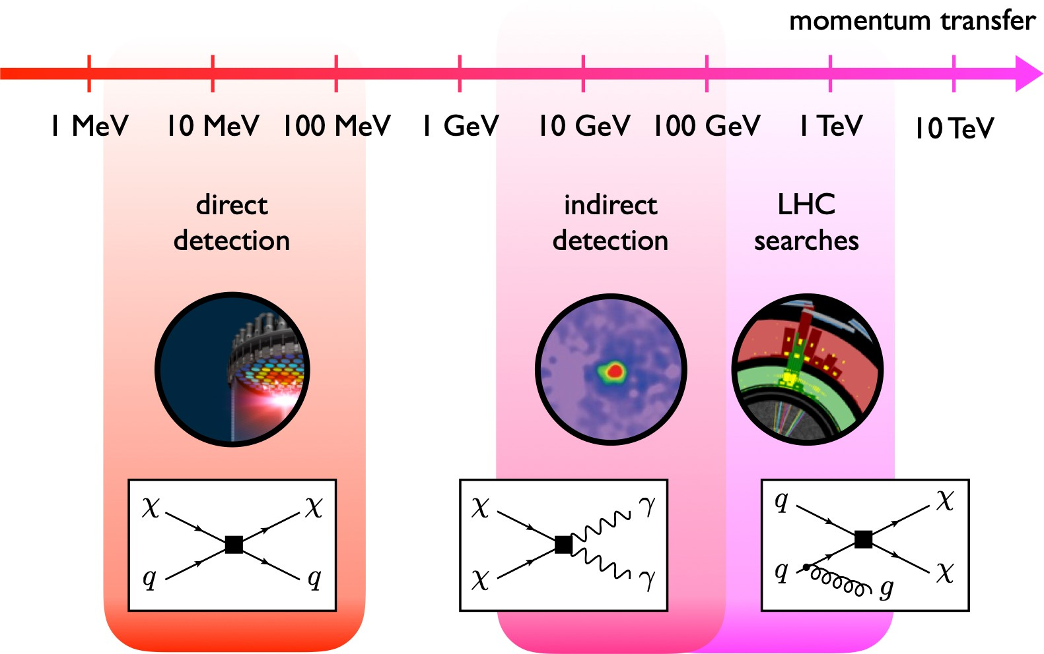
Dark Matter
Presence of Dark Matter (DM) well established.
Its nature is an open question
Weakly Interacting Massive Particle (WIMP): an attractive option…
Heavy, stable, & couples to SM
Naturally accounts for observed relic density (WIMP Miracle)
But many other hypotheses and models, e.g:
‣
Axion-like-particle (ALP)
Dark sectors consisting of many DM particles
1810.09420

Slide 14
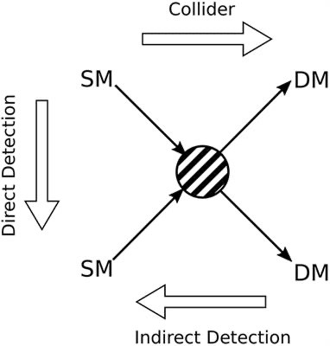
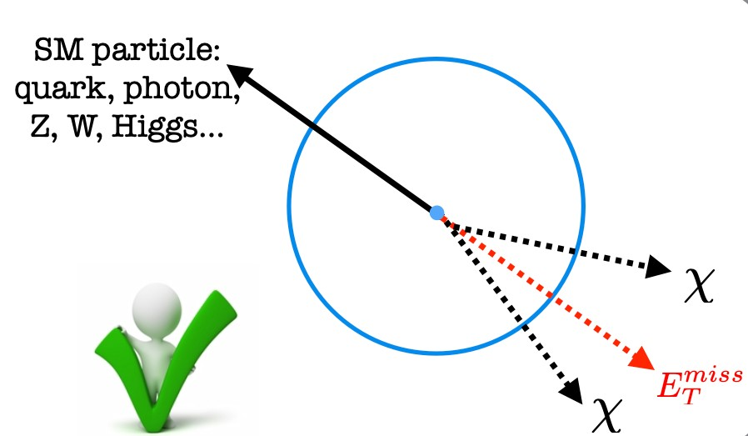
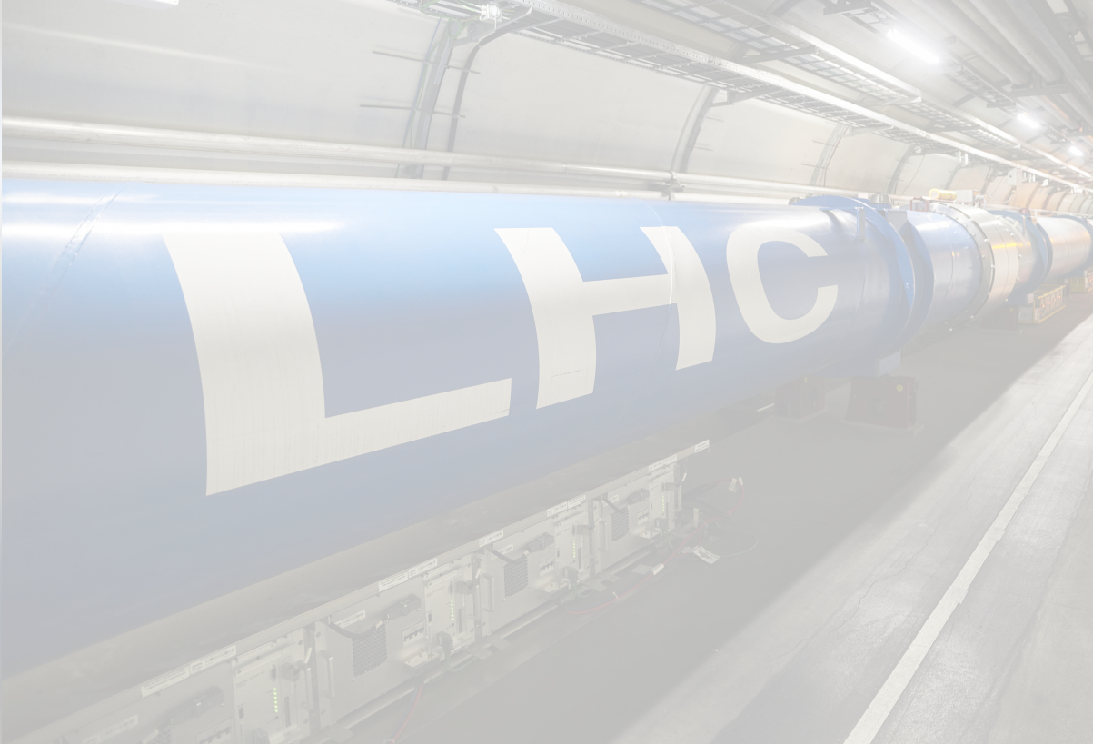
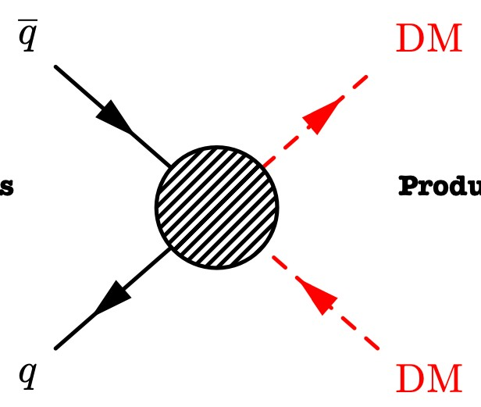
Dark Matter
DM candidates can be produced at the LHC but cannot be observed directly ➾
A SM particle is needed to recoil against DM candidates
Inferred through momentum imbalance (MET) in plane transverse to beam
Visible particles from initial state radiation (ISR) or associated production can tag DM pair production
Dark Energy 68.3%
PRODUCTION DETECTION
Known particles
DM
particles

Slide 15
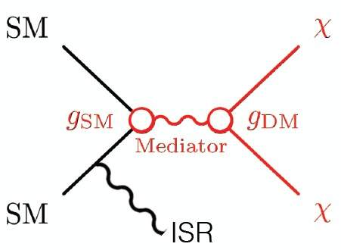
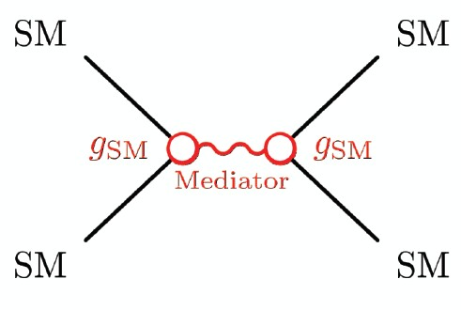
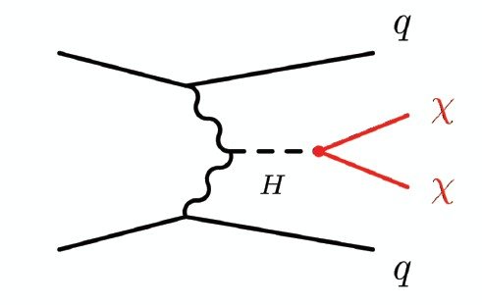
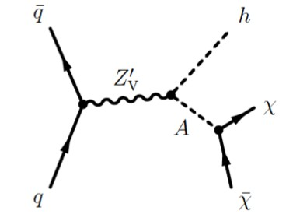
Overview of collider searches
“Direct” searches: X + ETmiss using ISR or associated production
➾ Look for deviation from SM backgrounds
Mediator searches: bump hunt for mediator decays to fermions
➾ Look for mass peak above background continuum
Searches with a Higgs boson mediator
➾ Look for enhancement of Higgs boson decays to invisible
Searches in the extended Higgs sector: Two Higgs doublet model extended
with a pseudoscalar A mediating the SM-DM interaction
Searches in Dark sectors: particles from a
shadowy sector that interact with particles
from SM through subtle mixing
Photon
Dark Photon
Standard model
Dark sector
Higgs
Dark Higgs
Mixing

Slide 16
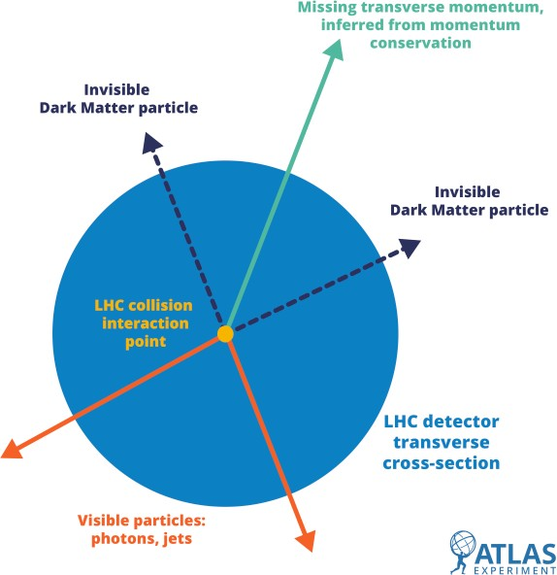
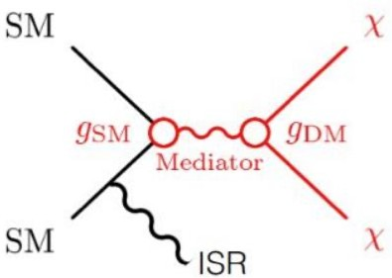
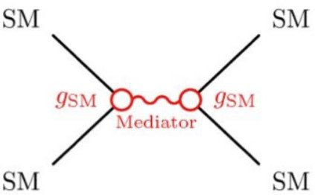
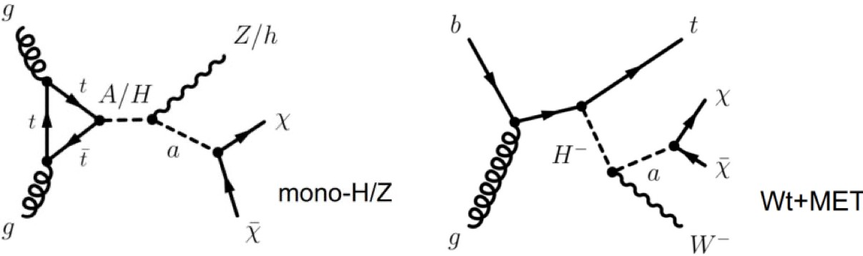
The typical ATLAS WIMP search
Any WIMP DM produced at collider experiments will interact weakly and pass invisibly through the detector
Theoretical models to optimize searches and characterize a possible discovery, e.g:
Simplified s-channel model
2HDM+a model
Small set of free parameters: M_{χ}, M_{med}, g_{χ}, g_{q}, g_{l} Complementarity between Mono-X (X+MET) and resonance searches
Two Higgs doublet extensions with an extra pseudoscalar. Gauge-invariant. Richer kinematics + phenomenology
Notes:
The motivation for the latter arises from a paradigm known as the WIMP miracle.
Assuming DM to be produced via the freeze-out mechanism, the relic density of non-relativistic matter in the early universe [44], measured in data from the WMAP [4] and Planck [5] missions, can be achieved when the DM mass is close to the electroweak scale and when the DM coupling to Standard Model particles is of the order of the weak interaction. Consequently, WIMP DM particles could be produced and studied at the LHC experiments.
A particular strength of collider searches lies in the fact that the high-energy collisions of SM particles could not only produce DM directly under controlled experimental conditions but also provide access to particles
mediating the interactions between DM and the SM sector. A mediator produced in a collision could decay into DM particles, which themselves could not be detected, resulting in a momentum imbalance in the
plane tranverse to the collision axis, referred to as missing transverse momentum 𝑝®miss, with magnitude 𝐸miss. Alternatively, a mediator could decay back into SM particles, from which its properties could be T
reconstructed. Dark matter searches at the LHC explore both these avenues in the quest to solve the puzzle of DM.
Invisible mediator decays can be detected only if the mediator is produced in association with another particle or particles, for example a quark or gluon from initial-state radiation that results in a hadronic jet
(𝑗), leading to a characteristic 𝐸miss + 𝑗 signature [45, 46]. These signatures are referred to as 𝐸miss + 𝑋 TTsignatures in the following. Visible mediator decays allow for the reconstruction of the mediator particle from its decay products, for example in the context of resonance searches, if the mediator is produced in the 𝑠-channel [47–51].
The searches mentioned above are traditionally interpreted in the context of simplified models of DM, which rely on a minimal set of new particles and interactions. The most commonly used among these simplified models postulate the existence of a single fermionic DM particle and a single mediator, which, depending on the model, may be a vector, axial-vector, scalar, or pseudo-scalar particle [52–54]. The models are characterised by a minimal set of free parameters, typically the masses and couplings of the DM and mediator particles. While this facilitates the definition of benchmark scenarios that can be used to compare results between experiments, the theoretical incompleteness of simplified models can limit the range of collider signatures realised.

Slide 17
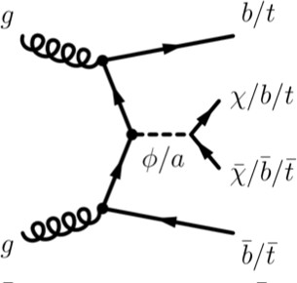
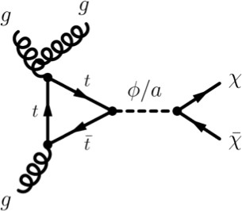
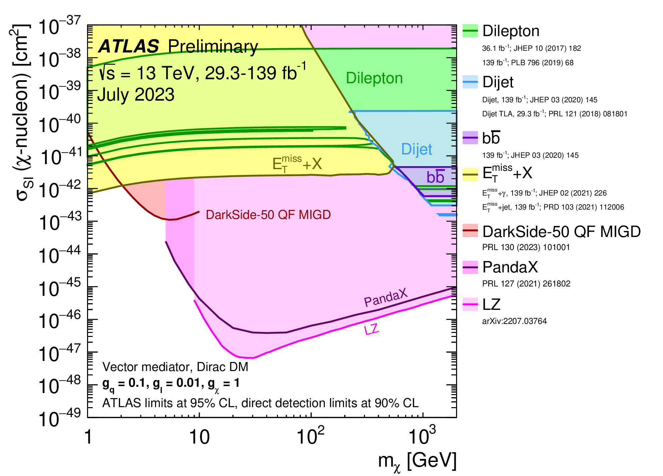
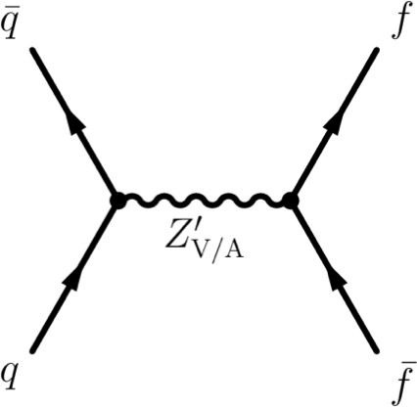
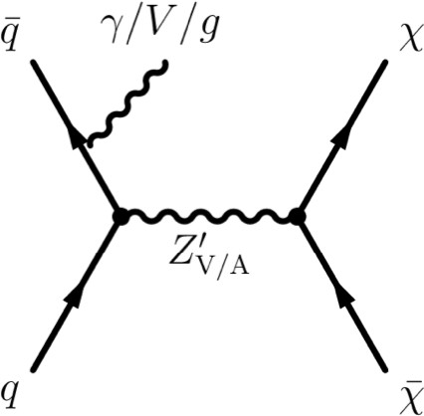
Spin-0 Mediators
Spin-1 Mediators
PHYS-PUB-2023-018
PHYS-PUB-2023-018
Scalar (φ) or pseudoscalar (a) mediator
Yukawa-type couplings →
  heavy quark (b/t)-associated searches
  Dominate: tt+MET comb, tW+MET, bb+MET, mono-jet
Vector or Axial-vector mediator
  mono-jet/photon, di(b)-jet, TLA di-jet, dilepton
Translated into spin-independent DM-nucleon elastic scattering cross-section limits → compared to direct searches
s=13 TeV, 139 fb⁻¹ July 2023
^{σ/σ}theory
bb+E^{miss} 0L, [JHEP 05 (2021) 093], (1)
ATLAS Preliminary All limits at 95% CL Scalar φ, φ→χχ
T
Monojet, [PRD 103 (2021) 112006], (2)
tW+E^{miss} 1L, [EPJC 81 (2021) 860], (3)
1000
T
tj+E^{miss} 1L, [EPJC 81 (2021) 860], (3)
T
miss
g = g = 1
tW+E 2L, [EPJC 81 (2021) 860], (3)
q χ
T
Dirac DM, m = 1 GeV
tt+E^{miss} Comb., [EPJC 83 (2023) 503], (3)
χ
100
T
(1) DMbb, (2) j+φ, (3) DMtt + DMt
Expected Observed
10
1
0.1
10
20
30 40 50 60
100
200 300 400
m_{φ} [GeV)
ATLAS results are particularly competitive for low DM masses
Strongest limits from new tt+MET combination EPJC83(2023)503
Notes:
This model introduces a Dirac fermion dark matter candidate, and a new spin zero particle , and assumes minimal flavour violation and a Yukawa like structure of the couplings of the new mediator to the SM particles. There is a common coupling with SM particle (g_q), mass of the DM, of the mediator and strenght of interaction between mediator and DM (g_X).
LEFT: Exclusion limits for colour-neutral scalar mediator dark matter models [25] as a function of the mediator
mass mφ for a dark matter mass mχ of 1 GeV. The limits are calculated at 95% CL and are expressed in terms of
the ratio of the excluded cross-section to the nominal cross-section for a coupling assumption of gq = gχ = 1. The
solid (dashed) lines show the observed (expected) exclusion limits for different analyses. The interpretation of the
bb ̄+Emiss 0L analysis, the tX+Emiss analyses and the mono-jet analysis is made using the three implementations of TT
the simplified spin-0 models described in the text.
A comparison of the inferred limits with the constraints from direct-detection experiments on the spin-independent WIMP--nucleon scattering cross-section in the context of the leptophilic vector mediator simplified model. Each shaded region represents the union of the exclusion contours of the individual analyses listed in the legend, where more than one result contributes. The results from this analysis are compared with limits from the direct-detection experiments. LHC limits are shown at 95% CL and direct-detection limits at 90% CL. The comparison is valid solely in the context of this model, assuming a mediator width fixed by the dark matter mass, a DM coupling gχ = 1, quark coupling gq = 0.1, and lepton coupling gl = 0.01. LHC searches and direct-detection experiments exclude only the shaded areas. Exclusions of smaller scattering cross-sections do not imply that larger scattering cross-sections are also excluded. The resonance and ETmiss+X exclusion region represents the union of exclusions from all analyses of that type.

Slide 18
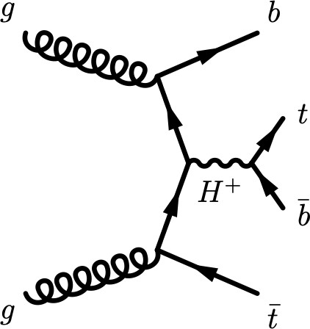


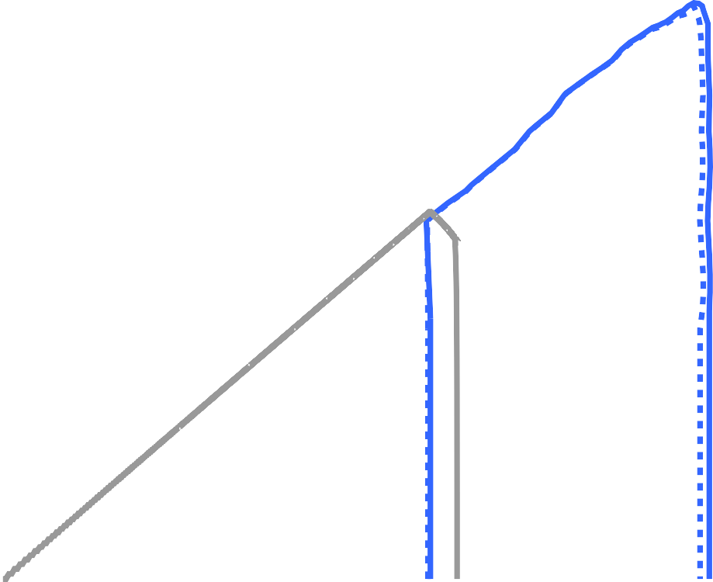

Combination and summary: 2HDM+a model
Example
Add complex doublet + pseudoscalar mediator + fermionic DM candidate
  3 of most sensitive searches combined statistically:
mono-H(→bb), Mono-Z(→ll), tbH(→tb)
  Complementarity with lower-mass searches for pseudoscalars (2202.12631)
signatures
g
Z/h
t
H/A
t
t
a
χ¯
g
χ
‣
h→aa→SM resonance searches
2HDM+a, Dirac DM, sinθ = 0.7, tan β = 1, m = 10 GeV, g = 1, m = m_{H} = m_{H±}
χ χ A
2HDM+a, Dirac DM, sinθ = 0.35, tan β = 1, g = 1, m = m_{H} = m_{H±} = 1.2 TeV
χ A
2000
E^{miss}+h(γ γ ) , 139 fb⁻¹
E^{miss}+h(bb), 139 fb⁻¹
[GeV]
ATLAS
s = 13 TeV, 139 fb⁻¹
Γ/m > 20%
T
JHEP 10 (2021) 13
[GeV]
T
JHEP 11 (2021) 209
h→invisible, 139 fb⁻¹
arxiv:2301.10731
1800
E^{miss}+tW, 139 fb⁻¹
ATLAS
T
arXiv:2211.13138
miss
10³
-1
Limits at 95% CL
Observed Expected
s = 8 TeV, 20.3 f
h→aa→μμττ, 20.3 fb
PRD 92 (2015) 052002
-1
m_{A}
1600
E_{T} +j, 139 fb
-1
m_{χ}
s = 13 TeV, 36.1 - 139 fb⁻¹
Not excluded
PRD 103 (2021) 112006
tttt, 139 fb⁻¹
arXiv:2211.01136
h→invisible, 139 fb⁻¹
arxiv:2301.10731
h→aa→μμμμ, 36.1 fb⁻¹
JHEP 06 (2018) 166
h→aa→μμμμ, 139 fb⁻¹
JHEP 03 (2022) 041
h→aa→bbbb, 36.1 fb⁻¹
JHEP 10 (2018) 031
h→aa→bbμμ, 139 fb⁻¹
PRD 105 (2022) 012006
1400
1200
Not excluded
10²
Combination
1000
E^{miss}+h(bb), E^{miss}+Z(ll), tbH±(tb)
Limits at 95% CL
Observed Expected
T T
800
m_{a} = m_{h}/2
Observed Relic Ω h² = 0.12
/2
c
a
10
m
= m
600
χ
m
A
= m
a
Wide range of masses are excluded
400
200
Expected Relic Ω_{c}h² > 0.12
Mono-H(→bb)
100 200 300 400 500 600 700 800
m_{a} [GeV]
1
10
10²
10³
m_{a} [GeV]
Invisible Higgs signatures
2306.00641
kick in for lower DM masses
Notes:
A more complete benchmark model with a rich collider phenomenology is explored in this paper, known as the Two Higgs Doublet Model (2HDM) plus pseudo-scalar mediator 𝑎, denoted 2HDM+𝑎 [55]. In this model, the scalar sector of the SM is extended by an additional complex doublet, an extension that is well motivated by theories beyond the SM addressing, for example, the electroweak hierarchy problem [56–61], baryogenesis [62–68], or the strong CP problem [69]. The model also contains a pseudo-scalar mediator which couples to a fermionic dark matter candidate, 𝜒.
The 2HDM+𝑎 is a simple, ultra-violet-complete (UV-complete), gauge-invariant, and renormalisable extension of the pseudo-scalar mediator simplified models [52, 70]. A pseudo-scalar mediator is chosen primarily due to the reduced constraints from direct detection experiments, and its ability to reproduce the observed relic abundance across much of the model parameter space, making LHC searches particularly important. Another reason the 2HDM+𝑎 is of high interest for the LHC community is the fact that it predicts a wide range of collider signatures with a complex interplay across the model parameter space, including signatures not predicted in the commonly used simplified models. It is promoted by the LHC Dark Matter Working Group as a complete benchmark model [71].
In total, the 2HDM+𝑎 adds five new states to the SM scalar sector: a scalar 𝐻, pseudo-scalar 𝐴, charged Higgs bosons H±, and the pseudo-scalar mediator 𝑎. After the discovery of the Higgs boson h by the LHC experiments [72, 73], the exploration of the scalar sector of the SM is another high experimental priority. The results of searches for additional (pseudo-)scalar bosons constrain this model, thus complementing
constraints from searches targeting 𝐸miss + 𝑋 signatures. A comprehensive synopsis is presented of the diverse set of collider signatures of the 2HDM+𝑎 benchmark explored through improved ATLAS searches using 139 fb−1 of LHC Run 2 data. Compared with earlier summaries, additional signatures are considered, the individual analysis exclusions are improved and a wider range of interpretations are considered. In particular, a statistical combination is performed of
three of the most sensitive analyses: a search for large 𝐸miss produced in association with a leptonically decaying 𝑍 boson, 𝐸miss + 𝑍(ll) [74], a search for large 𝐸miss produced in association with a SM Higgs TT
boson decaying into 𝑏𝑏 ̄, 𝐸miss + h(𝑏𝑏 ̄) [75], and a search for associated production of a top and a bottom quark with a charged Higgs boson decaying into a top and a bottom quark, 𝑡𝑏𝐻±(𝑡𝑏) [76].

Slide 19
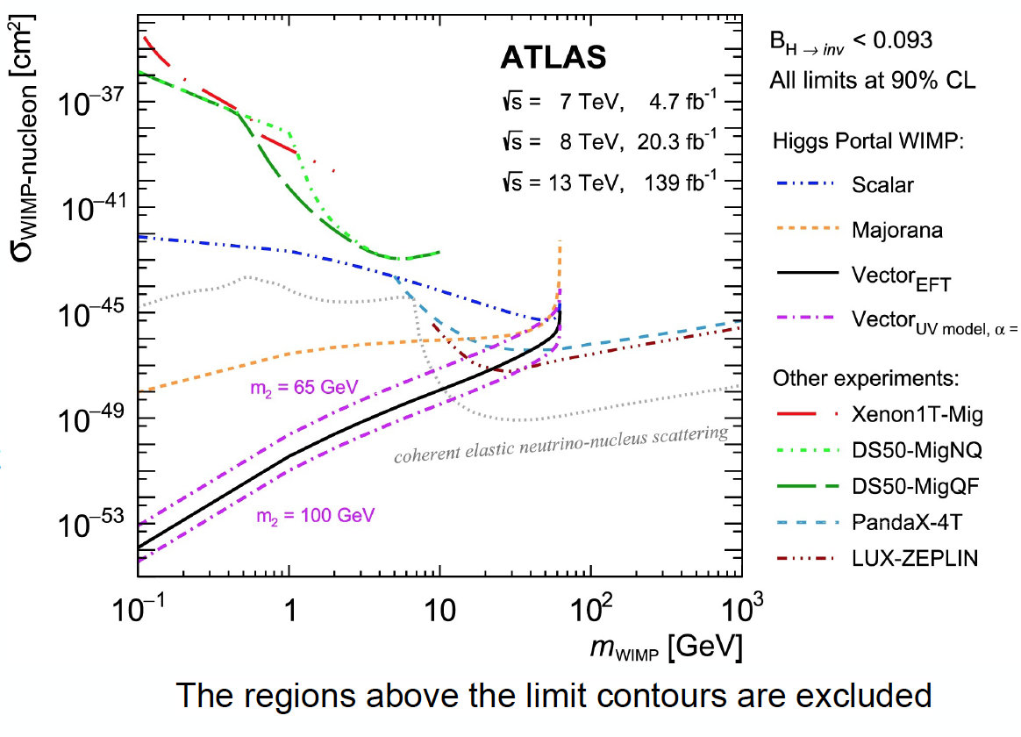
Combination and summary: Higgs portal
90% CL on the spin-independent WIMP-nucleon scattering cross-section
SM particles get mass through the Higgs → DM could also be produced in Higgs decays
SM Higgs invisible decays are <0.1%
The analysis: B(H→inv)_{obs} < 10.7% @95%CL
B(H→inv) _{exp}< (7.7%) @95%CL best to date
Results also interpreted in the context
of models with SM Higgs boson is portal to
dark matter
Exclusion regions extend to very low DM mass
Phys. Lett. B 842 (2023) 137963

Slide 20
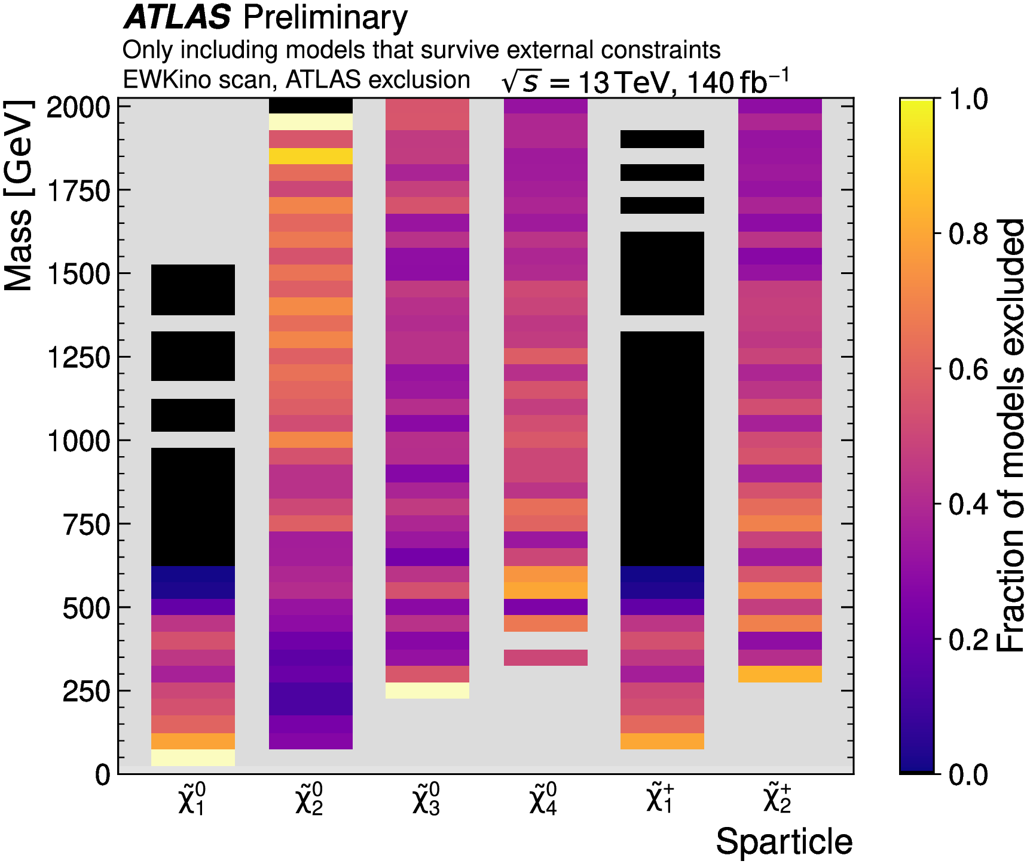
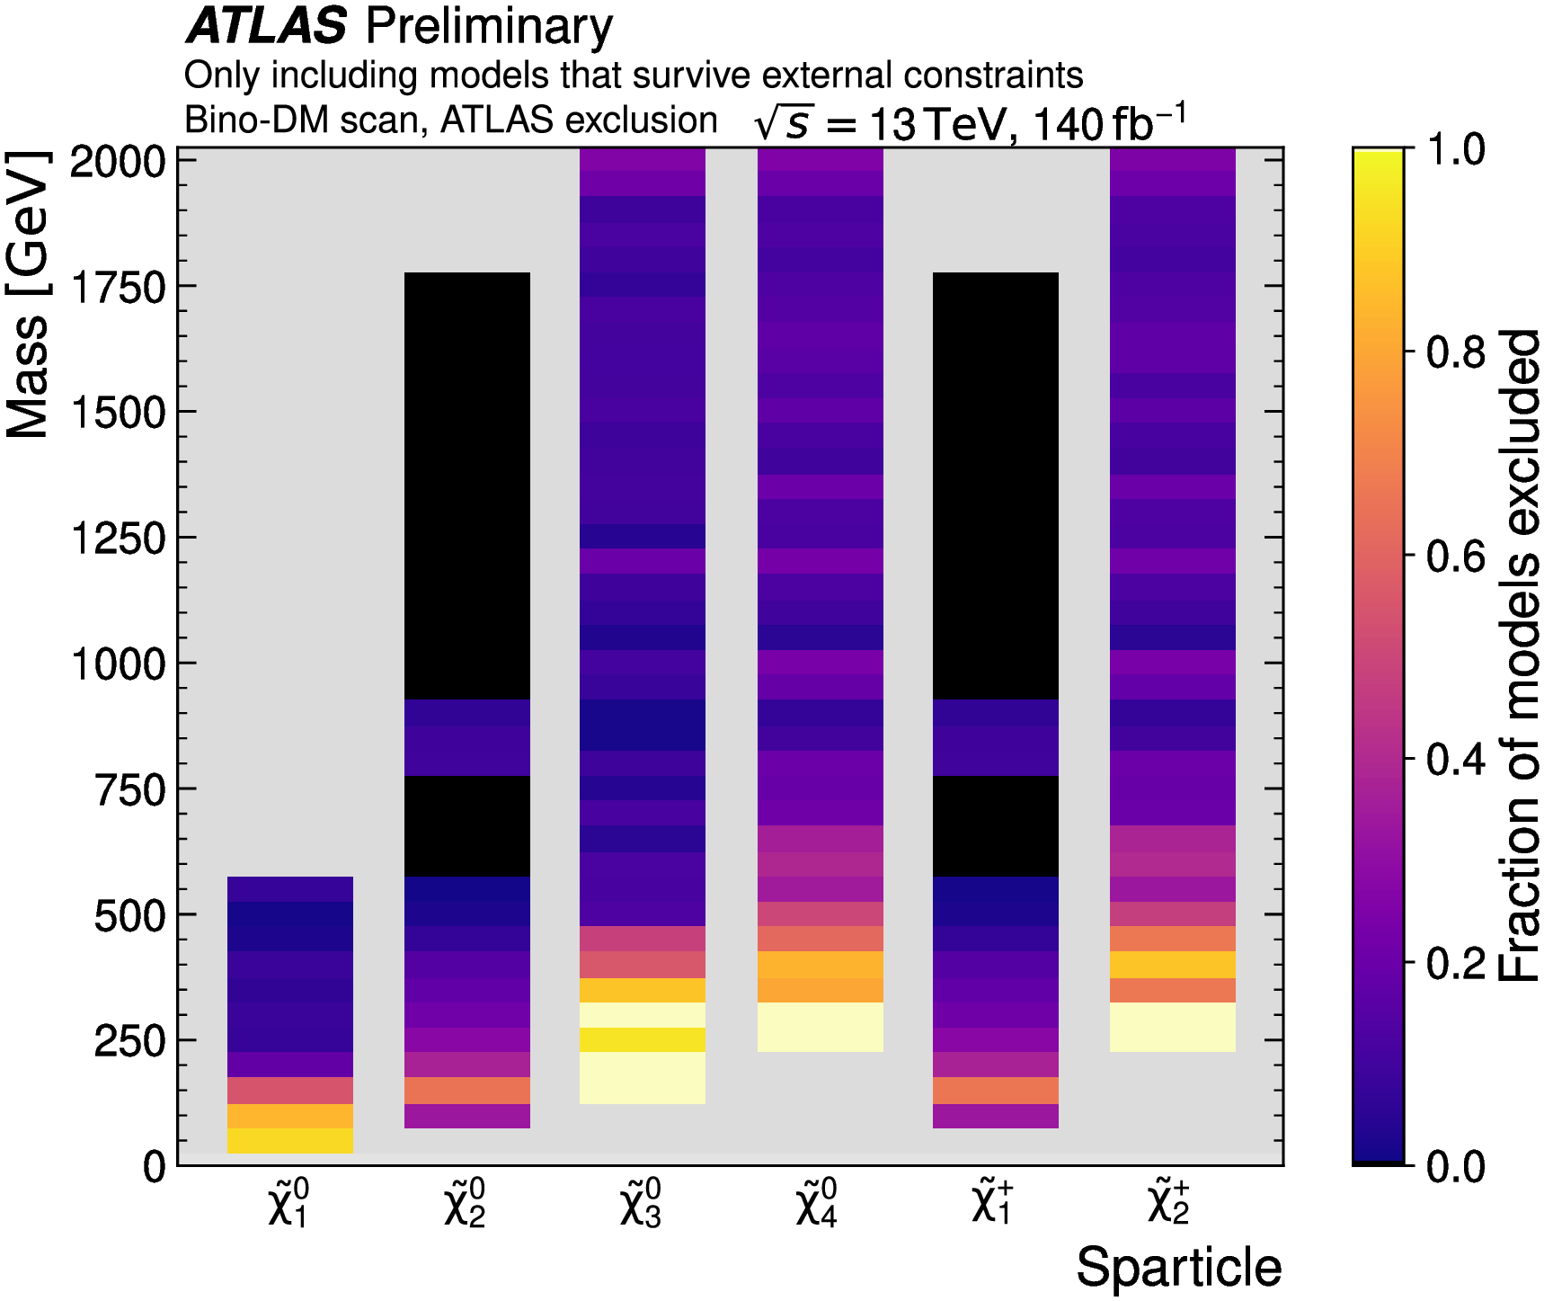
Review of SUSY Dark Matter
Scan exploring Phenomenological Minimal
Supersymmetry (pMSSM: UV complete Model,
normally simplified models are used)
Tens of thousands of different models, with different masses predictions tested
Impose LHC + external constraints
LEP, flavor, precision EWK, DM direct
24
Notes:
ATLAS physicists looked for evidence of “lab-made” dark matter – that is, dark matter created in LHC collisions. Their searches are found to be very complementary to other experiments that are seeking natural, “relic” dark matter left over from the Big Bang (see Figure 2). Unlike collider searches, which don’t need to see the dark matter to infer its presence, the latter experiments rely on the dark-matter particles having a sufficiently large probability to hit normal materials and so to be detected. the ATLAS Collaboration provides its most comprehensive overview of the searches for weakly-interacting supersymmetric particles. By developing new search algorithms and exploiting machine learning techniques, researchers have probed deep into this difficult-to-reach territory.
Two pMSSM scans have been processed with different parameter ranges and sampling strategies. In both scans, the sleptons and all squarks and gluinos are “decoupled”, i.e. mass parameters are set at sufficiently
high to not influence the production or decays of the electroweakinos. The first scan focuses on general 3 electroweakino production and is denoted the “EWKino scan” for the remainder of this article. The parameter ranges for the EWKino scan are listed in Table 3. The EWKino scan comprises 12,704 modelswhich survive all of the constraints and filters when starting from an initial set of 20,000 models randomly sampled (with a flat prior) from these ranges.Applying the relic dark matter constraint Ωh2 ≤ 0.120 (where the inequality allows the neutralino LSP to be a subdominant component of dark matter) would thus remove almost all models in the EWKino scan with a bino-like LSP. To compensate for this and to produce a sizable sample of bino-LSP models with Ωh2 ≤ 0.12, a second scan is performed which oversamples such models. The ranges of this scan are thesame as those in Table 3 except that the bino mass parameter range is tightened to |𝑀1| < 500 GeV in order to focus on low-mass bino models. 437,500 models are randomly sampled from these ranges with a
flat prior, and only those with a bino-like LSP (defined as the LSP having a bino fraction greater than 0.5) and Ωh2 ≤ 0.12 are kept. These constraints, along with the additional filters, reduce the number of models
to 11,007 .
While possible hiding-places are being systematically reduced, plenty of models remain stubbornly evasive. Improving the sensitivity of ATLAS searches to these models will require more collision data and further clever developments in search strategy. One of the most consequential findings is that some previously-favoured regions for masses – where the dark-matter particle has about half the mass of the Z boson or the Higgs boson – have been almost totally excluded.
Figure 15 provides a visual summary of the constraints by showing the fraction of models excluded by ATLAS as a function of the masses of each electroweakino for models passing all of the external constraints. For both the EWKino and Bino-DM scans, the bar for the LSP shows predictable behaviour where the fraction of models excluded decreases with increasing LSP mass. A similar trend is observed for all
electroweakinos in the Bino-DM scan. For the EWKino scan, there is an interesting effect for the 𝜒 ̃20 where models at higher mass show high exclusion fractions. This is partly driven by wino-like LSP models, where
Δm(𝜒 ̃1±, 𝜒 ̃10), and therefore the lifetime and the sensitivity of the disappearing track analysis, depends on 459 𝑚 ( 𝜒 ̃ 20 )
Summary plots showing the fraction of models excluded by ATLAS across the masses of each electroweakino for models which pass external constraints. The first column shows the EWKino scan and the second column the Bino-DM scan. Note that bins in grey have no models to consider, while for bins in cream (black) all models are (not) excluded. (a) EWKino scanr scale shows the fraction of the supersymmetry models excluded by the ATLAS Run-2 searches, for various different supersymmetric particles (horizont
al axis) as a function of each particle’s mass (vertical axis).

Slide 21
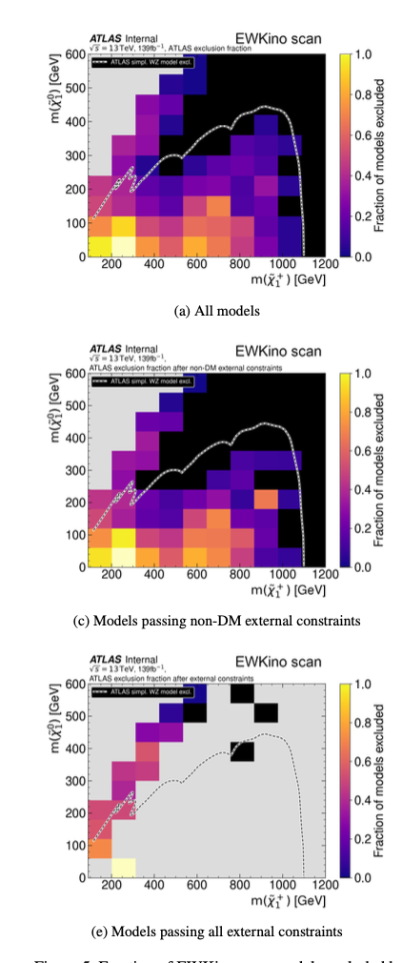
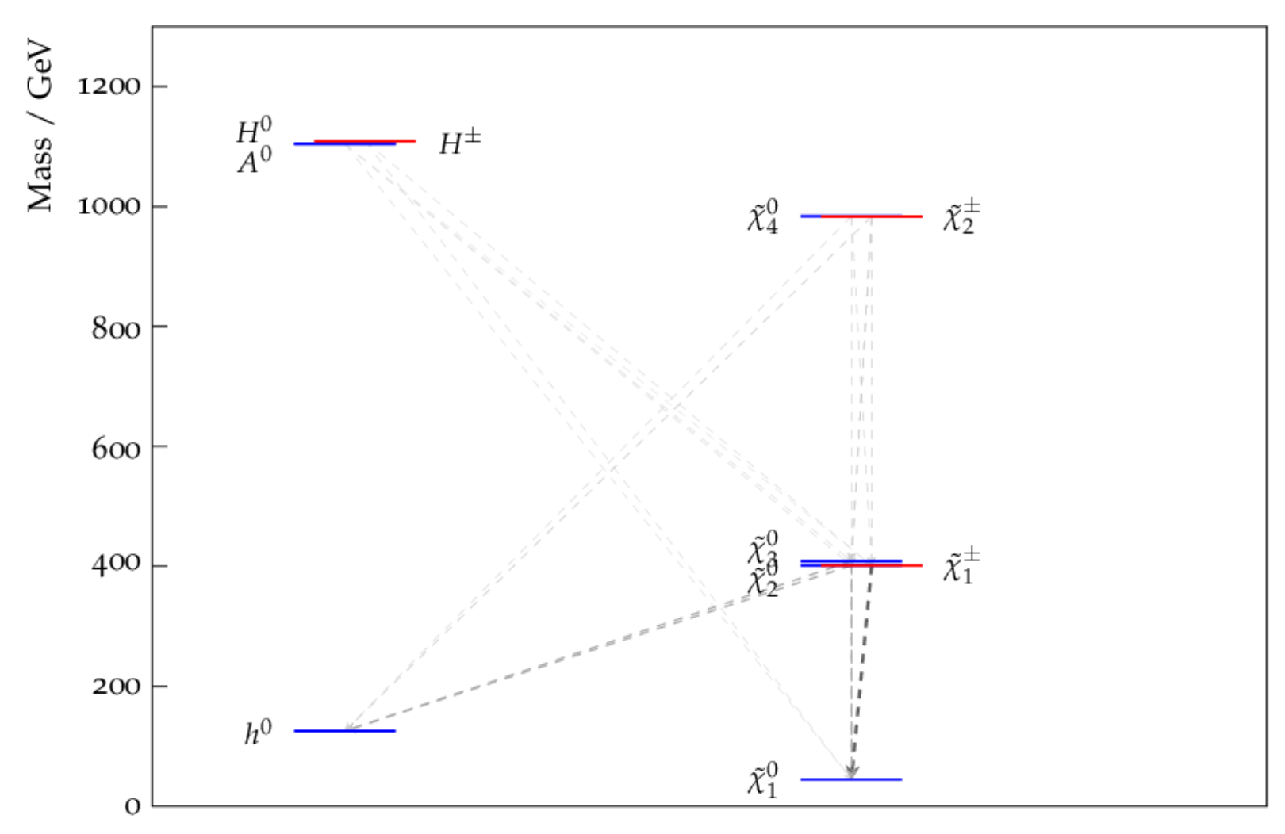
Review of SUSY Dark Matter
Almost full exclusion of low-mass χ₀₁ in regions where it would not oversaturate DM relic abundance
Surviving SUSY model: not excluded but with mass-spectrum within published simplified model contours.
Z/h funnel region
24
Notes:
Fraction of EWKino scan models excluded by ATLAS Run 2 results. The first column shows the 𝑚(𝜒 ̃1±)vs. 𝑚(𝜒 ̃0) plane and the second column the 𝑚(𝜒 ̃0) vs. 𝑚(𝜒 ̃0) plane. The first row includes all models, the second 121
includes all models that pass the non-DM external constraints and the third row models that pass all external constraints. The overlaid dashed line shows the envelope of the 3L [18], 2L2J [20] and FullHad [19] exclusion of a (b) All models wino 𝜒 ̃±𝜒 ̃0 → 𝑊𝑍𝜒 ̃0𝜒 ̃0 simplified model with BR(𝜒 ̃0 → 𝑍𝜒 ̃0) = 100%. Note that bins in grey have no models to 21 consider, while for bins in bright yellow all models are excluded.
Figure 16(a) shows a model in the 𝑍/h funnel region. This model differs from typical simplified
468 models as the 𝜒 ̃1± and 𝜒 ̃20 Higgsino fraction is greater than 98%. Additionally, this scenario has
469 BR(𝜒 ̃20 → 𝜒 ̃10h) ≈ BR(𝜒 ̃20 → 𝜒 ̃10𝑍) ≈ 50%. Scenarios such as this will therefore have smaller signal yields
470 than typical simplified models due to the higgsino-like 𝜒 ̃1±/𝜒 ̃20 production cross-sections being smaller
471 than for wino-like particles and the branching ratios to the typical 𝜒 ̃20 decay modes being half the usual
472 simplified model assumption of 100%
One of the benefits of this study is understanding which pMSSM models have been missed by previous searches and can thus be targeted by future searches in Run 3 of the LHC and beyond. Figure 16 shows
the mass spectrum for four benchmark models with a bino-like LSP which pass all constraints and are not excluded by ATLAS Run 2 analyses. The 𝜒 ̃10, 𝜒 ̃1± and 𝜒 ̃20 masses of all of these models lie within the
published ATLAS simplified model contours for at least one of the SUSY searches considered in this analysis.
bino-like LSP which pass all constraints and are not excluded despite having a mass-spectrum within published ATLAS simplified model contours

Slide 22
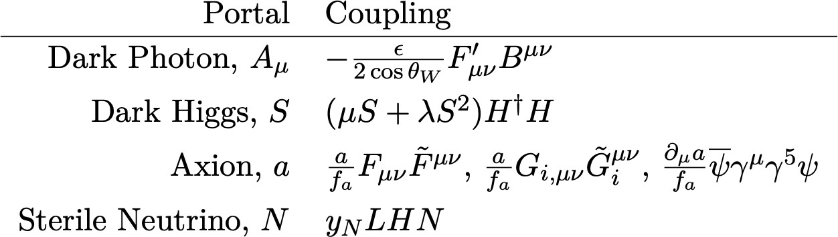
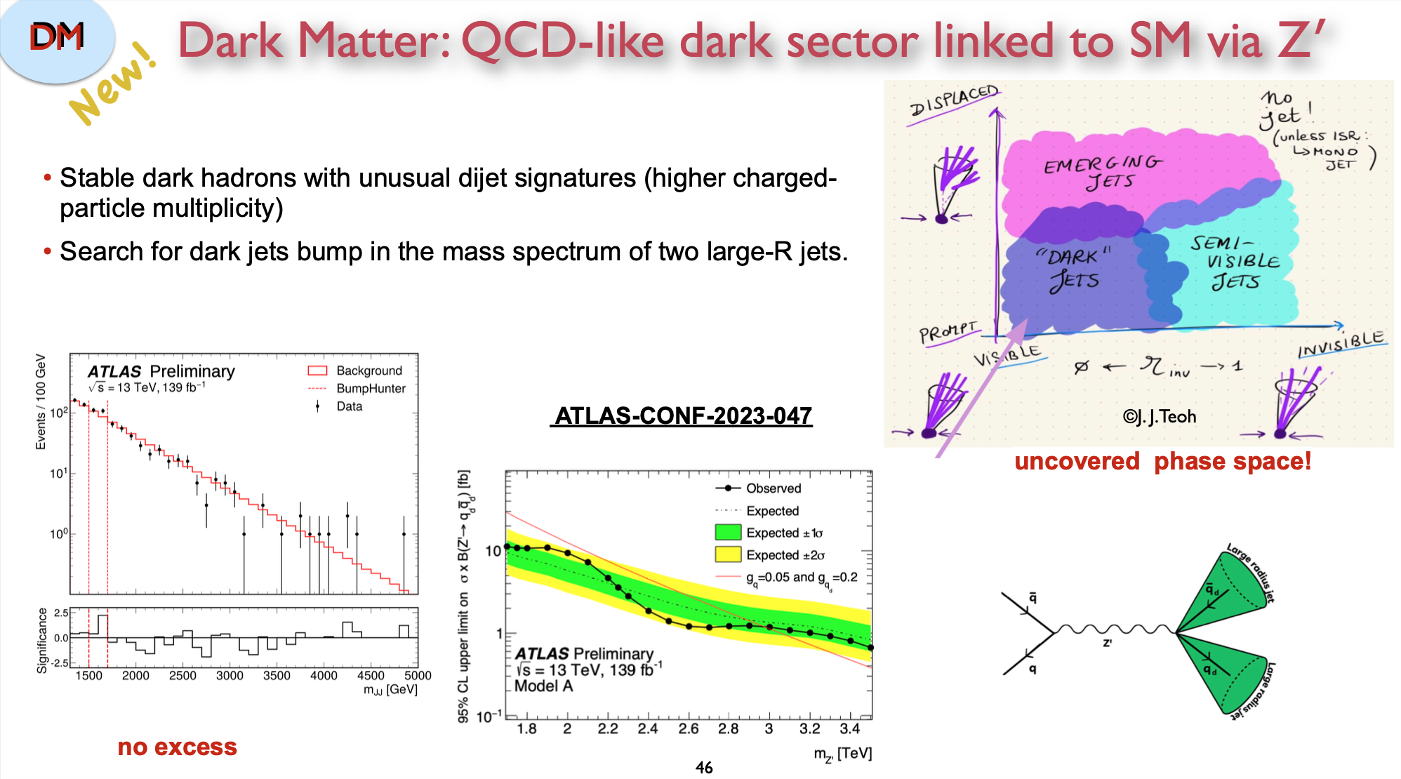
Dark sector searches
1901.09966
DM in a hidden sector, with particles which donʼt undergo SM gauge interactions
May communicate with SM via mediators, which could be DM candidates OR provide portals to them
Coupling to SM encoded in a mixing term in the Lagrangian
Can also have strongly interacting dark
sectors with new SU(N)
Very wide range of signatures to search for!
Dark quarks form bound dark hadron states
Unstable dark hadrons can decay to SM quarks, others traverse the detector → dark or semi-visible jets

Slide 23
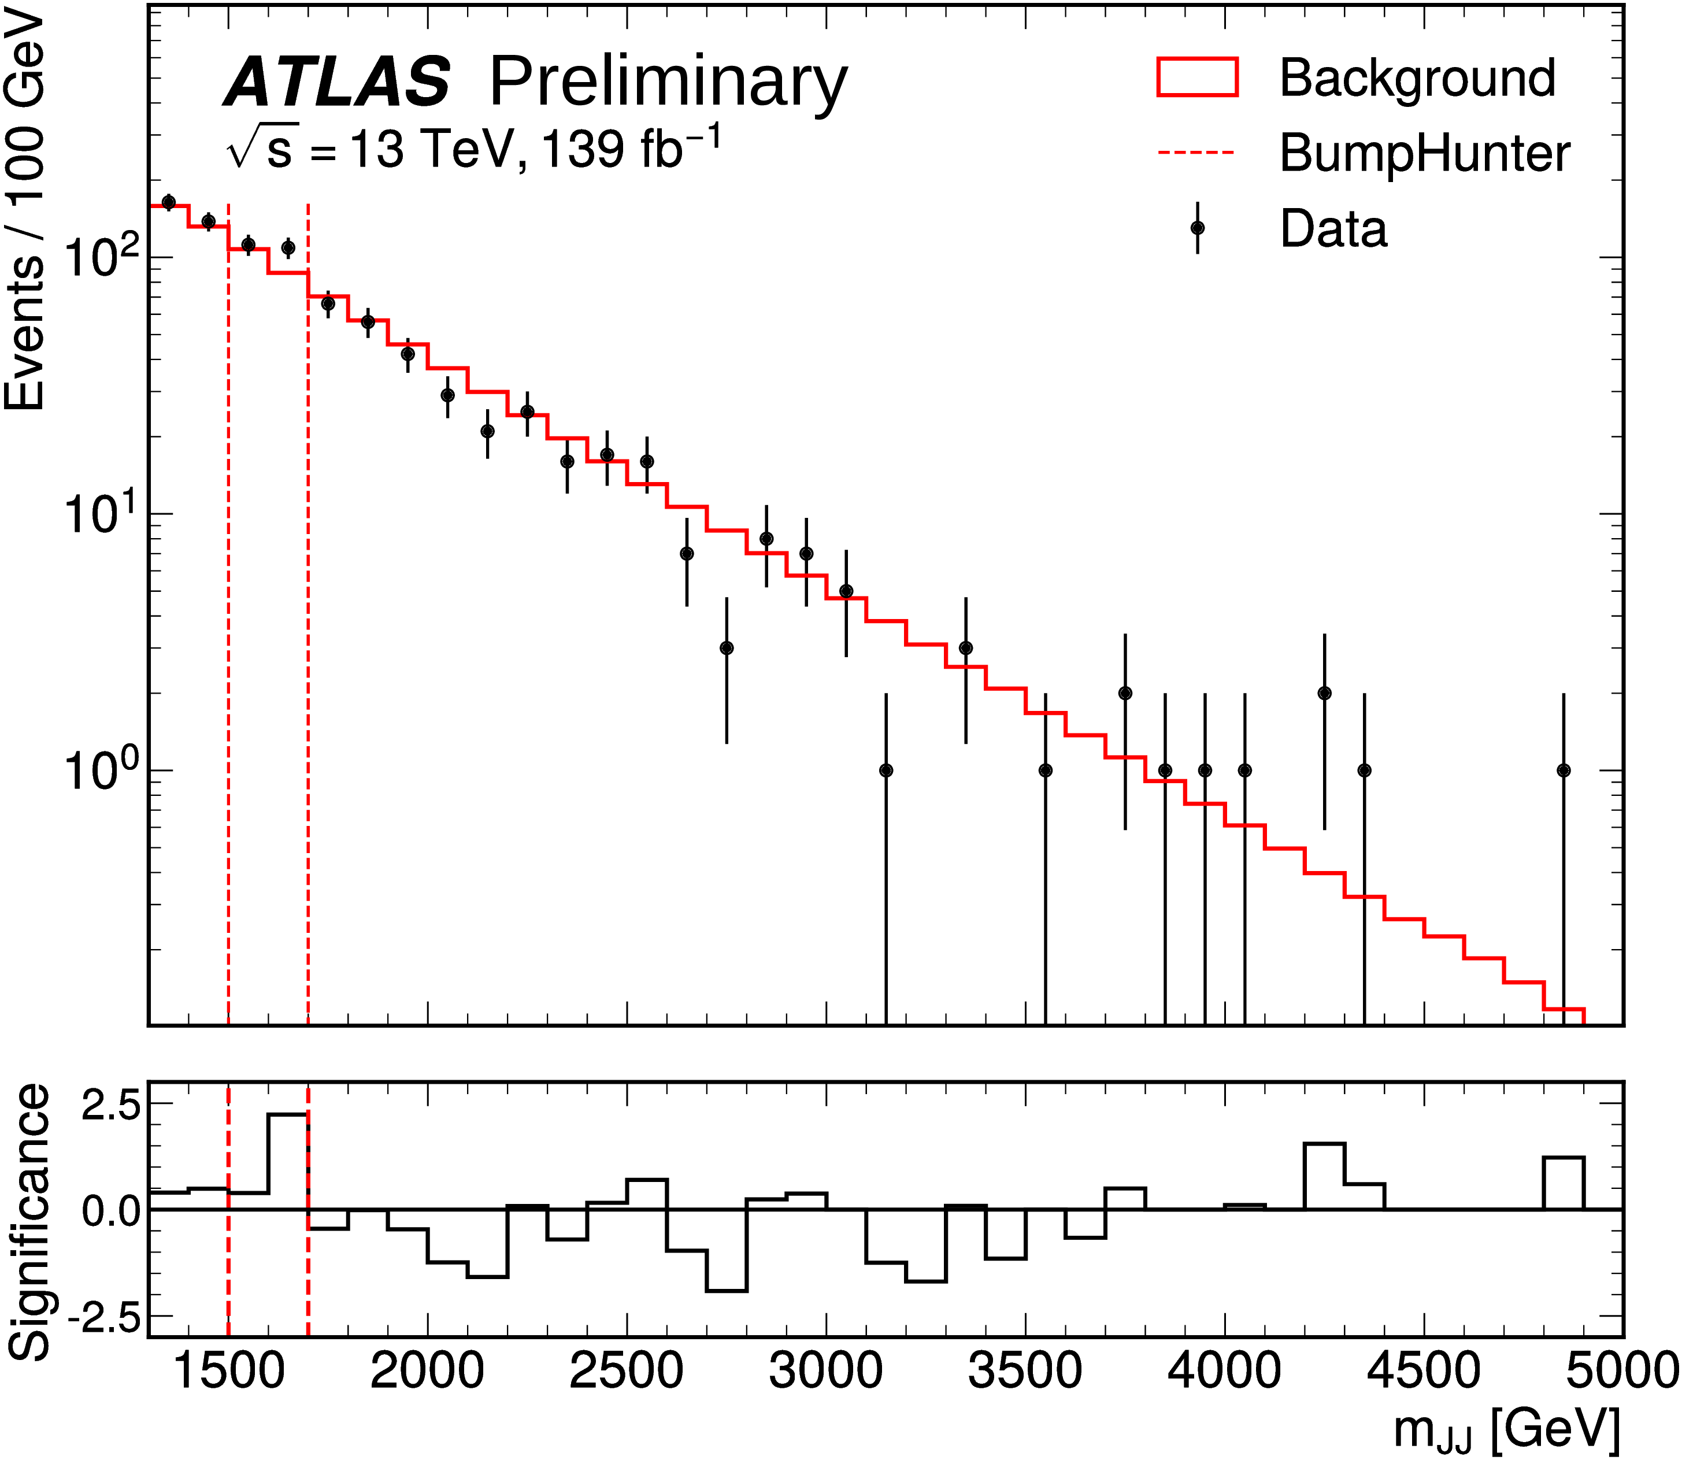

Dark Jet Resonance
Model: QCD-like dark sector linked to SM through Z’
Stable dark hadrons with unusual dijet signatures (higher charged-particle multiplicity)
Search for dark jets bump in mass spectrum of two large-R jets
Heavy mediator
Jets wider and with
higher multiplicy
CONF-2023-047
No excess found
Notes:
At the LHC, dark quarks could be produced in the decay of a heavy mediator. The dark quarks would then hadronise into dark hadrons, whose decay into Standard Model (SM) particles would produce jet-like objects with properties that depend on the underlying theory parameters. These signatures include semi-visible jets, for which limits have been set using the full Run-2 dataset by the ATLAS and CMS Collaborations [2, 3], and emerging jets, for which limits have been set using a partial Run-2 dataset by the CMS Collaboration [4].
In this note, the resonant production of a pair of dark quarks through a heavy Z′ mediator, as shown in Figure 1, is considered. In the benchmark models considered here, the dark hadrons are assumed to decay promptly into SM particles and the fraction of invisible components (stable dark hadrons) produced is assumed to be negligible, thus covering a complementary part of the parameter space with respect to semi-visible jet and emerging jet searches. The dark jets considered here are typically wider than the SM QCD jets due in part to the double hadronisation procedure which takes place, first in the dark sector and then in the SM. They also display a higher charged-particle multiplicity due to the different fragmentation in the dark sector models considered, which is exploited to increase the signal-to-background ratio. This analysis hence looks for a resonant excess above a smooth background in the di-jet invariant mass distribution, after preselecting events containing at least two high transverse momentum, pT, large-radius jets with high track multiplicity, thus complementing the Z′ → qq ̄ di-jet resonance search
Distribution of mJJ in the SR (black points) compared to the background-only expectation, where the shape is derived from the CR and the normalisation is fitted in the SR. The most discrepant interval found by the BumpHunter algorithm, indicated by the vertical lines, is between 1500 GeV < mJJ < 1700 GeV, with a p0-value of 0.63. This p0-value and the bin-by-bin significance shown in the lower panel are computed considering statistical uncertainties only.
The invariant mass spectra of the two highest-momentum large-R jets is probed after selecting jets with a high track multipliticity using a variable which decorrelates this selection from the mJJ distribution. No significant excess is observed above the Standard Model multi-jet background whose shape is obtained in a data-driven way from a low-track multiplicity control region. Constraints on the production cross-section times branching ratio to dark quarks are presented for four different dark QCD scenarios as a function of the Z′ mass, excluding masses of up to 3.0 TeV for gq = 0.05 and gqd = 0.2, depending on the model.
Observed and expected limits at 95% CL on the cross-section times branching ratio for the production of dark quarks through a Z' as a function of the Z' mass for models A, B, C and D (see the text for details). The darker and lighter shaded bands around the expected limits represent the ±1σ and ±2σ uncertainty range, respectively. The predicted cross-section times branching ratio is also shown for g_{q}=0.05 (g_{q}=0.15) and g_{qd}=0.2 (g_{qd}=0.5) for models A and D (B and C) as a thin solid line
In model C, the dark photons decay to any pair of charged fermions excluding third-generation quarks (due to the choice of dark photon mass), while in model D the dark photons decay predominantly to charged pions, and occasionally to electron and muon pairs.
.

Slide 24





Dark photons in rare Z decays
Dark Abelian Higgs model adds dark Higgs hD for massive dark photon A’
Z → hD A’ for light A’ masses
A’ decays into lepton pairs (or hadrons)
Final state: at least two lepton pairs with similar masses
Parameters:
m_{hD,} m_{A}’,
coupling of A with SM (ε),
coupling of A’ with DM (α_{D})
coupling of h_{D} with H
$\sim$decay rate
Events/GeV
10 ATLAS
s = 13 TeV, 139 fb⁻¹
SR
Others Fake
qq → 4ℓ Syst. Data
₁₀−1
α_{D}ε²
₁₀₋₂ ATLAS
Belle Obs.
PRL 114(2015)211801
ATLAS Obs.
_{m}
m _{h} = 20 GeV
8
₁₀−3
₁₀−4
s = 13 TeV, 139 fb
-1
h
= 1 GeV
D
m = 30 GeV
Signals (m_{A′},m )
D
m = 3 GeV
h
h_{D}
D
m = 40 GeV
(12, 40) GeV
(25, 40) GeV
(35, 40) GeV
90% CL
h_{D}
m = 5 GeV
h_{D}
h_{D}
m = 50 GeV
6
m _{h} = 7 GeV
D
h_{D}
m _{h} = 60 GeV
₁₀−5
₁₀−6
₁₀−7
₁₀−8
m = 9 GeV
_{m}
D
= 70 GeV
h_{D}
h
D
4
2
Data/Pred.
2
1.5
1
0.5
10
−9
2306.07413 submitted to PRL
0 1 2 3 4 5 9 13 17 21 25 29 33 37 41 45
m_{A'} [GeV]
0
5
10 15 20 25 30 35 40 45
m¯ _{ℓℓ} [GeV]
Complementary to Belle searches
Notes:
Dark matter is generally expected to interact very weakly with Standard Model (SM) particles. This motivates the extension of the SM with hidden or dark sectors (DS). One of the simplest examples is an additional 𝑈(1)D gauge symmetry associated with a gauge boson, the dark photon 𝐴′, that mediates DS–SM interactions [5, 6]. In the dark Abelian Higgs scenario, the 𝑈 (1)D symmetry group could be spontaneously broken by a Higgs mechanism through which the dark photon acquires a mass, adding a dark Higgs boson hD to such models [7, 8].
The minimal 𝐴′ model has three unknown parameters: the mass of the dark photon, 𝑚 𝐴′ ; the effective coupling of the dark photon to SM particles, 𝜀, induced via kinematic mixing with the SM photon; and the hidden-sector gauge coupling, 𝛼D, which is the coupling of the 𝐴′ to DS particles [7]. Dark photons will decay into visible SM particles, either lepton pairs or hadrons, or invisible particles of the DS. Constraints wereplacedonvisible𝐴′decays,intheparameterspaceof𝑚𝐴′ and𝜀,bypreviousbeam-dump,fixed-target and collider experiments [7, 9–13]. The dark Abelian Higgs model introduces two additional unknown parameters: the mass of the dark Higgs boson, 𝑚hD , and the mixing between hD and the SM Higgs boson. The Higgs-strahlung channel, where a dark photon is produced in association with a dark Higgs boson, was also explored at low-energy electron–positron colliders via 𝑒+𝑒− → 𝐴′hD [14, 15]. The Higgs-strahlung channel is sensitive to 𝛼D, which is also the coupling of the 𝐴′ to the hD. Hence, experimental evidence of a signal in this process would provide information complementary to that from direct searches for 𝐴′.
The 𝑚 ̄ ll distribution in the (a) CR, (b) VR and (c) SR for the data and post-fit background contributions. The error bands include experimental and theoretical systematic uncertainties as constrained by a background-only fit. The contributions from the production of 𝑞𝑞 → 4l events are scaled by a normalization factor 0.95, from the simultaneous fit in the SR and CR. The “Others” category combines 𝑔𝑔 → 𝑍𝑍, Higgs, 𝑉𝑉𝑉 and 𝑡𝑡𝑍 background contributions. The “Fake” background represents the contribution from non-prompt leptons. Three representative signaldistributionsareoverlaidintheSR,assuming𝑚hD =40GeVanddifferentvaluesof𝑚𝐴′.Thecross-sections for these benchmark points are calculated with 𝛼D = 0.1 and 𝜀 = 10−3.
Observed 90% CL upper limits on 𝛼D𝜀2, as a functiono of 𝑚𝐴′ with different dark Higgs boson masses, from this search (solid curves) compared with the results from Belle

Slide 25


ALP search with AFP
JHEP07(2023)234
ALPs with forward proton scattering in association with photon pairs
ALP
First BSM search using ATLAS Forward Proton (AFP) (ATLAS-TDR-024, ATL-PHYS-PUB-2017-012)
4 tracking units located at 𝑧 = ± 205 m and ± 217 m
Diphoton resonance search in events with at least one proton tagged in AFP
Data-driven estimate of combinatorial background from photon pairs w/ protons from another collision
Events / 29 [GeV]
ATLAS
s = 13 TeV, 14.6 fb⁻¹
χ²/DOF = 1.11
Cross section σ_{fid} [fb]
10²
10²
ATLAS
-1
s = 13 TeV, 14.6 fb
10
Observed CL_{s} limit
Expected CL_{s} limit
1
10
Expected ± 1 σ
Expected ± 2 σ
Data
Background-only fit
₁₀−1
Ratio
2
1
⁰ 200 400 600 800 1000 1200 1400 1600
1
m [GeV]
200 400 600 800 1000 1200 1400
m_{X} [GeV]
γγ
Unbinned maximum likelihood fit to the m𝛾𝛾 distribution
No excess → Cross section exclusion limits
Notes:
Axions are another well motivated DM candidate, that may simultaneously solve the CP problems of QCD. Axion DM particles are sufficiently light that they must be produced non-thermally through a gravitational, or misalignment production mechanism. Alternatively axions may be heavy and thermally produced in the early universe. The minimal axion model relates the mass and coupling constant of the axion. If this condition is relaxed the theory can be generalized to one of axion-like- particles (ALPs) and such a generalization may also be motivated from string theory. The search for axions and ALPs in the sub-eV mass range comprises a plethora of different experimental techniques and experiments as haloscopes, solar helioscopes and pure laboratory experiments among which, for example, regeneration or light-shining- through a wall (LSW) experiments. ALPs with masses in the MeV-GeV range can be produced, and possibly detected, at accelerator-based experiments.
Background-only fit to the observed numbers of events (black points) as a function of the diphoton invariant mass mγγ. The ratio of the data points to the fitted background (blue line) is shown in the bottom panel. The quantity χ2/DOF is the chi-squared per degree of freedom in the fit to data.
Expected and observed 95% CL upper limits on (a) the signal fiducial cross section σfid and (b) the ALP coupling constant, assuming 100% branching ratio for ALP decay into two photons, as functions of the hypothetical ALP mass mX . The 1σ and 2σ confidence intervals are shown by the coloured bands. Contours of the ALP natural width Γ are illustrated by the smooth blue solid lines.
No signal is observed, and the data are consistent with a smooth combinatorial background that can be assumed to come from Standard Model processes. The inferred upper limit on the ALP coupling constant, assuming a 100% decay branching ratio into two photons, is in the range 0.04–0.09 TeV−1 at 95% confidence level.

Slide 26



Highly ionizing particles
Search for pair of magnetic monopoles and stable particles with high electric charges
Factor 3 better than previous x-section limits by ATLAS, with 36 fb⁻¹
First ATLAS limits on photon-fusion pair production mechanism.
Signal region
HIPs produce TRT tracks with δ-rays → many high TRT hits (HT)
Too massive to produce shower in EM calo → low lateral dispersion (w)
Notes:
In 1931, physicist Paul Dirac proved that the existence of magnetic monopoles would be consistent with quantum mechanics. In the 1970s, scientists found that magnetic monopoles were also predicted by new theories attempting to unify all the fundamental forces of nature, inspiring theoretical physicist Joseph Polchinski to claim that their existence is “one of the safest bets that one can make about physics not yet seen.”
Physicists at the ATLAS Experiment are searching for pairs of point-like magnetic monopoles with masses up to about 4 TeV, which could be produced in 13 TeV proton-proton collisions via two different mechanisms: “Drell-Yan”, in which a virtual photon produced in proton collisions creates the magnetic monopoles; or “photon-fusion”, where two virtual photons scattering off proton collisions interact to create the magnetic monopoles.
Their detection strategy relies on Dirac’s theory, which says that the magnitude of the smallest magnetic charge (gD) is equivalent to 68.5 times the fundamental unit of electric charge (e, the charge of the electron). Consequently, a magnetic monopole of charge 1gD would ionise matter in a similar way as a high-electric-charge object (HECO). When a particle ionises the detector material, ATLAS records the energy deposited, which is proportional to the square of the particle’s charge. Hence, magnetic monopoles or HECOs would leave large energy deposits along their trajectories in the ATLAS detector. Since the ATLAS detector was designed to record low-charge and neutral particles, the characterisation of these high-energy deposits is vital to the search for monopoles and HECOs.
In a new study presented at the EPS-HEP 2023 conference, the ATLAS Collaboration combed through the full LHC Run-2 dataset (recorded 2015-2018) in search for magnetic monopoles and HECOs (see Figure 1). The result places some of the tightest limits yet on the production rate of magnetic monopoles.
Physicists selected and analysed collision events with large energy deposits in both the ATLAS transition-radiation tracker and the calorimeter. With no evidence of either magnetic monopoles or HECOs, researchers established upper cross-section limits and lower mass limits on spin-0 and spin-½ particles. For magnetic monopoles in the charge range of 1gD to 2gD, ATLAS remains the most sensitive experiment (see Figure 3).
Two-dimensional distribution of the discriminators fHT and w for the data and a representative signal sample (green). The signal (A) and control (B, C and D) regions are shown.
Comparison of the lower mass limits obtained by LHC searches in Run 1 and Run 2 pp collisions for Drell-Yan and photon-fusion pair-produced magnetic monopoles. A Tevatron measurement by CDF in proton-antiproton collisions is also shown. The dashed and solid lines represent spin-0 and spin-½ measurements, respectively. (Image: ATLAS
Given that the predicted cross sections can only be calculated at leading order, these mass limits primarily serve as benchmarks for comparison with other experiments, as shown in Figure 10. The ATLAS cross-section limits for Drell-Yan production of HECOs in the range 20 ≤ |𝑧| ≤ 100 are several orders of magnitude better than those reported by MoEDAL in Ref. [103], which considers 8 TeV
𝑝𝑝 collision data. While MoEDAL is the only experiment sensitive to magnetic charges in the range 3𝑔D ≤ |𝑔| ≤ 5𝑔D [97–101], the present ATLAS search is able to set significantly better cross-section limits (one to two orders of magnitude) for 1𝑔D and 2𝑔D.

Slide 27
Conclusions
ATLAS: taking data, preparing for an ambitious HL-LHC upgrade, and analysing its fantastic Run-1, 2 and 3 data samples, with an extremely broad and diverse physics programme
Search program is benefiting from ever more sophisticated analyses
~40 new results released this summer: most with well-understood Run-2 dataset, first cross-section measurements at 13.6 TeV, incl. Higgs boson re-observation
Succesfull DM search programme
  Probing a wide range of final states and models
    Range of WIMP hypotheses - still many options
    Many results on other options: dark sectors, ALPs
LHC Run-2 results still coming and Run-3 dataset growing fast!
  Many new ideas, improved techniques and new theoretical models

Slide 28
Thank you!
17

Slide 29

New ATLAS detector
Muon New Small Wheels to replace innermost forward Muon station to

Slide 30


Higgs production
Higgs decay

Slide 31

Combination of di-Higgs searches

Slide 32


W boson mass with 7 TeV data
mW = 80360 ± 5 (stat.) ± 15 (syst.) = 80360 ± 16 MeV
Re-analysis: new log-likelihood fit constrains systematic uncertainties with data, more modern PDFs!
Extremely sensitive probe of,
and constraint on, new physics
ATLAS-CONF-2023-004
10

