Slide 1

TCM-42
Light lunch
27 and 28 November, 2024
h: 12.15
Aula Tavoli- CNR Research area
Ticket of 10€ each lunch to be paid as reserved at the Conference desk ONLY CASH
You will find coloured stickers on the back of your badge
( for 27 Nov. and for 28 Nov.)
Receipts will be distributed if needed on Thursday 28 November during the morning coffee break
Please wear your
id badge

Slide 2
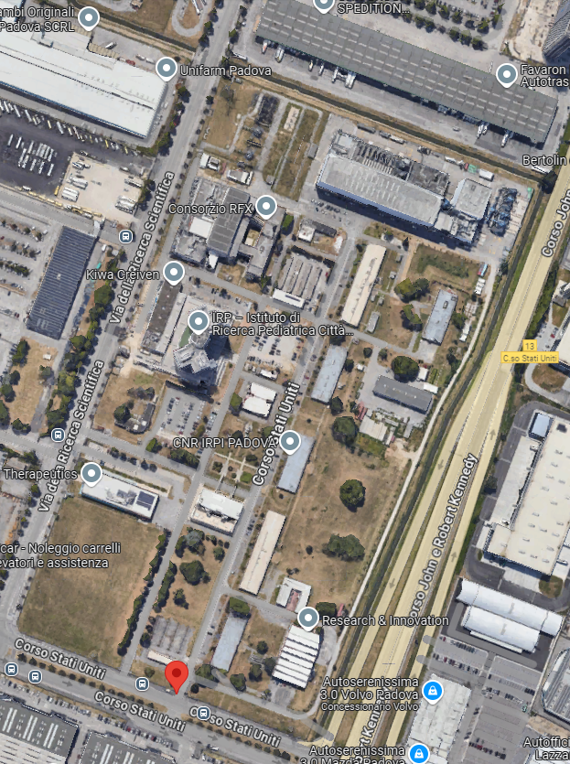

«NBTF Teaching room –Plenary session» 3rd floor
«Aula Tavoli» 2nd floor
5 minutes walk from Plenary session room
CNR Research Area entrance

