Slide 1
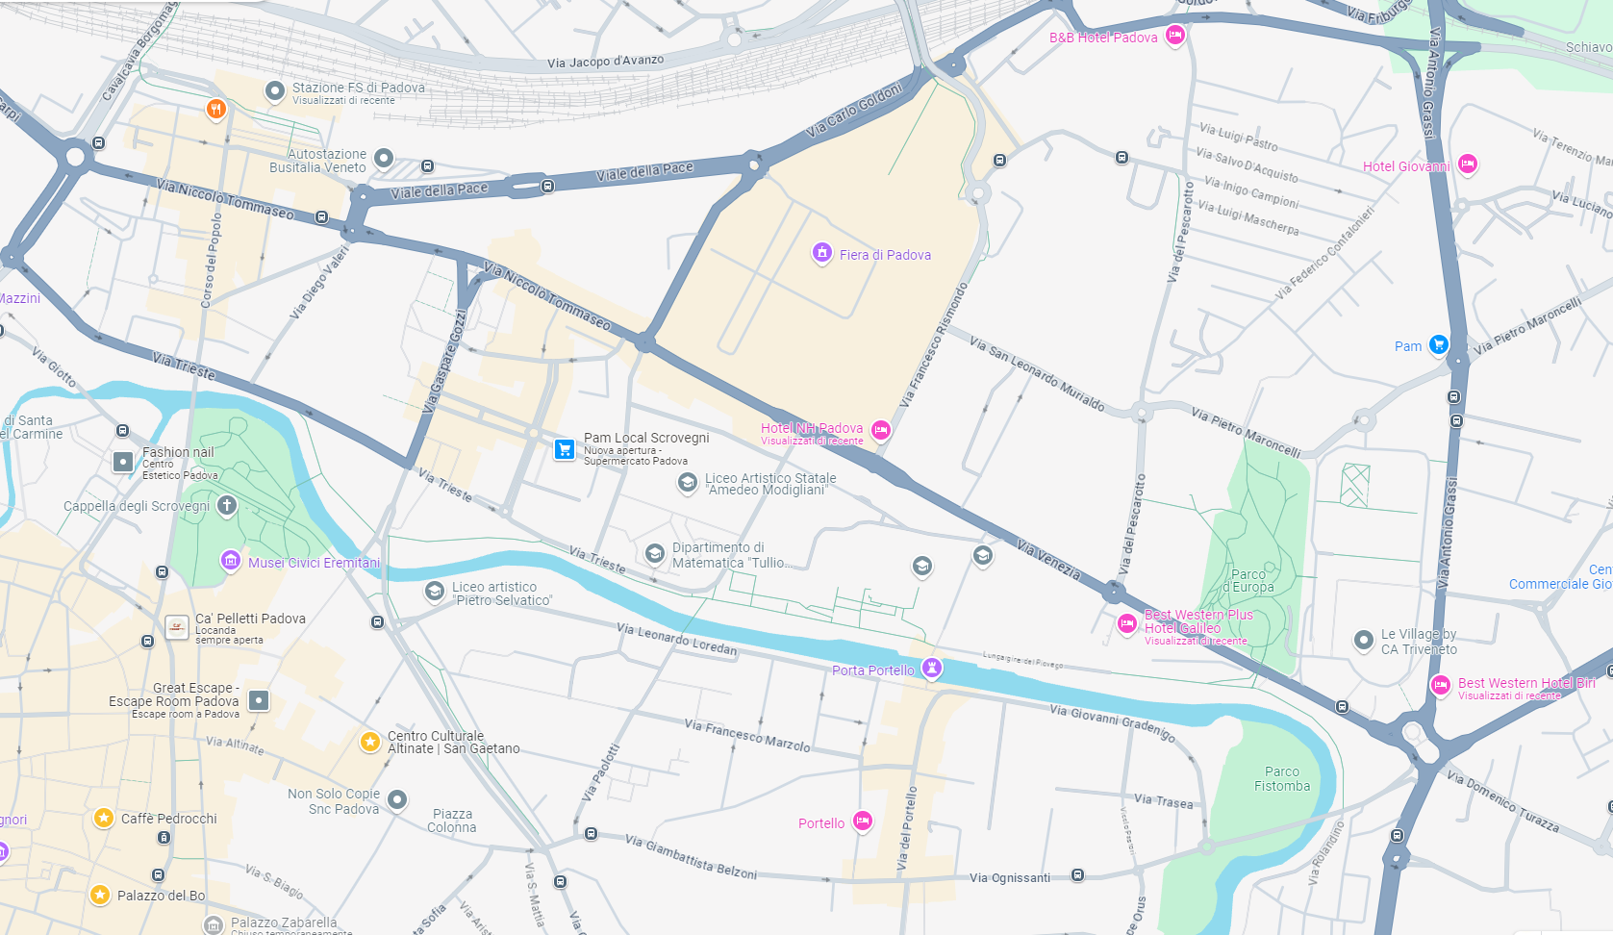
Pick-up point 1
Hotel NH Mantegna Via Tommaseo
27 and 28 November- 8.30 am
Pick-up point 2
Hotel Galileo Via Venezia
27 and 28 November- 8.35 am
Service by «Michielotto Bus»
Pick-up point 1
Hotel NH Mantegna Via Tommaseo
Pick-up point 2
Hotel Galileo Via Venezia

