Slide 1




New insights in current sheet instability theory through combined gyrofluid and gyrokinetic approaches
EFTC – 2023
Camille Granier
Max-Planck-Institut for Plasma Physics (IPP), Germany
E. Tassi*, D. Grasso’, D. Borgogno’, L. Comisso°, R. Numata`, T. Passot*, P-L. Sulem*, D. Laveder*
*Laboratoire Lagrange. ‘ISC-CNR, Polito. °Columbia Univ. `Kyogo Univ.

Slide 2
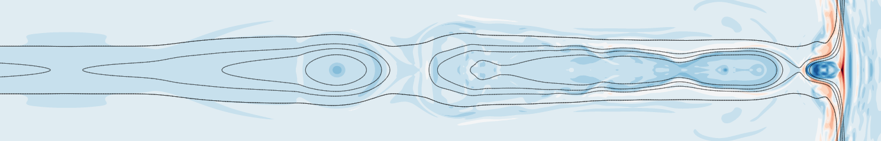

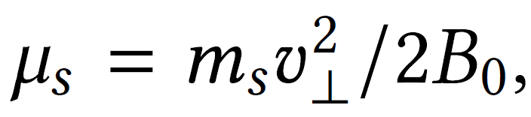
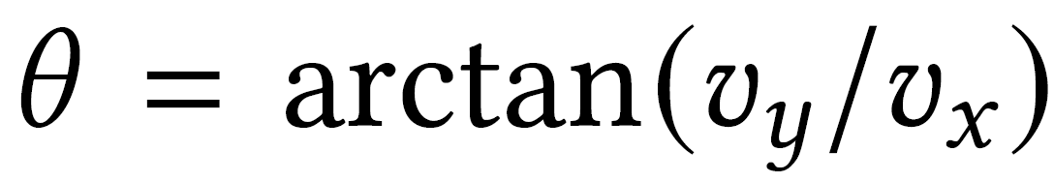
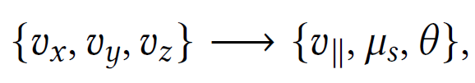
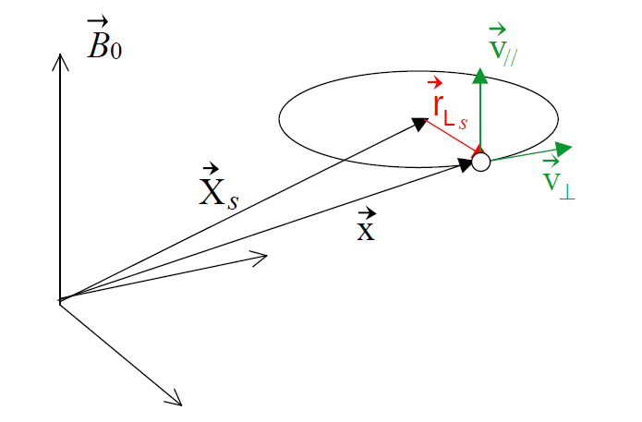
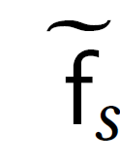
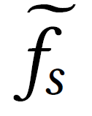

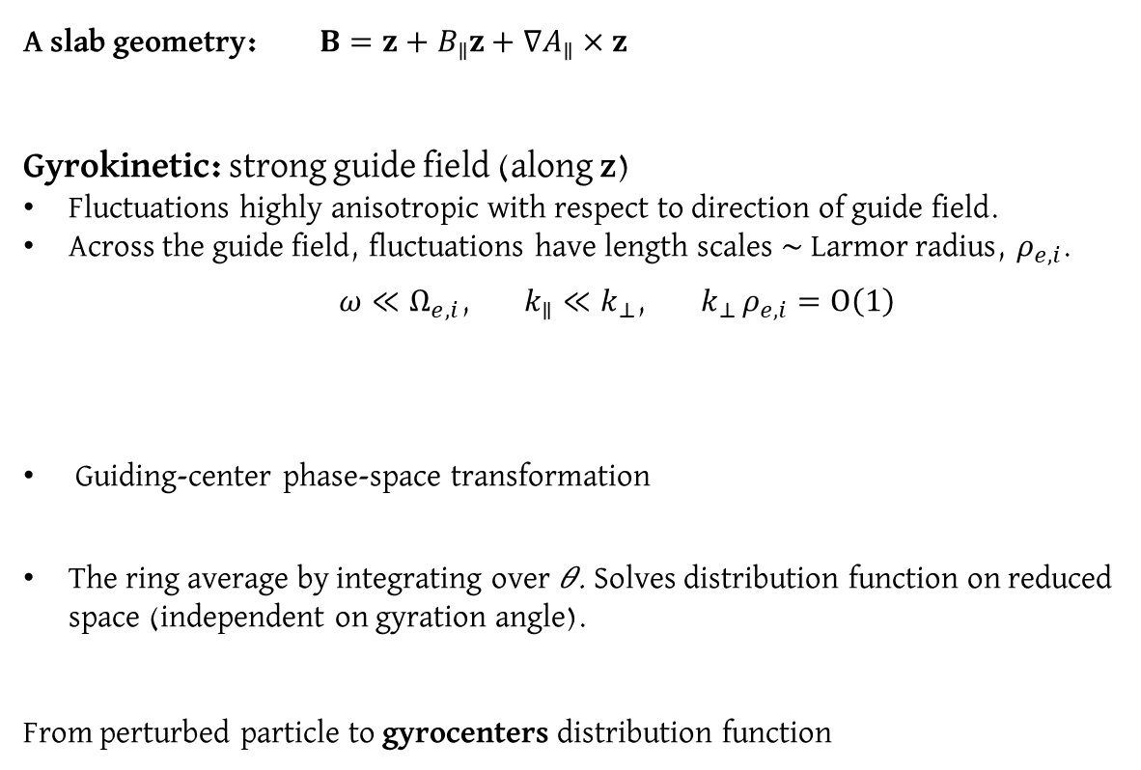
1. The gyrofluid approach
A slab geometry: $B=z+B_{∥}z+∇A_{∥}×z$
Gyrokinetic: strong guide field (along z)
Fluctuations highly anisotropic with respect to direction of guide field.
Across the guide field, fluctuations have length scales $\sim$Larmor radius, $ρ_{e,i}$.
$ω≪Ω_{e,i}$, $k_{∥}≪k_{⊥}$, ${ k}_{⊥ }ρ_{e,i}=O\left(1\right)$
Guiding-center phase-space transformation
The ring average by integrating over 𝜃. Solves distribution function on reduced space (independent on gyration angle).
From perturbed particle to gyrocenters distribution function

Slide 3
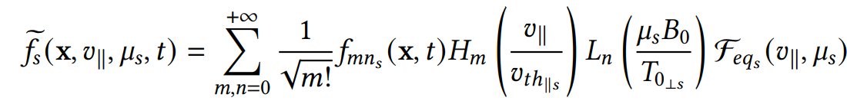
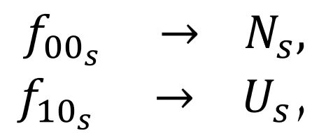
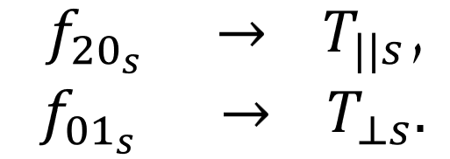
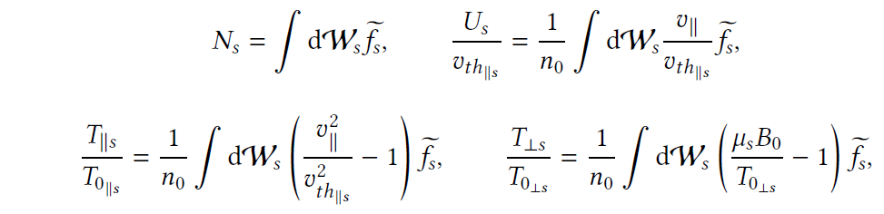
1. The gyrofluid approach
The perturbed gyrocenter distribution function can be developed as a series of its gyrocenter moments using Hermite polynomials 𝐻𝑚 and Laguerre polynomials 𝐿𝑛
Taking moments of the gyrokinetic equations:
Quasi-static closure for the electrons and a truncation for the ions (Tassi (2019) (2020)). Implies
$${t_{∥}}_{e,i}=0, {{ t}_{⊥}}_{e}=0,{{ T}_{⊥}}_{i}=0.$$
Scott et al. (2010); Mandell et al. (2018), Tassi (2019) (2020).

Slide 4
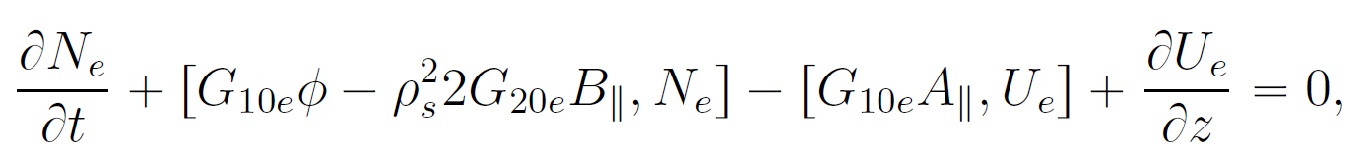
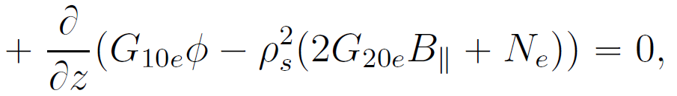
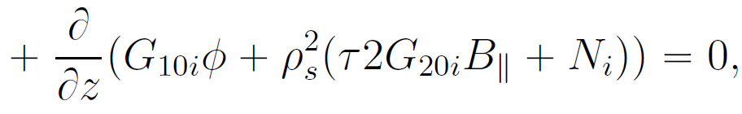
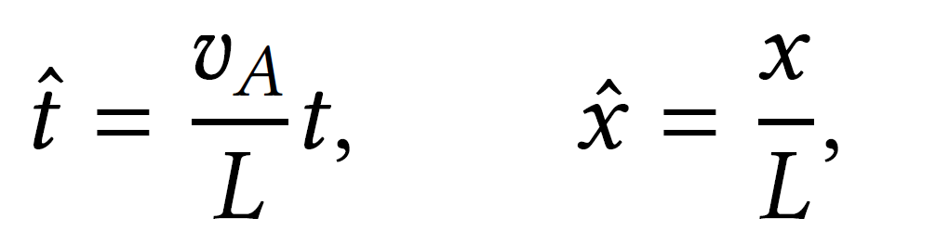
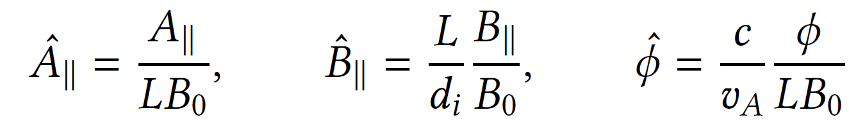
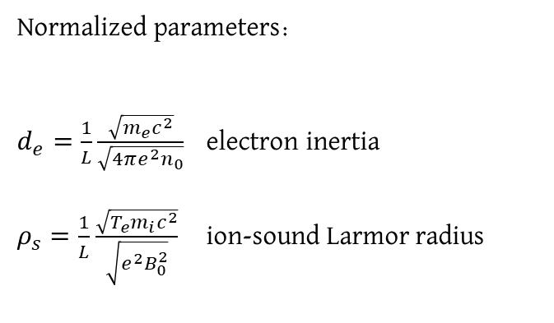
1. The gyrofluid approach
Theoretical framework that describes a plasma in a strong guide field, incorporating the effects of particle gyration and fluid-like properties while neglecting particle collisions.
Normalisation:
Normalized parameters:
$d_{e}=\frac{1}{L}\frac{\sqrt{m_{e}c^{2}}}{\sqrt{4πe^{2}n_{0}}}$ electron inertia
$ρ_{s}=\frac{1}{L}$ $\frac{\sqrt{T_{e}m_{i}c^{2}}}{\sqrt{{e^{2}B}_{0}^{2}}}$ ion-sound Larmor radius

Slide 5


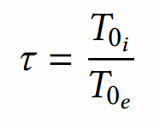



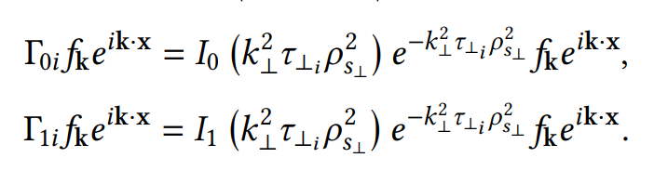
1. The gyrofluid approach

Slide 6
I) A limit to retain electron FLR effects.
Model used in CG, Numata, Borgogno, Tassi, Grasso. (2023) JPP.
II) A limit to retain ion FLR effects.
Model used in Passot, Sulem, Tassi (2018), Cerri et al. (2023), CG ongoing work.

Slide 7
I) A limit to retain electron FLR effects.
Model used in CG, Numata, Borgogno, Tassi, Grasso. (2023) JPP.
II) A limit to retain ion FLR effects.
Model used in Passot, Sulem, Tassi (2018), Cerri et al. (2023), CG ongoing work.

Slide 8
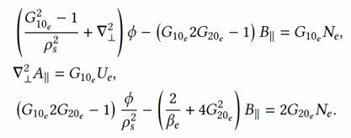

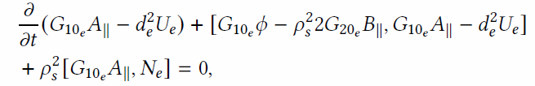
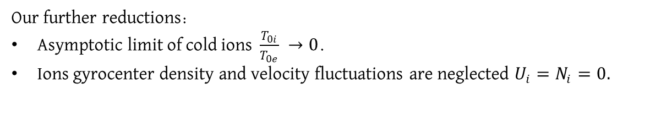
2. Cold ions. On the plasmoid instability.
Our further reductions:
Asymptotic limit of cold ions $\frac{T_{0i}}{T_{0e}} →0$.
Ions gyrocenter density and velocity fluctuations are neglected $U_{i}=N_{i}=0.$
Quasi-neutrality, Ampère’s Law:

Slide 9
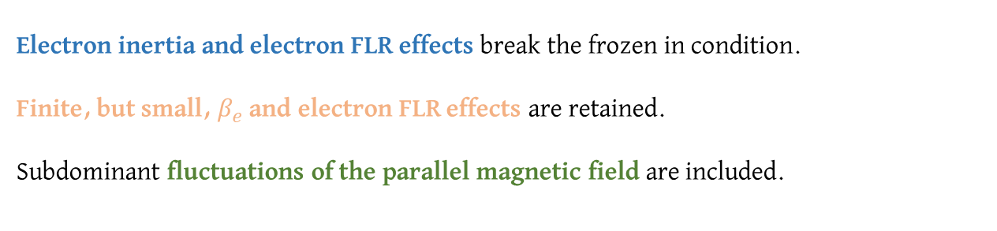
2. Cold ions. On the plasmoid instability.
Our further reductions:
Asymptotic limit of cold ions $\frac{T_{0i}}{T_{0e}} →0$.
Ions gyrocenter density and velocity fluctuations are neglected $U_{i}=N_{i}=0.$
Quasi-neutrality, Ampère’s Law:
Electron inertia and electron FLR effects break the frozen in condition.
Finite, but small, $β_{e}$ and electron FLR effects are retained.
Subdominant fluctuations of the parallel magnetic field are included.
Implemented in SCOPE3D (Borgogno (2005)). Pseudo spectral code.

Slide 10
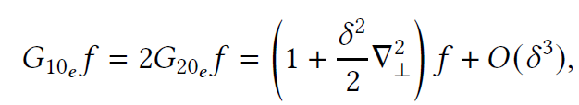
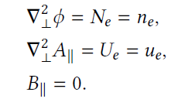

2. Cold ions. On the plasmoid instability.
Our further reductions:
Asymptotic limit of cold ions $\frac{T_{0i}}{T_{0e}} →0$.
Ions gyrocenter density and velocity fluctuations are neglected $U_{i}=N_{i}=0.$
Quasi-neutrality, Ampère’s Law:
In the limit $β_{e}→0$ :
Model reduced to the cold ion model of Schep et al. (1994).
Electron inertia and electron FLR effects break the frozen in condition.
Finite, but small, $β_{e}$ and electron FLR effects are retained.
Subdominant fluctuations of the parallel magnetic field are included.
Implemented in SCOPE3D (Borgogno (2005)). Pseudo spectral code.

Slide 11

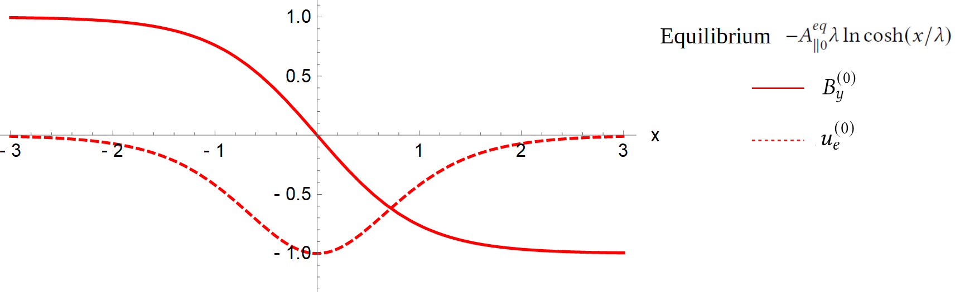
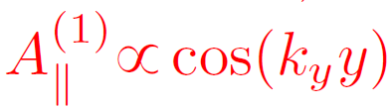
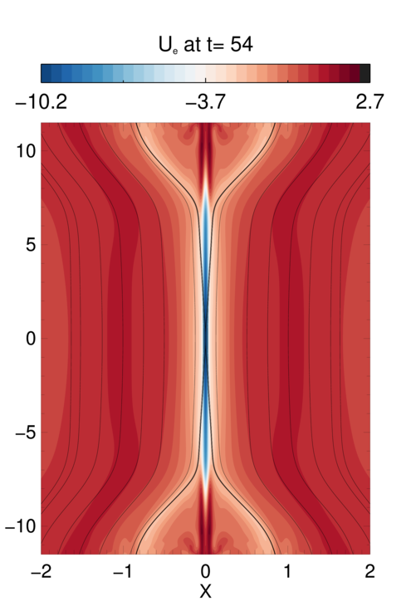


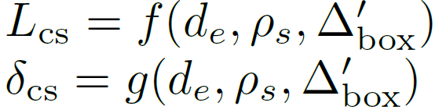

2. Cold ions. On the plasmoid instability.
Equilibrium:
Pertubation:
Secondary
Current Sheet
characterization
≡ width

Slide 12
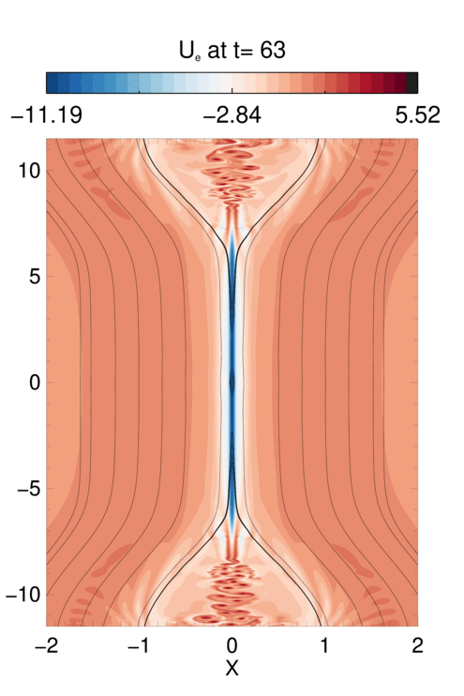
2. Cold ions. On the plasmoid instability.
Condition for it
to be plasmoid
unstable
Secondary
Current Sheet
characterization
Plasmoids onset
depending on
≡ width
2000x2400 points

Slide 13
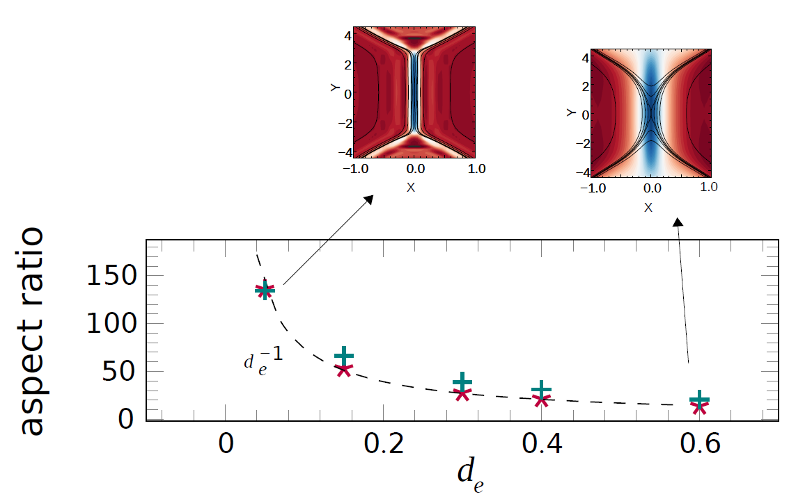

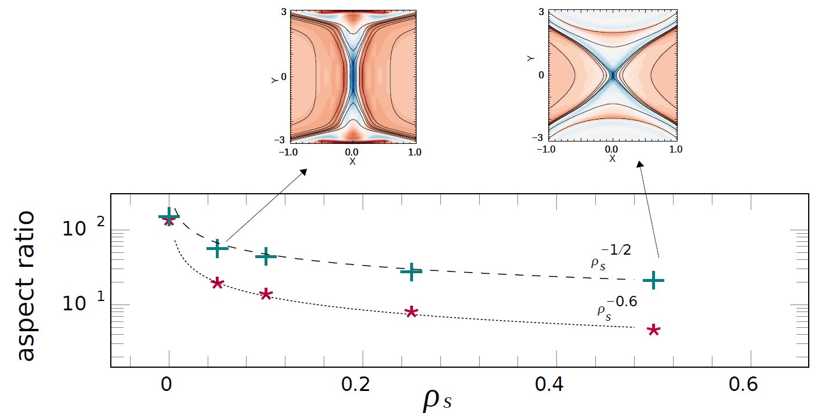

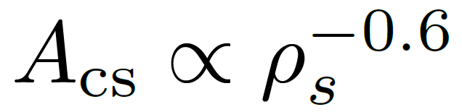
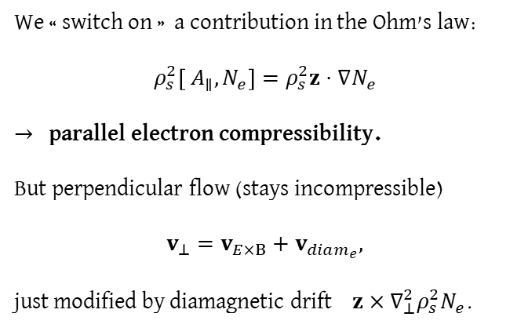
2. Cold ions. On the plasmoid instability.
(1)
We « switch on » a contribution in the Ohm’s law:
$$ρ_{s}^{2}\left[ A_{∥}, N_{e}\right]=ρ_{s}^{2}z⋅∇N_{e}$$
$→$ parallel electron compressibility.
But perpendicular flow (stays incompressible)
$$v_{⊥}=v_{E×B}+v_{diam_{e}},$$
just modified by diamagnetic drift ${ z×∇_{⊥}^{2}ρ}_{s}^{2}N_{e}$.
(2)
CS changes into a cross shaped CS aligned with the separatrices Aydemir (1992),Cafaro et al. (1998), Hirota (2015).

Slide 14




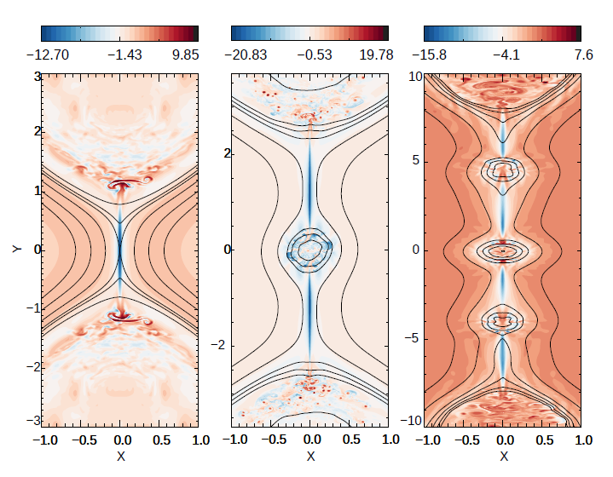
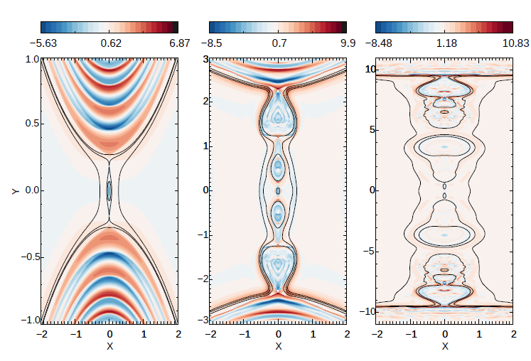
2. Cold ions. On the plasmoid instability.
Increasing the lenght of the equilibriuml current sheet $→$ incresing $Δ_{box}^{′}$.
From 1728x1728 to
2000x2400 points

Slide 15
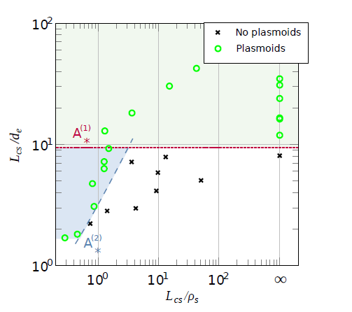
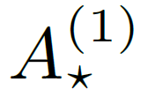
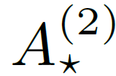
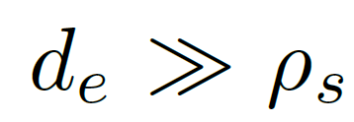

2. Cold ions. On the plasmoid instability.
Take away message
New parameter space diagram (Collisionless counterpart of the collisional case).
Cases with plasmoids above or .
(1) The threshold aspect ratio is
So for the marginally unstable case

Slide 16

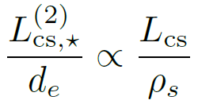
2. Cold ions. On the plasmoid instability.
Take away message
New parameter space diagram (Collisionless counterpart of the collisional case).
Cases with plasmoids above or .
(1) The threshold aspect ratio is
So for the marginally unstable case
(2) A scaling derived in Granier et al (2022) predicts
Can be used to approximate and seems to correctly capture the plasmoid formation.

Slide 17
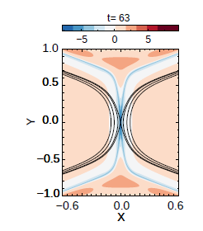
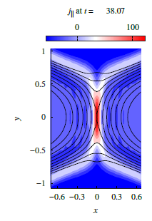
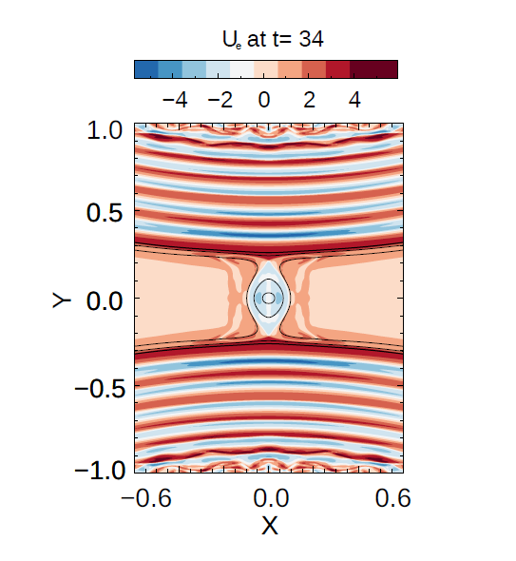
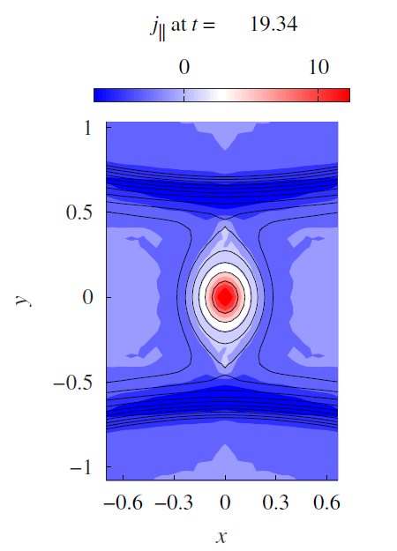

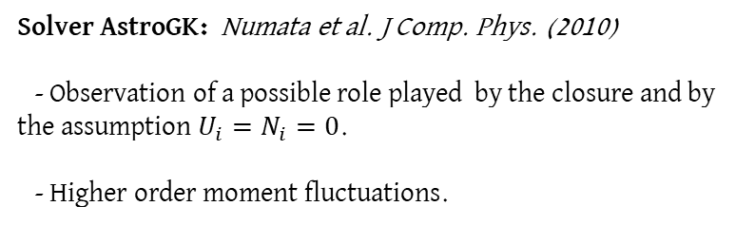
2. Cold ions. On the plasmoid instability.
Solver AstroGK: Numata et al. J Comp. Phys. (2010)
- Observation of a possible role played by the closure and by the assumption $U_{i}=N_{i}=0$.
- Higher order moment fluctuations.
Fluid
GK (small $β_{e}$)
Fluid
GK (small $β_{e}$)
1728 x 1728
Simulation time < 5h
256 x 196

Slide 18

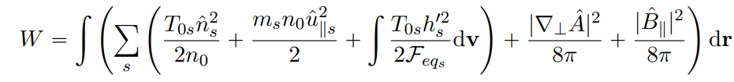



2. Cold ions. On the plasmoid instability.
Comparison of the energy redistribution in the plasmoid unstable case, $ρ_{s}≫d_{e}.$
Fluid
GK (small $β_{e}$)
Difference in the parallel election acceleration. But doesn’t affect the results on plasmoids.
Gyrokinetic simulations show that a large fraction of magnetic energy goes into energy of higher order moments.
Like temperature fluctuation.

Slide 19








2. Cold ions. On the plasmoid instability.
Finite βe effects:
$B_{||} →$ nonlinear Grad B drift.
Perpendicular flow modified by the drift ${ z×∇_{⊥}^{2}ρ}_{s}^{2}2 G_{20e}B_{||}$.
Electron FLR effects.
Impact on the linear tearing mode:
CG, Borgogno, Grasso, Tassi. JPP (2022)
Numata & Loureiro (2011)
Dispersion relation for βe=0 Porcelli (1991).
Can account for small eFLR effects
Interpreted as:
Fixed density, $n_{0}$, ion mass and $B_{0}$, Increasing $T_{0e}$.
$d_{e}$ and $ρ_{s}$ fixed
CG, Borgogno, Grasso, Tassi. JPP (2022)

Slide 20






2. Cold ions. On the plasmoid instability.
Finite βe effects:
$B_{||} →$ nonlinear Grad B drift.
Perpendicular flow modified by the drift ${ z×∇_{⊥}^{2}ρ}_{s}^{2}2 G_{20e}B_{||}$.
Electron FLR effects.
Linear growth is slower. A single plasmoid enters the non-linear phase and grows very fast.
Gyrokinetic:
Larger plasmoids despite smaller aspect ratio.
Island not affected by the upstream and downstream outflow, and ejects any other growing magnetic islands towards the m=1 mode islands.
2304x2400 points

Slide 21
I) A limit to retain electron FLR effects.
Model used in CG, Numata, Borgogno, Tassi, Grasso. (2023) JPP.
II) A limit to retain ion FLR effects.
Model used in Passot, Sulem, Tassi (2018), Cerri et al. (2023), Granier ongoing work.

Slide 22

3. Arbitrary $τ$.
Derived in Passot, Sulem, Tassi (2018).
Combining 2 scalings with: $\frac{β_{e}}{2}=d_{e}^{2}=O{\left(\frac{m_{e}}{m_{i}}\right)}^{\frac{1}{2}}, ρ_{s} =O\left(1\right).$
Scaling I: $τ=O\left(1\right).$
Scaling II: $τ=O {\left(\frac{m_{e}}{m_{i}}\right)}^{−\frac{1}{2}}.$
Ion FLR effects are retained.
Small, but moderate βe and electron inertia (negligible electron FLR effects).

Slide 23








3. Arbitrary $τ$.
Derived in Passot, Sulem, Tassi (2018).
Combining 2 scalings with: $\frac{β_{e}}{2}=d_{e}^{2}=O{\left(\frac{m_{e}}{m_{i}}\right)}^{\frac{1}{2}}, ρ_{s} =O\left(1\right).$
Scaling I: $τ=O\left(1\right).$
Scaling II: $τ=O {\left(\frac{m_{e}}{m_{i}}\right)}^{−\frac{1}{2}}.$
Ion FLR effects are retained.
Small, but moderate βe and electron inertia (negligible electron FLR effects).

Slide 24



3. Arbitrary $τ$. Tearing growth
$τ→ +∞, \frac{m_{e}}{m_{i}}≠0,$ and ${ 2/β}_{i}$ not <<1.
Inertial Kinetic Alfvèn wave equations of Chen & Boldyrev (2017).
$τ→ +∞, \frac{m_{e}}{m_{i}}≠0$ and ${ 2/β}_{i}$<<1.
REMHD (with electron inertia).
Linear tearing growth rates were derived in Bulanov & Pegoraro (1992) (large- $k_{y}$) and Attico (2000) (low- $k_{y}$).
$τ→0, \frac{m_{e}}{m_{i}}≠0,$
Schep et al. 1994

Slide 25



3. Arbitrary $τ$. On KH-type secondary instabilities.
Del Sarto (2017)
Secondary instabilities
Secondary instabilities observed in numerical simulations. Del Sarto (2003), (2006), (2011), Grasso (2007), (2009).
Investigated typically for $τ=$ $\frac{{ T}_{i0}}{T_{e0}}<1$.
Might be source for turbulence.
We analyze the ion temperature dependence and properties of turbulence following secondary instabilities.
R$egime τ>1$ relevant for electron-only reconnection in the Earth’s magnetosheath (Boldyrev & Loureiro (2019)).
Grasso (2009)

Slide 26




3. Arbitrary $τ$. On KH-type secondary instabilities.
$$τ=1→ \frac{ρ_{i}}{L}=1$$
Velocity shear at the separatrice trigger Kelvin-Helmoltz.
Turbulence spreads extensively beyond the separatrix of the primary island.
No change of the magnetic field direction across the velocity shear.
outflow
inflow
2080x2080 points

Slide 27




3. Arbitrary $τ$. On KH-type secondary instabilities.
$$τ=100→ \frac{ρ_{i}}{L}=10.$$
Again followed by Kelvin-Helmoltz and large vortices formation.
2080x2080 points

Slide 28






3. Arbitrary $τ$. On KH-type secondary instabilities.
$E_{B_{⊥}}\left(k_{⊥}\right)∝k_{⊥}^{−\frac{13}{3}}$ below $k_{⊥d_{e}}$, as pedicted in Passot, Sulem, Tassi (2018).
Time averaged spectra for $τ=1.$
Region slightly affected by the presence of the equilibrium magnetic field.
$E_{B_{⊥}}\left(k_{⊥}\right)∝k_{⊥}^{−3.8}$ below $k_{⊥d_{e}}$, close to the predicted value of – 11/3 = 3.66 predicted in Meyrand & Galtier (2010), Chen & Boldyrev (2017), Passot et al. (2018).
Time averaged spectra for $τ=100.$

Slide 29

Conclusions:
New parameter diagram ($L_{cs}$/$d_{e}$ and $L_{cs}$/$ρ_{s}$) for plasmoid instability in collisionless plasmas (strong guide field, cold ions).
Turbulence induced by fast tearing at large $τ=$ $\frac{{ T}_{i0}}{T_{e0}}$.
Gyrofluid approach is powerful to obtain new insight.
For the future:
Decaying turbulence at sub-ion scale (and sub-$d_{e}$).

Slide 30




Thank you for your attention

Slide 31
Appendix

Slide 32






Appendix: Closures
Quasi-static closure:
We impose
Which is possible for fields slowly varying
implies the following (for isotropic case)
Particules:
for the particle distribution function
(Corresponds to (2.40), of Kunz (2015)?).
This gives,
$${t_{∥}}_{e}=0, {{ t}_{⊥}}_{e}=0,$$
Gyrocenters:
for$s=e.$
Quasi-static
Rq:
In the end, the model is assumed to be isotropic.

Slide 33






Appendix: Closures
Isothermal closure:
Particules:
$${t_{∥}}_{e}=0, {{ t}_{⊥}}_{e}=0,$$
Gyrocenters:
for$s=e$.
Requiers an additional ordering with
to be simplified to
Rq:
The equations can be obtained directly assuming ${t_{⊥}}_{e}=O (β_{e})$ and ${{ t}_{⊥}}_{e}$ decouples from the equations.

Slide 34


Appendix: Closures
Hamiltonian truncation in Tassi (2019):
We impose
${f_{mn}}_{s}=0,$ for $n≥1.$
In the expansion:

Slide 35



Appendix: Casimir invariants
The reduced gyrofluid model posses the Poisson Bracket
Prop: Noncanonical Poisson Bracket have Casimir invariants: $\left\{C, F\right\}=0, ∀F.$
where $C_{±}$are arbitrary functions, and
Notes:
Canonical Poisson Bracket are non-degenerate
{C,F}=0, $∀$F c F(L) -> C constant.
Noncanonical Poisson Bracket are just bracket for which this non-degeneracy isn’t fulfilled.
Because there exist some functions C, that are not constant, that are Casimir invariants.
They are constant of motion d_t C = {C,H}=0.

Slide 36





Appendix: The solver
SCOPE3D author: D. Borgogno.
(Solver for COllisionless Plasma Equations in 3D geometry).
Pseudo-spectral solver.
Advancement in time with third order explicit Adams-Bashforth scheme.
Used in 2D. With resolution up to 2400 X 2400.
Pencil decomposition. Parallelized with MPI. Using FFT + transposition of y and z to distribute them among processors.
HPC hosted at Observatoire Côte d’Azur and CINECA.

Slide 37









Appendix: Lagrangian invariants
The reduced gyrofluid model can be written
($⋆$)
with
($⋆$)
$A_{±}$are Lagrangian invariants advected by the velocity field $v_{±}$.
Del Sarto et al. (2003): current layers subject to secondary Kelvin-Helmotz instabilities the center of the primary magnetic islands in the regime $ρ_{s}$/ $d_{e}≪1$ ($⋆$).
We found that in the regime $ρ_{s}$/ $d_{e}≫1,$instabilities (KH ?) are located at the inner and outer edge of the separatrices ($⋆$).

Slide 38






Appendix: Comparison with observations in the magnetosheath
From Phan et al. Nature (2018):
$B_{z} \sim 40 nT≫B_{rec}\sim 1−9 nT$
$T_{i} \sim 3 T_{e}$
$T_{∥e} \sim 65 eV$
${\hat{L}}_{cs} \sim {\hat{d}}_{i} ∼50 km$
${\hat{a}}_{cs} \sim {\hat{d}}_{e}∼1 km$
$β_{⊥e} \sim 0.3$
$β_{i} \sim 1$
Assuming cold ions:
$$\hat{γ}=\hat{Δ^{′}} \frac{{{\hat{k}}_{y}{{v_{th}}_{∥}}_{e}\hat{d}}_{e}^{2}}{π{\hat{d}}_{i}}∼6.2 s^{−1}$$
$τ∼160 ms$
Reduces to that of Porceli 91, in the case of isotropic temperatures
With $T_{i} \sim 3 T_{e}$:
$$\hat{γ}=\hat{Δ^{′}} \frac{{{\hat{k}}_{y}{{v_{th}}_{∥}}_{e}\hat{d}}_{e}^{2}}{π{\hat{d}}_{i}}\sqrt{1+T_{i}/T_{e}}∼12.4 s^{−1}$$
$τ∼80 ms$

Slide 39



Appendix: Comparison with sawtooth crashes
Parameters for ASDEX Upgrade:
${\hat{L}}_{cs} \sim 10 cm$
${\hat{a}}_{cs} \sim 0.3 cm$
${\hat{d}}_{i} ∼5 cm$(tritium)
${\hat{d}}_{e}∼0.08 cm$
$T_{∥e} \sim 3 keV$
Assuming cold ions:
$$\hat{γ}=\hat{Δ^{′}} \frac{{{\hat{k}}_{y}{{v_{th}}_{∥}}_{e}\hat{d}}_{e}^{2}}{π{\hat{d}}_{i}}∼31936 s^{−1}$$
$τ∼31.3 μs$
Samoylov et al. (2022): sawtooth crashes in ASDEX Upgrade.
Dependance of the duration of the observed sawtooth crashes τ as a function of electron temperature.

