Slide 1
Non-linear free boundary MHD simulations of ELM suppression by resonant magnetic perturbations in ASDEX Upgrade plasmas
V Mitterauer
M Hoelzl, M Willensdorfer, M Dunne, S K Kim,
JOREK Team, ASDEX Upgrade Team
& EUROfusion MST1 Team

Slide 2
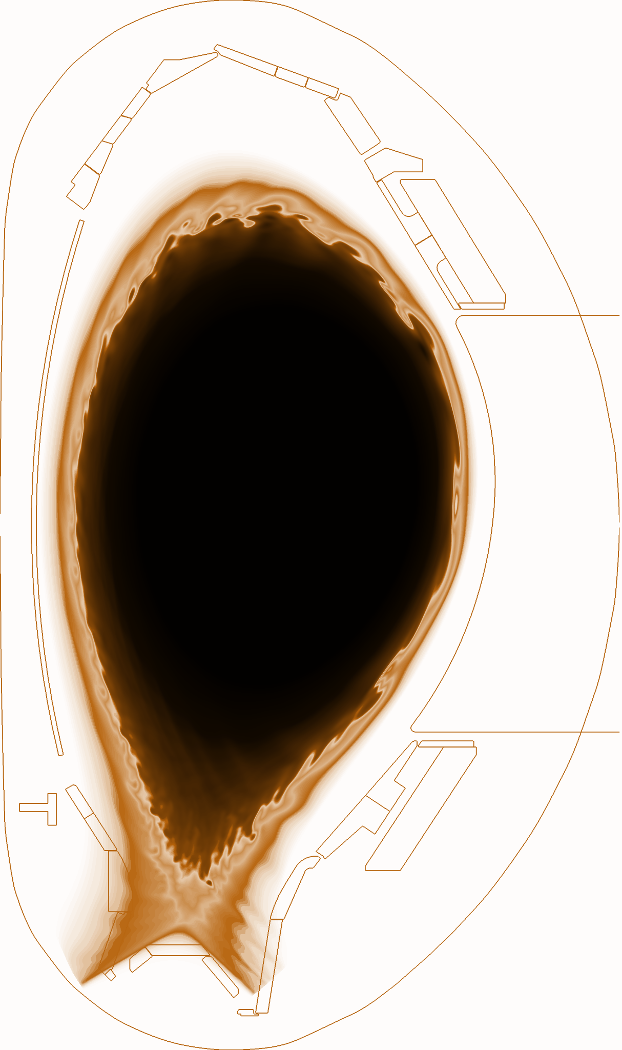

Motivation
Edge Localized Modes
Periodical expulsions of heat and particles from the boundary of the plasma. Large Type-I ELMs can reduce the lifetime of wall components in future devices
(Resonant) Magnetic Perturbations
Small 3D perturbations to the axisymmetric field of a tokamak. Planned method of ELM control for ITER
In this talk:
Introduce basic ELM & RMP physicswith im
Realistic AUG-RMP Simulations with JOREK-STARWAL
Confirmation of experimental evidence supporting a RMP-ELM suppression theory
Outlook towards advanced kinetic simulations
A. Cathey

Slide 3
Motivation
Edge Localized Modes
Periodical expulsions of heat and particles from the boundary of the plasma. Large Type-I ELMs can reduce the lifetime of wall components in future devices
Resonant Magnetic Perturbations
Small 3D perturbations to the axisymmetric field of a tokamak. Planned method of ELM control for ITER
In this talk:
Introdue basic ELM & RMP physics
Realistic AUG-RMP Simulations with JOREK-STARWAL with
Confirmation of experimental evidence supporting a RMP-ELM suppression theory
Outlook towards advanced kinetic simulations
A. Cathey

Slide 4
Motivation
Edge Localized Modes
Periodical expulsions of heat and particles from the boundary of the plasma. Large Type-I ELMs can reduce the lifetime of wall components in future devices
Resonant Magnetic Perturbations
Small 3D perturbations to the axisymmetric field of a tokamak. Planned method of ELM control for ITER
In this talk:
Introduce basic ELM & RMP physics
Development of self-consistent boundary conditions
for RMP studies with JOREK-STARWALL
Confirmation of experimental evidence supporting a RMP-ELM suppression theory
Outlook towards advanced kinetic simulations
A. Cathey

Slide 5
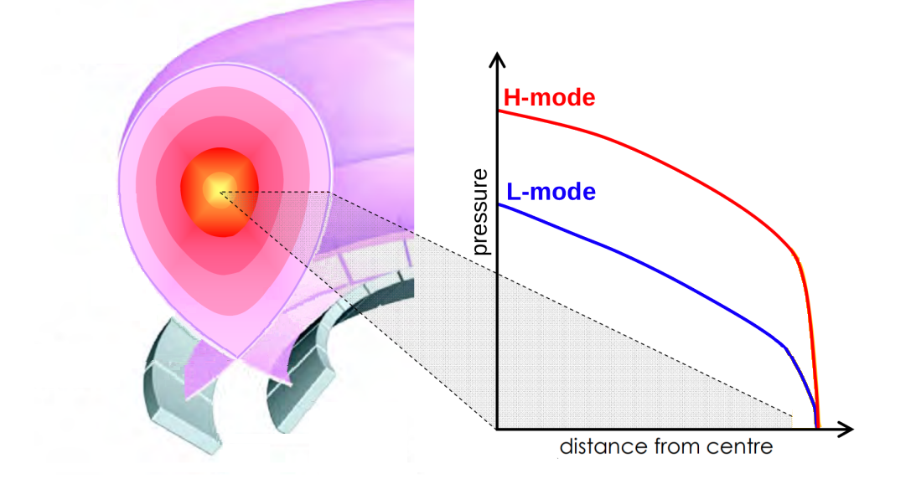
High confinement mode in tokamaks
H-Mode pressure profile characterized by steep pressure gradient at the edge
K. Park 2019 AiP

Slide 6
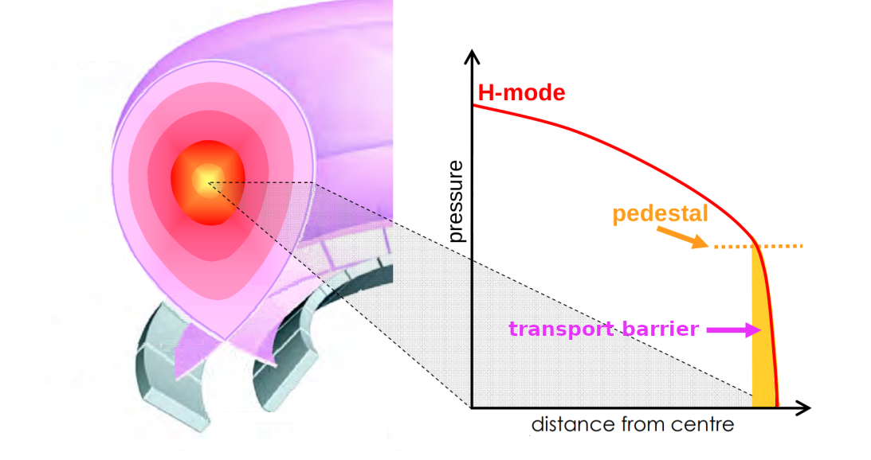
High confinement mode in tokamaks
H-Mode pressure profile characterized by steep pressure gradient at the edge
Transport is suppressed close to separatrix & leads to build up of pedestal
K. Park 2019 AiP

Slide 7
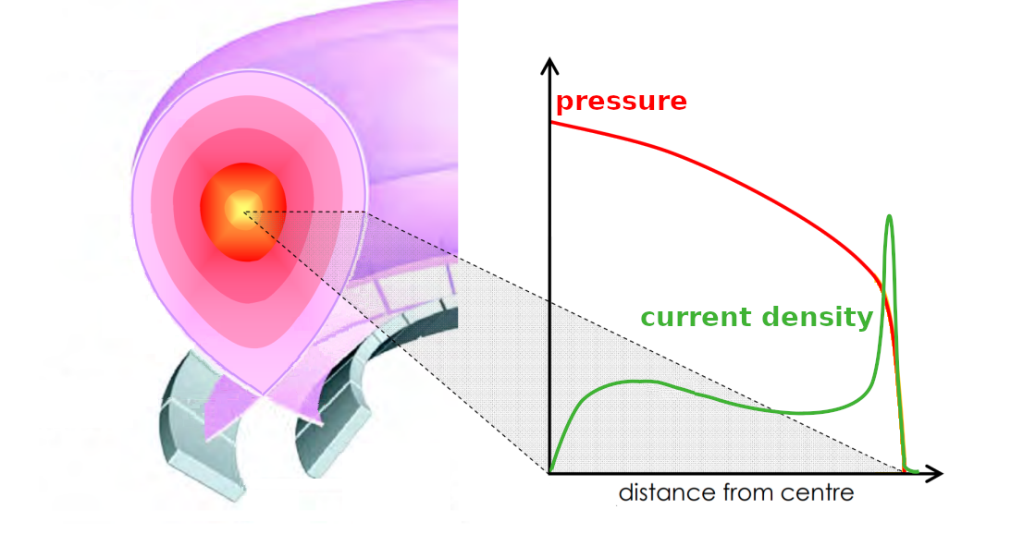
High confinement mode in tokamaks
H-Mode pressure profile characterized by steep pressure gradient at the edge
Transport is suppressed close to separatrix & leads to build up of pedestal
High current density follows from steep pressure gradient
MHD instabilities can be both pressure gradient driven and current density driven
K. Park 2019 AiP

Slide 8
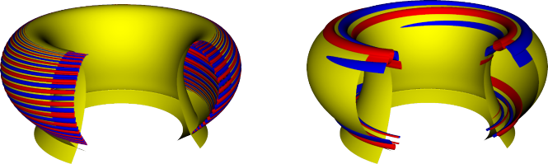
Ideal MHD instabilities in H-Mode pedestal
Ballooning Mode:
- pressure gradient driven
- high toroidal modes
- localized at low field side
H-Mode pressure profile characterized by steep pressure gradient at the edge
Transport is suppressed close to separatrix & leads to build up of pedestal
High current density follows from steep pressure gradient
MHD instabilities can be both pressure gradient driven and
current density driven
M. Hoelzl

Slide 9
Ideal MHD instabilities in H-Mode pedestal
Ballooning Mode:
- pressure gradient driven
- high toroidal modes
- localized at low field side
H-Mode pressure profile characterized by steep pressure gradient at the edge
Transport is suppressed close to separatrix & leads to build up of pedestal
High current density follows from steep pressure gradient
MHD instabilities can be both pressure gradient driven and
current density driven
M. Hoelzl
Peeling Mode:
- current density driven
- low toroidal modes
M. Hoelzl

Slide 10
Ideal MHD instabilities in H-Mode pedestal
Ballooning Mode:
- pressure gradient driven
- high toroidal modes
- localized at low field side
H-Mode pressure profile characterized by steep pressure gradient at the edge
Transport is suppressed close to separatrix & leads to build up of pedestal
High current density follows from steep pressure gradient
MHD instabilities can be both pressure gradient driven and
current density driven
Peeling and ballooning mode can couple to a coupled peeling-ballooning mode
ELMs are the non-linear consequence of peeling-ballooning modes
M. Hoelzl
Peeling Mode:
- current density driven
- low toroidal modes
M. Hoelzl

Slide 11
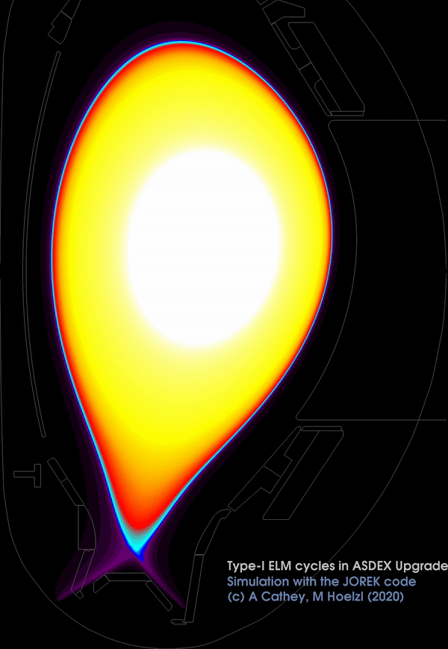
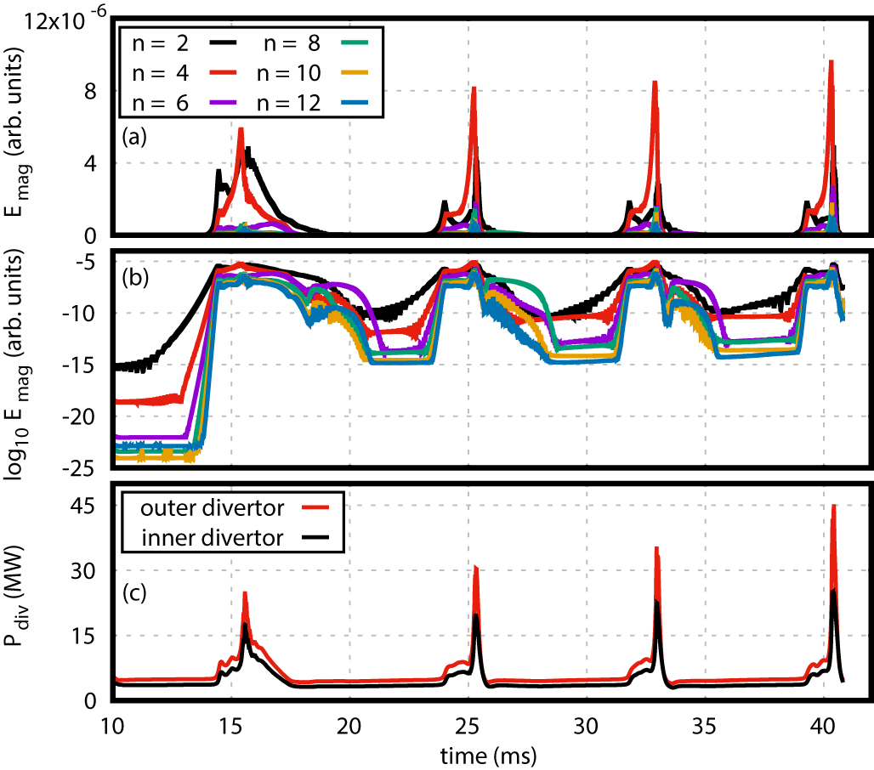
Edge Localized Modes [A. Cathey 2022 NF]
Precursor Phase: Destabilization of precursor peeling-ballooning modes due to pressure gradient and current density
ELM onset: Reduction in plasma flows - begin of faster-than exponential growth
ELM crash: Convective and conductive losses degrade the pedestal gradients
Recovery: Pedestal rebuilds
ELM cycles in AUG
by A. Cathey using JOREK
[A. Cathey 2022 NF]

Slide 12
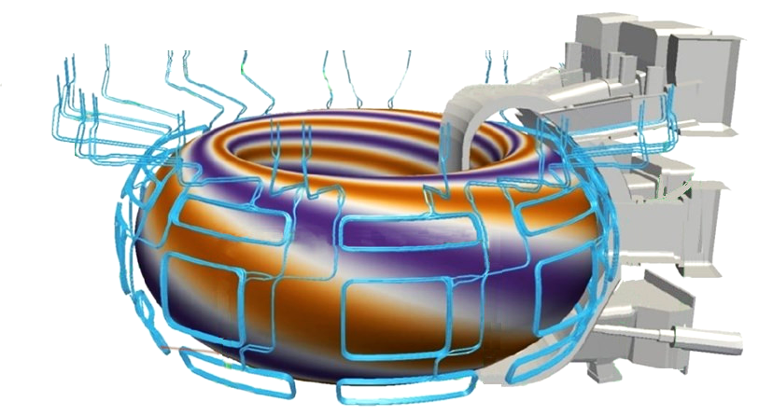
Type-I ELMs not supportable in future machines
Type-1 ELM eject typically 5-10% of plasma stored energy [Eich T. et al 2017 NME]
Losses during ELM crash directed towards divertor plates and cause high transient fluxes
not tolerable for future fusion devices
ELM control mechanisms under development
  Naturally ELM-free or small ELM Regimes
  Pellet Injection
  Application of Resonant Magnetic Perturbations
    Small helical field applied with external coils
    One dominant toroidal mode n_{RMP}
    broad poloidal spectrum
iter.org

Slide 13
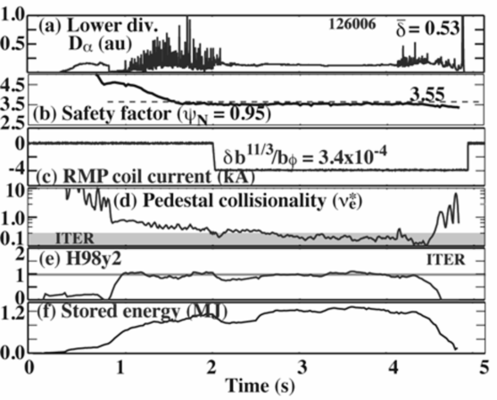
Magnetic perturbations can fully suppress ELMs
D-alpha signal as measure for ELM occurrences
⇒ RMP ramp up followed by ELM free phase
Empirical operational windows have been found
[W. Suttrop 2018 NF]
  Plasma edge density below critical threshold
  q95 within parameter ranges
  Requirements to plasma shaping and
  plasma pressure
[Evans, 2008 NF]
DIIID discharge with RMP-ELM suppression

Slide 14
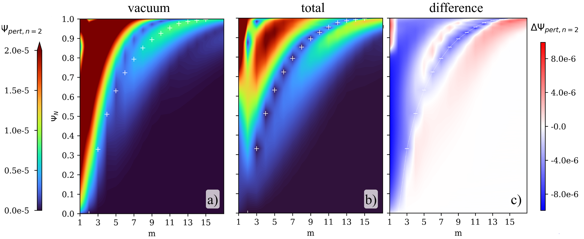
Initial hypothesis: 3D perturbation leads to stochastic edge
Rational surface: m/n_{RMP} helicity
Resonant surface: m/n_{RMP} helicity
q-profile determines radial location q=m/n_{RMP}
Poloidal spectrum of applied
n=2 perturbation
(without plasma response)
+ … resonant surfaces
1.0
0.8
0.6
0.4
0.2
0.0
+
+
+
+
+
+
+
+
+
5 -
4 -
3 -
2 -
+
9/2
radial coordinate →
8/2
+
qprofile
7/2
6/2
5/2
1 5 9 13 17
m
radial coordinate →

Slide 15
Initial hypothesis: 3D perturbation leads to stochastic edge
Rational surface: m/n_{RMP} helicity
Resonant surface: m/n_{RMP} helicity
q-profile determines radial location q=m/n_{RMP}
Poloidal spectrum of applied
n=2 perturbation
(without plasma response)
+ … resonant surfaces
1.0
0.8
0.6
0.4
0.2
0.0
+
+
+
+
+
+
+
+
+
5 -
4 -
3 -
2 -
+
9/2
radial coordinate →
8/2
+
qprofile
7/2
6/2
5/2
1 5 9 13 17
m
radial coordinate →
m/n_{RMP} component of perturbation non-zero at position of resonant flux surface - magnetic island forms

Slide 16
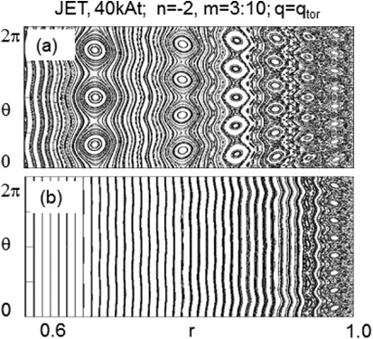
Initial hypothesis: 3D perturbation leads to stochastic edge
  Islands overlap at the edge and result in stochastic layer
  Fast heat transport along field lines
  ⇒ Reduction of Te in pedestal
  ⇒ stabilization of edge region
But: Te reduction generally not observed in experiment
[T. Evans Nature 2006]
:
M. Becoulet 2012 NF
F. Orain 2016 NF

Slide 17
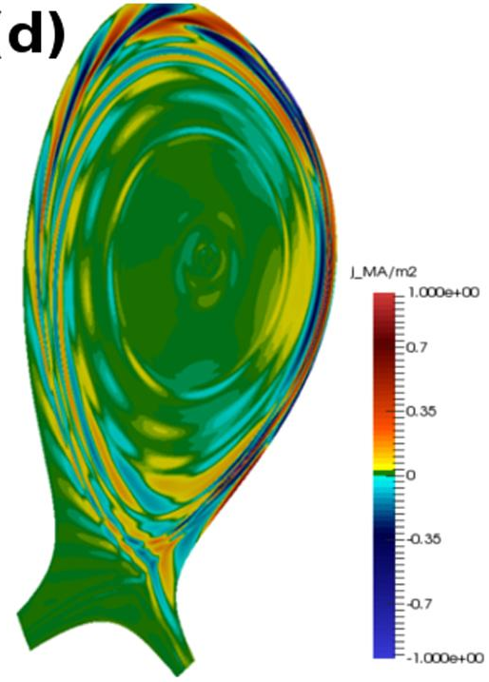
Plasma currents alter the total perturbation
Perturbation induces currents on resonant surfaces ⇒ Local screening of perturbation
⇒ Fewer islands form
Screening currents described by Ohm’s Law:
Small stochastic edge region remains due to resistivity
In addition: If diamagnetic and E×B-flows cancel locally (v_{⊥,e}=0) islands may penetrate on individual resonant surfaces
Two-fluid model requires v_{⊥,e}=0
Other conditions in kinetic models [Heyn 2014 NF] and experiment [Suttrop 2019 NF, Paz-Soldan 2020 NF]
M. Becoulet 2012 NF
F. Orain 2016 NF

Slide 18

Plasma currents alter the total perturbation
Perturbation induces currents on resonant surfaces ⇒ Local screening of perturbation
⇒ Fewer islands form
Screening currents described by Ohm’s Law:
Small stochastic edge region remains due to resistivity
In addition: If diamagnetic and E×B-flows cancel locally (v_{⊥,e}=0) islands may penetrate on individual resonant surfaces
Two-fluid model requires v_{⊥,e}=0
Other conditions in kinetic models [Heyn 2014 NF] and experiment [Suttrop 2019 NF, Paz-Soldan 2020 NF]
M. Becoulet 2012 NF
F. Orain 2016 NF

Slide 19
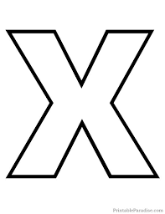
Perturbation screening and kink amplification
✖ Resonant Contributions are screened at the position of the respective resonant surfaces
1.0
0.8
0.6
0.4
0.2
0.0
+
+
+
+
+
+
+
+
+
+
+
+
+
+
+
+
+
+
+
+
+
+
+
+
+
+
+
+
+
+
+
+
+
1 5 9 13 17
m
1 5 9 13 17
m
1 5 9 13 17
m

Slide 20
Perturbation screening and kink amplification
✖ Resonant Contributions are screened at the position of the respective resonant surfaces
O Amplified Edge Kink Modes
1.0
0.8
0.6
0.4
0.2
0.0
+
+
+
+
+
+
+
+
+
+
+
+
+
+
+
+
+
+
+
+
+
+
+
+
+
+
+
+
+
+
+
+
+
1 5 9 13 17
m
1 5 9 13 17
m
1 5 9 13 17
m

Slide 21
Perturbation screening and kink amplification
Resonant Contributions are screened at the position of the respective resonant surfaces
O Amplified Edge Kink Modes
Ideal Kink Modes deform flux surfaces from their equilibrium positions (-----)
1.0
0.8
0.6
0.4
0.2
0.0
+
+
+
+
+
+
+
+
+
+
+
+
+
+
+
+
+
+
+
+
+
+
+
+
+
+
+
+
+
+
+
+
radial coordinate →
+
1 5 9 13 17
m
1 5 9 13 17
m
1 5 9 13 17
m
toroidal coordinate →

Slide 22
Island penetration at pedestal top
q=m/n_{RMP}= 7/2
vperp=0
Plasma rotation (close to) zero locally
⇒ Perturbation is not screened
RMP induced rotation braking on resonant surfaces through
- jxB currents
- toroidal mode coupling [F. Orain]
v_{⊥,e}≈ 0 at the position of a resonant surface:
magnetic island penetrates and locks to perturbation
Island at pedestal top generates additional transport to keep the pedestal from widening
Pedestal remains below critical gradients or width for ELM destabilization
plasma rotation
no screening
qprofile
q=3.5

Slide 23
Island penetration at pedestal top
q=m/n_{RMP}= 7/2
vperp=0
Plasma rotation (close to) zero locally
⇒ Perturbation is not screened
RMP induced rotation braking on resonant surfaces through
- jxB currents
- toroidal mode coupling [F. Orain]
v_{⊥,e}≈ 0 at the position of a resonant surface:
magnetic island penetrates and locks to perturbation
Island at pedestal top generates additional transport to keep the pedestal from widening ⇒ Pedestal remains stable [P Snyder 2012 PoP]
Supported by experimental findings of q95 windows
plasma rotation
no screening
qprofile
q=3.5
pressure

Slide 24
Increased particle transport
“Density Pump Out”: 3D geometry enhances several particle transport mechanisms:
Polarization Drift
Q.M. Hu et al 2020 Nucl. Fusion - TM1
Neoclassical Toroidal Viscosity
S.K. Kim et al 2023 Nucl. Fusion - JOREK-PENTRC
Increased Turbulence
N. Leuthold et al 2023 Nucl. Fusion - AUG

Slide 25
Increased particle transport
“Density Pump Out”: 3D geometry enhances several particle transport mechanisms:
Polarization Drift
Q.M. Hu et al 2020 Nucl. Fusion - TM1
  with RMPs, narrow islands in the pedestal region
  Parallel transport is increased around magnetic islands
Neoclassical Toroidal Viscosity
S.K. Kim et al 2023 Nucl. Fusion - JOREK-PENTRC
Increased Turbulence
N. Leuthold et al 2023 Nucl. Fusion - AUG

Slide 26
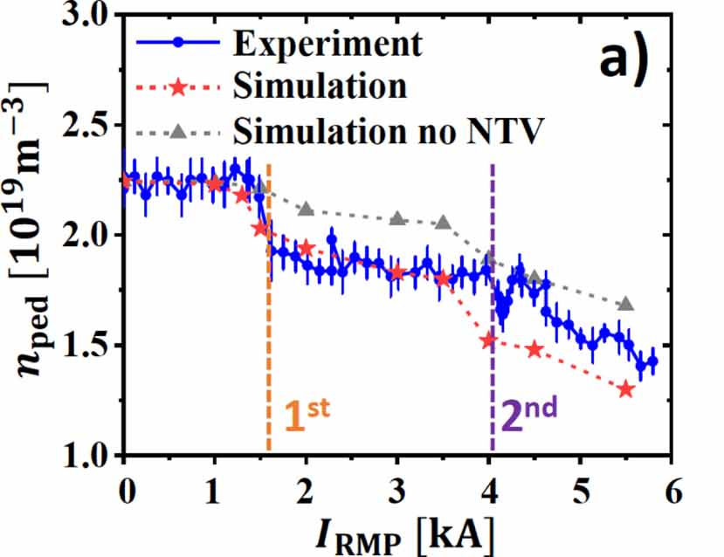
Increased particle transport
“Density Pump Out”: 3D geometry enhances several particle transport mechanisms:
Polarization Drift
Q.M. Hu et al 2020 Nucl. Fusion - TM1
Neoclassical Toroidal Viscosity
S.K. Kim et al 2023 Nucl. Fusion - JOREK-PENTRC
  non-axisymmetry changes neoclassical transport
  particle drift across flux surfaces
  modelling of polarization drift + NTV matches quite well
  KSTAR pump out
Increased Turbulence
N. Leuthold et al 2023 Nucl. Fusion - AUG

Slide 27
Increased particle transport
“Density Pump Out”: 3D geometry enhances several particle transport mechanisms:
Polarization Drift
Q.M. Hu et al 2020 Nucl. Fusion - TM1
Neoclassical Toroidal Viscosity
S.K. Kim et al 2023 Nucl. Fusion - JOREK-PENTRC
Increased Turbulence
N. Leuthold et al 2023 Nucl. Fusion - AUG
  Broadband Turbulence and QCM impact particle transport
  Toroidally and radially localized structures observed

Slide 28
Increased particle transport
“Density Pump Out”: 3D geometry enhances several particle transport mechanisms:
Polarization Drift
Q.M. Hu et al 2020 Nucl. Fusion - TM1
Neoclassical Toroidal Viscosity
S.K. Kim et al 2023 Nucl. Fusion - JOREK-PENTRC
Increased Turbulence
N. Leuthold et al 2023 Nucl. Fusion - AUG
⇒ Particle transport might keep pressure below ELM stability limit
⇒ supported by experimentally observed edge density threshold for ELM suppression [W. Suttrop 2018 NF]
s are needed.

Slide 29
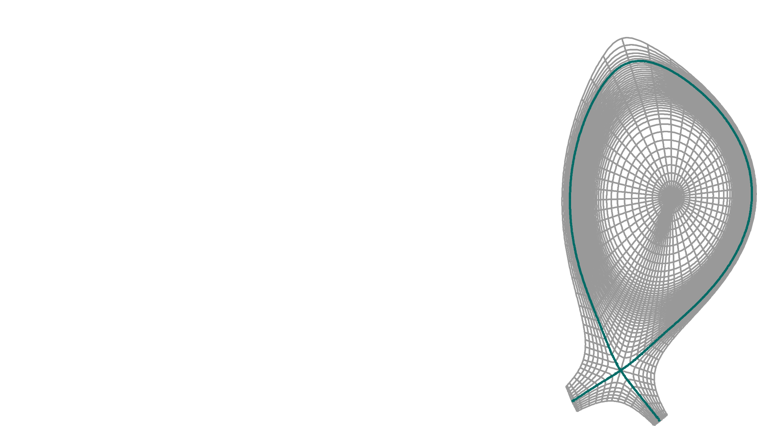
JOREK - 3D non-linear extended MHD code
Magneto-hydrodynamics (MHD) describes plasma as fluid
JOREK solves extended full or reduced MHD equations that describe evolution
  Density
  Temperature
  Velocity
  Current
  Magnetic Field
  Electric Field
2D finite elements with realistic geometry, toroidal Fourier expansion
Different MHD-models and extensions available
Here we use a reduced MHD model inc extensions for
two fluid effects, bootstrap current and
free boundary conditions with STARWALL extension
JOREK grid w reduced resolution
Separatrix (green) for orientation

Slide 30
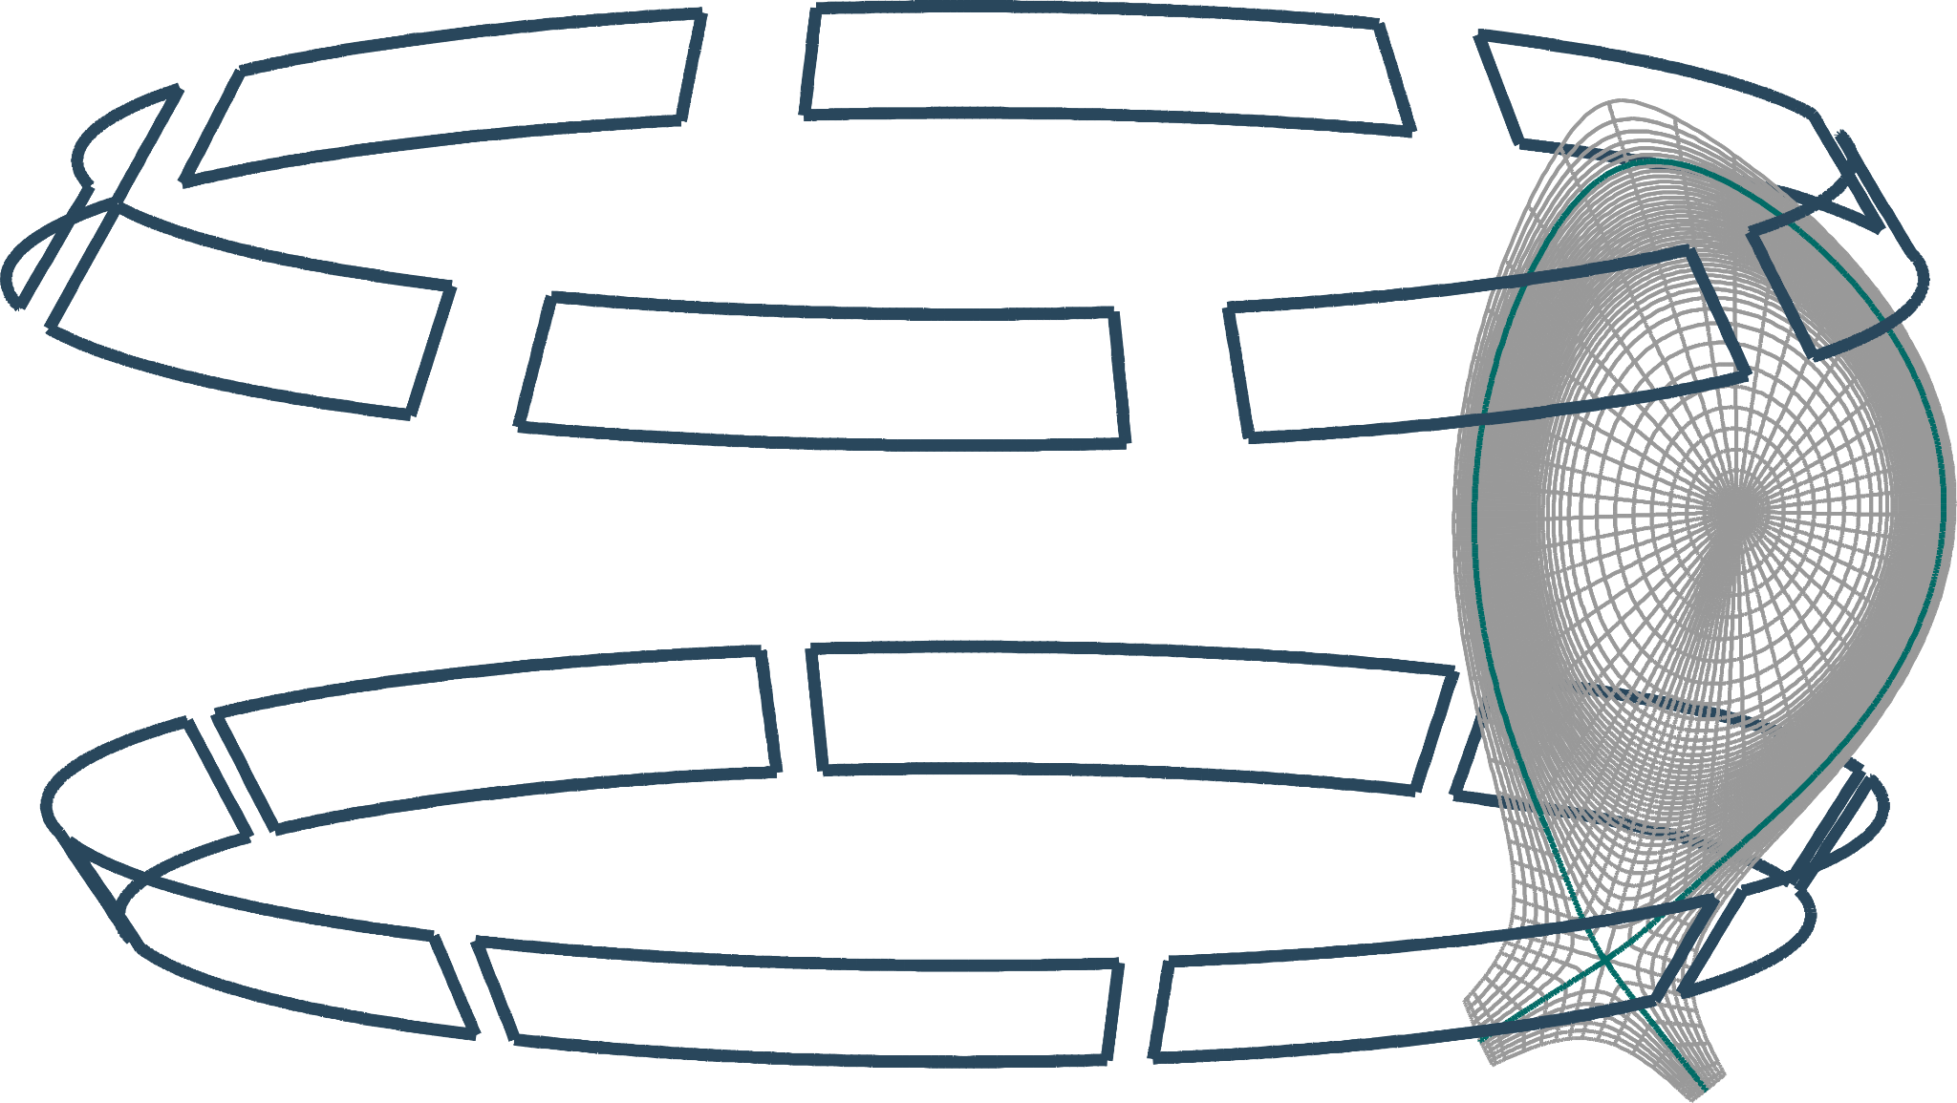
STARWALL
JOREK-STARWALL coupling via boundary conditions
“free boundary” instead of “fixed boundary”
Provides information about surrounding conducting structures
e.g. vacuum vessel, passive coils, active coils
Model of the magnetic field surrounding the computational domain,
linked by B⊥ and B॥.
JOREK grid w reduced resolution
Separatrix (green) for orientation

Slide 31
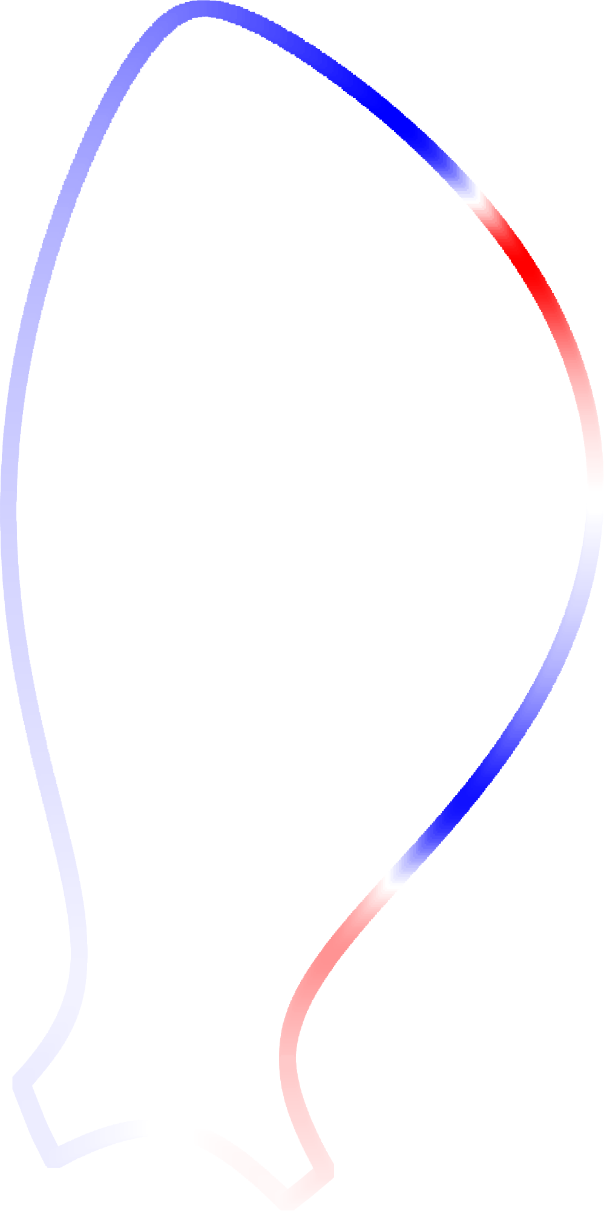

Impact of boundary conditions
Fixed boundary (JOREK)
Vacuum perturbation is applied directly at the boundary as magnetic flux boundary condition
Screening / amplification are neglected at boundary
Perturbation remains fixed in time:
plasma response has to converge
to vacuum solution at the boundary
at all times

Slide 32
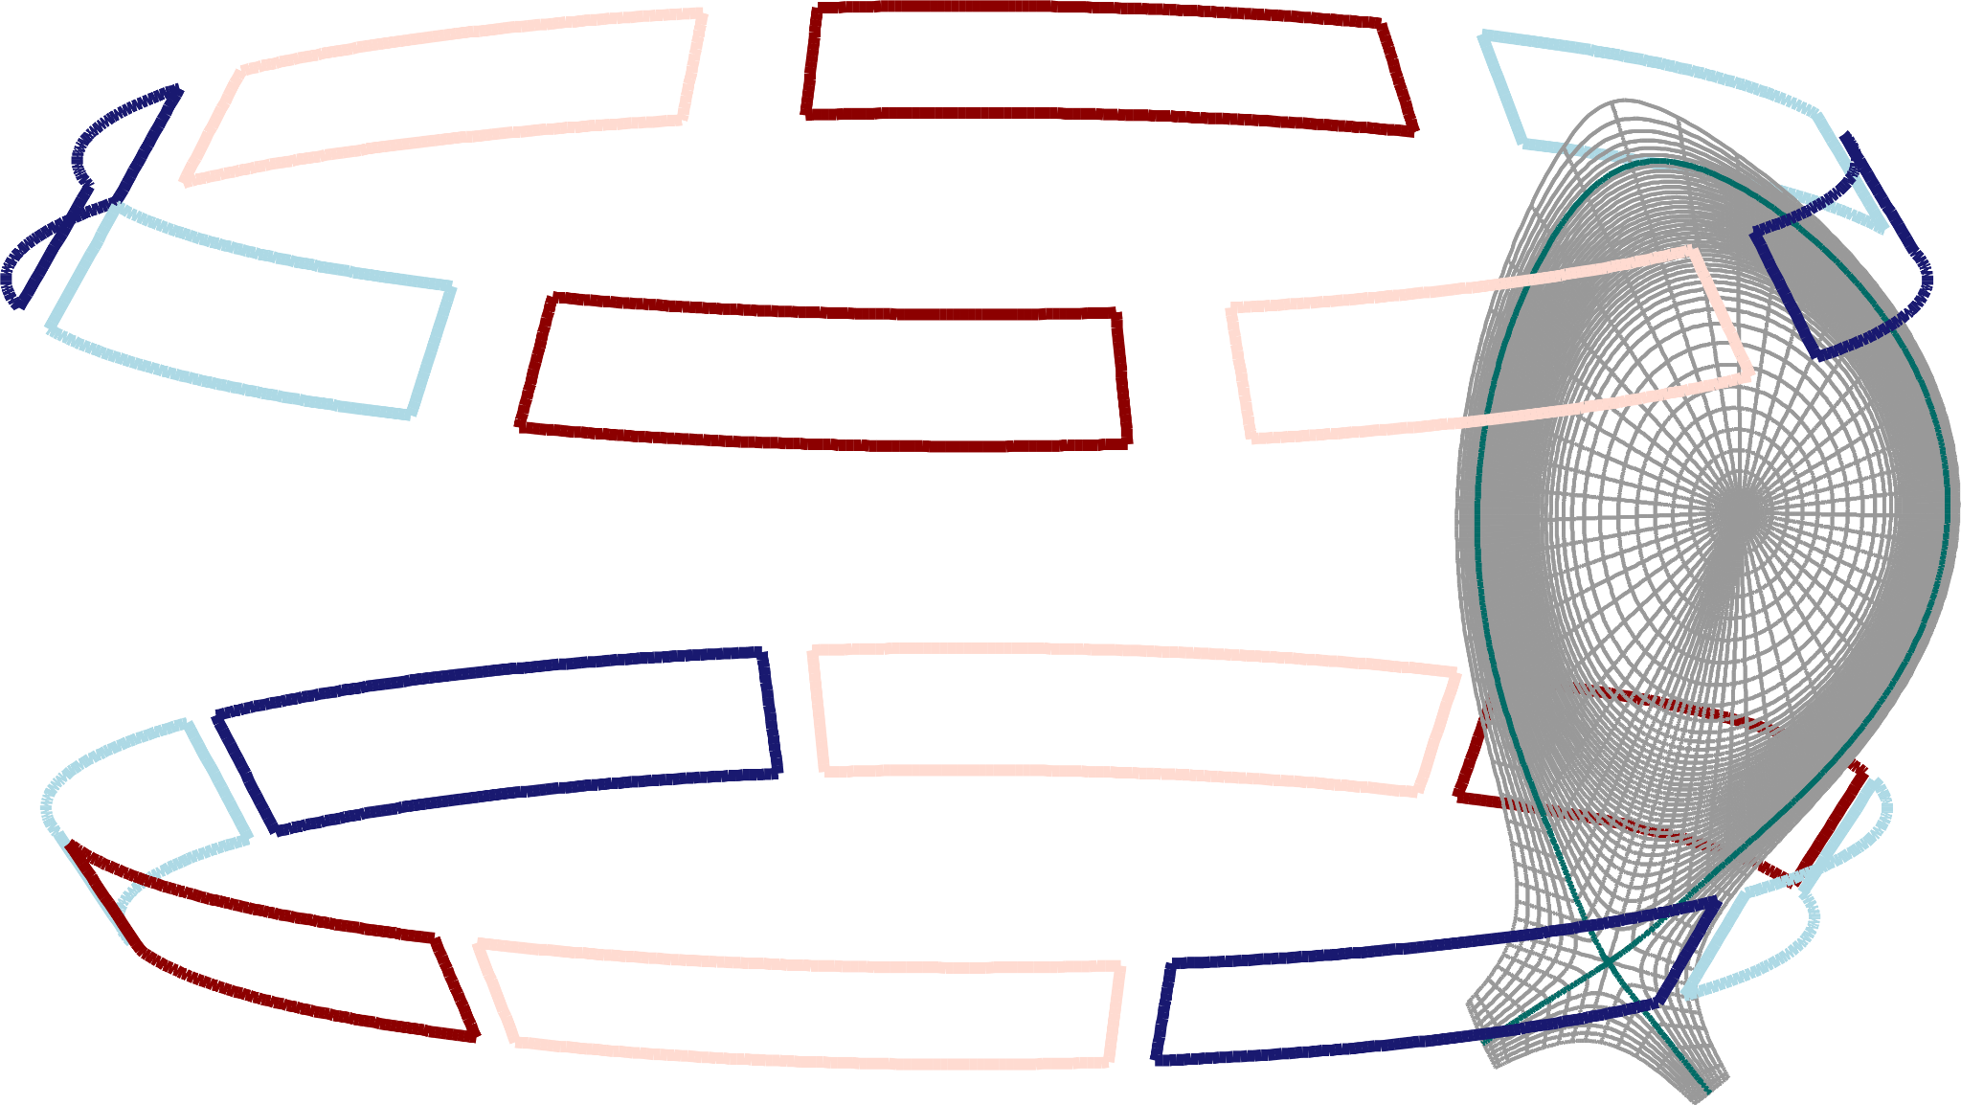
Impact of boundary conditions
Fixed boundary (JOREK)
Vacuum perturbation is applied directly at the boundary as magnetic flux boundary condition
Screening / amplification are neglected at boundary
Perturbation remains fixed in time:
plasma response has to converge
to vacuum solution at the boundary
at all times
Free boundary (JOREK-STARWALL)
Perturbation evolves according to coil currents
Flux fully self consistent, no artificial constraints as in fixed boundary
Plasma response taken into account in the full computational domain at all times

Slide 33
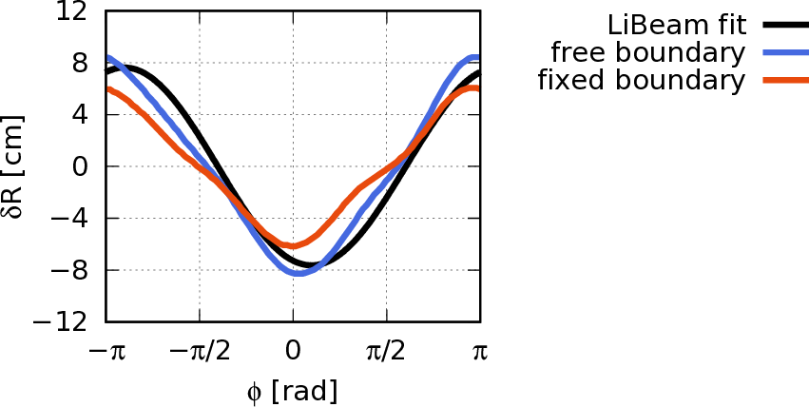
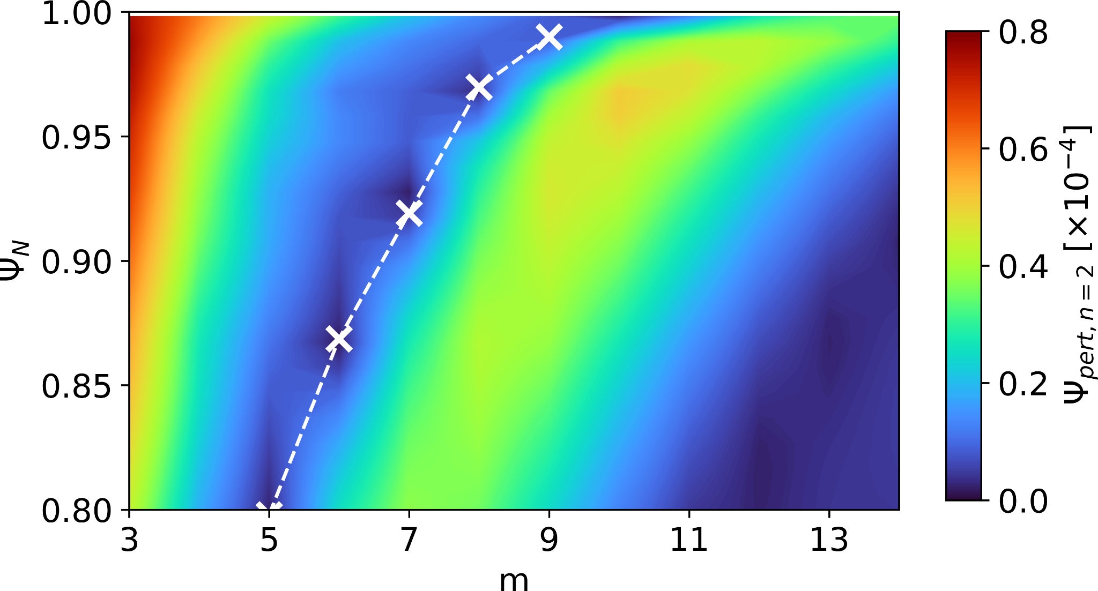
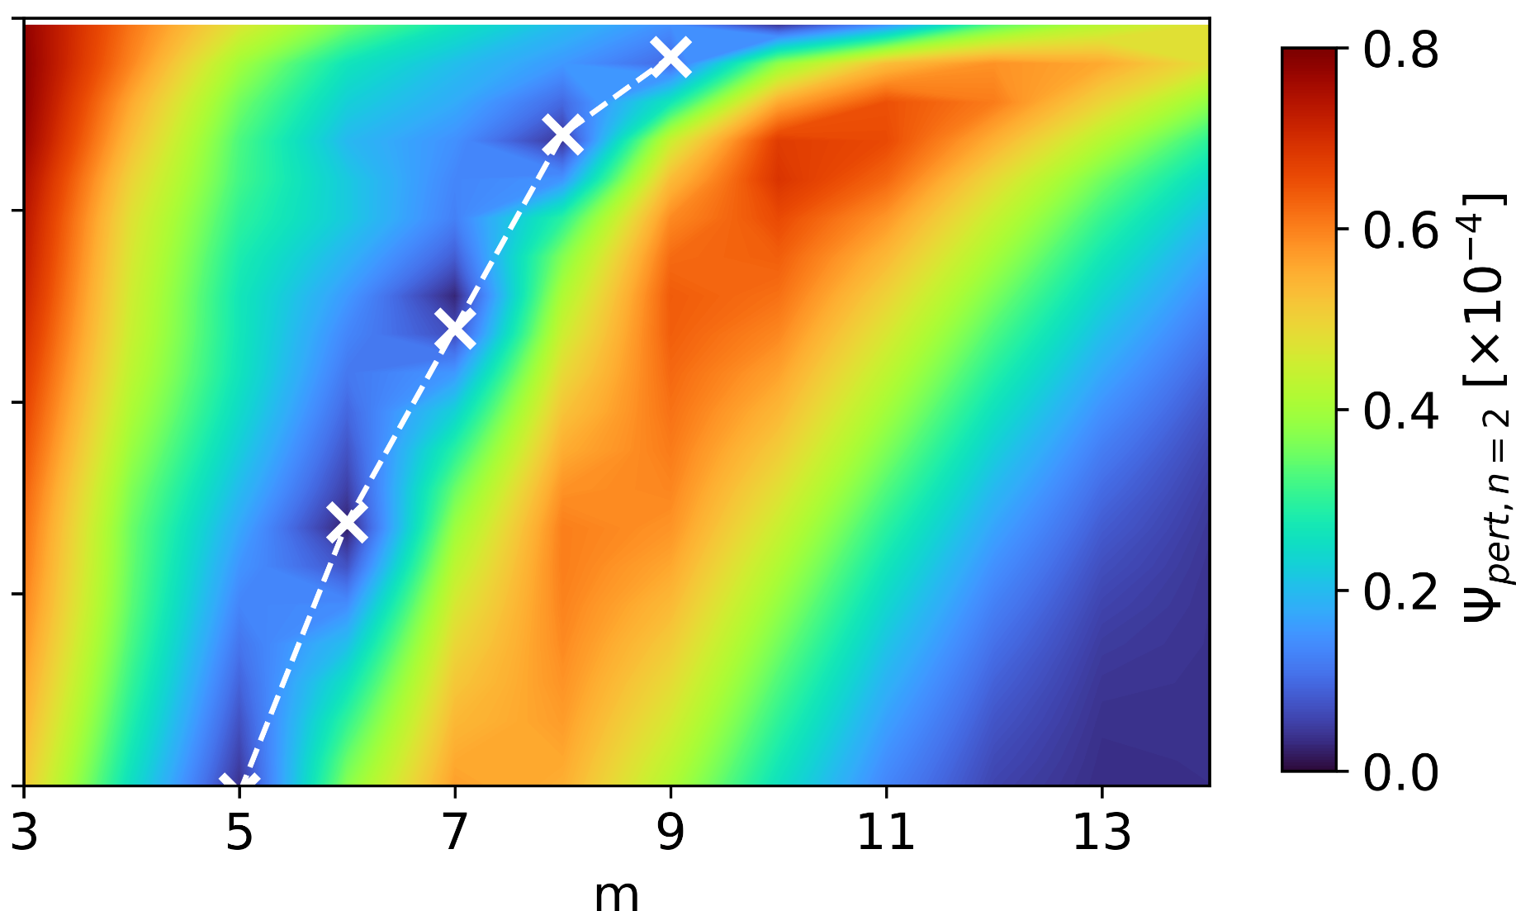
Impact of boundary conditions [V.Mitterauer et al. 2022]
Poloidal Mode spectrum of n=2 component of magnetic perturbation
fixed boundary
free boundary
Kink Mode Amplification larger in free boundary simulations
Fixed boundary artificially damps kink amplification at the edge to converge to vacuum perturbation at the boundary

Slide 34
Impact of boundary conditions [V.Mitterauer et al. 2022]
Deformation of separatrix from equilibrium position by RMPs
Poloidal Mode spectrum of n=2 component of magnetic perturbation
fixed boundary
free boundary
Kink Mode Amplification larger in free boundary simulations
Fixed boundary artificially damps kink amplification at the edge to converge to vacuum perturbation at the boundary
Free boundary improves match with experimental measurements
(LiBeam fit)

Slide 35
Simulation setup
Building up on previous work done with JOREK
close to experiment - despite high demand to computational resources & numerical stability
  Equilibrium is reconstructed from experimental density and temperature measurements
  RMP coil current pattern applied according to experiment
  Spitzer resistivity with neoclassical corrections and T^{-3/2} dependency
  Realistic viscosity: ~1 m²/s
  Realistic flows:
    Toroidal rotation torque source
    ExB and electron- and ion-diamagnetic flows
    self-consistent according to force balance

Slide 36
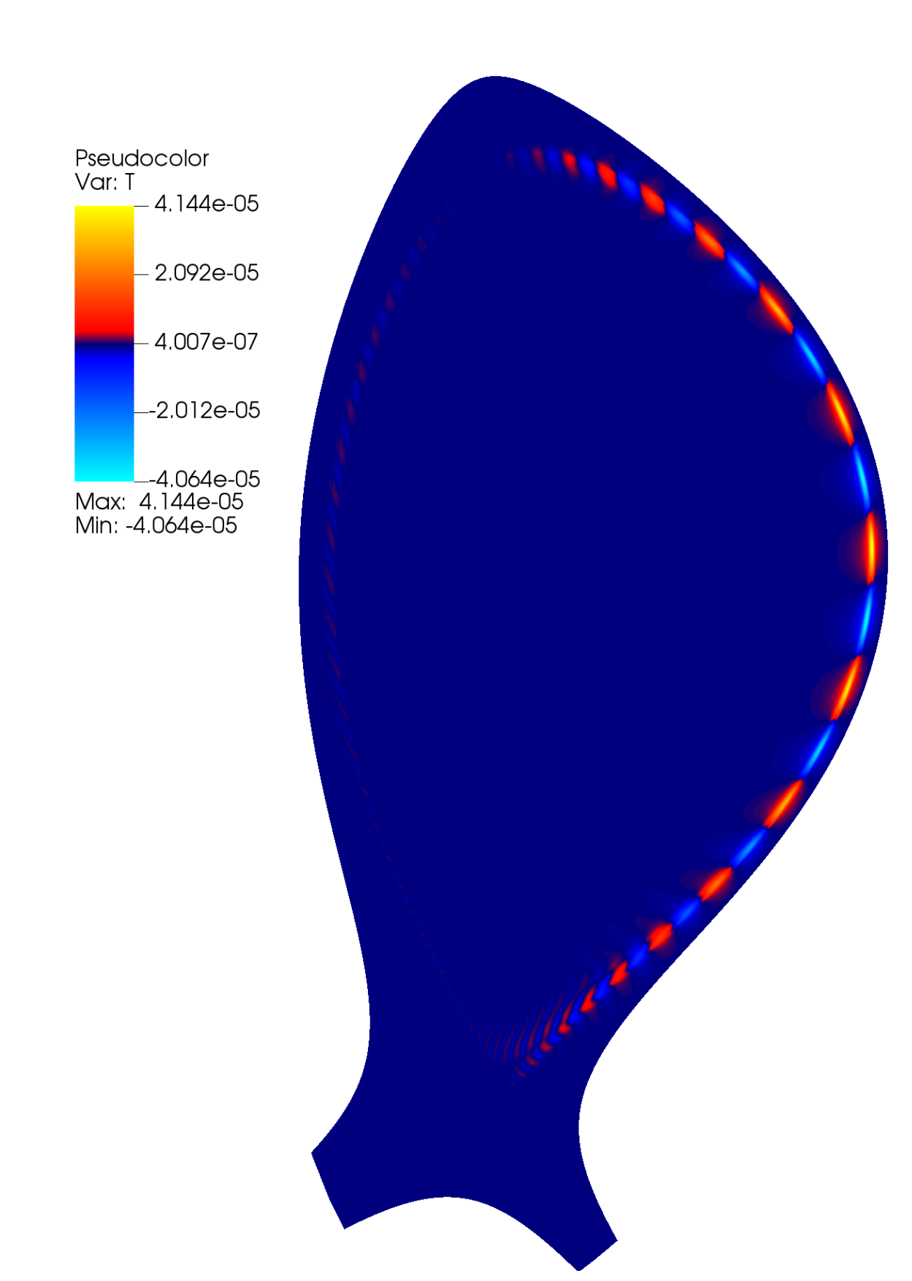
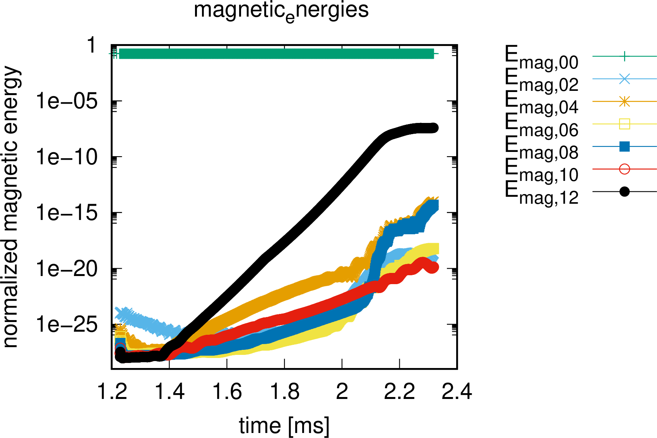
RMPs stabilize plasma edge
without application of RMPs:
ballooning unstable
With application of RMPs
Growing modes replaced
by saturated non-rotating
RMP modes

Slide 37
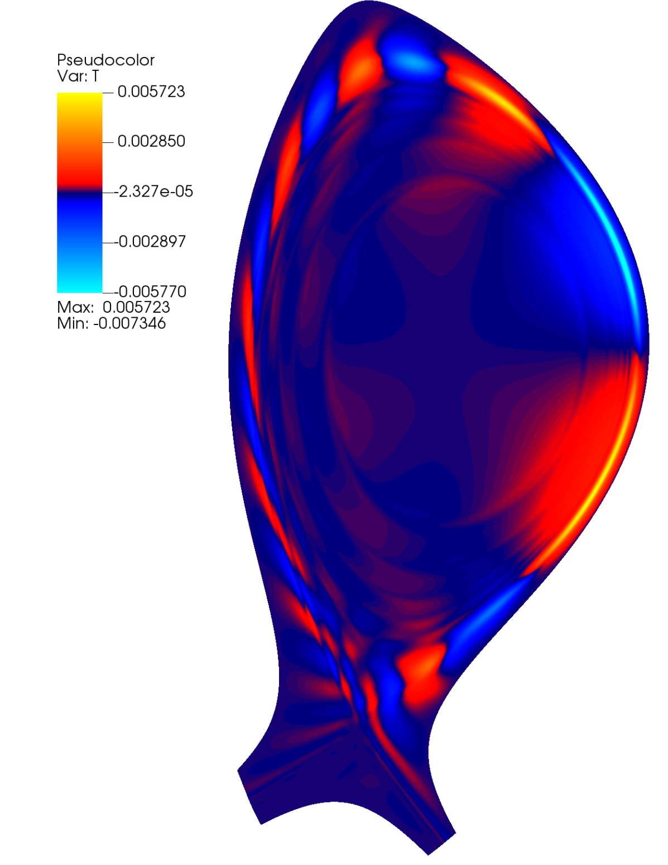
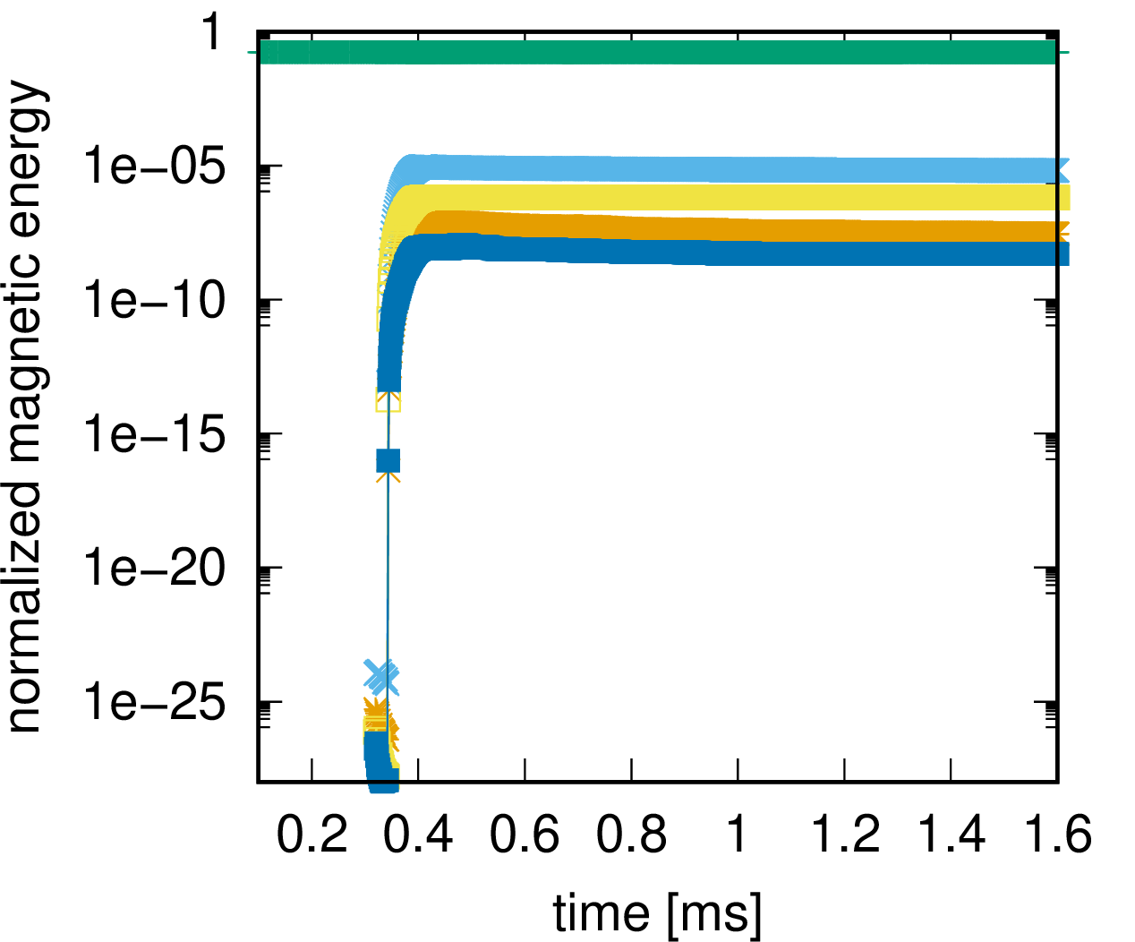
RMPs stabilize plasma edge
without application of RMPs:
ballooning unstable
With application of RMPs
Growing modes replaced
by saturated non-rotating
RMP modes
with application of RMPs
Modes saturate after RMP ramp up, with dominating n=2 and n=6

Slide 38
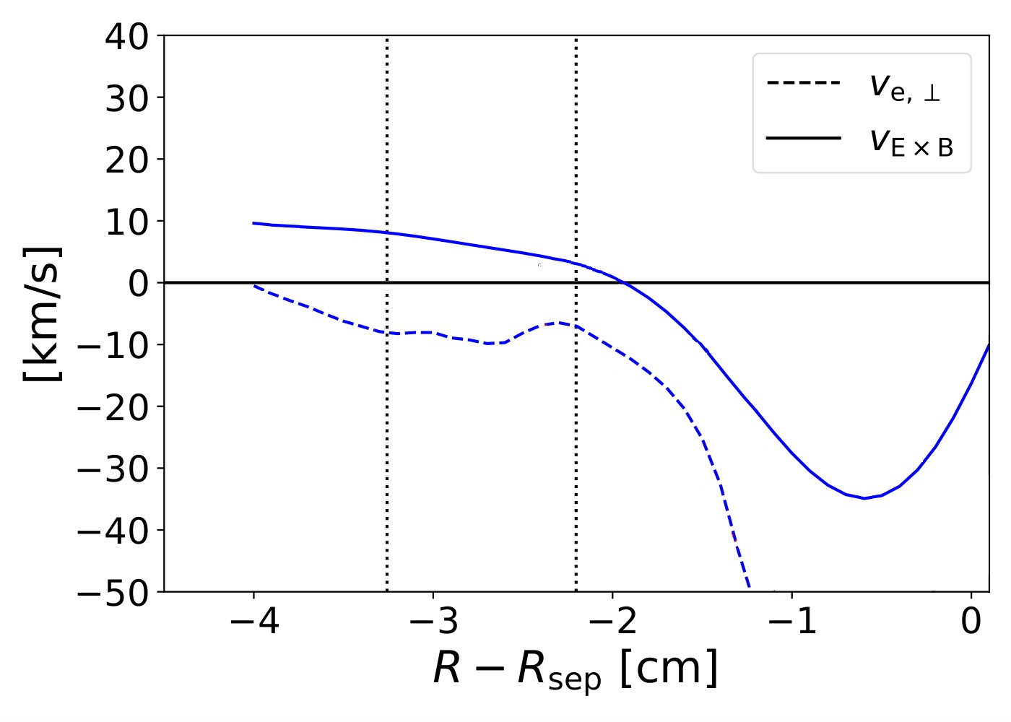
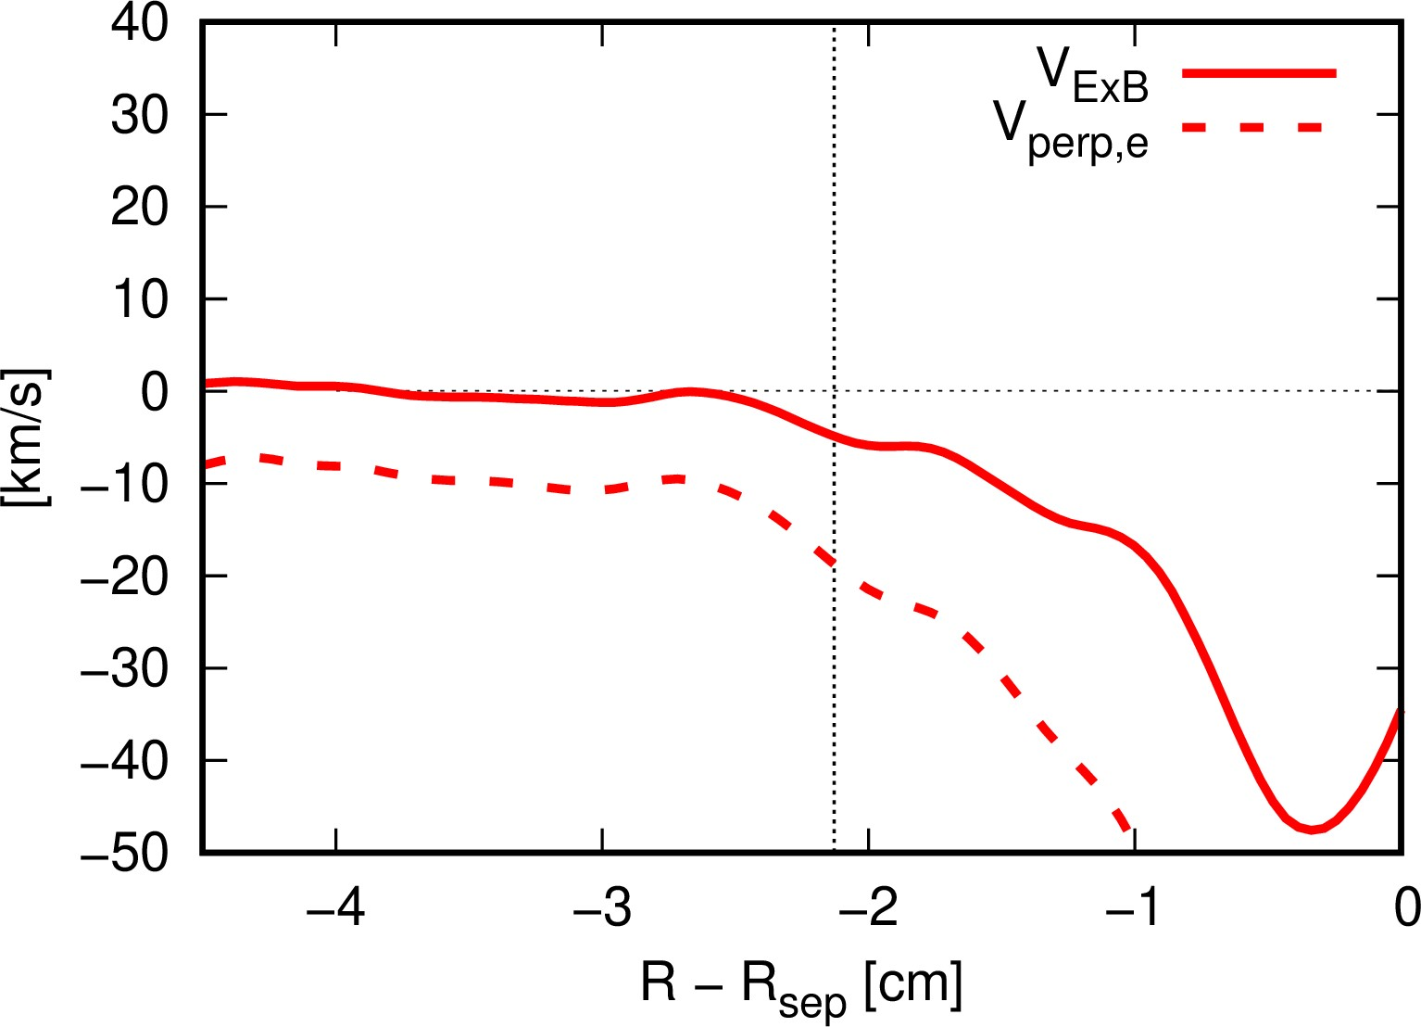
Comparison of plasma flows
Plasma flows in experiment
Plasma flows in JOREK

Slide 39
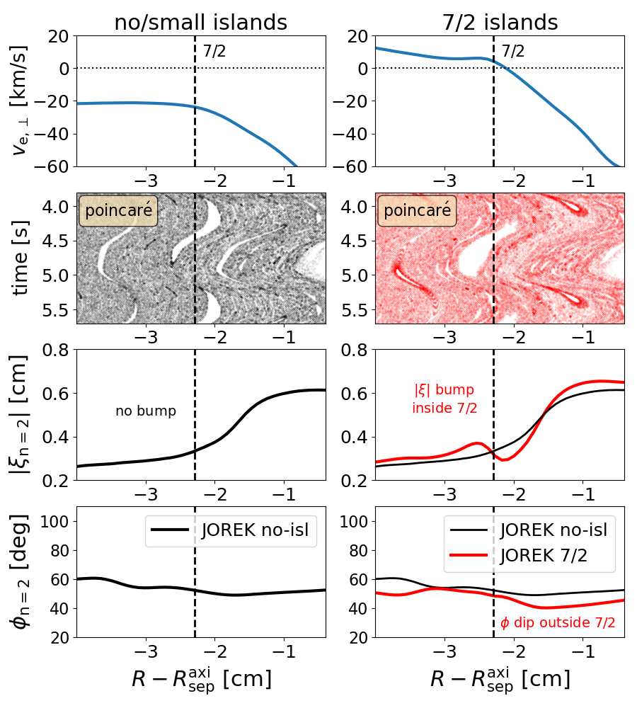
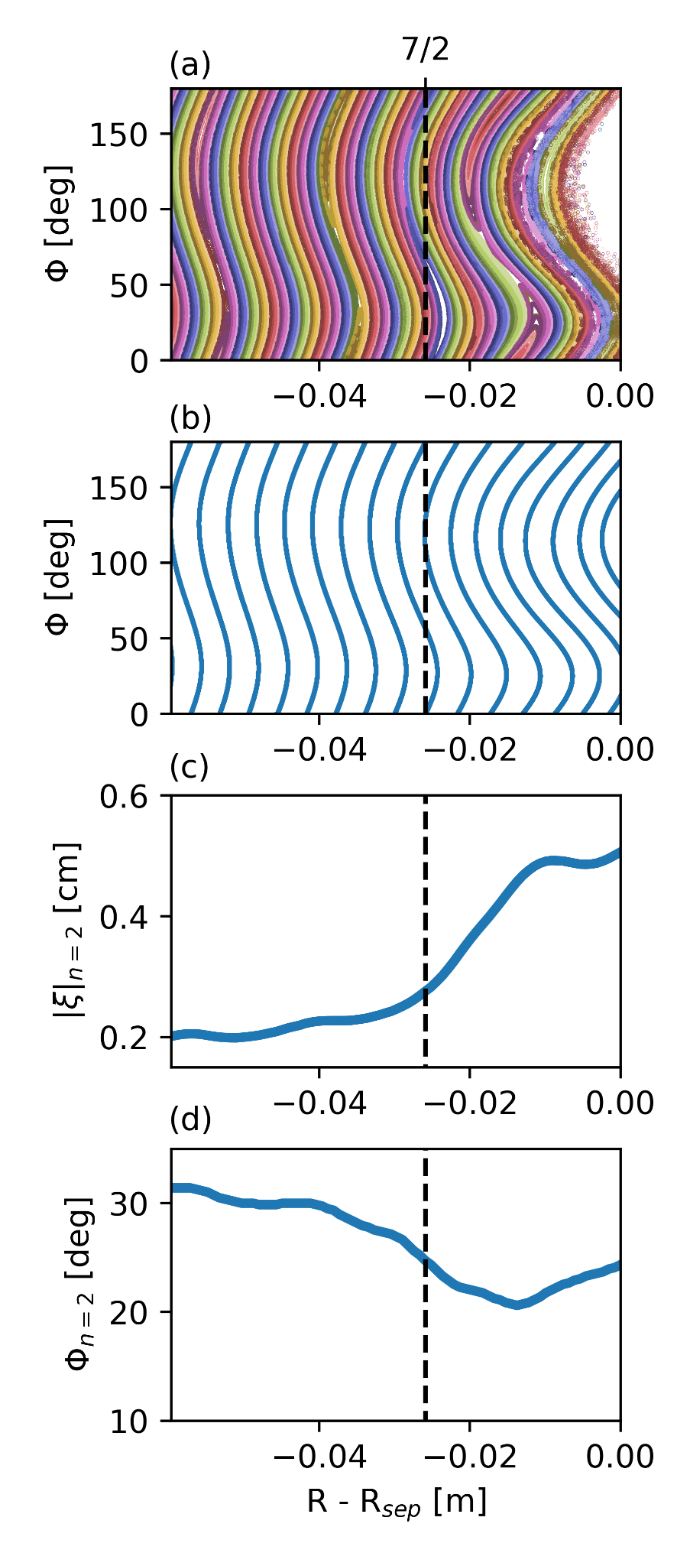
Island penetration and mode locking
Artificial Rotation Source applied to force zero-crossing of rotation at the 7/2 rational surface
Without zero crossing: small rotating islands
With zero crossing: Island penetrates, bifurcation to large size and locking to perturbation

Slide 40
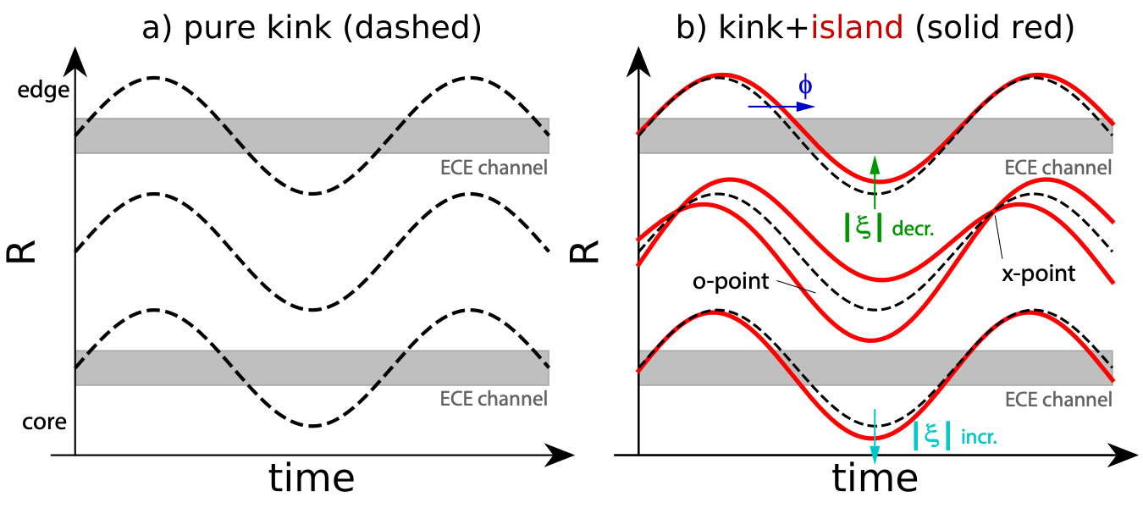
Experimental detection of magnetic islands during RMP application
Island detection difficult in experiment, as the
strong kink response dominates over tearing mode
Detection possible based on change of the
amplitude and phase of the deformation of the flux surfaces in vicinity of islands [M. Willensdorfer 2023, in review NP]
Requires high resolution temperature measurements, possible in AUG with ECE diagnostic.

Slide 41
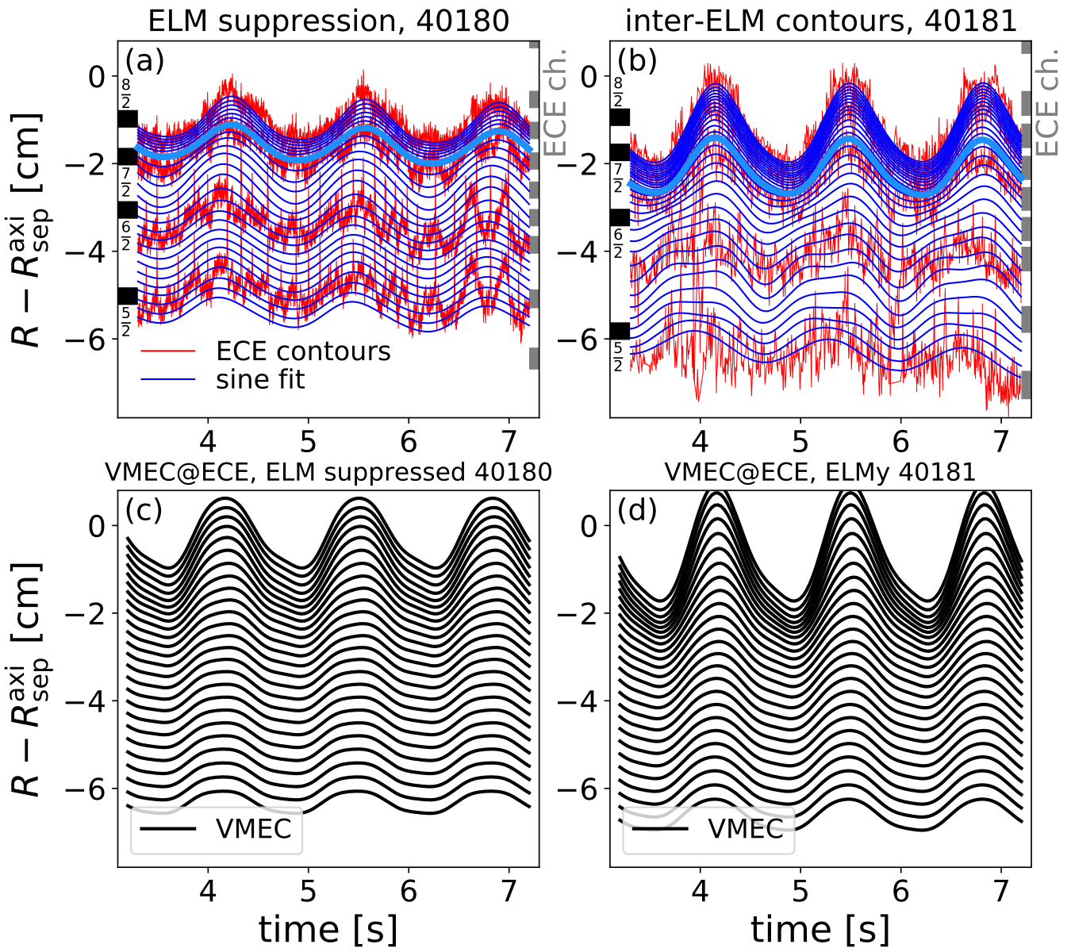
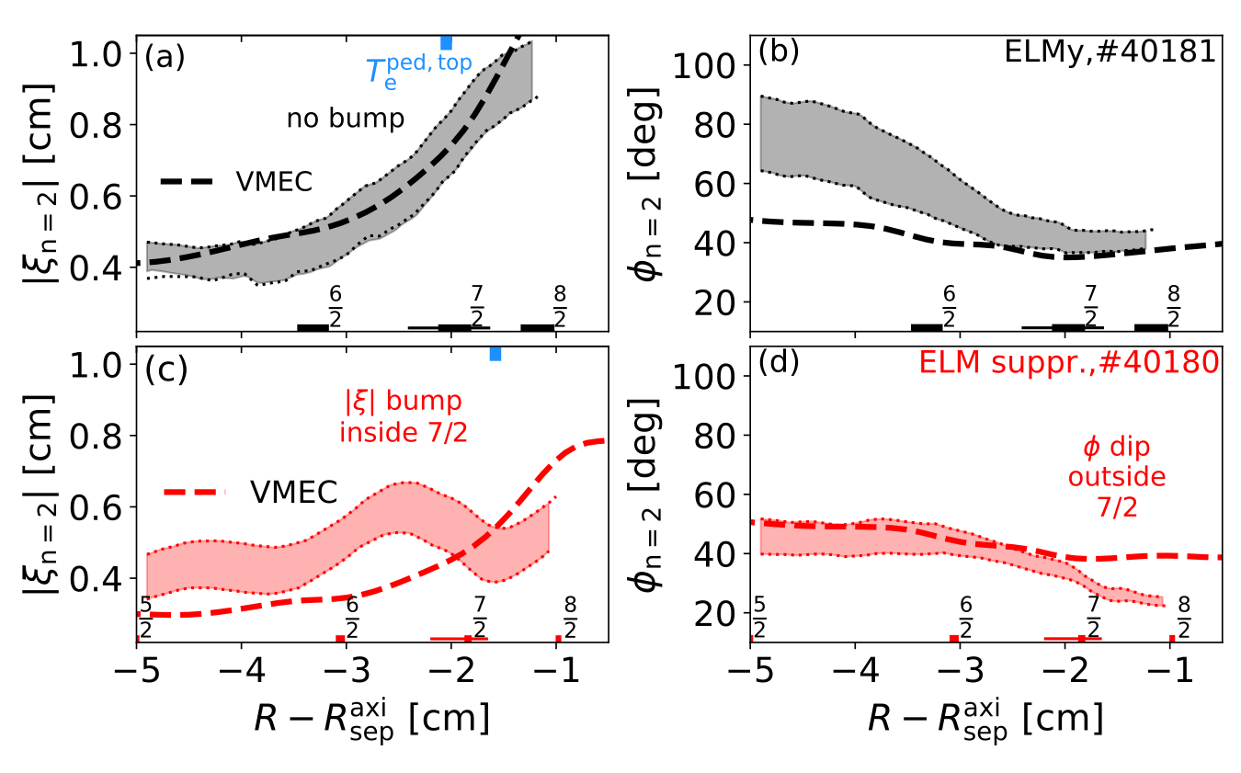
Experimental detection of magnetic islands during RMP application
Island detection difficult in experiment, as the
strong kink response dominates over tearing mode
Detection possible based on change of the
amplitude and phase of the deformation of the flux surfaces in vicinity of islands [M. Willensdorfer 2023, in review NP]
Requires high resolution temperature measurements, possible in AUG with ECE diagnostic.

Slide 42
Experimental detection of magnetic islands during RMP application
Island detection difficult in experiment, as the
strong kink response dominates over tearing mode
Detection possible based on change of the
amplitude and phase of the deformation of the flux surfaces in vicinity of islands [M. Willensdorfer 2023, in review NP]
Requires high resolution temperature measurements, possible in AUG with ECE diagnostic.

Slide 43
Confirming experimental island observation
Corrugation Amplitude and Phase obtained with the same diagnostic procedure in JOREK

Slide 44
Confirming experimental island observation
Corrugation Amplitude and Phase obtained with the same diagnostic procedure in JOREK
Bump in presence of penetrated island, but none if island is not penetrated

Slide 45
Confirming experimental island observation
Corrugation Amplitude and Phase obtained with the same diagnostic procedure in JOREK
Bump in presence of penetrated island, but none if island is not penetrated
Confirms experimental observation is associated with presence of island

Slide 46
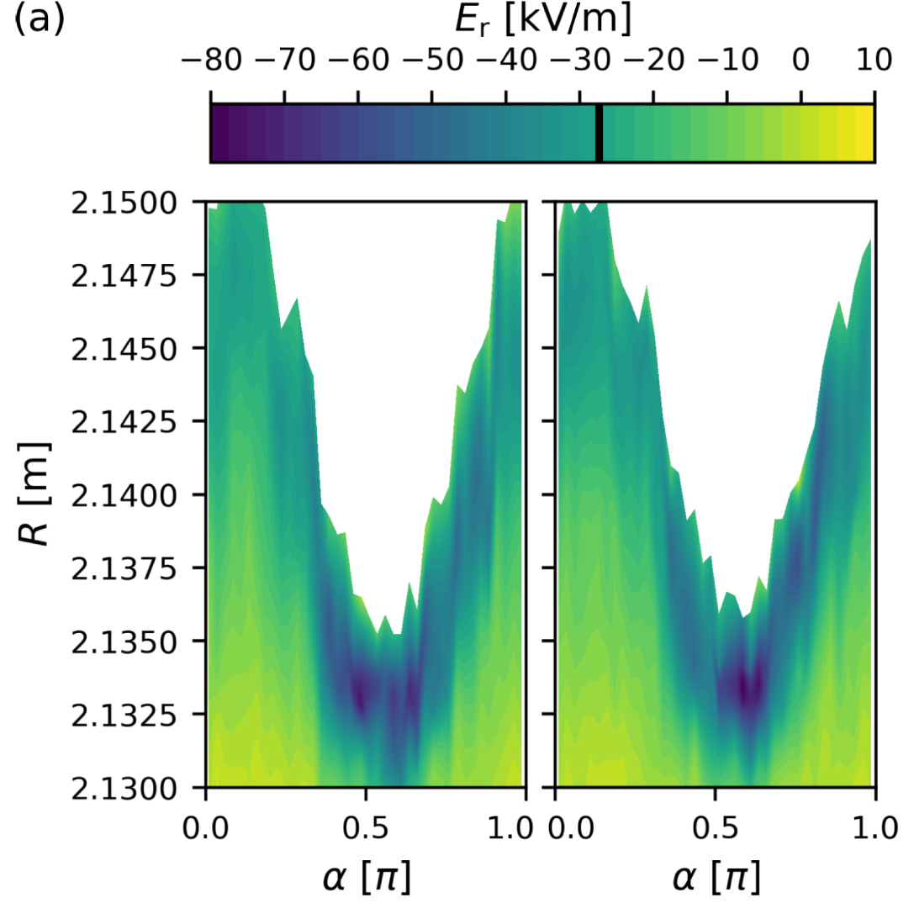
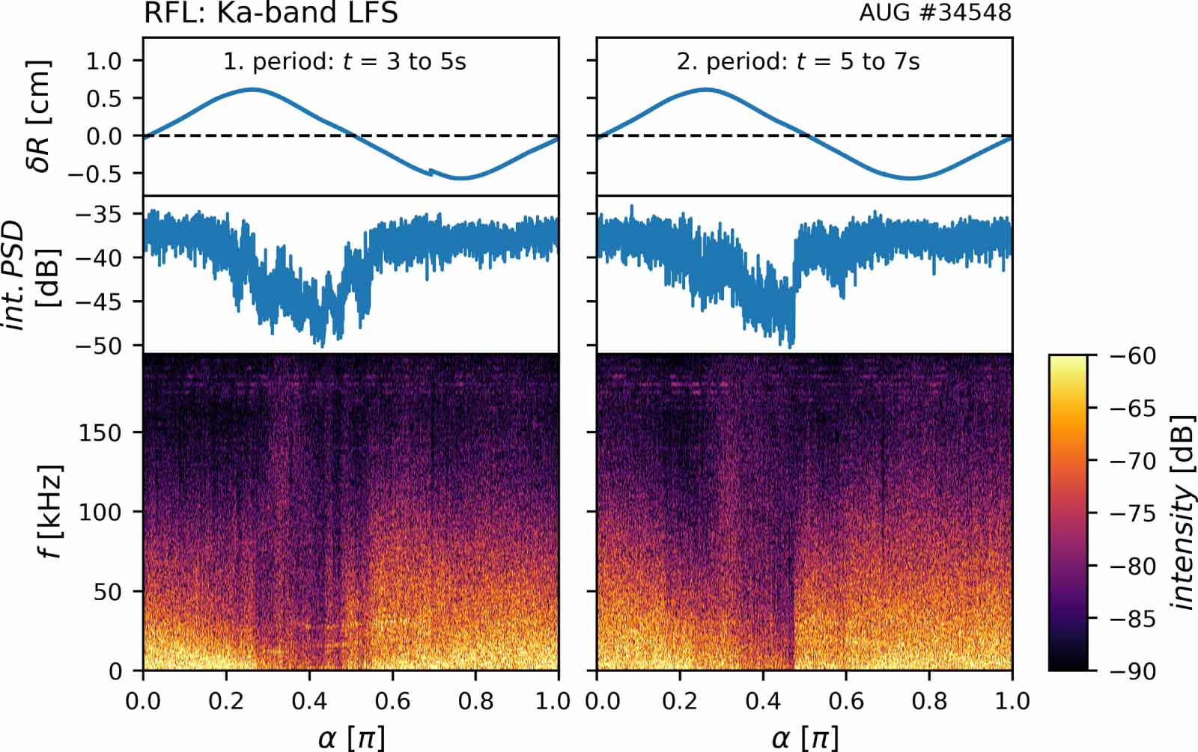
Increased turbulent transport in AUG-RMP experiments
Experimentally observed turbulent transport likely to contribute to
density pump-out [N. Leuthold 2023, NF]
Fluctuation disappears in region with highest ExB shear

Slide 47
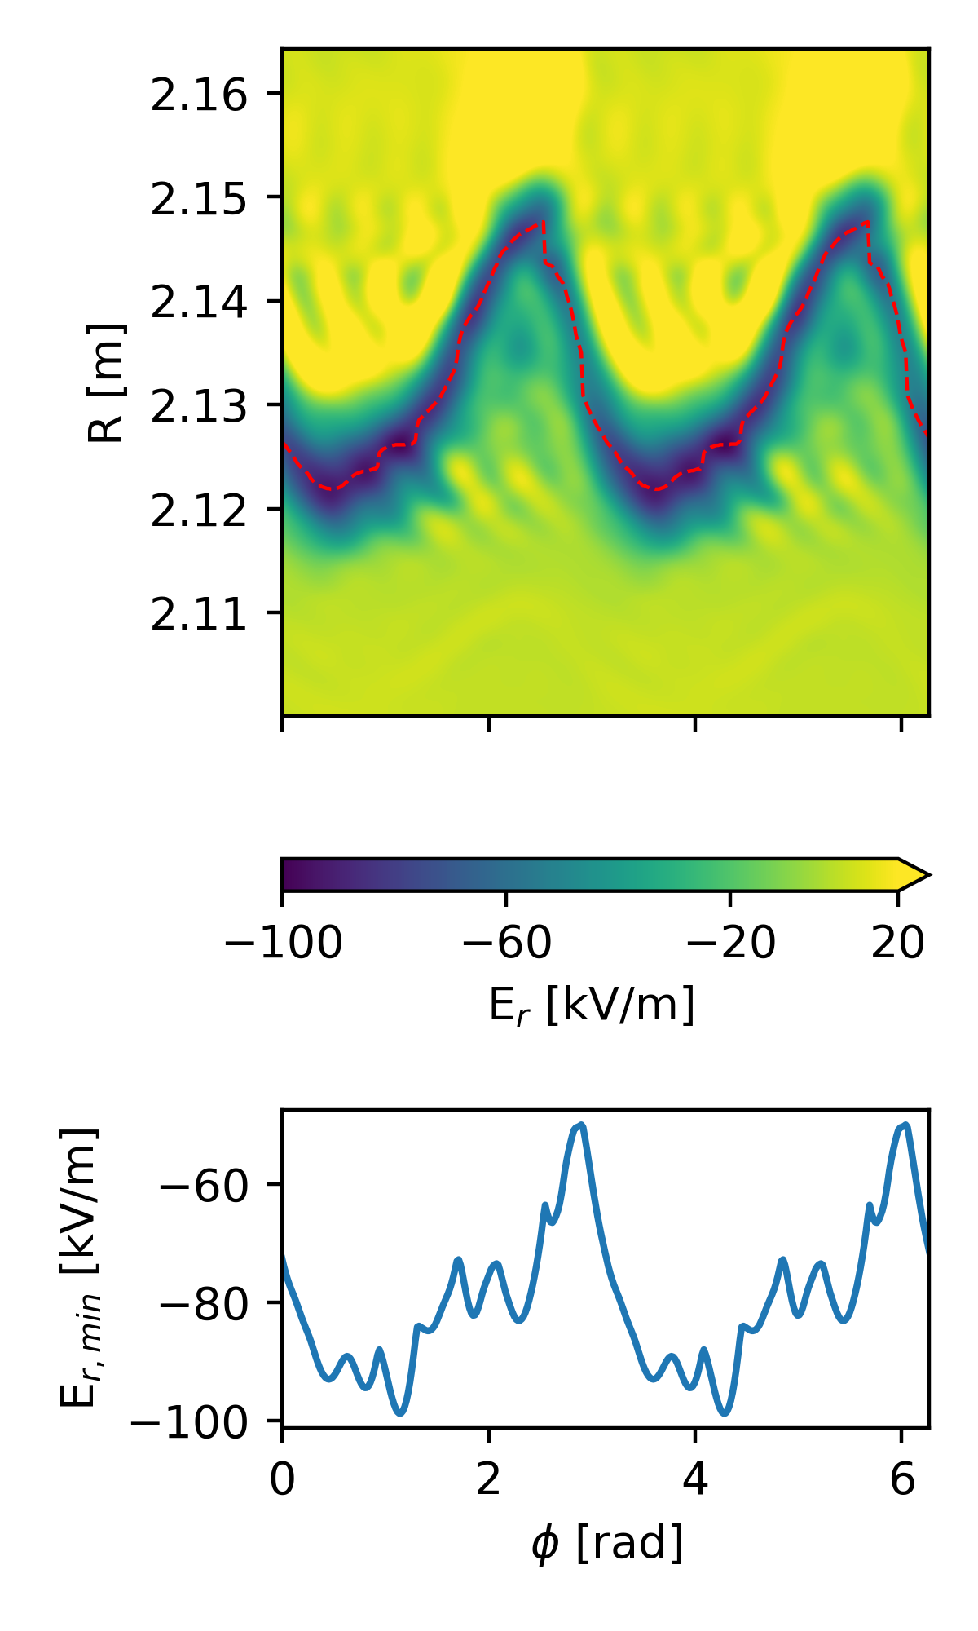
Increased turbulent transport in AUG-RMP experiments
JOREK shows comparable
Er variation:
Experimentally observed turbulent transport likely to contribute to
density pump-out [N. Leuthold 2023, NF]
Fluctuation disappears in region with highest ExB shear

Slide 48
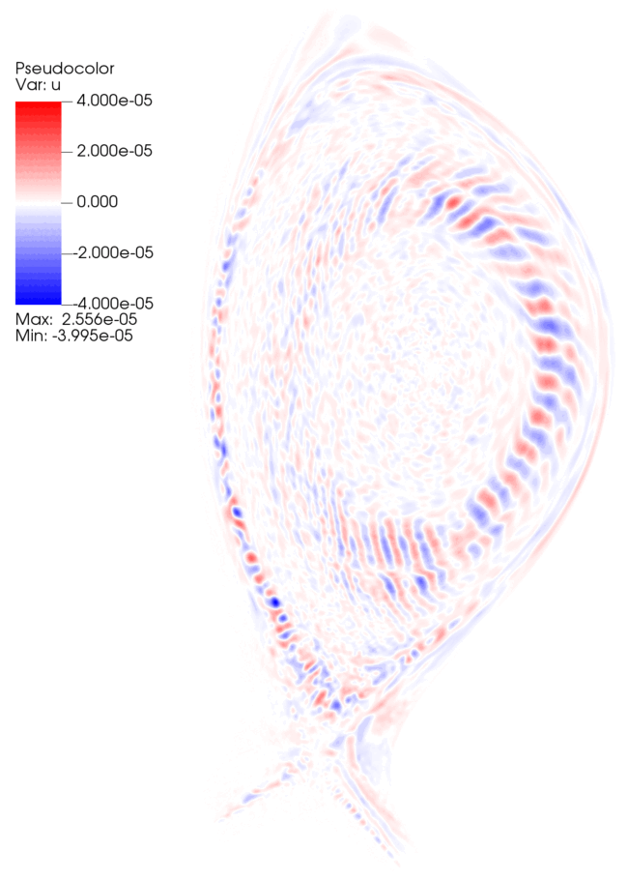
ITG Simulations on RMP fields
JOREK ITG Simulations building up on work by M. Becoulet
First results with turbulent structures on AUG-RMP fields
Adding collision operators to keep corrugated Er well

Slide 49
Summary
Type-I Edge Localized Modes unsupportable in future devices
Resonant Magnetic Perturbations are the planned ELM control mechanism for ITER
JOREK-STARWALL Simulations of AUG RMPs now with improved boundary conditions
Found support for experimental evidence of island at pedestal top during ELM suppression
JOREK ITG Simulations on RMP fields are on the way

