Slide 1

20th European Fusion Theory Conference
2 – 5 October 2023, Padova – Italy
Beam-tracing analysis of EC-assisted breakdown and high-frequency core heating in various DEMO scenarios
C. Tsironis¹, B. Baiocchi², A. Bruschi², L. Figini²,
J. P. Hogge³, M. Siccinio⁴, I. Tigelis⁵, C. Wu⁶
¹National Technical University of Athens, Athens, Greece
²Institute for Plasma Science and Technology – National Research Council, Milan, Italy
³Ecole Polytechnique Fédérale de Lausanne, Lausanne, Switzerland
⁴Max-Planck-Institute for Plasma Physics, Garching bei Muenchen, Germany
⁵National and Kapodistrian University of Athens, Athens, Greece
⁶Karlsruhe Institute of Technology, Karlsruhe, Germany

Slide 2
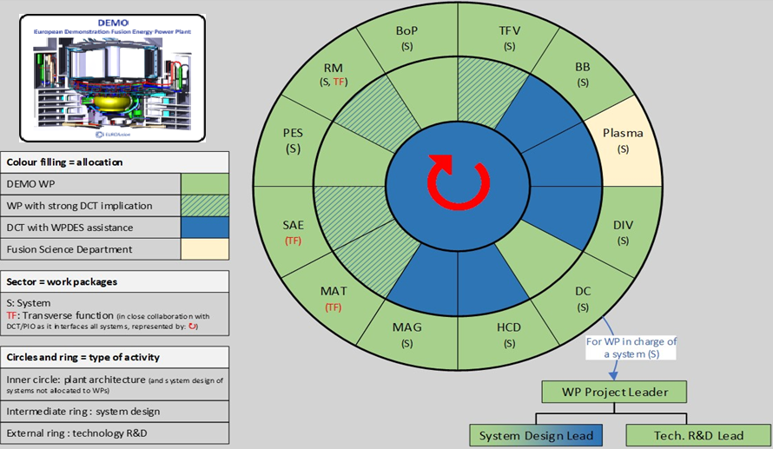
EUROfusion DEMO design
Fusion Technology Department (FSD) works on DEMO R&D

Slide 3
Heating and Current Drive work package
WP HCD for EC system conceptual design (phys + tech)
Launcher
Optical
design
Structural & mechanical
design
Integrated
control system
Switches & broadband windows
Transmission
Port-cell
Multi-beam
Individual
lines
Connection with gyrotrons
Gyrotron
Basic concepts
Control system
Interfaces
with system components
Auxiliaries

Slide 4
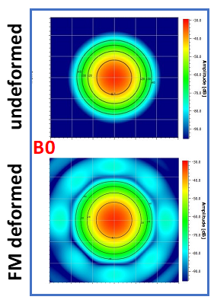
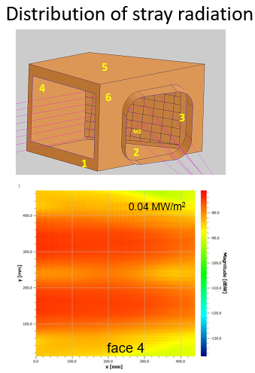
Organization of launcher design studies
S.01.03-T003: Port Plug (Launcher) optical component design
S.01.03-T004: Port Plug (Launcher) structural design
S.01.08-T002: Numerical analysis of broadband window concepts D001: Brewster windows & polarization aspects D002: Alternative joinings D003: Simulation of EM resonances in broadband windows
S.01.01-T003: WPHCD Launcher optical design D001: Stray radiation evaluations D002: Study of compatibility with higher frequency D003: Beam-tracing evaluations
S.01.02-T003: Thermal analysis on launcher components & cooling design D001: Cooling of M1 mirrors D002: Cooling design of M2 fixed mirror for BH
S.01.04-T002: Port-cell transmission line integration D001: TL Layout update D002: Waveguide components preliminary design D003: Integration of the components in the CAD design
S.01.05-T004: Multi-Beam transmission line design D001: TL Layout update D002: W7-X MBTL design, including mirrors and supporting structures D003: First design of MBTL mirror with cooling circuit
S.01.06-T004: Individual transmission line design D001: Study of losses for multi- frequency polarisers
S.01.07-T002: Impact of RAMI on the ECH system and its functions D001: Functional analysis D002: FMEA of the ECH system D003: Component reliability & control system techniques to improve W7-X system
Post-mirror beam pattern
WP HCD tasks & deliverables

Slide 5
Overview of beam-tracing analysis subtask
Beam tracing analysis in DEMO plasma scenarios of
core ECRH ● EC-assisted breakdown
INPUT
CODE
Magnetic field equilibrium,
plasma density & temperature profiles
based on latest EU DEMO Reference Design
equilibrium data (EQDSK)
https://idm.euro-fusion.org/default.aspx?uid=2PCR4X
profile data (MATLAB)
https://idm.euro-fusion.org/default.aspx?uid=2MMUDB
TORBEAM
pWKB beam tracing code
code manual (PDF)
https://www.sciencedirect.com/science/article/pii/S001046551730423X
INPUT
Beam trajectory
Power absorption
Driven current
task report (DOCX)
https://idm.euro-fusion.org/?uid=2QC8DZ
Launcher design (launch coordinates/directions), beam parameters (frequency, width/curvature radius)
based on latest ECRH Beam Configuration Data DEMO*
*Beam input data (EXCEL) based on EC Optical System Design
design model (CAD)
http://idm.euro-fusion.org/?uid=2MHNBC
OUTPUT

Slide 6
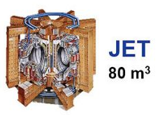
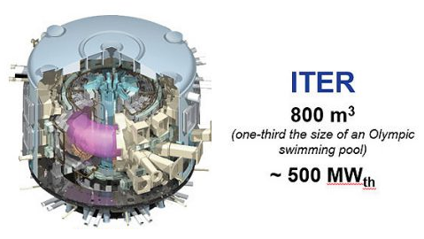
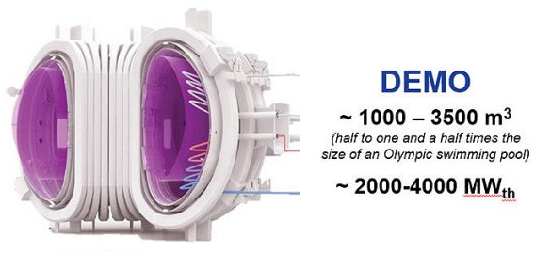
DEMO reference design parameters
Major radius [m] | 8.938
Minor radius [m] | 2.883
Aspect ratio | 3.1
Plasma volume [m³] | 2448
Plasma surface area [m²] | 1374
Elongation at 95% of plasma minor radius | 1.65
Triangularity at 95% of plasma minor radius | 0.333
Safety factor at 95% of plasma minor radius | 3.936
Vacuum toroidal magnetic field on axis [T] | 5.744
Plasma electric current [MA] | 18.27
Fusion power [MW] | 1871
Average electron density [10¹⁹ m⁻³] | 8.058
Ratio of peak vs average electron density | 1.52
Average electron temperature [KeV] | 11.31
Ratio of peak vs average electron temperature | 3.542
Effective charge of ions | 1.18
Bootstrap vs inductive current fraction | 0.362/0.477
Bootstrap vs auxiliary current fraction | 0.362/0.162

Slide 7
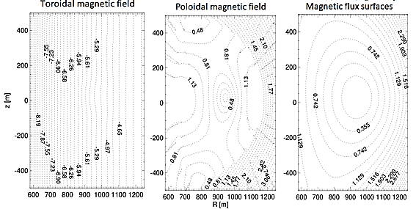
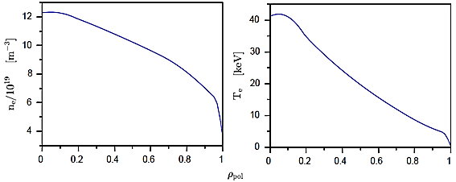
DEMO plasma configuration
Magnetic equilibrium
Density &
temperature
profiles

Slide 8
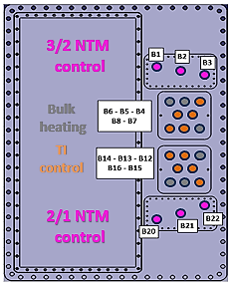
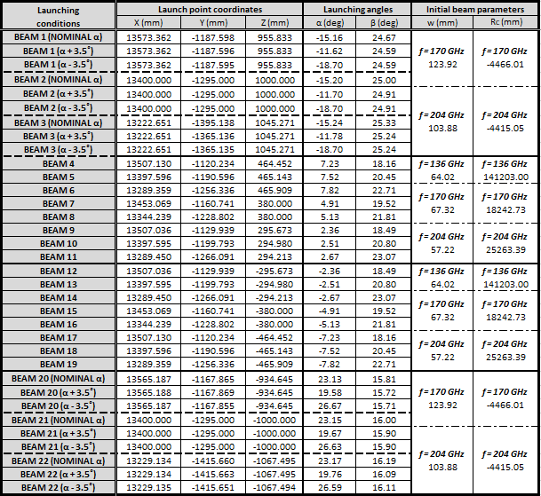
ECRH beam configuration
Equatorial Port Plug
Beam launching conditions

Slide 9
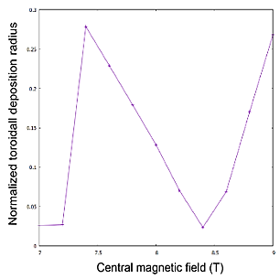
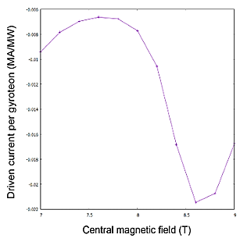
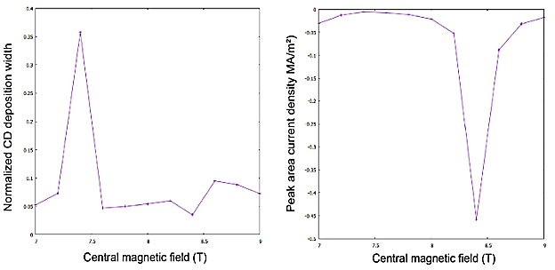
Core ECRH (high magnetic field scenario)
SRD REFERENCE VALUES
Up to 30 MW EC @ f < 240 GHz
ECRH/ECCD @ ρ_{t} < 0.3
HCD parameters vs central magnetic field
    Considerations of DEMO baseline
    with higher magnetic field
    Central toroidal field: 6 T < B₀ < 9 T
    Equilibrium & plasma input?
    Rescale B₀ (assuming an increase to q₉₅ so that B_{p}, n_{e} & T_{e} are retained)
B8
RESULTS for f = 238 GHz
Complete (single-pass) absorption
Deposition obeys SRD limit (0.02 < ρ_{t} < 0.27)
|I_{CD}|/P_{abs} [A/W] ranges from 0.003 to 0.054
Parasitic (O2) absorption decreases vs B₀
Deposition seems to become narrower vs B₀
(0.01 < Δρ_{p} < 0.05 when 7.5 < B₀ [T] < 8.5)
|Peak CD| [MA/m²] ranges from 0.01 to 0.5

Slide 10
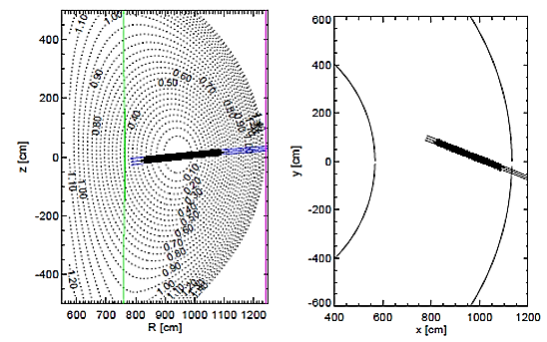
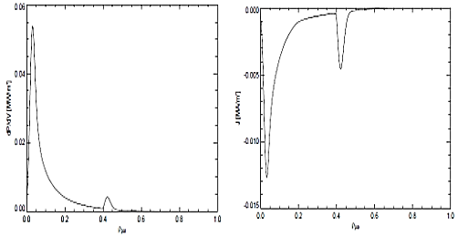
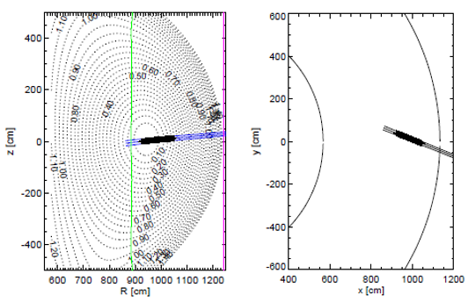
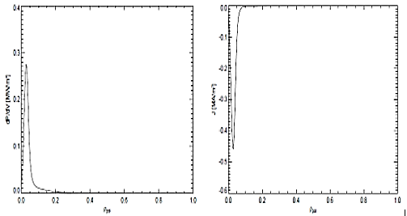
Beam tracing results for high magnetic field
B8
B₀
=
7.2
Τ
Measurable
parasitic absorption
LFS shift of
cold ECR
Minimal
refraction
Beam projections R, z (m)
Absorbed power per unit volume (MW/m³)
Driven current per
unit area (MA/m²)
B₀
=
8.4
Τ
Minimal
parasitic absorption

Slide 11
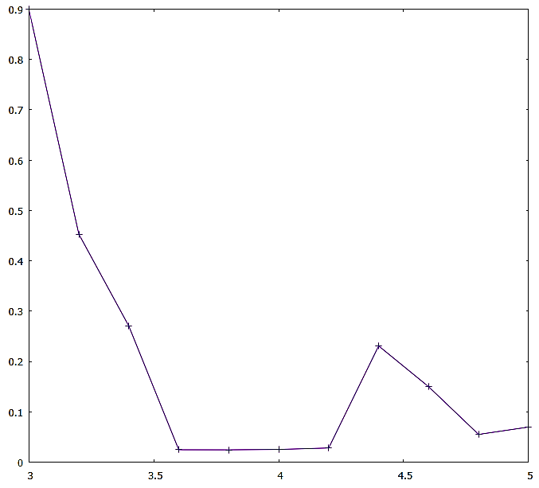
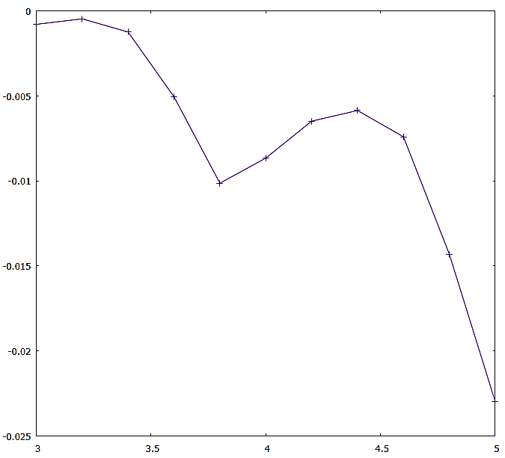
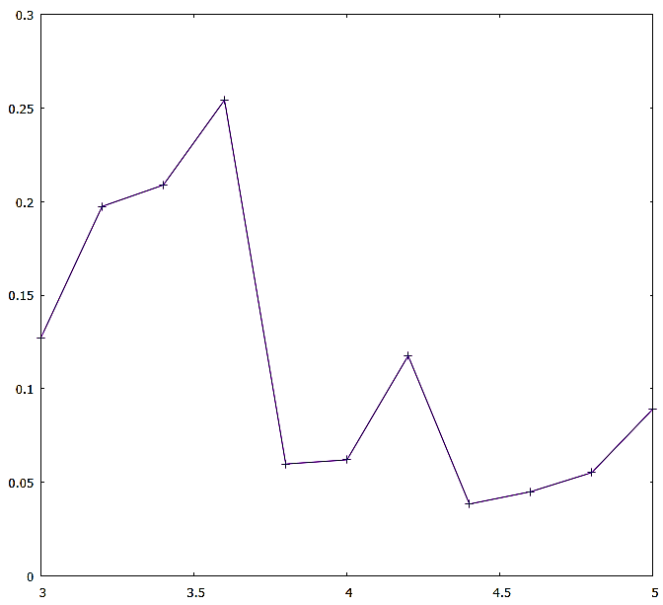
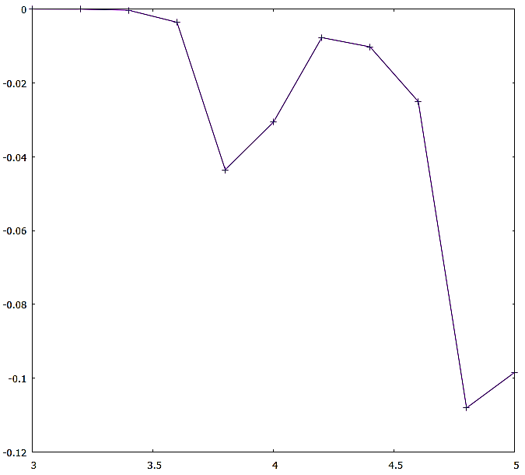
Core ECRH (low magnetic field scenario)
SRD REFERENCE VALUES
Same as in the high magnetic field scenario
HCD parameters vs central magnetic field
    Considerations of DEMO baseline
    with lower magnetic field
    Central toroidal field: 2 T < B₀ < 5 T
    Relevant to the analysis of low aspect ratio (AR) scenario
    Baseline with lower central field
    (to be analysed from late 2023 on)
B15
RESULTS for f = 136 GHz
Complete (single-pass) absorption
Deposition obeys SRD limit only for
B₀ [T] > 3.5 (ρ_{t} > 0.3 for B₀ [T] < 3.5 T)
|I_{CD}|/P_{abs} [A/W] is smaller than 0.025
Deposition seems to narrow down vs B₀
(0.05 < Δρ_{p} < 0.1 when B₀ [T] > 3.7)
|Peak CD| [MA/m²] is smaller than 0.11

Slide 12
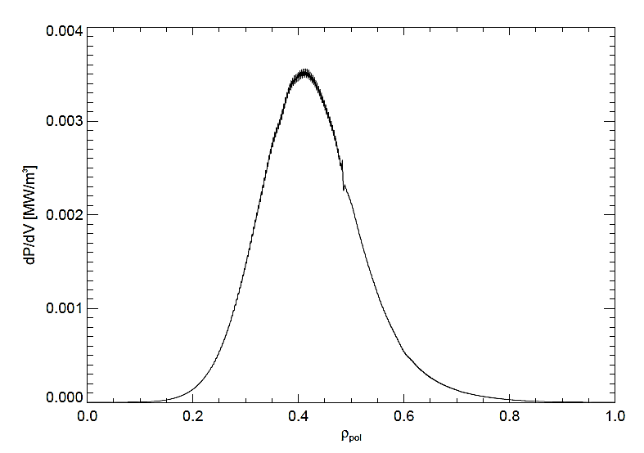
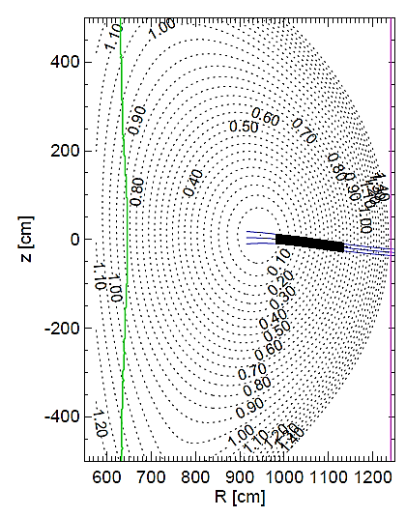
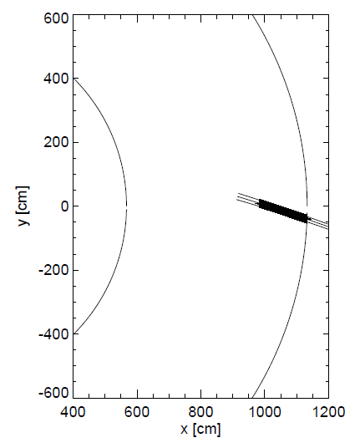
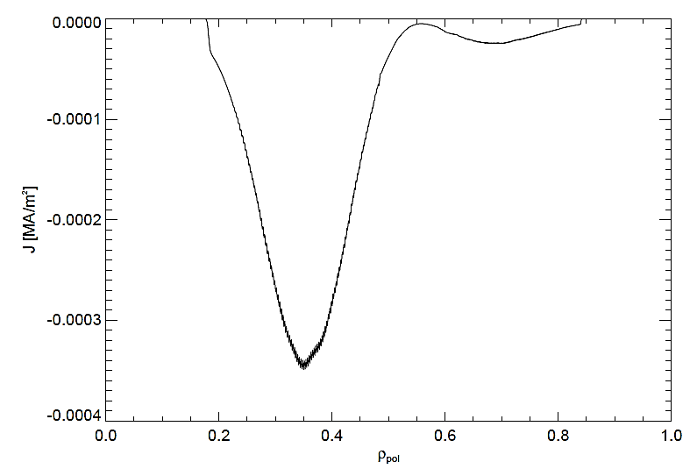
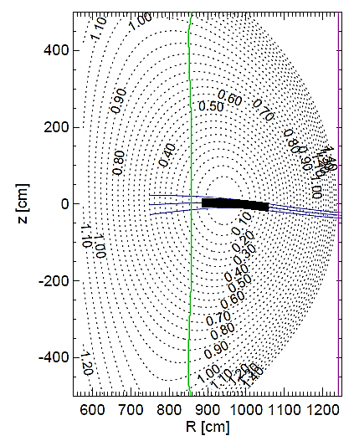
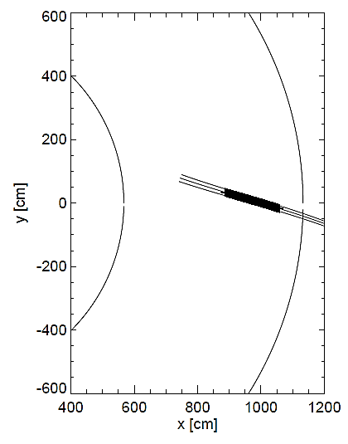
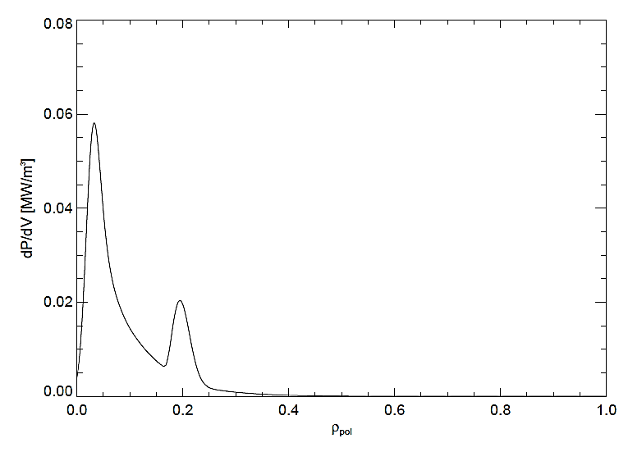
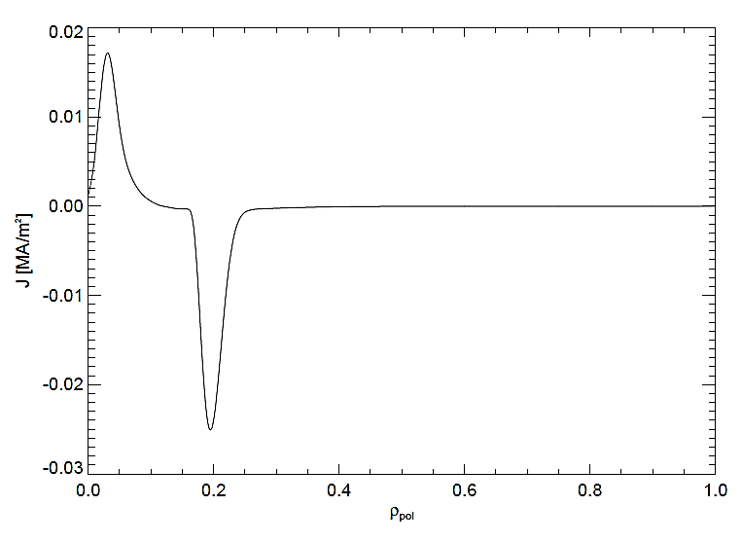
Beam tracing results for low magnetic field
B15
B₀
=
3.4
Τ
Reduced absorption
Measurable
refraction
LFS shift of
cold ECR
Absorbed power per unit volume (MW/m³)
Driven current per
unit area (MA/m²)
Beam projections R, z (m)
Measurable parasitic absorption
B₀
=
4.6
Τ

Slide 13
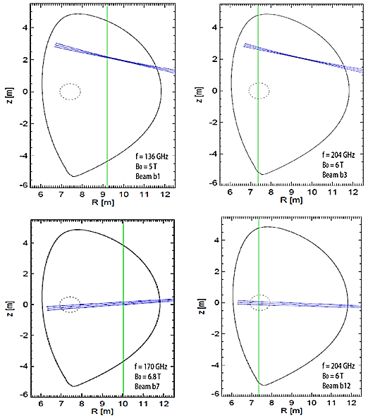
EC-assisted breakdown
SRD REFERENCE VALUES
Up to 10 MW EC @ f < 240 GHz
ECRH @ 1.5 ± 0.5 m from inner wall
Four different scenarios in the BKD setup
I
II
Plasma & device parameters
Low n_{e}
(< 10¹⁸ m⁻³)
Very low T_{e} (≈ 100 eV)
B = B_{t}
(3 – 7 T)
Iii
IV
EC-based breakdown (BKD) condition
    Beam trajectory & EC cold resonance line should both cross the region specified by SRD

Slide 14
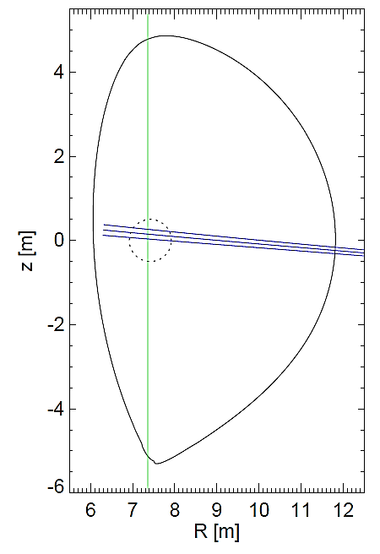

Qualified magnetic field scenarios
BEAM TRACING RESULTS
B15
All Mid Module beams
target the SRD region!
f-B₀ scenarios qualified for SRD
Frequency (GHz) | Central magnetic field (Tesla)
136 | 3.8 |  | 4.0 |  | 4.2
170 | 5.0 |  |  | 5.2
204 | 5.8 | 6.0 |  | 6.2 |  | 6.4
238 | 6.6 |  | 6.8 |  | 7.0
Linear absorption becomes effective (> 10%) after density threshold (n_{e} > 10¹⁹ m⁻³)
Reflection(s) of the EC beam to the inner/outer wall are not taken into account
f= 136 GHz
B₀ = 4 T

Slide 15
Conclusion – Discussion of results
    Core ECRH
    Launch conditions at the Mid Modules of the EC port plug, depending on f-B₀ combination, provide satisfactory operation within current SRD requirements
    Parasitic absorption is measurable for lower B₀, because cold ECR is located in
    HFS and beam path becomes longer in regions far from 1st harmonic absorption
    Frequency option 238 GHz more effective for B₀ ranging from 7.5 T to 8.5 T
    Frequency option 136 GHz more effective for B₀ larger than 3.5 T
    ⊳ First step in the analysis of DEMO low-AR scenario (ongoing work 2023 – 24)
    EC-assisted breakdown
    All beam conditions from the Mid Modules cross the BKD region
    Optimal/required gyrotron frequency depends on the central magnetic field:
    ⊳ 136 GHz for 3.7 T < B₀ < 4.3 T (relevant to low-AR scenario)
    ⊳ 170 GHz for 4.9 T < B₀ < 5.3 T
    ⊳ 204 GHz for 5.7 T < B₀ < 6.5 T
    ⊳ 238 GHz for 6.5 T < B₀ < 7.1 T (relevant to high magnetic field scenario)
(as seen in HCD 2021 & 2022 reports)
    Current design may fulfil the SRD goals for BH & BKD

Slide 16

References – Acknowledgements
1 | Tsironis C. | Beam tracing ECCD calculations for the optimization of the DEMO EC system design | WP16-HCD-4.1.6-T010-D001, WP17-HCD-4.1.6-T010-D001, WP18-HCD-4.1.6-T007-D002, WP19-HCD-4.1.6-T015-D001, WP20-HCD-4.1.6-T015-D002 (2016 – 2020)
2 | Tsironis C. | Beam – tracing evaluations of the configuration performances | WP21-HCD-S.01.01-T002-D002 (2021)
3 | Siccinio M. | EU DEMO1 Reference Design (March 2019) | https://idm.euro-fusion.org/?uid=2NT5PD
4 | Tran M. Q. | HCD System Requirements Document for FP9 (version 3.2) | https://idm.euro-fusion.org/?uid=2NV496
5 | Poli E. | TORBEAM, a beam tracing code for electron-cyclotron waves in tokamak plasmas | Comp. Phys. Commun. 136, 90 (2001)
6 | Pereverzev G. V. | ASTRA - an automatic system for transport analysis in a tokamak | IPP Report 5/42 (1991)
7 | Staebler G. M. | A theory-based transport model with comprehensive physics | Phys. Plasmas 14, 055909 (2007)
8 | Poli E. | Electron Cyclotron Current Drive eﬃciency in DEMO plasmas | Nucl. Fusion 53, 013011 (2012)
9 | Spaeh P. | WPHCD-EC2019_EQUATORIAL_LAUNCHER_V2_CATIA model | https://idm.euro-fusion.org/?uid=2NLLLX
10 | Moro A. | Study of the optical design for dual-frequency launchers at 136-170 or 170-204 GHz | WP21-HCD-S.01.01-T002-D001 (2021)
1 | Zohm H. | Update on DCT exploration of options | https://idm.euro-fusion.org/uid=2QBPE4
This work has been carried out within the framework of the EUROfusion Consortium, funded by the European Union via the Euratom Research and Training Programme (Grant Agreement No 101052200 – EUROfusion).
Views and opinions expressed are however those of the author(s) only and do not necessarily reflect those
of the European Union or the European Commission.
Neither the European Union nor the European Commission can be held responsible for them.

