Slide 1
Simple beam energy recovery as alternative to Residual Ion dump in Neutral Ion Beam Injections
Variale INFN-Bari, Via Orabona 4, 70126-Bari, Italy
M. Cavenago INFN-LNL, Via dell’Università 2, Legnaro (PD), Italy
V. Valentino INFN-Bari, Via Orabona 4, 70126-Bari, Italy
NIBS 2022 Padua (Italy)

Slide 2
Layout
Introduction (Energy recovery general concept scheme)
Beam energy recovery proposals for NBI applications
The simple space charge based collector proposed as
alternative to RID
Space charge calculation comparison in beam energy
recovery simulations between SIMION and COMSOL
Simulation results with COMSOL
Conclusions

Slide 3
Energy recovery concept
To underline that it is a general concept we show …
Hydrodinamic scheme example
h1 = h2 + h3 → P2<P1
h3
P1
P2
h1
work
h2
Dissipation/Friction

Slide 4
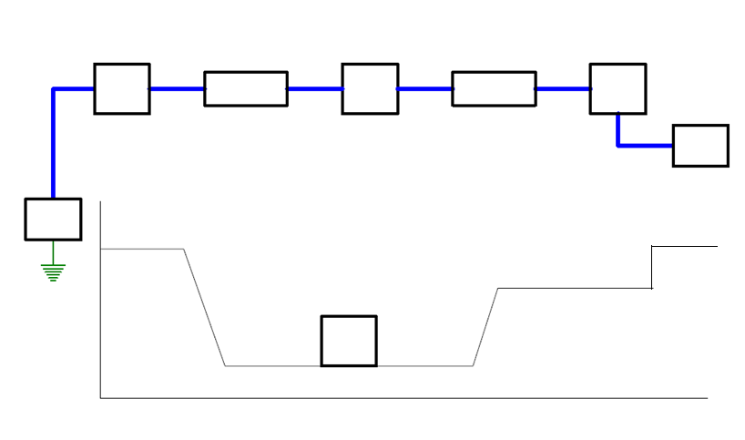
Beam energy recovery scheme example
Legenda
IS → Ion source
AT → Accelerating tube
DT → Decelerating tube
C → Collector
W → Work/dissipation
HVPS → HV Power Supply
PS → Power Supply
ΔV = HV – HV1
G → Ground
IS
AT
W
DT
C
ΔV
PS
HV
HV PS
Δ=Eki-Ekf ;
Ekf = Eki- Vc
HV
HV
HV1
Dec. Pot. Vc
W
Ekf
G
C
V=-200 kV
0 keV
V=-180 kV
20 keV
Notes: (i) the beam energy recovery is characterized by 2 types of efficiency: 1) the kinetic energy recovery efficiency ε=(1-Δ/Eki); 2) the charge collection efficiency, η=Qr/Qt (ii) η It is very important because η=1 → no ions re-accelerated towards the HV of the source); (iii) The decelerating voltage Vc < Eki (because of work and/or dissipation phenomena; (iiii) PS = dissipated power= ΔV*I_{beam})
V=-60 kV
140 keV
V=-40 kV
160 keV
V=-20 kV
180 keV
(The collector voltage Vc correspond to the final ion potential energy Ep)
x
G
Eki=200 keV
H-

Slide 5
Beam Energy recovery for Neutral Beam Injection application
Comments:
The electron beam energy recovery is regularly applied in many devices and from several years →
Electron coolers, Electron Beam Ion sources, FEL in Infra red region, …
The Ion Beam Energy recovery has not been used yet. Years ago, however, some proposals to apply it
to the Neutral Beam Injection (NBI) device used in the heating the TOKAMAC Plasma have been done.
One of these for example used a Big dipole magnet to deflect the residual ions D- and D+ and then
decelerating columns with final collectors ref. [1].
The complexity of that kind of device suggested to put off the beam energy recovery problem toward the DEMO project when the efficiency should be more important [2].
Few year ago, a simple collector based on the space charge effect that allowed the NB residual ion energy recovery without a deflecting magnet has ben proposed and a test experiment for the beamlet recovery of NIO1 source has been funded [3] by INFN.

Slide 6
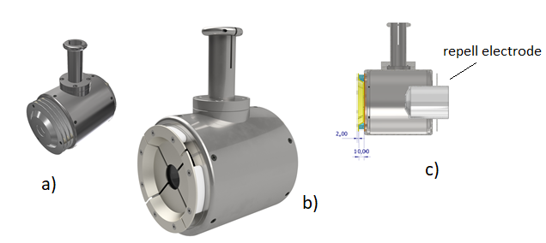
Simplified space charge based collector test proposal
The original space charge based collector designed for the test experiment on NIO1 (shown in a)), had 3 decelerating
electrodes, but the necessity of using a new smaller vacuum chamber induced us to eliminate the decelerating
electrodes and reduces its size (see fig. b) and c)) [5]:
Apart the diagnostic electrodes, it has , essentially, only 2 electrodes to drive the ion beam recover
Diagnostic electrodes
a) Original collector with decelerating electrodes; b) new simplified collector; c) Collector side view section
Note: the simplified space charge collector suggested us that it could be used as alternative to ERID in ITER or DTT

Slide 7
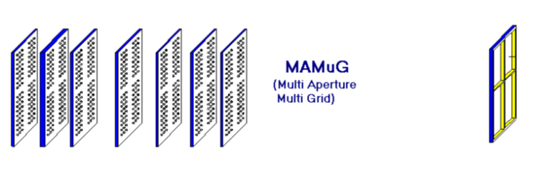
Simplified space charge collector proposed as alternative to NBI in ITER and DTT projects
In ITER the NB will be generated by a very large MAMuG sourse type:
S
PG
EG
AG 1 2 3 4 5 ..
To ERID
On the neutralizer
the extraction for very large ion source (ITER type
the beamlets after acceleration merge to become a large beam with rectangular section
Note: a beam energy recovery system for a MAMuG type ion source then should collect, at the end, ions in a beam with a large rectangular section.

Slide 8
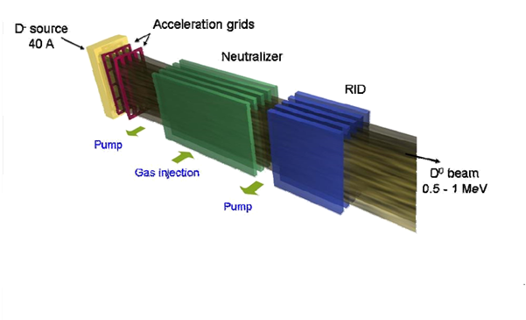
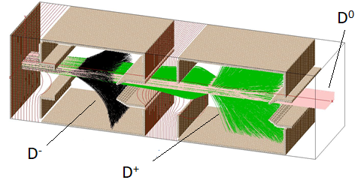
ERID in ITER NBI compared to Beam Energy Recovery (BER)
In the ICIS 2021 [2] a proposal of this very simple BER system has been presented as alternative to the foreseen Electrostatic
Residual Ion Dump (ERID)
ERID scheme for ITER; the beam has 4 sections
(ions deflected at full energy on the RID electrode plates)
BER SIMION simulations of double stage collectors that can recover one section of the beam (ions collected with η=1 and ε > 0.9→ 4 double stage collectors could take the place of the RID to recover all the beam)
Note: SIMION, however, uses a rough space charge calculation technique [3] then further simulations with a code that compute space charge effects with more accuracy was needed to confirm those simulation results.

Slide 9
Space charge calculation techniques
In SIMION
The Beam repulsion module treats each particle trajectory as a line of currents in [A] (see fig.). At each time step of the trajectory integration, SIMION consider a plane intersecting the particle #1 and computes the positions of the other particles on that plane and applies Coulomb’s Law forces between the line charges to only the particles in that plane.
Intersecting plane
Ion trajectories
Note: sometime within the given trajectory integration step, particles in that plane can have different actual time of flights and if the particles cross that plane at different times they are not included in SC calculation
Ions not included in SC calculation
#1
Note: SIMION can underestimate the space charge force.

Slide 10
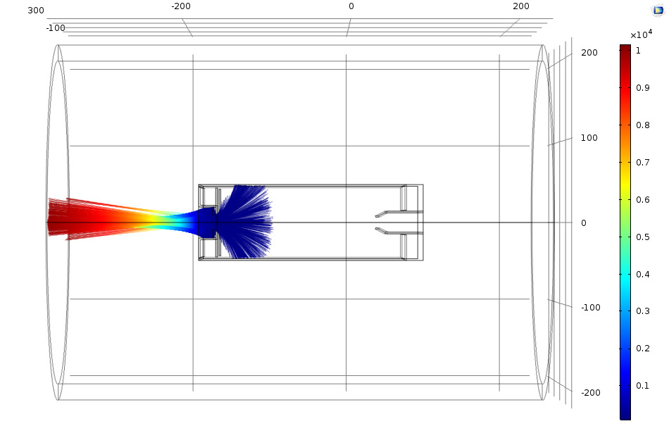
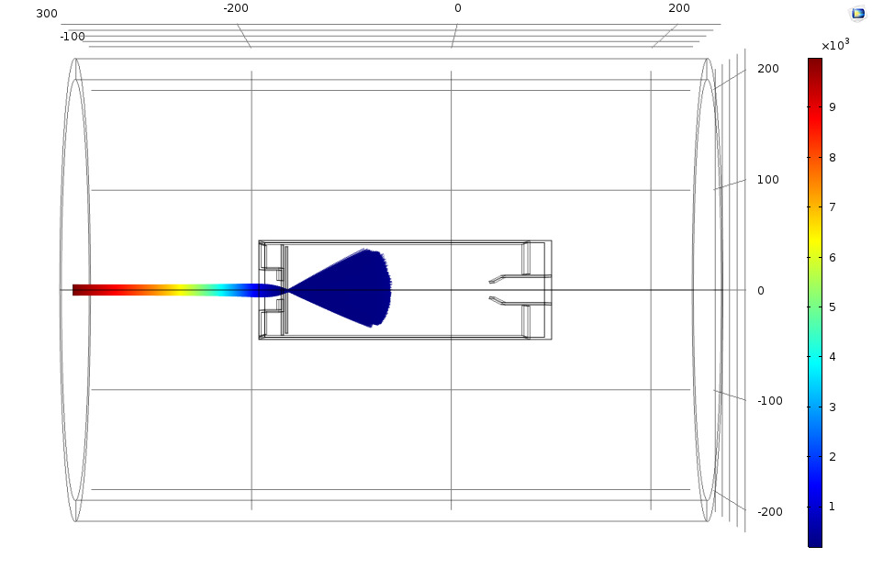
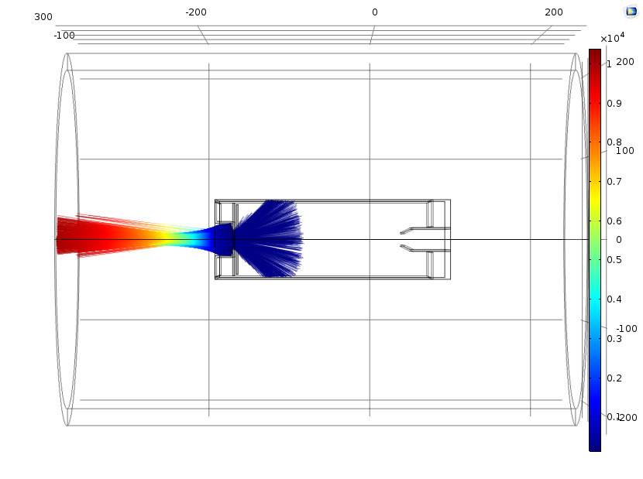
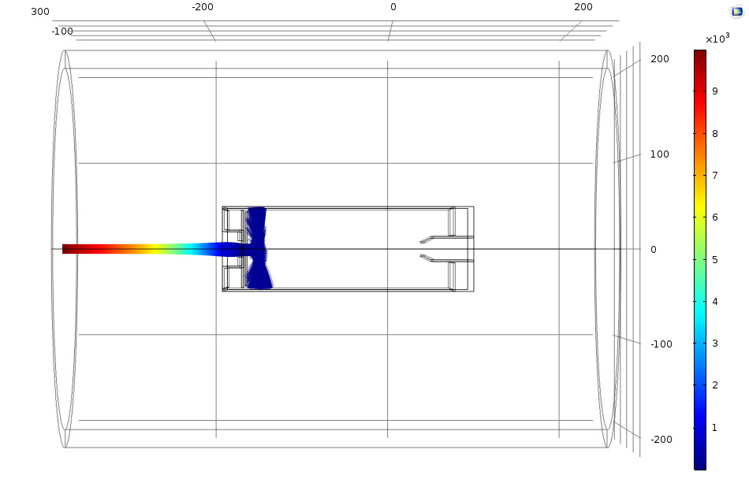
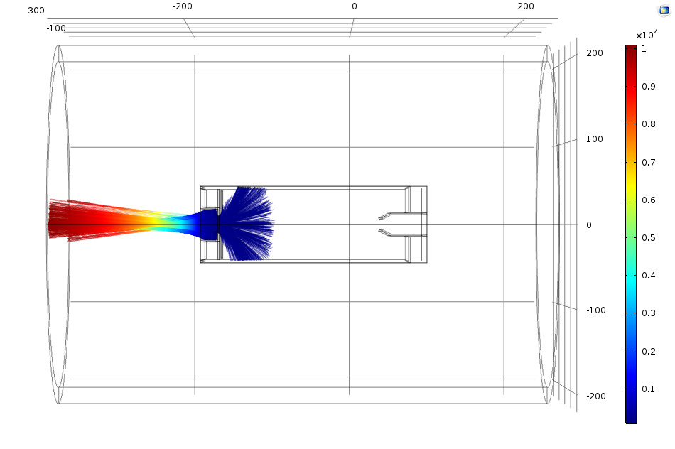
in COMSOL
The COMSOL [6] models the interactions of particles with stationary fields by using 2 solvers: 1) a Time-Dependent Solver for the
particle trajectories); 2) a Stationary Solver for the electric field calculation, included the SC due to particles.
The two solvers are repeated (iteration cycles) using a For-End For loop so that a self-consistent solution is obtained for the moving
particles and the stationary fields into account. As an example some cycles of the calculation are shown →
The SC force oscillate with decreasing amplitudes in the cycles up to convergence
Convergent
solution
Cycle 1 (no space charge included)
Cycle 20
Cycle 9 (SC computed from 8)
It is identical to Cycle 20
Cycle 2 (space charge computed from 1)
Cycle 21
Note: in our simulation the calculation started to converge after about 15 cycles but 20 cycles have been used for all the simulations – corresponding to a CPU time of few hours (in SIMION, CPU time was few minutes)
The Space charge calculations are more accurate in COMSOL

Slide 11
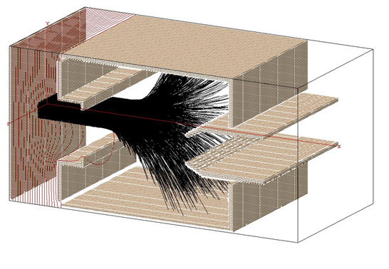
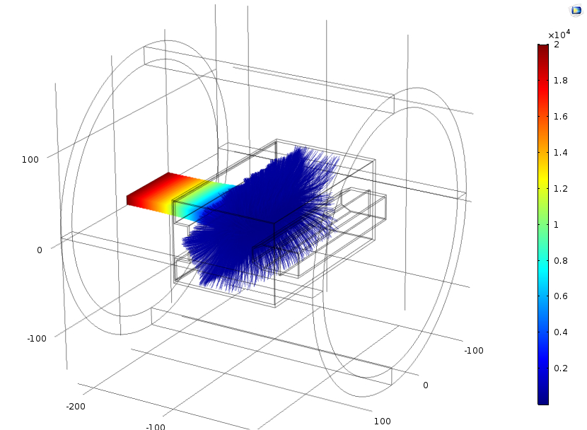
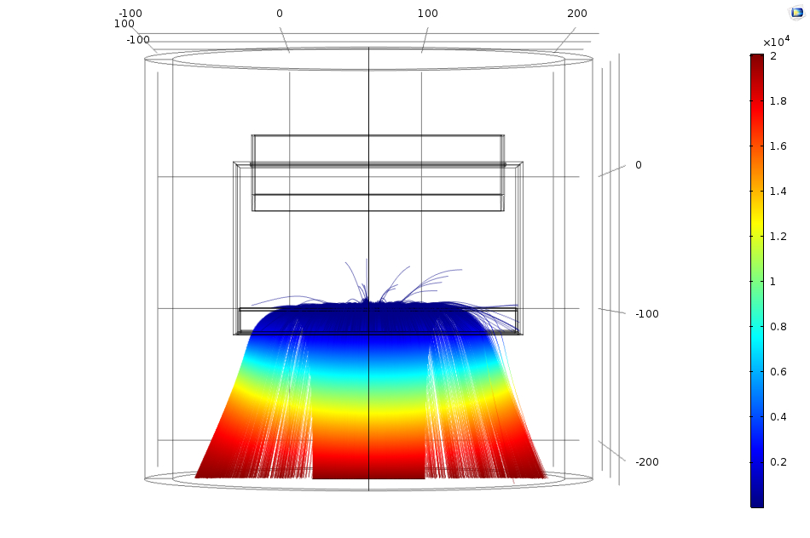
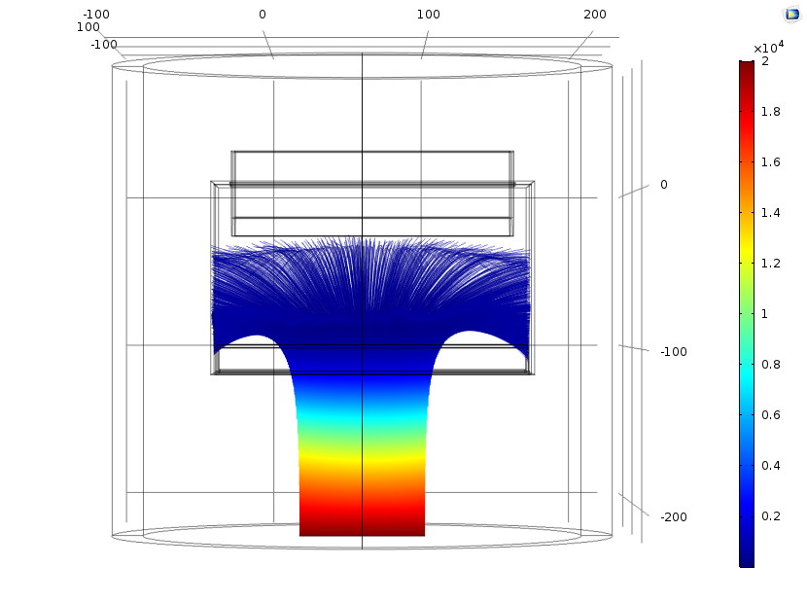
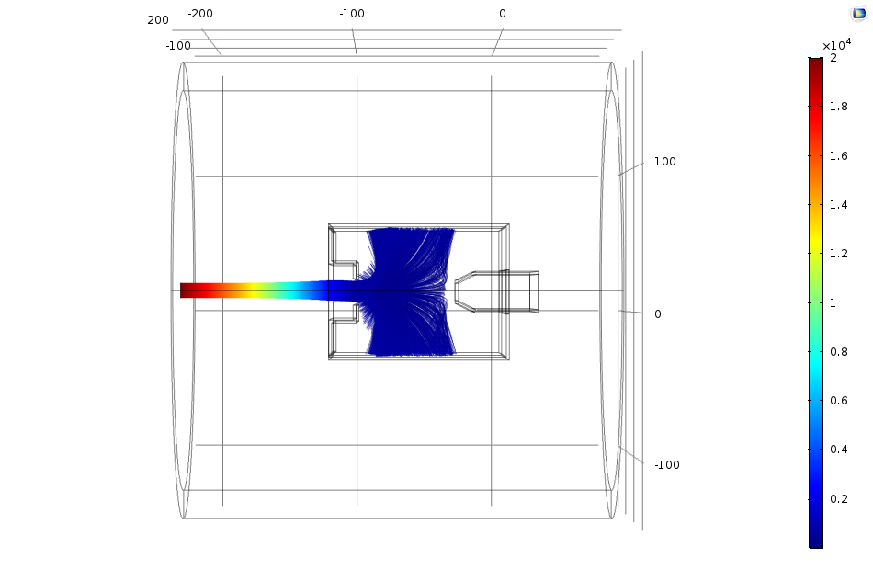
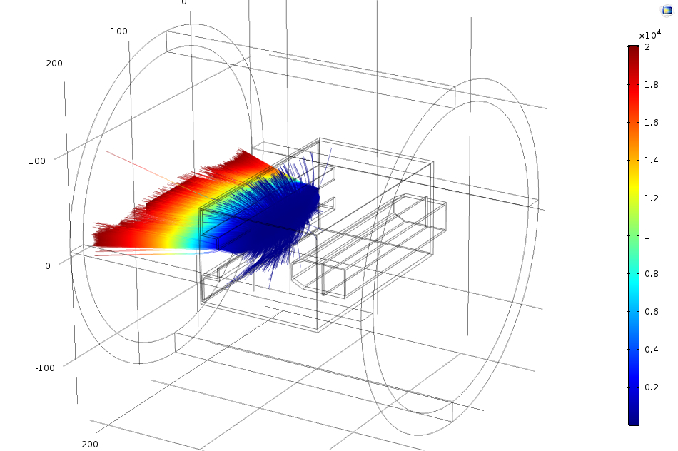
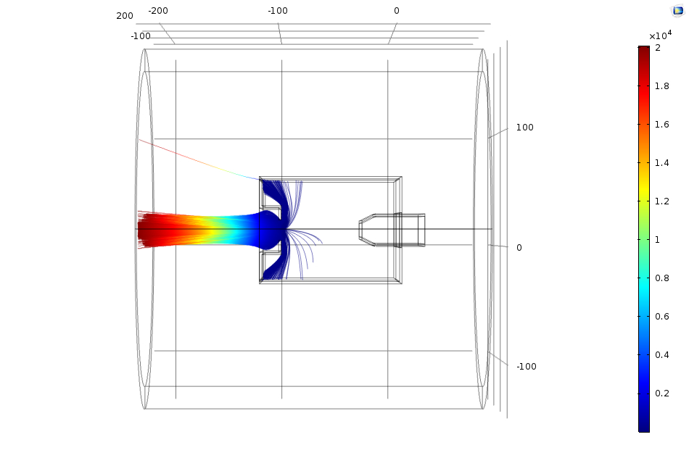
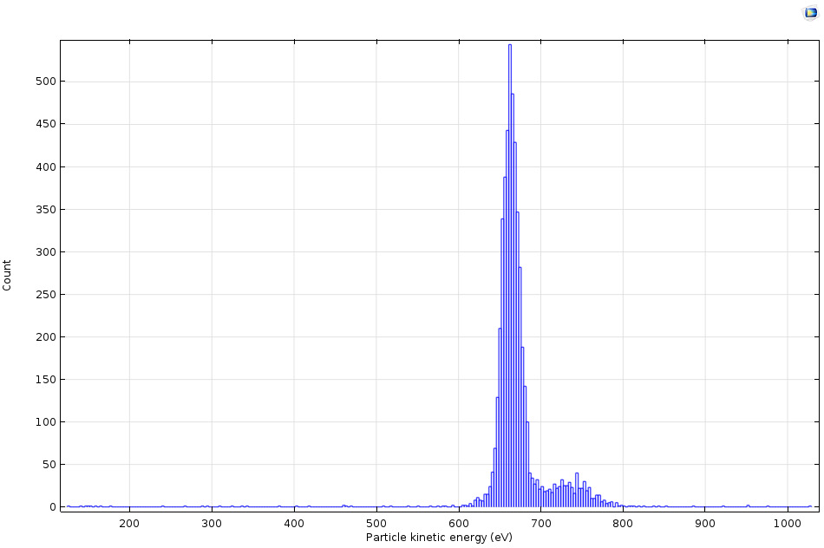
Simulation comparison with the COMSOL code
COMSOL model simulations for 20 keV with a lower
decelerating voltage, Vg=-19.30 kV; Vc=-19.35 kV; Vr=-20.2 kV.
From ref.[3]
Rectangular collector COMSOL model: Simualtions
for 20 keV with the same voltage of SIMION.
3D view
xy
3D view
Rectangular collector SIMION model, simulations for 20 keV
Beam energy with Vg=-19.75 kV; Vc=-19.80 kV; Vr=-20.5 kV).
xy
zy
Ekf distribution
3D view
zy

Slide 12
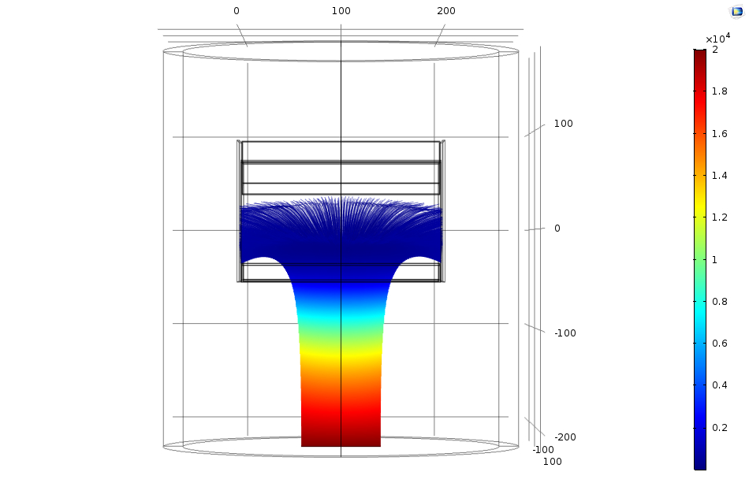
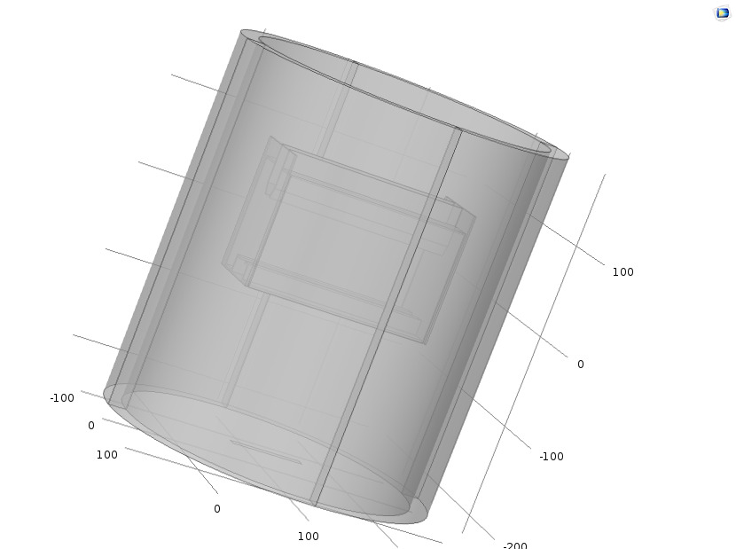
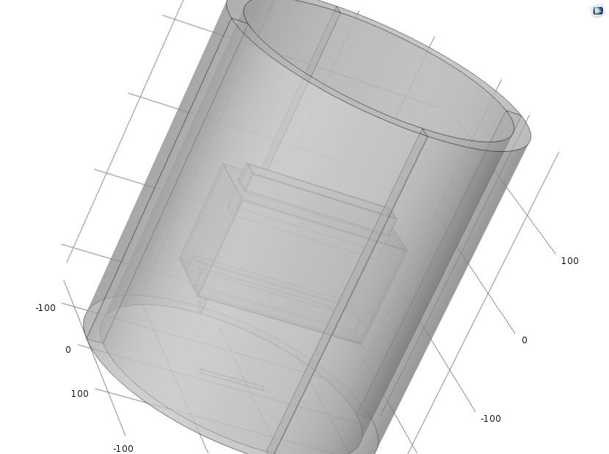
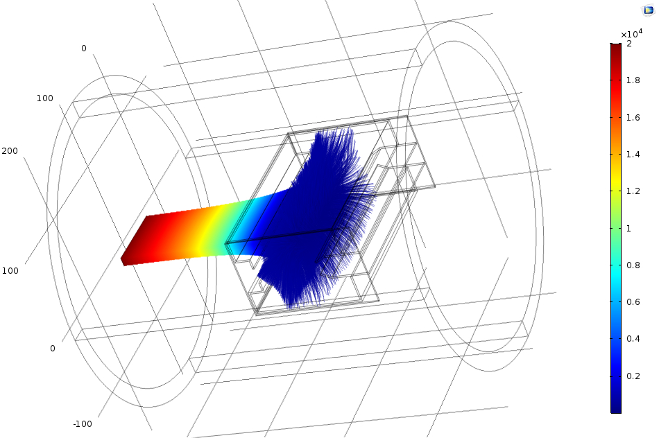
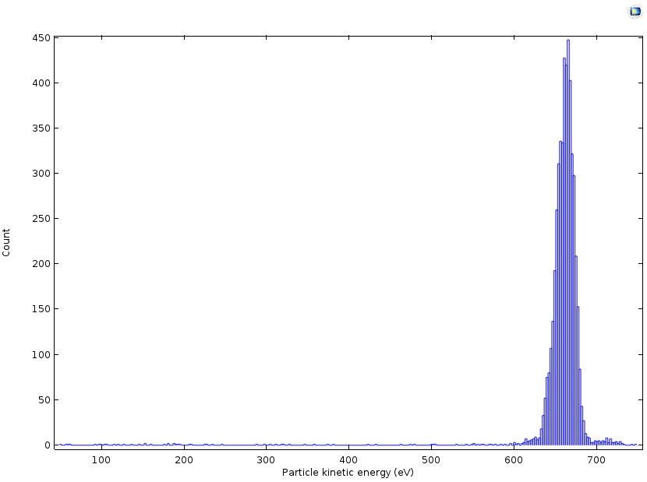
Simulation comparison comments
(1) When the same decelerating and repel voltages are used, COMSOL simulation results are different from SIMION results.
(2) To get the same results with COMSOL, the decelerating voltage, Vc, had to be reduced of few hundred Volts. That could be
due to the underestimated space charge calculation of SIMION.
The COMSOL collector model can be further simplified and the same or better collection efficiency results are obtained.
xy
3Dview

Slide 13
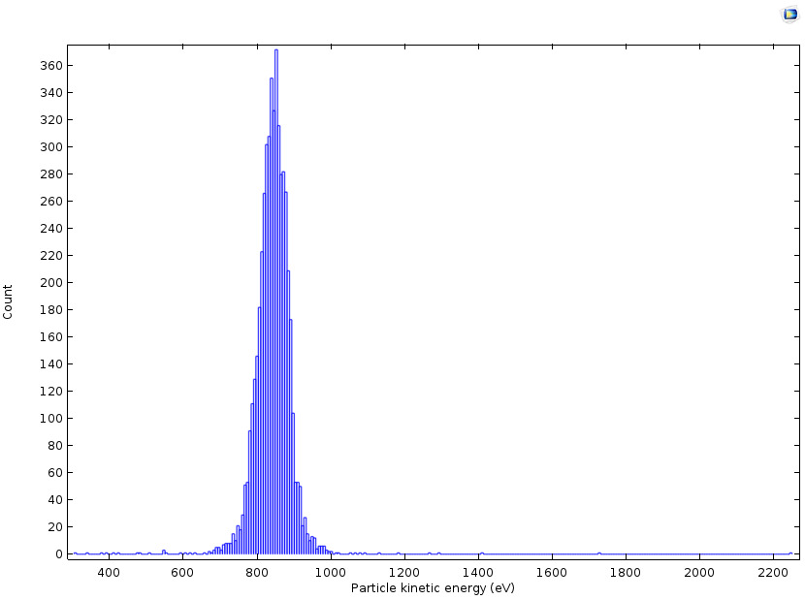
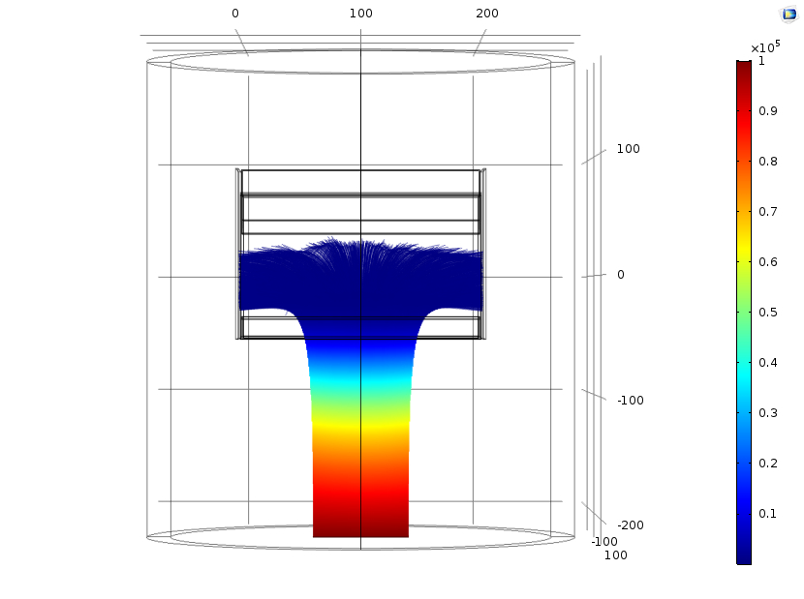
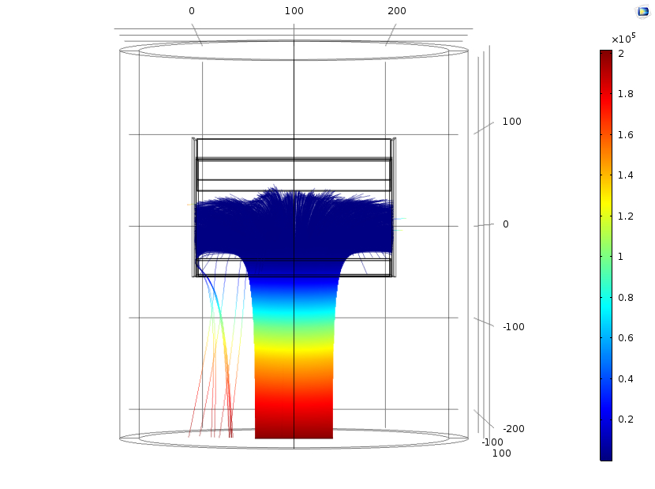
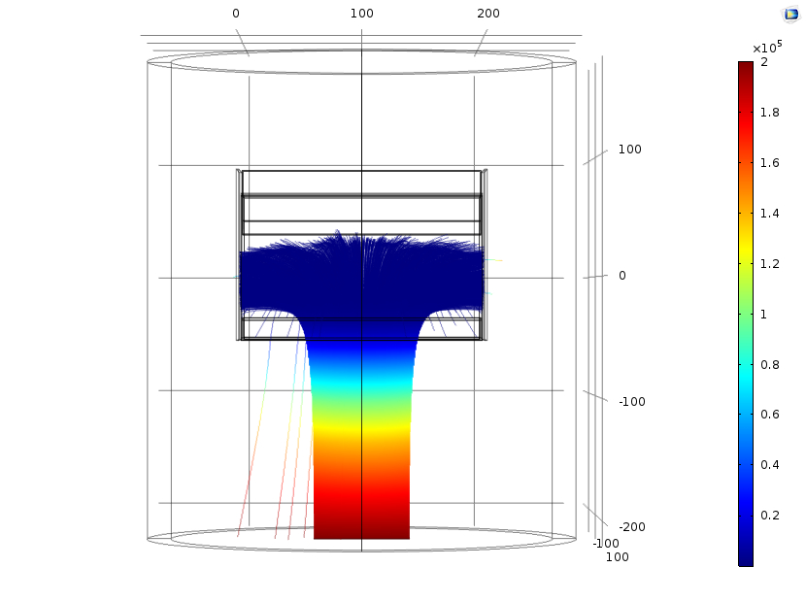
Simulation Comparison at higher beam energy required higher Δ values to get η=1:
For Eki=100 keV (Vc=-99200 V, Δ=800)
Note: if for increasing Eki, the same Δ (=Eki-Vc) is used, the charge collection efficiency η is no more 1 →
Ekf distribution (→power dissipated on the collector)
For Eki=200 keV (Vc=-199100 V; Δ=900 )
For Eki=200 keV (Vc=-199200 V, Δ=800 )
By decreasing the decelerating voltage (Vc), the ions should have more energy (Ekf) to better enter inside the collector.
some ions exit from the collector and are reaccelerated towards the ground.
and with Vc=-199100 V there is a lower number of ions which exit from the collector → better results but still η <1
At higher energy it is more difficult to obtain η=1

Slide 14
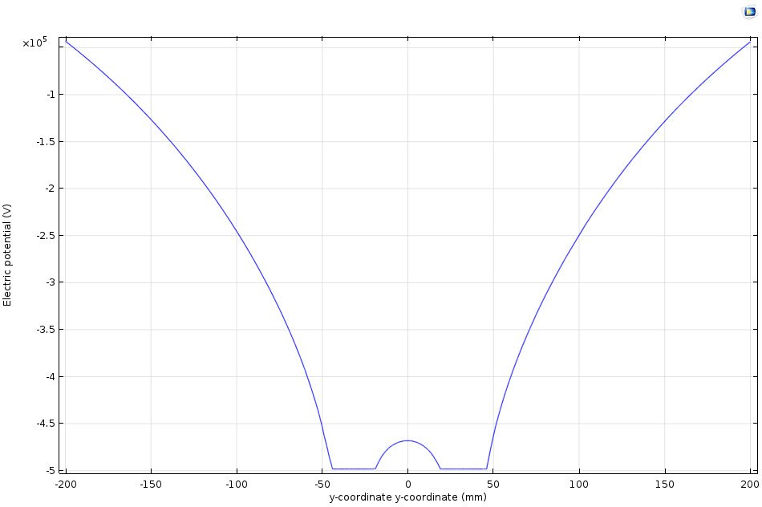
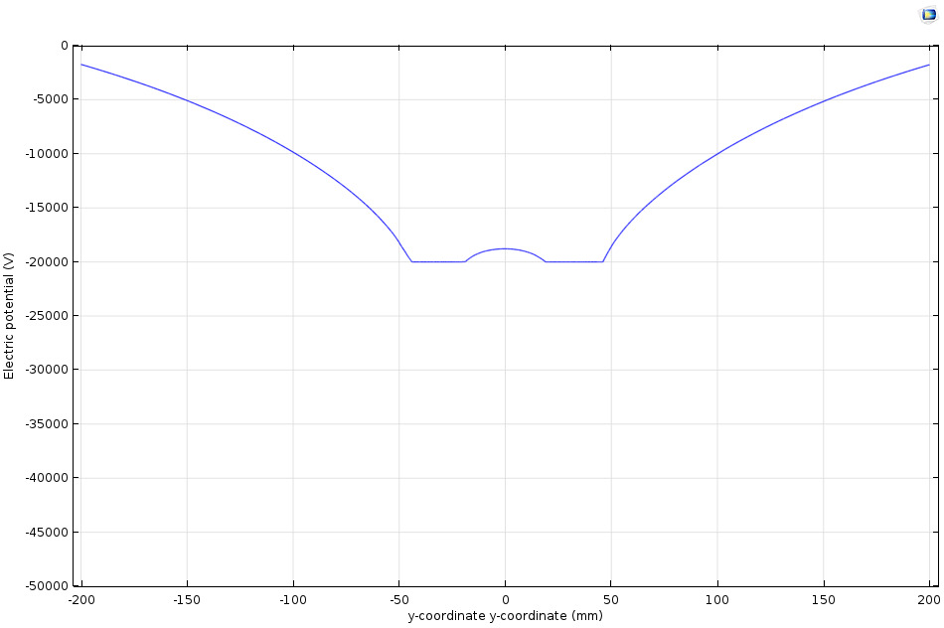
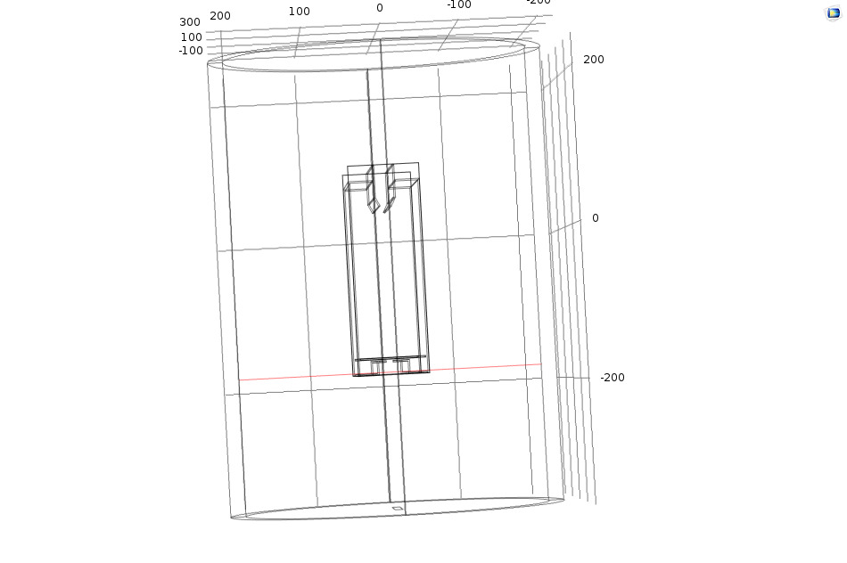
Problem for high energy beam recovery
At higher initial kinetic energy, Eki, the collector must be put, accordingly, to higher Vc potential (in principle, Vc=Eki) → higher potential distortion at the collector entrance.
The potentials along the red line of fig. a) are shown as an example to clarify the problem, for Vc=500 kV and Vc=20 kV :
a)
Vc=550 kV
Vc=20 kV
Note: at higher potential distortion on the collector aperture (see fig.s a and b) → Increase ion energy spread at the collector entrance → lower Vc values are required to allow the entrance of the all ions → However if Vc decreases too much the ions can overcome the repel electrode and exit from the top part of the collector → to avoid this the repel electrode potential (Vr) can be increased → but a higher Vr can push the ions to exit again from the entrance → A difficult trade off is needed. However a longer collector could help → a modified collector is considered

Slide 15
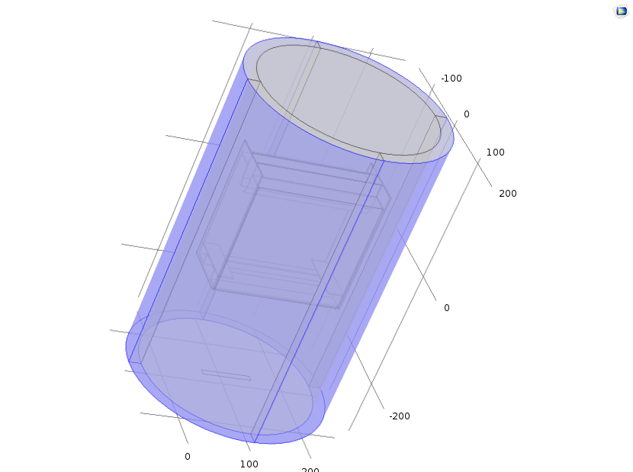
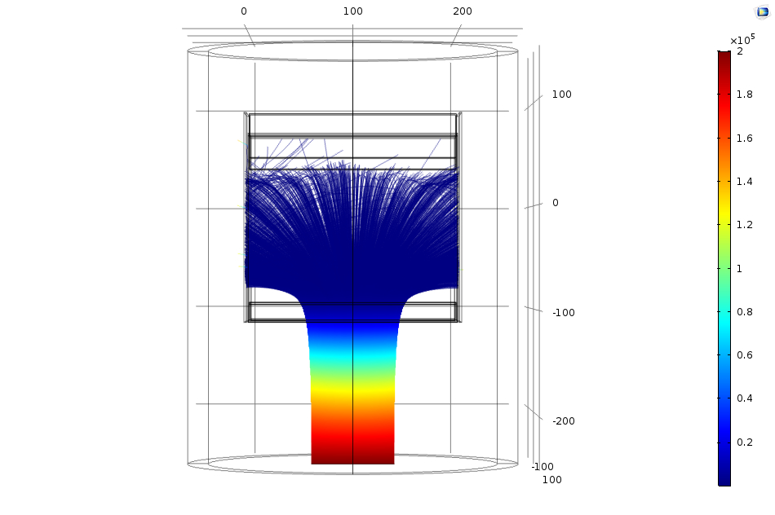
Modified collector
The collector has been elongated in the motion direction. Furthermore, at the side electrodes two steps have been added in such a way to reduce the collector aperture (see model figure) and increase η.
The modified collector model
For Eki=200 keV (Vc=-199200 V, Δ=800) → η=1
Side steps

Slide 16
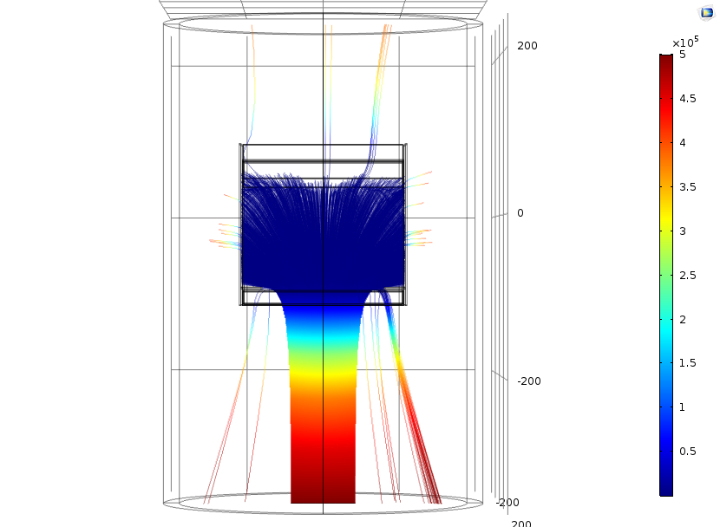
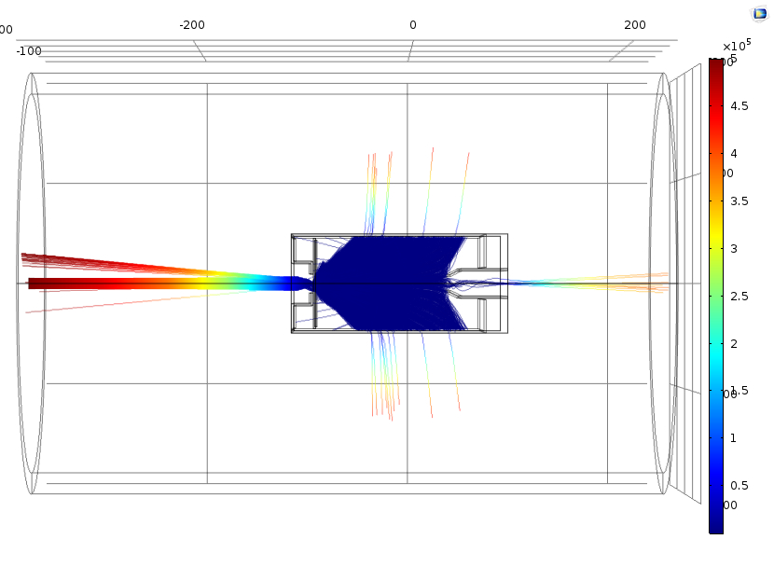
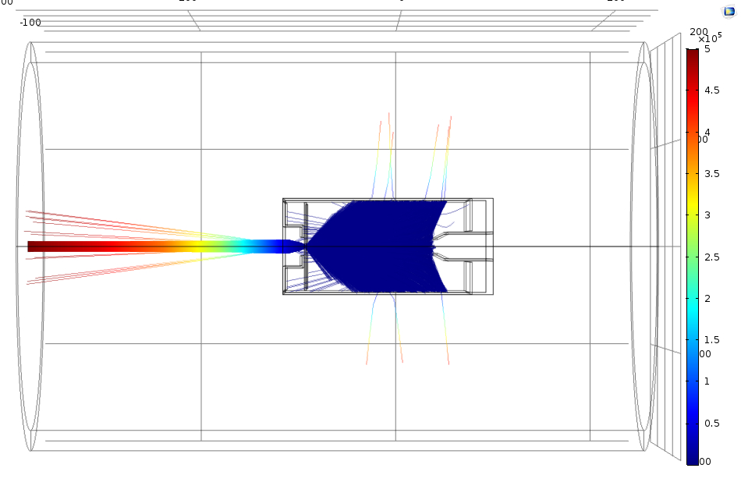
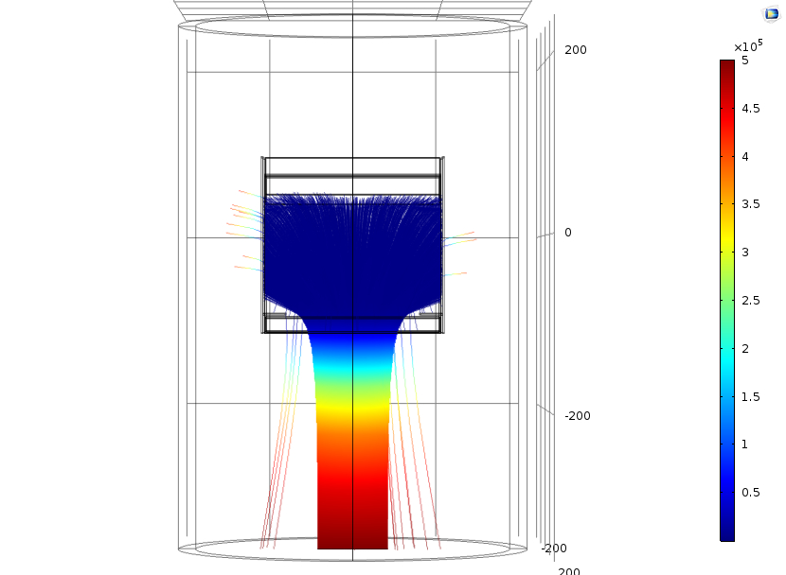
At DTT energy with Eki=500 keV
But at still higher energy problem remains also with the modified collector:
The case with VC=498 keV and Vr=500.3 keV show many ions not collected (η<1):
to improve the collection efficiency, Vc is decreased to Vc=495.0 and Vr has been increased to 500.7 keV.
These pot.ls changes gave better results but still some ions are back re-accelerated to the ground.

Slide 17
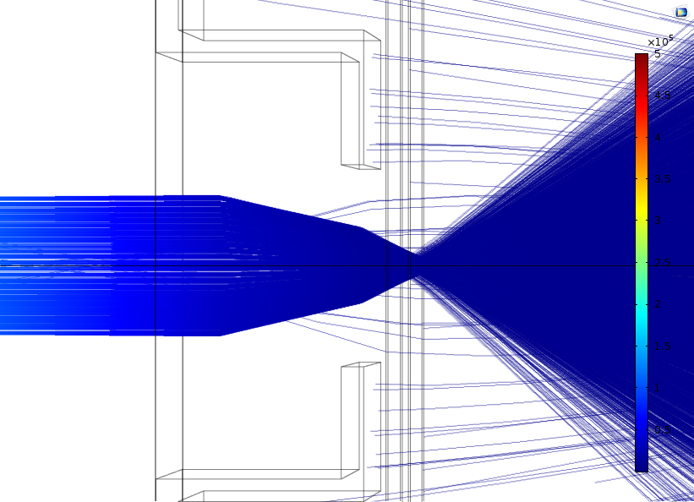
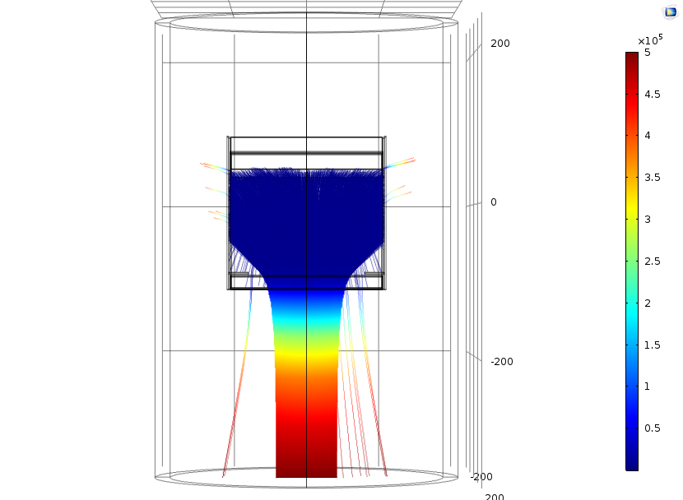
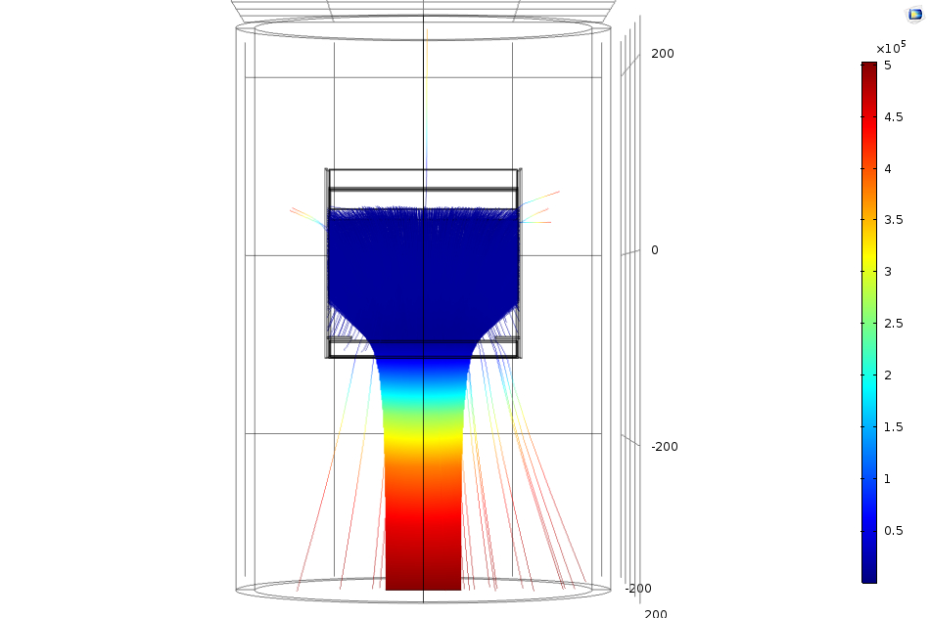
Note: further potential changes improved very lightly the collector efficiency η ◊
The details on the collector entrance show ions exiting from the central part of the hole
Vc=-495 kV
To improve the collection efficiency (Vc) a change in Vg voltage to give a further transverse E component to prevent the central ions exit however did not solve the problem:
Vc=-495 kV and Vg=-485 kV

Slide 18
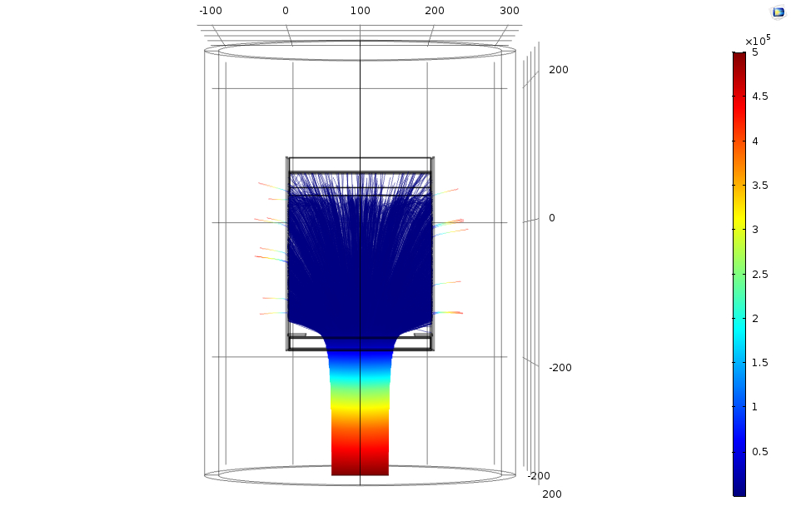
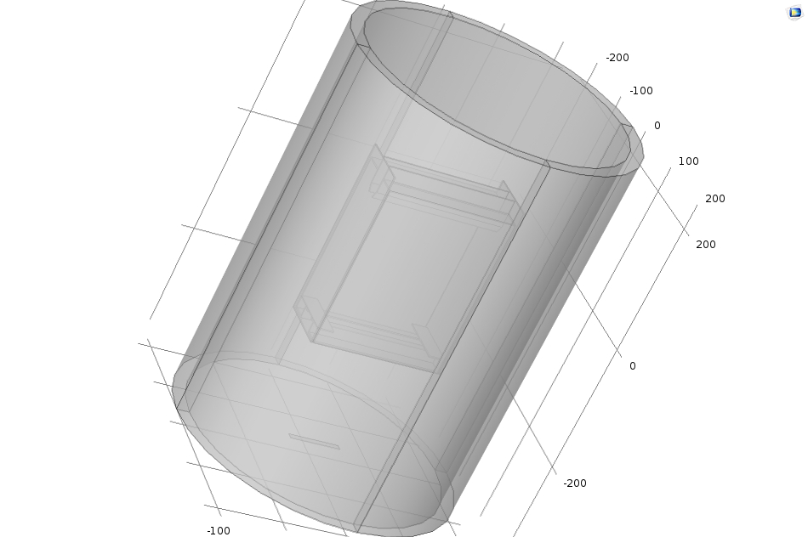
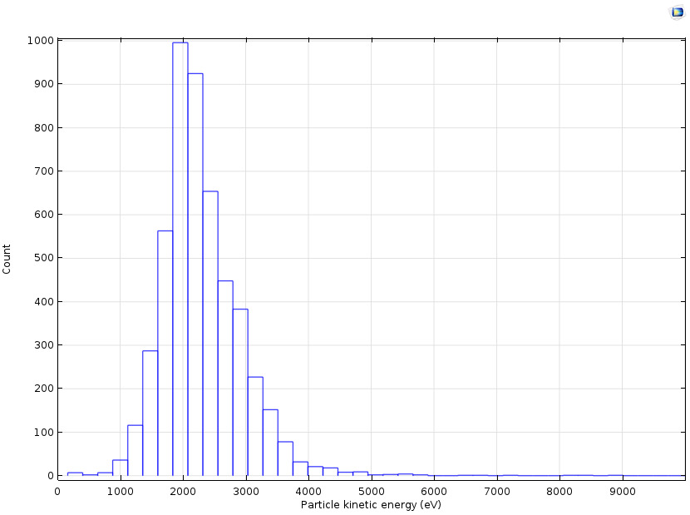
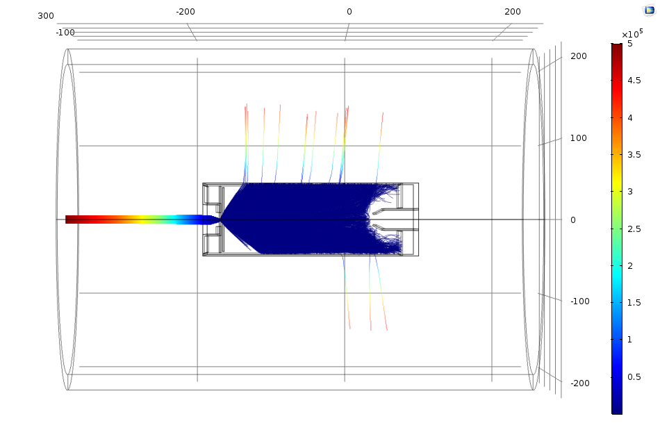
A new modified collector has been considered for higher energy
The new collector model, has been further elongated of 40% :
The modified collector allowed to reach again a η practically 1
For Eki=500 keV;
Vc=-498200 and Vr=-501150
Ekf [eV]
Note: From the Ekf distribution we could evaluate the power dissipation on the collector, Pd: Pd=Pg-Pr= VgIg-VcIc=(for e=1, Ir=Ig and (Vr=Vg-Vc))→Pd= VrIg in %Pd/Pg=Vr/Vg=

Slide 19
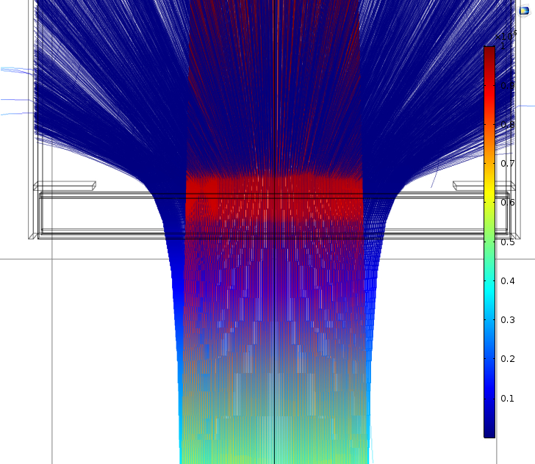
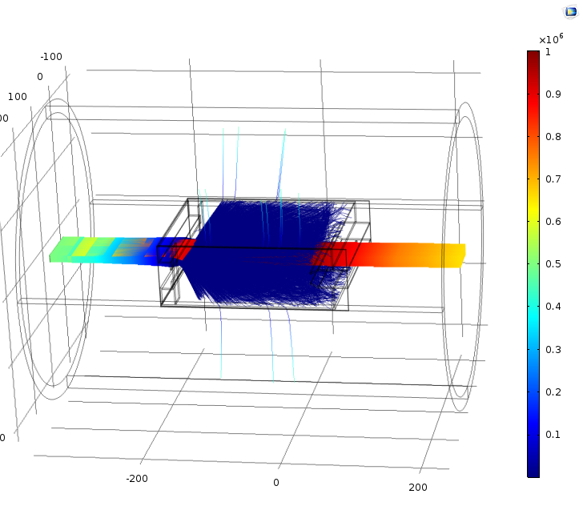
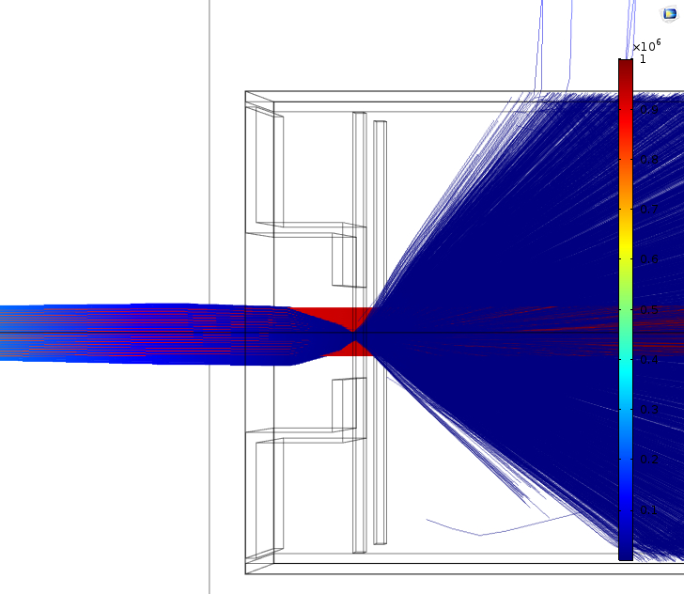
Simultaneous trajectory simulations of both D- and D+ ions
Case for Eki=500 keV with Vc=-498200 Vand Vr=501140 V→ D- are decelerated and collected, D+ accelerated pass through the collector and could collected with a second stage as in Simion simulations:
D+
Details in yx plane
D-
Simulation for the double stage as done with SIMION are in progress.
Details in xz plane

Slide 20
Conclusion
A very simple space charge based collector for the beam energy recovery has been proposed as an alternative to the ERID of DTT and possibly ITER.
Beam energy recovery simulation comparison between SIMION and COMSOL have been carried out since COMSOL uses more accurate space charge calculation.
Parameter conditions (Vc. Vr) to obtain the charge collection efficiency, η =1 have been found also with COMSOL.
The ion kinetic energy recovery efficiency, ε, becomes lower at higher energy for both the codes because of the increased potential distortion at the collector aperture. A longer collector has been considered to mitigate that problem.
In any case the ε obtained with COMSOL is lower than that one found with SIMION. That should be due to the space charge underestimate of SIMION.
The simulations of the double stage for both D- and D+ ions with COMSOL are in progress.

Slide 21
Thank you for your attention
References: [1] H. J. Hopman, NET team, Garching, ’Energy recovery for negative ion based neutral beam lines’, vol.29, N. 4 (1989)/685;
[2] R. Mc Adams, ‘Beyond ITER: NeutralBeamsfor a demonstration Fusion Reactor (DEMO)’, Rev.Sci. Instr. 85,02B319(2014)
[3] V. Variale, M. Cavenago, V. Valentino, ‘Space charged based Residual ion Beam recoveryfor Neuttral Beam Injection’, on proceeidings of ICIS 2021 (Vancouver)
[4] V. Variale, M. Cavenago, (2016) Rev. Sci. Instrum. Feb. 87-02B305
[5] Dahal D. A., SIMION manual 3D, INEEL 95/0403
[6] COMSPL Multiphysics 5.4 manual

