Slide 1


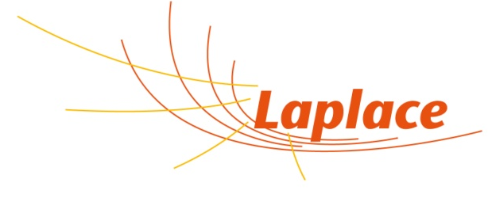
Properties of the negative ion beam extracted from a fusion-type ion source
G. Fubiani
CNRS/GREPHE/LAPLACE
University of Toulouse (Paul Sabatier)
31062 Toulouse, France
gwenael.fubiani@cnrs.fr

Slide 2
Model type/simulation domain
2.5D-3V Particle-In-Cell with Monte-Carlo Collisions (PIC-MCC)
Numerical resolution of 4096 𝗑 6144 nodes
320 nodes per apertures
Comprehensive chemistry for H₂
Plasma density of 2.5 𝗑 10¹⁵ m⁻³ in the driver
  A Scaling factor ε/ε₀= 400 is used.

Slide 3
Plasma properties/effect of the electron Hall current

Slide 4
Zoom around one aperture
Positive ion flux is tilted due to the asymmetry in the plasma parameters.
Negative ions are slightly magnetized.
  X-point is off axis.
  Induce an asymmetry in the beamlet current density profile.
Consistent with experiments.

Slide 5
Virtual cathode profile along the PG
plasma grid (PG)
f
Df
Depth of potential well in front of the PG surface is non-uniform which has an impact on the beam current density profile in the model

Slide 6
Extracted negative ion beamlet profile on the extraction grid (EG)

Slide 7
What about larger ion source volumes? : simulation domain
2.5D-3V PIC-MCC calculation
Numerical resolution of 2048 𝗑 6144 nodes
14 apertures (160 grid cell resolution for each one)
Comprehensive chemistry for H₂
A Scaling factor ε/ε₀= 400 is used.

Slide 8
The electron Hall current in the plasma still induce a noticeable asymmetry

Slide 9
Top/bottom asymmetry also for the electron current on the PG and extracted negative ion current

Slide 10
What about the effect of the grid geometry on the beamlet optics in the accelerator
Chamfered vs. bevel grid geometries
2D-3V PIC-MCC calculation (slit apertures)
Numerical resolution of 2048 𝗑 4096 nodes
Necessary to resolve the virtual cathode profile
Negative ions only produced on the PG surface
Average plasma density of 3 𝗑 10¹⁷ m⁻³
  No scaling factors (ε/ε₀= 1)
Simulation domain restricted to one aperture
Plasma injected into “grey” area

Slide 11
What about the effect of the grid geometry on the beamlet optics in the accelerator (cont’d)
Chamfered apertures generate aberrations in the beam
58% extraction probability on tilted side vs. 33% once an ion escape virtual cathode
  But lower saturation current
(I_{c}/I_{b})(S_{b}/S_{c}) ≈ 1.2, i.e, somewhat proportionnal to the surface as in the experiments

Slide 12
Halo visible on the beamlet phase-space distribution
Legend : black points for ions produced on the flat surface and red for the tilted one

Slide 13
Conclusion
An asymmetry in the plasma parameters is observed in the plane perpendicular to the magnetic filter field.
  This is caused by the electron Hall current intercepted by the ion source walls.
The asymmetry affects the extracted electrons and ions as well.
  Non-uniform saturation current profile along the PG for the ions.
An additional asymmetry for the ions originates from their slight magnetization by the magnetic filter field.
Comparing a chamfered vs. bevel grid geometry (slits), one finds an extracted current somewhat proportional to the surface area.
  Higher extraction probability on the tilted surface but lower saturation current.
Chamfered configuration generates a halo in the ion beam optics.
Simulation required a large number of grid cells in 2D (4096 𝗑 2048)
  Feasibility of a 3D calculation questionable
Conclusions from Particle-in-Cell model consistent with experimental observations.

