Slide 1

Study of plasma meniscus including the surface produced negative ions by using PIC-MCC simulation
K. Miyamoto^{a)}, K. Hayashi^{b)}, K. Hoshino^{b)} , and A. Hatayama^{b)}
a) Naruto University of Education
b) Faculty of Science and Technology, Keio University
8th International symposium on Negative Ions, Beams and Sources - NIBS'22
Oct 2 – 7, 2022, Orto Botanico - Padova, Italy
Notes:
Thank you, chairman. I present my talk titled “Study of plasma meniscus including the surface produced negative ions by using PIC-MCC simulation”.

Slide 2
Contents
Introduction
・Relation between shape of plasma meniscus and ion beam optics
2. Analytical theory of the effective distance d_{eff} between plasma meniscus and extraction electrode
・ It is shown that the effective distance d_{eff} depends on electro-negativity n_{H-}/n_{e}, plasma density, and so on.
3. 3D PIC-MCC simulation model
・Integrated model (source plasma, extraction region, and accelerator)
・Physical processes (surface production, various collision processes of H⁻ ions)
4. Simulation results
・Dependence of the effective distance d_{eff} on the electro-negativity n_{H-}/n_{e}
・Dependence of H⁻ ion beam optics on the plasma density
5. Summary and future plan
Notes:
The contents of my talk are summarized here.
In the introduction, I’ll show you the relation between shape of plasma meniscus which is an ion emitting surface, and ion beam optics. For positive ion extraction from an electropositive plasma, the theory of the plasma meniscus has already established. But, for negative ion extraction from an electro-negative plasma, the theory of the plasma meniscus is not established yet although the quality of the negative ion beam is determined by the shape of plasma meniscus. This is motivation of our study.
Next, I’ll present you the analytical theory of the effective distance deff between plasma meniscus and extraction electrode on the basis of the current continuity between inside and outside the source plasma. It will be shown that the effective distance deff depends on electro-negativity, plasma density, and so on.
This analytical theory was verified by using the 3D PIC simulation. The simulation result, especially the dependence of the effective distance deff on the electro-negativity will be shown later followed by the explanation of the outline of the simulation. Finally, summary and future plan.

Slide 3
Introduction
It is essential for a hydrogen negative ion source to generate the negative ion beams with good beam optics as well as with the high current density. For example, a negative ion beamlet with a divergence angle of 3 ~ 7 mrad is required for the negative ion source in the negative ion based NBI for ITER [1, 2].
If the negative ion beam divergence angle is large, the negative ion beam will impinge on the acceleration grid and other components during beam acceleration and transport, and then causes the heat loads, loss of the negative ion beam current, and break down of voltage holding due to the resultant secondary electrons.
Therefore, the negative ion beam optics has been studied intensively in development of the hydrogen negative ion sources. In general, an ion beam optics depends on the shape of plasma meniscus, which is an ion emitting surface.
[1] Hemsworth S R, Boilson D, Blatchford P, Palma D M, Chitarin G, Esch de L P H, Geli F, Dremel M, Graceffa J, Marcuzzi D 2017 New J. Phys. 19 025005.
[2] M. J. Singh, D. Boilson, A. R. Polevoi, T. Oikawa, and R. Mitteau 2017 New J. Phys. 19 055004.
Notes:
Now, I introduce the background of our study.
It is essential for a hydrogen negative ion source to generate the negative ion beams with good beam optics as well as with the high current density. For example, a negative ion beamlet with a divergence angle of 3 ~ 7 mrad is required for the negative ion source in the negative ion based NBI [1, 2].
If the negative ion beam divergence angle is large, the negative ion beam will impinge on the acceleration grid and other components during beam acceleration and transport, and then causes the heat loads, loss of the negative ion beam current, and break down of voltage holding due to the resultant secondary electrons.
Therefore, the negative ion beam optics has been studied intensively in development of the hydrogen negative ion sources. In general, an ion beam optics depends on the shape of plasma meniscus, which is an ion emitting surface

Slide 4
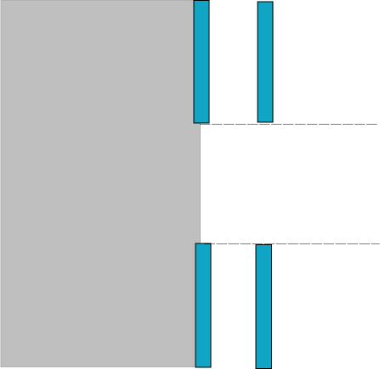
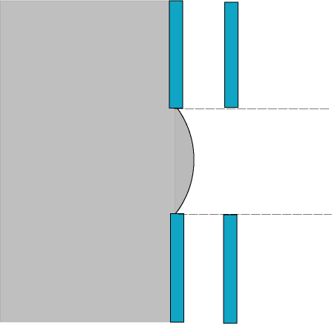
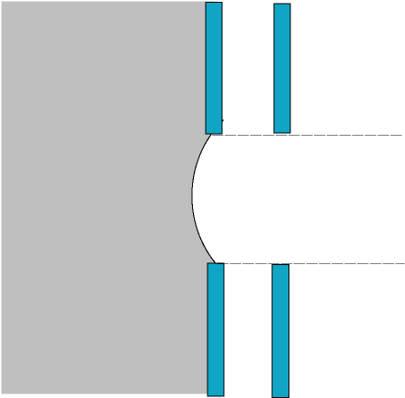
Relation between shape of plasma meniscus and ion beam optics
Control of effective distance d_{eff} between the Plasma Grid (PG) and the Extraction Grid (EG) (or equivalently the position of the plasma meniscus) is very important to obtain good beam quality.
d: geometrical distance between PG and EG
Optimum plasma density
High plasma density
Low plasma density
PG
EG
PG
EG
PG
EG
Source
Plasma
Extraction
aperture
Ion beam trajectory
d_{eff} = d
d_{eff} < d
d_{eff} > d
Plasma meniscus：flat
Extracted ion beam：parallel
Optimum perveance
Plasma meniscus : Convex 凸
comes out towards the EG
Extracted beams : diverged
Plasma meniscus : Concave 凹
penetrates into the source region
Extracted beams : over-focused
Notes:
As you know, control of effective distance d_{eff} between the Plasma Grid and the Extraction Grid, or equivalently the position of the plasma meniscus, is very important to obtain good beam quality.
For a given extraction voltage, the shapes of the plasma meniscus can be classified into the following three types by the plasma density as shown here: In the optimum plasma density, the plasma meniscus shape is relatively flat, that is, d_{eff} is almost equal to d where d is the geometrical distance between the PG and EG. The ion beam trajectory is parallel or convergent in good beam optics. When the plasma density is too high, the plasma meniscus shape is convex, that is, d_{eff} is smaller than d. The extracted ion beam is defocused and the divergence angle is large. When the plasma density is too low, and the plasma meniscus shape is concave, that is, d_{eff} is larger than d.. The extracted ion beam is over-focused, and is consequently divergent.

Slide 5
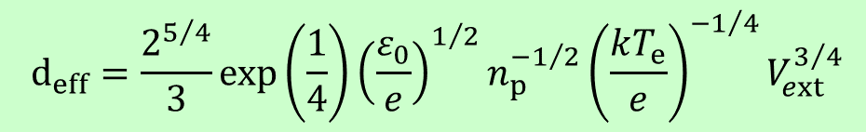
・What are the key parameters to determine/control d_{eff}?
・How d_{eff} depends on these key parameters ?
・How to control the plasma meniscus ?
For ordinary plasmas with single positive ions and electrons: well-known simple theory tells us:
M：mass of a positive ion
n_{p}: plasma density
T_{e}：electron temperature
V_{ext}：extraction voltage
$$d_{eff}=\frac{2^{5/4}}{3}exp\left(\frac{1}{4}\right){\left(\frac{ε_{0}}{e}\right)}^{1/2}n_{p}^{−1/2}{\left(\frac{kT_{e}}{e}\right)}^{−1/4}V_{ext}^{3/4}$$
However, for the electronegative plasma including the surface produced H⁻ ions in the negative ion sources, the key parameters to control the plasma meniscus and the dependence on these parameters are still unclear.
In this study, the plasma meniscus and relevant physical structure such as the sheath in the electronegative plasma including the surface produced H⁻ ions was investigated by using both analytical theory and 3D PIC-MCC simulation.
Notes:
In general, a quality of ion beam optics is determined by the shape of the plasma meniscus. Therefore,
・What are the key parameters to determine/control deff ?
・How deff depends on these key parameters ?
・How to control the plasma meniscus ?
These are essential for the good beam optics in the negative ion source.
For the ordinary plasmas with single positive ions and electrons, deff is given by well-known this theory. However, for the electronegative plasma including the surface produced H⁻ ions in the negative ion sources, the key parameters to control the plasma meniscus and the dependence on these parameters are still unclear. In this study, the plasma meniscus and relevant physical structure such as the sheath in the electronegative plasma including the surface produced H⁻ ions was investigated by using both analytical theory and 3D PIC-MCC simulation.

Slide 6
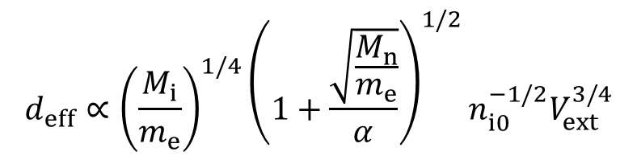

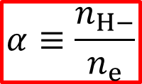
Analytic theory of the effective distance d_{eff} including surface produced H⁻ ions
Inside the source plasma
=> Current through the sheath
J_{sat} = J_{e}+J_{H-}
(Saturation current)
Outside the source plasma
(between PG and EG)
=> Total of extracted current
J^{ext}=J_{e}^{ext}+J_{H-}^{ext}
(Child-Langmuir current)
$$J_{sat}=J^{ext}$$
Current continuity
Effective distance d_{eff} between the plasma meniscus and the EG (J_{sat}=J^{ext})
$$d_{eff}∝{\left(\frac{M_{i}}{m_{e}}\right)}^{1/4}{\left(1+\frac{\sqrt{\frac{M_{n}}{m_{e}}}}{α}\right)}^{1/2}n_{i0}^{−1/2}V_{ext}^{3/4}$$
m_{e}：mass of electron
M_{i}：mass of H⁺ ion
M_{n}：mass of H⁻ ion
n_{i0}: H⁺ ion density at the sheath edge
V_{ext}：extraction voltage
Electro-negativity
α lower → d_{eff} larger : plasma meniscus penetrates deeper into the plasma
α higher → d_{eff} smaller : plasma meniscus penetrates shallower into the plasma
$$α≡\frac{n_{H−}}{n_{e}}$$
Electro-negativity α near the PG is a very important parameter to control d_{eff} (the plasma meniscus).
Notes:
Firstly, I’ll show you the analytic theory of deff for the electronegative plasma including the surface produced H⁻ ions briefly. Inside the source plasma, the positive ion saturation current is balanced with the sum of currents of electron and the negative ion reaching the wall. On the other hand, outside the source plasma, total of extracted current is given by the Child-Langmuir law. From the current continuity, deff for the electronegative plasma including the surface produced H⁻ ions can be given as this formula.
Like the ordinary plasmas with single positive ions and electrons, deff depends on the plasma density and extraction voltage. Moreover, deff also depends on the electro-negativity α, which is a ratio of the H- ion density to the electron density. As α becomes lower, deff becomes larger. This means that the plasma meniscus penetrates deeper into the source plasma. On the other hand, as α becomes higher, deff becomes smaller. This means that the plasma meniscus penetrates shallower into the source plasma. Thus, electro-negativity α near the PG is a very important parameter to control deff, or the plasma meniscus.
Next, we move to the modeling and result of the 3D PIC-MCC simulation.

Slide 7
3D PIC-MCC simulation model (I)
e
electron
+
H⁺
All the particles
x
40 mm
－
H⁻
x = +8.125 mm
30 mm
+
periodic boundary condition
+
magnetic filter
electron suppression magnetic field
e
×
z
source plasma
e
re-load
e
Surface produced H⁻
・half-Maxwellian
・angular distribution：cosine distribution
・H- is launched uniformly from the PG surface.
delete
－
－
－
－
z = z_{min}
PG
EG
SG (suppression grid)
GG (grounded grid)
x = -8.125 mm
Notes:
A schematic view of our model is shown here. The motion of charged particles is solved in their self-consistent electric field by using the spatially three-dimensional PIC method. A single aperture of negative ion extraction and acceleration region is modelled: The simulation domain consists of a source plasma, an extractor, which consist of the PG and EG, and an accelerator, which consists of the suppression grid (SG) and a grounded grid (GG).
The z-axis is taken to be the direction of negative ion extraction and acceleration. The magnetic filter and the electron suppression magnetic field are taken into account. The x-axis is parallel to the direction of the magnetic filter, while the y-axis is parallel to the direction of the electron suppression magnetic field.
The re-fluxing process is basically used that is, the particles moved out of the simulation region or hitting on the grids are re-loaded from the source plasma. However, only the negative ion particles moved out of the z_{max} are removed to obtain the steady state because in modeling the surface produced negative ions, a constant number of negative ion super-particles is launched from the PG surface each time step. The surface produced H⁻ ions are launched from the surface of the PG uniformly. The angular distribution is assumed to be a cosine distribution.

Slide 8
3D PIC-MCC simulation model (II)
Physical parameter | Value
Electron temperature | 1 eV
Hydrogen ion temperature | 0.3 eV （H⁺） 0.1 eV（volume produced H⁻） 1 eV（surface produced H⁻）
Electron density | 1.8×10¹⁷ m⁻³
Hydrogen atom temperature | 0.3 eV
Hydrogen molecule temperature | 0.1 eV
Hydrogen molecular density | 1.88×10¹⁹ m⁻³ (at 0.3 Pa)
Density ratio n_{H}/n_{H2} | 0.5
Number of H- particles / time step / process | Surface produced H⁻ ion flux from PG (A/m²)
20 | 39
60 | 146
100 | 255
In order to investigate the effect of electro-negativity (α ≡ n_{H-}/n_{e}) on the effective distance d_{eff}, the following numbers of the surface produced H⁻ ion super-particles per timestep were surveyed:
Notes:
The main physical parameters in the source region are summarized in this table. Electrons, H⁺ ions, and H⁻ ions are assumed to be launched as Maxwellian or half-Maxwellian distributions with these temperatures. These values are obtained from the experimental result. In order to investigate the effect of electro-negativity on the effective distance deff, the following numbers of the surface produced H- ion super-particles per timestep were surveyed. In this table, the corresponding surface produced H- ion flux from the PG is also shown.

Slide 9
3D PIC-MCC simulation model (III)
・The following collisions related to the H⁻ ions are taken into account:
Coulomb collision：H⁻－H⁺, H⁻ － H⁻
Charge exchange collision：H⁻ (fast)+ H(slow) → H⁻ (slow)+ H(fast)
Elastic collision：H⁻－H, H⁻ － H₂
Mutual neutralization：H⁺ + H⁻ → H + H
Other simulation conditions
・Initial super-particle numbers：
Electron (8.715×10⁷), H⁺ ion (1.245×10⁸), H⁻ ion (3.735×10⁷)
10 particles per mesh in average
・Neutral particles（H, H₂）are assumed to be the background particles.
・ Extraction and acceleration voltage:
V_{PG} = 0 V, V_{ext} = V_{SG} = 2.7, V_{acc} / V_{ext} = 22
Notes:
As for the collision processes of the H⁻ ions, the Coulomb collision with the H⁺ ions, the elastic collision with the H atoms and H₂ molecules and the charge exchange collision are taken into account. A binary collision model (BCM) by the Monte Carlo method is applied to the Coulomb collision with the H⁺ ions. Whether the elastic collision or the elastic collision occurs or not is determined by using the null collision model. Neutral particles are assumed to be the background particles. Initial super-particle numbers are as follows, which correspond to 10 super-particles per cell on average. Extraction and acceleration voltages are as follows:
OK, now I’ll show you the simulation results.

Slide 10
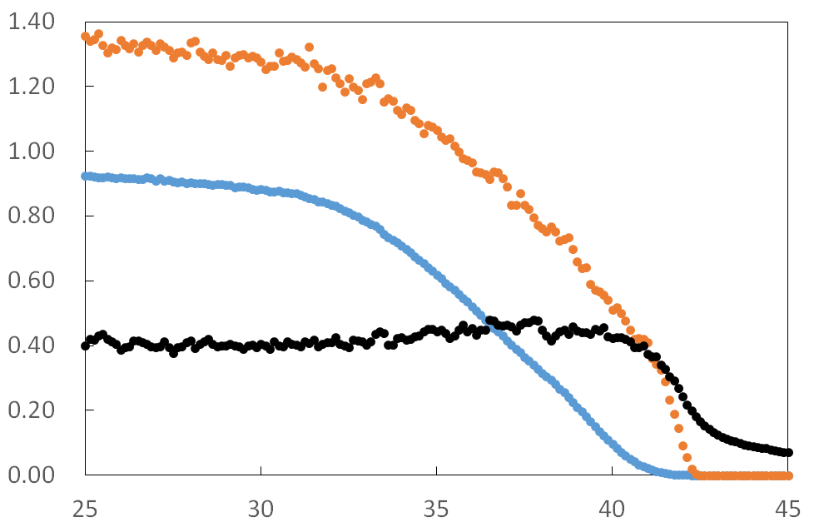
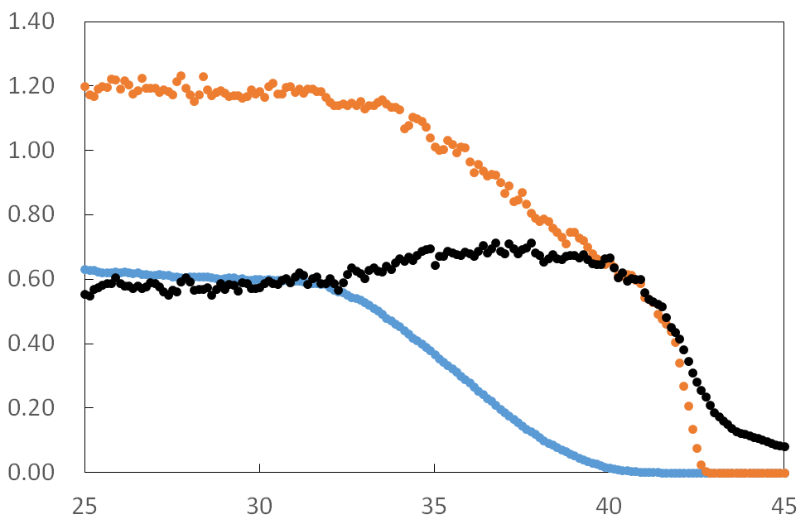
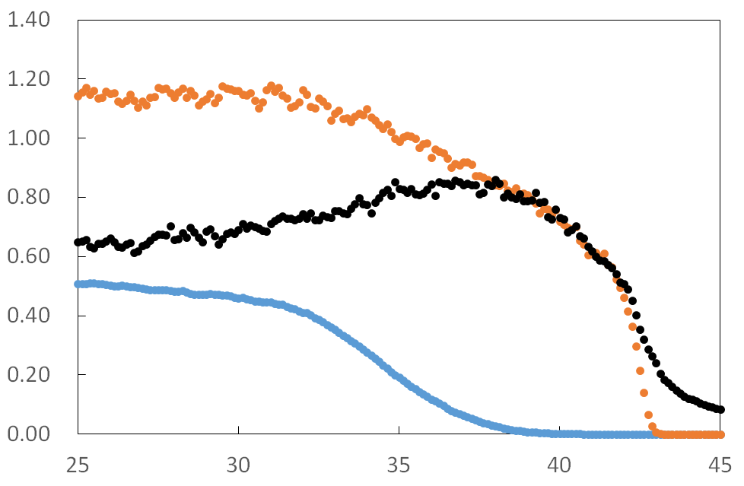
Spatial distribution of electron, H⁺ on, and H⁻ ion
J_{H-} = 39 A/m²
H⁺
electron
・Spatial distributions of electron H⁺ ion, and H⁻ ion densities along the z-axis are compared.
・The ratio n_{H-}/n_{e} increases as the flux of surface produced H⁻ particles per time increases.
n_{e}, n_{H+,} n_{H-} (×n_{e0} m⁻³)
H⁻
z (mm)
J_{H-} = 146 A/m²
J_{H-} = 255 A/m²
source plasma
PG
H⁺
H⁺
H⁻
H⁻
n_{e}, n_{H+,} n_{H-} (×n_{e0} m⁻³)
n_{e}, n_{H+,} n_{H-} (×n_{e0} m⁻³)
electron
electron
z (mm)
z (mm)
Notes:
The spatial distributions of the H⁺ ion, electron, and H⁻ ion densities around the PG are compared. The electron density decreases with the approach to the PG due to the magnetic filter. On the other hand, the H⁻ ion density is almost constant since the H⁻ ions are rarely magnetized. The H⁺ ion density also decreases with the approach to the PG in order to maintain plasma neutrality. Thus, the electron density is lower than or compatible with the H⁻ ion density near the PG. These tendency can be observed in the experimental and other simulation result.
The H⁺ ion density in the source plasma is almost the same for these surface produced H- ion fluxes. You can see that with the increase in the surface produced H- ion flux, the H- ion density increases while the electron density decreases. Thus, the ratio of H- ion density to electron density, or electro-negativity increases as the flux of surface produced H⁻ ion increases.

Slide 11
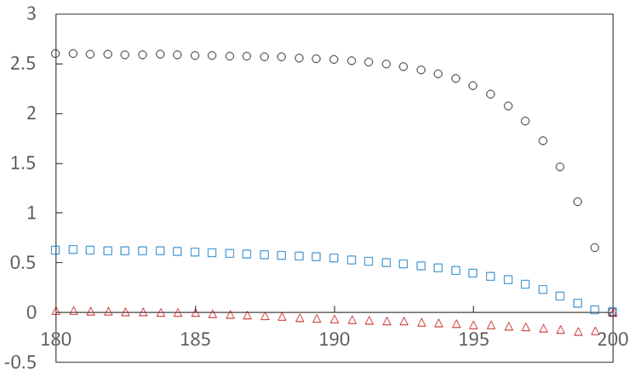
Potential profile in the sheath
・Sheath potential becomes lower compared with that without the surfaced produced H⁻ ions, which agrees with the experimental results [3, 4].
・Sheath potential decreases with the increase in the surface produced H⁻ ion flux.
・The onset of virtual cathode appears with the increase in the surface produced H⁻ ion flux.
entrance of PG
J_{H-} = 39 A/m²
[3] McNeely P, Dudin V S, Christ-Koch S, Fantz U, and the NNBI Team 2009 Plasma Sources Sci. Technol. 18 014011.
[4] McNeely P and Schiesko L 2010 Rev. Sci. Instrum. 81 02B111.
Potential (V)
J_{H-} = 146 A/m²
J_{H-} = 255 A/m²
virtual cathode
z (× λ_{De})
Notes:
The potential profiles in the sheath are compared in this viewgraph. We have already confirmed that the sheath potential becomes lower compared with that without the surfaced produced H- ions, which agrees with the experimental results. The sheath potential decreases with the increase in the surface produced H- ion flux. And then, the onset of virtual cathode appears for JH- = 255 A/m2.

Slide 12
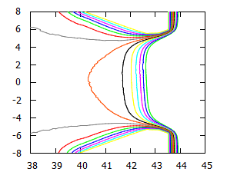

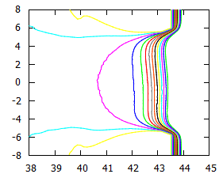
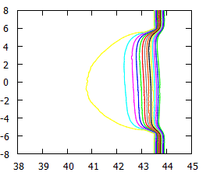
Effect of the ratio n_{H-}/n_{e} on the penetration of electric field
・Penetration of electric field for extraction becomes shallower with the increase of ratio n_{H-}/n_{e} .
・For the small ratio n_{H-}/n_{e}, the surfaced H⁻ ions are extracted directly from the PG surface rather than enter into the bulk plasma.
Contour map of the electrostatic potential near the PG
J_{H-} = 39 A/m²
J_{H-} = 146 A/m²
J_{H-} = 255 A/m²
PG
potential (V)
potential (V)
potential (V)
x (mm)
x (mm)
x (mm)
z (mm)
z (mm)
z (mm)
Notes:
The contour maps of the electrostatic potential near the PG are compared in tis viewgraph. The left side is the source plasma region while the right side corresponds to the extraction region. You can see that penetration of electric field for extraction becomes shallower with the increase of the surface produced H- ion flux, or the ratio of H- ion density to electron density. On the other hand, for the smaller ratio of H- ion density to electron density, penetration of electric field for extraction becomes deeper like this. Thus, the surfaced H⁻ ions are extracted directly from the PG surface rather than enter into the bulk plasma.

Slide 13
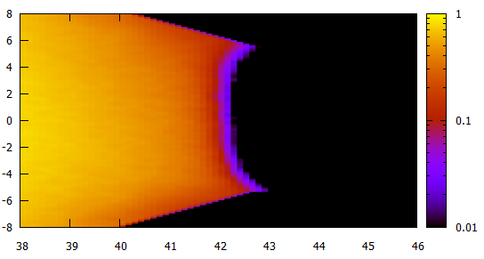
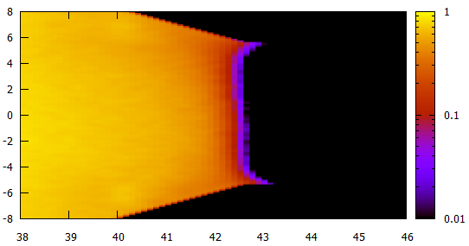
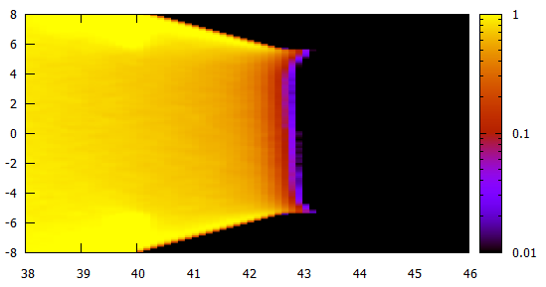
n_{H+}
(×n_{e0} m⁻³)
Comparison of the shape of plasma meniscus
J_{H-} = 39 A/m²
PG
source plasma
・The location of plasma meniscus is estimated from n_{H+} ~ 0.
・The shape of plasma meniscus becomes flat with the increase of ratio n_{H-}/n_{e} .
x (mm)
n_{H+}
(×n_{e0} m⁻³)
z (mm)
n_{H+}
(×n_{e0} m⁻³)
J_{H-} = 146 A/m²
J_{H-} = 255 A/m²
x (mm)
x (mm)
z (mm)
z (mm)
Notes:
The shapes of the plasma meniscus are compared in this viewgraph. Here, the plasma meniscus is defined as the location where the positive ion density is zero. This definition is based on that the positive ions are reflected and separated from the negative ions at the plasma meniscus. The shape of plasma meniscus varies from concave to flat with the increase of ratio H- ion density to electron density. This tendency is consistent with penetration of the electric field near the PG as shown in the previous viewgraph.
Notice that the asymmetry of the plasma meniscus is relatively clear for JH- = 39 A/m2. This asymmetry is caused by the E×B drift of electrons.

Slide 14
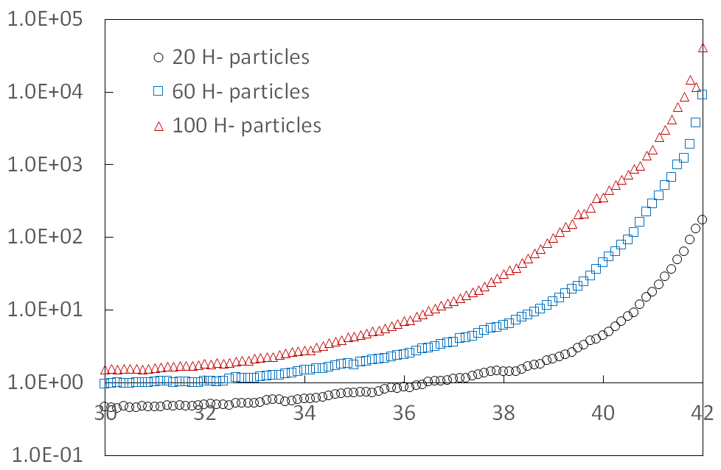
The dependence of plasma meniscus on n_{H-}/n_{e}
n_{H+}
(×n_{e0} m⁻³)
J_{H-} = 255 A/m²
High α
PG
J_{H-} = 39 mA/m²
J_{H-} = 146 mA/m²
J_{H-} = 255 mA/m²
Small d_{eff}
x (mm)
Electro-negativity α ≡ n_{H-}/n_{e}
z (mm)
Low α
n_{H+}
(×n_{e0} m⁻³)
J_{H-} = 39 A/m²
z (mm)
Large d_{eff}
x (mm)
The shape of plasma meniscus or the effective distance d_{eff} depends on the electro-negativity α ≡ n_{H-}/n_{e}.
High α (J_{H-} = 255 A/m²) : Small d_{eff}
Low α (J_{H-} = 39 A/m²) : Large d_{eff}
z (mm)
Notes:
The dependence of the shape of plasma meniscus or the effective distance deff on the electro-negativity is shown here. The electro-negativity along the z-axis is shown in this figure. In the bulk plasma, the electro-negativity is almost constant. However, the electro-negativity increases near the PG since the electron densities decrease.
It is shown that the electro-negativity increases with the increase in the surface produced H⁻ ion flux. You can see that the shape of plasma meniscus or the effective distance deff depends on the electro-negativity. For JH- = 255 A/m2, the electro-negativity is high and the effective distance deff is small. On the other hand, For JH- = 39 A/m2, the electro-negativity is low, and the effective distance deff is large.

Slide 15
The experimental result in ref. [5] may support the present simulation result that the shape of the plasma meniscus depends on electro-negativity $α$.
[5] Kisaki M, Ikeda K, Nakano H, Tsumori K, Fujiwara Y, Haba Y, Kamio S, Nagoka K, Osakabe M 2018 Plasma Fusion Res. 13 1205110.
Notes:
It seems that there are no systematic experimental result which can compare with our simulation result so far, and it is difficult to compare directly our result with the experimental result. However, the experimental result in this reference may support the simulation result that the shape of the plasma meniscus depends on the ratio of the negative ion density to the electron density.
This figure shows the full-width at half-maximum (FWHM) beam width as a function of the bias voltage at various discharge powers. It is clearly shown that the beam width changes with the bias voltage and reaches a minimum.
As you know, by increasing the bias voltage, the electron density decreases while the negative ion density slightly changes. Thus, the electro-negativity depends on the bias voltage. Actually, in this experiment, it was shown that the ratio of negative ion current to electron current as well as the beam optics strongly depend on the bias voltage. This experimental results indicates that the shape of the plasma meniscus depends on the ratio of the negative ion density to the electron density.

Slide 16
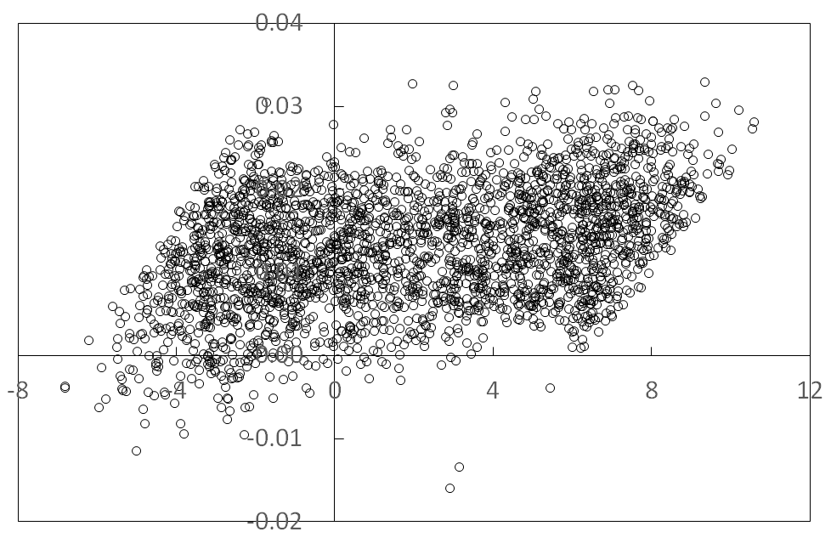
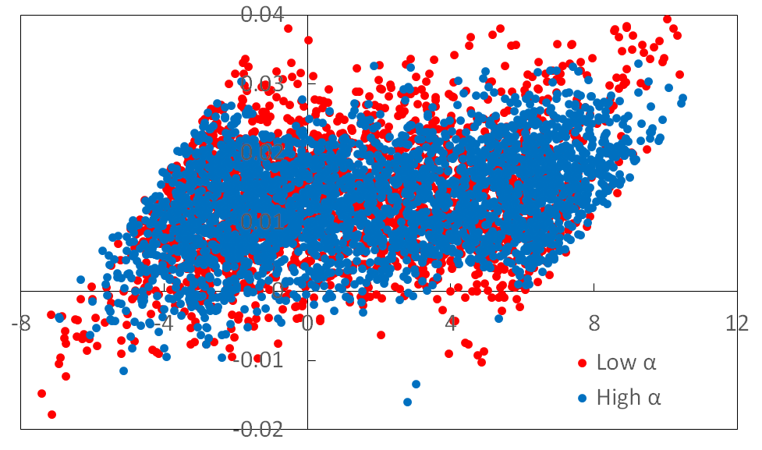
Effect of the ratio n_{H-}/n_{e} on the beam optics
Emittance diagram at the location of 30 mm from the exit of GG
High α
1) upper edge
v_{x} / v_{z}
3) lower edge
x (mm)
2) central region
2) central region
x (mm)
3) lower edge
z (mm)
Comparison of emittance diagram for low α and high α
1) upper edge
v_{x} / v_{z}
z (mm)
・The H⁻ ions extracted from the edge of plasma meniscus become more pronounced for the low electro-negativity α in the emittance diagram.
・It is verified that the ratio of n_{H-}/n_{e} affects the H⁻ ion beam optics.
J_{H-} = 39 A/m²
J_{H-} = 255 A/m²
z (mm)
Notes:
The effect of the electro-negativity on the H- ion beam optics is shown in this viewgraph. This figure shows that the plasma meniscus can be divided into three regions, namely, an upper edge of the meniscus, the central region and a lower edge of the meniscus. This is an emittance diagram of H- ion beam at the location of 30 mm from the exit of GG. The plots in the emittance diagram are classified into three categories, that is, the plots of negative ions extracted from the upper edge of the meniscus, the central region and the lower edge of the meniscus.
In this figure, emittance diagrams for low electro-negativity and high electro-negativity are superimposed and compared. It is shown that the H⁻ ions extracted from the edge of plasma meniscus become more pronounced for the low electro-negativity α in the emittance diagram since the curvature of the plasma meniscus becomes larger and then, the H- ions extracted from the edge of the meniscus are easily over-focused. Therefore, it is verified that the electro-negativity affects the H- ion beam optics.

Slide 17
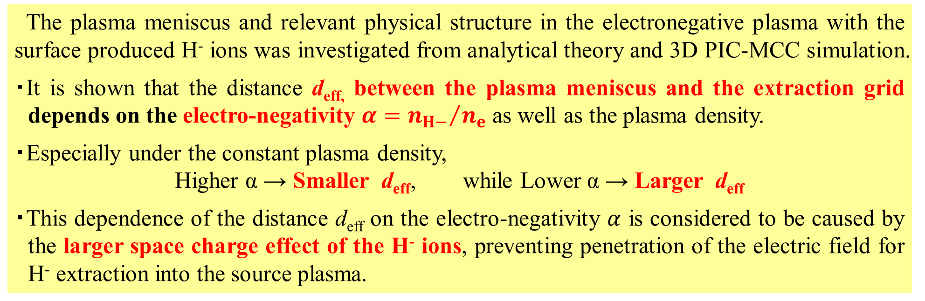
Summary and future plan
The plasma meniscus and relevant physical structure in the electronegative plasma with the surface produced H⁻ ions was investigated from analytical theory and 3D PIC-MCC simulation.
・It is shown that the distance d_{eff,} between the plasma meniscus and the extraction grid depends on the electro-negativity $α={n_{H−}}/{n_{e}}$ as well as the plasma density.
・Especially under the constant plasma density,
Higher α → Smaller d_{eff}, while Lower α → Larger d_{eff}
・This dependence of the distance d_{eff} on the electro-negativity $α$ is considered to be caused by the larger space charge effect of the H⁻ ions, preventing penetration of the electric field for H⁻ extraction into the source plasma.
The future plans for the study of the plasma meniscus and H⁻ ion beam optics are as follows:
1) A systematic comparison with the experimental result
2) Further investigation of the relevant physics of the plasma meniscus, for example
・asymmetry structure of the plasma meniscus
・relationship between extraction mechanism of surface produced H⁻ ions and beam optics

Slide 18
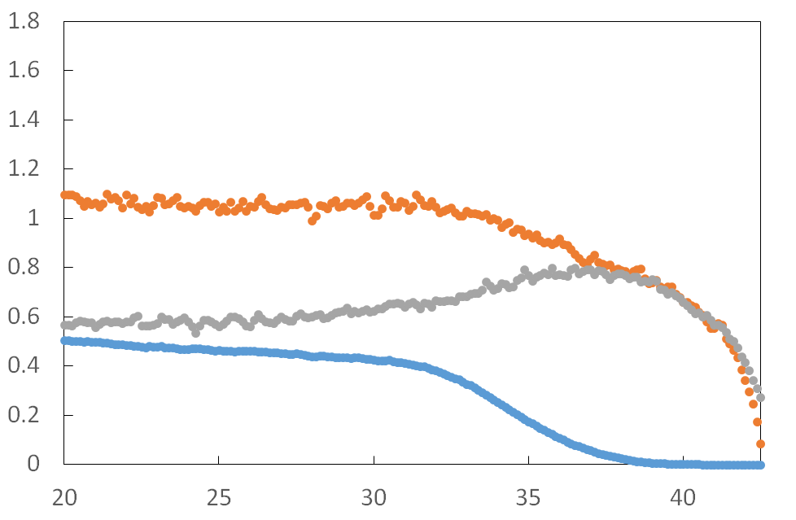
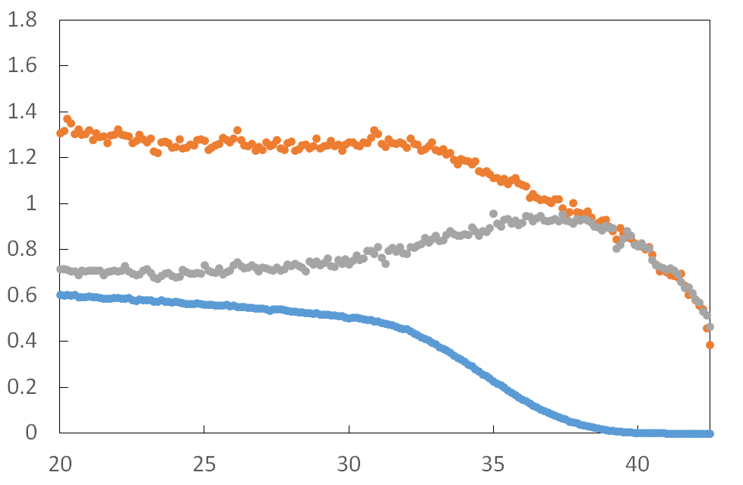
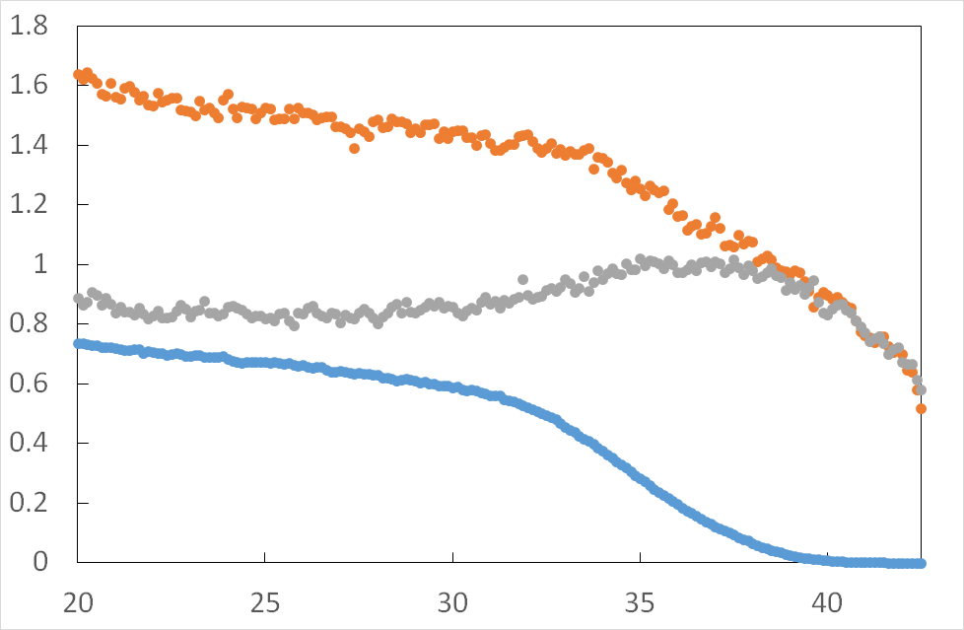
Dependence of shape of plasma meniscus on plasma density(I)
×n_{e0} (1.8×10¹⁷)
crho = 0.054
・The charged particle densities n_{e}, n_{H+}, and n_{H-} along the z-axis.
・In the simulation, the plasma density was varied by changing the weighting parameter “crho”, which correspond to the number of real particles per super-particle of the simulation.
・The plasma density increases with increase in the value of crho.
H⁺ ion
Particle density (m⁻³)
H⁻ ion
electron
z (mm)
×n_{e0} (1.8×10¹⁷)
crho = 0.060
×n_{e0} (1.8×10¹⁷)
crho = 0.078
source plasma
PG
H⁺ ion
H⁺ ion
H⁻ ion
Particle density (m⁻³)
H⁻ ion
Particle density (m⁻³)
electron
electron
z (mm)
z (mm)

Slide 19
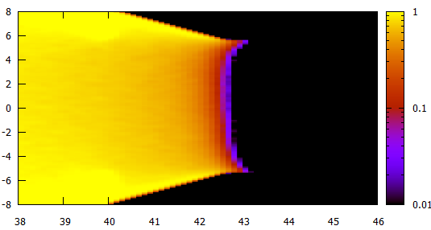
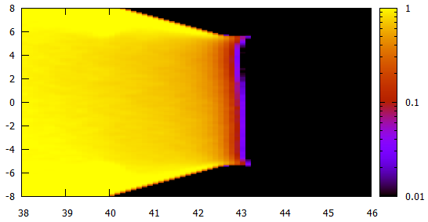
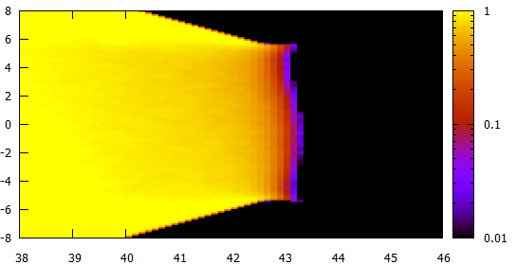
n_{H+}
(×n_{e0} m⁻³)
Dependence of shape of plasma meniscus on plasma density (II)
crho = 0.054
PG
source plasma
・It is verified that he shape of plasma meniscus depends on the plasma density.
・With the increase in the plasma density, the shape of plasma meniscus varies as follows:
concave 凹 → almost flat → convex 凸
x (mm)
n_{H+}
(×n_{e0} m⁻³)
z (mm)
n_{H+}
(×n_{e0} m⁻³)
crho = 0.066
Crho = 0.078
x (mm)
x (mm)
z (mm)
z (mm)

