Slide 1
Impact of divertor X-points on axisymmetric modes in tokamaks
19th European Fusion Theory Conference, October 2021
Franco Porcelli
Polytechnic University of Turin, Italy
In collaboration with:
A. Yolbarsop, U. of Science and Technology of China, Hefei
R. Fitzpatrick, IFS, U. of Texas at Austin

Slide 2
OUTLINE
INTRODUCTION: X-point resonance, why it matters
The math of the X-point singularity, and (perhaps) a surprising result
CONCLUSIONS and DEVELOPMENTS – A new line of research, what to expect

Slide 3
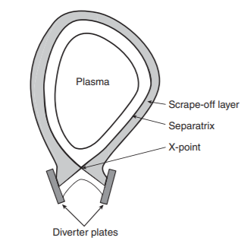
INTRODUCTION:
X-point resonance
B∙∇ξ = i(n/R)B_{T} ξ + i B_{P}(ψ, ϑ) Σ_{m} (m/r) ξ_{m} = 0
Resonance condition at the X-point
satisfied for n=0 and any m
because B_{P}(ψ, ϑ)=0 on the X-point.
The toroidal field line going through the magnetic X-point is resonant to n=0 perturbations!
Schematic diagram of a divertor (single null configuration)

Slide 4
Axisymmetric Modes and X-point resonance: Why it matters
Axisymmetric (n=0) modes in shaped toroidal plasmas are global plasma modes, normally associated with VDEs.
Because of the X-point resonance, current sheets localized along the magnetic separatrix are likely to form. This may have an important impact on plasma edge activity.
Ref.: A. Yolbarsop, F. Porcelli, R. Fitzpatrick, Nuclear Fusion Letters 2021.
Furthermore, a stable n=0 mode tends to acquire an Alfvénic oscillation frequency. As a result, a “resonant” interaction with energetic particles can lead to a new type of fast ion instability (but this is another talk, see Tommaso Barberis, this conference, Thursday afternoon, poster session).

Slide 5

Let us review the philosophy behind passive and active feedback stabilization of vertical plasma displacements.
A heuristic model:
three parallel current wires.
Lister et al, NF 1990;
Lazarus et al, NF 1990.

Slide 6
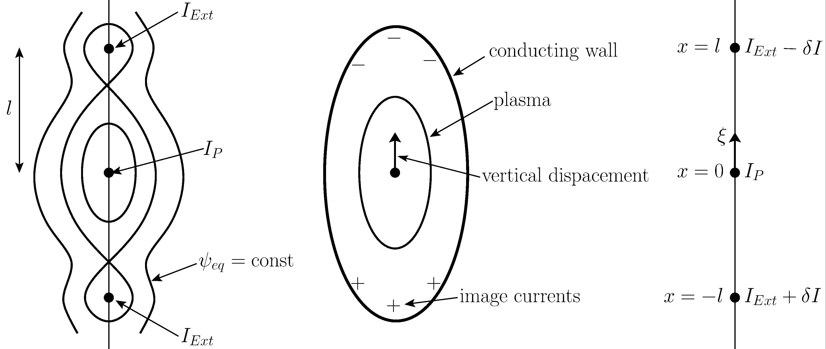
Three-current-wires model

Slide 7

Cubic dispersion relation
$μ\overset{⃛}{ξ}+\frac{1}{τ_{R}}\ddot{ξ}+ω_{0}^{2}\dot{ξ}−$ $\frac{1}{τ_{R}}\frac{ω_{0}^{2}}{D−1}=0$
where
$ω_{0}^{2}=\left(D−1\right)e_{0}ω_{pA}^{2}$; $D=\frac{b^{2}+a^{2}}{{\left(b−a\right)}^{2}}\frac{b_{w}−a_{w}}{b_{w}}$ (Laval et al, PF1974)
$D>1$ for passive feedback stabilization
Three roots:
$ω=±ω_{0}−\frac{iD}{2\left(D−1\right)τ_{R}}$ stable, oscillatory
$ω=iγ=i\frac{1}{\left(D−1\right)τ_{R}}$ unstable (requires active feedback)
Note: only two oscillatory roots for $τ_{R}→∞$ : $ω^{2}=ω_{0}^{2}$ (ideal wall limit)

Slide 8
Comments
Only the weakly growing, zero frequency mode is considered for active feedback stabilization.

Slide 9
Comments
Only the weakly growing, zero frequency mode is considered for active feedback stabilization.
No X-point resonance effects.

Slide 10
Comments
Only the weakly growing, zero frequency mode is considered for active feedback stabilization.
No X-point resonance effects.
Hey! What about the weakly damped, high frequency solutions?

Slide 11
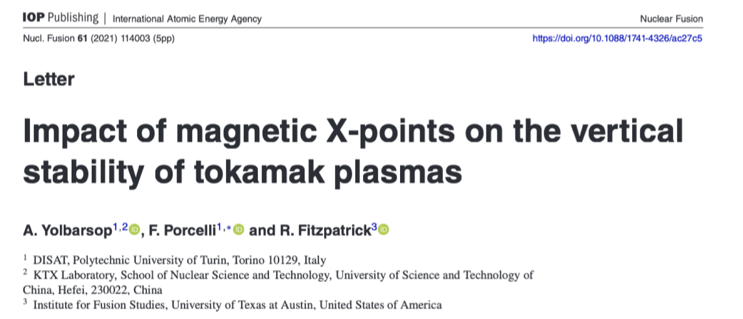
The math of X-point singularity, and (perhaps) a surprising result.
For details, see:

Slide 13
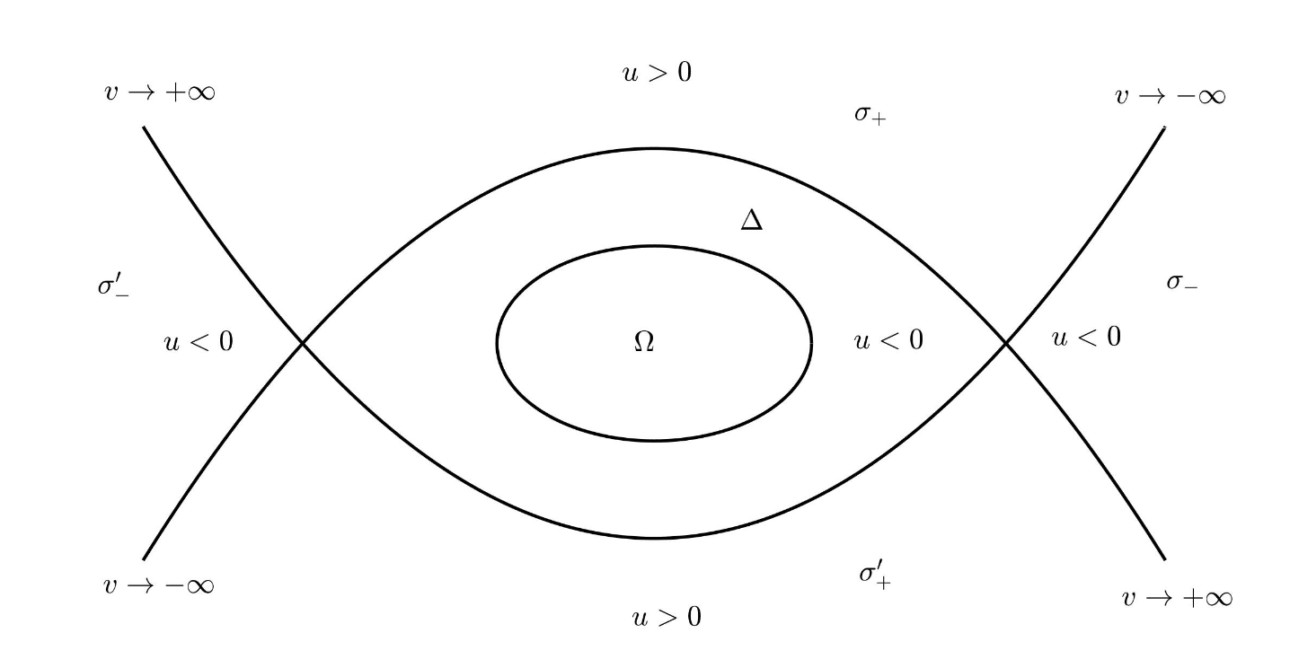
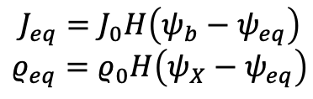

Equilibrium magnetic structure
$$J_{eq}=J_{0}H\left(ψ_{b}−ψ_{eq}\right)$$
$$ρ_{eq}=ρ_{0}H\left(ψ_{X}−ψ_{eq}\right)$$
Plasma occupies $Ω$ and $Δ$ regions

Slide 14

Perturbations:
The ideal-MHD constraint at the magnetic X-point rigid-shift analytic solution.

Slide 15









EXACT ANALYTIC SOLUTION
Rigid-vertical-shift stream function
$$φ=−γξy$$
Elliptical coordinates
$$x=A\cosh{μ \cos{θ}}$$
$$A= {\left(b^{2}−a^{2}\right)}^{1/2}$$
$$y=A\sinh{μ}\sin{θ}$$
X- point coordinates
$μ=μ_{X}=2μ_{b}$ and $θ=θ_{X}=0, π$
Stream function in elliptical coordinates:
$$φ\left(μ, θ\right)=−γA\sinh{μ}\sin{θ}$$
Note:
single m=1
harmonic in
elliptical angle;
perturbed flux
vanishes at
X-points.
Use flux-freezing condition to obtain perturbed flux

Slide 16
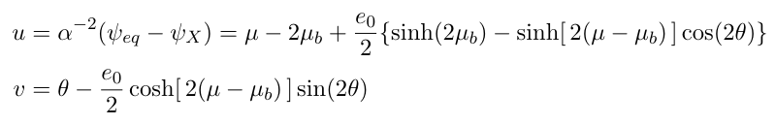

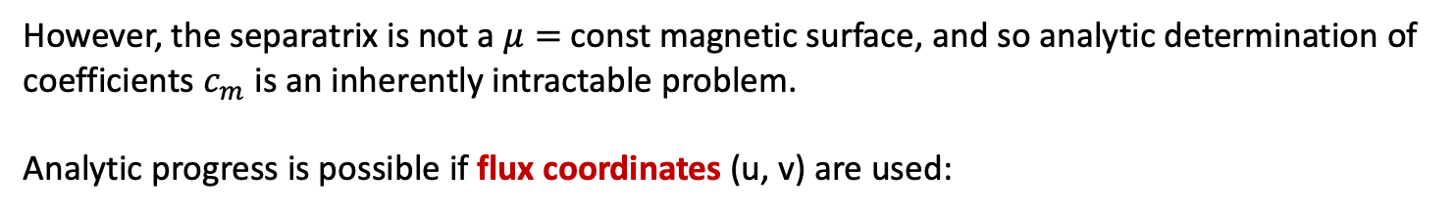
Vacuum solution (no wall)
However, the separatrix is not a $μ=$const magnetic surface, and so analytic determination of
coefficients $c_{m}$ is an inherently intractable problem.
Analytic progress is possible if flux coordinates (u, v) are used:
orthogonal coordinates!

Slide 17
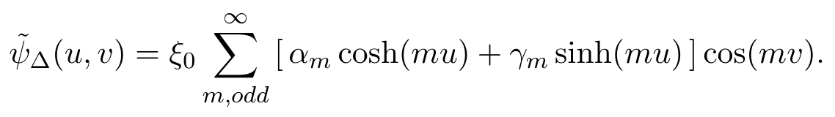
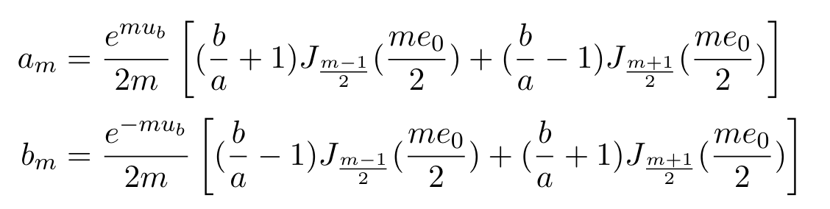


Since $∇^{2}{\tilde{ψ}}_{Δ}=0$
${\tilde{ψ}}_{Δ}\left(u,v\right)= {\tilde{ψ}}_{Δ}(μ, θ)$. We can use this to determine
the $α_{m}, γ_{m}$coefficients.
After straightforward algebra, we obtain $α_{m}= a_{m}+b_{m} , { γ}_{m}= {−a}_{m}+b_{m}$

Slide 18

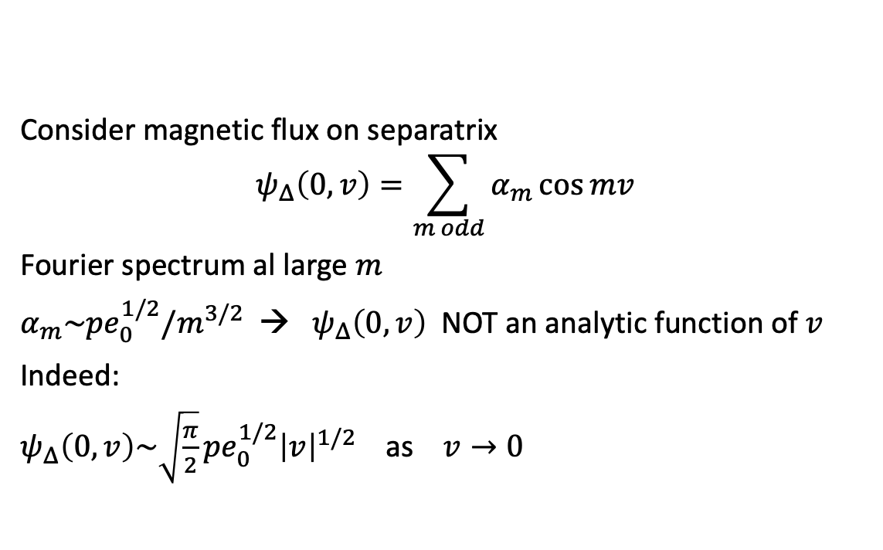

Mathematics of X-point singularity – in essence:
(1) non-analiticity
Consider magnetic flux on separatrix
$$ψ_{Δ}\left(0, v\right)=\sum_{m odd}{α_{m}\cos{mv}}$$
Fourier spectrum al large $m$
$α_{m}\sim {pe}_{0}^{1/2}{/m}^{3/2}$ → $ψ_{Δ}\left(0, v\right)$ NOT an analytic function of $v$
Indeed:
$ψ_{Δ}\left(0, v\right)\sim \sqrt{\frac{π}{2}}{{pe}_{0}^{1/2}\left|v\right|}^{1/2}$ as $v→0$
$p≈{\left(2e_{0}/π\right)}^{1/2}$ for small $e_{0}$

Slide 19

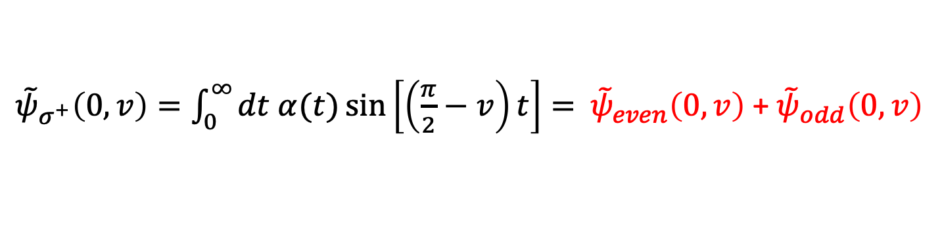
Continuity along the separatrix determines the perturbed flux in the vacuum region. This involves a parameter q.
Along the separatrix:
${\tilde{ψ}}_{σ^{+}}\left(0,v\right)=\int_{0}^{∞}{dt α(t)\sin\left[\left(\frac{π}{2}−v\right)t\right]= }$ ${\tilde{ψ}}_{even}\left(0,v\right)$ + ${\tilde{ψ}}_{odd}\left(0,v\right)$
even: q = p/2
odd: q = - p/2
$p≈{\left(2e_{0}/π\right)}^{1/2}$ for small $e_{0}$

Slide 20
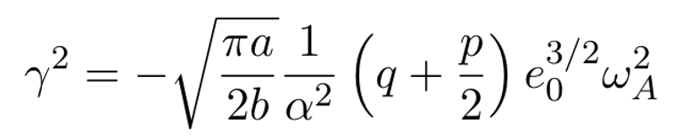


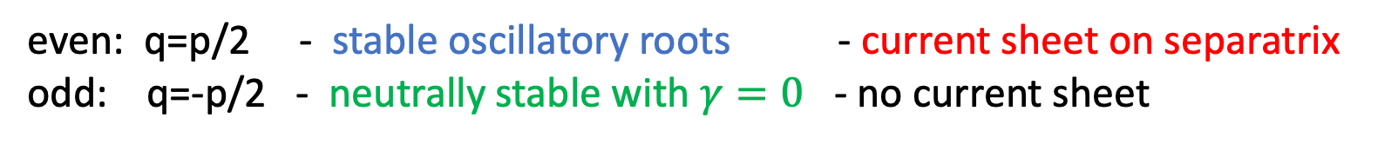
Current sheet along the separatrix:
$$\tilde{J}\left(u,v\right)\sim j_{X}(v)δ(u)$$
where
$j_{X}(v)\sim e_{0}^{3/2}\left(\frac{p}{2}+q\right)ξ_{0}{\left|v\right|}^{1/2}$ as $v→0$
Growth rate:
Two classes of modes:
even: q=p/2 - stable oscillatory roots - current sheet on separatrix
odd: q=-p/2 - neutrally stable with $γ=0$ - no current sheet
$p≈{\left(2e_{0}/π\right)}^{1/2}$ for small $e_{0}$

Slide 21
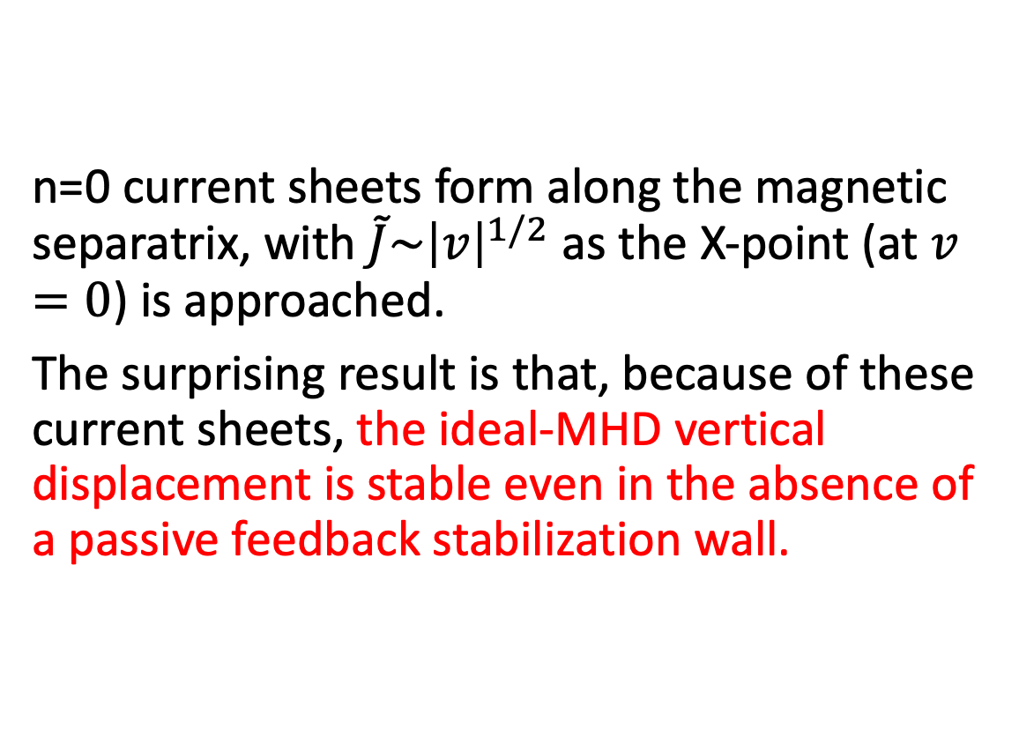
Conclusions – 2
The mathematics of the X-point singularity is established!
Conclusions
n=0 current sheets form along the magnetic separatrix, with $\tilde{J}\sim {\left|v\right|}^{1/2}$as the X-point (at $v=0$) is approached.
The surprising result is that, because of these current sheets, the ideal-MHD vertical displacement is stable even in the absence of a passive feedback stabilization wall.

Slide 22
Conclusions
The stabilization mechanism is a direct consequence of the ideal-MHD flux-freezing constraint on the X-points, which generates current sheets localized along the magnetic separatrix, exerting a force capable of pushing back the plasma in its vertical motion.

Slide 23
Have these axisymmetric X-point current sheets been observed?
Perhaps yes…
JET experiments:
- J. Lingertat et al., J. Nucl. Mat. 241, 402 (1997);
- E. R. Solano et al., Nucl. Fusion 57, 022021 (2016).
Numerical simulations (M3D-C¹; NIMROD; JOREK):
- I. Krebs, F. G. Artola, C. R. Sovinec, S. C. Jardin, K. J. Bunkers, M. Hoelzl, and N. M. Ferraro, Phys. Plasmas 10, 930 (2020).

Slide 24

CONCLUDING REMARKS
Have we forgotten anything?

Slide 25
Check-list for n=0 developing theory
Ideal-MHD
Resistive-MHD
Extended-MHD
Hybrid Kinetic-MHD
SOL Physics, field-line-tying, special boundary conditions
other…

Slide 26
Check-list for n=0 developing theory
Ideal-MHD (Yolbarsop, Porcelli, Fitzpatrick, NF Letter 2021)
Resistive-MHD
Extended-MHD
Hybrid Kinetic-MHD (Barberis, Porcelli, Yolbarsop, 2021 EFTC, to submitted)
SOL Physics, field-line-tying, special boundary conditions
other…
V
V

Slide 27

Thank you for your attention!

Slide 28
Additional material

Slide 29

Mathematics of X-point singularity – in essence:
(2) $v$ non-periodic in vacuum region

Slide 30
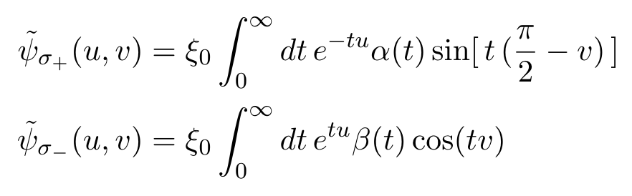
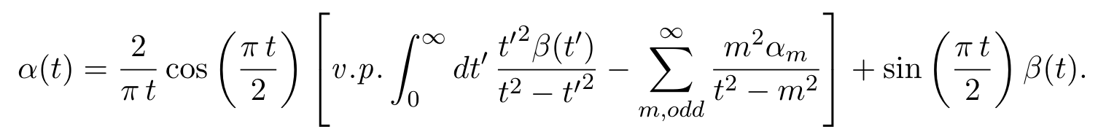
In the vacuum regions, $σ_{±}$, $v$ is no longer a periodic variable. Suitable solutions of $∆^{2}ψ=0$ that
decay (no wall!) to zero at infinity are
Continuity of flux at the separatrix provides a relationship between $α\left(t\right)$ and $β(t)$

Slide 31
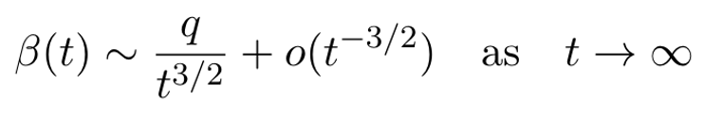
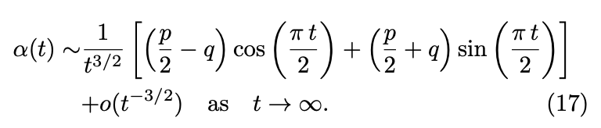


Consistent behavior requires
and
${\tilde{ψ}}_{σ^{+}}\left(0,v\right)=\int_{0}^{∞}{dt α(t)\sin\left[\left(\frac{π}{2}−v\right)t\right]= }$ ${\tilde{ψ}}_{even}\left(0,v\right)$ + ${\tilde{ψ}}_{odd}\left(0,v\right)$
even: q = p/2
odd: q = - p/2
$p≈{\left(2e_{0}/π\right)}^{1/2}$ for small $e_{0}$

