Slide 1
Progress in Physics Modelling in support of the ITER Research Plan
19th European Fusion Theory Conference (EFTC)
11-15 October 2021
Mireille Schneider
mireille.schneider@iter.org
      ITER Organization, Route de Vinon-sur-Verdon, CS 90 046, 13067 St. Paul-lez-Durance, France
Disclaimer: The views and opinions expressed herein do not necessarily reflect those of the ITER Organization

Slide 2
Outline
  The ITER mission goals and Research Plan
  The IMAS Integrated Analysis and Modelling Suite
  Examples of modelling results for each phase of the ITER Research Plan
  Conclusion

Slide 3
Outline
  The ITER mission goals and Research Plan
  The IMAS Integrated Analysis and Modelling Suite
  Examples of modelling results for each phase of the ITER Research Plan
  Conclusion

Slide 4
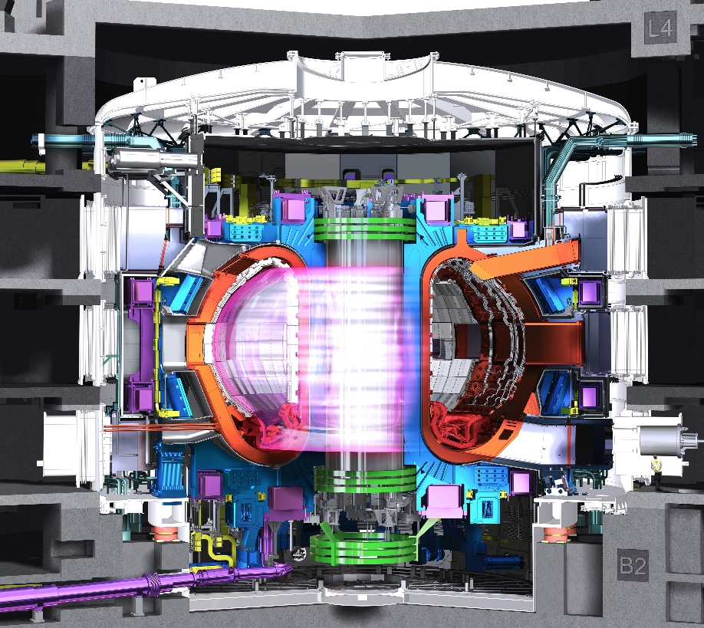
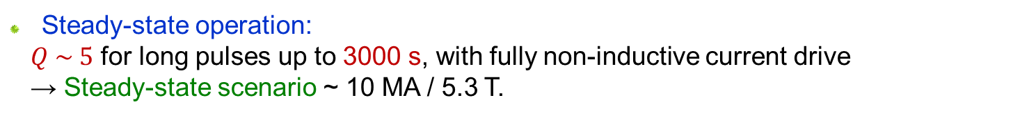
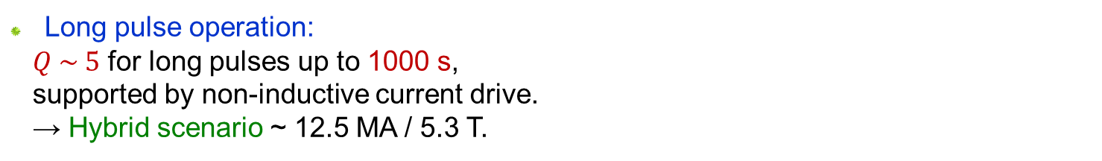
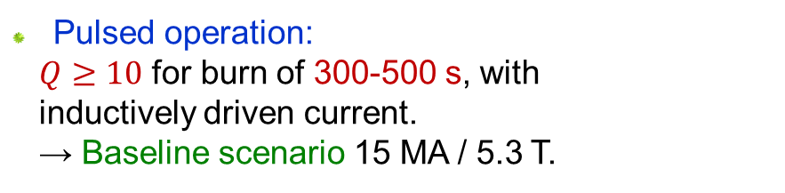
ITER mission goals
ITER shall demonstrate the scientific and technological feasibility of fusion energy:
  Pulsed operation:
  $Q≥10$ for burn of 300-500 s, with inductively driven current.
  → Baseline scenario 15 MA / 5.3 T.
  Long pulse operation:
  $Q \sim 5$ for long pulses up to 1000 s,
  supported by non-inductive current drive.
  → Hybrid scenario ~ 12.5 MA / 5.3 T.
  Steady-state operation:
  $Q \sim 5$ for long pulses up to 3000 s, with fully non-inductive current drive
  → Steady-state scenario ~ 10 MA / 5.3 T.

Slide 5
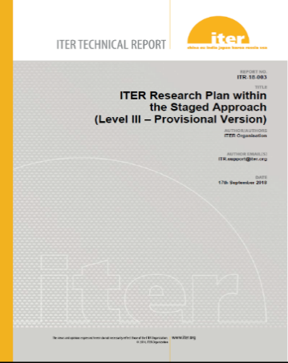
The ITER Research Plan
  The ITER Research Plan defines the strategy to achieve its mission goals throughout the scientific and technical exploitation of the tokamak and its ancillary systems.
  It will unfold in four stages:
  It includes the testing program for the Test Blanket Modules (TBMs)
Link to ITR-18-003
First Plasma
Pre-Fusion Power Operation 1
and 2
Fusion Power Operation
18 months
FP
18 months
PFPO-1
21 months
PFPO-2
16m periods
FPO
H plasmas
H, ⁴He plasmas
H, ⁴He plasmas
D, DT plasmas
ECH - 6.7 MW
ECH - 20 (+10) MW
ECH, ICRH, NBI 73 (+10) MW
ECH, ICRH, NBI + fusion
73 (+10) MW + 100 MW
Integrated commissioning
of tokamak core components
Main plant systems commissioning
P_{L-H} determination
Q=10
Long pulse operation
Burning plasmas
Raise current and power
Increase pulse duration

Slide 6
Outline
  The ITER mission goals and Research Plan
  The IMAS Integrated Analysis and Modelling Suite
  Examples of modelling results for each phase of the ITER Research Plan
  Conclusion

Slide 7
The ITER Integrated Modelling & Analysis Suite (IMAS)
  IMAS is the collection of physics software that will be used to support ITER operations and research as defined in the ITER Integrated Modelling Programme
  It uses standard Interface Data Structures (IDS) for access to experimental and simulated data that are defined in collaboration with the ITER Members
  It is suitable for any fusion device
  It will be capable of high physics-fidelity predictive simulations of ITER plasmas
  It will be used for ITER data processing and analysis
Databases
Set of machine-independent IDSs defining the IMAS standard
Scenarios
Machine Descr.
Atomic data
Functions for data access, storage, manipulation, visualization
Data model
Doc & support
Generic tools
Tutorials
Web documentation
Tracker system
Applications
Physics codes, physics workflows, control algorithms

Slide 8
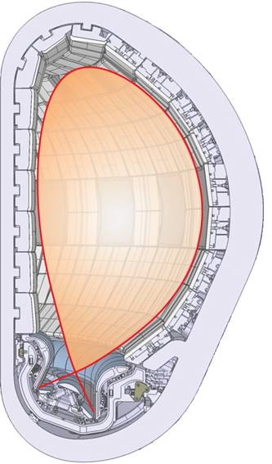
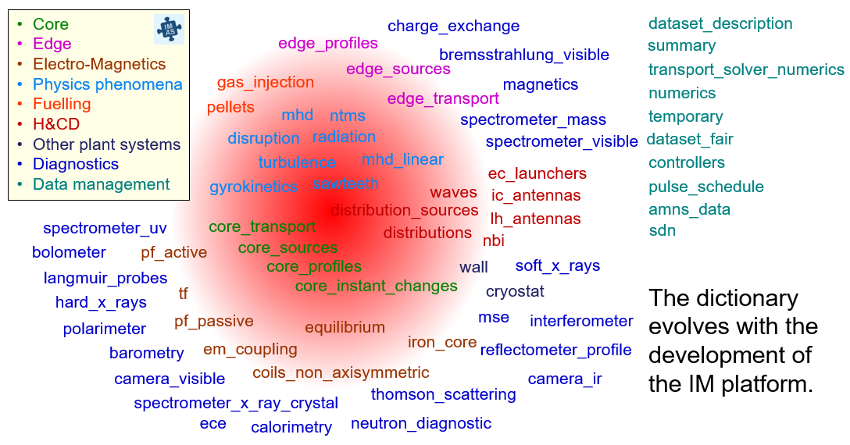
The IMAS Data Dictionary
barometry
bolometer
bremsstrahlung_visible
calorimetry
camera_ir
camera_visible
ece
hard_x_rays
interferometer
langmuir_probes
magnetics
neutron_diagnostic
polarimeter
reflectometer_profile
refractometer
soft_x_rays
spectrometer_mass
spectrometer_uv
spectrometer_visible
spectrometer_x_ray_crystal
thomson_scattering
Diagnostics
edge_profiles
edge_sources
edge_transport
amns_data
controllers
dataset_description
dataset_fair
numerics
pulse_schedule
sdn
summary
temporary
transport_solver_numerics
disruption
gyrokinetics
mhd
mhd_linear
ntms
radiation
sawteeth
turbulence
Edge
transport
core_instant_changes
core_profiles
core_sources
core_transport
Physics phenomena
Fuelling
H&CD
Core
transport
coils_non_axisymmetric
em_coupling
equilibrium
iron_core
pf_active
pf_passive
tf
cryostat
divertors
wall
distribution_sources
distributions
ec_launchers
ic_antennas
lh_antennas
nbi
waves
Electro-
Magnetics
gas_injection
gas_pumping
pellets
Other plant systems
Data management

Slide 9
Towards a high-fidelity plasma simulator
  IMAS will integrate free-boundary evolution, core-edge-SOL transport, divertor physics and PFC models to allow high fidelity physics simulations.
  Diagnostic and actuator models will be used together with control algorithms to simulate the behaviour of the Plasma Control System.
Synthetic Diagnostics workflow
ASTRA
RAPTOR
CORSICA
NCLASS
NFM
DIM
CASPER
ECRAD
SMITER
REFRACTOMETER
TOFU
JINTRAC
SOLPS-ITER
transport
VSRS
DIVIMP
METIS
DIP_TIP_POP
H_ALPHA
SPECTRASIM
DNFM
CXRS
equilibrium
XICSRT
Machine Description Database
DINA
CHEASE
HELENA
diagnostics
H&CD workflow
EQUINOX
SPIDER
NEMO
CYRANO
controllers
ASCOT
PION
Plasma Control System Simulation Platform
STIXREDIST
LION
pulse schedule
TORBEAM
AFSI
BBNBI
TOMCAT
t = t_{init}
actuators
GENRAY
SPOT
FOPLA
RISK
GRAY
TOMCAT
Y
N
Scenario Database
t = t+∆t
t < t_{end}?

Slide 10
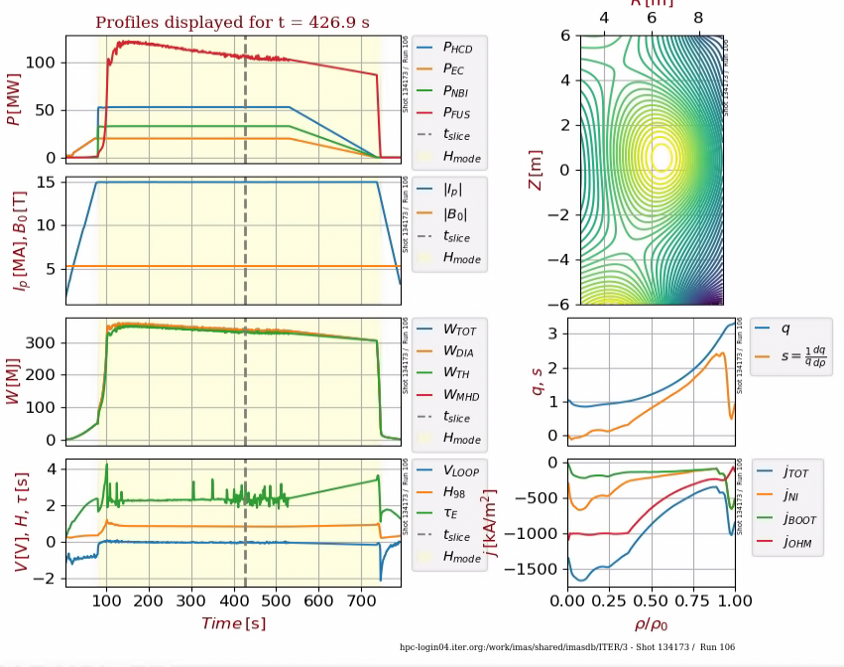
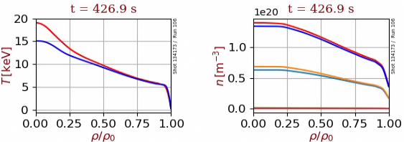
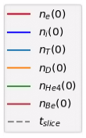
IMAS scenario database
  ~1800 simulations for core and/or edge scenarios, among which 680 are active
----> Default call equivalent to:
scenario_summary -c shot,run,database,ref_name,ip,b0,fuelling,confinement,workflow
------------------------------------------------------------------------------------------------------------------------------
Pulse Run Database Reference Ip[MA] B0[T] Fuelling Confinement Workflow
------------------------------------------------------------------------------------------------------------------------------
100001 2 ITER ITER-full-field-H -15.0 -5.3 H L-mode METIS
100002 1 ITER ITER-half-field-H -7.5 -2.65 H L-mode METIS
100003 1 ITER ITER-third-field-H -5.0 -1.8 H L-H-L METIS
100007 1 ITER ITER-intermediate-3T-H -8.5 -3.0 H L-H-L METIS
100008 1 ITER ITER-intermediate-3.3T-H -9.5 -3.3 H L-H-L METIS
100009 1 ITER ITER-intermediate-4.5T-H -12.5 -4.5 H L-mode METIS
100013 1 ITER ITER-PFPO1-1.8T-H -5.0 -1.8 H L-H-L METIS
100014 2 ITER ITER-PFPO2-1.8T-H-0.5*n_GW-NBI_530keV_9.4MW -5.0 -1.8 H L-H-L METIS
100015 1 ITER ITER-PFPO2-1.8T-H-0.9*n_GW-NBI_745keV_22.3MW -5.0 -1.8 H L-H-L METIS
100501 3 ITER ITER-nonactive-H -7.5 -2.65 H L-H-L CORSICA
100502 3 ITER ITER-nonactive-H -7.5 -2.65 H L-H dithering CORSICA
100503 3 ITER ITER-nonactive-H -7.5 -2.65 H L CORSICA
100504 3 ITER ITER-nonactive-H -9.6 -3.25 H L CORSICA
100505 3 ITER ITER-nonactive-H -12.7 -4.7 H L CORSICA
100506 3 ITER ITER-nonactive-H -15.0 -5.3 H L CORSICA
100507 3 ITER ITER-nonactive-H -5.0 -1.77 H L-H-L CORSICA
101000 50 ITER PFPO-2 tf=tE,2NBI,highTped,postST -7.5 -2.65 H H-mode ASTRA
101001 50 ITER PFPO-2 tf=tE,2NBI,highTped,preST -7.5 -2.65 H H-mode ASTRA
101002 50 ITER PFPO-2 tf=tE,2NBI,lowTped,postST -7.5 -2.65 H H-mode ASTRA
101003 50 ITER PFPO-2 tf=tE,2NBI,lowTped,preST -7.5 -2.65 H H-mode ASTRA
101004 60 ITER PFPO-2 tf=2tE,2NBI -7.5 -2.65 H H-mode ASTRA
101005 60 ITER PFPO-2 tf=tE,2NBI -7.5 -2.65 H H-mode ASTRA
101006 60 ITER PFPO-2 tf=0.5tE,2NBI -7.5 -2.65 H H-mode ASTRA
101007 40 ITER PFPO-2 H-5MA-20EC-10NBI Pr=0.3(tF/tE=2) -5.0 -1.8 H H-mode ASTRA
101007 41 ITER PFPO-2 H-5MA-20EC-10NBI Pr=0.3(tF/tE=1) -5.0 -1.8 H H-mode ASTRA
101007 42 ITER PFPO-2 H-5MA-20EC-10NBI Pr=0.3(tF/tE=0.65) -5.0 -1.8 H H-mode ASTRA
DINA-JINTRAC free boundary core-edge
ITER DT scenario 15 MA / 5.3 T
Tools are available to list and visualise all available simulations in the scenario database.

Slide 11
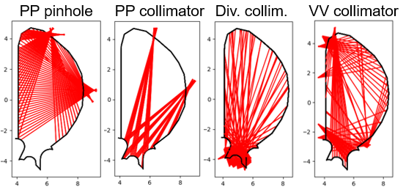
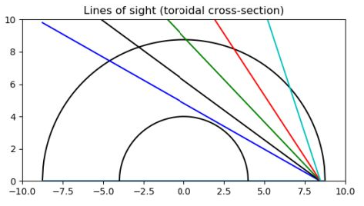
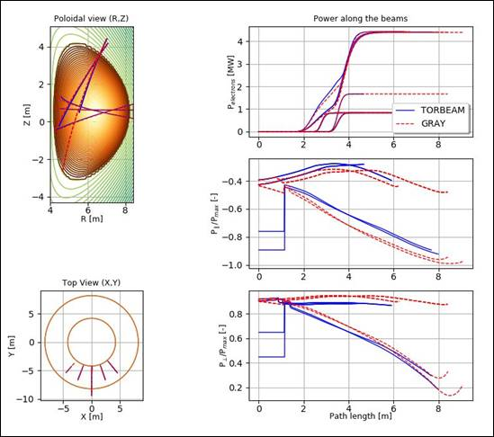
IMAS Machine Description database
  Machine Description available for H&CD systems, many diagnostics, wall and magnetics:
----> Default call equivalent to:
md_summary -c pbs,ids,description
----------------------------------------------------------------------------------------------------------------------------
PBS IDS DESCRIPTION SHOT/RUN
----------------------------------------------------------------------------------------------------------------------------
PBS-55.E5 spectrometer_x_ray_crystal Core X-Ray Spectrometer (XRCS) 150505/1
PBS-11 pf_active PF/CS Coil System 111001/1
PBS-11 tf TF Coil System 111002/1
PBS-11 coils_non_axisymmetric Ex-Vessel Coils (EVC) Systems (CC) 111003/1
PBS-15 coils_non_axisymmetric In-Vessel Coils (IVC) Systems (ELM) 115001/1
PBS-15 coils_non_axisymmetric In-Vessel Coils (IVC) Systems (ELM periodic) 115002/1
PBS-15 coils_non_axisymmetric In-Vessel Coils (IVC) Systems (VS) 115003/1
PBS-55.D1 bolometer PP pinholes and collim., Div. collim., VV collim. (550 channels) 150401/2
PBS-55.EC spectrometer_visible Charge Exchange Recombination Spectroscopy (CXRS) Edge 150512/2
PBS-55.E1 spectrometer_visible Charge Exchange Recombination Spectroscopy (CXRS) Core 150501/2
PBS-55.EF spectrometer_visible Charge Exchange Recombination Spectroscopy (CXRS) Pedestal 150515/2
PBS-52 ec_launchers Electron Cyclotron (EC) launchers 120000/1
PBS-55.F1 ece Electron Cyclotron Emission (ECE) - Radial O-mode 150601/1
PBS-55.F1 ece Electron Cyclotron Emission (ECE) - Radial X-mode 150601/2
PBS-55.F1 ece Electron Cyclotron Emission (ECE) - Oblique O-mode 150601/3
PBS-55.F1 ece Electron Cyclotron Emission (ECE) - Oblique X-mode 150601/4
PBS-51 ic_antennas Ion Cyclotron (IC) antennas 110000/1
PBS-55.C5 interferometer Toroidal Interfero-Polarimeter (TIP) 150305/1
PBS-55.FA interferometer Density Interfero-Polarimeter (DIP) 150610/1
PBS-55.A* magnetics AD,AE,AF,AH,AI,A3,A4,A5,A6,AA,AB,AJ,AL,A9,AC,AG,AP magnetic systems 150100/3
PBS-53 nbi Heating Neutral Beams (HNB) - H beams 870 keV - off-off 130000/1201
PBS-53 nbi Heating Neutral Beams (HNB) - H beams 870 keV - off-on 130000/1301
PBS-53 nbi Heating Neutral Beams (HNB) - H beams 870 keV - on-on 130000/1501
PBS-53 nbi Heating Neutral Beams (HNB) - D beams 1 MeV - off-off 130000/2201
PBS-53 nbi Heating Neutral Beams (HNB) - D beams 1 MeV - off-on 130000/2301
PBS-53 nbi Heating Neutral Beams (HNB) - D beams 1 MeV - on-on 130000/2501
PBS-53 nbi Diagnostic Neutral Beam (DNB) - on-axis 130000/3201
PBS-53 nbi Diagnostic Neutral Beam (DNB) - off-axis 130000/3101
PBS-55.C6 polarimeter Poloidal Polarimeter (POP) 150306/1
PBS-55.F9.40 refractometer Sub-system refractometer of HFS reflectometer 150609/401
PBS-55.E6 spectrometer_visible Visible Spectroscopy Reference System (VSRS) 150506/2
PBS-16 wall First wall and divertor geometry for PFPO and FPO phases 116000/2
PBS-16.FC wall First Plasma Protection Components (FPPC) 116612/1
----------------------------------------------------------------------------------------------------------------------------
Bolometers
  150305/1/public/ITER_MD
Tor. Interf. Polarimeter
EC launchers
ULs
EL
  The MD database provides the geometry of the plant systems to be used as input of simulation codes.

Slide 12

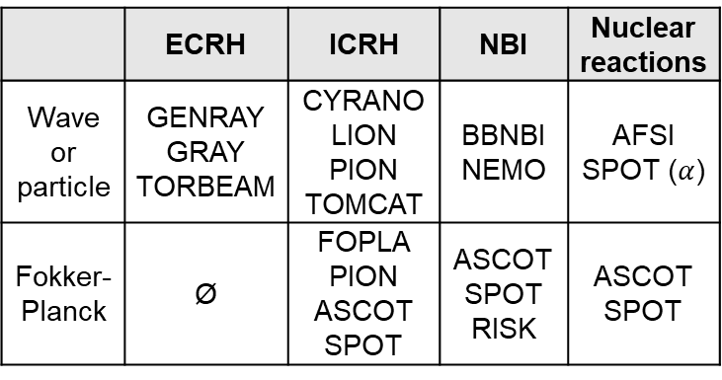
The H&CD workflow and its components
 | ECRH | ICRH | NBI | Nuclear reactions
Wave or particle | GENRAY GRAY TORBEAM | CYRANO LION PION TOMCAT | BBNBI NEMO | AFSI SPOT ($α$)
Fokker-Planck | Ø | FOPLA PION ASCOT SPOT | ASCOT SPOT RISK | ASCOT SPOT
Default algorithm
EC WAVE SOLVER
IC WAVE SOLVER
NBI SOURCE
NUCLEAR SOURCE
Fokker Planck IC
Fokker Planck NBI
Fokker Planck fus
MERGE WAVES
MERGE
DISTRIBUTIONS
MERGE
SOURCES
  The flexible/composable workflow approach allows for various algorithms implementations.
HCD2CORE_SOURCES and HCD2CORE_PROFILES
  The H&CD workflow can be used in two different contexts:
    As an internal component of a transport solver, as part of a high fidelity plasma simulator
    As a standalone tool to run H&CD codes from existing plasma scenarios, through a graphical interface

Slide 13
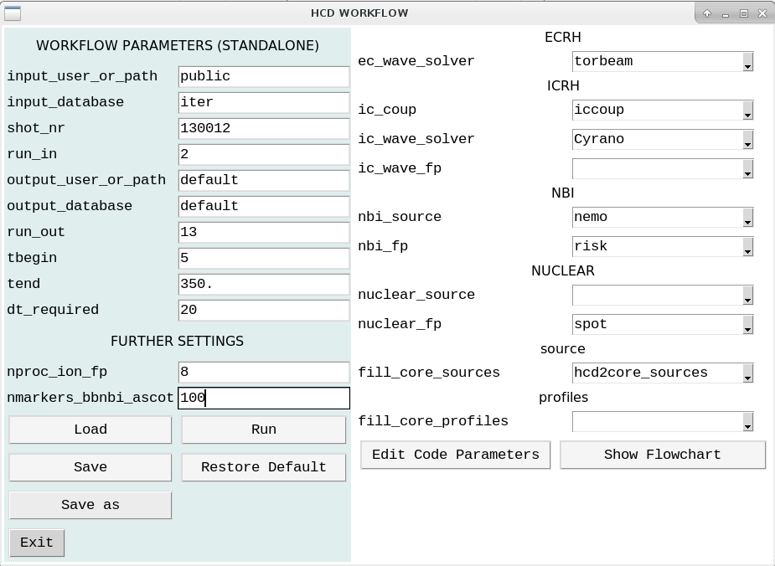
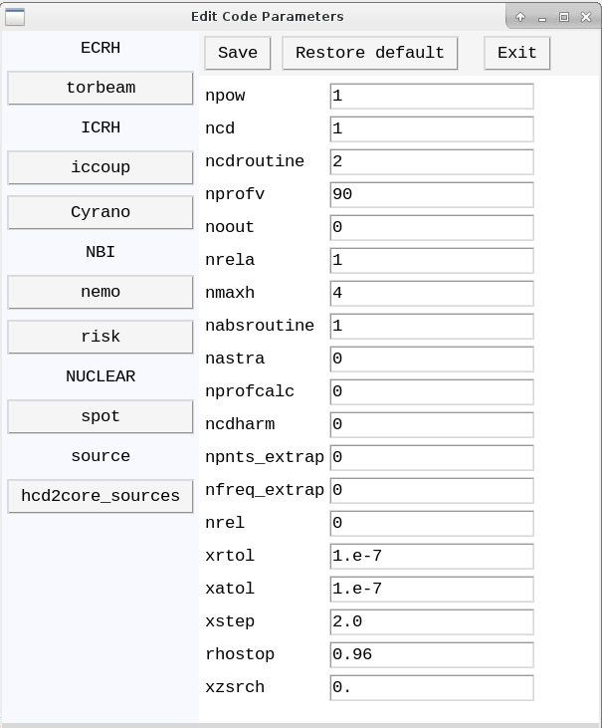
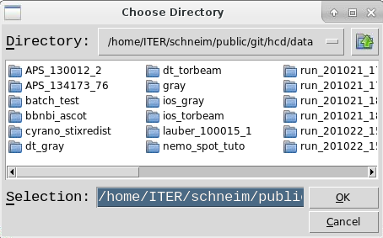

GUI to configure the H&CD workflow
  Choice of H&CD codes for each source
  GUI for configuration of parameters for each code automatically generated
  Workflow and code-specific configuration stored in a specific configuration folder
  Possibility to configure a time loop for standalone H&CD execution on an existing scenario

Slide 14
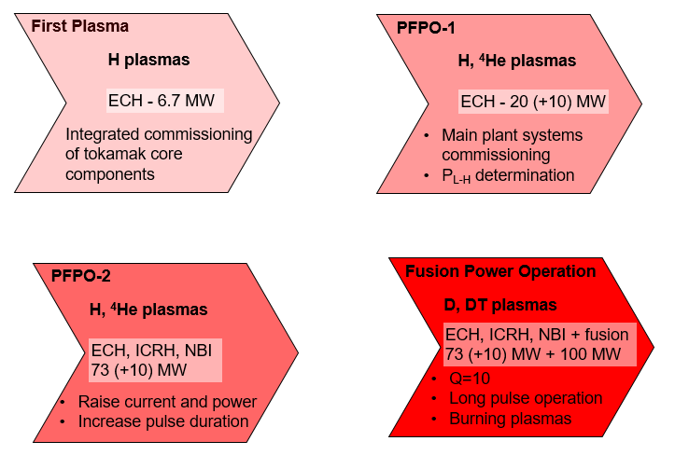
How does IMAS support the ITER Research Plan?
Plasma initiation:
Breakdown
Burnthrough
Basic control
Analysing discharges
Preparing discharges
EC shine-through losses
L-H transition prediction
Synthetic diagnostics
NBI shine-through losses
Core-edge transport modelling
MHD activity
ICRH coupling
Integrated control:
Density control
Magnetic control
Stability control
etc.
H&CD prediction
Burning plasma physics

Slide 15
Outline
  The ITER mission goals and Research Plan
  The IMAS Integrated Analysis and Modelling Suite
  Examples of modelling results for each phase of the ITER Research Plan
  Conclusion

Slide 16
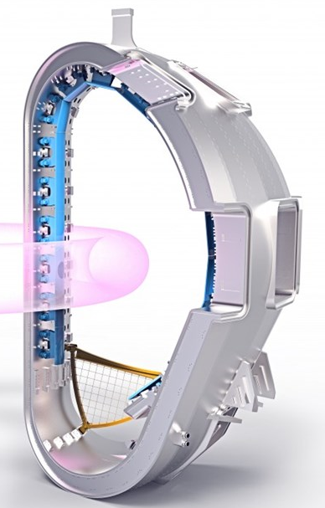
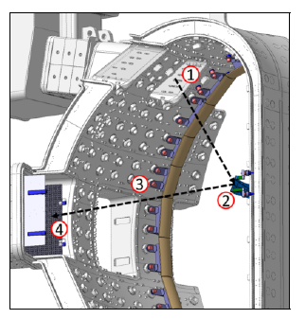
First Plasma
  The First Plasma phase (18 months) consists of three campaigns:
    Integrated Commissioning (11 months):
      Demonstrate integration of core tokamak components with control and interlock systems for plasma operation
    First Plasma (1 month):
      Integrated operation of tokamak core components to make a plasma of at least 100 kA for 100 ms, at 2.65T
      EC-assisted breakdown if necessary
    Engineering Operation (6 months):
      Commissioning of tokamak magnets to their full current capability (to ensure that 15 MA / 5.3T is achievable)
      If plasma initiation unsuccessful at 2.65T → Demonstrate it at 5.3T
  H&CD and diagnostics commissioning:
    Partial EC system: 8 gyrotrons (1 UL) to provide 6.7 MW
    Basic set of diagnostics
First Plasma
Protection Components
EC configuration for First Plasma

Slide 17
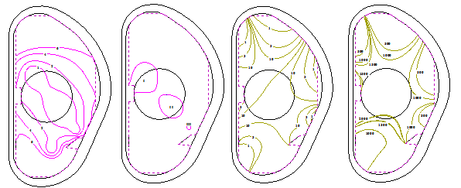



Breakdown / burnthrough modelling for First Plasma
  Null formation during ohmic plasma formation in H at 2.65 T with steel limiter, starting with 20 kA in CS coils, computed by TRANSMAK transport code [Kavin et al, 2016]:
Poloidal magnetic field surfaces at
1, 2, 4, 6 mT
$αL =$1, 3, 10
surfaces (0.8 mPa)
Gas breakdown region
0.6 MA
Ip
$α$ = Townsend coefficient
$L$= connection length
Partial
burnthrough
Ohmic breakdown if $αL>1$
t(s)
3 s
  Breakdown (Ohmic or EC-assisted) + partial burnthrough formation
  1 MA / 3 s is the maximum the limiter can stand (heat loads, disruption forces)
  The Pulse Design Simulator will be an IMAS GUI to support the design and validation of plasma pulses, with an initial focus on plasma initiation for First Plasma [J.A. Snipes et al, NF (2021)]

Slide 18
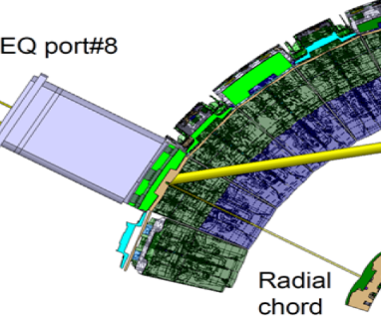
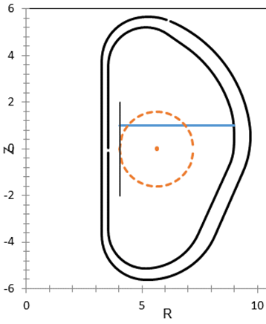
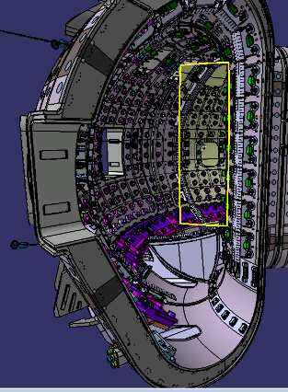
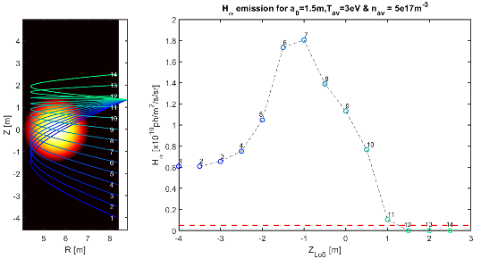
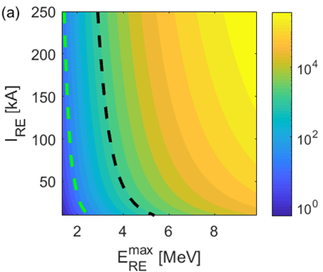
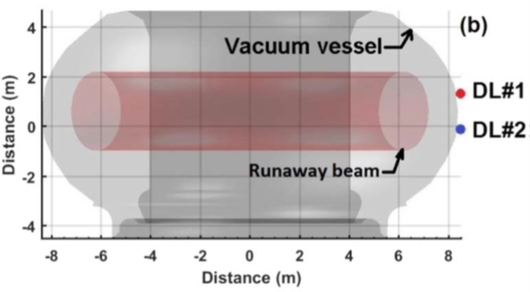
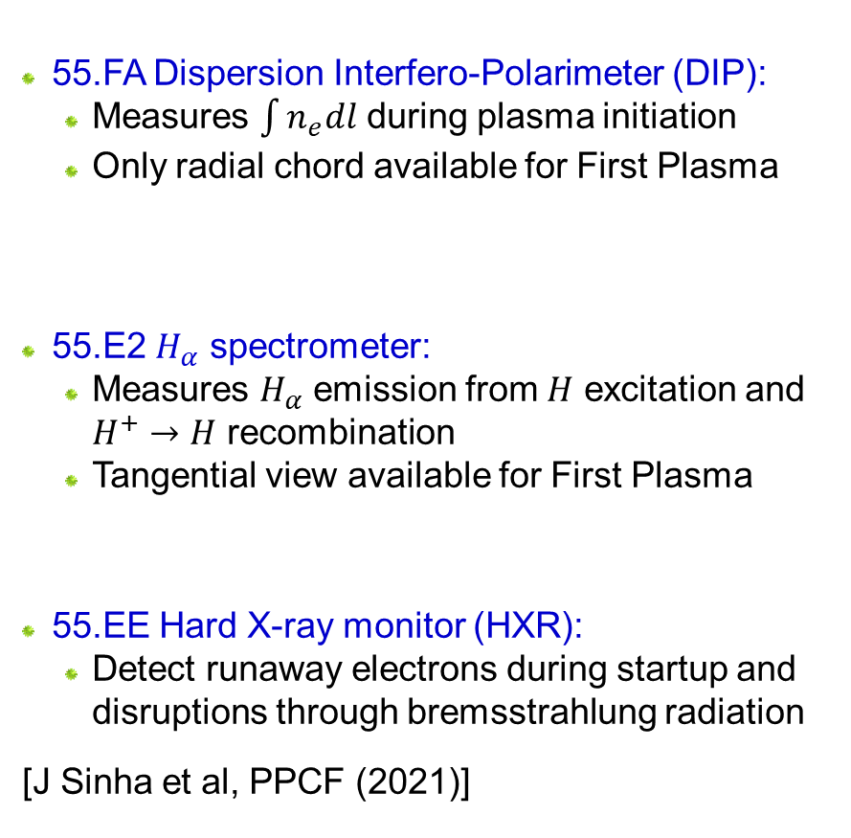
Synthetic Diagnostics development for First Plasma
  55.FA Dispersion Interfero-Polarimeter (DIP):
    Measures $\int{n_{e}dl}$ during plasma initiation
    Only radial chord available for First Plasma
  55.E2 $H_{α}$ spectrometer:
    Measures $H_{α}$ emission from $H$ excitation and $H^{+}→H$ recombination
    Tangential view available for First Plasma
  55.EE Hard X-ray monitor (HXR):
    Detect runaway electrons during startup and disruptions through bremsstrahlung radiation
  [J Sinha et al, PPCF (2021)]
No 2D image available for FP, but can select multiple LoS in this field of view
Counting statistics (~30%) threshold
Bkg noise threshold

Slide 19
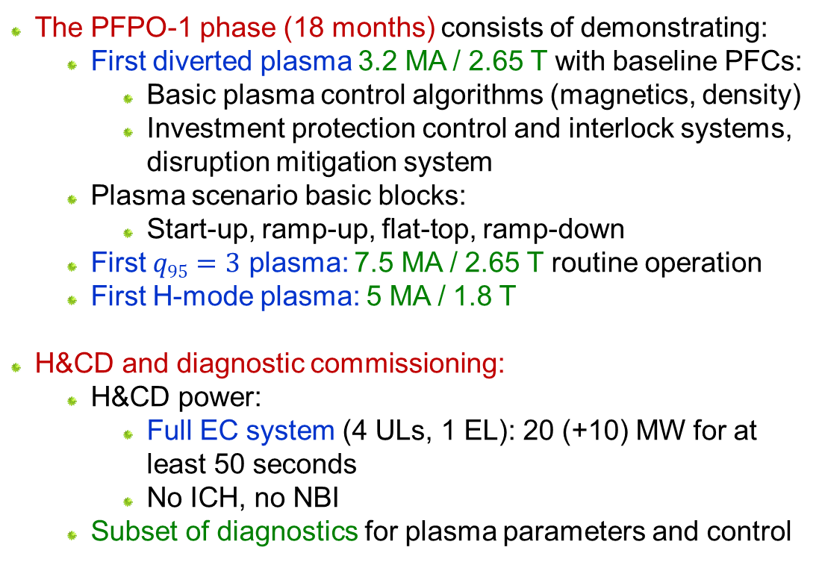
Pre-Fusion Power Operation phase 1
  The PFPO-1 phase (18 months) consists of demonstrating:
    First diverted plasma 3.2 MA / 2.65 T with baseline PFCs:
      Basic plasma control algorithms (magnetics, density)
      Investment protection control and interlock systems, disruption mitigation system
    Plasma scenario basic blocks:
      Start-up, ramp-up, flat-top, ramp-down
    First $q95=3$ plasma: 7.5 MA / 2.65 T routine operation
    First H-mode plasma: 5 MA / 1.8 T
  H&CD and diagnostic commissioning:
    H&CD power:
      Full EC system (4 ULs, 1 EL): 20 (+10) MW for at least 50 seconds
      No ICH, no NBI
    Subset of diagnostics for plasma parameters and control
DINA, first diverted plasma
I_{cs}=12kA
DINA, first q₉₅=3 plasma
I_{cs}=30kA

Slide 20
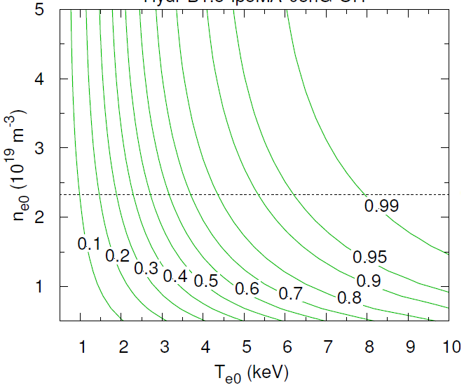
ECH modelling at 5 MA / 1.8 T in PFPO-1
  Operation at 5 MA / 1.8 T for early H-mode access in the Research Plan:
      To evaluate L-H power threshold in ITER / sustain H-mode plasmas
      To address operational issues with H-mode regime
  Concern: 1.8 T → X3 ECH absorption, weak at low density and temperature
  → Potential heat loads on the wall
  GRAY modelling of ECH absorption with density and temperature scan:
GRAY ray-tracing code,
EC First Pass Absorption
EL-MID
  → Only 40% EC absorption for ohmic plasma conditions…
  But self-consistent transport calculations needed to really quantify the issue.
Ohmic plasma conditions
~ 40%

Slide 21
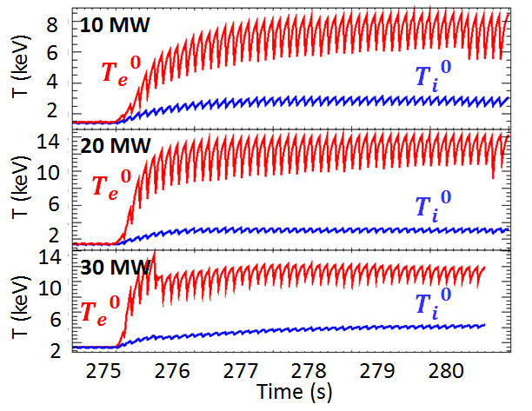
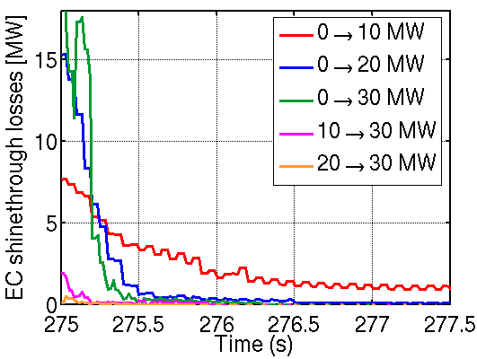
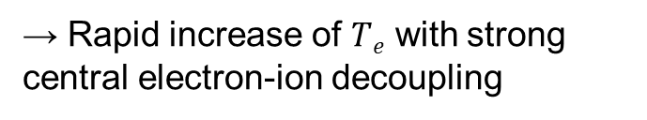
ECH + transport modelling at 5 MA / 1.8 T in PFPO-1
  Scenario: PFPO-1, 5 MA / 1.8 T, H plasma, 0.5 n_{GW}, only ECH (170 GHz, P ≤ 30 MW)
  Codes: JINTRAC for transport suite + GRAY for ECH
[M. Schneider et al, NF (2019)]
Ohmic to L-mode
Ohmic to L-mode
Ohmic to H-mode
  → Rapid increase of $Te$ with strong central electron-ion decoupling
  → EC first pass absorption >99% at 20-30 MW, in less than 0.5 s
  → No major wall loads expected from X3 ECH at 5 MA / 1.8 T.

Slide 22
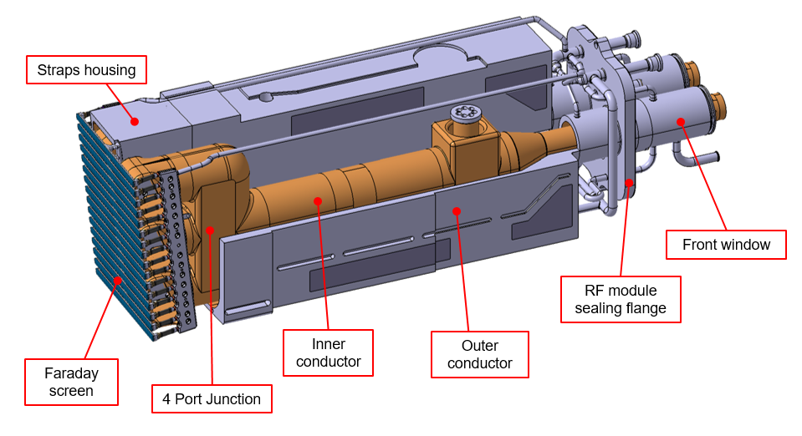
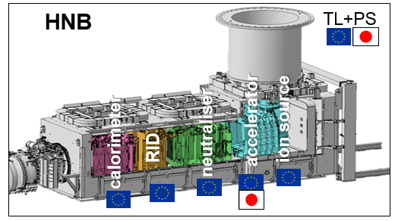
Pre-Fusion Power Operation phase 2
  The PFPO-2 phase (21 months) consists of demonstrating:
    Routine tokamak operation at 15 MA / 5.3 T
    7.5 MA / 2.65 T H-mode
    Re-commissioning of control algorithms at nominal
    H&CD power of:
      Basic plasma control algorithms
      Investment protection control and interlock systems
      Shape and vertical position control up to 15 MA
    Methods for divertor and first wall protection in H-mode
    Electromagnetic TBMs: response to EM transients,
    effect of TBMs on plasma
  H&CD and diagnostic commissioning:
    H&CD power for durations ≥ 100 s:
      Full EC system (4 ULs, 1 EL): 20 (+10) MW
      Full IC system (2 antennas 40-55 MHz): 20 MW
      Full NBI system (2 injection boxes, H beams 870 keV): 33 MW
    Nearly complete set of diagnostics
EC UL
EC EL
IC
NBI

Slide 23
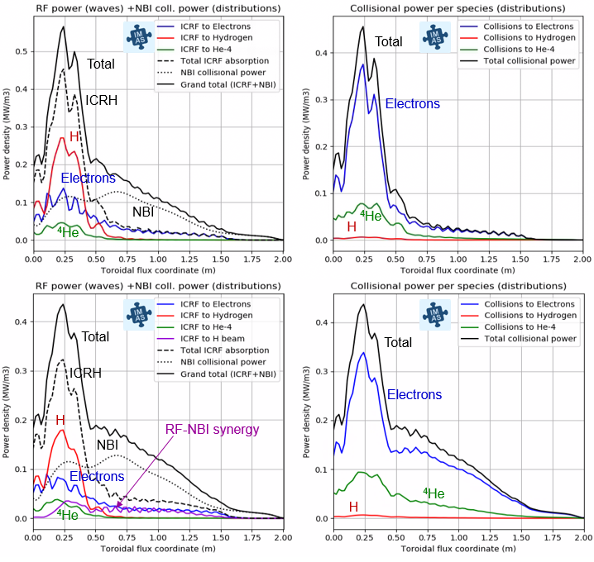
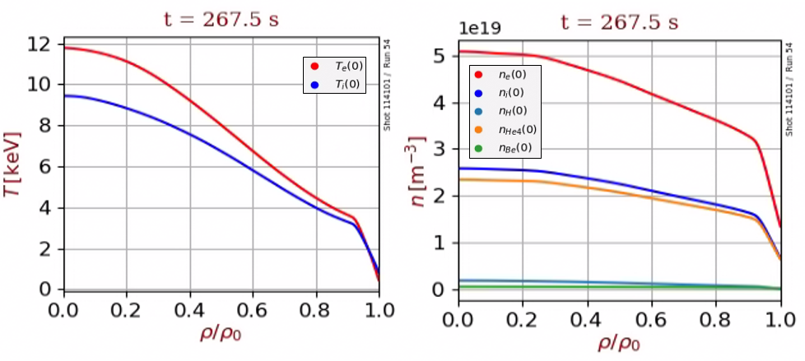
Synergy between NBI and ICRH for ITER Helium scenario
  2.65 T / 7.5 MA H-mode scenario (JINTRAC)
  20 MW ICRH, 43 MHz, N=1 H (CYRANO/FOPLA)
  33 MW NBI, 870 keV (NEMO/RISK)
[M. Schneider et al, sub. to NF (2021)]
Decoupled ICRH and NBI sources
  Significant synergetic effect between NBI and ICRH
  Fraction of RF power absorbed off-axis by H beams (higher collisionality)
    → Less energetic fast H distribution, leading to reduced neutron production
    [A. Polevoi et al, NF (2021)]
With NBI+ICRH synergy

Slide 24
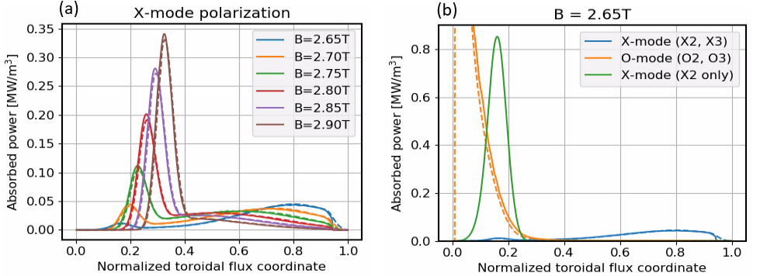
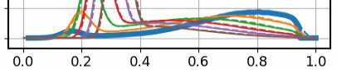
Study of ECH absorption profiles in 7.5 MA / 2.65 T scenarios
  X3 parasitic absorption at the edge: can be compensdated by either increasing B-field or switching to O-mode polarization
  Excellent agreement between TORBEAM (solid) and GRAY (dashed).
[M. Schneider et al, sub. to NF (2021)]

Slide 25
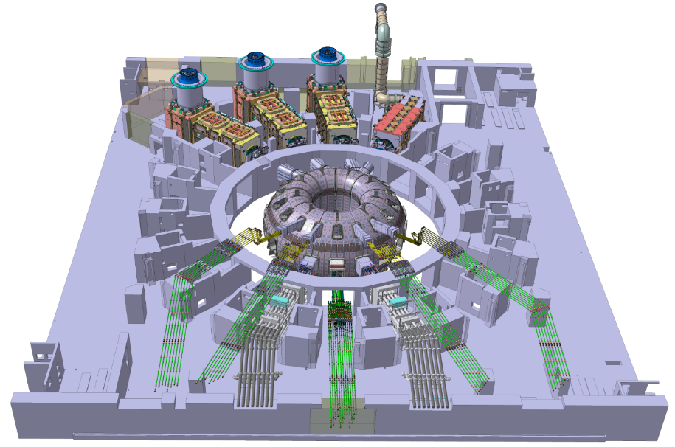
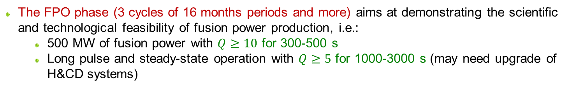
Fusion Power Operation phase
  The FPO phase (3 cycles of 16 months periods and more) aims at demonstrating the scientific and technological feasibility of fusion power production, i.e.:
    500 MW of fusion power with $Q≥10$ for 300-500 s
    Long pulse and steady-state operation with $Q≥5$ for 1000-3000 s (may need upgrade of H&CD systems)
  → It should demonstrate:
    Plasma self-heating by fusion-born alpha particles
    Nuclear TBMs: tritium management / tritium breeding
  H&CD and diagnostics commissioning:
    Nominal H&CD capabilities
      Full EC system (unchanged)
      Full IC system (unchanged)
      Full NBI system: D beams 1 MeV, 33 MW
    Complete set of diagnostics including for DT fusion products
(HNB)
HNB
HNB
DNB
D+T→ α+n
EC
EC
EC
EC
EC
IC
IC

Slide 26
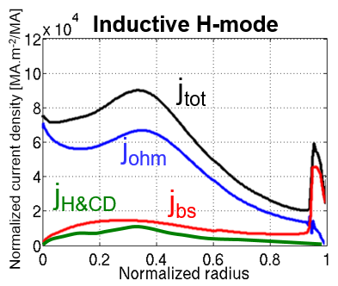
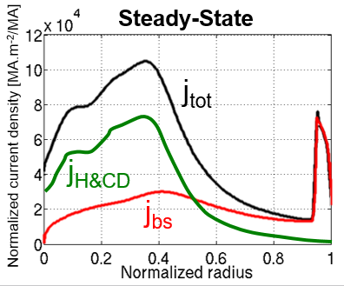
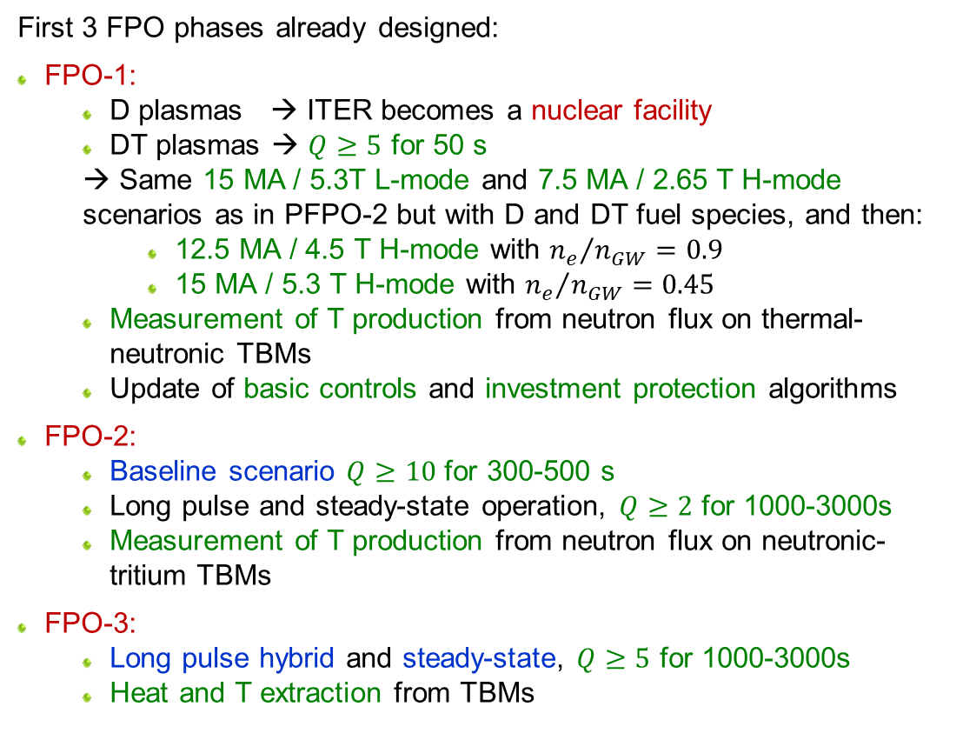

Fusion Power Operation phase
  First 3 FPO phases already designed:
  FPO-1:
    D plasmas → ITER becomes a nuclear facility
    DT plasmas → $Q≥5$ for 50 s
    → Same 15 MA / 5.3T L-mode and 7.5 MA / 2.65 T H-mode scenarios as in PFPO-2 but with D and DT fuel species, and then:
      12.5 MA / 4.5 T H-mode with ${n_{e}}/{n_{GW}}=0.9$
      15 MA / 5.3 T H-mode with ${n_{e}}/{n_{GW}}=0.45$
    Measurement of T production from neutron flux on thermal-neutronic TBMs
    Update of basic controls and investment protection algorithms
  FPO-2:
    Baseline scenario $Q≥10$ for 300-500 s
    Long pulse and steady-state operation, $Q≥2$ for 1000-3000s
    Measurement of T production from neutron flux on neutronic-tritium TBMs
  FPO-3:
    Long pulse hybrid and steady-state, $Q≥5$ for 1000-3000s
    Heat and T extraction from TBMs
$$j_{tot}=j_{ohm}+j_{bs}+j_{H\&CD}$$

Slide 27
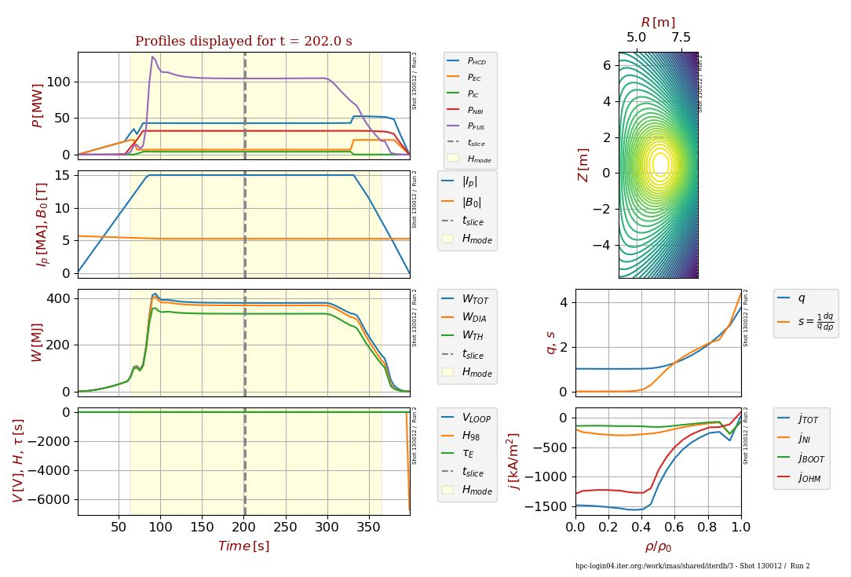
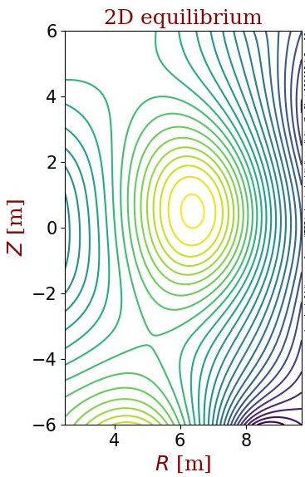

H&CD modelling for an ITER 15MA / 5.3T DT scenario
  Input scenario from IMAS scenario database:
  ITER DT 15 MA / 5.3 T (from METIS)
  ICRH modelling: 20 MW:
    40 MHz, for N=1 D(+Be)
    53 MHz for N=2 T heating
(T)

Slide 28
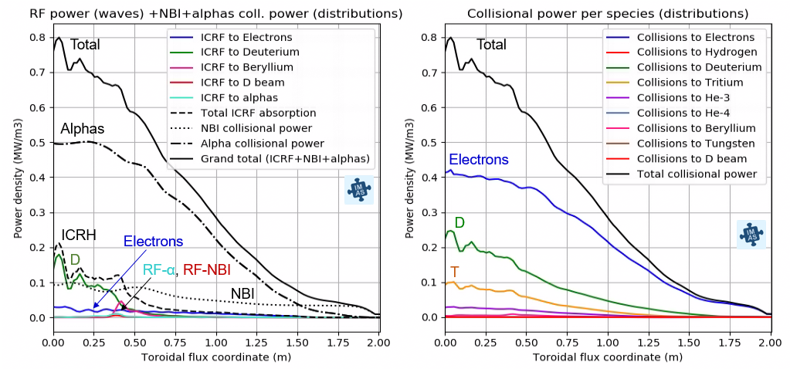
Results for NBI (33MW) + alphas (96MW) + ICRH (20MW)
Weak RF-α and RF-NBI synergy (<5% ICRH)
  Dominant electron heating (alphas)
  Significant core ion heating (~40%) due to combined ICRH, NBI and α heating
[M. Schneider et al, sub. to NF (2021)]

Slide 29
Outline
  The ITER mission goals and Research Plan
  The IMAS Integrated Analysis and Modelling Suite
  Examples of modelling results for each phase of the ITER Research Plan
  Conclusion

Slide 30
Conclusion
  IMAS supports the ITER Research Plan by providing a standard for integrated modelling delivering a high level of modularity and flexibility
  Scenarios are available for each phase of the ITER Research Plan
  A Machine Description database is available to describe ITER plant systems
  IMAS contains a high-fidelity plasma simulator including self-consistent calculation of free-boundary equilibrium + core-edge transport
  The H&CD workflow has been developed as an essential element of any high-fidelity plasma simulator, enabling the modelling of the synergy between different H&CD sources
  Other workflows being prepared for ITER operation using the IMAS framework include those for interpretive equilibrium reconstruction, stability assessment, and general data analysis and interpretation encompassing synthetic diagnostic models and tools for Bayesian inference.

