Slide 1
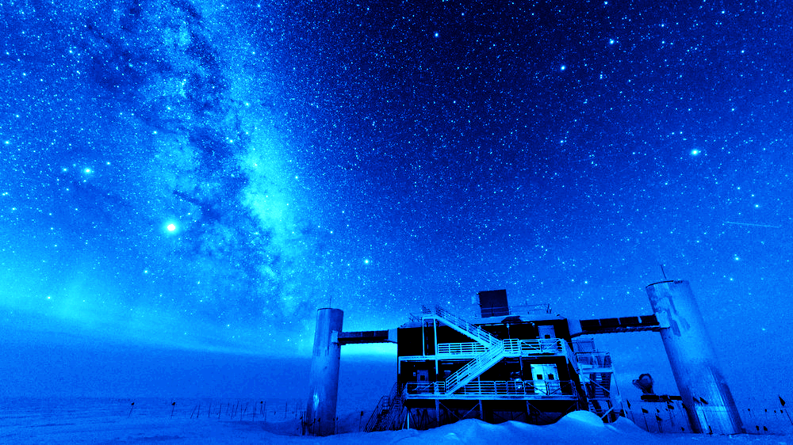



Beyond-Standard-Model Neutrino Oscillations Analyses
in IceCube
GRANT K. PARKER
grant.parker@mavs.uta.edu
SNOWMASS JOINT WORKSHOP
SPRING 2022
PARALLEL SESSION 2: ASTROPHYSICAL NEUTRINOS

Slide 2
Overview
A quick introduction to IceCube
  Detector design
  Signal principles
  Atmospheric neutrinos
2. BSM oscillations studies
  Heavy neutral leptons
  Neutrino decoherence
  Neutrino-matter non-standard interactions
    High-Energy
    Low-Energy
3. Concluding
Remarks

Slide 3
Detector Principles

Slide 4
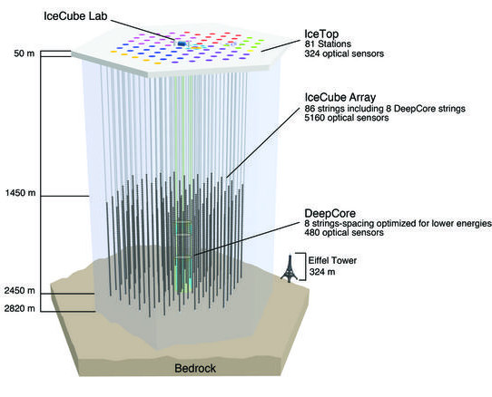
The IceCube Neutrino Observatory
Gigaton-scale, 1 km³ volume Cherenkov detector and telescope, located within the South Pole glacial ice.
  78 main detector strings (125 m string spacing) with 60 digital optical modules (DOMs) each (17 m DOM spacing)
  8 additional center strings of higher efficiency DOMs (~40% improvement), 7 m DOM spacing
Detection principle:
  Neutrino-matter interaction products with sufficient energy produce Cherenkov (photon) radiation. Light collected by DOMs allows for neutrino direction and energy reconstruction.
Oscillation analyses study energy and zenith dependence of both tracks (muons, linear trajectories) and cascades (EM/hadronic, blob-like signal).
Figure: The IceCube neutrino observatory. DeepCore is an additional collection of center strings that allow for signals as low as 5 GeV. Credit: IceCube Collaboration gallery.

Slide 5
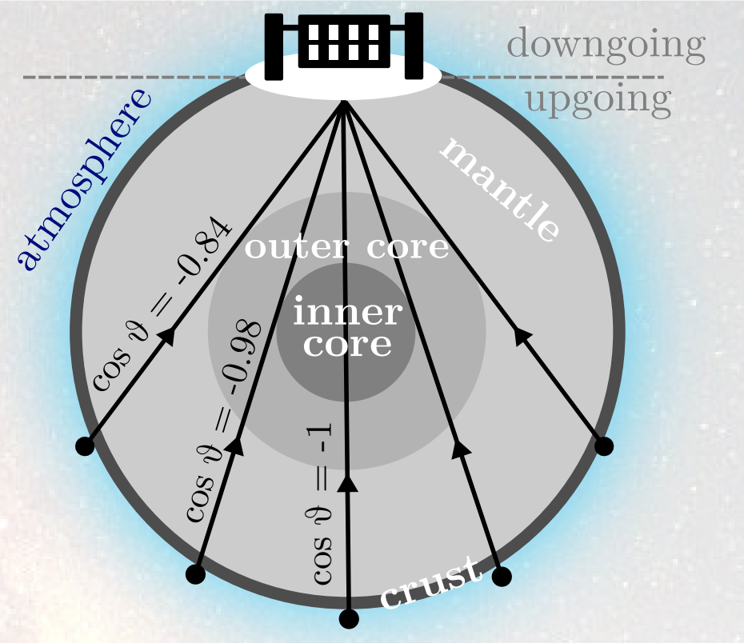
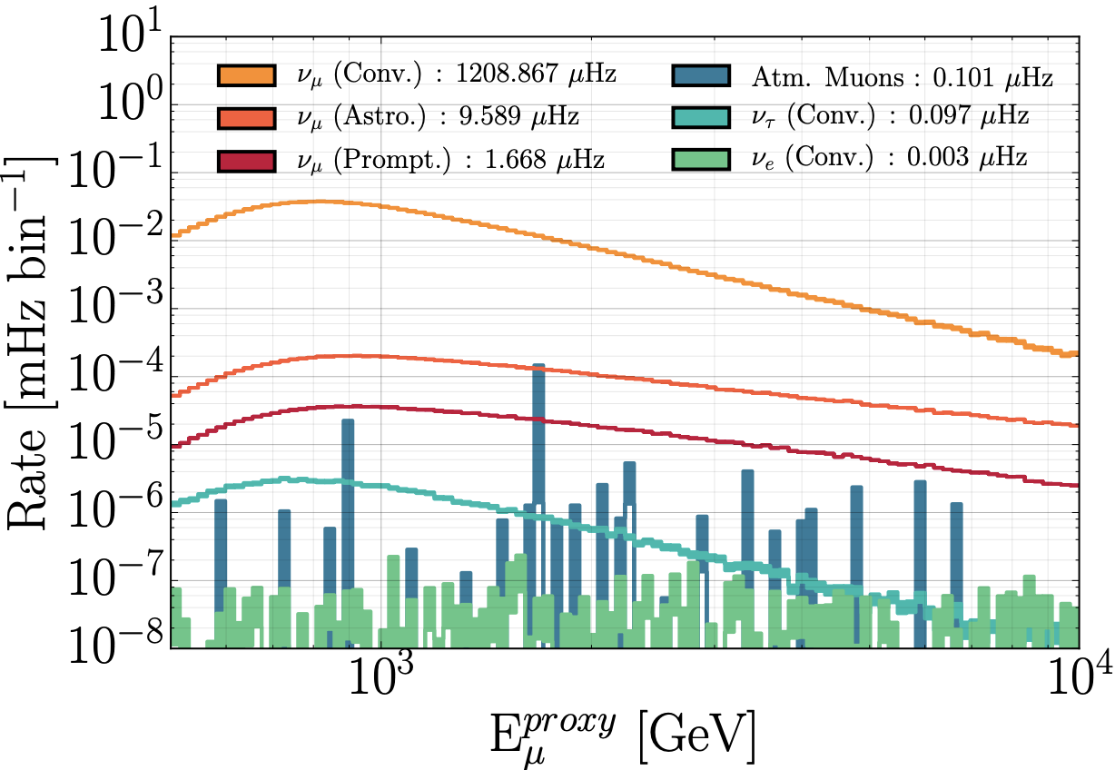
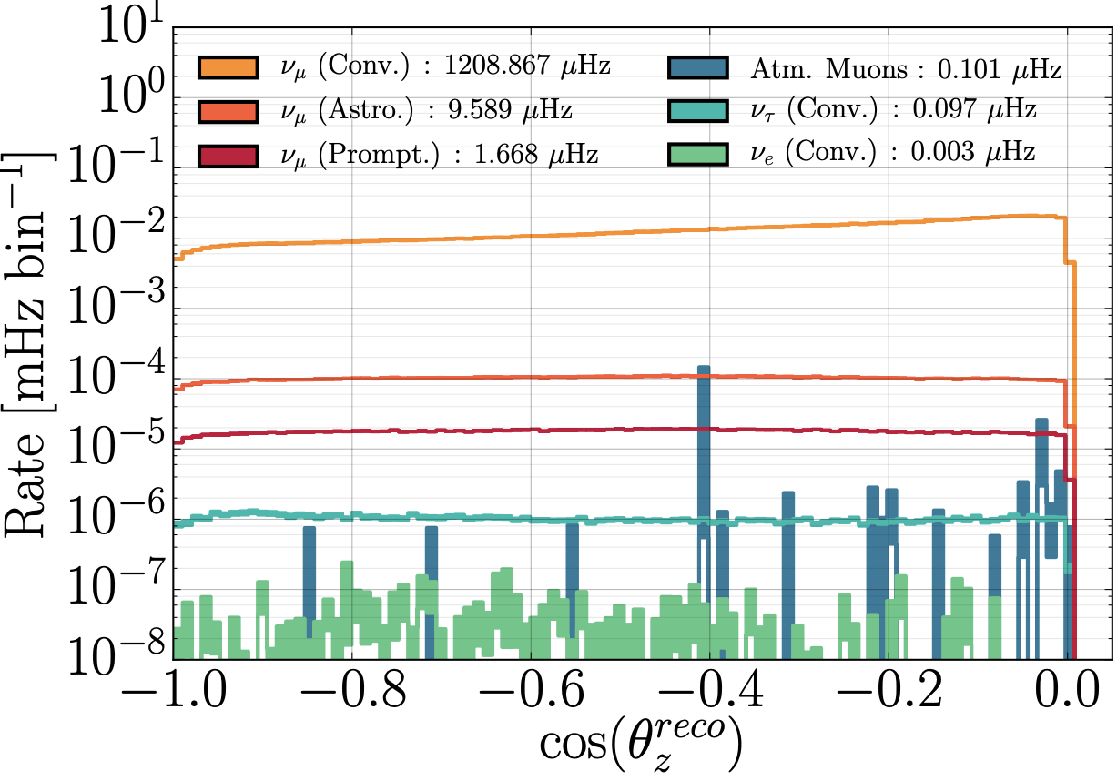
Atmospheric Neutrinos as Data
Oscillations studies often require large baselines and high statistics. IceCube meets both of these requirements by detecting atmospheric neutrinos generated across Earth’s surface.
BSM signals often rely on matter effects, in which case the Earth provides a suitably large target medium. IceCube atmospheric neutrino samples frequently consist of “upgoing” signals.
Additional IceCube advantages are the sensitivity to high event energies and possible access to tau appearance.
Figure: (Bottom) Signal and background distributions at IceCube binned in muon energy (left) and zenith (right) [Aartsen et al 2020]. (Top Right) Diagram demonstrating how atmospheric neutrinos can travel to IceCube. Credit: E. Lohfink for the IceCube collaboration.

Slide 6
Beyond-Standard-Model Analyses

Slide 7
Heavy Neutral
Leptons

Slide 8
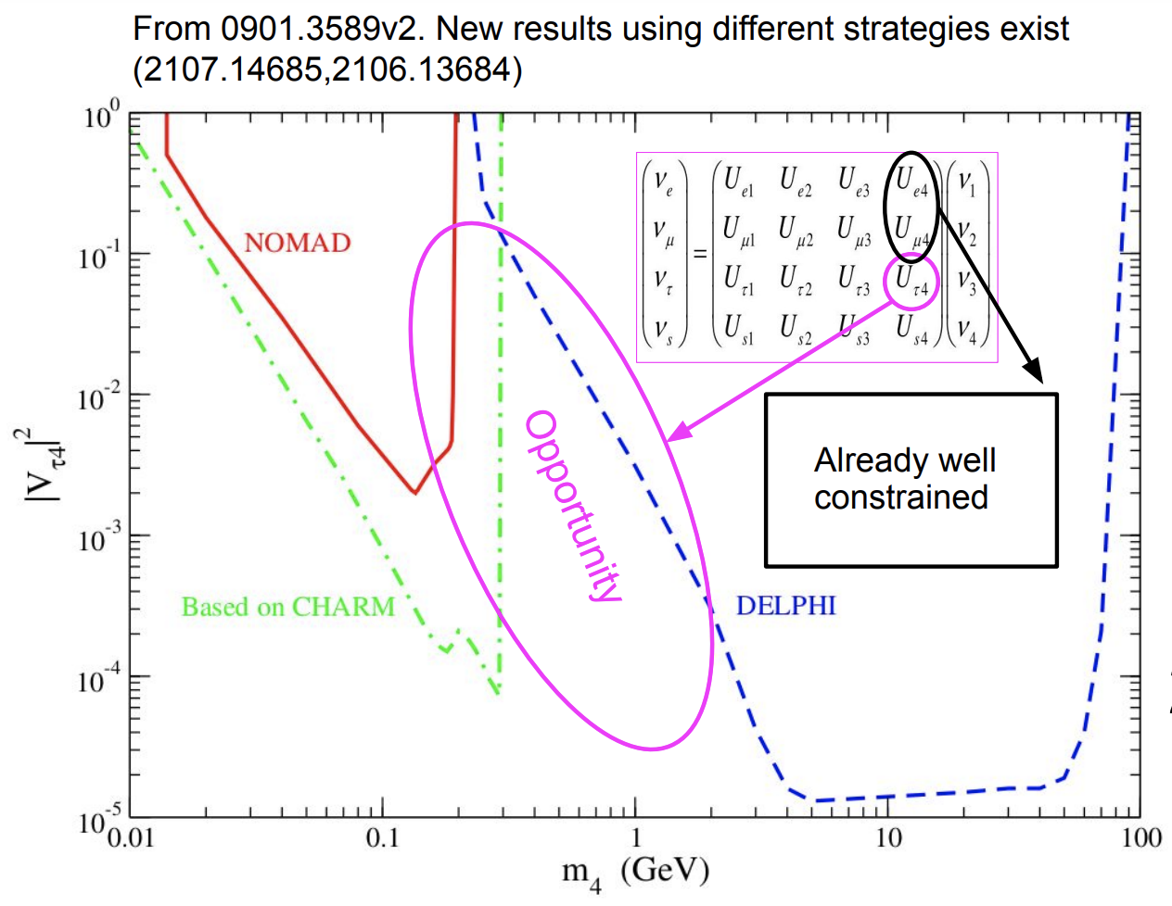
Heavy Neutral Leptons
Previous IceCube sterile searches have assumed light-masses, leading to strong constraints in U_{e4} and U_{𝜇4}.
Lacking constraints on tau-sterile mixing (U_{𝛕4}) allows for a larger sterile (heavy neutral lepton, HNL)
A possible signature of a heavy neutral lepton decay would appear similar to the double-bang cascade signal of 𝛎_{𝛕}-CC interactions.
Depending on the HNL mass, the HNL lifetime may be longer than that of the tau lepton, allowing for topological discrimination of signals.

Slide 9
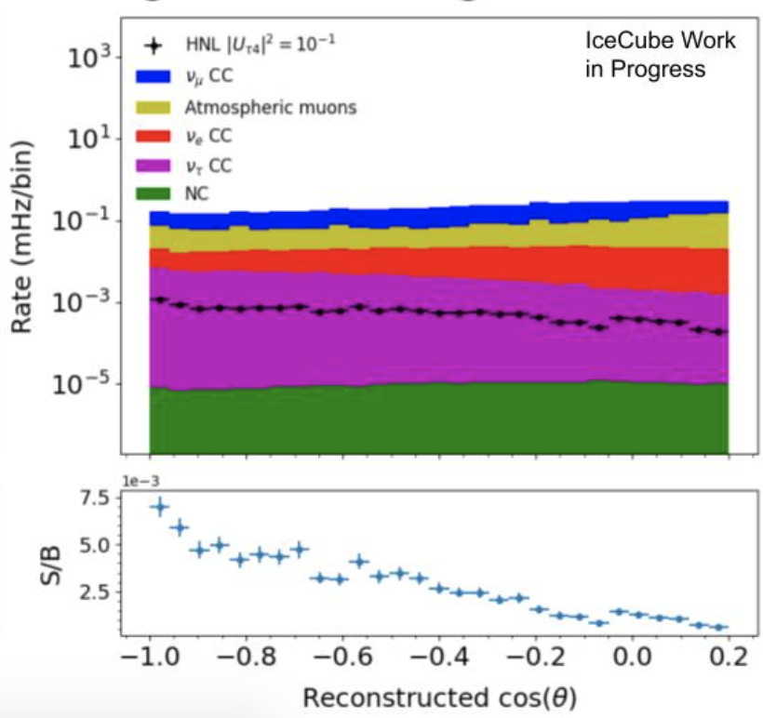
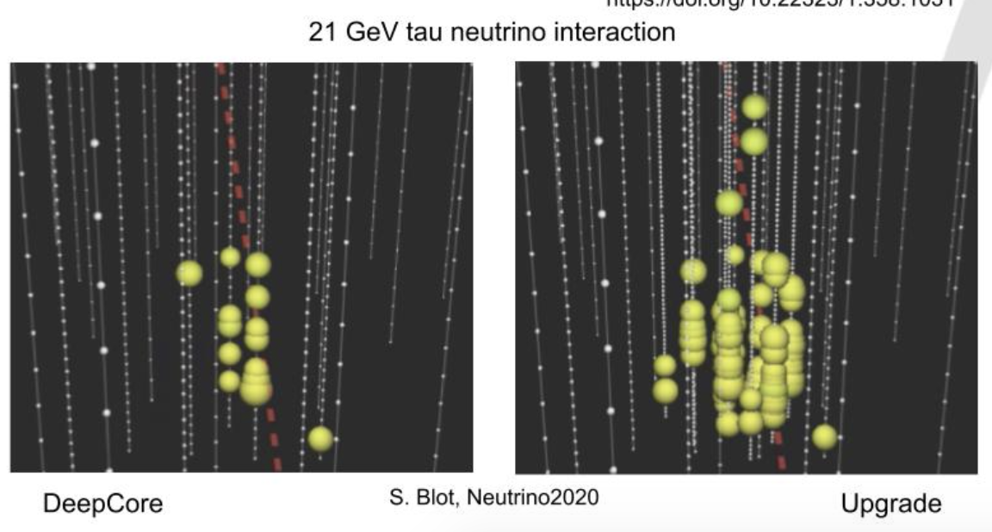
Heavy Neutral Leptons
Recently, a low-energy event selection was paired with a boosted decision tree (BDT) discriminator to determine the a sensitivity.
Simulation found that current IC array is not sensitive to HNL decay due to heavy backgrounds and poor low-energy cascade reconstruction (right figure).
IceCube Upgrade (additional 7 strings of specialized DOMs) will push us into HNL sensitivity from improved low-energy cascade reconstruction (below figure):
Figure: Comparison of a tau neutrino event in DeepCore (left) vs DeepCore+Upgrade (right). Credit: Summer Blot for the IceCube Collaboration
Figure: Comparison of simulated HNL decay event rate to IceCube backgrounds. Credit: David Vannerom for the IceCube Collaboration.

Slide 10
Oscillation Decoherence

Slide 11
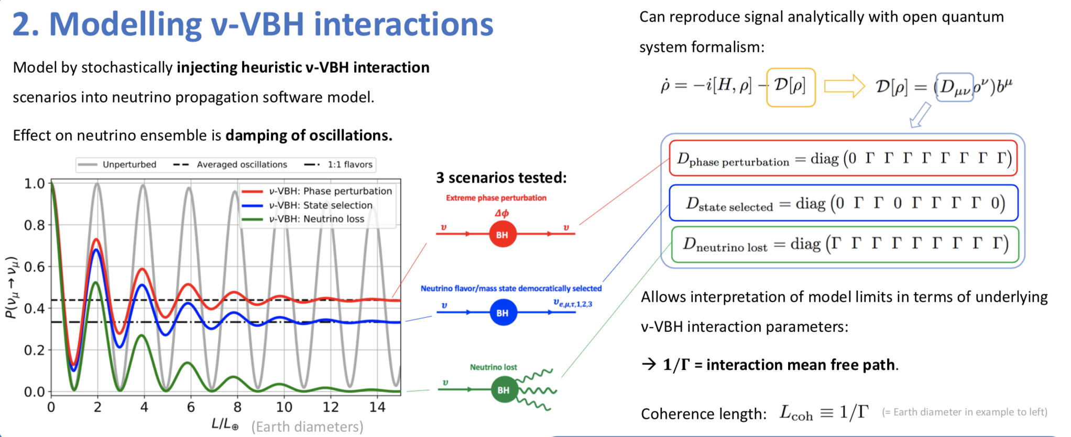
Oscillation Decoherence Analyses
Spacetime fluctuations at the quantum scale may allow for virtual black hole (VBH) pair production, a form of quantum foam.
We call the subsequent loss of coherent SM oscillations decoherence.
Decoherence can be introduced as an operator in the quantum system formalism below:
Figure: (Left) Modified neutrino survival probabilities as a function of coherence length for the 3 tested decoherence scenarios. (Center) Diagramed neutrino-VBH interactions for the 3 scenarios. (Right) The operator matrix representation for each scenario. Credit: T. Stuttard for the IceCube collaboration [arxiv:2007.00068].

Slide 12
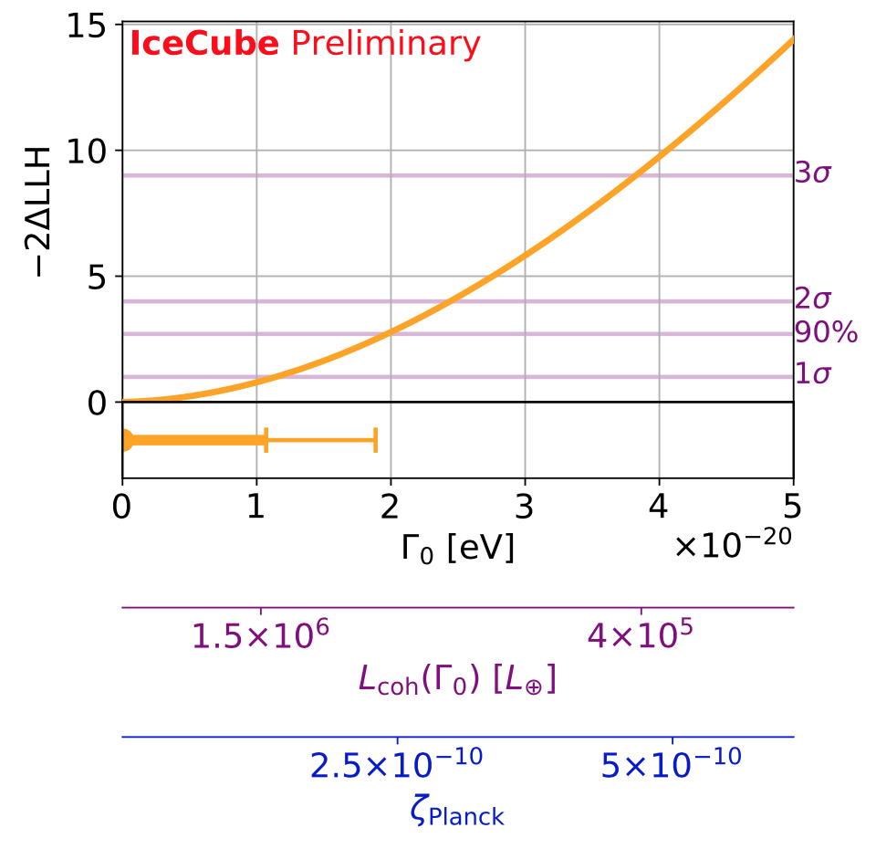
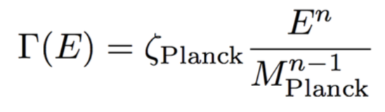

Oscillation Decoherence Analyses
Coherence length L_{coh} is the mean free path, defined as 1/𝚪 , where 𝚪 is the decoherence damping factor.
with characterizing the Planck-scale coherence length.
Two analyses underway:
  Low energy (~ 5 Gev - 300 GeV) with DeepCore 8-year sample of tracks + cascades.
  High energy (~ 0.5 TeV - 10 TeV) using 2020 8-year sterile analysis track sample.
  The complementarity of these analyses allows for a big-picture view of 𝚪 and n-index values across a wide energy spectru.
Figure: IceCube sensitivity to 𝚪₀ , L_{coh}, and 𝜻_{Planck} for an n=0 in the “democratic selection” scenario. [Stuttard T., Jensen M. 2020; arxiv:2007.00068]

Slide 13
Nonstandard Interactions

Slide 14
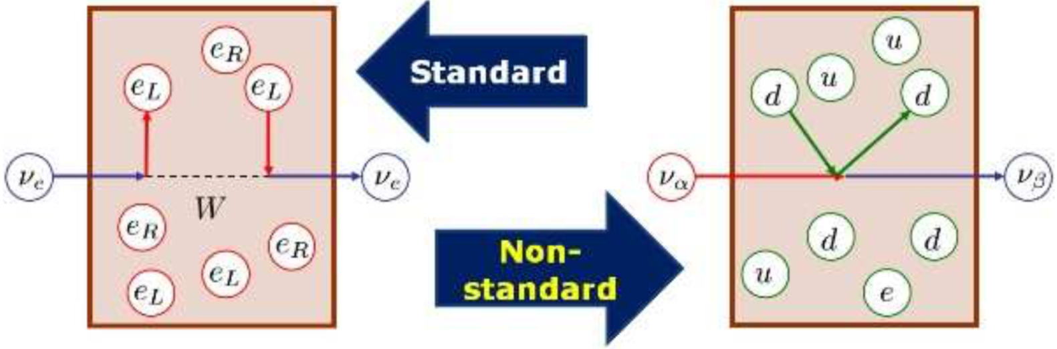
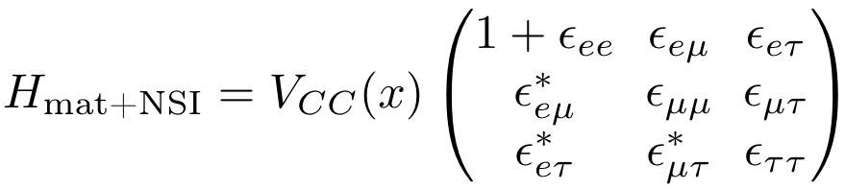
Brief NSI Review
Neutrino masses are a BSM phenomenon:
  Neutrino masses can be added through the dim-5 Wolfenstein operator.
  Dim-6 operators may contribute new interactions scaled by a characteristic energy.
IceCube is sensitive to propagation NSI (as opposed to production NSI).
NSI are modeled by generalized coupling strengths corresponding to each flavor-violating (off-diagonal) and flavor-conserving (diagonal) instance (lower-right equation).
Figure: Diagramed neutrino-matter interactions for SM and NSI [Ohlsonn 2013 arXiv:1209.2710].
Equation: Matter+NSI Hamiltonian. Each epsilon parameter is a weighted sum of the NSI contributions from the individual matter constituents.

Slide 15
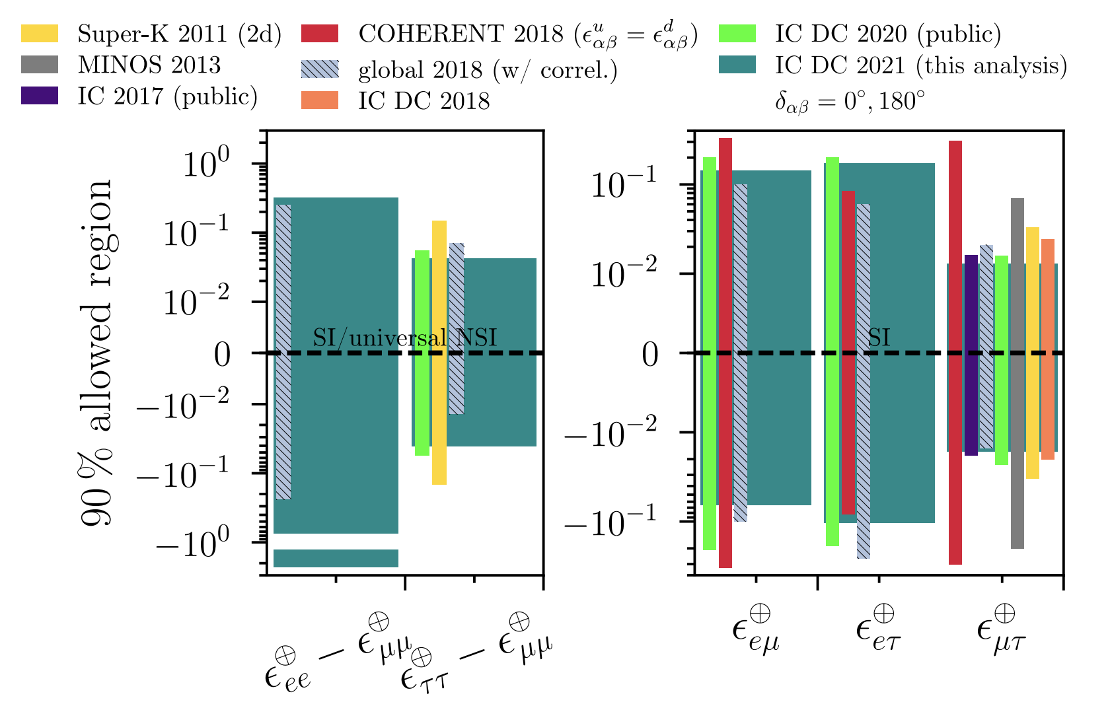
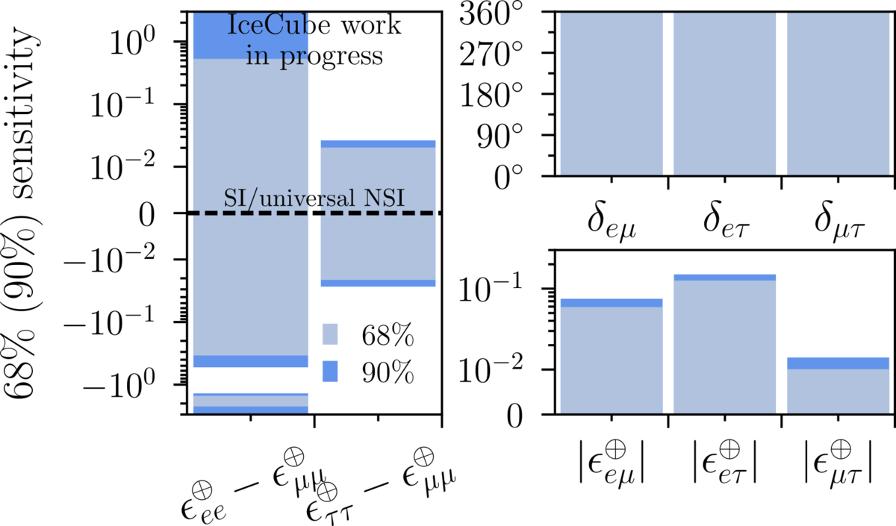
DeepCore Analyses
Recently: All-parameter constraints using 3-years of 5 - 300 GeV events [arxiv:2106.07755], a first among NSI searches.
Upcoming: All-parameter constraints with 8-years of DeepCore data (6-fold increase in sample size).
Figure: Results of the 3-year low-energy NSI analysis [arxiv:2106.07755].
Figure: Sensitivities for the 8-year low-energy NSI analysis. Credit: E. Lohfink for the IceCube collaboration.

Slide 16
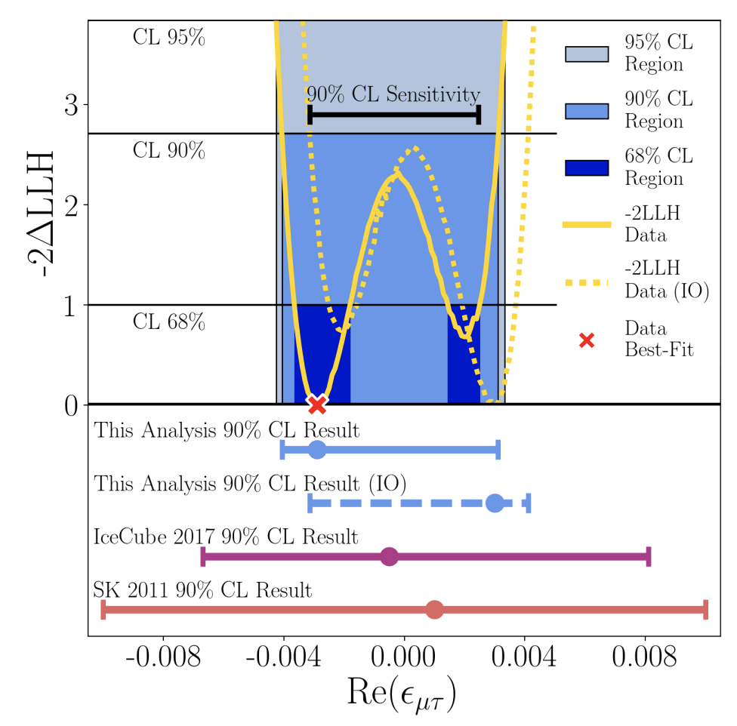
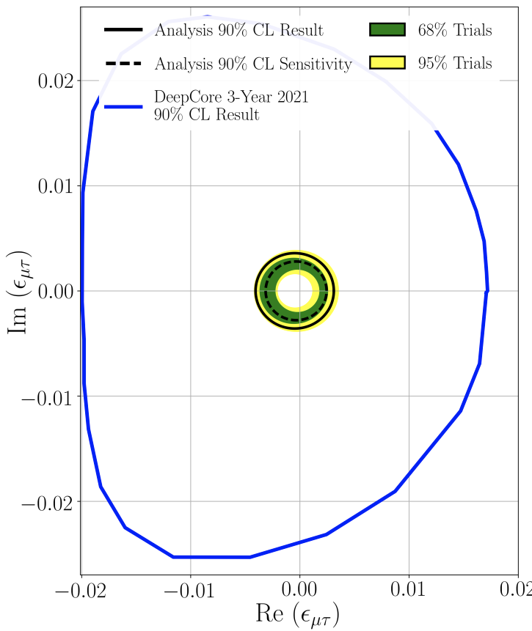
TeV-Scale Analysis
Uses 2020 8-year sterile sample of atmospheric neutrinos, fits only 𝜀_{𝜇𝜏} .
Set leading real-valued and complex constraints (arxiv:2201.03566)
Left figure displays the fit to real-valued NSI in the top panel, while the lower panel demonstrates the improvement in 90% CL limits.
Right figure shows the complex 90% CL result compared to the DeepCore 3-year complex result.

Slide 17
Concluding Remarks
10-years of data from the full IceCube array has opened significant constraint opportunities in BSM oscillations studies.
With Earth as a variable matter baseline, IceCube has many opportunities to explore a vast range of BSM oscillation models and accomplish:
  Leading measurements of sterile neutrino parameters after extensive work in data filtering, data stability, and nuisance parameter studies;
  New sterile decay parameter constraints;
  A new probe of quantum foam models;
  World-leading NSI parameter constraints.

Slide 18
Thank You

Slide 19
Additional Material

Slide 20
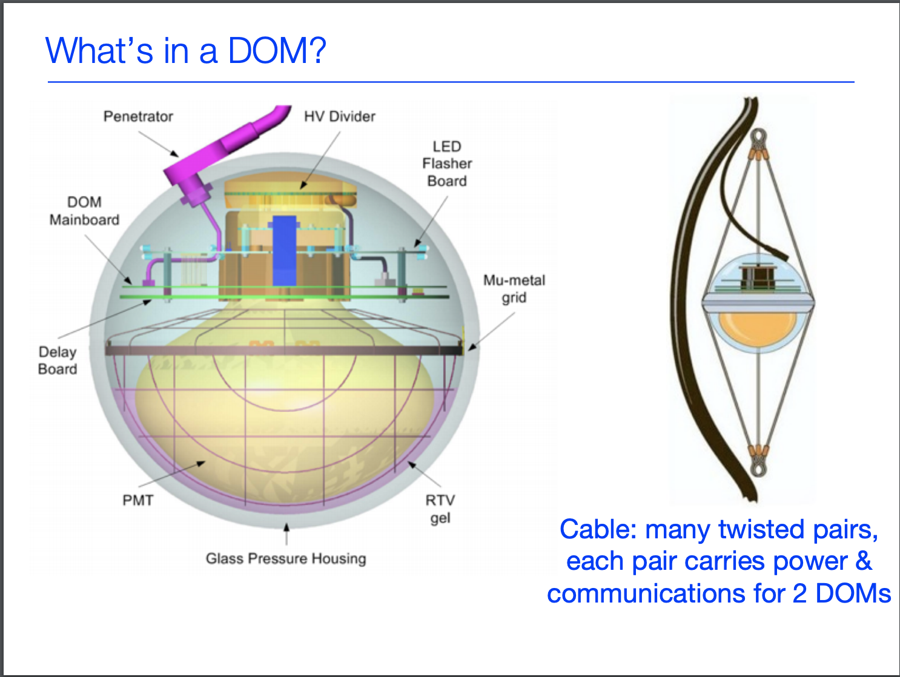
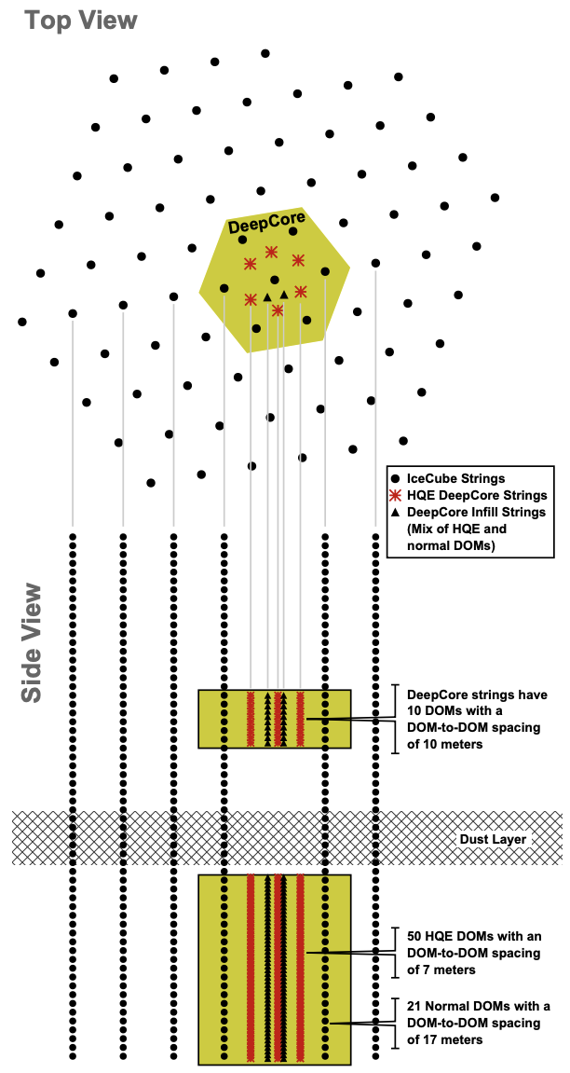
DeepCore Design
DeepCore consists of 8 additional strings (red stars) of specialized DOMs placed within the center of the array.
“High Quantum Efficiency” DOMs have ~40% improvement in optical sensitivity
The dust layer (2000 - 2100m) presents unknown absorption and scattering parameters for detected event light. This adds a systematic that is accounted for in IceCube analyses.
DeepCore lowers the event energy threshold to ~10 GeV.

Slide 21
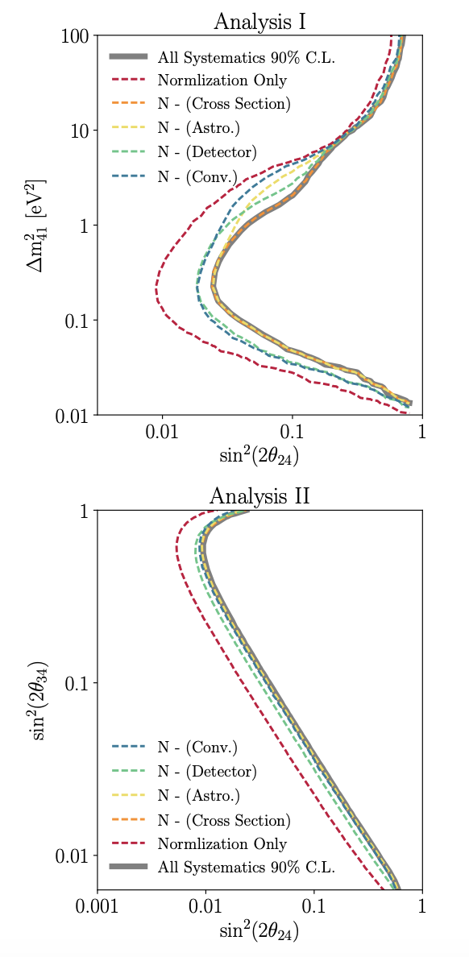
Studies of Nuisance Parameters
Bulk Ice: Scattering and absorption of glacial ice at different depths has wide uncertainty.
  New method developed to study correlation effects via perturbed central MC
Hole Ice: Ice in sensor column has different scattering and absorption.
  Broken into two parameters-- central MC selected after testing different parameter values on angular acceptance
DOM Efficiency: Optimal module photon detection efficiency.
  5 distinct DOM efficiency sets were used to create a splined continuous parameterization fit to zenith and energy reconstructions
Atmospheric Neutrino Flux: Neutrino production factors and uncertainties.
  Switched from discrete CR + hadronic models to continuous parameterizations of physically-motivated variables (Barr hadronic parameterization, CR spectral slope, conventional normalization, kaon-nuclei x-section, atmospheric density)
Cosmic Ray and Neutrino Flux: The cosmic ray spectral index and neutrino flux normalization have parameterized uncertainties.
  Normalization and spectral index with correlated uncertainties to fit IceCube’s measurements
Figure: 90% CL sensitivities for analyses I and II of the 8-year sterile analysis with individual nuisance parameter groups removed. Grey is the original sensitivity [Aartsen et al 2020]

Slide 22
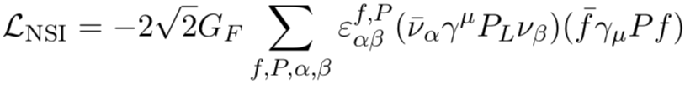
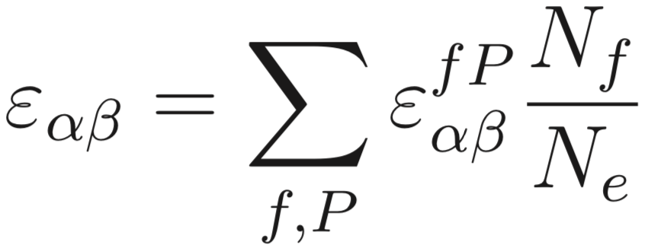
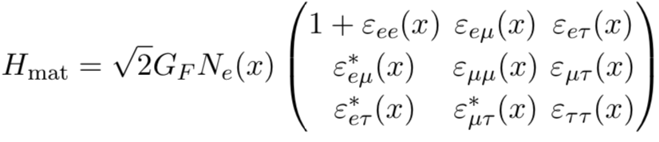
NSI Formalism
NSI’s come in two types:
  Neutral-Current (NC)
  Charged-Current (CC)
In IceCube we only look for NC NSI:
  NC affect propagation, so we use the Earth as a large matter filter to search for NSI signals from “upgoing” atmospheric neutrinos that reach IceCube.
Start with the NC NSI Lagrangian
Generalize the parameters
Add the NSI Hamiltonian to the matter Hamiltonian.

Slide 23
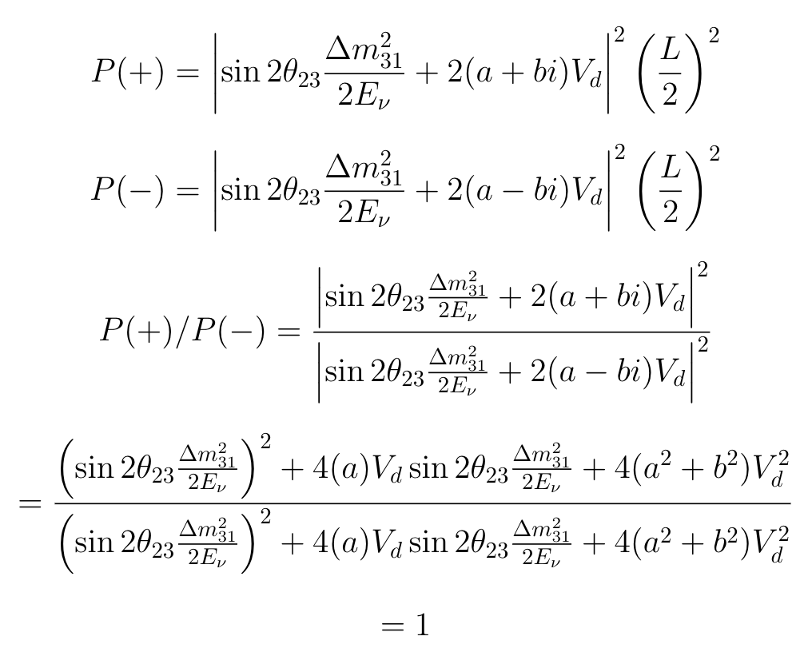
Symmetry Between +Im(NSI) and -Im(NSI
For a given Re, +Im and -Im are identical in the two-neutrino calculation (right)
Therefore, we can:
  1: Scan only the Re axis to get all the information
  2: Calculate statistics object for 1 DoF

Slide 24
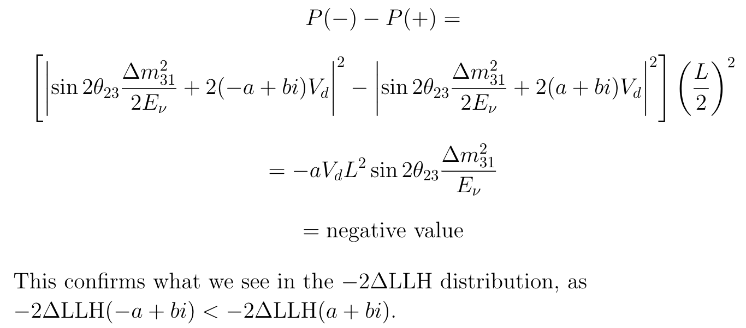
NSI LLH Offset
At sample energies, the electron flavor state decouples from atmospheric oscillation.
Below is the approximate calculation of the difference in probabilities for NSI values with equal imaginary components, opposite-sign real components.

