Slide 1
Joint BSM@ν Workshop Overview
Feb. 10, 2022
Snowmass BSM@ν Joint Workshop
Jaehoon Yu*
University of Texas at Arlington
Outline
BSM@ν the Genesis & Strategy
BSM@ν focus for Snowmass
Workshop Goals
Snowmass Report Timeline

Slide 2
BSM@ν, the genesis
BSM@ν picked up steam after the 2013 U.S. Snowmass exercise
The P5 science drivers clearly lists strategic opportunities

Slide 3
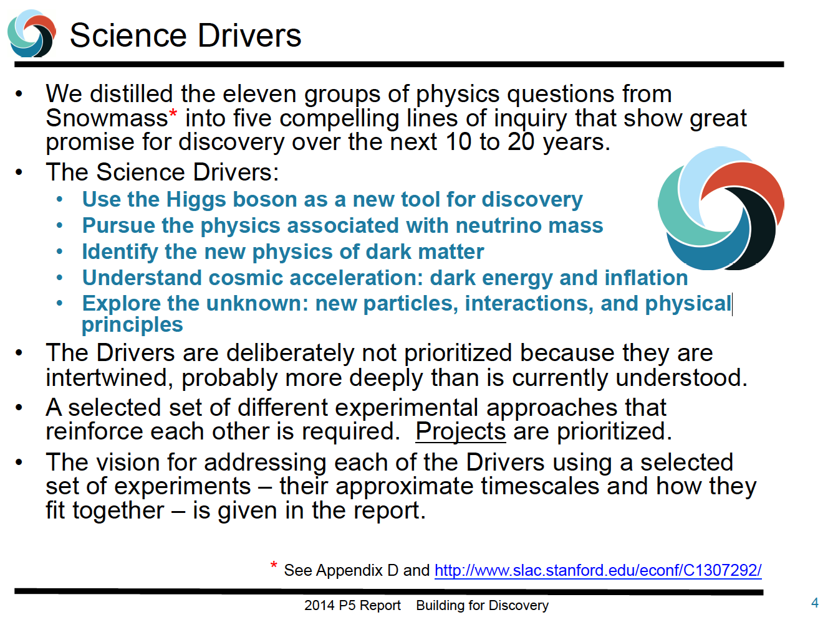
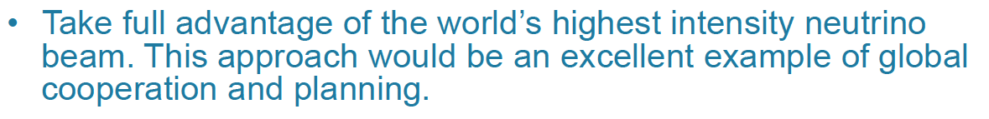

Slide 4
BSM@ν, the genesis
BSM@ν picked up steam after the 2013 U.S. Snowmass exercise
The P5 science drivers clearly lists strategic opportunities
Must leverage the neutrino facility capabilities for precision oscillation measurements to the next step
Need to further increase community interests on BSM opportunities and complement those in the EF regime
Leadership needed in expanding physics opportunities
Theory and experiment groups have been working together closely and playing the necessary leadership roles!
A paper on ROP covers some of these opportunities (Argüelles et al., ROP 83, 124201, 2020)

Slide 5
BSM@ν Strategy, Thus far
Overarching strategic goal : To ensure the BSM physics at neutrino experiments a solidly established area of study
Strategy
  Ensure BSM@ν physics to be an official topic at all subsequent future Snowmass studies
  Increase awareness and interests on BSM@ν physics within and outside the community
  Ensure BSM@ν topics to take a prominent presence in all official documents ➔ P5 strategic plan, Science book, CDR, PDR, TDR, Review reports and presentations, etc
  Form a strong collaborative group of experimentalists and theorists to continue developing and exploring new ideas and publish the work

Slide 6
Some BSM@ν Topics
High beam power, large detector mass + highly capable, precision near and far detectors with low E threshold make BSM physics viable
  Signal to background ratio grows by the sqrt of the beam power
  Near Detector Searches ➔ Take advantage of high beam power
    Low mass Dark Matter (LDM)
    Axion-like Particles (ALP)
    Heavy Neutral Leptons (HNL)
    Milli-charge Particles (mCP)
    Neutrino Trident
  Far Detector Searches ➔ Take advantage of ND, large V_{A} FD and long baseline
    Sterile neutrino searches
    Non-standard Interactions, Non-Unitarity, CPT violation
    Large Extra Dimensions (LED)
    Boosted Dark Matter (BDM)/ Inelastic Boosted Dark Matter (iBDM)
Promote strong collaboration of theorists and experimentalists
Some of these topics from DUNE covered in EPJ C.81, 322 (2021)

Slide 7
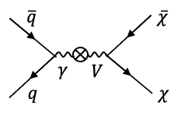
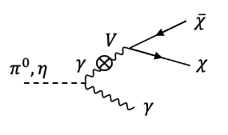
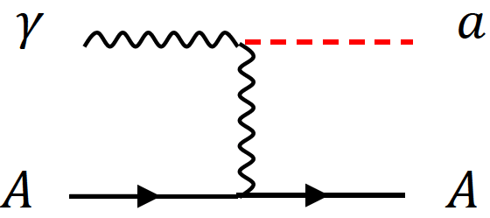
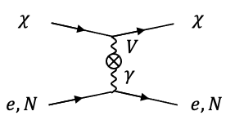
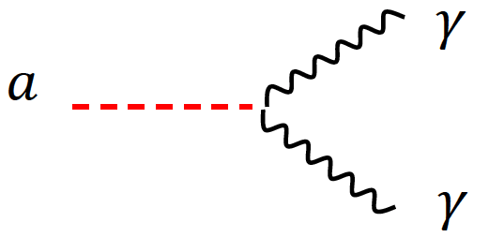
BSM@ν Physics Signatures at ND
High intensity proton beams produce large number of photons from brem, DY or neutral mesons decays ➔ Make it possible to contemplate couplings of new U(1) gauge to the SM γ
Detection through an electron, μ, N(n) recoil or 1, 2 γ final states

Slide 8
BSM Signature Categories
Direct Observation Signatures
  Requires high beam flux
  Sufficiently large mass for interaction signatures
  Sufficiently large volume for decay signatures
Inferred Observation Signatures from both beam and cosmogenic sources
  Leverage oscillatory behaviors
  Large target mass FD for interactions
What do we need to know?
  Signal flux
  Neutrino flux

Slide 9
Some BSM Signatures & BCK
BSM signal final states include charged leptons (e+/-, μ+/-), photons and nucleus (nucleon) recoil ➔ ν-N interactions the primary background
Process | Signatures | Background
ALP | Scattering: γ+e/ γ+N (n) Decay in flight : γγ | ν coherent, NC w/ π⁰, ν_{e} CC w/ π⁰, etc
LDM | χe⁻◊χe⁻, χN◊N’n | NC w/ π^{0,} ν_{e} CC, QE, RES
mCP | Multiple e⁻ scatterings | ν_{e} CC w/ π⁰
Dark Photon | A→e⁻e⁺, μ⁻μ⁺ | ν CC + mis-ID π, Accidental overlap of CC
HNL | Ν → νe⁻e⁺, νμ⁻μ⁺, νeμ, νπ⁰, eπ, μπ | ν CC + mis-ID π, ν_{e} CC w/ π⁰
ν trident | ν→νe⁻e⁺, νμ⁻μ⁺, νeμ | ν_{μ}N◊ν_{μ}πN’ (ν CC)
BDM/ iBDM | χN◊e⁻N | ν coherent, NC w/ π⁰, ν_{e} CC

Slide 10
Low Energy ν Interactions
QE and RES dominate ν-N interactions in DUNE E_{ν} range where the two oscillation maxima reside
QE & RES critical to understanding background to BSM
Large uncertainties for ν-N x-sec calculations in the critical region
  Precision calculations w/ improved nuclear models and event generations essential for oscillation physics
  Planned measurement, such as at e4ν collaboration could provide critical missing info
  Need to clearly identify the list of measurements that can help improving calculations and prioritize them to target low hanging fruits first

Slide 11
Tails, tails, tails
BSM effects extremely rare and are in the tail ends of the SM processes ➔ can easily be masked by SM fluctuations
Many theoretical predictions and generators for ν–N interactions have been in existence and continue making remarkable improvements ➔ but they still have sizeable uncertainties within each and between themselves

Slide 12
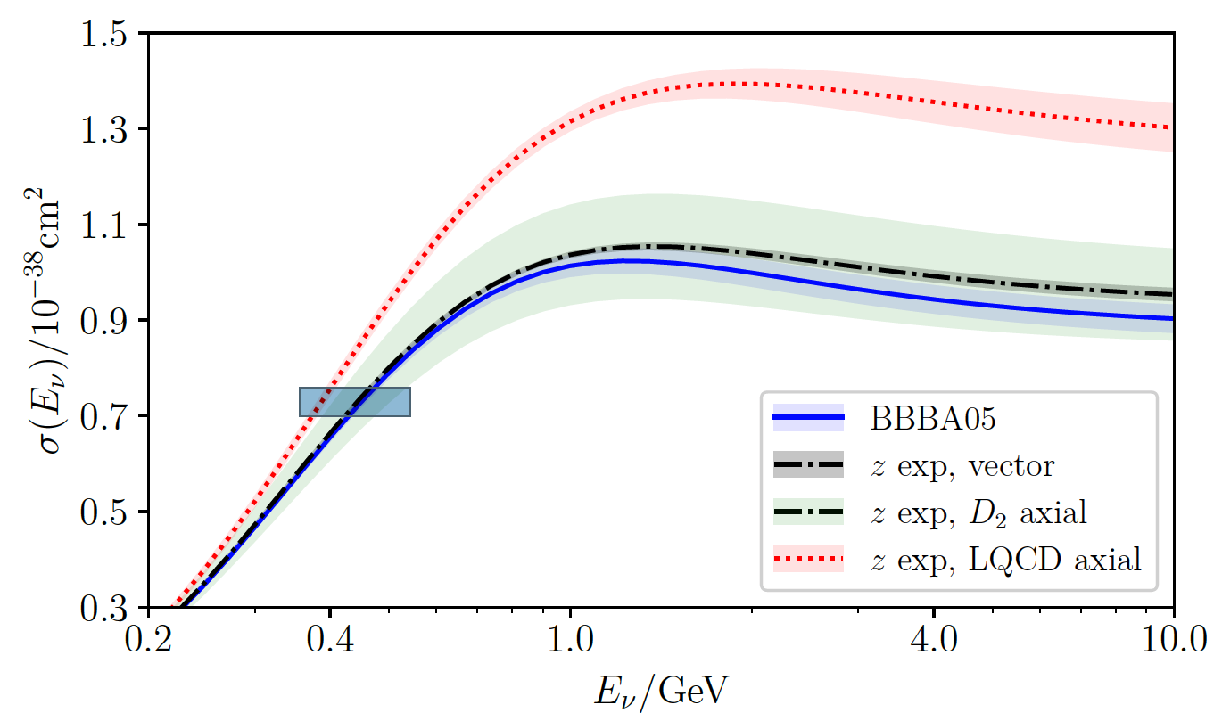
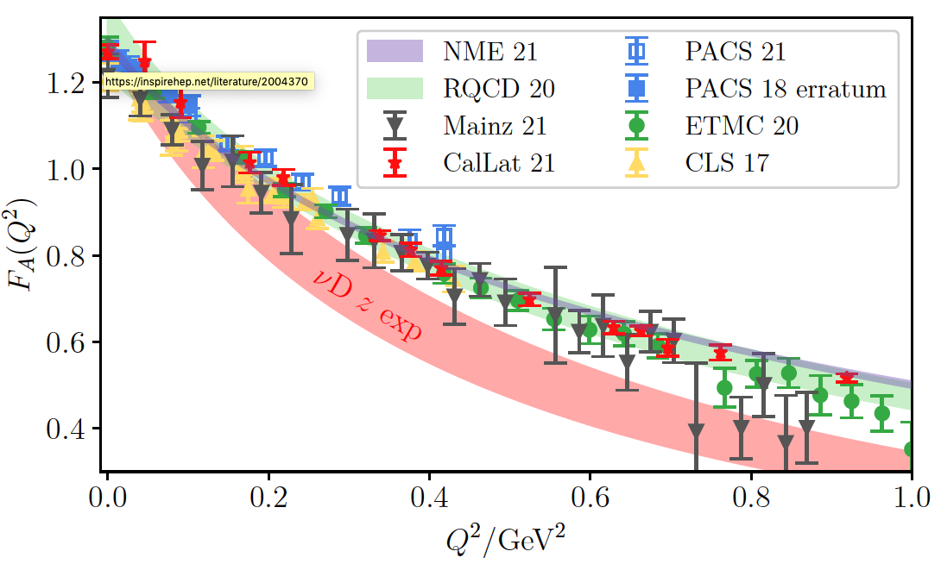
At the CERN ν-N Interactions workshop..
ν+n
A. Kronfeld
2GeV ν_{μ}+Ar
Resonant single γ production
C. Andreopoulos

Slide 13
, and tails
Tails, tails, tails
BSM effects extremely rare and are in the tail ends of the SM processes ➔ can easily be masked by SM fluctuations
Many different theoretical predictions and generators for ν–N have been in existence and continue improving ➔ but they still have sizeable uncertainties within each and between themselves
  Significantly reducing the uncertainties critical for B&B osc. physics
  Essential for estimating backgrounds to BSM searches
Generators begin to incorporate BSM processes but could take a long time to implement due to insufficient resources ➔ need further strengthening the efforts
  Strong collaborations between generator teams and experiments a way to boost
  NP and HEP communities must work together to understand low E processes
  In addition, we need more concerted efforts and get them done in a timely fashion

Slide 14
Timelines to Consider
The documents we work on should provide info to help making strategic plan ➔ long term visions must be incorporated
What would the ν world be like in 2030s?
  Existing experiments will have increased their exposure
  Most of the experiments currently in design or in construction will be taking data
    SBN experiments will have been taking data over 5 years together
    DUNE (2 FD’s) and Hyper-K will have started operating
  Signal simulations and ν-N modeling would have improved
    But at what level and what is missing?
What should the ν world be like in 2040 – 2050?
  What capabilities should the experiments have to support BSM?
    Accelerators and detectors

Slide 15
Signals and Backgrounds
Currently running experiments looking into their data for BSM explorations ➔ Essential for feedback
Most studies on BSM physics in future ν experiments thus far primarily at the phenomenological level
Sufficient demonstration of BSM@ν needs to be accompanied with more realistic studies
  Signals ➔ Tools must be able to incorporate numerous new signatures with ease, a good verifiability and cross check, and the output be easily fed into the full detector simulations
  Backgrounds ➔ The ν-N interaction model must be improved to reduce uncertainties in ν interaction background

Slide 16
The next BSM@ν Strategy
Overarching strategic goal : To ensure the BSM@ν a science driver and a primary goal of future ν experiments
Strategy
  Ensure extracting a large number of quantitative BSM physics results from experiments in 2030 time scale
  Further increase awareness and interests on BSM@nu physics within and outside the community
  Ensure BSM@ν topics to take an essential presence in all official documents ➔ P5 strategic plan, Science book, CDR, PDR, TDR, Review reports and presentations, etc
  Further strengthen the collaborative group of experimentalists and theorists to continue developing and exploring new ideas and publish the work

Slide 17
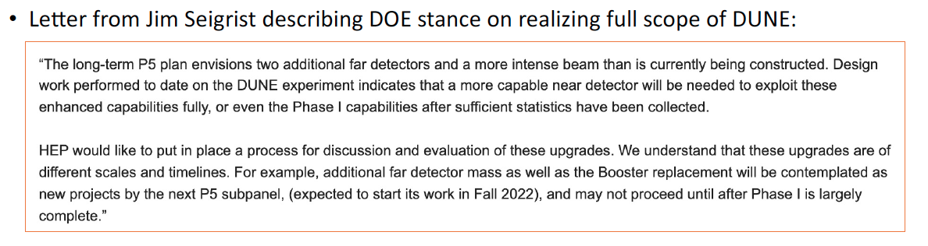
Why are we here?
To make sure we can do for BSM physics in neutrino experiments at present and in the future!
To inform the community of this incredible opportunity
If the necessary tools and resources are not there already then what must we do to make it happen?
We then document the info for strategic planning and decision making!
  Provides essential scientific justifications for realizing the full scope of DUNE with two additional FD, 2.4MW beams and the full complement of the ND

Slide 18
Workshop Goals
This workshop is the 2nd in the series of the BSM@ν after the 2019 Arlington workshop (d%^&* COVID!)
Goals of this workshop
  Discuss activities and progress on Snowmass studies on new physics opportunities at neutrino experiments.
  Provide a status update of sub-topical groups activities and remaining studies including timelines, if incomplete.
  Finalize sub-topical group whitepapers!!!!!
  Generate first draftsof topical frontier group reports (NF01, NF02, NF03, RF06 & TF11) on new physics opportunities.
  Define clear timelines for completing the sub-topical group whitepapers and topical group reports.

Slide 19
NF03 Sub-topical Groups and the Leads
Sub-topical groups formed based on submitted LOI’s @ https://www.snowmass21.org/neutrino/bsm/start
Heavy Neutral Leptons: I. Shoemaker, A. de Roeck
  Coordinate with NF02
Coherent Elastic Neutrino-Nucleus Scattering: L. Strigari, P. Barbeau, R. Strauss
BSM searches within neutrino oscillations: P. Coloma, D. Forero, T. Katori
  Covers Large Extra Dimension searches, Lorentz and CPT symmetry, Non-unitarity of the neutrino mixing matrix, Non-standard interactions, etc
  Coordinate with NF01 & NF02
Baryon number violation: B. Dev, L. Koerner
  Coordinate with RF04 and any related CPM groups
Cosmogenic dark matter and exotic particle searches: D. Kim, Y. Tsai
  Coordinate with CPM97
Beam-originating dark matter candidate searches: B. Batell, J. Yu
  Coordinate with CPM108

Slide 20
Snowmass Report Timeline
Community feedback meetings for report input: Jan-Mar
Topical Group Report drafts due for community (NF): March 11
Community feedback period on first TG drafts: Mar. 11-Apr. 10
NF Workshop @ ORNL : March 16-18
Preliminary (TG & Frontier) Reports due (NF): May 10
Preliminary (TG & Frontier) Reports due (Snowmass): May 31
Community feedback period: June 1 – July 26
Community Summer Study (Seattle): July 17-26
Final (TG & Frontier) Reports due (NF): Sept 9
Final (TG & Frontier) Reports due (Snowmass): Sept 30

