Slide 1
Joint BSM@ν Workshop Summary
Feb. 12, 2022
Snowmass BSM@ν Joint Workshop
Jaehoon Yu*
University of Texas at Arlington

Slide 2
BSM@ν Strategy, Thus far
Overarching strategic goal : To ensure the BSM physics at neutrino experiments a solidly established area of study ➔ Accomplished!
Strategy
  Ensure BSM@ν physics to be an official topic at all subsequent future Snowmass studies
  Increase awareness and interests on BSM@ν physics within and outside the community
  Ensure BSM@ν topics to take a prominent presence in all official documents ➔ P5 strategic plan, Science book, CDR, PDR, TDR, Review reports and presentations, etc
  Form a strong collaborative group of experimentalists and theorists to continue developing and exploring new ideas and publish the work

Slide 3
BSM Signature Categories
Direct Observation Signatures
  Requires high beam flux
  Sufficiently large mass for interaction signatures
  Sufficiently large volume for decay signatures
Inferred Observation Signatures from both beam and cosmogenic sources
  Leverage oscillatory behaviors
  Large target mass FD for interactions
What do we need to know?
  Signal flux and realistic behaviors in the detector
  Neutrino flux and their interactions in the detector as bck

Slide 4
Sub-topical White Papers
Impressive progress have been made
All six white papers are in excellent shape
  Generating large interests
  Working closely with other topical groups and frontiers
Many new contributors have joined in at this workshop, helping to finalize the papers

Slide 5
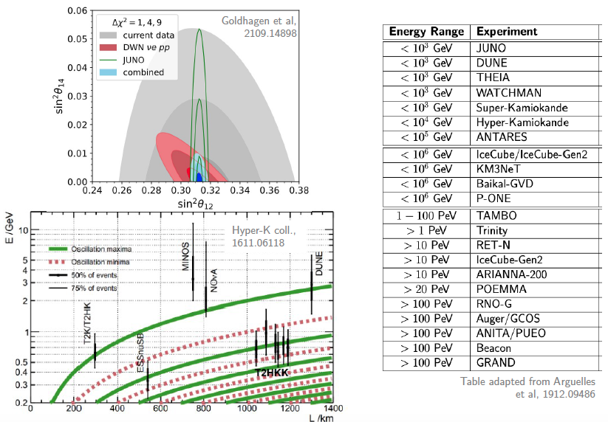
BSM Effects on ν-flavor
Lead editors : Pilar Coloma, David Forero and Teppei Katori
Rich BSM physic topics in neutrino behaviors that can be explored in broad kinematic phase space

Slide 6
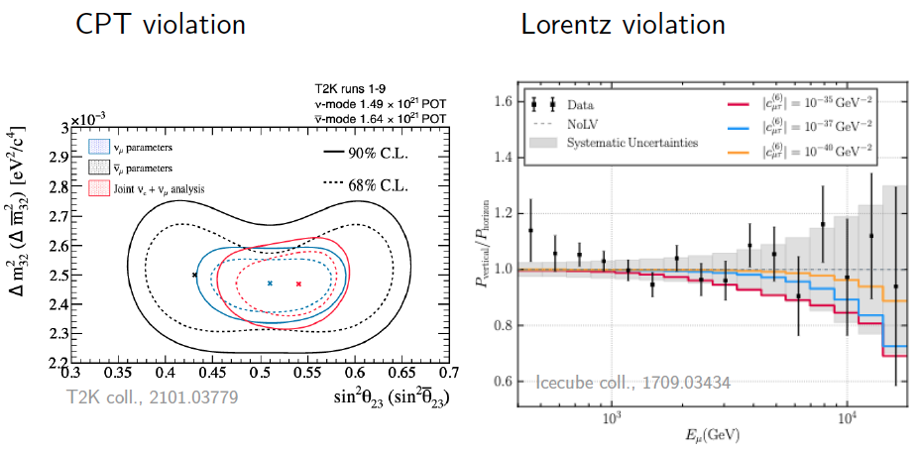
BSM Effects on ν-flavor
Test of fundamental symmetry

Slide 7
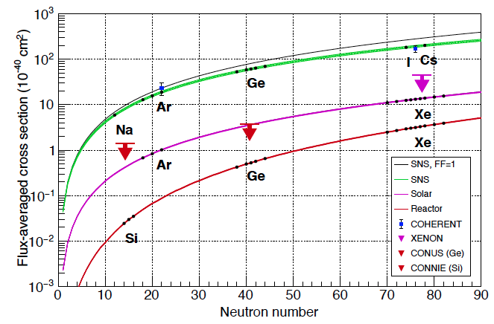
CEνNS
Lead editors : Louis Strigari, Phil Barbeau and Raimund Strauss
CEνNS is important physics and an essential testing ground for BSM at as low E as possible in many nuclei

Slide 8
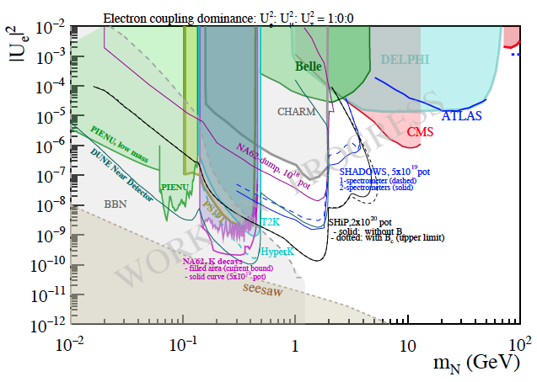
Heavy Neutral Leptons
Lead editors: Ian Shoemaker and Albert de Roeck
Collider and fixed target experiments – DUNE, NA62, SHiP & SHADOWS - compliment each other

Slide 9
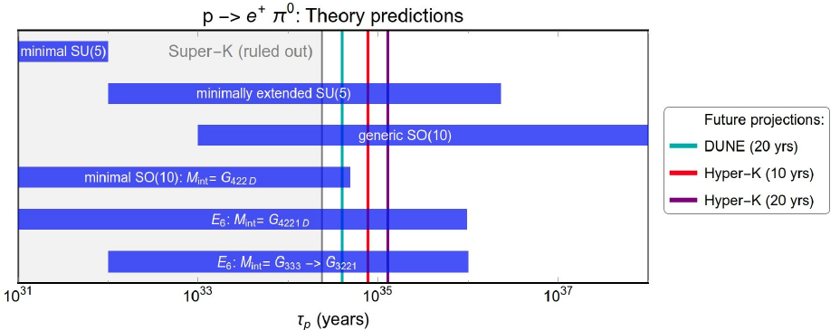
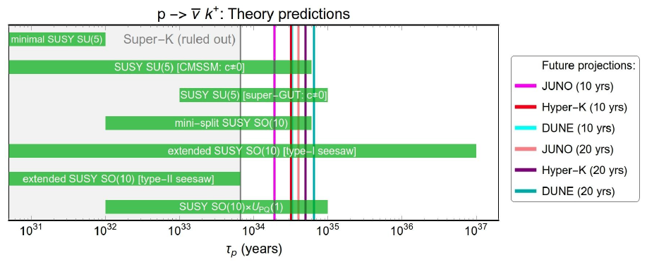
Baryon Number Violation
Lead editors: Lisa Koerner and Bhupal Dev
Non-SUSY GUT
Experiments complement each other
SUSY GUT

Slide 10
Cosmogenic BSM Particles
Lead editors: Yun-tse Tsai and Doojin Kim
New opportunities on probing cosmogenic BSM particles (BDM, iBDM, etc) with the operating and future neutrino experiments, leveraging the large detector mass
Discuss consistency and complementarity among different detection technologies
Describe techniques developed for new detection technologies (e.g. LArTPCs)
Summarize analysis strategies

Slide 11
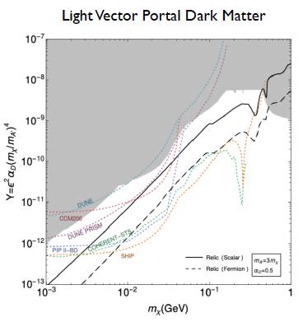
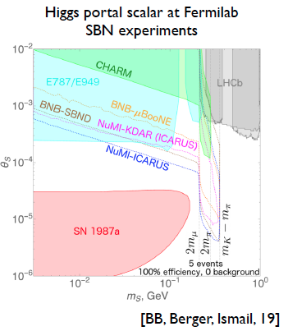
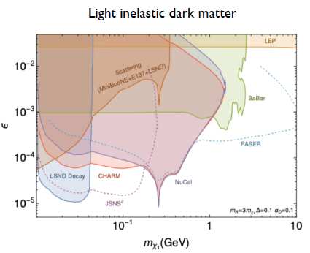
Dark Sector Particles in the Beam
Lead editors : Brian Batell and Jae Yu
Set of new particles which do not experience the known forces; Weakly coupled to visible sector through a mediator or “portal”
Numerous opportunities to create dark sector particles, thanks to high intensity proton beams ➔ Toward the beams of DSP

Slide 12
Shared Interests with Other TG’s & TF’s
Joint TG’s and TF’s : NF01, NF02, RF06 and TH11
Natural to have many shared interests across different TG’s within NF and with other TF’s
Want to avoid duplicate efforts that could distract the focus and attention
We have much clearer distinctions between these groups to ensure the focus of WP’s and reports
  Still some overlapping topics but at the level of directing attention to the relevant WP’s
Joint TG’s and TF’s at this workshop ensures capturing all physics topics and contributions of all interested members

Slide 13
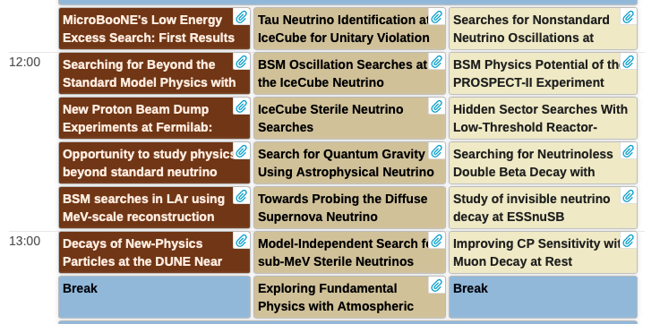
Contributed Talks
Total of 19 contributed talks by junior colleagues
A healthy mixture of experiment and theory talks
Five talks on BSM search analyses using existing data
Several new ideas on upcoming and future experiments

Slide 14
Timelines to Consider
The documents we work on should provide info to help making strategic plan ➔ long term visions must be incorporated
What would the ν world be like in 2030s?
  Existing experiments will have increased their exposure
  Most of the experiments currently in design or in construction will be taking data
    SBN experiments will have been taking data over 5 years together
    DUNE (2 FD’s) and Hyper-K will have started operating
  Signal simulations and ν-N modeling would have improved
    But at what level and what is missing?
What should the ν world be like in 2040 – 2050?
  What capabilities should the experiments have to support BSM?
    Accelerators and detectors

Slide 15
Sub-topical White Papers
Impressive progress have been made
All six white papers are in excellent shape
  Generating large interests
  Working closely with other Topical groups and frontiers
Many new contributors have joined in at this workshop, helping to finalize the papers
Need to be cleaned up to be in a releasable shape in the archives
Executive summaries (~ 2 pages each) still needed for topical group report draft due March 11

Slide 16
Signals and Backgrounds
Currently running experiments looking into their data for BSM physics ➔ essential for quanttiative feedback
Most studies on BSM physics in future ν experiments thus far primarily at the phenomenological level
Sufficient demonstration of BSM@ν needs to be accompanied with more realistic studies
  Signals ➔ Tools must be able to incorporate numerous new signatures with ease, a good verifiability and cross check, and the output be easily fed into the full detector simulations
  Backgrounds ➔ The ν-N interaction model must be improved to reduce uncertainties in ν interaction background

Slide 17
Workshop Goals
This workshop was the 2nd in the series of the BSM@ν after the 2019 Arlington workshop (d%^&* COVID!)
Goals of this workshop
  Discuss activities and progress on Snowmass studies on new physics opportunities at neutrino experiments
  Provide a status update of sub-topical groups activities and remaining studies including timelines, if incomplete
  Finalize sub-topical group whitepapers
  Generate first drafts of topical frontier group reports (NF01, NF02, NF03, RF06 & TF11) on new physics opportunities
  Ensure capturing and integrating all BSM physics opportunities
  Define clear timelines for completing the sub-topical group whitepapers and topical group reports

Slide 18
Snowmass Dates to Keep in Mind
Community feedback meetings for report input: Jan-Mar
Topical Group Report drafts due for community (NF): March 11
Community feedback period on first TG drafts: Mar. 11-Apr. 10
NF Workshop @ ORNL : March 16-18
Preliminary (TG & Frontier) Reports due (NF): May 10
Preliminary (TG & Frontier) Reports due (Snowmass): May 31
Community feedback period: June 1 – July 26
Community Summer Study (Seattle): July 17-26
Final (TG & Frontier) Reports due (NF): Sept 9
Final (TG & Frontier) Reports due (Snowmass): Sept 30

Slide 19
The next BSM@ν Strategy
Overarching strategic goal : To ensure the BSM@ν a science driver and a primary goal of future ν experiments
Strategy
  Ensure extracting large number of quantitative BSM physics results from experiments based on data prior to the start of next Snowmass
  Further increase and strengthen awareness and interests on BSM@ν physics within and outside the community
  Ensure BSM@ν topics to take an essential presence in all official documents ➔ P5 strategic plan, CDR, PDR, TDR, Review reports and presentations, etc
  Enhance collaboration of experimentalists and theorists, with the NP community, to continue developing and exploring new ideas, improve tools and publish the work

Slide 20
Summary
The joint workshop was a smashing success!
It clearly demonstrated an explosive growth of interests in the community (44➔141 participants)
  The large number of junior participants shows a clear path for continued growth
To produce quantitative results, the tools for the signal studies and improved ν-N interaction modelling for background studies are essential
  Collaboration with NP community critical
  The insufficient resource issues for tools development must be addressed ASAP

