Slide 1
Jet SIFT-ing
A Scale-Invariant Jet Clustering Algorithm for the Substructure Era
Joel W. Walker
Sam Houston State University
with special thanks:
Andrew Larkoski (SLAC), Denis Rathjens (CMS), and Jason Veatch (ATLAS)
PHENO
University of Pittsburgh
May 9-11, 2022

Slide 2
SIFT: Scale-Invariant Filter Tree
Outline of Presentation
SCALE INVARIANT
  Jet Clustering Background
  Motivation for Scale Invariance
  Algorithm Implementation
  Algorithm Visualization
  Algorithm Testing
FILTER
  Integrated Grooming
  Remove Soft Wide-Angle Radiation
  A Natural Halting Condition
TREE
  Fast Algorithms
  Multidimensional Trees

Slide 3
SIFT: SCALE-INVARIANT Filter Tree
Traditional Jet Clustering imposes a fixed cone size, and thus a fixed scale on events
Boosted objects tend to collimate and fall into a single jet radius
Substructure techniques are essential for recovering information inside the jet
However, these techniques are often complicated, with de- and re-clustering
We propose as SCALE INVARIANT approach which is intrinsically suitable for tagging substructure AS the jet is being assembled

Slide 4
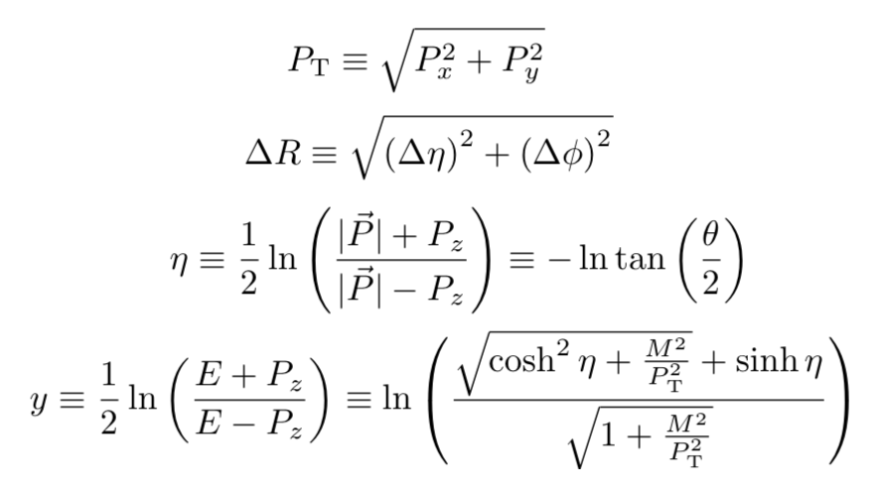
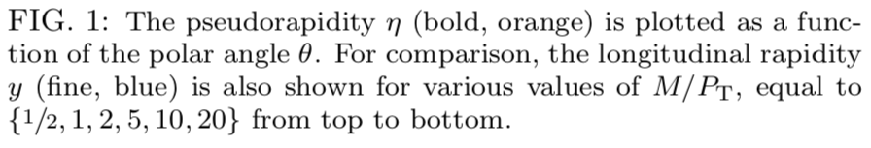
Collider Variables & Coordinates
Transverse components (perpendicular to the beam) are very important (invariant under longitudinal boosts, P_{T} total is zero)
Differences in orientation characterized by ΔR, referring also to azimuth angle φ
The pseudorapidity η is a proxy for the polar (beam) angle θ, defined such that differences Δη are (almost) invariant under longitudinal boosts
This invariance is exact for the rapidity y (difference is handling of MASS)

Slide 5
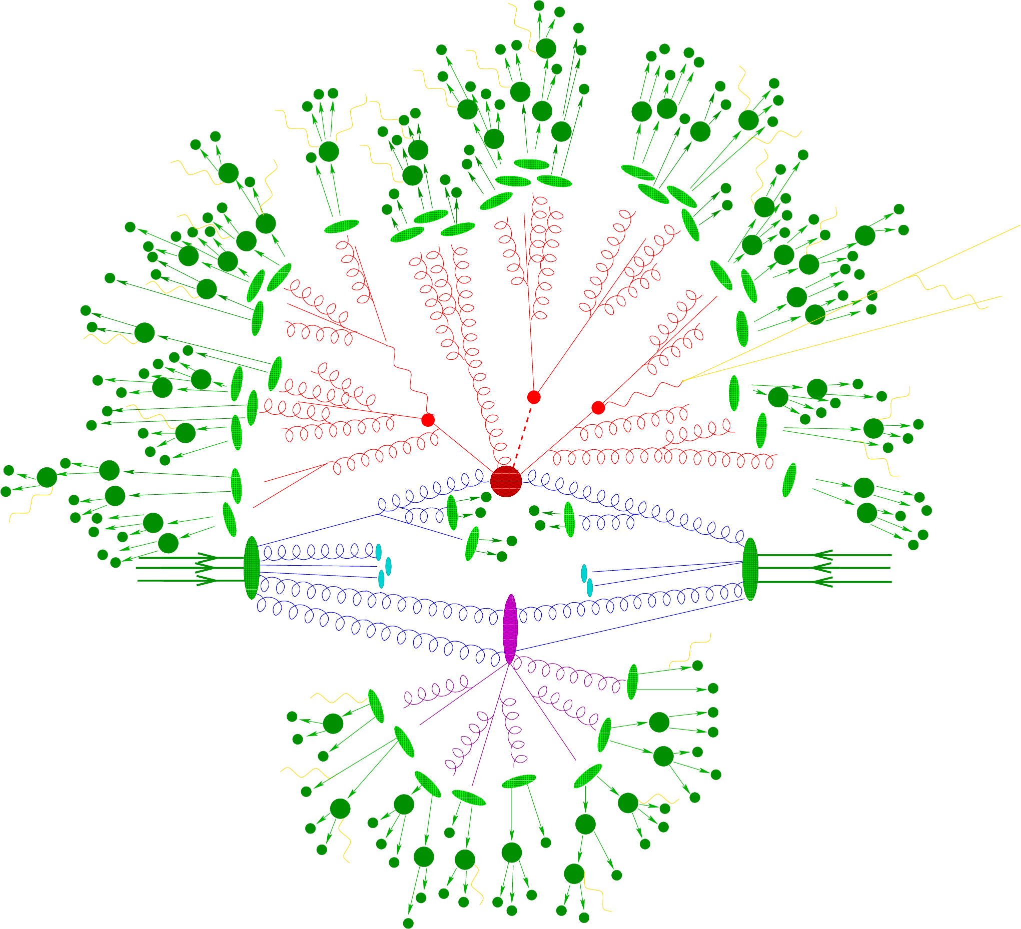
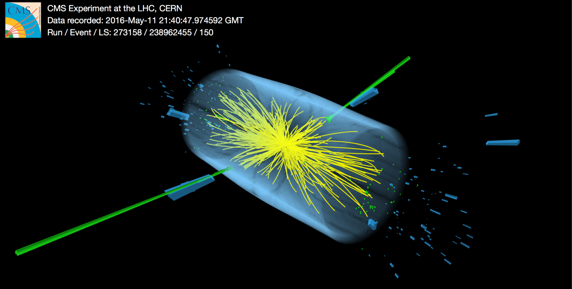
Formation of Hadronic Jets
The hard partonic event may result in the production of objects with color (at Feynman diagram level, e.g. MadGraph)
These objects rapidly ”shower”, radiating quarks & gluons (e.g. Pythia)
QCD confinement implies that strongly charged particles cannot exist as free objects at large separations; they must convert “hadronize” (e.g. Lund color strings in Pythia) into color-neutral particles such as pions, K mesons, etc.
Color strings may convolve descendants of partonic objects with each other and even with the underlying beam; this is partially mitigated in a lepton collider
Image: CMS
Image: Stefan Höche

Slide 6
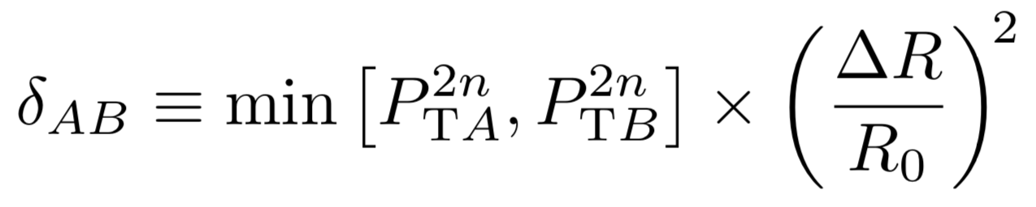
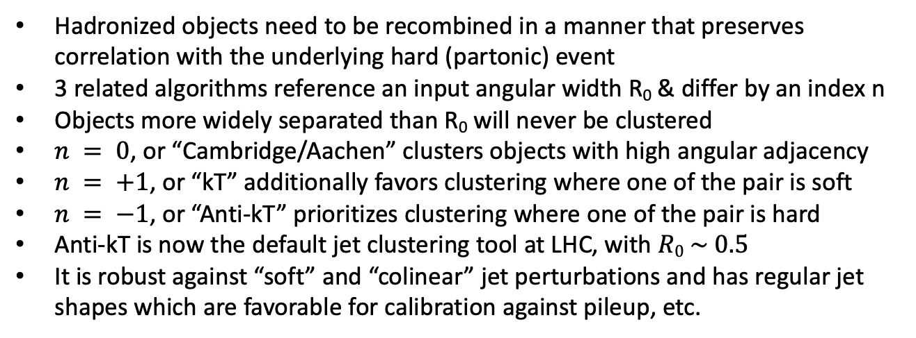
Standard Jet Clustering Algorithms
Hadronized objects need to be recombined in a manner that preserves correlation with the underlying hard (partonic) event
3 related algorithms reference an input angular width R₀ & differ by an index n
Objects more widely separated than R₀ will never be clustered
$n = 0$, or “Cambridge/Aachen” clusters objects with high angular adjacency
$n = +1$, or “kT” additionally favors clustering where one of the pair is soft
$n = −1$, or “Anti-kT” prioritizes clustering where one of the pair is hard
Anti-kT is now the default jet clustering tool at LHC, with $R0 \sim 0.5$
It is robust against “soft” and “colinear” jet perturbations and has regular jet shapes which are favorable for calibration against pileup, etc.

Slide 7
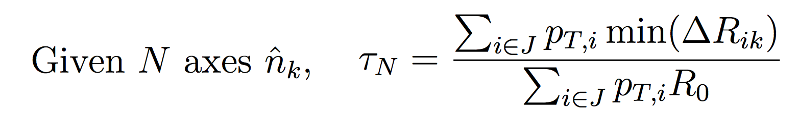
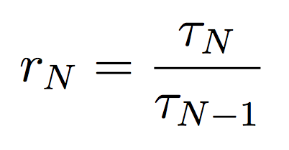
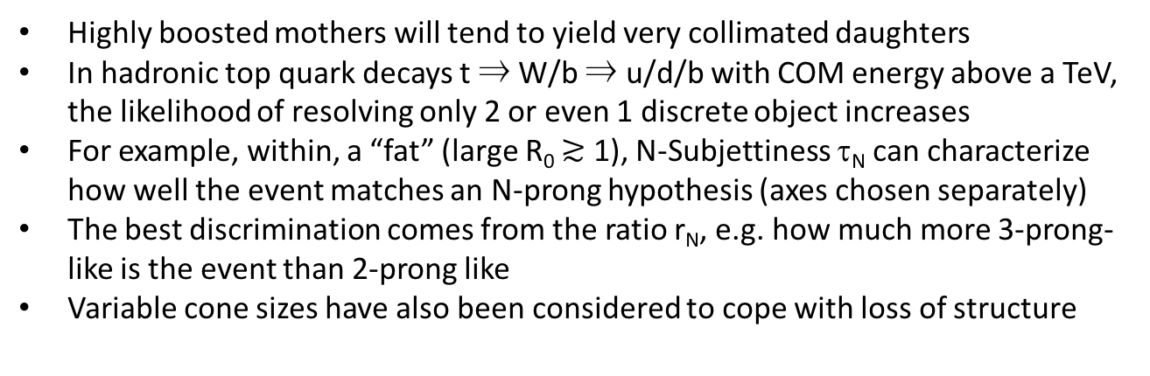
Jet Substructure
Highly boosted mothers will tend to yield very collimated daughters
In hadronic top quark decays t ⇒ W/b ⇒ u/d/b with COM energy above a TeV, the likelihood of resolving only 2 or even 1 discrete object increases
For example, within, a “fat” (large R₀ $≳$ 1), N-Subjettiness τ_{N} can characterize how well the event matches an N-prong hypothesis (axes chosen separately)
The best discrimination comes from the ratio r_{N}, e.g. how much more 3-prong-like is the event than 2-prong like
Variable cone sizes have also been considered to cope with loss of structure

Slide 8
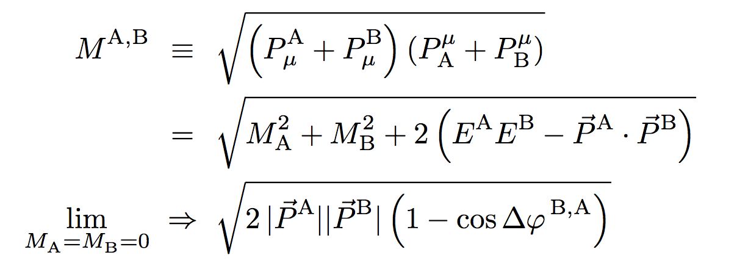
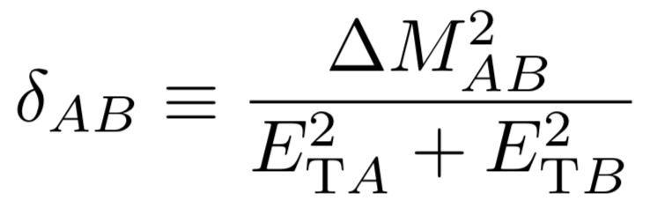
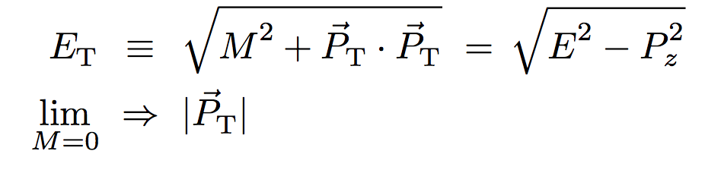
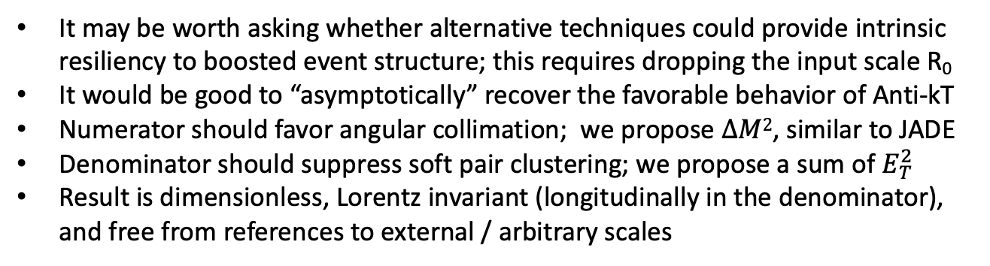
A Scale-Invariant Jet Algorithm
It may be worth asking whether alternative techniques could provide intrinsic resiliency to boosted event structure; this requires dropping the input scale R₀
It would be good to “asymptotically” recover the favorable behavior of Anti-kT
Numerator should favor angular collimation; we propose $∆M2$, similar to JADE
Denominator should suppress soft pair clustering; we propose a sum of $E_{T}^{2}$
Result is dimensionless, Lorentz invariant (longitudinally in the denominator), and free from references to external / arbitrary scales

Slide 9
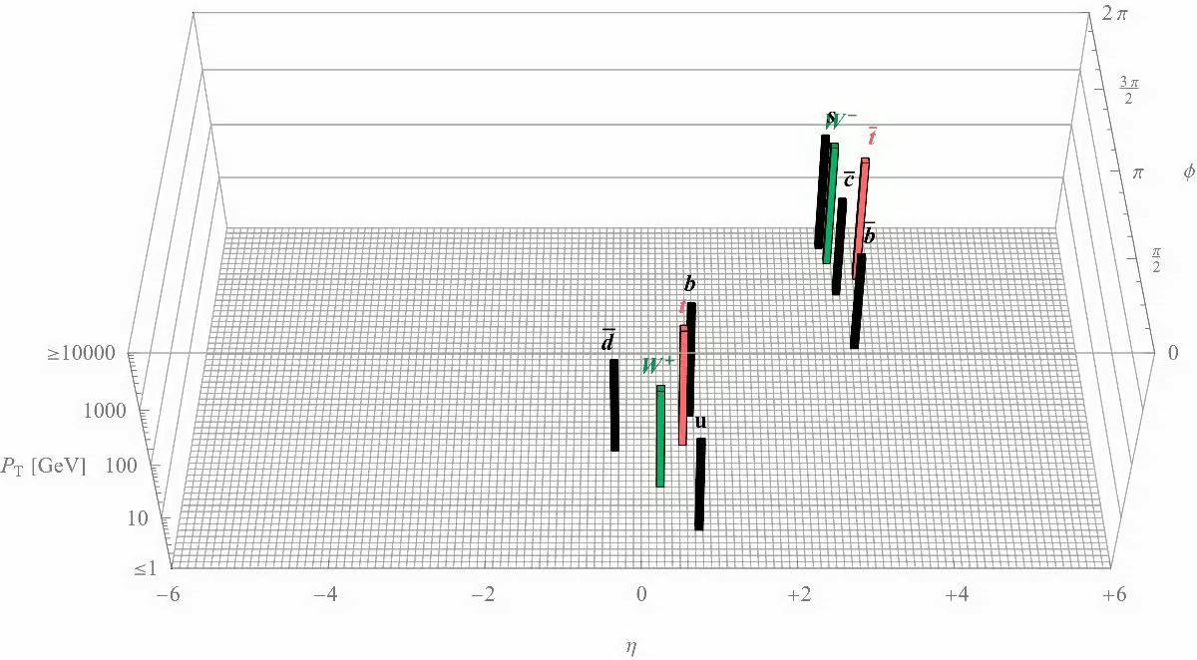
Hadronic TTbar Scale-Invariant Clustering

Slide 10
Test of Pre/Post Merger Statistic for Di-jets
95% of pairs reconstructed prior to 0.1
95% of final final mergers are after 2.0
Results are invariant wrt beam energy

Slide 11
Visualization of Statistic Jump at Clustering
The event jettiness count is intrinsically imprinted on the clustering history

Slide 12
Matching of final 6 objects with Truth-Level Quarks

Slide 13
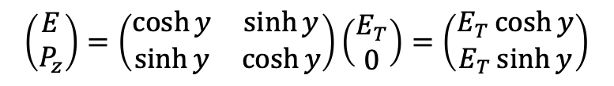
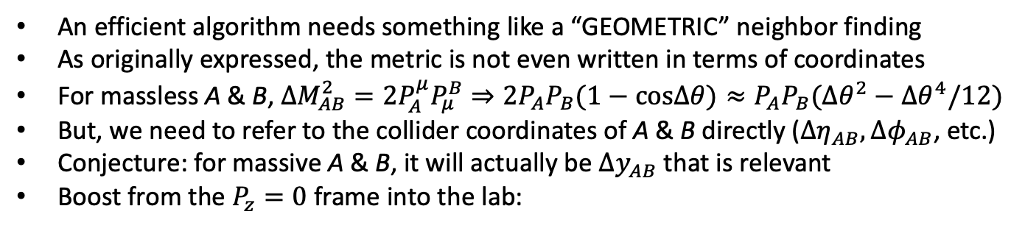
Moving Toward a Geometric Measure
An efficient algorithm needs something like a “GEOMETRIC” neighbor finding
As originally expressed, the metric is not even written in terms of coordinates
For massless A & B, $∆M_{AB}^{2}=2P_{A}^{μ}P_{μ}^{B}⇒2P_{A}P_{B}(1−cos∆θ)≈P_{A}P_{B}({∆θ}^{2}−{∆θ}^{4}/12)$
But, we need to refer to the collider coordinates of A & B directly ($∆η_{AB},∆φ_{AB}$, etc.)
Conjecture: for massive A & B, it will actually be $∆y_{AB}$ that is relevant
Boost from the $P_{z}=0$ frame into the lab:
$$\left(\begin{matrix}E \\ P_{z}\end{matrix}\right)=\left(\begin{matrix}\cosh{y} & \sinh{y} \\ \sinh{y} & \cosh{y}\end{matrix}\right)\left(\begin{matrix}E_{T} \\ 0\end{matrix}\right)=\left(\begin{matrix}E_{T}\cosh{y} \\ E_{T}\sinh{y}\end{matrix}\right)$$
$$2P_{A}^{μ}P_{μ}^{B}=2(E_{A}E_{B}−P_{z}^{A}P_{z}^{B}−P_{T}^{A}P_{T}^{B}\cos{∆φ_{AB})}$$
$$=2(E_{T}^{A}E_{T}^{B}[\cosh{y^{A}}\cosh{y^{B}}−sinh{y^{A}}\sinh{y^{B}]}−P_{T}^{A}P_{T}^{B}\cos{∆φ_{AB})}$$
$$=2(E_{T}^{A}E_{T}^{B}\cosh{∆y^{AB}}−P_{T}^{A}P_{T}^{B}\cos{∆φ_{AB})}$$

Slide 14
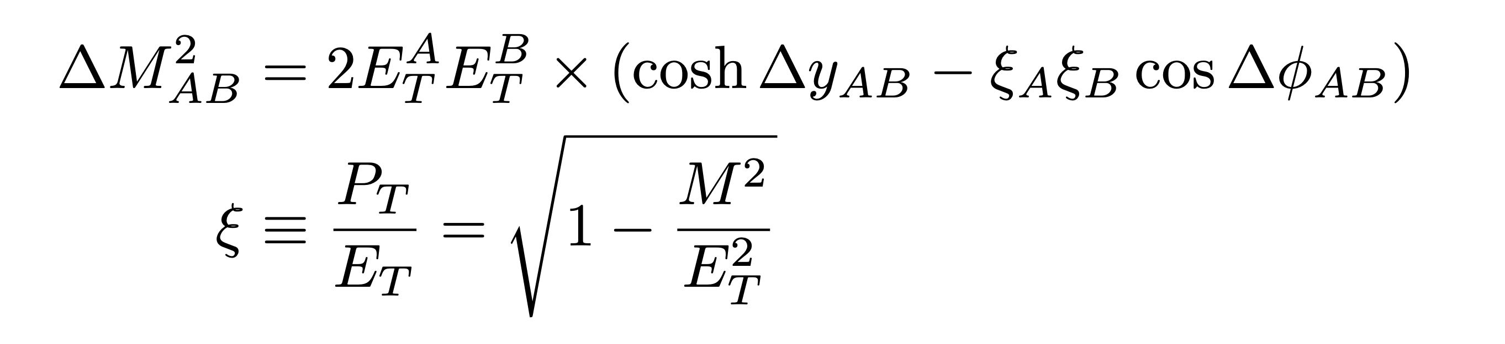
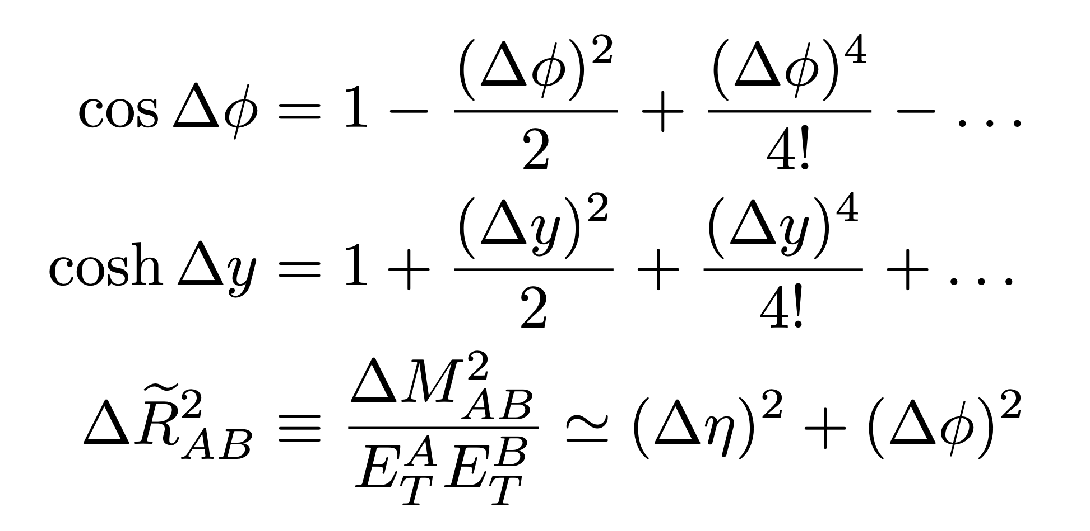
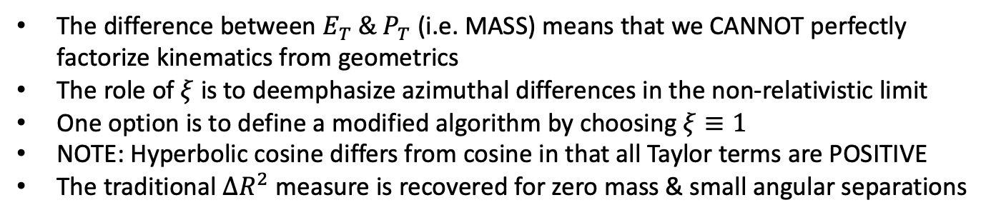
More Geometric Interpretation
The difference between $E_{T} \&{ P}_{T}$ (i.e. MASS) means that we CANNOT perfectly factorize kinematics from geometrics
The role of $ξ$ is to deemphasize azimuthal differences in the non-relativistic limit
One option is to define a modified algorithm by choosing $ξ≡1$
NOTE: Hyperbolic cosine differs from cosine in that all Taylor terms are POSITIVE
The traditional $ΔR^{2}$ measure is recovered for zero mass & small angular separations

Slide 15
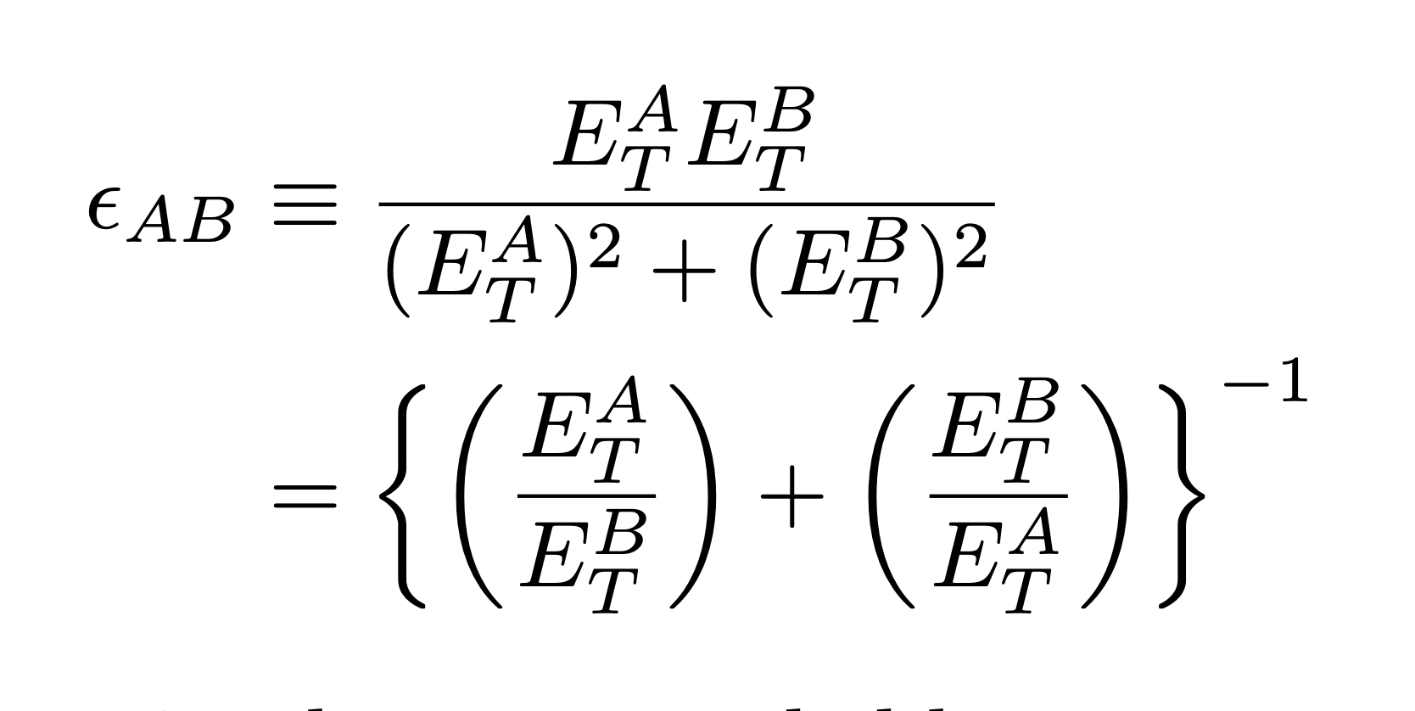
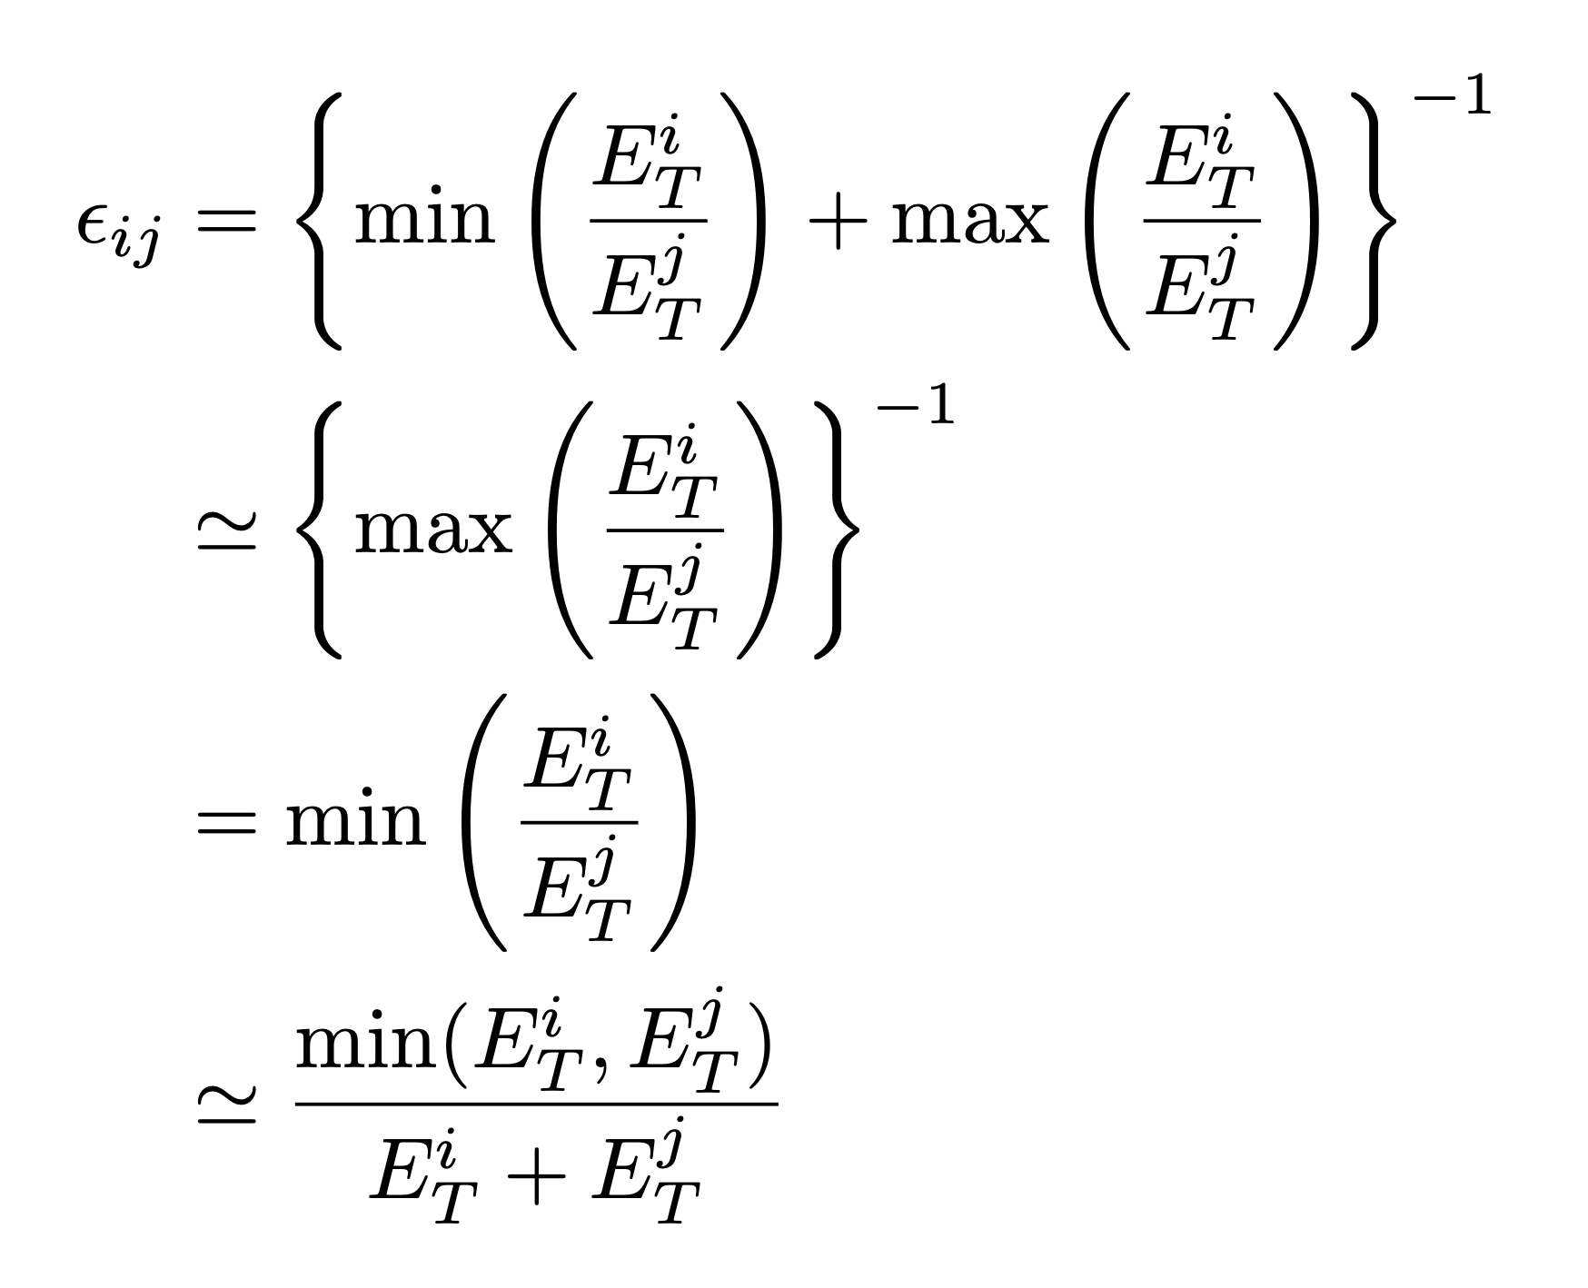
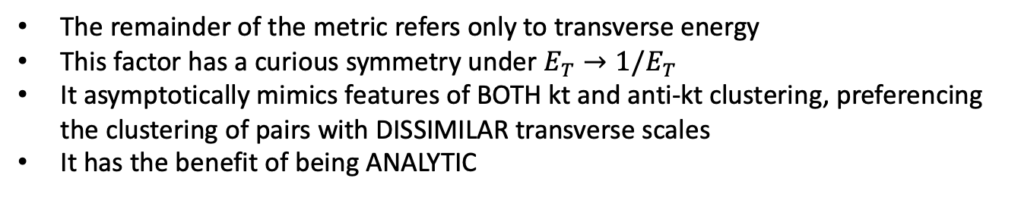
Asymptotic Recovery of KT and ANTI-KT
The remainder of the metric refers only to transverse energy
This factor has a curious symmetry under $E_{T}→1/E_{T}$
It asymptotically mimics features of BOTH kt and anti-kt clustering, preferencing the clustering of pairs with DISSIMILAR transverse scales
It has the benefit of being ANALYTIC

Slide 16
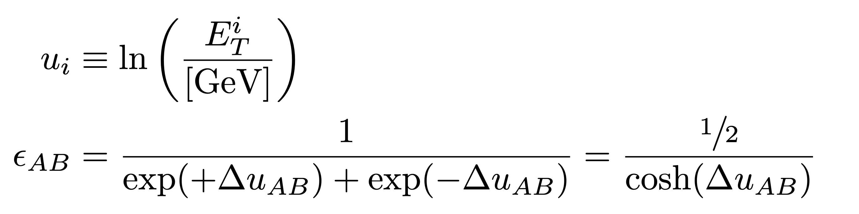
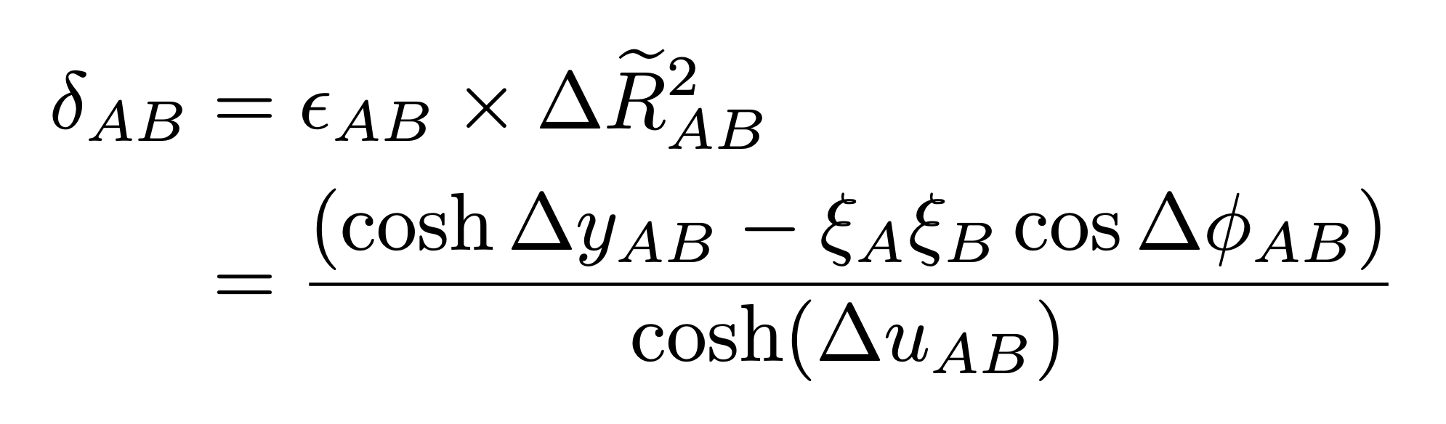
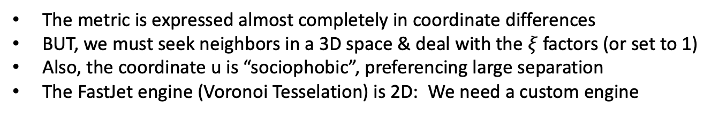
Geometrizing the Denominator
The ratio of scales is bounded by 0 and $∞$
It can be made more symmetric with a logarithmic transformation
The metric is expressed almost completely in coordinate differences
BUT, we must seek neighbors in a 3D space & deal with the $ξ$ factors (or set to 1)
Also, the coordinate u is “sociophobic”, preferencing large separation
The FastJet engine (Voronoi Tesselation) is 2D: We need a custom engine

Slide 17
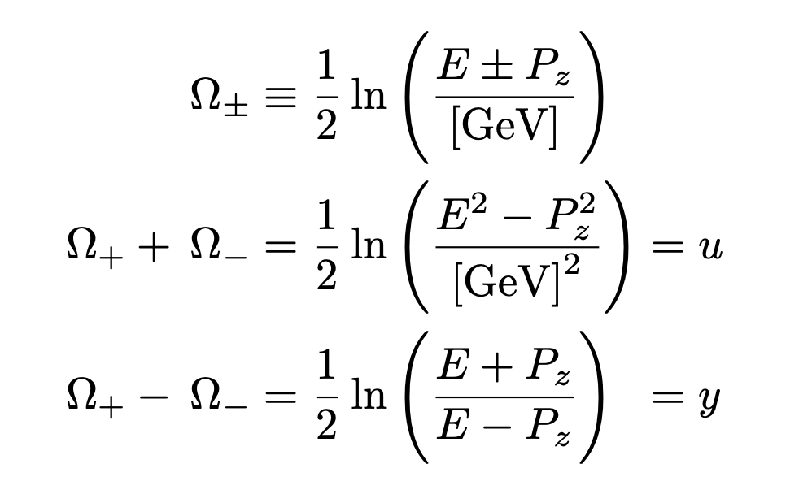
Conjugate Coordinates
There is a fascinating relationship between the rapidity and scale coordinates

Slide 18
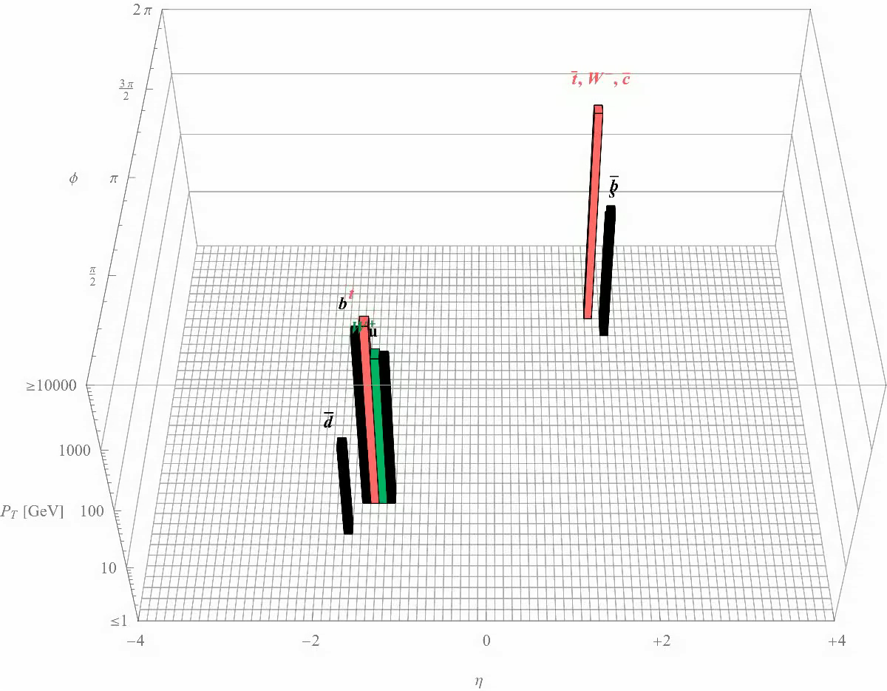
Comparison: Lepton to TTbar 2.5 TeV Anti-KT 0.5 with Ghosts
Boosted structure is lost early and stray radiation is collected last

Slide 19
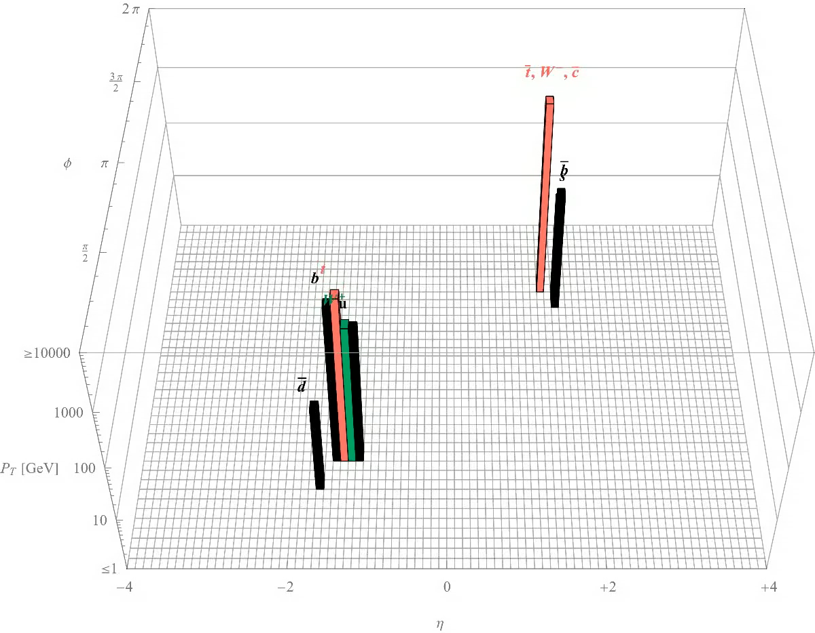
Lepton to TTbar 2.5 TeV Scale Invariant Clustering with Ghosts
Structure is retained until the end, but when should we stop clustering?
Extraneous soft radiation is assimilated early – can we fix that?

Slide 20
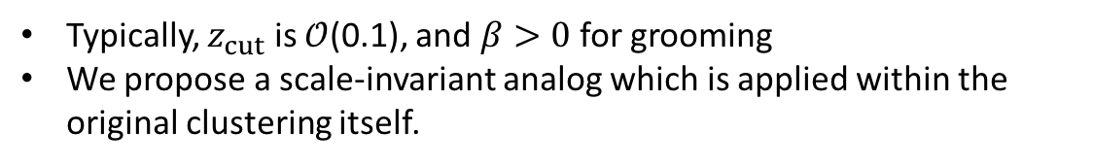
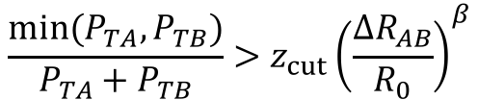
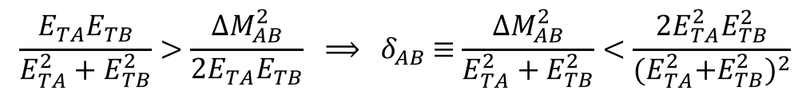
SIFT: Scale-Invariant FILTER Tree
Take a cue from “Soft Drop” (2014 Larkoski, Marzani, Soyez, Thaler)
This procedure “Grooms” a jet by removing soft, wide-angle radiation to mitigate contamination from ISR, UE, and pileup
SD iteratively DECLUSTERS C/A, dropping softer object unless & until:
$$\frac{min⁡(P_{TA},P_{TB})}{P_{TA}+P_{TB}}>z_{cut}{\left(\frac{ΔR_{AB}}{R_{0}}\right)}^{β}$$
Typically, $z_{cut}$ is $𝒪$(0.1), and $β>0$ for grooming
We propose a scale-invariant analog which is applied within the original clustering itself.
$$\frac{E_{TA}E_{TB}}{E_{TA}^{2}+E_{TB}^{2}}>\frac{∆M_{AB}^{2}}{{2E}_{TA}E_{TB}} ⟹{ δ}_{AB} ≡\frac{∆M_{AB}^{2}}{E_{TA}^{2}+E_{TB}^{2}}<\frac{{2E}_{TA}^{2}E_{TB}^{2}}{{{(E}_{TA}^{2}+E_{TB}^{2})}^{2}}$$
The softer object is considered isolated unless it passes this FILTER
This provides a natural halting condition to prevent total assimilation

Slide 21
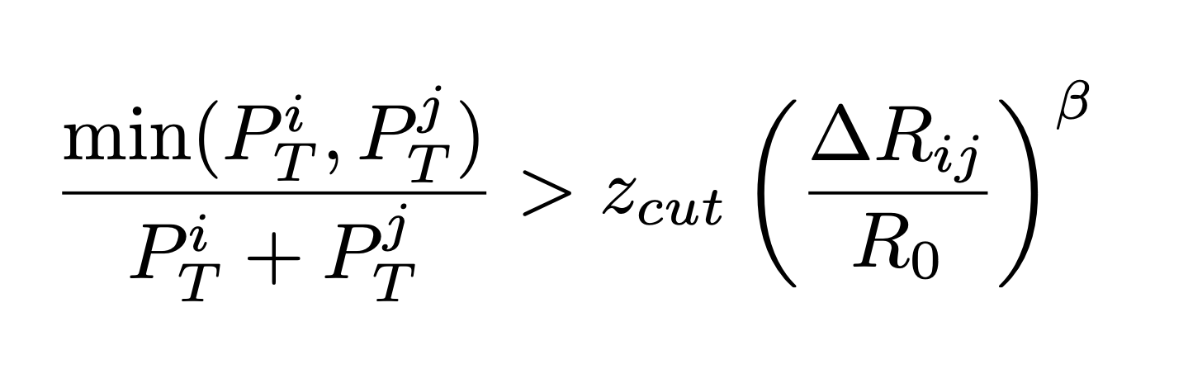
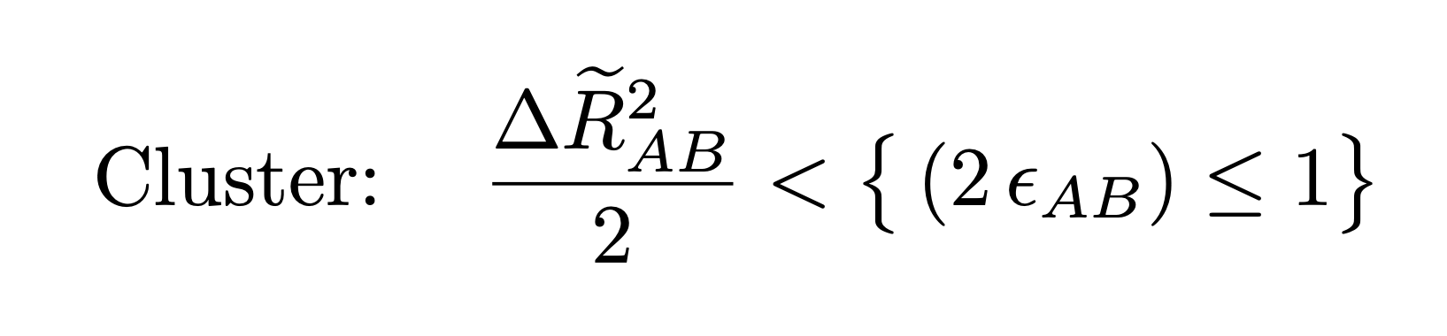
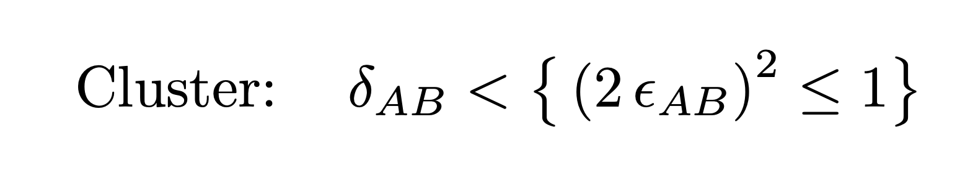

Reexpressing the Filtering Criterion
Our analog of the soft-drop criterion is also expressible in this new language
$$⟹$$
OR
With factors of 2 in their “natural” places the maximal effective cone size is $\sqrt{2}$
This is a soft DYNAMIC boundary, and the angular size reduces for imbalanced scales

Slide 22
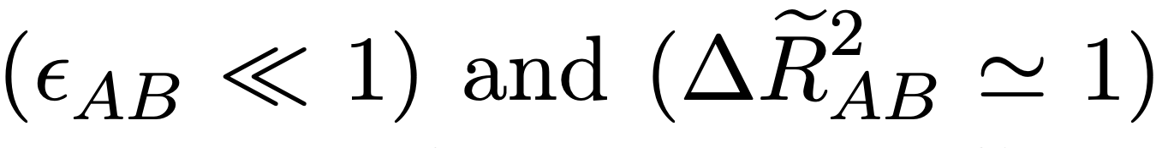
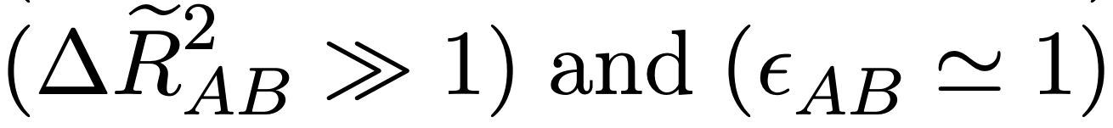
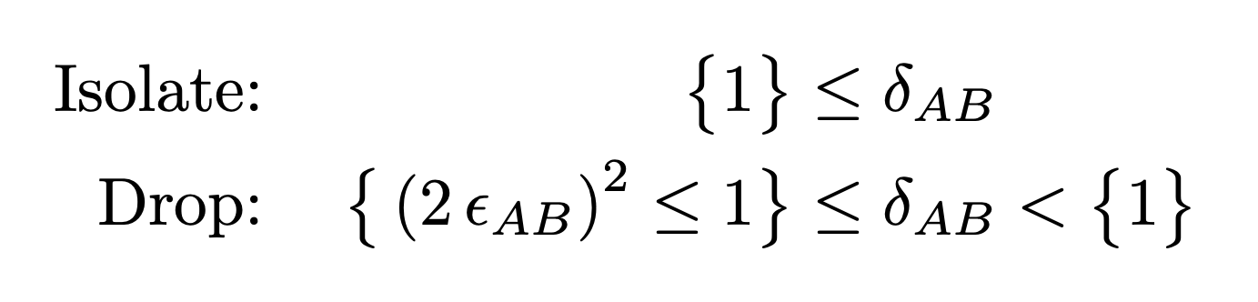
Dropping vs. Isolating
There are two distinct ways to fail the filtering criterion, to be handled differently
The scale disparity can be too extreme (soft radiation) at O(1) angular separation
In this case the metric product is small … DROP
Or, the angular separation can be too large (wide angle) with comparable scales
In this case the metric product is large … ISOLATE
This formalizes the intuition that substructure can be isolated by transitions across absolute numerical boundaries in the measure

Slide 23
Hadronic TTbar Scale-Invariant Clustering with Filtering

Slide 24
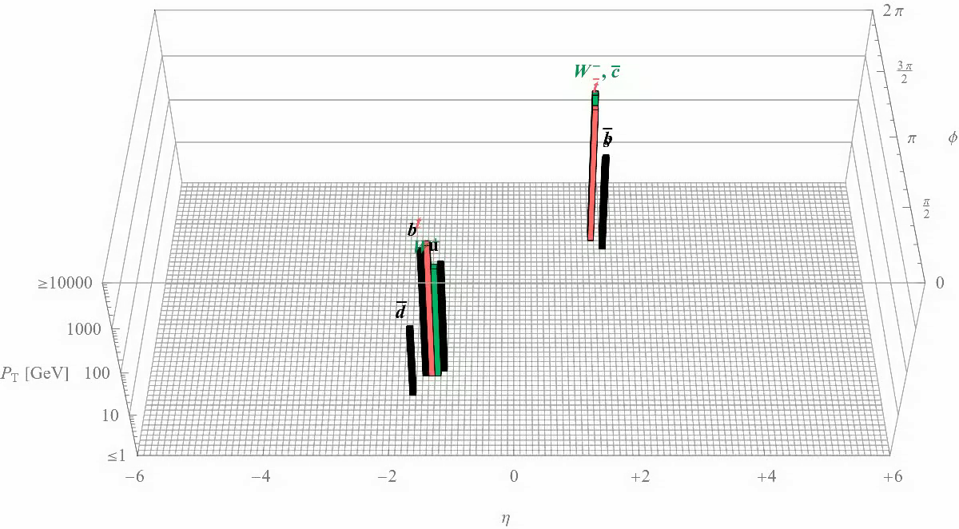
Lepton to TTbar 2.5 TeV SIFT Filtered Clustering with Ghosts

Slide 25

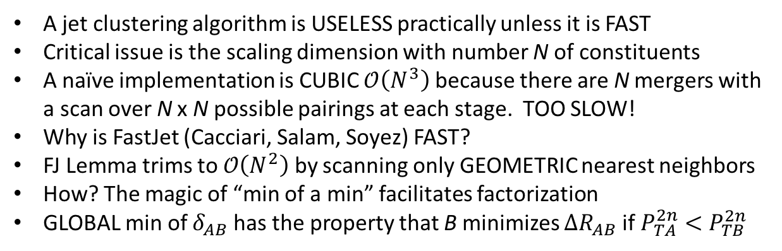
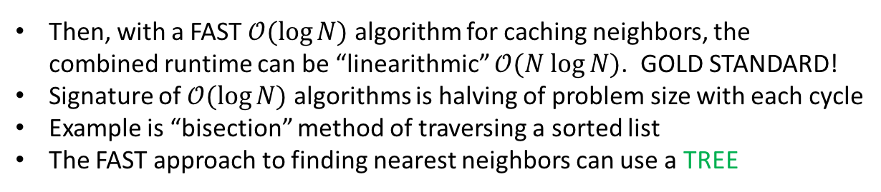
SIFT: Scale-Invariant Filter TREE
A jet clustering algorithm is USELESS practically unless it is FAST
Critical issue is the scaling dimension with number N of constituents
A naïve implementation is CUBIC $𝒪\left(N^{3}\right)$ because there are N mergers with a scan over N x N possible pairings at each stage. TOO SLOW!
Why is FastJet (Cacciari, Salam, Soyez) FAST?
FJ Lemma trims to $𝒪\left(N^{2}\right)$ by scanning only GEOMETRIC nearest neighbors
How? The magic of “min of a min” facilitates factorization
GLOBAL min of $δ_{AB}$ has the property that B minimizes $ΔR_{AB}$ if $P_{TA}^{2n}<P_{TB}^{2n}$
$δ_{AB}≡min⁡(P_{TA}^{2n},P_{TB}^{2n}$) $×{\left(\frac{ΔR_{AB}}{R_{0}}\right)}^{2}$
Then, with a FAST $𝒪(\log{N)}$ algorithm for caching neighbors, the combined runtime can be “linearithmic” $𝒪(N log{N)}$. GOLD STANDARD!
Signature of $𝒪(\log{N)}$ algorithms is halving of problem size with each cycle
Example is “bisection” method of traversing a sorted list
The FAST approach to finding nearest neighbors can use a TREE

Slide 26
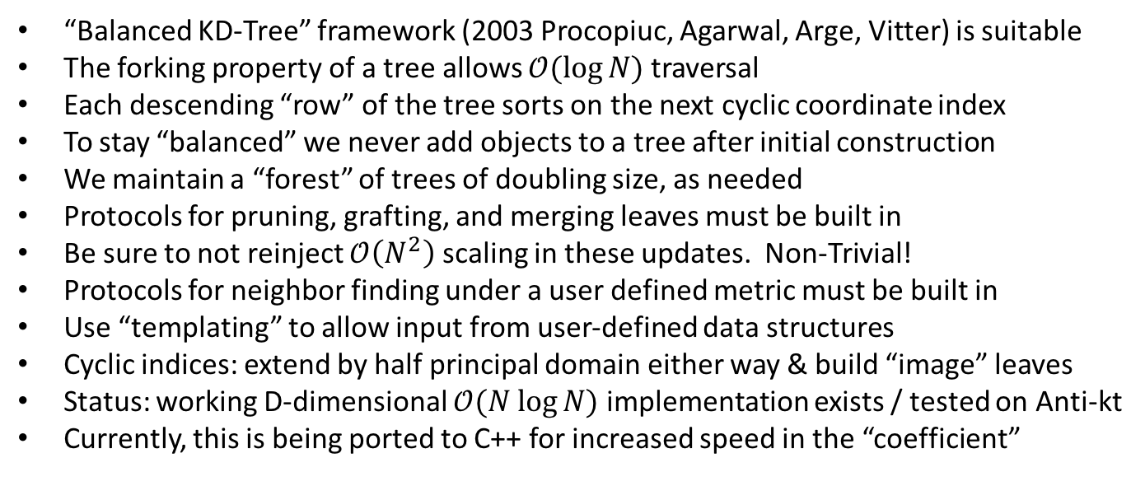
Building an D-Dimensional Tree
“Balanced KD-Tree” framework (2003 Procopiuc, Agarwal, Arge, Vitter) is suitable
The forking property of a tree allows $𝒪(\log{N)}$ traversal
Each descending “row” of the tree sorts on the next cyclic coordinate index
To stay “balanced” we never add objects to a tree after initial construction
We maintain a “forest” of trees of doubling size, as needed
Protocols for pruning, grafting, and merging leaves must be built in
Be sure to not reinject $𝒪\left(N^{2}\right)$ scaling in these updates. Non-Trivial!
Protocols for neighbor finding under a user defined metric must be built in
Use “templating” to allow input from user-defined data structures
Cyclic indices: extend by half principal domain either way & build “image” leaves
Status: working D-dimensional $𝒪(N log{N)}$ implementation exists / tested on Anti-kt
Currently, this is being ported to C++ for increased speed in the “coefficient”

Slide 27
Conclusions and Ongoing Work
SIFT is a SCALE INVARIANT clustering algorithm designed specifically for substructure
FILTER-ing of soft and wide-angle radiation can be done as the jet is clustered
Organization of the data structure in a balanced TREE can make clustering fast
The clustering history holds information – it may be better to not halt at all.
Could the algorithm be useful with existing fat jets for exclusive clustering?
What is the jet-energy resolution width, and does it vary with P_{T}?
How does SIFT fare with resiliency to heavy pileup?
What is the mass resolution of reconstructed particles?
Is the distilled clustering history amenable to machine learning applications?
Can SIFT intrinsically confront the problem of tagging boosted objects?
Does SIFT smoothly navigate the TRANSITION into the Boosted Regime?

Slide 28
Thank You
Full resolution videos are zipped up on Indico
Mathematica movie-generating notebook is available by request to jwalker@shsu.edu

