Slide 1

CMB Distortions From an Axion-Dark Photon-Photon Interaction
Clayton Ristow
Collaborators: Anson Hook and Gustavo Marques-Tavares
Email: cristow@umd.edu

Slide 2




Probing Axion Dark Matter
Dark Sector
Dark Matter:
Axion $φ$
Dark Photon $A_{D}^{μ}$
${10}^{−22}eV<m_{a}<{10}^{−13}eV$
$m_{D}<{10}^{−7}$ eV

Slide 3





Probing Axion Dark Matter
Dark Sector
Dark Matter:
Axion $φ$
Dark Photon $A_{D}^{μ}$
${10}^{−22}eV<m_{a}<{10}^{−13}eV$
$m_{D}<{10}^{−7}$ eV
Lowest order coupling:
$$γ$$
$$γ_{D}$$
$ℒ⊃\frac{φ}{2f_{a}}{\tilde{F}}_{μν }^{D}F^{μν}$where ${\tilde{F}}_{μν }^{D}=\frac{1}{2}ε_{μναβ}F^{αβ}$
$$a$$

Slide 4
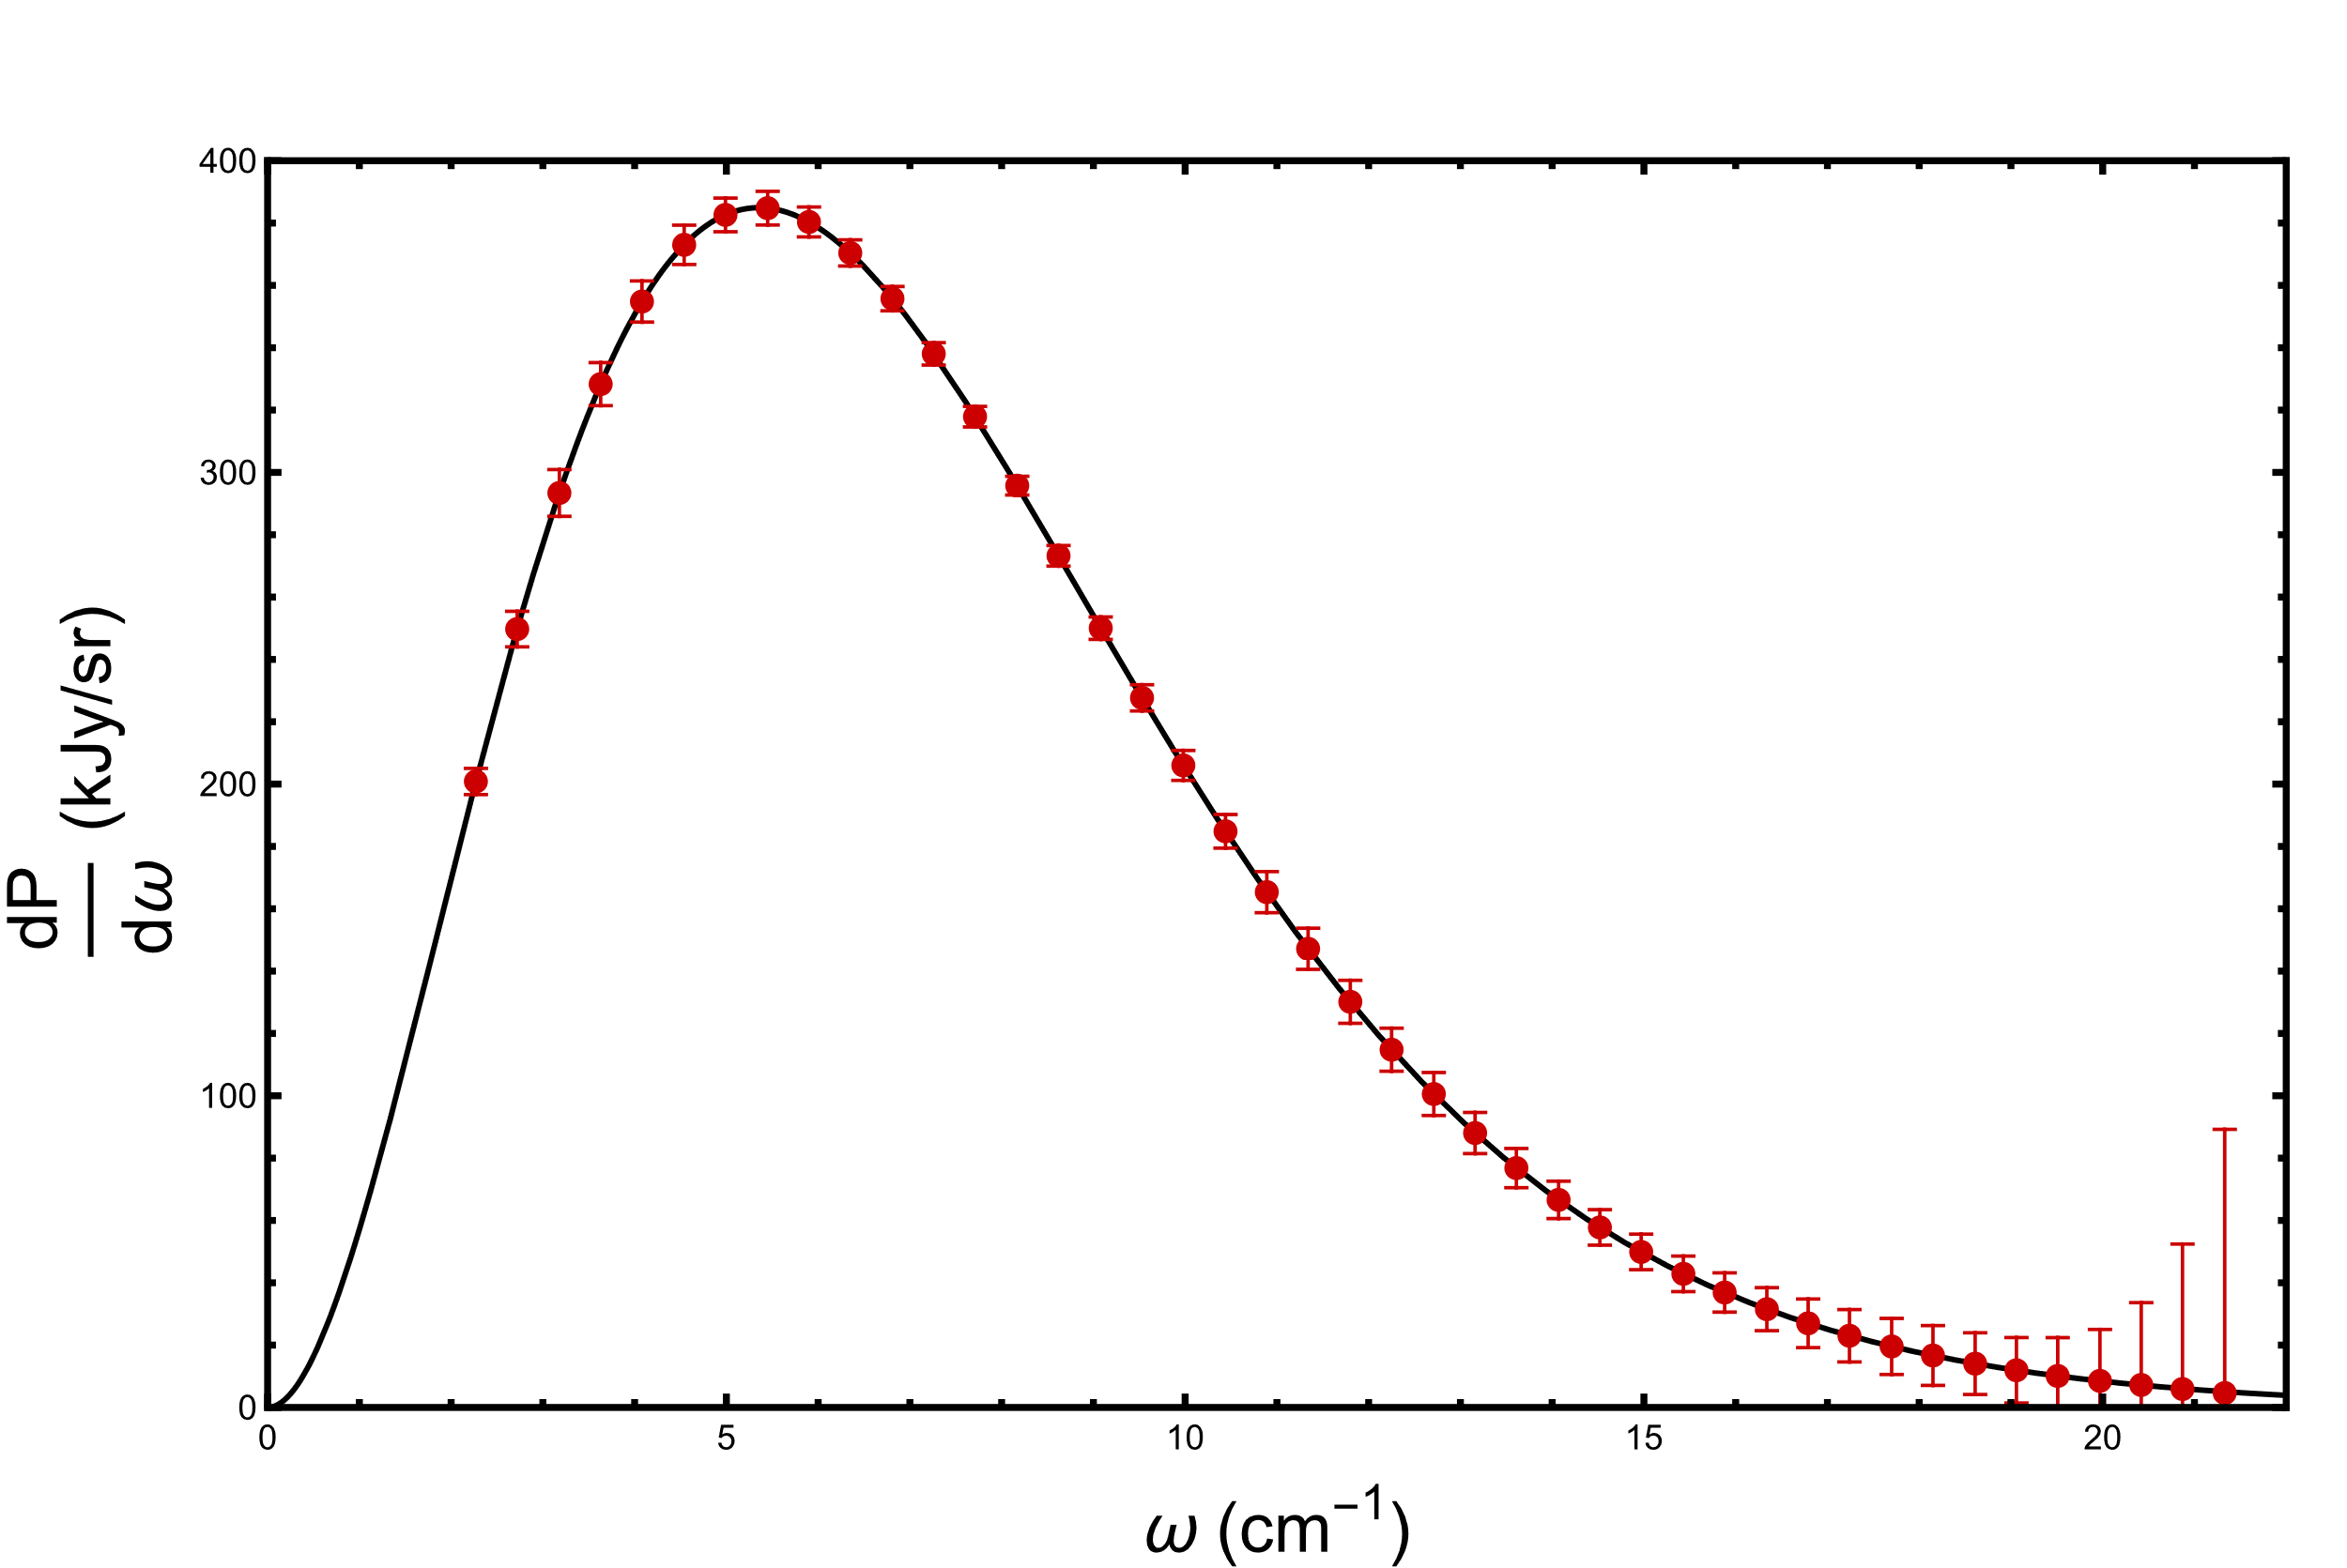
Cosmic Microwave Background (CMB)
FIRAS: CMB Monopole Spectrum
Fixsen et al. 1996, Astrophysical Journal, 473, 576

Slide 5


Cosmic Microwave Background (CMB)
FIRAS: CMB Monopole Spectrum
$$∗$$
Power spectrum matches perfect blackbody to ${10}^{−4}−{10}^{−5}$ precission
Any effect that would cause a deviation is highly constrained
$∗_{Error bars are increased by a factor of 300}$
Fixsen et al. 1996, Astrophysical Journal, 473, 576

Slide 6



CMB Distortion
$$γ$$
$$γ_{D}$$
$$a$$

Slide 7



CMB Distortion
$$γ$$
$$γ_{D}$$
$$a$$
$$z$$
$${10}^{3}$$
$$0$$

Slide 8
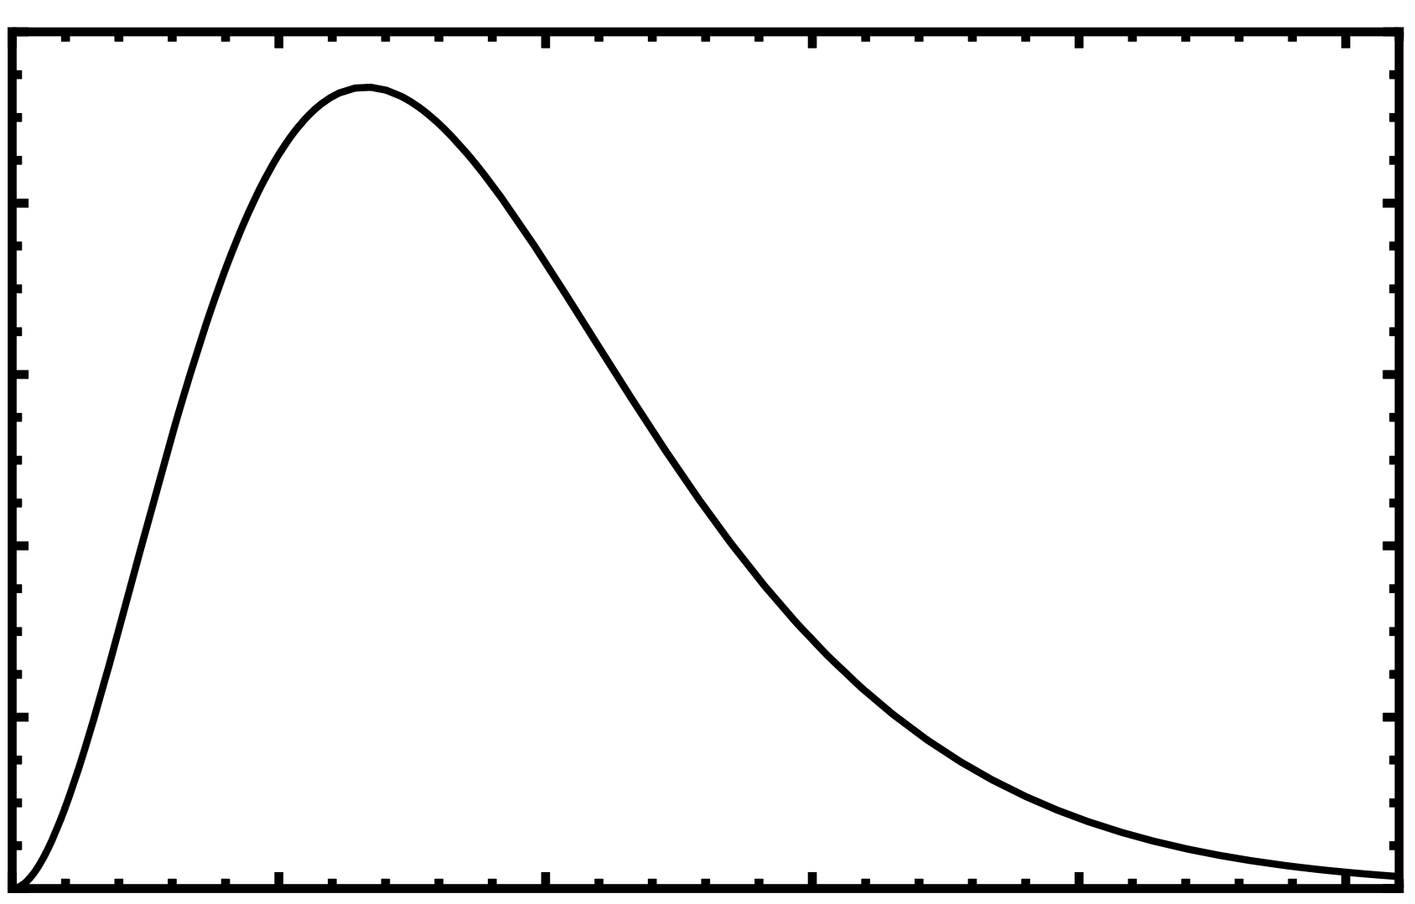
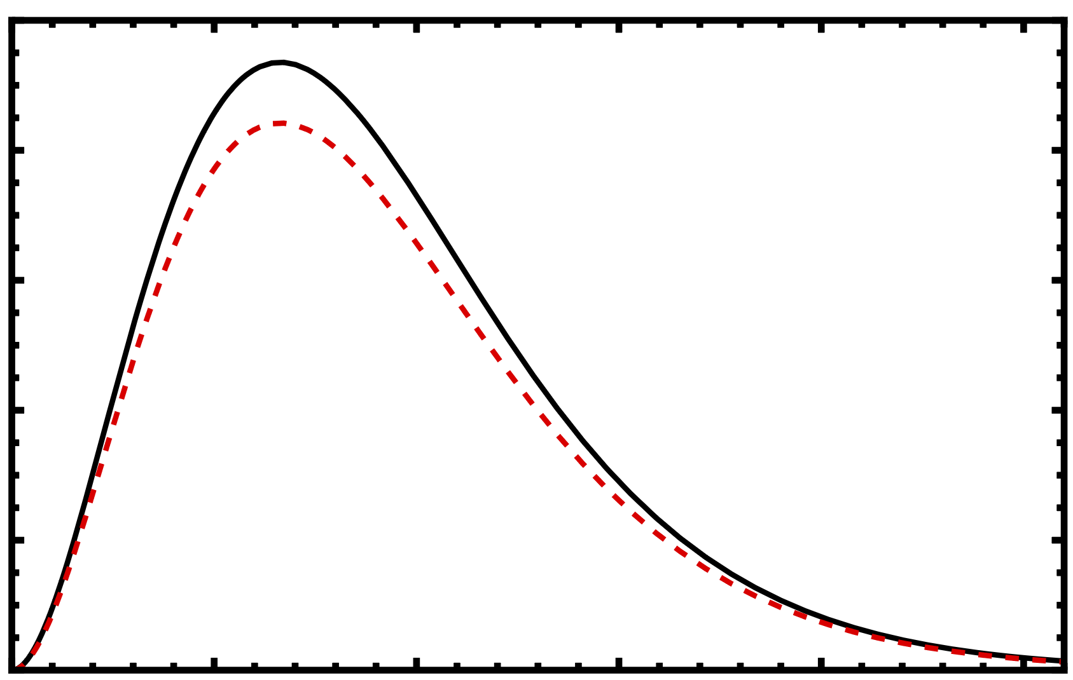




CMB Distortion
$$γ$$
$$γ_{D}$$
$$a$$
$$z$$
$${10}^{3}$$
$$0$$
$$\frac{dP}{dω}$$
$$P_{0}$$
$$P_{reduced}$$
$$ω$$
$$P_{reduced}\left(ω\right)=P_{0}(ω)(1−ε\left(ω\right))$$

Slide 9


CMB Distortion
$$γ$$
$$γ_{D}$$
$$a$$
$$z$$
$${10}^{3}$$
$$0$$
$$\frac{dP}{dω}$$
$$P_{0}$$
$ε(ω)$ is the proportion of photons lost in each mode $ω$
$$P_{reduced}$$
$$ε\left(ω\right)=\frac{n_{D}\left(ω\right)}{n_{γ}\left(ω\right)}=\frac{ \overline{{\left|{\tilde{A}}_{D}\left(ω\right)\right|}^{2}} }{\overline{{\left|\tilde{A}\left(ω\right)\right|}^{2}}}$$
$$ω$$
$$P_{reduced}\left(ω\right)=P_{0}(ω)(1−ε\left(ω\right))$$

Slide 10
Equations of Motion
FRLW Expanding Universe: $ds^{2}=dt^{2}−a^{2}\left(t\right)dx^{2}=a^{2}(η)(dη^{2}−dx^{2})$

Slide 11

Equations of Motion
FRLW Expanding Universe: $ds^{2}=dt^{2}−a^{2}\left(t\right)dx^{2}=a^{2}(η)(dη^{2}−dx^{2})$
$$∂^{μ}F_{μν}+a^{2}\left(η\right)m_{γ}^{2}\left(η\right)A_{ν}=−\frac{1}{f_{a}}∂^{μ}φ{\tilde{F}}_{μν}^{D}$$
$$∂^{μ}F_{μν}^{D}+a^{2}\left(η\right)m_{D}^{2}A_{ν}^{D}=−\frac{1}{f_{a}}∂^{μ}φ{\tilde{F}}_{μν}$$
$$∂_{μ}∂^{μ}φ+2H\left(η\right)∂_{η}φ+a^{2}\left(η\right)m_{a}^{2}φ=−\frac{1}{2f_{a}}F^{μν}{\tilde{F}}_{μν}^{D}$$

Slide 12


Equations of Motion
FRLW Expanding Universe: $ds^{2}=dt^{2}−a^{2}\left(t\right)dx^{2}=a^{2}(η)(dη^{2}−dx^{2})$
$$∂^{μ}F_{μν}+a^{2}\left(η\right)m_{γ}^{2}\left(η\right)A_{ν}=−\frac{1}{f_{a}}∂^{μ}φ{\tilde{F}}_{μν}^{D}$$
$$∂^{μ}F_{μν}^{D}+a^{2}\left(η\right)m_{D}^{2}A_{ν}^{D}=−\frac{1}{f_{a}}∂^{μ}φ{\tilde{F}}_{μν}$$
$$∂_{μ}∂^{μ}φ+2H\left(η\right)∂_{η}φ+a^{2}\left(η\right)m_{a}^{2}φ=−\frac{1}{2f_{a}}F^{μν}{\tilde{F}}_{μν}^{D}$$
$A_{D}$ is first order in $\frac{1}{f_{a}}$
Changes in $A$ and $φ$ are second order in $\frac{1}{f_{a}}$

Slide 13


Equations of Motion
FRLW Expanding Universe: $ds^{2}=dt^{2}−a^{2}\left(t\right)dx^{2}=a^{2}(η)(dη^{2}−dx^{2})$
$$∂^{μ}F_{μν}+a^{2}\left(η\right)m_{γ}^{2}\left(η\right)A_{ν}=−\frac{1}{f_{a}}∂^{μ}φ{\tilde{F}}_{μν}^{D}$$
$$∂^{μ}F_{μν}^{D}+a^{2}\left(η\right)m_{D}^{2}A_{ν}^{D}=−\frac{1}{f_{a}}∂^{μ}φ{\tilde{F}}_{μν}$$
$$∂_{μ}∂^{μ}φ+2H\left(η\right)∂_{η}φ+a^{2}\left(η\right)m_{a}^{2}φ=−\frac{1}{2f_{a}}F^{μν}{\tilde{F}}_{μν}^{D}$$
$A_{D}$ is first order in $\frac{1}{f_{a}}$
Changes in $A$ and $φ$ are second order in $\frac{1}{f_{a}}$
Treat the photon and axion as static backgrounds
Solve for $A_{D}$ using Greens functions
$ε\left(|k|\right)=\frac{ \overline{{\left|{\tilde{A}}_{D}\left(|k|\right)\right|}^{2}} }{\overline{{\left|\tilde{A}\left(|k|\right)\right|}^{2}}}=\frac{1}{4f_{a}^{2}}$ ${\left|\int_{t_{0}}^{t}{dt}e^{i\int_{t_{0}}^{t^{′}}{d\tilde{t}}\left(ω_{D}\left(\tilde{t}\right)−ω_{γ}\left(\tilde{t}\right)\right)}∂_{t}φ\left(t^{′}\right)\right|}^{2}$

Slide 14





Limits of the distortion
$ε\left(|k|\right)=\frac{1}{4f_{a}^{2}}$ ${\left|\int_{t_{0}}^{t}{dt′}e^{i\int_{t_{0}}^{t^{′}}{d\tilde{t}}\left(ω_{D}\left(\tilde{t}\right)−ω_{γ}\left(\tilde{t}\right)\right)}∂_{t}φ\left(t^{′}\right)\right|}^{2}$
Oscillates at:
$$ω_{D}−ω_{γ}$$
$$m_{a}$$
Axion is nonrelativistic:
$$φ(x)=\frac{φ_{0}}{a^{3/2}(t)}\cos{(m_{a}t+β)}$$
Photon and Dark Photon are relativistic:
$$ω_{D}−ω_{γ}≈\frac{a(t)}{2\left|k\right|}\left(m_{D}^{2}−m_{γ}^{2}\left(t\right)\right)$$

Slide 15



Limits of the distortion
$ε\left(|k|\right)=\frac{1}{4f_{a}^{2}}$ ${\left|\int_{t_{0}}^{t}{dt′}e^{i\int_{t_{0}}^{t^{′}}{d\tilde{t}}\left(ω_{D}\left(\tilde{t}\right)−ω_{γ}\left(\tilde{t}\right)\right)}∂_{t}φ\left(t^{′}\right)\right|}^{2}$
Oscillates at:
$$ω_{D}−ω_{γ}$$
$$m_{a}$$
Axion is nonrelativistic:
$$φ(x)=\frac{φ_{0}}{a^{3/2}(t)}\cos{(m_{a}t+β)}$$
Photon and Dark Photon are relativistic:
$$ω_{D}−ω_{γ}≈\frac{a(t)}{2\left|k\right|}\left(m_{D}^{2}−m_{γ}^{2}\left(t\right)\right)$$
Limit 1: $m_{a}≫\left|ω_{D}−ω_{γ}\right|$:
Exponential is constant
$$ε\left(|k|\right)=\frac{φ_{0}^{2}}{8f_{a}^{2}a_{∗}^{3}}=\frac{ρ_{DM}}{4 f_{a}^{2}m_{a}^{2}a_{∗}^{3}}$$
The bound on $\frac{1}{f_{a}}$ will scale as $m_{a}$

Slide 16



Limits of the distortion
$ε\left(|k|\right)=\frac{1}{4f_{a}^{2}}$ ${\left|\int_{t_{0}}^{t}{dt′}e^{i\int_{t_{0}}^{t^{′}}{d\tilde{t}}\left(ω_{D}\left(\tilde{t}\right)−ω_{γ}\left(\tilde{t}\right)\right)}∂_{t}φ\left(t^{′}\right)\right|}^{2}$
Oscillates at:
$$ω_{D}−ω_{γ}$$
$$m_{a}$$
Axion is nonrelativistic:
$$φ(x)=\frac{φ_{0}}{a^{3/2}(t)}\cos{(m_{a}t+β)}$$
Photon and Dark Photon are relativistic:
$$ω_{D}−ω_{γ}≈\frac{a(t)}{2\left|k\right|}\left(m_{D}^{2}−m_{γ}^{2}\left(t\right)\right)$$
Limit 1: $m_{a}≫\left|ω_{D}−ω_{γ}\right|$:
$$1/f_{a}$$
Exponential is constant
$$ε\left(|k|\right)=\frac{φ_{0}^{2}}{8f_{a}^{2}a_{∗}^{3}}=\frac{ρ_{DM}}{4 f_{a}^{2}m_{a}^{2}a_{∗}^{3}}$$
$$m_{a}≫\left|ω_{D}−ω_{γ}\right|$$
The bound on $\frac{1}{f_{a}}$ will scale as $m_{a}$
$$m_{a}$$

Slide 17




Limits of the distortion
$ε\left(|k|\right)=\frac{1}{4f_{a}^{2}}$ ${\left|\int_{t_{0}}^{t}{dt′}e^{i\int_{t_{0}}^{t^{′}}{d\tilde{t}}\left(ω_{D}\left(\tilde{t}\right)−ω_{γ}\left(\tilde{t}\right)\right)}∂_{t}φ\left(t^{′}\right)\right|}^{2}$
Oscillates at:
$$ω_{D}−ω_{γ}$$
$$m_{a}$$
Axion is nonrelativistic:
$$φ(x)=\frac{φ_{0}}{a^{3/2}(t)}\cos{(m_{a}t+β)}$$
Photon and Dark Photon are relativistic:
$$ω_{D}−ω_{γ}≈\frac{a(t)}{2\left|k\right|}\left(m_{D}^{2}−m_{γ}^{2}\left(t\right)\right)$$
Limit 2: $m_{a}≪\left|ω_{D}−ω_{γ}\right|$:
$$1/f_{a}$$
Axion is constant
$$m_{a}≪\left|ω_{D}−ω_{γ}\right|$$
$$ε\left(|k|\right)=\frac{ρ_{DM}}{4 f_{a}^{2}a_{∗}^{3}{\left(ω_{D}−ω_{γ}\right)}^{2}}$$
$$m_{a}≫\left|ω_{D}−ω_{γ}\right|$$
The bound on $\frac{1}{f_{a}}$ in independent of $m_{a}$
$$m_{a}$$

Slide 18

Limits of the distortion
$ε\left(|k|\right)=\frac{1}{4f_{a}^{2}}$ ${\left|\int_{t_{0}}^{t}{dt′}e^{i\int_{t_{0}}^{t^{′}}{d\tilde{t}}\left(ω_{D}\left(\tilde{t}\right)−ω_{γ}\left(\tilde{t}\right)\right)}∂_{t}φ\left(t^{′}\right)\right|}^{2}$
Oscillates at:
$$ω_{D}−ω_{γ}$$
$$m_{a}$$
Axion is nonrelativistic:
$$φ(x)=\frac{φ_{0}}{a^{3/2}(t)}\cos{(m_{a}t+β)}$$
Photon and Dark Photon are relativistic:
$$ω_{D}−ω_{γ}≈\frac{a(t)}{2\left|k\right|}\left(m_{D}^{2}−m_{γ}^{2}\left(t\right)\right)$$
Limit 2: $m_{a}≪\left|ω_{D}−ω_{γ}\right|$:
$$1/f_{a}$$
Axion is constant
$$m_{a}≪\left|ω_{D}−ω_{γ}\right|$$
$$ε\left(|k|\right)=\frac{ρ_{DM}}{4 f_{a}^{2}a_{∗}^{3}{\left(ω_{D}−ω_{γ}\right)}^{2}}$$
$$m_{a}≫\left|ω_{D}−ω_{γ}\right|$$
$$???$$
The bound on $\frac{1}{f_{a}}$ in independent of $m_{a}$
$$m_{a}$$

Slide 19
Limits of the distortion: Resonance
$ε\left(|k|\right)=\frac{1}{4f_{a}^{2}}$ ${\left|\int_{t_{0}}^{t}{dt′}e^{i\int_{t_{0}}^{t^{′}}{d\tilde{t}}\left(ω_{D}\left(\tilde{t}\right)−ω_{γ}\left(\tilde{t}\right)\right)}∂_{t}φ\left(t^{′}\right)\right|}^{2}$
Oscillates at:
$$ω_{D}−ω_{γ}$$
$$m_{a}$$
$$1/f_{a}$$
$$m_{a}≪\left|ω_{D}−ω_{γ}\right|$$
$$m_{a}≫\left|ω_{D}−ω_{γ}\right|$$
$$???$$
$$m_{a}$$

Slide 20









Limits of the distortion: Resonance
$ε\left(|k|\right)=\frac{1}{4f_{a}^{2}}$ ${\left|\int_{t_{0}}^{t}{dt′}e^{i\int_{t_{0}}^{t^{′}}{d\tilde{t}}\left(ω_{D}\left(\tilde{t}\right)−ω_{γ}\left(\tilde{t}\right)\right)}∂_{t}φ\left(t^{′}\right)\right|}^{2}$
$$\left|ω_{D}−ω_{γ}\right|≈m_{a}$$
Oscillates at:
$$ω_{D}−ω_{γ}$$
$$m_{a}$$
$$γ$$
$$γ_{D}$$
$$ω_{D}−ω_{γ}$$
$$m_{a}$$
$$γ_{D}$$
$$γ$$
$$a$$
$$a$$
Single particle absorption/emission
Driven SHO Analogy: Axion drives conversion at the resonant frequency
$$1/f_{a}$$
$$m_{a}≪\left|ω_{D}−ω_{γ}\right|$$
$$m_{a}≫\left|ω_{D}−ω_{γ}\right|$$
$$???$$
$$m_{a}$$

Slide 21



Limits of the distortion: Resonance
$ε\left(|k|\right)=\frac{1}{4f_{a}^{2}}$ ${\left|\int_{t_{0}}^{t}{dt′}e^{i\int_{t_{0}}^{t^{′}}{d\tilde{t}}\left(ω_{D}\left(\tilde{t}\right)−ω_{γ}\left(\tilde{t}\right)\right)}∂_{t}φ\left(t^{′}\right)\right|}^{2}$
$$\left|ω_{D}−ω_{γ}\right|≈m_{a}$$
Oscillates at:
$$ω_{D}−ω_{γ}$$
$$m_{a}$$
$$γ$$
$$γ_{D}$$
$$ω_{D}−ω_{γ}$$
$$m_{a}$$
$$γ_{D}$$
$$γ$$
$$a$$
$$a$$
Single particle absorption/emission
Driven SHO Analogy: Axion drives conversion at the resonant frequency
$$ε_{res}\left(|k|\right)\sim \frac{ρ_{DM} }{f_{a}^{2}H|ω_{D}−ω_{γ}|}=\frac{ρ_{DM} }{f_{a}^{2}Hm_{a}}$$
$$1/f_{a}$$
$$\frac{ε_{res}\left(|k|\right)}{ε_{non−res}\left(|k|\right)}=\frac{m_{a}}{H}≳\frac{{10}^{−19}eV}{{10}^{−29}eV}={10}^{10}$$
$$m_{a}≪\left|ω_{D}−ω_{γ}\right|$$
$$m_{a}≫\left|ω_{D}−ω_{γ}\right|$$
Resonance can enhance conversation to dark photons by factors $≳ {10}^{10}$!
$$m_{a}$$

Slide 22
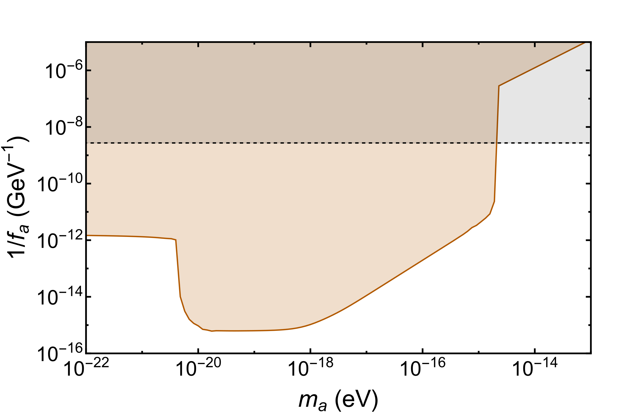

Bounds on Coupling
White Dwarf
CMB
$m_{D}={10}^{−9}$eV
White Dwarf Bound: A. Hook, G. Marques-Tavares and C. Ristow, JHEP 06, 167 (2021)

Slide 23
Thanks
Conclusion
Interactions that couple photons to dark matter (axion) and another dark sector particle (dark photon) can be highly constrained by CMB monopole spectrum
Careful treatment of the various effects (expanding universe, plasma) is necessary and can improve naïve bounds by several orders of magnitude
Anson Hook and Gustavo Marques-Tavares
University of Maryland, MCFP, NSF
PHENO 2022 and the University of Pittsburgh

Slide 24
Backup Slides

Slide 25
















Coupling
Start with Axion $(φ)$, Photon $(A)$, Dark Photon $(A_{D})$, and heavy Fermion $\left(ψ\right)$
Axion is CP odd:
$$γ$$
$$γ_{D}$$
$$γ$$
$$a$$
$$a$$
$$a$$
$$γ_{D}$$
$$γ_{D}$$
$$γ$$
Axion is odd under $C_{D}$ (Dark Charge Conjugation) $→$ only middle diagram survives and kinetic mixing is forbidden
$$γ$$
$$γ$$
Integrate out heavy fermion
$$a$$
$$a$$
$$γ_{D}$$
$$γ_{D}$$
$ℒ⊃\frac{φ}{2f_{a}}{\tilde{F}}_{μν }^{D}F^{μν}$where ${\tilde{F}}_{μν }^{D}=\frac{1}{2}ε_{μναβ}F^{αβ}$
Kunio Kaneta, Hye-Sung Lee, and Seokhoon Yun Phys.Rev.Lett. 118 (2017) 10, 101802

Slide 26

Plasma Effects
Plasma effects change photon dispersion and polarization and give rise to a potential longitudinal polarization (plasmon)
Plasma effects are characterized by scale, $ω_{p}\sim \sqrt{\frac{n_{e}}{m_{e}}}$
Plasma frequency is largest at recombination: $ω_{p}≲{10}^{−10}$ eV
Photon momenta is smallest at the present day: $ω_{γ}≳{10}^{−4}$ eV
We are always working in the limit $ω_{γ}≫ω_{p}$. In this limit:
Longitudinal polarizations (plasmons) are forbidden from propagating
Polarization renormalizations reduce to 1
The effective dispersion is
$$ω_{γ}^{2}−{\left|k\right|}^{2}=m_{γ}^{2} where ω_{p}^{2}=m_{γ}^{2}$$
E. Braaten and D. Segel, Phys. Rev. D 48 (1993) 1478–1491

Slide 27






Frequency dependence of distortions
How do the distortions depend on photon momentum |k|?
$m_{a}≫\left|ω_{D}−ω_{γ}\right|$ $: ε\left(|k|\right)=\frac{ρ_{DM}}{4 f_{a}^{2}m_{a}^{2}a_{∗}^{3}}$
$m_{a}≪\left|ω_{D}−ω_{γ}\right|$ $:ε\left(|k|\right)=\frac{ρ_{DM}}{4 f_{a}^{2}a_{∗}^{3}{\left(ω_{D}−ω_{γ}\right)}^{2}}$
Resonant Region: $ε\left(|k|\right)=\frac{ρ_{DM}}{8 f_{a}^{2}a_{res}^{3} Hm_{a}}$
$ε\left(|k|\right)$ is independent of $|k|$
$$ω_{D}−ω_{γ} \sim \frac{Δm^{2}}{\left|k\right|}$$
$$ε\left(|k|\right) \sim {\left|k\right|}^{2}$$
|k| dependence is found by determining where resonance happened
$$m_{a}=Δω\left(a_{res}\right)=\frac{a_{res}}{\left|k\right|}Δm^{2}$$
$$a_{res}=\frac{\left|k\right|m_{a}}{Δm^{2}}$$
Matter Domination: $H\sim a^{−3/2}$
$$ε_{res}\left(|k|\right) \sim a_{res}^{−3/2} \sim {\left|k\right|}^{−3/2}$$

Slide 28



Green’s Functions
Fourier Transform in space,
Solve the free equations for $η>η^{′}$
Derive Boundary matching conditions from E.o.M.
Do boundary matching between the two regions
$$G_{μν}\left(x,x^{′}\right)=\int{\frac{d^{3}k}{{\left(2π\right)}^{3}}}\sum_{λ=1,2,L }{\frac{ε_{μ}^{λ}\left(k,η\right){ε^{∗}}_{ν}^{λ}\left(k,η^{′}\right)}{\sqrt{ω_{D}\left(η\right)ω_{D}\left(η^{′}\right)}}}e^{−i(\int_{η′}^{η}{\int{d\tilde{η}}ω_{D}\left(\tilde{η}\right)−k⋅(x−x^{′})})}+h.c.$$
Compare with flat space Greens Function:
$$G_{μν}\left(x,x^{′}\right)=\int{\frac{d^{3}k}{{\left(2π\right)}^{3}}}\sum_{λ=1,2,L }{\frac{ε_{μ}^{λ}\left(k\right){ε^{∗}}_{ν}^{λ}\left(k \right)}{ω_{D}}}e^{−ik⋅(x−x^{′})}+h.c$$

