Slide 1
Constraining Vector Dark Matter with Neutrino Experiments
Saurav Das
In collaboration with
Dawid Brzeminski , Anson Hook, Clayton Ristow
sauutsab[at]umd[dot]edu
hep-ph/2207:XXXXX

Slide 2
Introduction
When we think about DM detection, we think of Table-top Experiments or
Collider.
Here we will see that Neutrino experiments can be used to detect DM
if it interacts with neutrinos.
Flavor eigenstates are NOT mass eigenstates
Neutrino Oscillation

Slide 3
Introduction
For
Colliders are not sensitive to such low energy effects which makes neutrino
detectors so interesting.
Propagation through matter prefers particular flavor eigenstate
MSW Effect
Mikheyev, S.P., Smirnov, A.Y. Il Nuovo Cimento C 9, 17–26 (1986)

Slide 4
Our Model
We add a gauge boson which gauges either of the flavor lepton number difference
If is cosmological Dark Matter

Slide 5

Our Model

Slide 6

Time Average
The easiest effect to detect is time averaged response.
+
+
+
+
+
For a fixed uncertainty, limits on gets weaker for higher mass with slope 1.

Slide 7
Time Average
For heavier mass, the limits weakens much faster.

Slide 8
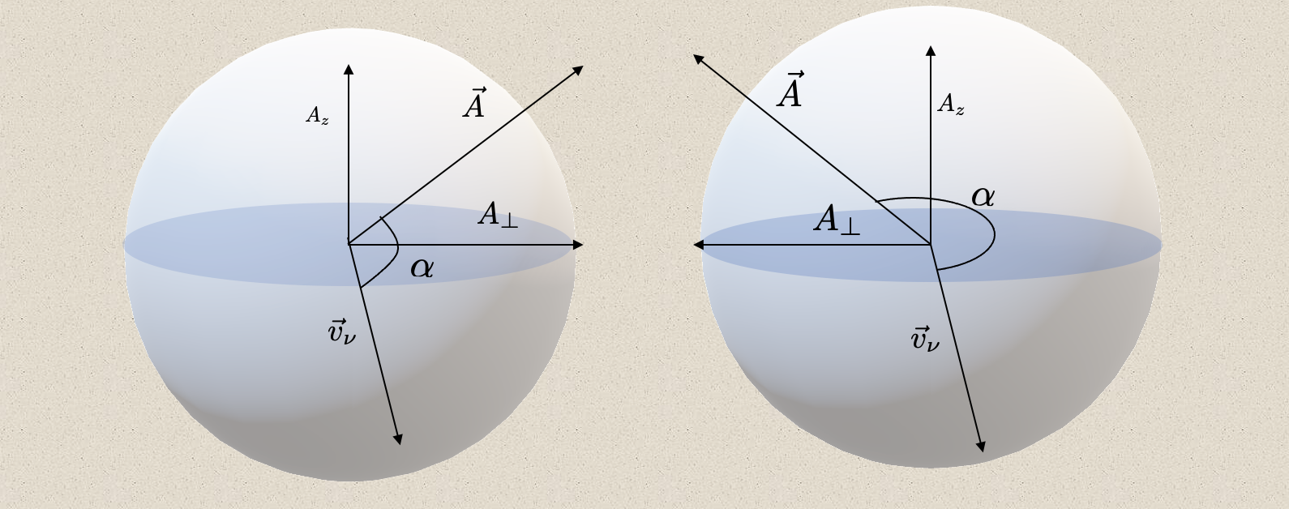


Daily Modulation

Slide 9
Daily Modulation + Time Average
Daily average picks up the polar component, not 0

Slide 10
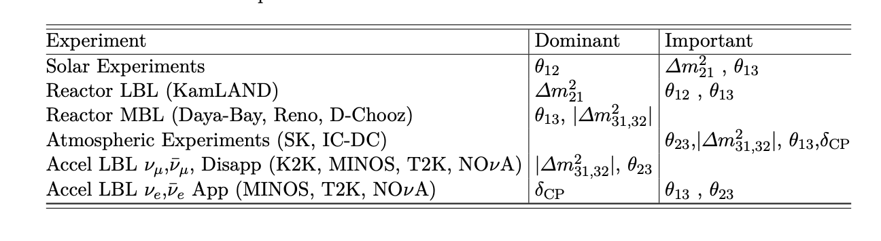
Neutrino Experiment
We prefer neutrinos with higher energy to suppress the vacuum oscillation
We want good statistics, which is hard to obtain for extragalactic neutrinos.
The best existing experiment is Super K. An exciting upcoming one is DUNE.

Slide 11
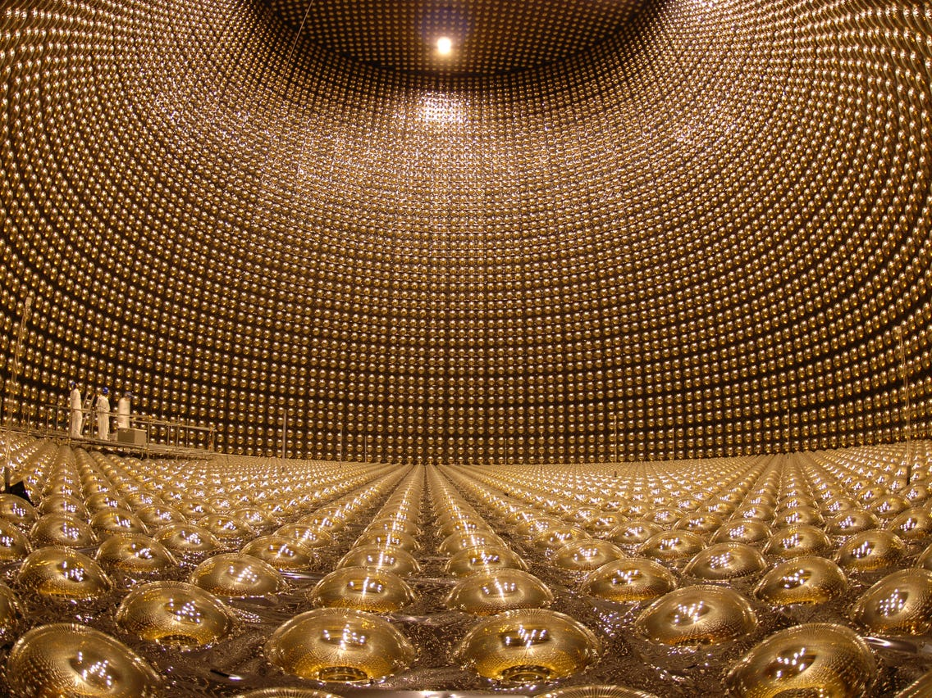
Super Kamiokande
Stainless steel tank of 50m³ ultrapure water.
Inside the tank are mounted 13000 PMTs.
Neutrinos are detected through Cherenkov radiation.
Sensitive to a wide range of neutrino energy
Suzuki, Y. The Super-Kamiokande experiment. Eur. Phys. J. C 79, 298 (2019)
Super K can observe neutrinos with energy MeV to hundres of GeV, https://link.springer.com/article/10.1140/epjc/s10052-019-6796-2

Slide 12
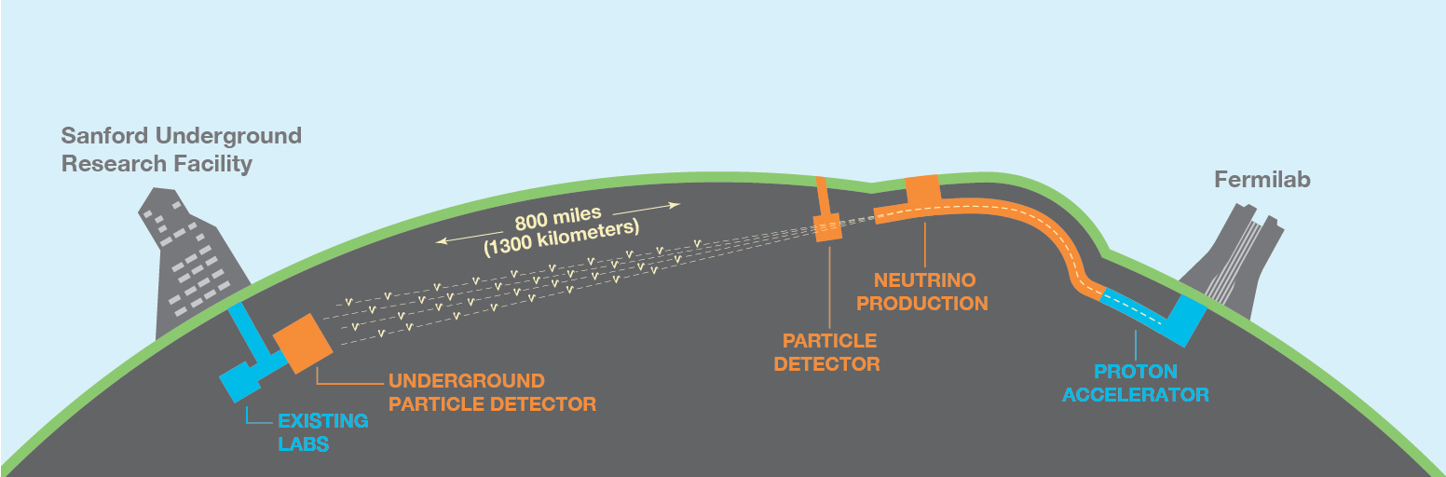
DUNE
DUNE is a neutrino experiment under construction.
At Fermilab, neutrinos are produced for decay of pions.
The far detector is located at Sanford, about 1300km away.
The far detector is sensitive to neutrinos with energy 0.5-8.0 GeV
It will observe about 2000 events over 3.5 years.
DUNE Collaboraion, arxiv 1601.05471

Slide 13
Bound
13

Slide 14
Bound

Slide 15
Summary
Neutrino experiment are sensitive to dark matter interacting with neutrinos.
Existing and upcoming neutrino experiments can constrain DM parameter space not accessible to other experiments and observations.
It would be interesting to observe the phase dependent DM effect.

Slide 16
Thank you

