Slide 1

Seattle Snowmass 2022
S.-C. Hsu
G. Watts

Slide 2
Basics Setup
Website: http://seattlesnowmass2021.net/
  Anyone can contribute changes by submitting a PR to https://github.com/gordonwatts/seattlesnowmass2021
Dates are fixed: July 17-26 (10 Days)
  Planning for ~700 people
  Flexibility to increase that up to ~1000
  Finance not well understood yet, but probably down to 500
  We are aiming for $800 per person for 10 days before any grants or sponsorship
  Private, modern dorm rooms (with private shower) close to campus, about $120 per night.
Broad Goals:
  Community Consensus
  Cross-group Collaboration
  Paper prep
  Preparing the story for the P5 hand off

Slide 3
700 People in One Place At One Time
This can’t be a (giant) zoom meeting, but in person
(plenary status reports bad?)

Slide 4
That said…
We will offer support for zoom for the larger group meetings
Smaller groups and meetings can use their own zoom links if they like
Presentations over zoom are possible
Question we’ve not answered yet, but happy to have input:
  Do we charge for zoom attendance?
  We do need to assure enough people show up to make this financially viable.

Slide 5
COVID-19 Drop Dead Date
We are already on the hook for conference organization fees
We will be on the hook for room charges, etc., sometime in late Feburary.
Many spring meetings are canceling right now
We will have to make this decision in the middle of winter when COVID-19 will likely be going through the winter surge
Please get everyone you know and their friends and their friends friends friends friends friends friends (6-degrees of separation), and David Bowie, vaccinated.
We can’t delay this a year, and if this financially falls over there will never be another big physics meeting at UW

Slide 6
What do we need to decide now(ish)?
Enough that we can ask the DOE and NSF for funding and give them a “reasonable” budget
Shape of the 2013 meeting:
  First day and last 1.5 days were plenaries
  Mornings were scheduled “formal” parallel sessions. Between 10-15 each morning
  Afternoons were panel sessions and colloquia, and lots of time for informal get togethers and meetings
    the reason people traveled
    rather than just listened on vidyo!
  Scatter through out were other things – like out reach, etc.
  Link to Snowmass 2013: https://indico.fnal.gov/event/6890/
Does this shape still make sense?

Slide 7
Functional…
First day of plenaries
  Expectation setting, getting everyone on the same page
Morning Parallel Sessions
  Frontiers, and sub-frontier working groups have reports and formal discussions.
  Status updates on whitepapers and important contributions.
Afternoons
  Small number of colloquia on ‘important questions’ – a way to bring people onto the same page
  Panel Discussions – open questions, things requiring more feedback from the community, presentations of plans that require feedback from the community
Last 1.5 day
  Frontier Reports
  “why particle physics matters”
  Invited representatives from other regions (Europe, Japan, etc.)
  Intro by the P5 committee
  Closeout

Slide 8
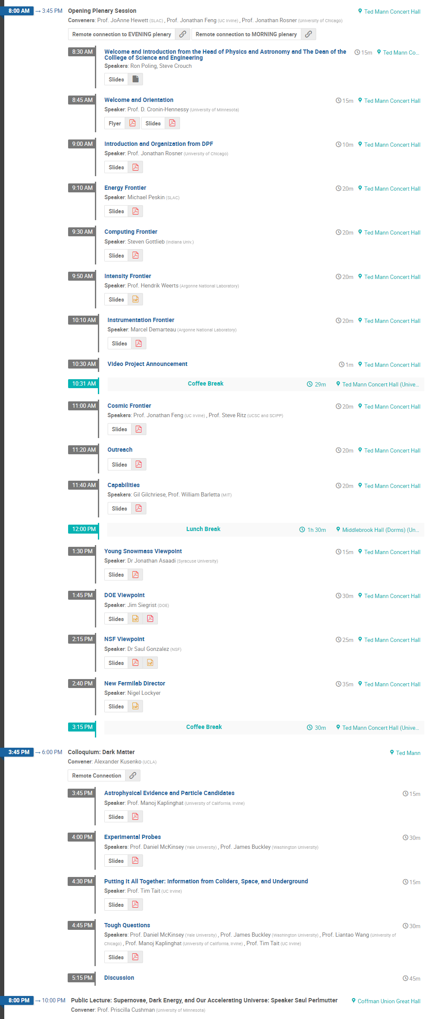
Day 1

Slide 9
Last non-Sunday Parallel Sessions
Baryon Number Violations: Panel discussions (n-nbar)
Capabilities Frontier (WP reports)
Energy Frontier: Electro weak
Energy Frontier: Flavor at High Energy
Energy Frontier: Higgs
Energy Frontier: New particles, forces, dimensions
Energy Frontier: QCD
Joint Instrumentation and Intensity Frontier
Intensity Frontier: mu to e gamma and mu to 3 e
Cosmic Frontier: Plenary (Dark matter)
Energy Fronter: Top
Instrumentation Fronter: Speed
Communication, Edu, Out: Inreach
First Day Parallel Sessions
Capabilities Frontier (all)
Computing Frontier (all)
Cosmic Frontier (CF6)
Cosmic Frontier (CF5)
Cosmic Frontier (CF3)
Cosmic Frontier (CF1 & CF4)
Cosmic Frontier (CF2)
Energy Fronter Plenary (WG reports)
Fronter Capabilities: Underground Facilities
Instrumentation Frontier Parallel (internal Meetings)
Intensity Frontier (Plenary on Phys Opp at Project X)
Theory Panel: Discussion of community issues
Joint EF and Capabilities Plenary
Communication, Edu, Outreach: Policy Makers & the Public
Advanced Network Services for Experiments

Slide 10
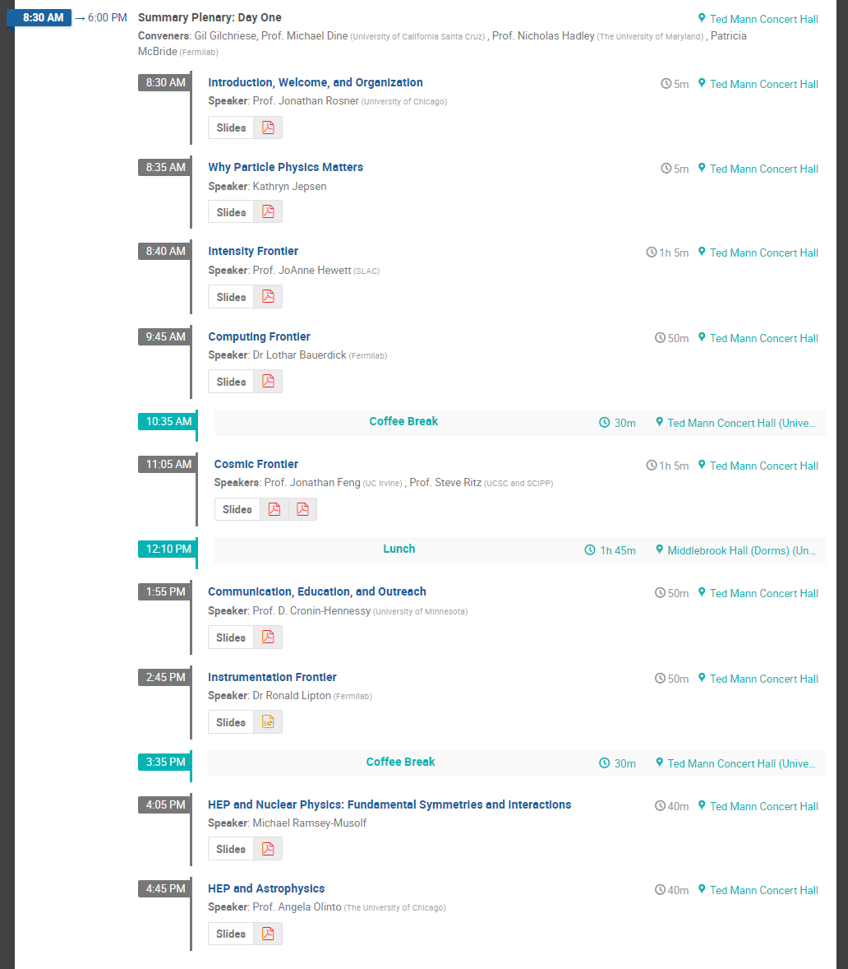
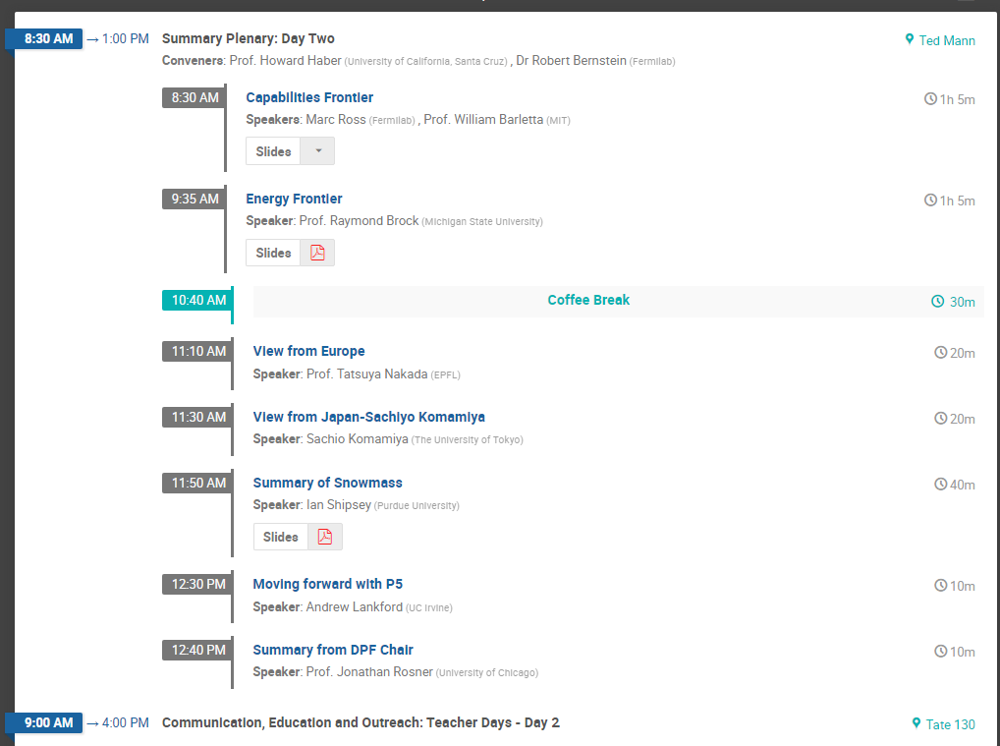
Day 9 Plenary
Day 10 Plenary

Slide 11
Other Meetings & Events at same time as Snowmass
Have some folks with access to training money
  Possibly bring students by paying for most of their costs (but not 100%)
  Then they can hang around for snowmass pretty cheaply
There is an Ann Nelson memorial workshop just before Snowmass starts
  We do not think there will be overlap on Sunday of our start
Other meetings are fine – let us know – we will have to work on financing, but in general small rooms for an afternoon aren’t expensive

