Slide 1
Borexino and the first direct detection of CNO neutrinos
Barbara Caccianiga-
INFN Milano

Slide 2
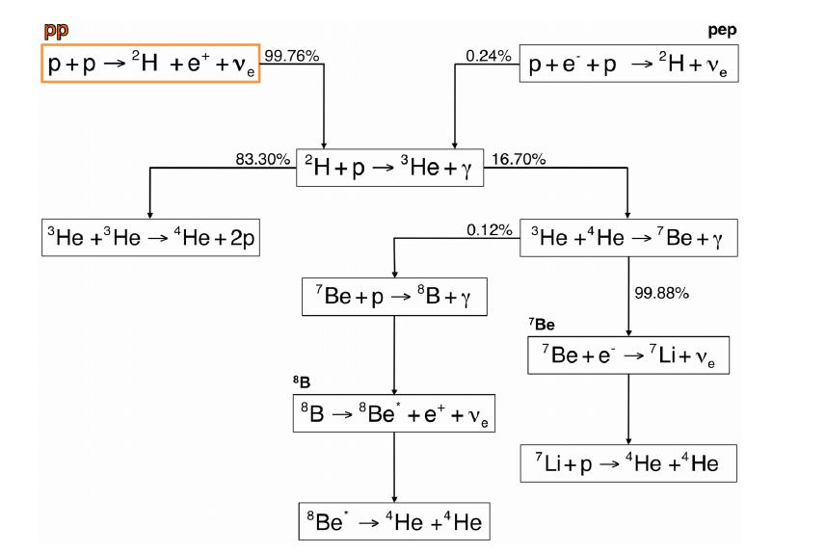
Studying Solar Neutrinos
The Sun is powered by nuclear reactions occurring in its core
4 p → α +2 e⁺ +2ν (E released ~ 26 MeV)
pp CHAIN:
~99% of the Sun energy
CNO CYCLE:
<1% of the sun energy
pp
pep
⁷Be
⁸B
Barbara Caccianiga (BX collaboration) ``Borexino and the first direct detection of CNO neutrinos’’

Slide 3
Studying Solar Neutrinos
Neutrinos propagates from the core to the surface of the Sun in few seconds and then take only 8 minutes to reach the Earth;
Unlike photons they provide a real time picture of the core of the Sun
Solar neutrino spectrum
Φ(proton-proton chain ν)
~6 x10 ¹⁰ ν /cm²/sec
Barbara Caccianiga (BX collaboration) ``Borexino and the first direct detection of CNO neutrinos’’

Slide 4
Studying Solar Neutrinos
Neutrinos propagates from the core to the surface of the Sun in few seconds and then take only 8 minutes to reach the Earth;
Unlike photons they provide a real time picture of the core of the Sun
Solar neutrino spectrum
Φ(proton-proton chain ν)
~6 x10 ¹⁰ ν /cm²/sec
Φ(CNO ν) (blue dotted line)
~5 x10 ⁸ ν /cm²/sec
Barbara Caccianiga (BX collaboration) ``Borexino and the first direct detection of CNO neutrinos’’

Slide 5
Studying Solar Neutrinos
The glorious past
Astrophysics
Original motivation of the first experiments on solar ν was to test Standard Solar Model (SSM);
Solar neutrino problem
Particle physics
Breakthrough! The solar neutrino problem provided one of the first hints towards the discovery of neutrino oscillations;
Study of the details of ν flux
Barbara Caccianiga (BX collaboration) ``Borexino and the first direct detection of CNO neutrinos’’

Slide 6
Studying Solar Neutrinos
The Borexino present
Borexino has studied extensively neutrinos from all the reactions in the Sun;
In particular, thanks to the low energy threshold it has been able of studying the most abundant pp neutrinos;
It has been able to single-out neutrinos from each different reactions, thus studying the details of the nuclear reactions powering our Sun;
It has provided the first direct measurement of neutrinos from the CNO cycle
NEW!!
Barbara Caccianiga (BX collaboration) ``Borexino and the first direct detection of CNO neutrinos’’

Slide 7
Studying Solar Neutrinos
The importance of the CNO cycle
In the Sun is subdominant; BUT
It is dominant in more massive Stars
A crucial process for energy production in the Stars;
Never observed directly;
The experimental proof of the existence of the CNO cycle is important in itself
Barbara Caccianiga (BX collaboration) ``Borexino and the first direct detection of CNO neutrinos’’

Slide 8
Studying Solar Neutrinos
The importance of the CNO cycle: the solar metallicity puzzle
Metallicity of the Sun: content of elements with Z>2;
Metallicity is a crucial input parameter of the Standard Solar Model;
Metallicity is obtained from spectroscopic measurement of the photosphere;
The most recent re-evaluation of metallicity leads to values lower than previously obtained (low-metallicity- LZ)
The Standard Solar Model which uses in input the low metallicity (LZ-SSM) gives output at odds with the measurement from helioseismology (helioseismology== study of propagation of sound waves on the Sun’s surface);
The Standard Solar Model which uses in input the older metallicity (HZ-SSM) gives output in agreement with the measurements from helioseismology;
Barbara Caccianiga (BX collaboration) ``Borexino and the first direct detection of CNO neutrinos’’

Slide 9
Studying Solar Neutrinos
The importance of the CNO cycle: the solar metallicity puzzle
The predictions for CNO neutrinos depends on the input metallicity:
Directly: CNO reactions depends directly on the content of C and N in the core of the Sun;
Indirectly: CNO reactions (as pp-chain reactions, 7Be and 8B neutrinos) depends on temperature → which in turn depends on opacity → which in turn depends on metallicity
FLUX | High Metallicity (HZ) | Low Metallicity (LZ) | DIFF. (HZ-LZ)/HZ
pp (10¹⁰ cm⁻² s⁻¹) | 5.98(1±0.006) | 6.03(1±0.005) | -0.8%
pep (10⁸ cm⁻² s⁻¹) | 1.44(1±0.01) | 1.46(1±0.009) | -1.4%
⁷Be (10⁹ cm⁻² s⁻¹) | 4.94(1±0.06) | 4.50(1±0.06) | 8.9%
⁸B (10⁶ cm⁻² s⁻¹) | 5.46(1±0.12) | 4.50(1±0.12) | 17.6%
¹³N (10⁸ cm⁻² s⁻¹) | 2.78(1±0.15) | 2.04(1±0.14) | 26.6%
¹⁵O (10⁸ cm⁻² s⁻¹) | 2.05(1±0.17) | 1.44(1±0.16) | 29.7%
¹⁷F(10⁶ cm⁻² s⁻¹) | 5.29(1±0.20) | 3.261±0.18) | 38.3%
Measuring the flux of CNO neutrinos could provide a crucial input to solve the puzzle;
Barbara Caccianiga (BX collaboration) ``Borexino and the first direct detection of CNO neutrinos’’

Slide 10
Borexino
Barbara Caccianiga (BX collaboration) ``Borexino and the first direct detection of CNO neutrinos’’

Slide 11
Borexino under the Gran Sasso mountain
Core of the detector: 300 tons of liquid scintillator (PC+PPO) contained in a nylon vessel of 4.25 m radius;
1st shield: 1000 tons of ultra-pure buffer liquid (pure PC) contained in a stainless steel sphere of 7 m radius;
2214 photomultiplier tubes pointing towards the center to view the light emitted by the scintillator;
2nd shield: 2000 tons of ultra-pure water contained in a cylindrical dome;
200 PMTs mounted on the SSS pointing outwards to detect light emitted in the water by muons crossing the detector;
Barbara Caccianiga (BX collaboration) ``Borexino and the first direct detection of CNO neutrinos’’

Slide 12
Borexino: the long story..
2007
PHASE-I
2010
2012
PHASE-II
2016
Purifications
Thermal insulation
PHASE 1 (2007-2010)
Solar neutrinos
⁷Be ν : 1st observation+ precise measurement (5%); Day/Night asymmetry;
pep ν: 1st observation;
⁸B ν with low treshold;
CNO ν: best limit;
Other
geo-ν Evidence > 4.5σ
Limit on rare processes
Study on cosmogenics
PHASE 2 (2012-2016)
Solar neutrinos
pp neutrinos (Nature 2014)
seasonal modulations (2017)
``First simultaneous precision spectroscopy of pp, 7Be and pep solar ν with Borexino Phase-II’’
New results on ⁸B neutrinos (see Davide Franco’s talk)
PHASE 3
(2016-2020)
Solar neutrinos
6 cycles of water extraction
First detection
of CNO neutrinos
Barbara Caccianiga (BX collaboration) ``Borexino and the first direct detection of CNO neutrinos’’

Slide 13
Borexino: the long story..
2007
PHASE-I
2010
2012
PHASE-II
2016
Purifications
Thermal insulation
PHASE 1 (2007-2010)
Solar neutrinos
⁷Be ν : 1st observation+ precise measurement (5%); Day/Night asymmetry;
pep ν: 1st observation;
⁸B ν with low treshold;
CNO ν: best limit;
Other
geo-ν Evidence > 4.5σ
Limit on rare processes
Study on cosmogenics
PHASE 2 (2012-2016)
Solar neutrinos
pp neutrinos (Nature 2014)
seasonal modulations (2017)
``First simultaneous precision spectroscopy of pp, 7Be and pep solar ν with Borexino Phase-II’’
New results on ⁸B neutrinos (see Davide Franco’s talk)
PHASE 3
(2016-2020)
Solar neutrinos
6 cycles of water extraction
Proton-proton
neutrinos
First detection
of CNO neutrinos
Barbara Caccianiga (BX collaboration) ``Borexino and the first direct detection of CNO neutrinos’’

Slide 14
Borexino: essential ingredients
Borexino detects neutrinos through scattering on electrons
ν_{x} + e⁻ → ν_{x} + e⁻
Barbara Caccianiga (BX collaboration) ``Borexino and the first direct detection of CNO neutrinos’’

Slide 15
Borexino: essential ingredients (1)
For each scintillation event, we record
Number of collected photons (~ 500 p.e./MeV)
Energy
Time of arrival of collected photons @ each PMT
Position
Pulse-shape discrimination
α, β⁻, β⁺
Barbara Caccianiga (BX collaboration) ``Borexino and the first direct detection of CNO neutrinos’’

Slide 16
Borexino: essential ingredients (1)
For each scintillation event, we record
Number of collected photons (~ 500 p.e./MeV)
Actually much more complicated than this:
Energy reconstruction is affected by non-linearities (for example, quenching effect) ; also it depends on position and on particle type;
σ(E) has non-Poissonian dependencies from E and also depends on position;
Position reco and resolution are also energy and position dependent;
It is crucial to be able of modeling correctly these effects (either analytically or with MonteCarlo simulations)
!
Time of arrival of collected photons @ each PMT
Barbara Caccianiga (BX collaboration) ``Borexino and the first direct detection of CNO neutrinos’’

Slide 17
Borexino: essential ingredients (2)
Borexino detects neutrinos through scattering on electrons
ν_{x} + e⁻ → ν_{x} + e⁻
So, what we see is only the energy carried away by the electron NOT the total neutrino energy
dN/dE
E
Barbara Caccianiga (BX collaboration) ``Borexino and the first direct detection of CNO neutrinos’’

Slide 18
Borexino: essential ingredients (2)
pep ν
⁷Be ν
pp ν
CNO ν
So, what we see is only the energy carried away by the electron NOT the total neutrino energy
dN/dE
E
Barbara Caccianiga (BX collaboration) ``Borexino and the first direct detection of CNO neutrinos’’

Slide 19
Borexino: essential ingredients (3)
Relatively high light yield
(with respect, for example, to Cerenkov detectors)
pros
Number of photons larger than random instrumental noise →
Low energy threshold is possible
Hardware threshold~ 50 keV
Relatively good energy resolution →
Possibility to distinguish contributions from different signal/background in the energy spectrum;
Barbara Caccianiga (BX collaboration) ``Borexino and the first direct detection of CNO neutrinos’’

Slide 20
Borexino: essential ingredients (4)
Scintillator light is not directional
cons
Signal cannot be separated from background using correlation with the Sun position
Extreem radiopurity needed!
Barbara Caccianiga (BX collaboration) ``Borexino and the first direct detection of CNO neutrinos’’

Slide 21
Borexino: the quest for the radiopurity Grail
Requirements
The expected rate of solar neutrinos in BX is at most ~ 50 counts/day/100t (7Be) or ~5 cpd/100t in case of CNO which corresponds to ~ 5 10⁻⁹ Bq/Kg ~ 5 10⁻⁸ Bq/Kg;
Just for comparison:
  Natural water is ~ 10 Bq/Kg in ²³⁸U, ²³²Th and ⁴⁰K
  Air is ~ 10 Bq/m³ in ³⁹Ar, ⁸⁵Kr and ²²²Rn
  Typical rock is ~ 100-1000 Bq/m³ in ²³⁸U, ²³²Th and ⁴⁰K
BX scintillator must be 9/10 order of magnitude less radioactive than anything on Earth!
Barbara Caccianiga (BX collaboration) ``Borexino and the first direct detection of CNO neutrinos’’

Slide 22
Borexino: the quest for the radiopurity Grail
15 years of work
Internal background: contamination of the scintillator itself
(²³⁸U, ²³²Th, ⁴⁰K, ³⁹Ar, ⁸⁵Kr, ²²²Rn)
  Solvent purification (pseudocumene): distillation, vacuum stripping with low Argon/Kripton N2 (LAKN);
  Fluor purification (PPO): water extraction, filtration, distillation,N₂ stripping with LAKN;
  Leak requirements for all systems and plants < 10⁻⁸ mbar· liter/sec;
External background: γ and neutrons from surrounding materials
  Detector design: concentric shells to shield the inner scintillator;
  Material selection and surface treatement;
  Clean construction and handling;
Barbara Caccianiga (BX collaboration) ``Borexino and the first direct detection of CNO neutrinos’’

Slide 23
Borexino: the quest for the radiopurity Grail
Achievements
Internal background: contamination of the scintillator itself
  Contamination from ¹⁴C ~ 2x10⁻¹⁸ ¹⁴C/¹²C
  Contamination from ²³⁸U chain ~10⁻¹⁷ g/g and ²³²Th chain ~5x×10⁻¹⁸ g/g; More than one order of magnitude better than specifications!
  Contamination from ⁴⁰K not observed;
  Contamination from ⁷Be (cosmogenic) not observed;
  Contamination from ³⁹Ar <<1 cpd/100t
  Some backgrounds out of specifications:²¹⁰Po, ⁸⁵Kr, ²¹⁰Bi, ¹¹C)
External background: γ and neutrons from surrounding materials
  Contribution in the relevant energy window ~3 counts/day/100t
OK!
OK!
OK!
OK!
OK!
See later
Barbara Caccianiga (BX collaboration) ``Borexino and the first direct detection of CNO neutrinos’’

Slide 24
Borexino: the quest for the radiopurity Grail
The fight against background is not over...
Even in these high radiopurity conditions, we still have background events contaminating our solar neutrino signal;
We need to apply software cuts to data, in order to remove as much background as possible;
Barbara Caccianiga (BX collaboration) ``Borexino and the first direct detection of CNO neutrinos’’

Slide 25
Borexino: data selection
¹⁴C
All data no cuts
1 MeV
Barbara Caccianiga (BX collaboration) ``Borexino and the first direct detection of CNO neutrinos’’

Slide 26
Borexino: data selection
¹⁴C
All data no cuts
Where are neutrinos?
1 MeV
Barbara Caccianiga (BX collaboration) ``Borexino and the first direct detection of CNO neutrinos’’

Slide 27
Borexino: data selection
¹⁴C
All data no cuts
1 MeV
Barbara Caccianiga (BX collaboration) ``Borexino and the first direct detection of CNO neutrinos’’

Slide 28
Borexino: data selection
CUT 1
μ rejected with the external water cerenkov veto and exploiting the fact that muon pulse are not point-like
μ daughter rejected by vetoing 300 ms after each muon
¹⁴C
CUT 1
μ and μ-daughter
1 MeV
Barbara Caccianiga (BX collaboration) ``Borexino and the first direct detection of CNO neutrinos’’

Slide 29
Borexino: data selection
CUT 1
μ rejected with the external water cerenkov veto and exploiting the fact that muon pulse are not point-like
μ daughter rejected by vetoing 300 ms after each muon
¹⁴C
CUT 1
μ and μ-daughter
1 MeV
Barbara Caccianiga (BX collaboration) ``Borexino and the first direct detection of CNO neutrinos’’

Slide 30
Borexino: data selection
¹⁴C
CUT 2
the innermost region of the scintillator is selected to reject external background
R<2.8 m
-1.8 m<z<2.2 m
CUT 2
FV cut
1 MeV
Barbara Caccianiga (BX collaboration) ``Borexino and the first direct detection of CNO neutrinos’’

Slide 31
Borexino: data selection
¹⁴C
CUT 2
the innermost region of the scintillator is selected to reject external background
R<2.8 m
-1.8 m<z<2.2 m
CUT 2
FV cut
1 MeV
Barbara Caccianiga (BX collaboration) ``Borexino and the first direct detection of CNO neutrinos’’

Slide 32
Borexino: data selection
¹⁴C
CUT 2
the innermost region of the scintillator is selected to reject external background
R<2.8 m
-1.8 m<z<2.2 m
CUT 2
FV cut
Where are neutrinos?
⁷Be ν’s
1 MeV
Barbara Caccianiga (BX collaboration) ``Borexino and the first direct detection of CNO neutrinos’’

Slide 33
Borexino: data selection
¹⁴C
CUT 2
the innermost region of the scintillator is selected to reject external background
R<2.8 m
-1.8 m<z<2.2 m
CUT 2
FV cut
²¹⁰Po
⁷Be ν’s
¹¹C
⁸⁵Kr
²¹⁰Bi
1 MeV
Barbara Caccianiga (BX collaboration) ``Borexino and the first direct detection of CNO neutrinos’’

Slide 34
Borexino: extraction of the neutrino signal
Strategy to extract the neutrino signal from data
In order to extract the signal due to neutrinos from data we exploit the differences between signal and backgrounds in:
  Energy
  Position
  Pulse-shape
  Three-fold-Coincidence (TFC)
Barbara Caccianiga (BX collaboration) ``Borexino and the first direct detection of CNO neutrinos’’
Barbara Cacciania (BX collaboration) ``First evidence of CNO neutrinos with Borexino’’

Slide 35
Borexino: extraction of the neutrino signal
Strategy to extract the neutrino signal from data (1): ENERGY
We exploit the difference in the energy distribution of signal and backgrounds to separate them;
How do we know the spectral shapes for each components of signal and backgrounds? By MonteCarlo simulations
MonteCarlo g4bx
Based on Geant4;
Full simulation of all processes: energy deposition, light production (scintillator and Cerenkov), propagation and collection;
All known materal properties included;
Known time variations of the detector included (for example, number of live PMTs and electronics channels);
Tuned on calibration data of Phase-I;
Barbara Caccianiga (BX collaboration) ``Borexino and the first direct detection of CNO neutrinos’’
Barbara Cacciania (BX collaboration) ``First evidence of CNO neutrinos with Borexino’’

Slide 36
Borexino: extraction of the neutrino signal
Strategy to extract the neutrino signal from data (1): ENERGY
We exploit the difference in the energy distribution of signal and backgrounds to separate them;
How do we know the spectral shapes for each components of signal and backgrounds? By MonteCarlo simulations
Barbara Caccianiga (BX collaboration) ``Borexino and the first direct detection of CNO neutrinos’’

Slide 37
Borexino: extraction of the neutrino signal
Strategy to extract the neutrino signal from data (2): POSITION
In addition, the radial distribution of events is included in the fit
to improve the fit capability to disentangle external background
The residual external background which is able of penetrating even inside the FV can be disentangled from events uniformly distributed in the volume by their radial distribution;
Barbara Caccianiga (BX collaboration) ``Borexino and the first direct detection of CNO neutrinos’’

Slide 38
Borexino: extraction of the neutrino signal
Strategy to extract the neutrino signal from data (3): PULSE-SHAPE
The pulse-shape variable PS-L_{PR}
to improve the fit capability to disentangle ¹¹C
¹¹C decays β⁺
The probability density function (PDF) of the scintillation time profile is different for e⁻ and e⁺ for two reasons:
in 50% of the case e⁺ annihilation is delayed by ortho-positronium formation (τ~3ns);
e⁺ energy deposit is not point-like because of the two annihilation gammas;
New discrimination parameter based on the output likelihood of the pos-reco alghoritm;
Barbara Caccianiga (BX collaboration) ``Borexino and the first direct detection of CNO neutrinos’’

Slide 39
Borexino: extraction of the neutrino signal
Strategy to extract the neutrino signal from data (4): TFC
In addition to the spectral shapes we exploit the Three Fold Coincidence method to tackle 11C
¹¹C is produced by muons together with neutron(s);
to improve the fit capability to disentangle ¹¹C
μ + ¹²C → μ +¹¹C + n
Muon
Spherical cut
around 2.2 γ
¹¹C → ¹¹B + e⁺ + ν_{e}
t~30min
n + p → d + γ
τ∼260μs
n
Cylindrical cut
Around μ-track
¹¹C
The data-set is divided in two samples: one depleted in ¹¹C (TFC-subtracted) and one enriched in ¹¹C (TFC-tagged) which are simultaneously fit;
Barbara Caccianiga (BX collaboration) ``Borexino and the first direct detection of CNO neutrinos’’
Barbara Cacciania (BX collaboration) ``First evidence of CNO neutrinos with Borexino’’

Slide 40
‘’Neutrinos from the proton-proton chain’’

Slide 41
Neutrinos from the proton-proton chain
Nature, 496 (2018) 505.
Barbara Caccianiga (BX collaboration) ``Borexino and the first direct detection of CNO neutrinos’’

Slide 42
Neutrinos from the proton-proton chain
Extracting the neutrino signal from data
The presence of residual backgrounds (¹⁴C, pile-up, ⁸⁵Kr, ²¹⁰Bi, ²¹⁰Po, ¹¹C) makes it complex to extract the neutrino signal from our data;
A multivariate fit is performed including in the likelihood
Energy spectrum (TFC-tagged and TFC-subtracted)
Pulse-shape distribution PS-L_{PR} ;
Radial distribution;
to improve the fit capability to disentangle ¹¹C
to improve the fit capability to disentangle external background
Barbara Caccianiga (BX collaboration) ``Borexino and the first direct detection of CNO neutrinos’’

Slide 43
Neutrinos from the proton-proton chain
Energy spectrum (TFC subtracted)
Energy spectrum (TFC tagged)
PHASE-II
Dec 14th 2011- May 21st 2016);
1291.51 days x 71.3 tons;
PS_L_{Pr} distribution
Radial distribution
Barbara Caccianiga (BX collaboration) ``Borexino and the first direct detection of CNO neutrinos’’

Slide 44
Neutrinos from the proton-proton chain
Borexino results and comparison with the theoretical predictions
Neutrino rates
Neutrino fluxes Φ
*oscillation parameters from: I.Esteban, MC.Gonzalez-Concha, M.Maltoni, I.Martinez-Soler and T.Schwetz, Journal of High Energy Physics 01 (2017)
**neutrino fluxes from: N.Vinyole,A.Serenelli, F.Villante, S.Basu, J.Bergstrom,M.C.Gonzalez-Garcia, M.Maltoni, C.Pena-Garay, N.Song, Astr.Jour. 835,202 (2017)
Barbara Caccianiga (BX collaboration) ``Borexino and the first direct detection of CNO neutrinos’’

Slide 45
Neutrinos from the proton-proton chain
The importance of this result
Borexino is the only experiment able to single-out each component of the proton-proton chain (SuperK and SNO are only sensitive to 8B neutrinos; Gallex/SAGE and Homestake measure an integrated flux, they cannot distinguish between different reactions);
It has proven directly the existence of 7Be, pep and pp neutrinos;
7Be neutrino is measured with high precision 2.7%.
The combined results of Borexino on 7Be and 8B neutrinos give a slight preference towards the High Metallicity hypothesis (~2.0 σ)
Barbara Caccianiga (BX collaboration) ``Borexino and the first direct detection of CNO neutrinos’’

Slide 46
Neutrinos from the proton-proton chain
Implications of the new BX results: probing solar fusion
From the pp and ⁷Be flux measurements it is possible to determine the ratio R between the rate of ³He-³He e ⁴He-³He;
It is an important experimental test of the solar fusion
Theoretical predictions *
From the pp and ⁷Be flux new measurement
  R(HZ)= 0.18 ± 0.01
  R(LZ)= 0.16 ± 0.01
* Private communications C.Pena-Garay
R = 0.18 ± 0.02
Barbara Caccianiga (BX collaboration) ``Borexino and the first direct detection of CNO neutrinos’’

Slide 47
Neutrinos from the proton-proton chain
Implications of the new BX results: survival probability P_{ee}
From the measured interacton rates and assuming HZ-SSM fluxes we get:
P_{ee}(pp)=0.57±0.10
P_{ee}(⁷Be,862keV)=0.53±0.05
P_{ee}(pep)=0.43±0.11
⁸B point still from the old BX measurement PRD 82 033006 (2010)
Barbara Caccianiga (BX collaboration) ``Borexino and the first direct detection of CNO neutrinos’’

Slide 48
First direct detection of CNO neutrinos
Barbara Caccianiga (BX collaboration) ``Borexino and the first direct detection of CNO neutrinos’’

Slide 49
First direct detection of CNO neutrinos
Nature, 587 (2020) 577.
Barbara Caccianiga (BX collaboration) ``Borexino and the first direct detection of CNO neutrinos’’

Slide 50
CNO neutrinos: the needle in a haystack
Extracting the CNO neutrino signal from data
Data set: Phase-III
July 2016 – feb 2020
(after selection cuts)
Where are CNO neutrinos?
Barbara Caccianiga (BX collaboration) ``Borexino and the first direct detection of CNO neutrinos’’

Slide 51
CNO neutrinos: the needle in a haystack
Strategy to extract the CNO neutrino signal from data
Data set: Phase-III
July 2016 – feb 2020
(after selection cuts)
Where are CNO neutrinos?
They are submerged by residual backgrounds like a needle in a haystack
Barbara Caccianiga (BX collaboration) ``Borexino and the first direct detection of CNO neutrinos’’

Slide 52
CNO neutrinos: the needle in a haystack
Strategy to extract the CNO neutrino signal from data (1)
We exploit the difference in the energy distribution of signal and backgrounds to separate them;
How do we know the spectral shapes for each components of signal and backgrounds? By MonteCarlo simulations
A fit is performed to the energy dstribution of events assumed to be the sum of signal and backgrounds;
The spectral shapes are those determined with MC simulations;
The rates of each species are the only free parameters of the fit;
Barbara Caccianiga (BX collaboration) ``Borexino and the first direct detection of CNO neutrinos’’

Slide 53
The problem of 210Bi
Barbara Caccianiga (BX collaboration) ``Borexino and the first direct detection of CNO neutrinos’’

Slide 54
CNO neutrinos: the problem of ²¹⁰Bi
The main problem for the extraction of CNO neutrinos is ²¹⁰Bi;
THE PROBLEM
The rate of CNO signal and ²¹⁰Bi is expected to be comparable;
The spectral shape is very similar → the fit cannot disentangle the two contributions easily!
Need to determine the rate of ²¹⁰Bi independently in order to constrain it in the fit
Barbara Caccianiga (BX collaboration) ``Borexino and the first direct detection of CNO neutrinos’’

Slide 55
CNO neutrinos: the problem of ²¹⁰Bi
The main problem for the extraction of CNO neutrinos is ²¹⁰Bi;
THE PROBLEM
The rate of CNO signal and ²¹⁰Bi is expected to be comparable;
The spectral shape is very similar → the fit cannot disentangle the two contributions easily!
Need to determine the rate of ²¹⁰Bi independently in order to constrain it in the fit
Barbara Caccianiga (BX collaboration) ``Borexino and the first direct detection of CNO neutrinos’’

Slide 56
CNO neutrinos: the problem of ²¹⁰Bi
How can we measure the ²¹⁰Bi rate independently from the fit?
²¹⁰Bi comes from ²¹⁰Pb
²¹⁰Pb → ²¹⁰Bi + β⁻ (τ=33y)
²¹⁰Bi → ²¹⁰Po +β⁻ (τ=7d)
²¹⁰Po → ²⁰⁶Pb +α (τ=200d)
²¹⁰Po
At secular equilibrium, the rate of rate(²¹⁰Po) = rate(²¹⁰Bi);
²¹⁰Po is relatively easy to count since it is a peak and it is an alpha → pulse-shape discrimination methods can be used;
Barbara Caccianiga (BX collaboration) ``Borexino and the first direct detection of CNO neutrinos’’

Slide 57
CNO neutrinos: tagging ²¹⁰Bi with ²¹⁰Po
210Po
Barbara Caccianiga (BX collaboration) ``Borexino and the first direct detection of CNO neutrinos’’

Slide 58
CNO neutrinos: tagging ²¹⁰Bi with ²¹⁰Po
What is causing the large instabilities of the ²¹⁰Po rate?
We realized they are strongly correlated to temperature variations
The vessel containing the scintillator is contaminated with ²¹⁰Pb;
Temperature variations are causing convective motions which bring ²¹⁰Po from the vessel into the scintillator;
In these conditions the secular equilibrium is broken and the tagging of ²¹⁰Bi with ²¹⁰Po gives misleading results, since ²¹⁰Po is the sum of two contributions:
²¹⁰Po from the ²¹⁰Pb chain (rate= ²¹⁰Bi)
²¹⁰Po from the vessel
Barbara Caccianiga (BX collaboration) ``Borexino and the first direct detection of CNO neutrinos’’

Slide 59
CNO neutrinos: tagging ²¹⁰Bi with ²¹⁰Po
Need to thermally stabilize the detector
Insulation of the detector with a 20cm-thick layer of rock wool (work completed in dec 2015)
Barbara Caccianiga (BX collaboration) ``Borexino and the first direct detection of CNO neutrinos’’

Slide 60
CNO neutrinos: tagging ²¹⁰Bi with ²¹⁰Po
210Po
Barbara Caccianiga (BX collaboration) ``Borexino and the first direct detection of CNO neutrinos’’

Slide 61
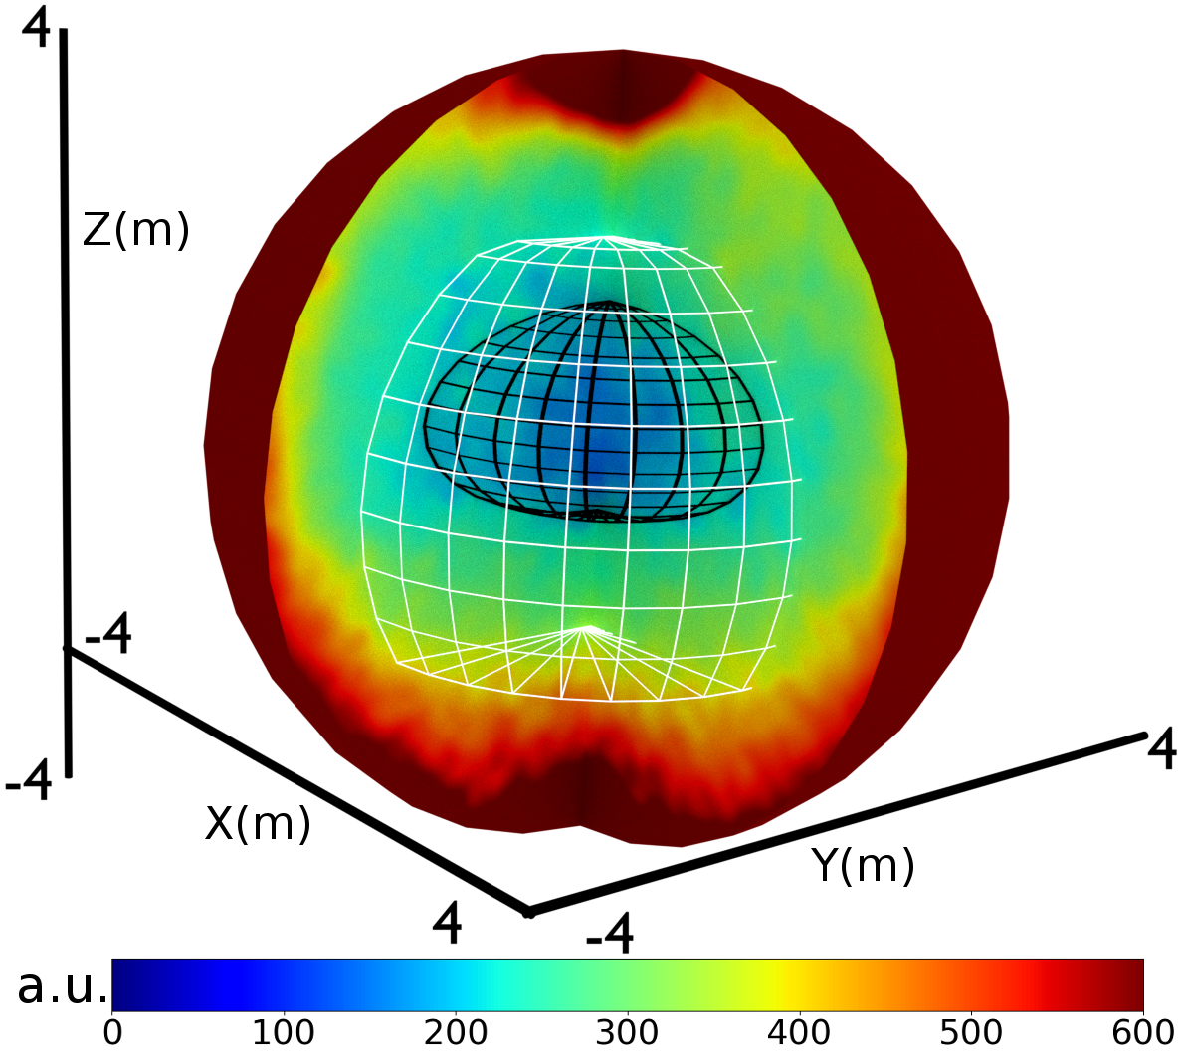
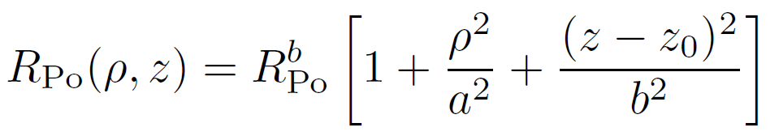
CNO neutrinos: tagging ²¹⁰Bi with ²¹⁰Po
Thanks to the insulation the convective currents are significantly reduced;
There is an innermost region almost free of convective currents (Low Polonium Field-LPoF);
2D fit to the LPoF to find the minimum
This gives an upper limit of the ²¹⁰Bi rate
R (²¹⁰Bi) < 11.8 +/- 1.3 counts/day/100t
Barbara Caccianiga (BX collaboration) ``Borexino and the first direct detection of CNO neutrinos’’

Slide 62
CNO neutrinos: results
We now have all the elements to extract CNO neutrinos from data;
STEP 1
Apply selection cuts to the dataset (July 2016-Feb 2020)
We have ~90000 events surviving the cuts in the energy region between 320 keV and 2.8 MeV
The rate of signal and backgrounds are the free parameters of the fit:
Two exceptions:
²¹⁰Bi: rate is costrained to the upper limit found by the ²¹⁰Po tag analysis (11.8 +/- 1.3 cpd/100t)
pep ν rate is constrained to the value found by a global anslysis of all solar experiments + luminosity constraint;
STEP 2
Multivariate fit including energy and radial distributions
Barbara Caccianiga (BX collaboration) ``Borexino and the first direct detection of CNO neutrinos’’

Slide 63
CNO neutrinos: results
Energy (keV)
Energy (keV)
cpd/100t
Barbara Caccianiga (BX collaboration) ``Borexino and the first direct detection of CNO neutrinos’’
Barbara Caccianiga (BX collaboration) ``First evidence of CNO neutrinos with Borexino’’

Slide 64
CNO neutrinos: results
Log-likelihood profile for CNO
Results (including sys errors)
Rate(CNO)= 7.2 ^{+3.0} _{-1.7} cpd/100t
φ(CNO)= 7.2 ^{+3.0} _{-2.0} x 10⁸ ν cm ⁻² s ⁻¹
We confirm the presence of CNO neutrinos with a 5σ significance
The results are consistent with both HZ and LZ predictions;
At the moment we cannot discriminate between HZ and LZ;
Barbara Caccianiga (BX collaboration) ``Borexino and the first direct detection of CNO neutrinos’’

Slide 65
Conclusions
After many years of hard work
Borexino has completed the real time picture of the Sun, measuring both processes that sustain it: the pp chain and the CNO cycle
It has singled-out all the components of the proton-proton chain, proving directly the existence of 7Be, pep and pp neutrinos for the first time;
It has measured the 7Be flux (2.8% error), the pep neutrino flux (~20% error) the pp neutrinos with (~10% error);
It has demonstrated the existence of CNO neutrinos for the first time (5σ);
This proves experimentally for the first time the existence of the cathalized hydrogen fusion mechanism envisaged in the ‘30s by Bethe and Weiszacker which plays a crucial role in stellar physics, since it is believed to be dominant in Stars heavier than the Sun)
Barbara Caccianiga (BX collaboration) ``Borexino and the first direct detection of CNO neutrinos’’

Slide 66
Thank you!
Barbara Caccianiga (BX collaboration) ``Borexino and the first direct detection of CNO neutrinos’’

Slide 67
Backup slides
Barbara Caccianiga (BX collaboration) ``Borexino and the first direct detection of CNO neutrinos’’

Slide 68
Studying Solar Neutrinos
Neutrino oscillations
Three types (flavors) of neutrinos: ν_{e}, ν_{μ}, ν_{τ}
Neutrinos emitted in the Sun are only of the electron type;
Breakthrough! The solar neutrino problem provided one of the first hints towards the discovery of neutrino oscillations:
ν_{e} from the Sun have some probability to transform (oscillate) into neutrinos of other flavors
Barbara Caccianiga (BX collaboration) ``Borexino and the first direct detection of CNO neutrinos’’

Slide 69
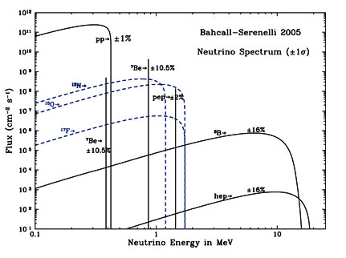
Studying Solar Neutrinos
SuperK,SNO
Homestake
Gallex/SAGE
Borexino
Barbara Caccianiga (BX collaboration) ``Borexino and the first direct detection of CNO neutrinos’’

Slide 70
Seasonal modulations
Search for the seasonal variations of the neutrino interaction rate due to the varying distance L(t) between Sun and Earth during the year;
September
December
June
L₀= 1 a.u.
T=1 year
ε=0.0167
March
Barbara Caccianiga (BX collaboration) ``Borexino and the first direct detection of CNO neutrinos’’

Slide 71
Seasonal modulations
Search for the seasonal variations of the neutrino interaction rate due to the varying distance L(t) between Sun and Earth during the year;
Events between 215-715 keV
Muon and muon daughter cuts
FV cut: r<3m + paraboloidal cuts at the vessel poles;
New alpha/beta cut (MLP) to reject ²¹⁰Po alpha’s;
September
December
June
March
Barbara Caccianiga (BX collaboration) ``Borexino and the first direct detection of CNO neutrinos’’

Slide 72
Seasonal modulations
Search for the seasonal variations of the neutrino interaction rate due to the varying distance L(t) between Sun and Earth during the year;
September
December
June
Fit to the evolution of the rate in time (bin of 30 days)
ε = (1.74 ± 0.45)%
T = (367 ± 10) days
Φ = (-18 ± 24) days
March
Measurement of the astronomic year with solar neutrinos!
Barbara Caccianiga (BX collaboration) ``Borexino and the first direct detection of CNO neutrinos’’

Slide 73
Seasonal modulations
Search for the seasonal variations of the neutrino interaction rate due to the varying distance L(t) between Sun and Earth during the year;
This analysis greatly benefits from the reduced background and from the improved stability in time of the detector with respect to Phase-I;
September
Consistent results are obtained using the Lomb-Scargle and the Empirical Mode Decomposition techniques;
December
June
Lomb-Scargle periodogram
March
Barbara Caccianiga (BX collaboration) ``Borexino and the first direct detection of CNO neutrinos’’

Slide 74
First simultaneous precision spectroscopy of pp,⁷Be and pep
Implications of the new BX results: metallicity issue
The new Borexino results on ⁷Be neutrino rate seem to give an hint towards the High Metallicity hypothesis
  p-value (HZ)= 0.87
  p-value (LZ)= 0.11
We are now largely dominated by the theoretical error;
Global fit to all solar + Kamland data (including the new ⁷Be result from BX)
Barbara Caccianiga (BX collaboration) ``New results from Borexino’’

Slide 75
Discrimination between HZ and LZ
Frequentist hypothesis test
CURRENT: results of BX on Be7, 8B and CNO neutrinos
FUTURE hypothetical result on CNO at 10% error
FUTURE hypothetical result on CNO at 2% error
Esclusion of LZ at ~2.1 σ
Esclusion of LZ at ~2.2 σ
Esclusion of LZ at ~2.6 σ
Even in the most optimistic case the discrimination power is small, due to large theoretical uncertainties
Barbara Caccianiga (BX collaboration) ``Borexino and the first direct detection of CNO neutrinos’’
Barara Caccianiga (BX collaboration) ``First evidence of CNO neutrinos with Borexino’’

Slide 76
Neutrinos from the proton-proton chain
Systematic errors
Two methods to take into account pile-up:
Effects of non perfect modelling of the detector response;
Uncertainty on theoretical input spectra (²¹⁰Bi);
⁸⁵Kr constrained to be <7.5cpd/100t(95% C.L.) (from Kr-Rb delayed coincidences)
Barbara Caccianiga (BX collaboration) ``Borexino and the first direct detection of CNO neutrinos’’

Slide 77
CNO neutrinos: results
Systematic errors
Barbara Caccianiga (BX collaboration) ``Borexino and the first direct detection of CNO neutrinos’’

Slide 78
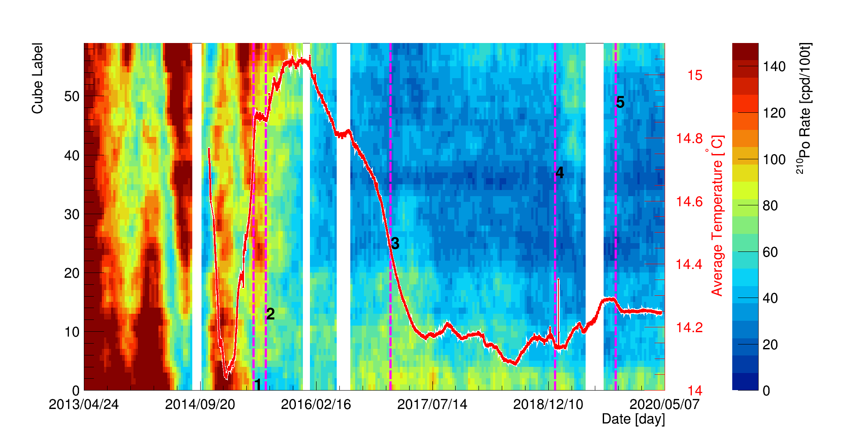
CNO neutrinos: tagging ²¹⁰Bi with ²¹⁰Po
Detector TOP
²¹⁰Po rate as a function of time
Detector BOTTOM
Barbara Caccianiga (BX collaboration) ``Borexino and the first direct detection of CNO neutrinos’’

Slide 79
CNO neutrinos: tagging ²¹⁰Bi with ²¹⁰Po
We have to prove the uniformity of ²¹⁰Bi in the entire volume
The systematic error associated to ²¹⁰Bi uniformity is 0.78 counts/day/100t
Barbara Caccianiga (BX collaboration) ``Borexino and the first direct detection of CNO neutrinos’’

