Slide 1

The REDTOP experiment: Rare Eta Decays to Explore new Physics
REDTOP
Rare Eta Decays with a
Tpc for Optical Photons
Corrado Gatto
INFN Napoli and Northern Illinois University

Slide 2

Rationale for an η/η‘ Factory
REDTOP
Recent LHC results suggest that the next search for New Physics should be in the MeV-GeV mass range with high-intensity beams.
“…Light dark matter must be neutral under SM charges, otherwise it would have been discovered at previous colliders…” [G. Krnjaic RF6 Kickoff Meeting, August 12, 2020]
The only known particles with all-zero quantum numbers are the η/η’ mesons and the Higgs boson
All electromagnetic and strong decays of the neutral and long-lived and ’ are suppressed at first order and weak decays have branching ratios of order 10⁻¹¹. Branching Ratio of processes from New Physics are enhanced compared to SM.
“….The physics sectors which can be probed at REDTOP range from the violation of discrete symmetries to the search for new particles…” [S. Tulin et al. https://arxiv.org/abs/2007.00664]

Slide 3
Detecting BSM Physics with REDTOP (η/η’ factory)
  Assuming a yield ~10¹³ η mesons/yr and ~10¹¹η’ mesons/yr
  C, T, CP-violation
  CP Violation via Dalitz plot mirror asymmetry: η → π^{ο} π⁺π⁻
  CP Violation (Type I – P and T odd , C even): η−> 4π^{ο} → 8γ
  CP Violation (Type II - C and T odd , P even): η → π^{ο} l⁺l and η → 3γ
  Test of CP invariance via μ longitudinal polarization: η → μ⁺μ –
  CP inv. via γ∗ polarization studies:η → π⁺π –e⁺e – & η → π⁺π –μ⁺μ –
  CP invariance in angular correlation studies:η → μ⁺μ – e⁺e –
  T invariance via μ transverse polarization: η → πºμ⁺μ – and η → γ μ⁺μ –
  CPT violation: μ polar. in η → π⁺μ⁻ν vs η → π⁻μ⁺ν and γ polar. in η → γ γ
  New particles and forces searches
  Scalar meson searches (charged channel): η → π^{ο} Η with H→e⁺e⁻ and H→μ⁺μ⁻
  Dark photon searches: η → γ Α’ with Α’ → l⁺l⁻
  Protophobic fifth force searches : η → γ X₁₇ with X₁₇ → e⁺e⁻
  QCD axion searches : η → ππ a₁₇ with a₁₇ → e⁺e⁻
  New leptophobic baryonic force searches : η → γ B with B→ e⁺e⁻ or B→ γ π^{ο}
  Indirect searches for dark photons new gauge bosons and leptoquark: η → μ⁺μ⁻ and η → e⁺e⁻
  Search for true muonium: η → γ (μ⁺μ – )|_{2Mμ} → γ e⁺e –
  Lepton Universality
  Other discrete symmetry violations
  Lepton Flavor Violation: η → μ⁺e – + c.c.
  Double lepton Flavor Violation: η → μ⁺μ⁺e – e – + c.c.
  Other Precision Physics measurements
  Proton radius anomaly: η → γ μ⁺μ – vs η → γ e⁺e⁻
  All unseen leptonic decay mode of η / η ‘ (SM predicts 10⁻⁶ -10⁻⁹)
  Non-η/η’ based BSM Physics
  Dark photon and ALP searches in Drell-Yan processes: qqbar → A’/a → l⁺l–
  ALP’s searches in Primakoff processes: p Z → p Z a → l⁺l– (F. Kahlhoefer)
  Charged pion and kaon decays: π+ → μ⁺ν Α’ → μ⁺ν e⁺e– and Κ+ → μ⁺ν Α’ → μ⁺ν e⁺e–
  Neutral pion decay: πº → γA’ → γe⁺e–
  Nuclear models
  Chiral perturbation theory
  Non-perturbative QCD
  Isospin breaking due to the u-d quark mass difference
  Octet-singlet mixing angle
  Electromagnetic transition form-factors (important input for g-2)
  High precision studies on medium energy physics

Slide 4
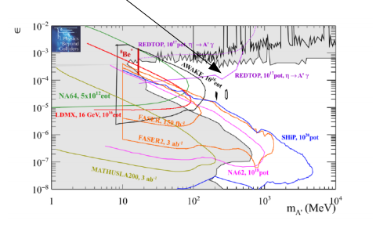
Dark photon searches:
REDTOP
  η → γ Α’ with A’→ μ⁺ μ⁻ and e⁺ e⁻
  Studied within the “Physics Beyond Collider” program at CERN for 10¹⁷ POT
  Other laboratories can provide 10x more POT
  Only “bump hunt analysis”. Vertexing being added in studies for Snowmass2021 to improve the sensitivity to physics BSM by 10x
REDTOP@CERN
4

Slide 5
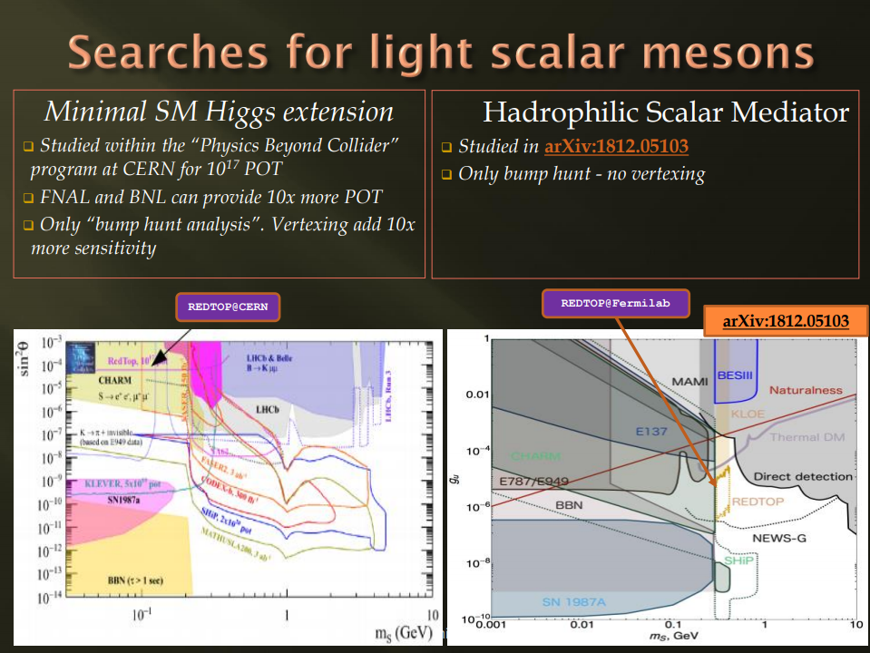
REDTOP

Slide 6
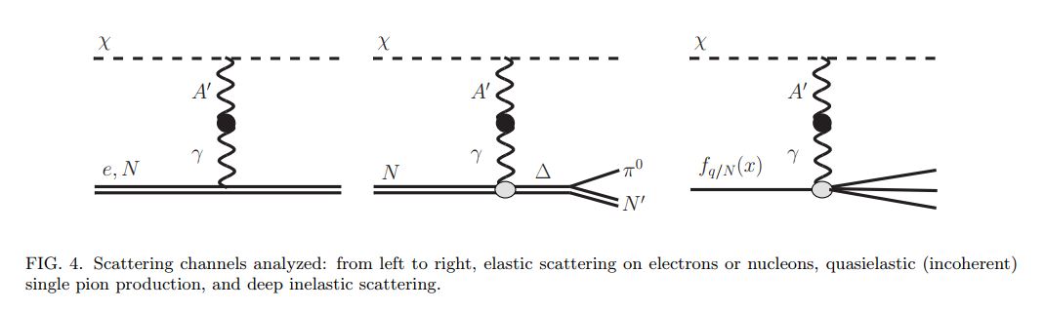
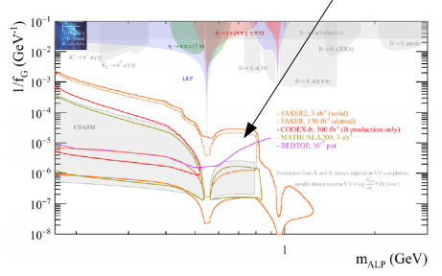
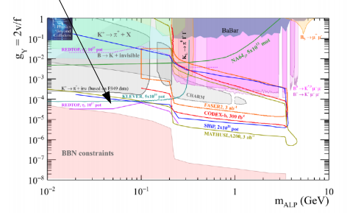
Searches for ALPs with fermion or gluon coupling
REDTOP
  Beam emitted ALP’s from the following processes:
    Drell-Yan processes: qqbar → A’/a → l⁺l–
    Proton bremsstrahlung processes: p N → p N A’/a with A’/a → l⁺l– (J. Blümlein and J. Brunner)
    Primakoff processes: p Z → p Z a → l⁺l– (F. Kahlhoefer, et. Al.)
  Only “bump hunt analysis” with 10¹⁷ POT (CERN). Will add vertexing+timing to the analysis.
  Redtop@PIP-II will provide x100 sensitivity (ALPACA study).
p N → p N a with a → l⁺l–
REDTOP@CERN
REDTOP@CERN
η → π⁺ π⁻ a with a → l⁺l–

Slide 7
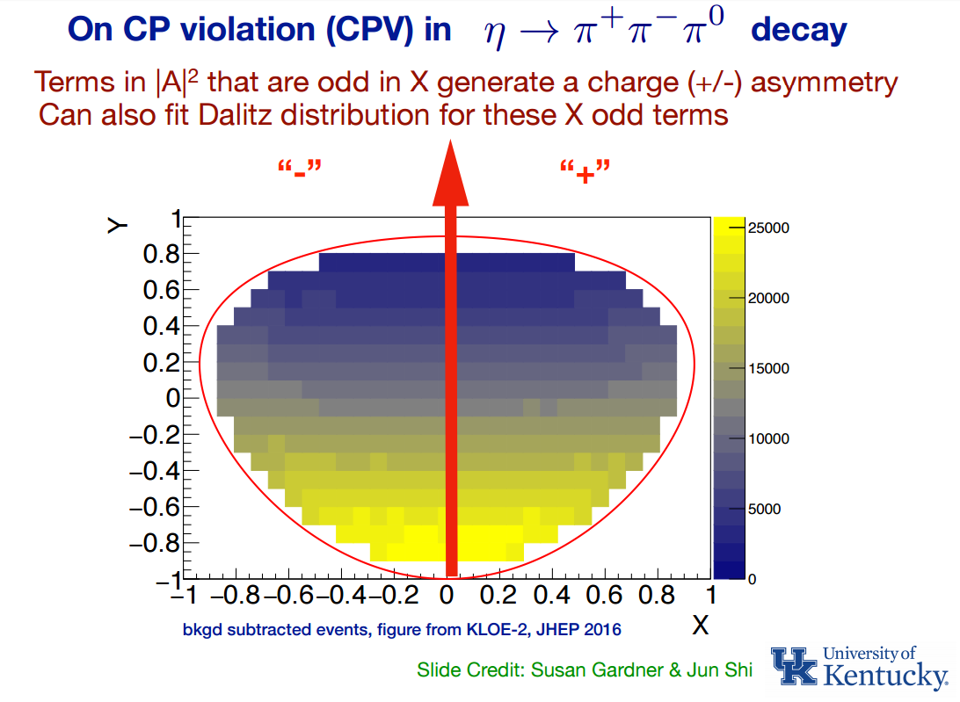
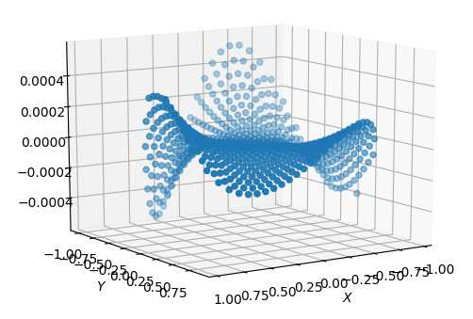
  CP Violation from Dalitz plot mirror asymmetry in η−> π⁺π⁻π^{ο}
REDTOP
  CP-violation from this process is not bounded by EDM as is the case for the η→4π process.
  Complementary to EDM searches even in the case of T and P odd observables, since the flavor structure of the eta is different from the nucleus
  Current PDG limits consistent with no asymmetry
  REDTOP will collect 4x10¹¹ such decay (factor 100 in stat. error vs PDG)
  New model in GenieHad (collaboration with S. Gardner & J. Shi – UK) based on https://arxiv.org/abs/1903.11617

Slide 8
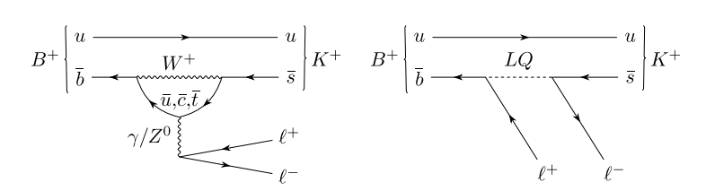
Lepton Universality Test
  LHCb latest results: with Β+ → μ⁺μ⁻Κ⁺ vs e⁺e–Κ⁺
Based on 3850 vs 1640 evts (BR_{SM} = 10⁻⁶)
3.1σ discrepancy vs SM
  η/η’ factories are especially important to confirm the anomaly
If new particle has a mass close to 2xM_{μ}, the m-e non-universality could be due to a phase space effect rather than a non-universal coupling
Low energy experiments are more sensitive to that mass scale
Several processes under study:
  η→ γ μ⁺ μ⁻ vs γ e⁺ e⁻
  η → μ⁺ μ⁻ μ⁺ μ⁻ vs e⁺ e⁻ μ⁺ μ⁻ vs e⁺ e⁻ e⁺ e⁻
    η → π^{ο} μ⁺ μ⁻ vs π^{ο} e⁺ e⁻
The most rare of the processes involving leptons could have as much as several 10⁴ SM events (BR_{SM} ~ 10⁻⁸)

Slide 9
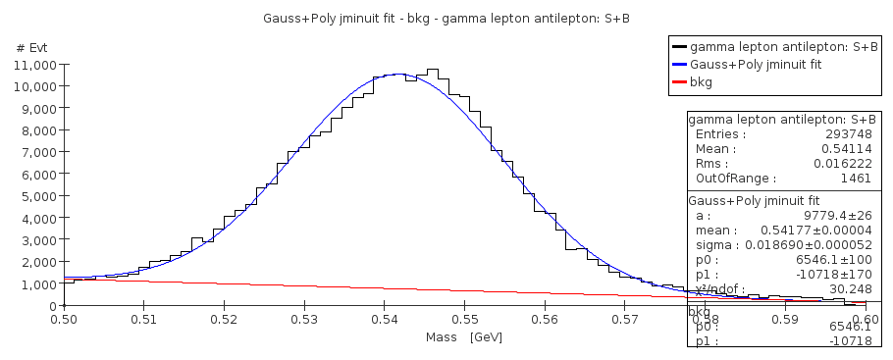
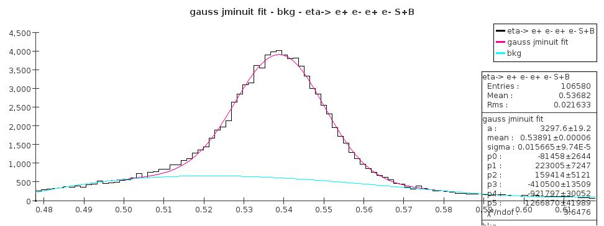
Lepton Universality Test: REDTOP
  η→ γ μ⁺ μ⁻ vs γ e⁺ e⁻
Preliminary studies based on 3x10¹⁰ POT (9x10⁷ η mesons) or 10⁻⁵ of the 1-year run statistics
Background rejection from η→ γ γ using high-resolution energy measurement (ADRIANO2) and vertex reconstruction
Preliminary stat uncertainty:
  < 0.3% for η→ γ e⁺ e⁻ ( cfr LHCb @ 4.2%)
  < 0.9% for η→ γ μ⁺ μ⁻ ( cfr LHCb @ 1.8%)
Preliminary
  η → μ⁺ μ⁻ μ⁺ μ⁻ vs e⁺ e⁻ μ⁺ μ⁻ vs e⁺ e⁻ e⁺ e⁻
Theoretical calculations at the 10⁻³ precision from Kampf, Novotný, Sanchez-Puertas (PR D 97, 056010 (2018)) – hard photon corrections need to be included
Preliminary studies based on 3x10¹⁰ POT (9x10⁷ η mesons) or 10⁻⁵ of the 1-year run statistics
Preliminary stat uncertainty: ~ 0.5%
Preliminary

Slide 10
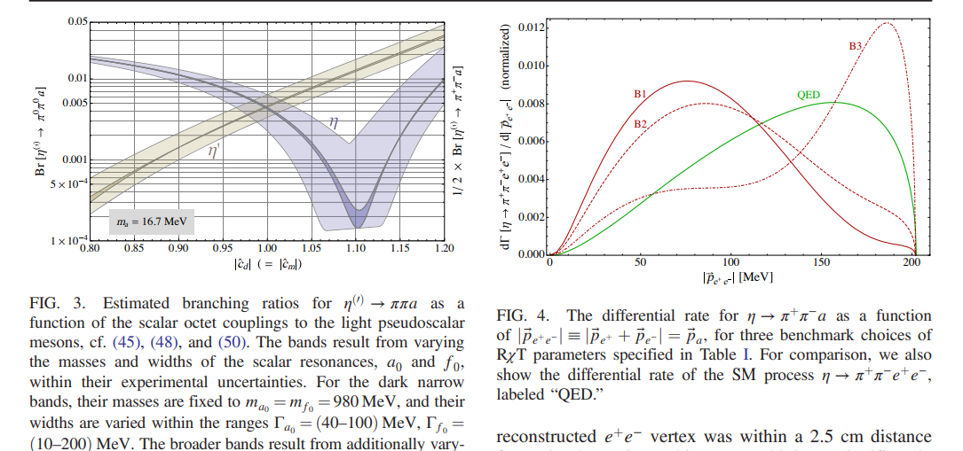
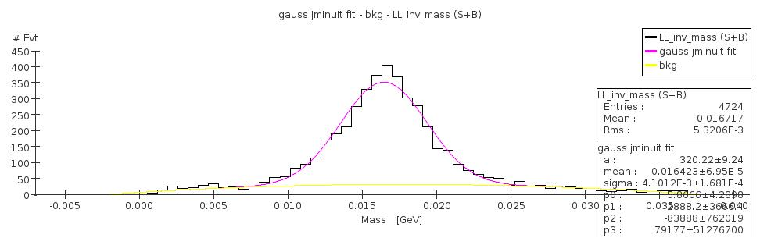
QCD axion studies
Based on D. Alves model (PR D 103, 055018 (2021) )
Assume the axion is the 17 MeV anomaly observed in Atomki experiment
Below KLOE sensitivity
the CELSIUS/WASA Collaboration observed 24 evts with SM expectation of 10
Preliminary studies based on 3x10¹⁰ POT (9x10⁷ η mesons) or 10⁻⁵ of the 1-year run statistics
Main background η→ πº π⁺ π ⁻ η→ γ π⁺ π⁻ with ensuing gamma-conversion. Rejected with high resolution ADRIANO2 and vertexing
Large statistics to disentangle the six parameters of the model
Preliminary

Slide 11
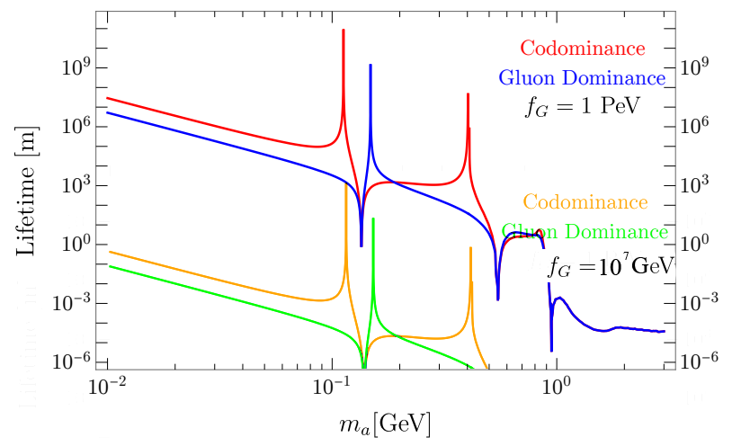
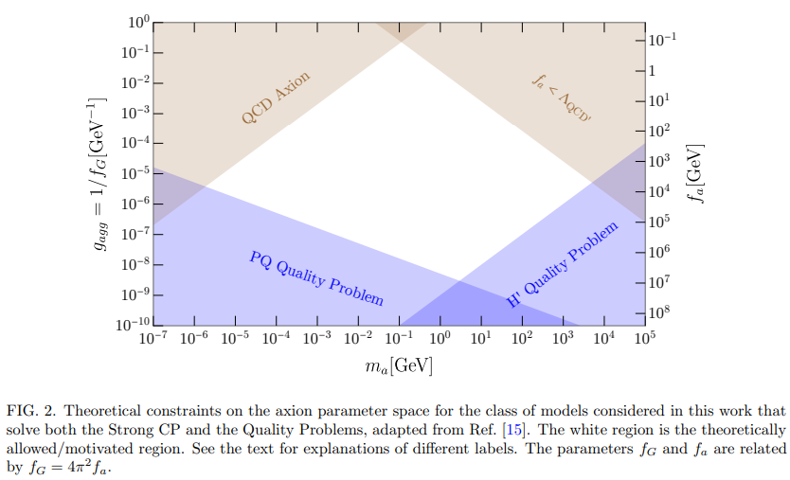
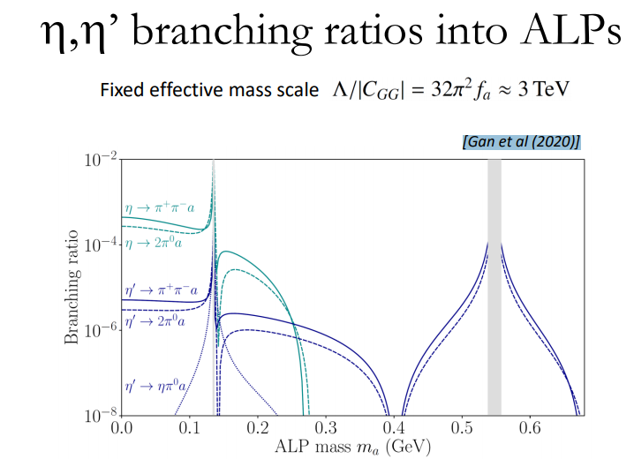
More ALPs studies
Based on [Gan et al (2020) , Kelly et al (2020) ]
Original work (tailored for beam dump experiments) assume f_{G} = 10¹² GeV
More realistic assumption for f_{G} indicate that a fixed target experiment is way more suited than a beam dump
Expect 10⁵-10⁹ events at REDTOP
REDTOP sensititvity

Slide 12
More Studies for Snowmass2021
η→ μ⁺ μ⁻ and η→ e⁺ e⁻
Based on the work by Pere Masjuan and Pablo Sanchez-Puertas [JHEP 1608, 108 (2016)]
Ultra rare process: very sensitive to physics BSM , in particular new couplings (necessarily SU(2) breaking), or lepton flavor violating (LFV) models
One operator inducing CP-violation not baound by EDM measurements [arXiv:1909.07491]
CP violation in η→ π⁺ π⁻ e⁺ e⁻
Based on the work by D. N. Gao [arXiv:hep-ph/0202002].
Study of the angular correlation of the e⁺ e⁻ and π⁺ π⁻ planes due to the interference between the magnetic and electric decay amplitudes.
More alps studies from rare πº and η decays
Based on the work by Stefania Gori, Wolfgang Altmannshofer , Lucian Harland-Lang Joerg Jaeckel, and Michael Spannowsky, Felix Kahlhoefer. Et al.
Uses interface between GenieHad and ALPCA event generator [
arXiv:1902.04878 [hep-ph]]
Muon polarization studies
Independent window on CPviolation
Require implementation of polarimetry in the ADRIANO2 calorimeter

Slide 13
Present & Future η Samples
REDTOP
 | Technique |  | η → 3πº | η → e⁺e⁻γ | Total η mesons
CB@AGS | π⁻⁻p→η n |  | 9×10⁵ |  | 10⁷
CB@MAMI-B | γ⁻p→η p |  | 1.8×10⁶ | 5000 | 2×10⁷
CB@MAMI-C | γ⁻p→η p |  | 6×10⁶ |  | 6×10⁷
KLOE | e+e-→Φ→ηγ |  | 6.5×10⁵ |  | 5×10⁷
WASA@COSY | pp→η pp pd→η ³He |  |  |  | >10⁹ (untagged) 3×10⁷ (tagged)
CB@MAMI 10 wk (proposed 2014) | γ⁻p→η p |  | 3×10⁷ | 1.5×10⁵ | 3×10⁸
Phenix | d Au→η X |  |  |  | 5×10⁹
Hades | pp→η pp p Au→η X |  |  |  | 4.5×10⁸
Near future samples
GlueX@JLAB (just started) |  | γ_{12 GeV}p → η X → neutrals |  |  | 5.5×10⁷/yr
JEF@JLAB (recently approved) |  | γ_{12 GeV}p → η X → neutrals |  |  | 3.9×10⁵/day
REDTOP (proposing) |  | p_{1.8 GeV}Li → η X |  |  | 2.5×10¹³/yr

Slide 14
REDTOP Requirements
REDTOP
Phase – I: Untagged >10¹³ η/η’ mesons
Medium energy proton beam: ~2 GeV (η)– ~4(η’) GeV
Low intensity beam: 10¹⁸ POT/yr on Li or Be solid target
Calorimetric σ(E)/E ~ 5%/ √ E (ADRIANO2 dual readout)
High PID efficiency: 98/99% (e,γ), 95% (μ), 95% (π), 99.5%(p,n)
σ_{tracker}(t) ~ 80psec, σ_{calorimeter}(t) ~ 80psec, σ_{Rich}(t) ~ 80psec
Low-mass vertex detector (fiber tracker LHCb-style)
Near -4π detector acceptance (as the η/η’ decay is almost at rest).
Phase – II: Tagged ~10¹³ η/η’ mesons
Low energy proton beam: ~0.9 GeV (η)– ~1.7(η’) GeV
High intensity beam: 10¹⁸ POT/yr on De gaseous target
Same detector as Phase-I + forward tagger

Slide 15
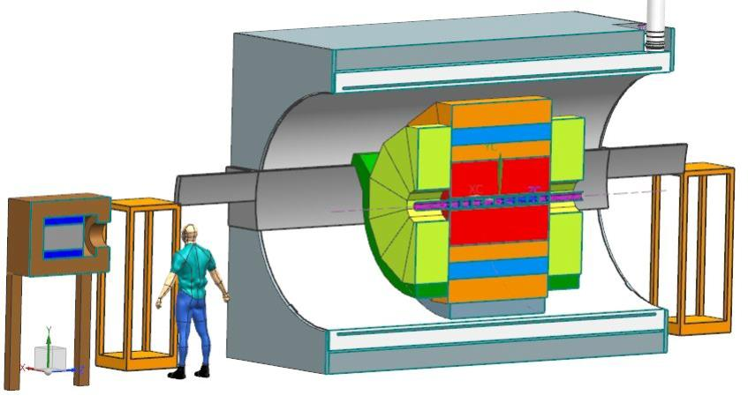
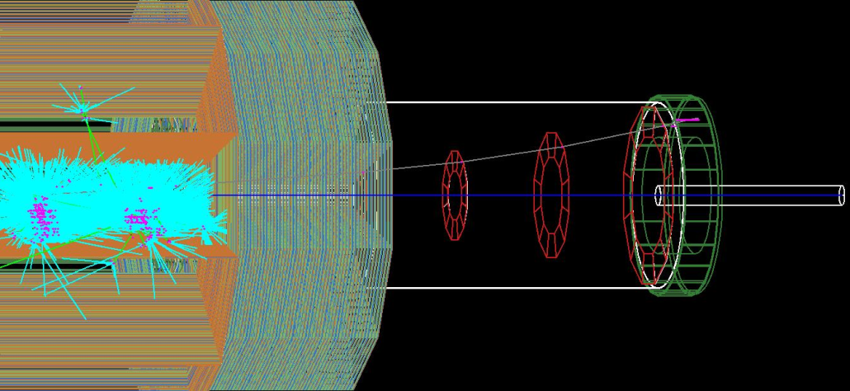
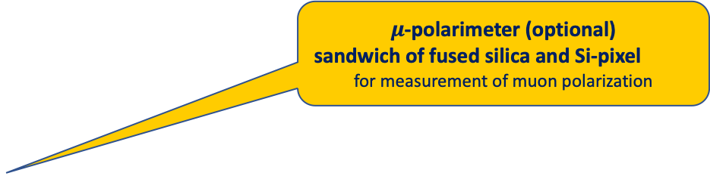
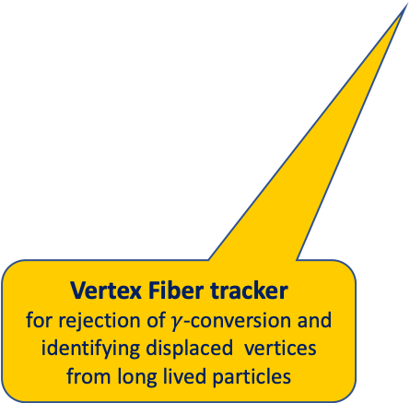
REDTOP detector
REDTOP
Optical-TPC
For slow background rejection
or
LGAD Tracker surrounded by Quartz cells
For 4D track reconstruction and TOF measurements
5D- Calorimeter: ADRIANO2
(Dual-readout +PFA)
Sci and Cer light read by SiPM or SPAD
For excellent energy , position resolution and PID
$μ$-polarimeter (optional)
sandwich of fused silica and Si-pixel
for measurement of muon polarization
Vertex Fiber tracker
for rejection of $γ$-conversion and identifying displaced vertices from long lived particles
Forward Detector for Option 2
for tagging ³He⁺⁺ ions
10x Be or Li targets

Slide 16
REDTOP Collaboration
REDTOP
11 Countries, 35 Institutions, 92 Collaborators
J. Comfort, P. Mauskopf, D. McFarland, L. Thomas
Arizona State University, (USA)
I. Pedraza, D. Leon, S. Escobar, D. Herrera, D Silverio
Benemérita Universidad Autónoma de Puebla, (Mexico)
A. Alqahtani
Georgetown University, (USA)
F. Ignatov
Budker Institute of Nuclear Physics – Novosibirsk, (Russia)
A. Kotwal
Duke University, (USA)
M. Spannowsky
Durham University, (UK)
J. Dey, V. Di Benedetto, B. Dobrescu, E. Gianfelice-Wendt, E. Hahn, D. Jensen,
C. Johnstone, J. Johnstone, J. Kilmer, G.Krnjaic, T. Kobilarcik, A. Kronfeld,
K. Krempetz, M. May, A. Mazzacane, N. Mokhov, W. Pellico, A. Pla-Dalmau,
V. Pronskikh, E. Ramberg, J. Rauch, L. Ristori, E. Schmidt, G. Sellberg, G. Tassotto,
Y.D. Tsai
Fermi National Accelerator Laboratory, (USA)
P. Sanchez-Puertas
IFAE – Barcelona (Spain)
C. Gatto^{1†}
Istituto Nazionale di Fisica Nucleare – Sezione di Napoli, (Italy)
W. Baldini
Istituto Nazionale di Fisica Nucleare – Sezione di Ferrara, (Italy)
R. Carosi, A. Kievsky, M. Viviani
Istituto Nazionale di Fisica Nucleare – Sezione di Pisa, (Italy)
W. Krzemień, M. Silarski, M. Zielinski
Jagiellonian University, Krakow, (Poland)
D. S. M. Alves, S. Pastore
Los Alamos National Laboratory, (USA)
M. Berlowski
National Centre for Nuclear Research – Warsaw, (Poland)
G. Blazey, A. Dychkant, K. Francis, M. Syphers, V. Zutshii, P. Chintalapati, T. Malla, M. Figora
Northern Illinois University, (USA)
D. Egaña-Ugrinovic
Perimeter Institute for Theoretical Physiscs – Waterloo, (Canada)
Y. Kahn
Princeton University – Princeton, (USA)
P. Meade, S. Homiller
Stony Brook University – New York, (USA)
A. Gutiérrez-Rodriguez, M. A. Hernandez-Ruiz
Universidad Autónoma de Zacatecas, (Mexico)
B. Fabela-Enriquez
Vanderbilt University, (USA)
J. Jaeckel
Universität Heidelberg, (Germany)
C. Siligardi, S. Barbi, C. Mugoni
Università di Modena e Reggio Emilia, (Italy)
L. E. Marcucci⁴
Universita’ di Pisa, (Italy)
M. Guida³
Università di Salerno, (Italy)
S. Charlebois, J. F. Pratte
Université de Sherbrooke, (Canada)
L. Harland-Lang
University of Oxford, (UK)
S. Gori
University of California Santa Cruz, (USA)
R. Gardner, P. Paschos
University of Chicago, (USA)
J. Konisberg
University of Florida, (USA)
M. Murray, C. Rogan, C. Royon, Nicola Minafra, A. ​Novikov, F. Gautier, T. Isidori
University of Kansas, (USA)
S. Gardner, J. Shi, X. Yan
University of Kentucky, (USA)
M. Pospelov
University of Minnesota, (USA)
D. Gao
University of Science and Technology of China, (China)
K. Maamari
University of Southern California, (USA)
A. Kupsc
University of Uppsala, (Sweden) S. Tulin
York University, (Canada)
Notes:
16

Slide 17
Summary
REDTOP
All meson factories: LHCb, B-factories, Dafne, J/psi factories - all have produced a broad spectrum of nice physics
The η /η’ meson is a excellent laboratory for studying rare processes and physics BSM at a lower mass scale
Existing world sample not sufficient for breaching into decays violating conservation laws or searching for new particles
REDTOP goal is to produce ~10¹³ untagged η mesons/yr and ~ 10 ¹¹ η’ /year in Phase-I and ~10¹³ tagged mesons in Phase-II
Relatively low beam requirements could be met by several laboratories in US and Asia
Fermilab is the only laboratory with beam for Phase-I (Delivery Ring) and Phase-II (PIP-II)

Slide 18
Backup slides

Slide 19
Why the η meson is special?
REDTOP
It is a Goldstone boson
It is an eigenstate of the C, P, CP and G operators (very rare in nature): I^{G} J^{PC} =0⁺ 0⁻⁺
All its additive quantum numbers are zero
Q = I = j = S = B = L = 0
All its possible strong decays are forbidden in lowest order by P and CP invariance, G-parity conservation and isospin and charge symmetry invariance.
EM decays are forbidden in lowest order by C invariance and angular momentum conservation
The η decays are flavor-conserving reactions
Symmetry constrains its QCD dynamics
It can be used to test C and CP invariance.
Its decays are not influenced by a change of flavor (as in K decays) and violations are “pure”
It is a very narrow state (Γ_{η}=1.3 KeV vs Γ_{ρ}=149 MeV)
Contributions from higher orders are enhanced by a factor of ~100,000
Excellent for testing invariances
Decays are free of SM backgrounds for new physics search
η is an excellent laboratory to search for physics Beyond Standard Model

Slide 20

Sensitivity Studies at CERN PBC
REDTOP
REDTOP@CERN
ALPs
Dark photon
REDTOP@CERN
REDTOP@Fermilab
booster
REDTOP@Fermilab
PIP-III
Hadrophilic dark scalar
CP-violation
20
Physics beyond colliders at CERN: beyond the Standard Model working group report:arXiv:1901.09966v2
APS April Meeting 2021
20
2021/04/20
Notes:
20

Slide 21
More ALPs studies
REDTOP
It an be searched at REDTOP in η→ π⁺ π⁻ a with a → γ γ or 3 π
ALP–η coupling depends on a-η mixing angle
Vertex detector and high energy resolution dual-readout calorimeter help to reject the background (η→ πº π⁺ π ⁻ and η→ γ π⁺ π⁻ )
Expect 10⁵-10⁹ events at REDTOP, (m_{a} dependent)
Dark sectors in η,η’ decays [S. Tulin, Snowmass 2021 RF6 Kickoff meeting]

