Slide 1
Observable Flashes from Dark Photons in Binary Neutron Star Mergers
Melissa Diamond
Johns Hopkins University
mdiamon8@jhu.edu
Ongoing work with Gustavo Marques Tavares

Slide 2
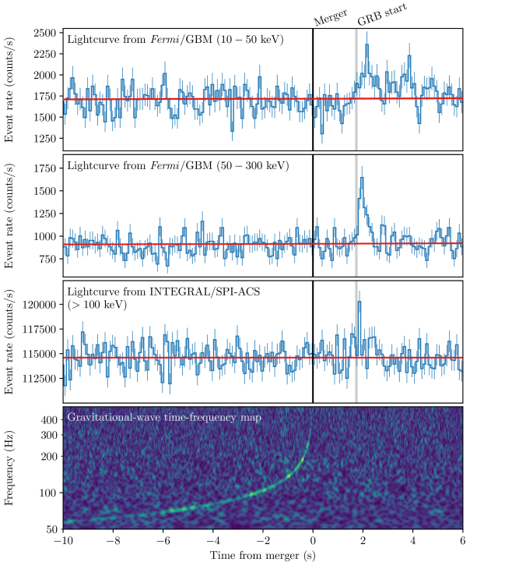
Multimessenger Astrophysics
SN1987a
Neutrinos + photons=
broad constraints on new physics
GW 170817
Gravitational waves + photons=
A new probe of extreme physics
How can we use Binary Neutron Star Mergers to probe new physics?

Slide 3
Binary Neutron Star Mergers
A Window into the Dark Sector
Neutron star merger produce MeV scale particles
Dark sector decay -> produce gamma ray signal
Detect unique dark sector signals using gravitational waves and photons together

Slide 4
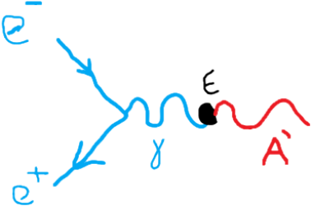
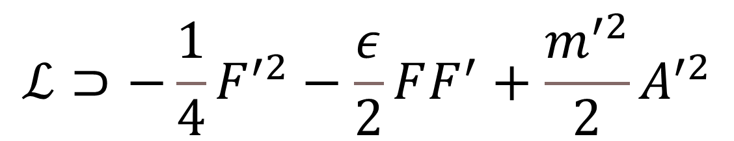
Dark photons
$$ℒ⊃−\frac{1}{4}F^{′2}−\frac{ε}{2}FF^{′}+\frac{m^{′2}}{2}A^{′2}$$
Massive Vector
Kinematically mixes with the photon
Connects dark sector to standard model

Slide 5
Dark photon freeze in

Slide 6
Dark photon parameter space

Slide 7
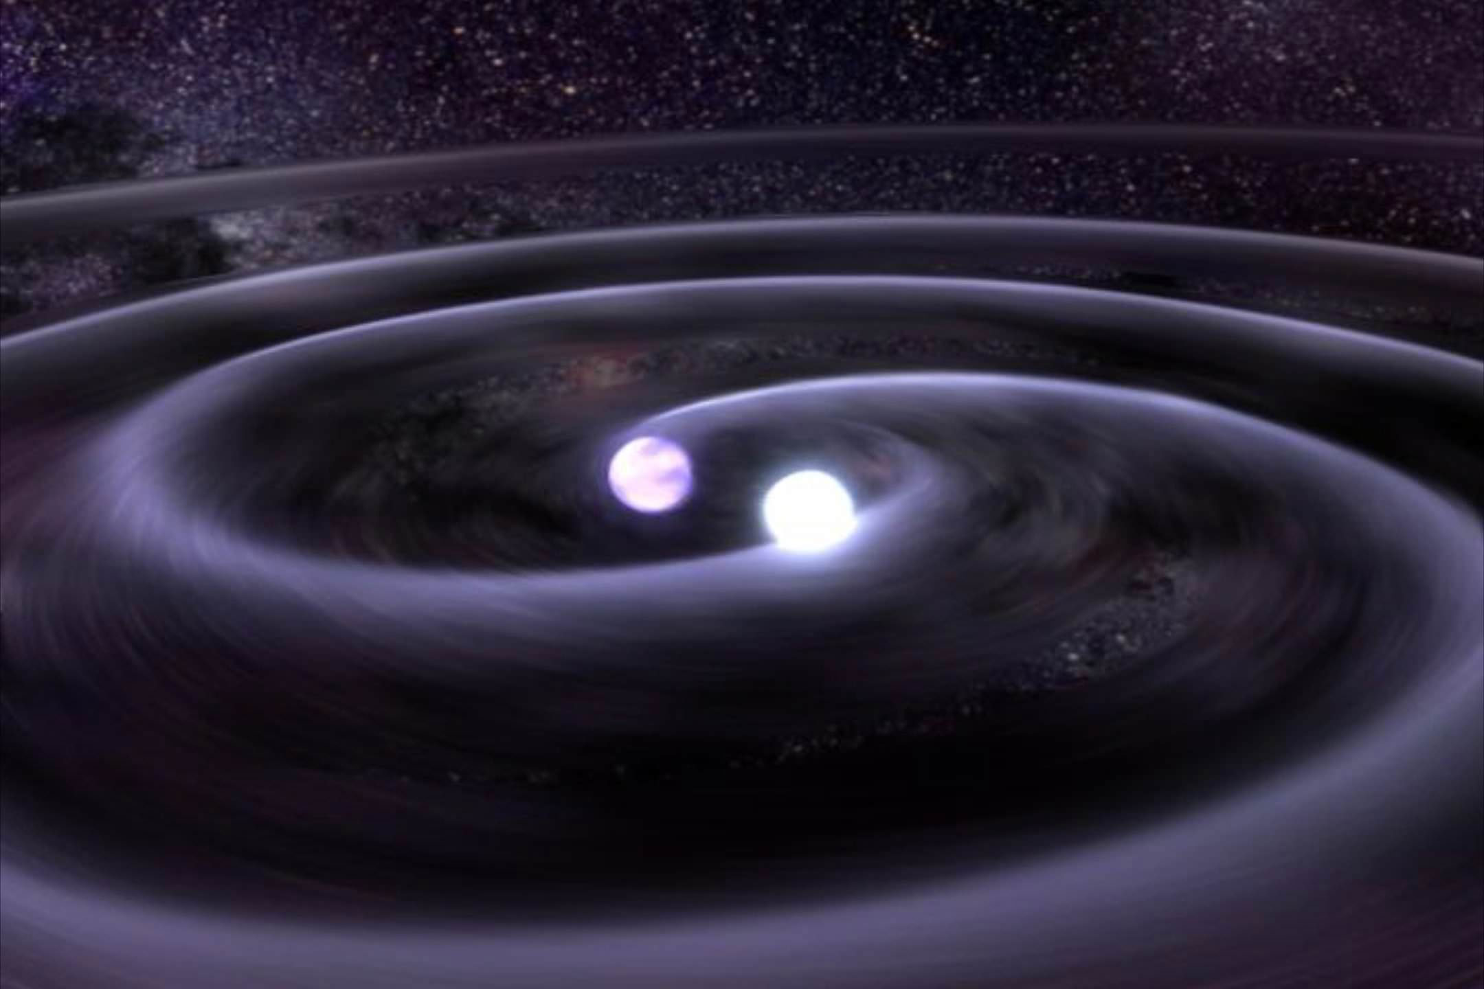
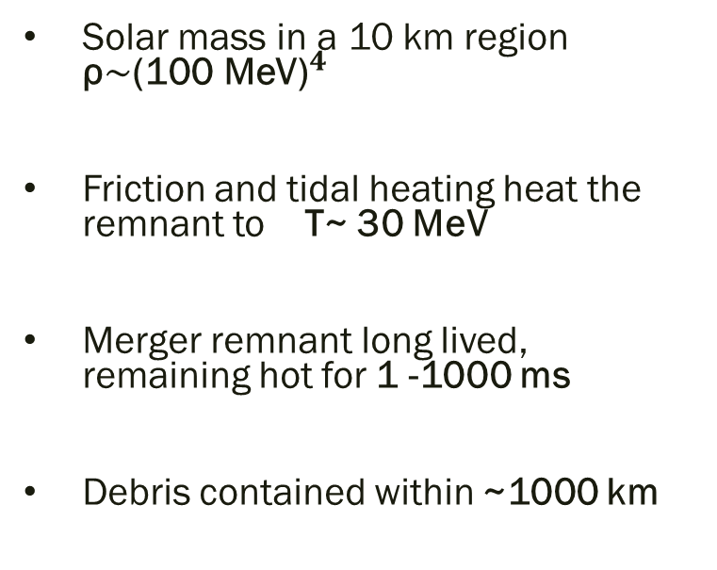
Why Binary Neutron Star Mergers?
Solar mass in a 10 km region ρ${\sim \text{(100 }\text{MeV}\text{)}}^{4}$
Friction and tidal heating heat the remnant to T~ 30 MeV
Merger remnant long lived, remaining hot for 1 -1000 ms
Debris contained within ~1000 km

Slide 8
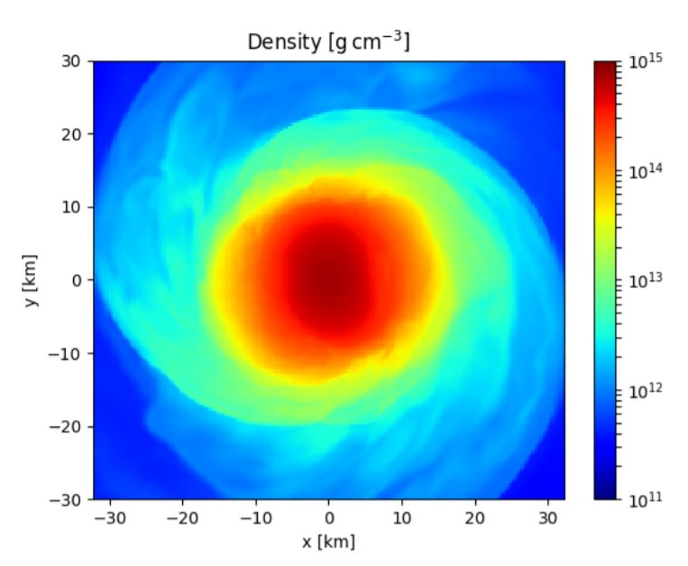
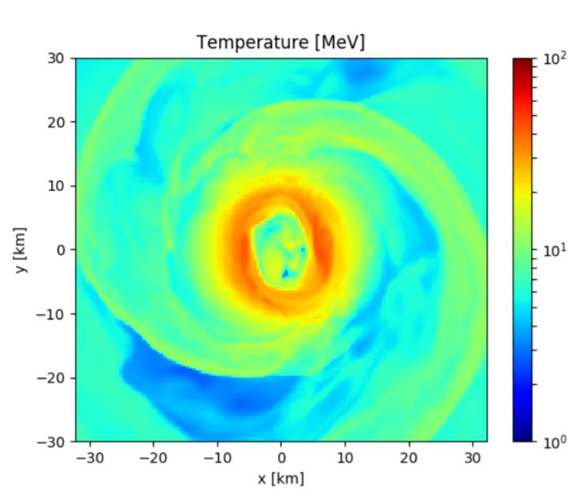
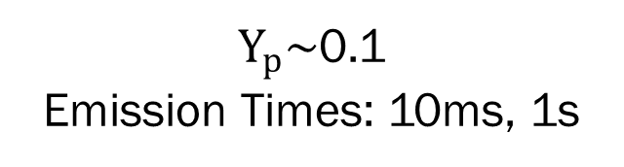
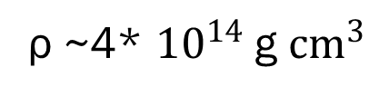
BNM Characteristics
ρ ~4* ${10}^{14}$g ${cm}^{3}$
T~ 30 MeV
Perego, A., Bernuzzi, S., Radicce, D., Eur. Phys. J. A 55, 124
5 km
$Y_{p}\sim$0.1
Emission Times: 10ms, 1s
10 km

Slide 9
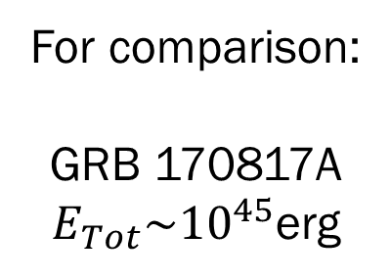
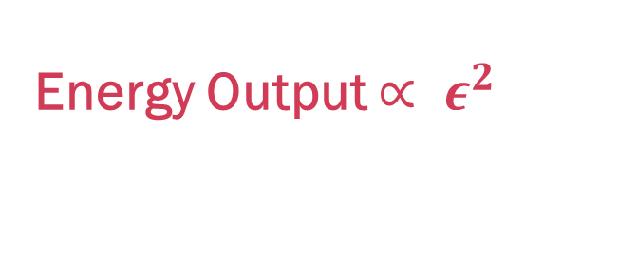
Dark Photon Emission—Proof of Concept
For comparison:
GRB 170817A
$E_{Tot}\sim {10}^{45}$erg
Energy Output $∝ ε^{2}$

Slide 10

From Merger to Observable signal
Merger Remnant Radiates Dark Photons
Energy Output $∝ ε^{2}$

Slide 11
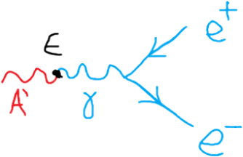

From Merger to Observable signal
Merger Remnant Radiates Dark Photons
Expanding plasma shell formed
e+
e+
Dark Photons Decay
e+
e-
e-
e-
e+
e+
e-
e-
e-
e+
e-
e-
e+
e+
e-
Energy Output $∝ ε^{2}$
$d\sim {\left(\frac{{10}^{−9}}{ε}\right)}^{2}\left(\frac{10 \text{MeV}}{m^{′}}\right){10}^{4}$ km
T~m’

Slide 12

From Merger to Observable signal
Merger Remnant Radiates Dark Photons
Expanding plasma shell formed
e+
e+
Dark Photons Decay
e+
e-
e-
e-
e+
e+
e-
e-
e-
e+e- scattering slow
e+
e-
Non thermal signal
e-
e+
e+
e-
Energy Output $∝ ε^{2}$
$d\sim {\left(\frac{{10}^{−9}}{ε}\right)}^{2}\left(\frac{10 \text{MeV}}{m^{′}}\right){10}^{4}$ km
T~m’
some γ formed
many e+ e- escape

Slide 13
From Merger to Observable signal
Thermal Fireball
Merger Remnant Radiates Dark Photons
Expanding plasma shell formed
e+e- scattering
fast
e+
e+
Dark Photons Decay
e+
e-
e-
Bright γ signal
e-
e+
e+
e-
e-
e-
e+e- scattering slow
e+
e-
Non thermal signal
e-
e+
e+
e-
Energy Output $∝ ε^{2}$
$d\sim {\left(\frac{{10}^{−9}}{ε}\right)}^{2}\left(\frac{10 \text{MeV}}{m^{′}}\right){10}^{4}$ km
T~m’
some γ formed
many e+ e- escape

Slide 14
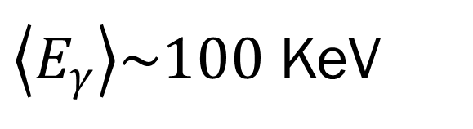
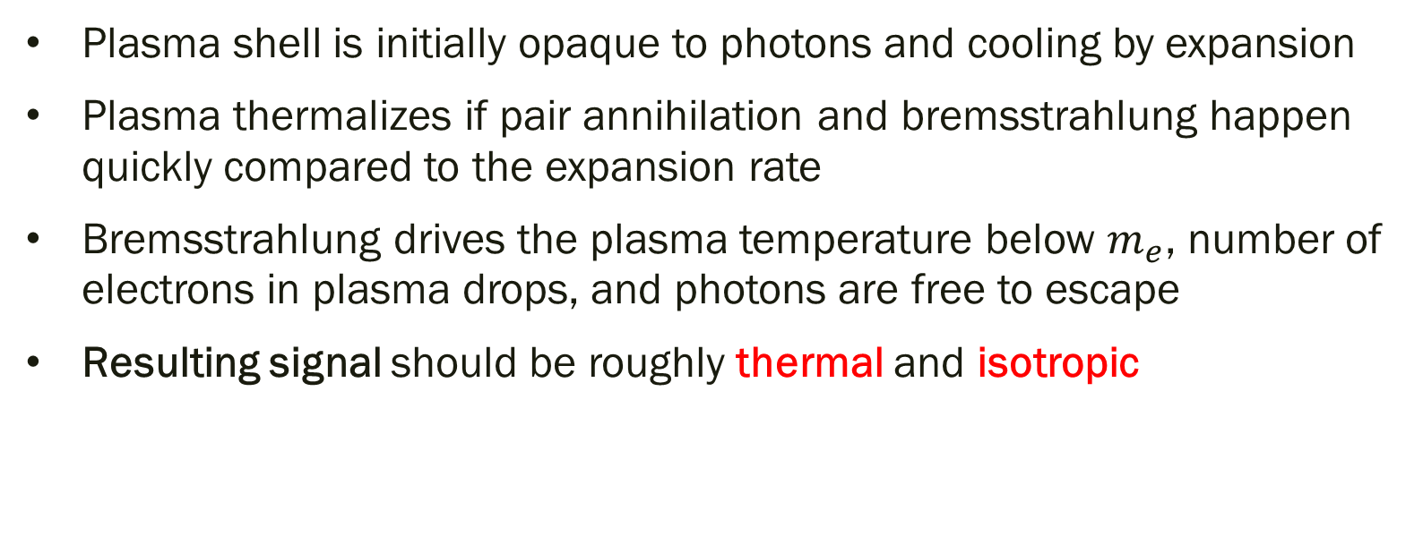
The Thermal Fireball Case
Plasma shell is initially opaque to photons and cooling by expansion
Plasma thermalizes if pair annihilation and bremsstrahlung happen quickly compared to the expansion rate
Bremsstrahlung drives the plasma temperature below $m_{e}$, number of electrons in plasma drops, and photons are free to escape
Resulting signal should be roughly thermal and isotropic
$\left\langle E_{γ}\right\rangle \sim 100$ KeV

Slide 15
Results
Observable signal

Slide 16
Conclusion and Outlook
Binary neutron star mergers provide a new way to investigate the dark sector
Future merger events should give information about the viable freeze in parameter space for dark photons with masses between 1-100 MeV
Detection prospects will improve as midband gravitational wave detectors and new MeV telescopes come online
Thank you!
mdiamon8@jhu.edu

Slide 17
Results

Slide 18
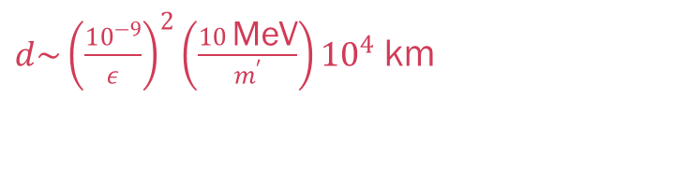
Dark photon decay
Plasma Shell
e+
e+
e+
e-
e-
e+
e-
e+
e+
e-
In Expanding Shell
T ~m’
e-
e-
Merger Remnant
e-
e+
e-
e-
e+
e+
$d\sim {\left(\frac{{10}^{−9}}{ε}\right)}^{2}\left(\frac{10 \text{MeV}}{m^{′}}\right){10}^{4}$ km
e+
e-

Slide 19
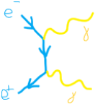
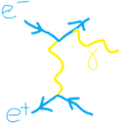
Fireball reprocessing
Expansion
e+
e+
Plasma Shell
e+
e-
e-
e+
e-
e+
Pair Annihilation
e+
e-
e-
e-
Merger Remnant
e-
e+
e-
e-
e+
e+
e+
e-
Bremsstrahlung

