Slide 1


Mathematical foundations of quantum machine learning
Roberto Moretti – XXXVIII cycle – 2CFU seminar
Summer School 10-14 Jul. 2023

Slide 2
Outline
Qubits and modern quantum processors towards fault-tolerance.
Quantum gates and qubit control.
Fault-tolerant quantum advantage.
Adiabatic quantum computing and QAOAs.
Classical Machine Learning.
Variational algorithms
  Example: NISQ – Quantum Machine Learning.
  Boosting gradient descent with the Parameter-Shift rule.
Machine Learning with kernel methods.
Quantum Support Vector Machine.
Conclusions and outlook.
1

Slide 3
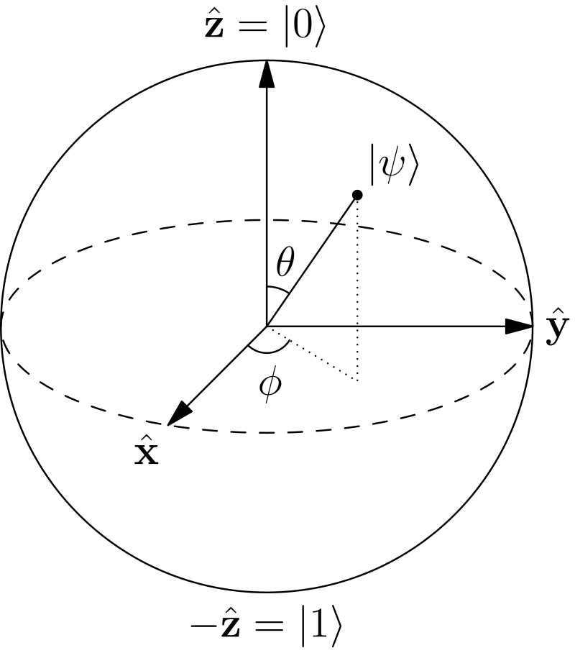
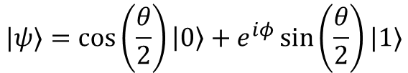
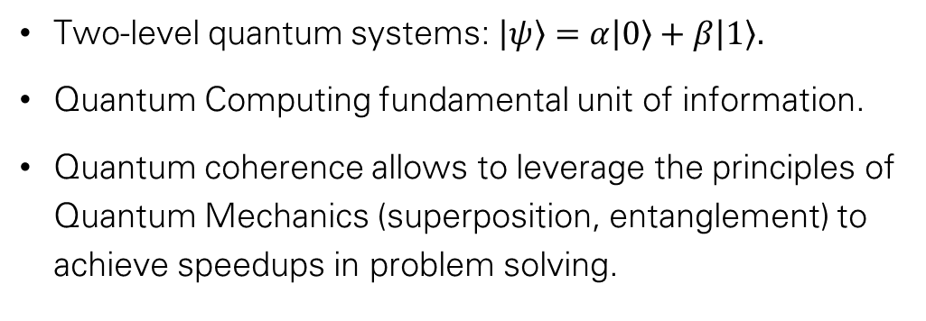
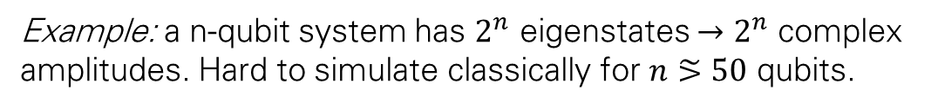

qubits
Bloch sphere parametrization
Two-level quantum systems: $\left|ψ\right\rangle =α\left|0\right\rangle +β\left|1\right\rangle .$
Quantum Computing fundamental unit of information.
Quantum coherence allows to leverage the principles of Quantum Mechanics (superposition, entanglement) to achieve speedups in problem solving.
Example: a n-qubit system has $2^{n}$ eigenstates $→2^{n}$ complex amplitudes. Hard to simulate classically for $n⪞50$ qubits.
$\left|ψ\right\rangle ={\left(\frac{1}{\sqrt{2}}\right)}^{n}\left(|0\right\rangle +\left|1\right\rangle ) ^{⊗n}$= ${\left(\frac{1}{\sqrt{2}}\right)}^{n}\sum_{i=1}^{n}{|i⟩}$
2

Slide 4
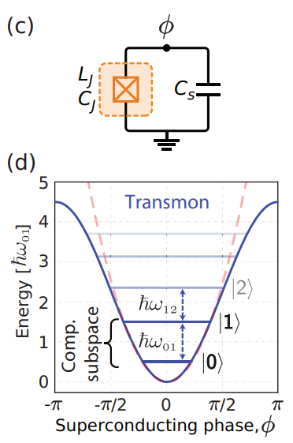
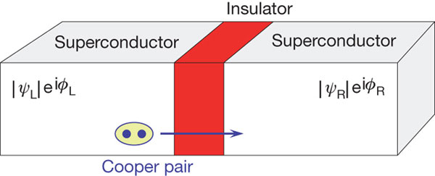
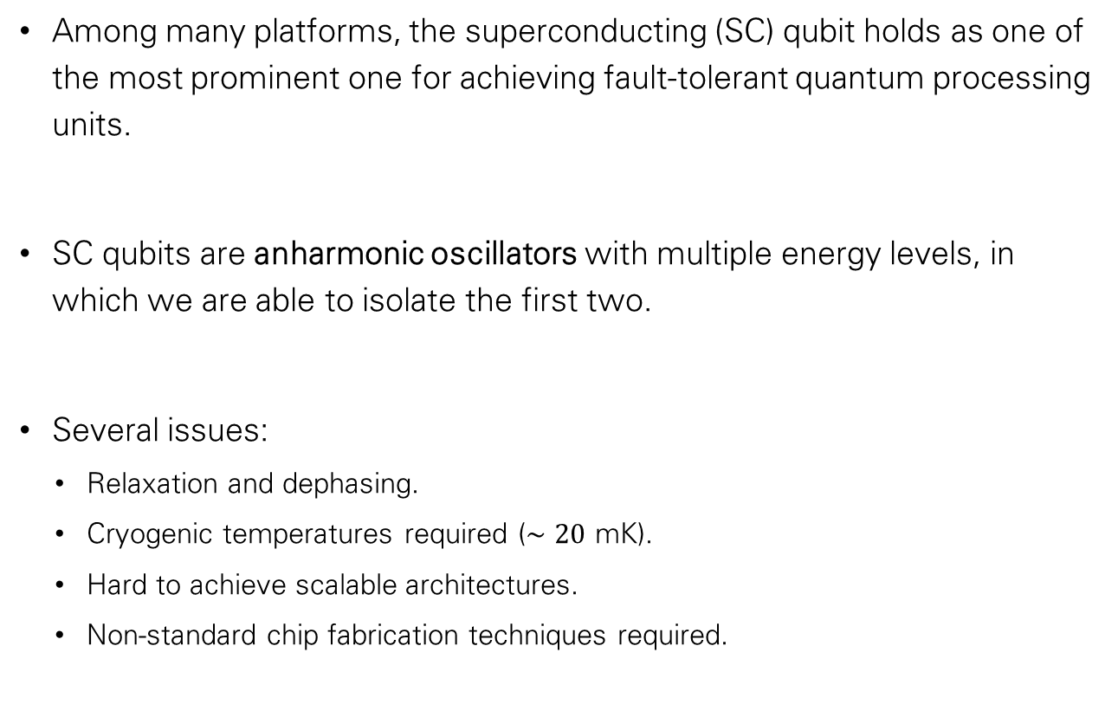
Quantum hardware
Among many platforms, the superconducting (SC) qubit holds as one of the most prominent one for achieving fault-tolerant quantum processing units.
SC qubits are anharmonic oscillators with multiple energy levels, in which we are able to isolate the first two.
Several issues:
  Relaxation and dephasing.
  Cryogenic temperatures required ($∼20$ mK).
  Hard to achieve scalable architectures.
  Non-standard chip fabrication techniques required.
3

Slide 5
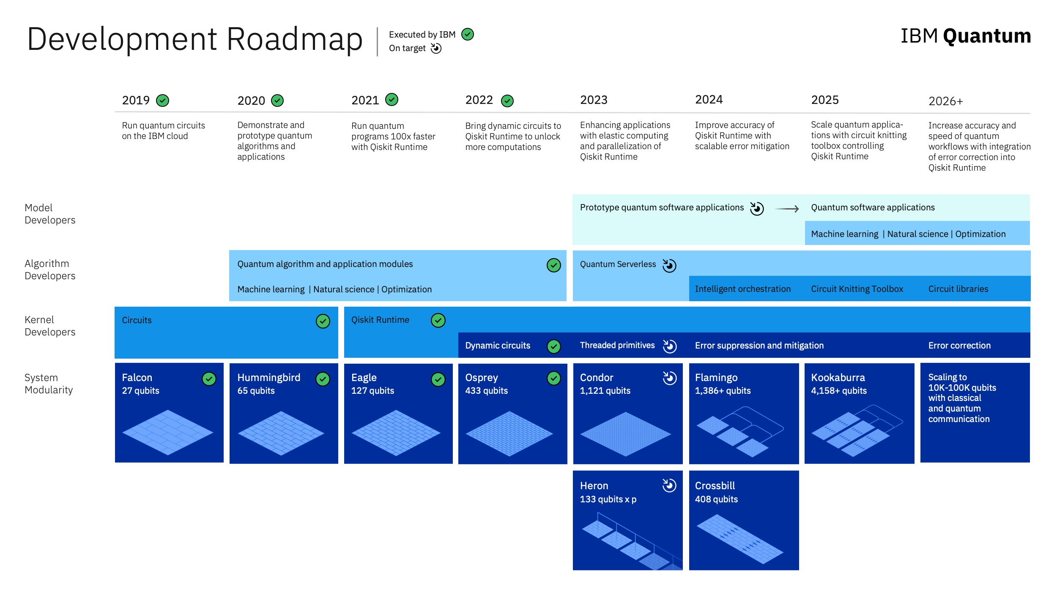
Noise Intermediate Scale Quantum (NISQ) era:
Small/medium sized QPUs, significant error rate.
6

Slide 6
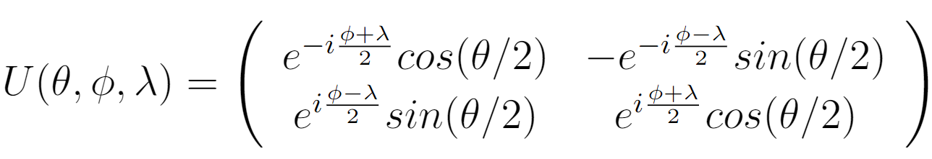
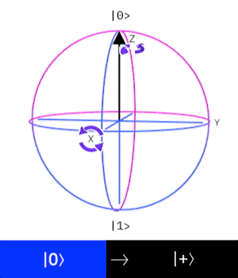

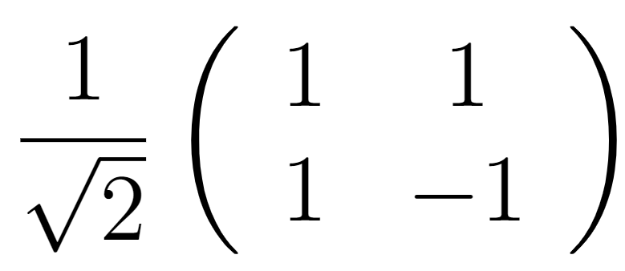
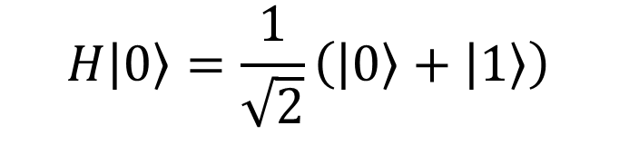
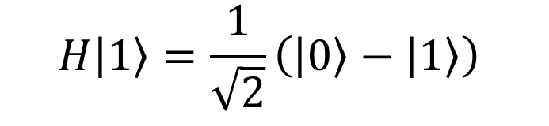

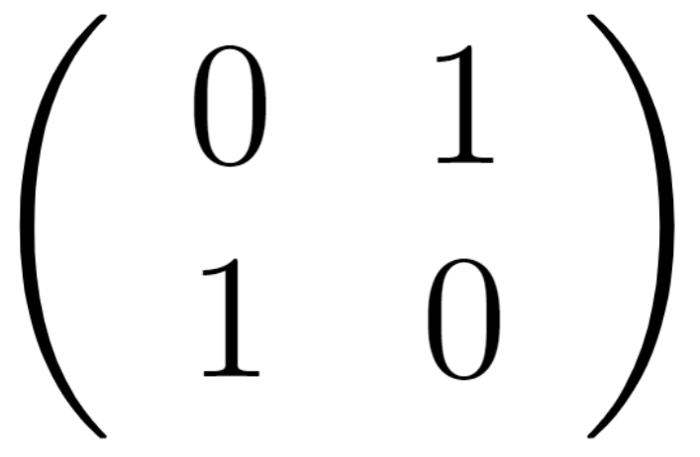





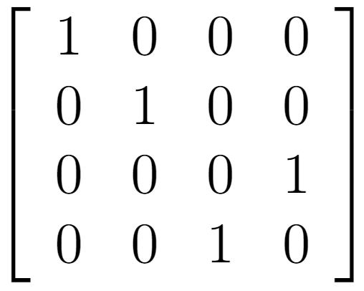


Quantum gates
Multi-qubit states are governed by quantum gates.
The most common are single-qubit (can be visualized on the Bloch sphere) and two-qubit gates.
A sequence of quantum gates acting on an initial state implements a quantum algorithm, often indicated as quantum circuit.
Single qubit gates are SU(2) rotations:
$$\left|0\right\rangle =\left(\begin{matrix}1 \\ 0\end{matrix}\right) \left|1\right\rangle =\left(\begin{matrix}0 \\ 1\end{matrix}\right)$$
Name | Symbol | Matrix rep. | Action
Hadamard
Not
Pauli rotations |  |  | Rotation along X, Y, Z axis on the Bloch Sphere
C-Not
4

Slide 7
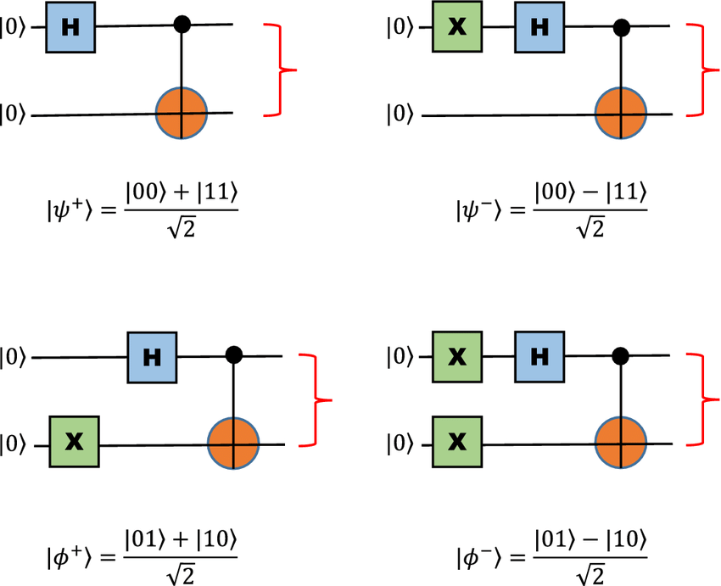
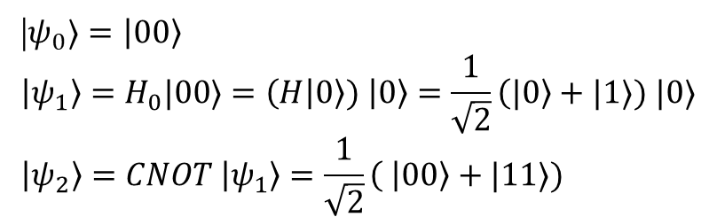
Quantum circuit examples
Entangling two qubits with a quantum gate set
|$ψ_{0}⟩=\left|00\right\rangle$
$$\left|ψ_{1}\right\rangle =H_{0}|00⟩=\left(H | 0\right\rangle ) \left|0\right\rangle =\frac{1}{\sqrt{2}}\left(|0\right\rangle +|1⟩) |0⟩$$
$$\left|ψ_{2}\right\rangle =CNOT \left|ψ_{1}\right\rangle =\frac{1}{\sqrt{2}}\left( | 00\right\rangle +|11⟩)$$
«Bell pairs»
Few gates can produce two-qubit, maximally entangled states.
Entanglement is what makes quantum advantage possible.
Otherwise, any quantum circuit would be easy to reproduce classically.
5

Slide 8
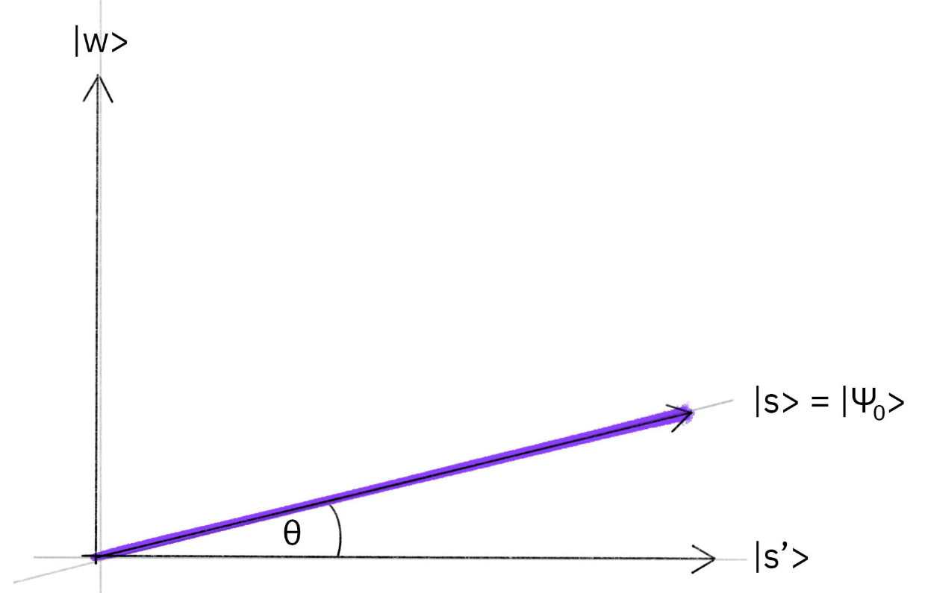
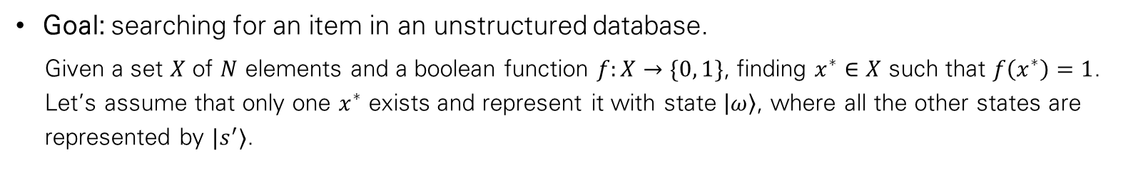
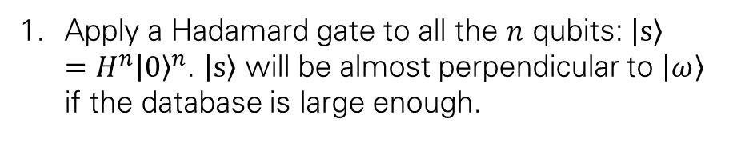
Grover search I
A remarkable example of Quantum Advantage that will be achievable through fault-tolerant quantum computers.
Goal: searching for an item in an unstructured database.
  Given a set $X$ of $N$ elements and a boolean function $f:X→\{0, 1\}$, finding $x^{∗}∈X$ such that $f\left(x^{∗}\right)=1$. Let’s assume that only one $x^{∗}$ exists and represent it with state $\left|ω\right\rangle$, where all the other states are represented by $|s^{′}⟩$.
Apply a Hadamard gate to all the $n$ qubits: $\left|s\right\rangle =H^{n}{\left|0\right\rangle }^{n}$. $\left|s\right\rangle$ will be almost perpendicular to $\left|ω\right\rangle$ if the database is large enough.
7

Slide 9
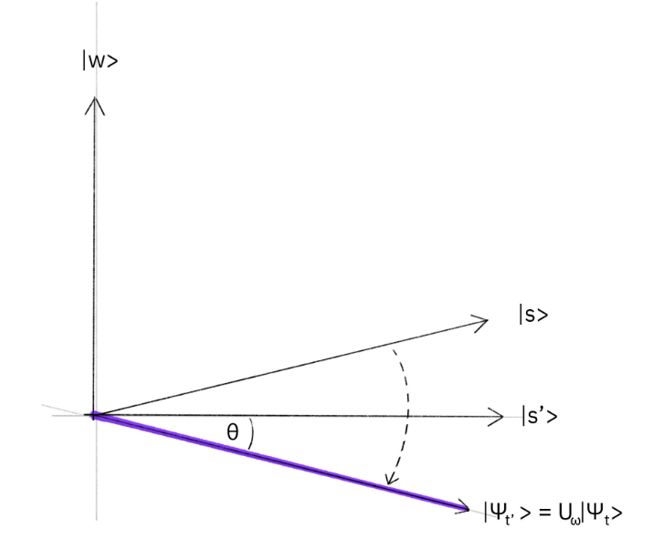
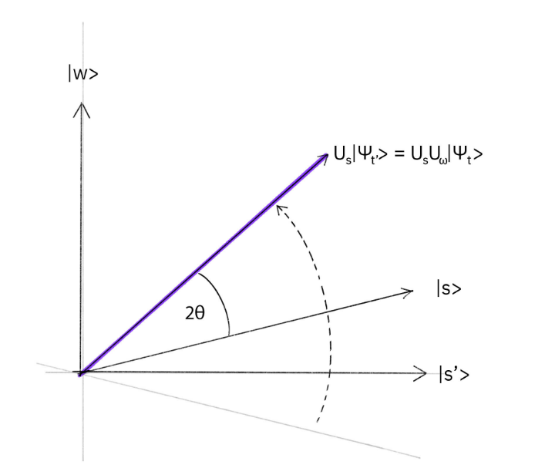
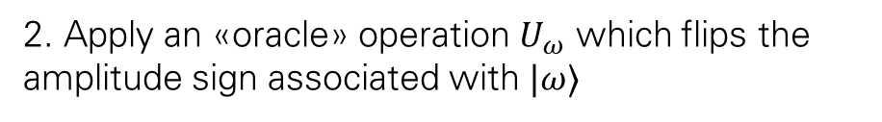
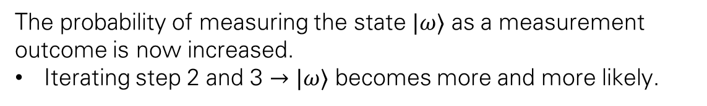
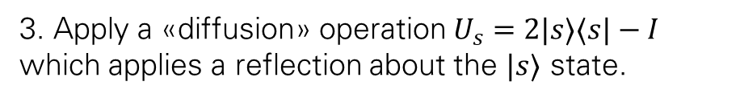
Grover search II
2. Apply an «oracle» operation $U_{ω}$ which flips the amplitude sign associated with $|ω⟩$
3. Apply a «diffusion» operation $U_{s}=2|s⟩⟨s|−I$ which applies a reflection about the $|s⟩$ state.
The probability of measuring the state $|ω⟩$ as a measurement outcome is now increased.
Iterating step 2 and 3 $→$ $|ω⟩$ becomes more and more likely.
8

Slide 10
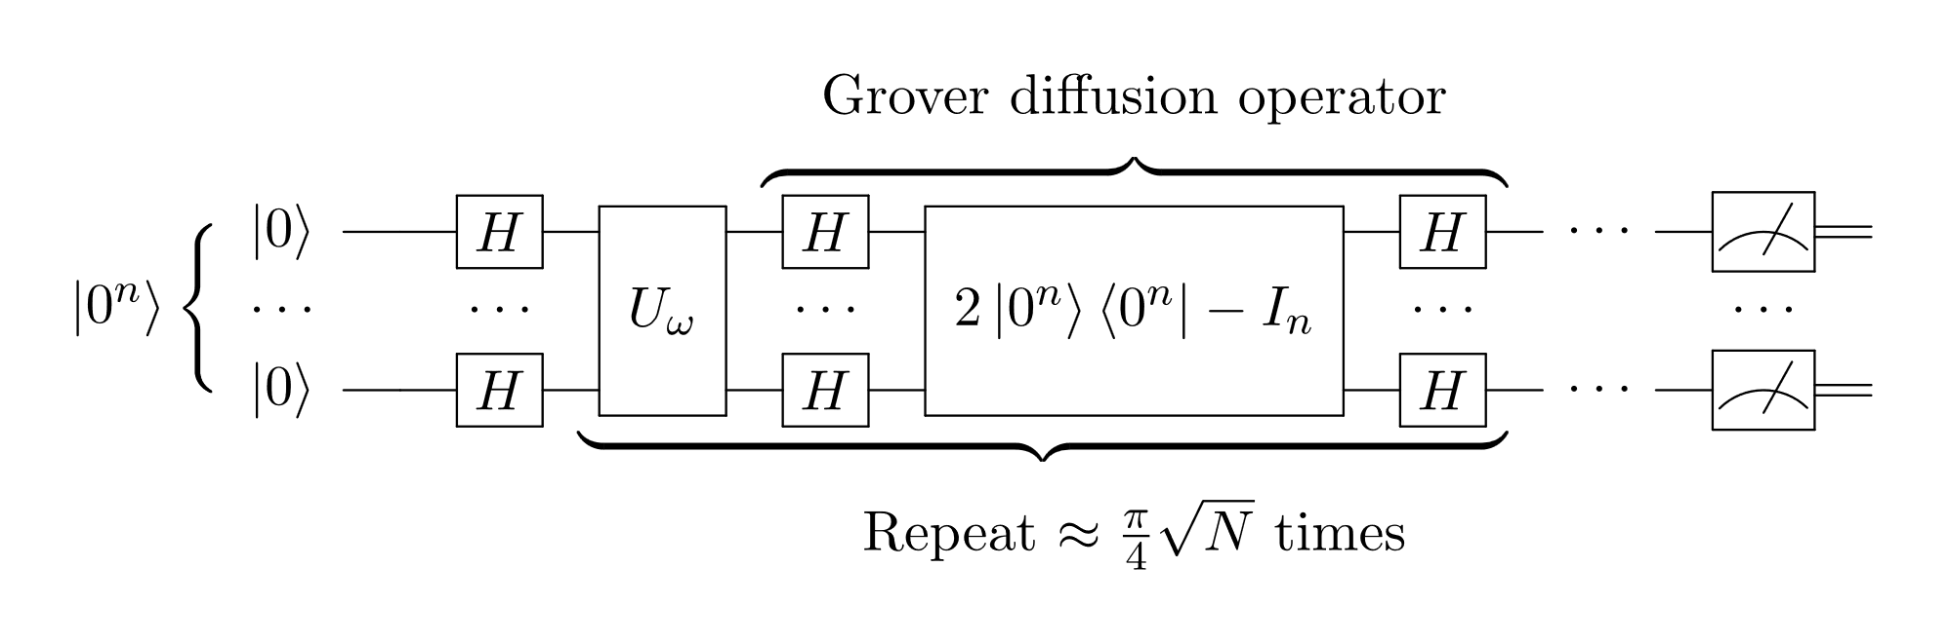
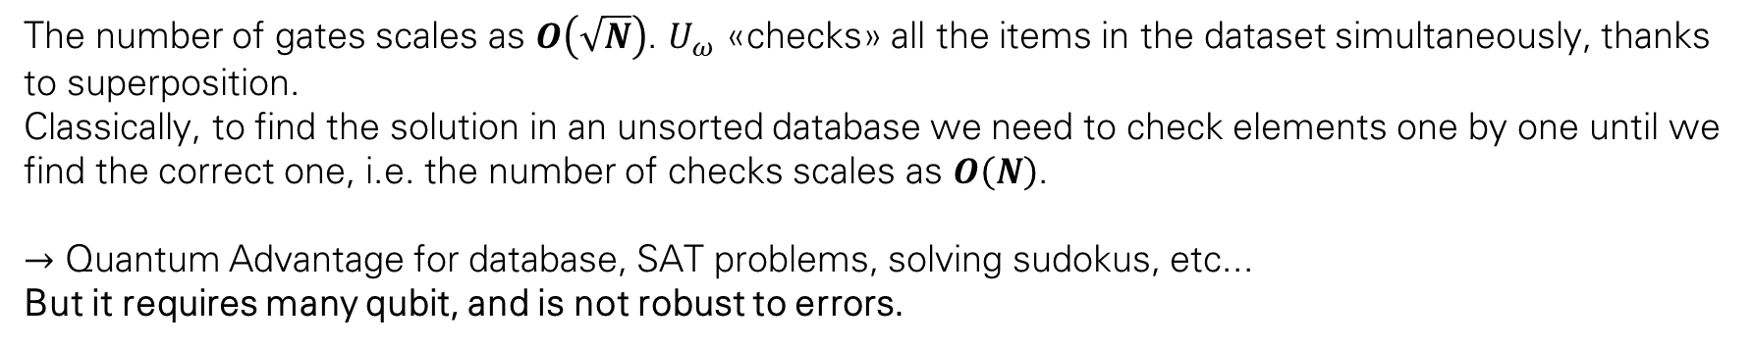
Grover search iiI
The number of gates scales as $O\left(\sqrt{N}\right)$. $U_{ω}$ «checks» all the items in the dataset simultaneously, thanks to superposition.
Classically, to find the solution in an unsorted database we need to check elements one by one until we find the correct one, i.e. the number of checks scales as $O\left(N\right)$.
$→$ Quantum Advantage for database, SAT problems, solving sudokus, etc...
But it requires many qubit, and is not robust to errors.
9

Slide 11
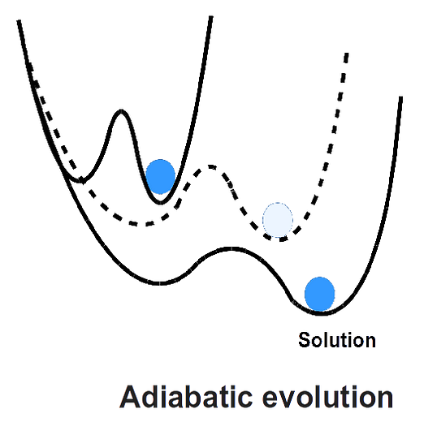
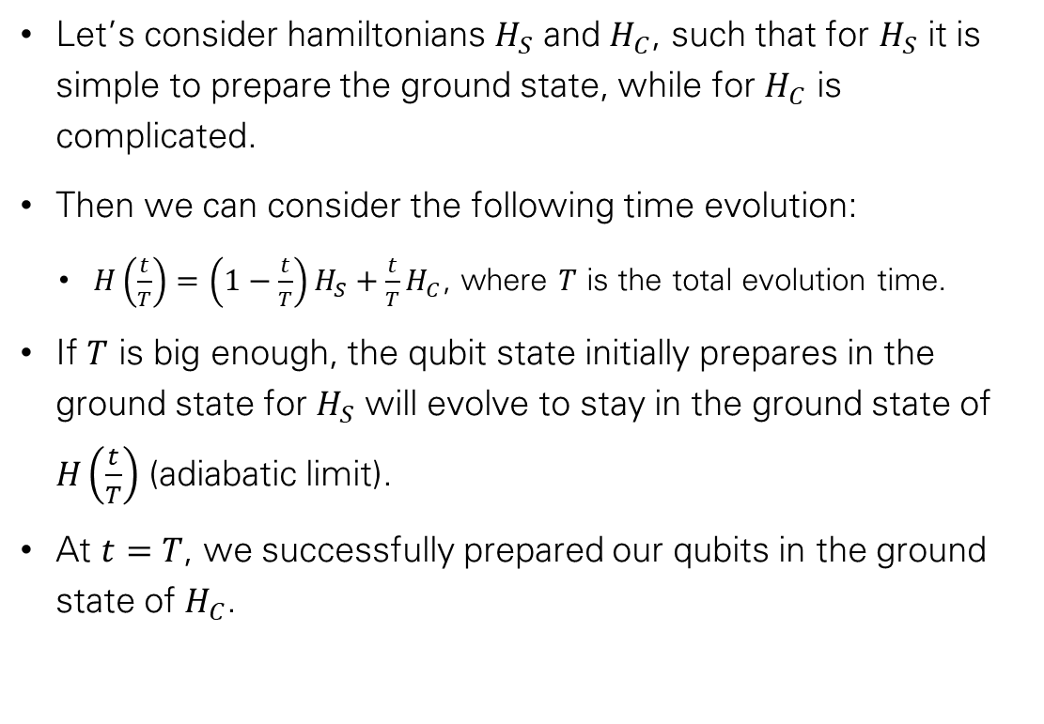
Adiabatic quantum computing
Let’s consider hamiltonians $H_{S}$ and $H_{C}$, such that for $H_{S}$ it is simple to prepare the ground state, while for $H_{C}$ is complicated.
Then we can consider the following time evolution:
  $H\left(\frac{t}{T}\right)=\left(1−\frac{t}{T}\right)H_{S}+\frac{t}{T}H_{C}$, where $T$ is the total evolution time.
If $T$ is big enough, the qubit state initially prepares in the ground state for $H_{S}$ will evolve to stay in the ground state of $H\left(\frac{t}{T}\right)$ (adiabatic limit).
At $t=T$, we successfully prepared our qubits in the ground state of $H_{C}$.
10

Slide 12
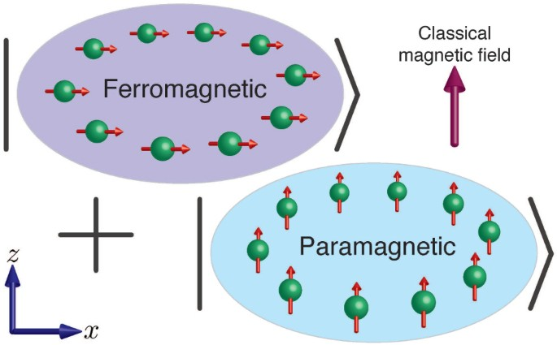
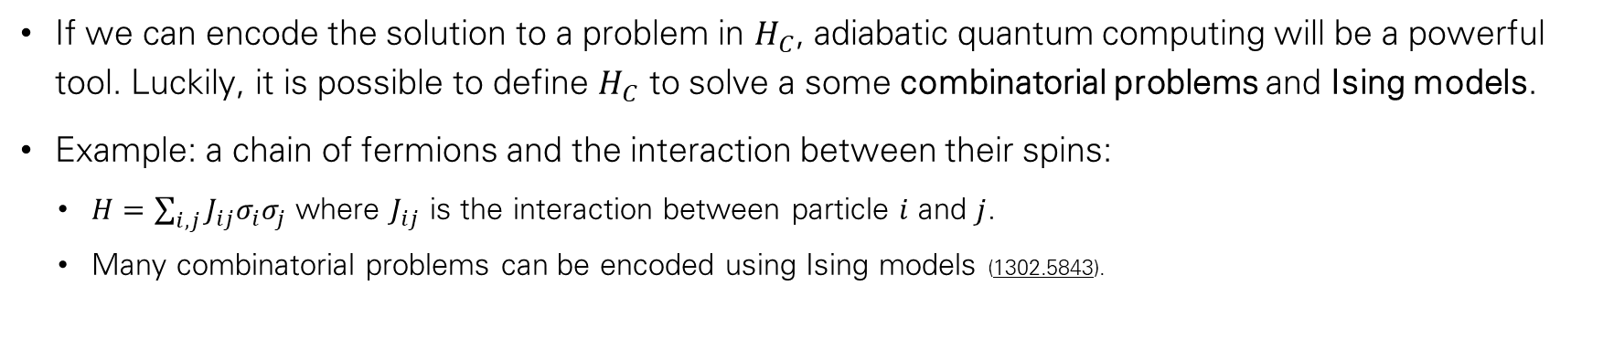
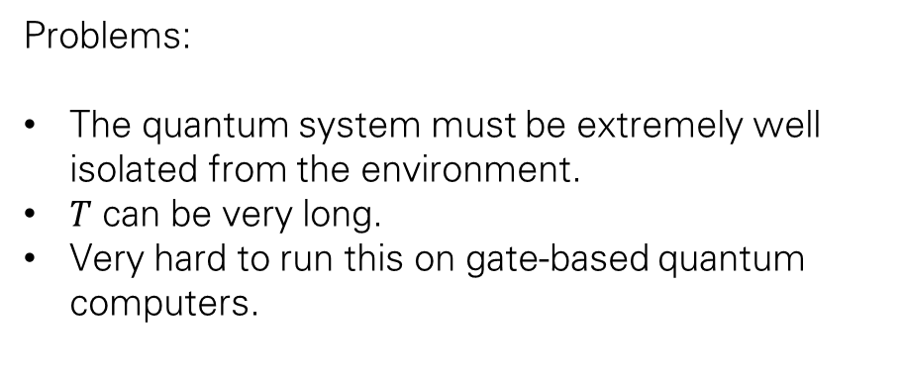
Adiabatic qc in practice
If we can encode the solution to a problem in $H_{C}$, adiabatic quantum computing will be a powerful tool. Luckily, it is possible to define $H_{C}$ to solve a some combinatorial problems and Ising models.
Example: a chain of fermions and the interaction between their spins:
  $H=\sum_{i, j}^{ }{J_{ij}σ_{i}σ_{j}}$ where $J_{ij}$ is the interaction between particle $i$ and $j$.
  Many combinatorial problems can be encoded using Ising models (1302.5843).
Problems:
The quantum system must be extremely well isolated from the environment.
$T$ can be very long.
Very hard to run this on gate-based quantum computers.
11

Slide 13
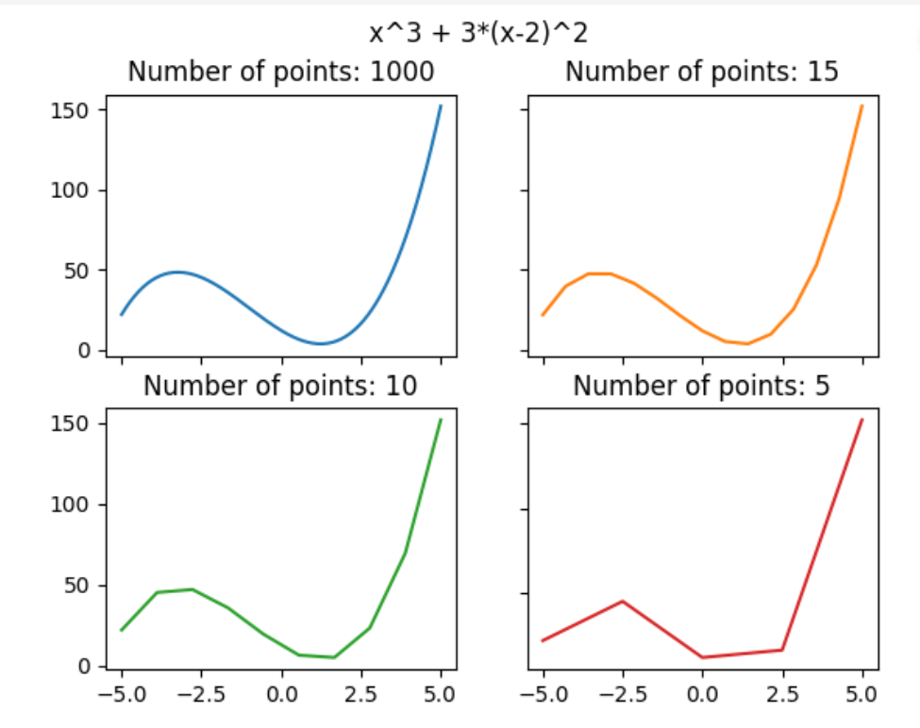
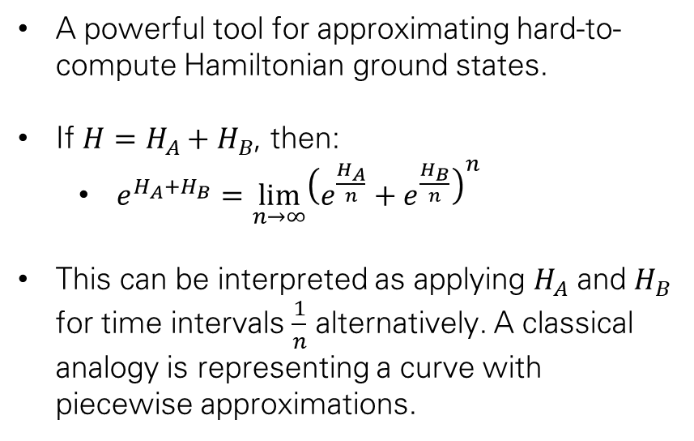
trotterization
A powerful tool for approximating hard-to-compute Hamiltonian ground states.
If $H=H_{A}+H_{B}$, then:
  $e^{H_{A}+H_{B}}=\lim_{n→∞}{\left(e^{\frac{H_{A}}{n}}+e^{\frac{H_{B}}{n}}\right)}^{n}$
This can be interpreted as applying $H_{A}$ and $H_{B}$ for time intervals $\frac{1}{n}$ alternatively. A classical analogy is representing a curve with piecewise approximations.
12

Slide 14
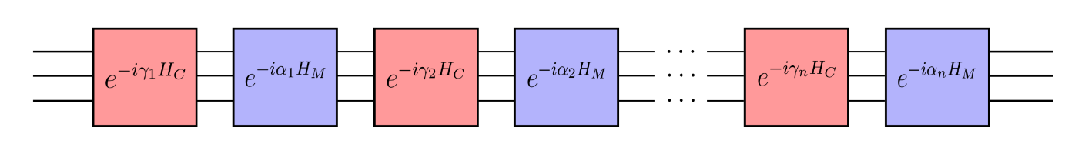

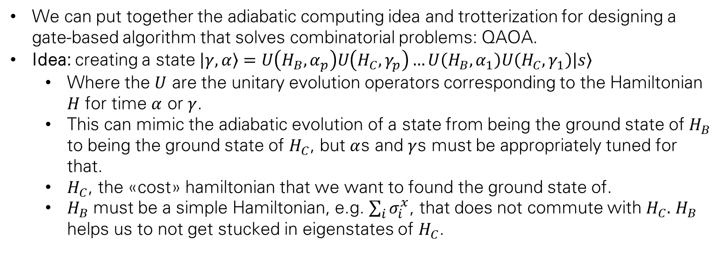
Quantum approximate optimization algorithm
We can put together the adiabatic computing idea and trotterization for designing a gate-based algorithm that solves combinatorial problems: QAOA.
Idea: creating a state $\left|γ, α\right\rangle =U\left(H_{B}, α_{p}\right)U\left(H_{C}, γ_{p}\right)…U\left(H_{B}, α_{1}\right)U\left(H_{C}, γ_{1}\right)\left|s\right\rangle$
  Where the $U$ are the unitary evolution operators corresponding to the Hamiltonian $H$ for time $α$ or $γ$.
  This can mimic the adiabatic evolution of a state from being the ground state of $H_{B}$ to being the ground state of $H_{C}$, but $α$s and $γ$s must be appropriately tuned for that.
  $H_{C}$, the «cost» hamiltonian that we want to found the ground state of.
  $H_{B}$ must be a simple Hamiltonian, e.g. $\sum_{i}^{ }{σ_{i}^{x}}$, that does not commute with $H_{C}.$ $H_{B}$ helps us to not get stucked in eigenstates of $H_{C}$.
How can we tune the time-steps $α$ and $γ$?
13

Slide 15
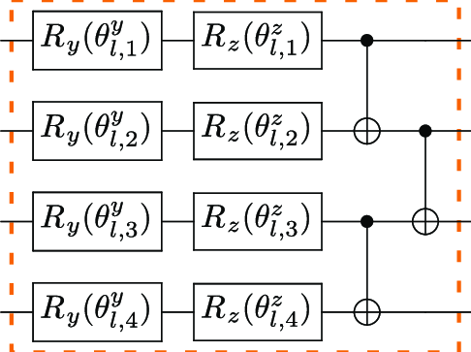
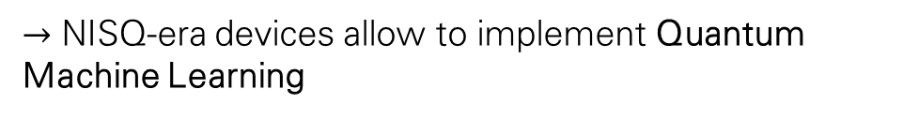
Nisq-era parametric quantum circuits
A prominent approach to quantum algorithms, typically robust to errors and suitable for NISQ devices.
General idea: parametrizing quantum gates, allowing us to:
  Minimize complicated cost functions
    Quantum Neural Networks, Quantum Eigensolvers, ...
  Encode classical data in large Hilbert spaces:
    Amplitude/angle embedding, Quantum Kernels, ...
$→$ NISQ-era devices allow to implement Quantum Machine Learning
14

Slide 16
Quantum machine learning
A vast research field in rapid expansion.
Tipically divided into four cathegories:
Classical, or quantum-inspired classical models for analysing classical data.
Quantum models for analysing classical data
  New approaches for data analysis in physics
Classical, or quantum-inspired classical models for analysing quantum data.
Quantum models for analysing quantum data
  May prove to be useful in quantum sensing.
15

Slide 17
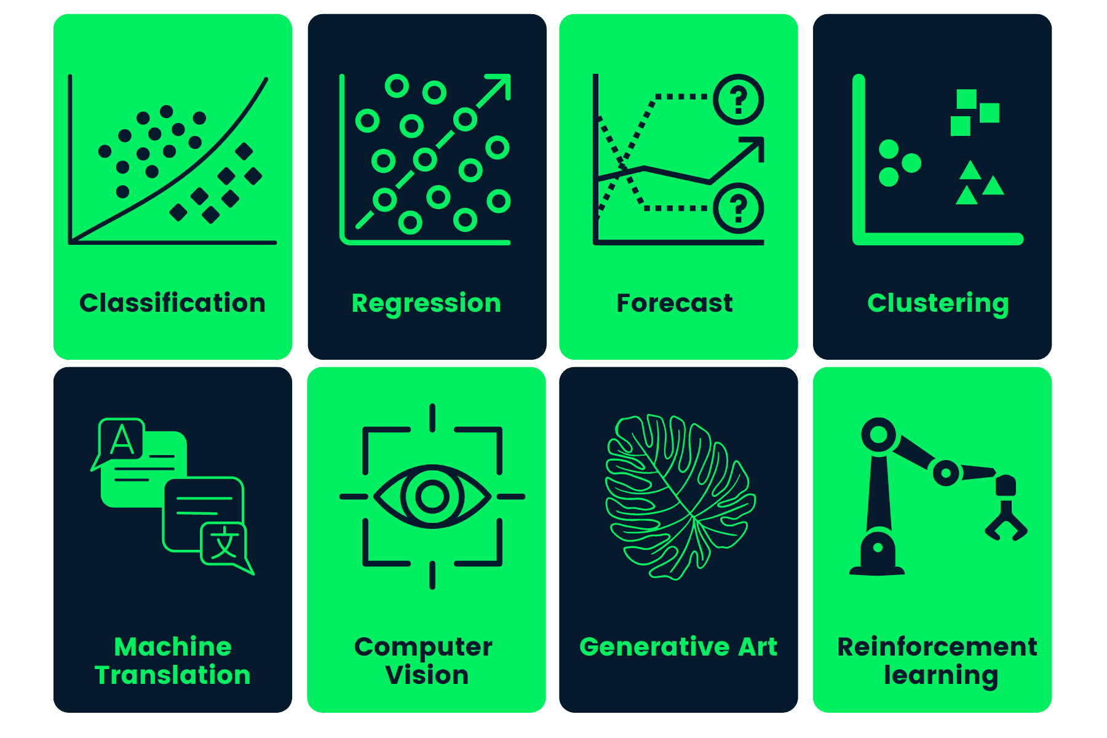
Digression: machine learning
Resolving problems without explicit programming through data-oriented approaches.
A very typical approach is to give a model many degrees of freedom, and looking for the best way to fix their values, i.e. Trying to minimize a cost function, which is related to how well a model solves the problem.
In a neural network, such degrees of freedom are the weights that connect the neurons trough different layers.
Minimization occurs though stochastic gradient descent.
16

Slide 18
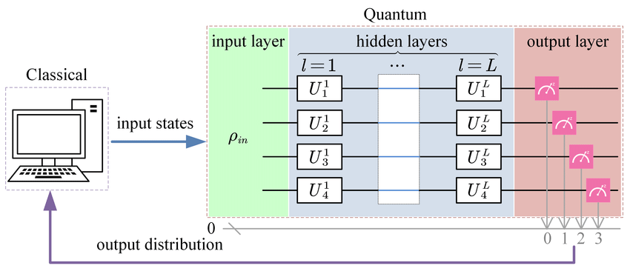
Quantum neural networks
Recipee:
Encoding data in a quantum Hilbert space.
Weighted gates (quantum layers).
Output retrieved by running the circuit many times and averaging
Updating the weights via classical or quantum method.
Sometimes, classical NN layers may be useful (hybrid QNNs) for dimensionality reductions.
Quantum layers topology might be inspired by the physics of the process, or enforce particular rules for the system.
(or quantum)
17

Slide 19
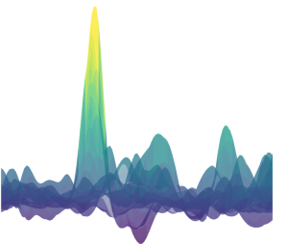
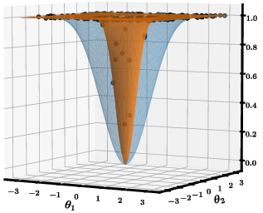
Qnn learning methods
Hard to minimize cost funciton
Finding the global minimum of a QNN loss function is nontrivial:
Complicated landscapes with many local minima.
Occurrence of barren plateaus when increasing the number of qubits.
Noise of quantum device and statistical fluctuations from repeating the measurements.
Possible approaches:
Classical evaluation of stochastic gradient descent through finite difference
Quantum evaluation of stochastic gradient descent through finite difference
Quantum evaluation of stochastic gradient descent through exact gradient evaluation through the Parameter-shift rule.
Barren plateau example
18

Slide 20

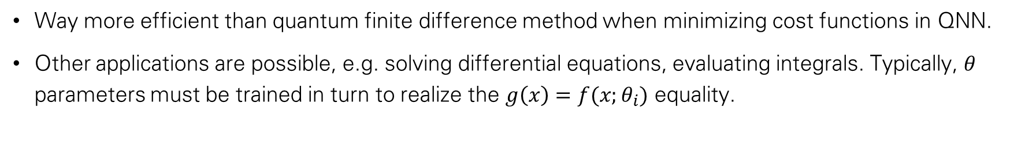
Parameter-shift rule
If we can express a function $g(x)$ as $g\left(x\right)=f(x;θ_{i})$ where $x, θ_{i}$ are parameters of a quantum circuit, i.e:
Then we can write the exact derivative of the function as:
Way more efficient than quantum finite difference method when minimizing cost functions in QNN.
Other applications are possible, e.g. solving differential equations, evaluating integrals. Typically, $θ$ parameters must be trained in turn to realize the $g\left(x\right)=f(x;θ_{i})$ equality.
19

Slide 21
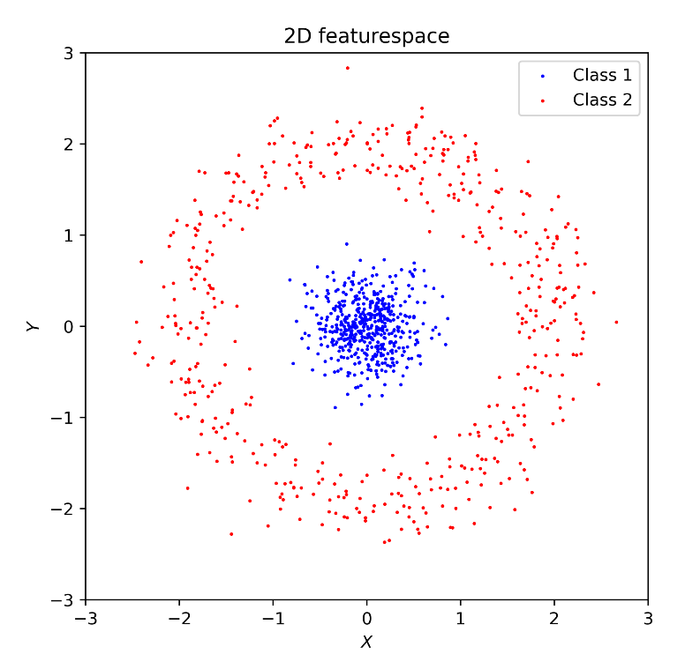
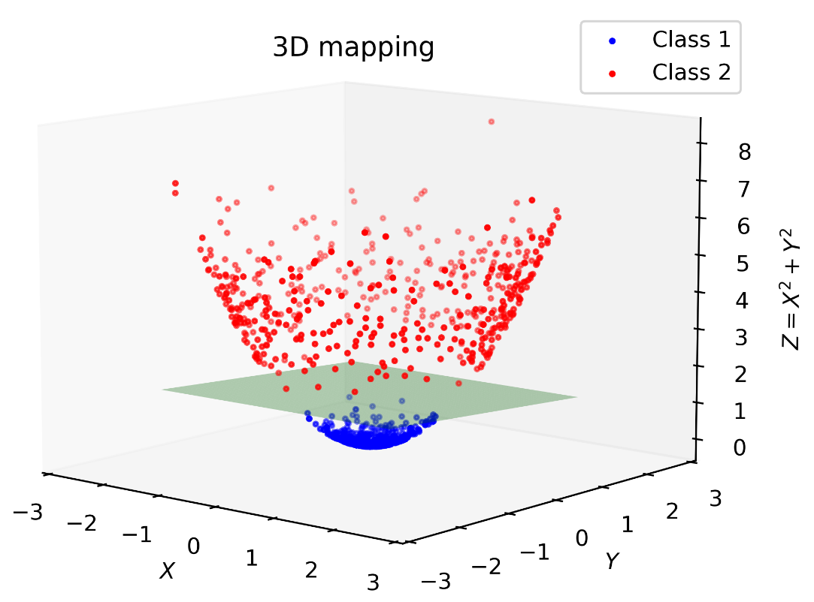
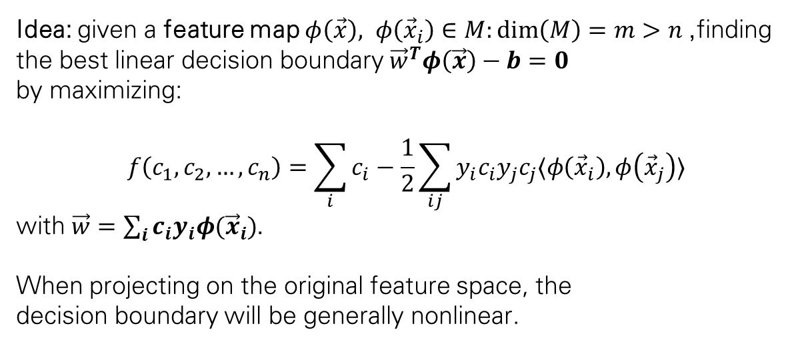
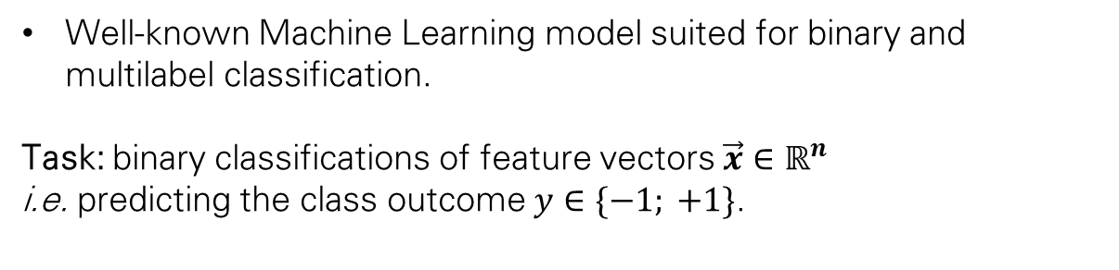
Support vector machine
Well-known Machine Learning model suited for binary and multilabel classification.
Task: binary classifications of feature vectors $\vec{x}∈ℝ^{n}$
i.e. predicting the class outcome $y∈\{−1; +1\}$.
Idea: given a feature map $φ\left(\vec{x}\right), φ\left({\vec{x}}_{i}\right)∈M:\dim\left(M\right)=m>n$, finding the best linear decision boundary ${\vec{w}}^{T}φ\left(\vec{x}\right)−b=0$
by maximizing:
$$f\left(c_{1}, c_{2}, …, c_{n}\right)=\sum_{i}{c_{i}}−\frac{1}{2}\sum_{ij}{y_{i}c_{i}y_{j}c_{j}〈φ\left({\vec{x}}_{i}\right), φ\left({\vec{x}}_{j}\right)〉}$$
with $\vec{w}=\sum_{i}{c_{i}y_{i}φ({\vec{x}}_{i})}$.
When projecting on the original feature space, the
decision boundary will be generally nonlinear.
20

Slide 22
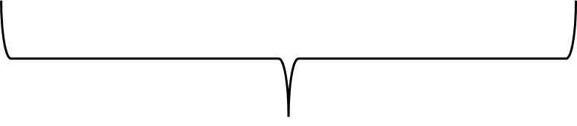

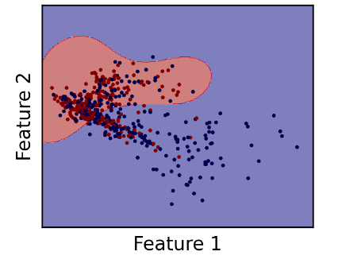

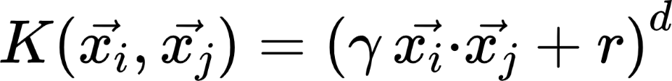


Svm kernel functions
$$f\left(c_{1}, c_{2}, …, c_{n}\right)=\sum_{i}{c_{i}}−\frac{1}{2}\sum_{ij}{y_{i}c_{i}y_{j}c_{j}〈φ\left({\vec{x}}_{i}\right), φ\left({\vec{x}}_{j}\right)〉}$$
High-dimensional featuremaps are implicitly defined by a kernel function, which keeps the original feature dimension (hence more efficient to compute).
The kernel function can be interpreted as a distance between samples from the same dataset.
Kernel function
Common kernel choices:
Linear
Polynomial
Gaussian
21

Slide 23

Quantum svm
The kernel function is a non-trainable function of the inputs. Other weights that appears in the loss function can be trained classically.
Simple loss function landscape (it’s a quadratic form, easy to find global minimum).
The kernel function determines the overall classification performance, and model’s expressivity.
Quantum Support Vector Machine relies on a Quantum Computer to evaluate the kernel function, i.e. a Quantum Kernel.
Conjecture: some Quantum Kernels are too hard to compute classically, and such kernels may lead better classification performance.
22

Slide 24



Quantum kernels
Promoting the classical feature mapping to a quantum state:
Quantum circuits of with this structure are suitable kernels.
Feature maps are still implicitly defined.
Kernel function is still a measure of similarity between different samples.
Pros:
Hilbert space grows rapidly with qubit’s number
  Expressive classifiers.
Quantum kernels are generally hard to compute classically
  No classical counterpart.
Good results even with small sized circuits
  Is a NISQ-era algorithm.
Cons:
Lack of featuremap explainability
  Unintuitive relation between circuit and outcome.
Usually set arbitrarily
  Problem of chosing a good Quantum Kernel.
Room for quantum advantage.
23

Slide 25


Quantum kernel issues
One risk of quantum kernels, which is observed when the number of qubit increases, is the tendency to map the initial features very «far from each other», because the Hilbert space have a big dimension. This leads to overfitting, i.e. a limited prediction power of the model to data unseen during the training phase, and additionally, due to NISQ hardware noise, kernel values $K\left(x_{i}, x_{j}\right)≪1$ would be very hard to estimate.
One technique that mitigates this effect is the Projected Quantum Kernel, in which part of the quantum information is trown away through partial tracing.
24

Slide 26
conclusions
Quantum computing is a field in rapid expansion, which is gaining more and more interests.
Quantum advantage has been demonstrated (on paper) for many-qubits, fault-tolerant computing.
Nowadays, no quantum advantage has been proven experimentally, principally due to hardware limitations.
However, modern NISQ-era computing is leading to several intriguing applications, one of the most prominent field being Quantum Machine Learning.
Parametrized quantum circuits are the key for QML success:
  Variational: trainable circuits, suitable QNN layers, QAOAs, ...
  Feature-embedding: mapping data in high-dimensional Hilbert spaces, boosting discrimination power of classical algorithms.
25

