Slide 1

Finest High-quality Natural and synthetic polymer substrates and fibers innovative plasma treatments for fashion
MUSA Project- Spoke 5 Fashion
Rabia Maryam
PhD Student in Plasma Physics- 38th Cycle
Supervisor: Laura Russo Tutor : Professor Claudia Riccardi

Slide 2
Summary
  State of the art
  Fabrication of Graphene Oxide
  Characterization techniques
  Results
  Plasma treatment on Polymers
  Deposition of GO on Polymers
  Discussion
  Future Aspects

Slide 3
Motivation
Textiles going beyond clothing, actively contributing to well-being and comfort.
Reshaping textiles through nanoscale surface modifications and plasma treatment.
Introducing GO, rGO, and rGOQD’s coatings to adapt textiles to diverse applications (UV protection, antistatic, antibacterial, thermoregulating, photoluminescent finishes, improvement of mechanical properties, flexible supercapacitors, sensors) Nascimento et al. 2021[1].
Revolutionize antibacterial and comfortable (thermoregulating) textiles for clothing, paving the way for applications in healthcare, sportswear, and beyond.

Slide 4
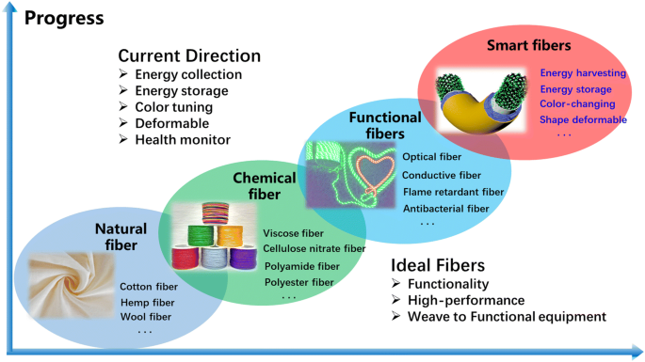
State of the Art
Innovation in Textile Industry: Weaving the future
"Traditional textiles face challenges—limited durability, suboptimal wettability, and a lack of specialized functionalities. These challenges demand innovative solutions to propel textiles into the future.
Plasma Treatment on textiles
Coating on Textiles
Different Textile materials respond uniquely depending on structures.
Fig 1. Innovation in textile industry

Slide 5
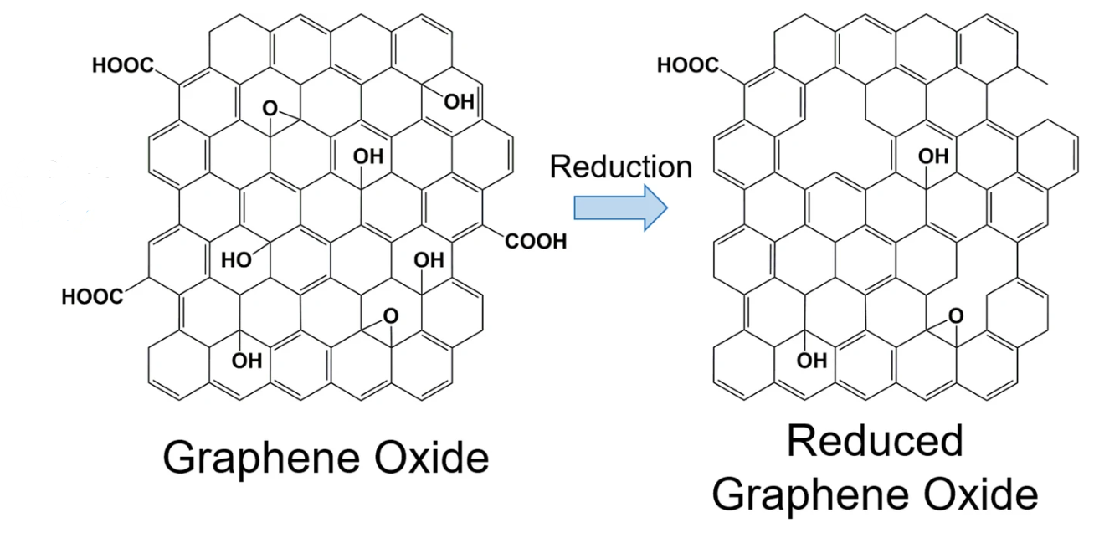
State of the Art
Graphene Oxide (GO), rGO, rGO-QD’s: As a coating material
Graphene Oxide, formerly called graphitic oxide, is a compound of carbon, oxygen, and hydrogen, obtained by treating graphite with strong oxidizers
Structurally, GO can be visualized as a graphene sheet with its basal plane decorated by oxygen-containing groups.
GO can be reduced to acquire rGO. Reduction eliminates the majority of the carbonyl, carboxyl, hydroxyl, and epoxy groups on the GO sheets
Fig 2. Structure of GO and rGO

Slide 6
State of the Art
Graphene Oxide (GO), rGO, rGQD’s: As a coating material
rGO-QDs, as a new type of zero-dimension quantum dot, have become one of the hottest interests compared to graphene form due to their unique properties originating from the quantum confinement effect
rGO-QDs have non-toxicity, chemical stability, excellent photostability and biocompatibility

Slide 7
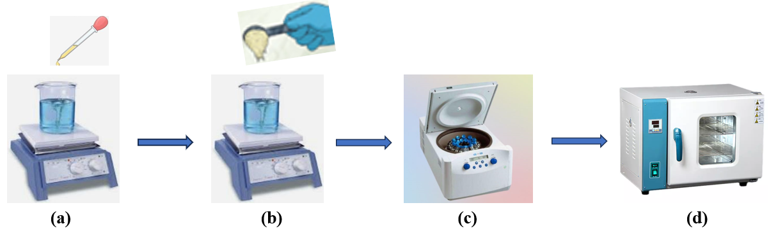
State of the Art
Methods:
Modified Humers Method ---- for fabrication of GO
Simple Dipping Method ----- for deposition
Fig. 3 Modified Humers Method (a) Stirring condition (b) Stirring condition adding powders (c) Centrifugation (d) Drying in Oven

Slide 8
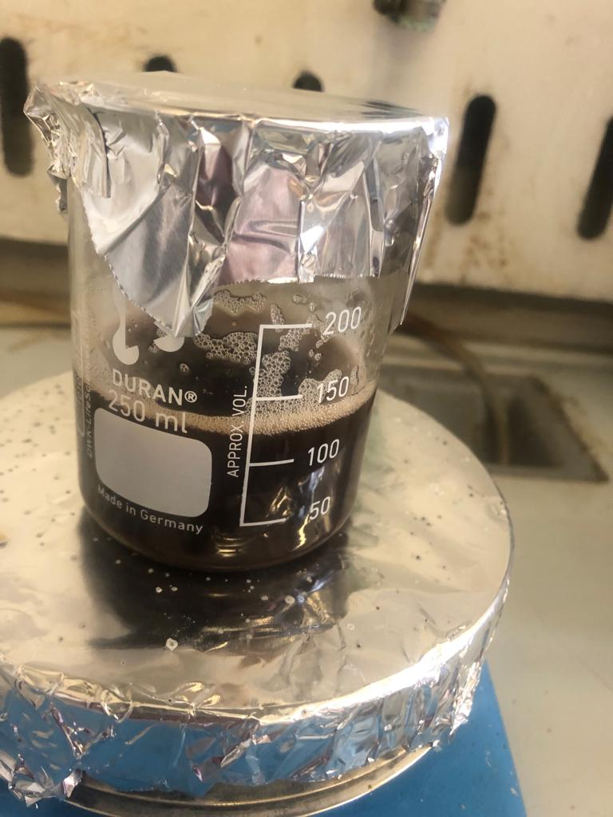
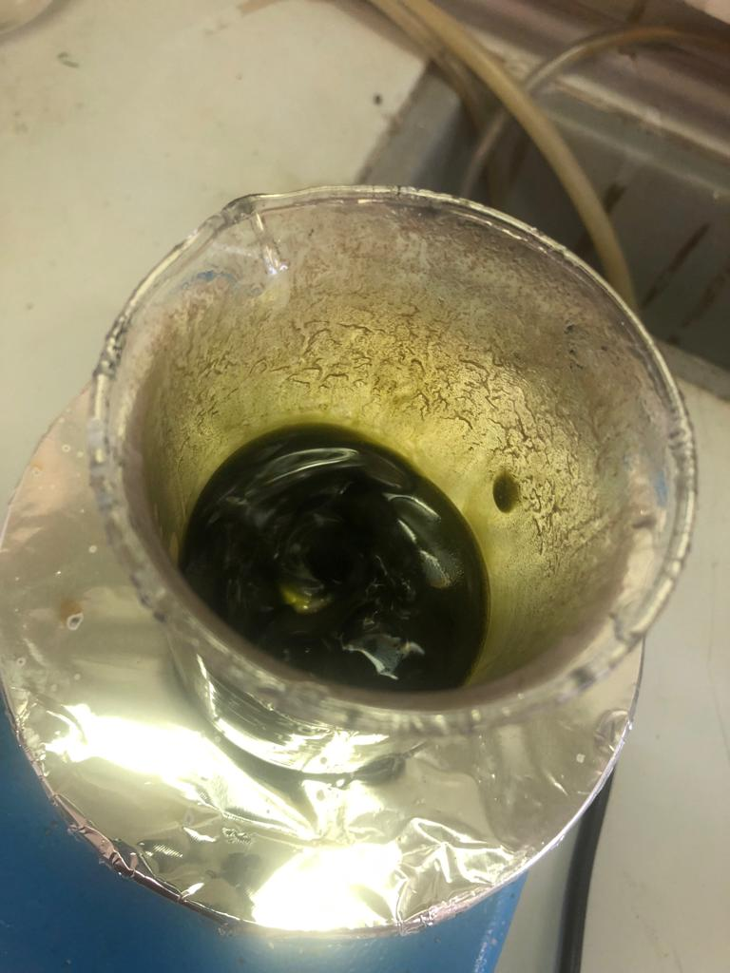
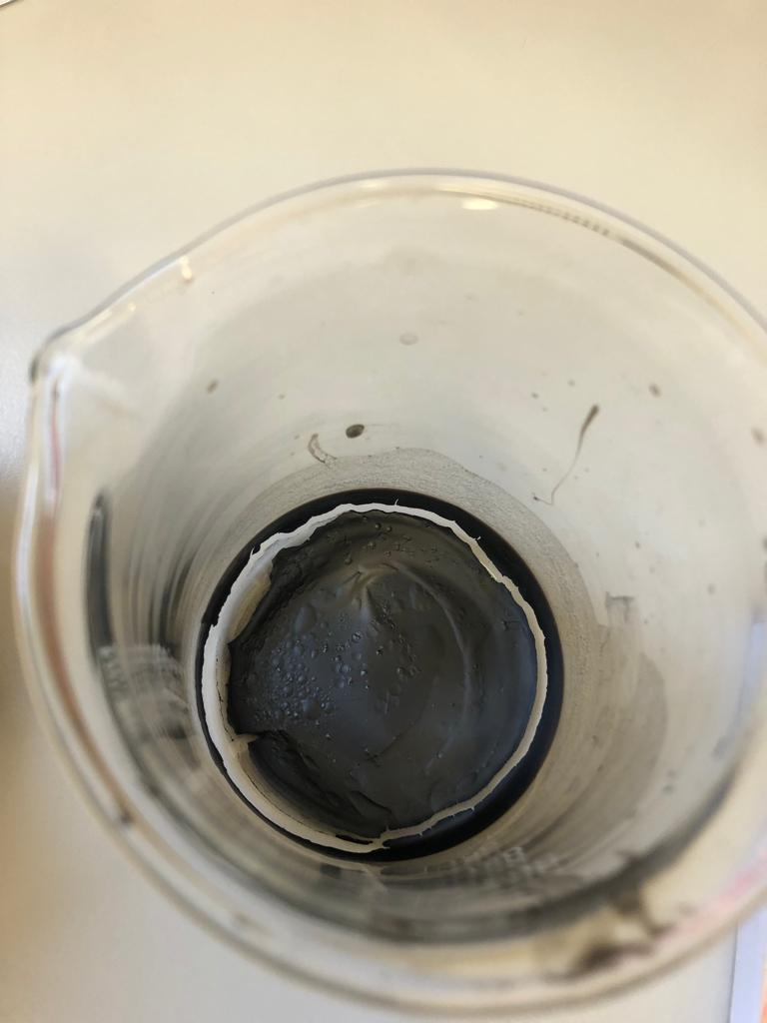
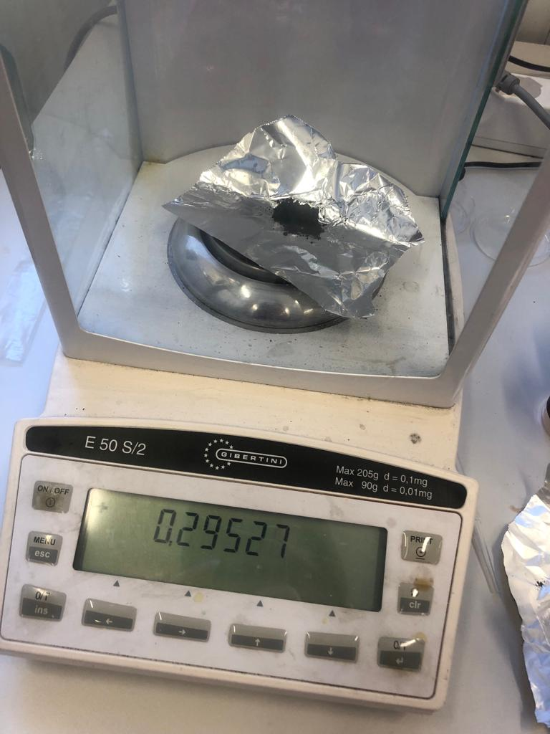
Fabrication of Graphene Oxide
Modified Humers Method Zaaba. et.al 2017[2]
27 ml of sulfuric acid (H₂SO₄) and 3 ml of phosphoric acid (H₃PO₄) (volume ratio 9:1) were mixed and stirred for several minutes.
0.225 g of graphite powder was added into the mixing solution under stirring condition
1.32 g of potassium permanganate (KMnO₄) was then added slowly into the solution.
Stirred for 6 hours until the solution became dark green.
To eliminate excess KMnO₄, 0.675 ml of hydrogen peroxide (H₂O₂) was dropped slowly and stirred for 10 minutes
10 ml of hydrochloric acid (HCl) and 30 ml of deionized water (DIW) were added and centrifuged 3 times each for 10 minutes
The washed GO solution was dried using the oven at 90 °C for 24 hours to produce the powder of GO
At Stirring condition
The solution became dark green
GO after drying
Fabricated GO at weight balance

Slide 9
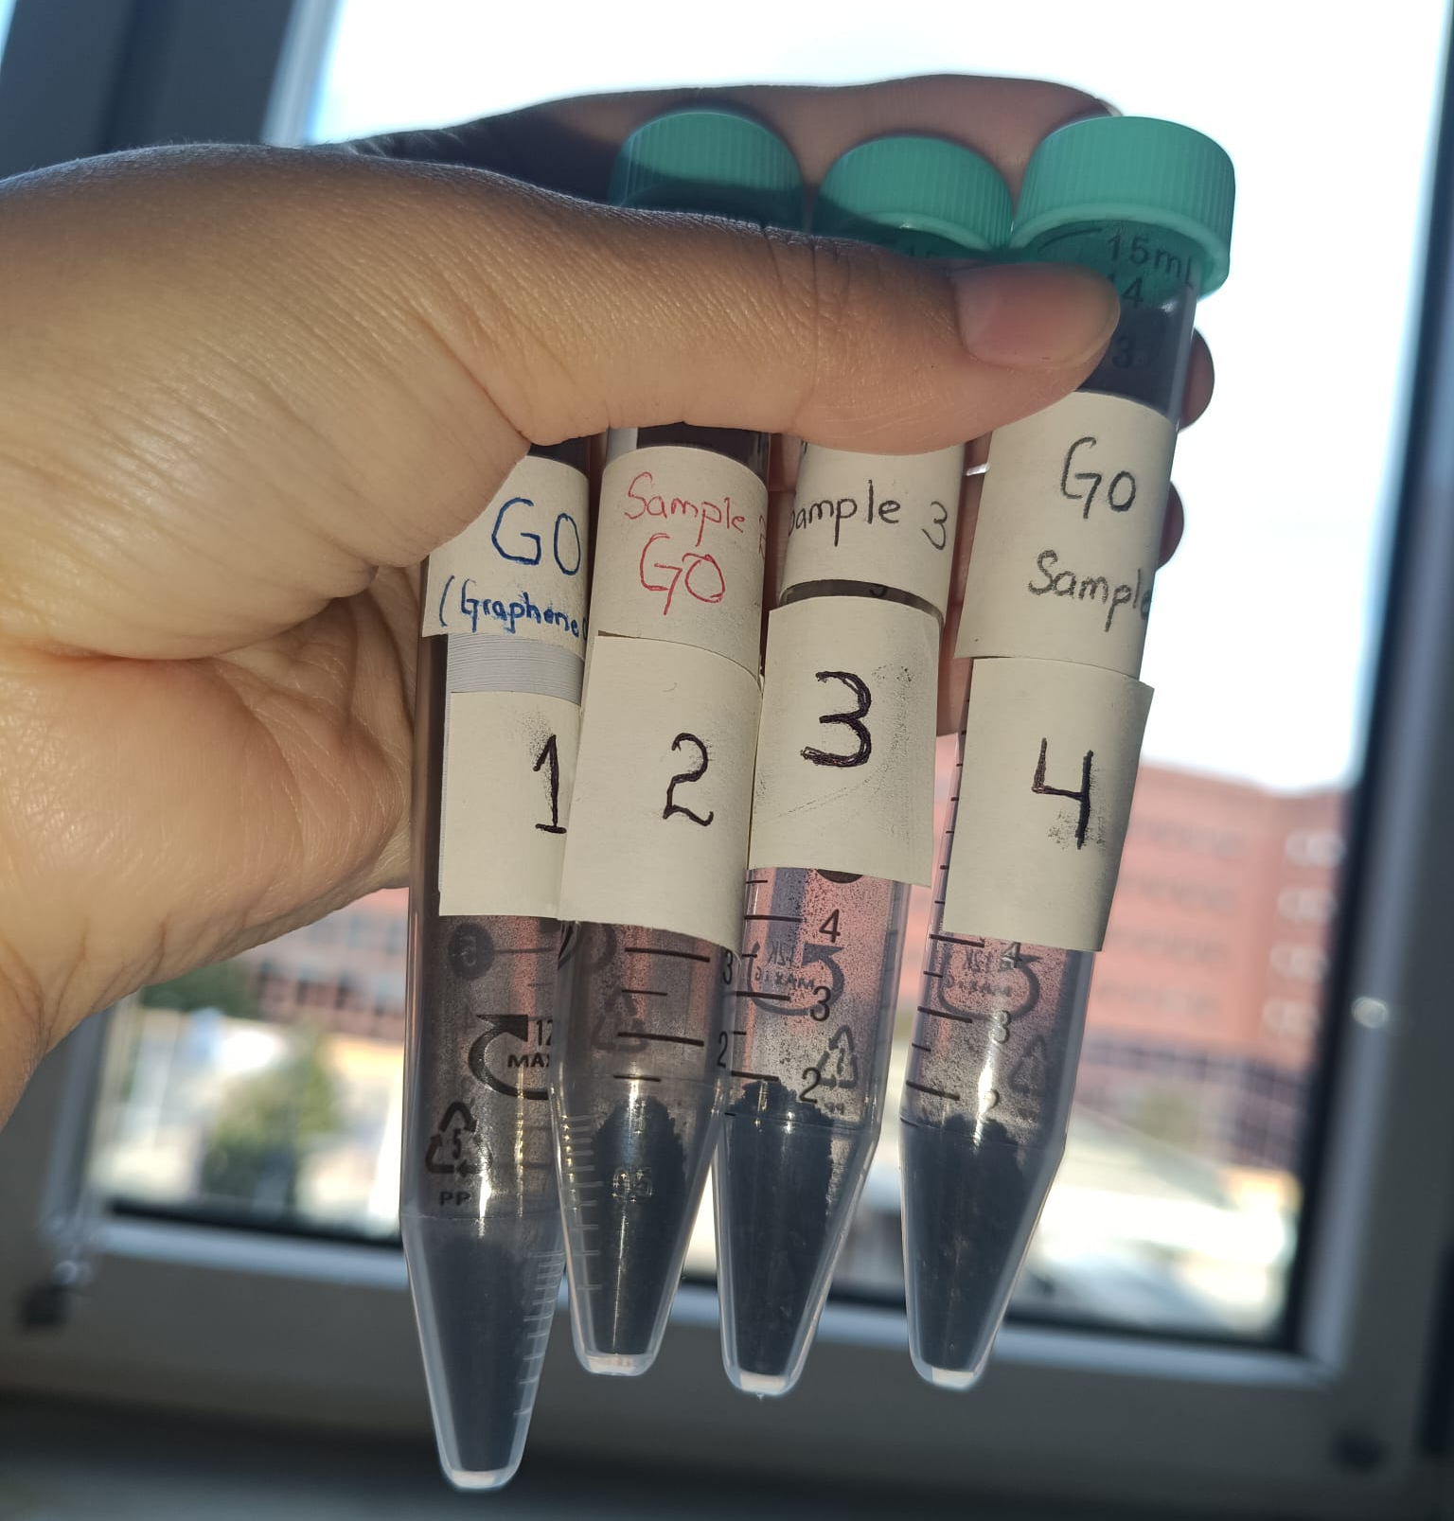
Fabrication of Graphene Oxide
Prepared 4 batches of Graphene Oxide
Each batch contains 4 days of fabrication.
Table 1: Weight and characterizations done of fabricated graphene oxide
 | 1 | 2 | 3 | 4
gram | 0.290 | 0.220 | 0.295 | 0.246
XRD | ✓ | ✓
RAMAN | ✓ | ✓
SEM | ✓ | ✓

Slide 10



Characterization Techniques
RAMAN SPECTROSCOPY
X-RAY SPECTROSCOPY
SCANNING ELECTRON MICROSCOPE
Scanning Electron Microscope
For Structural and Molecular Vibrations
For Structural Analysis
For Morphological Analysis
* Raman and XRD characterization was done by the collaboration of Material Science Department of Milano Bicocca and SEM was done by the collaboration of the Centre of Microscopy.

Slide 11
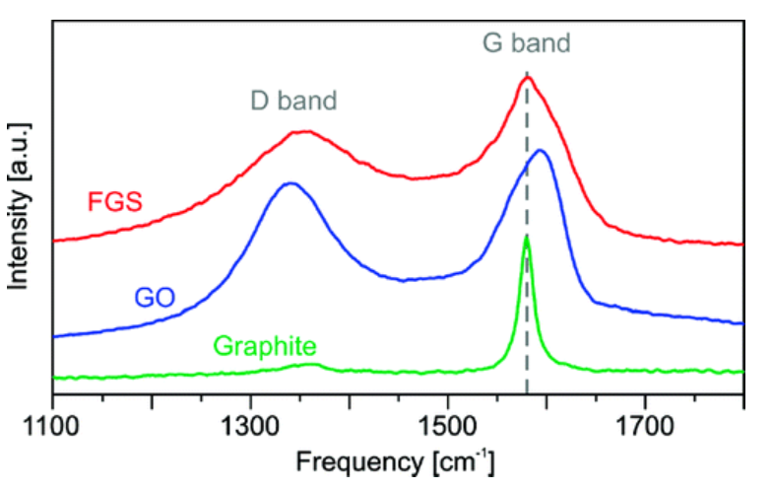
Results
  Raman Spectroscopy of GO
Fig. 4 Raman of Fabricated Graphene Oxide and Graphite Powder
Fig. 5 Raman of Graphite Powder and Graphene Oxide in Literature. Kudin et al. 2008 [2]

Slide 12
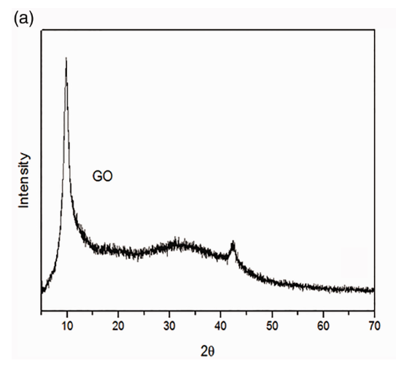
Results
Table 2: Crystallite size, lattice strains, and dislocation density calculation for GO
  X-ray Spectroscopy of GO
S.No | hkl | d-spacing (nm) | 2θ(degrees) | FWHM | Crystallite size (nm) | Lattice Strain | Dislocation density
1 | 001 | 0.84 | 10.3 | 0.16 | 50.2 | 0.808 | 0.0003
2 | 111 | 0.21 | 42.6 | 0.1 | 92.7 | 0.111 | 0.0001
Average crystallite size = 71.45nm
Fig. 6 XRD of Fabricated Graphene Oxide
Fig. 7 XRD of Graphene Oxide in Literature Thy, et al. 2020[3]

Slide 13
Results
  Scanning electron microscope (SEM) of Graphite powder and GO
Fig. 8 SEM images of Graphene Oxide at 1 μm,10 μm, 100 μm, and 200nm
Fig. 9 SEM images of Graphite Powder at 1 μm,10 μm, 100 μm, and 200nm

Slide 14
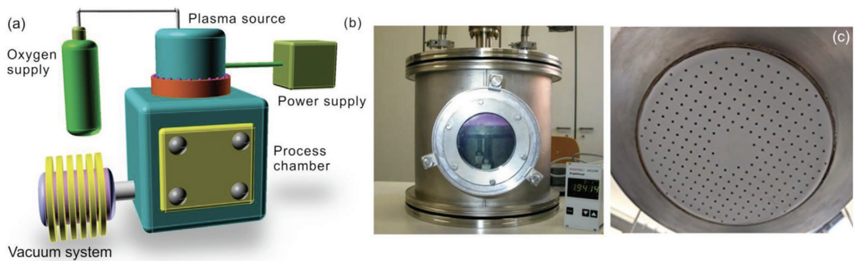
Plasma Treatment Setup
Plasma treatments were carried out to enhance surface area and change the wettability by chemical etching.
On polymeric (PET, PP, Teflon, Polycaprolactone) fabrics
Fig. 8 a) General schematics of the experimental setup, b) photograph of the process chamber with ignited plasma and of the upper aluminum plate (upper electrode) with about c) 250 holes of 2 mm diameter spaced at a distance of 10 mm

Slide 15
Plasma Treatment on Polyethylene tereftalato (PET)
The Oxygen-Plasma was performed by an inductively coupled generator with an output power of 100W at 13.56MHz.
The Pressure was assessed by a vacuum gauge of 1.5 ×10⁻¹ mbar.
The samples were placed in the discharge chamber, at a distance from the antenna between 2 and 5 cm, and treated for 2 min up to 30 min.

Slide 16
SEM Results of Non-Treated and Plasma-Treated (PET)
Fig 9. SEM images of non-treated PET Fabric at a) 100 μm b) 200nm
Fig 10. SEM images of 2mint Plasma-treated PET Fabric at a) 1μm b) 200nm
Fig 11. SEM images of 4mint Plasma-treated PET Fabric at a) 1μm b) 200nm

Slide 17
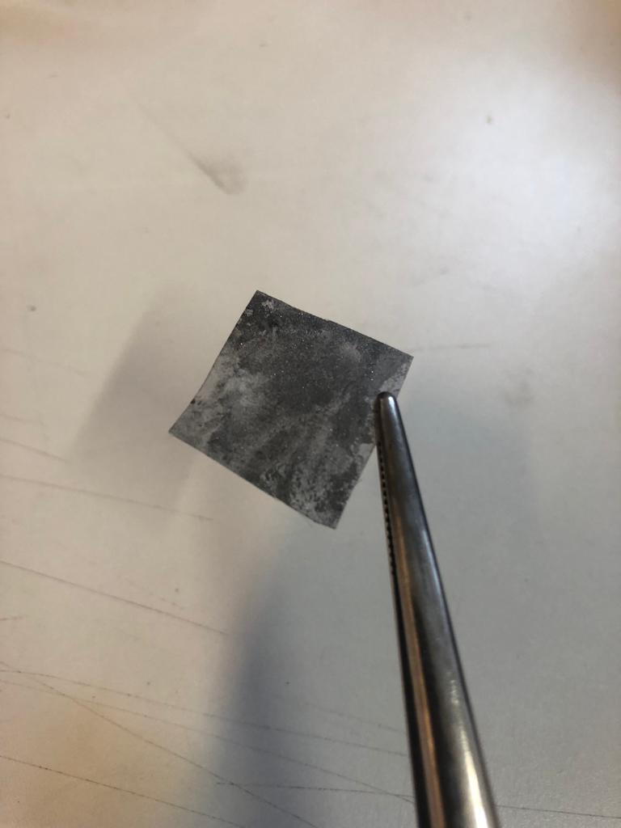
Deposition of Graphite and GO on PET
0.5% of GO and Graphite Powder is dispersed in the DI water and it is sonicated for 60 min.
The PET fabrics treated with plasma and non-treated are soaked in the solution of Graphite Powder and GO for 30 min
Fabrics are dried in a hot air oven at 80 °C for 30 min.
This process is repeated for several times to increase the adsorption of Graphite and GO.
Finally, the fabrics are washed to remove any unattached Graphite Powder and GO.
Dried again in an oven and kept in the desiccators
Fig. 12 Coated PET

Slide 18
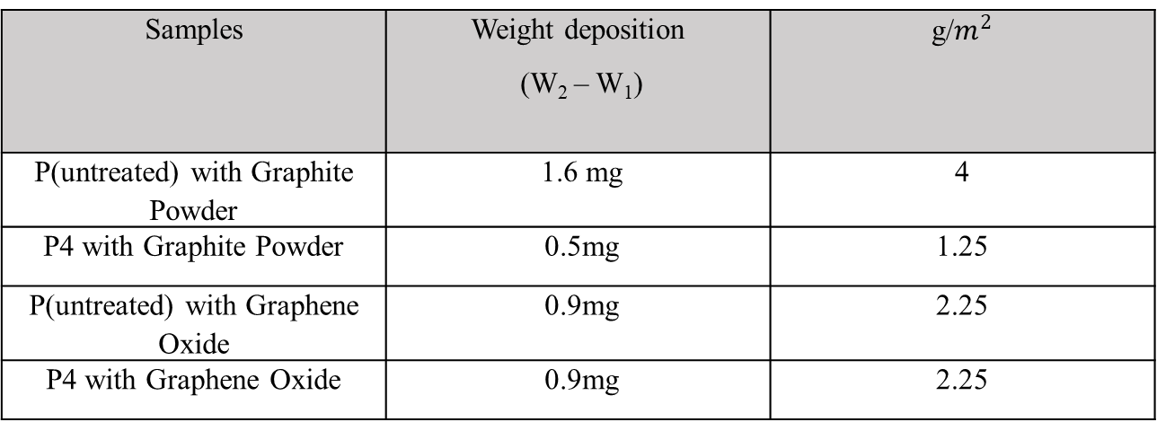
Water Contact Measurements
Table 3: Weight of samples after deposition
Table 4: Water Contact Angle Measurement of Samples
Samples | Weight deposition (W₂ – W₁)
P(untreated) with Graphite Powder | 1.6 mg | 4
P4 with Graphite Powder | 0.5mg | 1.25
P(untreated) with Graphene Oxide | 0.9mg | 2.25
P4 with Graphene Oxide | 0.9mg | 2.25
Samples | Contact Angles | Standard Deviation
P (untreated) | 113.4 ̊ | 6.09
P2 (2 mins oxygen-plasma treated), | 75.86 ̊ | 7.60
P4 (4 mins oxygen-plasma treated), | < 5 ̊ | -
P (untreated) coated with Graphite Powder | 91.5 ̊ | 7.04
P4 coated with Graphite Powder | 66.9 ̊ | 4.79
P (untreated) coated with Graphene Oxide | 26.7 ̊ | 4.5
P4 coated with Graphene Oxide (GO) | 57.9 ̊ | 1.97
In the case of plasma treatment the GO deposition did not change the wettability
Plasma changes the wettability while graphene will provide antibacterial, comfort, flexible supercapacitors, sensors, etc.
Next studies on GO release in time will be done.

Slide 19
SEM Results of Coating on PET Fabric
Fig 13. SEM images of non-treated PET Fabric coating with GO at a) 100 μm b) 200nm
Fig 14. SEM images of 4mint Plasma-treated PET Fabric coating with GO at a) 1μm b) 200nm
The coating of GO on PET covers almost all the fabric surface due to the particle size of Graphene Oxide. Next studies to reduce the GO size.

Slide 20


Discussion
Sizing of GO
Graphene Oxide Microparticles
Graphene Oxide Nanoparticles
Polymer Substrate
Polymer Substrate
Fig 15. Our Coated case
Fig 16. Required Coated case

Slide 21
Method to Reduce Particle Size
Graphene Quantum Dots
I will use the hydrothermal method.
For this I need a few things
    Teflon-lined Autoclave
    Dialysis bags
    Microporus membranes
    Some chemicals

Slide 22
Future Aspects 1
In the Future Quantum dots will be used.
Deposition of rGO QD’s nanoparticles on different textile materials
GO is an effective antibacterial agent. Antibacterial application will be used on rGO QDGO-coated textile materials

Slide 23
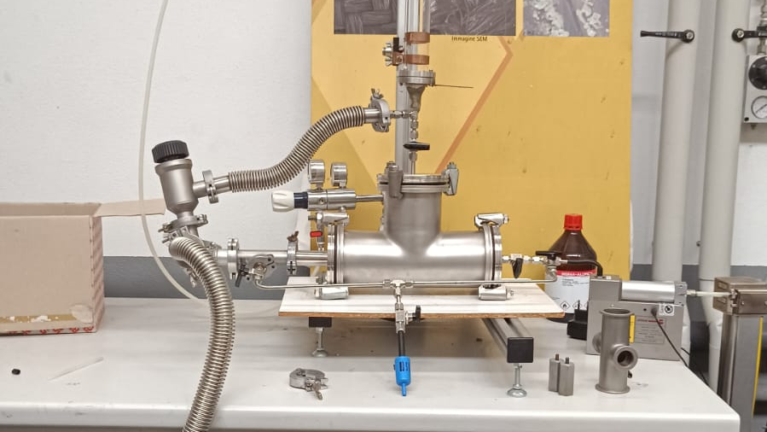
Future Aspects 2: plasma surface sizing
Study of Interaction of Plasma-Polymer by investigating the particle sizes in plasma gas and the polymer surface: correlation between surface roughness and the production of polymeric particles in plasma gas
Fig 17. Setup for Particle counter

Slide 24
Future Aspects 3: Review on graphene applied to textile
Will work on a Review article on graphene-coated fabrics
With the aspect of
      Toxicity of Graphene Oxide
      Coating methods
      Substrate behaviours
      Applications of GO coated fabrics

Slide 25
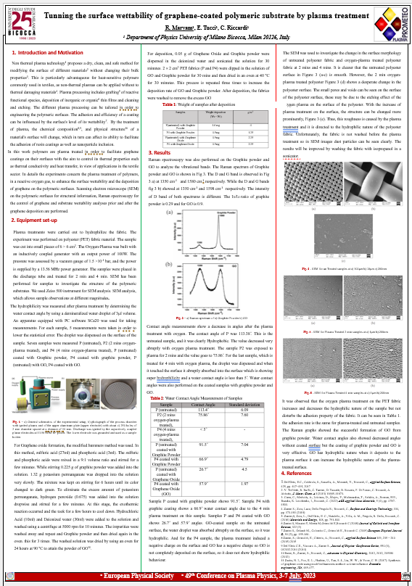
Conferences, Papers
EPS 49th Plasma Physics Conference - Poster
Proceedings: Tunning the surface wettability of graphene-coated polymeric substrates by plasma treatment, R.Maryam et al. 2023
Review article on Development of medical masks: performance, properties, and prospects, Memon et al., 2023

Slide 26
Courses
Course: “New lignin-based sustainable materials science and technological aspects” Luca Zoia (DISAT), Ruggero Barni (DFO) and Carmen Canevali (SdM), 1CFU
Course: “Masterclass in Big Data within Science and Industry” Dr. Elena Cuoco, Dr. Matteo Bregonzio, 1 CFU
Course: “Deep Learning for Physicists” Professor Stefano Giagu. 2 CFU

Slide 27
Thank you

Slide 28
References
[1] Nascimento, J. H. O., Felipe, B. H. S., Dias, J. M. T. C., Souza, A. G. F., Júnior, A. P. S., Galvão, F. M. F., ... & Ahmad, A. (2021). Creating Smart and Functional Textile Materials with Graphene. Nanomaterials and Nanotechnology: Biomedical, Environmental, and Industrial Applications, 411-444.
[2] Zaaba, N. I., Foo, K. L., Hashim, U., Tan, S. J., Liu, W. W., & Voon, C. H. (2017). Synthesis of graphene oxide using modified hummers method: solvent influence. Procedia engineering, 184, 469-477.
[3] Kudin, K. N., Ozbas, B., Schniepp, H. C., Prud'Homme, R. K., Aksay, I. A., & Car, R. (2008). Raman spectra of graphite oxide and functionalized graphene sheets. Nano letters, 8(1), 36-41.
[4] Thy, L. T. M., Thuong, N. H., Tu, T. H., My, N. H. T., Tuong, H. H. P., Nam, H. M., ... & Hieu, N. H. (2020). Fabrication and adsorption properties of magnetic graphene oxide nanocomposites for removal of arsenic (V) from water. Adsorption Science & Technology, 38(7-8), 240-253.

