Slide 1


Superconducting qubits for sensing applications
Danilo Labranca

Slide 2





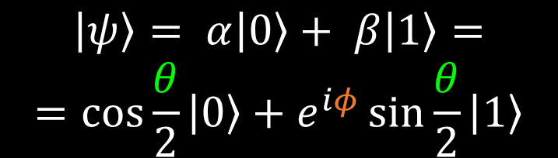
$$0$$
What is a qubit?
Classical bit
Qubits are two state quantum systems
They are the quantum mechanical analogous of the bit
More information is stored in a qubit
$$1$$
$$\left|\left.0\right\rangle \right.$$
$$\left|\left.ψ\right\rangle \right.= α\left|\left.0\right\rangle \right.+ β\left|\left.1\right\rangle \right.=$$
$$=\cos{\frac{θ}{2}}\left|\left.0\right\rangle \right.+e^{iφ}\sin{\frac{θ}{2}}\left|\left.1\right\rangle \right.$$
Quantum bit
$$\left|\left.1\right\rangle \right.$$

Slide 3
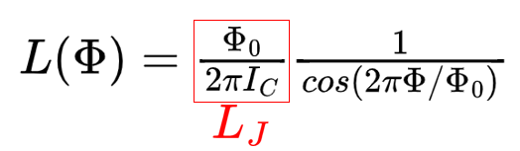
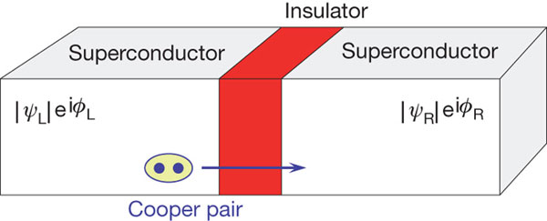
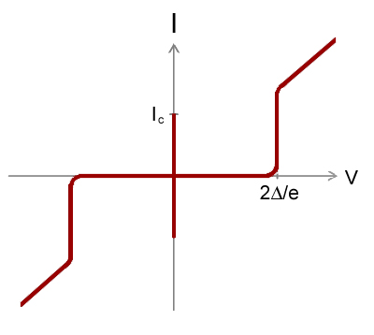
Superconducting Qubits
Junction critical current
Built with Josephson Junctions or STJ (Superconducting Tunnel Junctions)
Cooper pairs in the SC can go through the insulator barrier thanks to quantum tunneling. The junction behaves as a non-linear inductor.
Cooper pairs tunneling

Slide 4
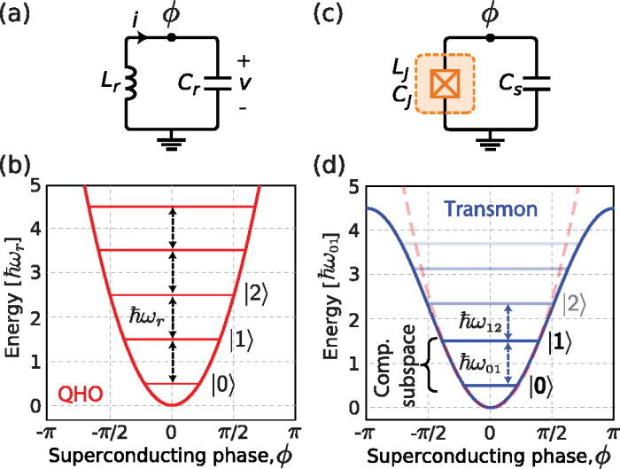




Transmon qubit
Transmon qubits are essentially LC oscillators with Josephson Junctions replacing the inductance.
It is a weakly anharmonic oscillator
It is the evolution of the Cooper pair Box with a ratio E_{J} / E_{C} >> 1
Frequencies are usually between 4 GHz and 10 GHz

Slide 5
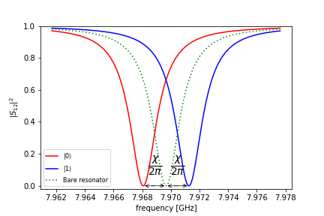
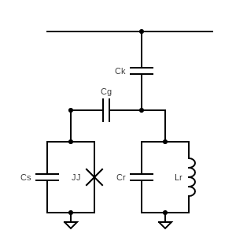

Qubit readout
Transmon coupled to a resonator
Dispersive readout → ω_{R} ≠ ω_{Q}
Resonator frequency depends on the qubit state
Frequencies are usually between 4 GHz and 10 GHz
Resonator mode frequency is qubit-state dependent

Slide 6
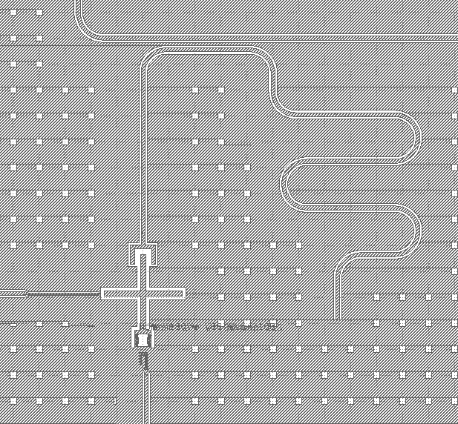

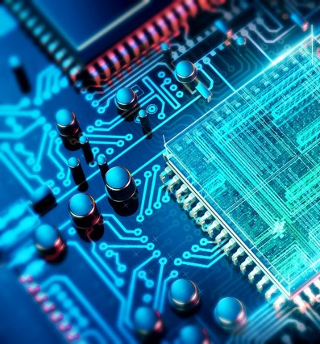
Qubit chip design for Qub-IT
2 qubit chip fabricated @ NIST
One tunable and one fixed frequency qubit on the same line with two readout resonators
The tunable resonator qubit is controllable with a drive line

Slide 7
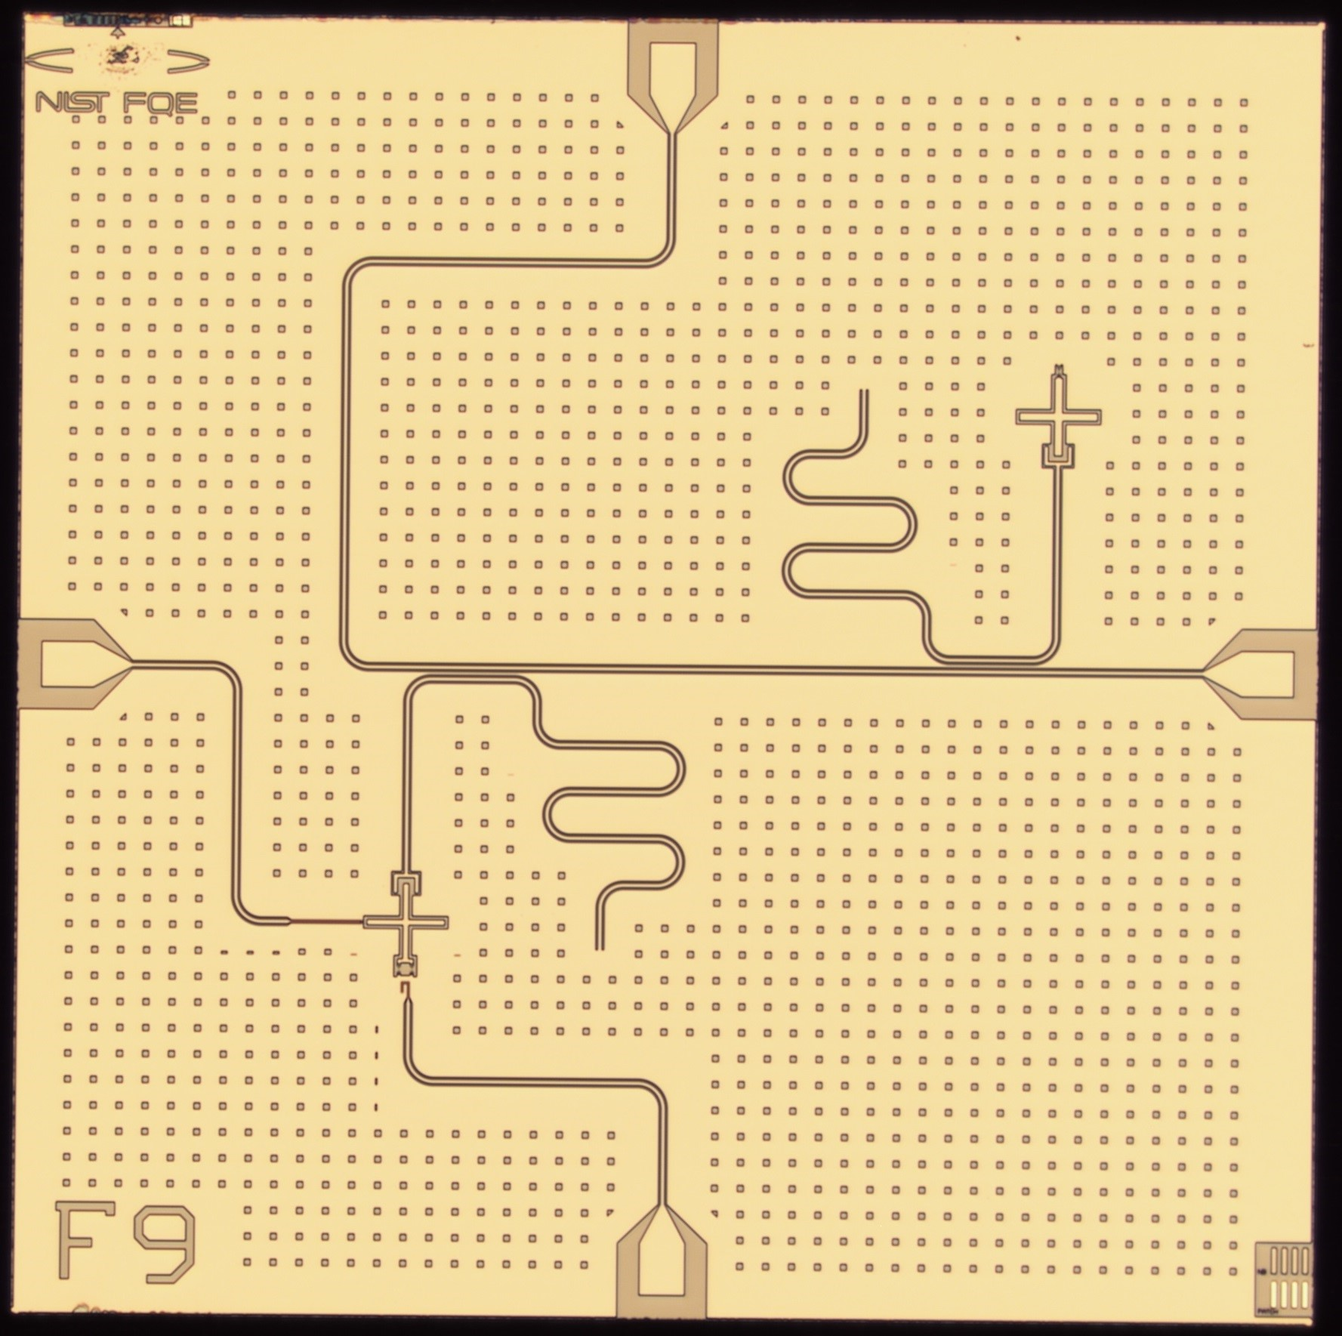
Superconducting Electronics Group
A. Sirois, M. Castellanos, D. Olaya, J. Bieseker, P. Hopkins, S. Benz

Slide 8

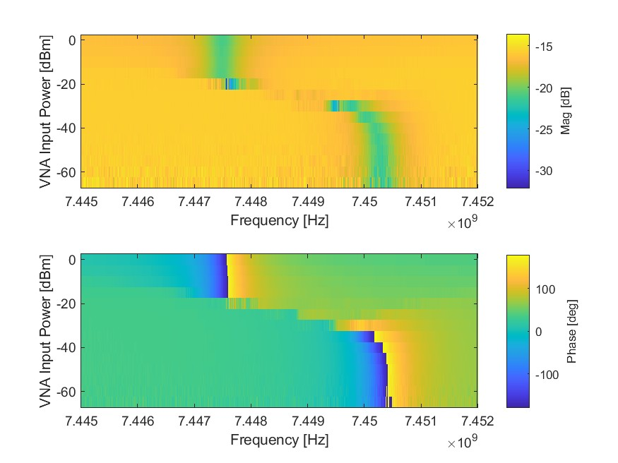
Qubit measurements @NIST
Cavity Spectroscopy
VNA
Qubit
Resonator
The first measurement to characterize a superconducting qubit is to find the resonator frequency
The high/low power measurement (or punch-out) show the bare (high-power) and “dressed” frequencies of the resonator

Slide 9
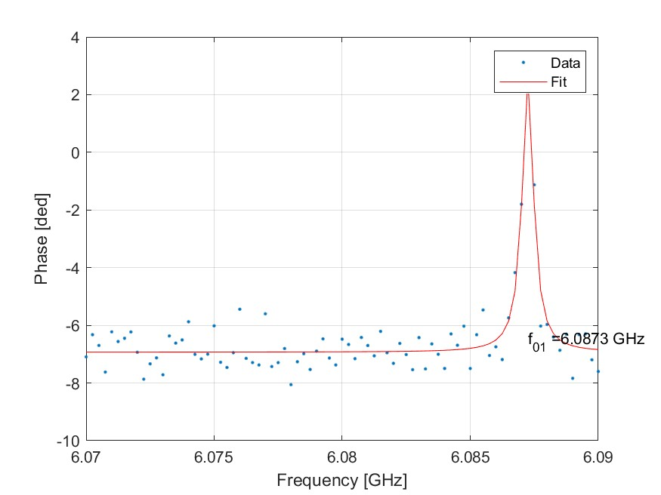




Qubit measurements @NIST
Qubit Spectroscopy
VNA
$f_{r}$ $− χ$
$$f_{q}$$
Qubit
Resonator
We can now fix the readout frequency at $f_{r} − χ$ and scan the qubit control tone frequency to find $f_{01}$
Readout tone transmission plotted as a function of the control frequency
Both phase and amplitude bring information on the qubit state, but at $f_{r} − χ$ the phase response is greater

Slide 10
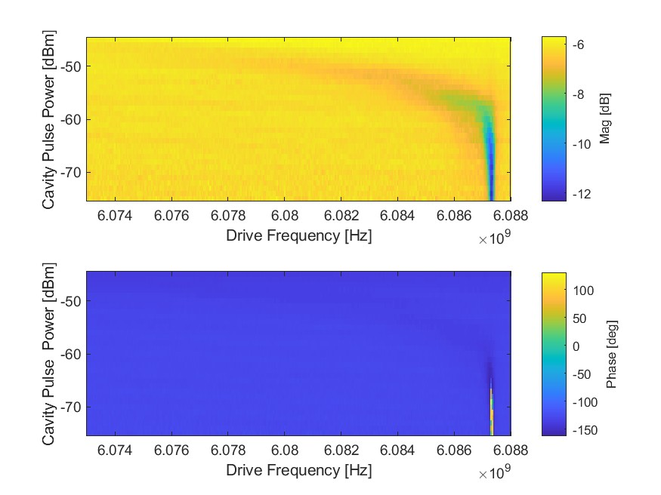

Qubit measurements @NIST
Qubit AC Stark Shift
VNA
$f_{r}$ $− χ$
$$f_{q}$$
Qubit
Resonator
Scanning the power of the VNA tone we can populate the cavity with more and more photons
By doing qubit spectroscopy at each power, we can observe the qubit Stark shift that depends on the number of photons in the cavity
$$ω_{01}^{′}= ω_{01} −2χ a^{†}a$$

Slide 11
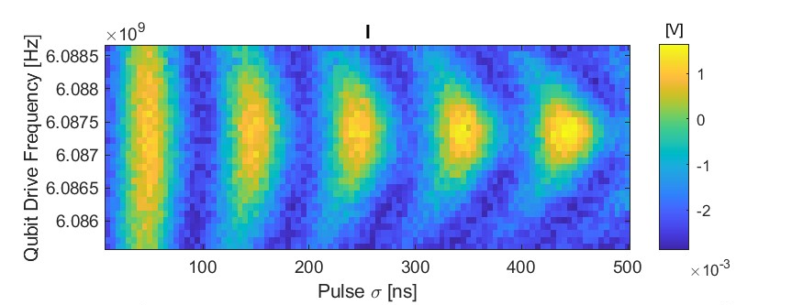
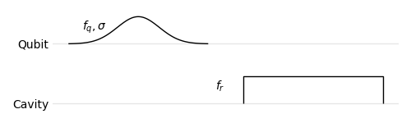
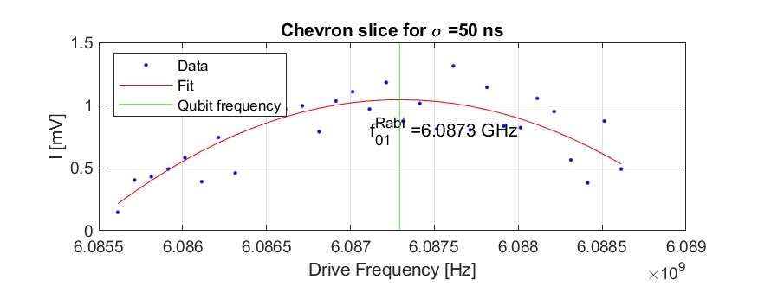

Qubit measurements @NIST
Chevron Plot
Chevron plot is built by scanning $f_{q}$ and $σ$
It is equivalent to Rabi flopping at detuned frequency from $f_{01}$
The oscillation dumping is dependent on the coherence times of the qubit
A better estimate of $f_{01}$ can be obtained by fitting the frequency profile of this plot → calibrate again the π-pulse

Slide 12
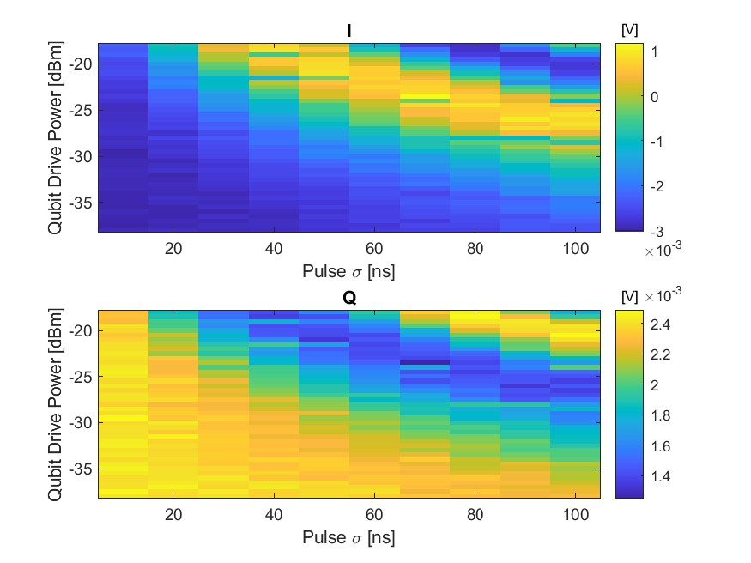
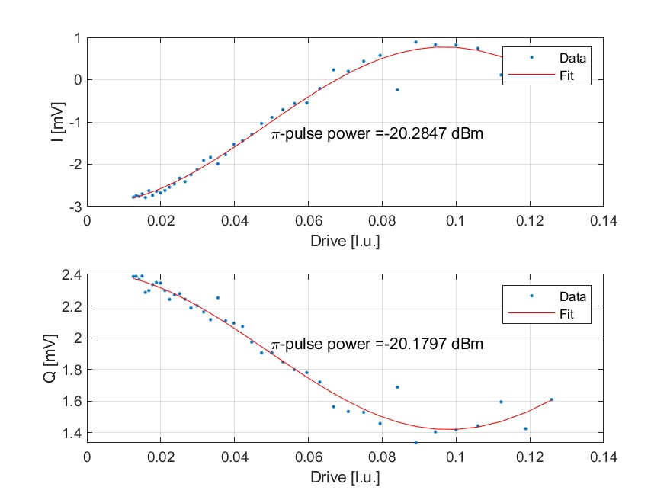

Qubit measurements @NIST
Rabi Flopping
We switch to time domain measurement
We pulse both tones:
Qubit: gaussian pulse at $f_{01}$
Cavity: square pulse at $f_{r}$ $− χ$
Observation of power and time Rabi flopping by scanning the power and duration of the qubit pulse
Note: qubit gaussian pulse is digitally truncated at $5σ$
@ 50ns

Slide 13
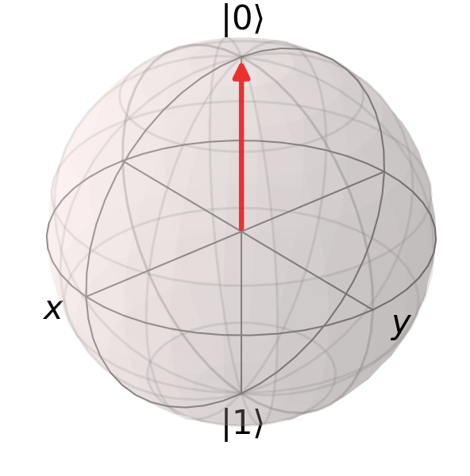

Qubit measurements @NIST
Chevron Plot
Chevron plot is built by scanning $f_{q}$ and $σ$
It is equivalent to Rabi flopping at detuned frequency from $f_{01}$
The oscillation dumping is dependent on the coherence times of the qubit
A better estimate of $f_{01}$ can be obtained by fitting the frequency profile of this plot → calibrate again the π-pulse

Slide 14
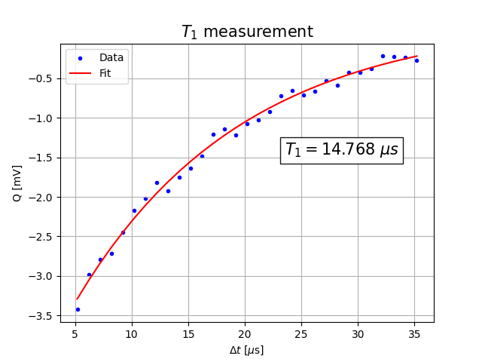
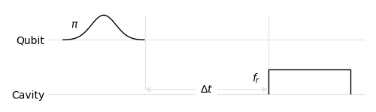
Qubit measurements @NIST
T₁ measurement
π-pulse followed by a cavity measurement after a time interval Δt repeated N times and averaged
Exponential decay of the excited population of the qubit

Slide 15
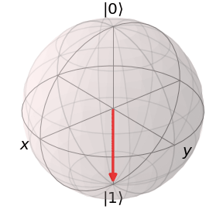
Qubit measurements @NIST
T₁ measurement
π-pulse followed by a cavity measurement after a time interval Δt repeated N times and averaged
Exponential decay of the excited population of the qubit

Slide 16
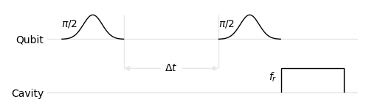
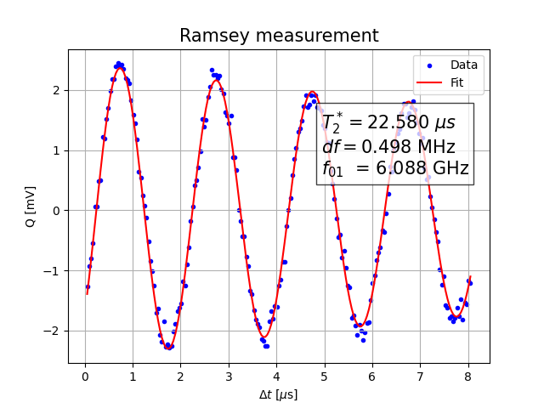

Qubit measurements @NIST
T₂* measurement - Ramsey
π/2-pulses separated by time interval Δt
π/2-pulse → half the amplitude of the π-pulses
We are mapping the qubit in a superposition state and monitoring the phase information lifetime
The oscillation frequency is equal to the detuning $f_{π/2}−f_{01}$ and gives the best estimate of $f_{01}$
The exponential decay is T₂* measurement

Slide 17
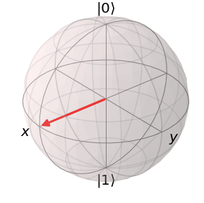
Qubit measurements @NIST
T₂* measurement - Ramsey
π/2-pulses separated by time interval Δt
π/2-pulse → half the amplitude of the π-pulses
We are mapping the qubit in a superposition state and monitoring the phase information lifetime
The oscillation frequency is equal to the detuning $f_{π/2}−f_{01}$ and gives the best estimate of $f_{01}$
The exponential decay is T₂* measurement

Slide 18
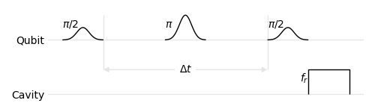
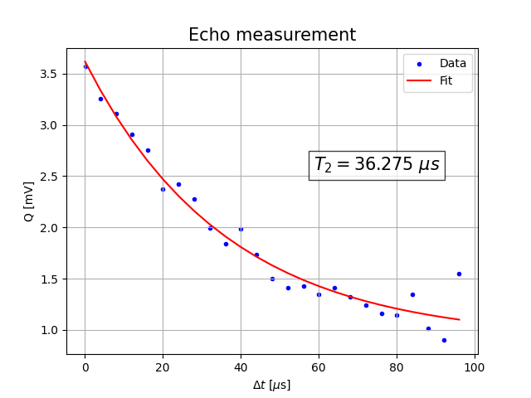
Qubit measurements @NIST
T₂E measurement – Spin Echo
Same as Ramsey pulse sequence with an additional π-pulses at Δt/2
This additional π-pulse has the goal to eliminate the impact of low frequency phase noise by refocusing the state
The exponential decay time is a measure closer to the actual T₂ of the qubit

Slide 19
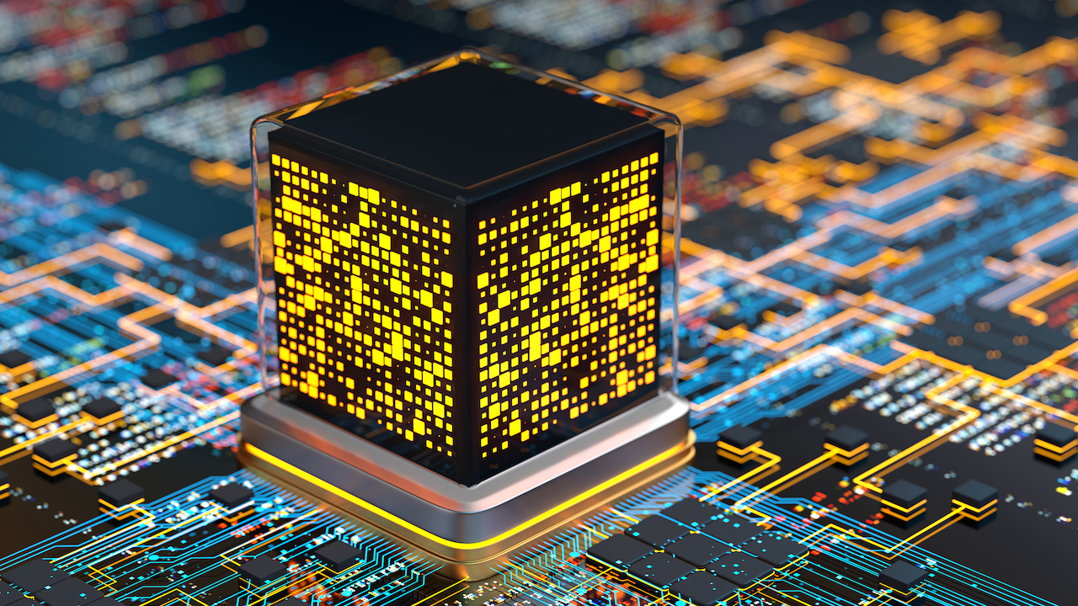
Sensing protocol

Slide 20
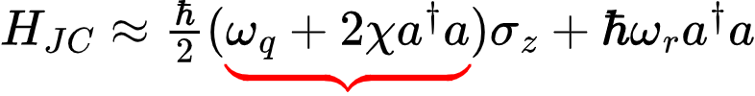
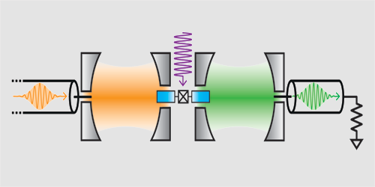
Photon in cavity - Ramsey mapping
R. Lescanne et al., Phys. Rev. X (2020)
Detection cavity
Readout cavity

Slide 21

Photon in cavity - Ramsey mapping
State preparation
No photon
1 photon

Slide 22


Photon in cavity - Ramsey mapping
State preparation
Interaction time
No photon
1 photon

Slide 23

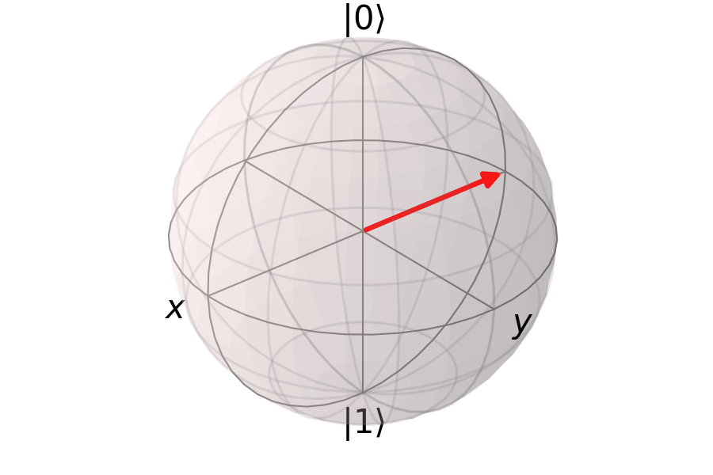
Photon in cavity - Ramsey mapping
Projection measurement
State preparation
Interaction time
No photon
1 photon

Slide 24
Itinerant photon
Same Ramsey Mapping, but the single photon reflecting on the cavity-qubit system causes a phase flip in the qubit state

Slide 25

Itinerant photon
Same Ramsey Mapping, but the single photon reflecting on the cavity-qubit system causes a phase flip in the qubit state

Slide 26
Itinerant photon
Same Ramsey Mapping, but the single photon reflecting on the cavity-qubit system causes a phase flip in the qubit state

Slide 27
Other interesting applications

Slide 28
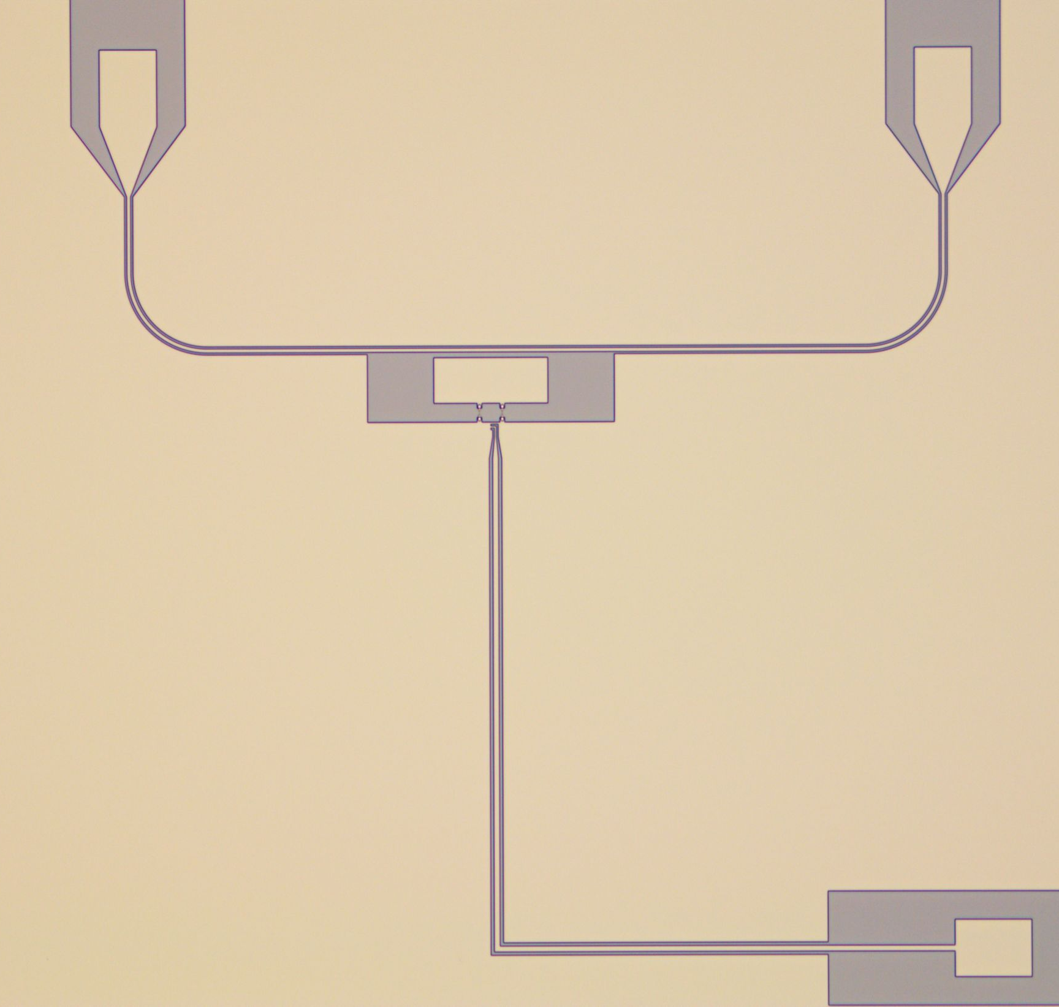
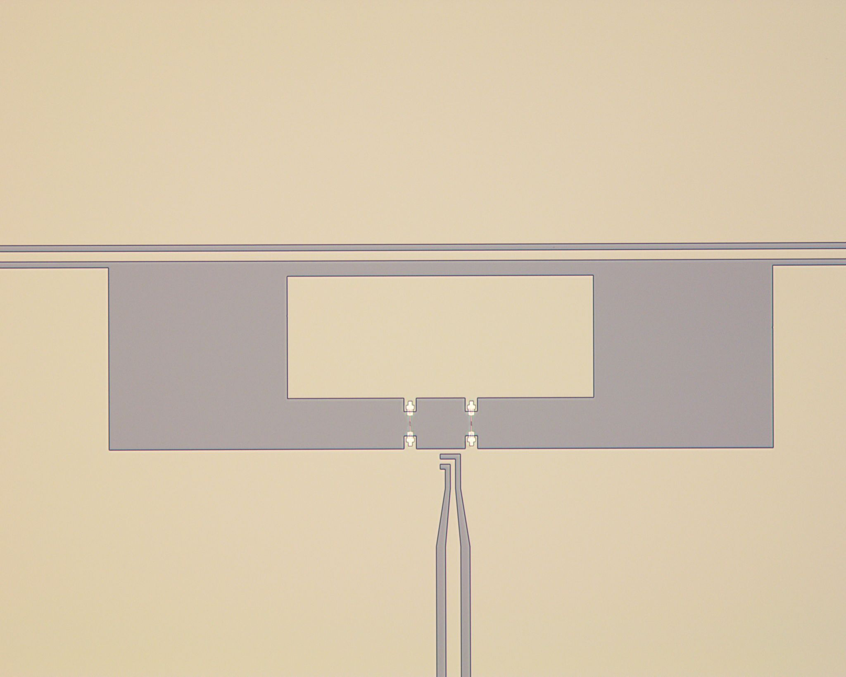
Transmon as a power-meter
Transmon qubit strongly coupled to a transmission line
Applications:
            Power measurement on chip
            Tunable single microwave photon source
300 μm

Slide 29
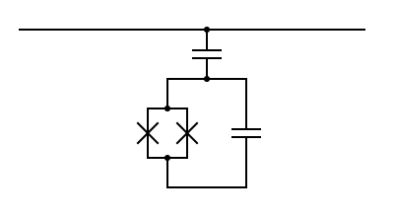

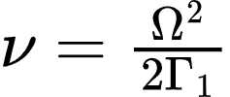
How it works
Transmission line
Ω
Coherent drive along a transmission line
            Incident photon rate (𝞶) depends on the drive power
            2-level system → absorbs photons with rate Ω
            Rabi frequency → Ω
            Qubit relaxation rate → г₁
Qubit
Incident power at the qubit
Incident photon rate

Slide 30
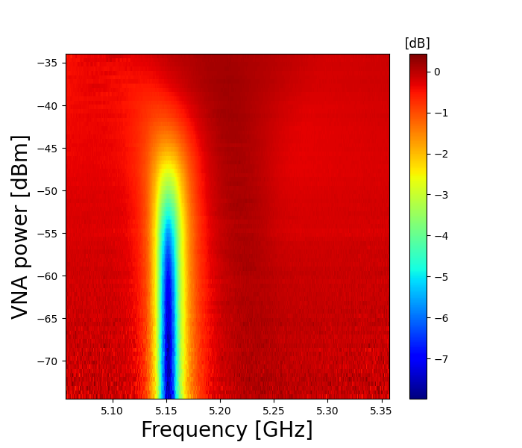
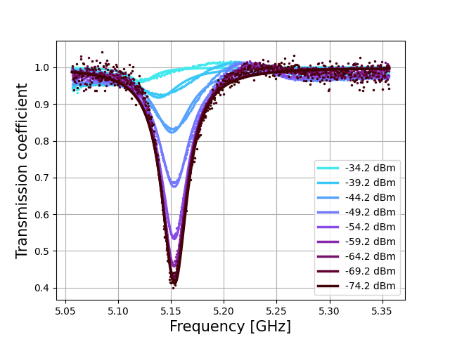
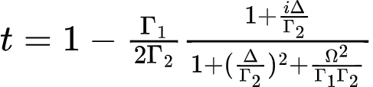
Transmission measurement
Varying input power with VNA
Higher power = Higher Ω
Depth of the resonance depends on the power at the qubit

Slide 31
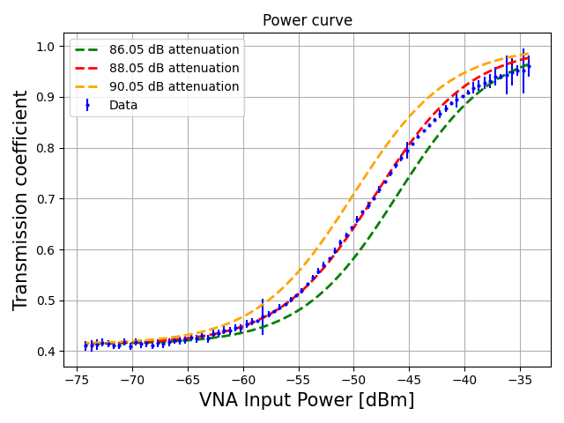
Power curve

Slide 32
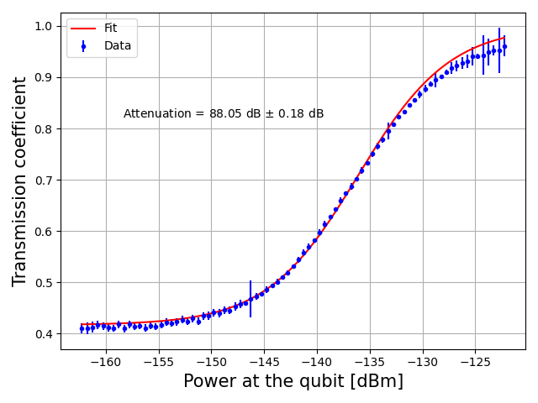
Power curve

Slide 33
Transmon as a single-photon source
Transmon is a TLS
Only single photons can be reflected
We can build a tunable single-microwave photon source
Source coherence measurements → Hanbury-Brown-Twiss (HBT) experiment
Reflection

Slide 34
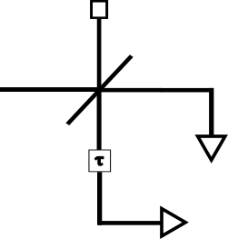


Hanbury-Brown-Twiss (HBT) experiment
$$\left.\left|vac\right.\right\rangle$$
Reflection
$$\left.\left|1\right.\right\rangle$$
Beam-splitter
JPA 2

Slide 35
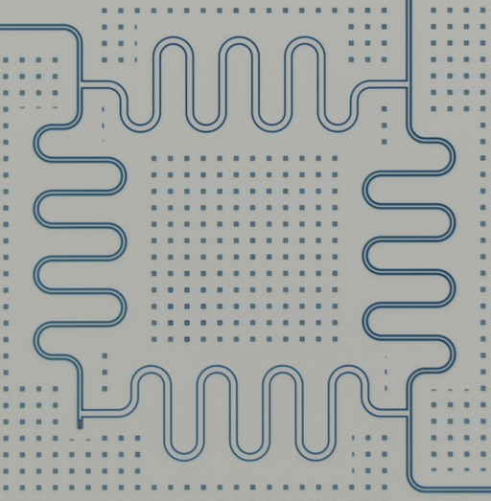





Beam-splitter - 90° hybrid
_{Input “a”}
_{Output “c”}
$$Z_{0}/\sqrt{2}$$
Superconducting CPW 50/50 beam-splitter
Four 𝛌/𝟒 sections with impedances 𝟓𝟎𝛀 and 𝟓𝟎𝛀/√𝟐
$$Z_{0}$$
Input modes
Output modes
$$\left.\left|10\right.\right\rangle ab$$
$\frac{1}{\sqrt{2}}\left.(\left|10\right.\right\rangle cd$ - $\left.\left|01\right.\right\rangle cd)$
_{Input “b” -}$50 Ω$ _{resistor}
_{Output “d”}

Slide 36
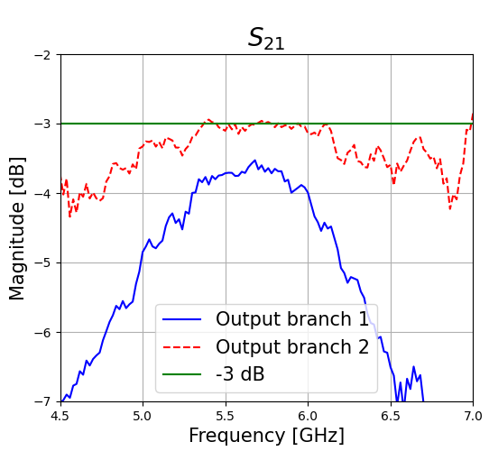
Beam-splitter - 90° hybrid
Superconducting CPW 50/50 beam-splitter
Four 𝛌/𝟒 sections with impedances 𝟓𝟎𝛀 and 𝟓𝟎𝛀/√𝟐
Input modes
Output modes
$$\left.\left|10\right.\right\rangle ab$$
$\frac{1}{\sqrt{2}}\left.(\left|10\right.\right\rangle cd$ - $\left.\left|01\right.\right\rangle cd)$

Slide 37
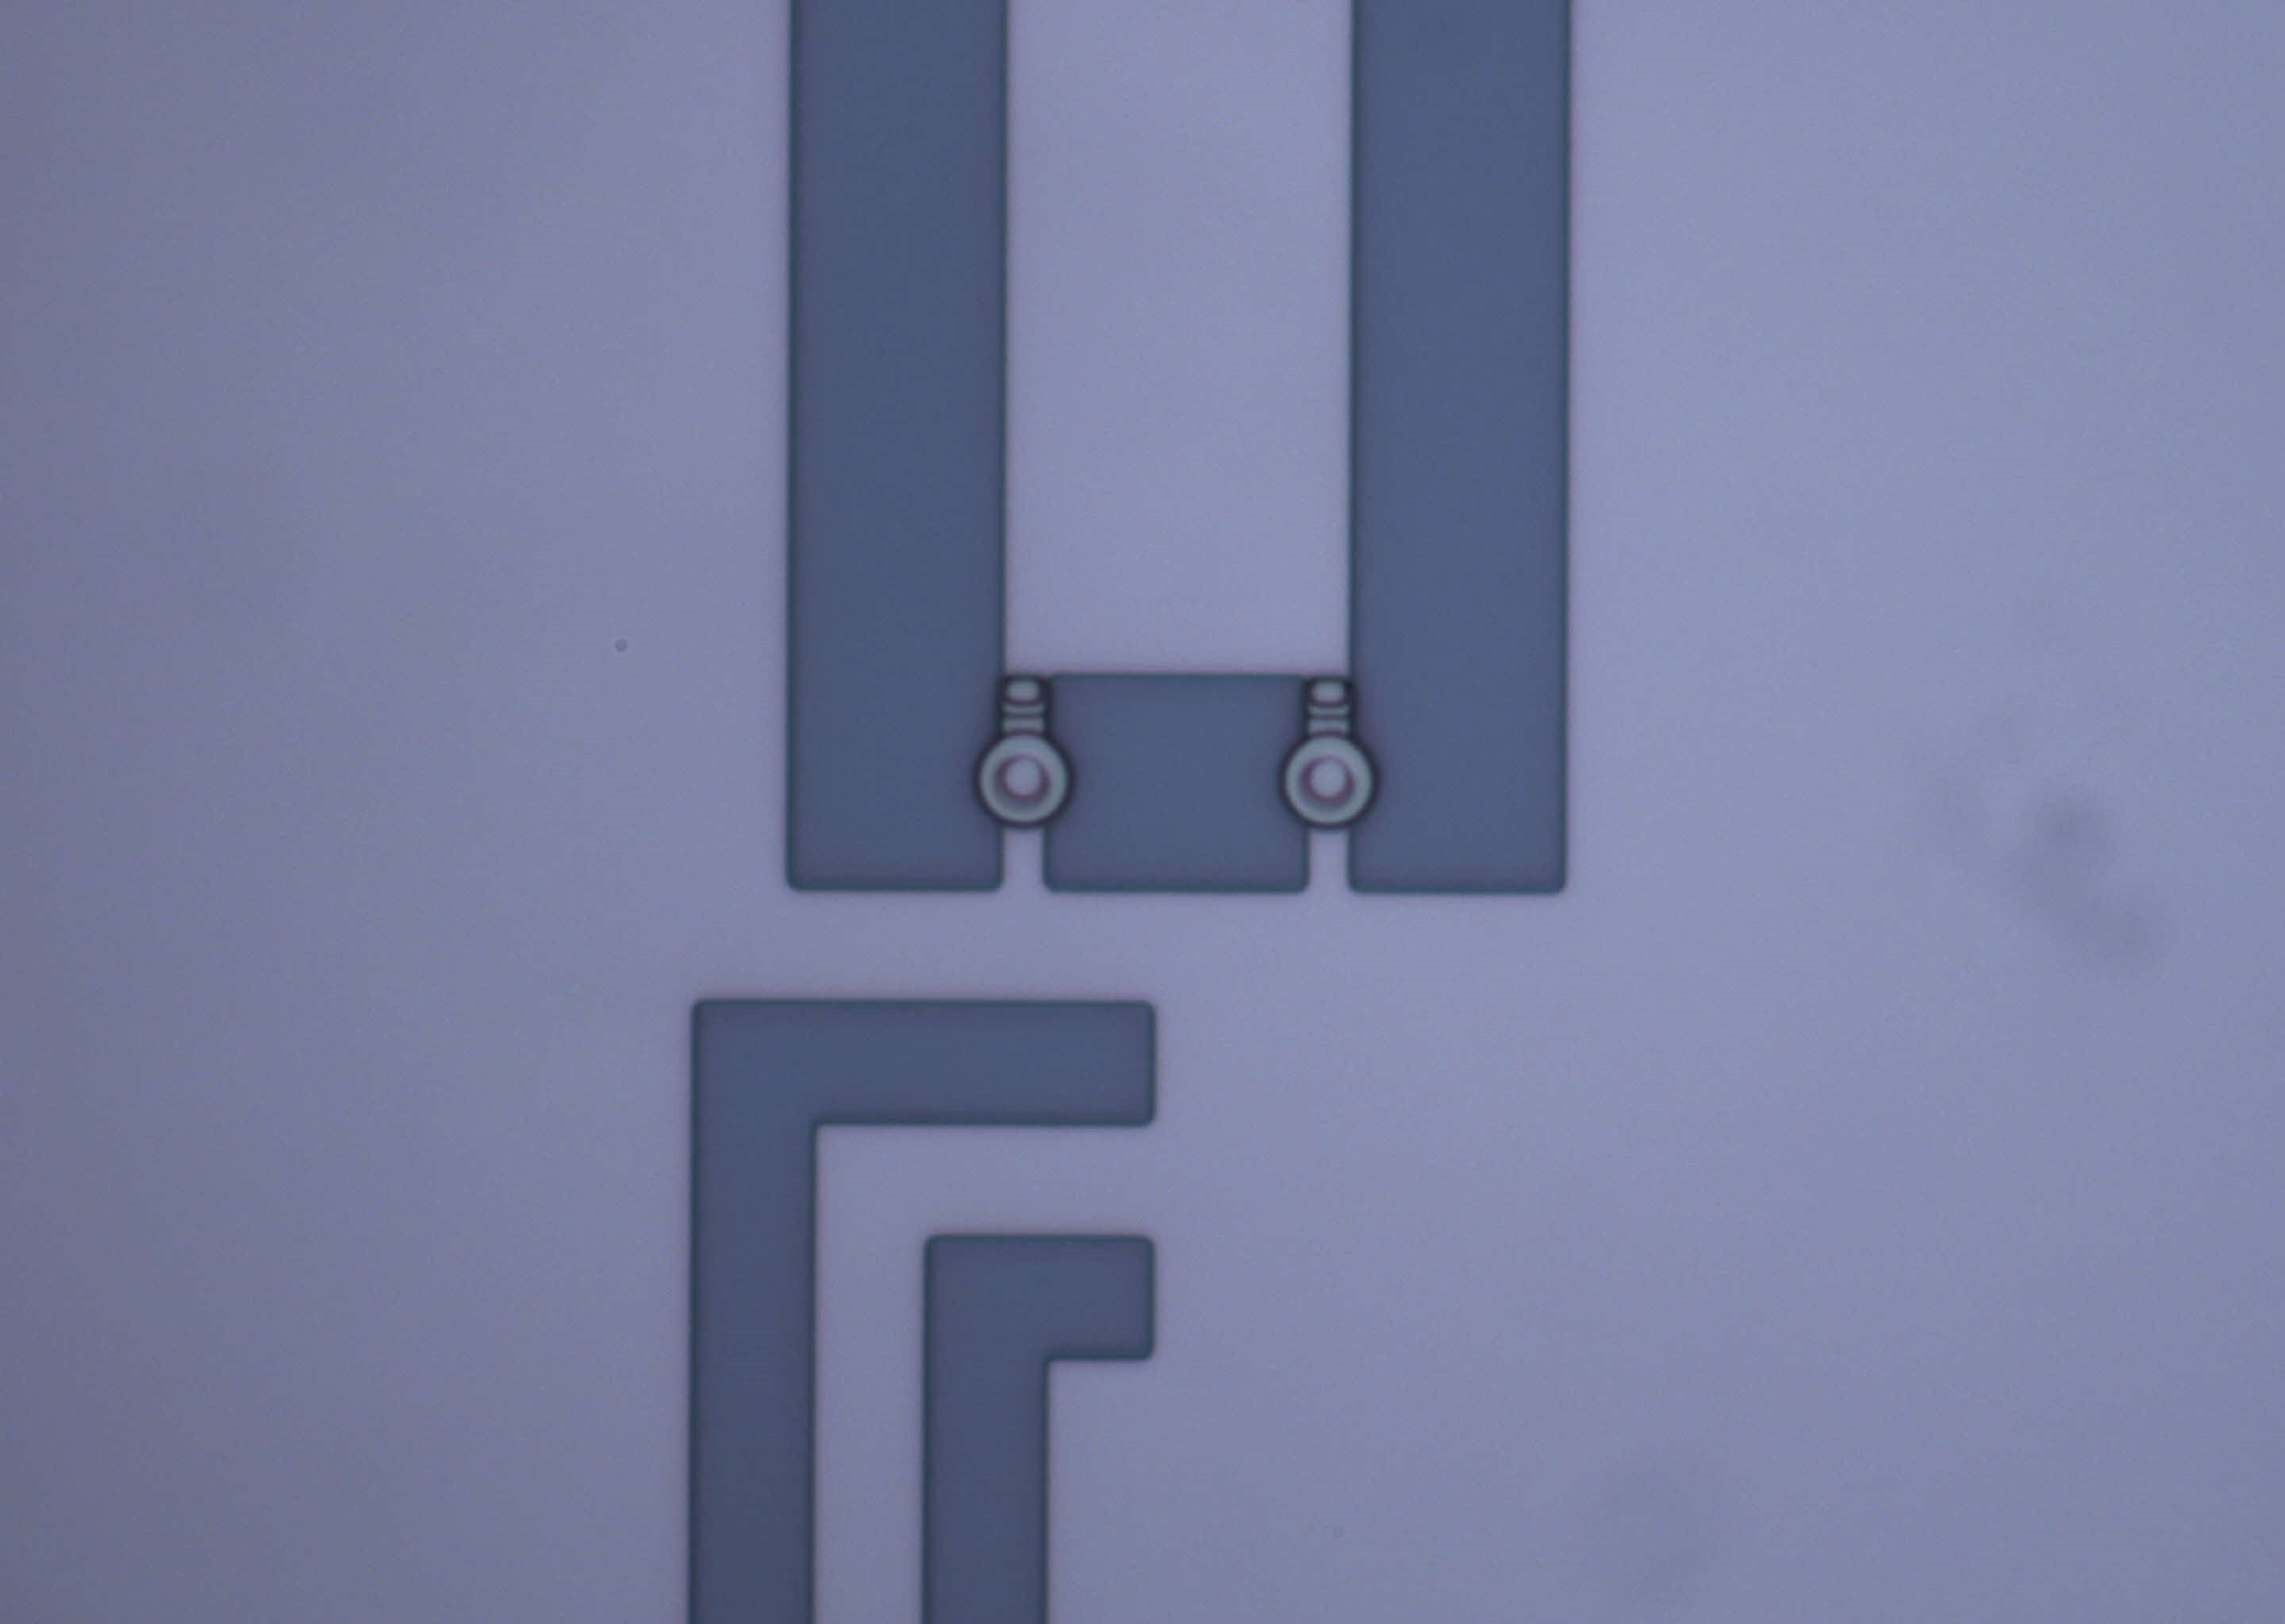
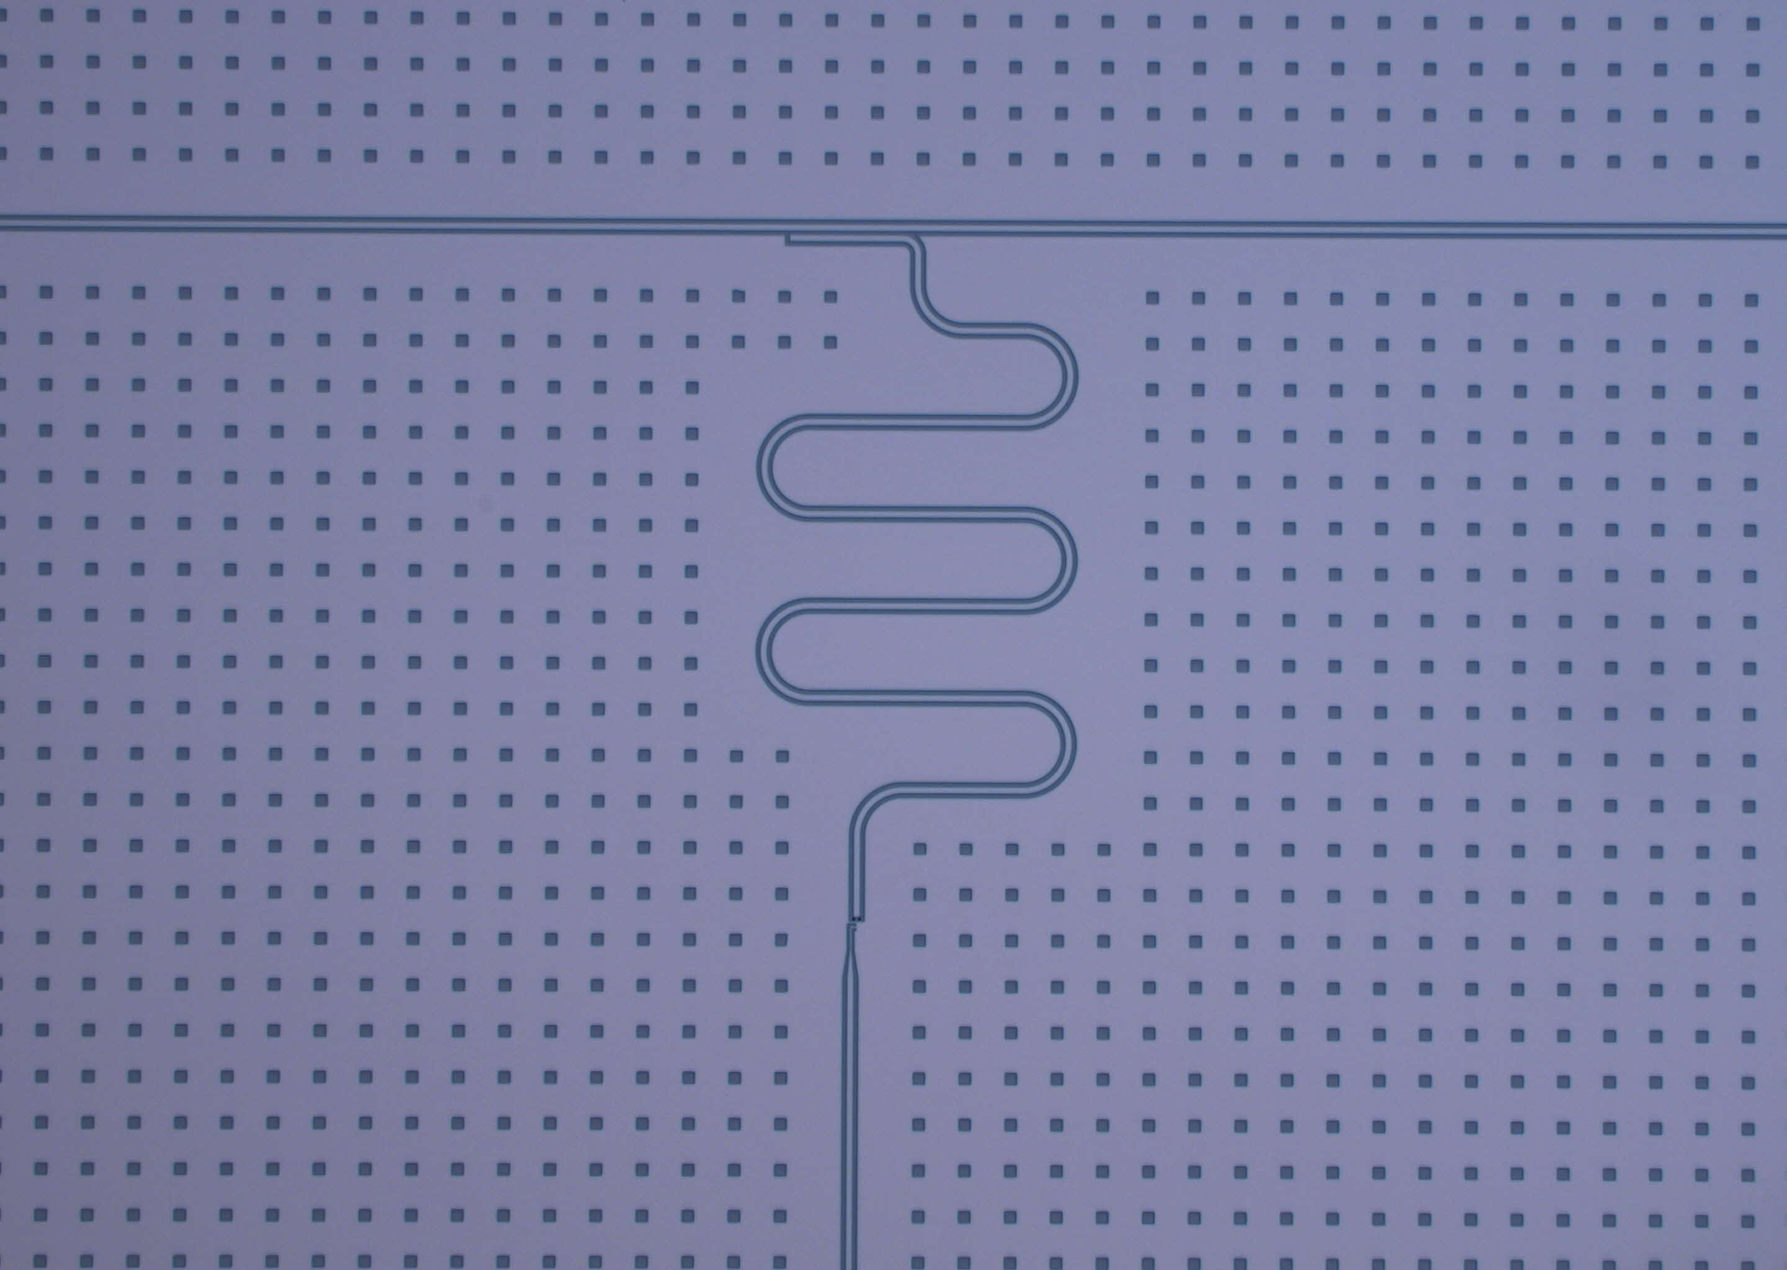
Delay unit
Superconducting CPW resonator shunted by a DC-squid
Tunable resonator to introduce a tunable time delay
The edge of the resonance permits fine tuning of the time delay

Slide 38
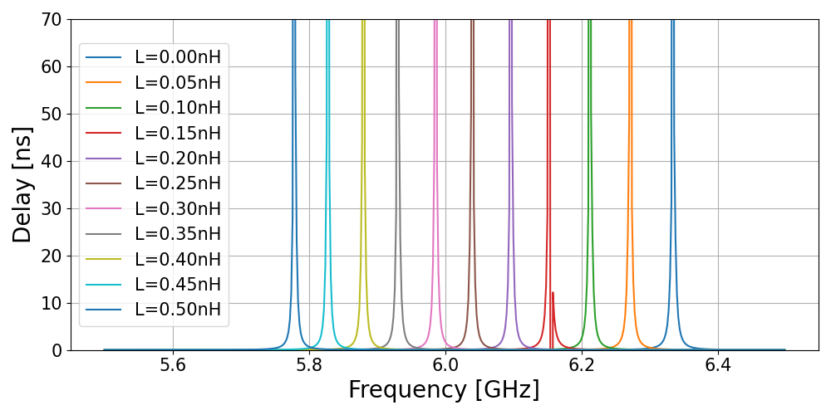
Delay unit
Superconducting CPW resonator shunted by a DC-squid
Tunable resonator to introduce a tunable time delay
The edge of the resonance permits fine tuning of the time delay

Slide 39

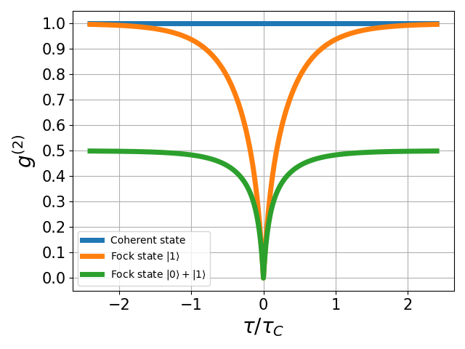
HBT expected result
Measuring g⁽²⁾(τ) > g⁽²⁾(0) values will prove the quantum nature of the traveling state
Measured Γ₁≈16.8 MHz → T₁≈9.5 ns → Improve efficiency
New design with higher T₁

Slide 40
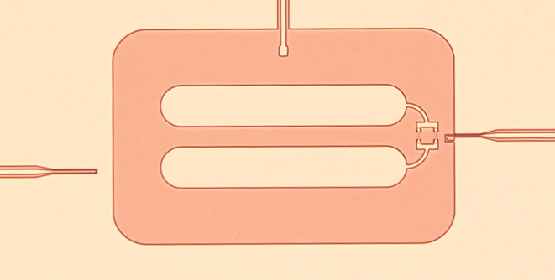
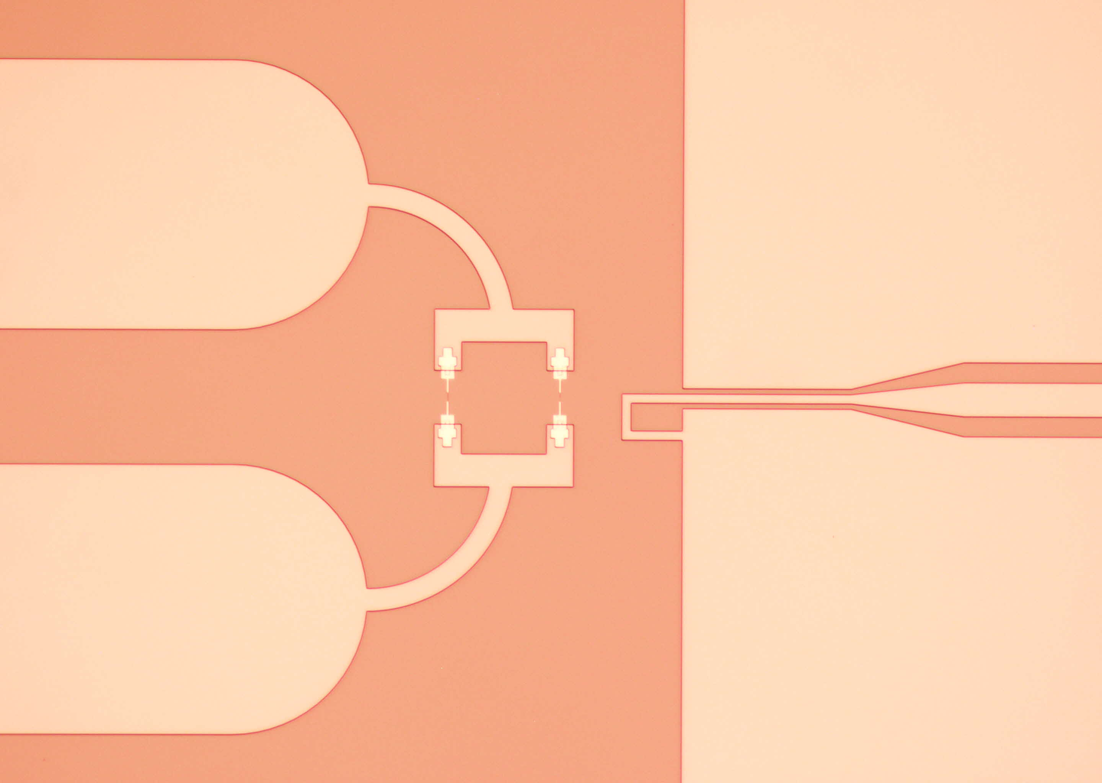
New design
_{Output line}
Direct drive control line
Unidirectional output line
Expected T₁≈500 ns
_{Drive line}
_{Flux line}

Slide 41
Conferences and courses
Conferences:
APS March Meeting 2023 | March 5-10, 2023 | Las Vegas, NV
16th European Conference on Applied Superconductivity | September 3-7, 2023 | Bologna, Italy
Courses
Quantum Optics, Adam Kaufman and James Thompson | Covers quantum optical and atomic systems including topics such as: coherent and squeezed states, theory of optical coherence, atom-radiation interaction, optical Bloch equations, open quantum systems, dynamics on the Bloch sphere, resonance fluorescence, beam-splitters and interferometry, entanglement and quantum information.
IBM QGSS 2023 – Theory to Implementation

Slide 42
Backup slides

Slide 43
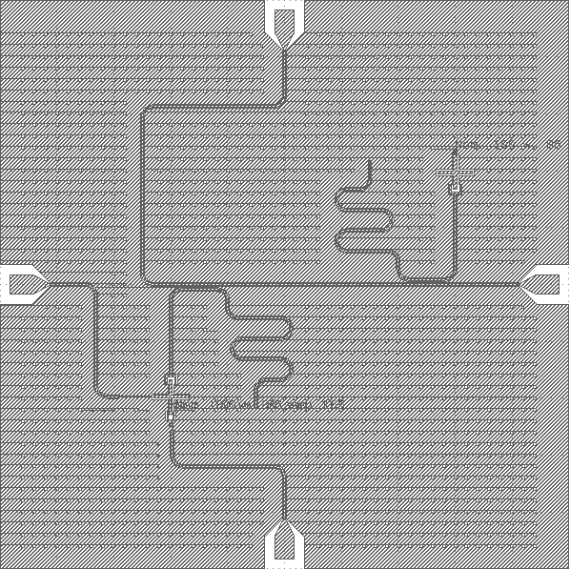

Slide 44



Lab frame
Qubit frame
RWA

