Slide 1
Nano second pulsed Laser driver for LIDAR
Niang Djibril
20/09/2021

Slide 2
Outline
Introduction
Target
Status
Main components
Firing Unit
DC-DC debug and measurements
Boost waveform
Efficiency
SEPIC waveform
Channel programming and control unit

Slide 3
Introduction and main target
2 independent channel voltage supply to provide adjustable stable voltage.
Capability to generate current spike up to 50A within 5ns
Standard automotive input battery voltage [6-18]V

Slide 4
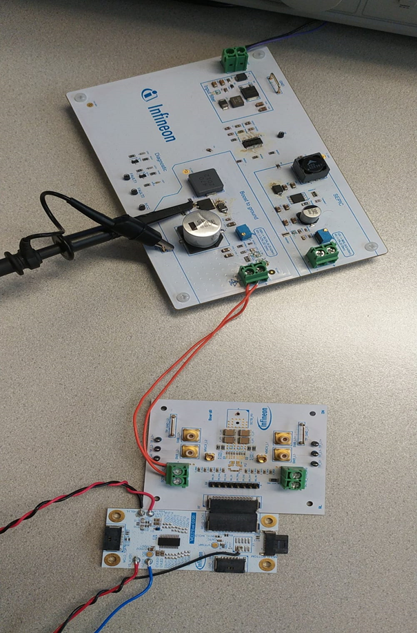
Introduction and status
Status as of September 2021
  Final design of DCDC completed, samples available
  Final design of control firing IC completed, samples available
  Final design of the controller unit board
  New version with laser diode started

Slide 5

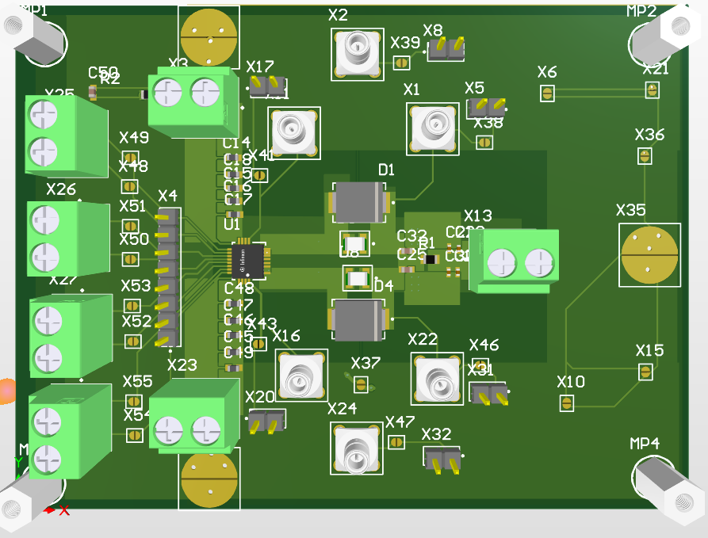
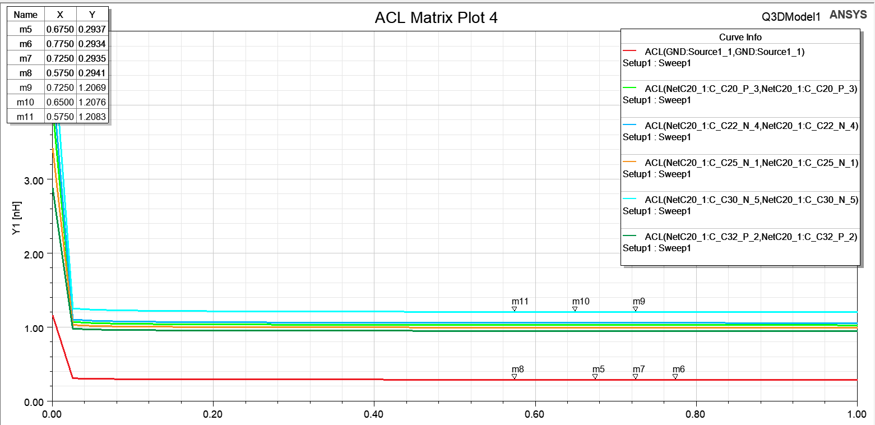
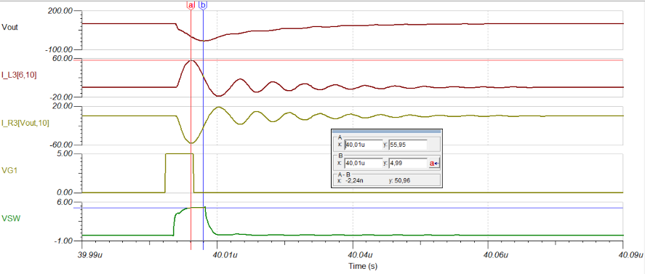
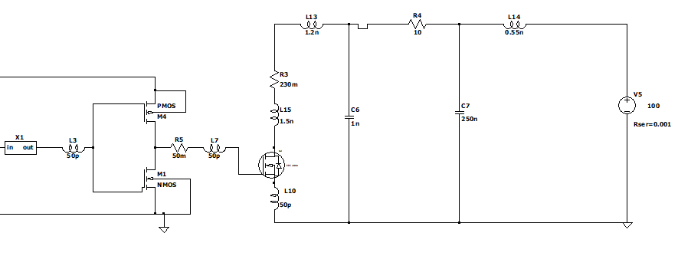
FIRING UNIT board
GaN and driver schematic with parasitic inductance
From PCB to Q3D simulation
Parasitic inductance at different frequency
Starting from PCB layout i extracted the parasitic inductance with Q3D, then simulated to obtain the drain current of the GaN in 5ns of ON time
50A of drain current with 30V of supply

Slide 6
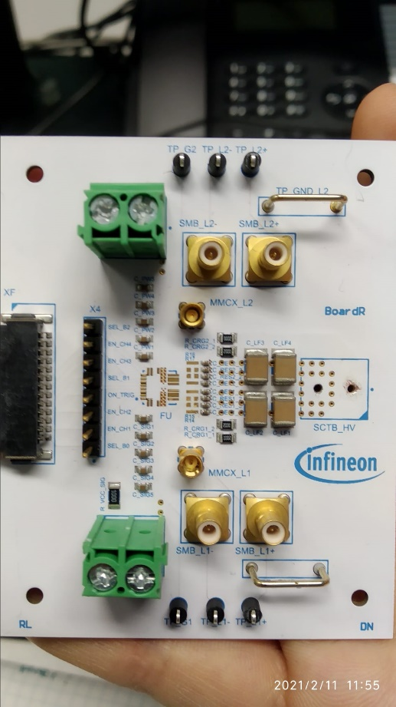
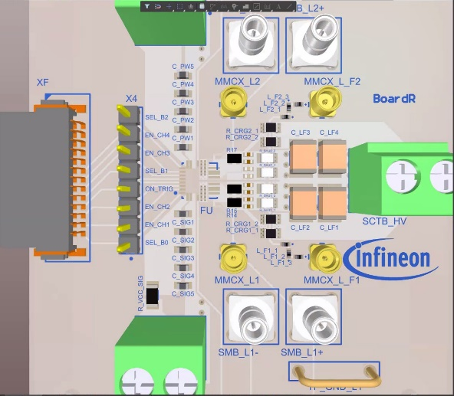
Firing Unit Board
Missing Driver+GaN
Sense resistor for current measurement
Simulation with new parasitic done
Soldered all components available

Slide 7
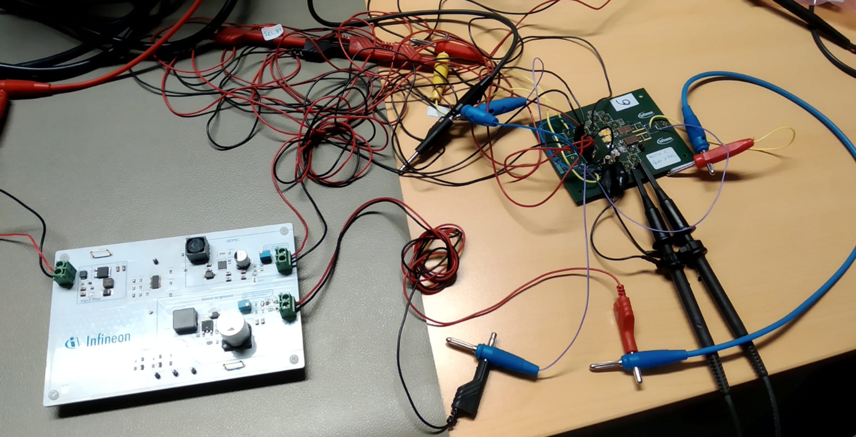
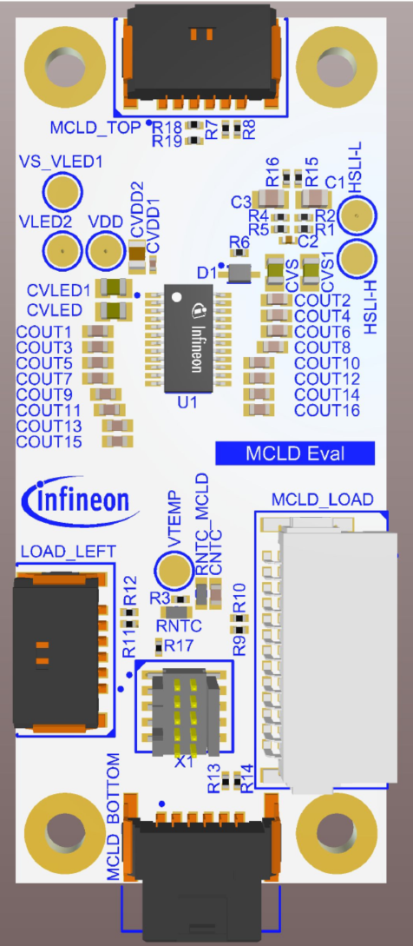
DC-DC debug
Started debug of DC-DC Board with firing unit board prototipe to check possible problem during the
high current spike and voltage drop and Stability (the old one).
This configuration shows also the importance of the control unit.

Slide 8
DC-DC measurements

Slide 9
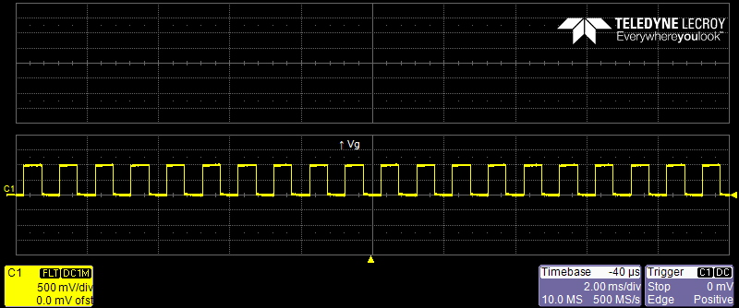
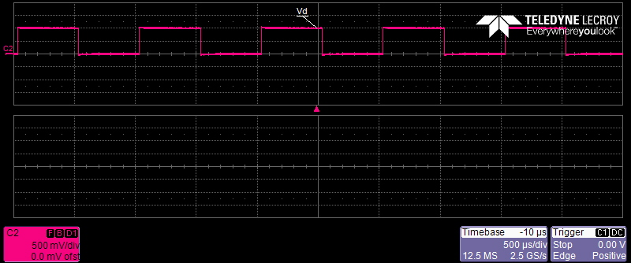
Probe compensation: Vg and Vd

Slide 10

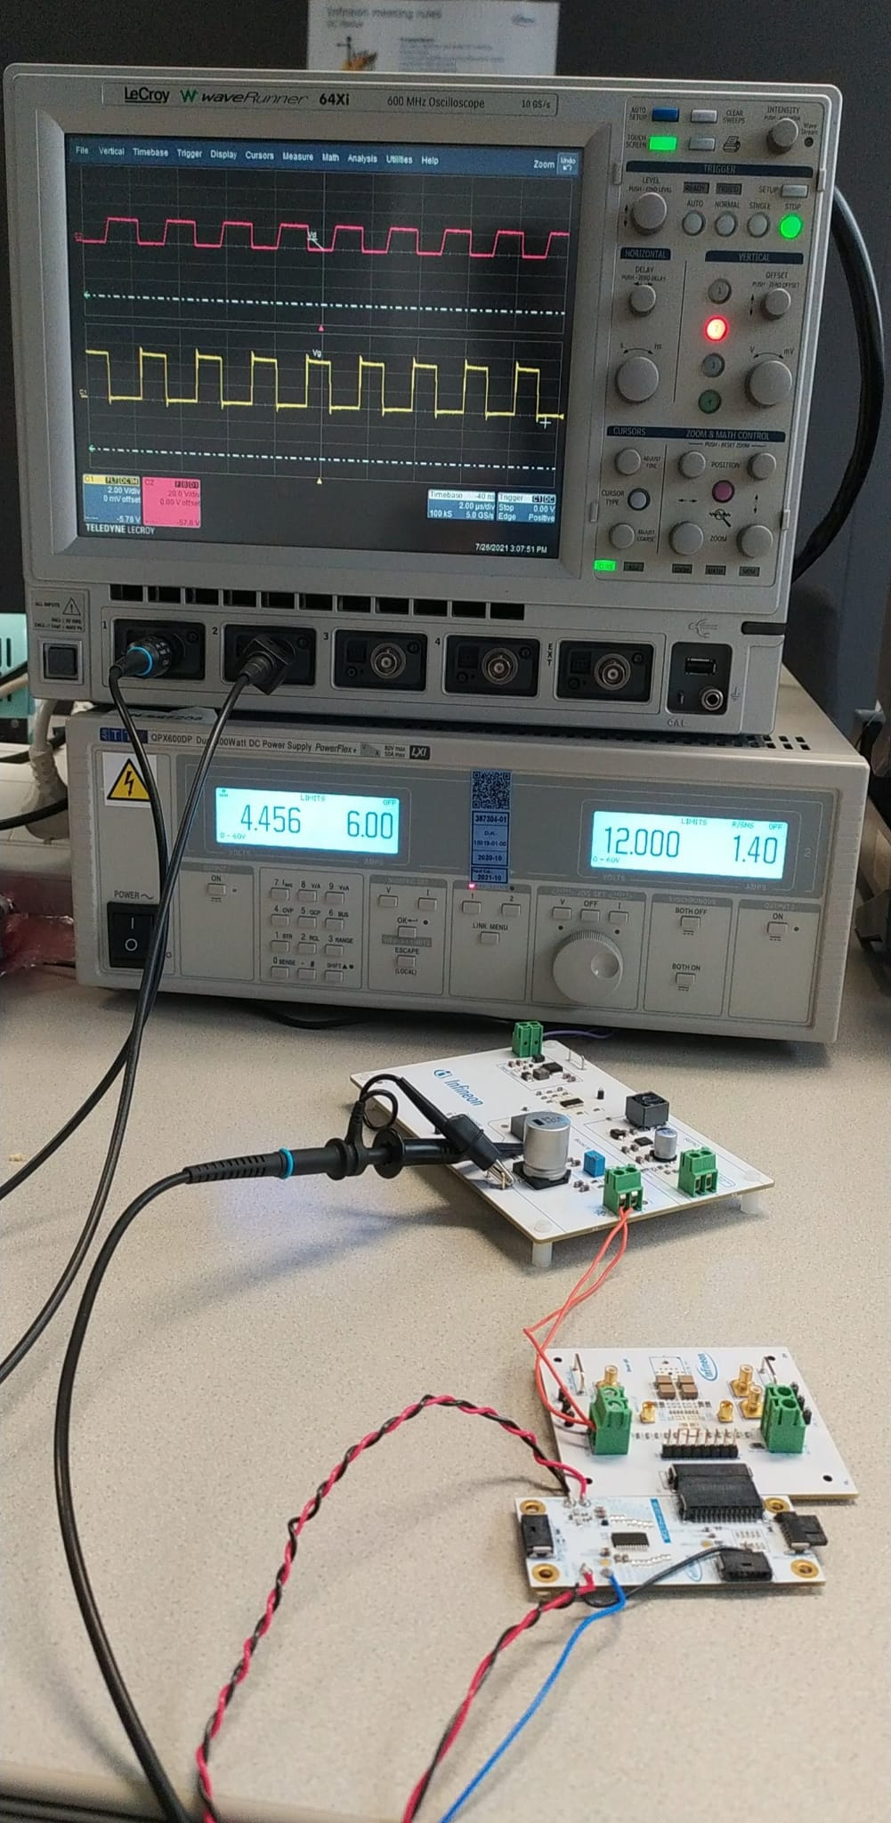
DC-DC, firing unit and control unit
DC-DC
The drain and gate voltage of the DC-DC are represented
A further discussion will be done
Firing Unit
ControlUnit

Slide 11
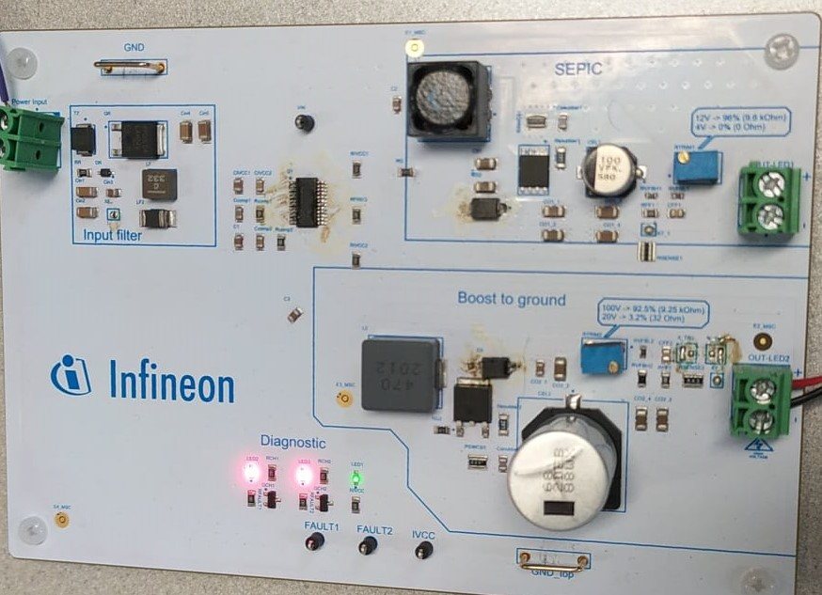
DC-DC input and output
The three led are turned on in normal condition
The boost output output maximum current is 350mA
The SEPIC output output maximum current is 1A
The maximum input current is 1.4A
The led3(the one in the middle) will switch off when the maximum input power is reached
The Led3 is related to the input
Led 1 and Led2 are related to the outputs

Slide 12
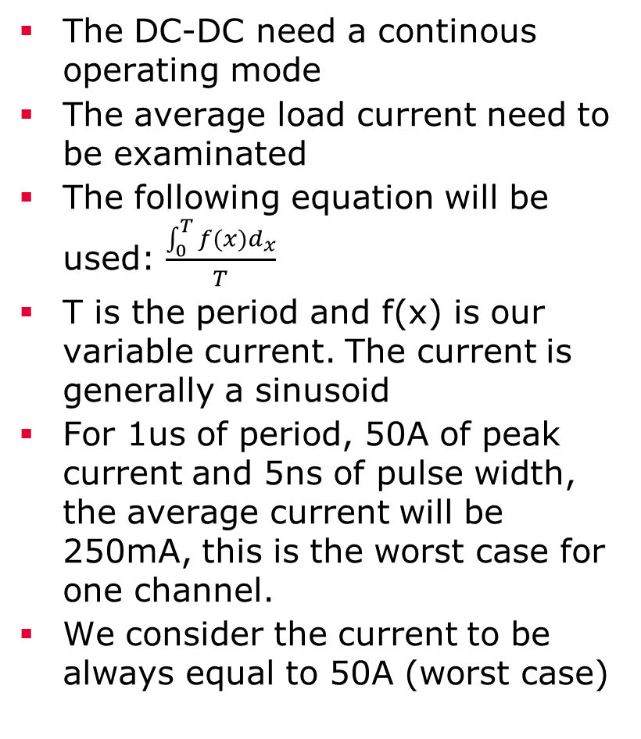
DC-DC measurements
The DC-DC need a continous operating mode
The average load current need to be examinated
The following equation will be used: $\frac{\int_{0}^{T}{f(x)d_{x}}}{T}$
T is the period and f(x) is our variable current. The current is generally a sinusoid
For 1us of period, 50A of peak current and 5ns of pulse width, the average current will be 250mA, this is the worst case for one channel.
We consider the current to be always equal to 50A (worst case)

Slide 13
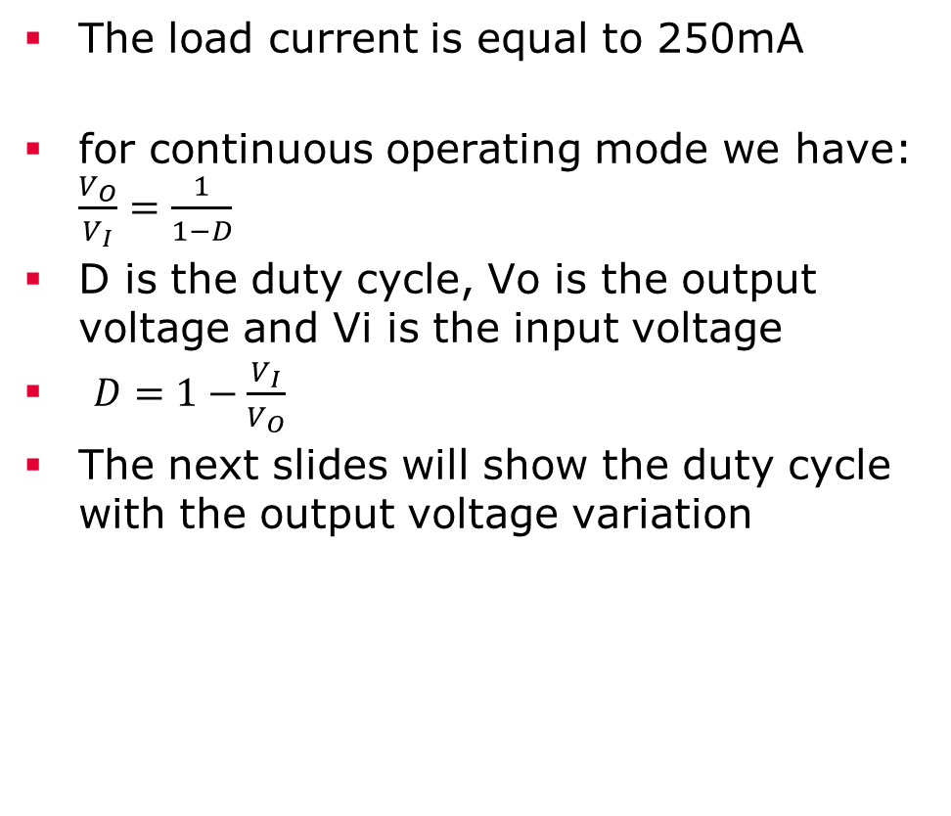
Waveform:BOOST continous operating mode
The load current is equal to 250mA
for continuous operating mode we have: $\frac{V_{O}}{V_{I}}=\frac{1}{1−D}$
D is the duty cycle, Vo is the output voltage and Vi is the input voltage
$D=1−\frac{V_{I}}{V_{O}}$
The next slides will show the duty cycle with the output voltage variation

Slide 14
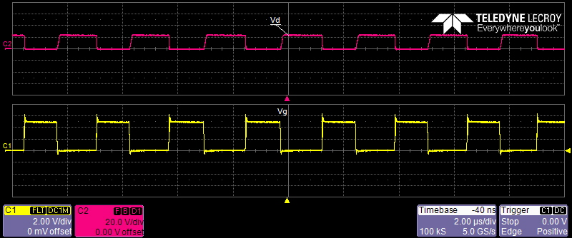
BOOST waveform: 22V,265mA output and 12V input
The gate and drain voltage are here represented
The output boost voltage is equal to 22V
Vg varies from 0 to 5V while Vd varie from 0 to 22V
The duty cycle is less than 50%

Slide 15

BOOST waveform: continous operating mode
The drain voltage is equal to 31V when the switch is open
The duty cycle of Vg increases when the output voltage increases
The drain duty cycle decreases when the output voltage increases

Slide 16
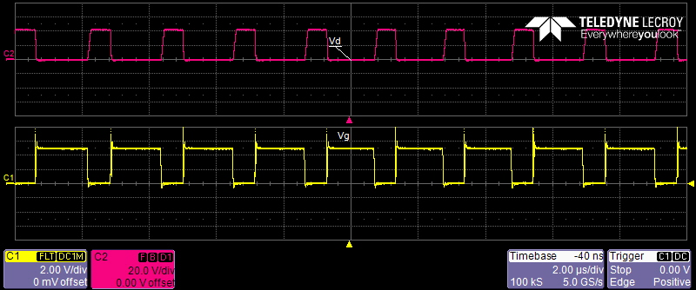
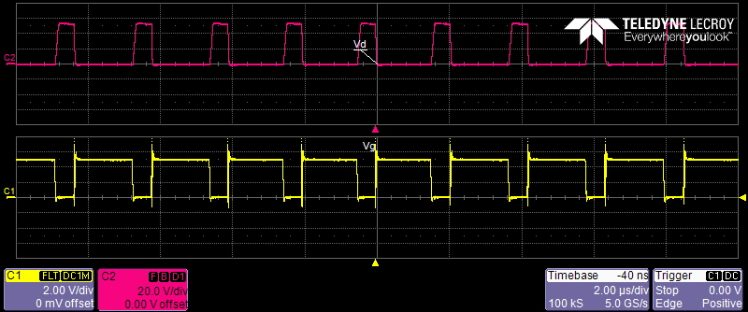
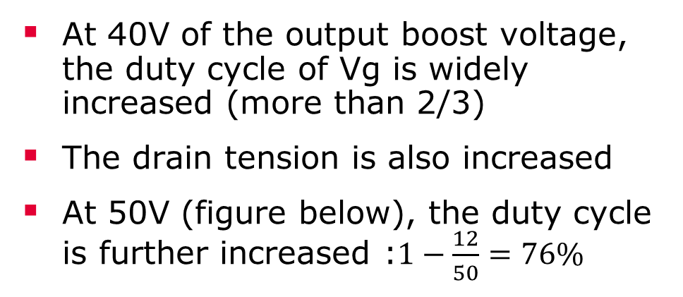
BOOST waveform: continous operating mode
At 40V of the output boost voltage, the duty cycle of Vg is widely increased (more than 2/3)
The drain tension is also increased
At 50V (figure below), the duty cycle is further increased :$1−\frac{12}{50}=76\%$

Slide 17
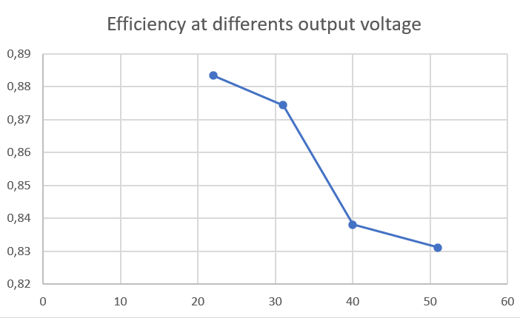
Efficiency :BOOST
We have the efficiency at the output voltage variation
The efficiency is measured at 12V input voltage
The efficiency decreases slowly when the output voltage increases.

Slide 18
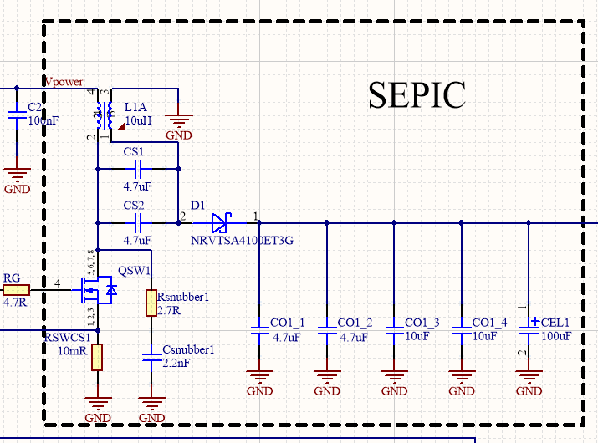
SEPIC Waveform: 514mA of output current
The gate and the drain of the switch will be measured
The tension at 2 will also be measured
QSW1 is the switch
The output voltage is 11.7V
The output current is 514mA while the input current is around 700mA

Slide 19
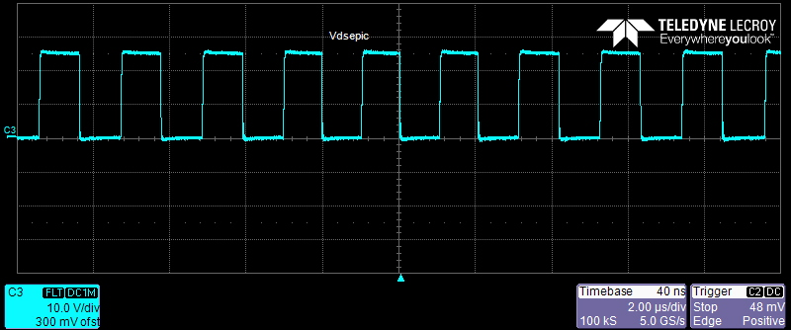
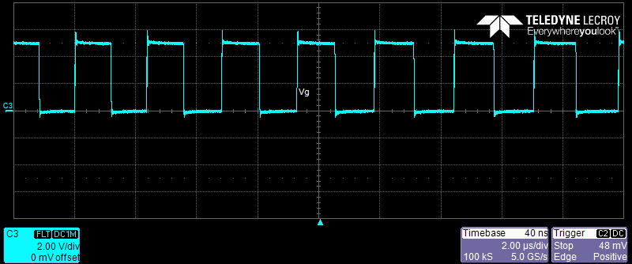
Drain and gate voltage of the switch with 12V input voltage

Slide 20
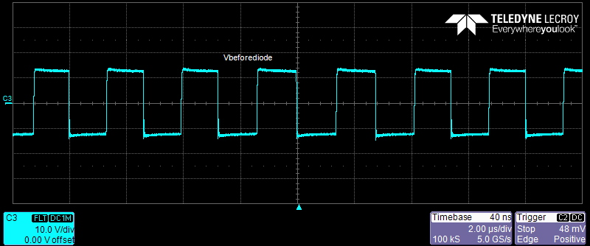
Voltage at the positive node of the diode: the voltage goes from 11 to-11V

Slide 21
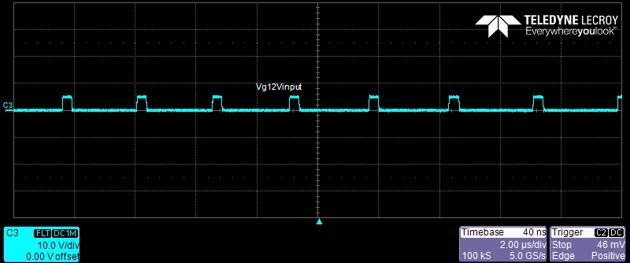
Gate voltage of the switch with 12V input voltage and 5V output voltage

Slide 22
Controller Unit board

Slide 23
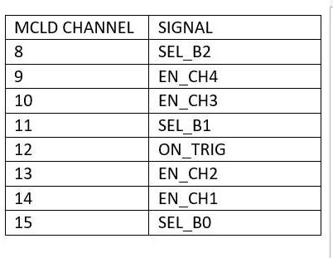
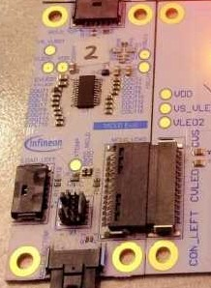
channel programming through the MCLD
The control is on the right
The chip will be programmed
The 8-15 channels are the one on the right of the arrow
15 is the one of the bottom

Slide 24
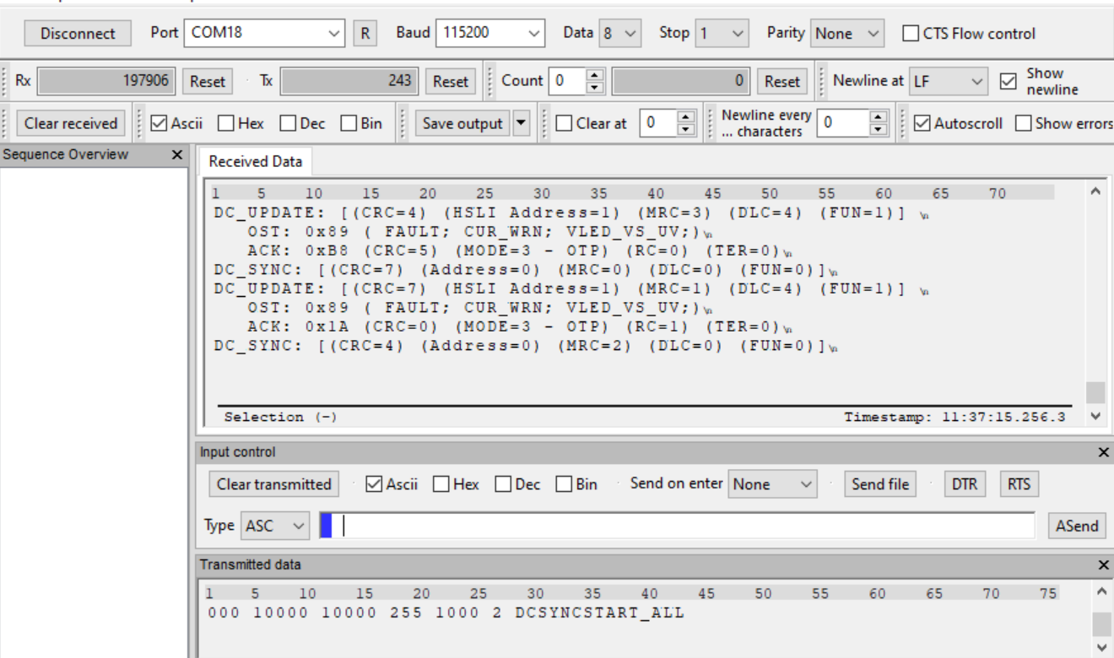
channel programming through the MCLD
This is Hterm: il software program
After connecting the PC to the MCLD, we need to connect the equivalent port: in this case COM18
To start, we digit the command MENU
Then the OTP command is digited, hterm has to respond in the OTP mode
Now we can program our channels

Slide 25
channel programming through the mcld
255 1000 0 DCUPD 0 0 0 0 0 0 0 0 duty1 duty2 ………duty8
255 is the number of time this command is repeated,1000ms is the period, 0ms is the offset
The micro-controller has 16 channels: the first 8 are inizialized to 0 , the second 8 are the one we need
The duty cycle is varied from 0 to 10000 (duty cycle at 100%)
7500 corresponds to 50% of duty cycle
255 1000 2 DCSYNC
This is the update command
START_ALL
Now we can start the program
STOP_ALL is to end the program

Slide 26
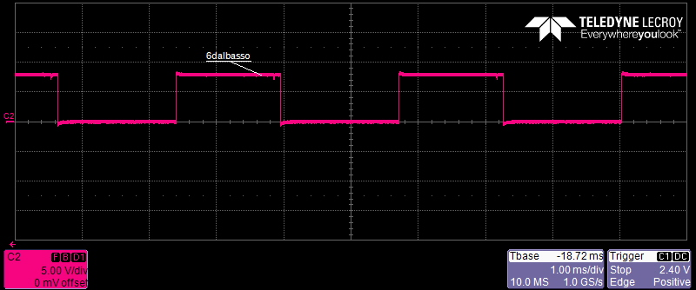
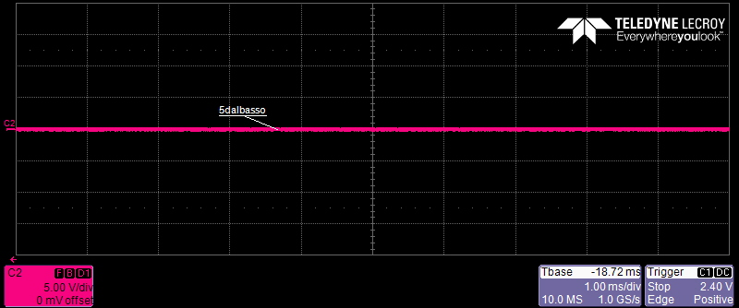


Oscilloscope results: channels 15, 14, 13, 12( On_trig is a pull down, always at 0)

Slide 27
CONCLUSION
The DC-DC has is working properly
The control unit is workink properly too
The chip should be availaible for next month
A new propotype of the FIRING UNIT with laser diode ongoing
The next step will be to connect all the board and analyse the firing UNIT
Course attented: ToM 2021/1, Python, Elettronica per fisici
Paper ongoing: 50A low side laser driver GaN in a system on package with a resonant circuit for LIDAR application

