Slide 1


Characterisation of the GEMINI chip coupled with Aluminium Triple-GEM detector
1° year Seminar
Tutor: Dr. Marco Tardocchi
Supervisor: Dr. Gabriele Croci
Candidate: Stephanie Cancelli

Slide 2
Outline
Gas Electron Multiplier detectors
PhD project
Aluminium GEM detector
GEMINI chip
GEMINI analog system
Analog system characterisation.

Slide 3
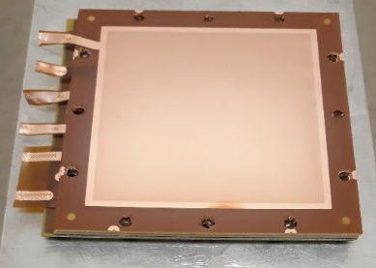
Gas Electron Multiplier (GEM) detectors
Developed in 1997 by F.Sauli at CERN.
Belong to Micro-pattern Gas Detector.
Gas used: ArCO2(70%-30%).
Standard GEM foil
Thickness of insulating layer: 50 μm
Thickness of conductive layer: 5 μm
Inner diameter of holes: 50 μm
External diameter of holes: 70μ
Pitch:140 μm

Slide 4
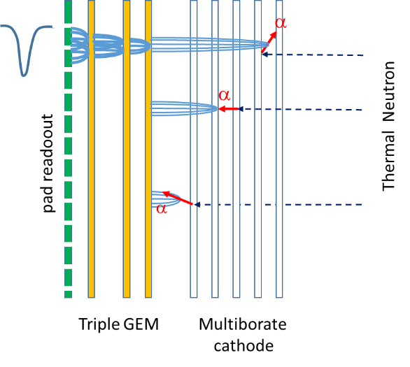
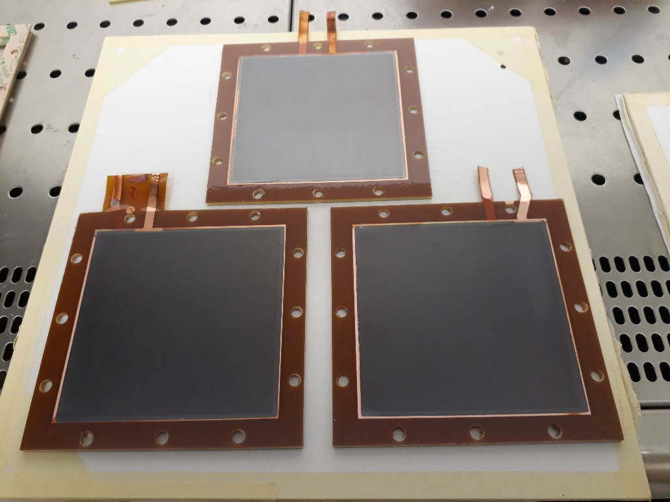
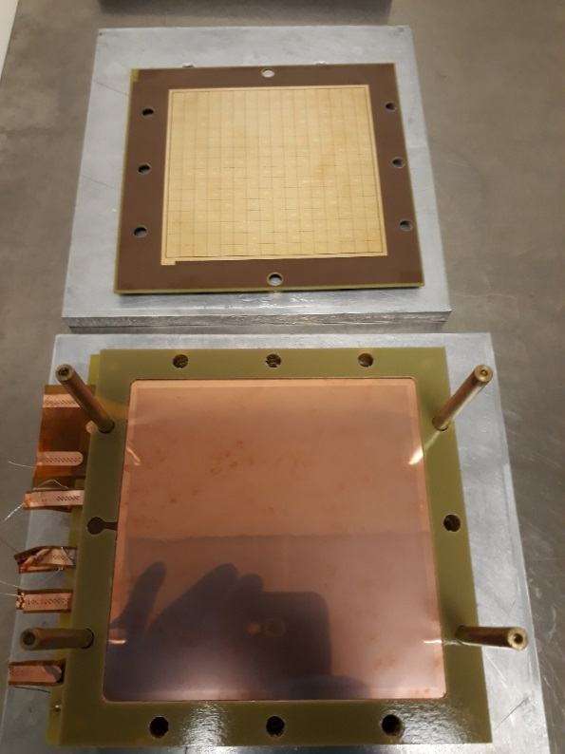

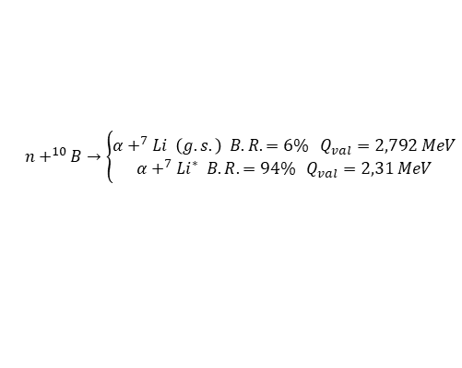
PhD Project
Development of a 10B multi-layer triple-GEM detectors optimised for slow neutron detection.
$$n+^{10}B→\left\{\begin{aligned}α+^{7}Li \left(g.s.\right) B.R.=6\% Q_{val}=2,792 MeV \\ α+^{7}Li^{∗} B.R. =94\% Q_{val}=2,31 MeV\end{aligned}\right.$$
BGEM foils
$$γ=482 keV$$
Standard GEM foils and padded anode
A.Muraro et al. “MBGEM: a stack of borated GEM detector for high efficiency thermal neutron detection”- Eur. Phys. J. Plus (2021)

Slide 5
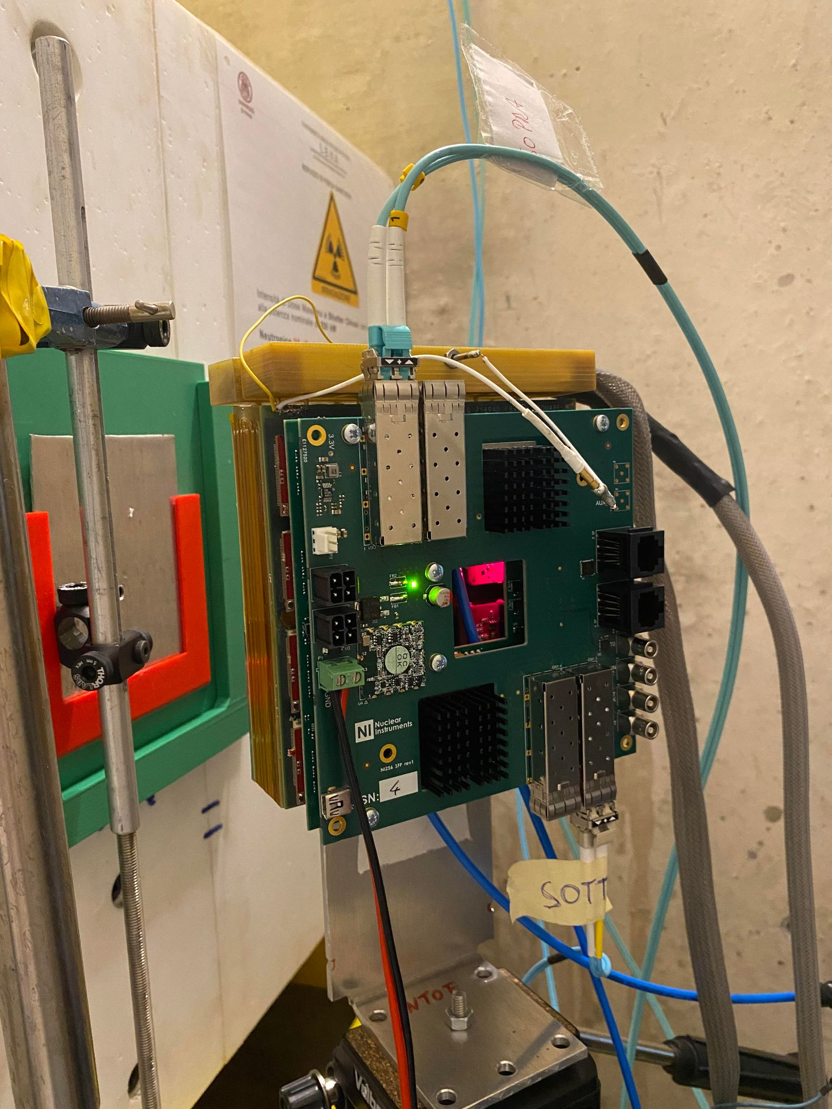
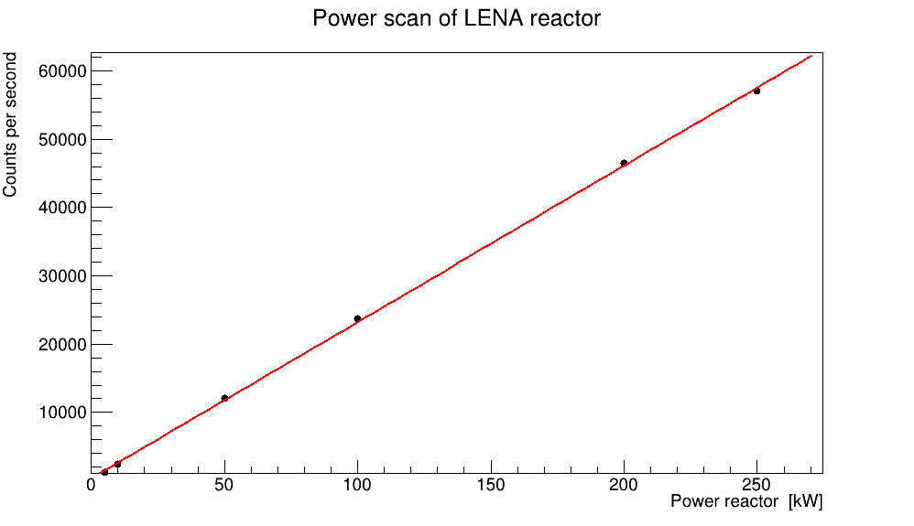
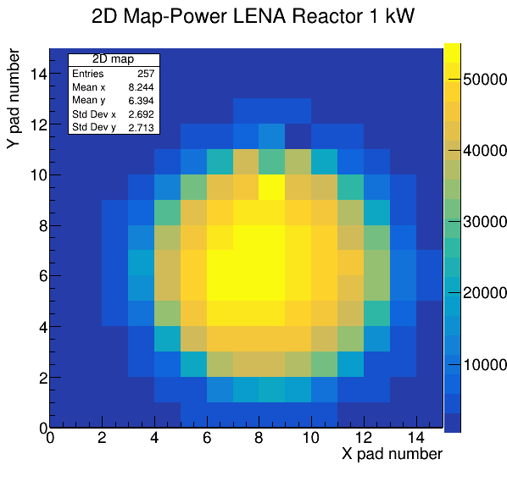
PhD Project
Development of a 10B multi-layer triple-GEM detectors optimised for slow neutron detection.
First prototype of MBGEM detector

Slide 6
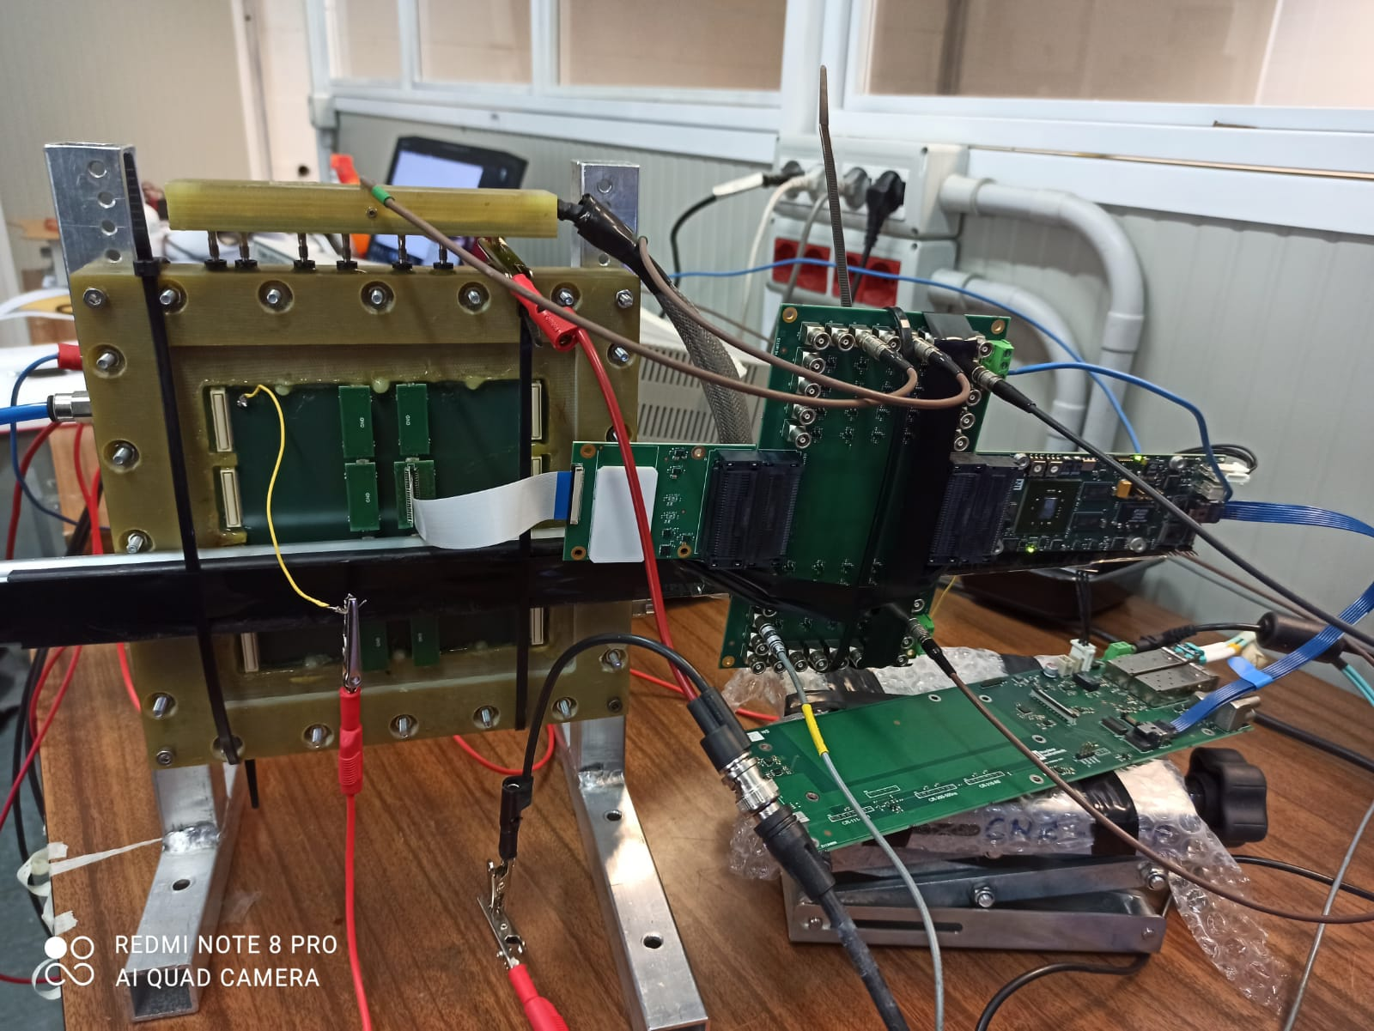
Aluminium triple-GEM detector
GEM detector optimised for Soft X-ray detection.
Three GEM foils covered with 200 nm Al.
Gas mixture of ArCO2(70%-30%).
Two system of GEMINI electronic readout (analog and digital).
Aluminium GEM foils
256 padded anode (one pad of 6x6 mm²)
Al GEM detector with analog and dital system

Slide 7
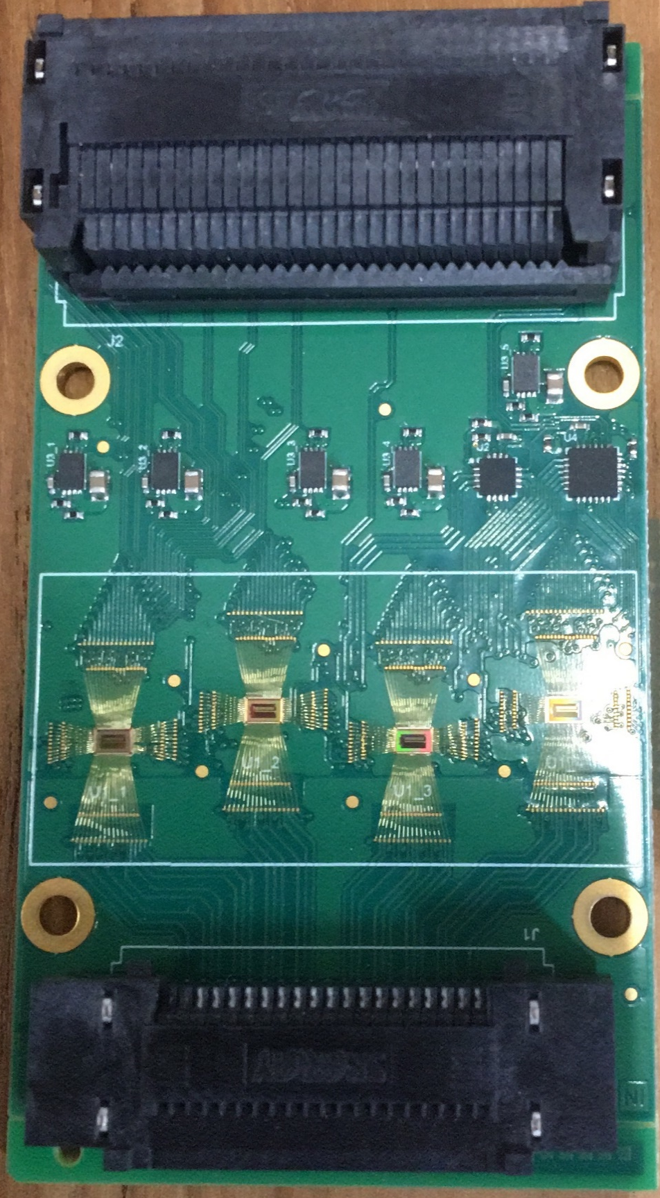
GEMINI Chip
Features | GEMINI | CARIOCA
CMOS technology | 180 nm | 250 nm
N° of channels | 16 | 8
Max pixel capacitance | 40 pF | 120 pF
Max count rate | 5 Mcps | 0.8 Mcps
Min detectable charge | 2.5 fC | 10 fC

Slide 8
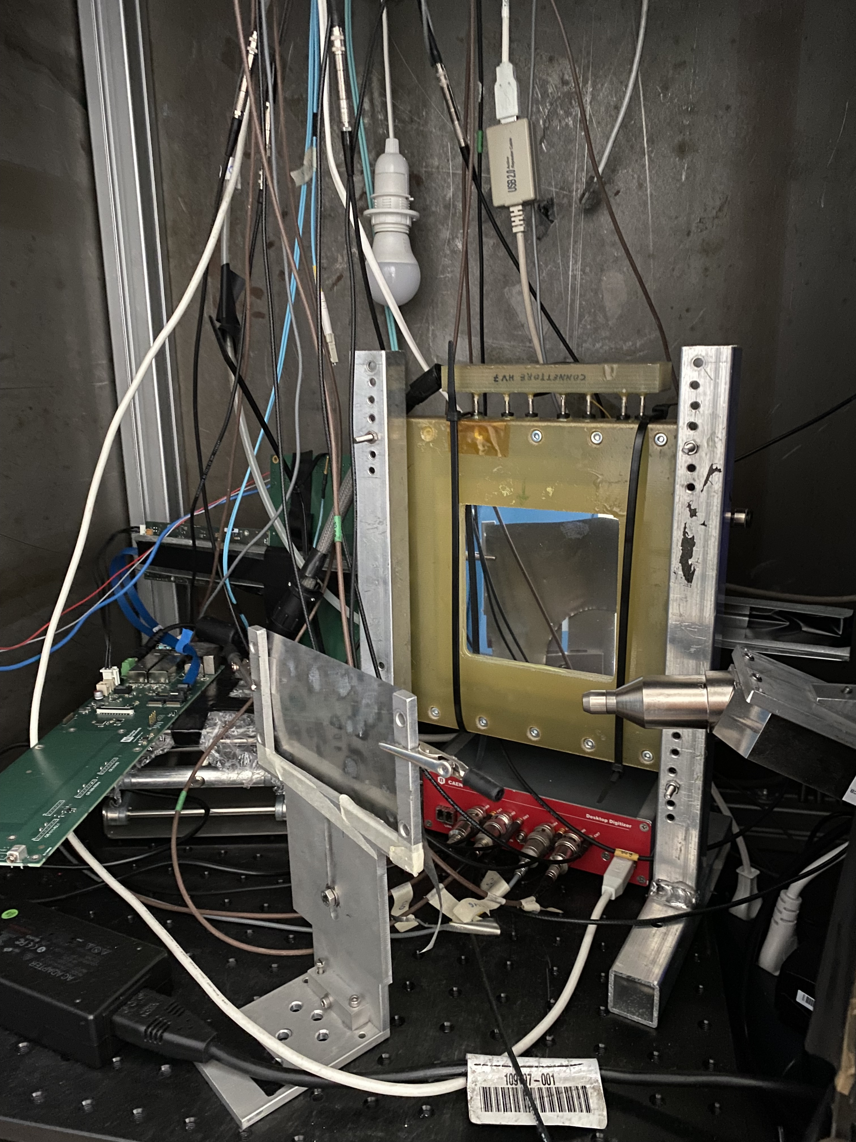
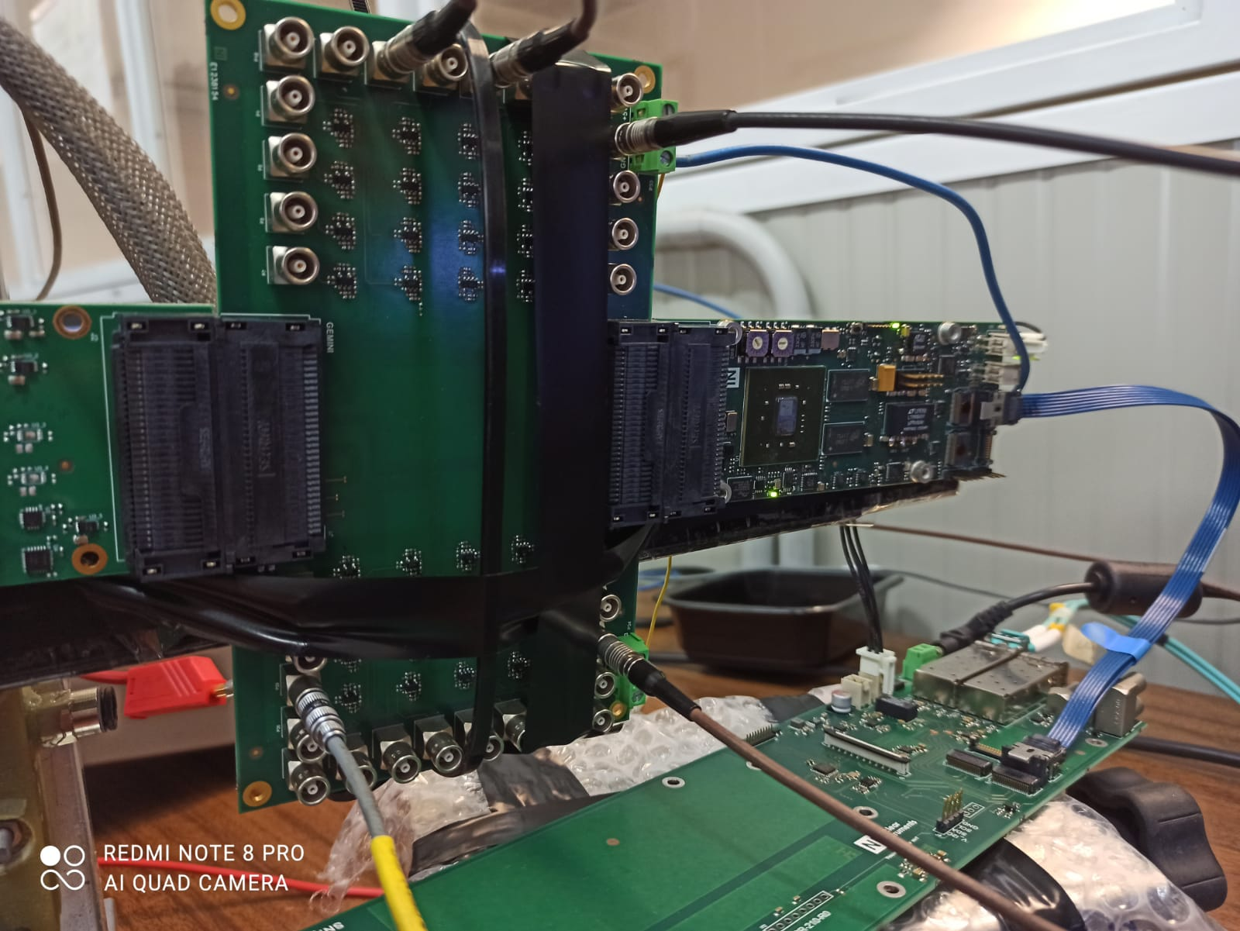
GEMINI Analog System
32 analog channel board and 64D GEMINI chip.
Caen digitizer (8 channels).
X-ray source and Titanium target.
Ch6 | Ch0 | Ch7
Ch1 | Ch 5 | Ch6
Ch3 | Ch4
X-ray source
Target
CAEN
digitizer

Slide 9
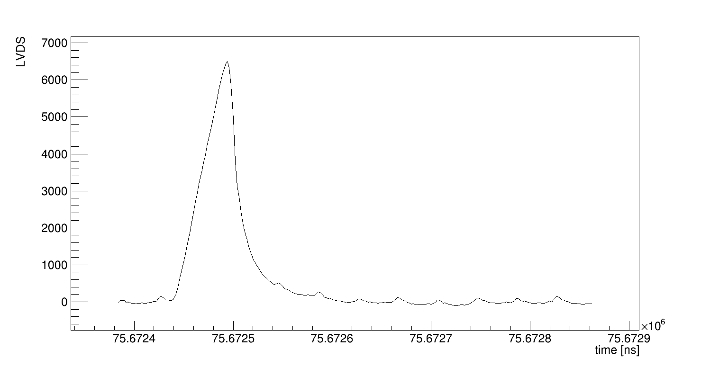
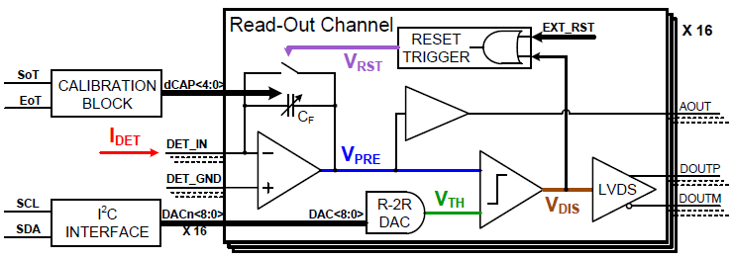
Analog System Characterisation
Waveform of a single event
Threshold
ToT

Slide 10
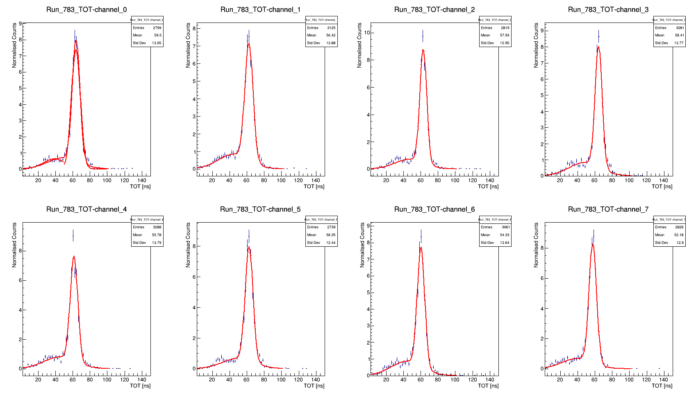
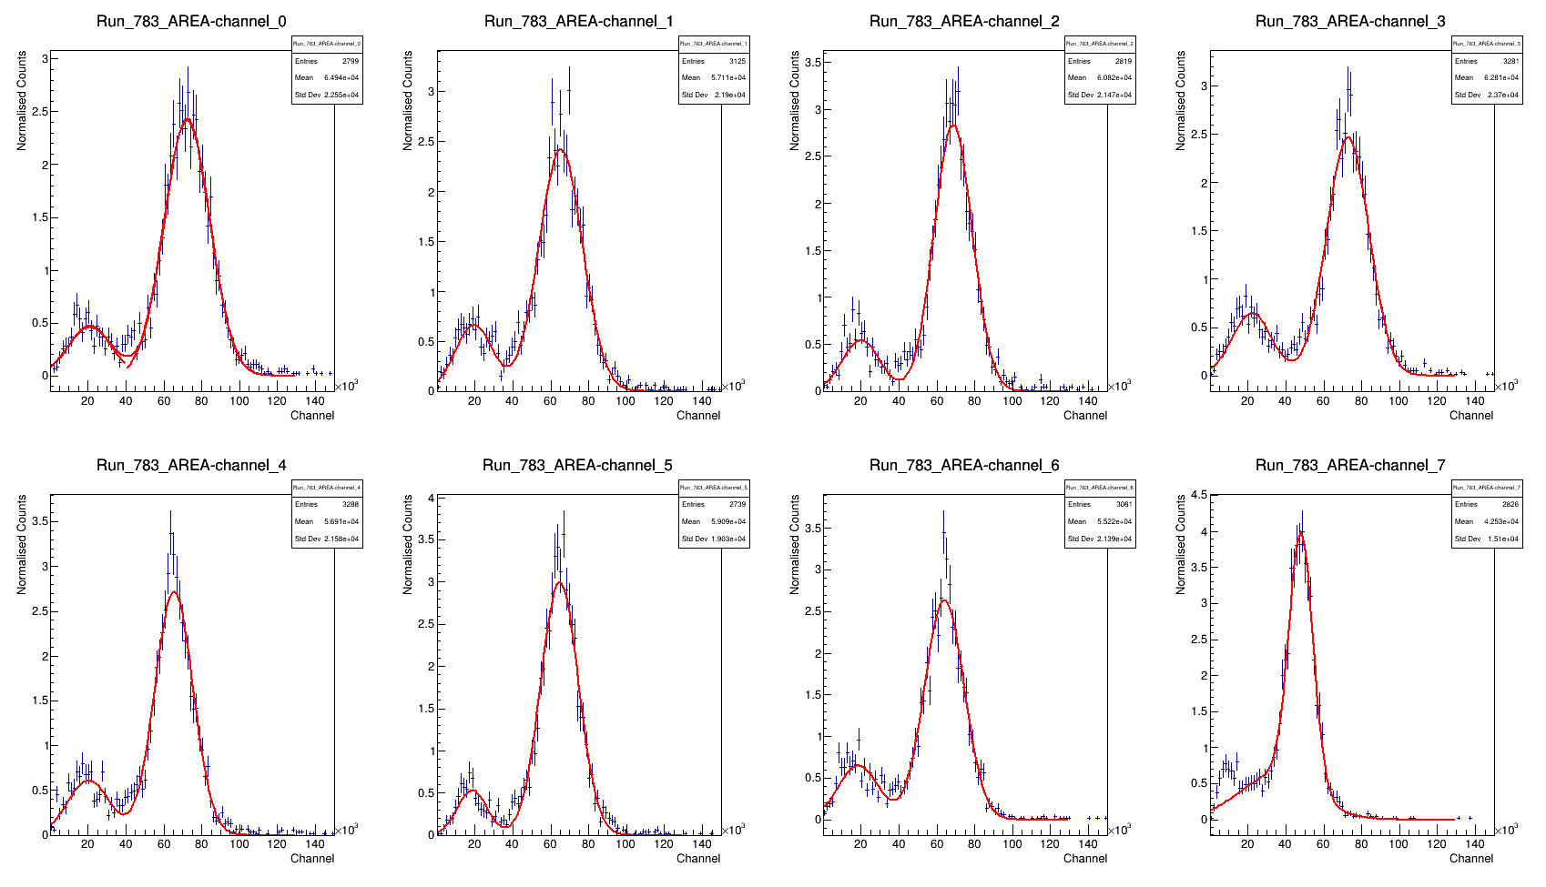
Analog System Characterisation
ToT and Pulse Hight spectra from analog data

Slide 11
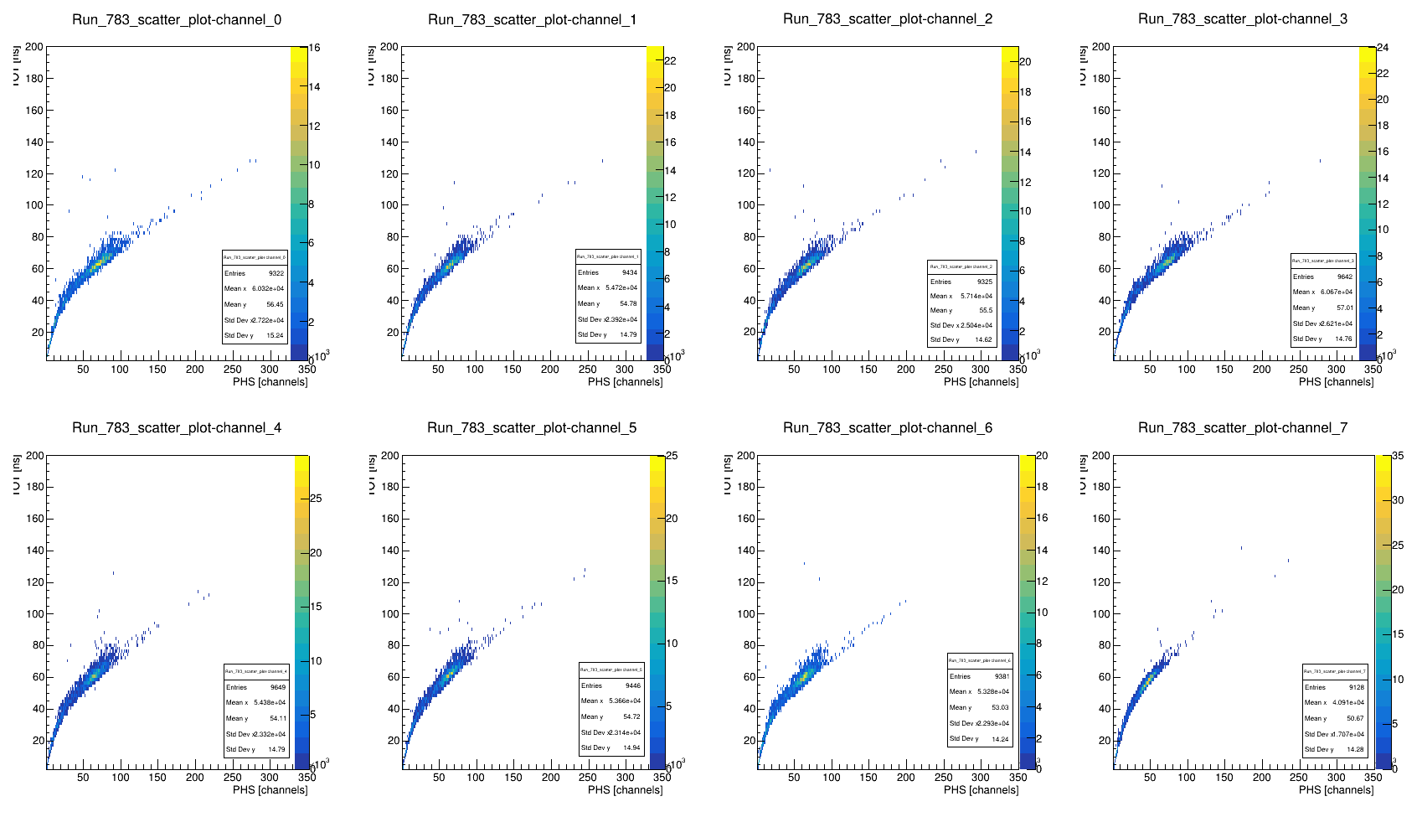
Analog System Characterisation
ToT as a function of PHS

Slide 12
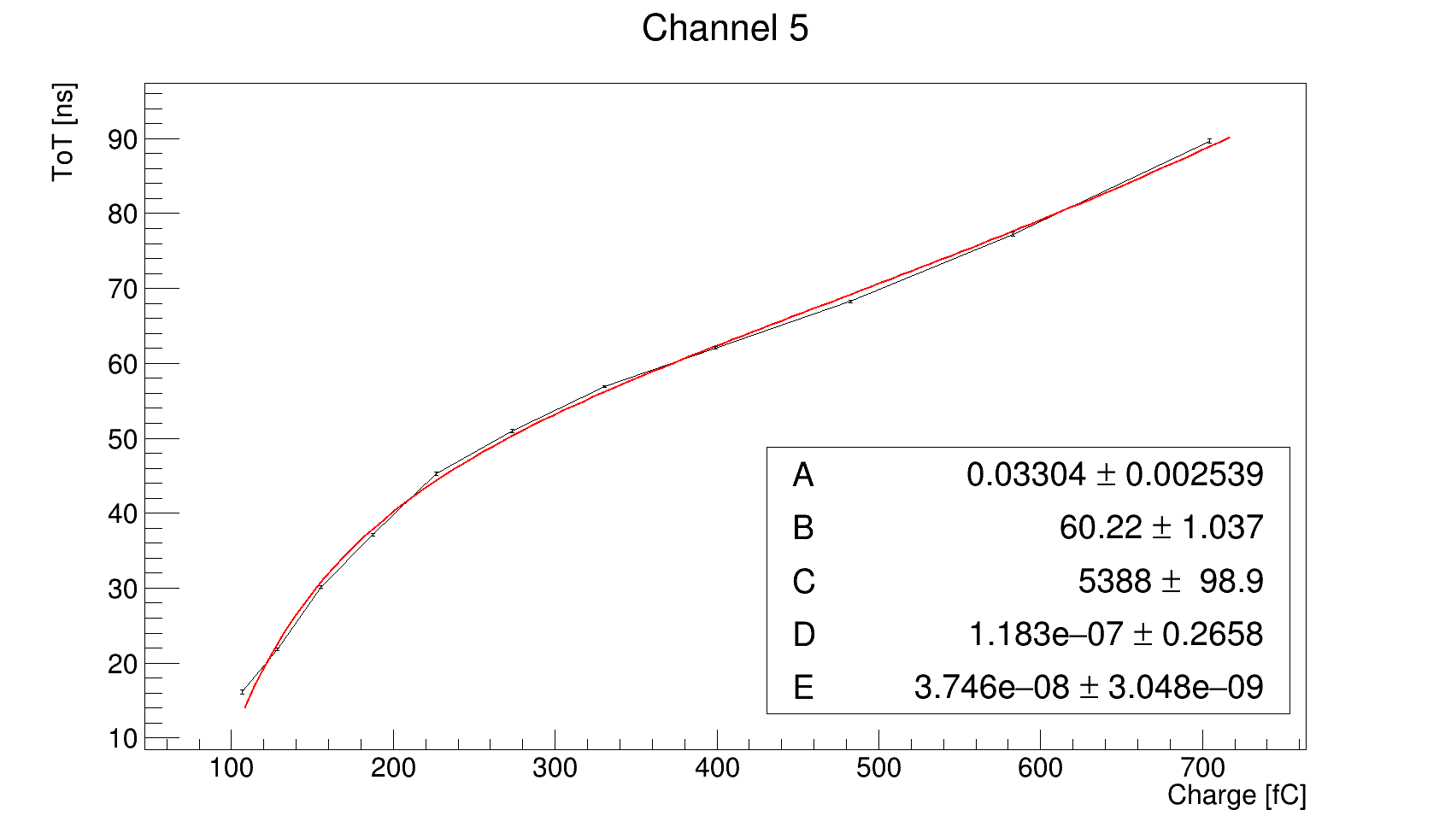
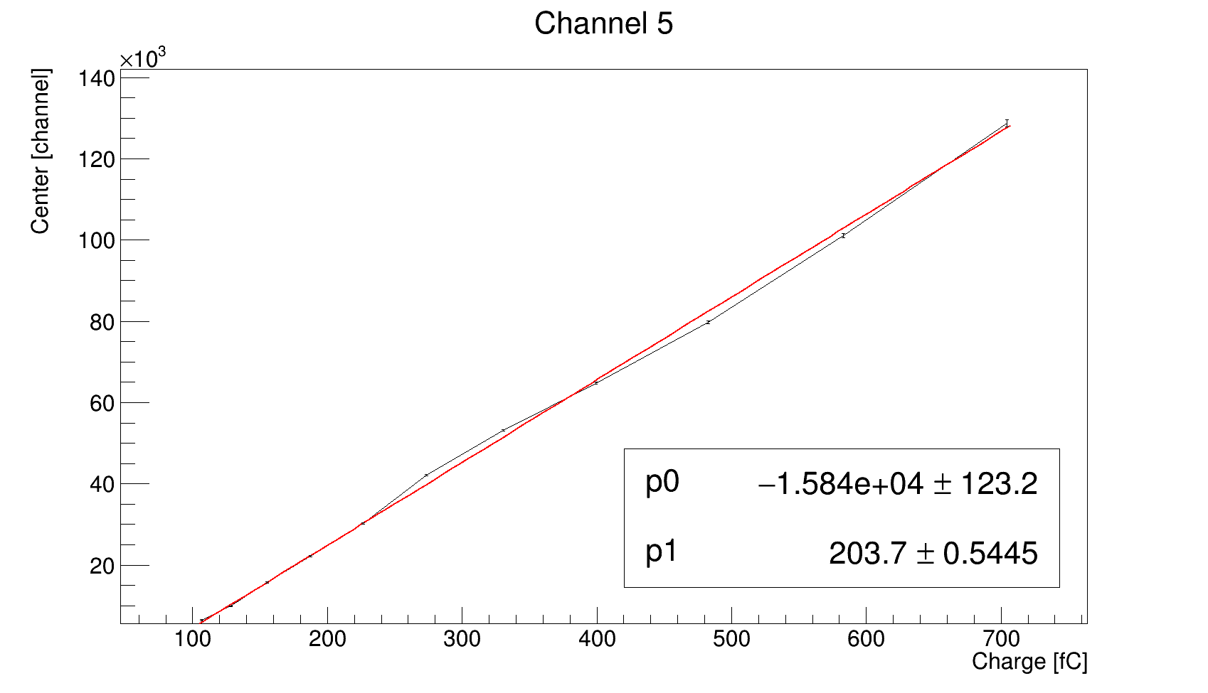


Analog System Characterisation
ToT and PHS calibration curves
$$ToT=Aq+B−\left(\frac{C}{q−D}\right)+Eq^{3}$$
$$center=Aq+B$$

Slide 13
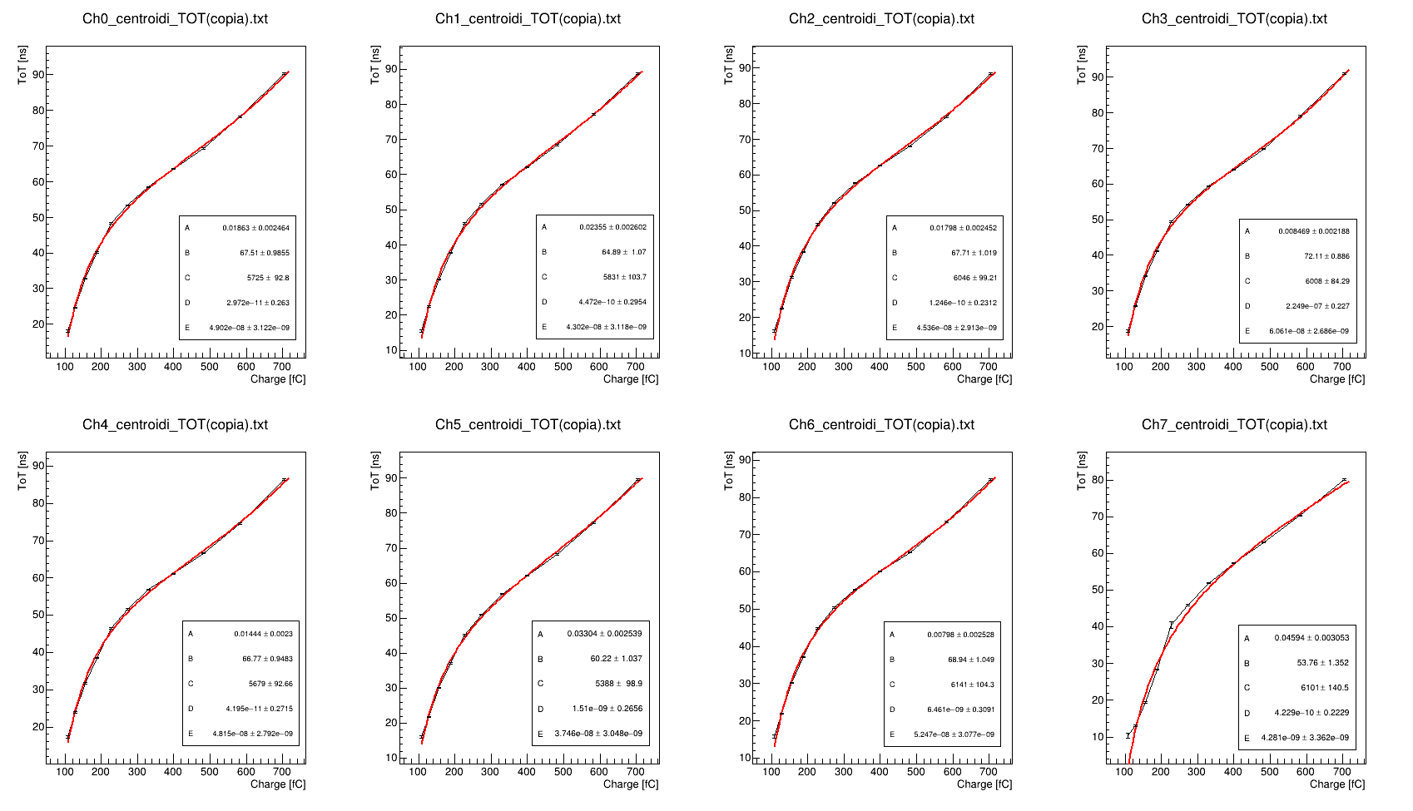
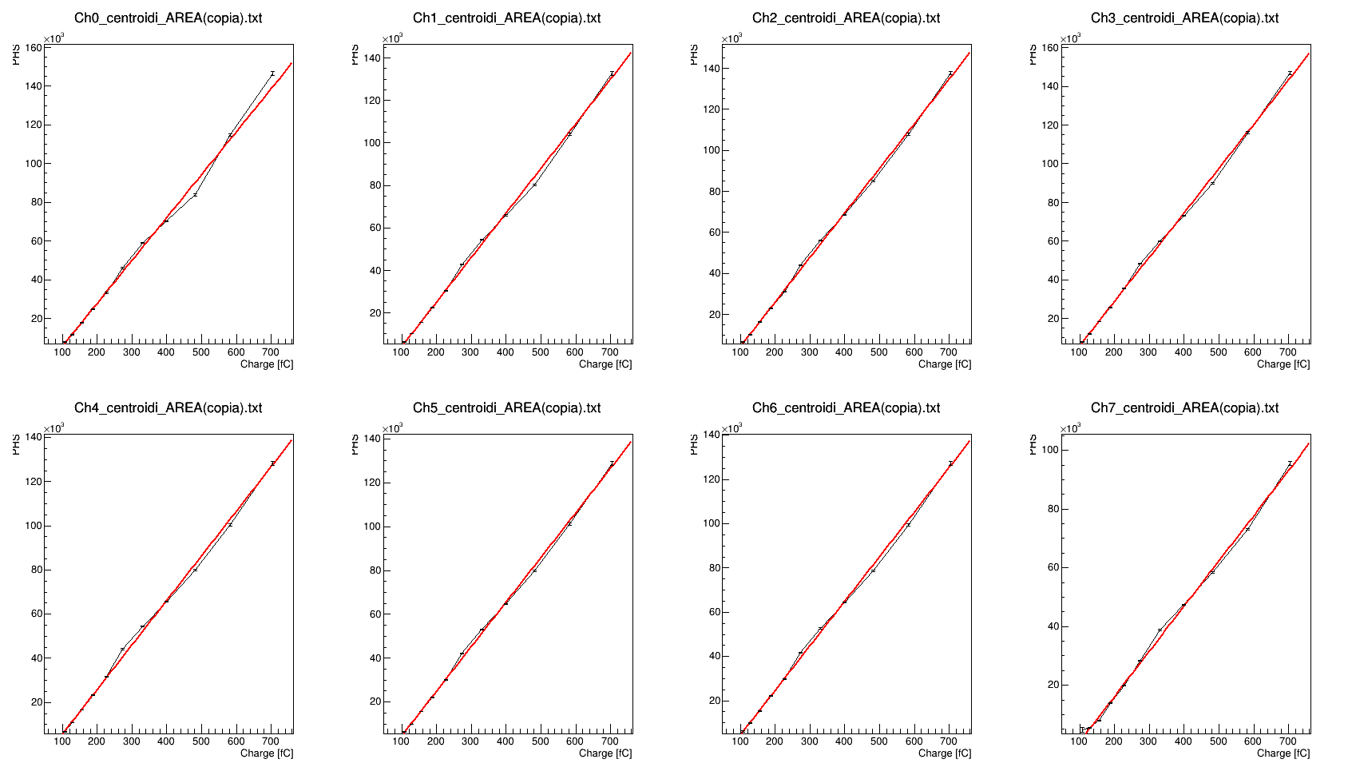
Analog System Characterisation
ToT and PHS calibration curves

Slide 14
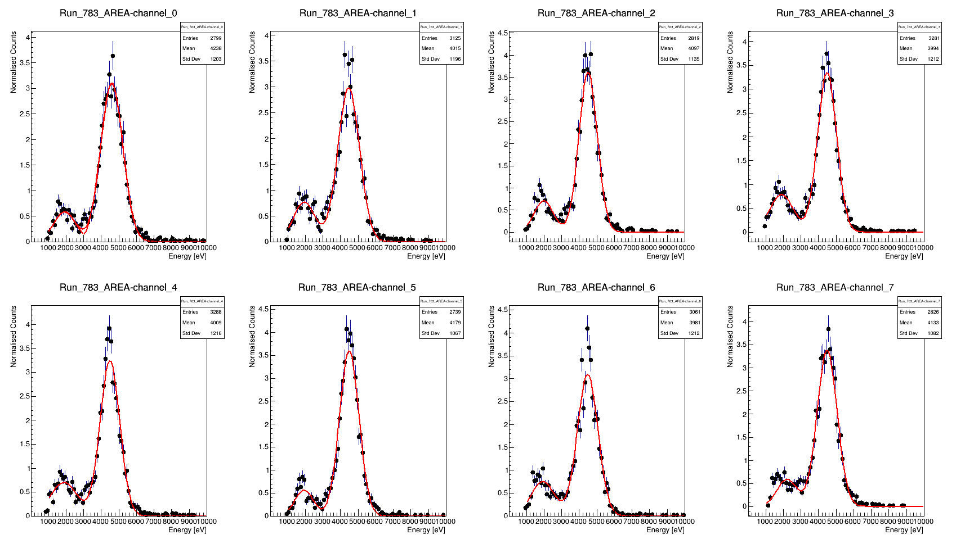
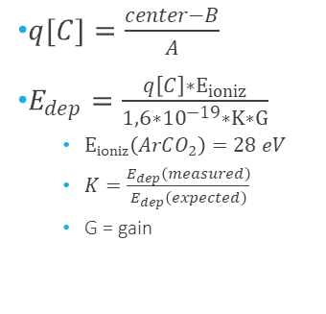
Analog System Characterisation
Energy Spectra of a Titanium target
$q[C]=\frac{center−B}{A}$
$E_{dep}=\frac{q\left[C\right]∗E_{ioniz}}{1,6∗{10}^{−19}∗K∗G}$
    $E_{ioniz}\left(ArCO_{2}\right)=28 eV$
    $K=\frac{E_{dep}\left(measured\right)}{E_{dep}\left(expected\right)}$
    G = gain

Slide 15
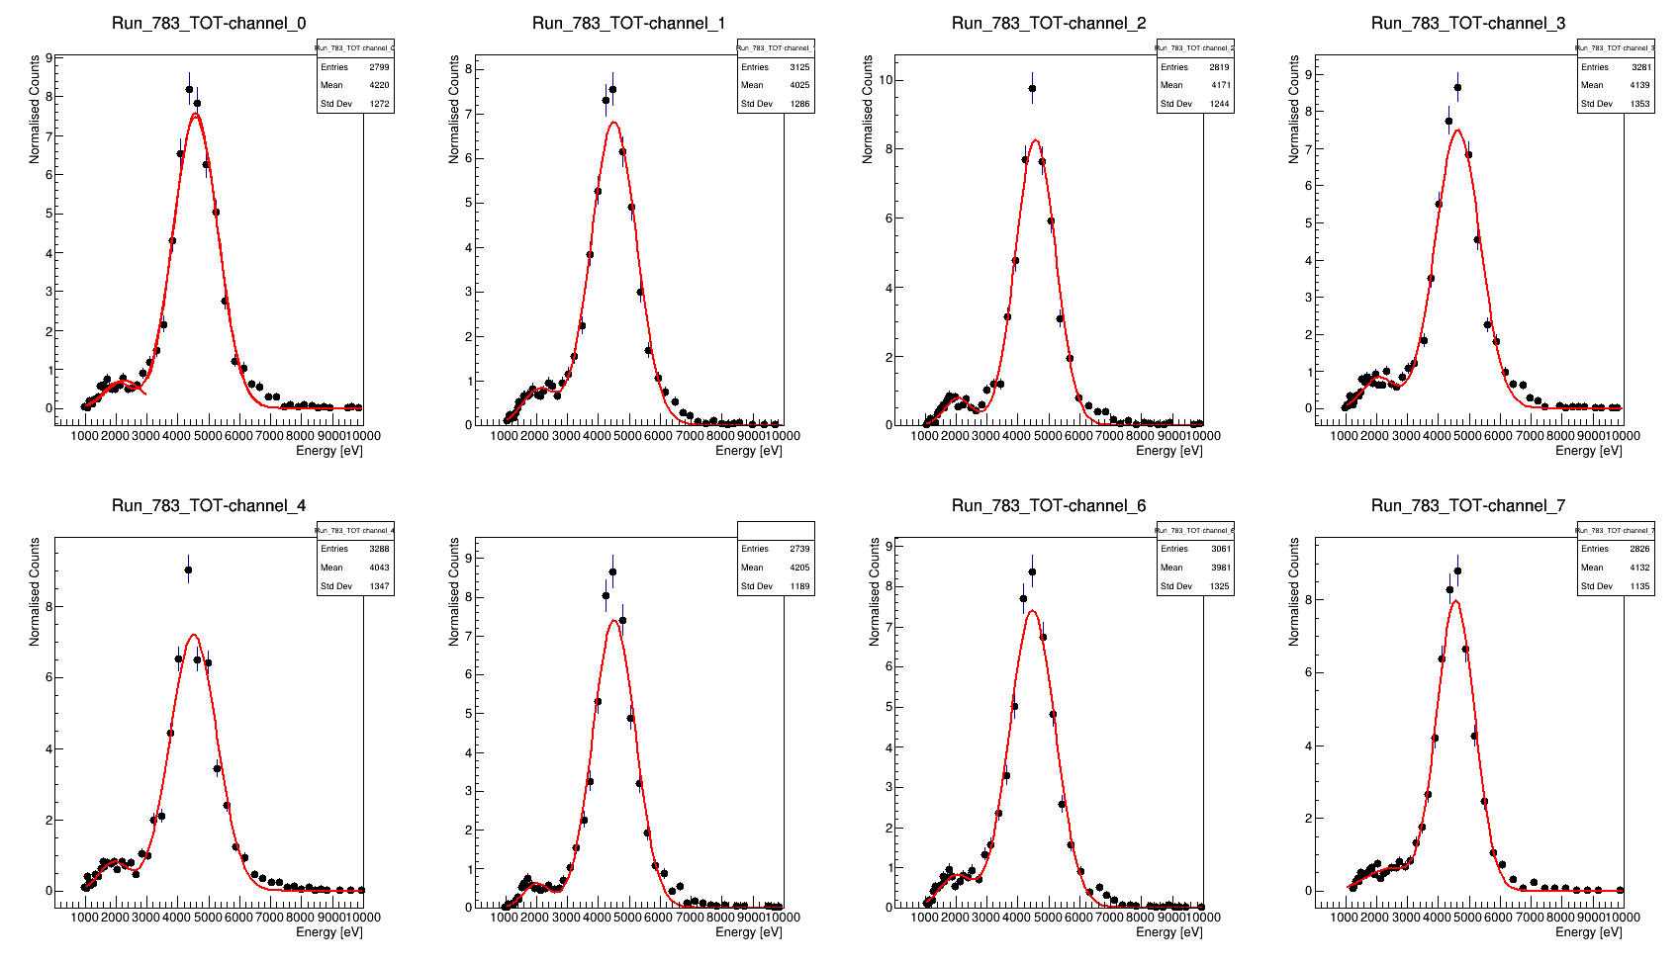
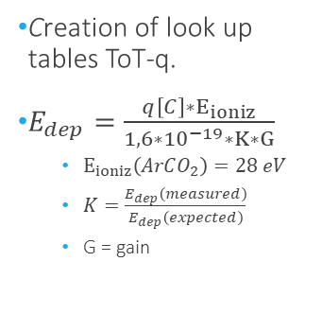
Analog System Characterisation
Energy Spectra of a Titanium target
Creation of look up tables ToT-q.
$E_{dep}=\frac{q\left[C\right]∗E_{ioniz}}{1,6∗{10}^{−19}∗K∗G}$
    $E_{ioniz}\left(ArCO_{2}\right)=28 eV$
    $K=\frac{E_{dep}\left(measured\right)}{E_{dep}\left(expected\right)}$
    G = gain

Slide 16
Analog System Characterisation
Energy Resolution
Channel | FWHM_{TOT} (eV) | Center_{TOT} (eV) | R_{TOT} | FWHM_{PHS} (eV) | Center_{PHS} (eV) | R_{PHS}
0 | 1711 | 4564±16 | 37% | 1471 | 4598±14 | 32%
1 | 1733 | 4495±16 | 38% | 1450 | 4460±14 | 32%
2 | 1518 | 4565±13 | 33% | 1230 | 4498±11 | 27%
3 | 1706 | 4622±15 | 37% | 1276 | 4485±12 | 28%
4 | 1779 | 4503±15 | 39% | 1311 | 4490±13 | 29%
5 | 1624 | 4505±15 | 36% | 1304 | 4490±12 | 29%
6 | 1734 | 4465±16 | 38% | 1374 | 4475±14 | 30%
7 | 1445 | 4555±15 | 31% | 1342 | 4485±14 | 30%

Slide 17
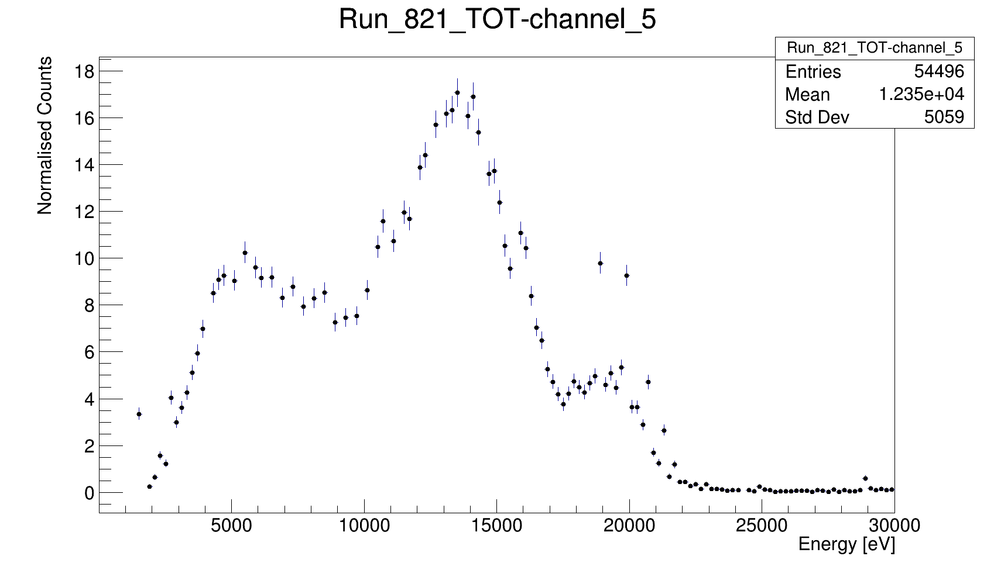
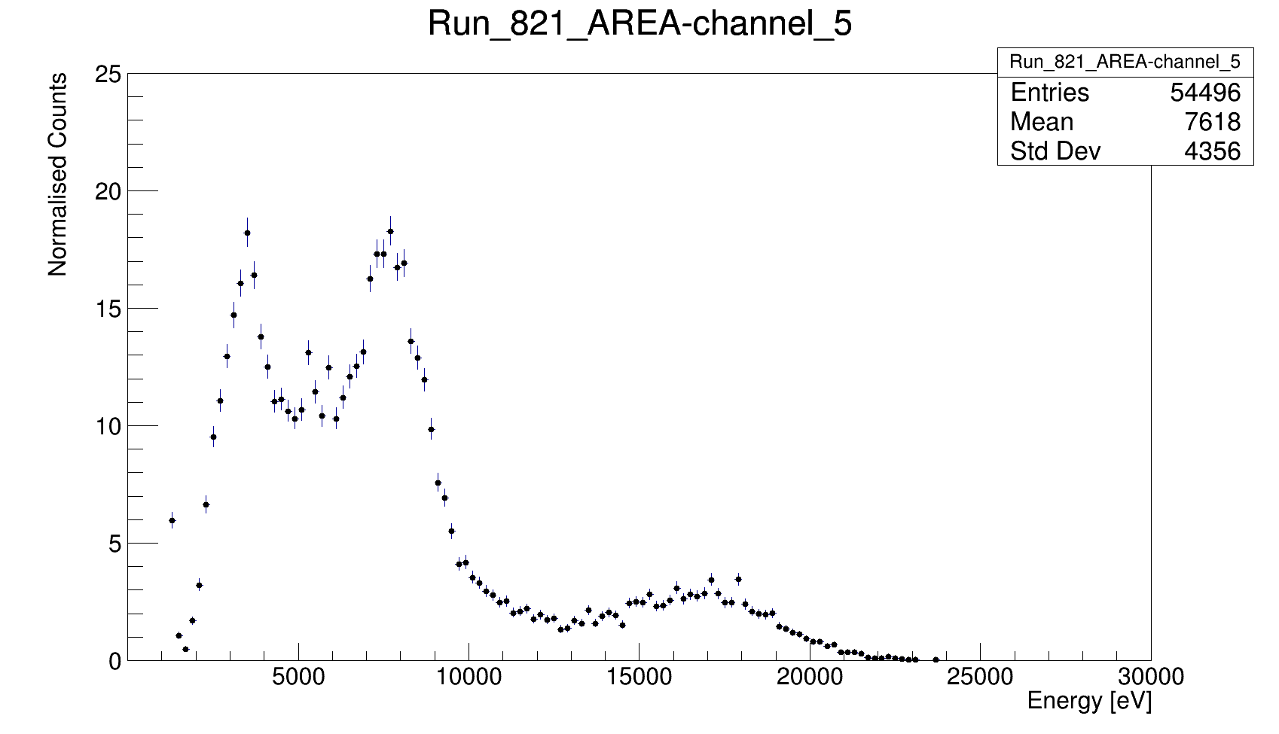
Analog System Characterisation
Energy Spectra of a Molybdenum target

Slide 18
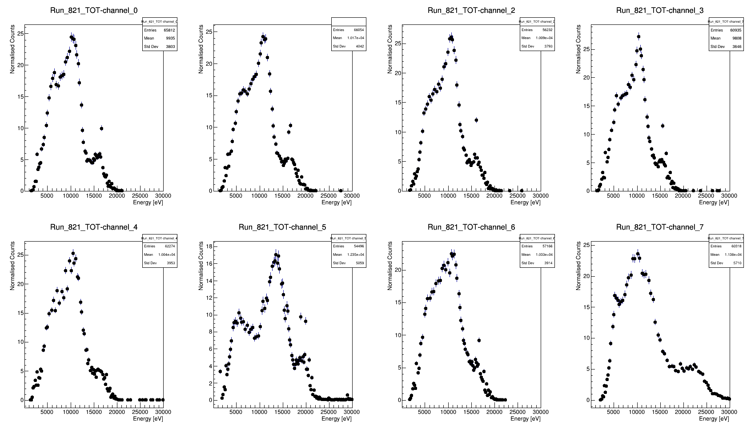
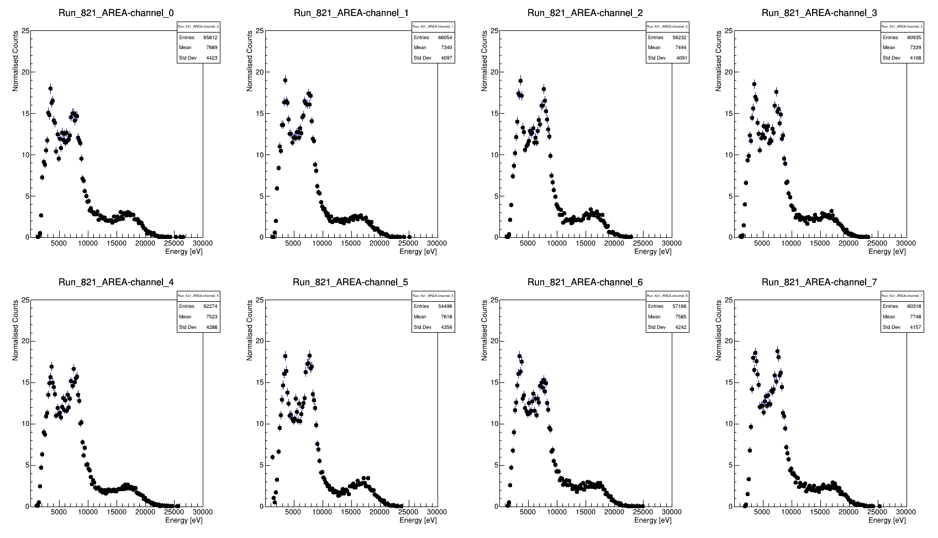
Analog System Characterisation
Energy Spectra of a Molybdenum target

Slide 19
Thank You
for Your Attention

Slide 20
Exams
Writing on scientific papers – verbalizzato il 30/06/2021 (1CFU)
Surfing the academic job market: how to publish in hight impact international journals – verbalizzato il 05/03/2021 (1CFU)
Introduction to Python Programming - sostenuto il 31/03/2021 (1CFU)
Advanced Topics in C++ - sostenuto il 13/05/2021 (2CFU)
Acquired CFU: 5

Slide 21
Publications
S. Cancelli, A. Muraro, E. Perelli Cippo et Al., (2021) “Development of a ceramic double thick GEM detector for transmission measurements at the VESUVIO instrument at ISIS ” – JINST.
Giovanni Romanelli, Dalila Onorati, Pierfrancesco Ulpiani, Stephanie Cancelli et Al., (2021) "Thermal neutron cross sections of amino acids from average contributions of functional groups" - Journal of Physics: Condensed Matter.
A.Muraro, G.Claps, G.Croci, C.-C. Lai, R.De Oliveira, S.Altieri, S.Cancelli et Al., (2021) “MBGEM : a stack of Borated GEM detector for high efficiency thermal neutron detection” - Eur. Phys. J. Plus.

Slide 22
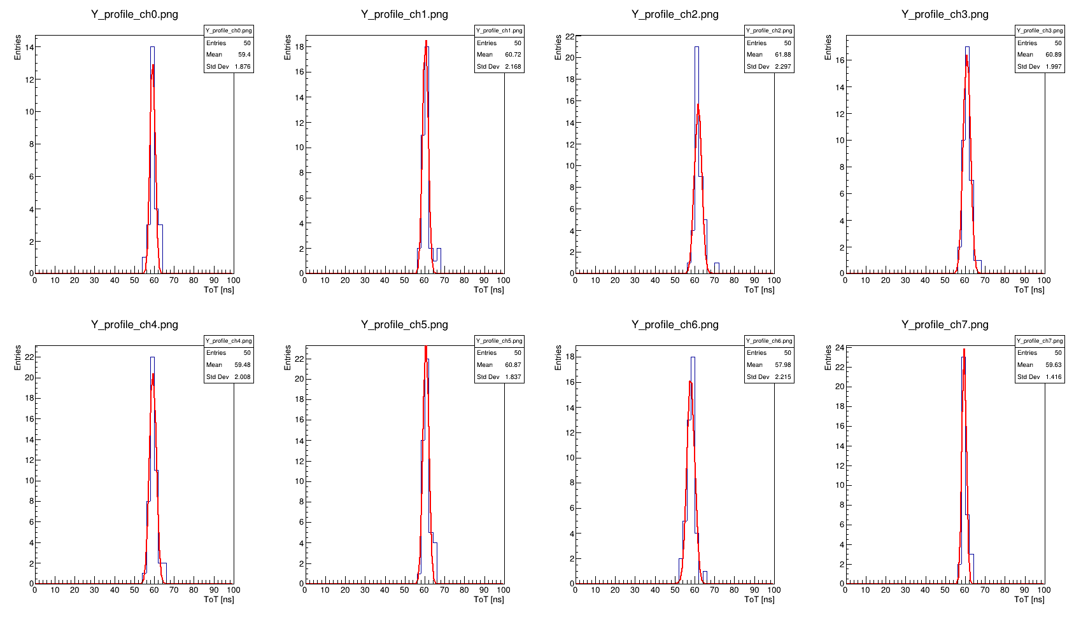
Analog System Characterisation
ToT as a function of PHS
Channel | FWHM | R
0 | 2,9 | 4,9%
1 | 3,2 | 5,3%
2 | 4,2 | 6,9%
3 | 4,2 | 6,9%
4 | 3,9 | 6,7%
5 | 4,6 | 7,9%
6 | 2,5 | 4,1%
7 | 2,5 | 4,2%

Slide 23
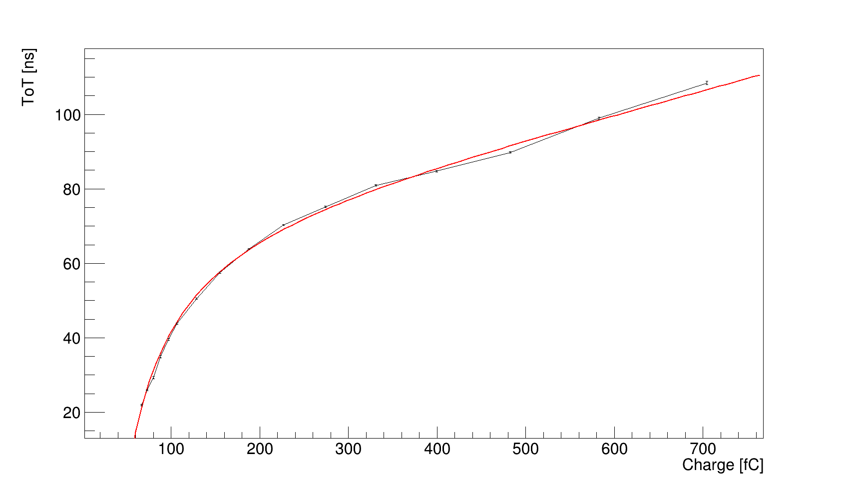
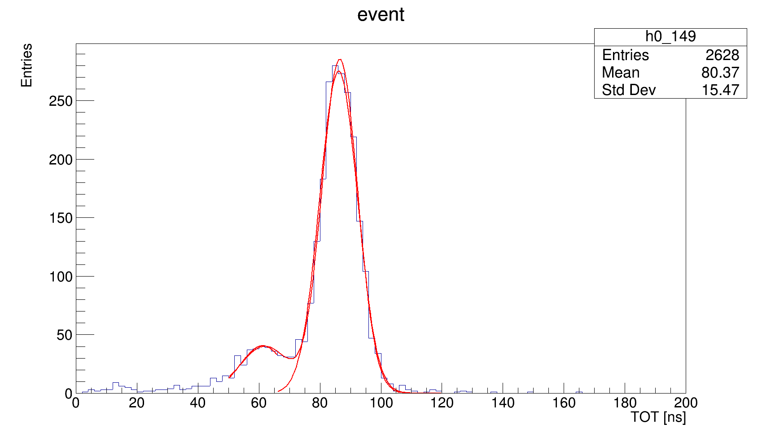
Digital signal analysis

