Slide 1

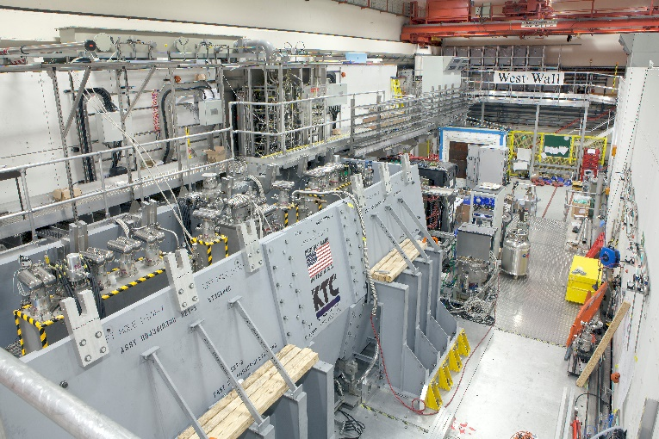
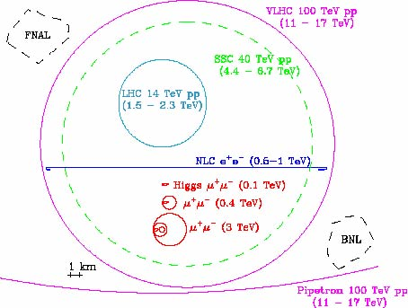
Muon colliders e … molto altro
M. Bonesini
Sezione INFN Milano Bicocca
Dipartimento di Fisica G. Occhialini

Slide 2
Why muon beams
Muon beams have potential to :
  Serve neutrino physics with intense beams (μ⁺ -> e⁺ν_{e}ν_{μ}) that have equal fractions of electron and muon neutrinos at high intensity with a precisely known energy spectrum - the Neutrino Factory (NF) concept
  Muon collisions offer a large coupling
  to the “Higgs mechanism” (Higgs factory)
  As with an e⁺e⁻ collider, a μ⁺μ⁻ collider would
  offer a precision probe of fundamental interactions
    With extremely small energy spread;
    Most effective way to achieve E_{cm} > 1 TeV
    Small footprint to fit inside existing HEP labs
Potential applications outside HEP
  Muon radiography
  Muon capture studies of archelogical materials (CHNET)
  Study of fundamental physics (proton radius puzzle, QED
  … FAMU at RIKEN-RAL)

Slide 3
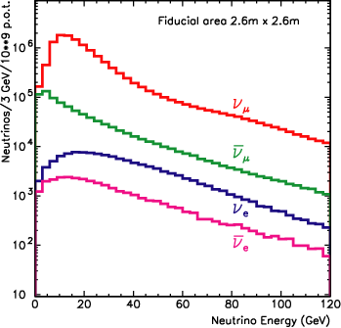
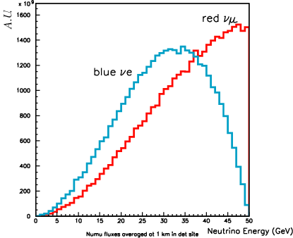
ν beams: conventional and NF beams
Problem in conventional ν beams: a lot of minority components (beam understanding)
Following muon collider studies, accelerated muons are ALSO an intense source of “high energy” ν
Crucial features:
high intensity (x 100 conventional beams)
known beam composition (50% ν_{μ} 50% ν_{e})
Possibility to have an intense ν_{e} beam
Essential detector capabilities:
detect μ and determine their sign
WANF (conventional ν beam at SPS)
NUFACT beam

Slide 4
Key points
μ – an elementary charged lepton:
  200 times heavier than the electron
  2.2 μs lifetime at rest
The large muon mass strongly suppresses synchrotron
radiation
  Muons can be accelerated
  and stored using rings at
  much higher energy than
  electrons
  a Colliding beams can be of
  higher quality with reduced
  beamstrahlung
3 TeV
Beamstrahlung in
any e+e- collider
δE/E ∝ γ²

Slide 5
The Muon Accelerator Program (MAP)
NF and MC share the same initial steps

Slide 6


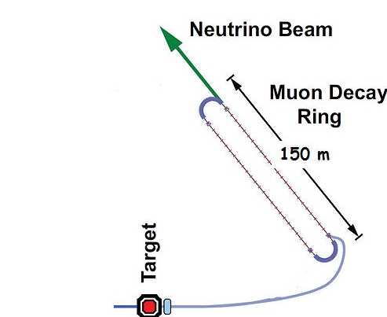
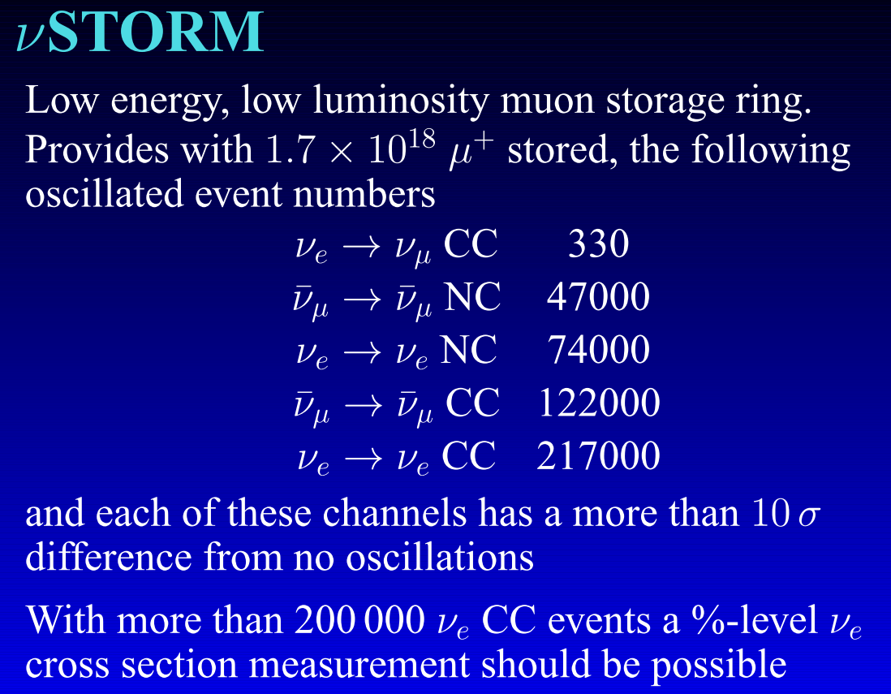
An entry level NF ? NuSTORM (demonstrator for muon collider ?)
DOES NOT
Require the
Development of
ANY
New Technology
3.8 GeV/c
stored μ
10-100kW

Slide 7
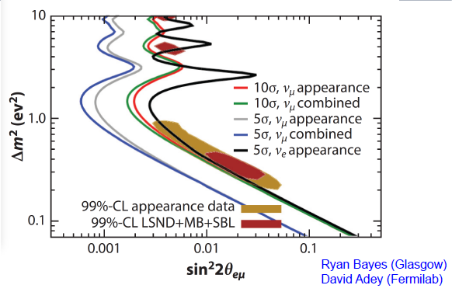
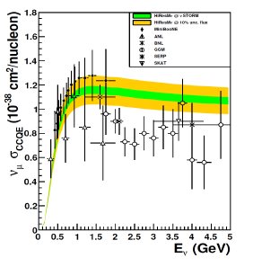
NuSTORM physics reach
Sterile ν search
Data for ν_{μ} and v_{e} interactions

Slide 9
Technical challenges for MC and NF: a long list
High-power (multi-MW) p beam (e’g. SNS, ESS, … proton driver)
Suitable targetry (MERIT @CERN, 2007 demonstrated that a > 4 MW Hg jet target is feasible)
Muon cooling (small 4D cooling (transverse) sufficient for NF , final 6D cooling essential for MC )
  μ unstable -> must cool quickly [MICE]
  Requires high-gradient RF cavities in B > 1 T fields [FNAL MTA]
Rapid acceleration
  Linac-RLAs-(FFAGs)-RCS [EMMA@DL, 2011 proved principle of non-scaling FFAG technique]
High storage-ring bending field (to maximize # of cycles before decay and small β _|_ for high L
[solution devised @ FNAL B~10 T, β ~1 cm]

Slide 10
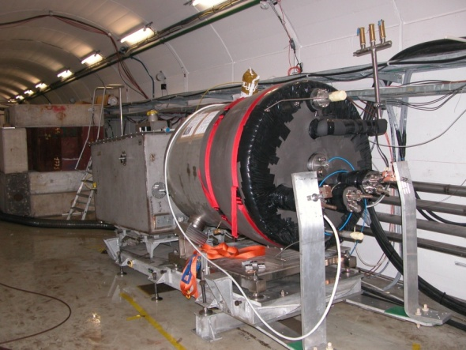
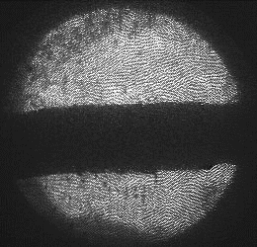
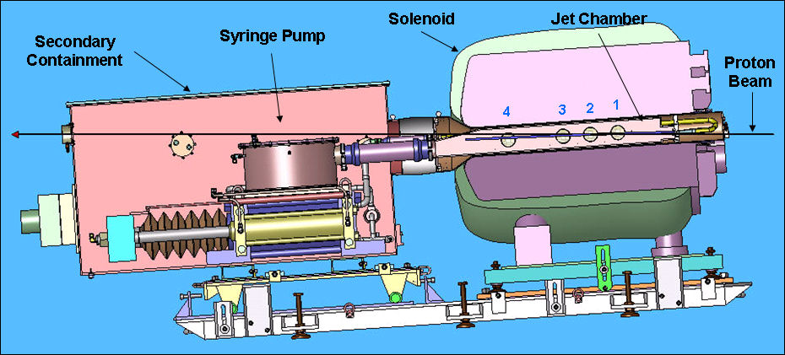
Key Technologies – Target
The MERIT Experiment at the CERN
  Demonstrated a 20m/s liquid Hg jet injected into a 15 T solenoid and hit with a 115 KJ/pulse beam!
  Jets could operate with beam powers up to 8 MW with a repetition rate of 70 Hz
1 cm
Hg jet in a 15 T solenoid
with measured disruption length ~ 28 cm

Slide 11
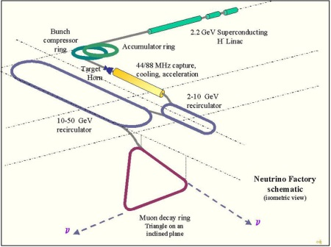
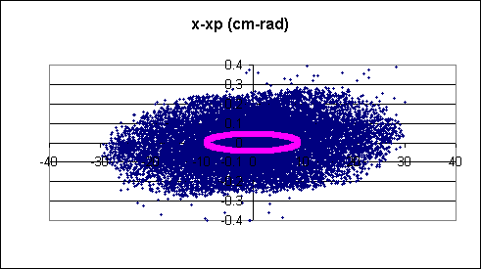
Reduction of μ emittance: μ cooling
Accelerator acceptance
R ≈ 10 cm, x’ ≈ 0.05 rad
rescaled @ 200 MeV
Accelerato
π and μ after focalization
The muon beam emittance must be reduced for injection into the acceleration system
Energy spread ► phase rotation
Transverse emittance ► cooling

Slide 12
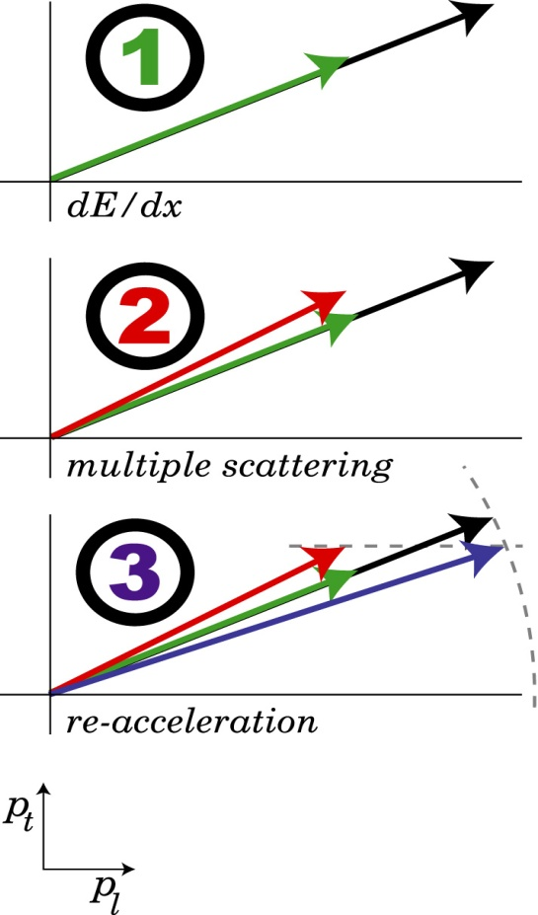
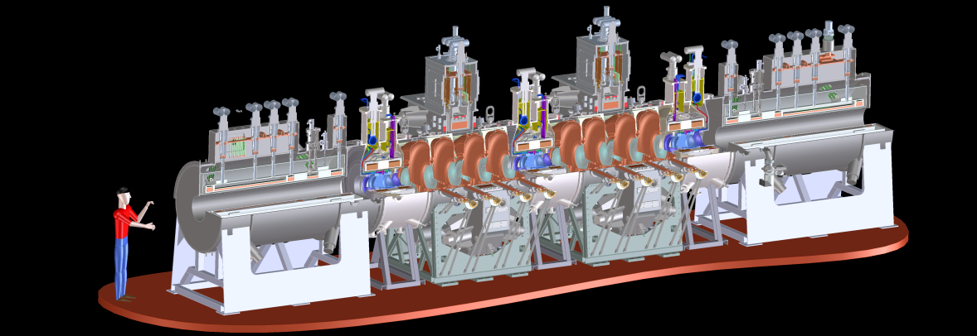
Muon ionization cooling
Stochastic cooling is too slow.
A novel method for μ+ and μ- is needed: ionization cooling
principle
reality including beam diagnostics(MICE)
reduce p_{t} and p_{l}
heating
Build a section of cooling channel long enough to provide measurable cooling (10% ) and short enough to be affordable and flexible
Wish to measure this change to 1%
Requires measurement of emittance of beams into and out of cooling channel to 0.1% !
Cannot be done with conventional beam monitoring device
Instead perform a single particle experiment:
  High precision measurement of each track (x,y,z,px,py,pz,t,E)
  Build up a virtual bunch offline
  Analyse effect of cooling channel with bunches of different emittances
  Study cooling channels parameters over a range of initial beam momenta and emittances
increase p_{l}

Slide 13
Possible thesis arguments
Inside the International Muon Collider collaboration (CERN based)
  Study of new targets (with Roma 3, LNL, …)
  Application of the cooling techniques (follow up of MICE, with STFC,…)
  Contribution to the design of a demonstrator (see NuStorm)
For more details:
- https://muoncollider.web.cern.ch/welcome-page-muon-collider-website
https://indico.cern.ch/event/1030726/
http://mice.iit.edu/
For infos:
Maurizio.bonesini@mib.infn.it

