Slide 1

Gravitational Waves from Early Universe Turbulence
Tina Kahniashvili
(Carnegie Mellon University & Ilia State University)
In collaboration with: Axel Brandenburg, Arthur Kosowsky,
Sayan Mandal, Alberto Roper Pol
Pheno 2019: May 6, 2019

Slide 2
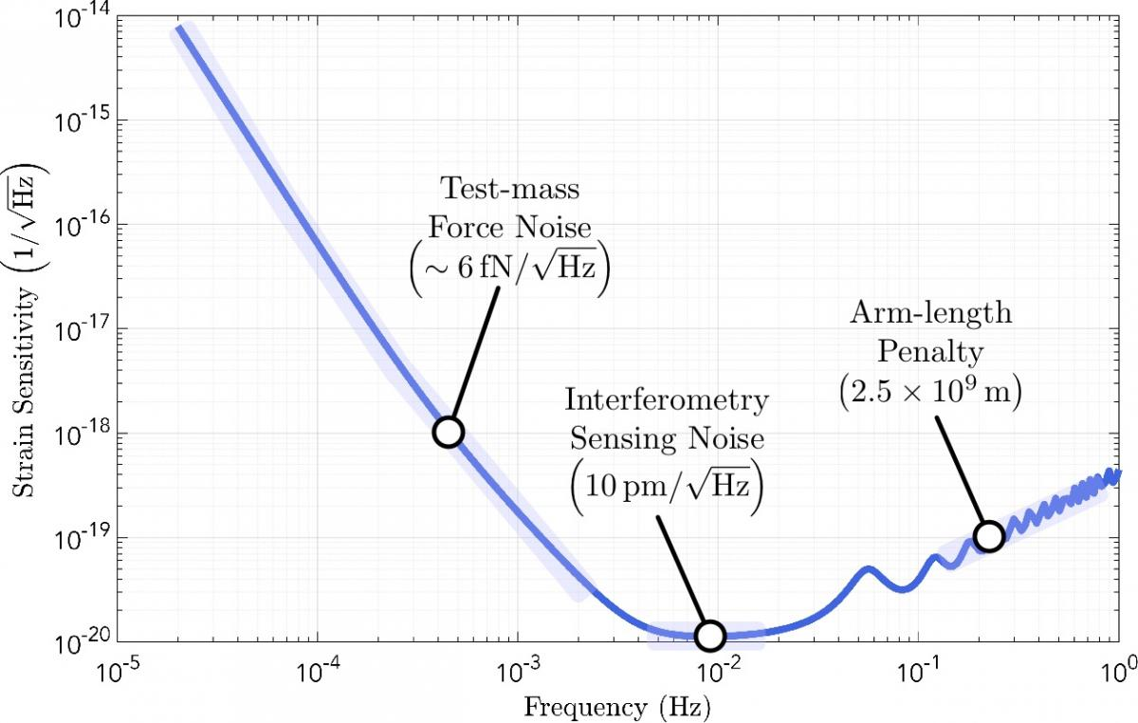
LISA sensitivity & electroweak scale physics
Credit: LISA Consortium
LISA’s peak sensitivity corresponds to ~ 1/10 of Hubble horizon at 1 TeV energy scale
Hubble frequency
f₀=10⁻⁴Hz (T/1Tev)
https://www.lisamission.org/multimedia/image/lisa-sensitivity
Large Hadron Collider (LHC) vs relic gravitational waves:
Detecting New Physics?

Slide 3
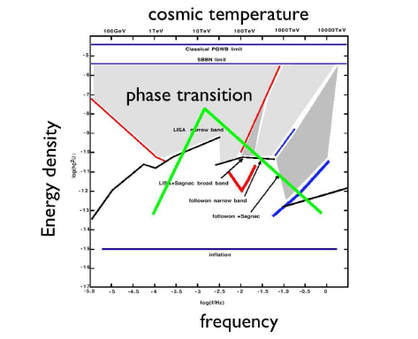
relic gravitational waves from phase transitions
Pioneering works:
Winicour 1973
Hogan 1982, 1986
Turner & Wilczek 1990
Kosowsky et al. 1992
Kosowsky & Turner 1993
Kamionkowski et al. 1994;
:
C. Hogan, 2006

Slide 4
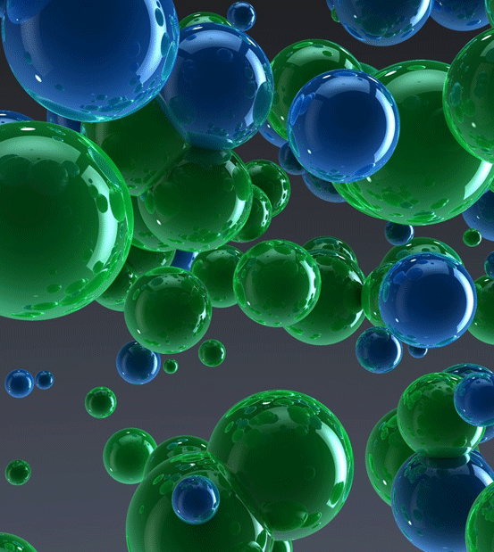
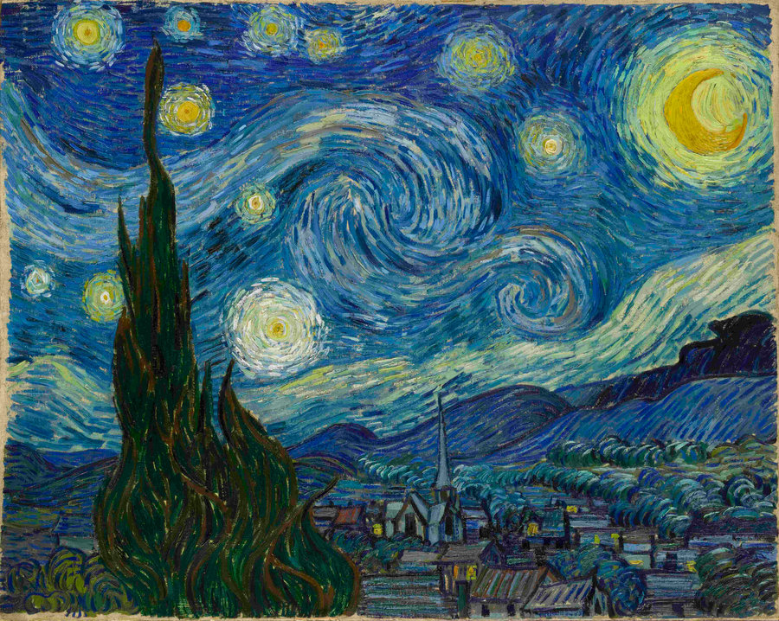
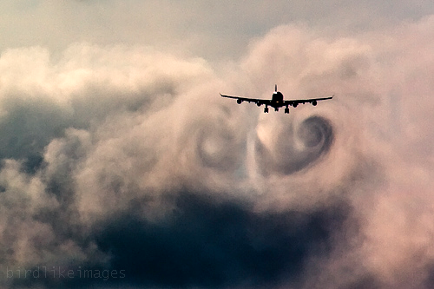

phase transitions turbulence
“Van Gogh's Turbulent Mind Captured Turbulence” credit Cosmos and Culture, 2015
Vacuum bubbles in the early universe (unlicensed artist's image)
Aeroacoustic:
Sound waves generation by turbulence
Lighthill, 1952; Proudman 1952

Slide 5
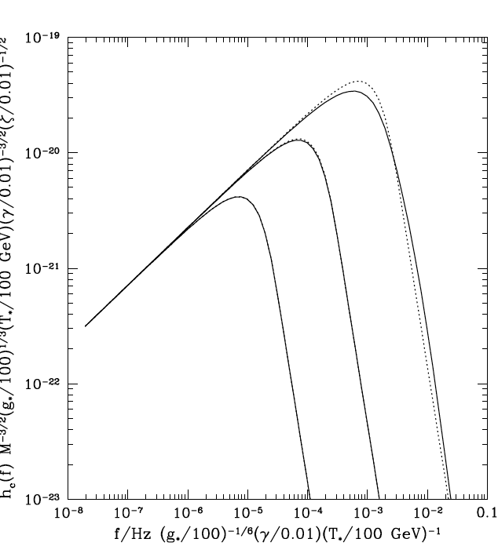



aeroacoustic approximation
Gogoberidze, Kahniashvili, Kosowsky 2007
Parameters:
τ_{T} turbulence lasting time
k₀ stirring scale
M = v₀/c - Mach number
R^{3/4}=k_{d}/k₀ - Reynolds number

Slide 6
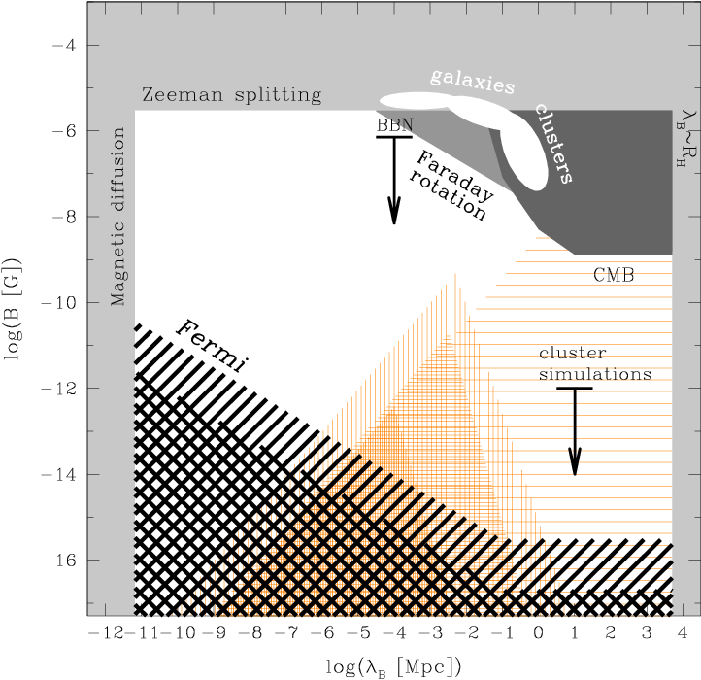
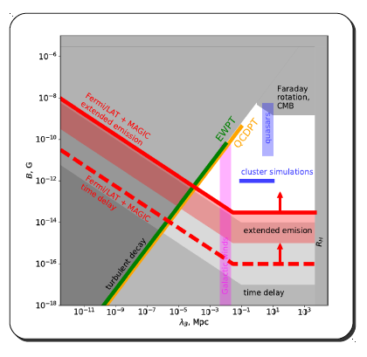
why primordial MHD turbulence?
Observations – lower limits of extragalactic magnetic fields in voids
Neronov & Vovk 2010
Slide from Vovk’s talk 2018

Slide 7
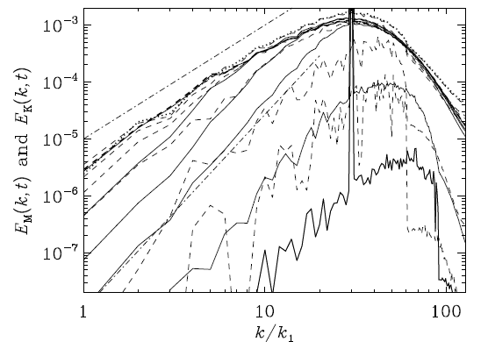
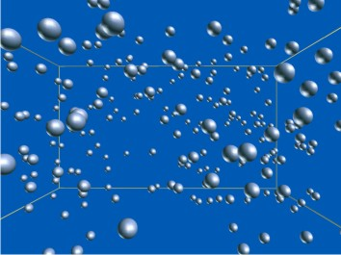
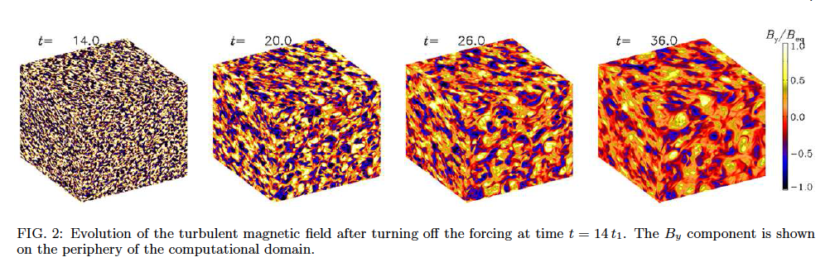
turbulence modeling
Coupling of the magnetic field with primordial plasma
Injection of the magnetic energy at a given scale (phase transition bubble)
Kahniashvili, Brandenburg, Ratra, Tevzadze 2010

Slide 8
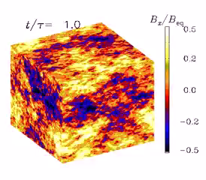
MHD turbulence
Cosmic magnetic field origin – generation in the early universe
Observations – lower limits of extragalactic magnetic fields in voids
Primordial magnetic fields – effects on PT physics
PENCIL CODE 3D compressible MHD
Brandenburg, Kahniashvili, Tevzadze, 2015
See Sayan Mandal’s talk

Slide 9
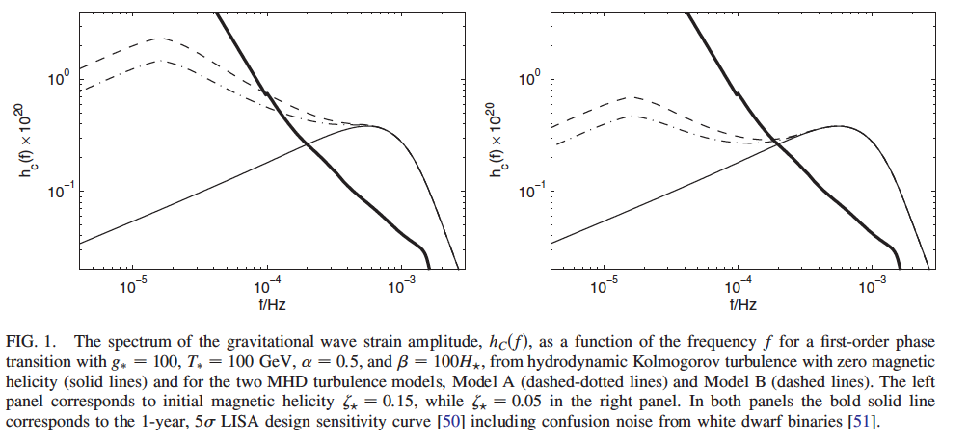
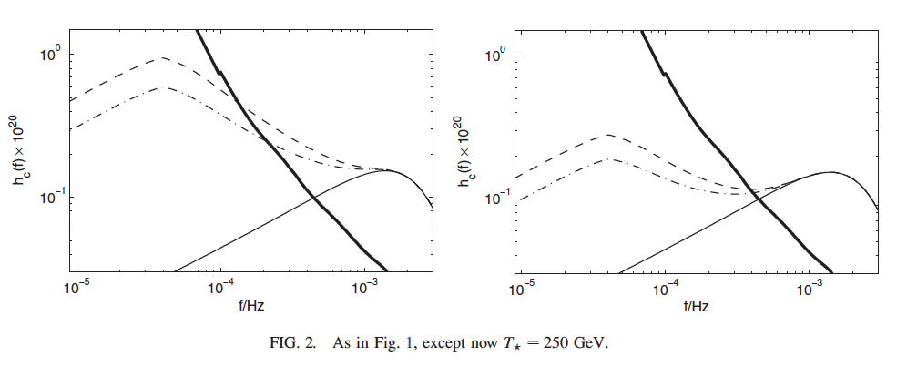
importance of MHD
Cosmic magnetic fields – relic seed magnetic fields
Effects on turbulence development and generation of sound waves (Kulsrud 1955) and gravitational waves
Enhancement of the signal
  Wider ranger of frequencies
  Larger amplitude
Kahniashvili et al. 2008

Slide 10


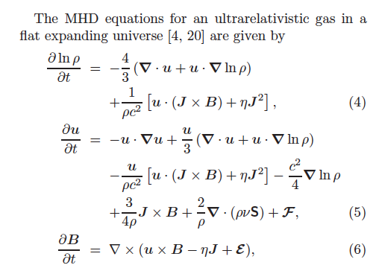
numerical simulations
To account properly non-linear processes (MHD)
Not be limited by the short duration of the phase transitions
Two stages turbulence decay
  Forced turbulence
  Free decay
The source is present till recombination (after the field is frozen in)
Results – strongly initial conditions dependent
Grishchuk 1974

Slide 11
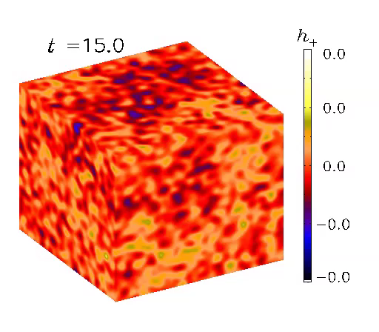
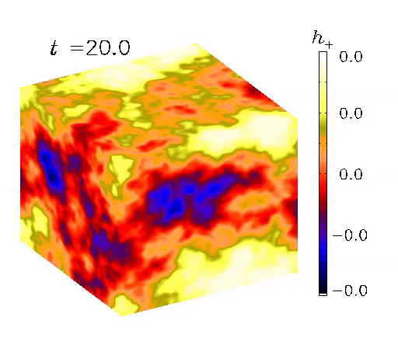
gravitational Waves from turbulence
Acoustic turbulence
Vortical turbulence

Slide 12
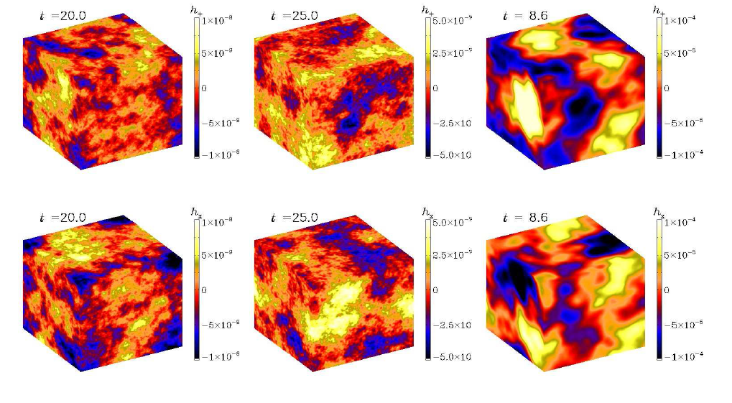

gravitational waves: results
Roper Pol et al. 2019 PRL submitted

Slide 13
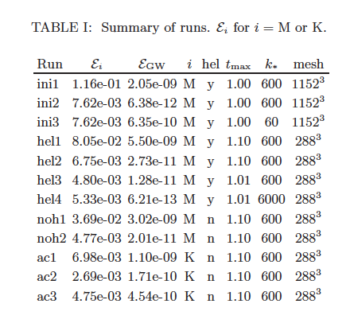

Slide 14
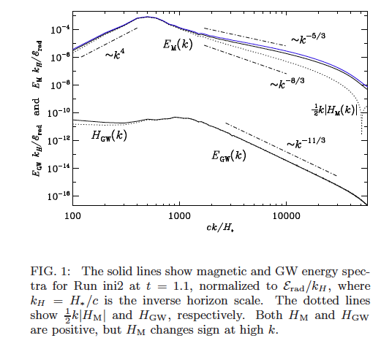

Slide 15
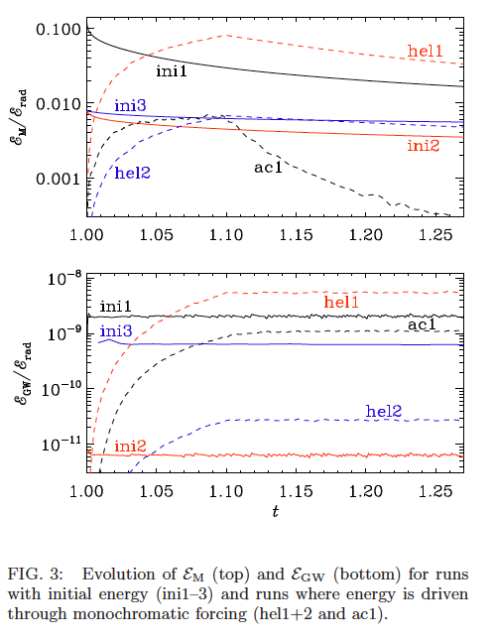

Slide 16
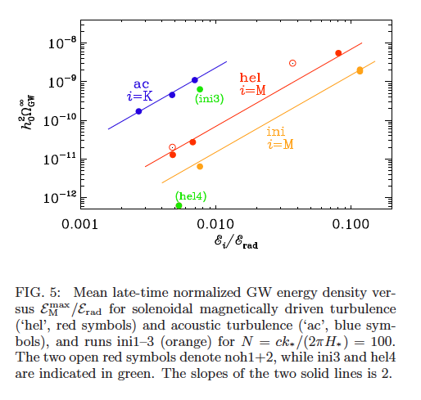

Slide 17
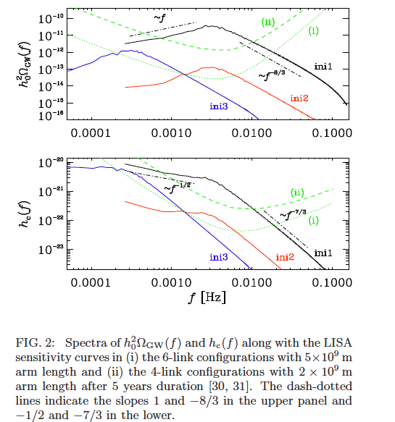

Slide 18
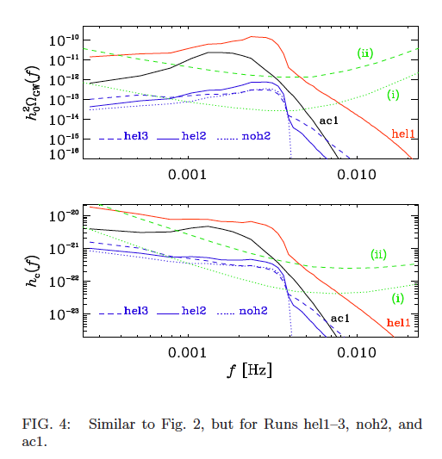

Slide 19
conclusions
Primordial turbulence is potentially detectable by LISA
Primordial magnetic fields can serve as seeds for the observed cosmic magnetic fields.
Presence of primordial magnetic field makes the gravitational wave signal substantially stronger and allows it to spread over a wide range of frequencies.
LISA mission offers a possibility to understand the physics of phase transitions (and possibly baryogenesis)
Parity violating sources produce circularly polarized gravitational waves, and the polarization degree might be around 100% (for fully helical sources).

Slide 20
Thank you!

