Slide 1
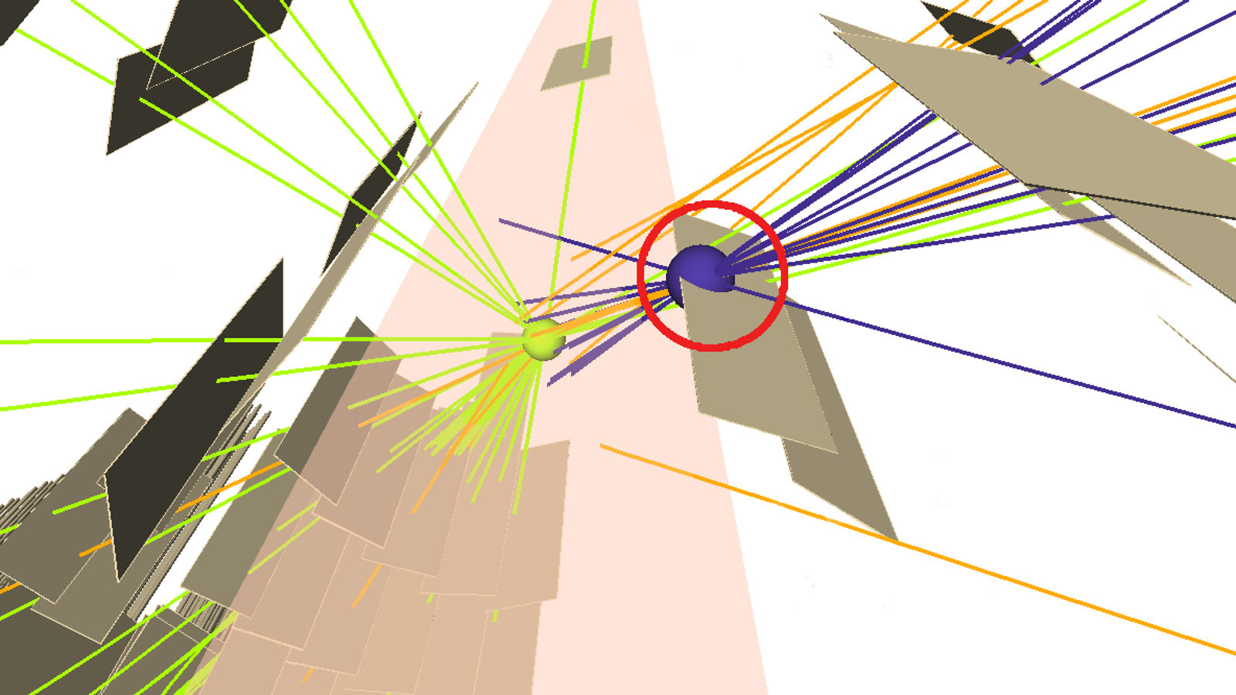
New Physics at Lifetime Frontier
Shreyashi Chakdar
Colby College
S. Chakdar, P.Q Hung, arXiv: 1906.xxxx
arXiv:1606.08502, arXiv:1508.07318

Slide 2
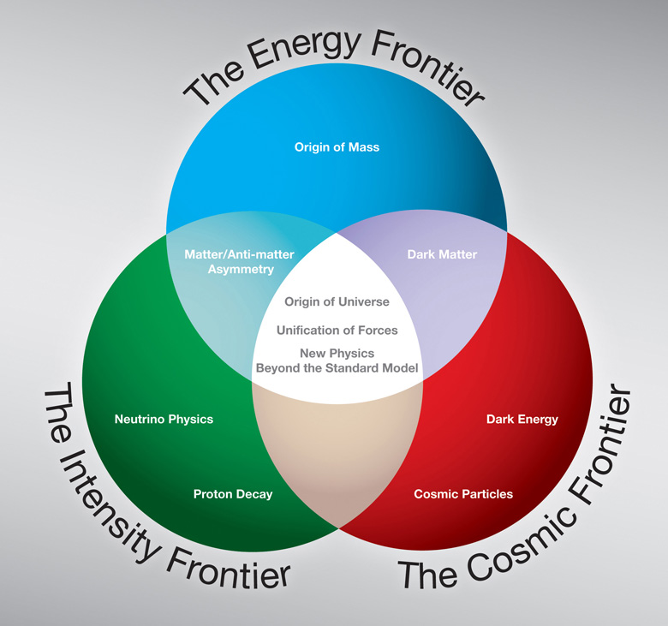
The Frontiers
The Lifetime Frontier!
Energy x Intensity

Slide 3
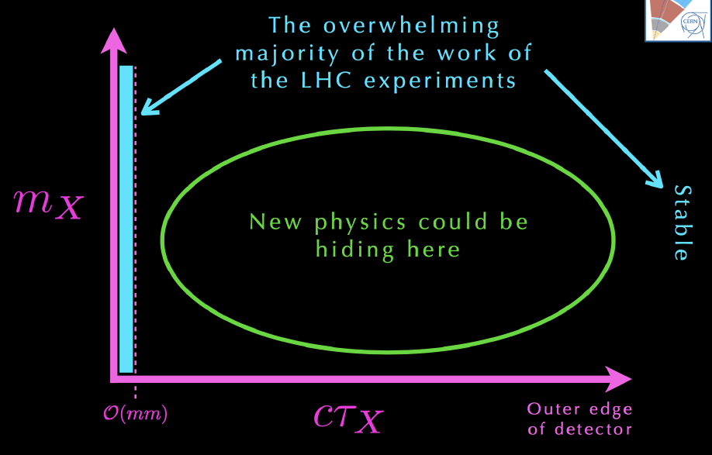

New Physics at the LHC
LLPs?
Slide courtesy: J. Beacham

Slide 4

Long Lived particles (LLPs)
A neutral or charged particle that decays a macroscopic, reconstructable distance from the p-p interaction point or is quasi-stable in the scale of the relevant detectors
LLPs : non-negligible lifetime decaying in detector acceptance; can have largely different masses; decay slowly or fast to q, g, l..
LLPs in SM:
  muons (2 $μs$), $π^{+}→ μ^{+}ν_{μ }$(20 ns), b-quarks (ps)
LLPs in BSM: variety of mechanisms can suppress decay width!
  Small couplings, approximate symmetries, heavy mediators…
  LHCb, CMS, ATLAS, MilliQan, MATHUSLA, CODEX-b , FASER, SHiP
Notes:
MilliQan: search for milli-charged particles produced at the LHC is expected to obtain sensitivity to charges of 10⁻¹−10⁻³ for masses in the 0.1 - 100 GeV range
CODEX b : Mini-Mathusla near LHC b.
FASER: ForwArd Search ExpeRiment, or FASER, which would be placed downstream of the ATLAS or CMS interaction point (IP) in the very forward region
MATHUSLA: dedicated search detector for LLPS in HL-HE LHC
SHiP: Light LLPs < 10 MeV

Slide 5
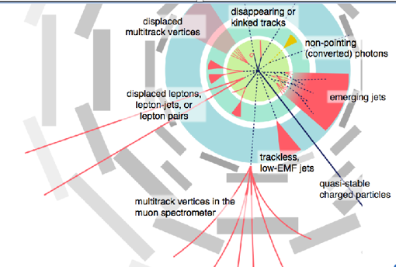
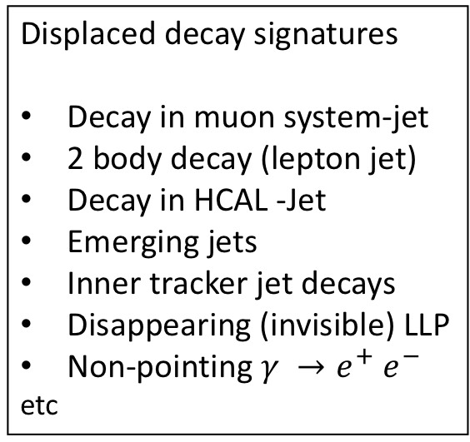
LLP Signature Space in LHC
Inner tracker Green
EM Calorimeter Blue-green
Hadronic Calorimeter Blue
Muon system Grey
Displaced decay signatures
Decay in muon system-jet
2 body decay (lepton jet)
Decay in HCAL -Jet
Emerging jets
Inner tracker jet decays
Disappearing (invisible) LLP
Non-pointing $γ →e^{+}$ $e^{−}$
etc
Dedicated searches are needed!

Slide 6

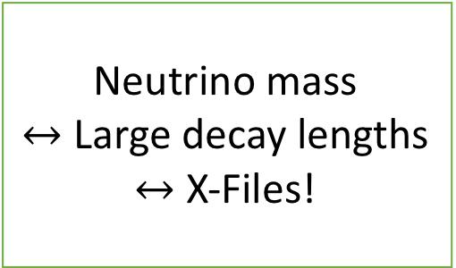
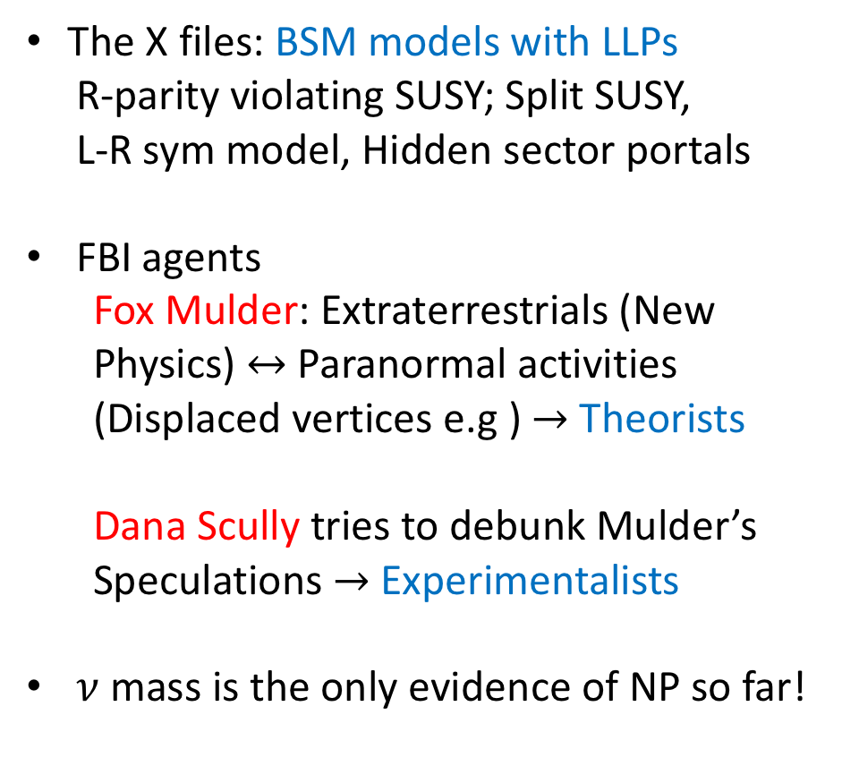
Theory motivations: The X-Flies?
The X files: BSM models with LLPs
R-parity violating SUSY; Split SUSY,
L-R sym model, Hidden sector portals
FBI agents
  Fox Mulder: Extraterrestrials (New Physics) $↔$ Paranormal activities (Displaced vertices e.g ) $→$ Theorists
  Dana Scully tries to debunk Mulder’s
  Speculations $→$ Experimentalists
$ν$mass is the only evidence of NP so far!
Neutrino mass
$↔$ Large decay lengths
$↔$ X-Files!

Slide 7
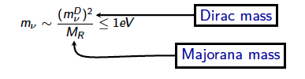
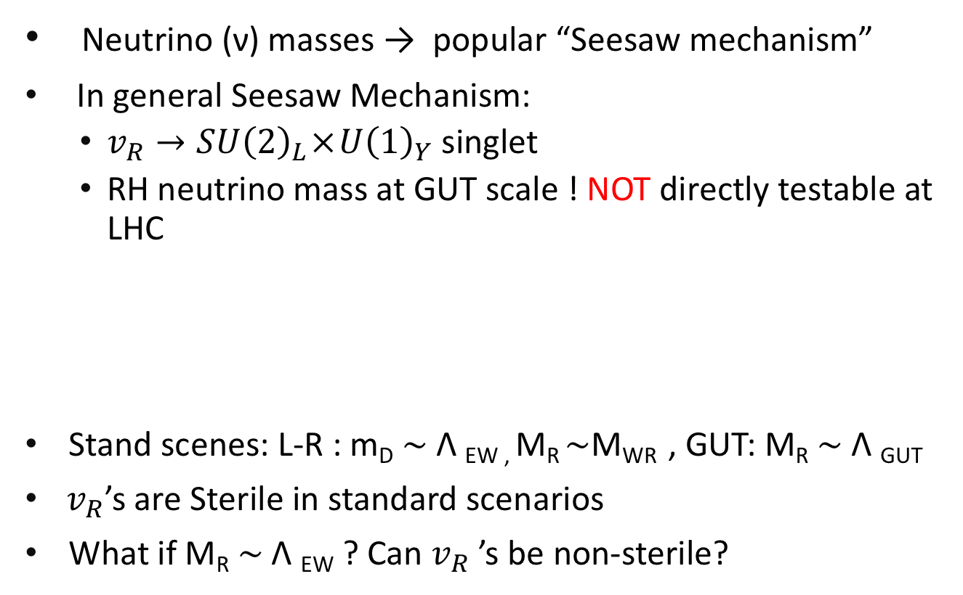

EW$ν_{R }$Model and Framework
Neutrino (ν) masses → popular “Seesaw mechanism”
In general Seesaw Mechanism:
  $v_{R}→SU{\left(2\right)}_{L} × U{\left(1\right)}_{Y}$ singlet
  RH neutrino mass at GUT scale ! NOT directly testable at LHC
Stand scenes: L-R : m_{D} $\sim$ Λ _{EW ,} M_{R} $\sim$M_{WR} , GUT: M_{R} $\sim$ Λ _{GUT}
$v_{R}$’s are Sterile in standard scenarios
What if M_{R} ~ Λ _{EW} ? Can $v_{R}$ ’s be non-sterile?

Slide 8
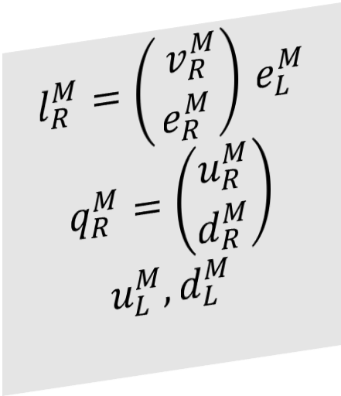
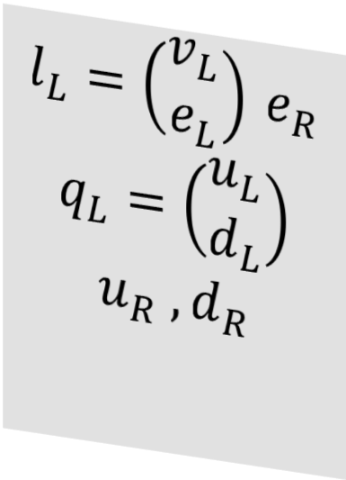

EW$ν_{R }$Model and mirror fermions
SM + Mirror Fermions + extended scalar sector
Gauge Group : SU(3)_{c} x SU(2)_{W} x U(1)_{Y}
$$l_{L}=\left(\begin{matrix}v_{L} \\ e_{L}\end{matrix}\right) e_{R}$$
$$q_{L}=\left(\begin{matrix}u_{L} \\ d_{L}\end{matrix}\right)$$
$$u_{R} ,d_{R}$$
$$l_{R}^{M}=\left(\begin{matrix}{ v}_{R}^{M} \\ e_{R}^{M}\end{matrix}\right) e_{L}^{M}$$
$$q_{R}^{M}=\left(\begin{matrix}u_{R}^{M} \\ d_{R}^{M}\end{matrix}\right)$$
$$u_{L}^{M},d_{L}^{M}$$

Slide 9
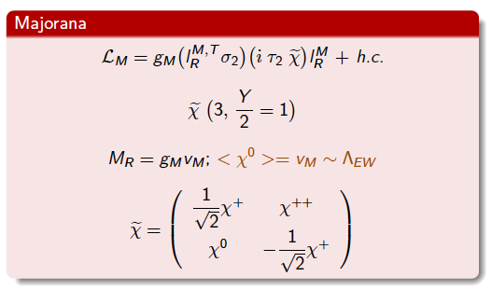
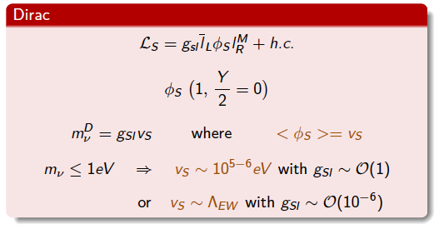

Majorana and Dirac masses
$ν_{R}^{′}s$are non-sterile, RH doublets couples to the same W
Testable see-saw signals in the reach of the LHC!

Slide 10
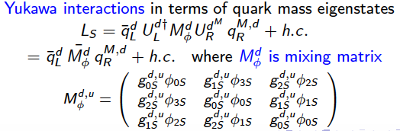
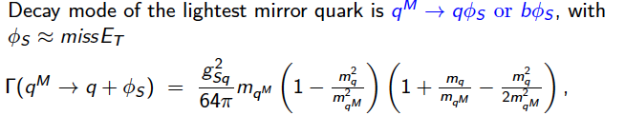
Mirror fermion decay: LLPs

Slide 11
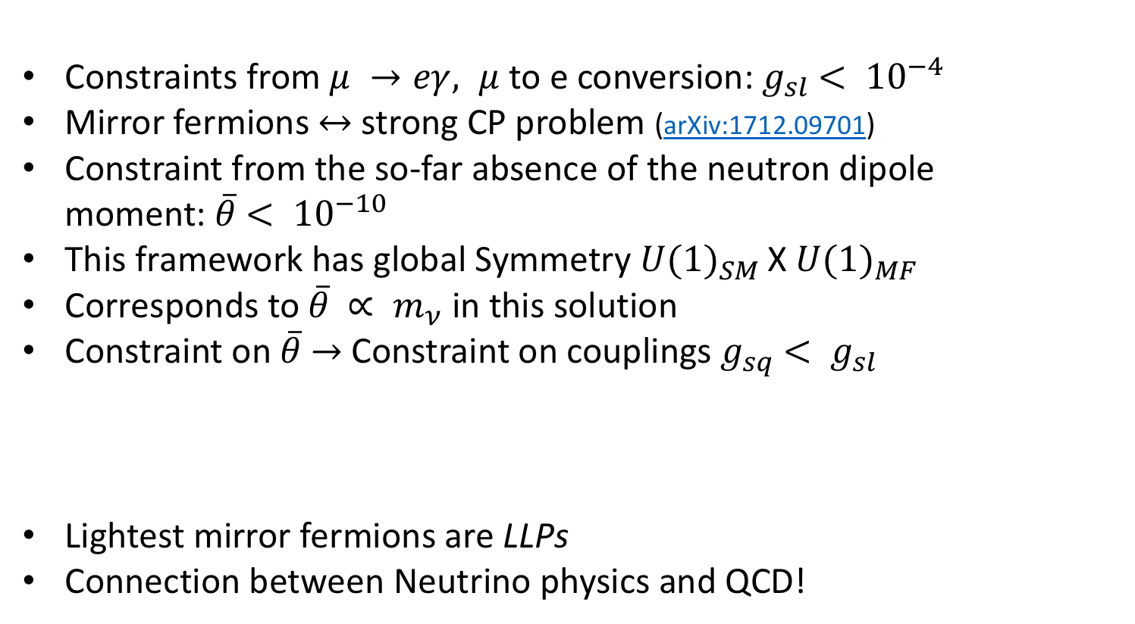
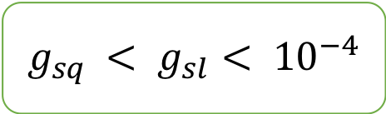
Constraints from the lepton sector
Constraints from $μ →eγ, μ$ to e conversion: $g_{sl}$ $< {10}^{−4}$
Mirror fermions $↔$strong CP problem (arXiv:1712.09701)
Constraint from the so-far absence of the neutron dipole moment: $\overline{θ}$ $< {10}^{−10}$
This framework has global Symmetry ${U(1)}_{SM }$X ${U(1)}_{MF }$
Corresponds to $\overline{θ}$ $∝ m_{ν}$ in this solution
Constraint on $\overline{θ}$ $→$ Constraint on couplings $g_{sq}$ $< g_{sl}$
Lightest mirror fermions are LLPs
Connection between Neutrino physics and QCD!
$g_{sq}$ $< g_{sl}< {10}^{−4}$

Slide 12
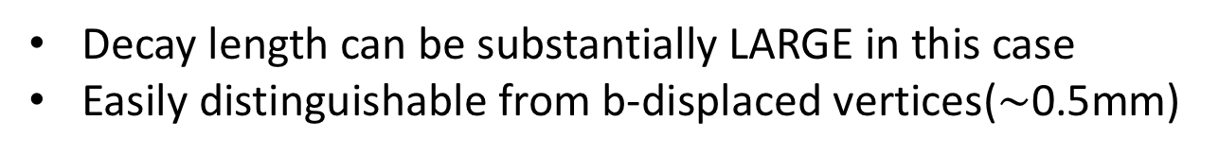
Mirror quarks Decay width
Decay length can be substantially LARGE in this case
Easily distinguishable from b-displaced vertices($\sim$0.5mm)

Slide 13
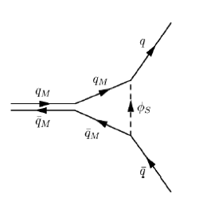
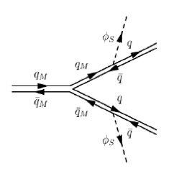
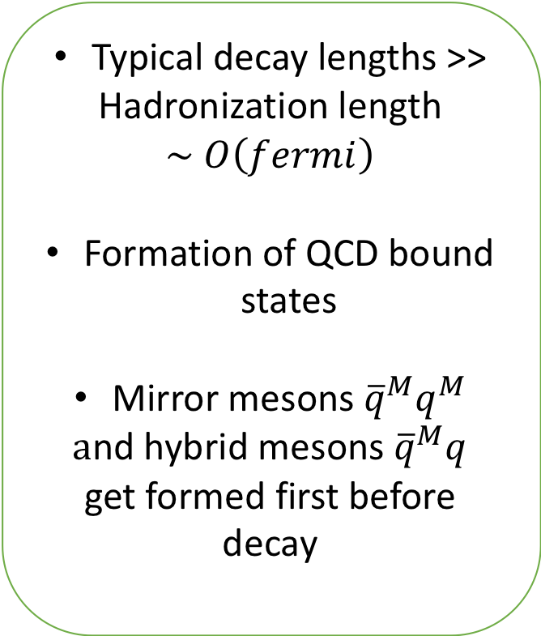
Mirror Meson formation
Typical decay lengths >>
Hadronization length
$$\sim O\left(fermi\right)$$
Formation of QCD bound states
Mirror mesons ${\overline{q}}^{M}q^{M}$
$a$nd hybrid mesons ${\overline{q}}^{M}q$
get formed first before decay

Slide 14
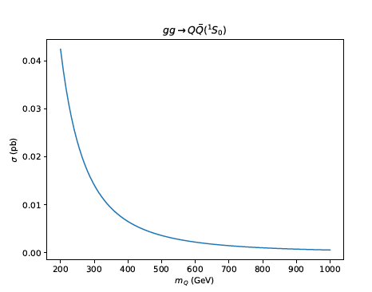
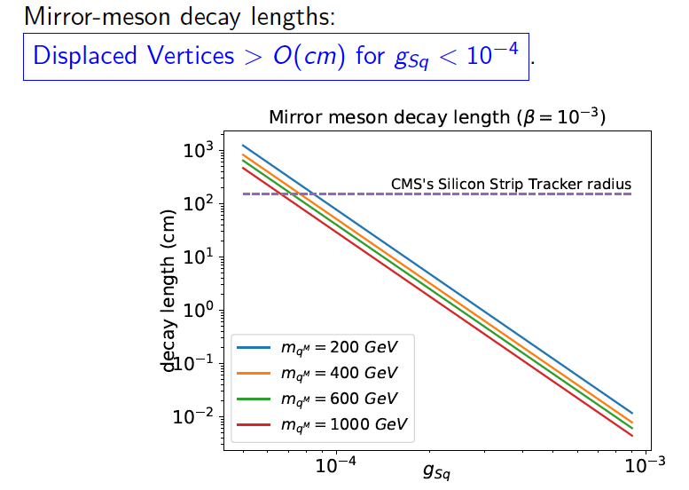

Mirror meson production & decays
Mirror meson production at 13 TeV LHC

Slide 15
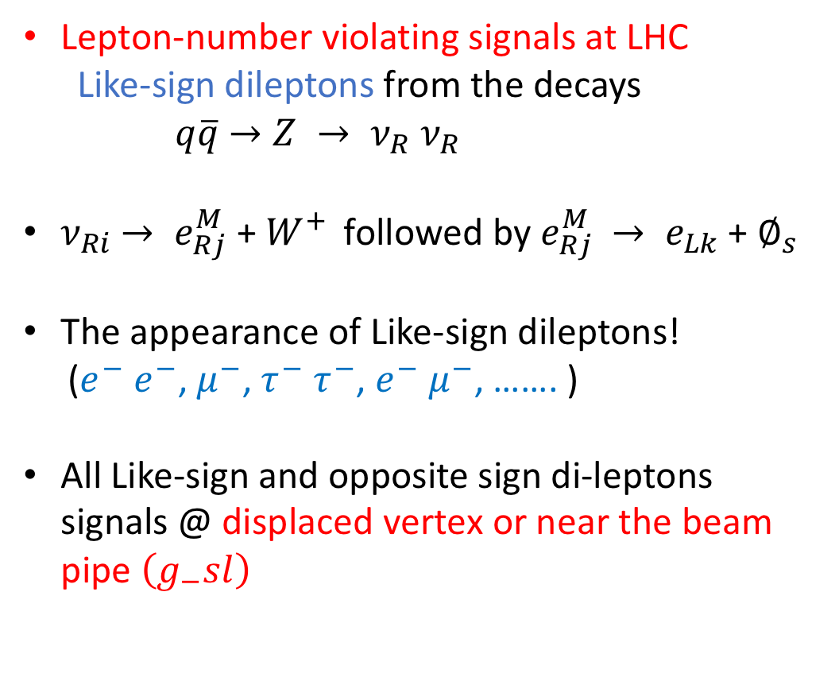
LLP Signals in Lepton Sector
Lepton-number violating signals at LHC
Like-sign dileptons from the decays
$q\overline{q}$ $→Z → ν_{R}$ $ν_{R}$
$ν_{Ri}$ $→ e_{Rj}^{M}$ + $W^{+ }$ followed by $e_{Rj}^{M}$ $→ e_{Lk}$ + $∅_{s}$
The appearance of Like-sign dileptons!
($e^{−}$ $e^{−}$, $μ^{−}$, $τ^{−}$ $τ^{−}$, $e^{−}$ $μ^{−}$, ……. )
All Like-sign and opposite sign di-leptons signals @ displaced vertex or near the beam pipe $\left(g_{−}sl\right)$

Slide 16

LLPs in Scalar Sector
Scalars
Singlet
Doublet
$$∅_{2} \left\langle v_{2}\right\rangle$$
couples to SM
∅_2 ⟨𝑣_2 ⟩
couples to SM
Triplet
$$\tilde{χ}, \left\langle χ^{0}\right\rangle =v_{M}$$
Majorana mass
𝜒 ̃, ⟨𝜒^0 ⟩=𝑣_𝑀
Majorana mass
$$ξ, \left\langle ξ^{0}\right\rangle =v_{M}$$
Custodial symmetry
𝜉, ⟨𝜉^0 ⟩=𝑣_𝑀
Custodial symmetry
$$∅_{2}^{M}\left\langle v_{2M}^{M}\right\rangle$$
couples to Mirror Fermions
∅_2^𝑀 ⟨𝑣_2𝑀^𝑀 ⟩
couples to Mirror Fermions
$∅_{s}$ $\left\langle v_{s}\right\rangle$
Dirac mass
∅_𝑠 ⟨𝑣_𝑠 ⟩
Dirac mass

Slide 17
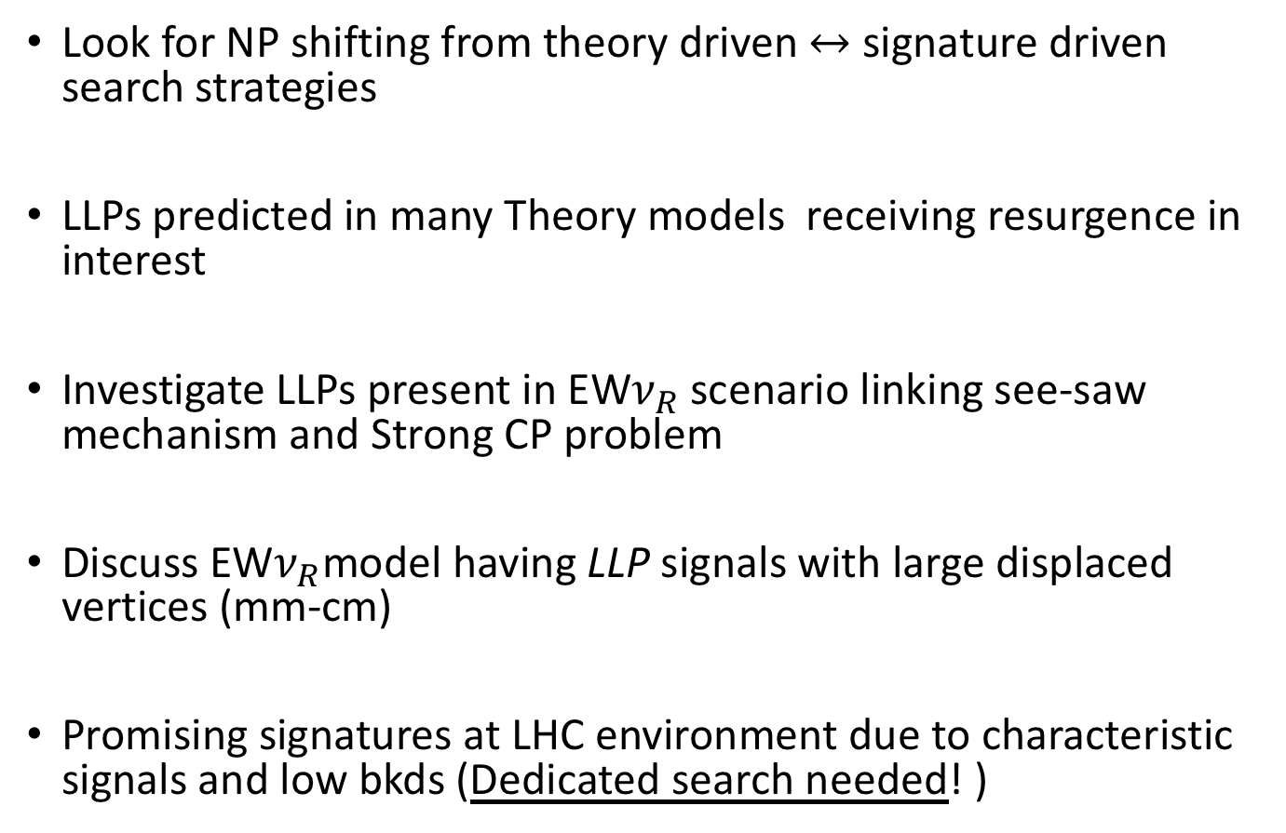
Final Remarks
Look for NP shifting from theory driven $↔$ signature driven search strategies
LLPs predicted in many Theory models receiving resurgence in interest
Investigate LLPs present in EW$ν_{R}$scenario linking see-saw mechanism and Strong CP problem
Discuss EW$ν_{R}$model having LLP signals with large displaced vertices (mm-cm)
Promising signatures at LHC environment due to characteristic signals and low bkds (Dedicated search needed! )

Slide 18

THANK YOU!

