Slide 1



Gauge boson in association with J/Ψ at ATLAS
Weimin Song
Rutherford Appleton Laboratory, Oxford, UK
wesong@cern.ch
2019 Phenomenology Symposium
May 6-8
University of Pittsburgh

Slide 2
Outline
Gauge boson in association with J/Ψ at ATLAS
1. W+J/Ψ production (JHEP 04 (2014) 172)
2. Z+J/Ψ production (Eur. Phys. J. C (2015) 75:229)
Summary

Slide 3
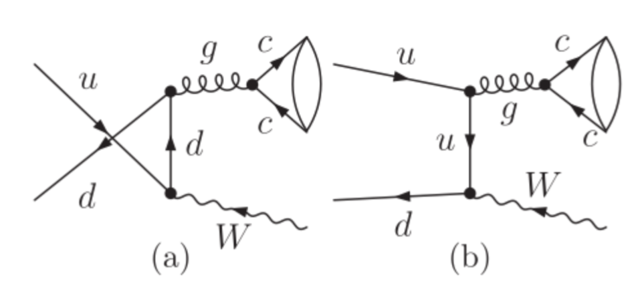
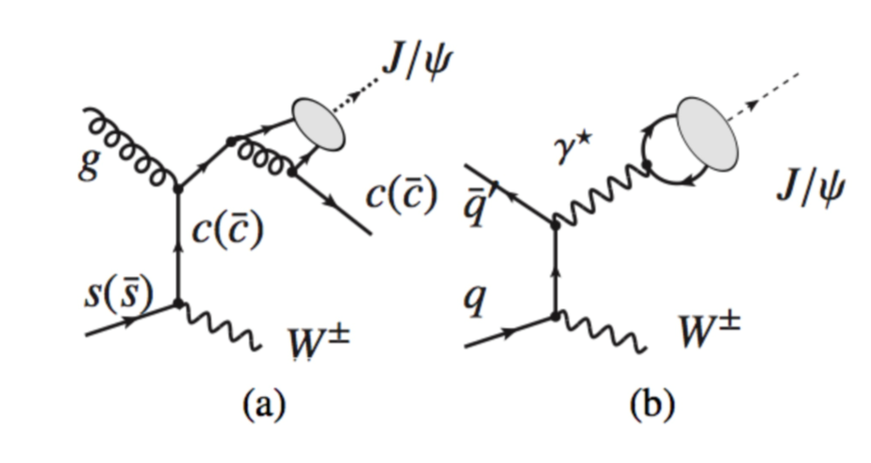
Motivation
Is the CO really dominated?
Colour Octet Model
Colour Singlet Model

Slide 4
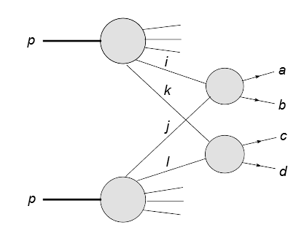
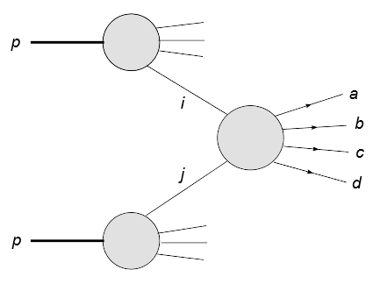
Motivation
SPS or DPS?
Double Parton Scattering
Single Paton Scattering

Slide 5
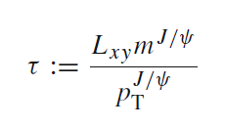
General information
W+J/Ψ:
4.5 fb⁻¹ at 7 TeV
W→µν, J/Ψ→µµ; three muons + missing transverse energy
Prompt J/Ψ only
Z+ J/Ψ:
20.3 fb⁻¹ at 8 TeV
Z→ee or µµ, J/Ψ→µµ; four leptons
Both prompt and non-prompt J/Ψ
Pseudo-proper time definition:

Slide 6
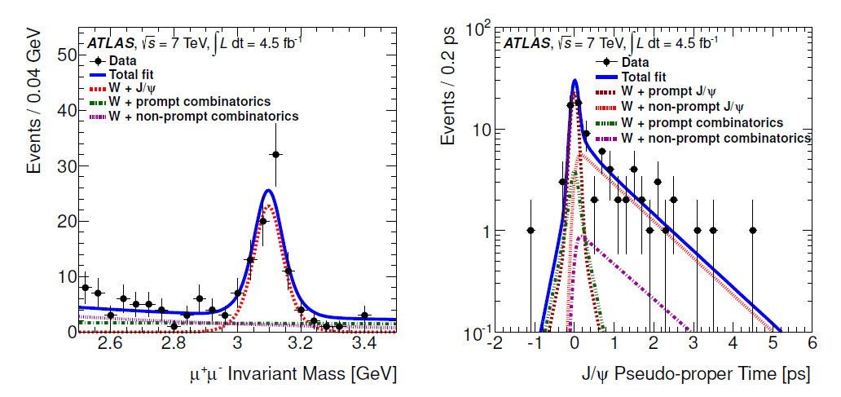
Methodology: step 1
W+J/Ψ
Select the J/Ψ with two opposite charged muons; separate the prompt and non-prompt by fitting the pseudo-proper time distributions (2D fit: mass and time):
Two rapidity regions of are fitted separately, due to different resolution.
(different multi-scattering status and different magnetic field)

Slide 7
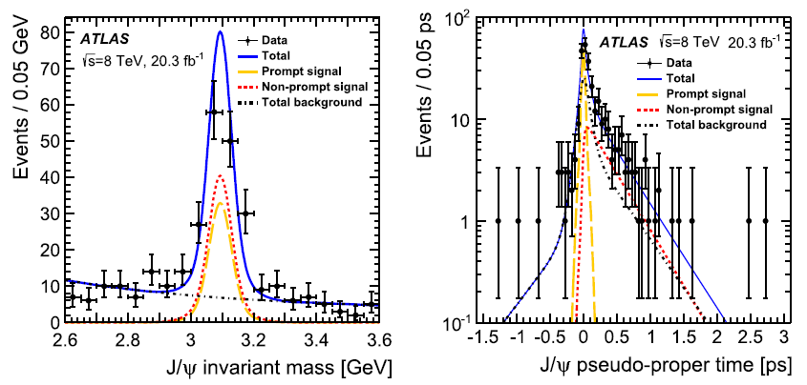
Methodology: step 1
Z+J/Ψ
Select the J/Ψ with two opposite charged muons; separate the prompt and non-prompt by fitting the pseudo-proper time distributions (2D fit: mass and time):
Two rapidity regions of are fitted separately, due to different mass resolution.
(different multi-scattering status and different magnetic field)

Slide 8
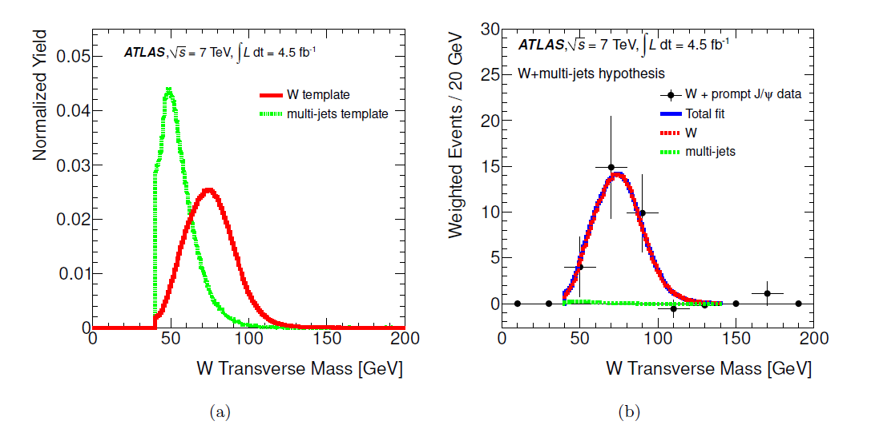
Methodology: step 2
W+J/Ψ
Fit the transverse mass or invariant mass for W or Z (event weight gotten from previous fit is applied):
W template is from MC; multi-jet is data driven.

Slide 9
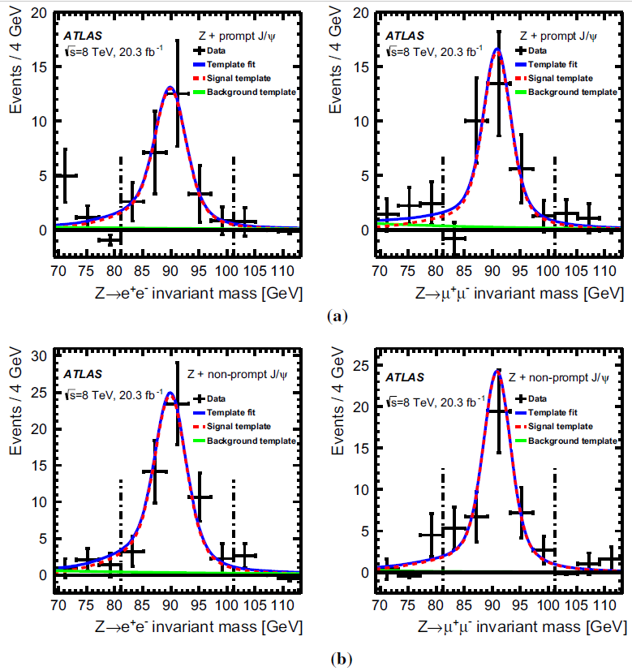
Methodology: step 2
Z+J/Ψ
Fit the transverse mass or invariant mass for W or Z (event weight gotten from previous fit is applied):
Prompt Z to ee
Prompt Z to µµ
Non-Prompt Z to ee
Non-prompt Z to µµ
Signal: Gaussian convolved with a BW. Background: exponential.

Slide 10
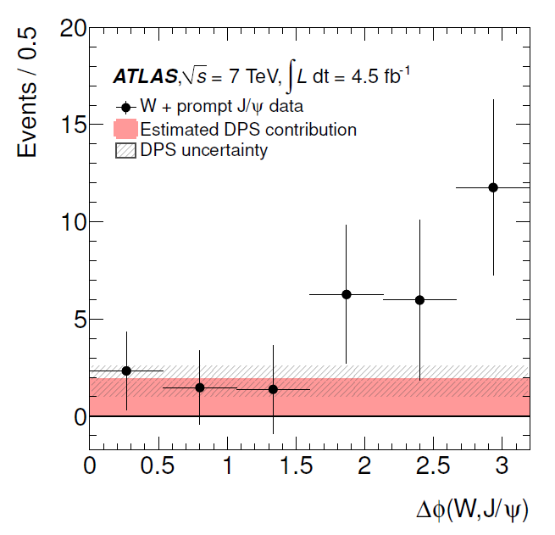
Methodology: step 3
W+J/Ψ
Δϕ (boson, J/Ψ) used to separate SPS and DPS, and the latter has flat distribution:

Slide 11
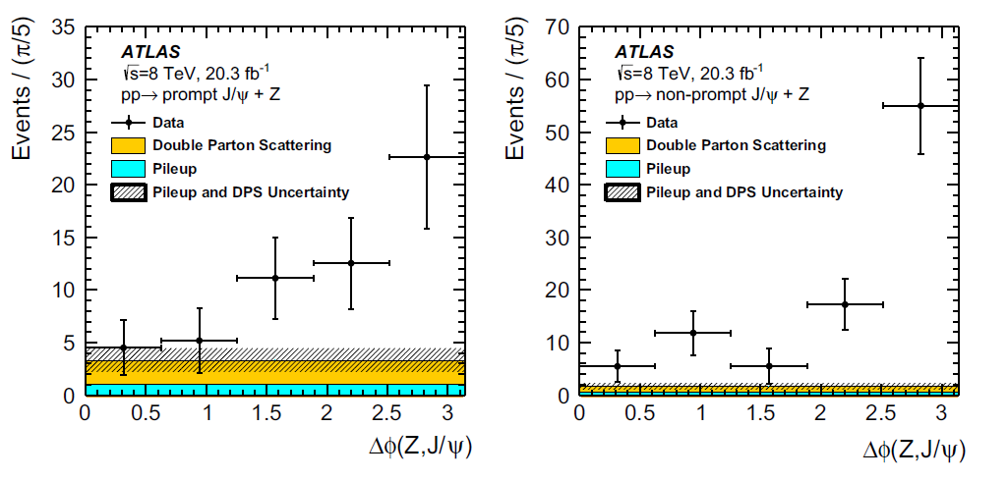
Methodology: step 3
Z+J/Ψ
Δϕ (boson, J/Ψ) used to separate SPS and DPS, and the latter has flat distribution:
Prompt
Non-Prompt

Slide 12
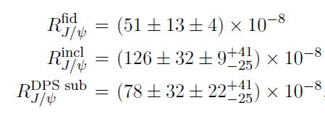
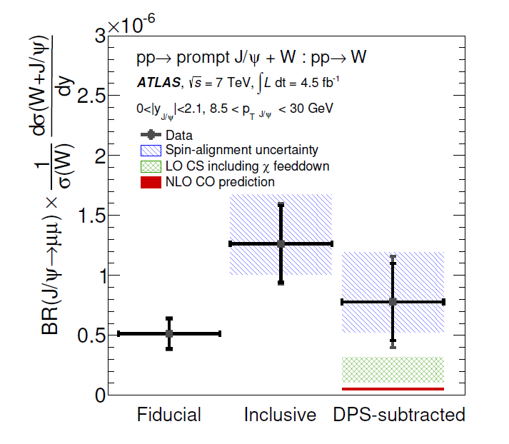
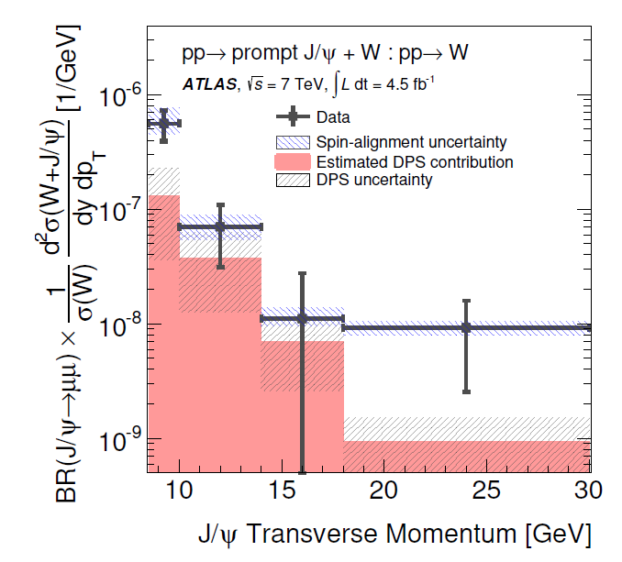
W+J/Ψ Results
Observed the process: 5.1 Ϭ
LO CS is more consistent with data, compared to NLO CO
SPS is dominant at low J/Ψ transverse momenta.

Slide 13
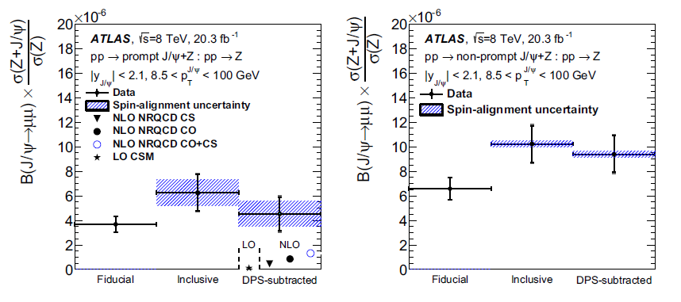
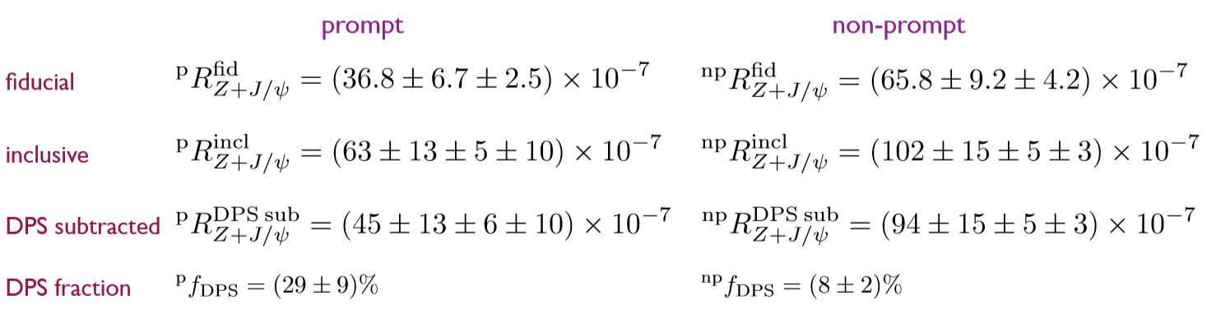
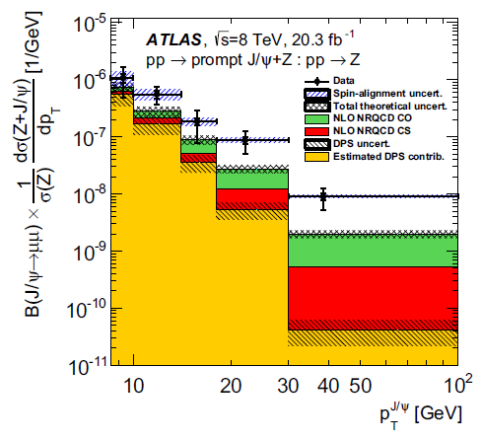
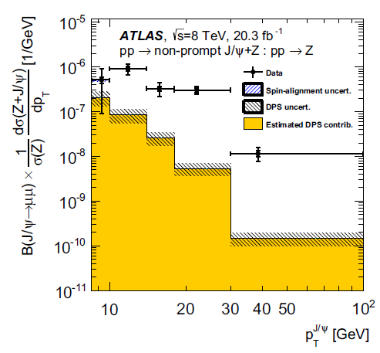
Z+J/Ψ Results
>5 Ϭ
>5 Ϭ
A higher production rate is predicted through colour-octet transitions than through colour-singlet processes, but the expected production rate from the sum of singlet and octet contributions is lower than the data by a factor of 2 to 5;
Momentum dependence is observed.

Slide 14
Summary
Both W+J/Ψ and Z+J/Ψ are observed with ATLAS data;
In the two processes, DPS is evident;
The agreement between data and current calculation is not good. Results with larger data sample will come soon.

Slide 15
Thank you very much!

