Slide 1


Strong New Limits on Light Dark Matter from Neutrino Experiments
Chris Cappiello
With John Beacom

Slide 2
Traditional Direct Detection Limits
ArXiv:1310.8327

Slide 3
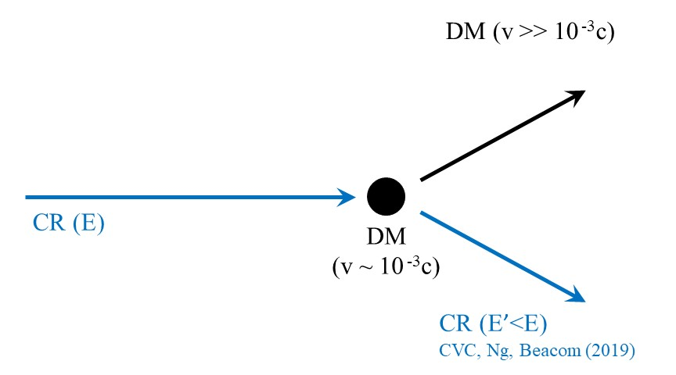
Cosmic Ray Probes of Light Dark Matter

Slide 4
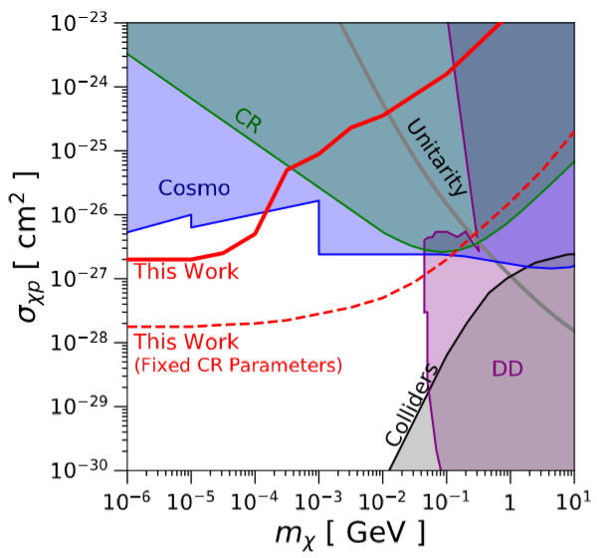
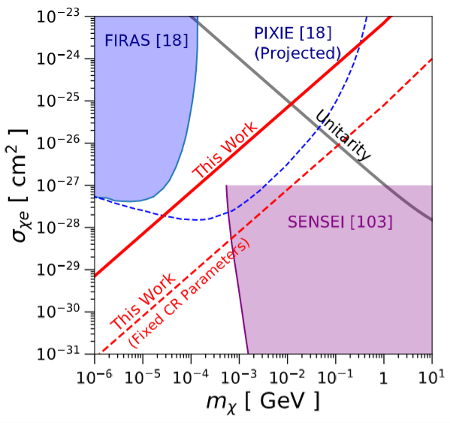
Cosmic Ray Probes of Light Dark Matter
ArXiv:1810.07705

Slide 5
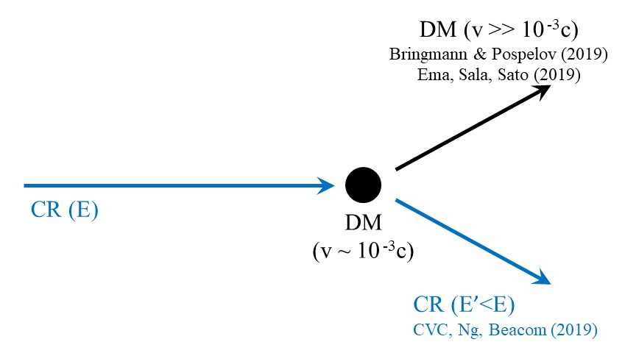
Cosmic Ray Probes of Light Dark Matter

Slide 6
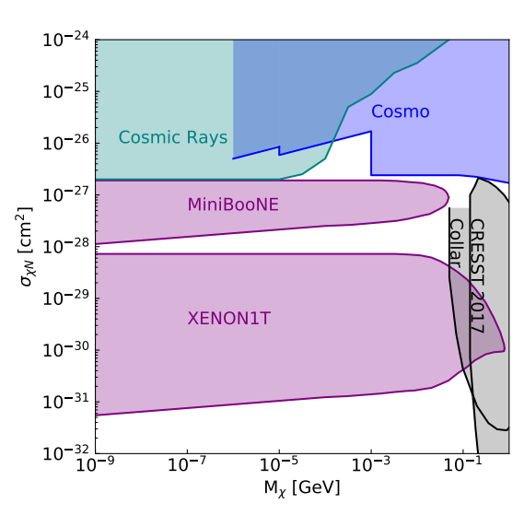
CR-DM Constraints on Scattering with Nuclei
Previous Results (Bringmann & Pospelov)
Assumed energy-independent cross section
Recast XENON1T limits, but overburden leads to ceiling
Search for proton recoils in MiniBooNE to probe higher cross section
Adapted from ArXiv:1810.10543

Slide 7
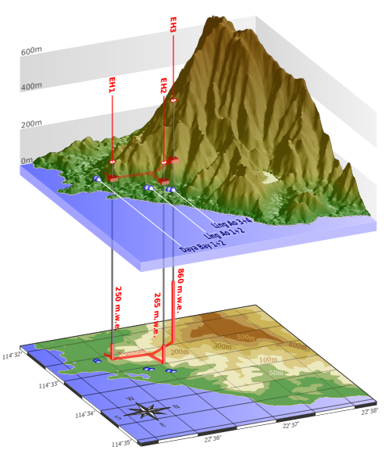
Daya Bay
Antineutrino detectors distributed between three experimental halls with different overburdens
Shallowest detectors at depth of 250 mwe
Shallower than XENON1T, lower background than MiniBooNE
ArXiv:1708.01265
ArXiv:1405.6190

Slide 8
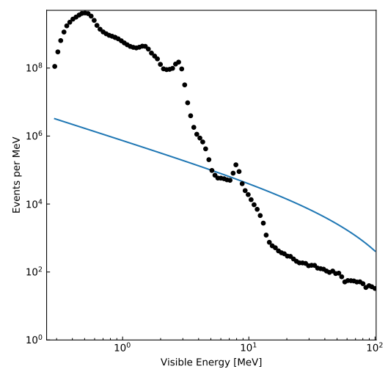
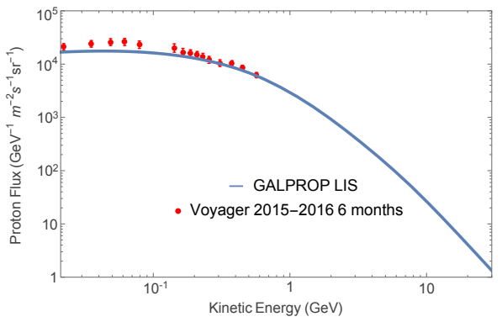
From Cosmic Rays to Dark Matter Detection
From Cosmic Rays to Dark Matter Spectrum
NFW DM profile
CR halo: h = 1 kpc, R = 10 kpc
Dark Matter Propagation Through Overburden
Straight-line trajectory
Continuous energy loss
Compute Recoil Distribution
Compare DM event rate to total measured rate
σ = 10⁻²⁸ cm², M_{DM} = 1 MeV
ArXiv:1704.06337
ArXiv:1708.01265

Slide 9
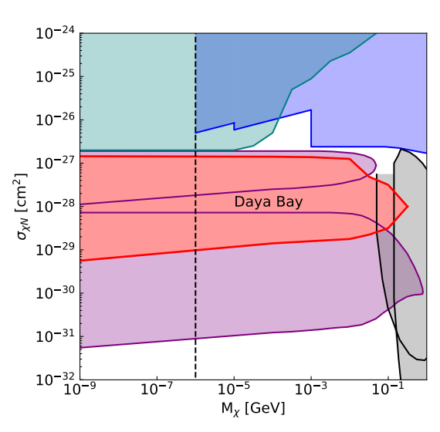
Light Dark Matter at Daya Bay
Antineutrino detectors distributed between three experimental halls with different overburdens
Shallowest detectors at depth of 250 mwe
Shallower than XENON1T, lower background than MiniBooNE

Slide 10
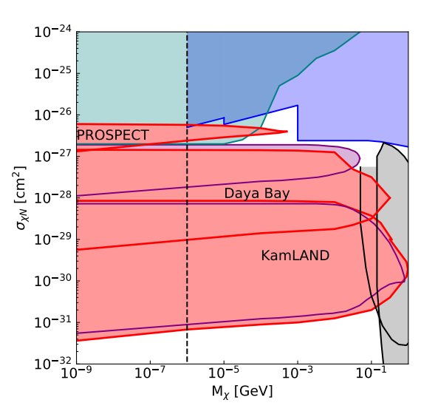
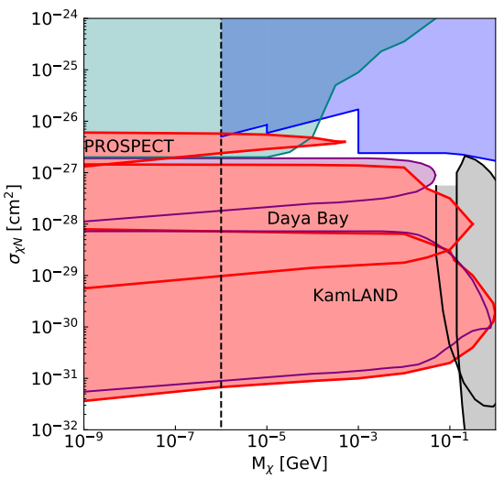
Further Constraints
PROSPECT
Located at Earth’s surface
Can reach high cross section, but also high background
KamLAND
1 km underground, similar to XENON1T
Low background, but also low ceiling

Slide 11
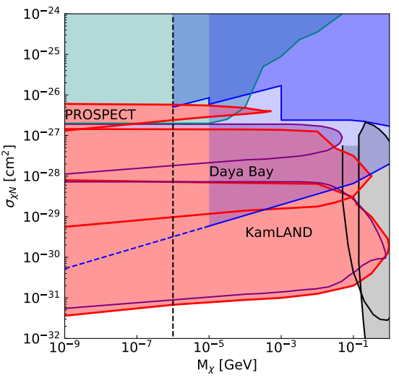
Further Constraints
PROSPECT
Located at Earth’s surface
Can reach high cross section, but also high background
KamLAND
1 km underground, similar to XENON1T
Low background, but also low ceiling

Slide 12
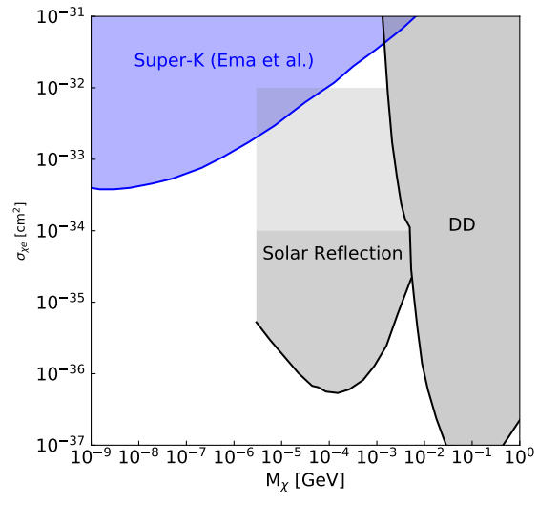
What About Electrons?
Previous Results (Ema et al.)
Upscattered dark matter causes electron recoils in Super-Kamiokande
Set constraints for mass down to 1 eV
Adapted from ArXiv:1811.00520

Slide 13
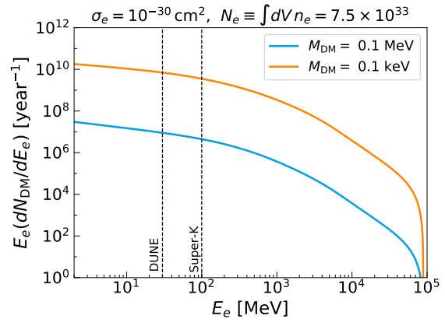
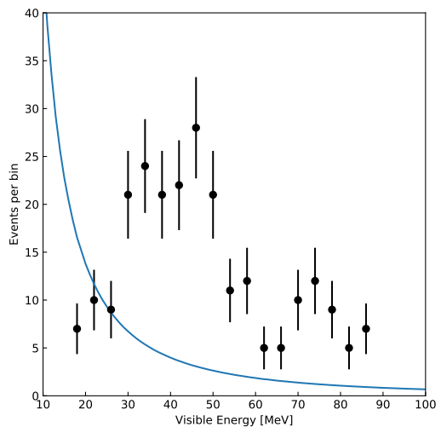
What About Electrons?
σ = 10⁻³² cm², M_{DM} = 1 MeV
ArXiv:1811.00520

Slide 14
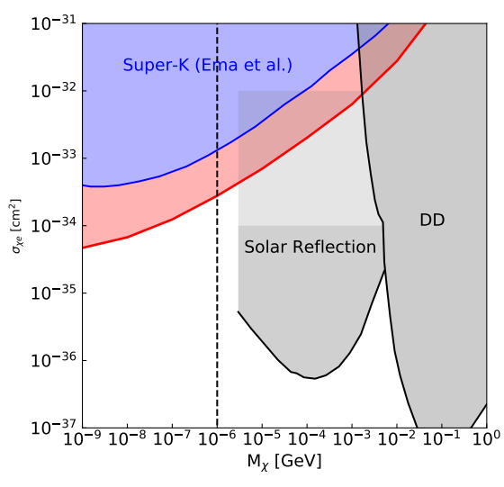
New Constraints from Super-Kamiokande
Recoil spectrum increases rapidly at lower energy
Lower energy gives higher signal/background
Improve sensitivity by close to an order of magnitude

Slide 15
Summary
Cosmic ray-dark matter scattering can be a powerful probe of dark matter, and only gets more powerful as more data is considered
Considering different detector depths allows us to probe different cross sections
Considering different energy range can improve signal/background

Slide 16
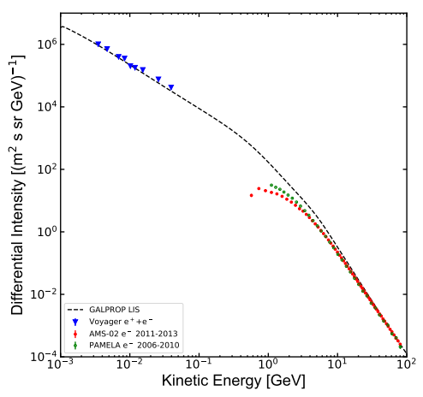


From Cosmic Rays to Dark Matter Spectrum
dφ_{i}/dT_{i} is local interstellar CR spectrum (LIS)
Integrate over dark matter density distribution times CR spectrum
Integrate over all directions to get incoming dark matter flux
ArXiv:1801.04059

Slide 17

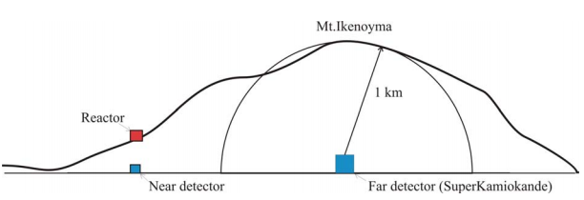
Propagation Through Overburden
ArXiv:hep-ph/0311181

Slide 18

Detected Recoil Distribution
dφ_{x}^{z}/dT_{x} is dark matter spectrum at depth z
Integrate over energy to get differential recoil rate
ArXiv:1811.00520

