Slide 1

Simulations & Background Analysis for MINER
Sam Houston State University
By: Jaime Navarrete
In collaboration with:
Dr. Andy Kubik, MINER, Texas A&M
Dr. James Dent, SHSU
Dr. Joel Walker,SHSU

Slide 2
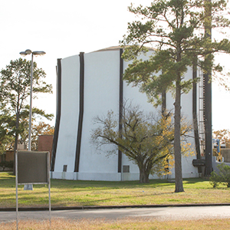
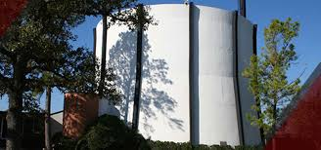
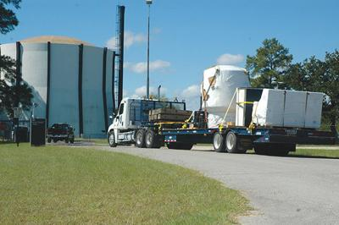

MINER
Mitchell Institute Neutrino Experiment at Reactor
Nuclear Science Center
College Station, TX

Slide 3
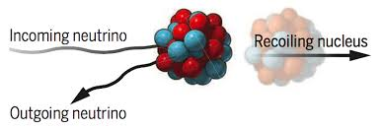
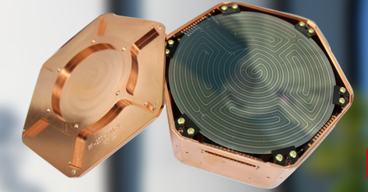
Primary Goal
Observe Coherent Elastic Neutrino-Nucleus Scattering (CEvNS)
- Yet to be observed at any reactor experiment
- Long standing prediction of standard model
- New channel to probe neutrino physics and astrophysics
CEvNS used to probe new physics scenarios
- Search for sterile Neutrino
- Neutrino Magnetic Moment
- Process beyond the Standard Model
A&M website

Slide 4
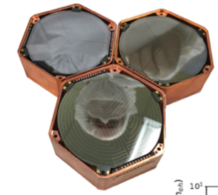
Why haven’t we observed CEvNS?
- Mainly detector technology
- Past detectors couldn’t provide the low threshold sensitivity needed to register the kinetic energy deposition of the heavy recoiling nucleus
Solution
Cryogenically cooled semiconductor detectors with transition edge sensors
2 Types of Detectors
iZIP detectors
- Able to recognize electron and nuclear recoils as low as ~ 1keV
Two High Voltage detectors:
-Silicon
-Germanium
Neganov-Luke Phonon Amplification Method
- Amplifies charge without increasing noise!
Picture courtesy of Andy Kubik, MINER collaboration, 2019

Slide 5
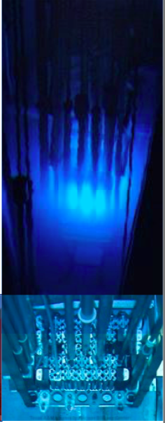
Reactor
Mega-Watt class TRIGA(Training, Research, Isotopes, General Atomics) pool reactor stocked with low enriched ²³⁵U
Reactor Advantages
  Movable Core
  Access to deploy detectors as close as 1m from reactor
  Expected to detect 5 to 20 events/kg/day in recoil energy range of 10 and 1000 eV_{nr}
Picture courtesy of Andy Kubik, MINER collaboration, 2019

Slide 6
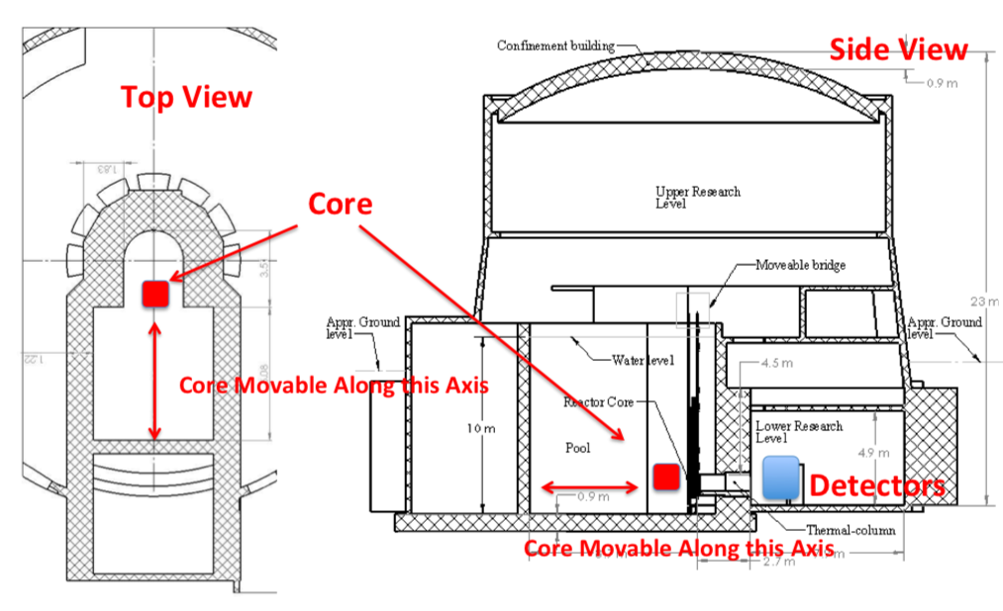
Nuclear Science Center
Andy Kubik, MINER
Notes:
23 m underground. Because of this and how sensitive the detector measuring background precisely is very important

Slide 7
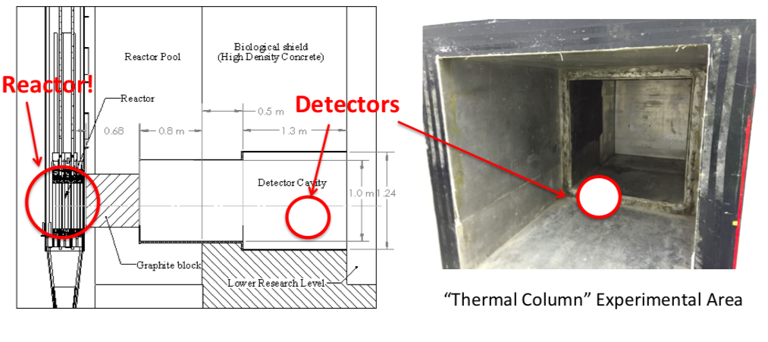
Andy Kubik, MINER

Slide 8
Geant4
Toolkit for simulating the passage of particles through matter using Monte Carlo Methods
Developed by CERN
World wide collaboration of scientist and software engineers
Applications
  High Energy Physics
  Nuclear Experiments
  Accelerator and Space Physics
  Medical
Notes:
As we know reactors are expensive to run and that’s what Geant is for

Slide 9
GDML
Geometry Definition Markup Language
Specialized XML-based language
  Designed to be an application-independent format that describes the geometries of detectors associated with physics measurements.
Can be easily shared
Easy to learn and implement
Its universal and most software supports it

Slide 10
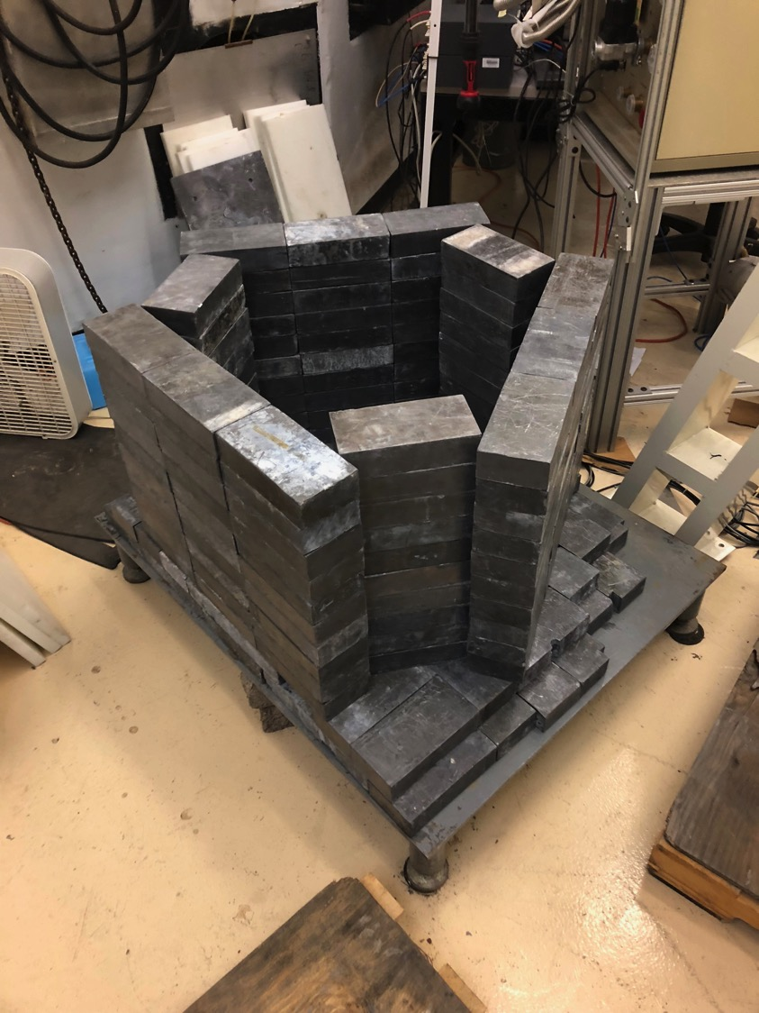
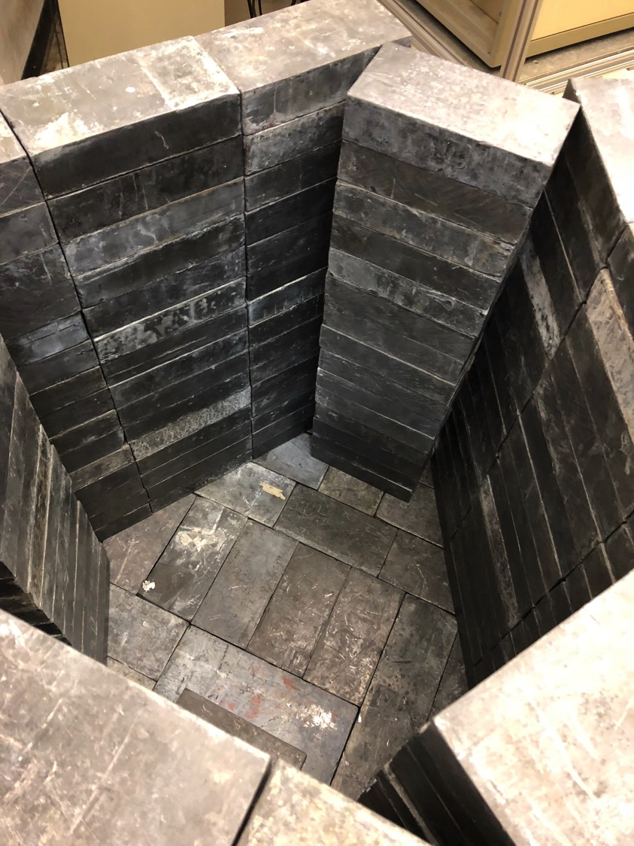
Andy Kubik, MINER

Slide 11
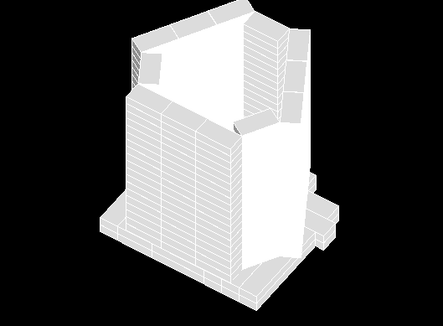
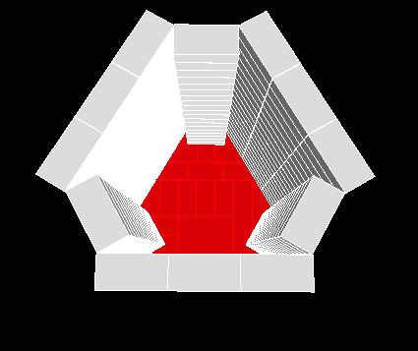

Slide 12
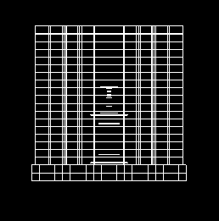
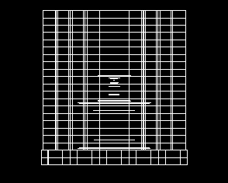
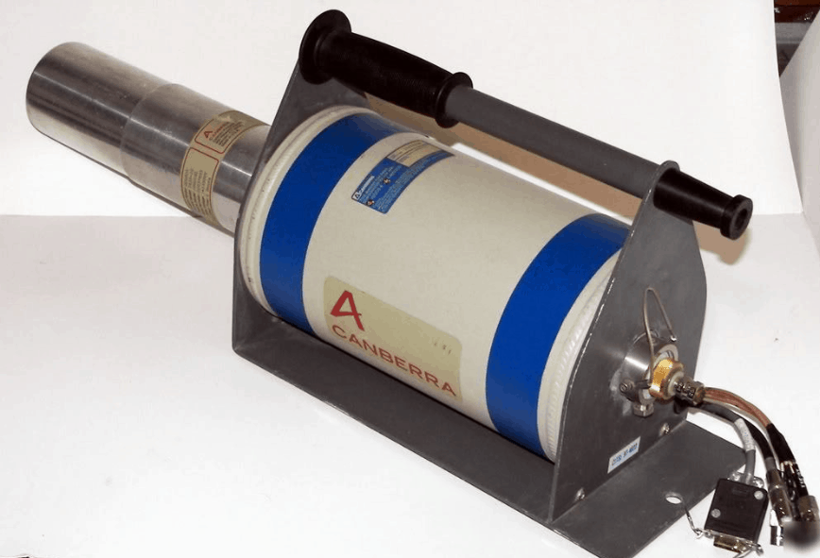
C++
GDML
HPGE
Detector

Slide 13
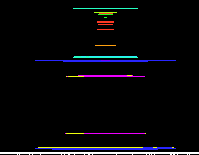
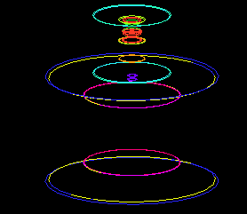
Orange – Copper Casing
Green – Germanium detector
Teal blue – liquid Nitrogen Tube
Yellow – Canberra Casing
Light Purple – Tin Casing
Blue – Stainless steel casing
Orange – Tube A
Lime Green - Tube B
Purple – Tube C
Aqua – Tube D

Slide 14
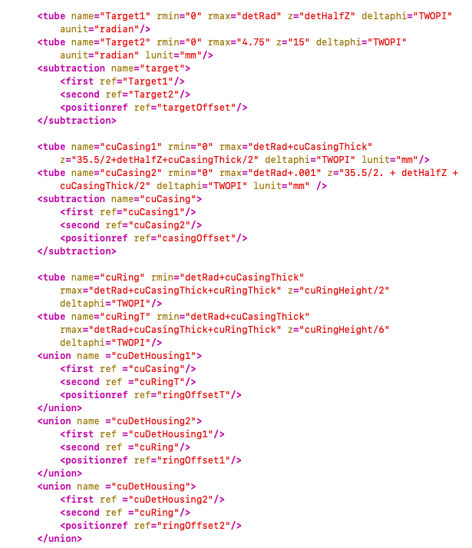
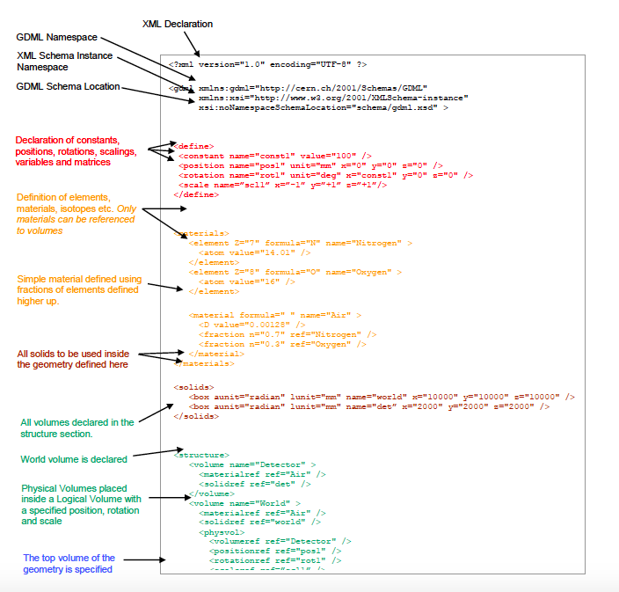
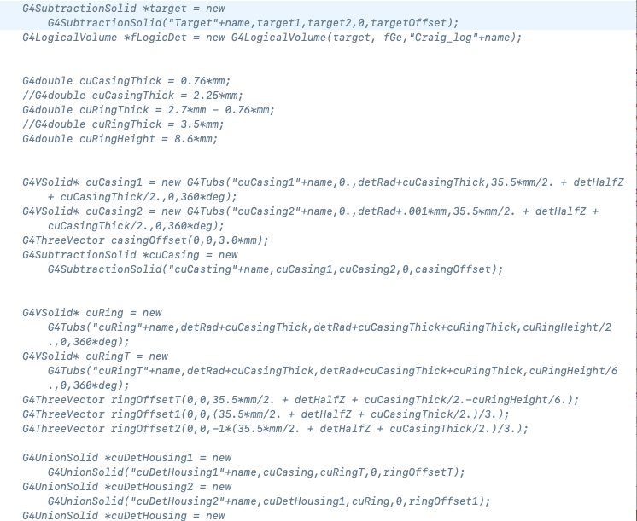
720
Cern, GDML guide
C++

Slide 15
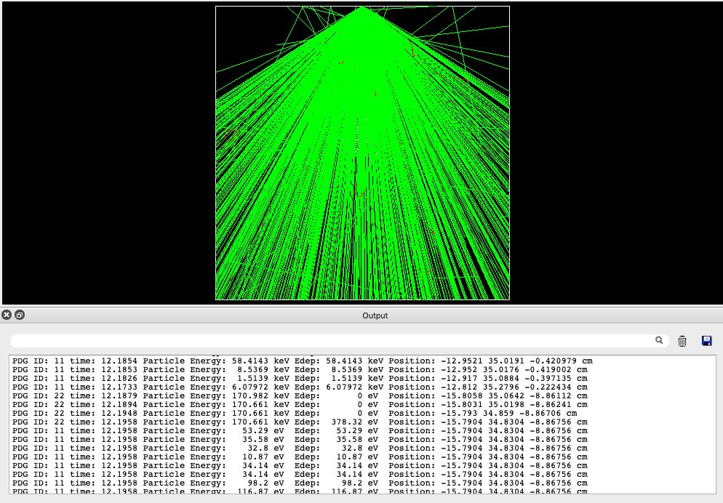

Slide 16
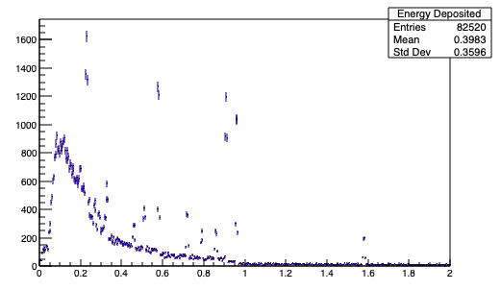
4 million Gamma particles
Counts
Energy[MeV]

Slide 17
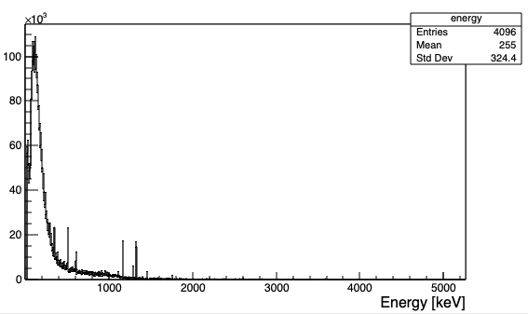
Counts/Kg/day
Energy[keV]

Slide 18
Conclusion
Geant4 is powerful tool!
MINER phase I begins this summer
When Geant4 simulation is fully built, it should mimic the exact results MINER puts out
In the future Geant4 could be used to run before the experiment begins, allowing the reactor to confirm the simulation

