Slide 1


Status of KATRIN and TRISTAN
m²_{ν,s}
m²_{ν,eff}
Diana Parno for the KATRIN Collaboration
Carnegie Mellon University
NuTheories, Pittsburgh, November 2018

Slide 2
Outline
Neutrino mass through β decay
Basics of the KATRIN experiment
First tritium runs
KATRIN and TRISTAN: eV and keV sterile searches
Outlook

Slide 3
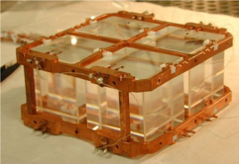
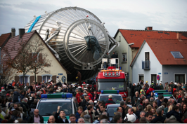
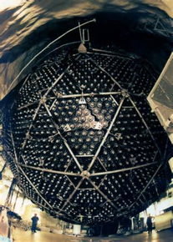
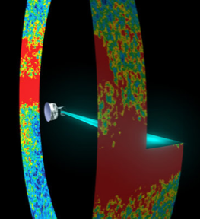
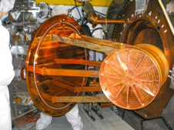
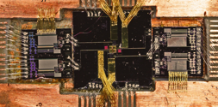
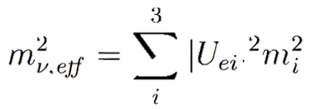
Probes of Neutrino Mass
 | ν oscillation | 0νββ | Cosmology | Decay kinematics
Observable
Present knowledge |  | m_{ββ} < (0.06-0.4) eV |  | m_{ν,eff} < 2 eV
Next gen. / near future |  | 0.01 – 0.05 eV | 0.01 – 0.05 eV | 0.2 eV
Model dependence of mass extraction | No mass-scale information | δ₁, δ₂ phases Nuclear matrix elements Requires LNV | ΛCDM Many parameters H₀ tension | Energy conservation

Slide 4
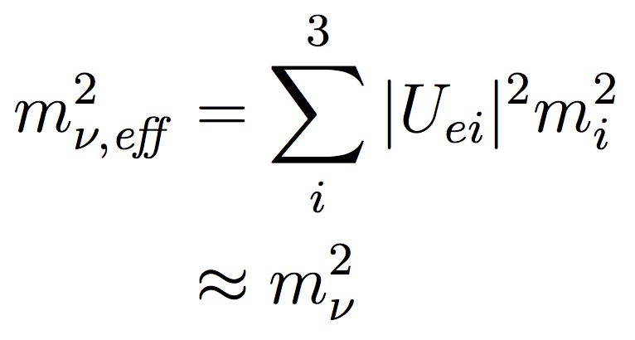
Kinematics of Tritium Decay
ν_{e}
e⁻
³H
³He
Probability (arb. u.)
Probability (arb. u.)
Super-allowed decay
  Q = 18.6 keV
  T_{1/2} = 12.3 yr
m_{ν,eff} = 1 eV
m_{ν,eff} = 0 eV
-5 -4 -3 -2 -1 0
β kinetic energy (eV)
β kinetic energy - Q (eV)
Extract effective neutrino mass from spectral shape near endpoint
(quasi-degenerate regime)

Slide 5
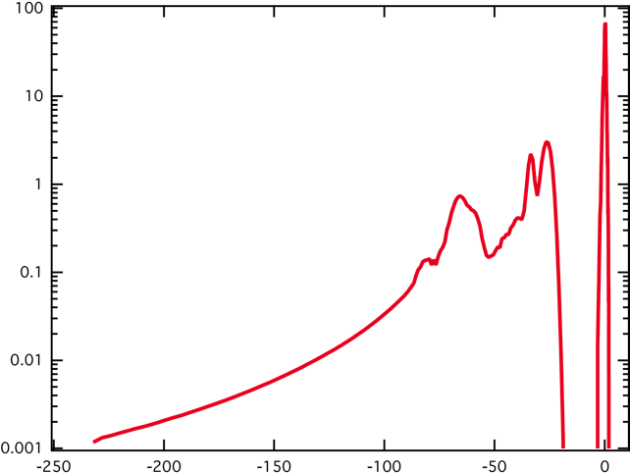
Molecular Tritium
Bodine, DSP, Robertson, PRC 91 (2015) 035505
KATRIN uses a T₂ source – not just T
β spectrum depends on excitation energies V_{k} and probabilities P_{k} – need 1% accuracy
Approaches to control uncertainty:
  Ongoing improvement in calculations
  Characterization of initial T₂ state
  TRIMS experiment to re-check predicted observable
Saenz et al.
PRL 84 (2000) 242
Relative probability (%/eV)
Binding energy (eV)

Slide 6
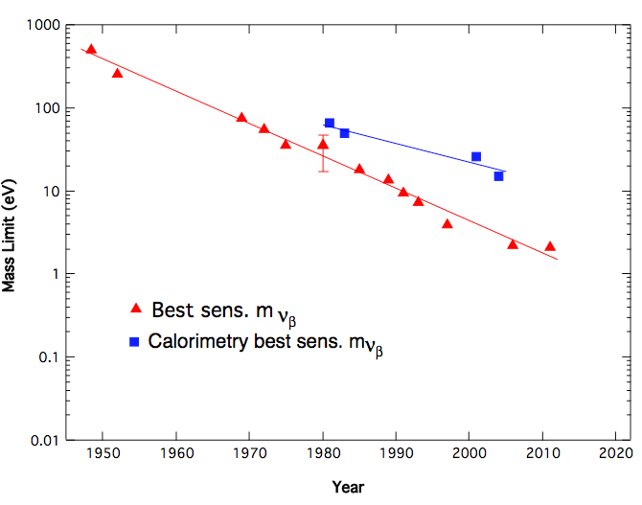
m_{ν,eff}²: A Brief History in Tritium
SuperK oscillation result
SNO oscillation result
MIBETA
Mass Limit (eV)
Neutrinos discovered
Troitsk
Mainz
KATRIN design
?
2025
Year
Adapted from J. Wilkerson, Neutrino 2012

Slide 7
Recipe for a New Measurement
The observable is m²_{ν,eff}
  100x better uncertainty → 10x better m_{ν,eff} sensitivity
Improve statistics
  Luminous β source (10¹¹ decays/s)
  Excellent energy resolution (0.93 eV)
  Low backgrounds (even at sea level)
Improve systematics
  Extensive commissioning
  Molecular physics
  Column density (activity, scattering)
  Point-to-point energy scale
  ...

Slide 8
Outline
Neutrino mass through β decay
Basics of the KATRIN experiment
First tritium runs
KATRIN and TRISTAN: eV and keV sterile searches
Outlook

Slide 9
The MAC-E Filter
Measure integral spectrum with moving threshold
Magnetic Adiabatic Collimation + Electrostatic filter
Electrodes
T₂ source
Detector
Analyzing plane
p_{e} (without E field)
Detailed application to KATRIN: Kleesiek et al., arXiv:1806.00369

Slide 10



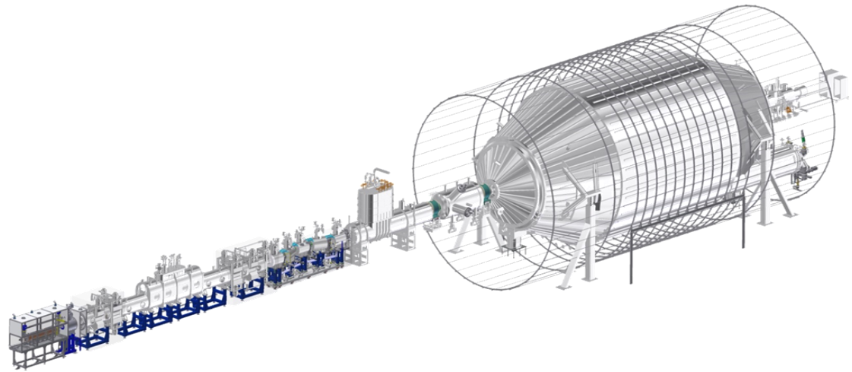
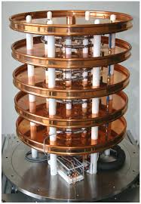
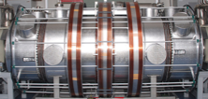
A Quick Tour of the Beamline
1 e⁻/sec
³H
³He
ν_{e}
10³ e⁻/sec
Detect βs
e⁻
10¹¹ e⁻/sec
Analyze β energy
Gaseous T₂ source
Electron transport + tritium retention
Monitor high voltage
Calibration

Slide 11
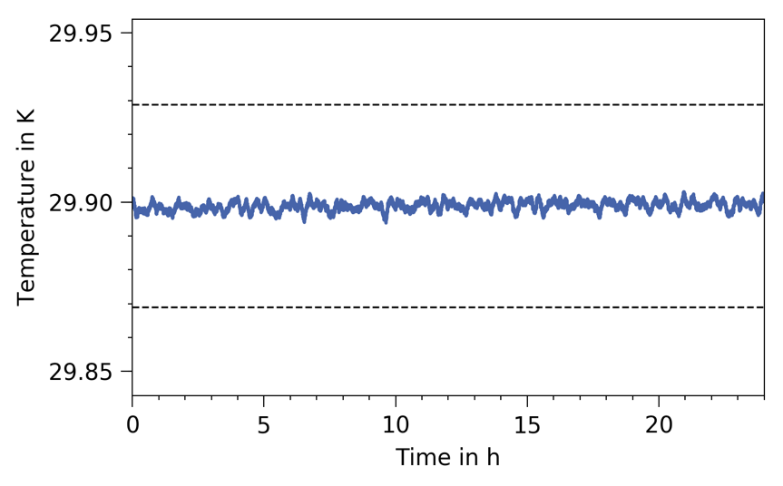
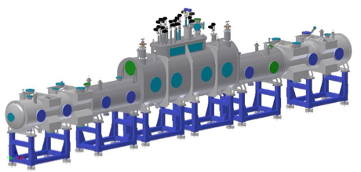
Windowless, Gaseous T₂ Source
16-m cryostat, 7 integrated superconducting solenoids
T₂ gas kept at 30 K in beam tube
Backed by closed tritium cycle with purification (40 g/day)
Temperature stability @ 30 K
Inject T₂
Pump out T₂
± 0.1%
Temperature (K)
Pump out T₂
Mar 30, 2018
0 5 10 15 20
~2 x 10⁻⁵ mbar
Time (hr)
~3 x 10⁻³ mbar
Gas dynamics model: Kuckert et al., arXiv:1805.05313
Two-phase Ne cooling: Grohmann et al., Cryogenics 49 (2009) 413
~2 x 10⁻⁵ mbar

Slide 12
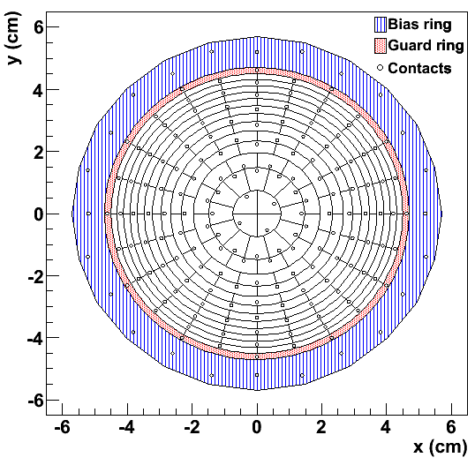
Focal-Plane Detector
Image analyzing plane with Si p-i-n diode from Canberra
90-mm active diameter
Entrance window 150 nm with 46% charge collection
148 pixels in dartboard pattern
Energy resolution around 2 keV FWHM
Amsbaugh et al., NIM A, 778 40 (2015)

Slide 13
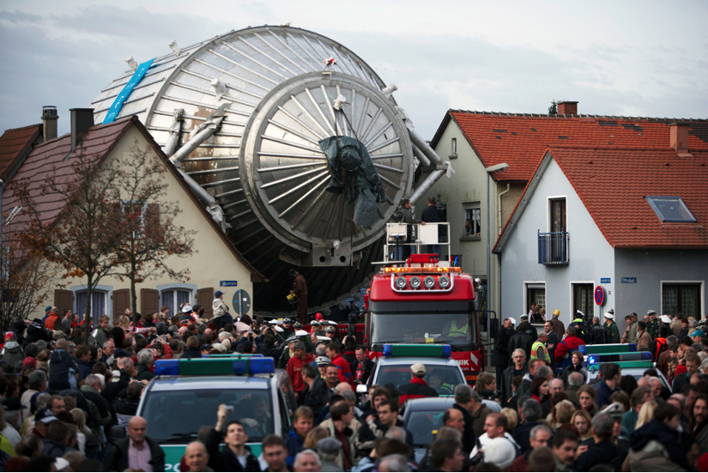
KATRIN by the Numbers
10¹¹ tritium decays per second
Magnetic field range 3 – 60000 G
Design filter width ΔE = 0.93 eV
Design sensitivity: 0.2 eV at 90% CL
Leopoldshafen, Germany
(near Karlsruhe)
November 2006

Slide 14
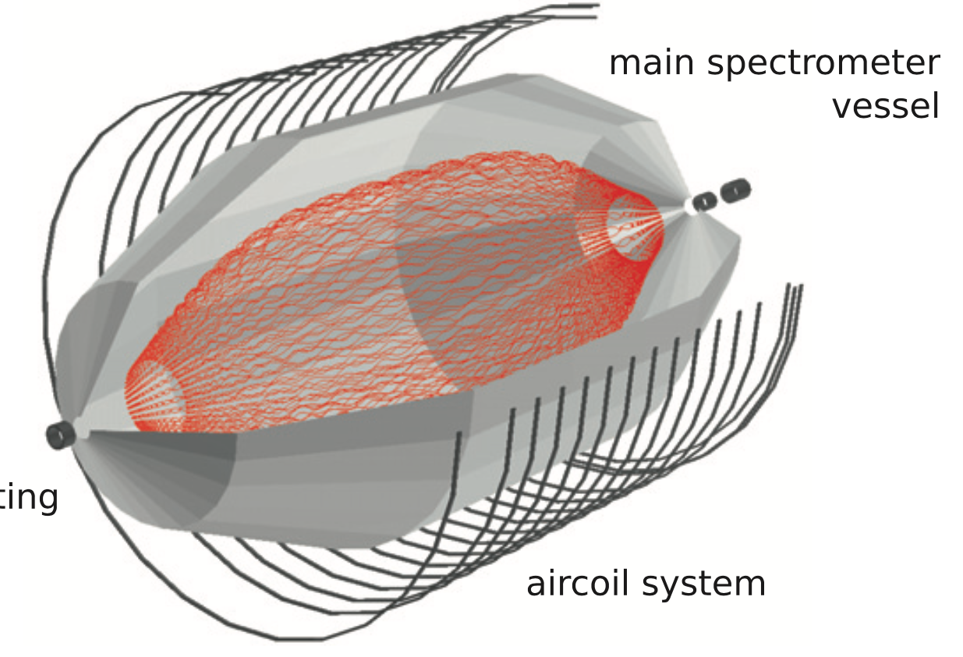


Spectrometer Backgrounds
Signal βs have E~0 keV in analyzing plane
Low-energy secondaries mimic the signal
Emission from walls (cosmic rays, environmental γs)
e⁻ from ionization (β flux, trapped e⁻, decays in volume...)
✓
Magnetic pulses vs stored-e⁻ background: KATRIN collab., EPJC 78, 778 (2018)
✓
Detector
α decay in walls (²¹⁰Pb chain from Rn plateout) sputters highly excited atoms
Rydberg atoms ionize in volume
Muon-induced background: KATRIN collab., arXiv:1805.12173
Simulated track from Mertens et al., Astropart. Phys. 41, 52 (2013)

Slide 15
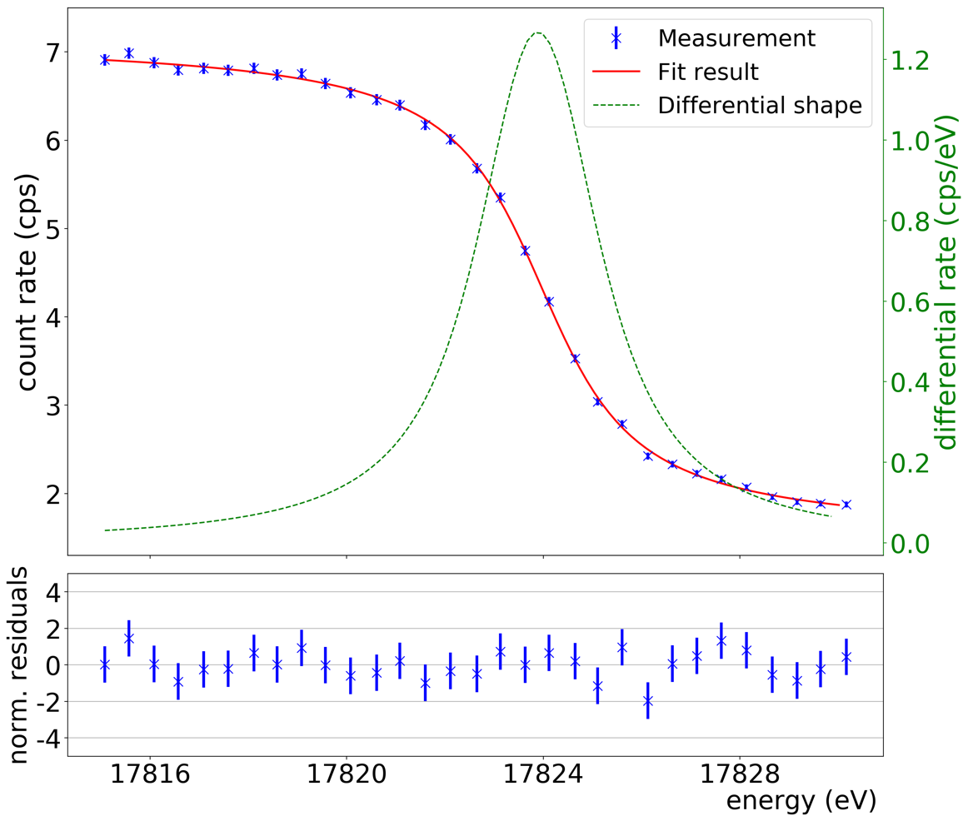
2017: ^{83m}Kr Spectroscopy
July 2017: Monoenergetic electrons from two beamline ^{83m}Kr sources
Commissioning with isotropic source
  Energy scans
  Demonstrate sub-eV energy resolution
  Calibration, monitoring equipment
Long-term stability of high-voltage divider: 2 ppm over 4 years
Count rate (cps)
K-32 line
Energy 17.8 keV
Natural width 2.7 eV
Averaged over 40/148 pixels
Differential rate (cps/eV)
KATRIN collab., JINST 13 P04020 (2018)
Norm. resid.
17816 17820 17824 17828
Energy (eV)
KATRIN collab., EPJ C 78 368 (2018)

Slide 16
Outline
Neutrino mass through β decay
Basics of the KATRIN experiment
First tritium runs
KATRIN and TRISTAN: eV and keV sterile searches
Outlook

Slide 17
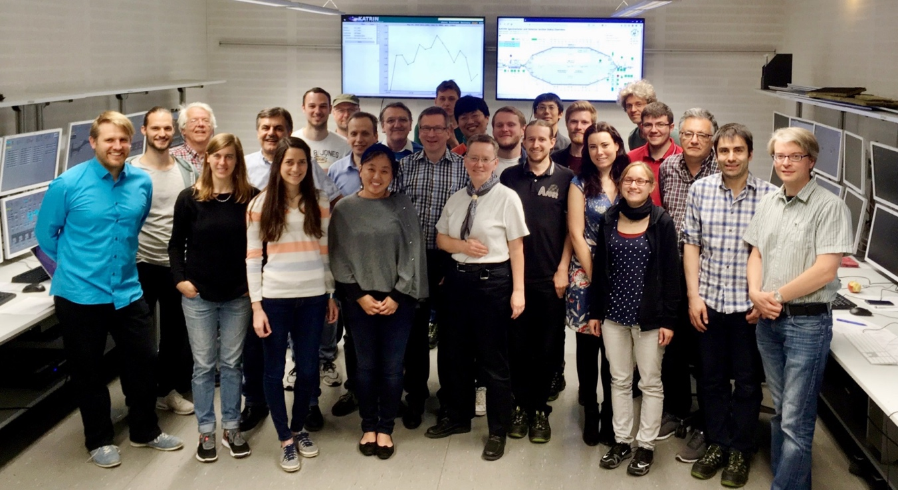
KATRIN’S Very First Tritium
Normal operation: Continuous gas flow through closed tritium cycle with purification
First commissioning: Inject known gas mix from prepared sample cylinders (4 doses)
  0.5% T atoms circulating in D₂ gas (90% nominal density)
First tritium injection:
Friday 18 May
7:48 am UTC
Notes:
Small doses for ion safety

Slide 18
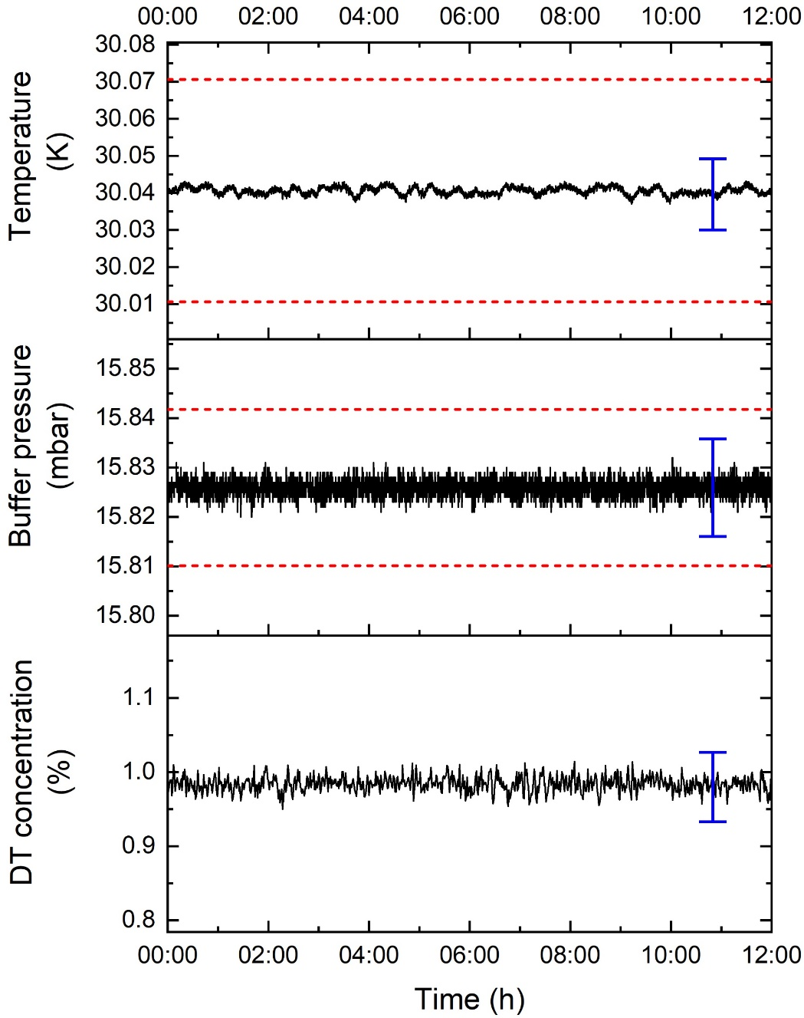
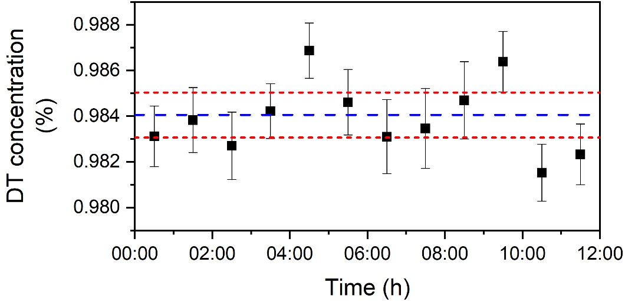
Source Stability over 12 Hours
Blue error bars indicate systematic uncertainty
Red dashed lines indicate 0.1% stability tolerance for neutrino-mass running
Slide credit: Magnus Schlösser

Slide 19
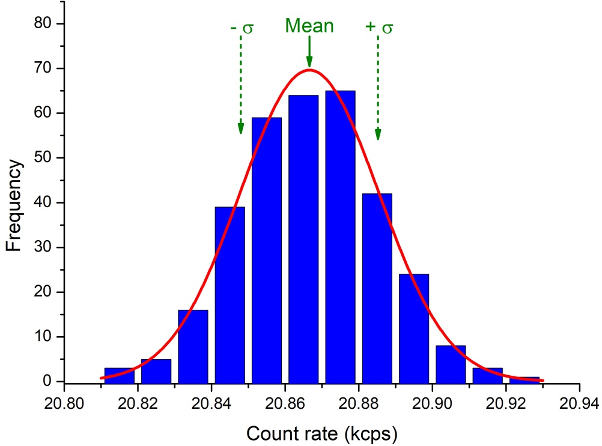
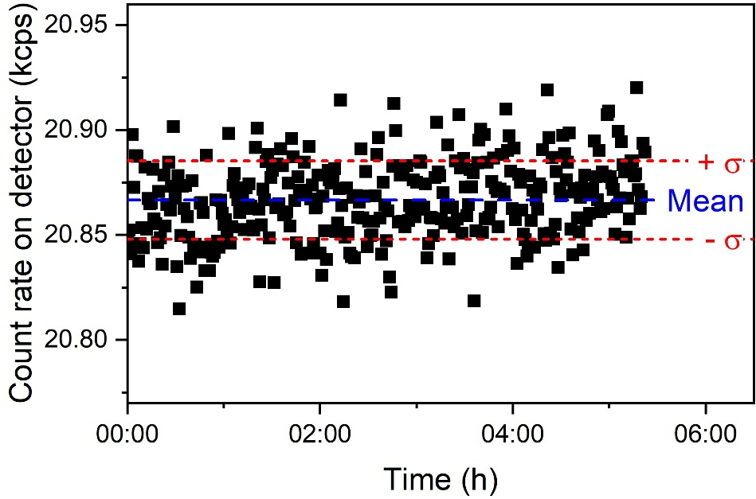
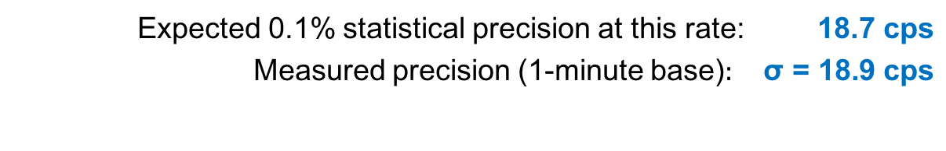
Integral Rate Stability (5 hours)
Retarding potential set to 1000 V below endpoint for 5 hours
Rate stability reflects overall performance of system
Expected 0.1% statistical precision at this rate: $\text{18.}\text{7} \text{cps}$
Measured precision (1-minute base)$: \text{σ} \text{= 18.}\text{9} \text{cps}$
Slide credit: Magnus Schlösser

Slide 20
Scanning the Tritium Spectrum
KATRIN tritium scan #1 (Day 2 of tritium commissioning)
Immediate comparison of data to model
Model initialized with system parameters from slow controls
Very good agreement “out of the box”
Preliminary

Slide 21
Fitting the Tritium Spectrum
Later that day, we fit the last 200 eV of the spectrum
Three fit parameters (neutrino mass fixed to 0):
  Overall activity
  Constant background
  Endpoint energy E₀
Statistical errors only in this early fit
χ²/dof = 15.0/14
Preliminary

Slide 22
First Look at Fit Systematics
Examined 400-eV analysis window for a single scan
Covariance-matrix approach to systematics
Propagated correlations with multisim method
Many systematics will improve after this commissioning cycle (e.g., column density)
χ²/dof = 15/16
Preliminary
Preliminary

Slide 23
Inactive-Gas Commissioning
September– October of this year
Tackle multiple systematics before next tritium runs
Transmission through spectrometer (spectral shape, efficiency)
Ion retention (backgrounds)
Column density (scattering, activity)
Upgraded DAQ (higher rates)
Local space charge (spectral shape)

Slide 24
The Next Few Years
Spring 2019: Further commissioning + tritium purity ramp-up
Summer/Fall: Neutrino mass running
Stay tuned! Even with increased background, we can reach a sensitivity of 0.24 eV by adjusting scan strategy
Full sensitivity (σ_{syst} = σ_{stat}) after 3 beam yrs (~5 calendar yrs)
m_{ν} limit (eV, 90% CL)
Discovery potential (σ)
Full beam time (months)
Full beam time (yrs)
G. Drexlin et al., Adv. High Energy Phys. 2013 (2013) 293986

Slide 25
Outline
Neutrino mass through β decay
Basics of the KATRIN experiment
First tritium runs
KATRIN and TRISTAN: eV and keV sterile searches
Outlook

Slide 26
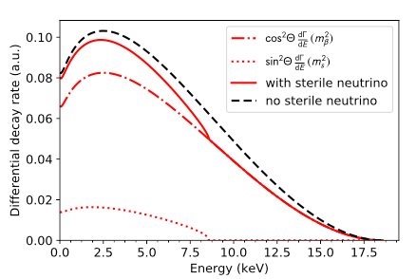
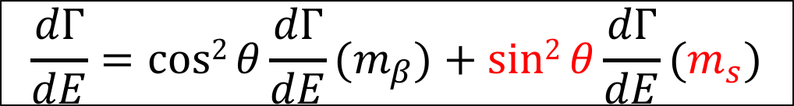
Sterile Neutrinos in β Decay
The large hypothesized mass splitting between the active and sterile sectors could be resolved by KATRIN!
Search for characteristic kink structure in spectrum (exaggerated in figure)
Sensitive to eV and keV scales
S. Mertens et al., arXiv:1810.06711
$$\frac{dΓ}{dE}=cos2{θ\frac{dΓ}{dE}(m_{β})}+sin2{θ\frac{dΓ}{dE}(m_{s})}$$

Slide 27
Sterile Neutrinos at eV Scales
Kink structure is within standard KATRIN analysis window (order 10 eV below endpoint)
Sensitivity improves further if combined with short-baseline oscillation data
Reactor antineutrino anomaly
95% C.L.
90% C.L.
68% C.L.
99% C.L.
Projected KATRIN exclusion after 3 years
Formaggio and Barrett, PLB 706 (2011) 68

Slide 28
Sterile Neutrinos at keV Scales
Endpoint of tritium β decay is 18.6 keV
  Sensitivity to m_{s} < 18.6 keV ?
First challenge: statistics
Regular neutrino-mass measurement
keV-scale sterile search
Imagery credit: Susanne Mertens

Slide 29
keV-Scale Search: Systematics
Adiabatic guiding of βs even with high surplus energy
Loss of βs back-scattered at detector
Now we detect more βs that lost energy:
  Back-scattered on rear wall
  Scattered multiple times in source
Slide credit: Susanne Mertens

Slide 30
The TRISTAN Project
R&D for KATRIN extension (after neutrino-mass running)
  Characterize KATRIN performance far below T endpoint (backgrounds, stability, transmission)
  Possible upgrades on source side
    Reduce back-scattering on rear wall via changes in composition and magnetic field?
  Detector upgrades
    Anticipated rates of 10⁸ cps or more
    Energy resolution ~ 300 eV (FWHM) at 30 keV
    Minimal backscattering
    High efficiency with minimal energy dependence

Slide 31
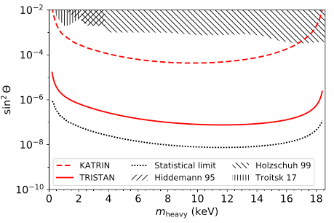
The TRISTAN Project
Anticipated 95% C.L. exclusion limits for 3 beam years of:
Standard KATRIN configuration
TRISTAN with 1% of KATRIN source strength
TRISTAN with 100% KATRIN source strength
S. Mertens et al., arXiv:1810.06711

Slide 32
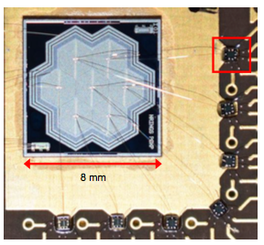
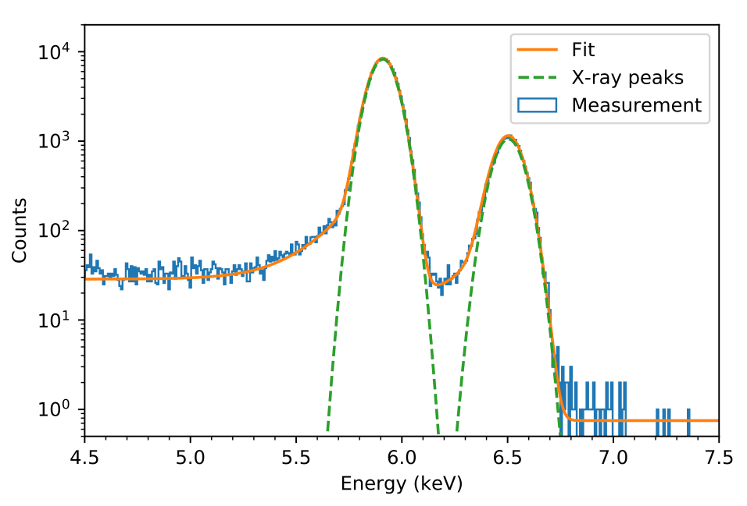
TRISTAN Detector Studies
Plan: Silicon drift detectors (SDDs) with integrated nJFET
Prototype: SDDs with external FET-equipped ASICs
Waveform digitization to mitigate ADC nonlinearities
⁵⁵Fe spectrum
ΔE = 139 eV
(FWHM)
Semiconductor Lab, Max Planck
S. Mertens et al., arXiv:1810.06711

Slide 33
TRISTAN Next Steps
Next-generation prototype under construction: 166 pixels
4-cm module to be tested on bench and at Troitsk’s existing MAC-E filter
TRISTAN concept has 21 modules for ~3500 pixels within a 20-cm diameter
Full detector
Detector module

Slide 34
Outlook
KATRIN is a working experiment
  First full-beamline data, Oct. 2016
  First spectral measurement of radioactive source, July 2017
  First tritium, 6 months ago!
  Fresh systematics data on disk
We expect m_{ν,eff} data in first half of 2019
TRISTAN R&D is proceeding well
  Staged detector prototypes
  Analysis of KATRIN commissioning data
  Active engineering work
  Deployment at KATRIN is possible after neutrino-mass run – 2025?

Slide 35
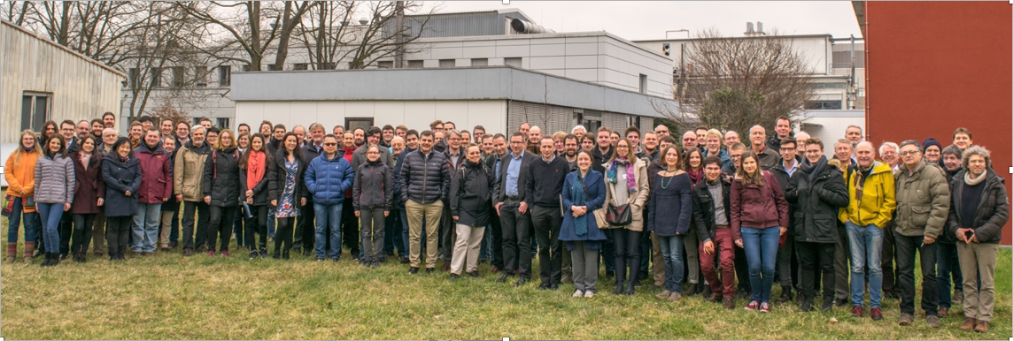
KATRIN Collaboration
Funding and support from: Helmholtz Association (HGF), Ministry for Education and Research BMBF (05A17PM3, 05A17PX3, 05A17VK2, and 05A17WO3), Helmholtz Alliance for Astroparticle Physics (HAP), and Helmholtz Young Investigator Group (VH-NG-1055) in Germany; Ministry of Education, Youth and Sport (CANAM-LM2011019), cooperation with the JINR Dubna (3+3 grants) 2017–2019 in the Czech Republic; and the Department of Energy through grants DE-FG02-97ER41020, DE-FG02-94ER40818, DE-SC0004036, DE-FG02-
97ER41033, DE-FG02-97ER41041, DE-AC02-05CH11231, DE-SC0011091, and DE-SC0019304 in the United States.

Slide 36
Backup Slides
Accounting for backgrounds in the KATRIN sensitivity
List of recent technical papers
Brief introduction to the TRIMS experiment

Slide 37
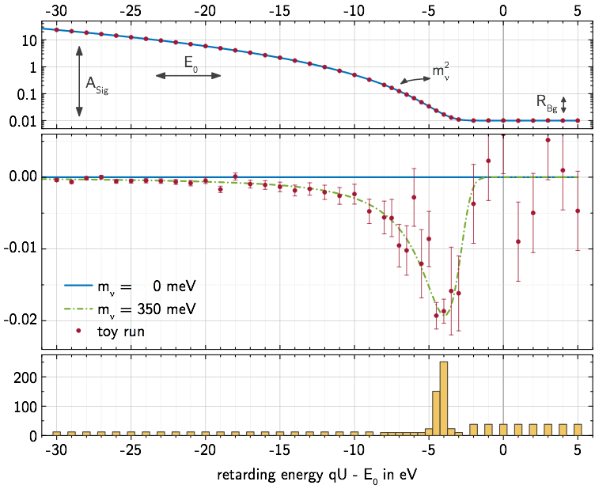
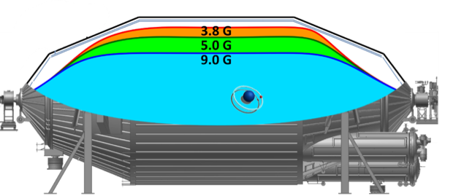
Background and Sensitivity
Shift scans to lower E_{β}
Extend data range by 30 eV
Shrink flux tube (slight cost in ΔE)
Rate (cps)
Relative difference
m_{ν} = 0 meV
m_{ν} = 350 meV
Toy run
0.38 mT
0.50 mT
0.80 mT
Time (d)
-60
Retarding energy qU – E₀ (eV)
Slide from Kathrin Valerius
Notes:
We are making a relative shape measurement of the beta spectrum, which gives us flexibility to mitigate background impact by adjusting our measurement strategy. Even without mitigating the Rydberg background events, we can reach a sensitivity of 240 meV by:

Slide 38
Recent Technical Papers
Mobile, external magnetic-field sensing
  Letnev et al., arXiv:1805.10819 [physics.ins-det]
Large-volume air-coil system
  Erhard et al., JINST 13 (2018) P02003
Electron gun for commissioning
  Behrens et al., Eur. Phys. J. C 77 (2017) 410
Kassiopeia particle-tracking software
  Furse et al., New J. Phys. 19 (2017) 053012

Slide 39
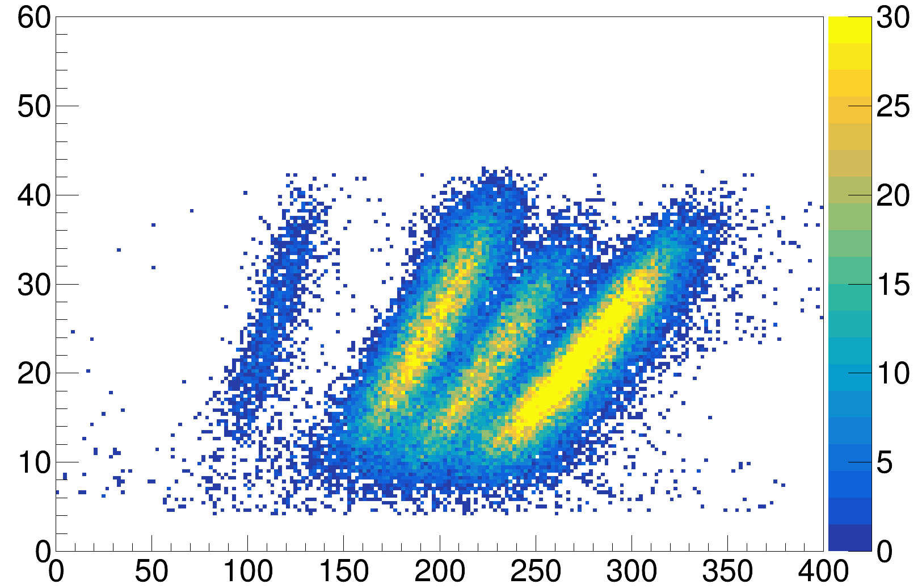
Tritium Recoil-Ion Mass Spectrometer
Molecular theory¹ predicts ³HeT⁺ should dissociate in 43-61% of β decays near endpoint
Two 1950s experiments^{2,3} found 5-10% dissociation over β spectrum
TRIMS is a time-of-flight mass spectrometer, now taking data at University of Washington to resolve the discrepancy!
30 minutes with HT – T₂ gas mix
TRIMS collaboration: Baek, Kallander, Lin, Machado, Parno, Robertson, Vizcaya Hernández
Preliminary
H⁺
³He⁺, T⁺
³HeT⁺
³HeH⁺
TRIMS Posters (Mon. session)
- TRIMS: Validating Tritium Molecular Effects for Neutrino Mass Experiments (Lin, #6)
- Detecting light ions and electrons with TRIMS silicon detectors (Baek, Vizcaya Hernández, #88)
Ion Energy (keV)
¹Jonsell et al., PRC 60 034601 (1999)
²Snell et al., J. Inorg. Nucl. Chem. 5 112 (1957)
³Wexler, J. Inorg. Nucl. Chem. 10 8 (1958)
Ion Timing – Beta Timing (ns)

