Slide 1
Welcome To Pittsburgh!

Slide 2
Welcome To PITT PACC!
Members: ~23 Pitt faculty
+ 2 PITT PACC Fellows
+ Postdocs, students, visitors
Associate Members:
CMU; PSU; OSU; MSU;
SUNY-Buffalo, CWRU
You can also join!
(free of charge; and free
Pheno Symp. & workshops)
In both theory and
Experiments/observation:
Expt: ATLAS;
T2K, NOva, MicroBooNE, MINOS, MINERvA, DUNE; Belle II … …
LSST, DESI, DEEP2,3 …
Theory: QCD, EWSB, Higgs, 𝛎’s, DM, BSM, …
Cosmo: CMB, DE …

Slide 3
PITT PACC Missions
Enhance research activities for particle physics, astrophysics, and cosmology.
Strengthen interactions and collaborations among theorists and experimentalists.
Promote local research to the general community.

Slide 4
PITT PACC Activities
Organizing joint seminars/colloquia
broad interests; joined with CMU
Organizing workshops:
in rapid-response, on hot topics
And other conferences:
Pheno Symposia; CTEQ Summer schools;
Experimental collaboration meetings …
Host visitors:
Faculty sabbatical; international postdocs & students
Host PITT PACC Public Lectures

Slide 5
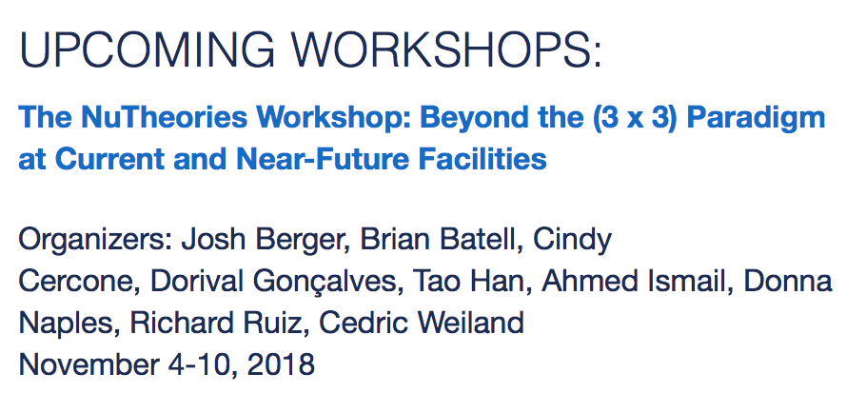
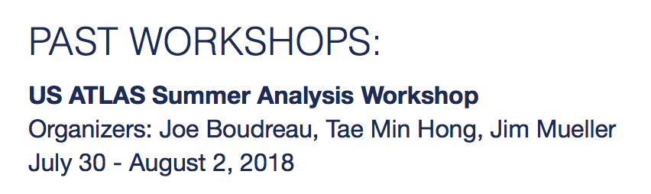
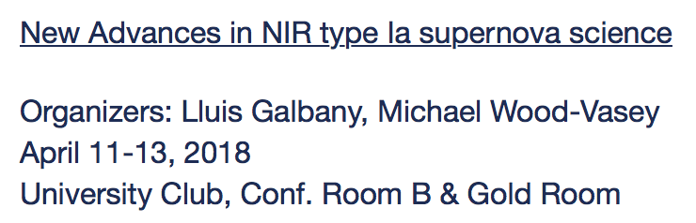
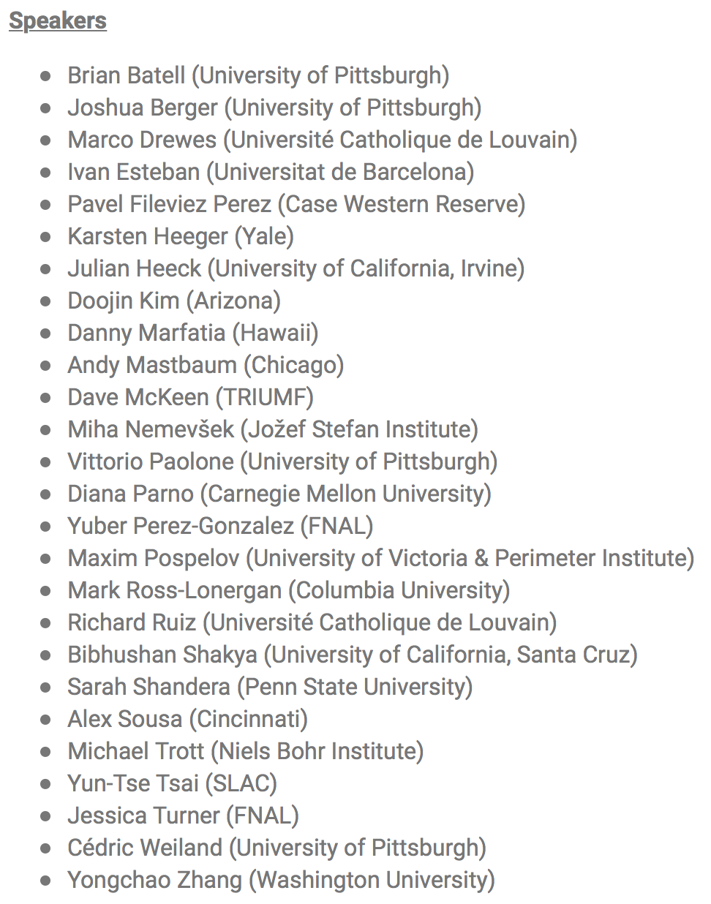
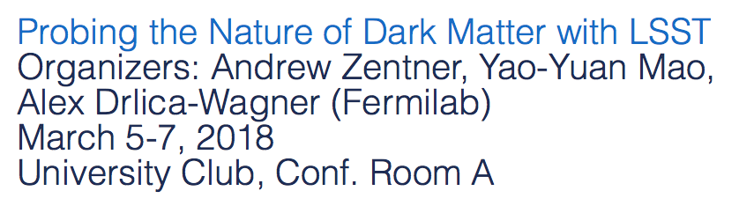
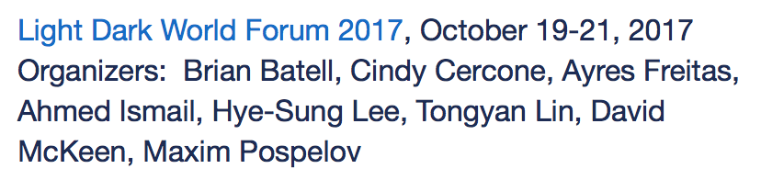
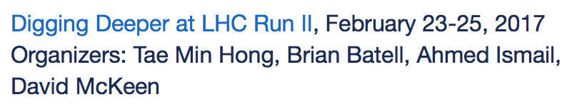
PITT PACC Workshops
Thank you all !

Slide 6
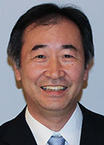
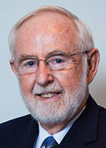

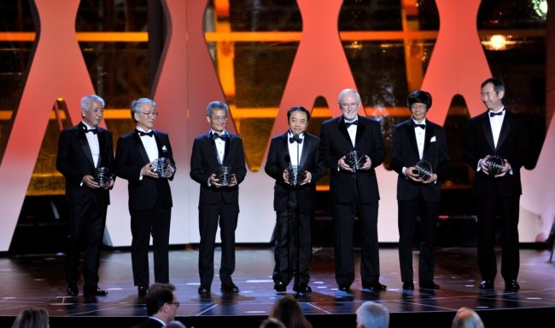
Great Years for ν-Physics!
"for the discovery of neutrino oscillations, which shows that neutrinos have mass"
T. Kajita & A. McDonald
Fundamental Physics Break Through Prize
Daya Bay, K2K/T2K, KamLand, SNO, SuperK
“For the fundamental discovery and exploration of neutrino oscillations, revealing a new frontier beyond, and possibly far beyond, the standard model of particle physics.”
PITT PACC is very proud of our awardees:
Donna Naples, Steve Dytman, Vittorio Paolone, Istvan Danko
Great potential for ν-Physics!

Slide 7
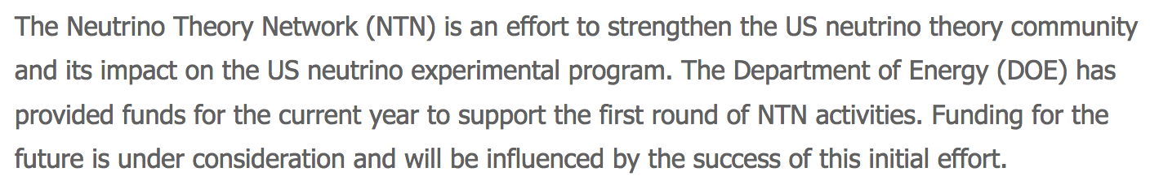
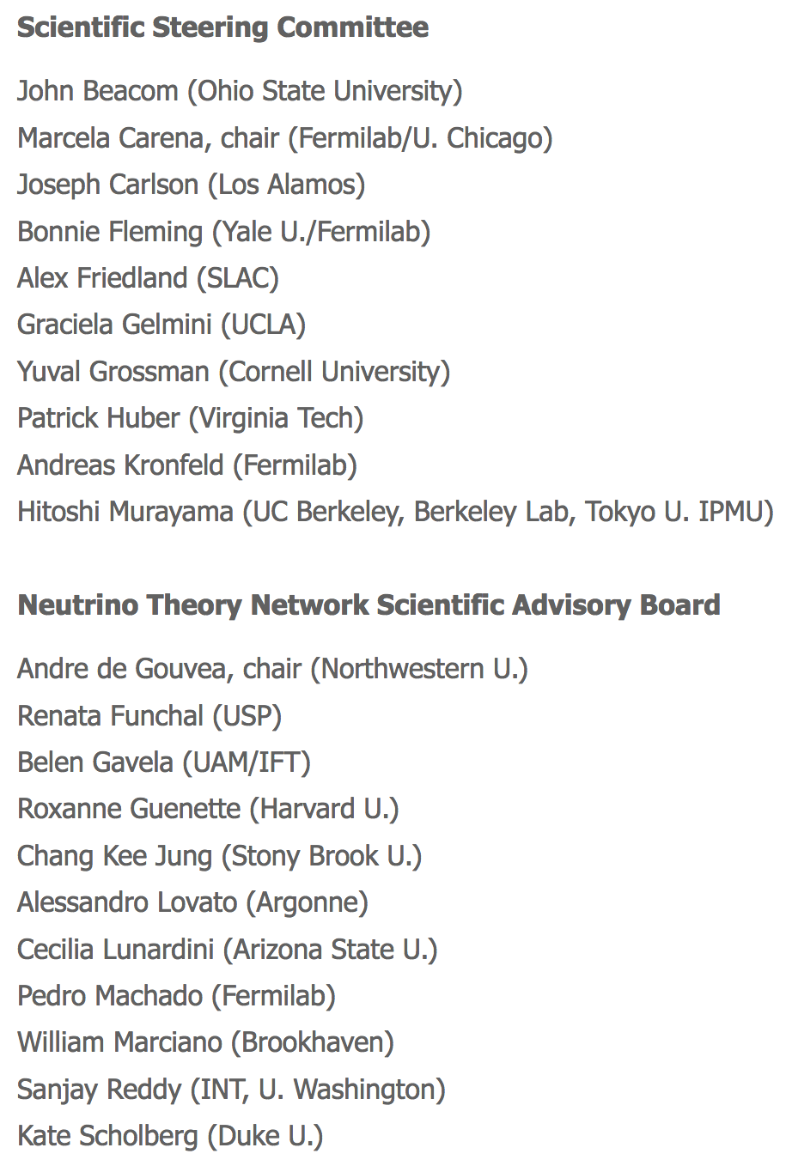
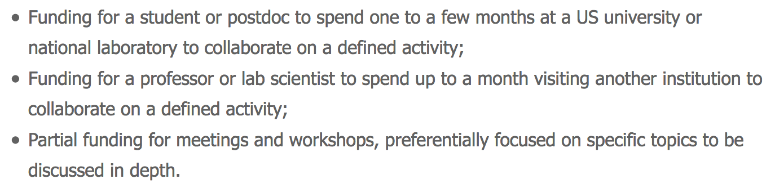
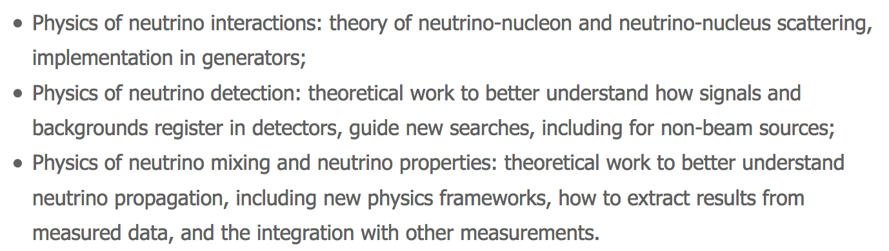
Acknowledging the “Neutrino Theory Network”
Thank you!
Co-PI’s: Cedric, Richard, TH
Let’s start the NTN kick-off activity !

Slide 8
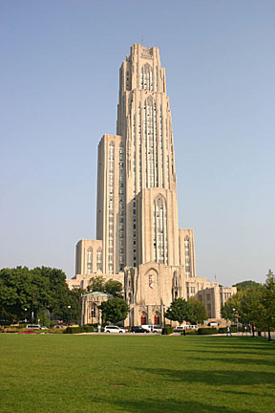
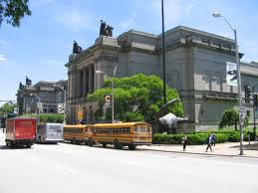

Welcome All!
Look forward to
the stimulating talks & discussions.
Hope you enjoy
the workshop and your stay at Pitt !
Soldiers & Sailors Museum
Cathedral of Learning
Phipps of Conservatory
Carnegie Museum

Slide 9
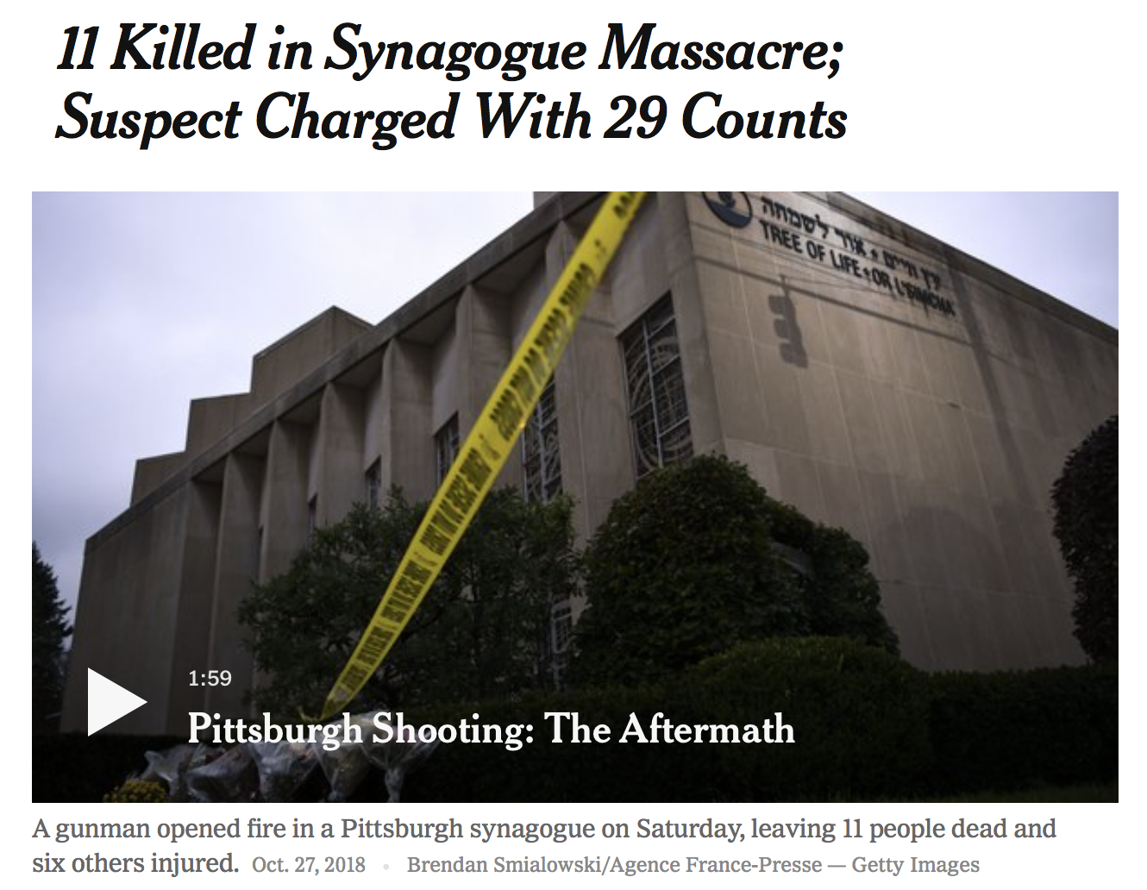
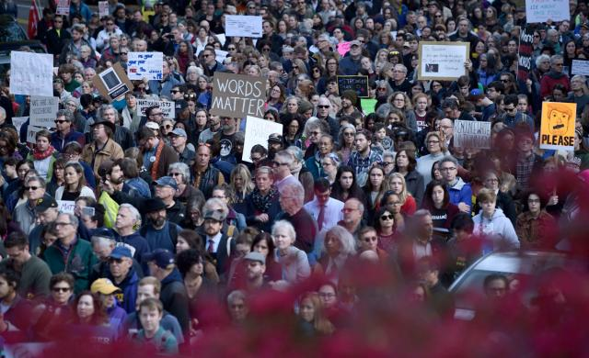
… the darkest days in Pittsburgh
Please join us to condemn the senseless hatred in the strongest terms,
offer the deepest sympathy to the victims and their families & friends.

