Slide 1


Reverse Direct Detection:
Cosmic Ray Scattering with Light Dark Matter
Chris Cappiello
With Kenny Ng, John Beacom

Slide 2
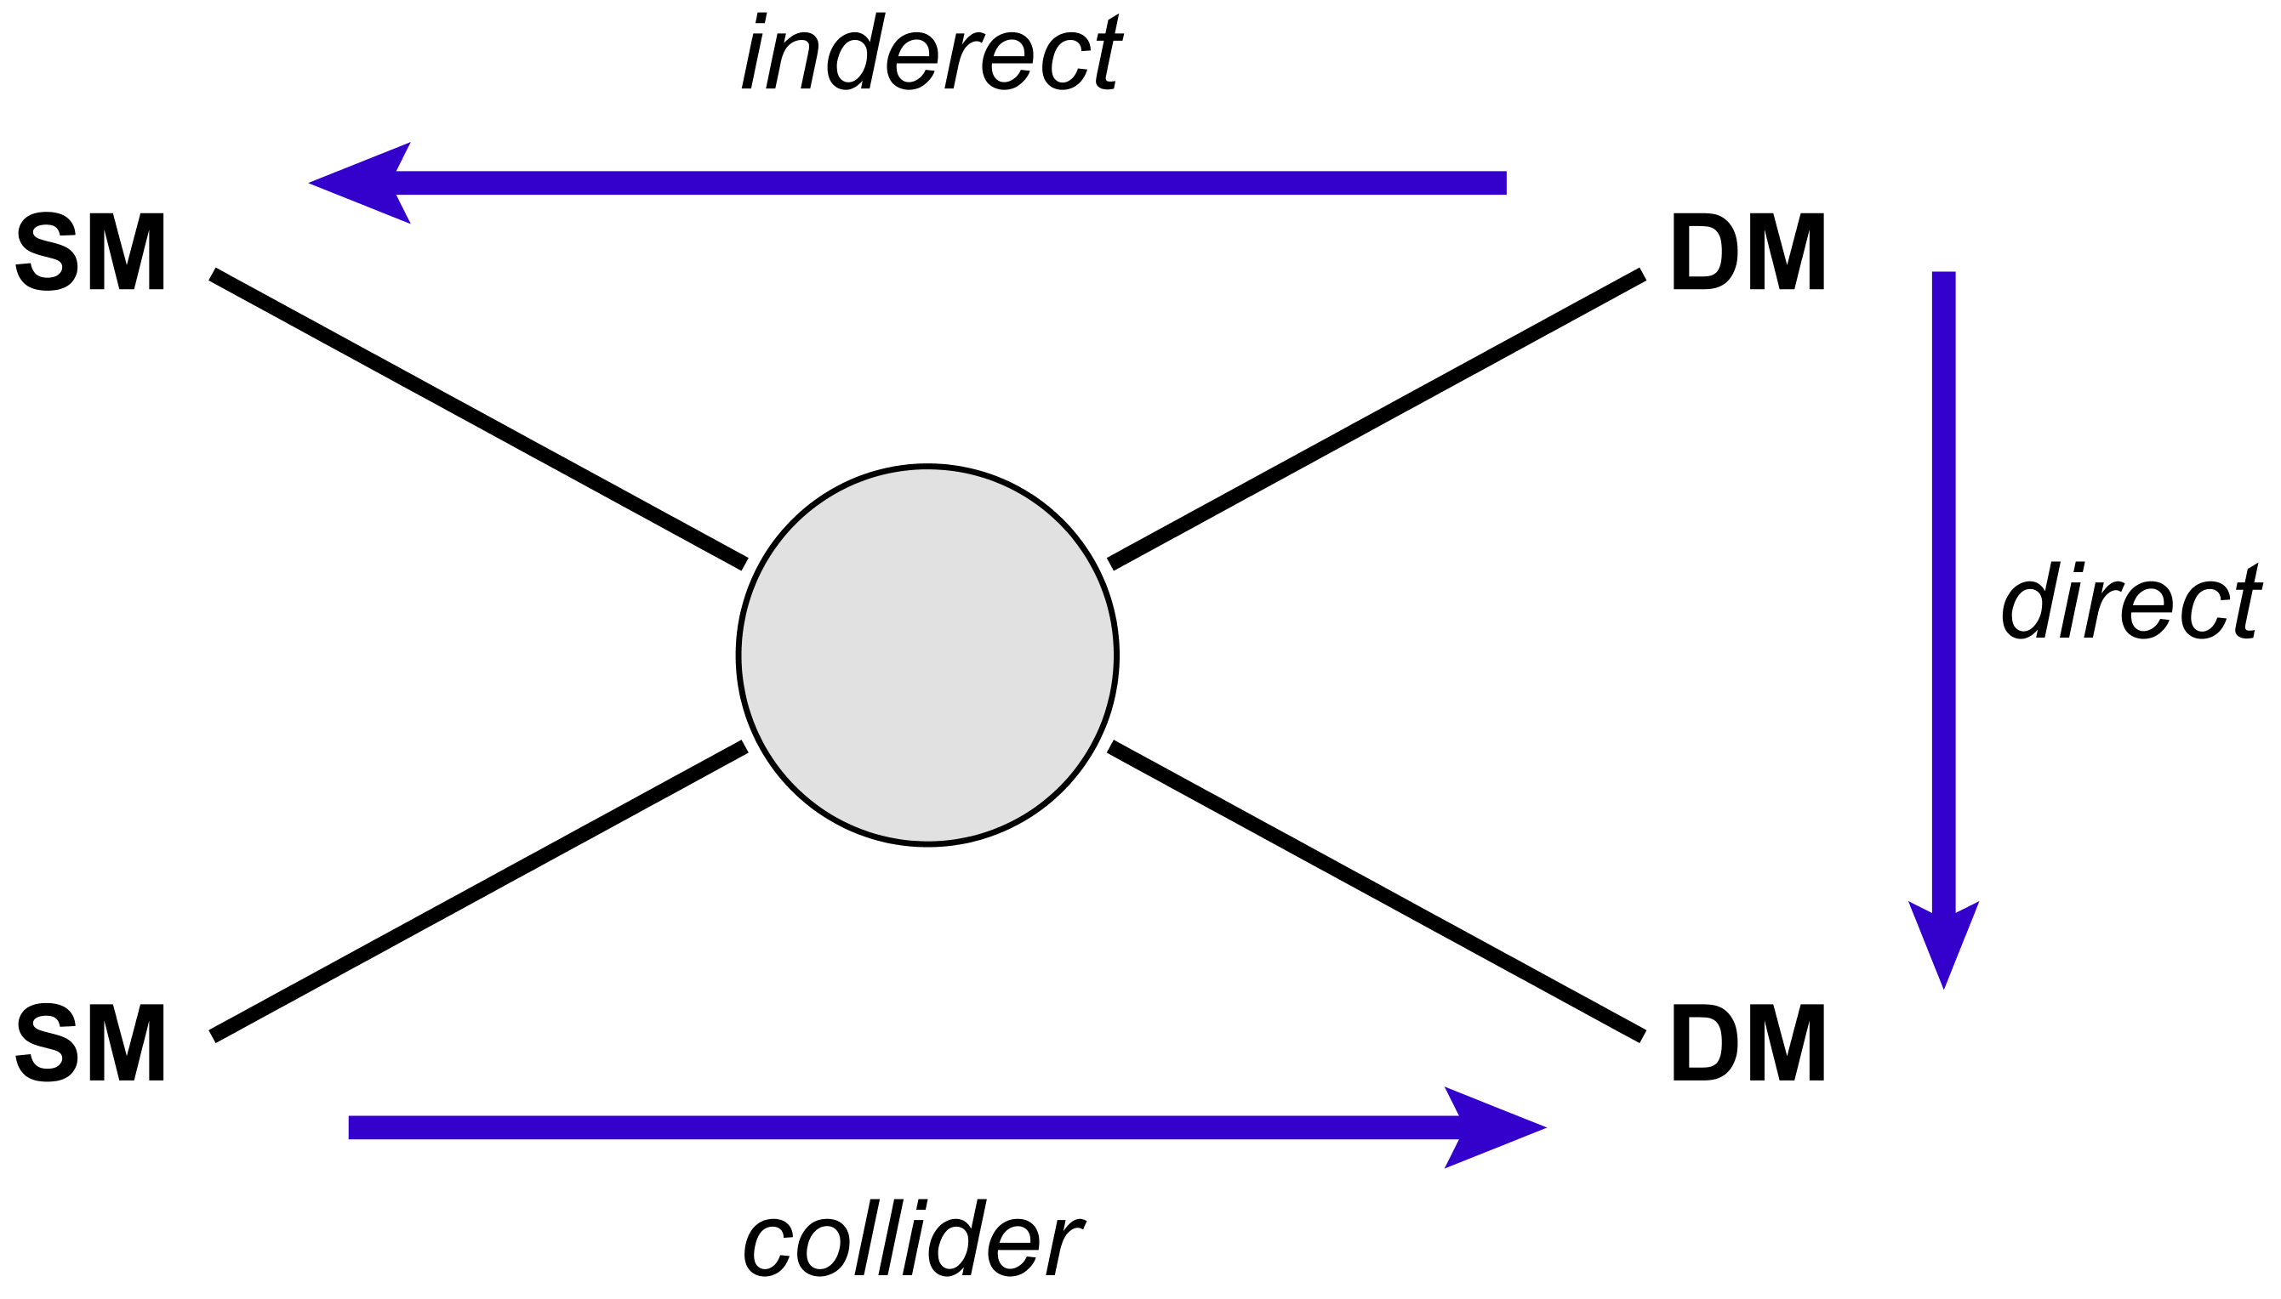
Dark Matter Search Strategies
Indirect Detection
(Photons, Neutrinos, Antimatter)
SM
DM
Direct Detection
(Nuclear Recoil)
?
SM
DM
Collider Searches
(Missing Transverse Energy)
inspirehep.net/record/1400608

Slide 3
Dark Matter Search Strategies
Indirect Detection
(Photons, Neutrinos, Antimatter)
SM
DM
RDD
(e.g. Cosmic Rays)
Direct Detection
(Nuclear Recoil)
?
SM
DM
Collider Searches
(Missing Transverse Energy)
inspirehep.net/record/1400608

Slide 4
Why RDD?

Slide 5
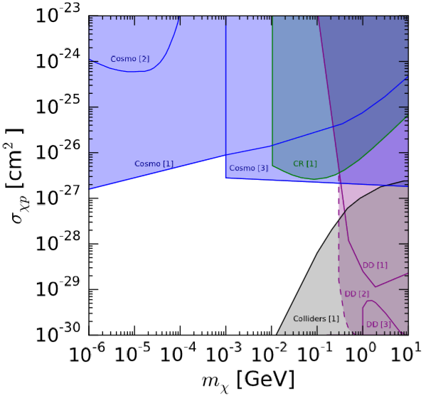
Sub-GeV Dark Matter
Blue: Cosmology
Green: CR-DM Inelastic Scattering
Purple: Direct Detection
Gray: Colliders
Gluscevic, Boddy 1712.07133
Ali-Haïmoud,Chluba, Kamionkowski 1506.04745
Xu, Dvorkin, Chael 1802.06788
COSMOLOGY
CR
Cyburt, Fields, Pavlidou, Wandelt astro-ph/0203240
Erickcek, Steinhardt, McCammon, McGuire 0704.0794
Mahdawi, Farrar 1709.00430
Aguilar-Arevalo et al. 1607.07410
DD
Daci et al. 1503.05505
Colliders

Slide 6
Sub-GeV Dark Matter
Blue: Cosmology
Green: CR-DM Inelastic Scattering
Purple: Direct Detection
Gray: Colliders
Gluscevic, Boddy 1712.07133
Ali-Haïmoud,Chluba, Kamionkowski 1506.04745
Xu, Dvorkin, Chael 1802.06788
COSMOLOGY
CR
Cyburt, Fields, Pavlidou, Wandelt astro-ph/0203240
Erickcek, Steinhardt, McCammon, McGuire 0704.0794
Mahdawi, Farrar 1709.00430
Aguilar-Arevalo et al. 1607.07410
DD
Daci et al. 1503.05505
Colliders
CR-DM Elastic Scattering?

Slide 7
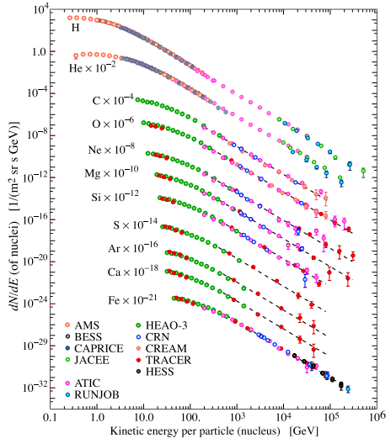
Cosmic Rays in the Galaxy
Acceleration: SNR
Propagation: Magnetic Fields ->
Diffusion-Like Propagation
Loss Processes: Spallation,
Decay, dE/dt, Escape
Astronomy.swin.edu.au
PDG 2015

Slide 8
Cosmic Ray Protons
Acceleration: SNR
Propagation: Magnetic Fields ->
Diffusion-Like Propagation
Loss Processes: Spallation,
Decay, dE/dt, Escape
PDG 2015

Slide 9
Leaky Box Model: Protons
Acceleration: Q(ε)
Diffusion -> T_{esc}
Energy Loss?

Slide 10
Leaky Box Model: Protons
Acceleration: Q(ε)
Diffusion -> T_{esc}
Energy Loss: negligible

Slide 11
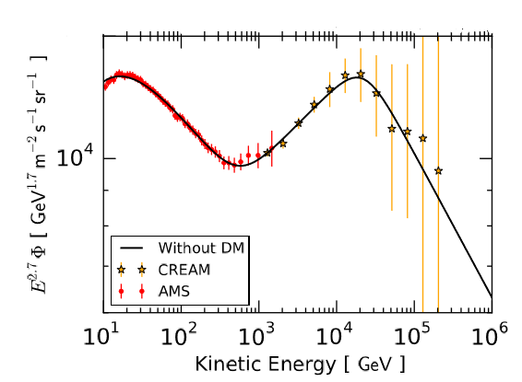
Leaky Box Model: Protons
Acceleration: Q(ε)
  2-Break Power Law
Diffusion -> T_{esc}
  Energy Power Law
Energy Loss: negligible

Slide 12
Leaky Box Model: Protons
Acceleration: Q(ε)
  2-Break Power Law
Diffusion -> T_{esc}
  Energy Power Law
Energy Loss: negligible
  BUT: Dark Matter?

Slide 13
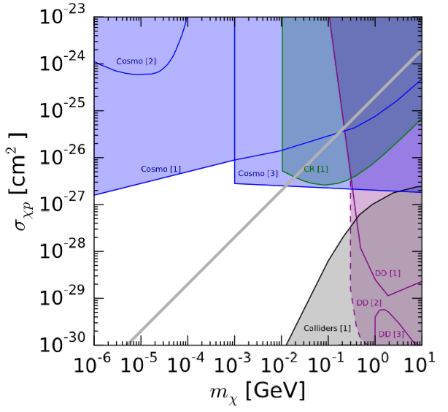
DM-Cosmic Ray Scattering
Grammage ~10 g/cm²
Gray: 1 scattering/particle
  “Best possible” sensitivity
Energy loss per collision
  Assume elastic scattering
CR
COSMOLOGY
DD
Colliders

Slide 14
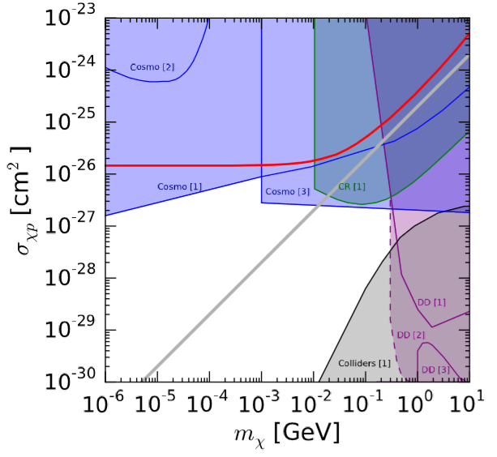

DM-Induced Energy Loss
Simplified Energy Loss Model:
  S-wave Elastic Scattering
  Energy-Independent Cross Section
Colored Curves: $\frac{dε}{dt}Tesc=ε$
CR
COSMOLOGY
10GeV
100GeV
DD
1000GeV
Colliders

Slide 15
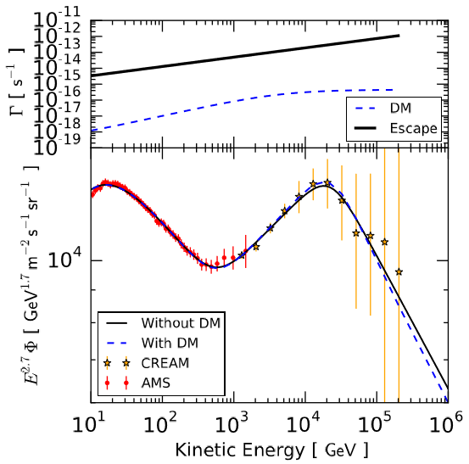
DM-Induced Energy Loss
Mx = 1e-4 GeV
σ = 1e-29 cm²
Vary:
  Break Energies
  Injection Indices
  Injection Normalization
  Escape Time Index
10GeV
100GeV
1000GeV
PDG 2015

Slide 16
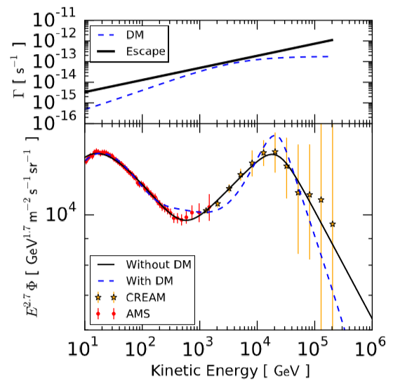

DM-Induced Energy Loss
Mx = 1e-4 GeV
σ = 1e-26.4 cm²
Vary:
  Break Energies
  Injection Indices
  Injection Normalization
  Escape Time Index
10GeV
100GeV
1000GeV
PDG 2015

Slide 17
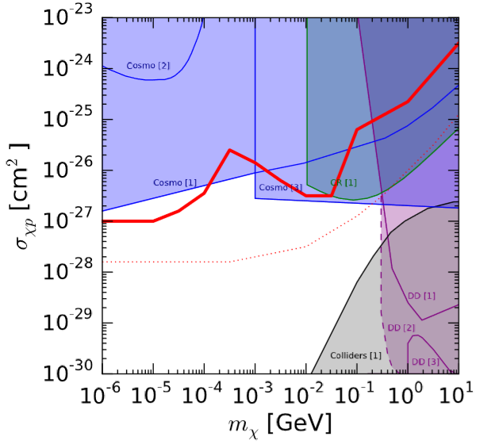

Proton Constraint
Δ$X^{2}$ = 25
Vary:
  Break Energies
  Injection Indices
  Injection Normalization
  Escape Time Index
COSMOLOGY
CR
DD
Colliders

Slide 18
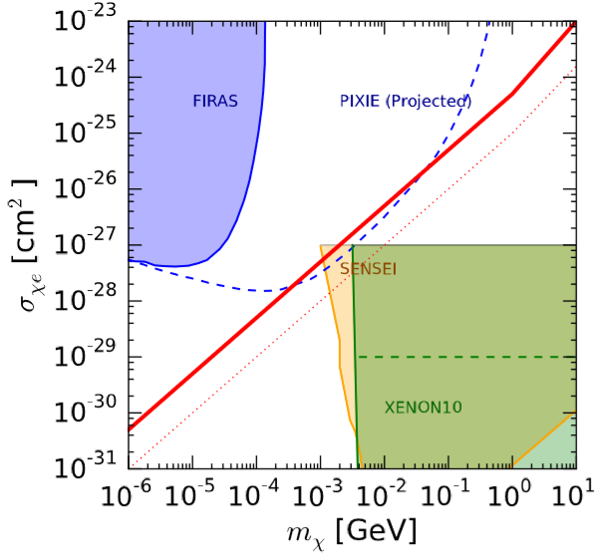
Electron Constraint
Model:
  Single Power Law
  Synchrotron + IC Losses
Vary:
  Injection Index
  Injection Normalization
  Escape Time Index
10GeV
100GeV
1000GeV
PDG 2015

Slide 19
Summary
CR-DM scattering -> Spectral Distortion
New Probe of Dark Matter
  Most sensitive to sub-GeV Dark Matter
  Uses available CR data
More to come!

Slide 20
Thank You!
PDG 2015
Astronomy.swin.edu.au

