Slide 1


Searches for new heavy resonances in final states with leptons, photons, and jets at CMS
Tyler Wang
Texas Tech University
On behalf of the CMS Collaboration
Tyler Wang
Texas Tech University
On behalf of the CMS Collaboration
Pheno – Pittsburgh
May 7 – 9, 2018
Pheno 2018
Pittsburgh, May 7 – 9

Slide 2


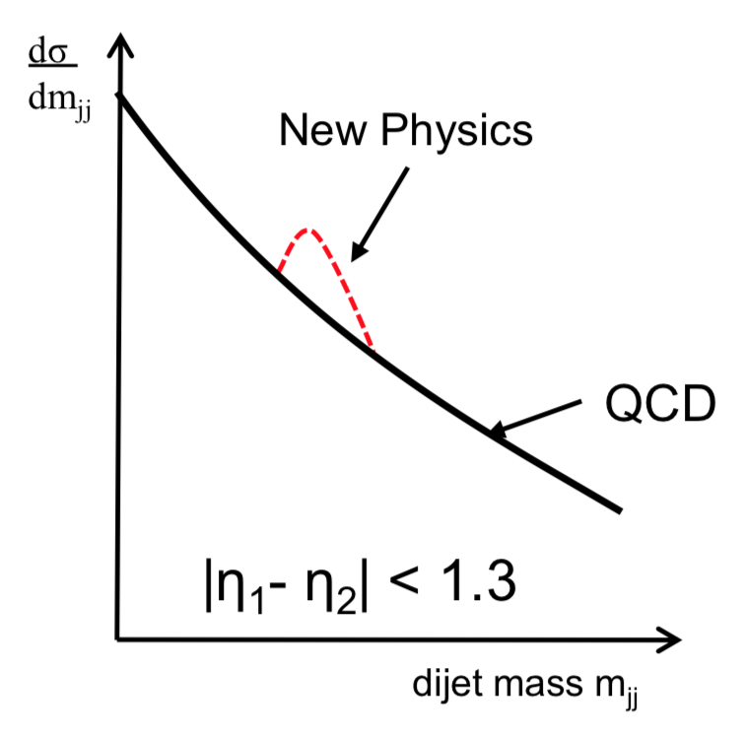
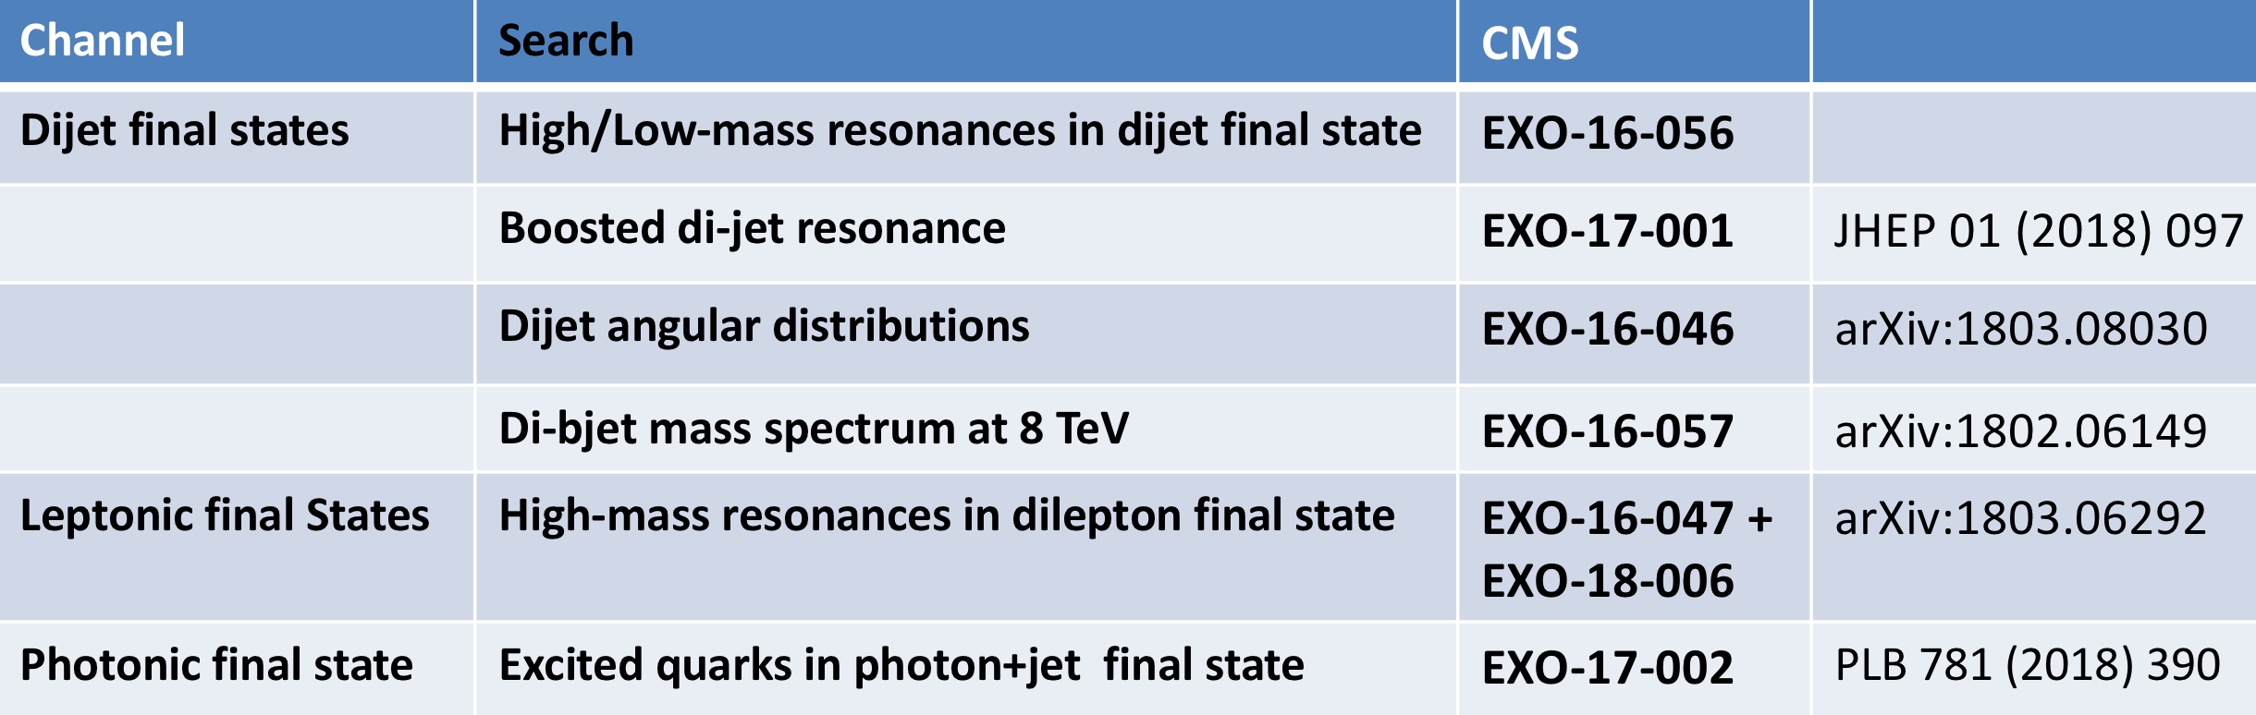
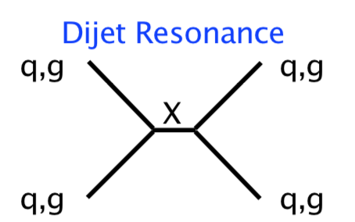
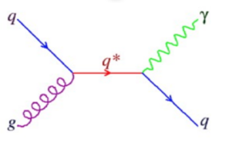
Introduction
Many models of beyond the standard model require new particles that couple to quarks and/or gluons and decay to photons, leptons and jets
  Such as leptophobic Z’, Extra dimensions, Compositeness and Quantum Black Hole (QBH).
Photons, leptons and jets in the final states are “classic signatures” to search for New physics
# of Event
R
Resonance mass
2
Notes:
Put more plots displace, model instru

Slide 3
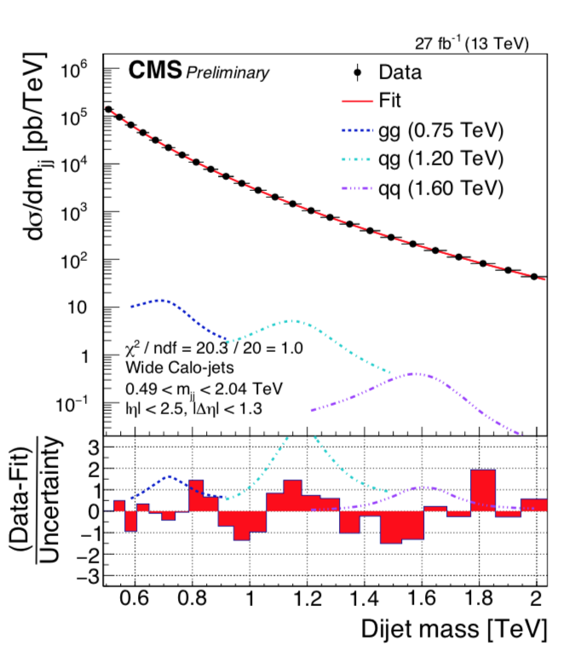
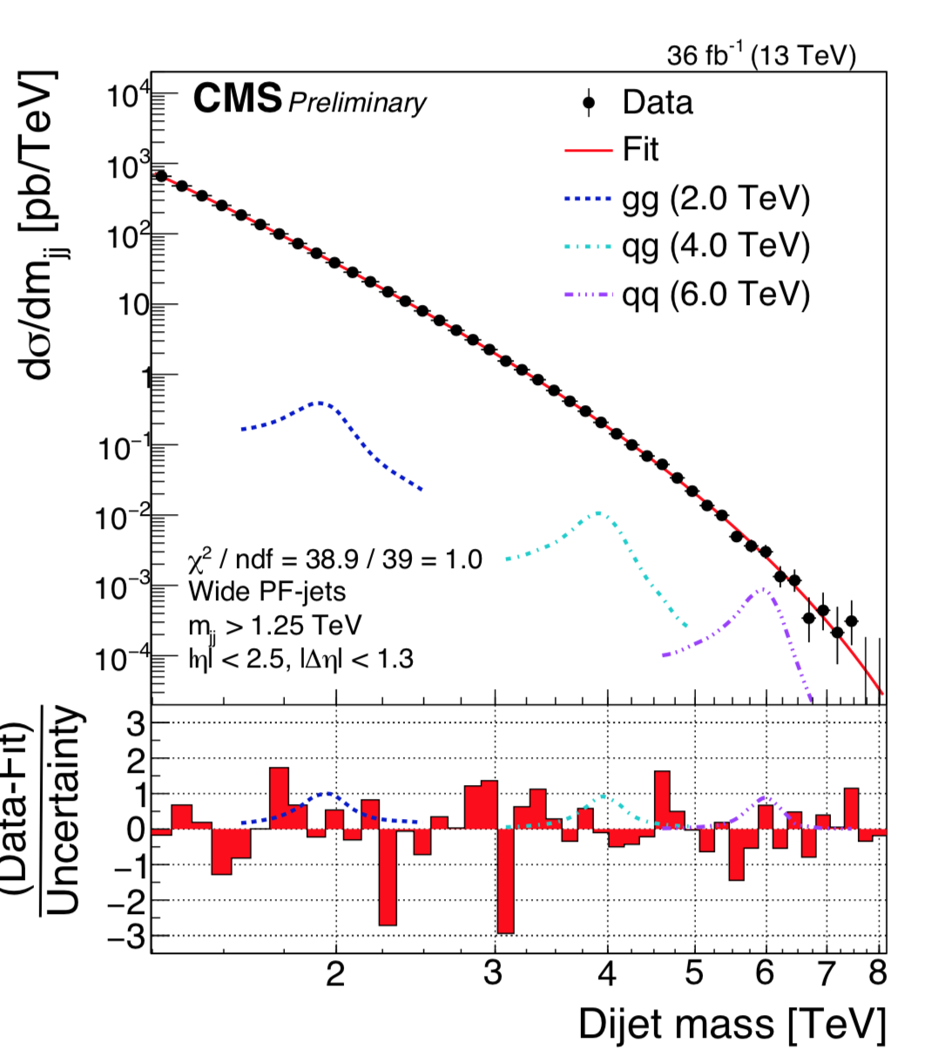

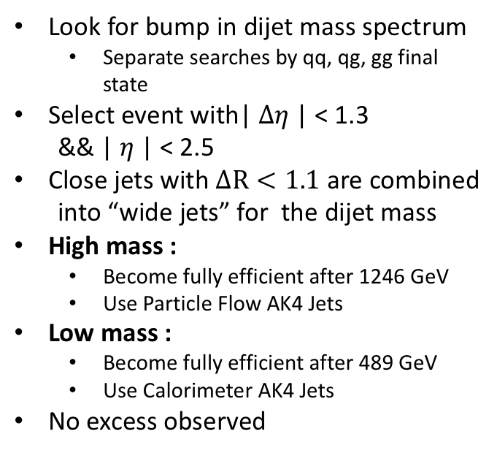
Search for high/low mass dijet resonances
CMS-EXO-16-056
2016 data (36 fb⁻¹)
Look for bump in dijet mass spectrum
  Separate searches by qq, qg, gg final state
Select event with| $∆η$| < 1.3
&& | $η$| < 2.5
Close jets with $∆R<1.1$ are combined
into “wide jets” for the dijet mass
High mass :
  Become fully efficient after 1246 GeV
  Use Particle Flow AK4 Jets
Low mass :
  Become fully efficient after 489 GeV
  Use Calorimeter AK4 Jets
No excess observed
Low mass
High mass
3
Notes:
Why doing dijet
1.3 (corresponds to cos$θ$ < 0.57)
To suppress QCD and enhance signal
→ Jets inside the tracker coverage region
QCD background smoothly falling
Enlarge the plot, remove the high and low mass text where is excluded

Slide 4
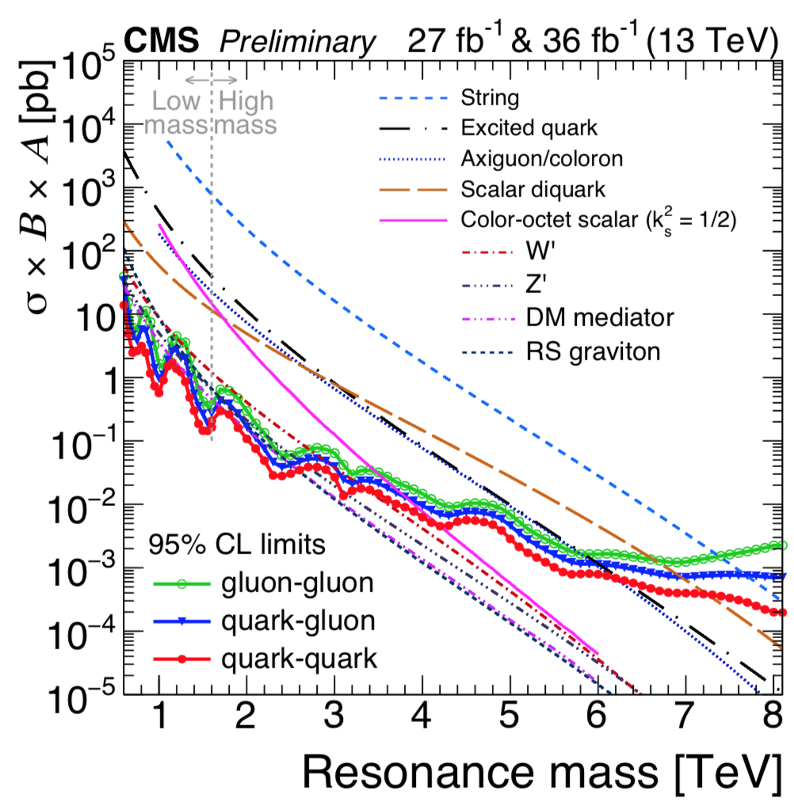
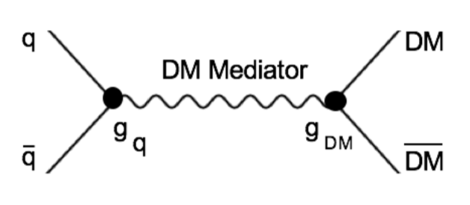
Search for high/low mass dijet resonances
We chose the simplified model recommended by the LHC DM working group to search for a DM mediator
7.7 TeV
7.2 TeV
6.1 TeV
(arXiv:1603.04156)
6.0 TeV
3.3 TeV
2.7 TeV
1.7 TeV
2.6 TeV
4
Notes:
Remove right hand space, put Page 6 to here.
Put the limit after the models

Slide 5
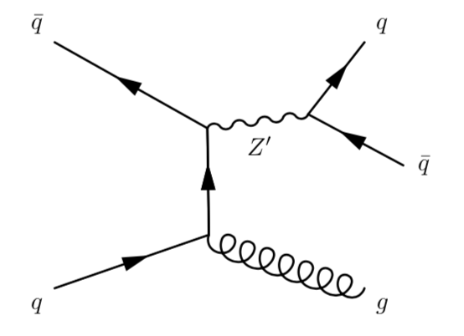
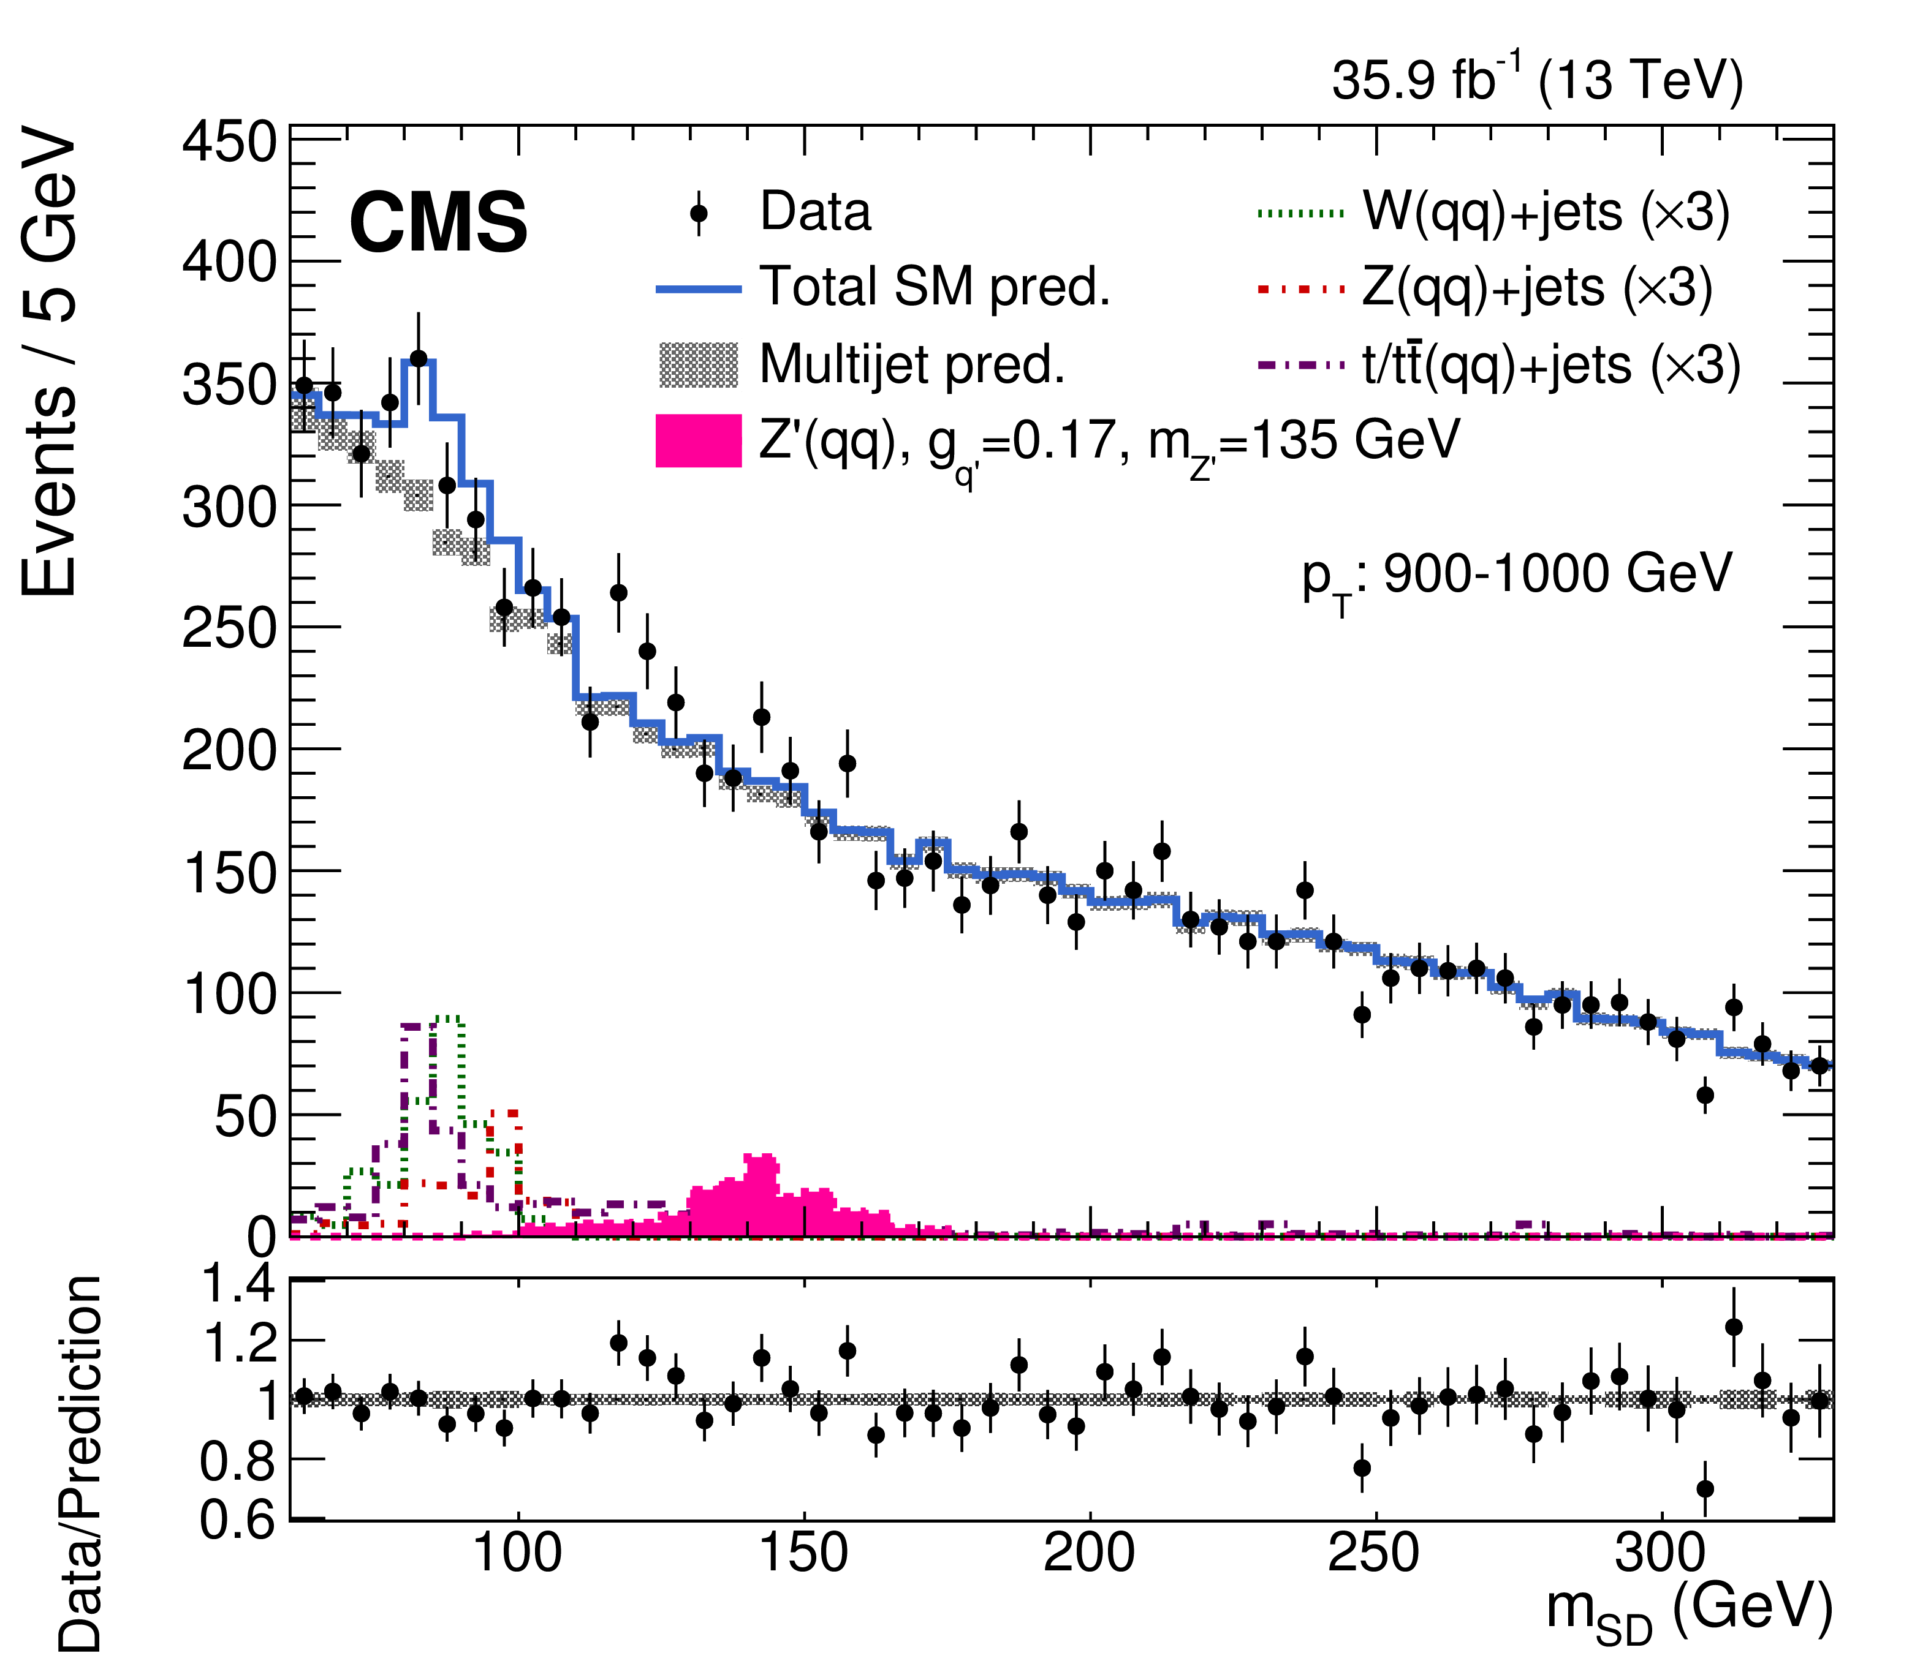
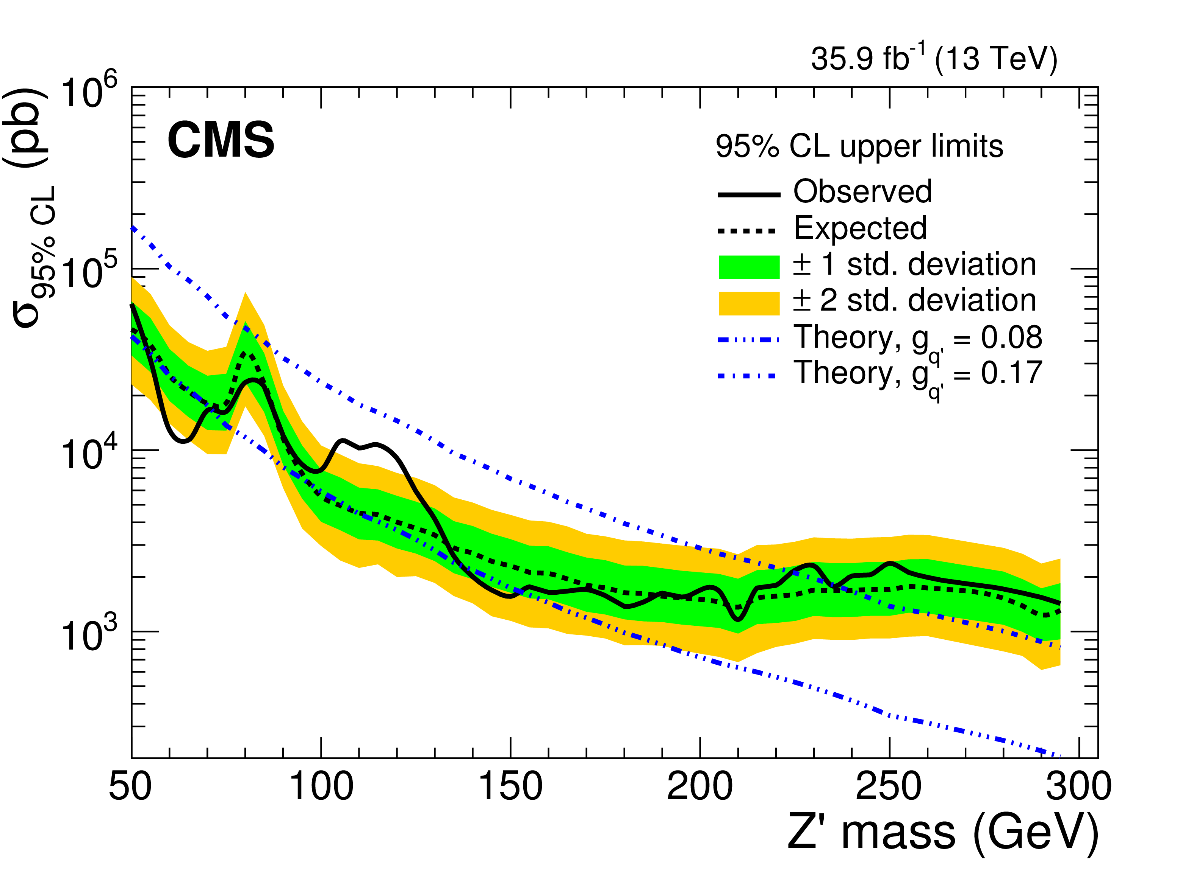
Boosted dijet resonances
CMS-EXO-17-001 (JHEP 01 (2018) 097)
2016 data (35.9 fb⁻¹)
Boosted dijet + associated ISR jet/photon
Soft Drop (SD) is a technique to remove soft and wide angle radiation
from parton shower etc.
No excess observed
Limits are set on the parameter space of a leptophobic axial-vector Z′ benchmark model
arXiv,1503.01088
Set limits on the Z boson production cross section, compare to Z’ with coupling either 0.08 and 0.17.
We extend the previous limits below 100 GeV.
5
Notes:
at least one high transverse momentum (pT) jet from initial-state radiation (ISR) is produced in association with a light resonance decaying into a qq pair.
its decay products are merged into a single jet with two-prong substructure
The search is performed using the distribution of the jet mass groomed with the soft-drop algorithm
to remove soft and wide-angle radiation inside the jet, produced by the parton shower, pileup interactions or underlying event. This technique improves the resolution of the jet mass after grooming (mSD). Jets are groomedusing the parameters z cut=0.1 and β=0. Here,z cuti s a threshold to remove soft jet con-stituents of all constituents considered at each step of the declustering. The parameterβis anangular exponent, so whenβ=0 soft drop ignores angular information
which close the sensitivity
Results are presented in a mass-coupling phase space and are the most sensitive to date, extending previous limits below 100 GeV.

Slide 6
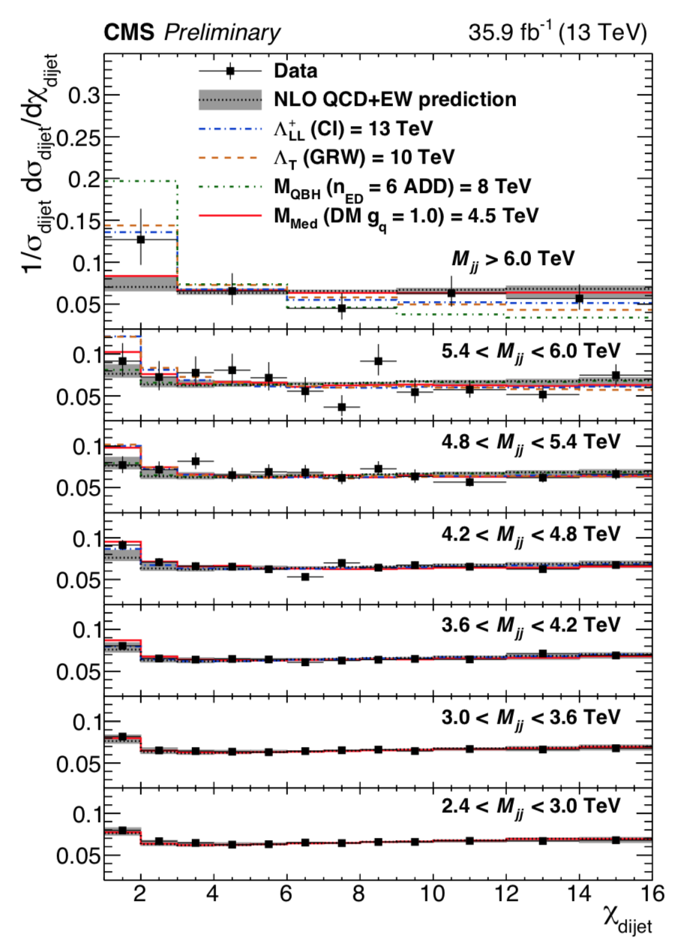
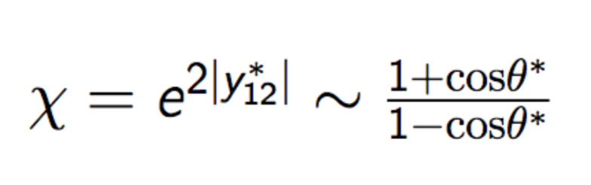
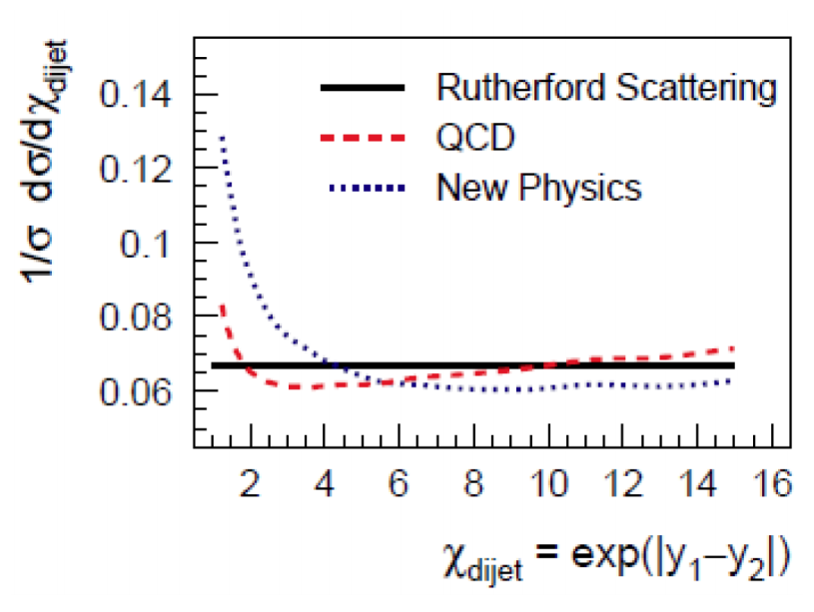
Dijet angular distributions
CMS-EXO-16-046 (arXiv:1803.08030)
2016 data (35.9 fb⁻¹)
Looking for rise at low χ, high m_{jj}
New Physics will change the χ_{dijet} distribution at low χ_{dijet} at high m_{jj}
χ_{dijet} is relatively flat for Leading QCD process
DM mediator QBH Extra Dimension Contact Interaction | 2 - 4.6 TeV 5.9 - 8.2 TeV 8.9 - 10.6 TeV 12.8 - 17.5 TeV
6
Notes:
Onlly this dijet analysis using NLO and EW correction
The observed distributions are found to be in agreement with predictions from perturbative quantum chromodynamics that include electroweak corrections, and constraints are placed on models containing quark contact interactions, extra spatial dimensions, quantum black holes, or dark matter.
Other dijet search are not very sensitive to wide resonances or non-resonant signatures; a more effective strategy to constrain such signatures is the study of dijet angular distributions
The dijet angular distribution is typically expressed in terms of χdijet
For collinear massless parton scattering,χdijettakes the formχdijet= (1+|cosθ∗|)/(1− |cosθ∗|), whereθ∗is the polarscattering angle in the parton-parton center-of-mass (CM) frame.
whereθ∗is the polar scattering angle in the parton-parton center-of-mass (CM) frame
For collinear massless parton scattering,χdijet
θ∗is the polar scattering angle
t-channel scattering contributes to the partonic cross section, theχ dijet distribution is independent of|y1−y2|
Data are unfolded to particle level using a D’Agostini iteration method implementedin RooUnfold
– Correct the effect of event migrating between Mjj and χdijet bins due to finite jetpT resolution
– Correction determined from a 2D response matrix that maps particle level Mjjand χdijet to detector level ones
– Use default regularization parameter (Niter=4)

Slide 7
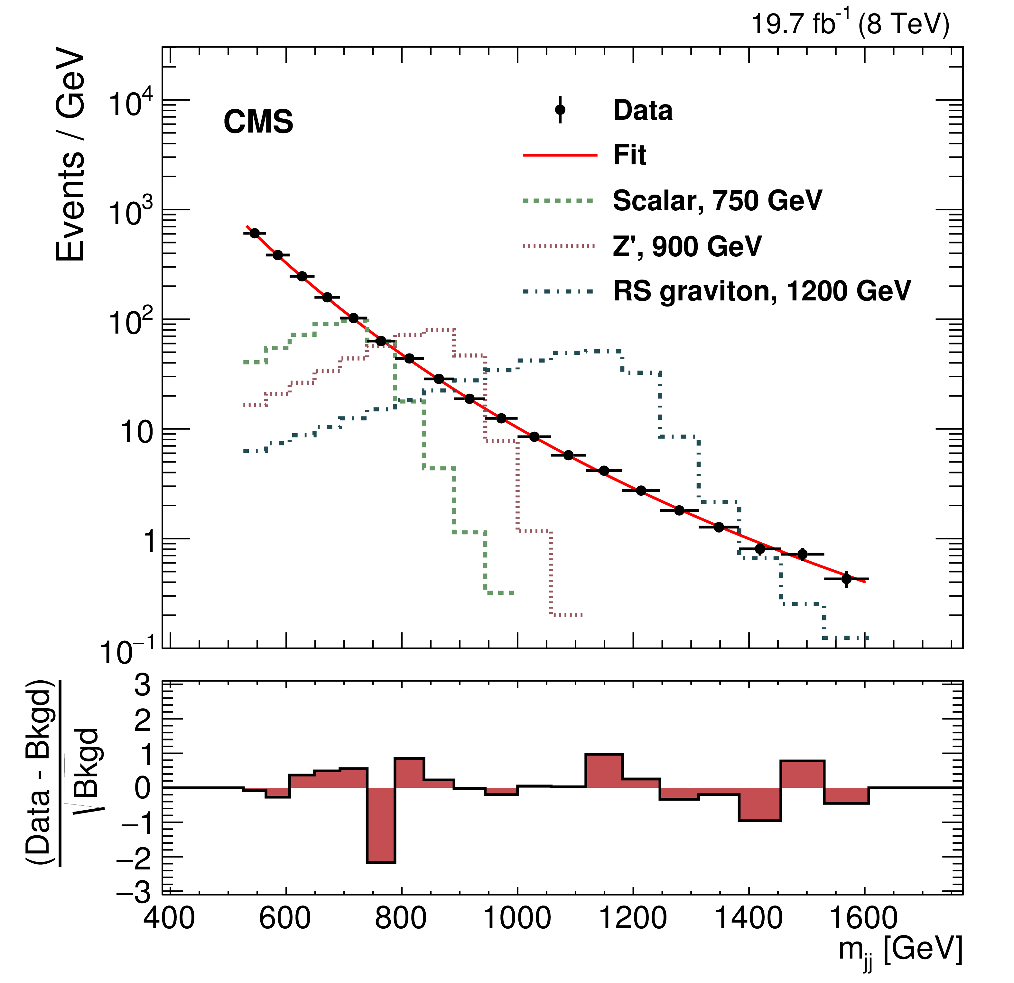
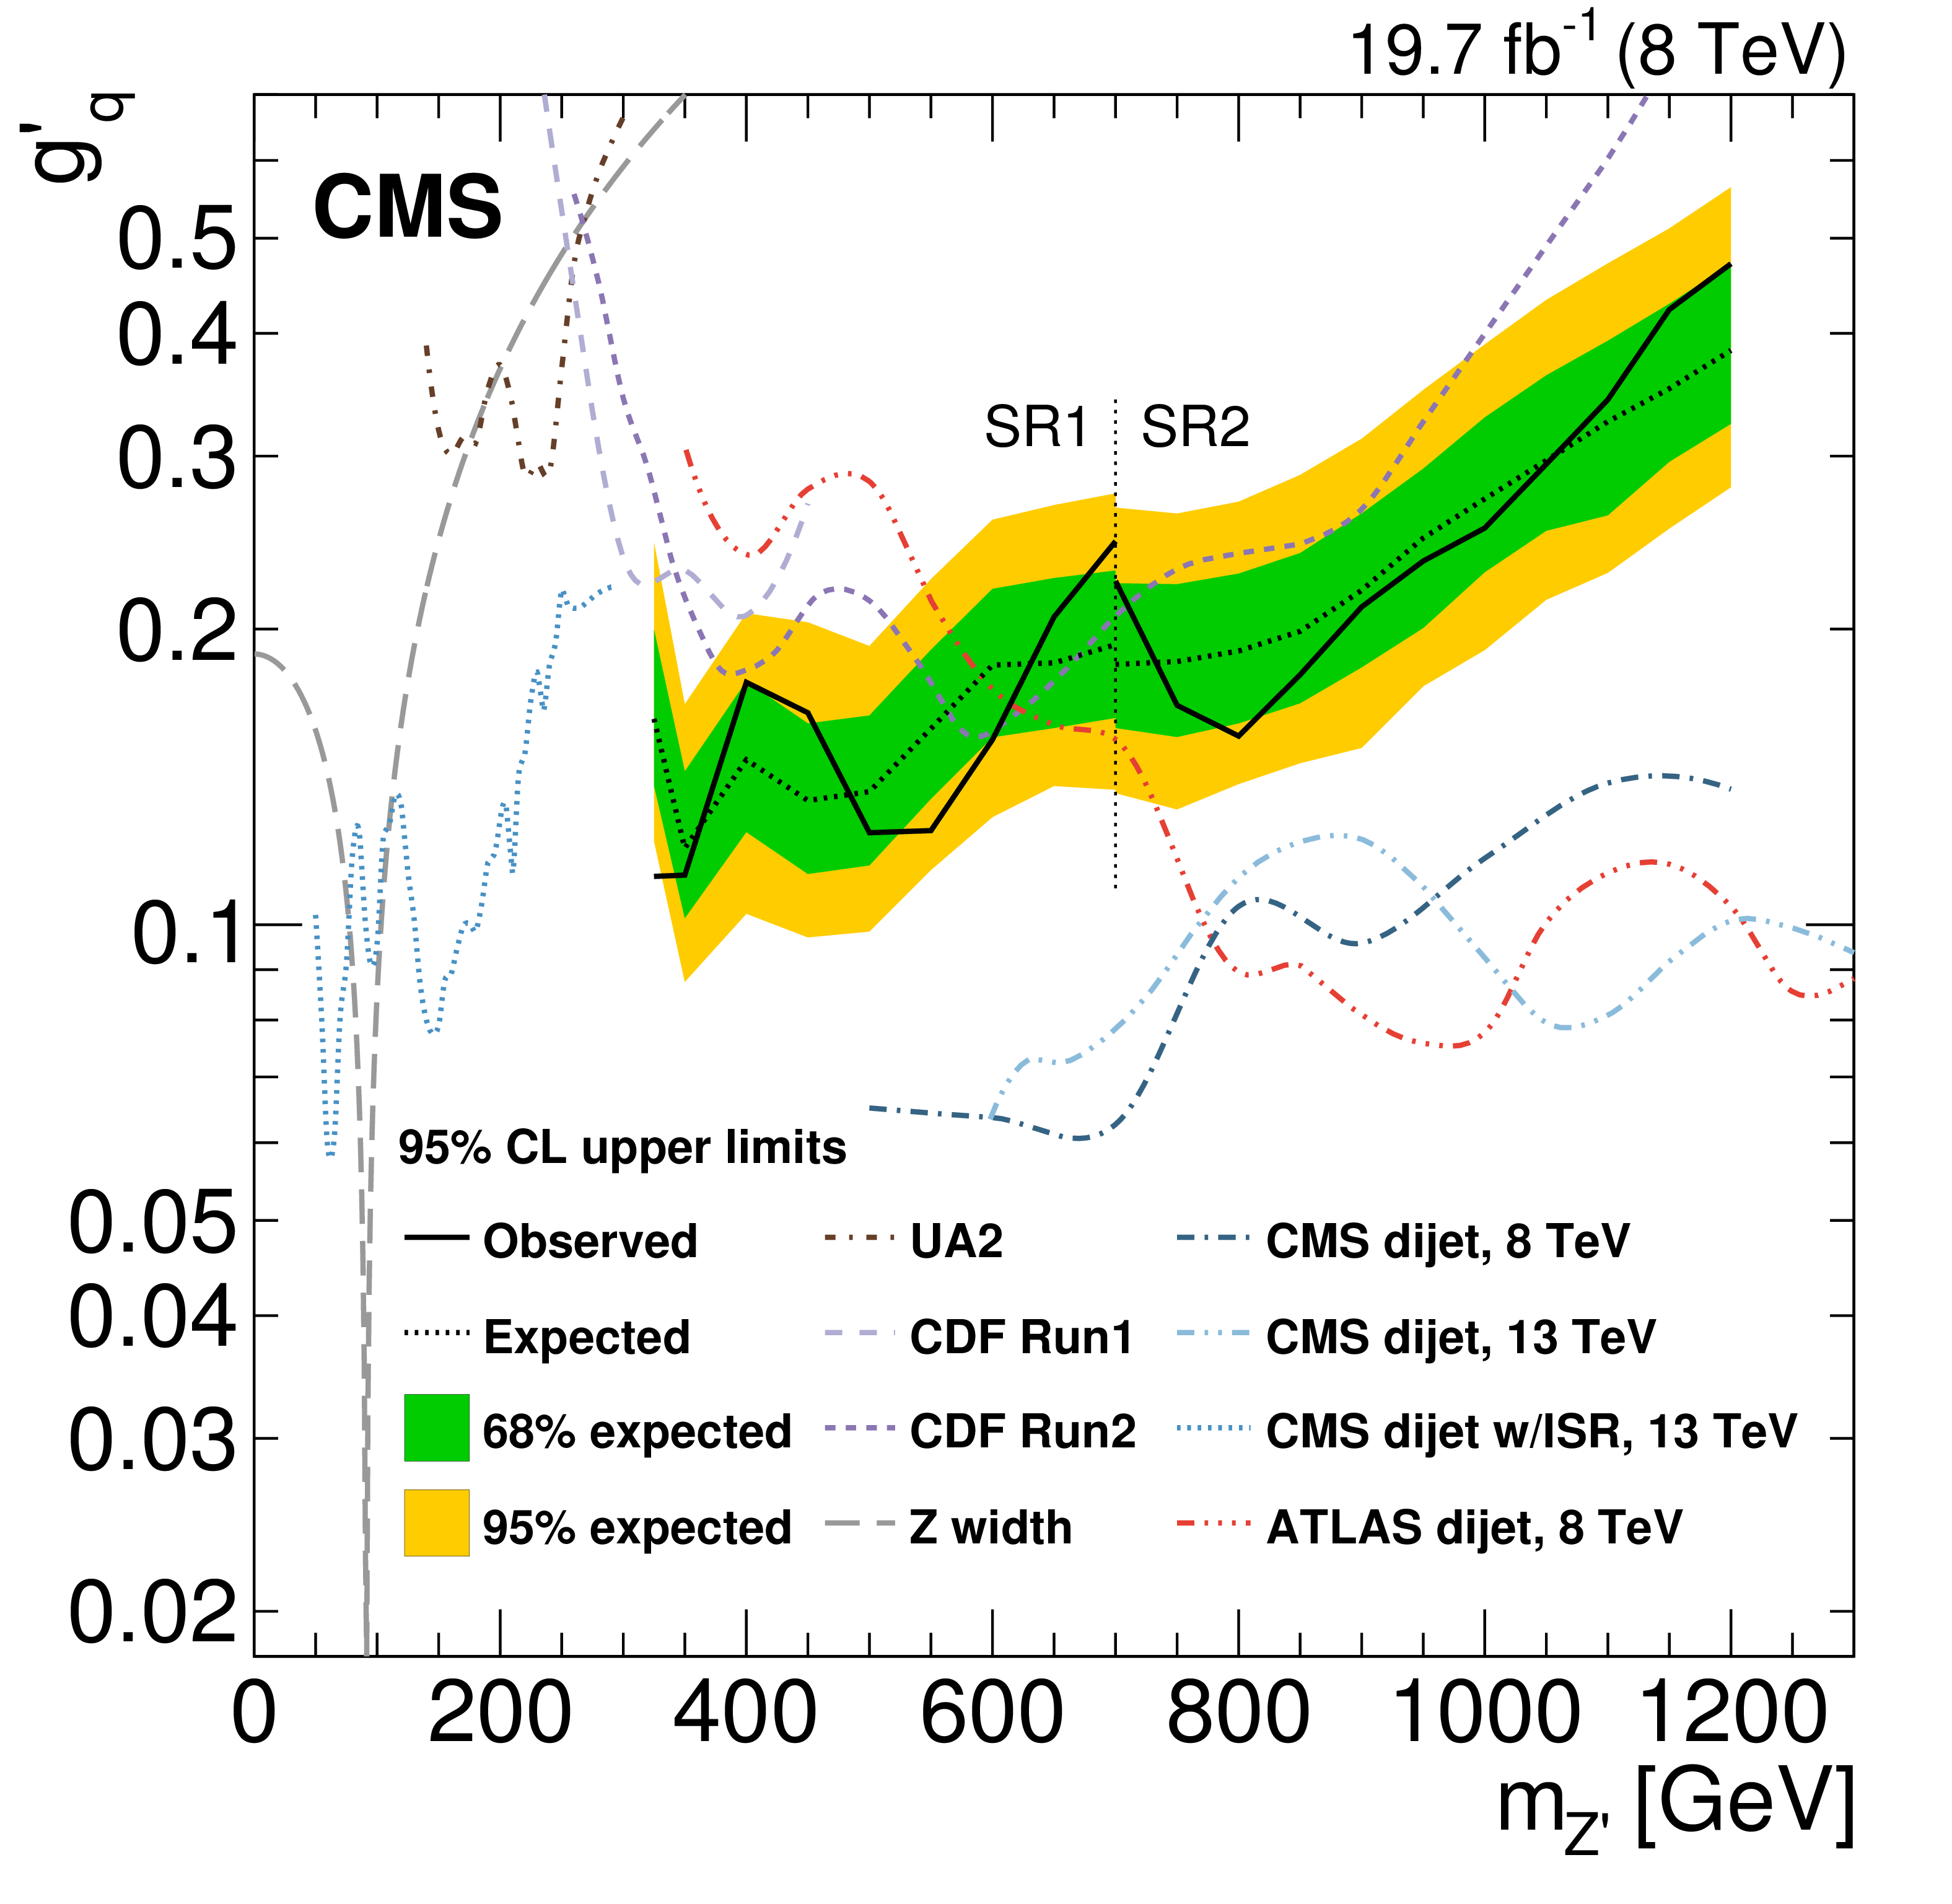
Di-bjet resonances search at 8 TeV
CMS-EXO-16-057 (arXiv: 1802.06149)
2012 data (8 TeV, 19.7 fb⁻¹)
Following the usual dijet searches, high mass resonance search with two
b-tagged jets.
Two signal regions due to the trigger requirement:
Signal Reign 1: m_{jj} = [296 - 1058 GeV]
Signal Reign 2: m_{jj} = [526 - 1607 GeV]
No excess observed
Limits are set on bottom quarks for spin 0, 1, and 2 resonances in the mass range of 325–1200 GeV.
The 95% CL upper limits on the universal coupling g’_{q} between the leptophobic Z′ and quarks.
Limits from other experiments and earlier CMS analyses are also shown.
b-tagged dijet mass spectrum in SR1
7
Notes:
. Limits areset on the product of cross section and branching fraction to bottom quarks for spin0, 1, and 2 resonances in the mass range of 325–1200 GeV. These results significantlyimprove on the limits
Don’t read number
for resonances decaying into jet pairs in the 325–500 GeV mass range.
Investigate the systematic

Slide 8
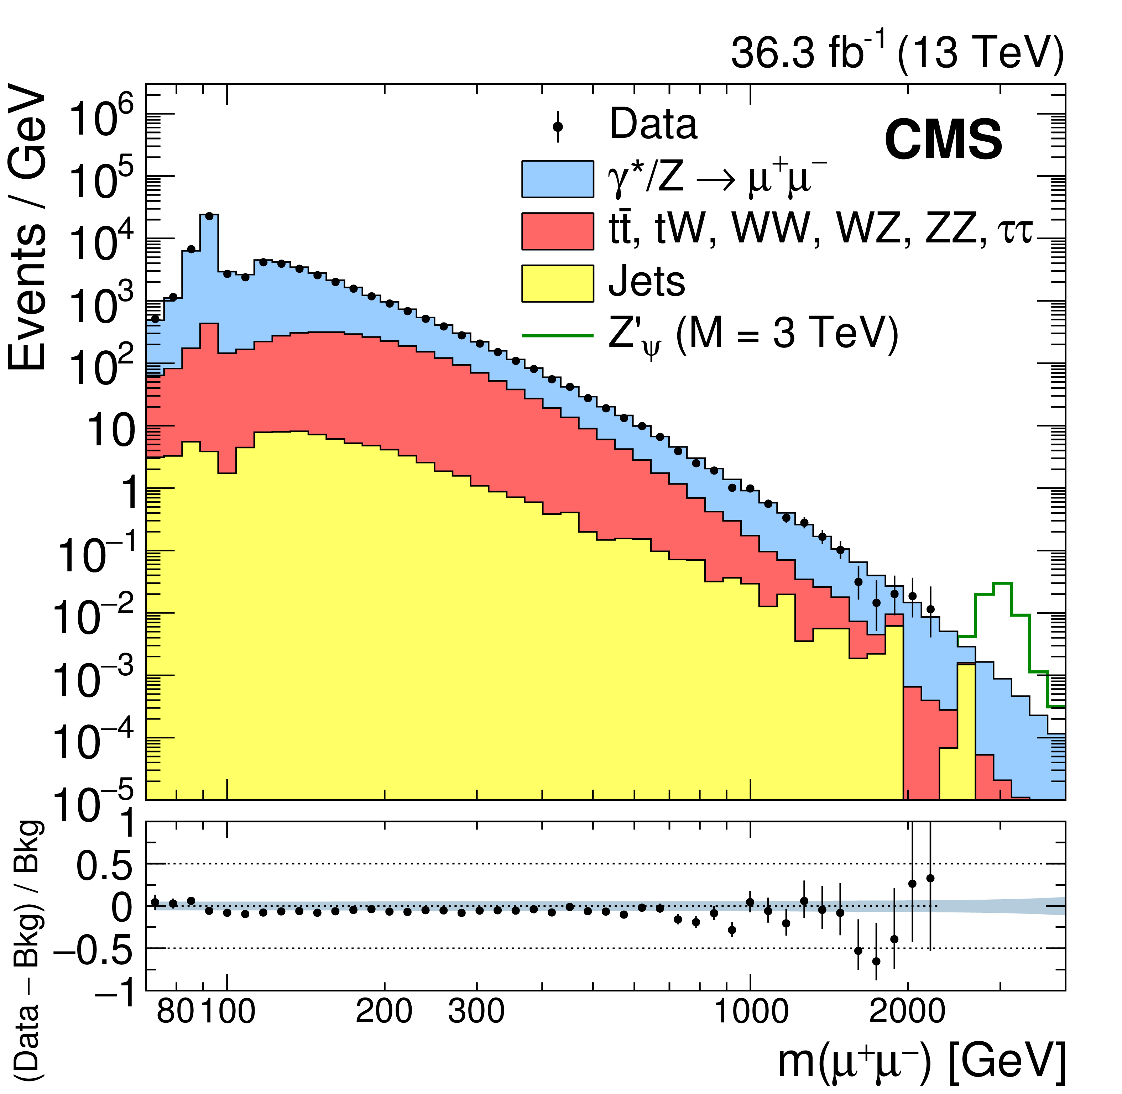
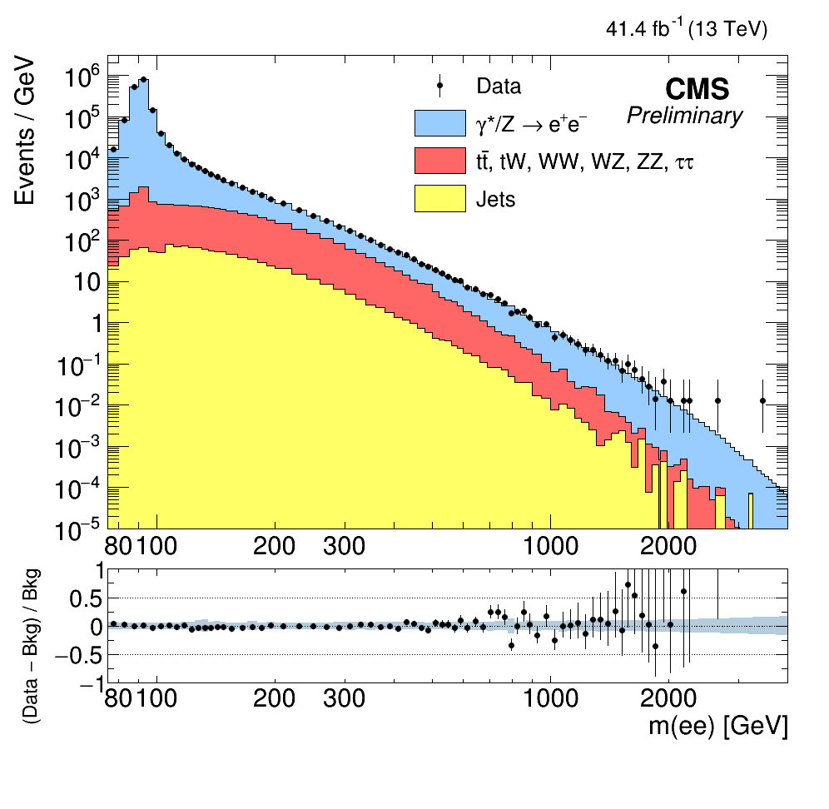


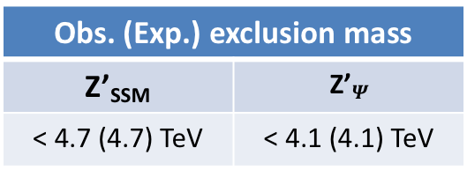
Search for high-mass resonance in dilepton final state
CMS-EXO-16-047 (arXiv: 1803.06292) & CMS-EXO-18-006
2016 data (36.3 fb⁻¹) + 2017 data (41.4 fb⁻¹)
Look for bump in dilepton mass spectrum
One of the most clean signatures
Events with two same-flavor leptons (e/μ) are selected
No significant excess observed
Obs. (Exp.) exclusion mass
Z’_{SSM} | Z’$Ψ$
< 4.7 (4.7) TeV | < 4.1 (4.1) TeV
$Mμμ$ (2016 data)
$Mee$ (2017 data)
8
Notes:
The transitionregion 1.44<|ηC|<1.57 is excluded as it leads to lower-quality reconstructed clusters, owing mainly to services and cables exiting between the barrel and endcap calorimeters
2016 Zssm 4.15(4.1) Zphi 3.55(3.35)
Study the model
The models

Slide 9
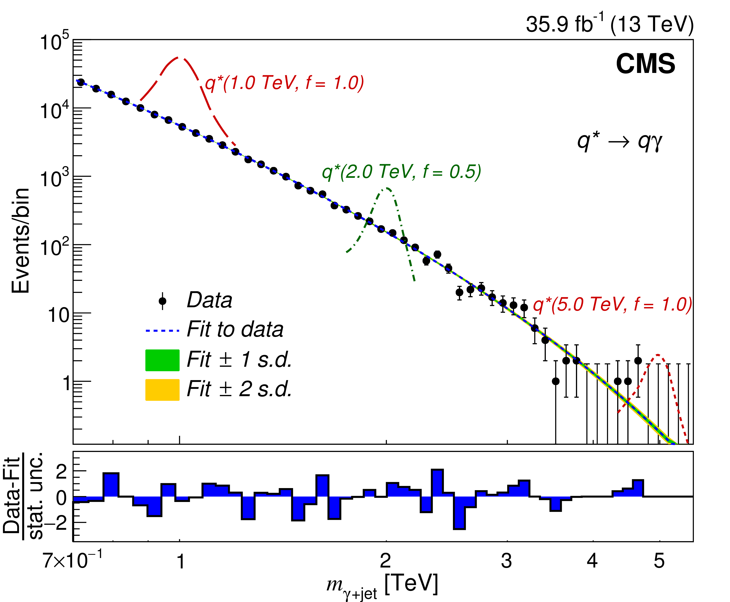
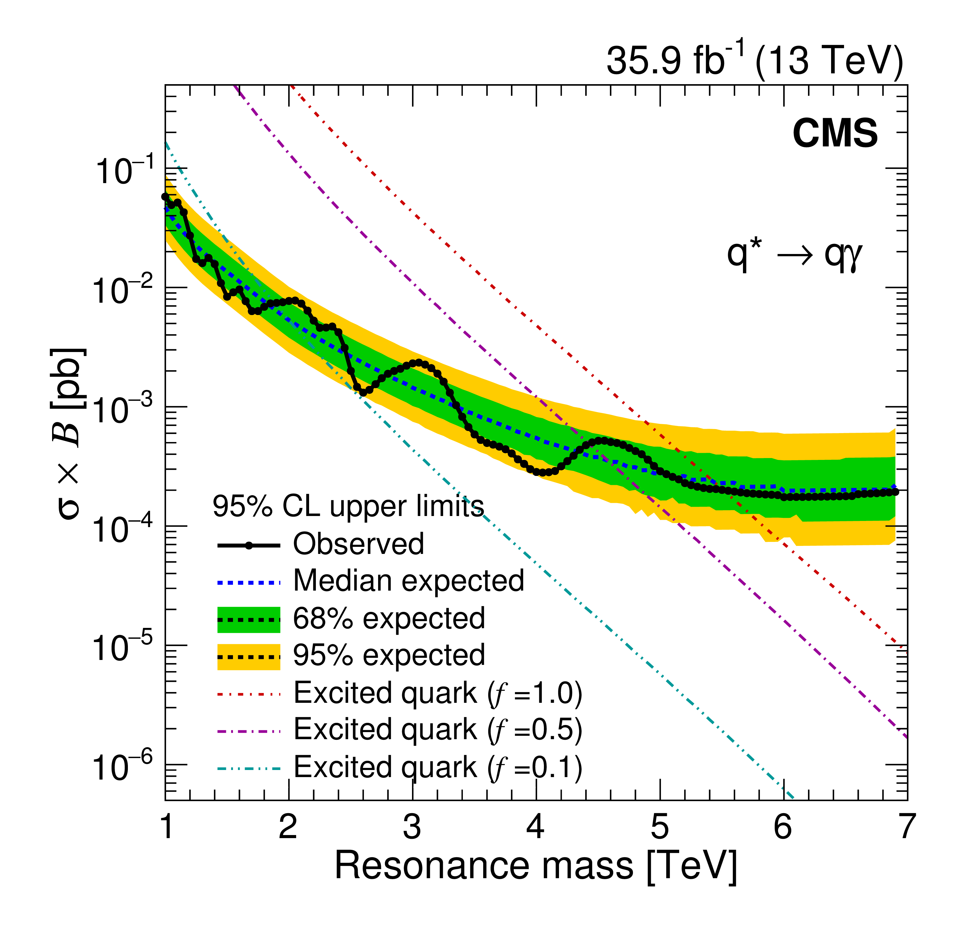
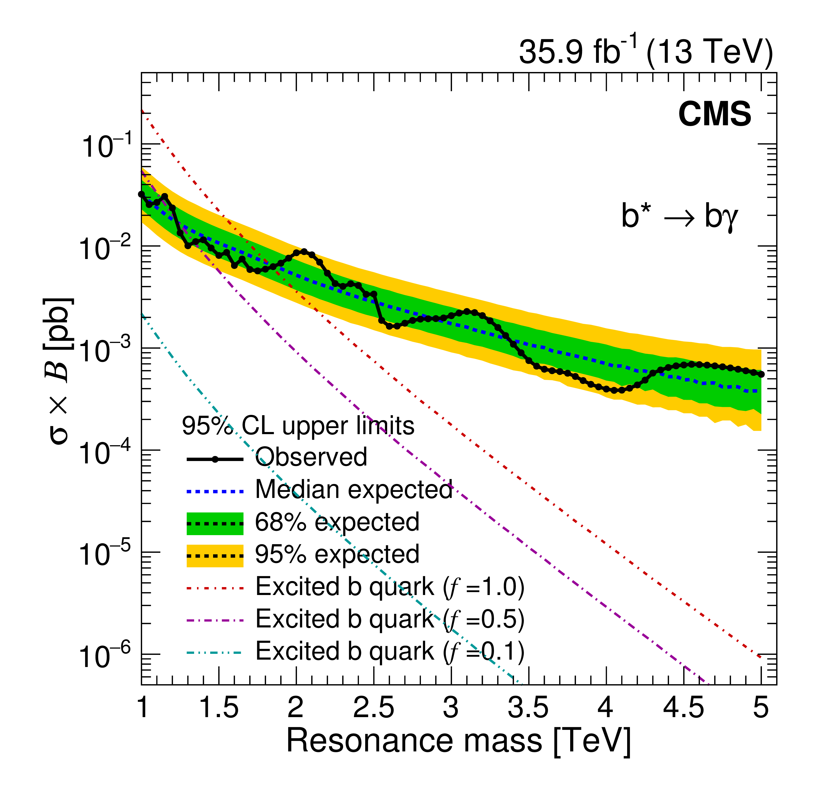


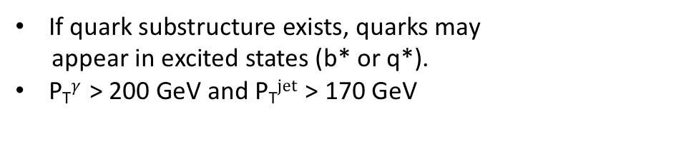
Search for the resonances in $γ$ + jet final state
EXO-17-002 (PLB 781 (2018) 390)
2016 data (35.9 fb⁻¹)
If quark substructure exists, quarks may
appear in excited states (b* or q*).
P_{T}$γ$ > 200 GeV and P_{T}$jet$ > 170 GeV
f: coupling to quark
m$γ$_{+jet}[TeV]
b* (f = 1.0) | q* (f = 1.0)
1.0 ~ 1.8 TeV | 1.0 ~ 5.5 TeV
9
Notes:
F = excited quark couplings to the standard model (SM) partners.
Study why they use f =1
In pp collisions, excited quarks are expected to be produced predominantly through quark-gluon fusion (qg), and then decay into a quark and a gauge boson (g, W, Z,γ).
Block the nubmers don’t use etc. Diphoton
gauge-invariant magnetic-moment operator, described by the effective Lagrangian
The quantities fs, f, and f′ are unknown dimensionless constants that represent the strengths of the excited quark couplings to the standard model (SM) partners. Their values aredetermined by the compositeness dynamics, and are usually assumed to be of order unity.

Slide 10
Conclusions
Searching for heavy resonances is one of the most direct ways to find new physics at TeV scale.
Many high mass di-jet, di-lepton and photonic resonance searches are performed.
Limits are interpreted to constrain parameters of models predicting a narrow di-jet,
di-lepton and photonic resonance.
No signals of the new physics BSM has been found in data.
CMS has begun exploring the full 13 TeV dataset. New exciting results are in the pipeline.
10

