Slide 1
An introduction to POWHEG
27.03.2017
Important references:
hep-ph/0409146, arXiv:0709.2092, arXiv:1002.2581
CREDITS: Thanks to E.Re and C.Oleari for a lot of the material appearing in the slides

Slide 2
Outline
Brief motivation: the quest of precision
Monte Carlo (MC) event generators
Parton shower vs fixed order calculations
How to merge NLO+PS: the POWHEG master formula
Phenomenological impact
Conclusions and outlook

Slide 3
Motivation: the quest for precision

Slide 4
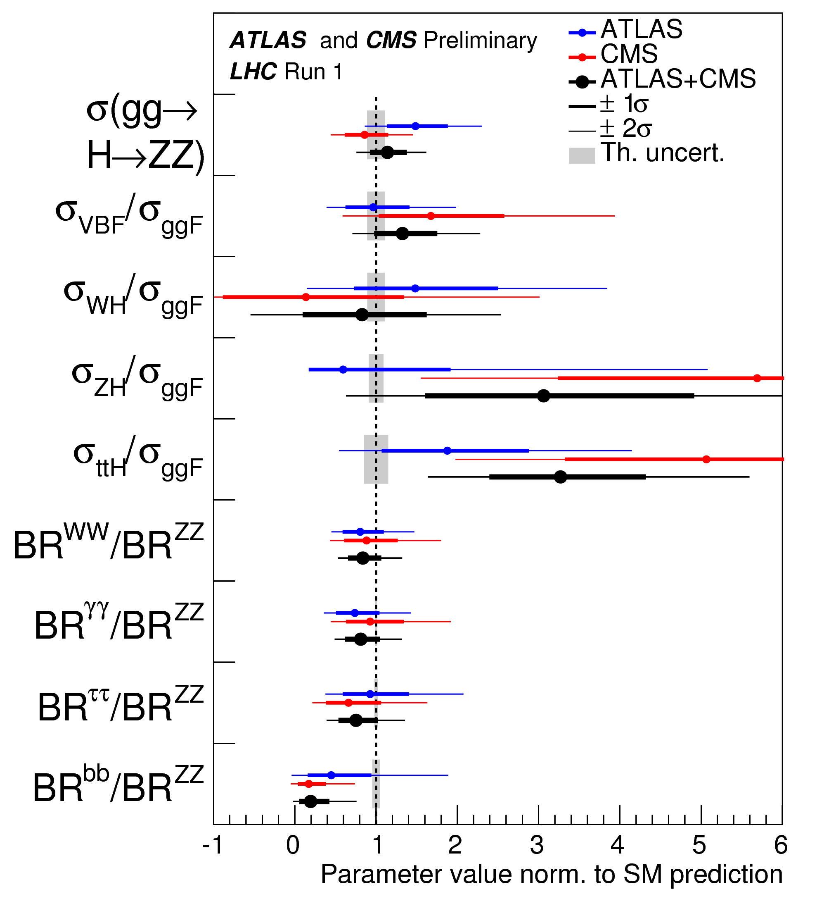
New Physics at the LHC?
After Higgs boson discovery focus on its properties and on hints for BSM physics
  So far no sign of new physics at the TeV scale from direct searches
Possible hits for new physics could come from very precise measurements e.g. in the Higgs sector
  Very accurate predictions are needed, both
  in shape
  in normalization
Precise description of scattering process at all stages!

Slide 5
Monte Carlo Event Generators
What they are and what they do

Slide 6
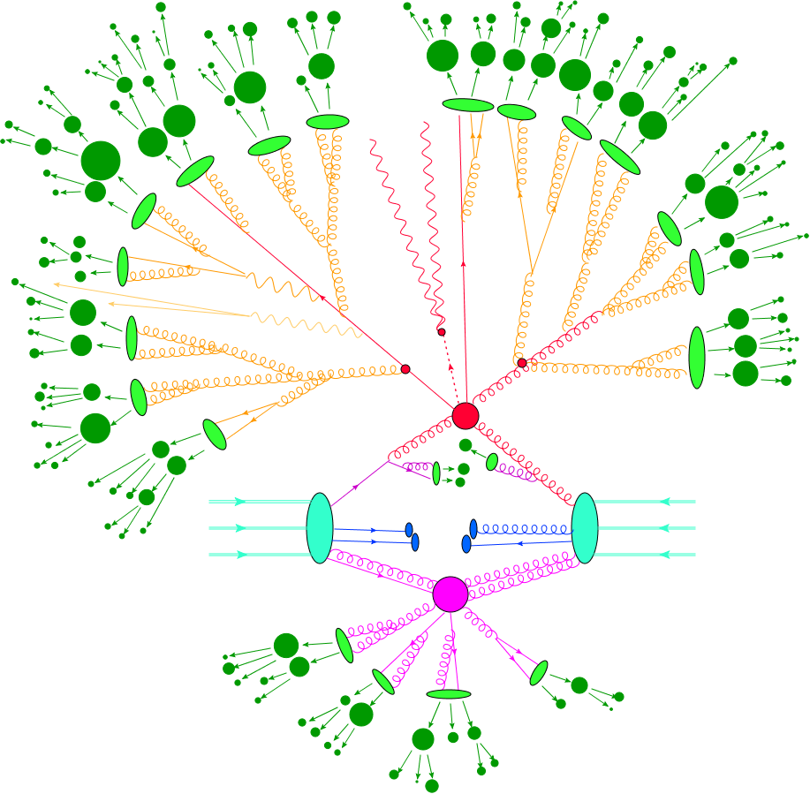
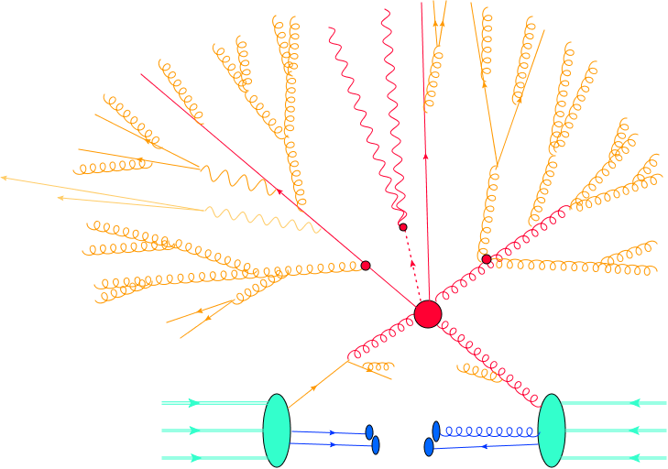
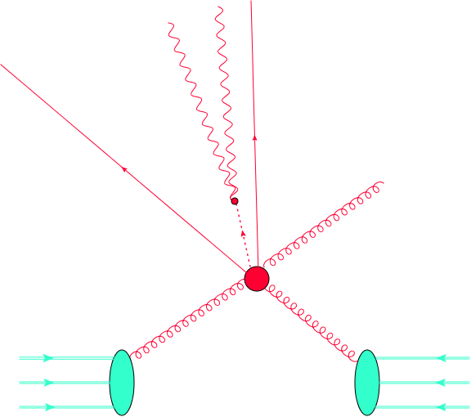
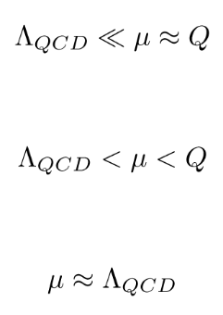

PDF‘s
Hard scattering
Parton shower
Beam remnants
Hadronization and
Hadron decay
Multiple interactions

Slide 7
PDF‘s
Determined from data
Hard scattering
Hard process computed using fixed order (FO) perturbation theory at LO, NLO, NNLO, N³LO,…
Hierarchy of scales appearing as large logarithms in the calculation.
Computed using resummation or MC parton showers (PS)
Parton shower
Beam remnants
Hadronization and
Hadron decay
Cannot be computed directly: non-perturbative models tuned to e⁺e⁻ data
Multiple interactions
PDFs
partonic cross section
np corrections

Slide 8
PDF‘s
Determined from data
PDF set
Hard scattering
Hard process computed using fixed order (FO) perturbation theory at LO, NLO, NNLO, N³LO,…
Theorists’ calculation
FO + PS matching: different orders different schemes
Hierarchy of scales appearing as large logarithms in the calculation.
Computed using resummation or MC parton showers (PS)
Theorists’ calculation, Pythia,
Herwig,
…
Parton shower
Beam remnants
Hadronization and
Hadron decay
Pythia, …
Cannot be computed directly: non-perturbative models tuned to e⁺e⁻ data
Multiple interactions
PDFs
partonic cross section
np corrections

Slide 9
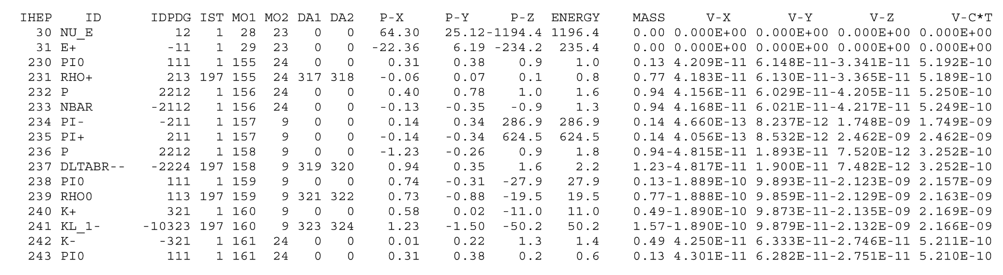
Monte Carlo Event Generators try to give the best full description of a collision combining theoretical predictions for the different stages of an event and providing a fully exclusive final state in terms of hadrons and leptons which is as close as possible to what is measured in a real experiment
Can be fed to a detector-simulation software to determine efficiencies

Slide 10
Parton showers and fixed order
Two complementary approach for parton level computations

Slide 11
Basics on parton showers
Describe evolution from hard process at scale to low energy (long distance) non-perturbative physics at scale
Proceeds via successive quark & gluon production
Start from a low multiplicity process at high
Color-charged partons like to radiate

Slide 12
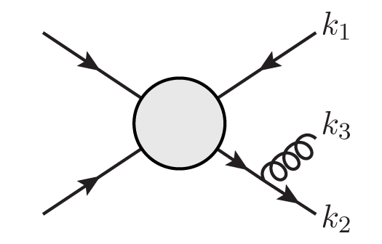
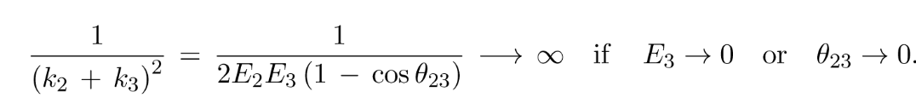
Basics on parton showers
Describe evolution from hard process at scale to low energy (long distance) non-perturbative physics at scale
Proceeds via successive quark & gluon production
Start from a low multiplicity process at high
Color-charged partons like to radiate
Leading contribution from soft/collinear emissions (propagators become small)

Slide 13
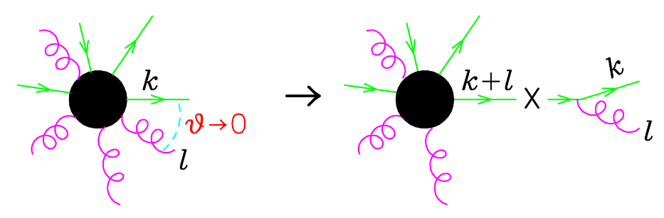
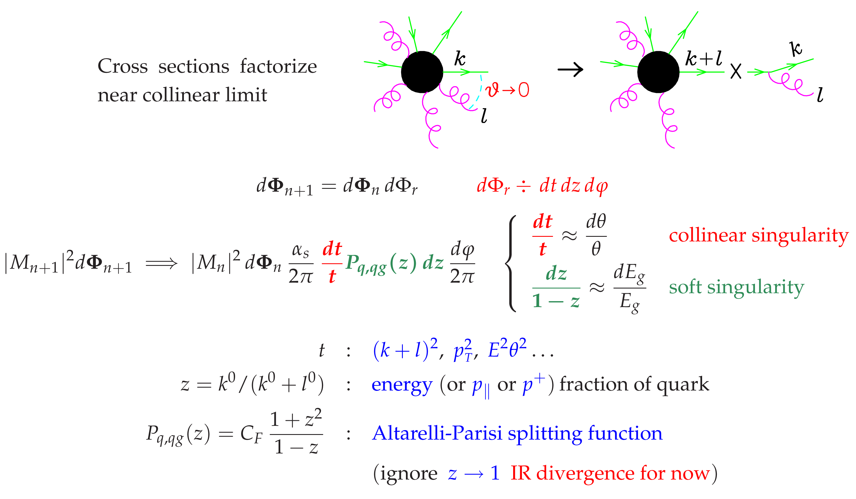
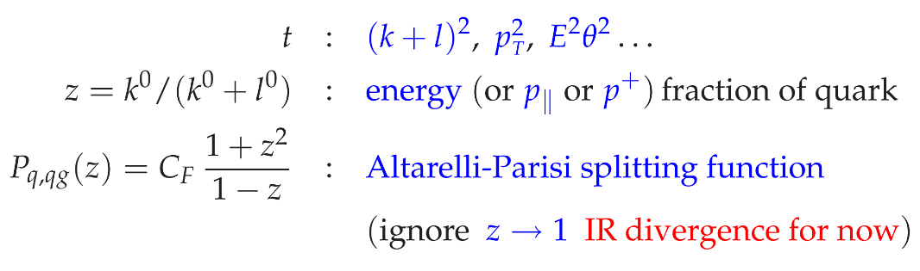

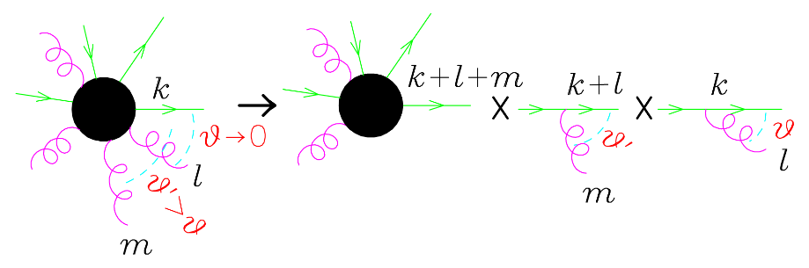

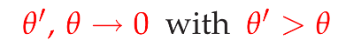
Basics on parton showers
In this limit QCD amplitudes factorize:
  Factorization of phase space:
  Factorization of matrix element:
  For successive emissions iterate this formula:
Gives rise to double logarithmic structure

Slide 14
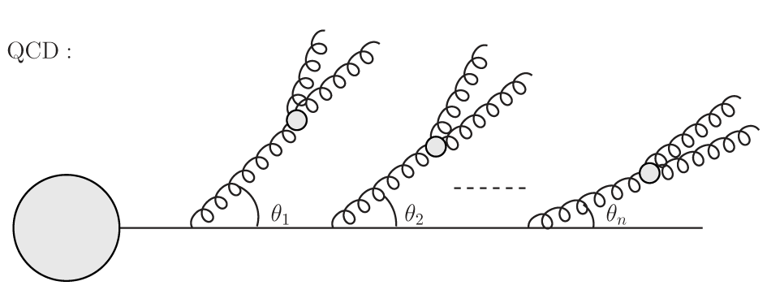
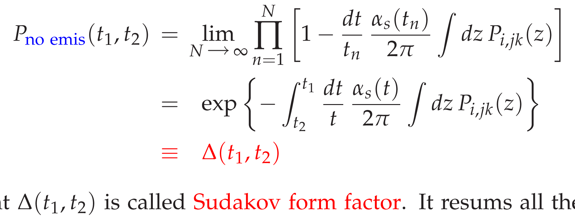
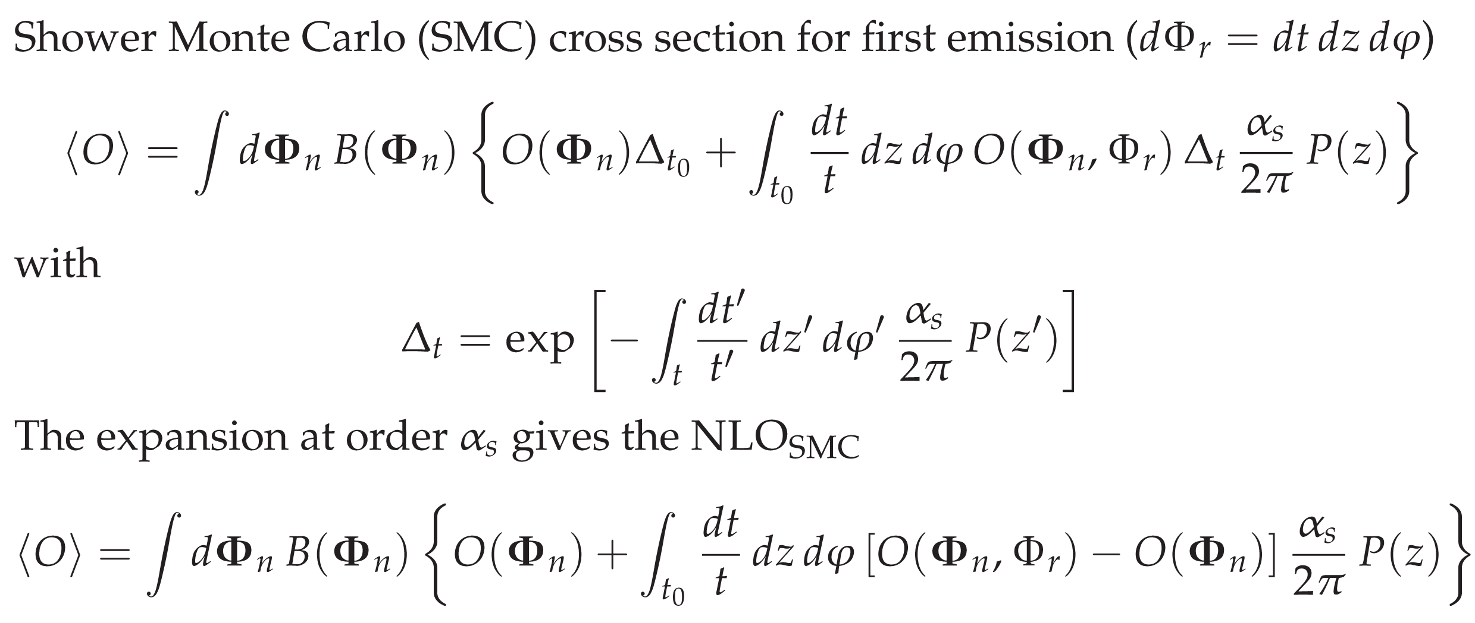
Basics on parton showers
Dominant contribution comes from strongly ordered emissions
Virtual corrections are also taken into account in the same approximation (they have same structure but opposite sign) leading to a Sudakov form factor :
  Corresponds to the probability of having no resolved emission between t₁ and t₂
Therefore, Shower Monte Carlo (SMC) cross section for first emission given by ( )
t₁ > t₂ > … > t_{n}
t₁
t₂
t_{n}
1

Slide 15
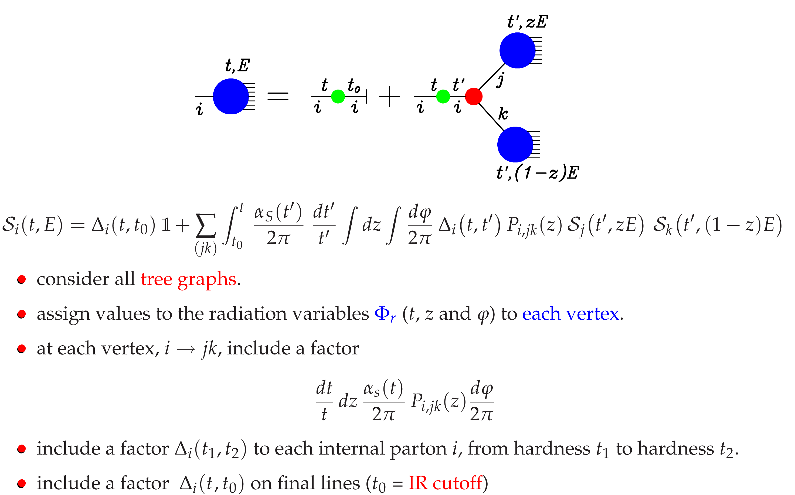
Basics on parton showers: final recipe
Consider all Born graphs
At each vertex: generate radiation variables and include factor
Include a factor to each internal parton i from hardness t1 to hardness t2
Include a factor on final lines (t₀ is IR cutoff)
This allows to resum the leading logarithmic contributions to all orders
  Probabilistic formulation of shower evolution
  Can change shapes of distributions but not the overall normalization: at the inclusive level the cross section remains unchanged (unitarity of PS)
  Attaching this to a LO matrix element allows to reach LO+LL accuracy

Slide 16

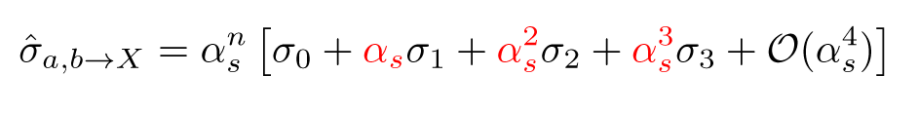
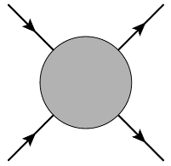
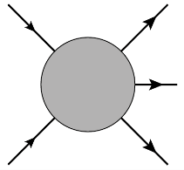
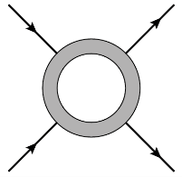
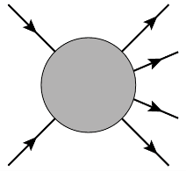
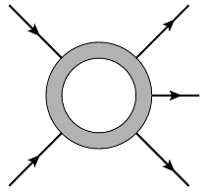
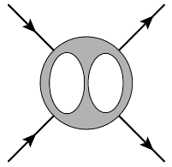
Fixed order calculations
Partonic cross section: for hard processes computed as series exp. in the strong coupling 0.1
  LO:
  NLO:
  NNLO:
LO
NLO
NNLO
N³LO
Predicts only the order of magnitude:
scale in coupling is not defined
1 parton 1 jet
First reliable predictions:
scale choices can be made
first description of jet substructure
Possible to quantify uncertainties:
convergence can be checked
richer jet substructure

Slide 17
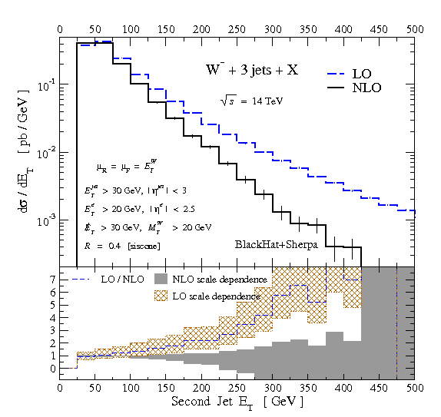
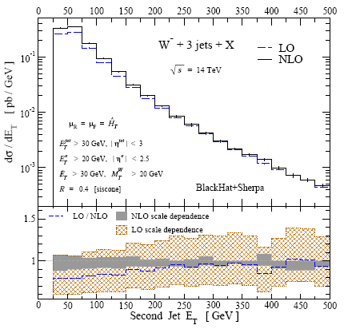
Importance of NLO calculations
To control the theoretical uncertainties in the computation of LHC processes NLO predictions are needed:
Consequences of a bad (wrong) scale choice!

Slide 18
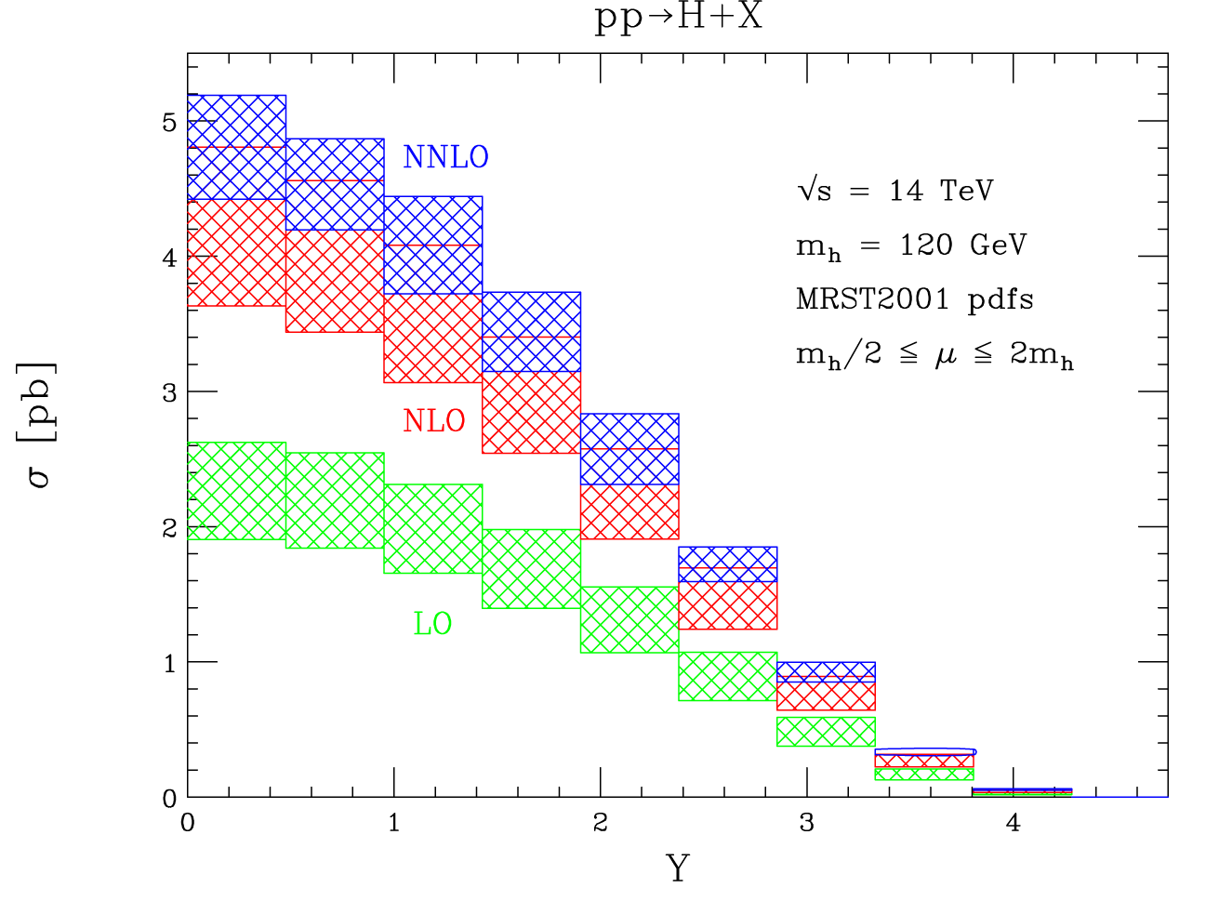
Sometimes not even NLO is enough
In some processes NLO corrections are still large: need to compute cross section at even higher accuracy to obtain a precise theoretical prediction
Canonical example: Higgs boson production
  Huge NLO [O(100%)] and NNLO [O(20%)] effects!
  Now known at N³LO:
[Anastasiou, Duhr, Dulat, Furlan, Gehrmann, Herzog, Lazopoulos, Mistlberger, ’15-‘16]
[Anastasiou, Melnikov, Petriello, ‘05]

Slide 19



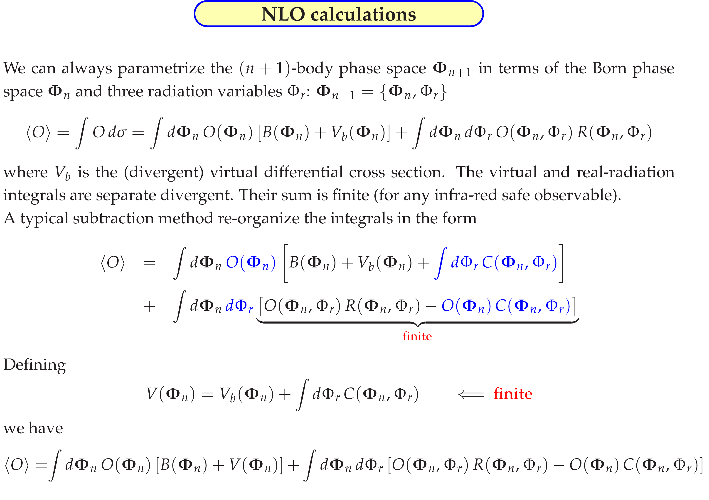
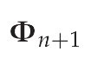
Structure of a NLO calculation
NLO calculation for an observable O consists of different ingredients:
[Parametrized (n+1)-body phase space in terms of Born and radiation ]
Separately
divergent

Slide 20
Structure of a NLO calculation
NLO calculation for an observable O consists of different ingredients:
[Parametrized (n+1)-body phase space in terms of Born and radiation ]
Divergent parts can be regulated e.g. with a subtraction scheme:
Defining:
Separately
divergent

Slide 21

PS vs NLO: pro and cons
NLO
Normalization accurate at NLO
reduced scale uncertainties
Accurate shapes at high p_{T}
Limited multiplicity
Fails on resummation regions
PS
Sudakov suppression at small p_{T}
Realistic & flexible (hadron level)
Limited precision (LO uncertainty)
Bad description at high pT
Two approaches are very complementary: ideal to merge them trying to keep the good features of both!
PROBLEM: avoid double counting! First extra emission is accounted for in both..
Several ways exist: MC@NLO [Frixione, Webber 2001], POWHEG [Nason 2004]
and more recently also: KrKNLO, Vincia, Geneva
x

Slide 22
NLO+PS: the POWHEG method

Slide 23
NLO+PS combination: SMC accuracy vs NLO
Let’s consider again the SMC cross section for first emission:
  with
Expand it in to get NLO_{SMC}:
This is the inexact NLO implemented in parton showers, as compared to the exact NLO:
How do we reach exact NLO accuracy retaining shower resummation?

Slide 24
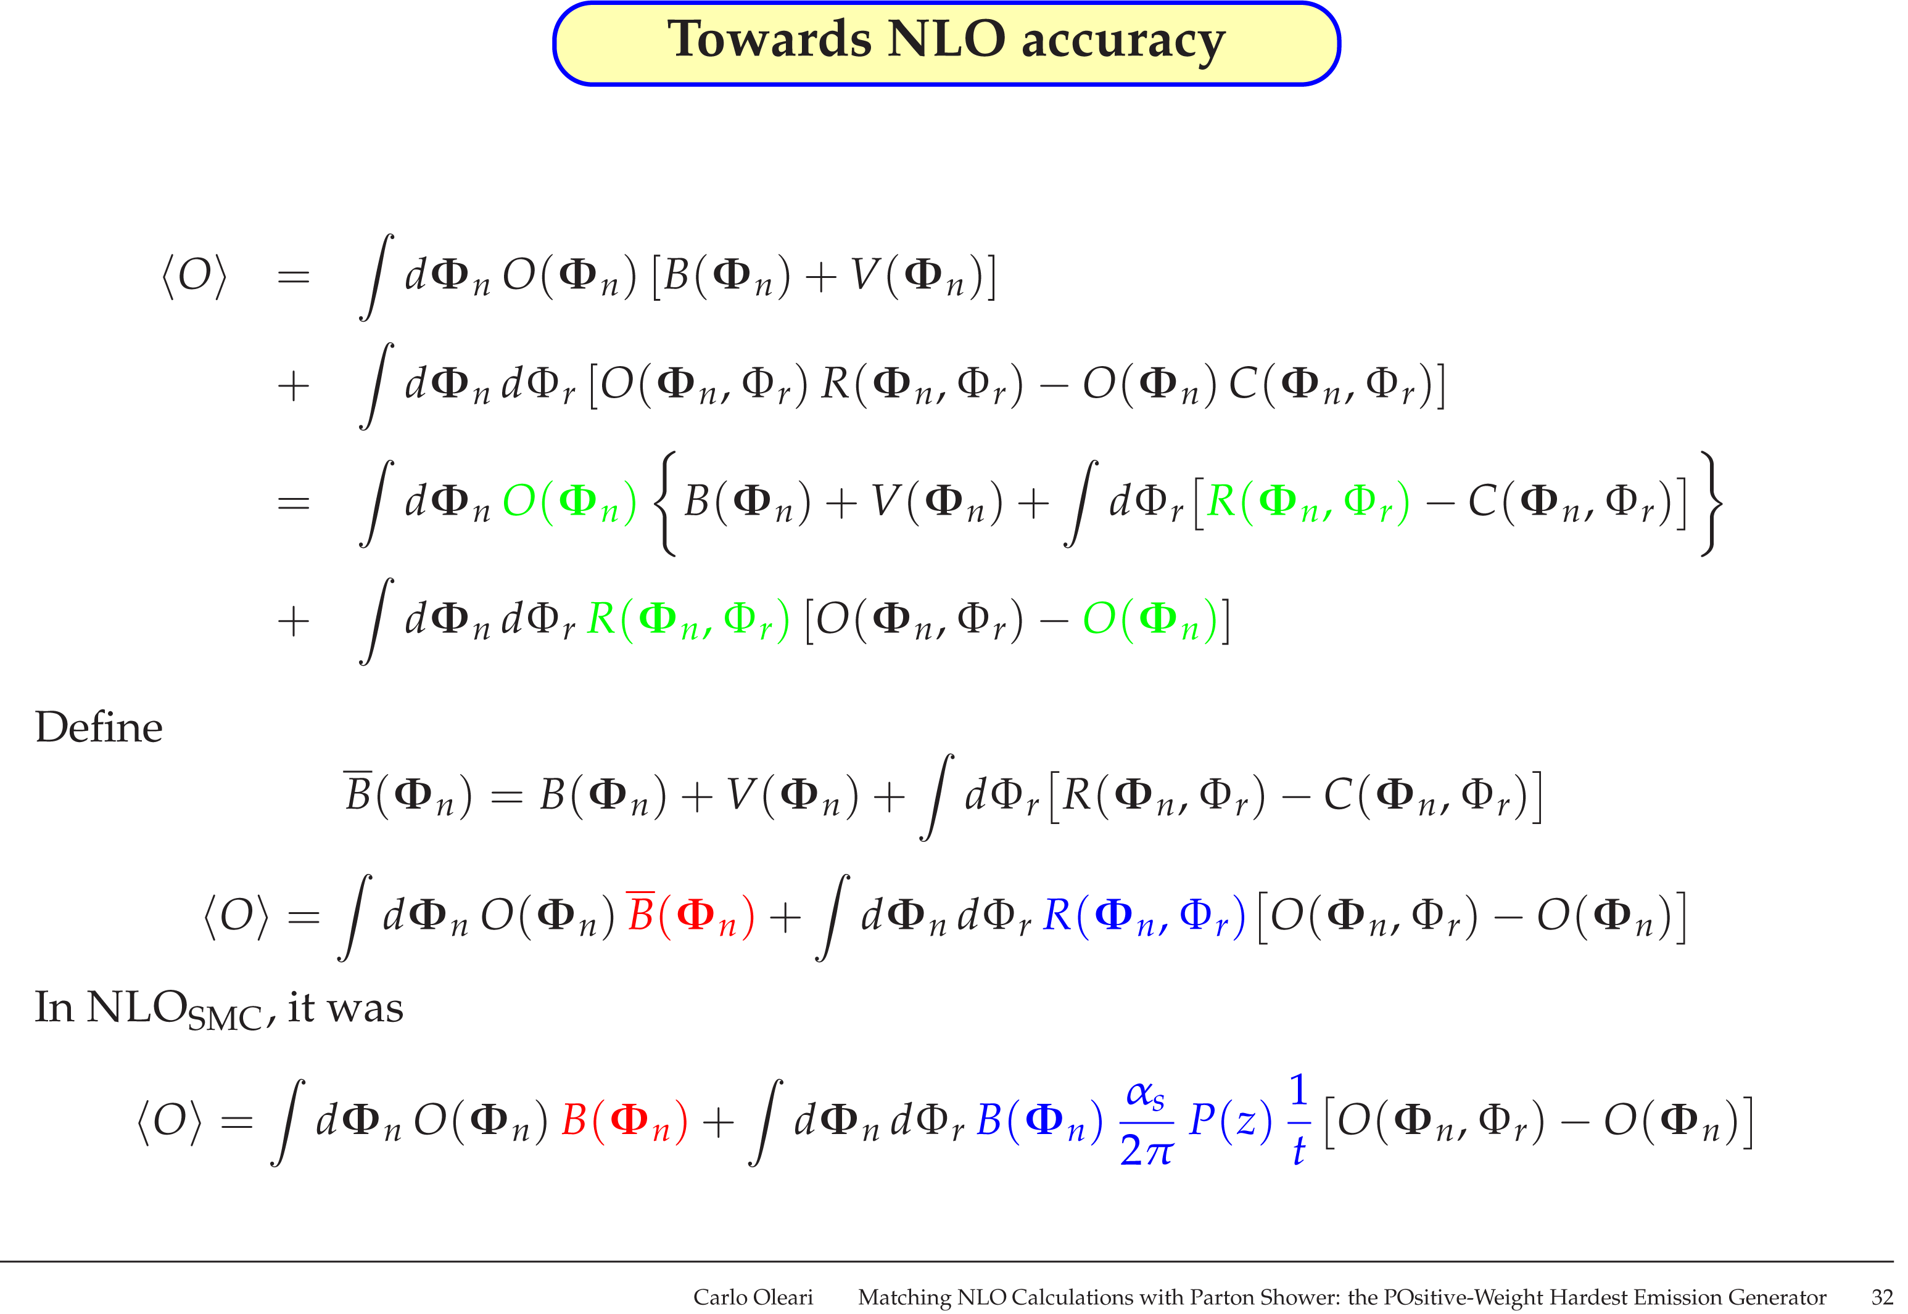
NLO+PS combination: towards NLO accuracy
Define:
And rewrite this as:
Let’s compare it again to the NLO_{SMC}:
Very similar structure, but upper one accurate at NLO

Slide 25
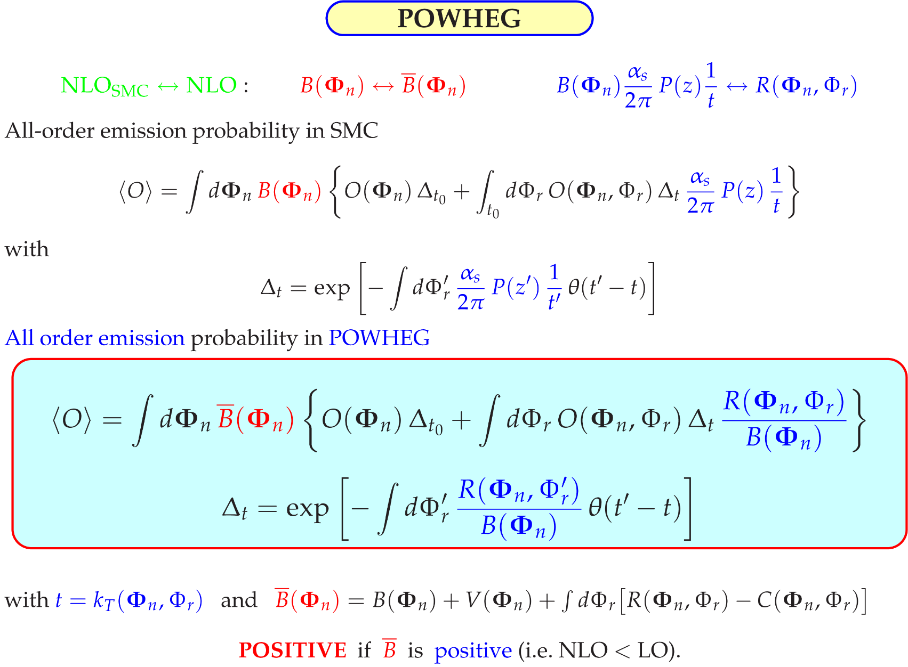
NLO+PS combination: POWHEG
In summary:
Back to all order: the emission probability in SMC was
All order emission probability in POWHEG:
with
with
and

Slide 26
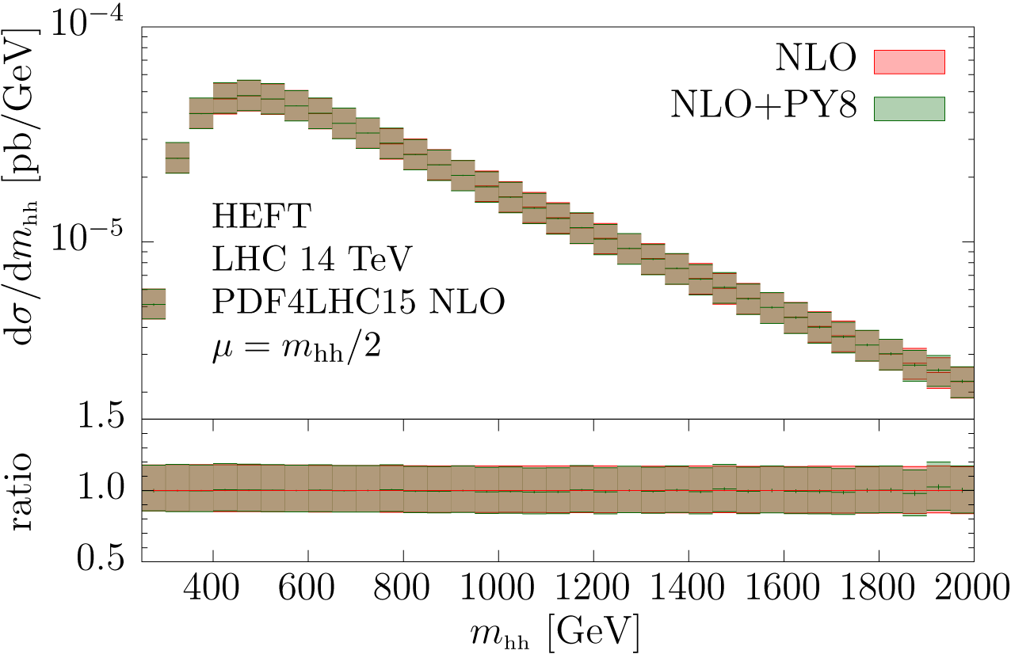
Phenomenological impact
What is the impact of PS corrections to NLO?
What should stay unchanged, what could/should instead change?
Consider most recent POWHEG implementation: HH-production
Parton shower cannot affect observables inclusive in the radiation:
[Heinrich, Jones, Kerner, G.L., Vryonidou to appear Wednesday]

Slide 27
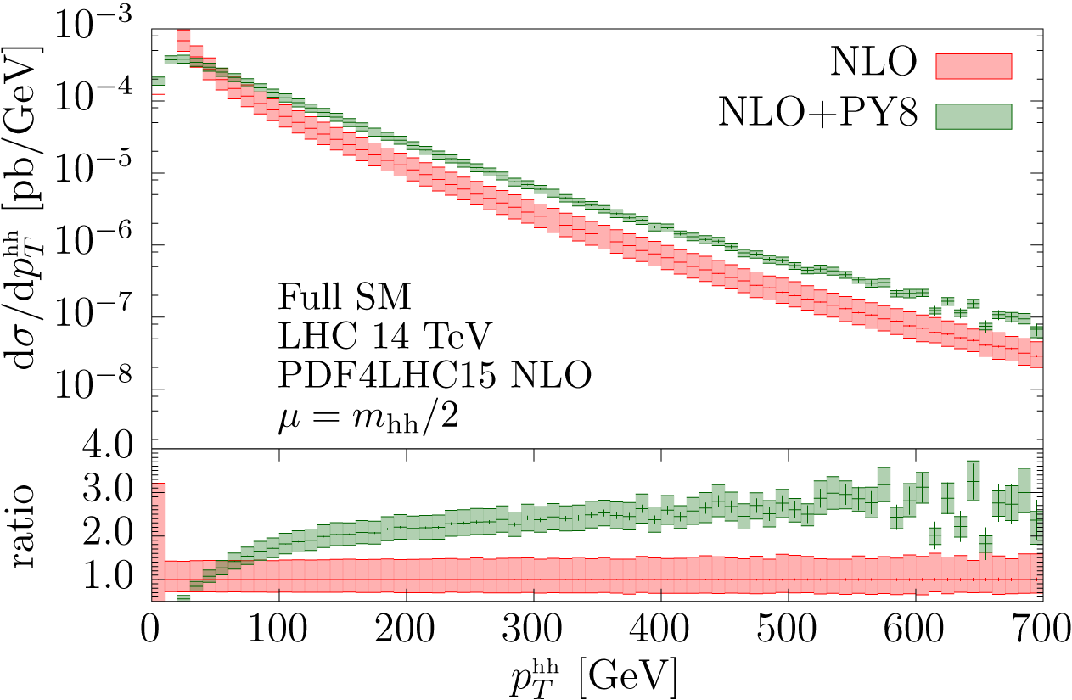
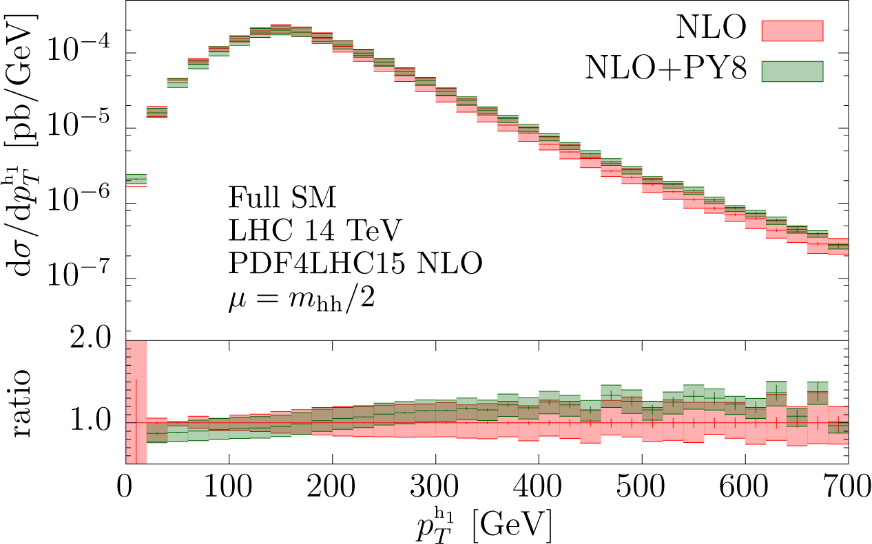
Phenomenological impact
Parton shower should instead modify the shape of observable sensitive to QCD (QED) radiation

Slide 28
Conclusions and Outlook
Fixed order computation and parton showers are two complementary approaches to compute a cross section
  Describe two different regimes in a particle scattering
Best solution is to combine (match) them together!
POWHEG is one possible matching scheme
NLO+PS has been extended to merge different multiplicity calculations at NLO and match them to PS:
MiNLO MEPS@NLO FxFx UNLOPS
In meanwhile first schemes exist for NNLO+PS matching: this is the future!

