Slide 1
EPS Prizes and Distinctions

Slide 2
An EPS Prize Committee?
Historical Background:
Originally Founded in 2020, tasked to review the nominations, especially in terms of diversity.
Suggested a common timeline for EPS Central Prizes
Never met again.
Chaired by Jo Hermann who sadly passed away this year.
Challenges remain!

Slide 3
Low number of nominations
Average number of nominations per EPS Prize in 2023 6.6
Maximum number of nominations for a Prize 23
Minimum number of nominations for a Prize 1
Number of prizes awarded with only 1 nomination 3

Slide 4
Low diversity of nominees
Average number of Female Nominees per prize 1.4
Maximum number of Female Nominees in 2023 5
Number of Prizes awarded with NO female nominees 7
Diversity doesn’t end with gender! We do not even have the data for any other axes of diversity

Slide 5
Variations
Variation in nomination procedure (who can nominate, who can be nominated):
Variation in deadlines
Variation in process
  Search committees
  Number of prizes
Variation in prize money from expenses for an invited talk to 10 000 Euro

Slide 6
Variation in rules (Central Prizes)
EPS Early Career Prize:
  Nominee must be a member of EPS or a member society
  Nominator/supporter can be anyone.
  3 letters of support
  Self nomination permitted
EPS Fellow:
  Nominee must be an EPS individual member
  Nominator must be an EPS member (Individual Members, Member Societies and Associate Members)
  3 letter of support from EPS members (from different countries and institutions)
  Self nomination not permitted
Gero Thomas Medal
  Nominee must be an EPS member
  Nominator must be an EPS member
  Only one nominator necessary
EPS Achievement Award
  Nominee must be an EPS member
  Nominator must be an EPS member
  Three letters of support from EPS members
EPS Emmy Noether Distinction
  Nominator must be an EPS member
  Nominee can be anyone
  Up to three letters of support (no restrictions)

Slide 7
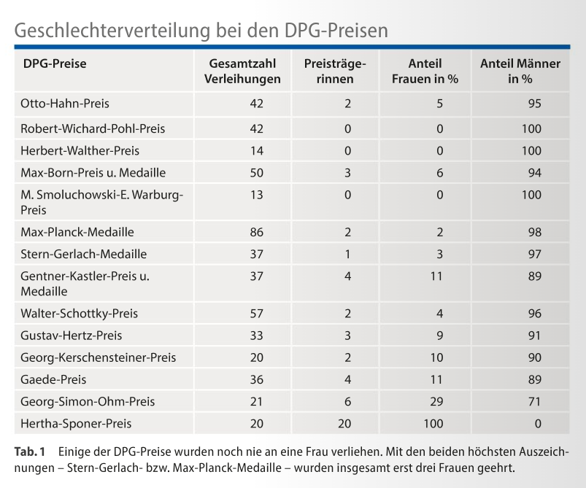
We are not alone
DPG shared this publicly
IoP (UK) have had similar problems

Slide 8
EPS Prizes and Distinctions
Awarded by the Executive Committee
  Gero Thomas Medal
  EPS Early Career Prize
  EPS Outstanding Achievement Award
Recommendations passed to Council
  EPS Honorary Member
  EPS Fellow
Nominations collected centrally but attributed by committee
Emmy Noether Distinction (NB no prize money)

Slide 9
Challenges
48 EPS prizes (if we include D/G) and at risk of inflation
Not all prizes have financial support
Low number of nominations
Poor diversity of nominations
Diffuse timelines which move make communication difficult

