Slide 1
CERN Site Engineering
-
Opportunità nelle opere di genio civile al CERN
Dr. Ing. Luigi Scibile
Head of the Site Engineering Group
Site Management and Buildings Department
14th June 2018

Slide 2
CERN/SMB-SE – Civil engineering
Introduction
Existing CERN Infrastructure and brief history
Scope of work
Organization: Services and projects
Site planning and development
Examples of planned projects
Opportunities at CERN for Consultancy firms & Contractors

Slide 3
Existing CERN Infrastructure and brief history
CERN/SMB-SE – Civil engineering

Slide 4
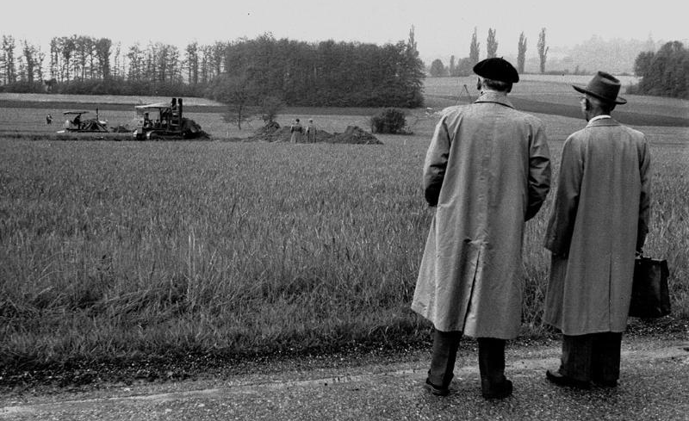
1954 – Day 1

Slide 5
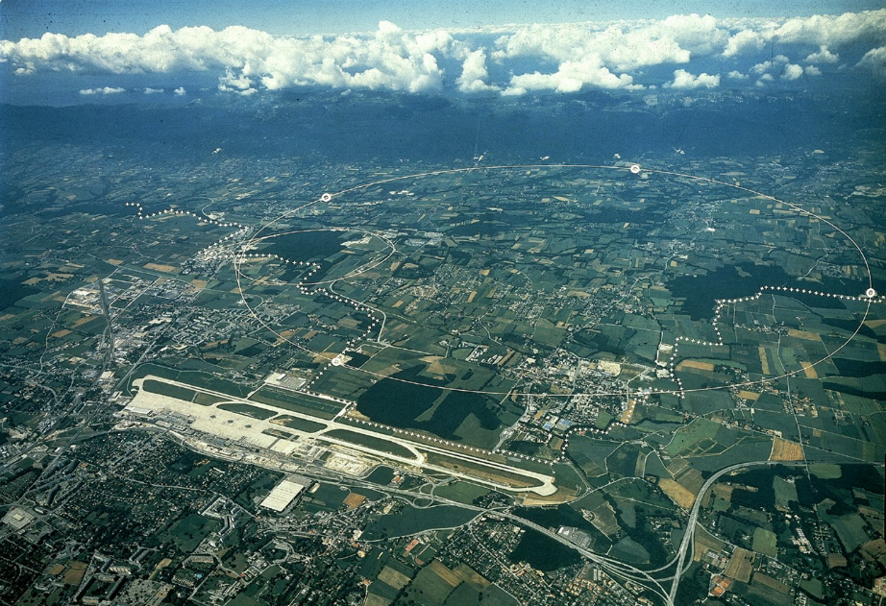
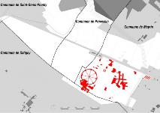
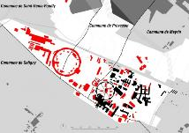
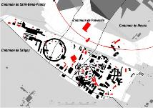
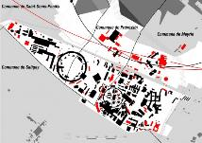
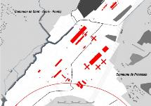
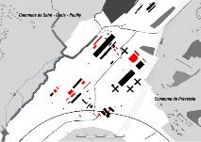
Two sites with a story
MEYRIN
1950-60
1960-75
1975-85
1985-10
PREVESSIN
1970-80
1980-10

Slide 6
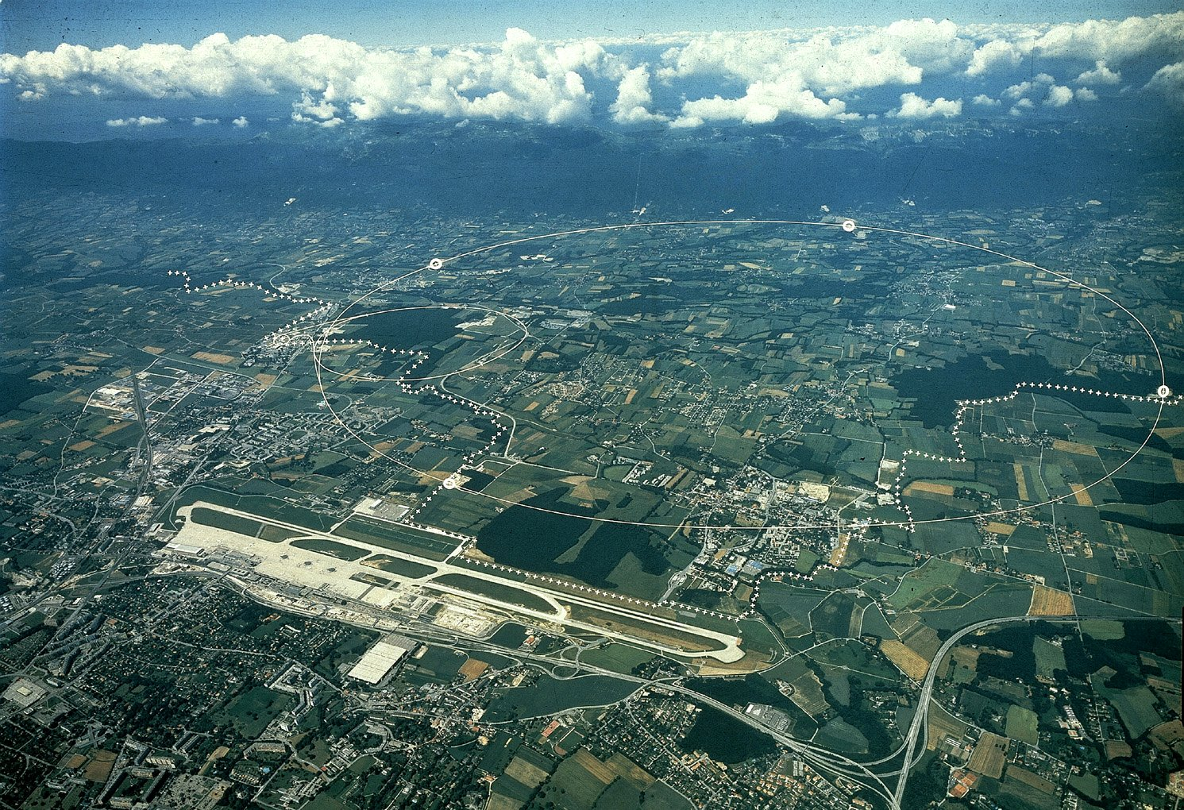
CERN Area
Prévessin (FR) Campus
Meyrin (CH) Campus
(it extends in French side)
LHC
Border
Geneva Airport

Slide 7
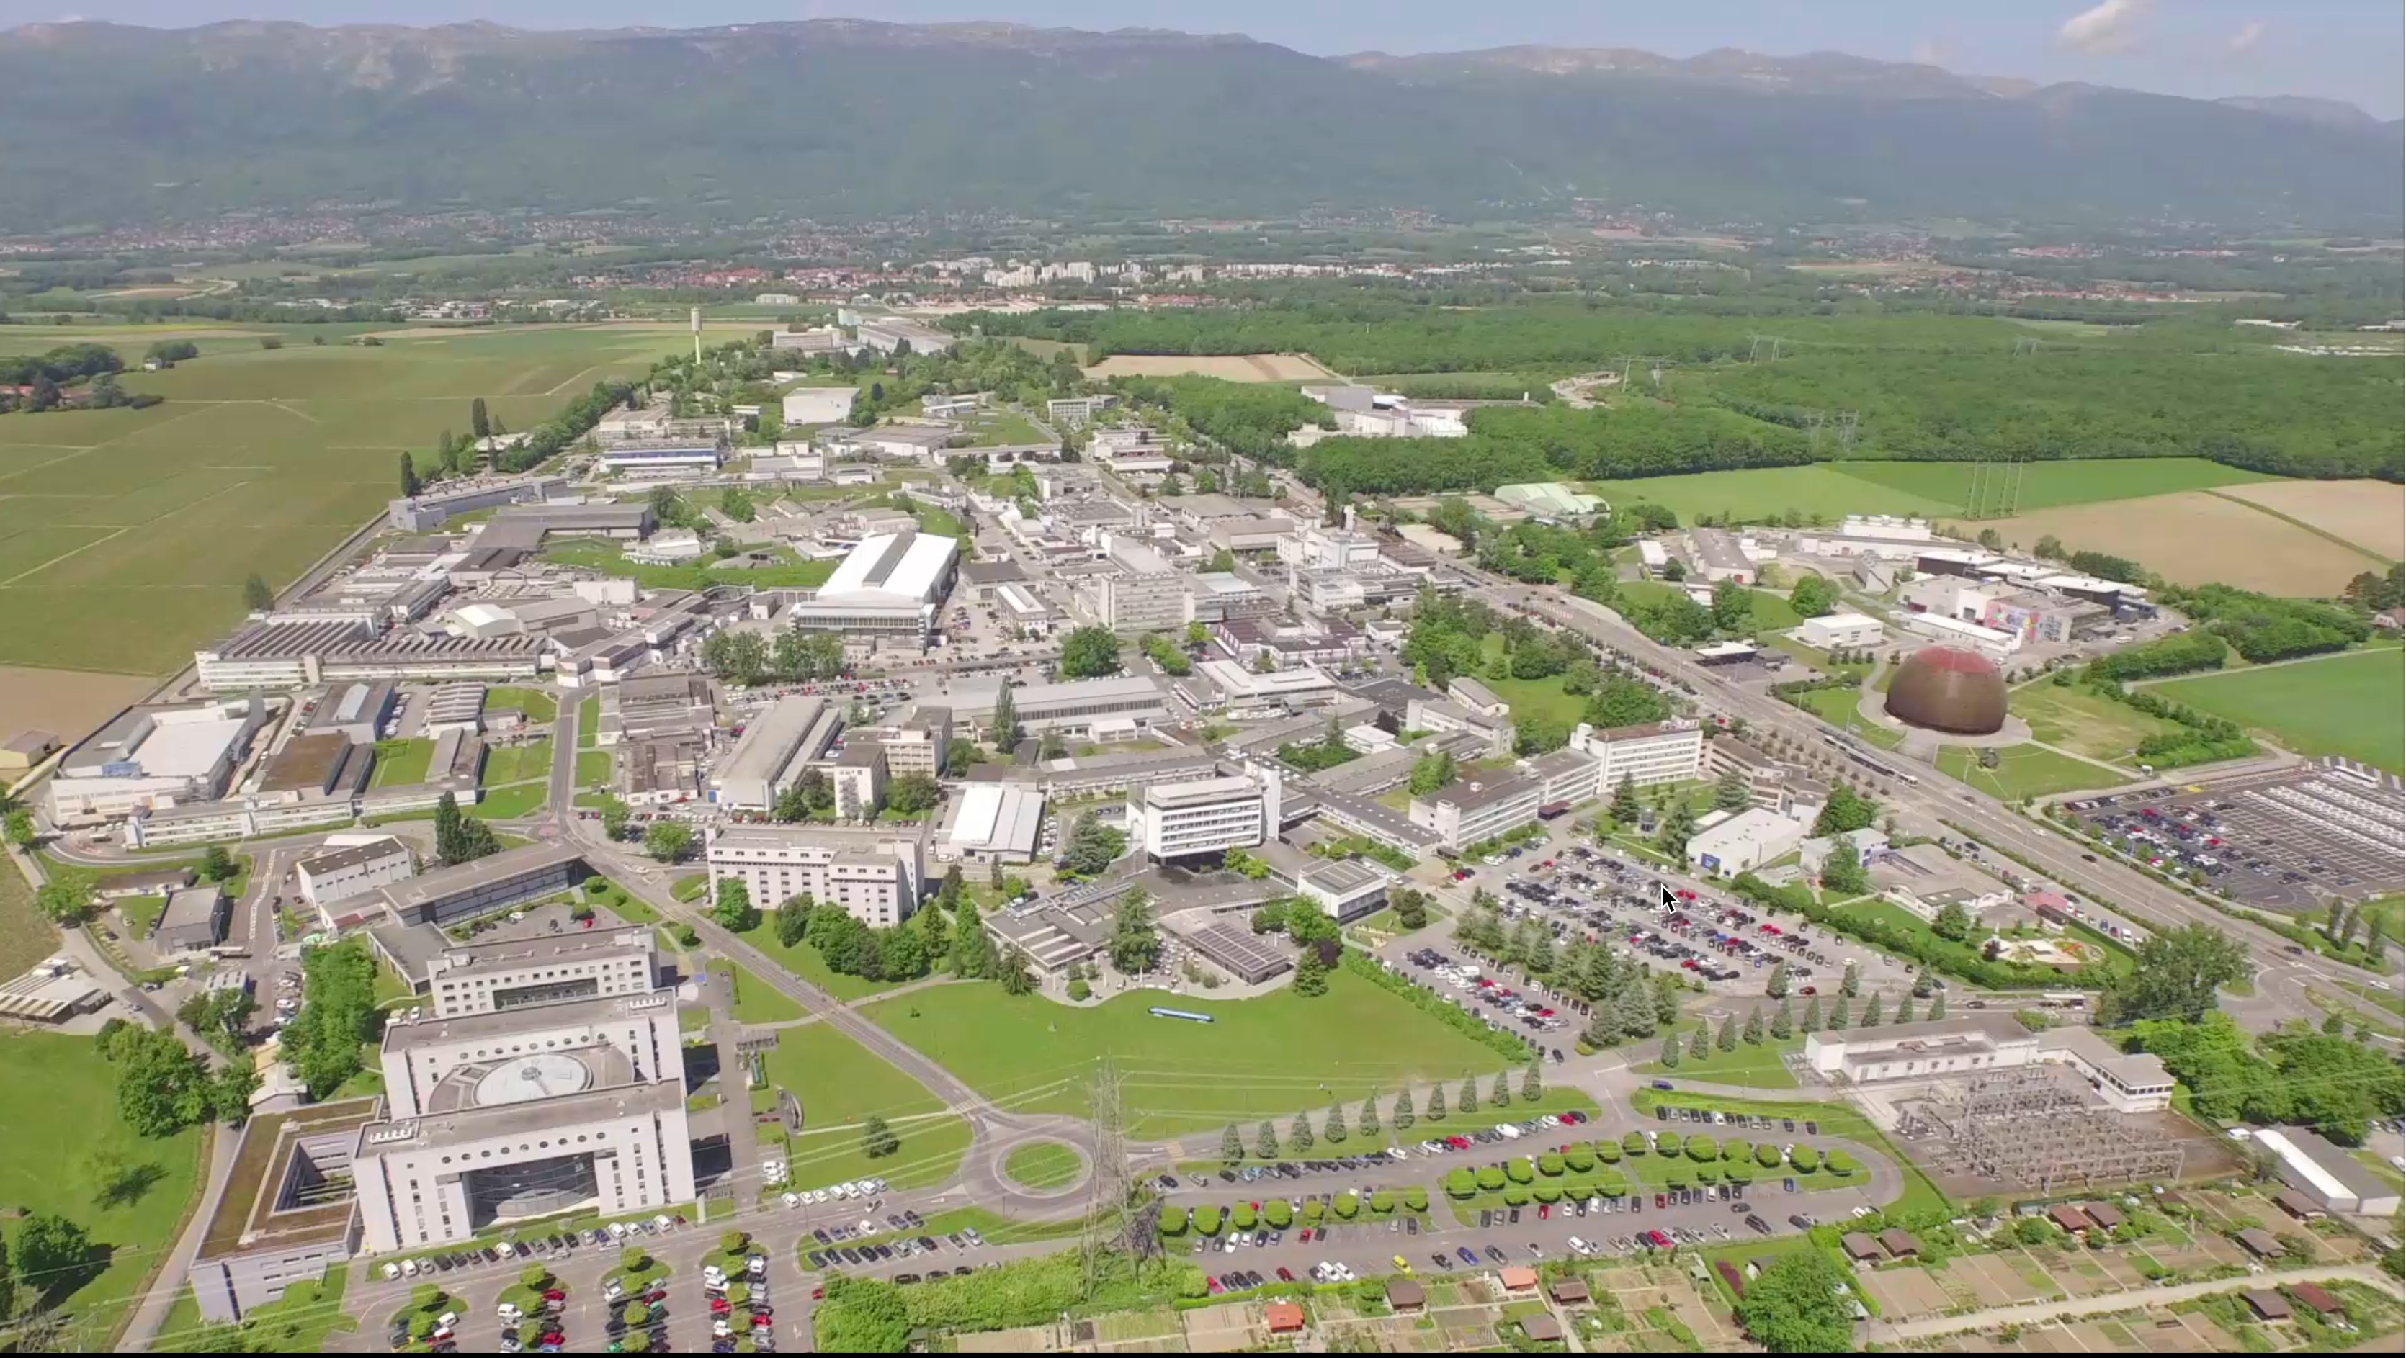
Meyrin Site

Slide 8
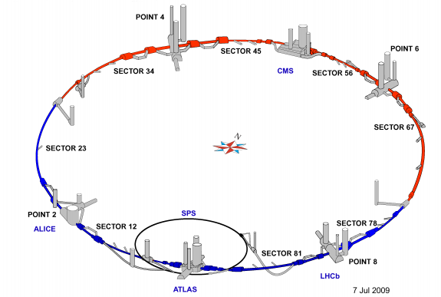
Current underground infrastructure
Tunnels:
27 km long
100 m approx. below grade
̴ 60km total length of tunnels

Slide 9
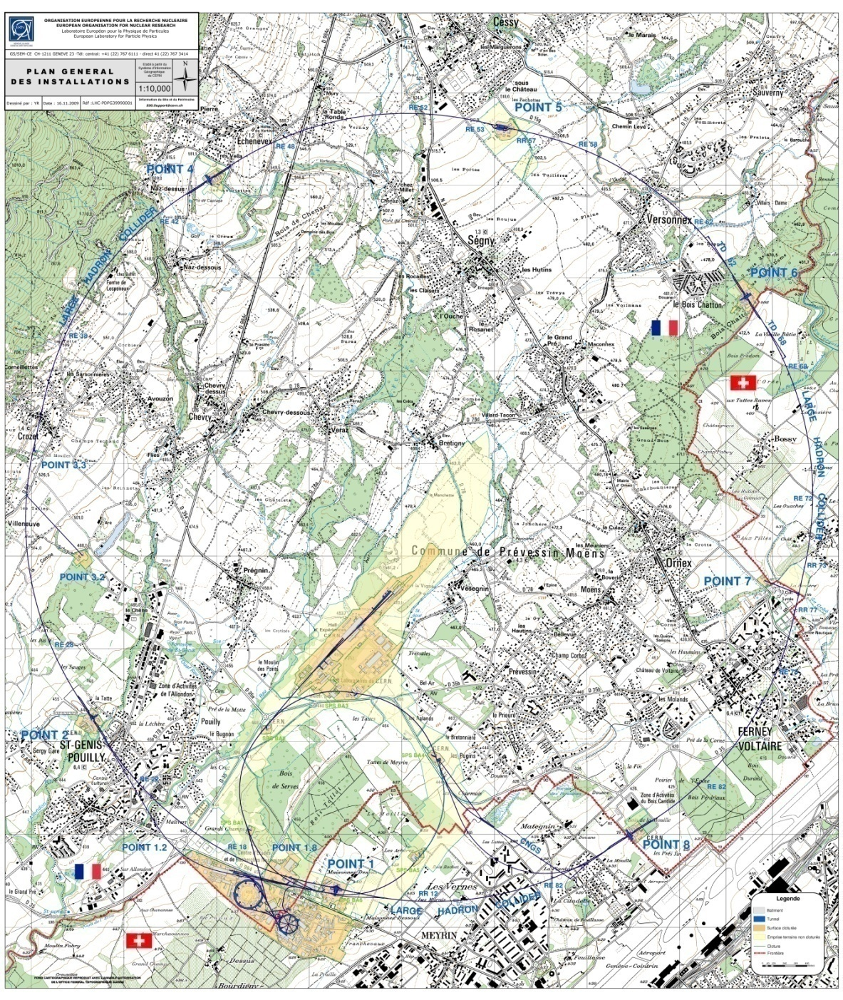
Overall key figures
GENERAL LAYOUT
Two main sites :
Meyrin (CH-FR) : 80 hect.
Prévessin (FR) : 83 hect
15 satellite sites
Number of buildings : ̴ 674
10m² up to 20.000m² , 425,000 m² of surface
60% of the buildings are 30+ years old
Tunnel lengths : ̴ 60 km
30 km of roads
1000 km of buried services
Total CERN fenced territory : 208 hect.
Total CERN unfenced territory : 418 hect
  fenced territory - CH: 51 hect.
  unfenced territory - CH : 59 hect.
  fenced territory - F : 157 hect.
  unfenced territory - F: 359 hect.
494 hostel rooms in Meyrin Site
̴ 2300 Staff
̴ 700 Fellows and Paid Assoc.
̴ 10’000 Users
----------------------------------------------
9’500 people every day at CERN

Slide 10
Site Engineering Group
The Site Engineering Group is responsible for :
  Design of all new buildings & civil engineering structures on CERN Site. Feasibility studies more often done in-house with outsourced consultancy services for more detailed design.
  Project Management for execution (with Consultants for larger projects)
  Maintenance of all buildings and underground structures
  Renovation Works
  HVAC & Electrical installation and maintenance for ‘tertiary’ buildings
  Patrimony data management
Group consists of approximately :
  10 engineers/architects
  10 draughtsman/designers
  25 technicians
Annual Group Budget approximately
  50+MCHF for Projects & Operation / Renovation Works

Slide 11
Organization
  Service oriented approach for
    Maintenance interventions
    Small works
    Design studies
    Patrimony
  Project oriented approach for
    Large renovations (consolidation program)
    New buildings or change of usage
    Underground civil engineering
Tools:
- InforEAM
- ServiceNOW

Slide 12
Services
Services
  Building, tunnels and road maintenance, repairs, minor works
  HVAC maintenance and works for tertiary buildings
  Electricity maintenance and works for tertiary buildings
  Patrimony and GIS
  CERN district heating operation and maintenance
  Barracks management and rental
  Engineering support
  Green spaces
Service Desk
  Access to most the group services is via the Service Desk and it is integrated in the ServiceNow tool: https://cern.service-now.com/
In the last 12 months, ~8000 incidents and ~5000 requests were carried out.

Slide 13
Projects
  Machine projects
  (linked to the functioning of the accelerator)
  Tertiary projects
  (linked to the functioning of the site)

Slide 14
Some examples of recent projects
Projects

Slide 15
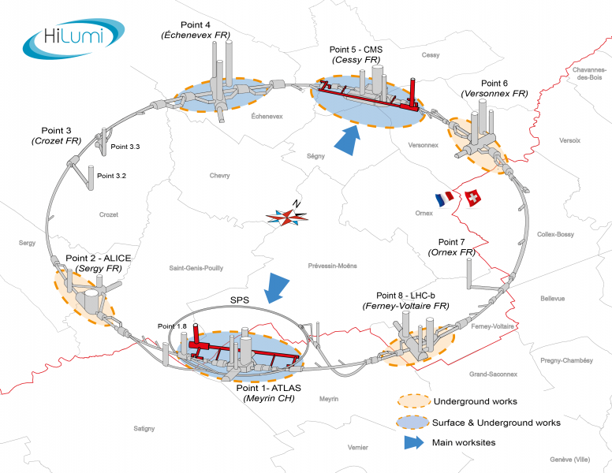
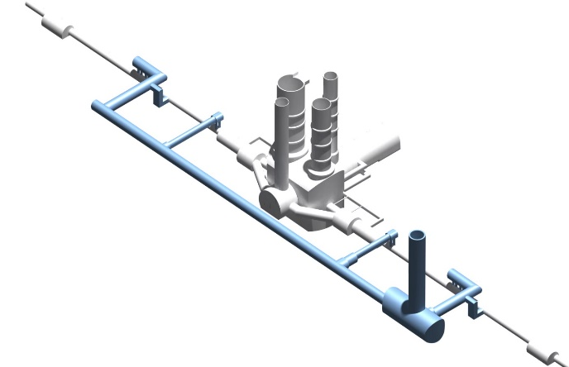
HL-LHC Project
Underground structures at Point 1

Slide 16
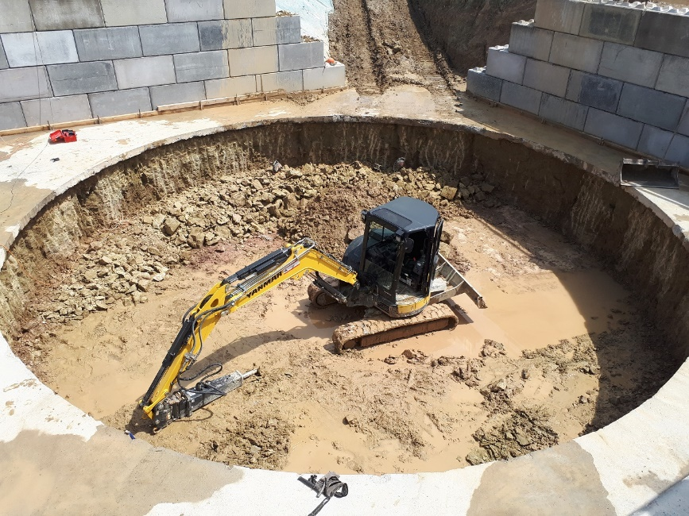
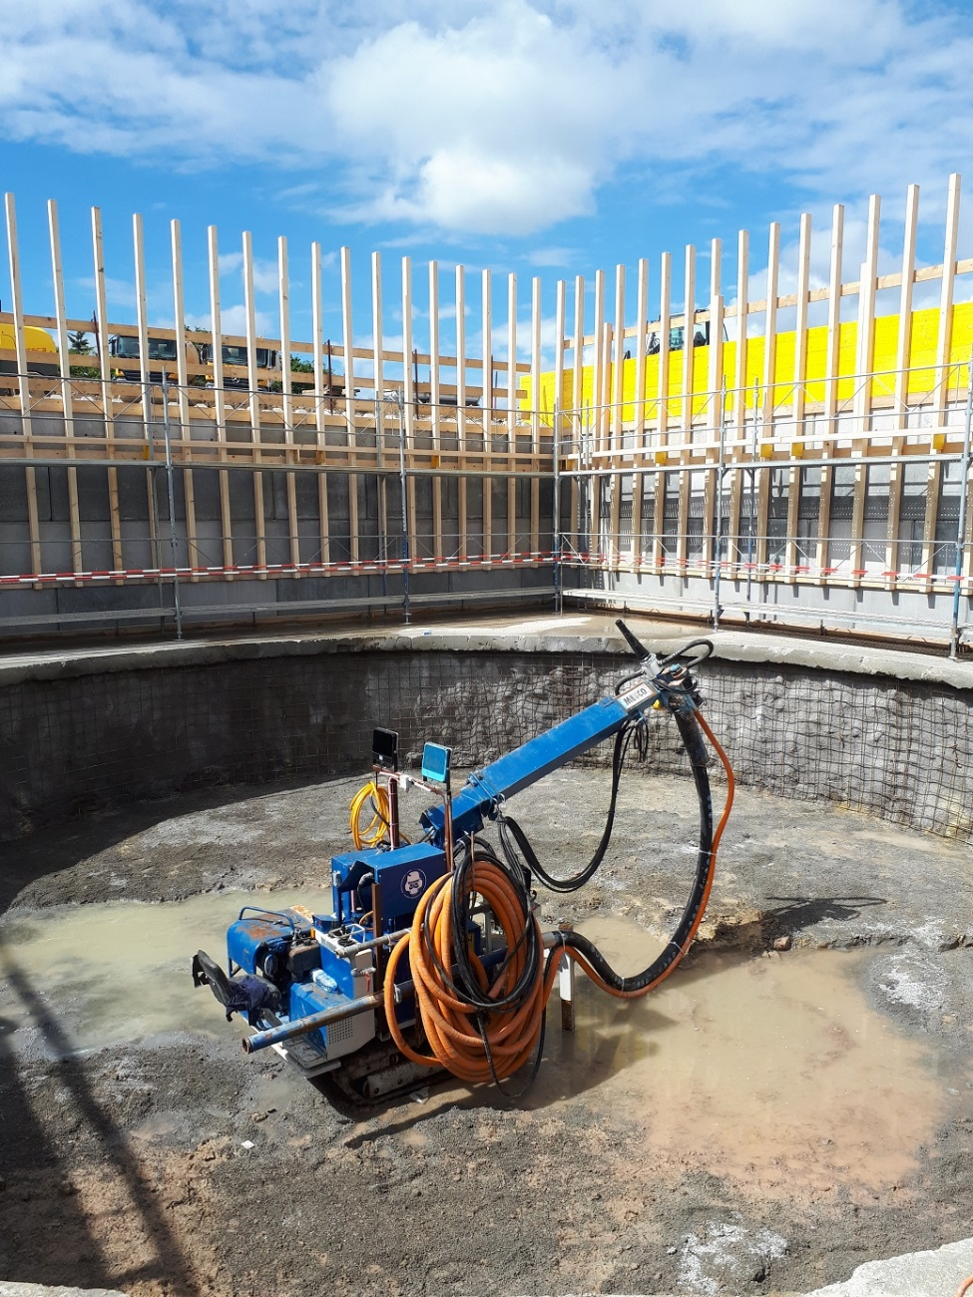
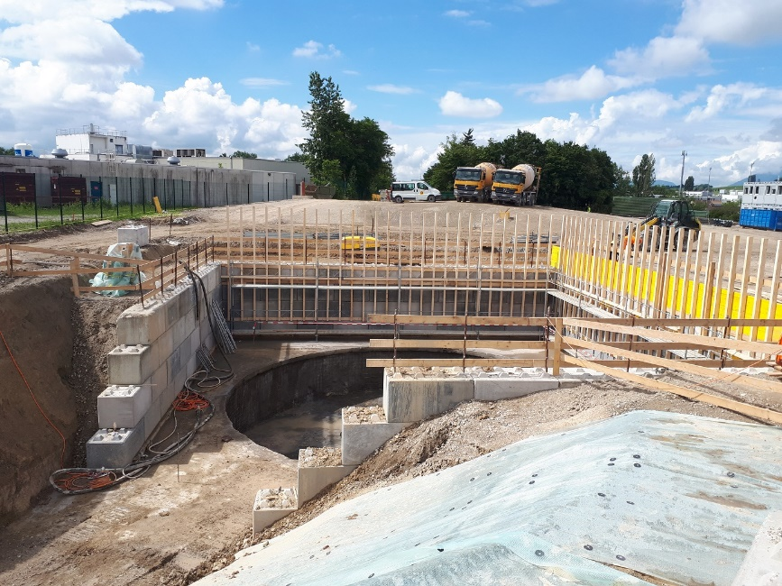
HL-LHC – Point 1
2001

Slide 17
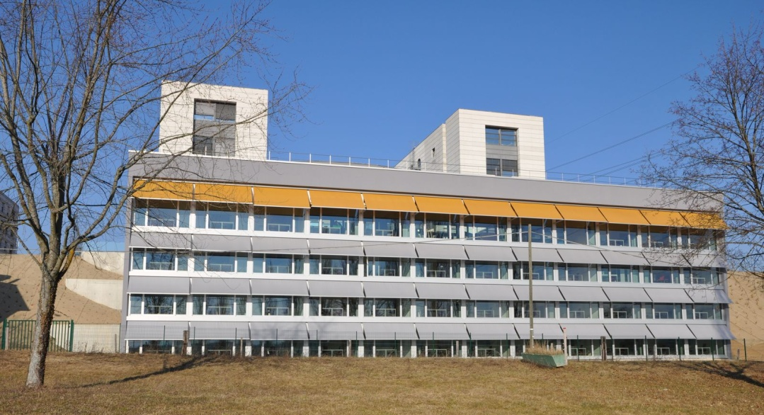
Building 42
Major achievements 2011
Tertiary Building - officies
Surface gross area : 3200 m2
Delivered : february 2013
Notes:
17

Slide 18
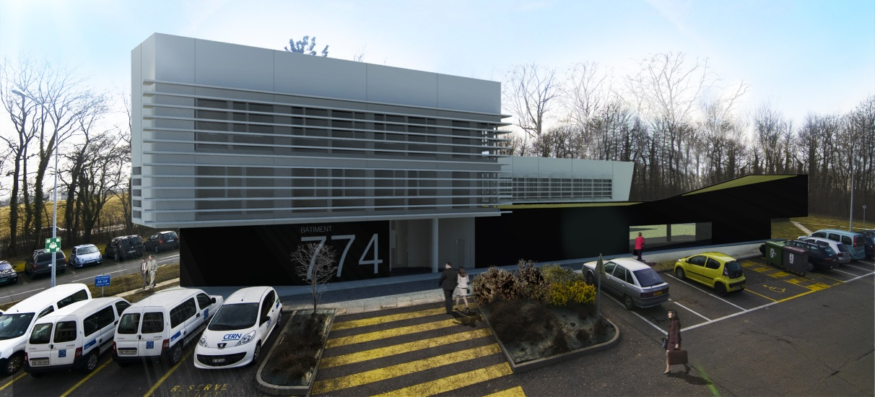
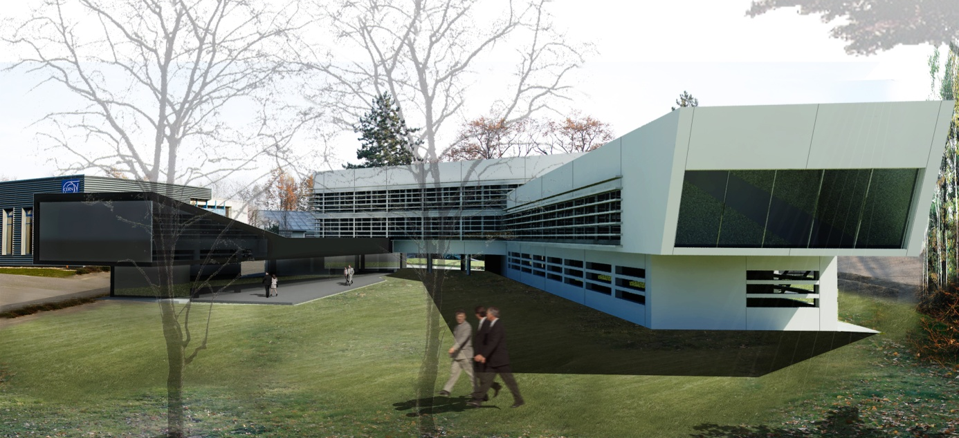
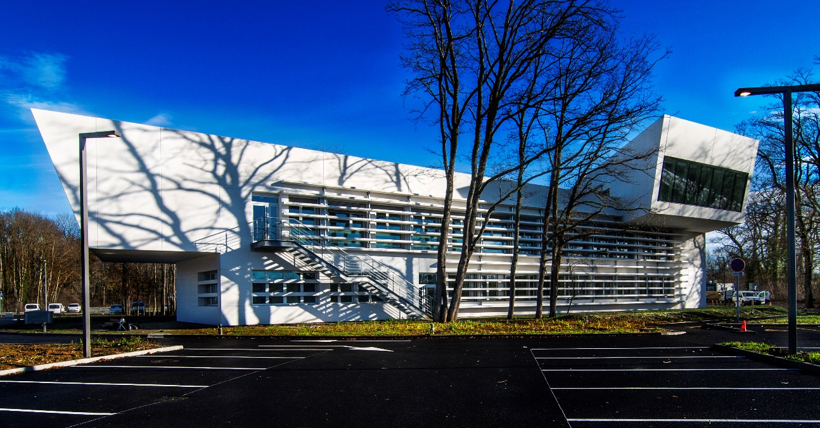
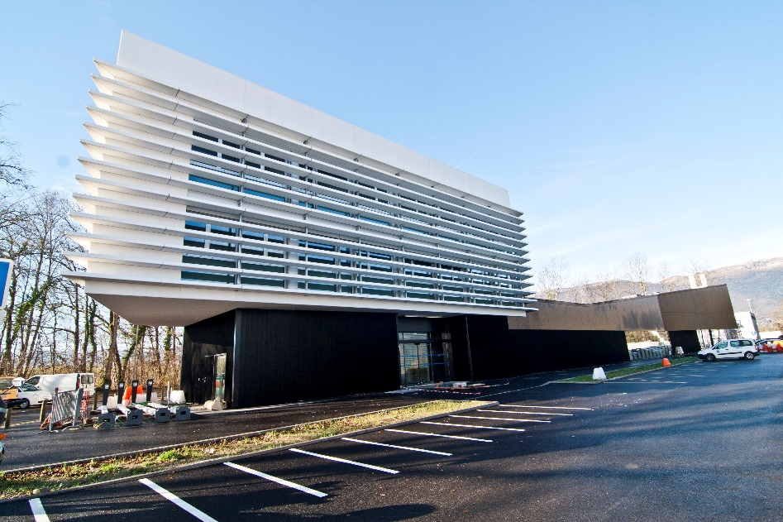
Building 774
Major Objectives 2012
Tertiary Building : officies and labs
Surface gross area : 3950 m2
Delivered : february 2015
Notes:
18

Slide 19
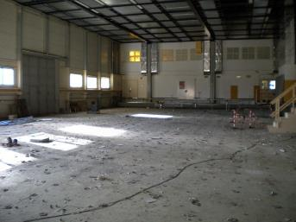
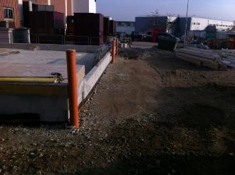
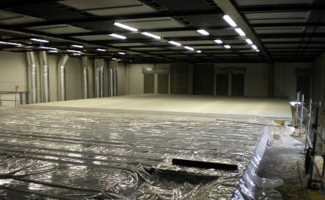
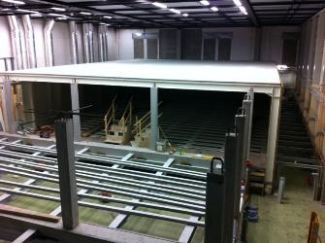
Computer Centre Upgrade

Slide 20
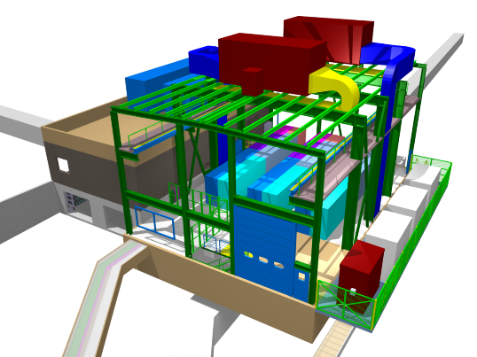
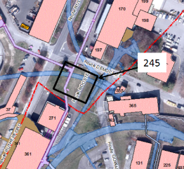
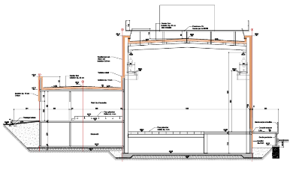
LIU-Booster – New Building 245 MPSB
Machine Building
Delivered : June 2016

Slide 21
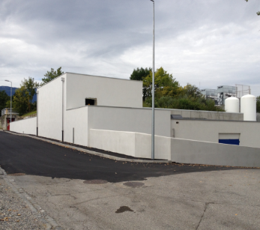
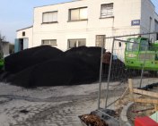
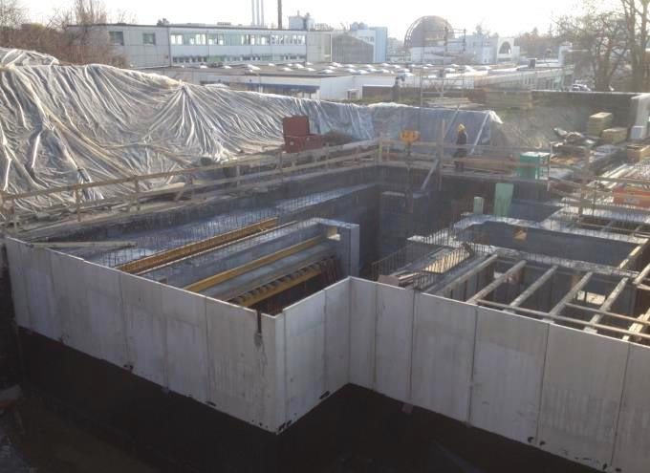
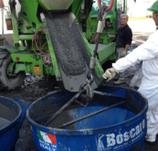
MEDICIS works
Addition of experimental area
Special shielding
Cross-border difficulties
Magnetite ore
Magnetite concrete high density 3.9 kg/dm3 (normal concrete 2.2 kg/dm3)
Preparation

Slide 22
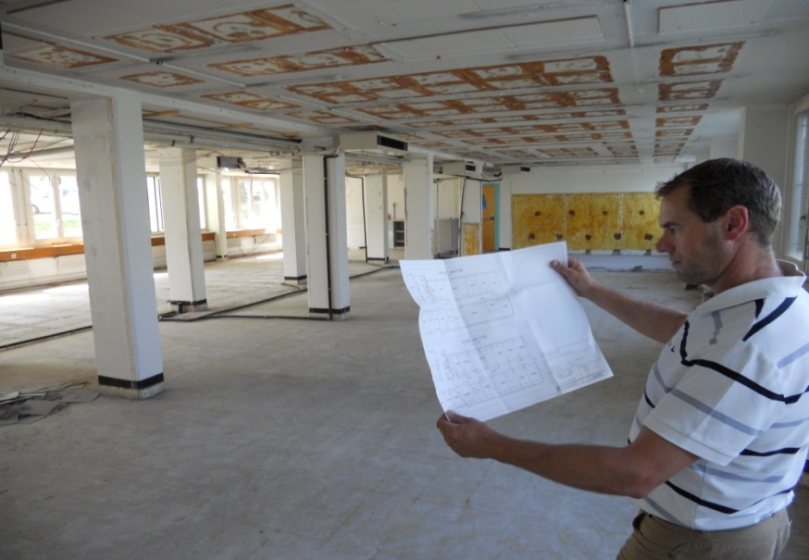
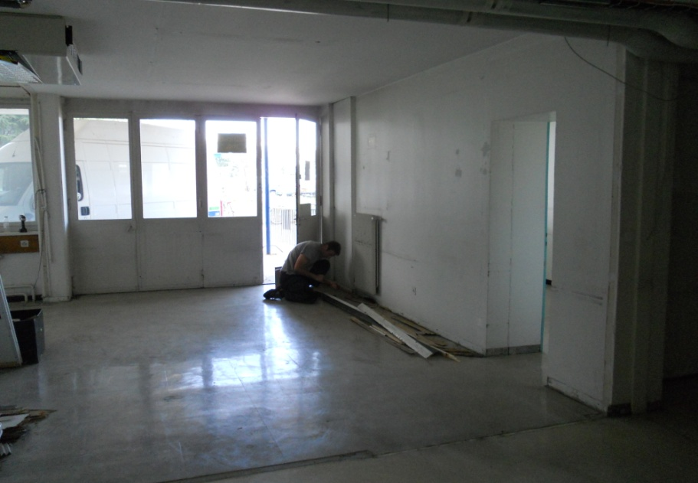
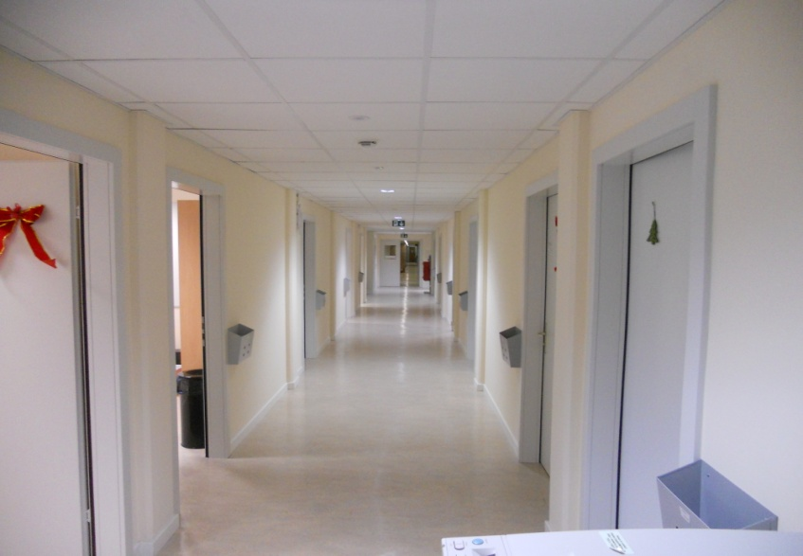
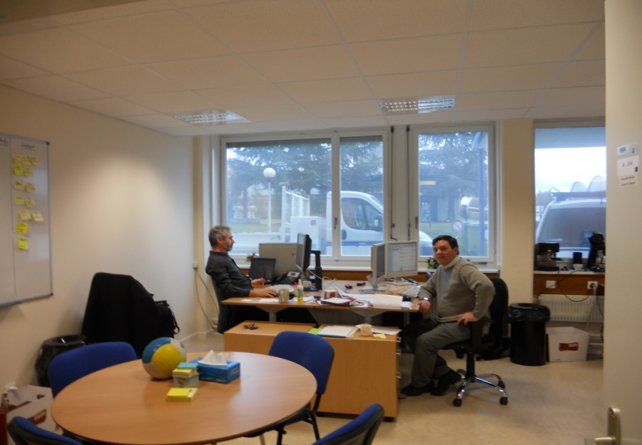
Renovation works : Offices
Notes:
What are the challenges for the next 12 months?
1 slide

Slide 23
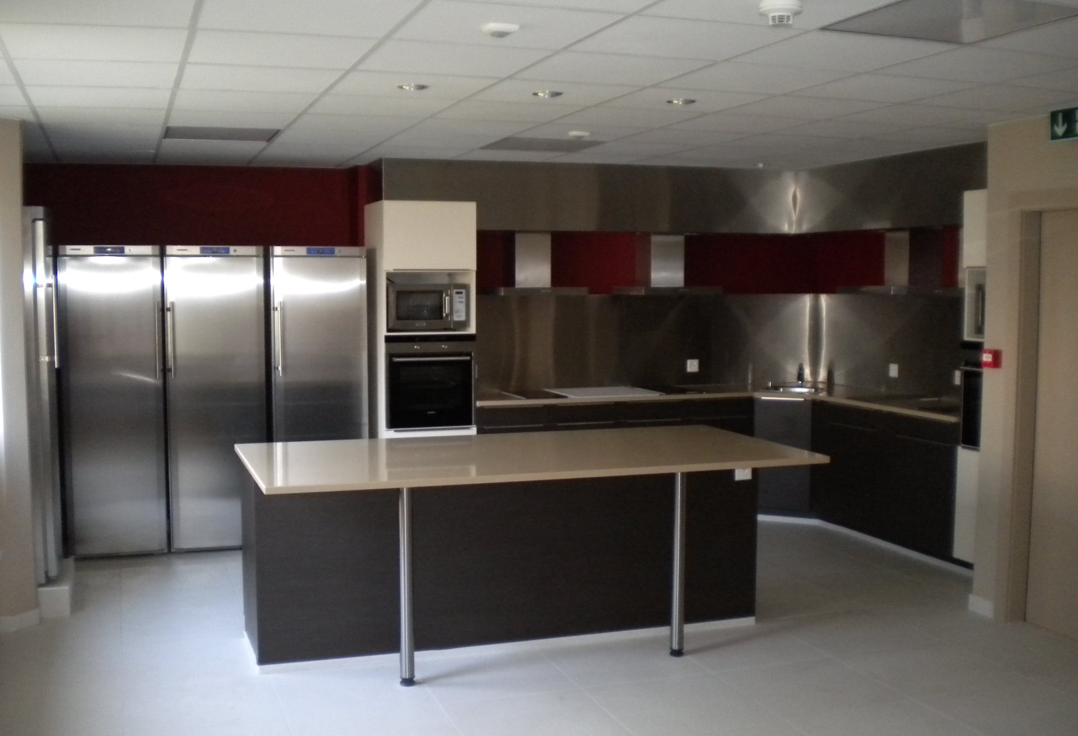
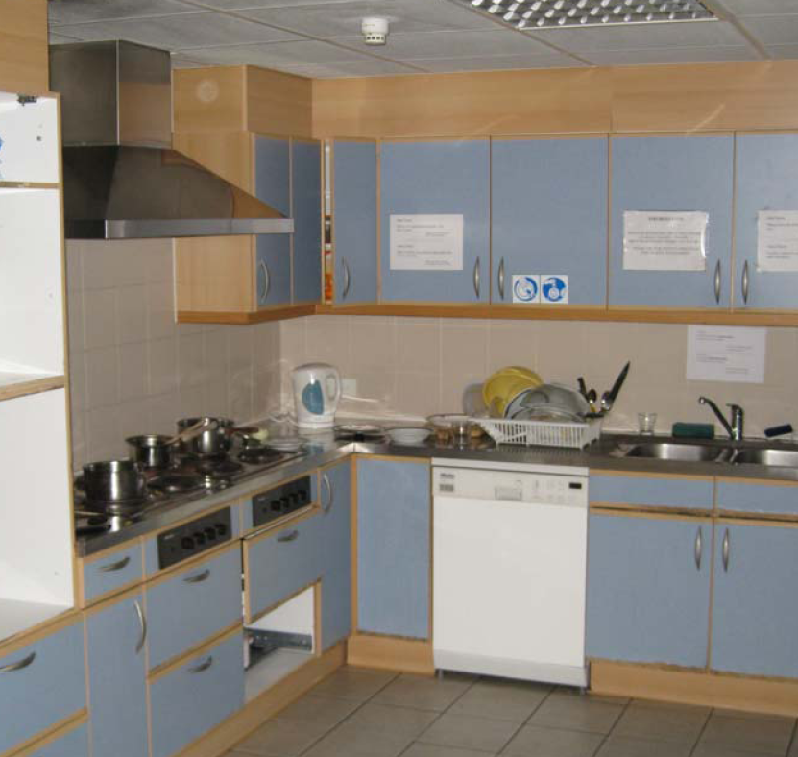
Renovation works : Hotels

Slide 24
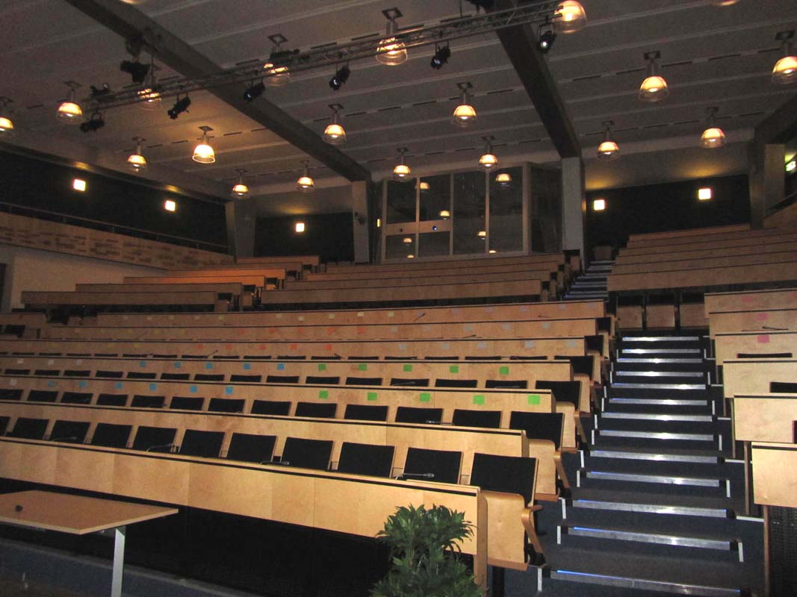
Renovation Works: Main auditorium

Slide 25
CERN/SMB-SE – Civil engineering
Site planning and development
TLEP

Slide 26
CERN 2030 Urban Masterplan
Déclaration d’intentions :
« Le Masterplan CERN 2030 vise à répondre aux besoins d’un laboratoire global, offrant à ses utilisateurs des zones fonctionnelles bien définies, desservies par des infrastructures et des services efficaces, permettant de garantir un fonctionnement opérationnel durable, tout en s’intégrant dans le développement du Projet d’agglomération franco-valdo-genevois .»
TLEP

Slide 27
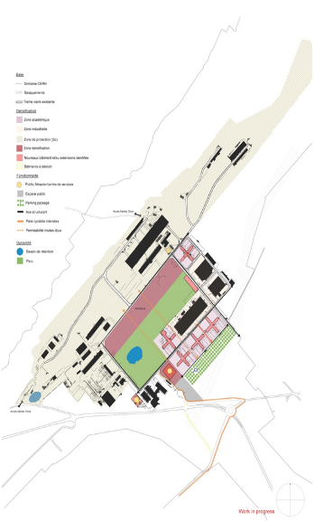
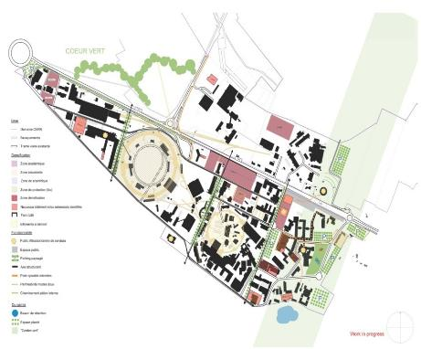
CERN 2030 Masterplan
TLEP

Slide 28
Opportunities at CERN
For Consultancy firms & Contractors
Call for tender for ‘Framework’ Contracts
Call for tender for specific Projects
TLEP

Slide 29
5Y Future and ongoing “Call for Tender”
Accelerator’s related
    ~2 contracts 3500kCHF ÷ 10000kCHF
    ~5 contracts 200kCHF ÷ 750kCHF
Implementation of the Consolidation of the infrastructure program and new buildings:
    ~ 2 contracts 3500 KCHF to 10000 KCHF
    ~ 10 contracts 750 KCHF to 2500 KCHF
    ~ 25 contracts 200 KCHF to 750 KCHF
Renewal of frame contracts :
    ~2 contracts 1000 KCHF/Y to 8000 KCHF/Y

Slide 30
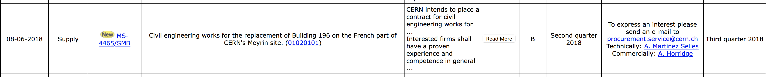
Links
Doing business with CERN official page:
http://procurement.web.cern.ch/en/doing-business-with-cern
Forthcoming market surveys and calls for tenders:
https://found.cern.ch/java-ext/found/CFTSearch.do
Example
Reference/department
Cost range
A <750k, 750k<B<5M, 5M<C<10M, D>10M

Slide 31
Conclusions
Opportunities for medium and large companies
Different specialties (underground and buildings)
Special attention to be paid to:
  The location and local rules (CH/F)
  The local prices (materials, wastes, workforce, etc.)
  CERN framework (Radiation areas, Worksites, Safety rules, etc.)

Slide 32
Thank You for your attention

