Slide 1

EP-DT-EO Detector Design Optimisation Tools
Diego Alvarez F., Mar Capeans, Andrea Catinaccio, Joao C. Batista L.
CERN EP-DT-EO
CERN, March 2016

Slide 2
EP-DT Group
The mandate of the EP-DT group:
development, construction, operation and maintenance of particle detectors for the experiments at CERN
services and infrastructure for experiments and detector R&D
Services
For experiments:
Gas systems
Detector cooling systems
Instrumentation, controls, DAQ
For Detector R&D:
Thin film & glass Lab
Silicon facility
Wire-bonding & QART Lab
Micro-Pattern Technologies
Irradiation facilities
Specialized labs (optics, gluing…)
Scintillator production
Engineering office
R&D Projects
Rad-tolerant silicon detectors (RD-50)
Gaseous detectors (RD-51)
Micro-systems engineering
Joint Projects
M&O and Upgrades of the LHC experiments
AEgIS, CAST, CLOUD, NA62
R&D for Linear Collider Detectors

Slide 3
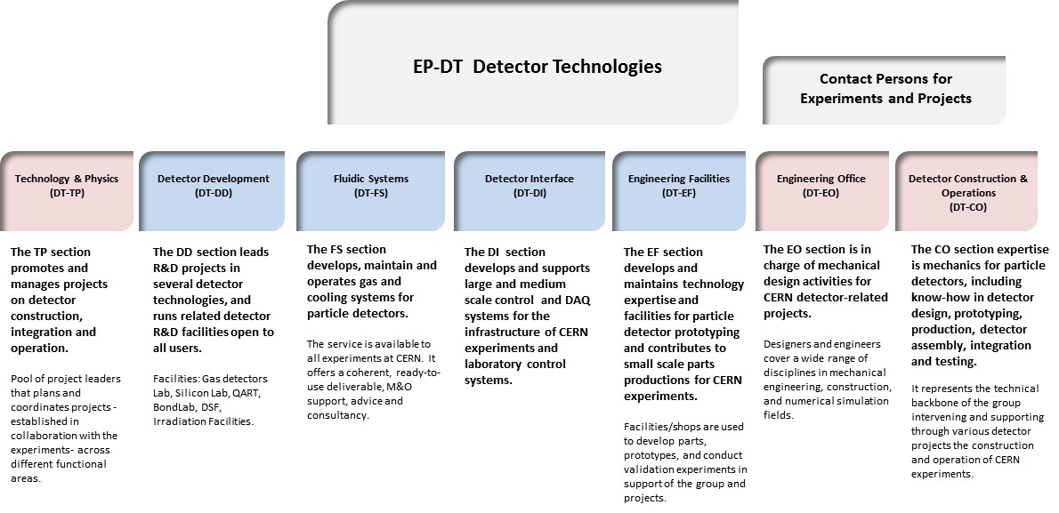
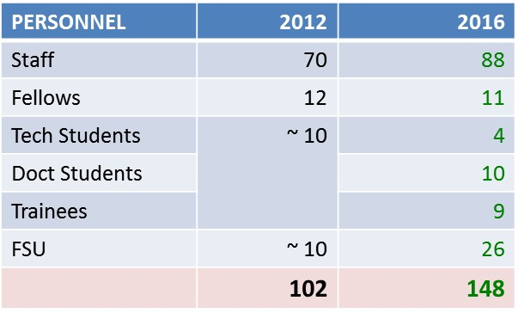
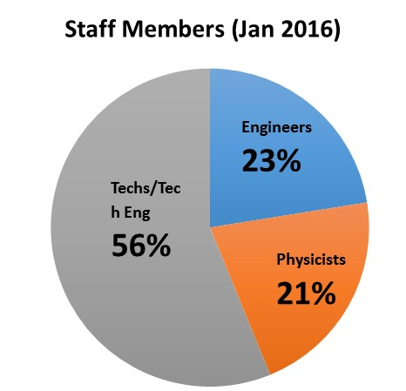
EP-DT Group
Projects
Services

Slide 4
Engineering Office (EO) Section
Mandate
To provide design & engineering expertise for the group’s projects
11 Staff members
1 Fellows
1 Tech Students
Staff and fellows profile:
8 engineers
4 designers
Averaging in between 11 and 20 engineers and designers per year.
4

Slide 5
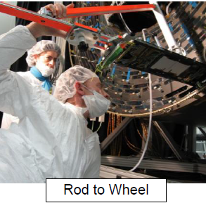
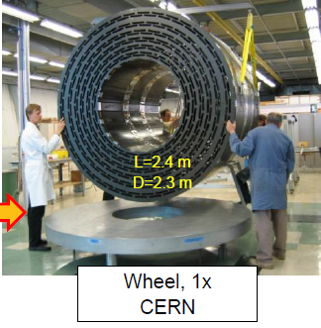
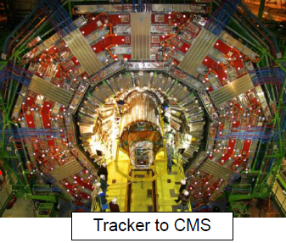
DT & EO in LHC Projects
Example CMS TOB, Tracker Outer Barrel

Slide 6
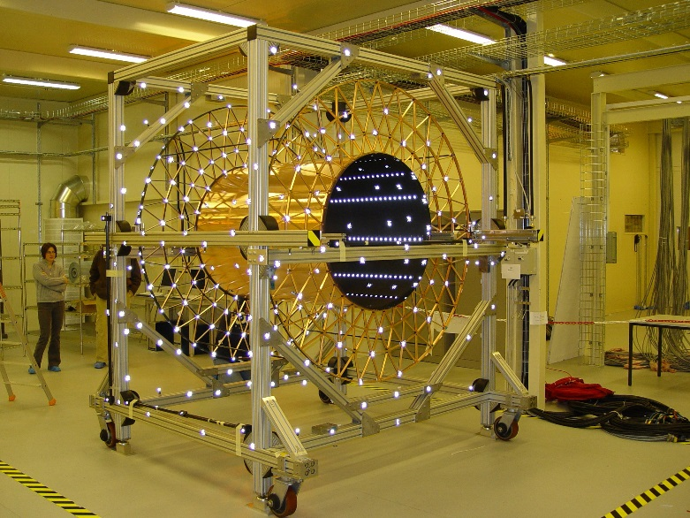
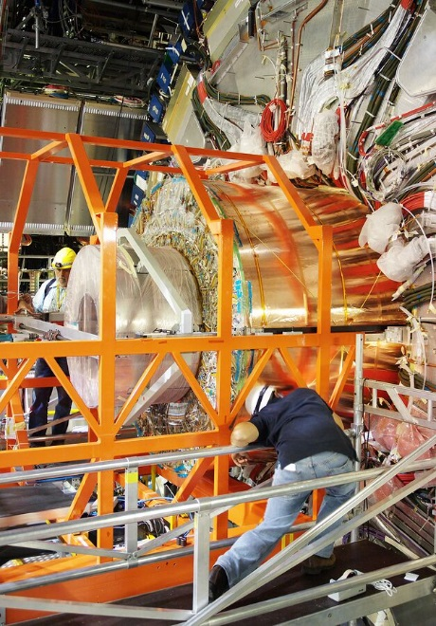
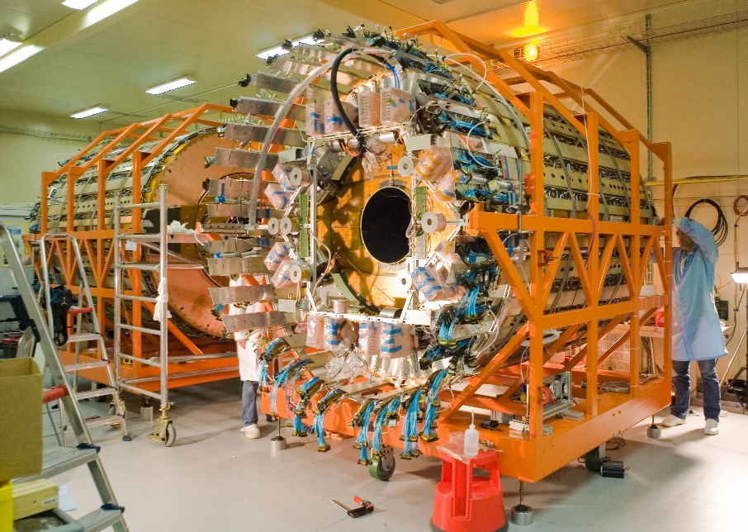
DT & EO in LHC Projects
Example ATLAS TRT and full Inner Detector,

Slide 7
DT in LHC Upgrades
LHCb
Up to LS2
Velo (mechanics)
ALICE
Up to LS2
LS3
ATLAS
Up to LS2
NSW Module0
UT (integration)
Integration aspects
Pixel (integration)
TK (modules, engineering
CMS
Up to LS2
Integration aspects
ALICE TPC (GEM prod.)
LS3
ITK Pixel
CO₂ cooling
CO₂ for Pixel
CO₂ cooling
GE1/1 (GEM prod.)
RICH/TORCH
ATLAS AFP (controls)
SciFi (detector)
ITS
CO₂ cooling
Detector Upgrades: EP-DT partners with CERN teams in the experiments (WP agreements)
On top, continuous M&O responsibility for magnet controls & safety, all gas systems, cooling coordination and since LS1 CO₂ detector cooling M&O

Slide 8
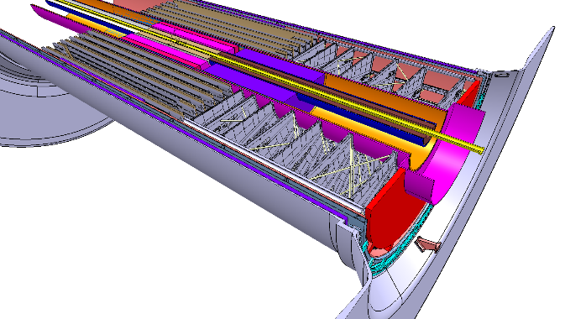
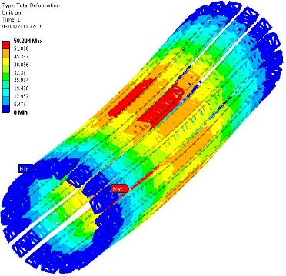
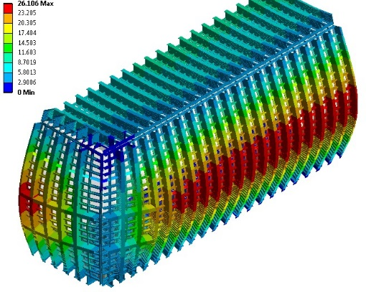
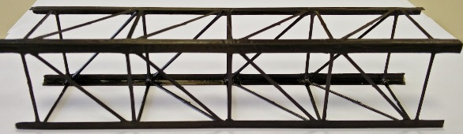
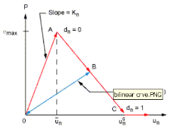
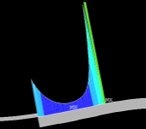
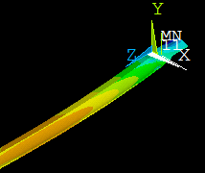
Section EP-DT-EO
Competencies & Infrastructure
EO covers a wide range of disciplines in mechanical engineering, construction, and numerical simulation fields.
The core competencies of the section comprise:
  Design studies, 3D modelling and drafting
  Integration studies of detectors
  Simulation for structural and thermal analyses, composites, fluid-dynamics, multi-physics and structural verifications according to relevant standards and codes
The section covers as well activities of:
  Composite Material prototyping and manufacturing
  Project Engineering, manufacturing support and follow-up, relations with external suppliers, installation and first commissioning.
A range of tools available for CAD, Finite Element Analysis and analytical tools, rapid prototyping techniques (3D Printing)

Slide 9
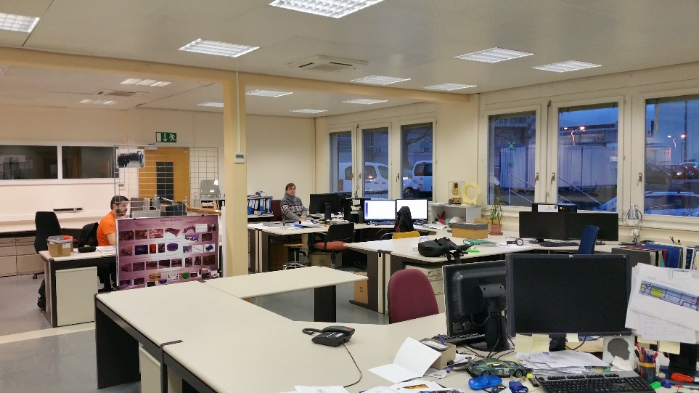
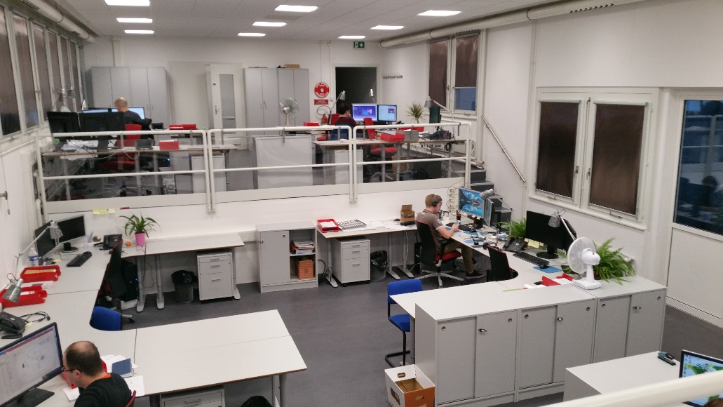
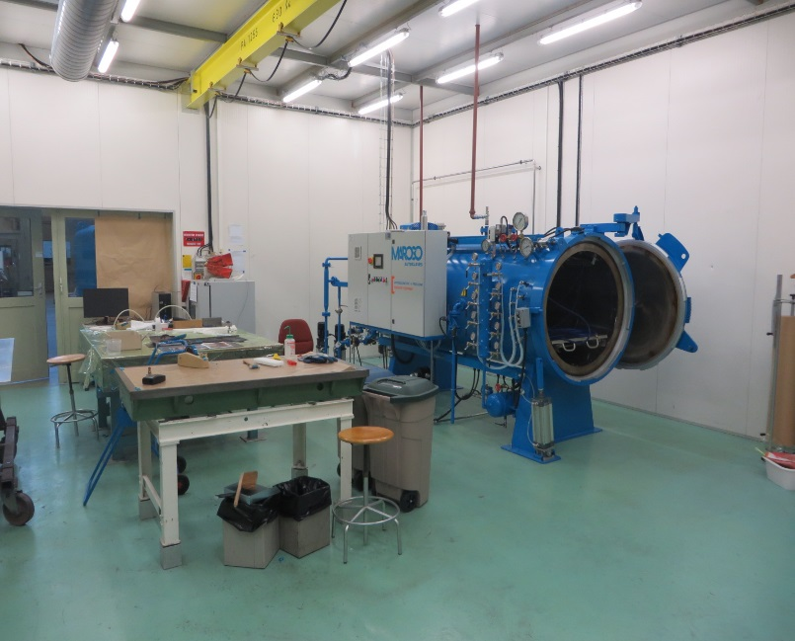
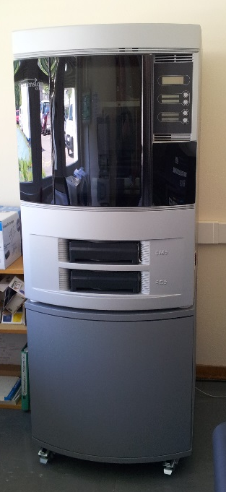
EP-DT-EO Infrastructure
Two open spaces and offices able to host 26 engineers and designers
Composite lab equipped with autoclave: provide capability to produce prototypes and final quality parts !
Testing equipment for R&D prototype characterisation
Additive Manufacturing 3D print (ABS)
Small test benches and equipment for project R&D (upgrades Atlas and CMS, Micromegas, LCD, etc.)

Slide 10
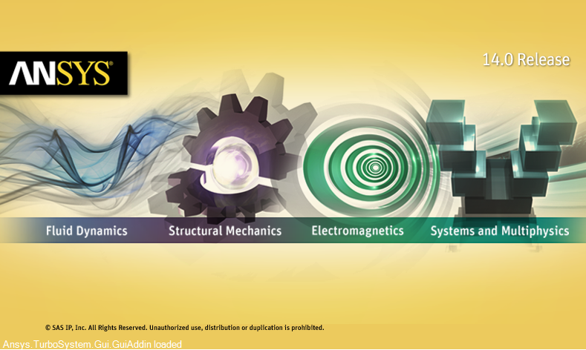
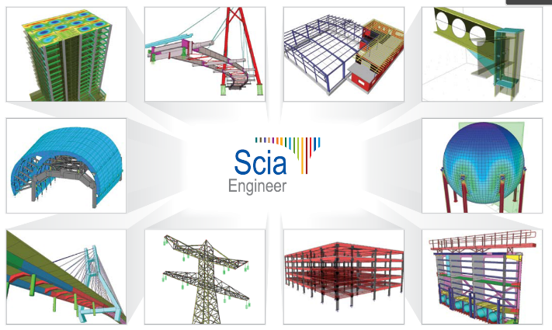
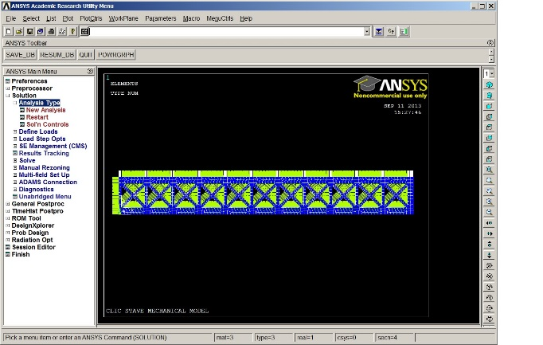
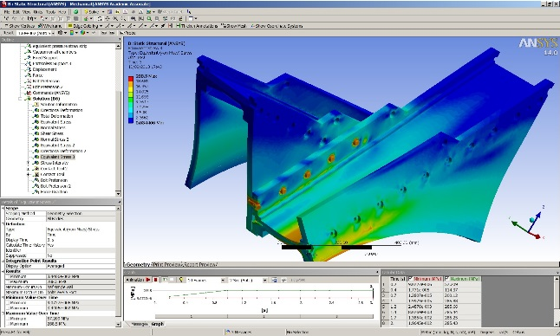
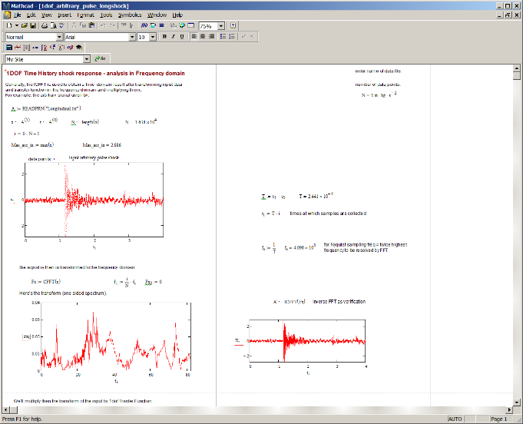
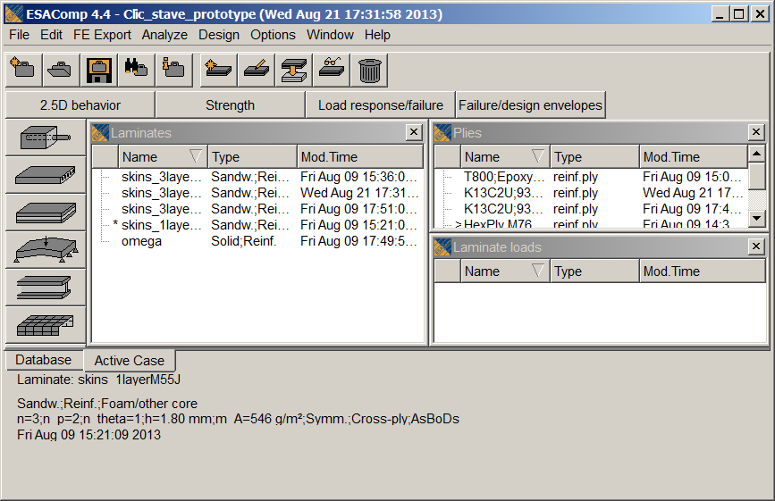
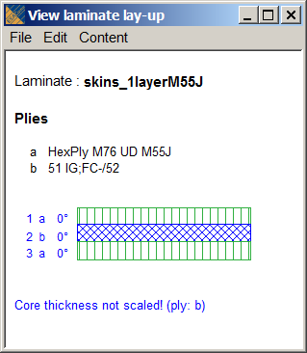
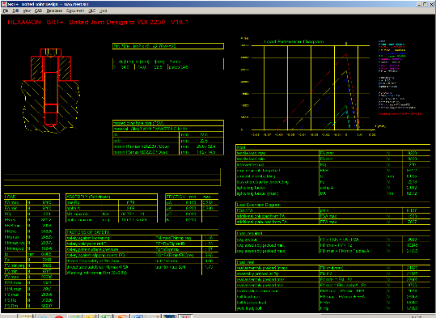
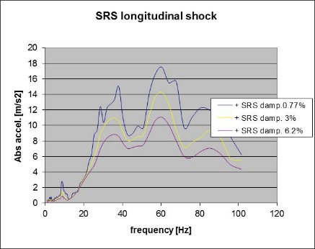
Main Engineering Tools (EO)
ANSYS Classic and APDL programming
Scia Engineer Structures
Analytical Mathcad library
Composites EsaComp
ANSYS Workbench
EXAGON assemblies
Vibration SRS software

Slide 11
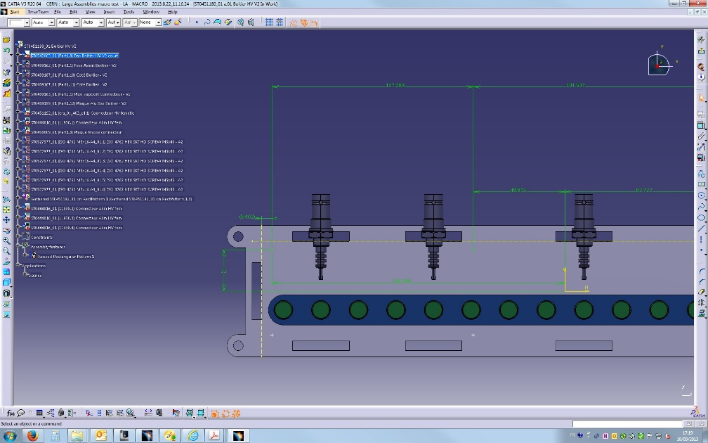
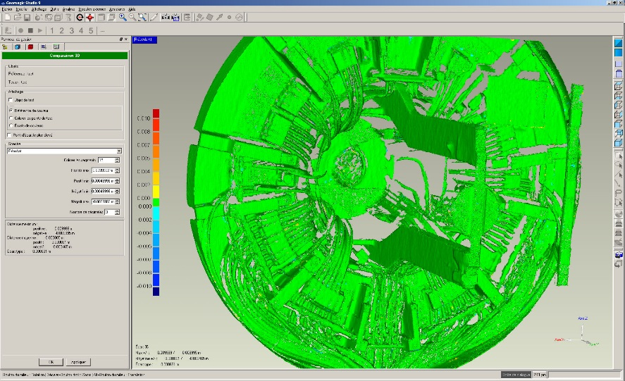

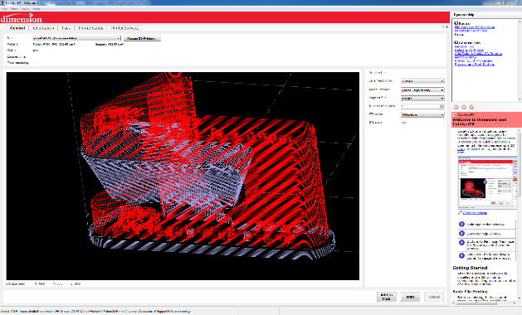
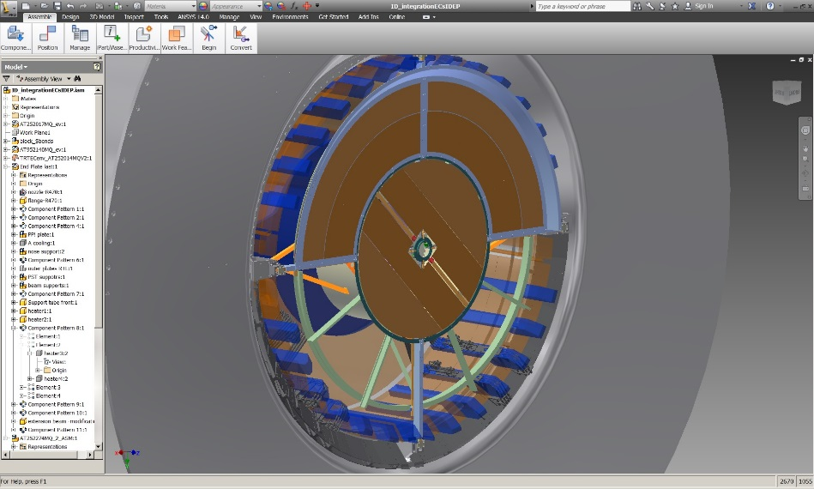
Main Design Tools (EO)
Geomagic – laser scan reconstruction
CATIA V5 - 3D modeling and Smarteam
Catalsyt for 3D printer Dimension Elite
Autodesk Inventor - 3D modeling

Slide 12
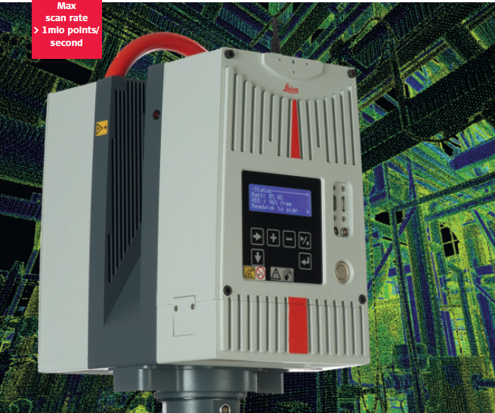
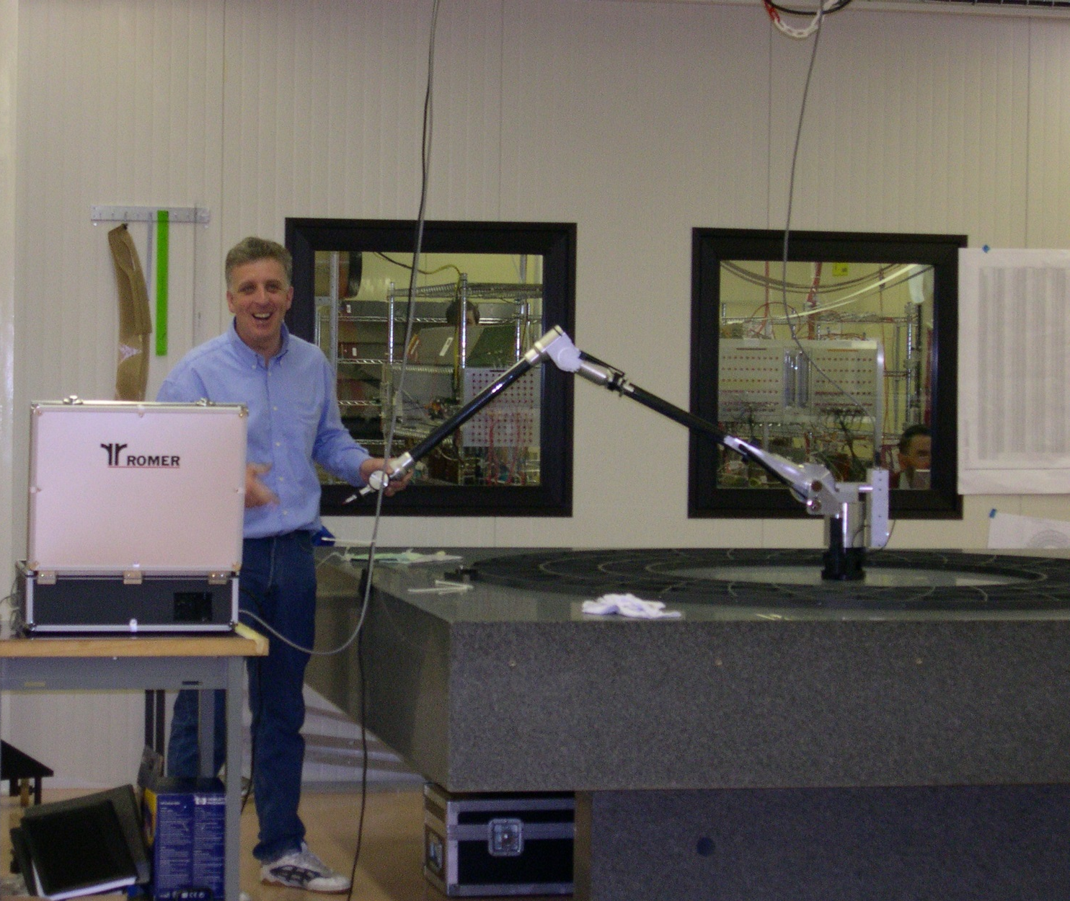
Integration design Tools (EO)
Leica HDS6200:
Ultra-high speed
scanning with > 1 million points/second. Reduces time needed for scanning
Romer Robotic measurement arm

Slide 13
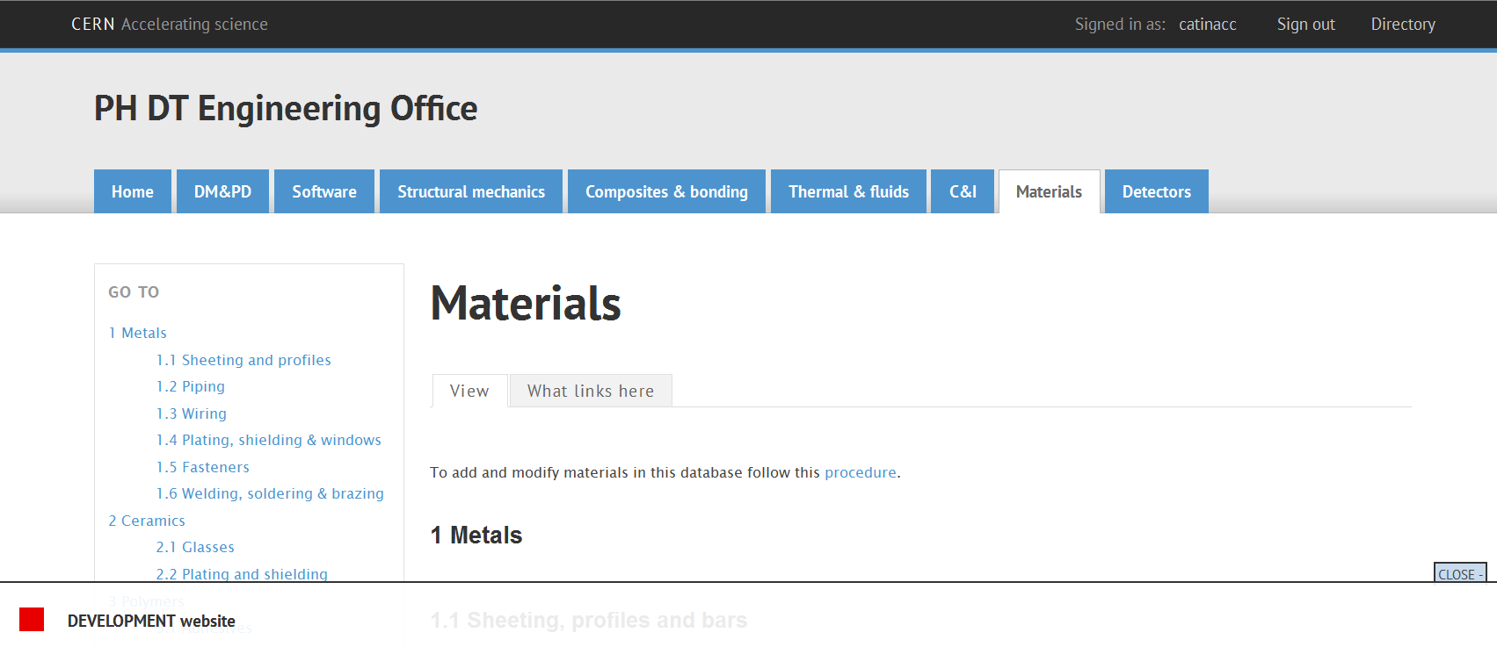
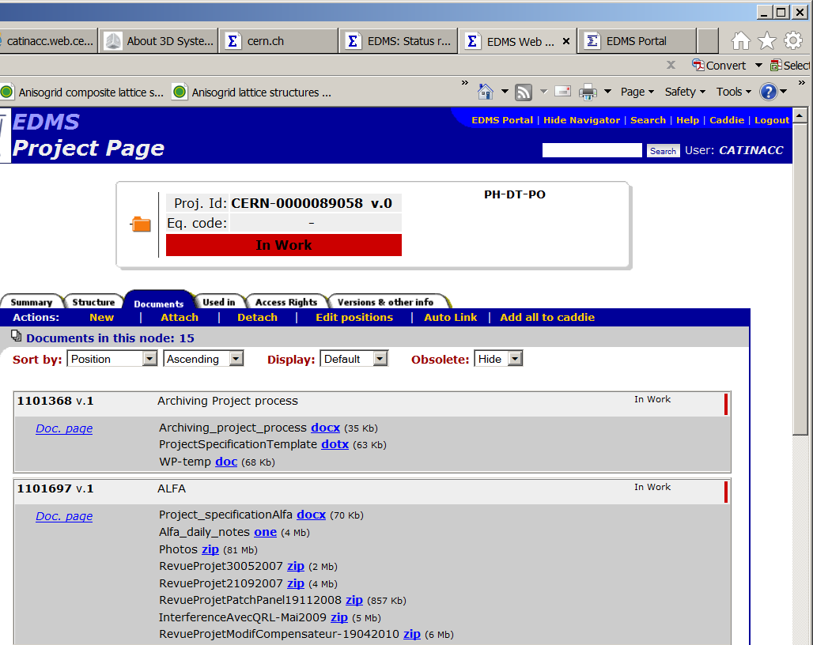
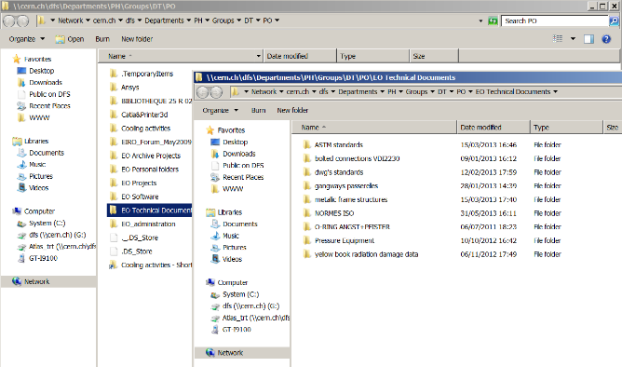
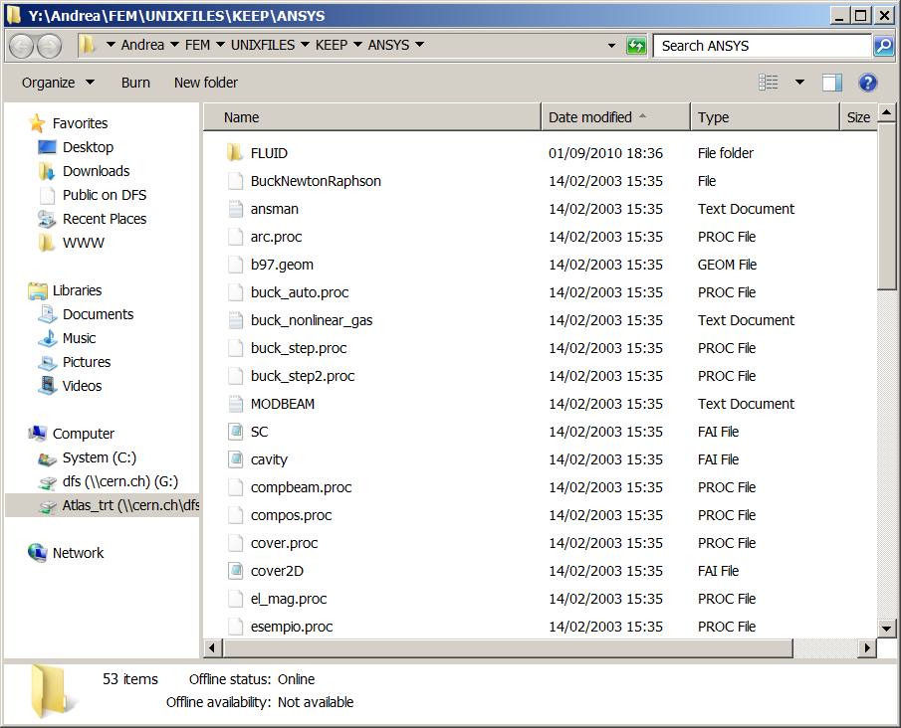
Web - EDMS and \dfs EO libraries
https://ph-dep-dt-eo.web.cern.ch/
ANSYS APDL scripts library
https://edms.cern.ch/nav/P:CERN-0000089058:V0/P:CERN-0000089058:V0/TAB3
Mathcad section library

Slide 14
EP-DT-EO Current Projects
More than 30 projects / activities (non exhaustive list):
Atlas Upgrade ITk Pixel, Pixel structures R&D, Slim project nIDEP design (closing of ID) Micromegas design, FEA CMS : Upgrade TOB, TIB Upgrade High granularity Si Calorimeter Alice ITS upgrade ITS, TPC, installation LS2 TC, integration LHCb upgrade (SciFi tracker), UT detector TC integration, infrastructure design and calculations | NA62 Straw detector GTK integration and micro-cooling TC integration Neutrino LBNF: Structural engineering and design review 4.6 FTE’s period end March end May. Still ongoing. LCD: CLICdp Vertex, Integration studies HCAL, ILC collaboration AIDA FCAL Support to the Cooling Project (EP-DT-FS)

Slide 15
EP-DT-EO Current Projects
More than 30 projects / activities (non exhaustive list):
Support (other projects) Micro-fabrication and micro-scint: Engineering support (for GTK, LHCb Velo, Alice), XY table FEA support: CMS HCAL, fracture mechanics, CMS tracker (student FEA), Alice ITS laser bonding, etc. Micro Cooling CFD Latch opto-links with ESE, design, creep studies X-ray generator Cubic GEM detector X-Ray bench x detector testing 3D printing, Catia user support | Composite lab Tools and infrastructures Prototype activities Thermal Testing Setup Engineering database Structure implementation Populating DB R&D Composite materials Thermal management materials Silicon fracture mechanics FEA methods: creep, CZM, fracture mechanics, XFEM, Ansys-Catia bi-directional associative connection, FEA model integration 3D printing technologies (Christophe)

Slide 16
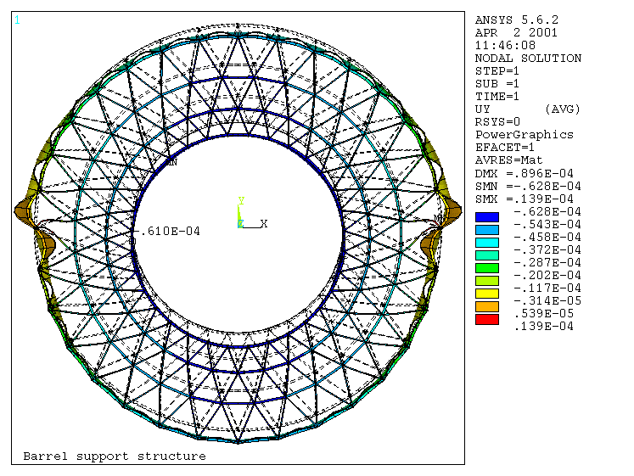
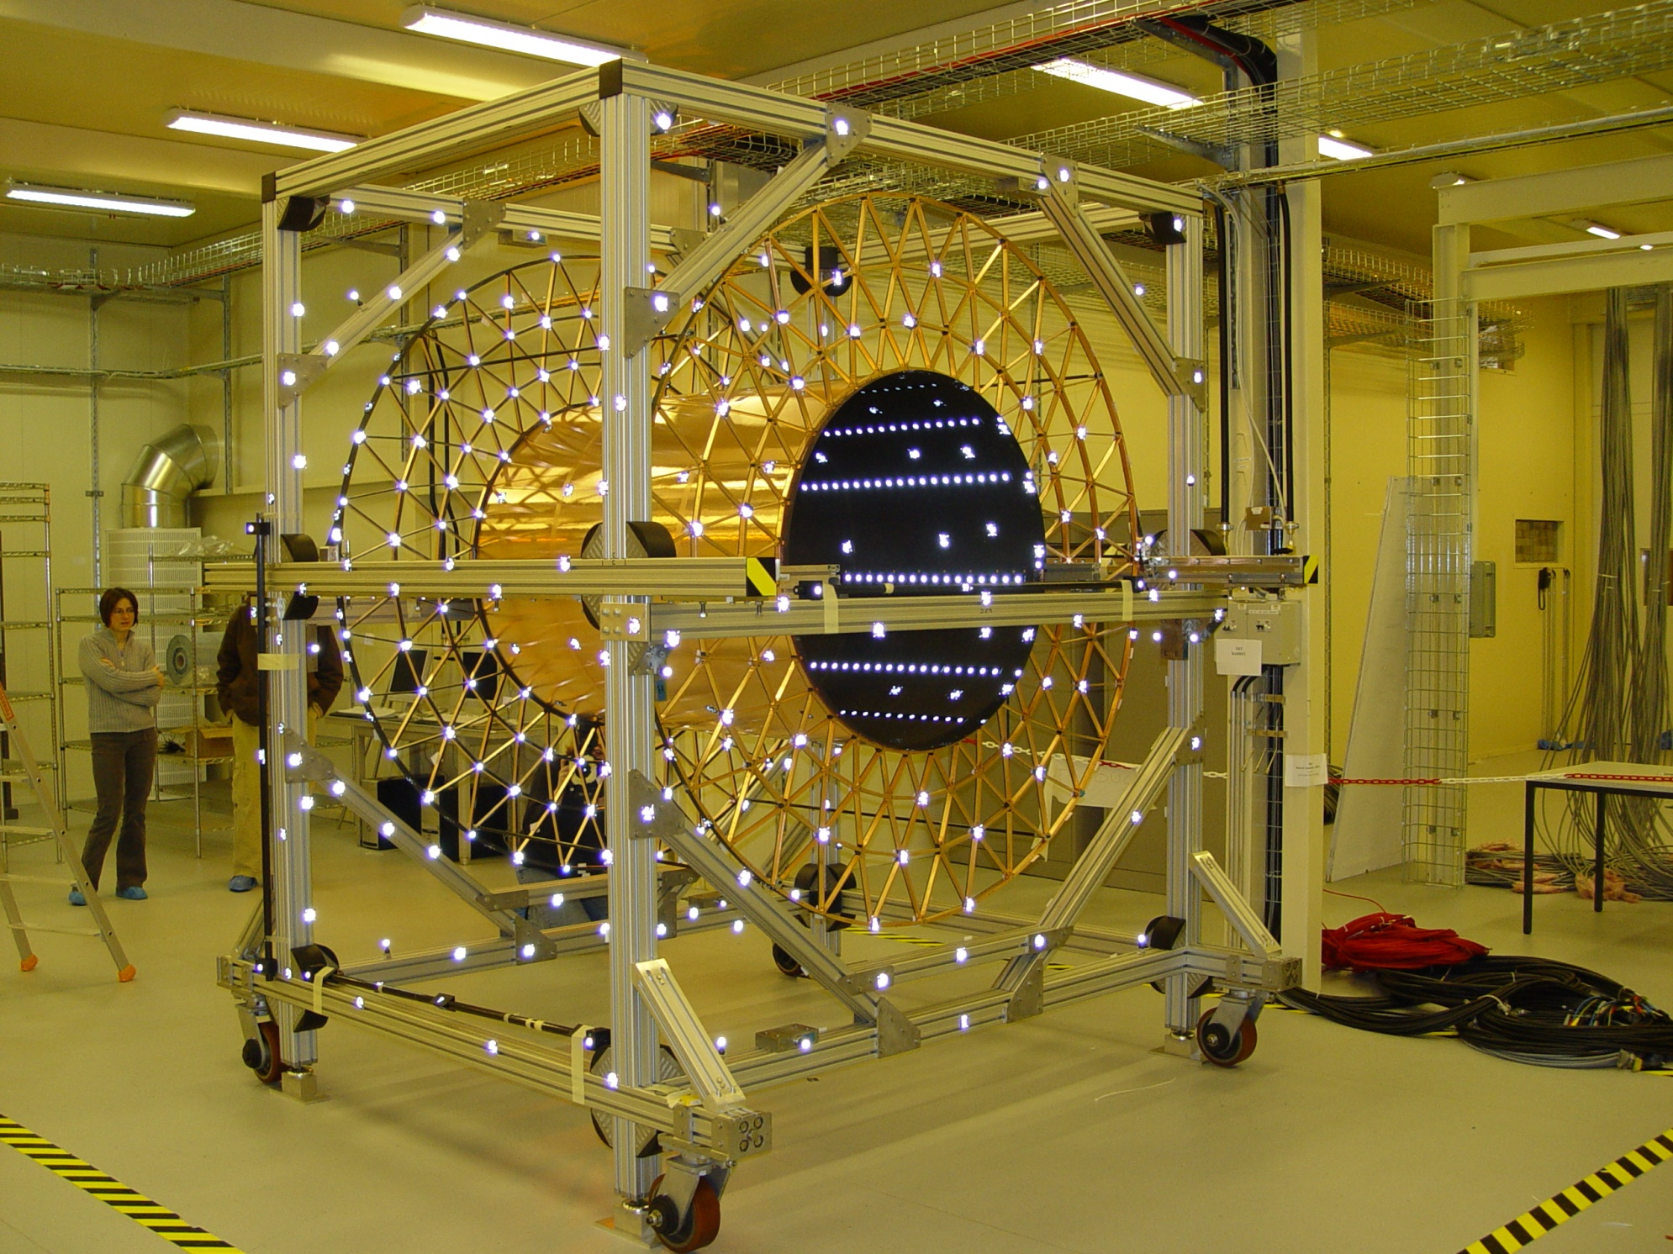
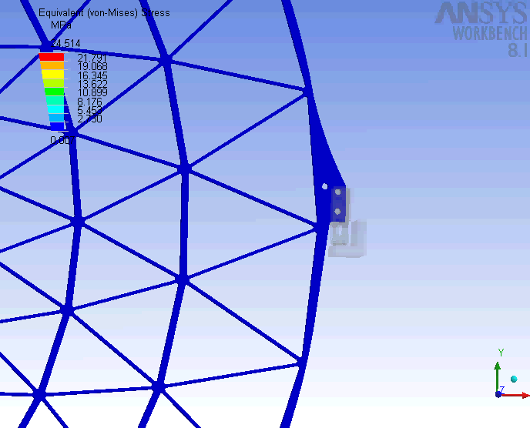
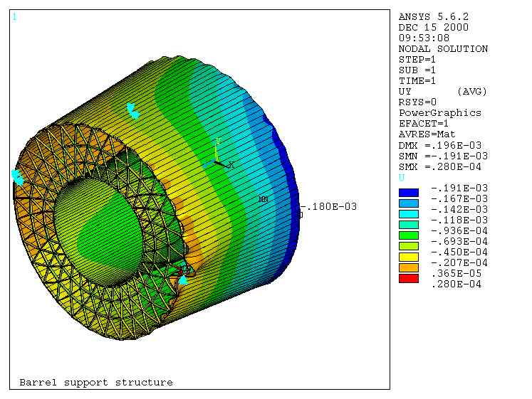
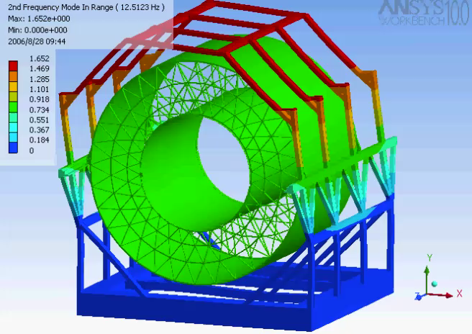
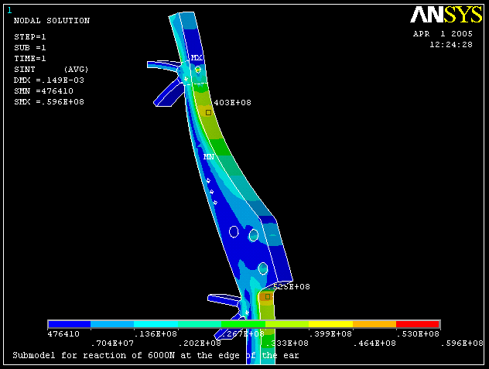
Some FEA examples for the ID BSS

Slide 17
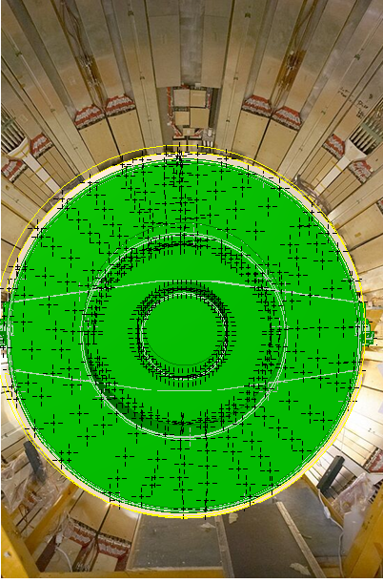
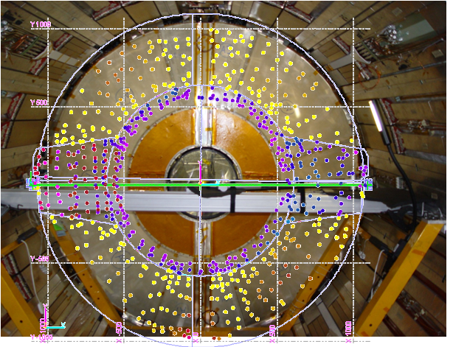
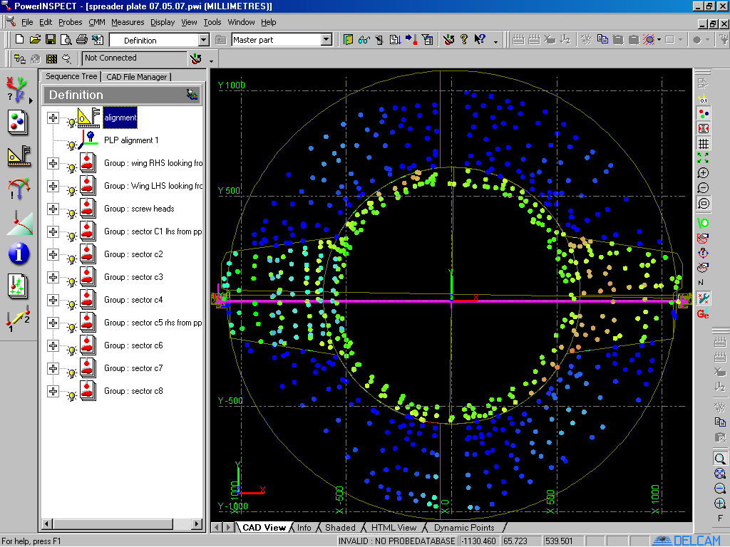
Integration tools – Robotic arm
Virtual positioning and probing (envelope of the front IDEC-A re-constructed)
A. Catinaccio - CERN
17

Slide 18
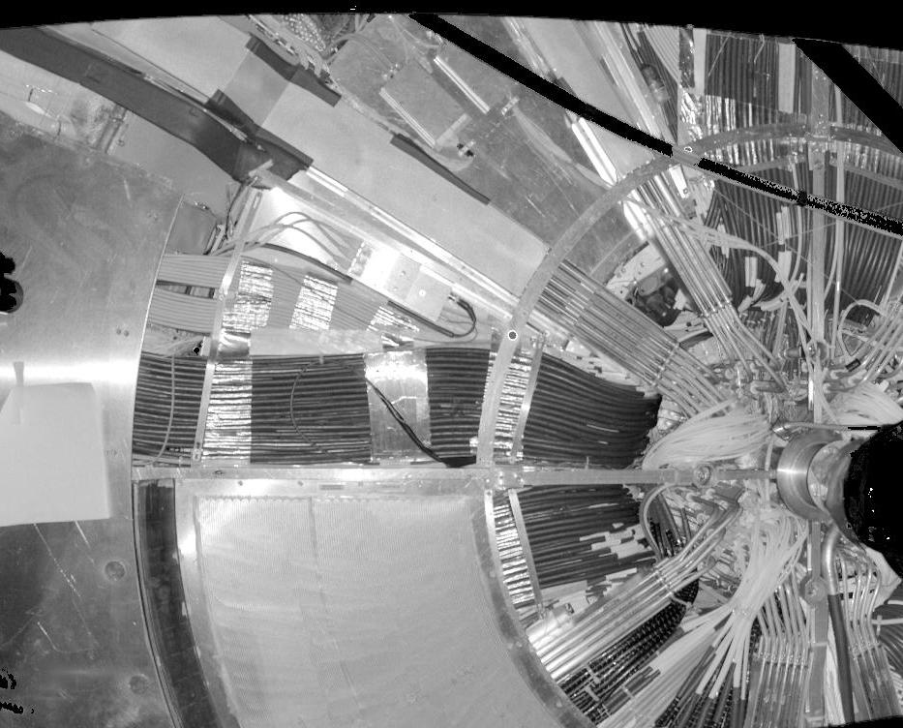
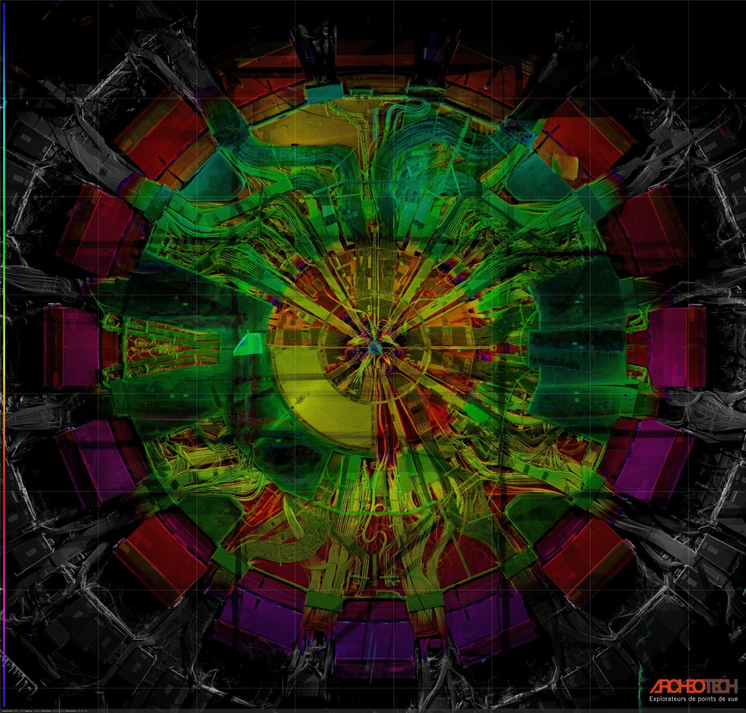

Integration tools – Laser scanner
Photo
Laser scan
Laser scan
A. Catinaccio - CERN
18
Notes:
18

Slide 19

Neutrino LBNF Detector: LAr Cryostats
4 x Steel Cryostats containing approximately 17kT of LAr
Internal Dimensions:
L = 62m
W = 15.1m
H = 14m
Long Wall ~114MN
(11.6kT)
Short Wall ~27.7MN
(2.8kT)
ANSYS WB Beam and beam-shell models of ¼ cryostat:
  Offset beams to simulate the main frame and the grid
  Shells to represent the warm vessel (10mm thick)
  Joint (MPC184) to model imperfect connections
(http://www.gtt.fr)
Notes:
TCP= Time Projection Chamber
SURF: Sanford Underground Research Facility
DUNE: Deep Underground Neutrino Experiment
The DUNE collaboration will develop detectors for both sites:
A fine-grained near neutrino detector to be installed 600 m downstream of the Fermilab beamline.
A 40,000 metric ton cryogenic liquid argon detector deployed deep underground at Sanford Lab, located 800 miles (1,300 km) downstream in South Dakota.
Examples of the loads exerted by the LAr on the various walls:
Long Vertical Wall: approx. 114MN (equivalent to 11.6kT).
Short Vertical Wall: approx. 27.7MN (equivalent to 2.8kT).

Slide 20








ANSYS WB: LBNF Cryostat Connections
Shell-to-Solid sub-modelling approach for structural connections:
  Bolts & Welds compliant with ASME Div2
Top Connection
Global Shell Model
Splice Connection
Bottom Connection

Slide 21




SCIA software – FEA and EC3 compliance
Axial loads
Moments
Vertical beams – compliance with Eurocodes

Slide 22


EC3 Mathacad – analytical calculations

Slide 23

Atlas Tracker Upgrade phase II
The ITk global
engineering effort
Integrated model and envelopes
Overall ITk support structure
Pixel global support
Barrel strips global support
Endcap strips global support
Thermal enclosure design
Surface assembly and installation
Access scenarios
Failure management
Material for Simulation
Positioning Requirements
Common standards
Internal services
PP1 and TE feed-troughs
CATIA V5 model of the integrated Atlas ITk

Slide 24






ANSYS ACP: CFRP Cylindrical Iso-grid
Feasibility study for ATLAS ITK Outer Cylinder
Edge-wise rosette to define fibre direction in the hoop, helicoidal reinforcements

Slide 25







ANSYS WB & ACP: Global ATLAS ITK Model
Global, integrated FEA model to assess:
  Interaction between different sub-detectors for different design configurations
  Influence of support conditions during service life (e.g. transport, insertion, final position)

Slide 26



ANSYS WB & ACP: ATLAS ITK CFRP Truss
ATLAS Pixel Barrel: Design and optimisation of CFRP truss (filament winding)
Corner longitudinal reinforcement
g
Cross-member
Angular section

Slide 27





Fracture Mechanics Prediction Tool for ScSi
Development of prediction methodology for ScSi (experimental + numerical)
  Fracture testing of ScSi (SEVNB Test samples)
  J-integral approach in ANSYS
Validated with standardised pressure test samples (single channel)

Slide 28




Alice Si micro-channel CFD simulations – manifold optimization (ANSYS CFX)

Slide 29








Other examples of projects
ALICE Inner Tracker Silicon Upgrade
Mechanics and Cooling New design and prototype
ATLAS Micromegas
ALICE upgrade (ITS)
CMS Tracker upgrade
NA62 design and construction
Carbon Fibre reinforced structure
with embedded polyimide cooling pipes (OD=1mm)
Outer layer stave 1500mm length, 80 gram weight

Slide 30
Material

Slide 31


Skills and Capabilities (EO)
3D modeling and drafting
Advanced FEA: structural mechanics, thermal, fluid, coupled-analyses
  Static structural
  Modal analysis, pre-stressed modal (FEA & Experimental)
  Harmonic analysis (steady state response)
  Transient dynamic (implicit transient response)
  Vibrations & shocks: spectrum analysis, random vibration analysis, SRS.
  Buckling analysis: linear (eigen-buckling) and non-linear methods
  Non-linearities: changing status (ie contacts), plasticity,
  creep, large strain, stress stiffening …)
  Fracture mechanics
  Composite analysis (micromechanics, lamination properties, failure criteria …)
  APDL routines
Knowledge of materials metals, polymers, composites
Standards and calculations for: metallic frames, pressure equipment, lifting equipment …
Connections: bolted, welded, bonded
Analytical methods and Mathcad library
Testing, metrology integration tools (Laser Scanner, Romer Arm)
Production follow up, QA

Slide 32
EP-DT Detector Technologies
Group leader: Mar CAPEANS
Deputies: Andrea CATINACCIO & Michael MOLL
Secretariat: Veronique WEDLAKE
Safety Linkperson: Isabelle MARDIROSSIAN
Contact Persons for Experiments and Projects
Technology & Physics
(DT-TP)
Burkhard SCHMIDT
Detector Development
(DT-DD)
Petra RIEDLER
Fluidic Systems
(DT-FS)
Paola TROPEA
Detector Interface
(DT-DI)
Giovanna LEHMANN
Engineering Facilities
(DT-EF)
Hans DANIELSSON
Deputy: PA.GIUDICI
Engineering Office
(DT-EO)
Andrea CATINACCIO
Detector Construction & Operations
(DT-CO)
Antti ONNELA
Deputy: F.PEREZ
DAVENPORT Martyn
GYS Thierry
HAHN Ferdinand
HAIDER Stefan
JORAM Christian
KLEMPT Wolfgang
MARTINENGO Paolo
SROKA S (Fell)
KOSTOGLOU S (Tech)
Silicon det R&D
MAPELLI Alessandro
HONMA Alan
MCGILL Ian
MANOLESCU Florentina
BONNAUD J (Fell)
GALLRAPP C (Fell)
BRONUZZI I (Doct)
CURRAS E (Doct)
MATEU I (TRN FTEC)
NEUGEBAUER H (Doct)
OTERO Sofia (Doct)
PITAES C (TRN Pt)
Gas Det R&D
ROPELEWSKI Leszek (PL)
OLIVERI Eraldo
RESNATI F (Fell)
THUINER P (Doct)
Irradiation Facilities
RAVOTTI Federico (PL)
GLASER Maurice
FORTIN Richard G
GORINE G (Doct)
GOTKSE B (Doct)
GUIDA Roberto (Gas PL)
PETAGNA (Cooling PL)
CARRIE Patrick
DAGUIN Jerome
D'AURIA Andrea
DE MENEZES Louis-Philippe
MERLET Frederic
NOEL Jerome
PAVIS Steven
VERLAAT Bart
WASEM Albin
ZWALINSKI Lukasz
GIAKOUMI K (Fell EU)
MANDELLI B (Fell)
MOUSSY Y (Fell)
OSTREGA M (Fell)
PIMENTEL T (TRN Pt)
HELLENSCHMIDT A (Doct)
ROMAGNOLI G (Doct)
SPADAVECHIA N (Tech)
PONS Xavier
BLANC Pascal
BOURGEOIS Nicolas
DERONT Laurent
MAIRE Gilles
RAVAT Sylvain
RIGAUT Y.A. (PA)
Thin Film & Glass
SCHNEIDER Thomas (PL)
DAVID Claude
VAN STENIS Miranda
Micro-Pattern Tech
DE OLIVEIRA Rui (PL)
FERRY Serge
GRIS Alexandra
PIZZIRUSSO Olivier
RANCHIN David
RODRIGUES Alexis
TEIXEIRA Antonio
CHAMLEY C (Tech)
Machine Shops
BODE Alain
BRENDLEN Romain
BRUNEL Bernard
CANTIN Bernard
GARNIER Francois
Magnets support
BERGSMA Felix (PL)
Design room
BAULT Christophe (PL)
DEGRANGE Jordan
JAMET Olivier
LENOIR Philippe
Design and Analysis
ALVAREZ Diego
BATISTA Joao Carlos
DUARTE Fernando
GARGIULO Corrado
HATCH Mark
WERTELAERS Piet
MARTENSSON O (Tech)
Composite Lab
BOYER F (TRN VIA)
UNIT1
BENDOTTI Jerome
DIXON Neil
DUMPS Raphael
GONGALVES Antonio
KOTTELAT Luc-Joseph
KRISTIC Robert
LAHU Gregory
LOOS Robert
PIEDIGROSSI Didier
VERGAIN Maurice
VOGEL A (Fell)
UNIT2
ANSTETT Didier Henri
BOUVIER Philippe Jacques
IJZERMANS Pieter
LESENECHAL Yannick
VAN BEELEN Jacob Bastiaan
FSU PH40
FSU PH02
Projects
Services

Slide 33

Laser scan of ID services
Notes:
33

