Slide 1
CERN civil engineering
Dr. Luigi Scibile
Head of the Site Engineering Group
CERN Site Management and Building Department

Slide 2
Introduction
Existing CERN Infrastructure and brief history
Scope of work
Organization: Services and projects.
Site planning and development
Opportunities at CERN for Consultancy firms & Contractors
Examples of planned projects

Slide 3
Existing CERN Infrastructure and brief history
11/06/15
EDMS: 1516402

Slide 4
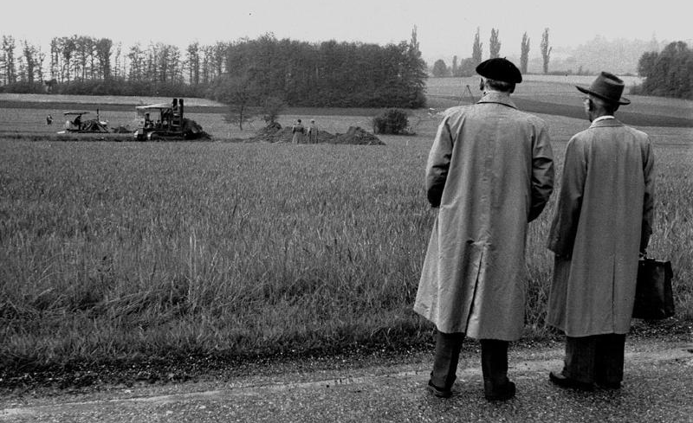
1954 - Day 1

Slide 5
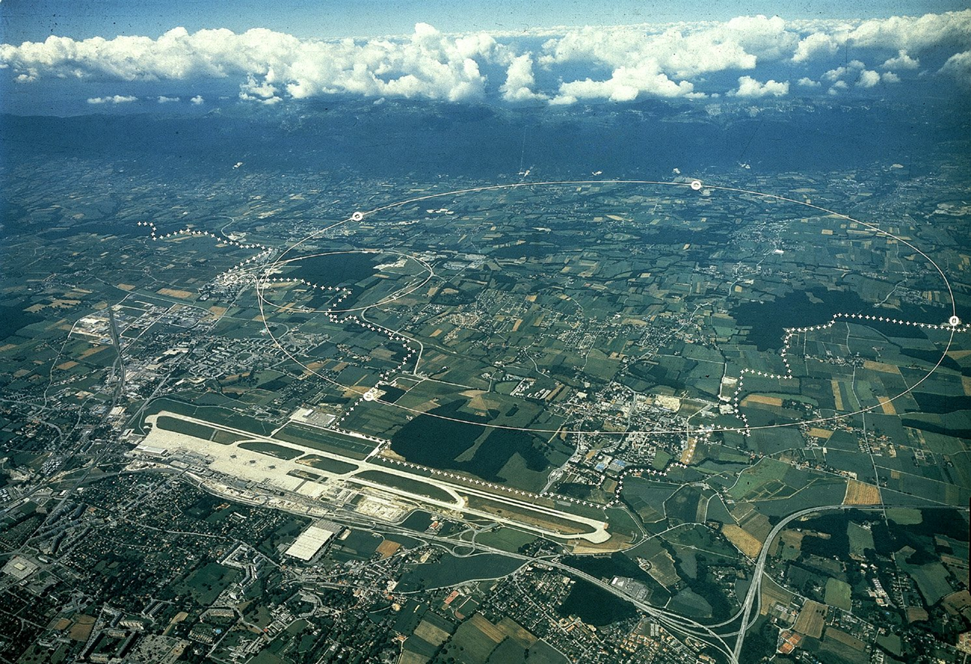
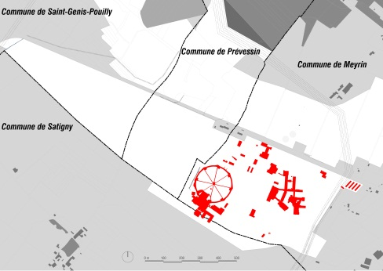
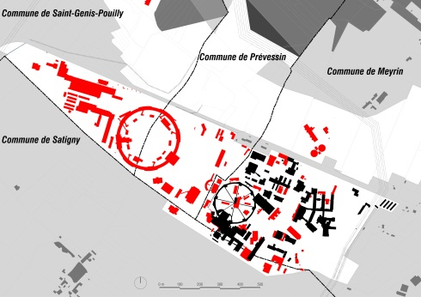
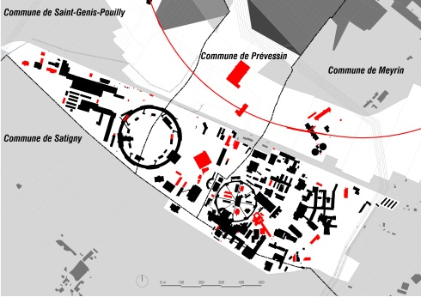
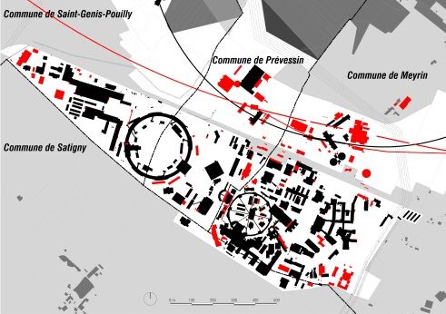
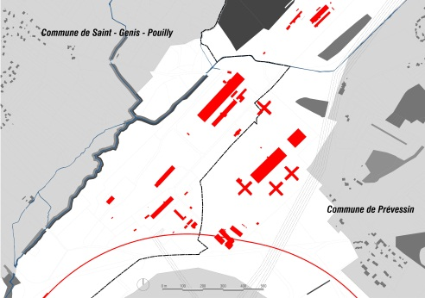
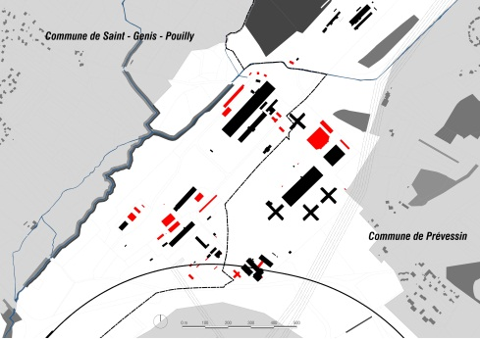
Two sites with a history
MEYRIN
1950-60
1960-75
1975-85
1985-10
PREVESSIN
1970-80
1980-10

Slide 6
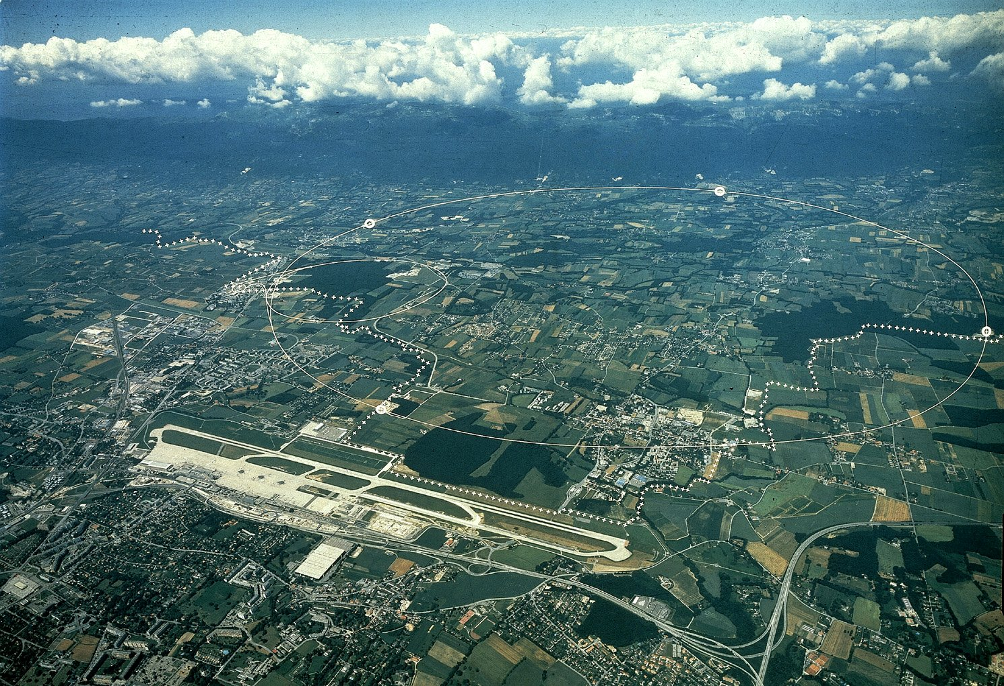
CERN Area
Prevessin (FR) Campus
Meyrin (CH) Campus (it extends in French territory)
LHC
Border

Slide 7
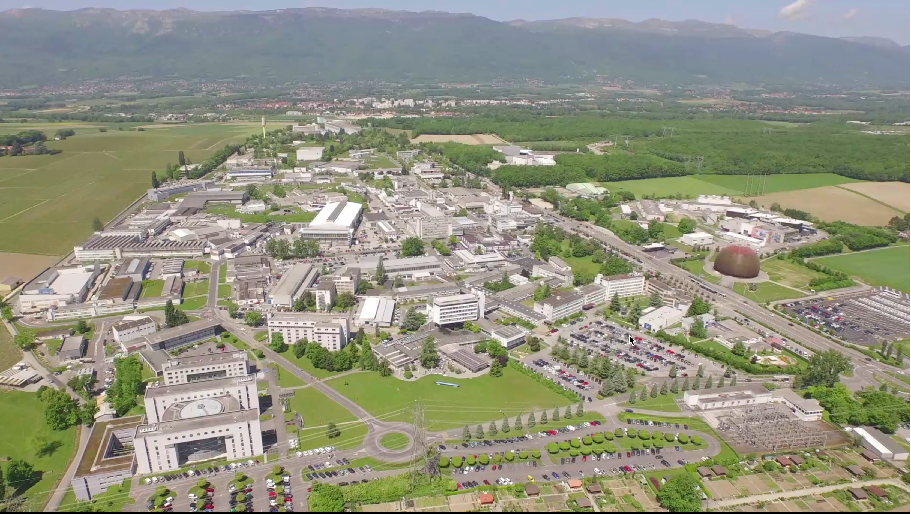
Meyrin site

Slide 8
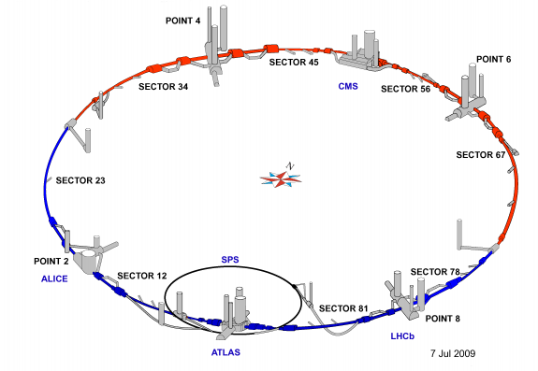
Current underground infrastructure
Tunnels:
27km long
100m approx. below grade
≈ 80km total length of tunnels

Slide 9
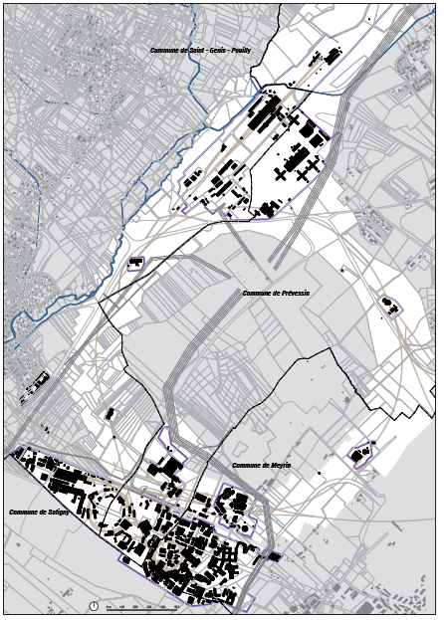
Overall key figures
590 hectares of available land
2 main sites
  Meyrin (CH)
  Prévessin (FR)
15 satellite sites
650 buildings - 10m² up to 20.000m² , 500,000 m² of surface
60% of the buildings are 30+ years old
80 km of tunnels
250 km of roads
1000 km of buried services

Slide 10
Site Engineering Group
The Site Engineering Group is responsible for :
  Design of all new buildings & civil engineering structures on CERN Site. Feasibility studies more often done in-house with outsourced consultancy services for more detailed design.
  Project Management for execution (with Consultants for larger projects)
  Maintenance of all buildings and underground structures
  Renovation Works
  HVAC & Electrical installation and maintenance for ‘tertiary’ buildings
  Patrimony data management
Group consists of approximately :
  10 engineers/architects
  15 draughtsman/designers
  20 technicians
Annual Group Budget approximately
  50+MCHF for Projects & Operation / Renovation Works

Slide 11
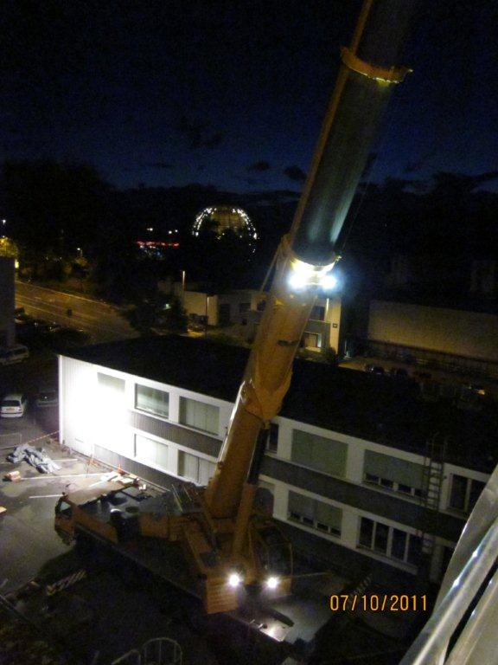
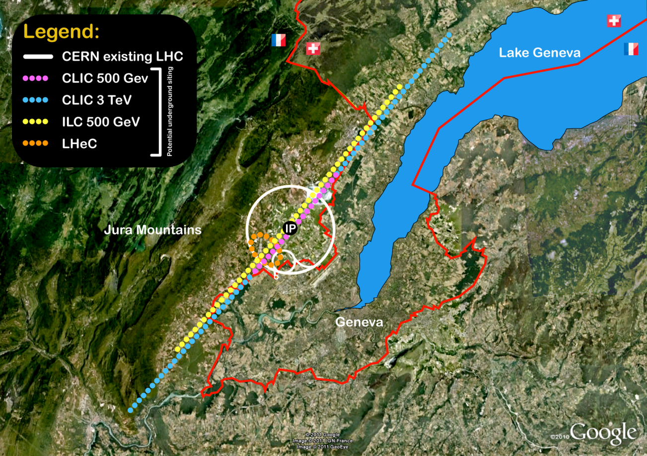
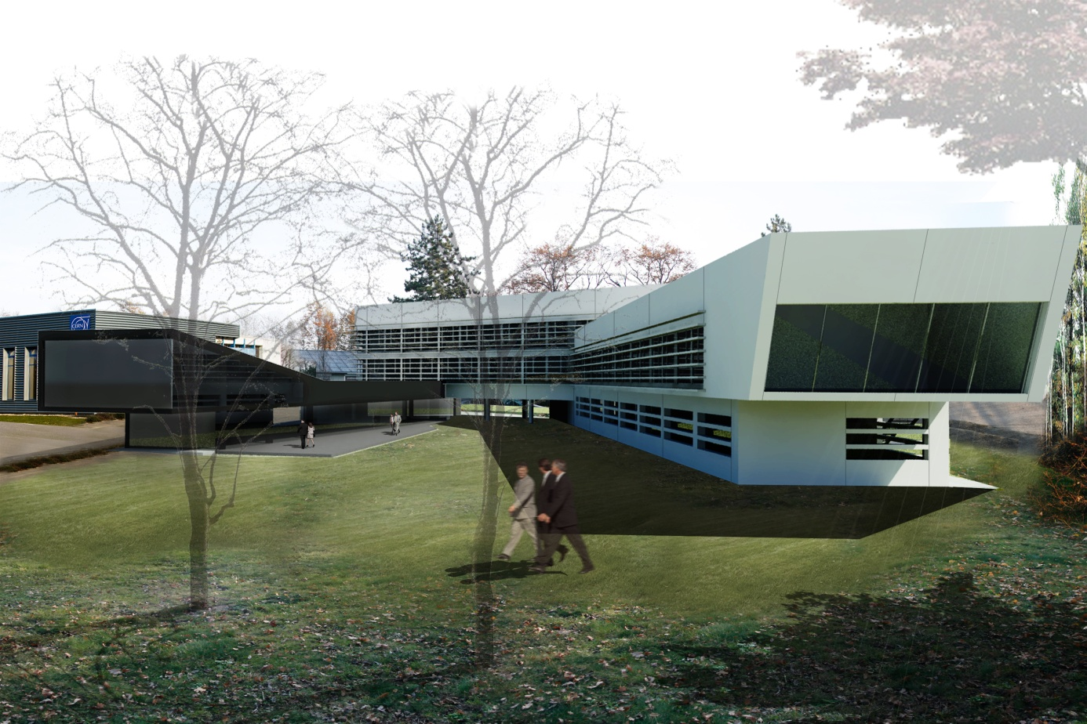
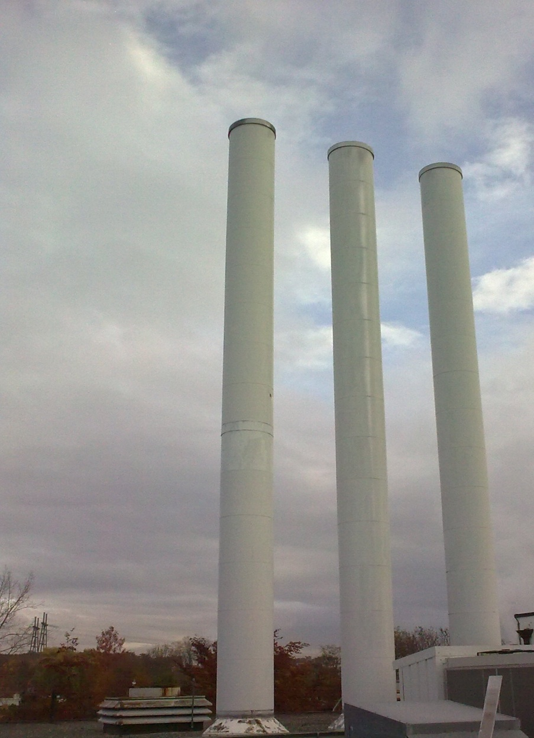
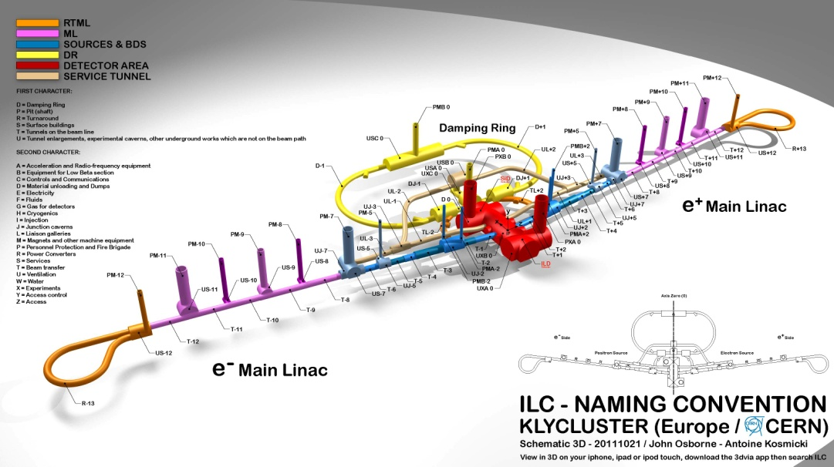
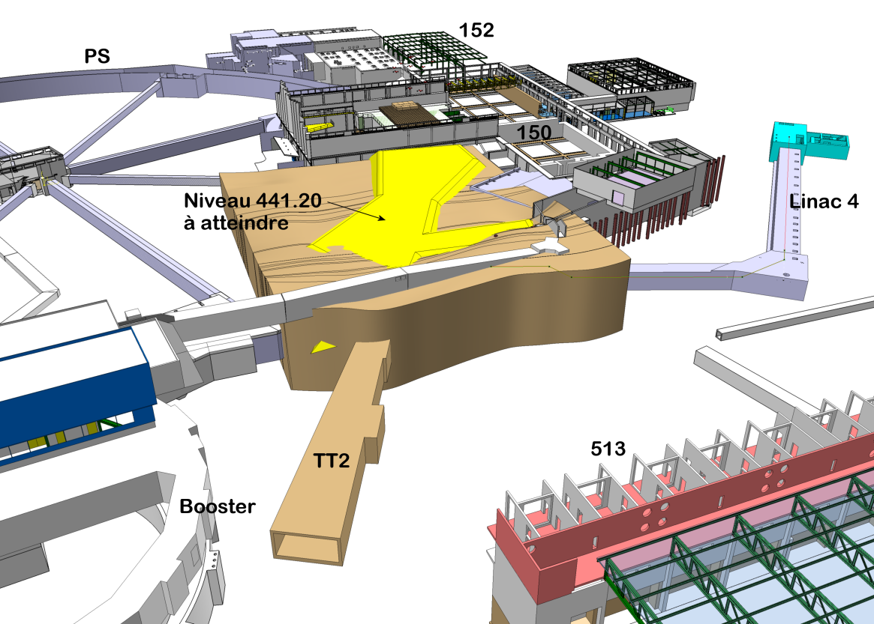
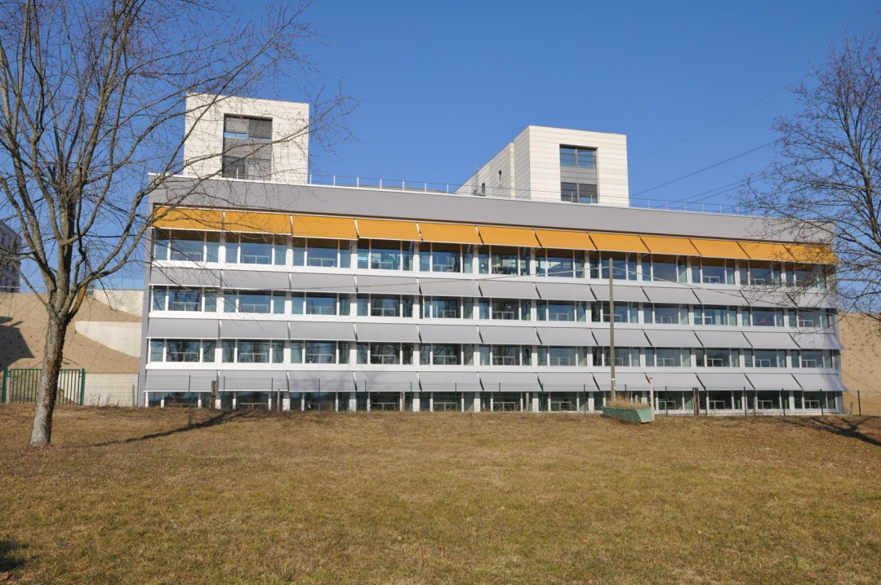
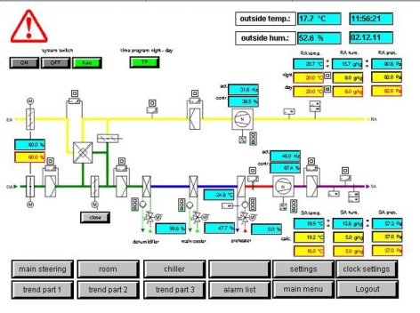
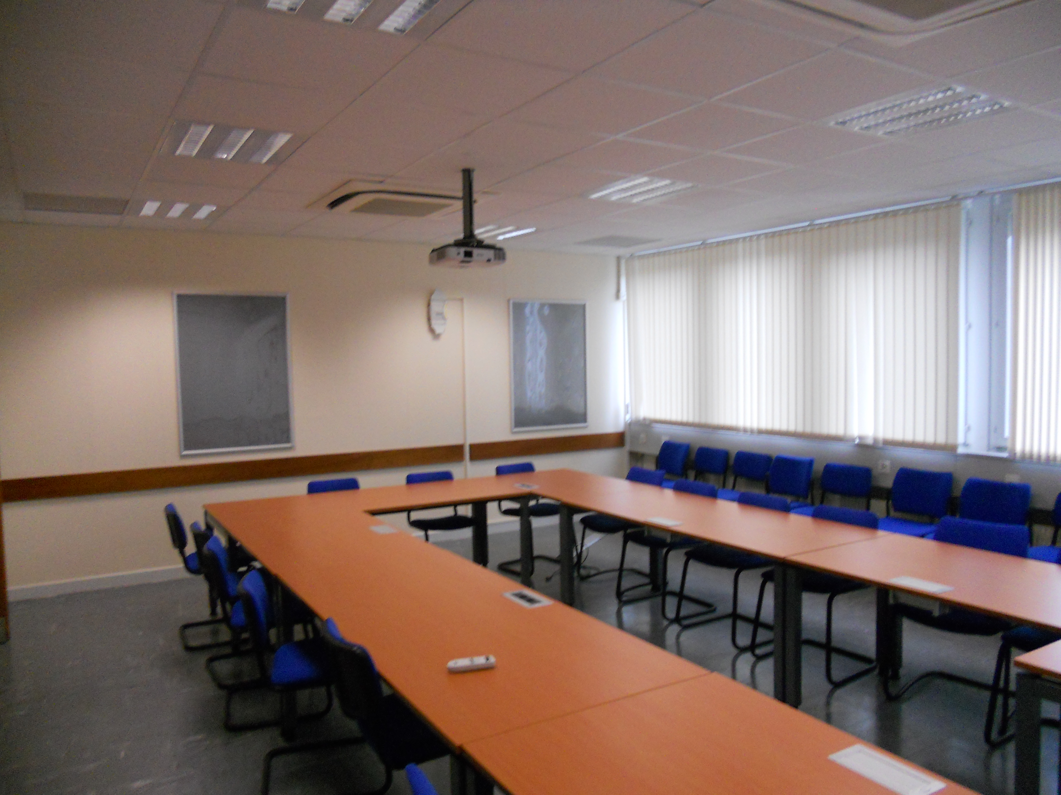
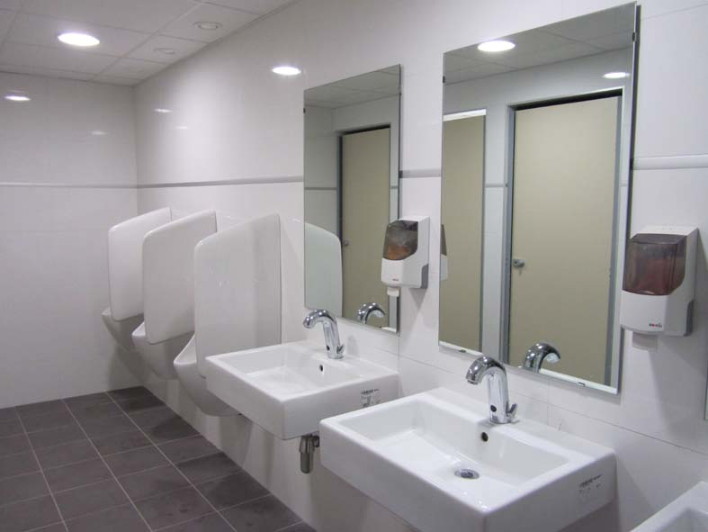
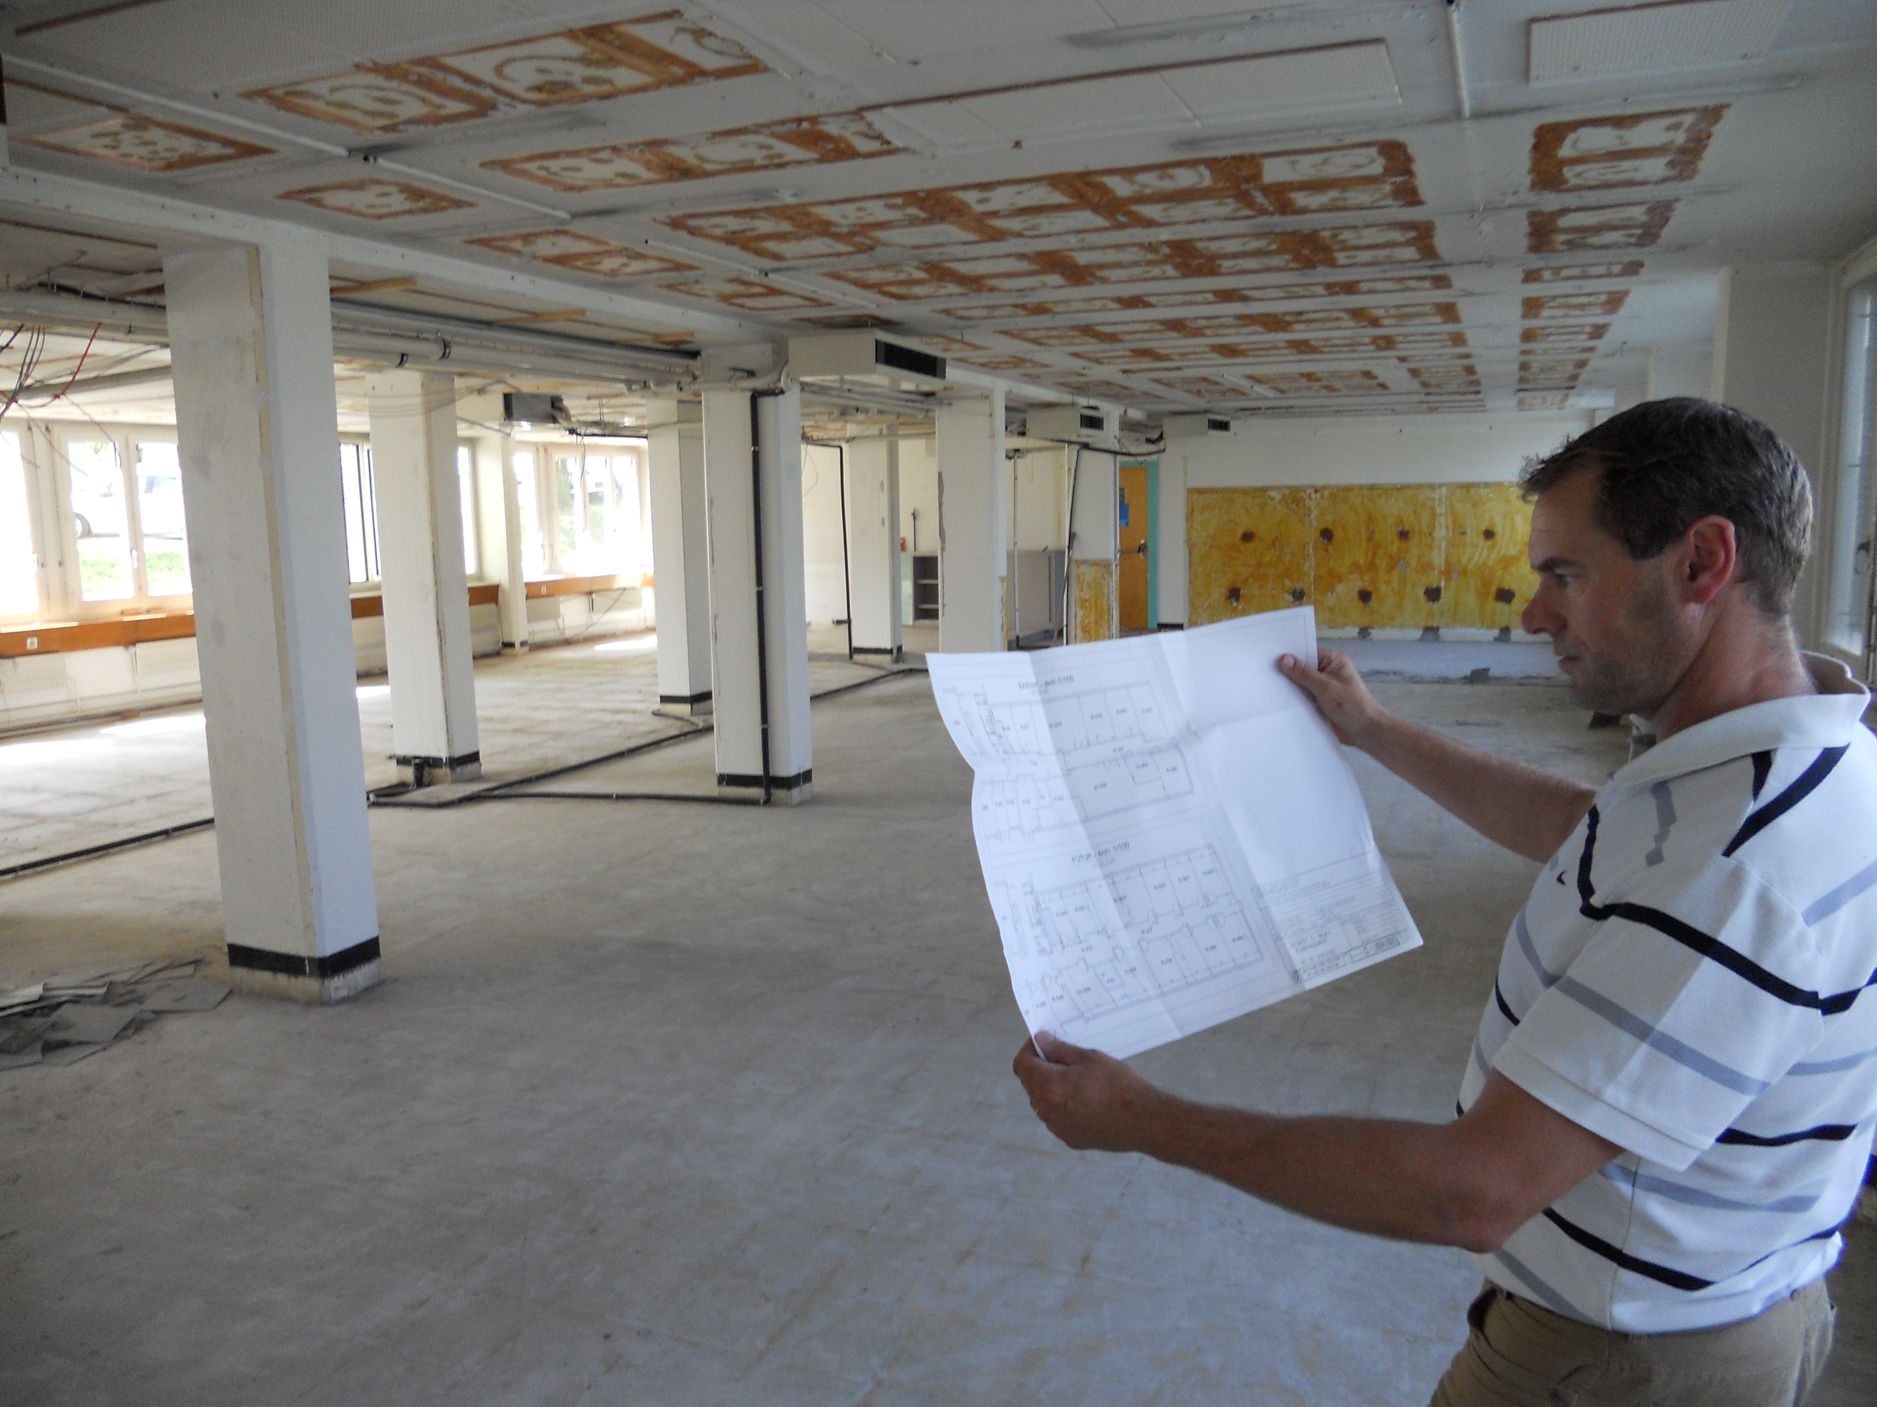
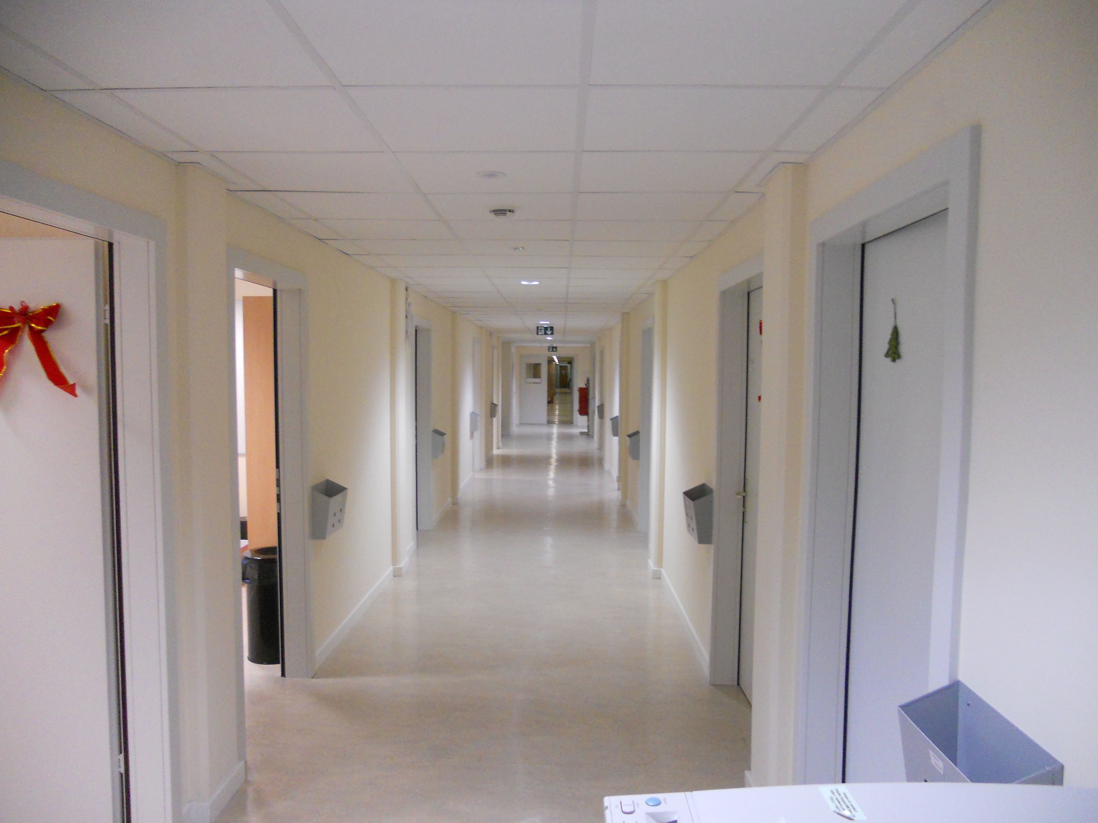
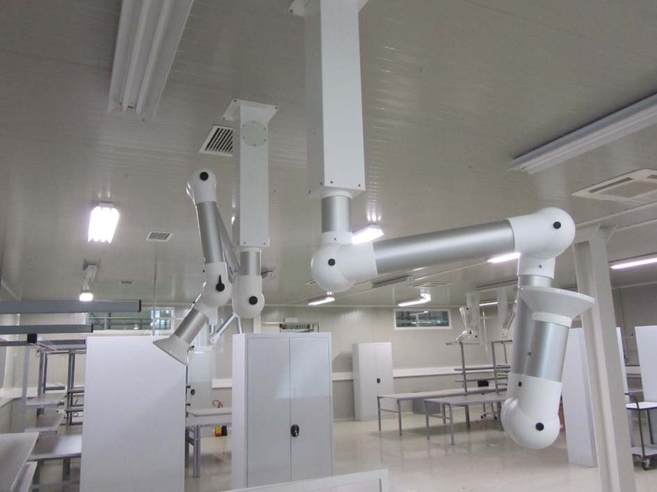
Groups scope
to large projects
COMPLEXITY
and Operation
& Maintenance
From Design
to construction
TIME
From minor works

Slide 12
Organization
  Service oriented approach for
    Maintenance interventions
    Small works
    Design studies
    Patrimony
  Project oriented approach for
    Large renovations (consolidation program)
    New buildings or change of usage
    Underground civil engineering
Tools:
- InforEAM
- ServiceNOW

Slide 13
Services (1/2)
Services
  Building, tunnels and road maintenance, repairs, minor works
  HVAC maintenance and works for tertiary buildings
  Electricity maintenance and works for tertiary buildings
  Patrimony and GIS
  CERN district heating operation and maintenance
  Barracks management and rental
  Engineering support
  Green spaces
Service Desk
  Access to most the group services is via the Service Desk and it is integrated in the ServiceNow tool: https://cern.service-now.com/
In the last 12 months, ~12’000 incidents and requests were carried out.

Slide 14
Services (2/2)
600
320

Slide 15
Projects
  Machine projects
  (linked to the functioning of the accelerator)
  Tertiary projects
  (linked to the functioning of the site)

Slide 16
Some examples of recent projects

Slide 17
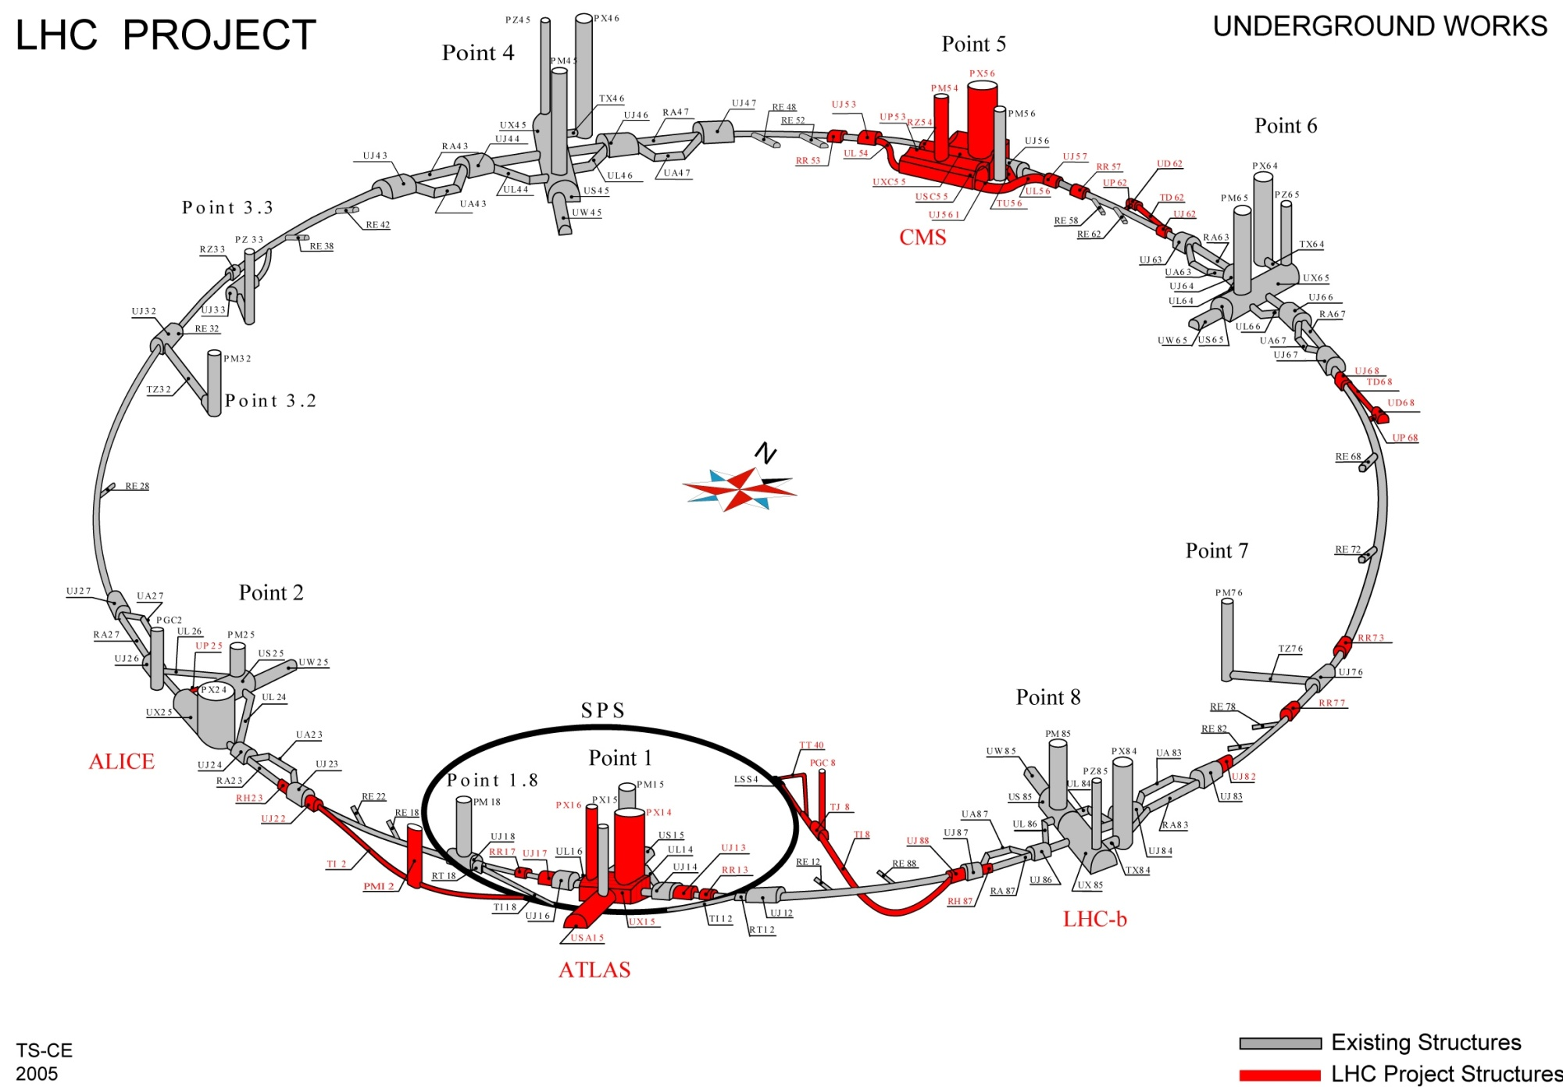
LHC Project

Slide 18
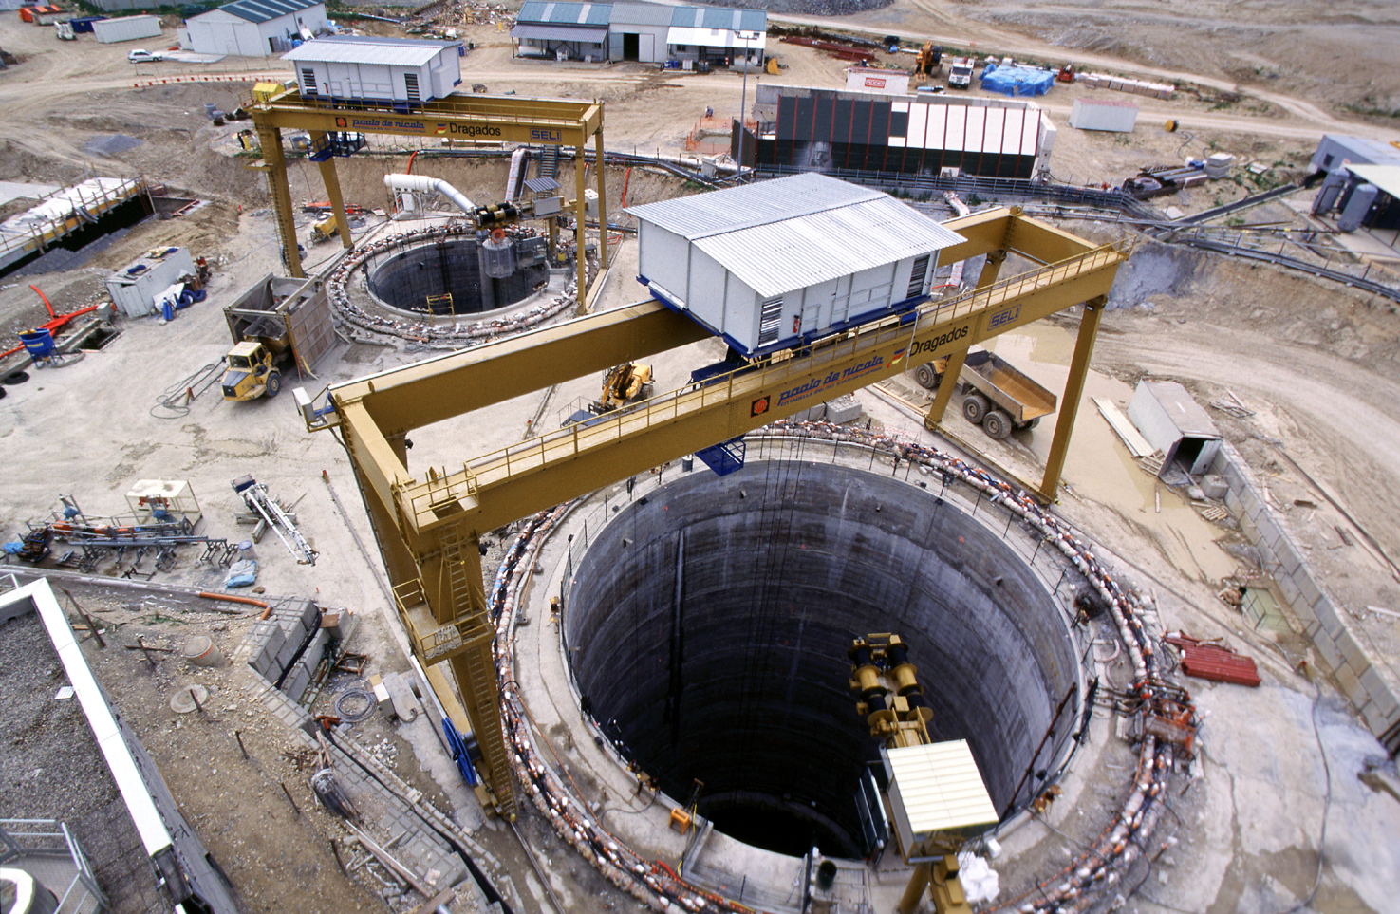
LHC - Point 5
Shafts 12.1m and 20.5m diameters, both approx. 100m deep
2001

Slide 19
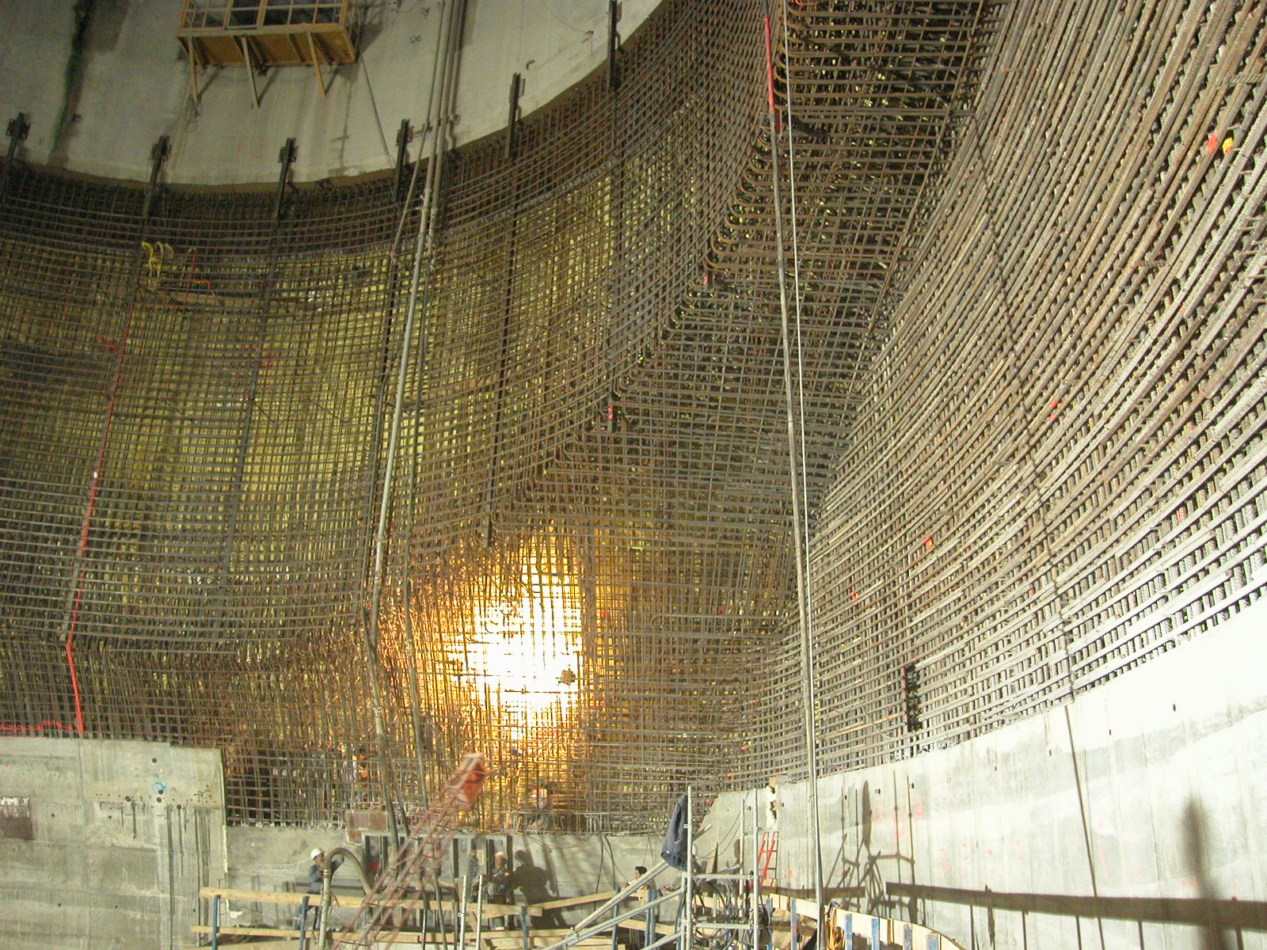
2004

Slide 20
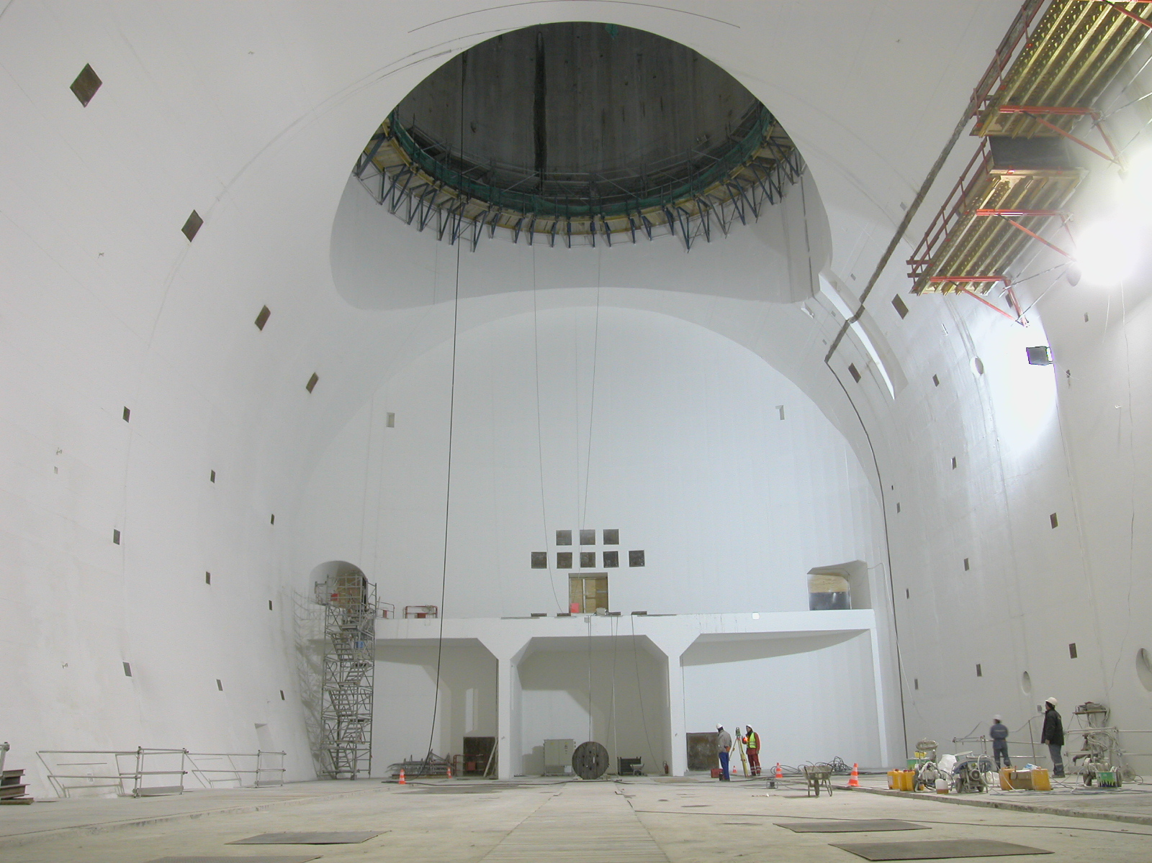
CMS cavern 53m long, 27m wide by 25m high
2005

Slide 21
Major achievements 2011
Building 42
Notes:
21

Slide 22
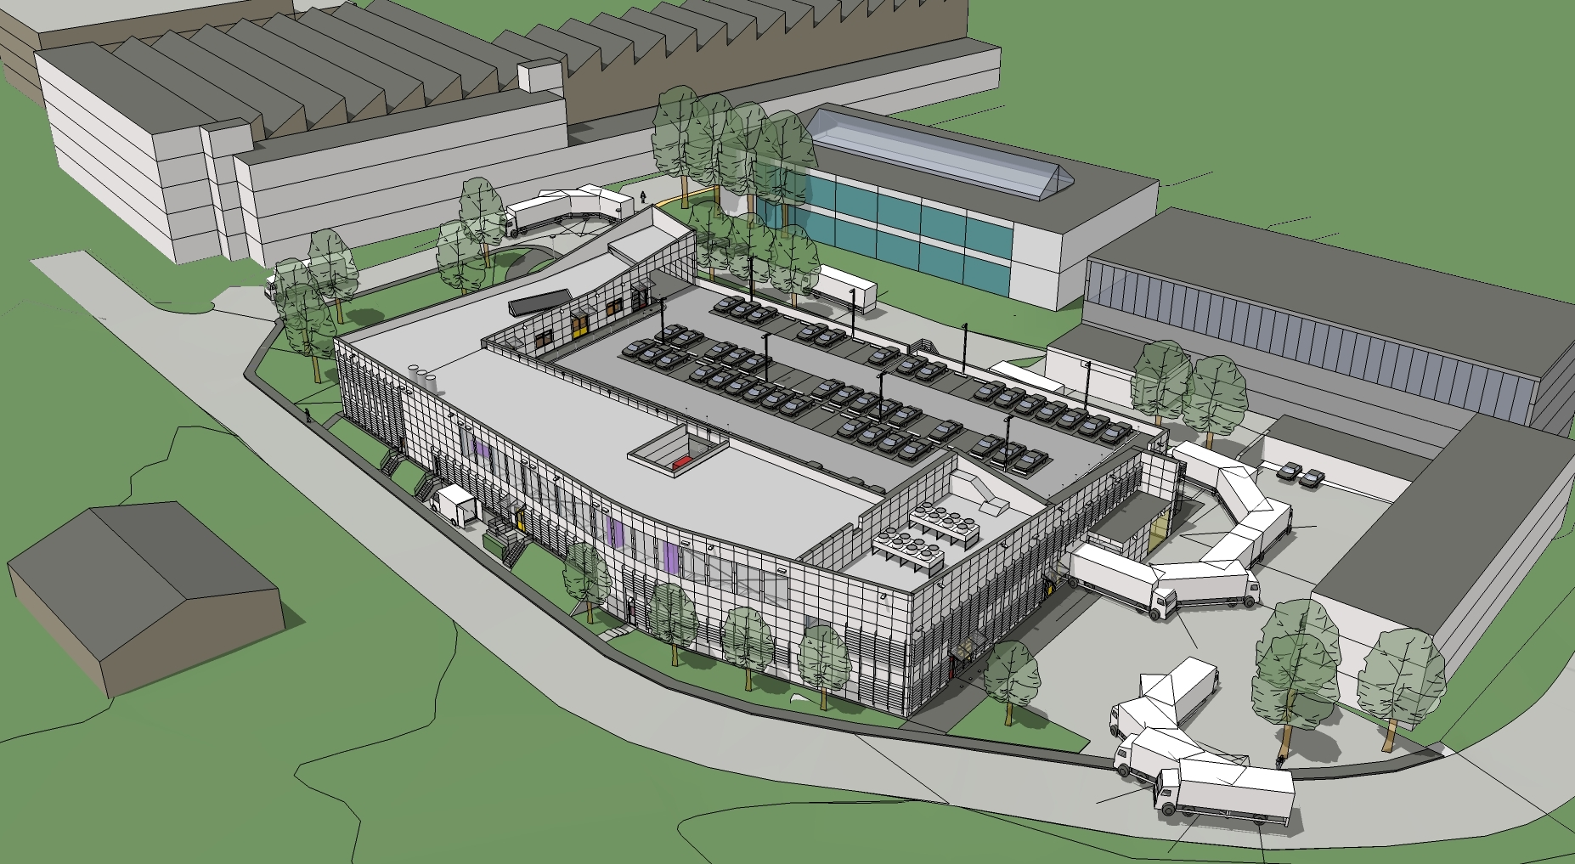
Recent Projects – Bld 107
GS-SE Review 2011
Bld 107 : New Chemical Surface Treatment Facility

Slide 23
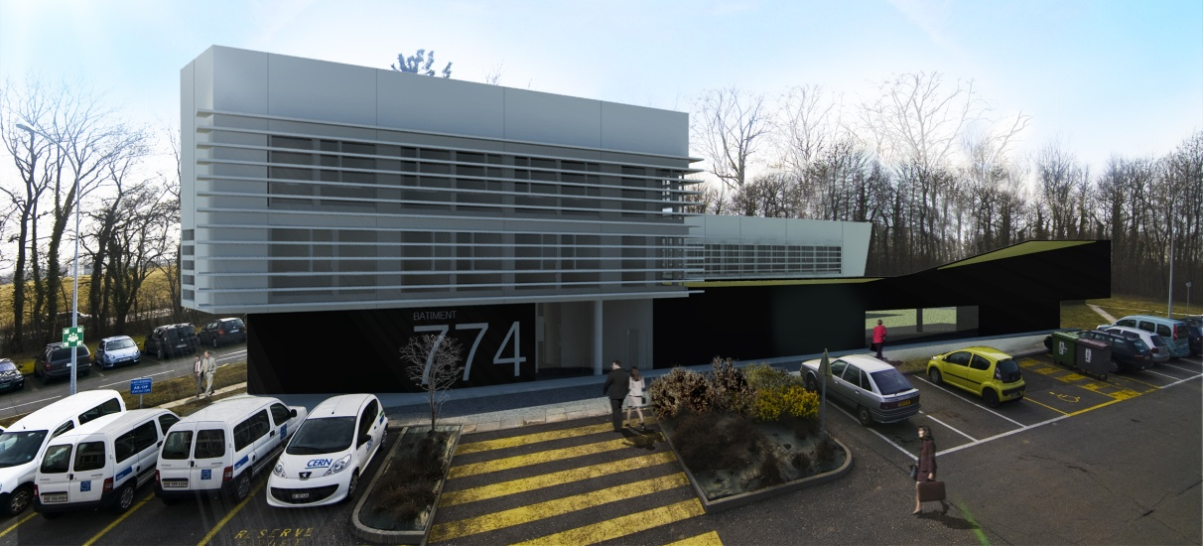
Major Objectives 2012
Building 774
Notes:
23

Slide 24
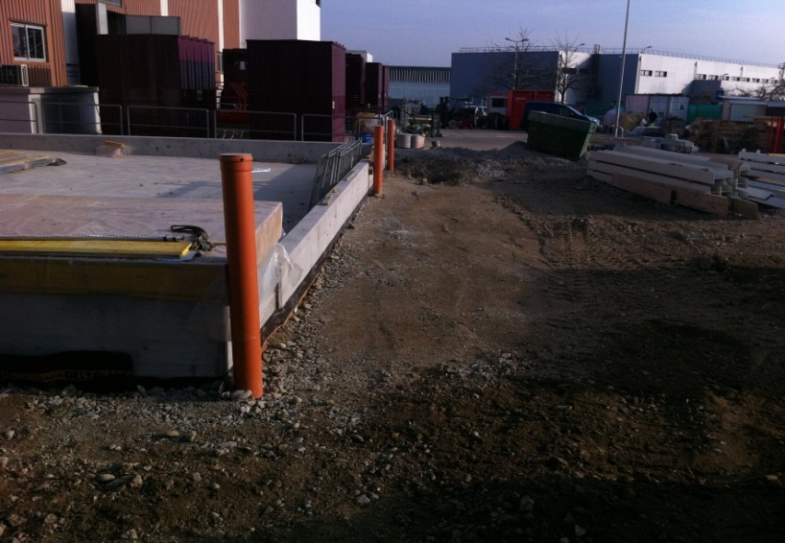
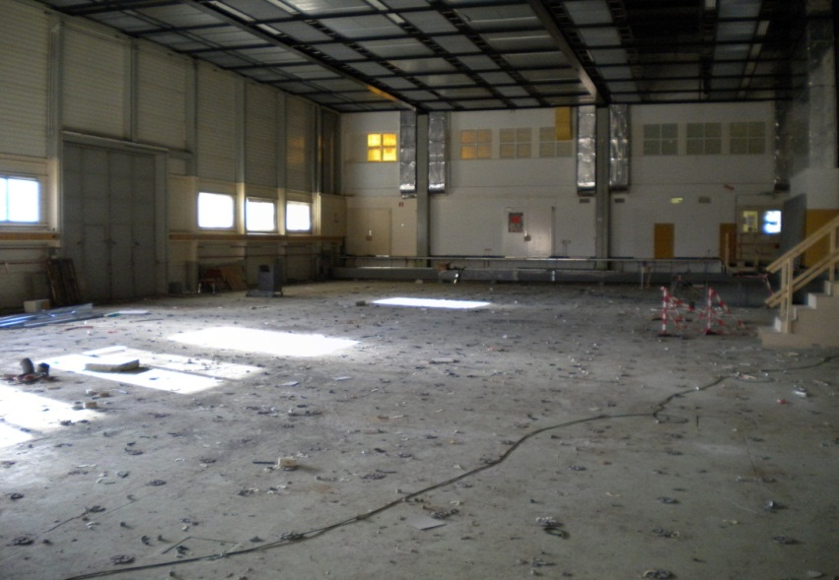
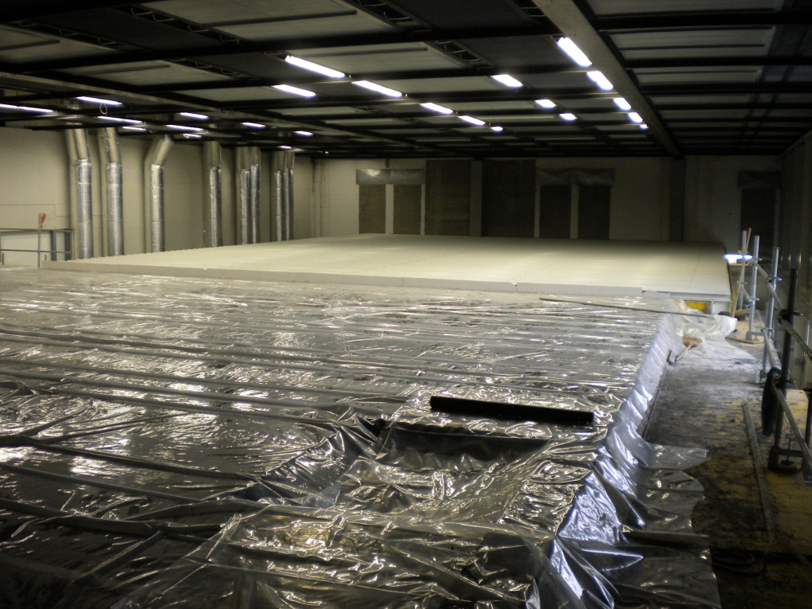
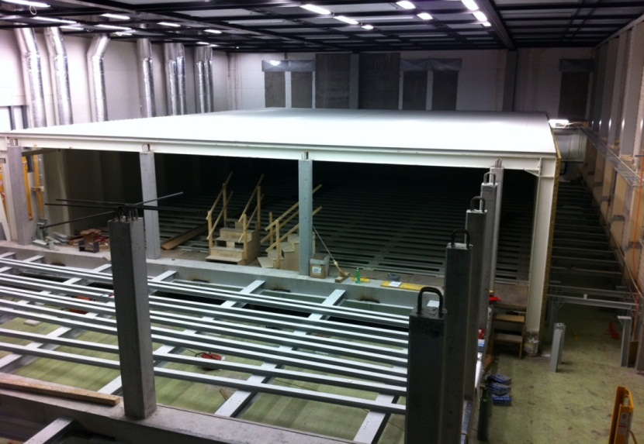
Computer Centre Upgrade

Slide 25
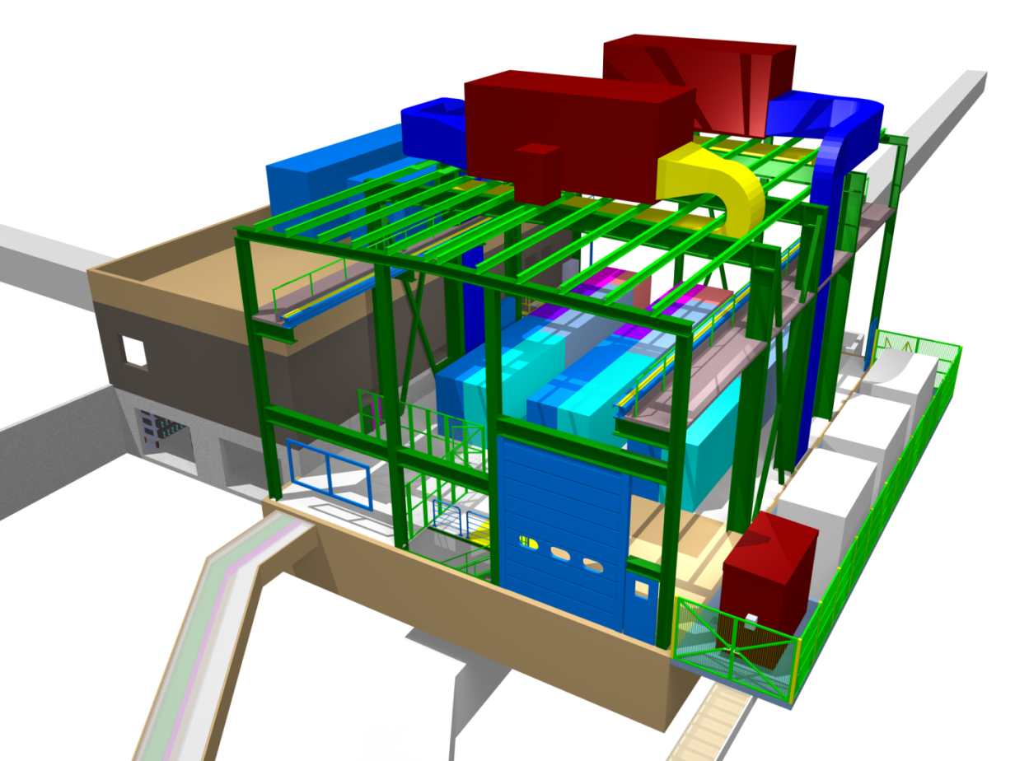
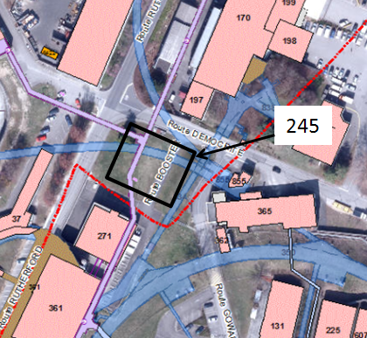
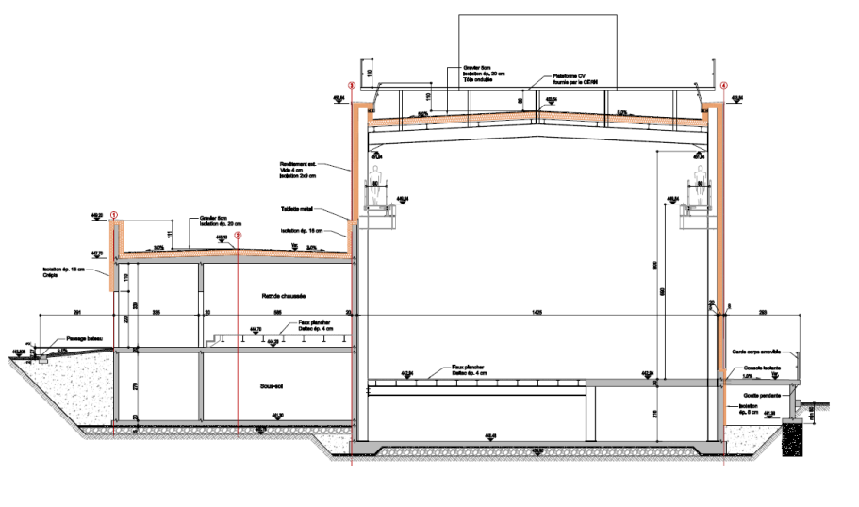
LIU- Booster : New building 245 MPSB

Slide 26
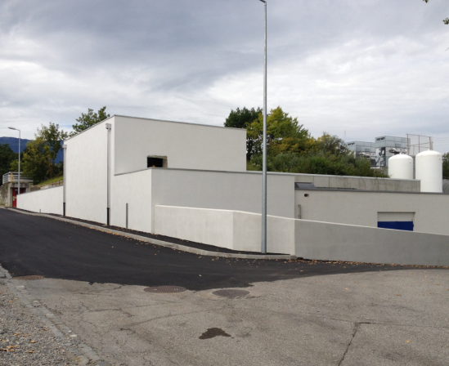
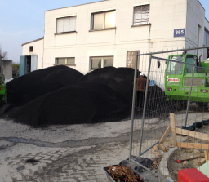
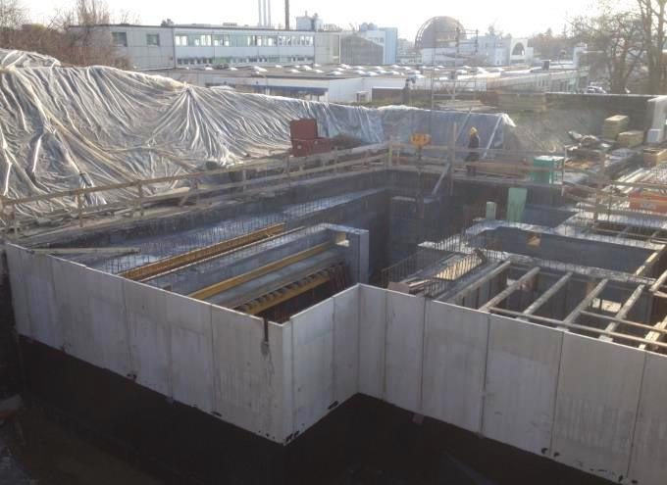
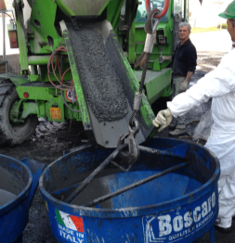
MEDICIS works
Addition of experimental area
Special shielding
Cross-border difficulties
Magnetite ore
Magnetite concrete high density 3.9 kg/dm3 (normal concrete 2.2 kg/dm3)
Preparation

Slide 27

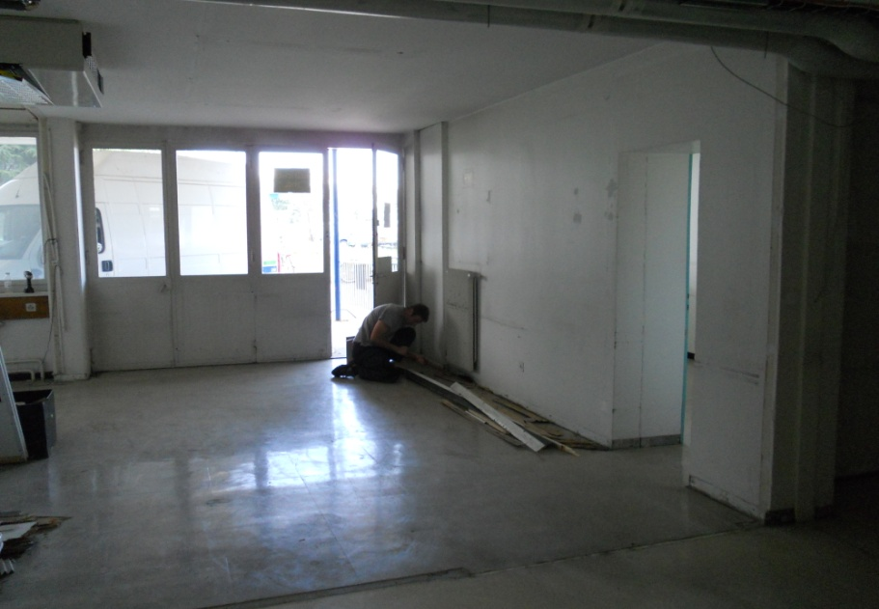

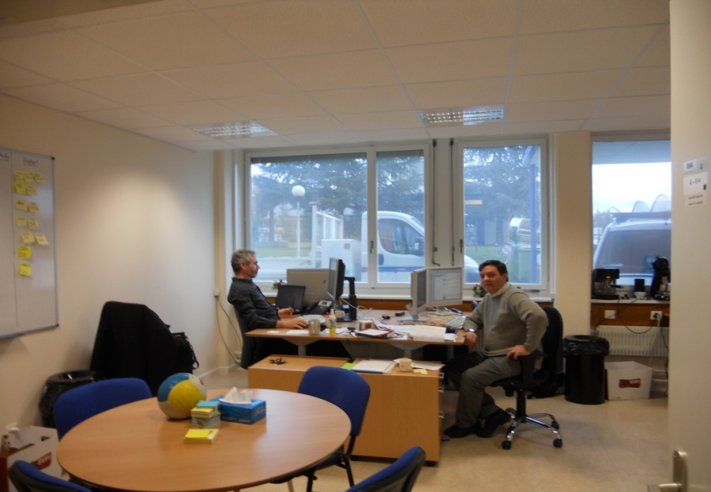
Renovation works: Offices
Notes:
What are the challenges for the next 12 months?
1 slide

Slide 28
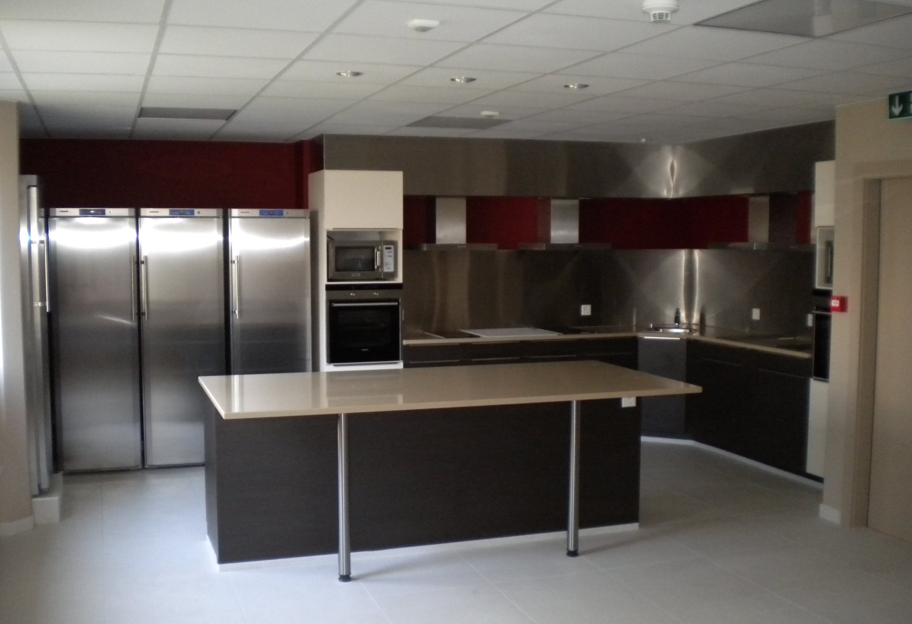
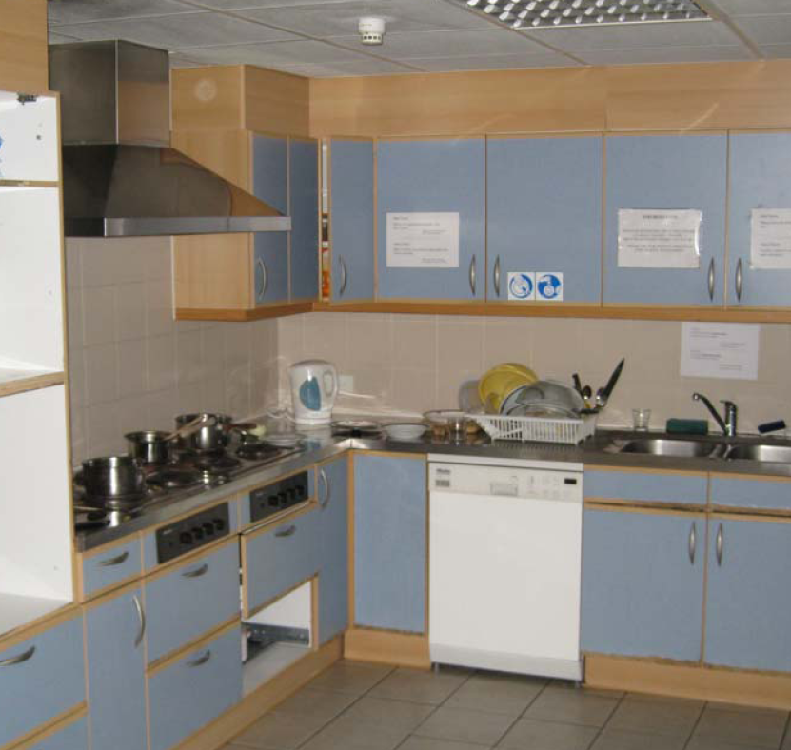
Renovation Works: Hotels

Slide 29
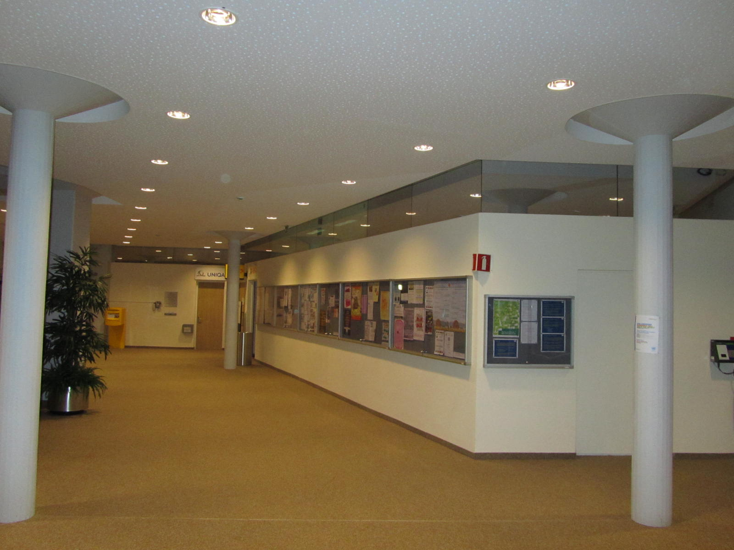
Renovation Works: Main hall
Notes:
Given the vision and the short term issues; how does this translate in objectives for the next 12 months
1 to 3 slides?

Slide 30
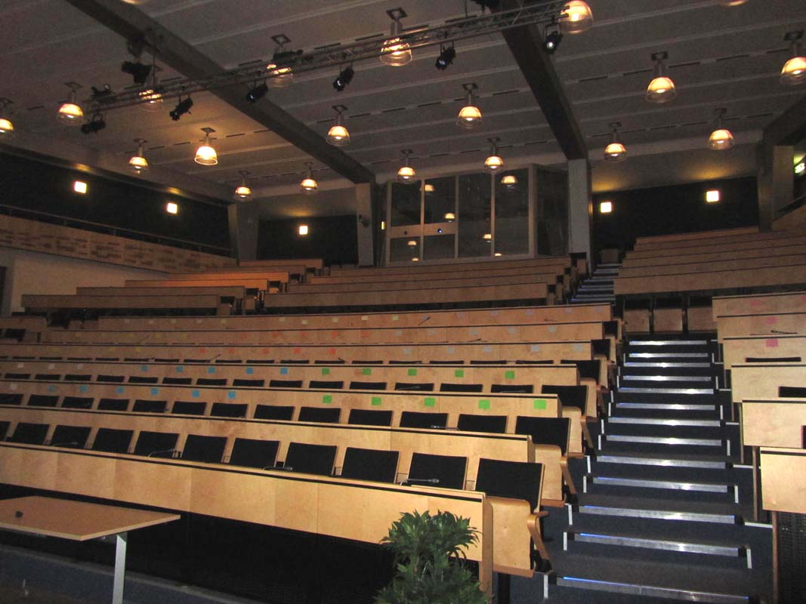
Renovation Works: Main auditorium

Slide 31
Site planning and development

Slide 32
CERN 2030 Urban MasterPlan
Déclaration d’intentions:
« Le Masterplan CERN 2030 vise à répondre aux besoins d’un laboratoire global, offrant à ses utilisateurs des zones fonctionnelles bien définies, desservies par des infrastructures et des services efficaces, permettant de garantir un fonctionnement opérationnel durable, tout en s’intégrant dans le développement du Projet d’agglomération franco-valdo-genevois .»
TLEP

Slide 33
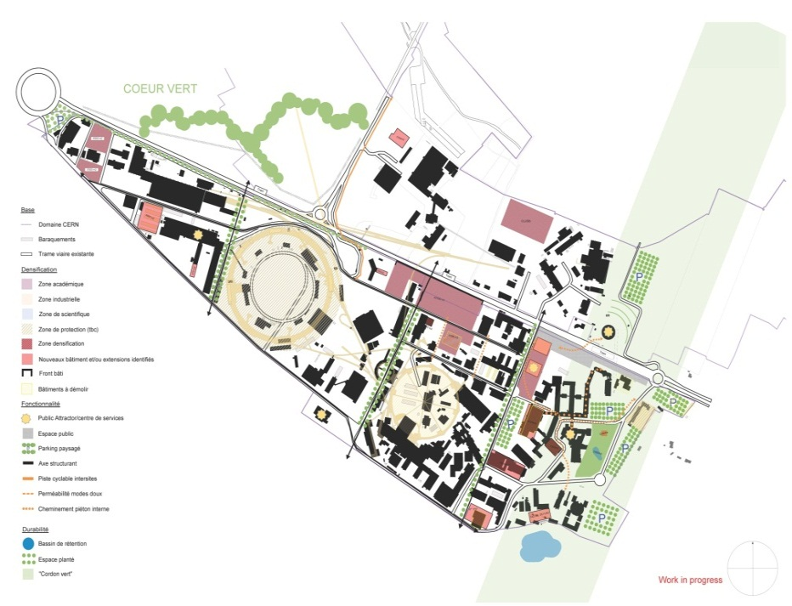
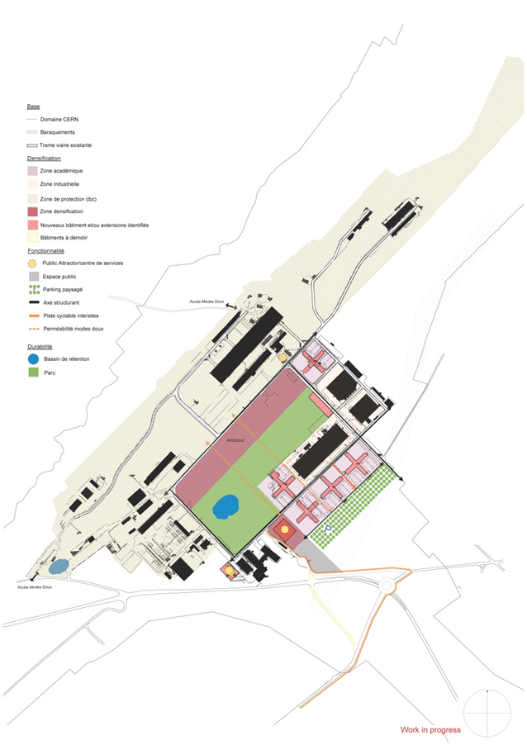

CERN 2030 MasterPlan
TLEP

Slide 34
Opportunities at CERN for Consultancy firms & Contractors
Call for tender for ‘Framework’ Contracts
Call for tender for specific Projects.

Slide 35
Future and ongoing ‘Call for tender’ (1/2)
Accelerator’s related (2016-2021)
    ~4 Contracts 3500kCHF ÷ 10000kCHF
    ~10 Contracts 200kCHF ÷ 750kCHF
HL-LHC (2016-2021):
    ~5 Contracts 10000kCHF ÷ 30000kCHF
    ~8 Contracts 200kCHF ÷ 750kCHF

Slide 36
Future and ongoing ‘Call for tender’ (2/2)
Implementation of the Consolidation of the infrastructure program and new buildings (2016-2021):
    ~ 3 contracts 3500kCHF ÷ 10000kCHF
    ~ 15 contracts 750kCHF ÷ 2500kCHF
    ~ 45 contracts 200kCHF ÷ 750kCHF
Hotels interior renovation (2016-2021):
    ~ 3 Contract ~ 2000kCHF
Renewal of frame contracts (2015-2018):
    ~5 contracts 1000kCHF/y ÷ 8000kCHF/y

Slide 37
Examples of planned projects

Slide 38

Underground works at LHC Point 1 & 5

Slide 39

Underground works at Point 5
Emergency escape tunnel option

Slide 40

Surface Works at Point 5 CMS

Slide 41

Surface Works at LHC Point 1 ATLAS (1)
LHC

Slide 42




New building 311 for magnetic measurements

Slide 43



New SPS Beam Dump

Slide 44




High Luminosity LHC (HL-LHC)
Civil Engineering works
@ Point 5
Civil Engineering works
@ Point 1
TLEP
Preliminary

Slide 45

Future accelerators
FCC

Slide 46
Conclusions
Opportunities for medium and large companies
Different specialties (underground and buildings)
Special attention to be paid to:
  The location and local rules (CH/F).
  The local prices (wastes, workforce, etc.).
  CERN framework (Radiation, worksites, etc.)

Slide 47
Thank You for your attention

