Slide 1

IUPAP and communication in physics
1st meeting of Working Group 20, 20 December 2024
Jens Vigen

Slide 2
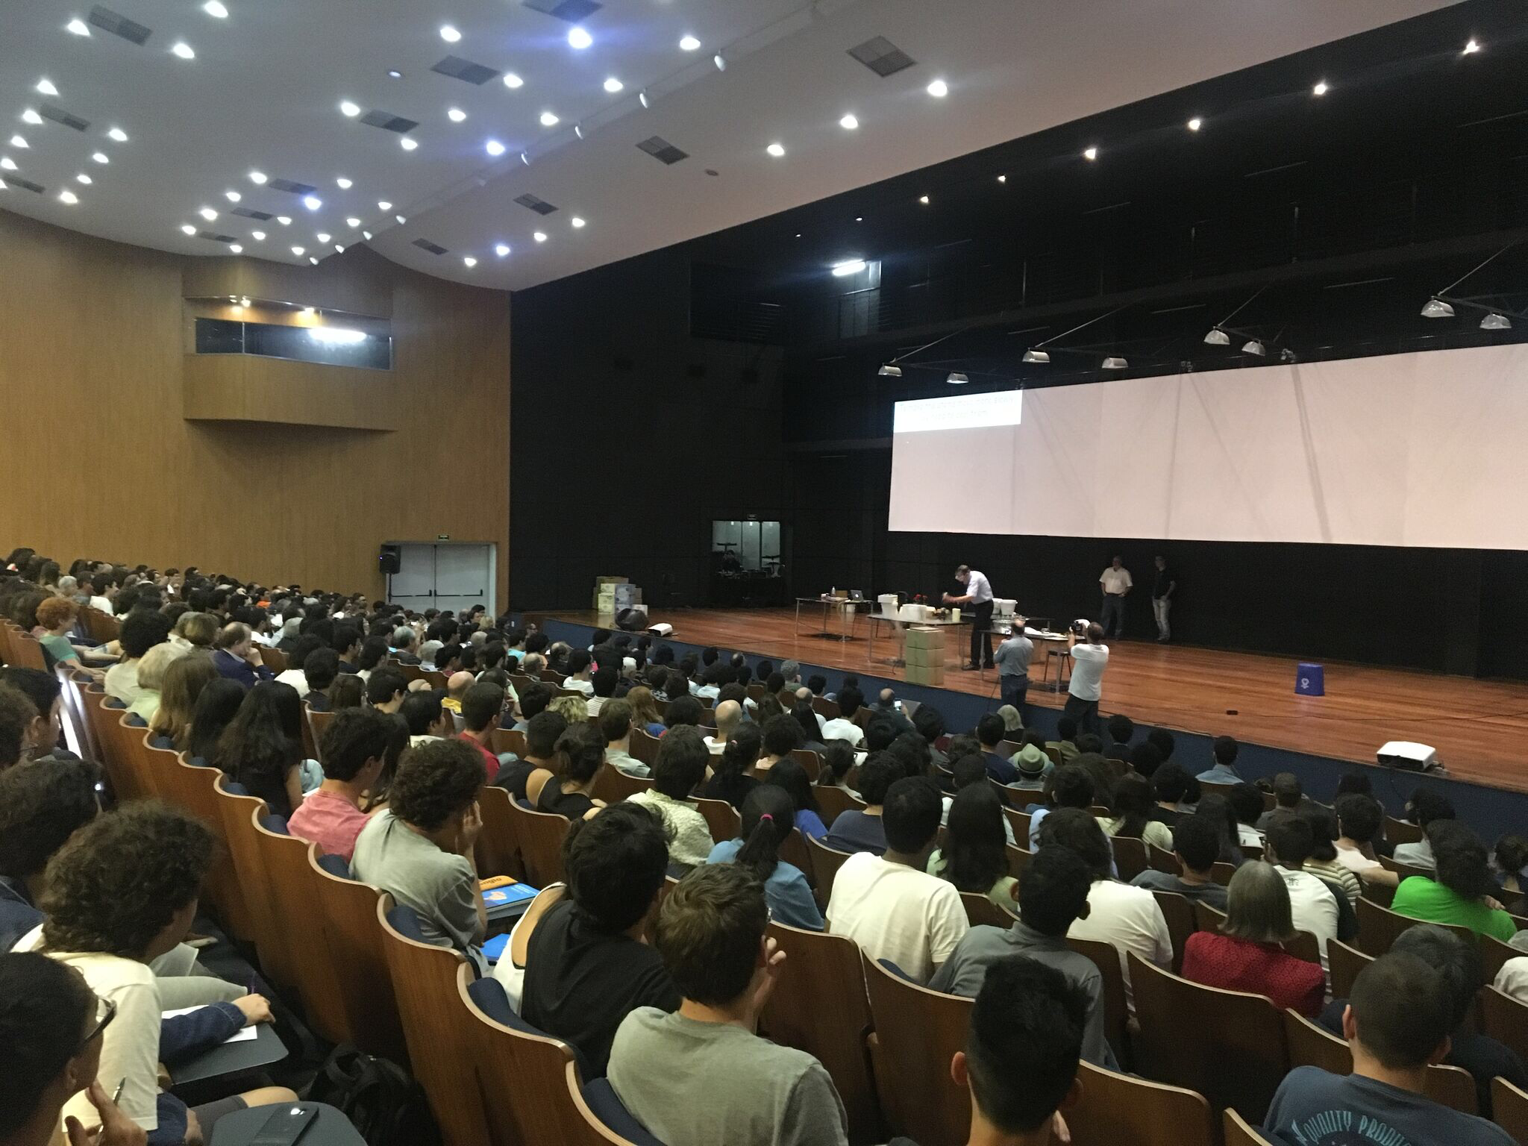
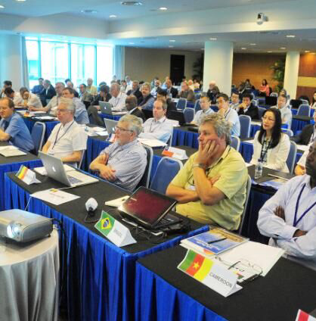
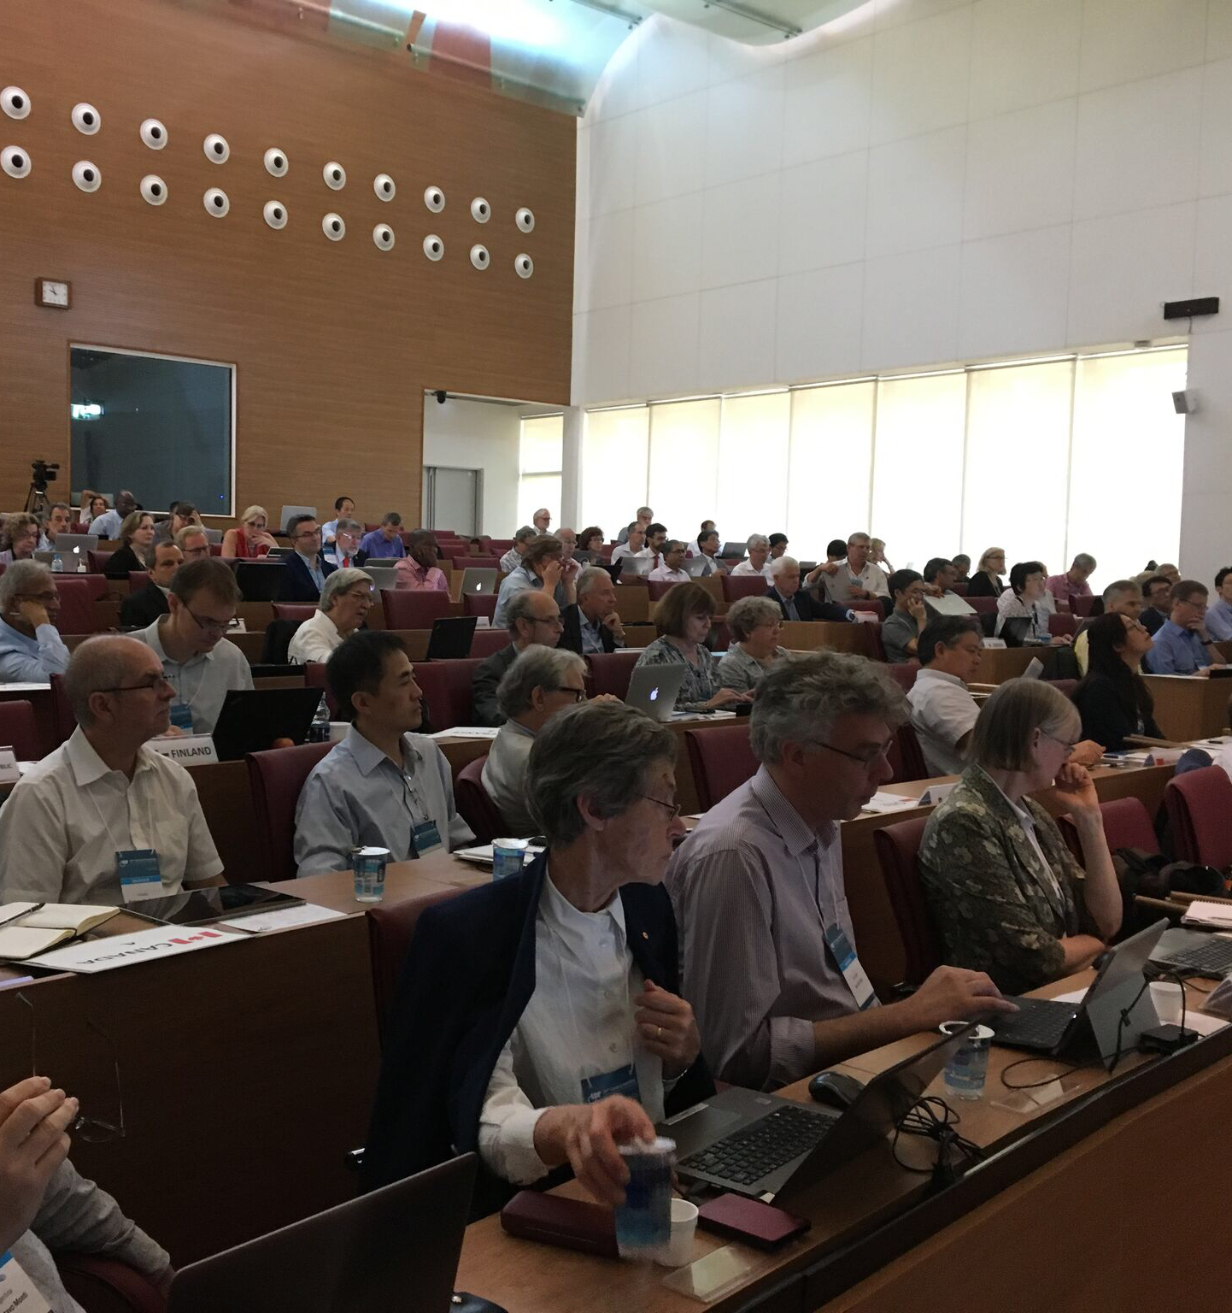
IUPAP mission:
“To assist in the worldwide development of physics, to foster international cooperation in physics, and to help in the application of physics toward solving problems of concern to humanity”.

Slide 3

Further IUPAP principles
Foster openness and inclusiveness in physics
Promote free circulation of physicists (and data)
Ensure integrity and credibility
Promote physics as a building block of innovation and multidisciplinary research
Promote physics as an essential tool for development and for sustainability

Slide 4
Members
Territorial members
  60 territories represented by adhering bodies
Personal members
  Only ex officio
Corporate associate member
  6 CAMs
New category: Associated territorial members
  Nepal “first out”

Slide 5
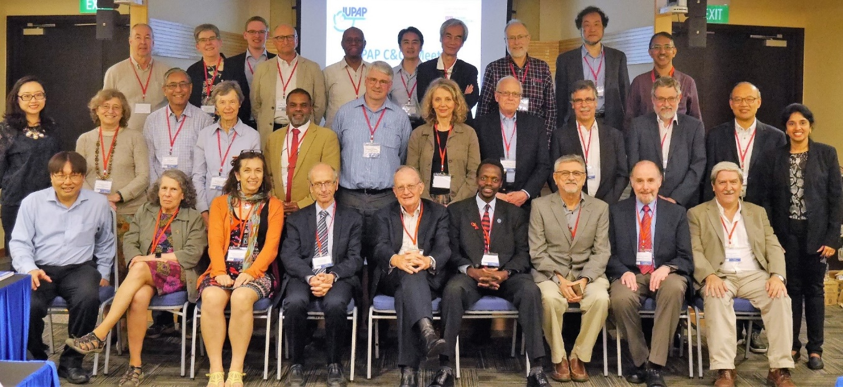
Commissions
• Policy and Finance (C1)
• Symbols and units (C2)
• Statistical mechanics (C3)
• Astroparticle physics (C4)
• Low temperature physics (C5)
• Biological physics (C6)
• Acoustics (C7) —> Became AC3 in 1996
• Semiconductors (C8)
• Magnetism (C9)
• Condensed matter (C10)
• Particles and fields (C11)
• Nuclear physics (C12)
• Physics for development (C13)
• Physics education (C14)
• Atomic molecular and optical physics (C15)
• Plasma physics (C16)
• Laser physics and photonics (C17)
• Mathematical physics (C18)
• Astrophysics (C19)
• Computational physics (C20)
The first scientific commission, on Units, was established in 1931 at the third General Assembly
Currently there are 18 Commissions
The Commissions organize the major international conferences in their field and award Early Career Scientist Prizes

Slide 6
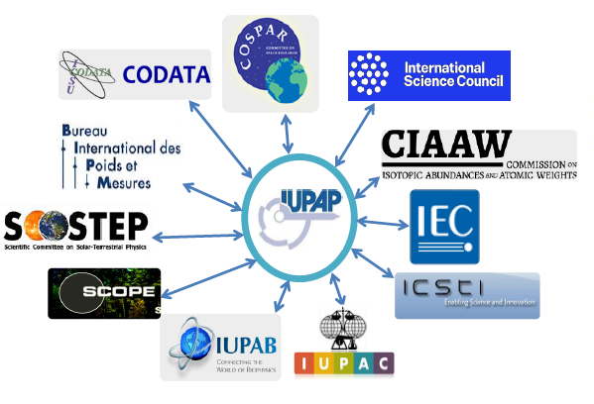
Affiliated commissions
International committees or organizations of physicists, with their own administrative structure, who wish to join IUPAP commissions
Participate in IUPAP activities, endorse IUPAP principles
Currently there are six affiliated commissions
International Commission for Optics (AC1)
International Commission on General Relativity and Gravitation (AC2)
International Commission on Acoustics (AC3)
International Commission on Medical Physics (AC4)
International Association of Physics Students (AC5)
Affiliated Commission on the History and Philosophy of Physics (AC6)

Slide 7
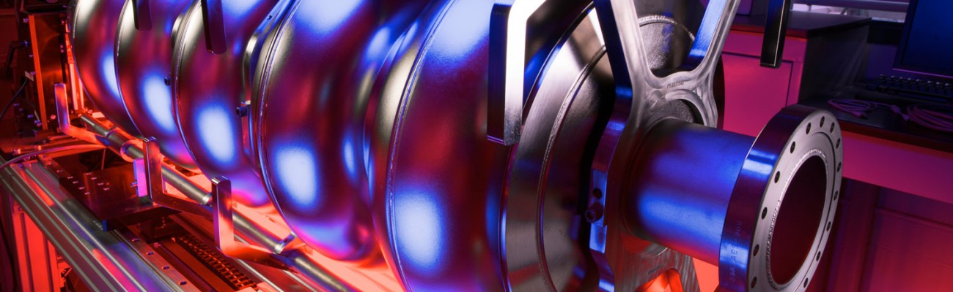
Working Groups
WG1: International Committee for Future Accelerators (ICFA)
WG5: Women in Physics
WG7: International Committee on Ultrahigh Intensity Lasers (ICUIL)
WG9: International Cooperation in Nuclear Physics (ICNP)
WG10: Astroparticle Physics International Committee (ApPIC)
WG11: Gravitational Wave International Committee (GWIC)
WG13: Newtonian Constant on Gravitation
WG14: Accelerator Science
WG15: Soft Matter
WG16: Physics and Industry
WG17: Centenary
WG18: Ethics
WG19: Quantum Science and Technology
WG20: Open Science
WG21: Physics for Climate Change Action and Sustainable Development
The Working Group on Women in Physics
Some working groups have had close links with
working groups of the OECD Global Science Forum
The Working Group on Women in Physics

Slide 8
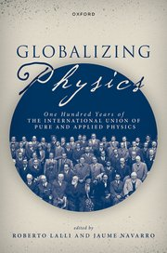
Open access book
Forcasted published 9 July

Slide 9
Working Group 20:
Open Science
(Preliminary) Mandate
Make a recommendation for a strategy to foster a culture of open science and aligning incentives for open science across all disciplines of physics—in particular, lay out the requirements to be put in place, with regards to open science, for IUPAP sponsored and endorsed conferences.
Closely follow the implementation of the UNESCO Recommendation on Open Science and take part in relevant UNESCO Open Science Working Groups to advocate the interest of physics.
Survey open science practices in physics and share the findings with the IUPAP commissions.
Chair: Alex Hansen
Members:
Xavier Bertou
Chaomei Chen
Sean Hill
Sauro Succi
Reina Camacho Toro

Slide 10
Some historical lines
Commission for Bibliography and Publications (established 1931)
WG2: Communication in Physics (Reconstituted 1998, officially terminated in 2022)
Working Group 2 (WG2), Communication in Physics, was created by the International Union of Pure and Applied Physics. It has been reconstituted to consider the problems that are emerging in electron publishing, and particularly considers internet availability/ reliability, linking between societies and publishers, availability of electronic communication in isolated areas, archiving, peer review, and intellectual property.
Charge to Working Group
It is the primary mission of the working group to make a set of recommendations on important issues in the international aspects of physics communication, especially electronic publication, that are appropriate for IUPAP action.

Slide 11
Some ideas for inclusion in the final report
Describe the current traditions and practices across physics
How physics differs from other diciplines
What physics can learn from other diciplines
Potentials within ”close reach”: obstacles to be overcome
  Special focus: IUPAP sponsored and endorsed conferences
Required open science infrastructures
Recommendations to the physics community at large

