Slide 1


Calculation of LGRBs Pseudo-Redshifts using
the Amati Correlation
Gabriela Xol
ECFM-USAC
In collaboration with:
Dr. Rodrigo Sacahuí
Dra. Magdalena González
Dr. Yunior Pérez
22nd ISVHECRI - Vallarta, July 2024

Slide 2
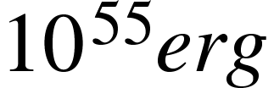

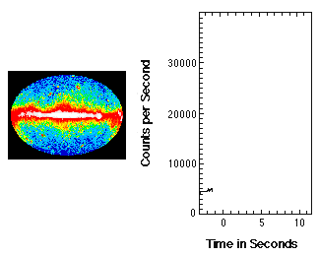
Gamma-Ray Burst (GRBs)
Among biggest explosions in the universe (~ )
Detectable at redshifts up to
Can last from milliseconds to several minutes
Can outshine entire galaxies
Credits: Laura Whitlock (Imagine The Universe!), GSFC, NASA

Slide 3
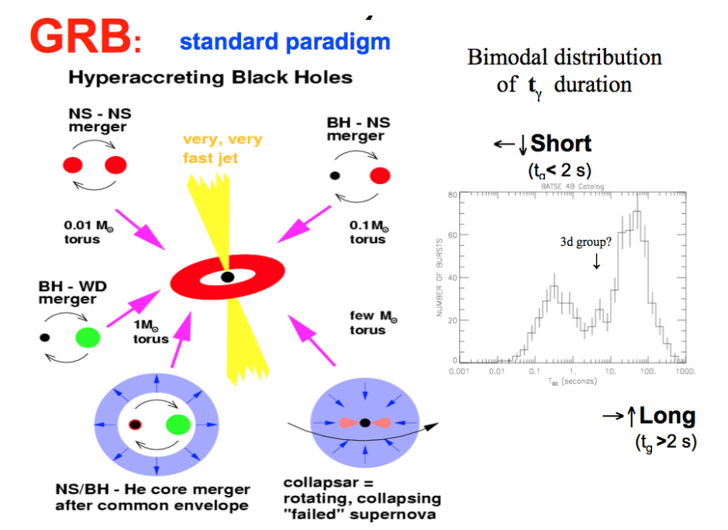
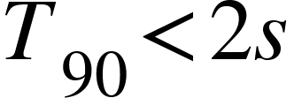
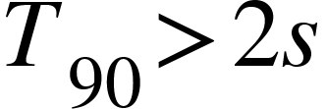
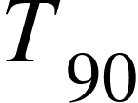
Gamma-Ray Burst Types and progenitors
Short gamma-ray burst
Long gamma-ray burst
: Time interval during which 90% of the total observed counts have been detected
Progenitors of long and short GRBs, after M. Ruffert and H.-Th. Jahnka (1996), duration distribution from Kouveliotou et al. (1993).

Slide 4

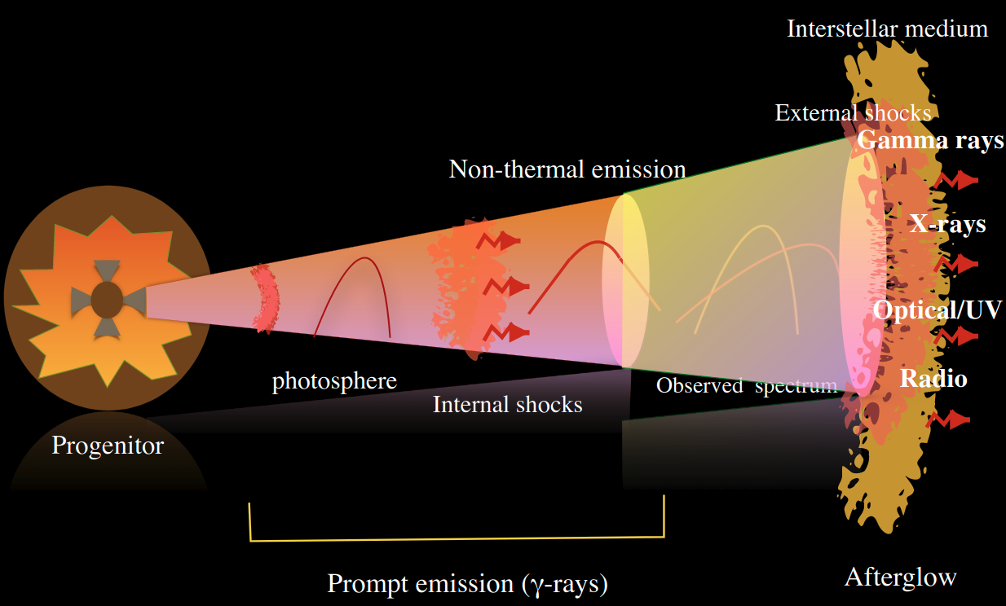
Fireball Model
Prompt emission: Initial and most intense part, where the gamma-rays are released , typically last a few seconds
Afterglow: Radiates in different wavelenghts, initially detected in X-rays. Last much longer than the prompt emission
Credits: Dr. S. Iyyani

Slide 5

Motivation
Few GRBs with z associated ( )
The measurement of the redshift (hence distance) of a GRB is essential to measuring its intrinsic properties.
Since LGRB are believed to originate from the core-collapse of massive stars, are powerful tools for investigating the early universe at high redshift.

Slide 6
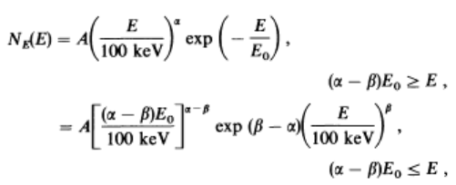
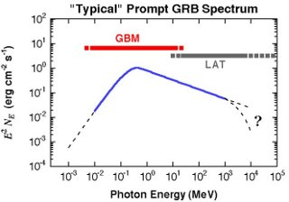
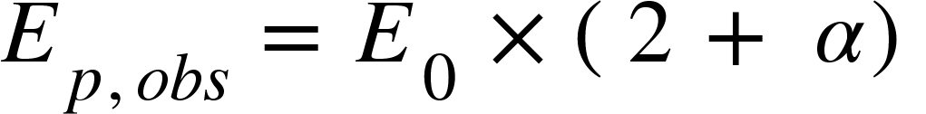

Empirical Correlations to inferred pseudo-redshifts
GRB spectra typically described by the empirical Band Function
Band. et.al (1993).
Peak energy of the spectrum
The typical spectrum of a gamma burst Credit: NASA

Slide 7

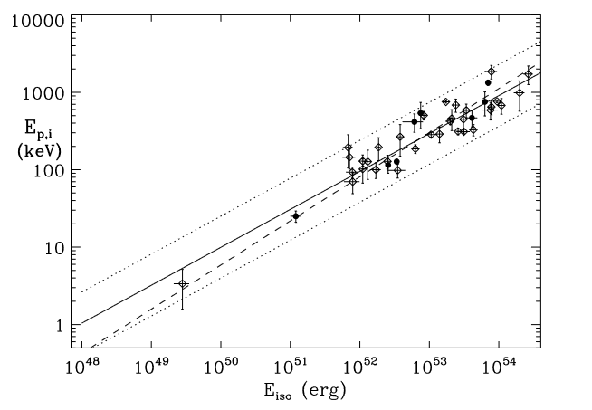
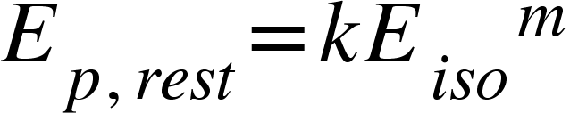


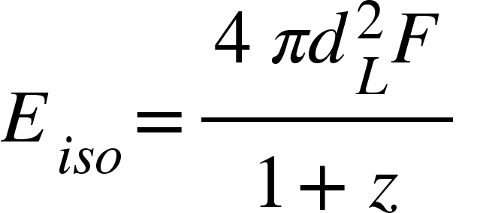
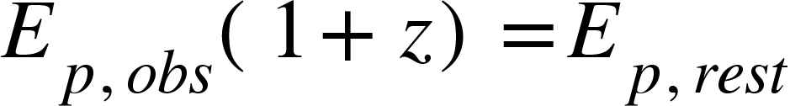
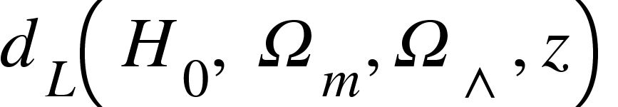
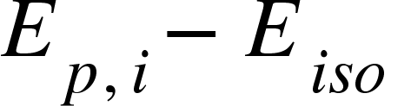
The Amati Correlation ( )
Amati correlation is given by
Since we don´t know the redshift…
Standard cosmological model was used since:
Correlation for 41 GRBs/XRFs L. Amati (2006)

Slide 8
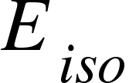
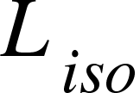
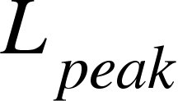
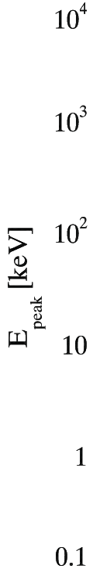
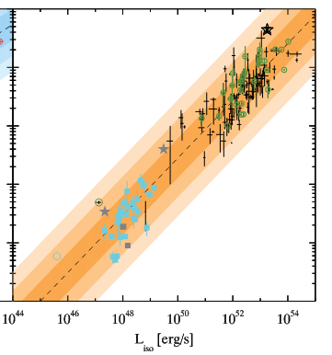
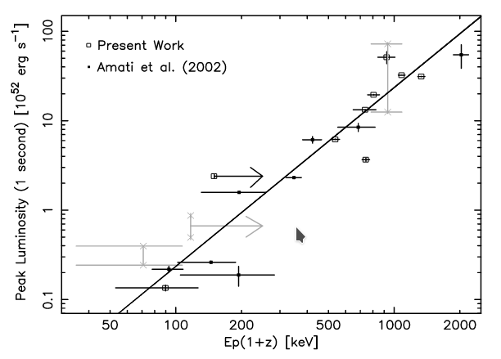
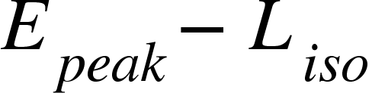
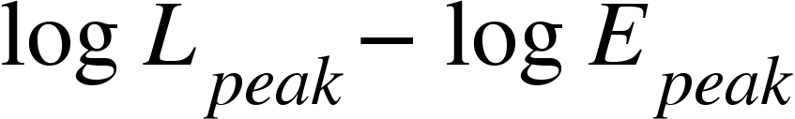
Other correlations
The correlation holds also when is substituted with (Ghirlanda et. al 2011)
or (Yonoteku 2004)
G. Ghirlanda et al. 2011
Yonetoku et al. 2004

Slide 9
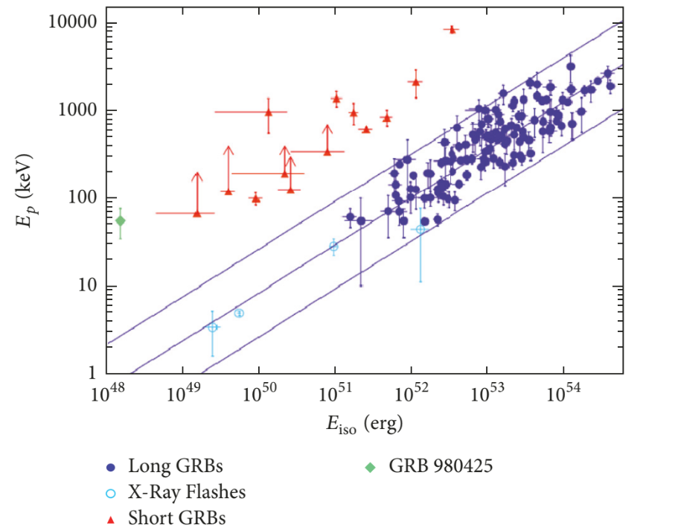
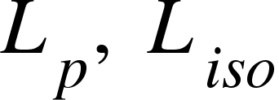

Why Amati Correlation?
is subject to more uncertainties (eg. light curves peaks at different times in different energy bands)
The lines indicates the best fit, and the confidence region for LGRBs

Slide 10
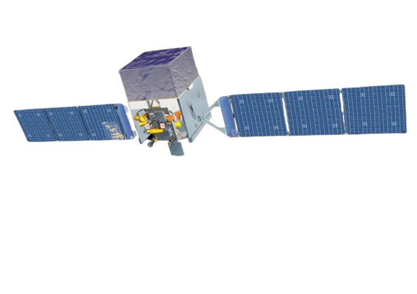
Goals
Methods
Use the Amati correlation to calculate the pseudo-redshift of a LGRBs sample, detected by Fermi telescope (GLAST)
Perform a time integrated spectral fitting to the LGRBs sample.
Obtain from the spectral fitting parameters: Peak energy, low energy index and high energy index
Perform the calculation of the pseudo- redshift to the sample
Hi~ I´m Fermi

Slide 11
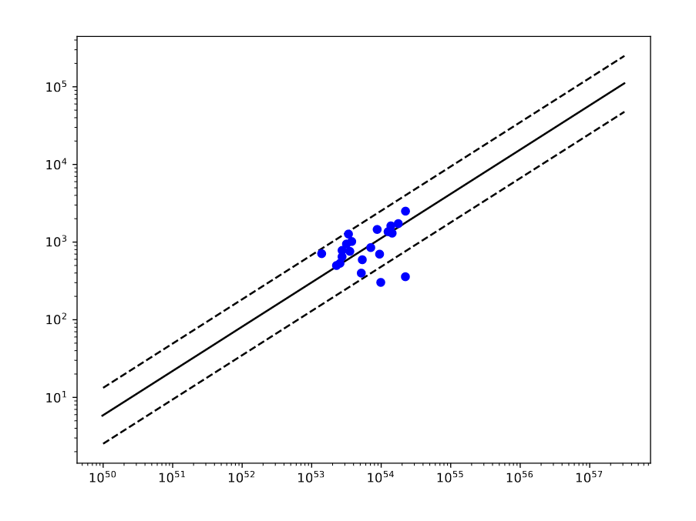
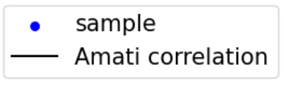
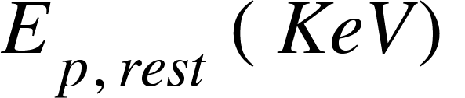
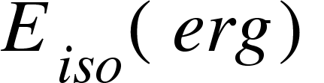
The initial sample
22 high fluence Long GRBs detected by Fermi-GBM, with reported redshift
Data show consistency with the Amati correlation

Slide 12
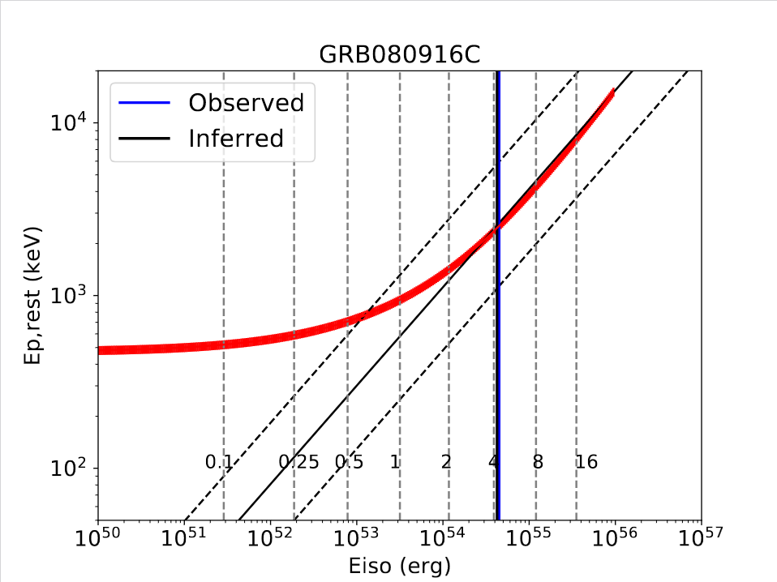
Preliminary Results
We used the Amati correlation to inferred the range of the redshift in which the burst is consistent
Z reported | Amati min z | Amati z
3.57 | 0.6 | 3.38
preliminar

Slide 13
Preliminary Results
GRB | Reported redshift | Min Amati pseudo-redshift | Amati pseudo-redshift
090323 | 3.57 | 0.6 | 3.38
140508A | 1.027 | 0.37 | 1.09
120711A | 5.2 | 0.54 | 1.81
170405A | 3.51 | 0.45 | 1.41
Some of the 22 preliminary results GRBs pseudo-redshifts
preliminar

Slide 14
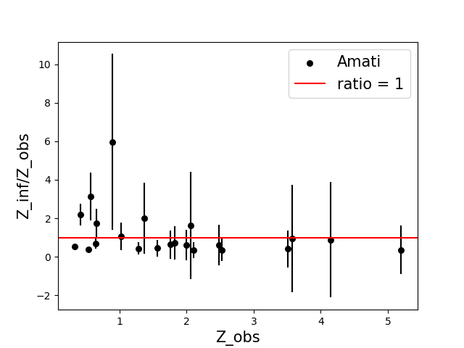
Preliminary Results
Ratio between the pseudo-redshift inferred using the Amati correlation and the redshift observed.

Slide 15
Summary and Future work
Preliminary results show consistency with the Amati correlation
Amati correlation shows consistency for a large range of redshifts: from 0.2 - 5
Combination with other methods and correlations can help us to better determined pseudo-redshifts for GRBs
We are going to extend the work for a bigger sample of LGRBs detected by FERMI-GBM, and combine Amati correlation with other methods

Slide 16
THANKS!
Thanks to the PAPIIT IG101323 project and the organizing committee
22nd ISVHECRI - Vallarta, July 2024

Slide 17
Backup Slides
22nd ISVHECRI - Vallarta, July 2024

Slide 18
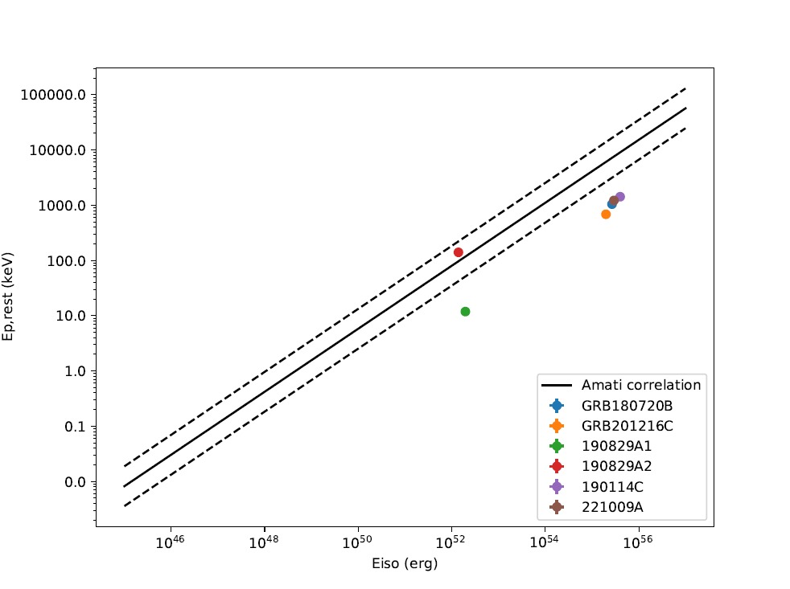
Backup slide 1
GRBs at GeV - TeV that don´t are consistent with the Amati correlation

Slide 19
Backup slide 2

Slide 20
Backup slide 3
Dashed line: best fitting power law obtained fitting the data without accounting for sample variance

