Slide 1


Neutrino Classification Through Deep Learning
Authors:
Romo Fuentes María Fernanda
Luis Eduardo Falcón Morales
July 9th 2024
22nd INTERNATIONAL SYMPOSIUM ON VERY HIGH ENERGY COSMIC RAY INTERACTIONS

Slide 2
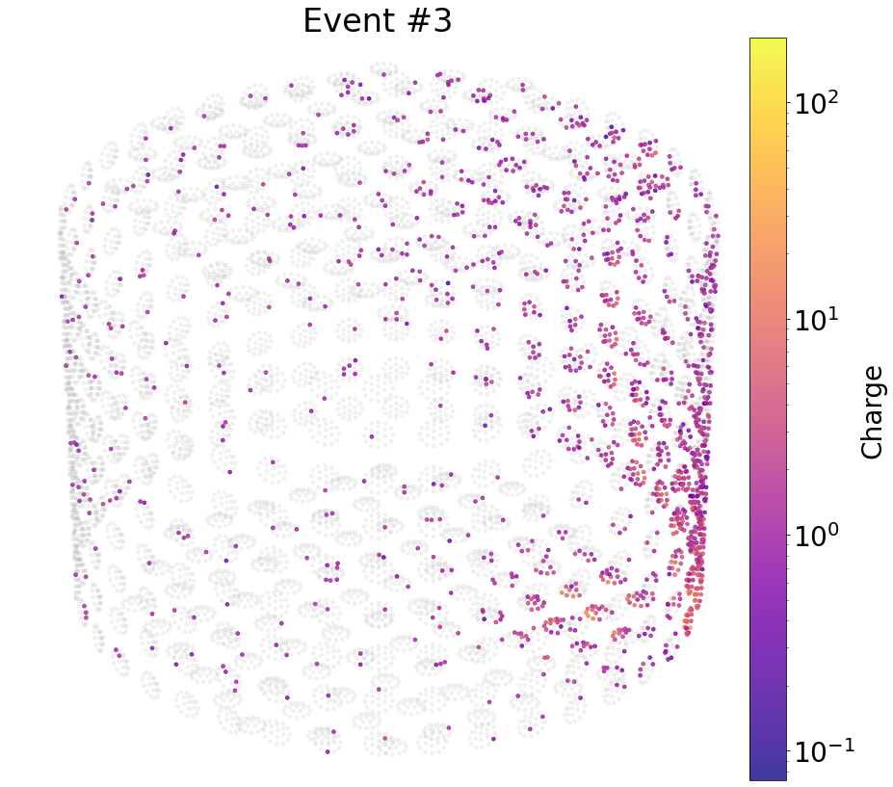
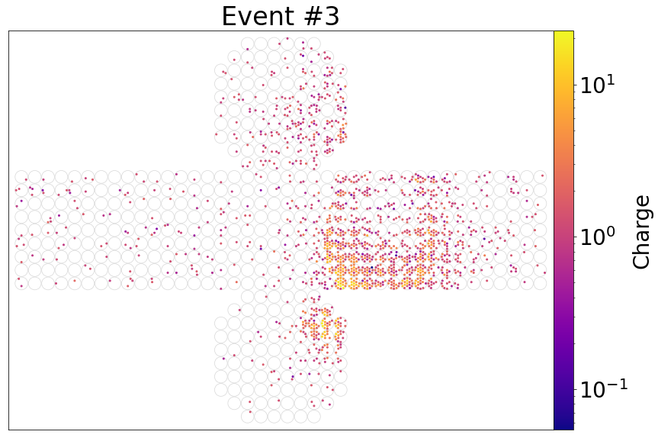
Introduction
Objective: Apply deep learning to the process of classifying particles involved in an event amid the Hyper-Kamiokande Project development and determine which works best

Slide 3

Data
Simulated with WCSim
IWCD Tank (8m tall, 10m diameter, 536 mPMTs)
Single ring events
3 classes: gamma/electron/muon
Database | Class | # Events
CADS | Gamma Electron Muon | 9k to 3M per particle
Cedar | Gamma Electron Muon | ~8 M ~8 M ~3 M
CADS/Cedar
Notes:
0 to 1000 MeV

Slide 4
Methodology
4 Deep learning architectures:
PointNet
VGG19
ResNet50
Vision Transformer
CNN based
Architecture hyper-parameters’ tuning
Output:
-Learning curves
-Average accuracy and los per epoch
-Confusion matrix
-ROC curve, AUC
-Efficicency
Input: data of neutrino event from H5 file
Conversion to appropriate format: stack of tensors or cloud of points
Data Pre Process (optional)
Training/ Validation
Testing
-Data Augmentation
-Double Cover
-Images filtering by pixel threshold

Slide 5
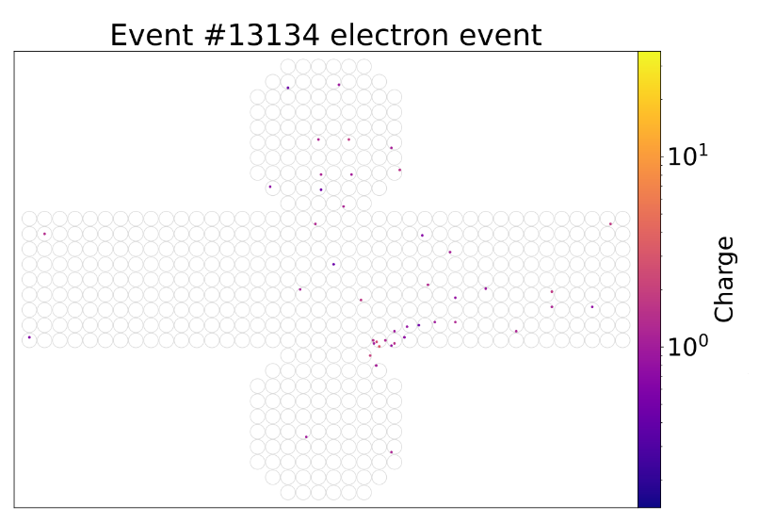
Developed Models
3 classes: gamma, electron, muon → 9k per class
VGG19
ResNet50 → Cedar dataset
PointNet
2 classes: electron, gamma → 30k, 300k per class
Vision Transformer Unfiltered Data
Vision Transformer Filtered Data
Vision Transformer Pretrained Filtered Data
ResNet50 Filtered Data
ResNet50 Pretrained Filtered Data
2 classes: muon, not muon → 9k, 18k, respectively
Vision Transformer Unfiltered Data

Slide 6
Results

Slide 7
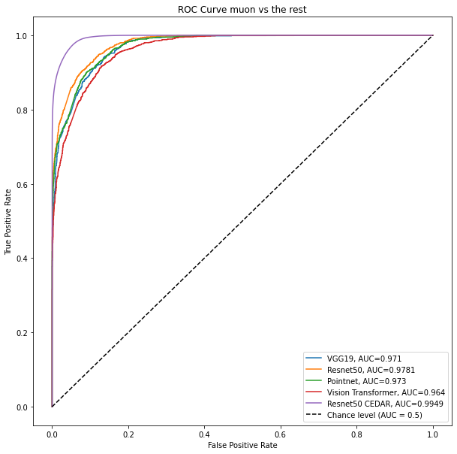
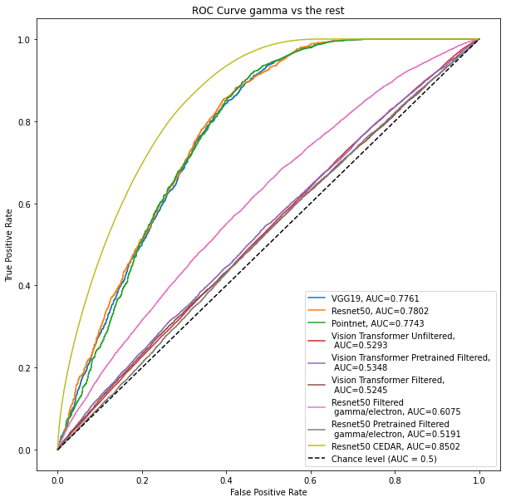

Slide 8
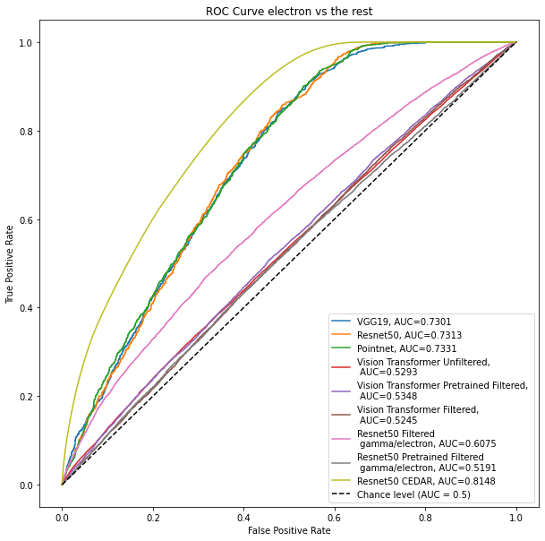

Slide 9
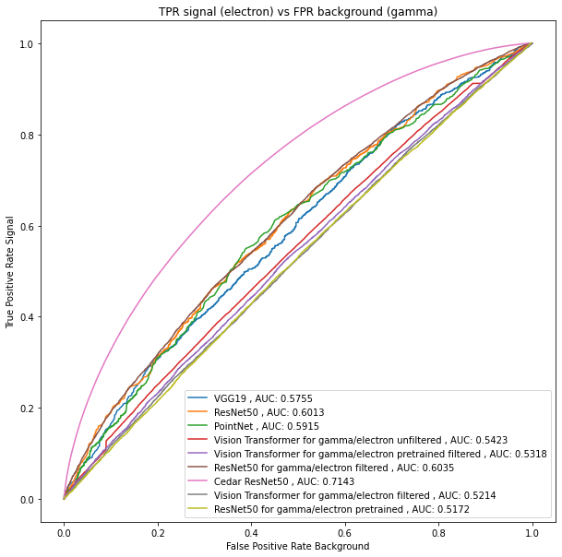
Efficiency plot for electron (signal) vs gamma (background)

Slide 10
Therefore, after training 4 architectures and producing 9 models…
ResNet50 provides the best results while also consuming the less computational resources → Greatest AUC for all applications in comparison to other models, stable efficiency for all classes.
VGG19 and PointNet come close to ResNet50’s results →The resources needed double or triple the time of ResNet50.
Vision Transformer gave the poorest results → Improved by using a pretrained model
Comparing with WatChMaL AUC 0.71 vs 0.77 and 0.74 (employing basic and all cuts) [1]
The more data we use the better the results.
[1] N. Prouse, “Machine Learning for Reconstruction (& detector simulation & calibration),” presented at the HK Collaboration Meeting, Kamioka Research Complex, Oct. 24, 2023

Slide 11
Future Work
Test other deep learning methods with similar functioning principle to ResNet50: DenseNet, InceptionNet.
Train VGG19 and PointNet with the largest dataset if posible.
Train Vision Transformer from scratch using the Cedar dataset.
Employ other Vision Transformer methods such as BEiT.
Test traditional machine learning techniques (extract features from the data and use them to train and test a classifier).
Romo-Fuentes et al. paper in progress

Slide 12

Thank you for your attention
mferomof@gmail.com

